Slide 2
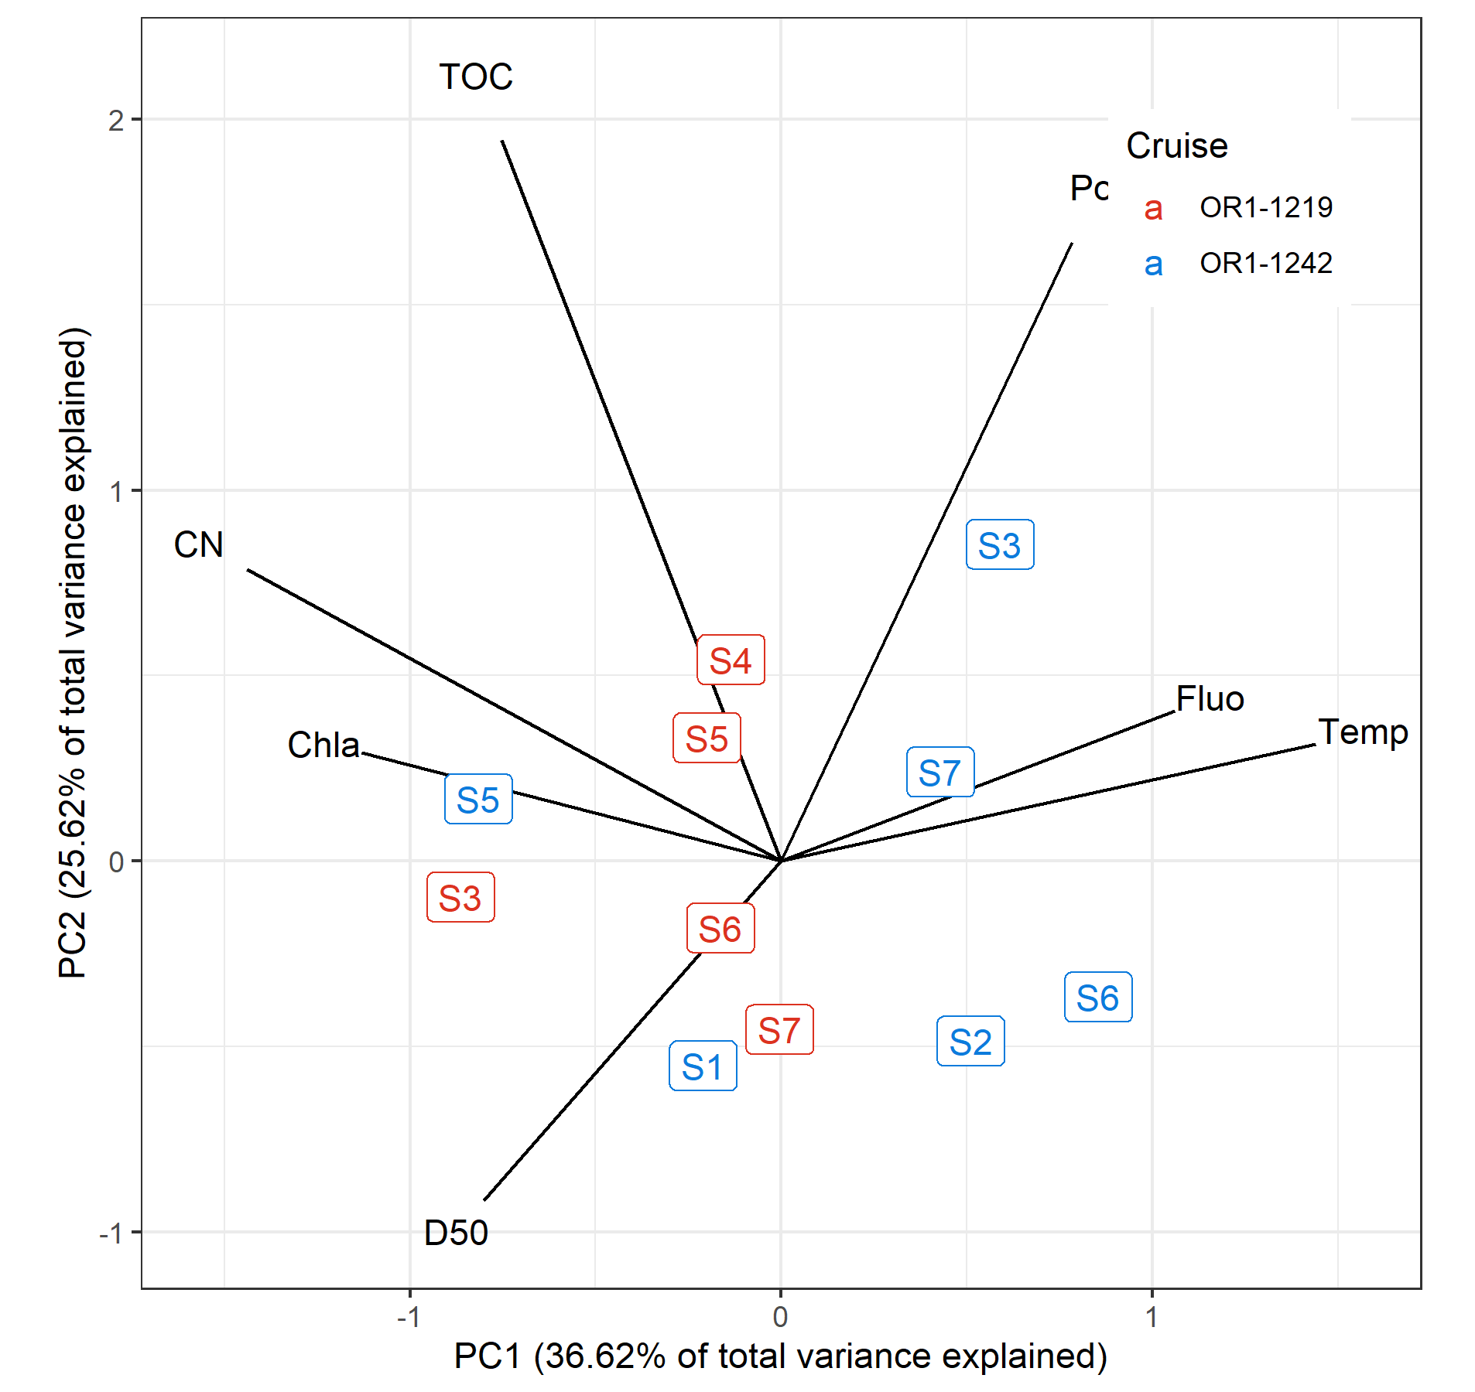
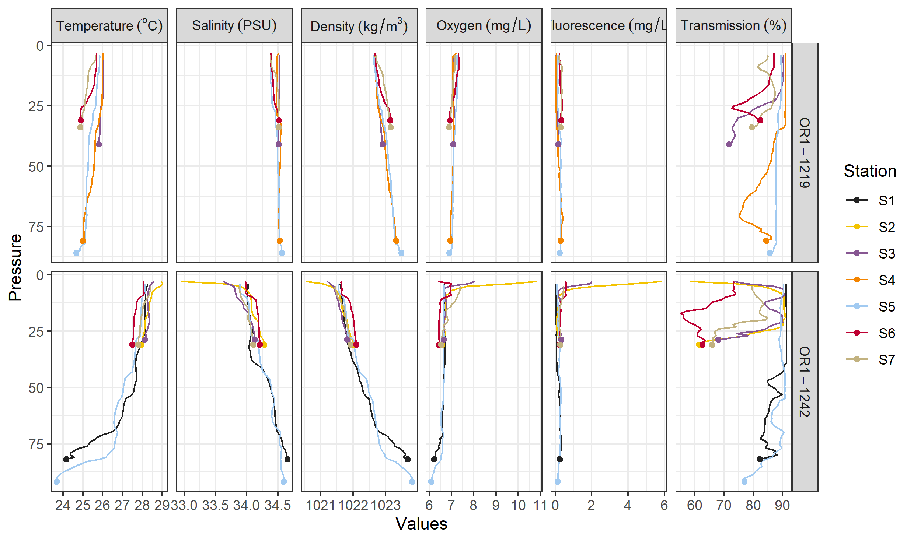
Environmental data
Depth and DRM were not included for this PCA and later analyses
Variables with |r| > 0.7 and/or ecologically irrelevant were omitted
Sal, Trans, Dens, Temp are highly correlated ➔ choosing Temp
Delta 13 C and Chla negatively correlated ➔ choosing Chla
TN correlated with Porosity ➔ choosing Por

Slide 3
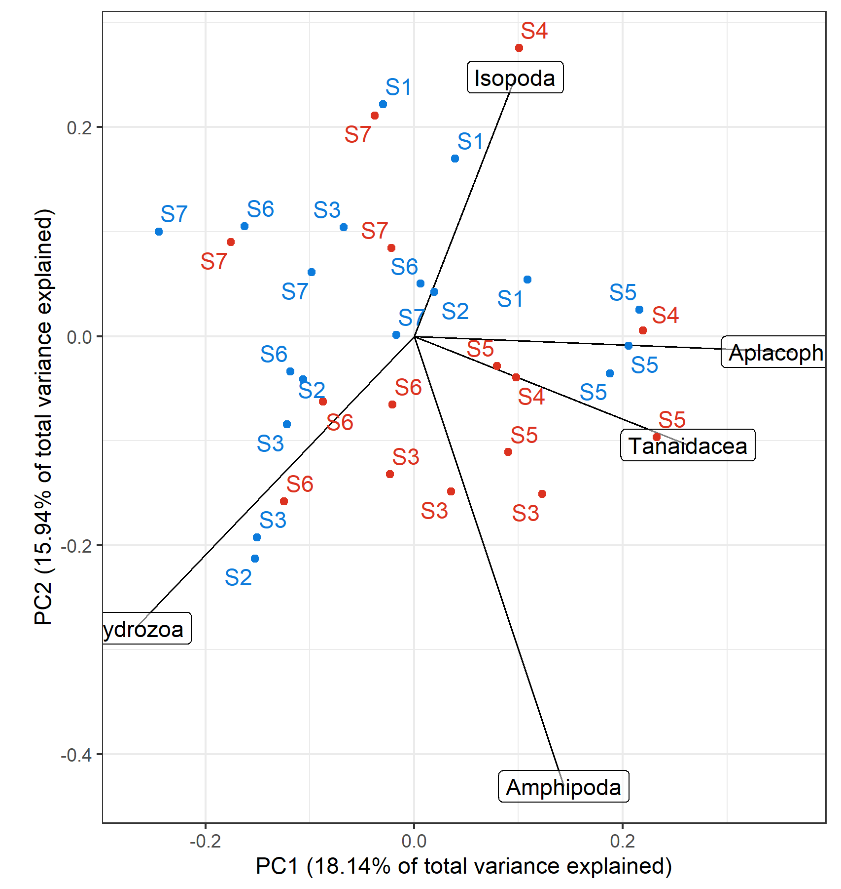
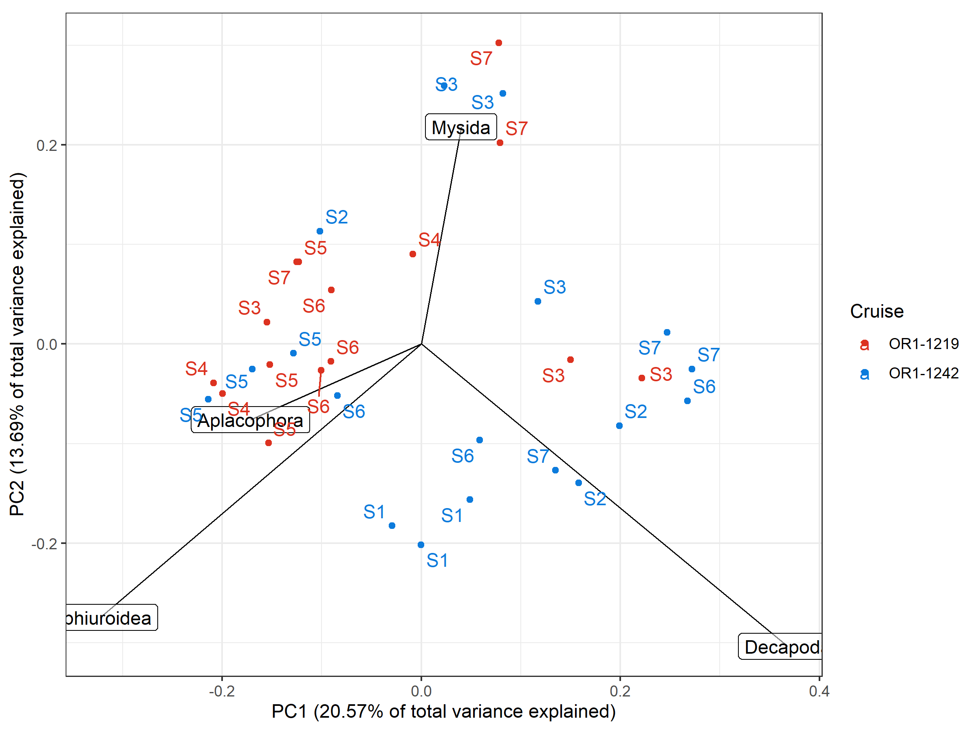
Box-Cox-chord transformed PCA, scaling 1
Count, exponent = 0.3
Biomass, exponent = 0.1
*Variation of peracarid abundance were largely captured within the first two PCs
*Biomass composition mainly reflects the presence of large taxa; noticeable groupings were present (if these are non-stochastic)

Slide 4
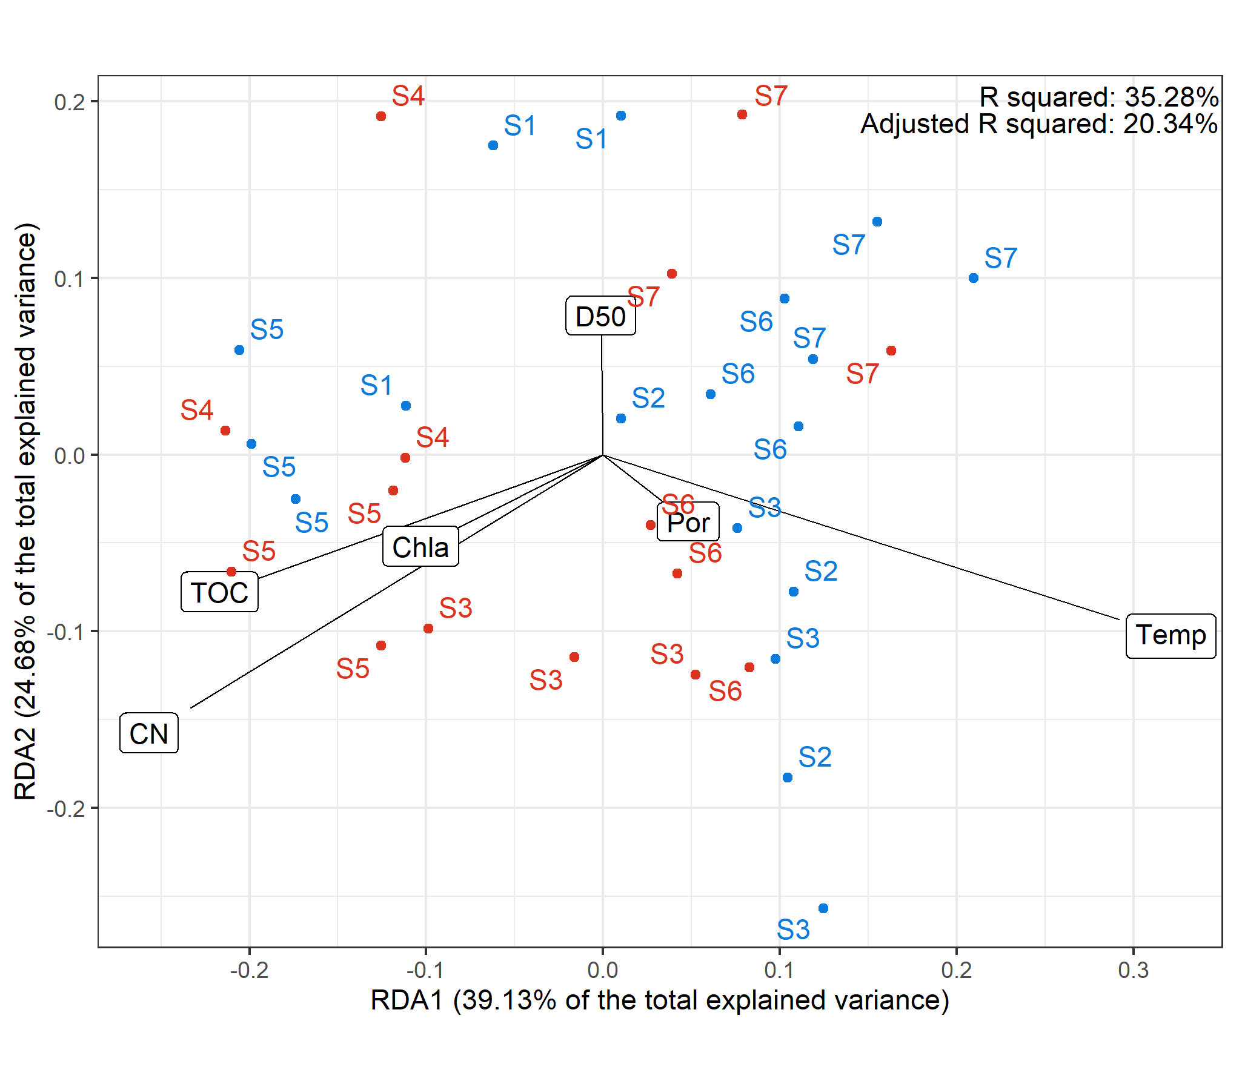
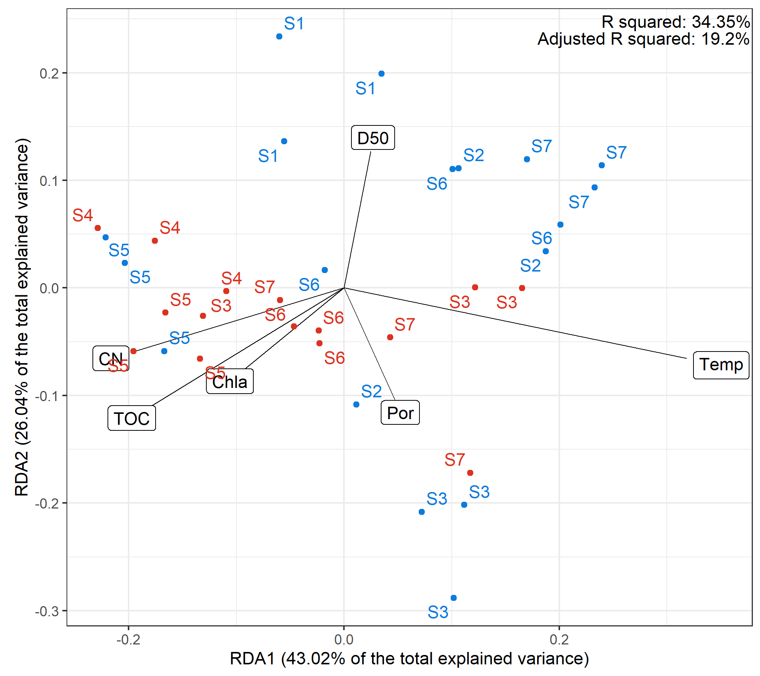
RDA biplot, scaling 1
Biomass, exponent = 0.1
Count, exponent = 0.3

Slide 5
Add a taxa-size figure (any statistical analyses can be present?)

Slide 6
