Slide 1



Project Progress
Evolutionary Neural Architecture Search
Based on NAS-Bench-101
Group Members：
陈哲葳 12540020
陈奕冲 12532567
张阳 12532611
2025年12月8日

Slide 2
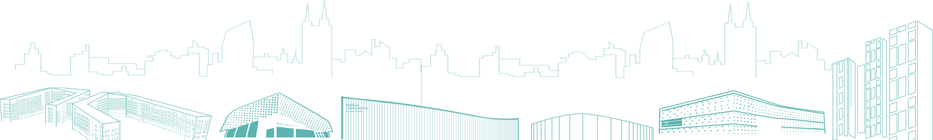
Topic review
  Main Goal： Apply evolutionary algorithms to search the NAS-Bench-101 cell space.
  Neural Architecture Search (NAS) aims to automatically design neural network architectures by exploring a large and discrete search space.
  Evolutionary Algorithms (EA) fit this task well: they do not rely on gradients, handle discrete graph structures naturally, maintain population diversity, and avoid getting trapped in local optima. Prior work also shows that EA performs competitively in irregular combinatorial spaces like NAS-Bench-101.

Slide 3

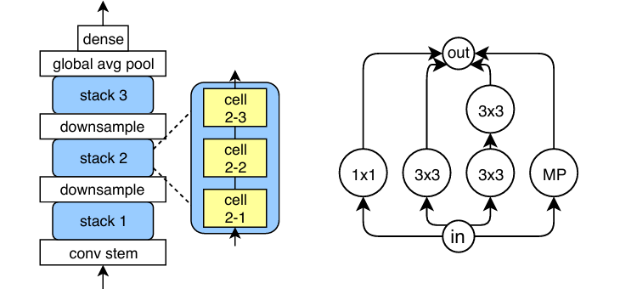
Topic Review
  NAS-Bench-101: Towards Reproducible Neural Architecture Search

Slide 4
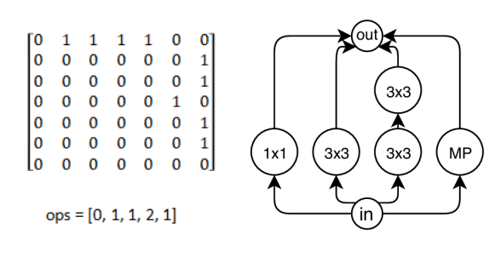
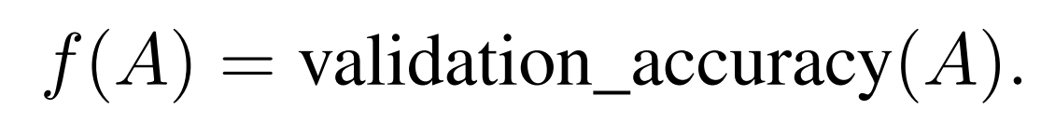
Methodology
Representation:
  0 → 1×1 Convolution
  1 → 3×3 Convolution
  2 → 3×3 Max Pooling
Fitness:
Adjacency Matrix and operation vector
Cell DAG Visualization

Slide 5
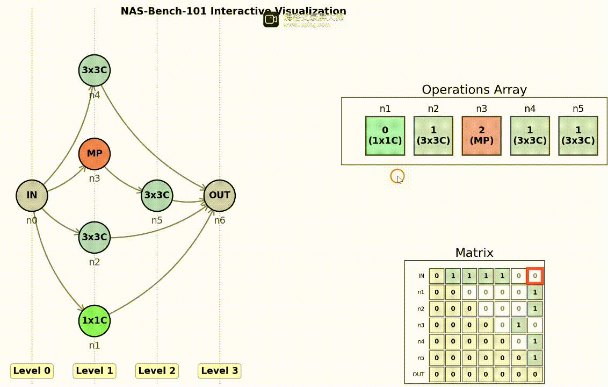
Methodology
Representation:
  0 → 1×1 Convolution
  1 → 3×3 Convolution
  2 → 3×3 Max Pooling
Fitness:
Adjacency Matrix and operation vector
Cell DAG Visualization

Slide 6
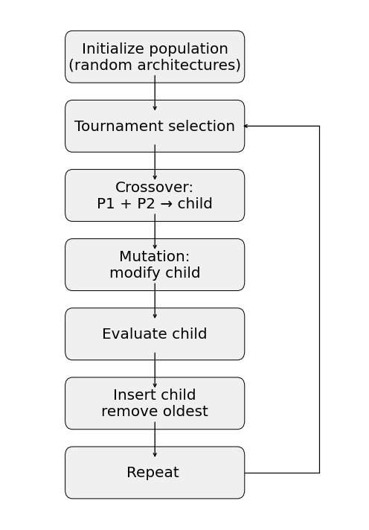
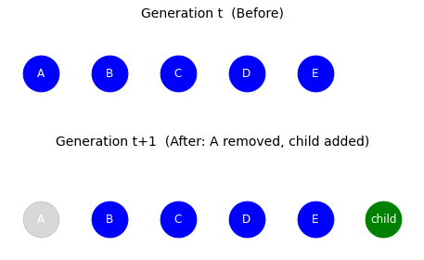
Methodology
AmoebaNet

Slide 7
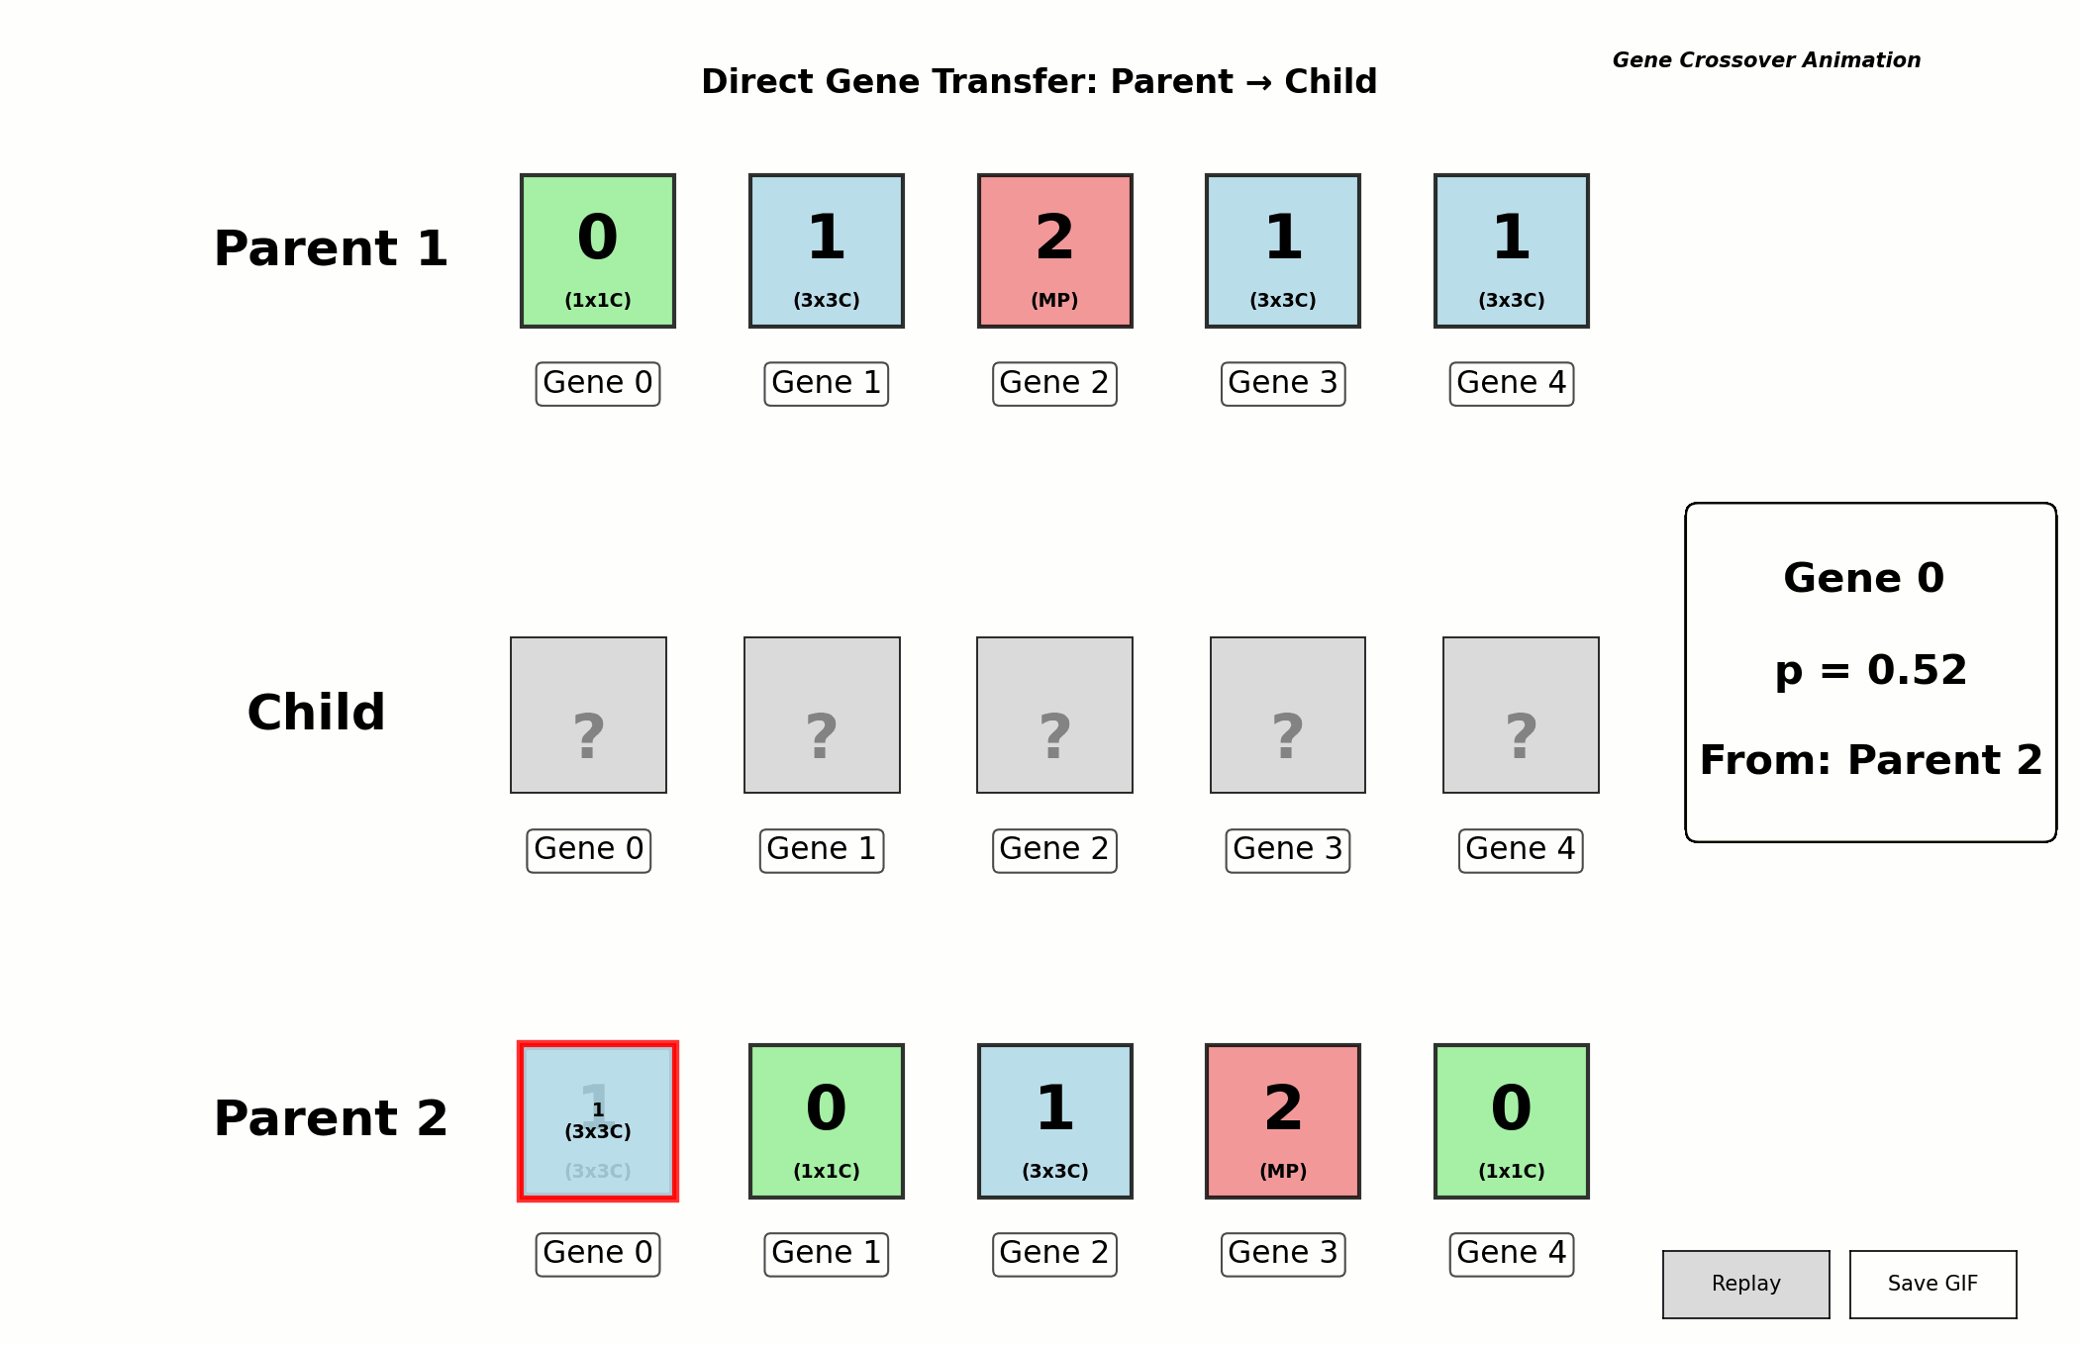
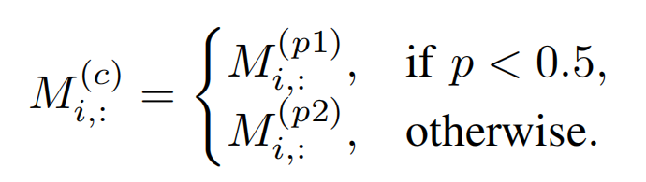
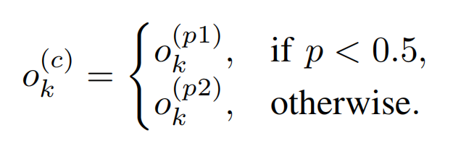
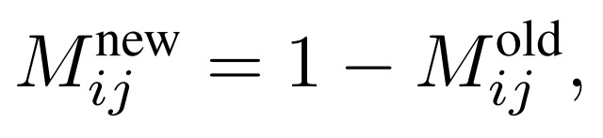
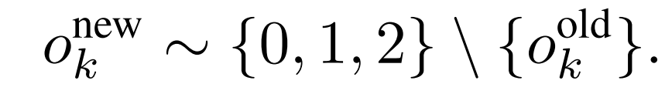
Methodology
Crossover:
Mutation：

Slide 8
Current Results
  1. Successful loading of the NASBench-101 dataset and implementation of the architecture query interface
  2. Construction of the NAS search space, including both the topological representation (adjacency matrices) and operation definition (node-level operator choices).
  3. Development of three search algorithms:
  Random Search
  Evolutionary Search with crossover
  Evolutionary Search without crossover
  4. Visualization of performance and algorithm comparison, illustrating how different search strategies evolve over time and how their efficiency differs under the same computational budget.

Slide 9
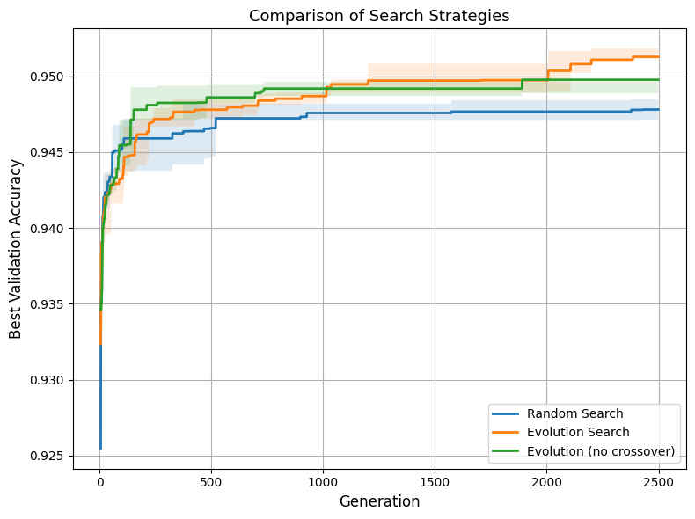
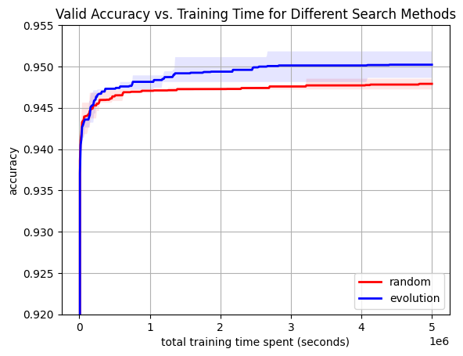
Current Results

Slide 10
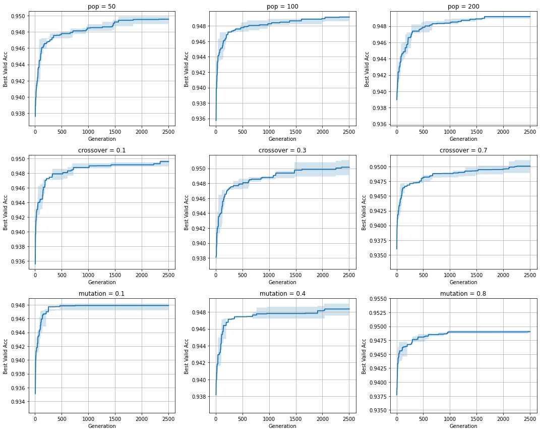
Current Results

Slide 11
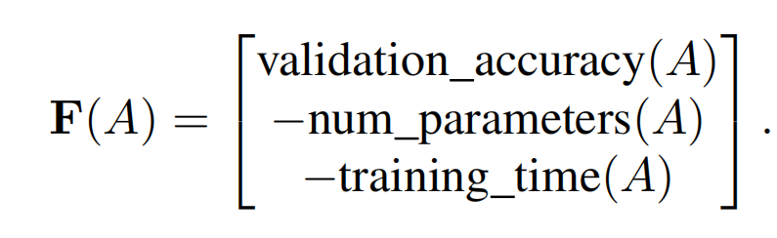
Future Work
Explore multi-objective optimization
PSO, BSO
Other benchmark

Slide 12
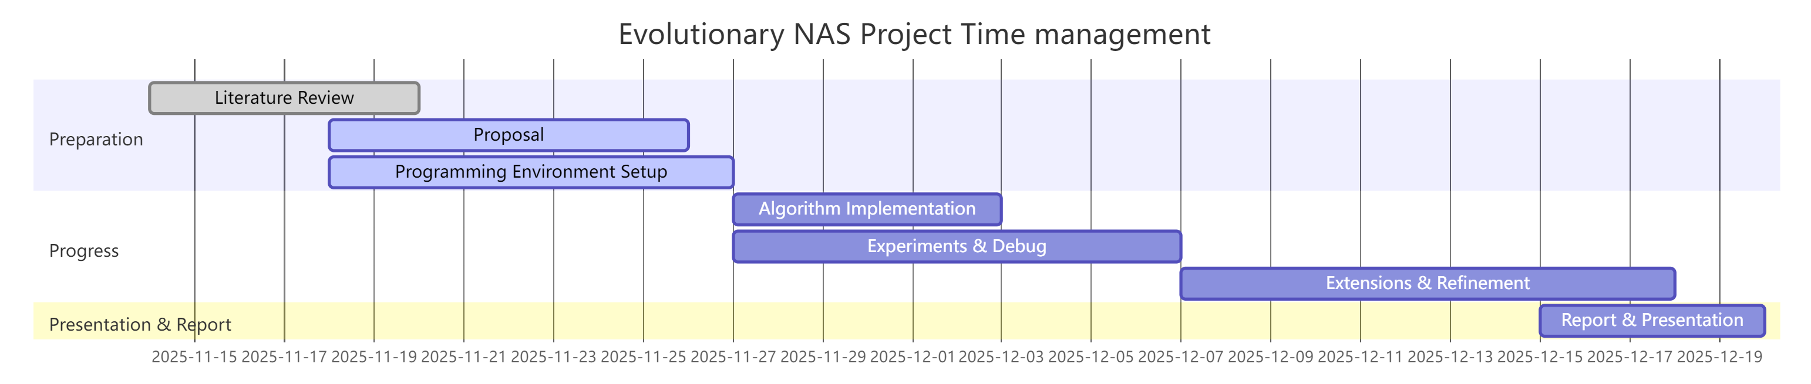
Time Management
Python
NAS-Bench-101:

Slide 13

Thank You
for your listening

