Slide 1
Research on MNIST handwritten digits dataset by applying MLP
Presenter: Dongxiao Ma
Major: Mechanical and Aerospace Engineering

Slide 2
Contents
Introduction
Body
The MLP architecture and data processing
One-hot encoded labels, SoftMax activation function and cross entropy loss function
Visualization of accuracy and loss for the training dataset evaluation
Conclusion

Slide 3
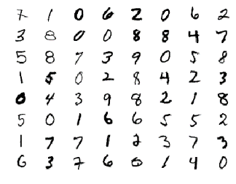
Introduction
MNIST handwritten digits
The MNIST dataset is a database of handwritten numbers that are 28 by 28 pixels and it contains 60k images in its training set,10k in testing set.
Figure 1: A random selection of MNIST digits.

Slide 4
Introduction
The goal of using the MNIST and method
Get the recognition accuracy, then take the handwritten single digit (0–9) and classify the image as the appropriate digit.
By modeling the Multilayer perceptron (MLP) to realize the goal.

Slide 5
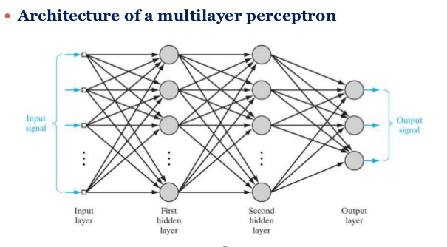
The MLP architecture and data processing
MLP
A MLP consists of at least three layers of nodes: an input layer, a hidden layer and an output layer. It can distinguish data that is not linearly separable.
Figure 2: Architectural graph of a multilayer perceptron with two hidden layers

Slide 6
The MLP architecture and data processing
MLP
Basic features:
1、Each neuron in the network includes an activation function that is differentiable .
2、The network contains one or more hidden layers.
3、The network exhibits a high degree of connectivity.

Slide 7
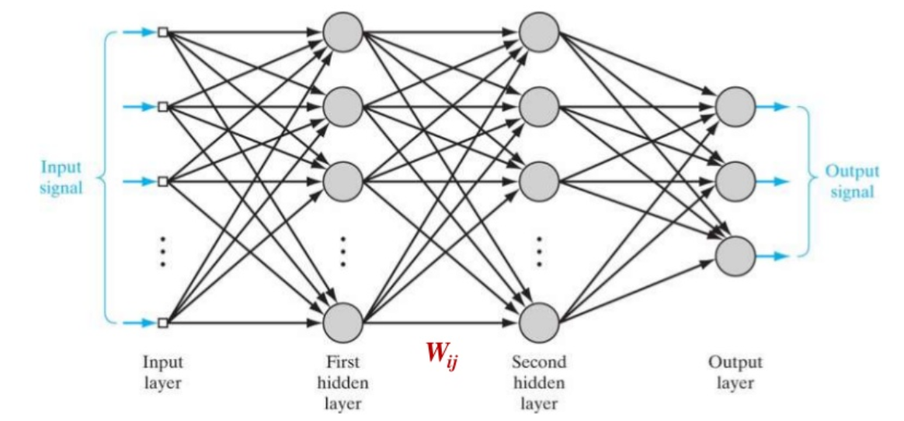
The MLP architecture and data processing
MLP
Weight Dimensions
If network has n units in layer i, m units in layer i+1, then the weight matrix Wij will be of dimension m*(n+1)
Figure 3: Weight dimension

Slide 8
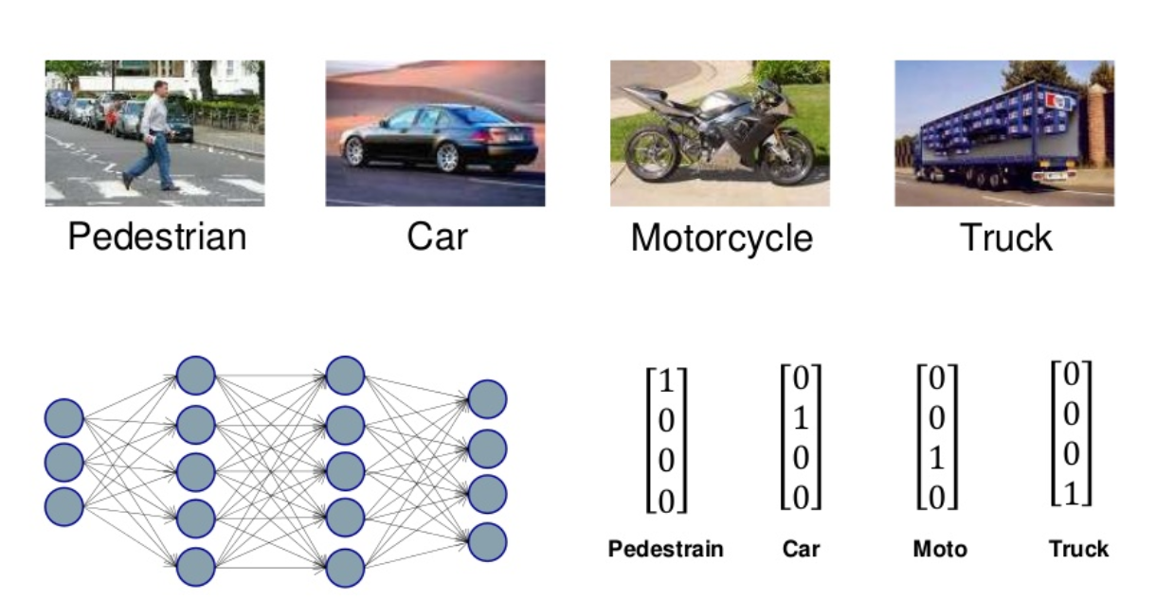
The MLP architecture and data processing
MLP

Slide 9
The MLP architecture and data processing
Data processing
The data can be gathered from the website http://yann.lecun.com/exdb/mnist
Thanks for the Keras library, the data has been collected and is already well-formatted for processing by applying two-line python codes.
Figure 4: Import data

Slide 10
The MLP architecture and data processing
Data processing
MLP does not recognize such things as ‘2D’.
It means the input data must be a vector. Instead of several 28 * 28 pixels image, we translate them that are all same length 784 (28 *28 = 784).
Figure 5: Reshape the 28*28 pixels pictures to the 1-D vectors which have 784 features

Slide 11
One-hot encoded labels, SoftMax activation function and cross entropy loss function
One-hot
The MNIST labels, which are just numbers (and numbers can take any value), are not categorical.
Thus, when we’re making predictions about categorical data (as opposed to values from a continuous range), the best practice is to use the ‘one - hot’ encoded vector.
Figure 6: Code for encoded the labels into categorical ones

Slide 12
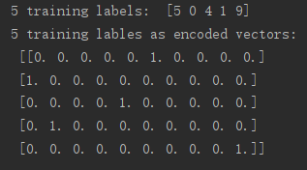
One-hot encoded labels, SoftMax activation function and cross entropy loss function
One-hot
For example, we create a vector as long as the number of categories we have, and force the model to set exactly one of the positions in the vector to 1 and the rest to 0.
Figure 7: Encoded version labels

Slide 13
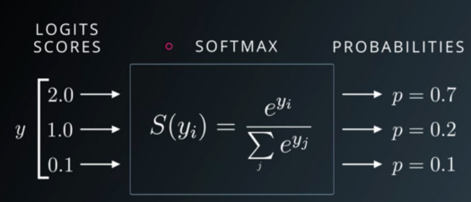
One-hot encoded labels, SoftMax activation function and cross entropy loss function
Softmax activation function
The output layer data through the softmax activation function will become the probabilities.
Figure 8: Softmax activation function

Slide 14
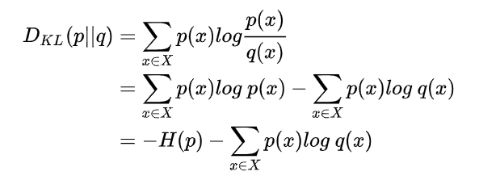
One-hot encoded labels, SoftMax activation function and cross entropy loss function
Cross entropy- Kullback-Leibler Divergence
Before we talk about the cross entropy, we have to introduce some background knowledge like the Kullback-Leibler Divergence, which is used to measure the distance of two distributions.
Figure 9: Kullback-Leibler Divergence

Slide 15


One-hot encoded labels, SoftMax activation function and cross entropy loss function
Cross entropy function
In function two, the H(p) means the entropy, we estimate there are two distributions, the cross entropy of them in the given sample space can be defined as
Figure 10: Cross Entropy function

Slide 16
One-hot encoded labels, SoftMax activation function and cross entropy loss function
Cross entropy
Back to our MLP, the true label can be seen as p(x) and predicted label (output layer) is q(x), after the one-hot encoded version transfer, it becomes a vector with ten features like [0. 0. 0. 0. 0. 1. 0. 0. 0. 0.], the sum of the probability is 1, [0. 0. 0. 0. 0. 1. 0. 0. 0. 0.] shows it belongs to class 5, meanwhile, data go through the SoftMax classifier is also a probability distribution, this is the output layer, it may look like [0.05, 0.06, 0.06, 0.22, 0.51, 0.13, 0.01, 0.02, 0.03, 0.15], the sum of [0.05, 0.06, 0.06, 0.22, 0.51, 0.13, 0.01, 0.02, 0.03, 0.15] is 1 as well. By putting these two one-dimension vectors into the cross entropy function, we can get the value of the cross entropy, the smaller means the higher match accuracy between the prediction and the truth.
Figure 11: Cross Entropy function

Slide 17
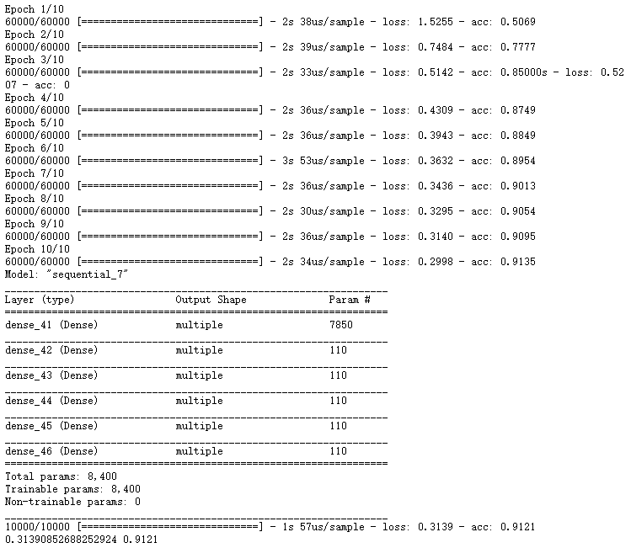
Visualization of accuracy and loss for the training dataset evaluation
MLP which has 5 hidden layers with 10 neurons each layer
Figure 11: 91% accuracy MLP

Slide 18
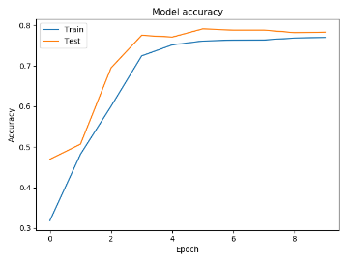
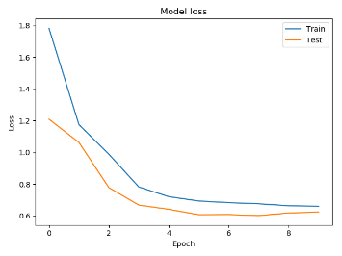
Visualization of accuracy and loss for the training dataset evaluation
MLP which has 5 hidden layers with 10 neurons each layer
Figure 13: Model accuracy and loss

Slide 19
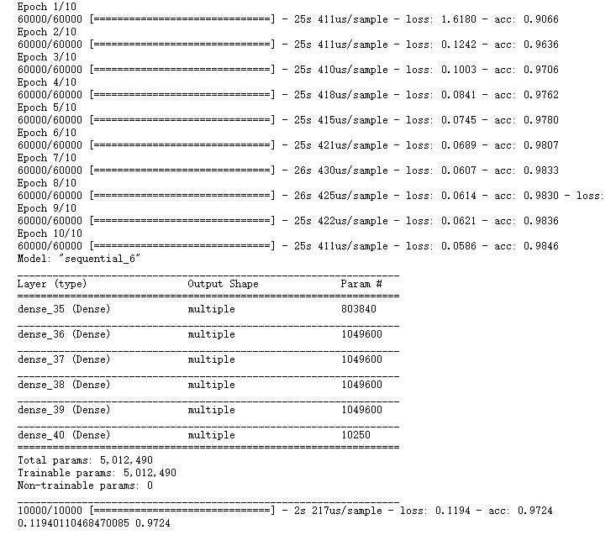
Visualization of accuracy and loss for the training dataset evaluation
MLP which has 5 hidden layers with 1024 neurons each layer
Figure 11: 98% accuracy MLP

Slide 20
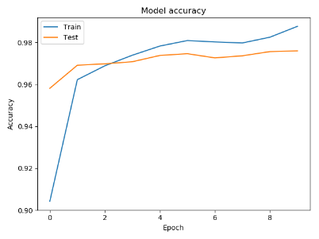
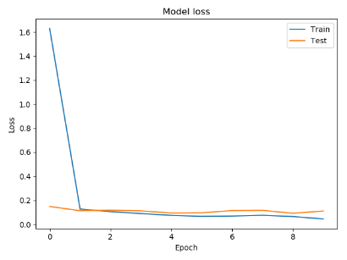
Visualization of accuracy and loss for the training dataset evaluation
MLP which has 5 hidden layers with 1024 neurons each layer
Figure 13: Model accuracy and loss

Slide 21
Conclusion
The model has been built performs quite good because its accuracy finally reach to 98%,however, there are some questions which still makes me not sure, such like I add the dropout layer at first, but the results of this change did decrease the accuracy instead of improving it. In my opinion, it may be the overfitting problem of my model is not so obvious that the dropout layer just drops the correct output for some hidden layers. Another problem which confused me is whether I can improve the accuracy through increasing more neurons is that just because more neurons can deal with more complicated information.

