Slide 1
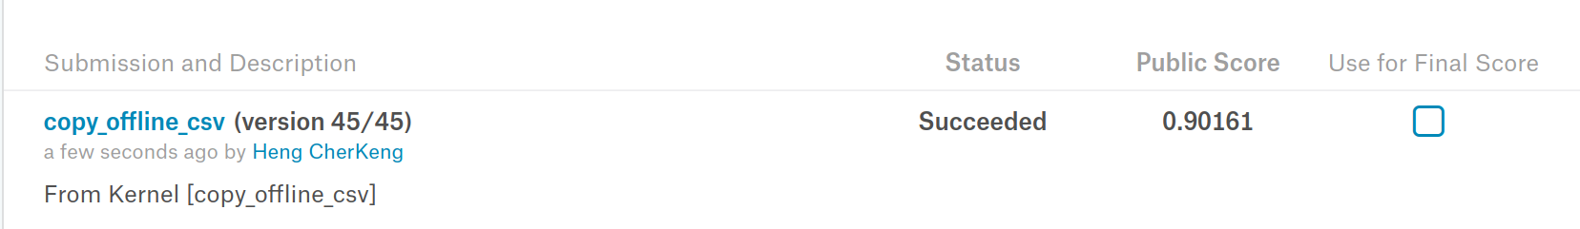
no defect (rle ='')
resnet34 classifier
image
defect (rle ='xx xxx')
resnet18 segmentation
the classification and segmentation are trained seperately

Slide 2
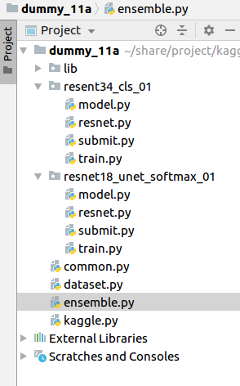
code : version dummy_11a
train classifier
make csv for detection only
train segmentation
make csv for segmentation only
make final submission csv by merging detection + segmentation

Slide 3
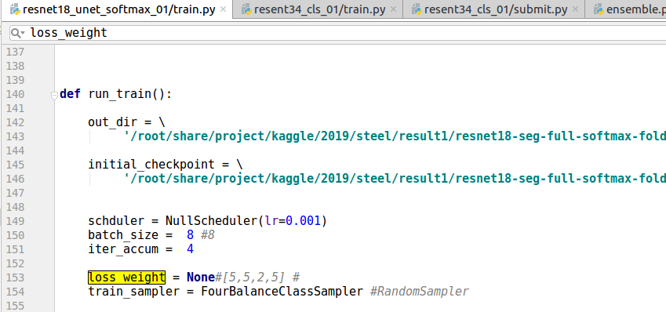
The detection and segmentation code are similar. We explain how to use the code using segmentation.
if the training loss cannot decrease initially, use class weight or balance class sampler. You can finetune without weight + normal random sampler at the end

Slide 4
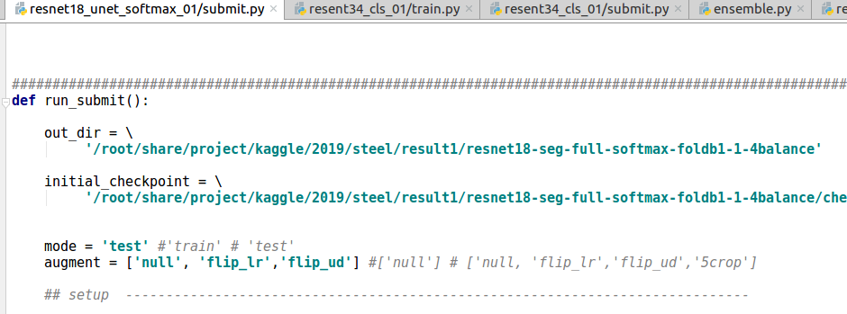
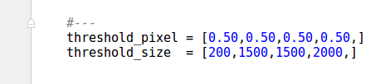
try various setting on your validation set.
you can do grid search, etc ....

