Slide 1
The web application contains two main pages, one is message list, the other one is log in page, which is called authentication on the web
Users first use authentication page to sign up, or once they already have accounts, they can simply login
Once users have logged in, they can switch to message page, type the note they want to store. The message page will show all notes from different users, but user could not modify they own notes

Slide 2
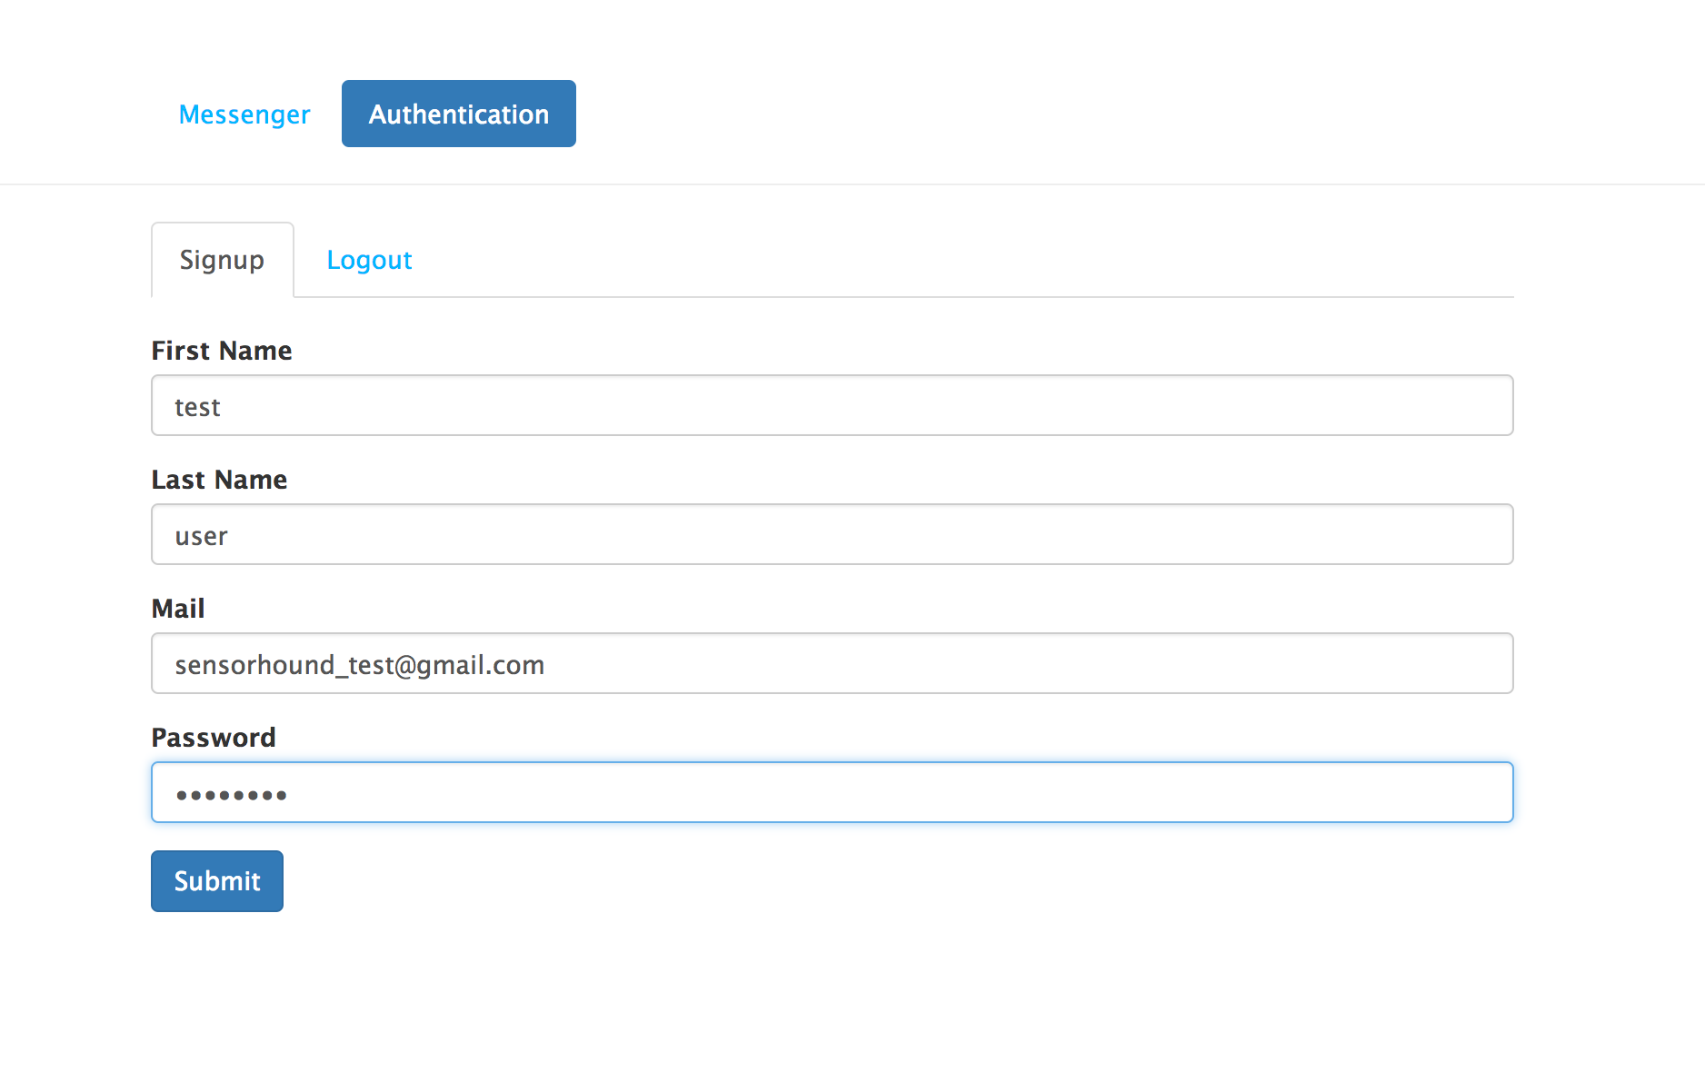
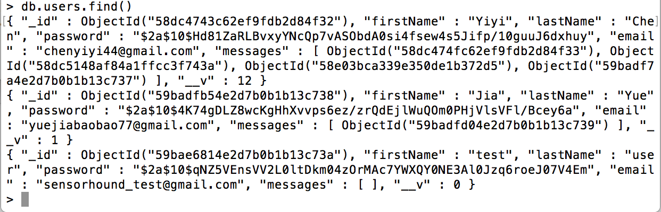
Here I show an example to create a new account in authentication page. You can see last thread is the one we just created.

Slide 3
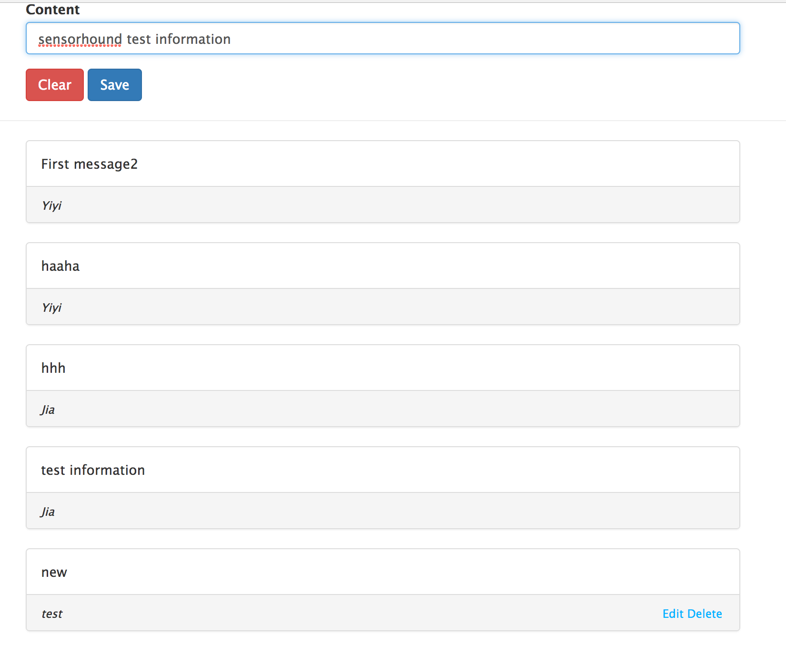
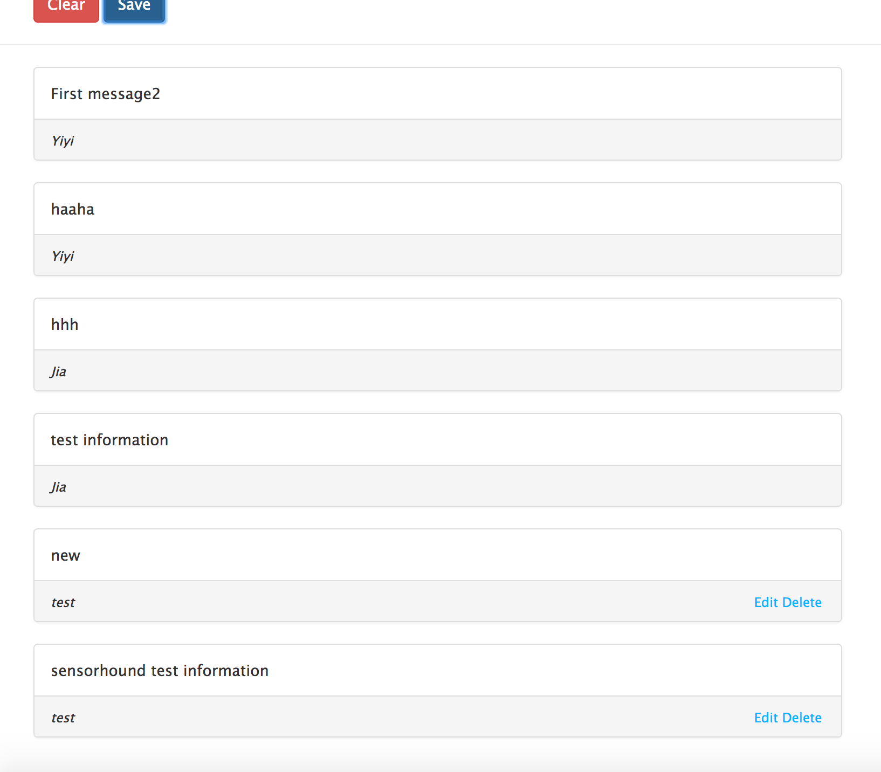
Here is a demo on message page, as you can see, after we add new message, the message will show in the list, with the first name of the user. And each user only has right to modify their own messages.

Slide 4
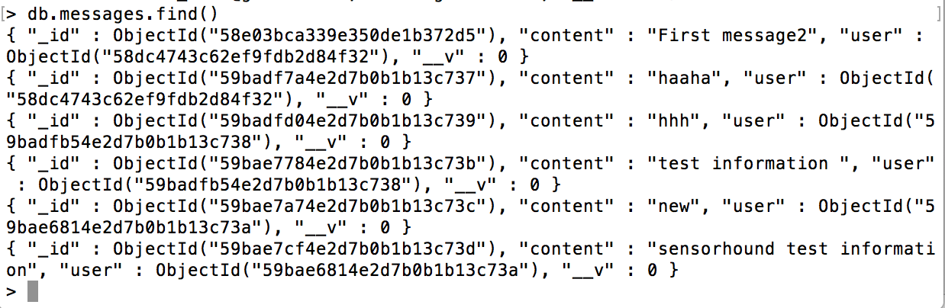
Here just show you the status in database for message table

