Slide 1
Applications of Radon transform in earthquake data processing
Yangkang Chen

Slide 2
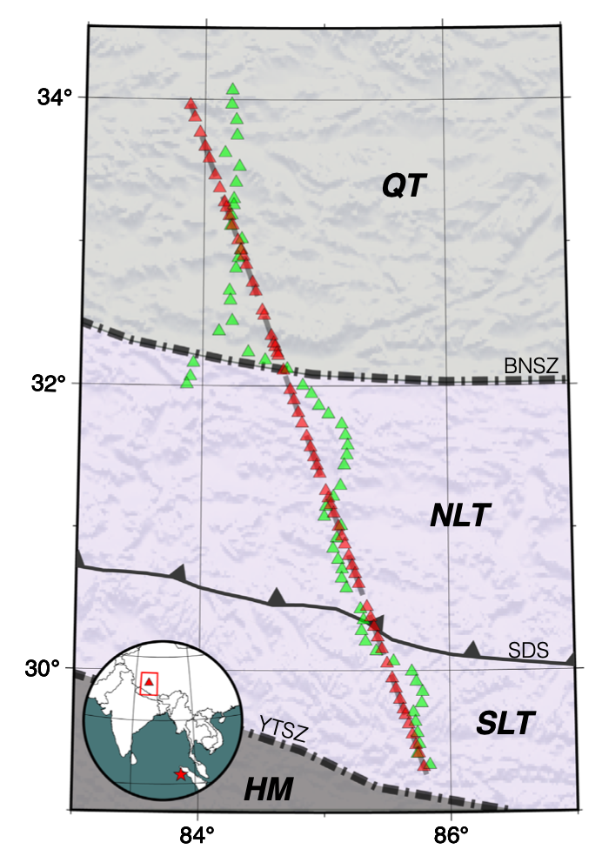
Improving receiver function imaging with high-resolution Radon transform
Notes:
Station distribution of the Hi-CLIMB network. Green and red triangles on the topographic map indicate the original and projected station locations, respectively. In the inset map, the location of the seismic network is highlighted by the red rectangular and red star marks the epicentre of a single event examined in this study. Abbreviation: QT, Qiangtang Terrane; NLT, North Lhasa Terrane; SLT, South Lhasa Terrane; HM, Himalayan Orogen; BNSZ, Bangong–Nujiang Suture Zone; SDS, Songduo Suture; YTSZ, Yarlung–Tsangpo Suture Zone (Zhang et al. 2014; Li et al. 2019; Spicer et al. 2021).

Slide 3
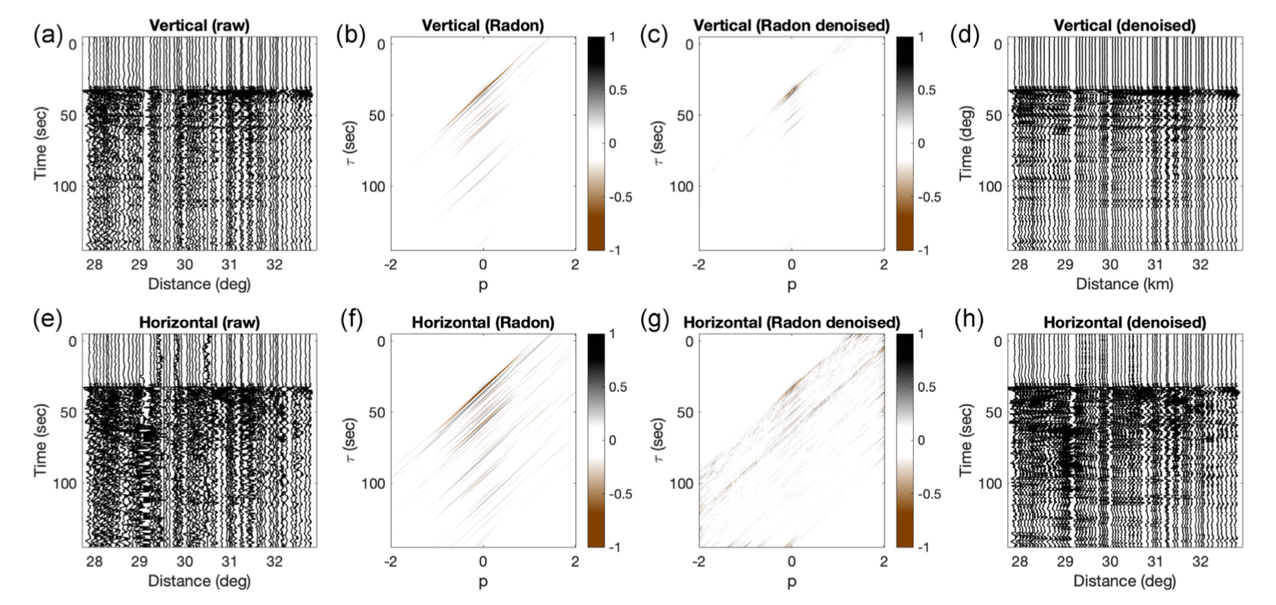
Teleseismic wavefield comparison
Notes:
Denoising results of teleseismic wavefields. (a) Vertical component seismograms for a single event arranged by epicentral distances; (b) The energy spectrum of the raw data in the Radon domain. (c) The energy spectrum of the processed data by high-resolution Radon transform. (d) Denoised vertical component seismogram. (e–h) Same as (a–d) but for the horizontal component.

Slide 4
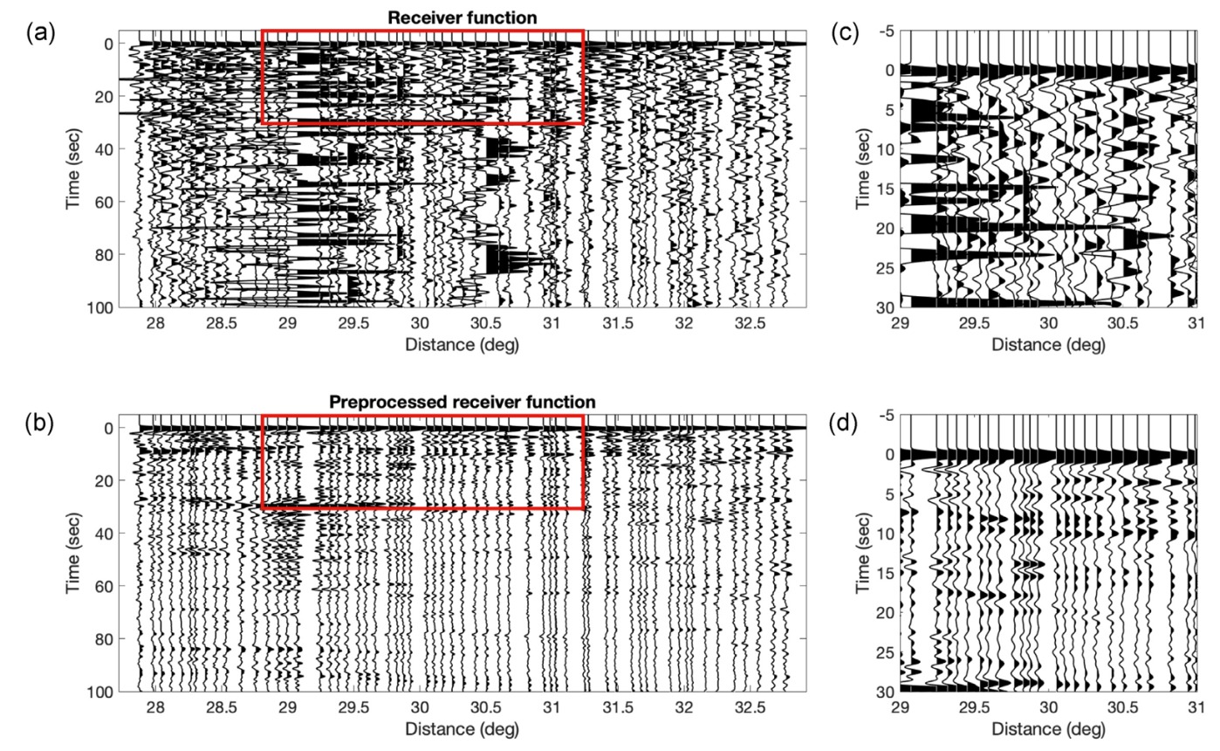
Receiver function profile comparison

Slide 5
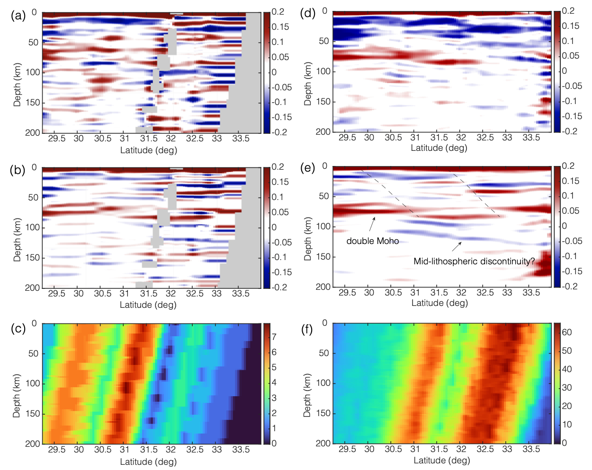
Notes:
Common conversion point stacking results using (a–c) 1 event and (d–f) 11 earthquakes. The areas masked in grey in (a) and (b) indicate empty bins with no data coverage. RFs computed from original data are shown in (a) and (d), whereas (b) and (e) are processed with the proposed workflow. Arrows in (e) indicate improved structural details in the denoised RF profile. The black dashed lines mark the potential subsurface extension of major geological boundaries in this region. (c) and (f) Fold maps demonstrate the number of stacks along the profile.

Slide 6
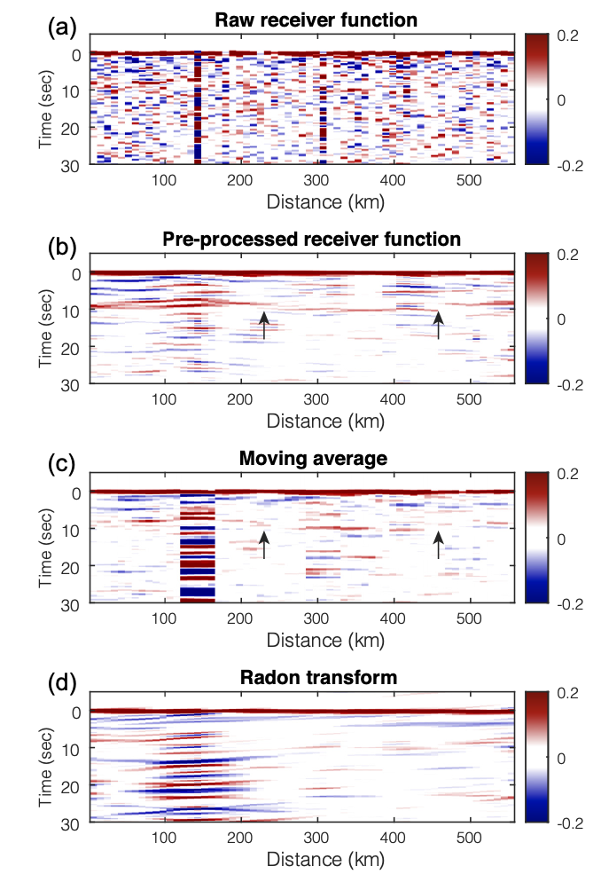
Comparison in RF imaging
Notes:
Comparison of several processing strategies for receiver function

