Slide 1
Experiment 1: Design
Click on the white fox
Which object is larger?
Which object is larger?
None
S
S+J
S+J+D
Simple Response
Size Judgement
Encoding of Distractors

Slide 2
Experiment 1: Procedure
Processing Phase
The next trial will start in 8 s
Press the space bar to start directly.
Which object is larger?
Which object is larger?
……
Max. 10 s
0.5 s
Until response or 2.5 s
Until response or 2.5 s
0.5 s
Processing + Memory Phase
The next trial will start in 8 s
Press the space bar to start directly.
Which object is larger?
Which object is larger?
……
Max. 10 s
2.5 s
0.5 s
2.5 s
0.5 s
Until response or 10 s

Slide 3
Experiment 1: Procedure
Processing task
(25 trials * 4 steps)
Processing task + Memory task
(15 trials)

Slide 4
Experiment 1: Results—Processing task

Slide 5
Experiment 1: Results—Processing task

Slide 6
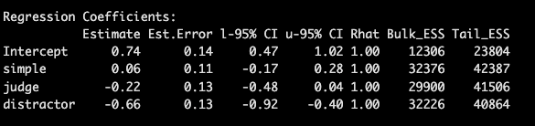
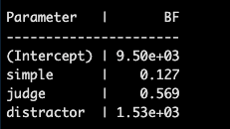
Experiment 1: Results—Memory task

Slide 7

Experiment 2: Design
Click on the white candle
Which object is larger?
Which object is larger?
$$×2$$
S
S+J2
S+J+D
Simple Response
Size Judgement
Encoding of Distractors

Slide 8
Experiment 2: Results—Processing task

Slide 9
Experiment 2: Results—Processing task

Slide 10
Experiment 2: Results—Memory task

Slide 11


Experiment 3a: Design
Click on the white candle
Which object is larger?
Which object is larger?
Which object is larger?
Which object is larger?
$$×2$$
$$×2$$
S
S+J
S+J2
S+J+D
S+J2+D
Judgement
High load
Distractor

Slide 12
Experiment 3: Results—Processing task

Slide 13
Experiment 3: Results—Processing task

Slide 14
Experiment 3: Results—Memory task

Slide 15
Cognitive load analysis

