Slide 1
Mining Data Streams
Professor Wei-Min Shen
University of Southern California
Thanks for source slides and material to:
J. Leskovec, A. Rajaraman, J. Ullman: Mining of Massive Datasets
http://www.mmds.org
Note to other teachers and users of these slides: We would be delighted if you found this our material useful in giving your own lectures. Feel free to use these slides verbatim, or to modify them to fit your own needs. If you make use of a significant portion of these slides in your own lecture, please include this message, or a link to our web site: http://www.mmds.org

Slide 2
Mining Data Stream
Motivation
Sampling
Fixed-portion sampling
Fixed-size (reservoir) sampling
Filtering
Bloom filter
Counting
Estimating # of distinct values, moments
Sliding window
Counting # of 1’s in the window

Slide 3
Data streams & applications
Query streams
How many unique users at Google last month?
URL streams while crawling
Which URLs have been crawled before?
Sensor data
What is the maximum temperature so far?

Slide 4
Stream data processing
Stream of tuples arriving at a rapid rate
In contrast to traditional DBMS where all tuples are stored in secondary storage
Infeasible to use all tuples to answer queries
Cannot store them all in main memory
Too much computation
Query response time critical

Slide 5
Query types
Standing queries
Executed whenever a new data tuple arrives
keep only one value
e.g., report each new maximum value ever seen in the stream
Ad-hoc queries
Normal queries asked one time
Need entire stream to have an exact answer
e.g., what is the number of unique visitors in the last two months?

Slide 6
Stream Processing Model
Ad-Hoc
Queries
Processor
. . . 1, 5, 2, 7, 0, 9, 3
. . . a, r, v, t, y, h, b
. . . 0, 0, 1, 0, 1, 1, 0
time
Streams Entering.
Each stream is composed of elements/tuples
Standing
Queries
Output
Limited
Working
Storage
Archival
Storage

Slide 7
Example: Running averages
Given a window of size N
Report the average of values in the window whenever a value arrives
N is so large that we can not store all tuples in the window
What is the type of this query?
How to do this?

Slide 8
Example: Running averages
First N inputs, accumulate sum and count
Avg = sum/count
A new element i
Change the average by adding (i - j)/N
j is the oldest element in the window
window size is fixed so we need to discard j

Slide 9
Roadmap
Motivation
Sampling
Fixed-portion & fixed-size (reservoir sampling)
Filtering
Bloom filter
Counting
Estimating # of distinct values, moments
Sliding window
Counting # of 1’s in the window

Slide 10
Sampling from a data stream
Scenario: Search engine query stream
Stream of tuples: (user, query, time)
Answer questions such as: How often did a user run the same query in a single day
Have space to store 1/10th of query stream
Method 1: sample a fixed portion of elements
e.g., 1/10
Method 2: maintain a fixed-size sample

Slide 11
Sampling fixed-portion

Slide 12
Sampling a fixed proportion
Search engine query stream
Stream of tuples: (user, query, time)
Example query
What fraction of queries by a user are duplicates?
Assumption
Have space to store 1/10 of stream tuples

Slide 13
Naive solution
For each tuple (store it or not?)
generate a random number in [0..9]
store it in the sample if the number is 0
Sample rate?
Example stream tuples:
(john, data mining, 2015/12/01 9:45)
(mary, inf 553, 2015/12/01 10:08)
(john, data mining, 2015/12/01 11:30)
…
Problems?
Your sampling may contain duplicates

Slide 14
The true fraction of queries with duplicates
A user issued s queries once & d queries twice
E.g., data mining, inf 553, movie, movie, tom, tom (s=d=2)
Total number of queries & duplicates = s + 2d
True fraction of queries with duplicates = d/(s+d)
Sampling rate = 1/10

Slide 15
Queries with duplicates in sample
The sample contains:
s/10 “s” queries, e.g., data mining
2d/10 “d” tuples, e.g., movie, tom, tom
If sample = data mining, movie, tom, tom, question:
What is the expected number of d queries with duplicates in the sample?
movie – d query without duplicates in the sample
tom, tom – d query with duplicates in the sample
E.g., both tom’s appear in the sample

Slide 16
Queries with duplicates in sample
s₁, s₂, …, s₈₀₀, d₁, d₁’, d₂, d₂’, …, d₁₀₀, d₁₀₀’
s = 800, d = 100
Each d_{j} has probability of 1/10 being selected
so prob. of two d_{j}’s being selected = 1/10 * 1/10
There are d number of d_{j}’s
so the expected number of duplicated pairs in sample = d/100
or d/100 queries + d/100 their duplicates
That is 2d/100

Slide 17
“d” Queries without duplicates in sample
The sample contains:
s/10 “s” queries, e.g., data mining
2d/10 “d” tuples, e.g., movie, tom, tom
Question:
What is the expected number of d queries without duplicates in the sample?
E.g., only one movie appears in the sample

Slide 18
“d” Queries without duplicates in sample
s₁, s₂, …, s₈₀₀, d₁, d₁’, d₂, d₂’, …, d₁₀₀, d₁₀₀’
s = 800, d = 100
Expected # of singleton d queries in sample
d_{j} selected, d_{j}’ not selected: 1/10 * 9/10
d_{j} not selected, d_{j}’ selected: 9/10 * 1/10
=> 9d/100+9d/100 = 18d/100

Slide 19
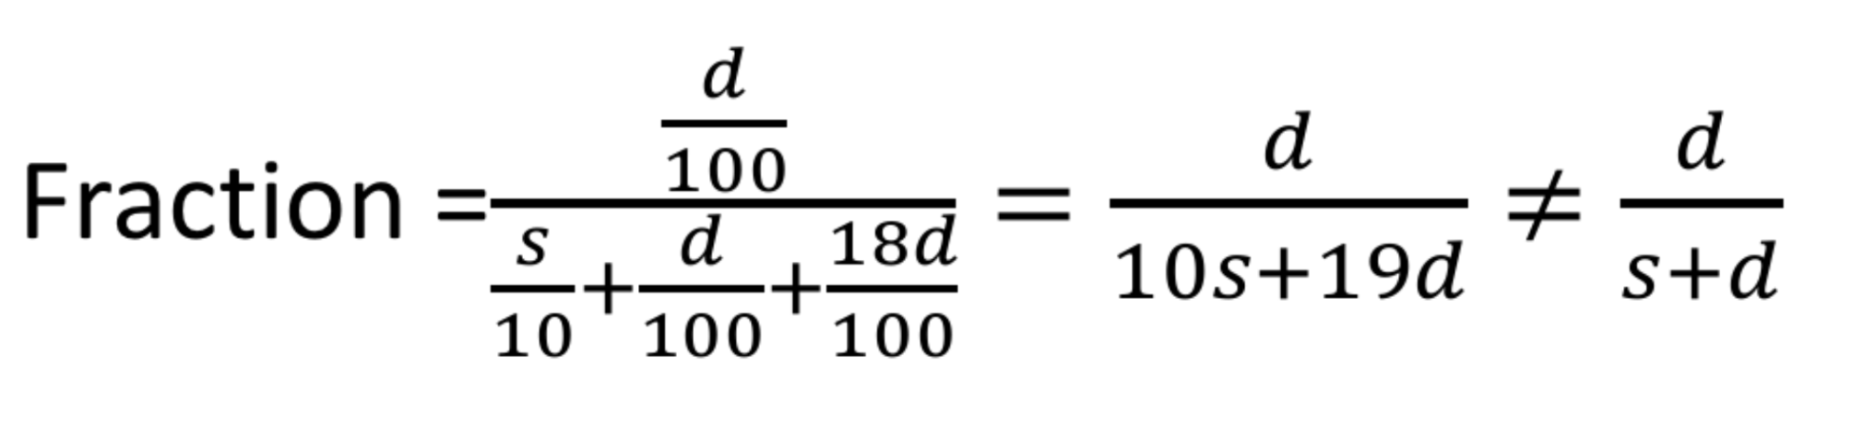
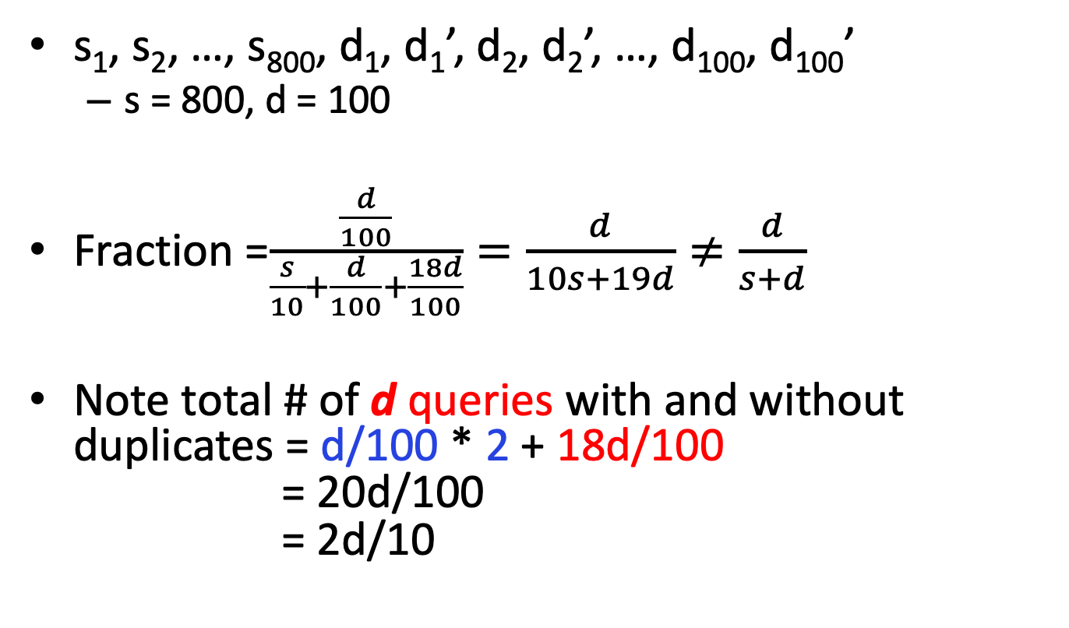
Fraction of queries in sample w/ duplicates
s₁, s₂, …, s₈₀₀, d₁, d₁’, d₂, d₂’, …, d₁₀₀, d₁₀₀’
s = 800, d = 100
Fraction =$\frac{\frac{d}{100}}{\frac{s}{10}+\frac{d}{100}+\frac{18d}{100}}=\frac{d}{10s+19d}≠\frac{d}{s+d}$
Note total # of d queries with and without duplicates = d/100 * 2 + 18d/100 = 20d/100 = 2d/10

Slide 20
What has been the problem?
Mistake: sample by position
When search tuple arrives, we flip a 10-side dice
Retain it if the dice shows up as 0
Solution: sample by user (by key)
When search tuple (user, query, time) arrives
We extract its user (key) component
Hash user into 10 buckets: 0, 1, …, 9
Retain all tuples for the user in the bucket 0

Slide 21
Sample by user
Sample = all queries for users hashed into bucket 0
All or none of queries of a user will be selected
Thus, the fraction of unique queries in sample
will be the same as that in the stream as a whole
Notes:
2018 1.1

Slide 22
General Sampling Problem
Stream of tuples with n components
Key = a subset of components
Search stream: (user, query, time)
Sample size: a/b
Sampling strategy:
Hash key (e.g., user) to b buckets
Accept tuple if key value < a

Slide 23
Example
Tuples: (empID, dept, salary)
Query: avg. range of salary within a dept.?
Randomly selecting tuples
Might miss the min/max salary
Key = dept.
Sample: some departments and all tuples in these departments

Slide 24
Sampling fixed-sized (Reservoir)

Slide 25
Roadmap
Motivation
Sampling
Fixed-portion sampling
Fixed-size (reservoir) sampling
Filtering
Bloom filter
Counting
Estimating # of distinct values, moments
Sliding window
Counting # of 1’s in the window

Slide 26
Problem with fixed portion sample
Sample size may grow too big when data stream in
Even 10% could be too big, e.g., tuples in bucket 1/10 exceed the memory size
Idea: throw away some queries
Key: do this consistently
remove all or none of occurrences of a query

Slide 27
Controlling the sample size
Put an upper bound on the sample size
Start out with 10%
Solution:
Hash queries to a large # of buckets, say 100
Put them into sample if they hash to bucket 0 to 9
When sample grows too big, throw away bucket 9
So on

Slide 28
Maintaining a fixed-size sample
Suppose we need to maintain a random sample, S, of size exactly s tuples (instead of %)
E.g., main memory size constraint
Why? Don’t know length of stream in advance
Suppose at time n we have seen n items
Each item is in the sample S with equal prob. s/n
A challenge to achieve !
How to think about the problem: say s = 2
Stream: a x c y z k c d e g…
At n= 5, each of the first 5 tuples is included in the sample S with equal prob.
At n= 7, each of the first 7 tuples is included in the sample S with equal prob.
Impractical solution would be to store all the n tuples seen so far and out of them pick s at random

Slide 29
Solution: Fixed Size Sample
Algorithm (a.k.a. Reservoir Sampling)
Store all the first s elements of the stream to S
Suppose we have seen n-1 elements, and now the n^{th} element arrives (n > s)
With probability s/n, keep the n^{th} element, else discard it
If we picked the n^{th} element, then it replaces one of the s elements in the sample S, picked uniformly at random
Claim: This algorithm maintains a sample S with the desired property:
After n elements, the sample contains each element seen so far with probability s/n

Slide 30
Proof: By Induction
We prove this by induction:
Assume that after n elements, the sample contains each element seen so far with probability s/n
We need to show that after seeing element n+1 the sample maintains the property
Sample contains each element seen so far with probability s/(n+1)
Base case:
After we see n=s elements the sample S has the desired property
Each out of n=s elements is in the sample with probability s/s = 1

Slide 31
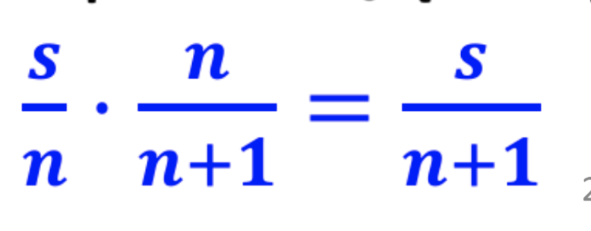
Proof: By Induction
Inductive hypothesis: After n elements, the sample S contains each element seen so far with prob. s/n
Now element n+1 arrives
Inductive step: For each element x already in S, probability that the algorithm keeps x in S is:
So, at time n, tuples in S were there with prob. s/n
Time n→n+1, tuple stayed in S with prob. n/(n+1)
So prob. tuple is in S at time n+1 =
Element n+1 discarded
Element n+1 not discarded
Element in the sample not picked

Slide 32
Roadmap
Motivation
Sampling
Fixed-portion & fixed-size (reservoir sampling)
Filtering
Bloom filter
Counting
Estimating # of distinct values, moments
Sliding window
Counting # of 1’s in the window

Slide 33
filtering

Slide 34
Stream Filtering
Application: spam filtering
Check incoming emails against a large set of known email addresses (e.g., 1 billion)
Application: URL filtering in Web crawling
Check if discovered URL’s have already been crawled

Slide 35
Bloom filter
Check if an object o is in a set S
without comparing o with all objects in S (explicitly)
No false negatives
If Bloom says no, then o is definitely not in S
But may have false positives
If Bloom says yes, it is possible that o is not in S

Slide 36
Components in a Bloom filter
An array A of n bits, initially all 0’s: A[0..n-1]
A set of hash functions, each
takes an object (stream element) as the input
returns a position in the array: 0..n-1
A set S of objects

Slide 37
Construct and apply the filter
Construction: for each object o in S,
Apply each hash function h_{j} to o
If h_{j}(o) = i, set A[i] = 1 (if it was 0)
Application: check if new object o’ is in S
Hash o’ using each hash function
If for some hash function h_{j}(o’) = i and A[i] = 0, stop and report o’ not in S

Slide 38
Example
11-bit array (n=11)
Stream elements = integers
Two hash functions
h₁(x) = (odd-position bits from the right) % 11
h₂(x) = (even-position bits from the right) % 11

Slide 39
Example: Building the filter
Stream element
h₁
h₂
Filter
0 | 0 | 0 | 0 | 0 | 0 | 0 | 0 | 0 | 0 | 0
25 = 1 1 0 0 1
5
2
0 | 0 | 1 | 0 | 0 | 1 | 0 | 0 | 0 | 0 | 0
159 = 1 0 0 1 1 1 1 1
7
0
1 | 0 | 1 | 0 | 0 | 1 | 0 | 1 | 0 | 0 | 0
585 = 1 0 0 1 0 0 1 0 0 1
9
7
1 | 0 | 1 | 0 | 0 | 1 | 0 | 1 | 0 | 1 | 0

Slide 40
Example: Using the filter
Is 118 in the set?
No false negative in Bloom
Stream element
h₁
h₂
Filter
118 = 1 1 1 0 1 1 0
3
5
1 | 0 | 1 | 0 | 0 | 1 | 0 | 1 | 0 | 1 | 0
Notes:
No

Slide 41
Example: False positive
Is 38 in the set (25, 159, 585)?
It turns on the same bits as 25, but in diff. ways
Stream element
h₁
h₂
Filter
38 = 1 0 0 1 1 0
2
5
1 | 0 | 1 | 0 | 0 | 1 | 0 | 1 | 0 | 1 | 0
Recall
25 = 1 1 0 0 1
5
2
0 | 0 | 1 | 0 | 0 | 1 | 0 | 0 | 0 | 0 | 0

Slide 42
False positive
x not in S, but identified as in S
Reason:
For all hash functions, x hashes into an 1 position
That is, h_{i}(x) = h_{j}(e), for some e in S
Note: j may be different from i

Slide 43
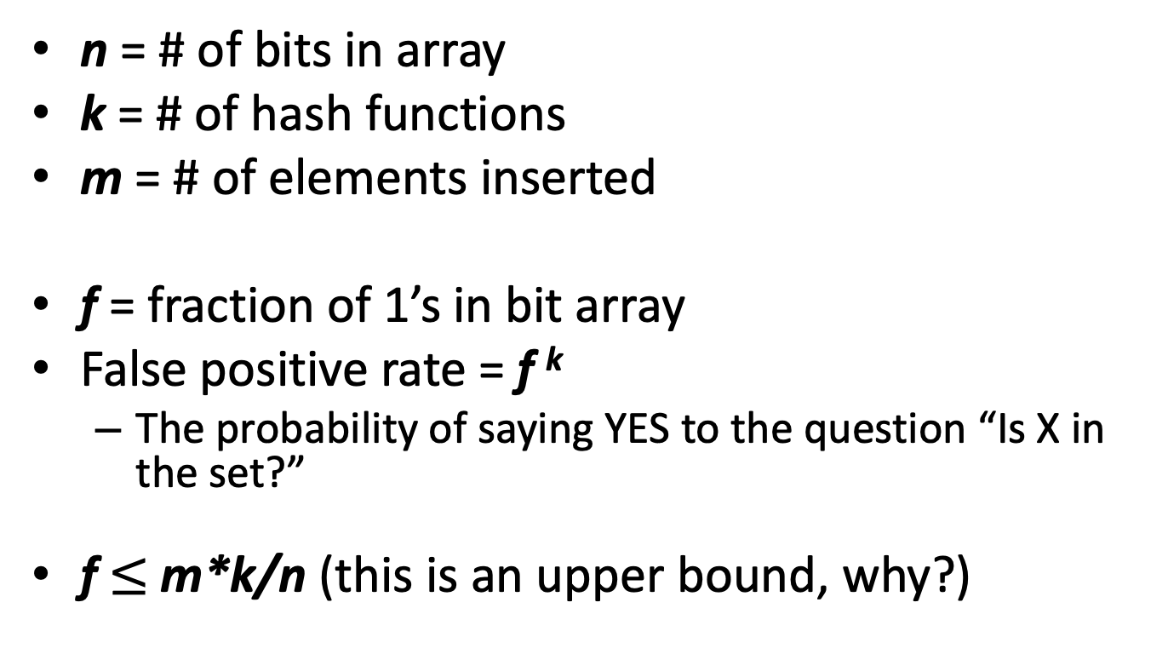
False positive rate (upper bound)
n = # of bits in array
k = # of hash functions
m = # of elements inserted
f = fraction of 1’s in bit array
False positive rate = f ^{k}
The probability of saying YES to the question “Is X in the set?”
f $≤$ m*k/n (this is an upper bound, why?)
Notes:
When there is no collision

Slide 44
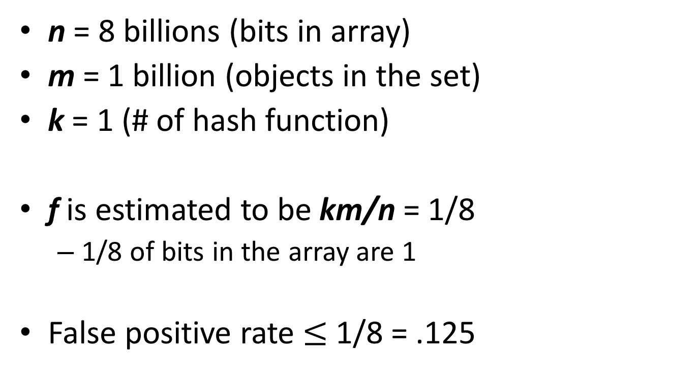
Example (upper bound)
n = 8 billions (bits in array)
m = 1 billion (objects in the set)
k = 1 (# of hash function)
f is estimated to be km/n = 1/8
1/8 of bits in the array are 1
False positive rate $≤$ 1/8 = .125

Slide 45
Accurate Estimation of fraction of 1’s
n = # of bits in array
k = # of hash functions
m = # of elements inserted
Fraction of 1’s = the probability that a bit in the array is set to 1 by at least one hashing
Total # of hashings: k * m

Slide 46
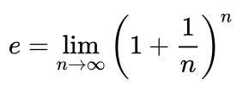
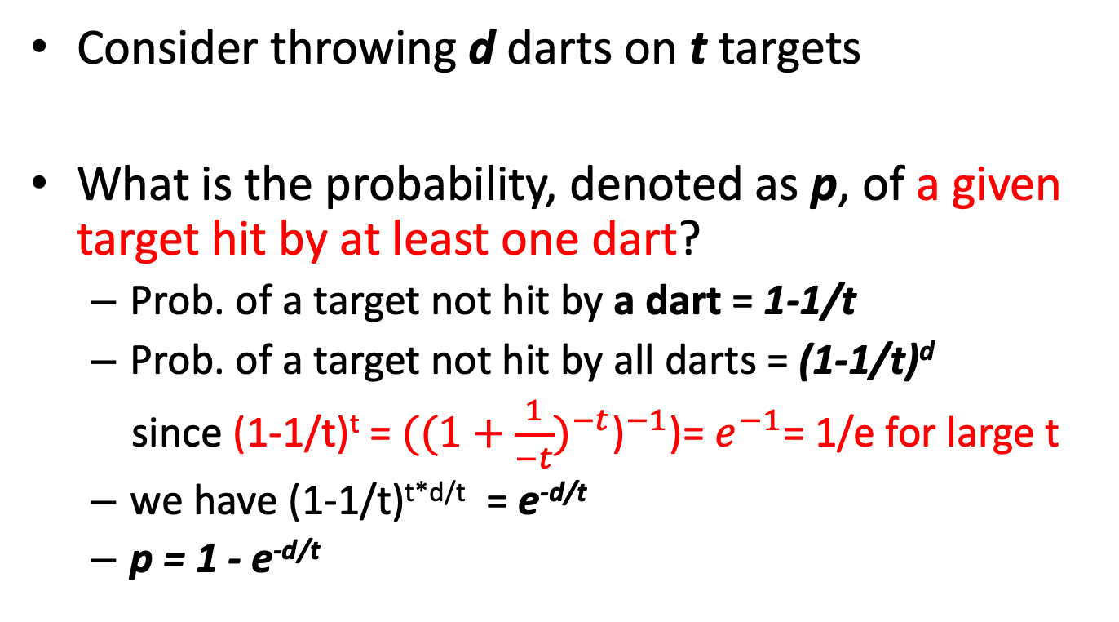
Estimation model
Consider throwing d darts on t targets
What is the probability, denoted as p, of a given target hit by at least one dart?
Prob. of a target not hit by a dart = 1-1/t
Prob. of a target not hit by all darts = (1-1/t)^{d}
since (1-1/t)^{t} = $({{(1+\frac{1}{−t})}^{−t}\text{)}}^{−1}$)= $e^{−1}$= 1/e for large t
we have (1-1/t)^{t*d/t} = e^{-d/t}
p = 1 - e^{-d/t}
Notes:
2016w1
E is the limit of (1+1/n)^n

Slide 47
Estimating the fraction of 1’s
n = # of bits in array
k = # of hash functions
m = # of elements inserted
Fraction of 1’s = the probability that a bit in the array is set to 1 by at least one hashing
1 – e^{-km/n}

Slide 48
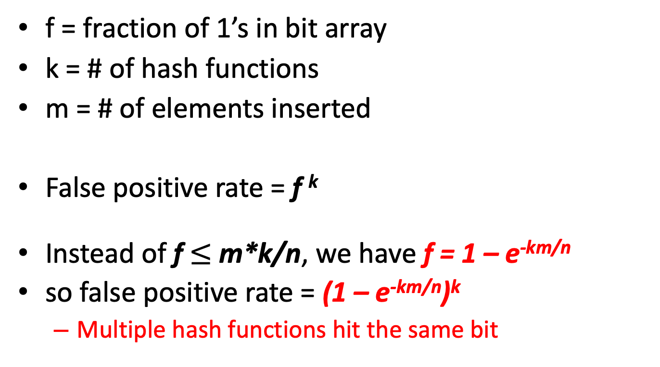
False Positive Rate (Accurate)
f = fraction of 1’s in bit array
k = # of hash functions
m = # of elements inserted
False positive rate = f ^{k}
Instead of f $≤$ m*k/n, we have f = 1 – e^{-km/n}
so false positive rate = (1 – e^{-km/n})^{k}
Multiple hash functions hit the same bit

Slide 49
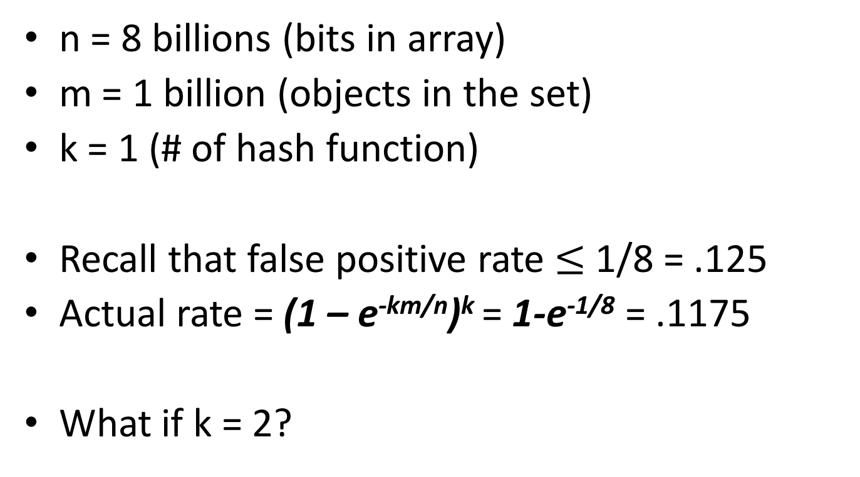
Example (actual rate)
n = 8 billions (bits in array)
m = 1 billion (objects in the set)
k = 1 (# of hash function)
Recall that false positive rate $≤$ 1/8 = .125
Actual rate = (1 – e^{-km/n})^{k} = 1-e^{-1/8} = .1175
What if k = 2?

Slide 50
Example (actual rate)
n = 8 billions (bits in array)
m = 1 billion (objects in the set)
k = 2 (# of hash function)
Actual rate = (1 – e^{-km/n})^{k} = (1-e^{-2/8})² = .2212² = .0489

Slide 51
Optimal k
n = 8 billions
m = 1 billion
k = # of hash functions
Rate = (1 – e^{-km/n})^{k}
= (1 – e^{-k/8})^{k}
Optimal k = n/m ln(2)
E.g., k = 8 ln (2) = 5.54 ~ 6
Error rate at k = 6: (1-e^{-6/8})⁶ = .0216
False positive rate
Number of hash functions, k

Slide 52
Roadmap
Motivation
Sampling
Fixed-portion & fixed-size (reservoir sampling)
Filtering
Bloom filter
Counting
Estimating # of distinct values, moments
Sliding window
Counting # of 1’s in the window

Slide 53
Counting (distinct elements)

Slide 54
Compute # of distinct elements
Applications
Compute # of distinct users to Facebook
Compute # of distinct queries submitted to Google
Obvious solution:
Hash table of distinct elements
Check if new element is there; if not, add it
Problems?

Slide 55
Flajolet-Martin algorithm
Estimating the counts
Hash every element a to a sufficiently long bit-string (e.g., h(element a) = 1100 – 4 bits)
Maintain R = length of longest trailing zeros among all bit-strings (e.g., R = 2)
Estimate count = 2^{R}, e.g., 2²= 4
Notes:
Estimate count = 2^{R} (e.g., need to hash about 4 elements before we see a bit string with 2 trailing 0’s)
2018 02 w1.1

Slide 56
Example (estimate by trailing 0s)
Consider 4 distinct elements: a, b, c, d
Hash value into bit string of length 4
How likely do we see at least one hash value with a 0 in the last bit? Next slide
hash(a) = 0010
hash(b) = 0111
hash(c) = 1010
hash(d) = 1111

Slide 57
Example: at least one ends with 0
E.g.,
hash(a) = 0010
hash(b) = 0111
hash(c) = 1010
hash(d) = 1111
Prob. of none of hash values ending with 0:
(1-½)⁴ (every string ends with 1; there are four strings)
Prob. of at least one ending with 0:
1-(1-½)⁴= .9375

Slide 58
Example: at least one ends with 00
E.g.,
hash(a) = 0100
hash(b) = 0111
hash(c) = 1010
hash(d) = 1111
Prob. of someone ending with 00:
(½) (½) = (½)² = 2⁻²
Prob. of none ending with 00:
(1-(½)²)⁴=.32
Prob. of at least one ending with 00:
1-.32 = .68

Slide 59
Example: at least one ends with 000
E.g.,
hash(a) = 1000
hash(b) = 0111
hash(c) = 1010
hash(d) = 1111
Prob. of someone ending with 000:
(½) (½) (½) = (½)³ = 2⁻³
Prob. of none ending with 000:
(1-(½)³)⁴=.59
Prob. of at least one ending with 000:
1-.59 = .41

Slide 60
Why it works?
Prob. of h(a) having at least r trailing 0’s
2^{-r}
Suppose there are m distinct elements (the true answer)
Prob. that h(a) for some element a has at least r trailing 0’s (as in the examples in the previous slides)
Notes:
E is the limit of (1+1/n)^n
Euler's number

Slide 61
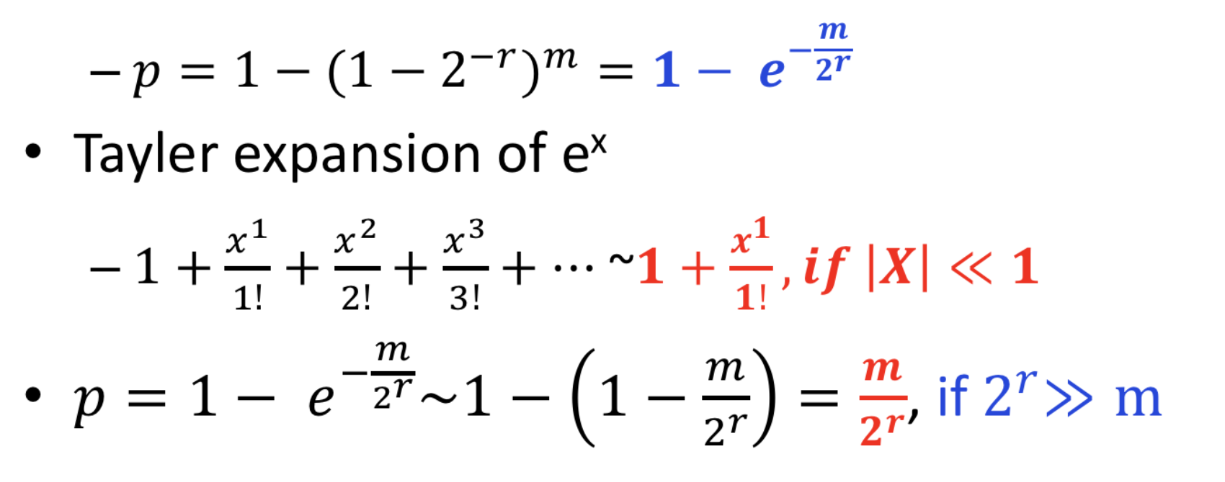
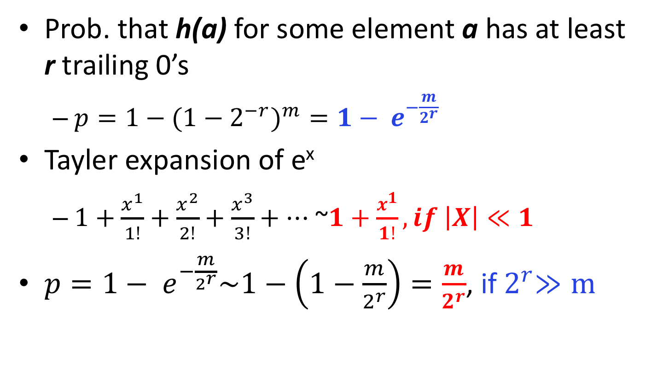
Why it works?
Prob. that h(a) for some element a has at least r trailing 0’s
${{p=1−(1−2}^{−r})}^{m}={1− e}^{−\frac{m}{2^{r}}}$
Tayler expansion of e^{x}
$1+\frac{x^{1}}{1!}+\frac{x^{2}}{2!}+\frac{x^{3}}{3!}+…$ ~$1+\frac{x^{1}}{1!}, if \left|X\right|≪1$
$p={1− e}^{−\frac{m}{2^{r}}}\sim 1−\left(1−\frac{m}{2^{r}}\right)=\frac{m}{2^{r}}$, if${ 2}^{r}≫m$
Notes:
2018 2.1

Slide 62
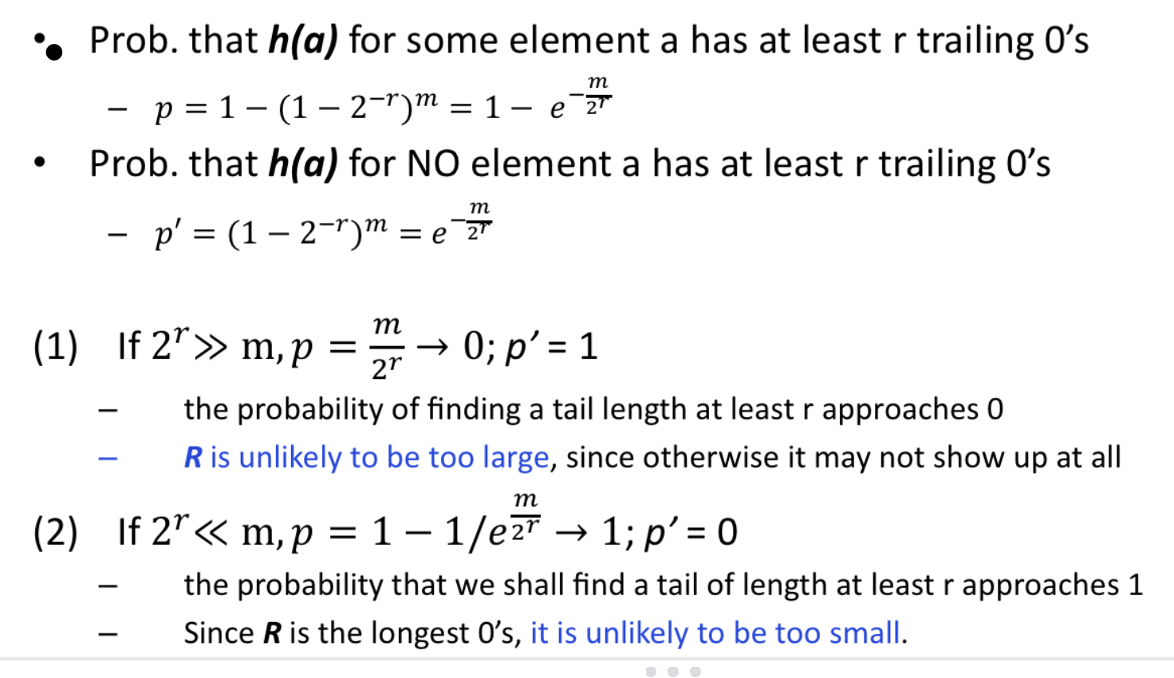
Why it works?
Therefore, 2^{R} is around m

Slide 63
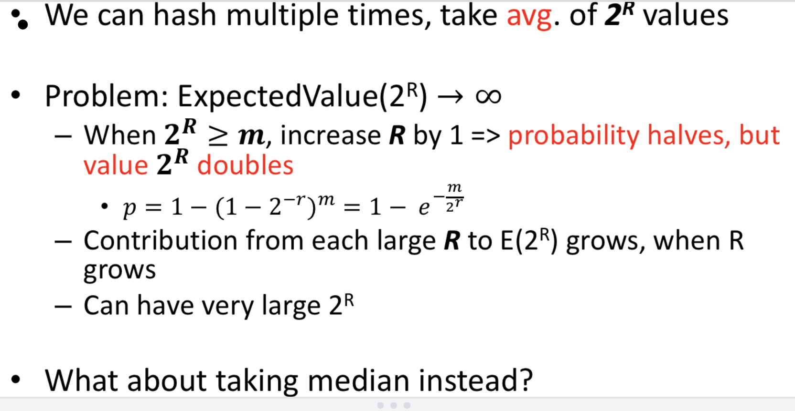
Problems in combining estimates

Slide 64
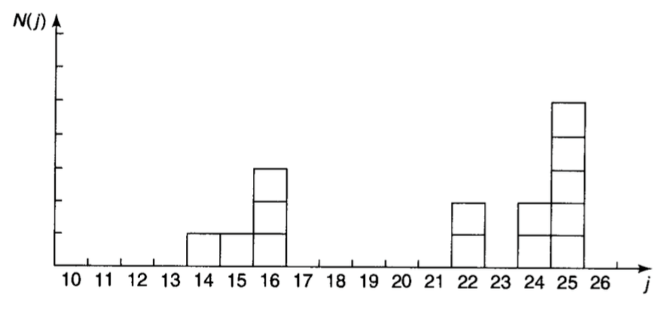
Examples of Probability
N people (e.g., N=14) with different age j
Probability P(j) = N(j)/N
Most probable? Media=? Average(mean) <j>=?
25.0
(14+25)/2
21.0
Probability Distribution
Notes:
MEDIA IS 23, BECAUSE 7 PEOPLE ARE BELOW 23, AND 7 people are older than 23.
Most probable is mode (the age that most people are at)
Mean is the Sum(age)/14people

Slide 65
Combining the estimates
Avg only: what if one very large value?
Median: all values are power of 2
1, 2, 4, 8,…,1024, 2048,…
Solution:
Partition hash functions into small groups
Take average for each group
Take the median of the averages

Slide 66
Counting (moments)

Slide 67
Roadmap
Motivation
Sampling
Fixed-portion & fixed-size (reservoir sampling)
Filtering
Bloom filter
Counting
Estimating # of distinct values, moments
Sliding window
Counting # of 1’s in the window

Slide 68
Moments
A stream S of elements drawn from a universal set: v₁, v₂, …, v_{n}
m_{i} is the number of occurrences of v_{i} in S
(1,4,1,3,4,1), m₁=3, m₂ = 2;
k-th moment of S:
Σ_{i=1}^{n} (m_{i})^{k}

Slide 69

K-th moments
0-th moment of the stream S
# of distinct elements in S
(1, 4, 1, 3, 4, 1)
1st moment of S
Length of S
2nd moment of S : sum of squared frequencies
Surprise number, measuring the evenness of distribution of elements in S

Slide 70
Surprise number
Steam of 100 elements, 11 values appeared
Unsurprising: m_{i} =10, 9, 9, 9, 9, 9, 9, 9, 9, 9, 9
Surprise number = 10² + 10 * 9² = 910
Surprising: 90, 1, 1, 1, 1, 1, 1, 1, 1, 1, 1
Surprise number = 90² + 10 * 1² = 8,110
… … …

Slide 71
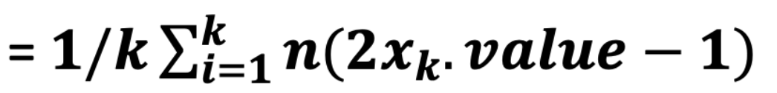
AMS (Alon-Matias-Szegedy) Algorithm
Estimating 2nd moment of a stream of length n
Pick k random numbers between 1 to n
For each, construct a variable X at position t
Record its count from position t onwards to n as X.value
Estimate
Explain next

Slide 72
Example
Stream: a, b, c, b, d, a, c, d, a, b, d, c, a, a, b
Stream length n = 15
a occurs 5 times
b occurs 4 times
c occurs 3 times
d occurs 3 times
2nd moment = 5² + 4² + 3² + 3² = 59

Slide 73
Random variables
Each random variable X records:
X.element: element in X
X.value: # of occurrences of X from time t to n
X.value = 1, at time t
At time t, we have the 1st encounter of this element
X.value++, when another X.element is seen

Slide 74
Random variables
Stream: a, b, c, b, d, a, c, d, a, b, d, c, a, a, b
Suppose we keep three variables: X₁, X₂, X₃
Introduced at position: 3, 8, and 13
Position 3: X₁.element = c, X₁.value = 1
Position 7: X₁.value = 2
3
8
13

Slide 75
Random variables
Stream: a, b, c, b, d, a, c, d, a, b, d, c, a, a, b
Position 8: X₂.element = d, X₂.value = 1
Position 11: X₂.value = 2
Position 12: X₁.value = 3
Position 13: X₃.element = a, X₃.value = 1
Position 14: X₃.value = 2
3
8
13

Slide 76
Random variables: final values
X₁.value = 3, X₂.value = 2, X₃.value = 2
Estimate of 2nd moment = n(2*X.value - 1)
Estimate using X₁: 15(6-1) = 75
Estimate using X₂or X₃: 15(4-1) = 45
Avg. = (75+45+45)/3 = 55 (recall actual is 59)

Slide 77
Why AMS works?
Stream: a, b, c, b, d, a, c, d, a, b, d, c, a, a, b
e(i): element that appears in position i
A random variable introduced at this positon will have X.element = e(i)
c(i): # of times e(i) appears in positions i…n
X.value = c(i)
e(6) = a, c(6) = 4
3
8
13
n

Slide 78
Why AMS works?
Stream: a, b, c, b, d, a, c, d, a, b, d, c, a, a, b
e(1) = a, c(1) = 5 = m_{a}
e(2) = b, c(2) = 4 = m_{b}
e(3) = c, c(3) = 3 = m_{c}
e(4) = b, c(4) = m_{b}-1
…
e(13) = a, c(13) = 2
e(14) = a, c(14) = 1
e(15) = b, c(15) = 1
3
8
13
1, 2, 3, …, m_{a}
If we can have a lot of random variables (e.g., 15)…

Slide 79
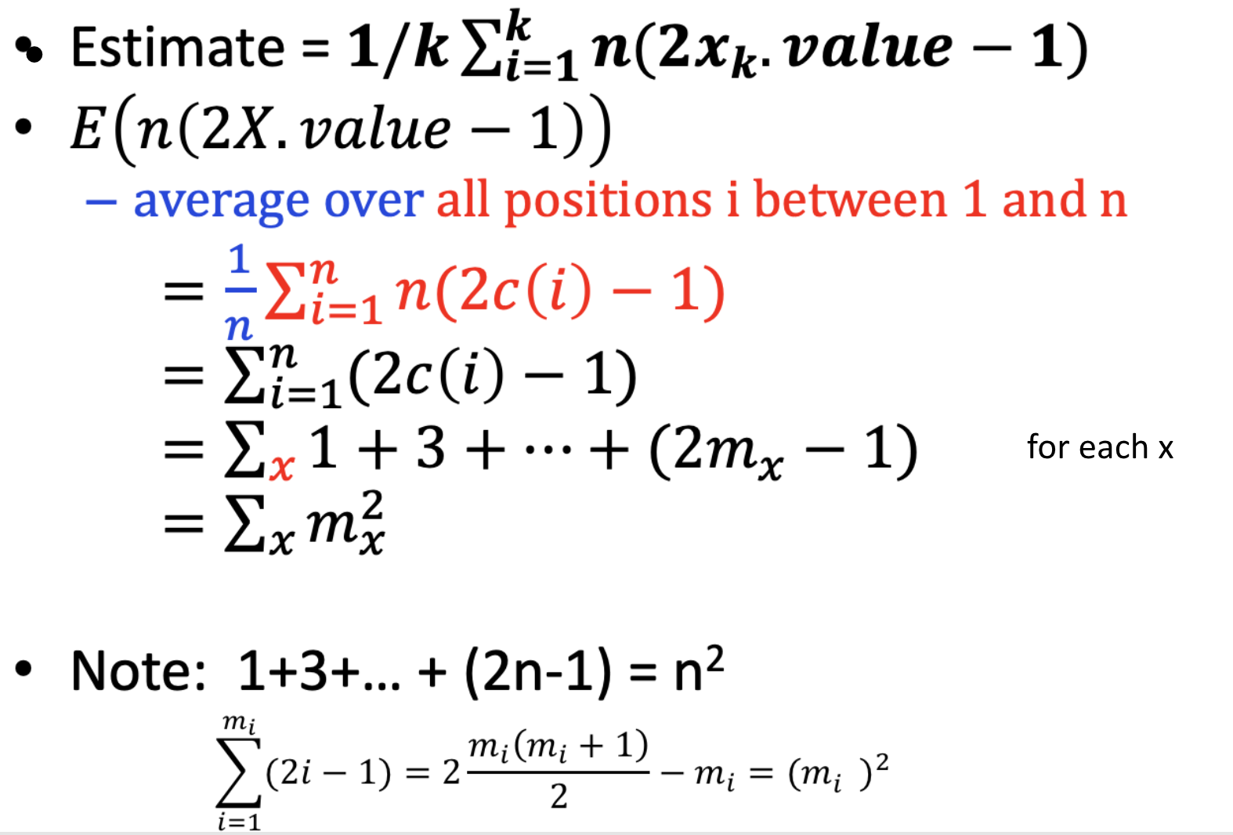
Why AMS works?
// this is the 2nd moments

Slide 80
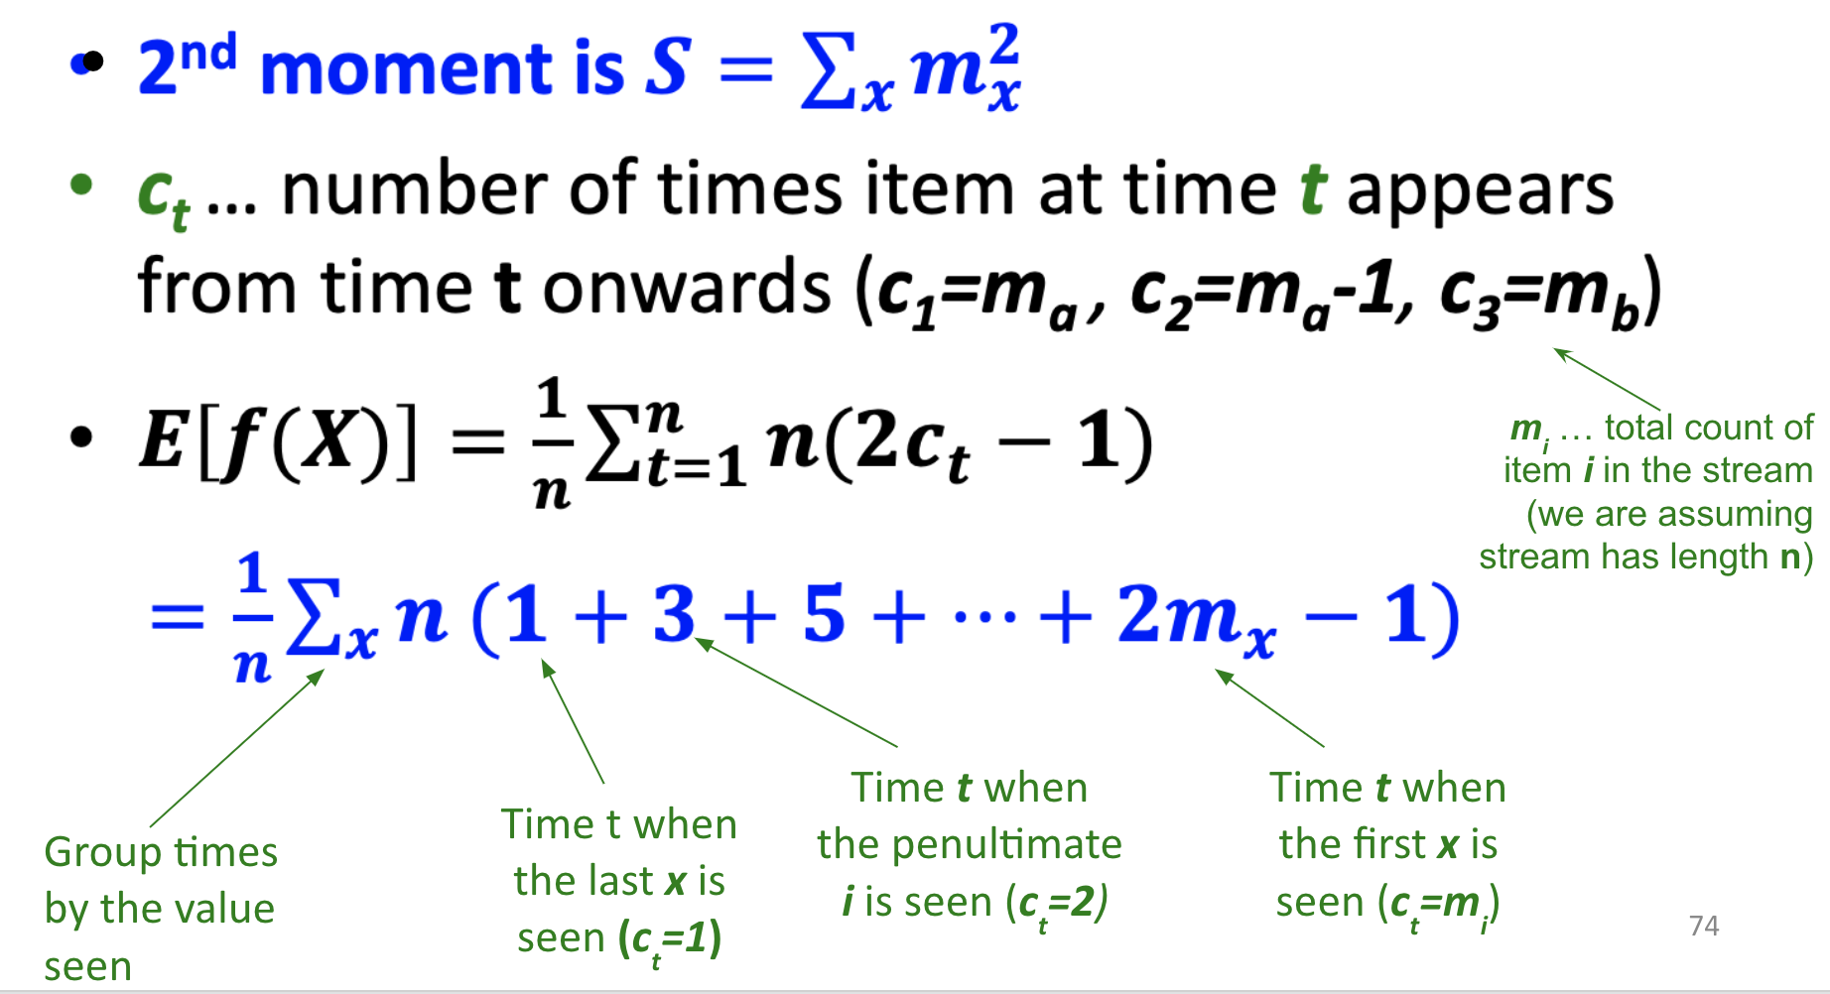
Expectation Analysis
Count:
1
2
3
m_{a}
Stream:
a
a
b
b
b
a
b
a
of

Slide 81
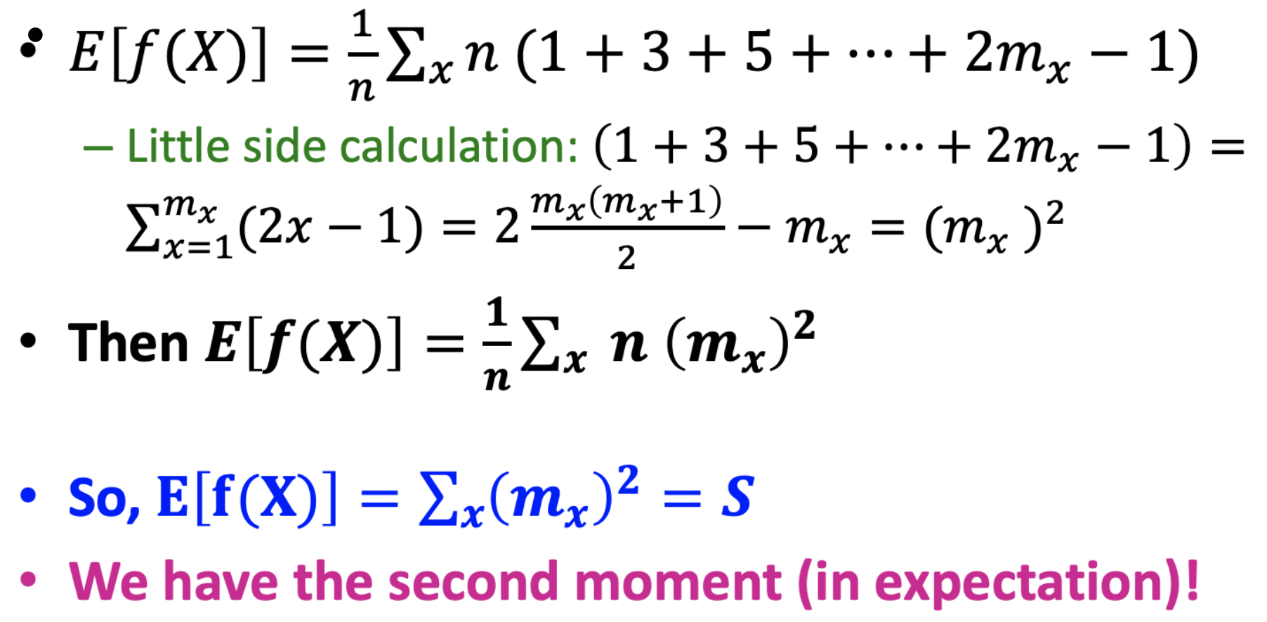
Expectation Analysis
Count:
1
2
3
m_{a}
Stream:
a
a
b
b
b
a
b
a

Slide 82
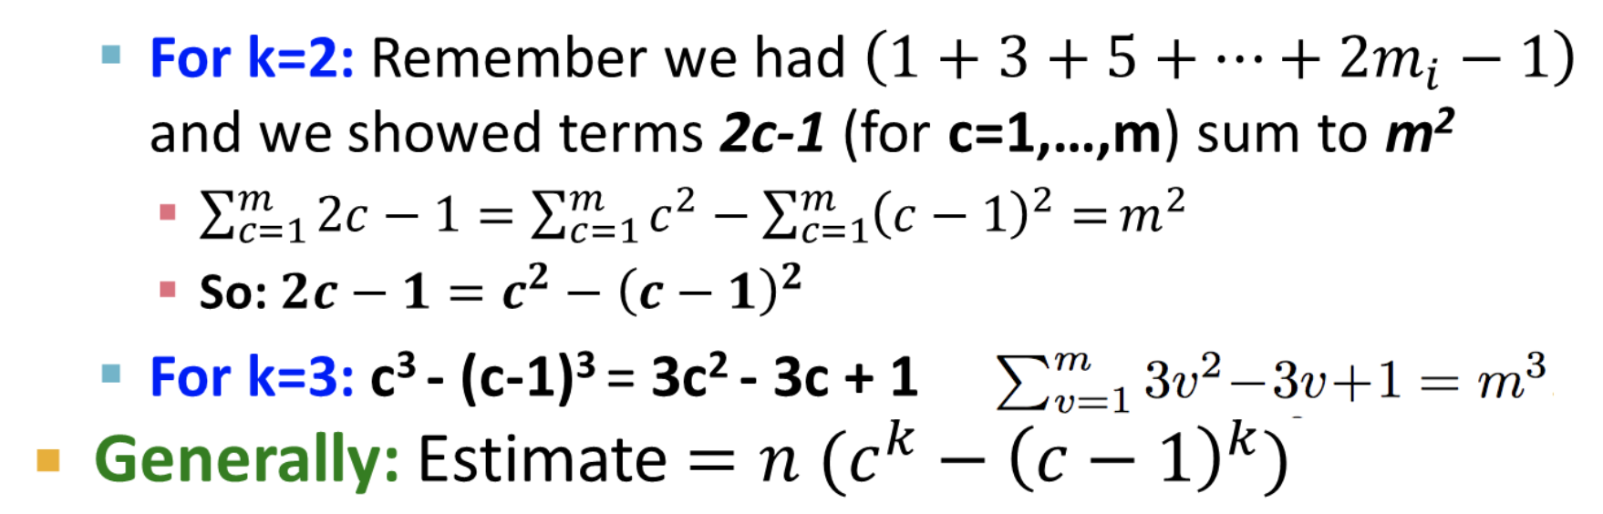

Higher-Order Moments
To estimate the k^{th} moment, we essentially use the same algorithm but change the estimate:
For k=2 we used n (2·c – 1)
For k=3 we use: n (3·c² – 3c + 1) (where c=X.val)
Why?
For k=2: Remember we had and we showed terms 2c-1 (for c=1,…,m) sum to m²
So:
For k=3: c³ - (c-1)³ = 3c² - 3c + 1
Generally: Estimate

Slide 83
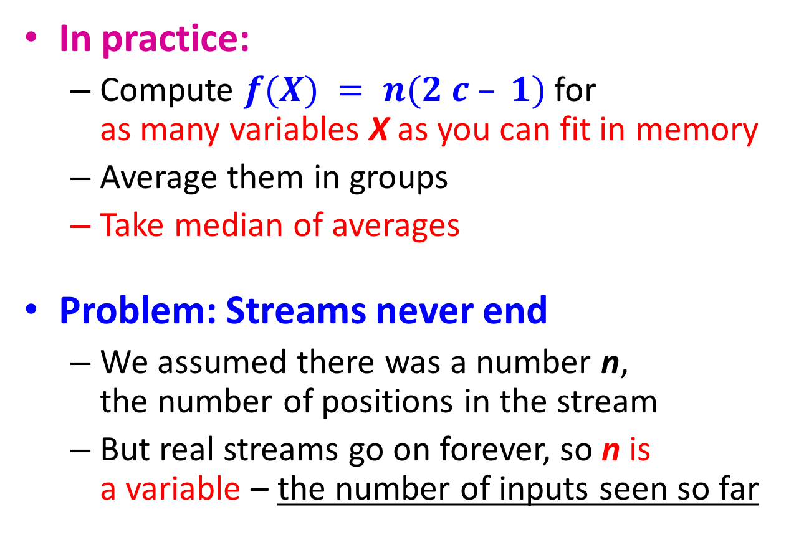
Combining Samples
In practice:
Compute $f(X) = n(2 c – 1)$for as many variables X as you can fit in memory
Average them in groups
Take median of averages
Problem: Streams never end
We assumed there was a number n, the number of positions in the stream
But real streams go on forever, so n is a variable – the number of inputs seen so far

Slide 84
Streams Never End: Fixups
(1) The variables X have n as a factor – keep n separately; just hold the count in X
(2) Suppose we can only store k counts. We must throw some Xs out as time goes on:
Objective:
Estimating 2nd moment of a stream of length n
Each starting time t is selected with probability k/n
Solution: (fixed-size sampling!)
Choose the first k times for k variables
When the n^{th} element arrives (n > k), choose it with probability k/n
If you choose it, throw one of the previously stored variables X out, with equal probability

Slide 85
Sliding windows

Slide 86
Roadmap
Motivation
Sampling
Fixed-portion & fixed-size (reservoir sampling)
Filtering
Bloom filter
Counting
Estimating # of distinct values, moments
Sliding window
Counting # of 1’s in the window

Slide 87
Sliding Windows
A useful model of stream processing is that queries are about a window of length N
the N most recent elements received
Interesting case: N is so large that the data cannot be stored in memory, or even on disk
Or, there are so many streams that windows for all cannot be stored
Amazon example:
For every product X we keep 0/1 stream of whether that product was sold in the n-th transaction
We want answer queries, how many times have we sold X in the last k sales (e.g., k = 10, 20, or 200; N=100,000)

Slide 88
Sliding Window: 1 Stream
N = 6
Sliding window on a single stream:
q w e r t y u i o p a s d f g h j k l z x c v b n m
q w e r t y u i o p a s d f g h j k l z x c v b n m
q w e r t y u i o p a s d f g h j k l z x c v b n m
q w e r t y u i o p a s d f g h j k l z x c v b n m
Past Future

Slide 89
Counting Bits (1)
Problem:
Given a stream of 0s and 1s
Be prepared to answer queries of the form How many 1s are in the last N bits?
Obvious solution: Store the most recent N bits
When new bit comes in, discard the N+1st bit
0 1 0 0 1 1 0 1 1 1 0 1 0 1 0 1 1 0 1 1 0 1 1 0
Suppose N=6
Past Future

Slide 90
Counting Bits (2)
You cannot get an exact answer without storing the entire window
Real Problem: What if we cannot afford to store N bits?
E.g., we’re processing 1 billion streams and N = 1 billion
But we are happy with an approximate answer
0 1 0 0 1 1 0 1 1 1 0 1 0 1 0 1 1 0 1 1 0 1 1 0
Past Future

Slide 91
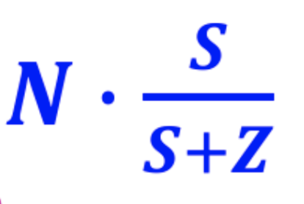
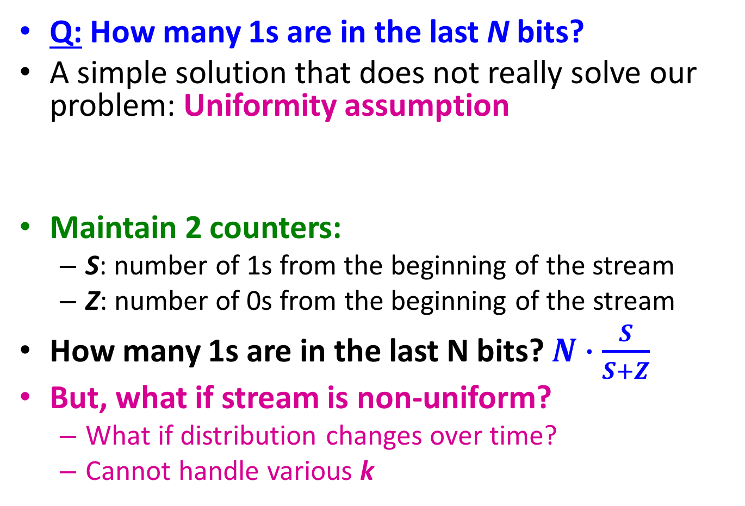
An attempt: Simple solution
Q: How many 1s are in the last N bits?
A simple solution that does not really solve our problem: Uniformity assumption
Maintain 2 counters:
S: number of 1s from the beginning of the stream
Z: number of 0s from the beginning of the stream
How many 1s are in the last N bits? $N∙\frac{S}{S+Z}$
But, what if stream is non-uniform?
What if distribution changes over time?
Cannot handle various k
N
0 1 0 0 1 1 1 0 0 0 1 0 1 0 0 1 0 0 0 1 0 1 1 0 1 1 0 1 1 1 0 0 1 0 1 0 1 1 0 0 1 1 0 1 0
Past Future

Slide 92
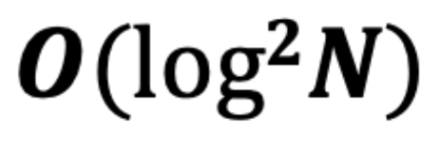
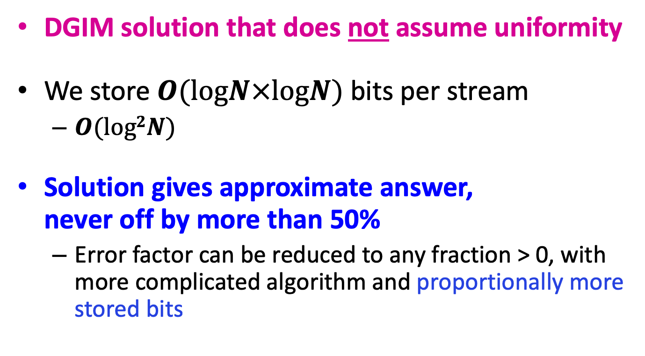
DGIM Method
[Datar, Gionis, Indyk, Motwani]
DGIM solution that does not assume uniformity
We store $O(logN×logN)$ bits per stream
$O(log2N)$
Solution gives approximate answer, never off by more than 50%
Error factor can be reduced to any fraction > 0, with more complicated algorithm and proportionally more stored bits
Notes:
2017 w1

Slide 93
Idea: Exponential Windows
Solution that doesn’t (quite) work:
Summarize exponentially increasing regions of the stream, looking backward
Drop small regions if they begin at the same point as a larger region
Window of width 16 has 6 1s
16
16
6
10
?
4
3
2
8
2
1
4
4
1
0
0 1 0 0 1 1 1 0 0 0 1 0 1 0 0 1 0 0 0 1 0 1 1 0 1 1 0 1 1 1 0 0 1 0 1 0 1 1 0 0 1 1 0 1 0
N
We can reconstruct the count of the last N bits, except we are not sure how many of the last 6 1s are included in the N
Notes:
remember -- this is a strawman algorithm that doesn't really work, so I never spent much time worrying about it, and you shouldn't either. However, you don't have to worry about where the buckets begin or end in this algorithm, since that is determined completely from the count of bits received so far. The rule for updating is as follows. 1. when a bit comes in, create a bucket of length 1 with the proper count (0 or 1). 2. If any level has 3 buckets: a) add the rightmost two and create a bucket at the next higher level (twice the length) with that sum. b) delete the leftmost two buckets, keeping only the rightmost of the three.. 3. Repeat (2) recursively for progressively higher levels. I hope this helps. I would really invite students to figure it out if they care (they won't).

Slide 94
What’s Not So Good?
As long as the 1s are fairly evenly distributed, the error due to the unknown region is small – no more than 50%
But it could be that all the 1s are in the unknown area at the end
In that case, the error is unbounded!
6
10
?
4
3
2
2
1
1
0
0 1 0 0 1 1 1 0 0 0 1 0 1 0 0 1 0 0 0 1 0 1 1 0 1 1 0 1 1 1 0 0 1 0 1 0 1 1 0 0 1 1 0 1 0
N

Slide 95
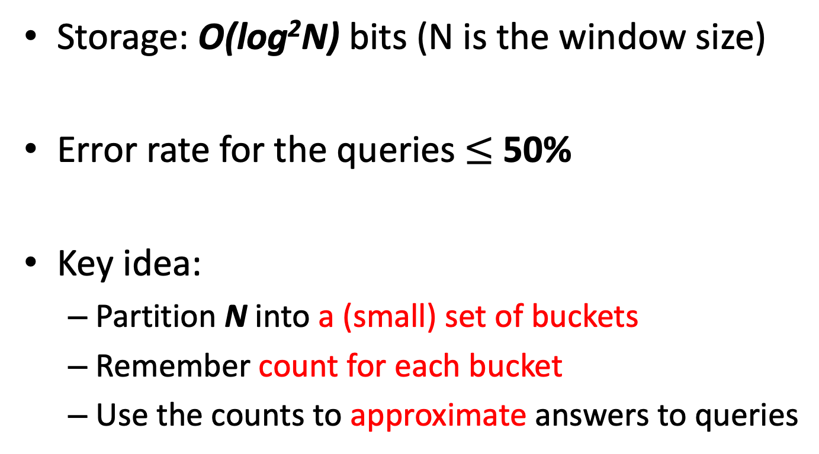
DGIM Algorithm
Storage: O(log²N) bits (N is the window size)
Error rate for the queries $≤$ 50%
Key idea:
Partition N into a (small) set of buckets
Remember count for each bucket
Use the counts to approximate answers to queries

Slide 96
Fixup: DGIM method
[Datar, Gionis, Indyk, Motwani]
Idea: Instead of summarizing fixed-length blocks, summarize blocks with specific number of 1s:
Let the block sizes (number of 1s) increase exponentially
When there are few 1s in the window, block sizes stay small, so errors are small
1001010110001011010101010101011010101010101110101010111010100010110010
N

Slide 97
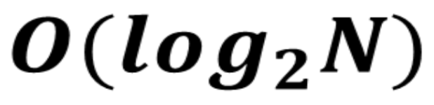
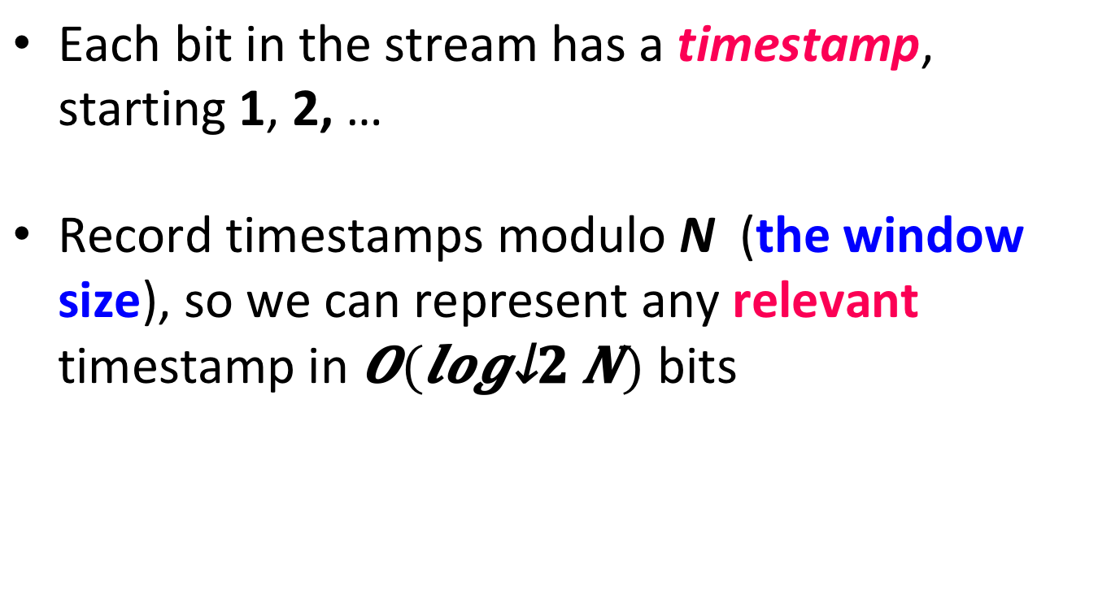
DGIM: Timestamps
Each bit in the stream has a timestamp, starting 1, 2, …
Record timestamps modulo N (the window size), so we can represent any relevant timestamp in $O(log_{2}N)$ bits

Slide 98
Bucket
Each represents a sequence of bits in window
It does not store the actual bits
Rather a timestamp and # of 1’s in the sequence
Timestamp of bucket
Timestamp of its end time
Bucket size = # of 1’s in the bucket
Always some power of 2: 1, 2, 4, …

Slide 99
Example Buckets
. . 1 0 1 1 0 1 1 0 0 0 1 0 1 1 1 0 1 1 0 0 1 0 1 1 0
Two size-1 buckets
One size-2 bucket
Two size-4 buckets
One size-8 bucket
Window size N = 25

Slide 100
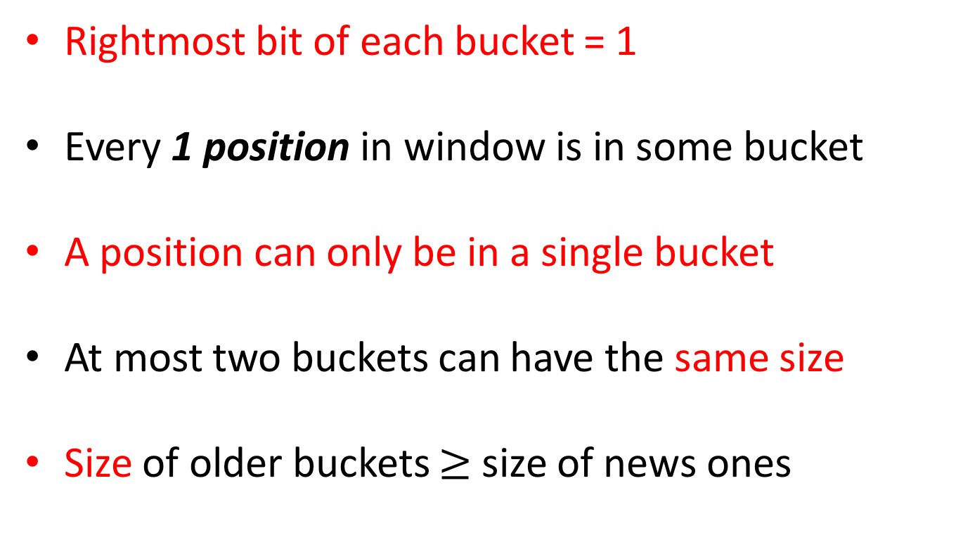
Rules for creating buckets
Rightmost bit of each bucket = 1
Every 1 position in window is in some bucket
A position can only be in a single bucket
At most two buckets can have the same size
Size of older buckets $≥$ size of news ones

Slide 101
Representing a Stream by Buckets
Either one or two buckets with the same power-of-2 number of 1s
Buckets do not overlap in timestamps
Buckets are sorted by size
Earlier buckets are not smaller than later buckets
Buckets disappear when their end-time is > N time units in the past

Slide 102
Example buckets
. . 1 0 1 1 0 1 1 0 0 0 1 0 1 1 1 0 1 1 0 0 1 0 1 1 0
Two size-1 buckets
One size-2 bucket
Two size-4 buckets
One size-8 bucket
Window size N = 25

Slide 103
Example: Bucketized Stream
At least 1 of
size 16. Partially
beyond window.
2 of
size 8
2 of
size 4
1 of
size 2
2 of
size 1
1001010110001011010101010101011010101010101110101010111010100010110010
N
Three properties of buckets that are maintained:
- Either one or two buckets with the same power-of-2 number of 1s
- Buckets do not overlap in timestamps
- Buckets are sorted by size

Slide 104
Updating Buckets (1)
When a new bit comes in, drop the last (oldest) bucket if its end-time is prior to N time units before the current time
2 cases: Current bit is 0 or 1
If the current bit is 0: no other changes are needed

Slide 105
Updating Buckets (2)
If the current bit is 1:
(1) Create a new bucket of size 1, for just this bit
End timestamp = current time
(2) If there are now three buckets of size 1, combine the oldest two into a bucket of size 2
(3) If there are now three buckets of size 2, combine the oldest two into a bucket of size 4
(4) And so on …

Slide 106
Example: Updating Buckets
Current state of the stream:
1001010110001011010101010101011010101010101110101010111010100010110010
Bit of value 1 arrives
0010101100010110101010101010110101010101011101010101110101000101100101
Two blue buckets get merged into a yellow bucket
0010101100010110101010101010110101010101011101010101110101000101100101
Next bit 1 arrives, new blue bucket is created, then 0 comes, then 1:
0101100010110101010101010110101010101011101010101110101000101100101101
Buckets get merged…
0101100010110101010101010110101010101011101010101110101000101100101101
State of the buckets after merging
0101100010110101010101010110101010101011101010101110101000101100101101

Slide 107
DGIM: Buckets
A bucket in the DGIM method is a record consisting of:
(A) The timestamp of its end [O(log₂ N) bits]
(B) The number of 1s between its beginning and end [O(log₂ log₂ N) bits]
log₂ N is the maximum # of bit, X, in a bucket (of size N)
to store X, we need log₂ X bits
Constraint on buckets: Number of 1s must be a power of 2
That explains the O(log₂ log₂ N) in (B) above
1001010110001011010101010101011010101010101110101010111010100010110010
N

Slide 108
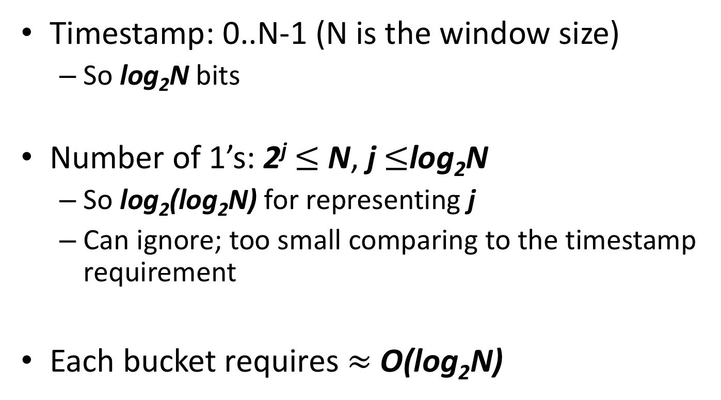
Storage for each bucket
Timestamp: 0..N-1 (N is the window size)
So log₂N bits
Number of 1’s: 2^{j} $≤$ N, j $≤$log₂N
So log₂(log₂N) for representing j
Can ignore; too small comparing to the timestamp requirement
Each bucket requires $≈$ O(log₂N)

Slide 109
Storage requirements of DGIM
At most 2*j buckets
of sizes: 2^{j}, 2^{j-1}, …, 1 (at most two for each size)
Size of the largest bucket 2^{j} ≤ N
So j ≤ log₂N and 2j ≤ 2log₂ N
Total storage: O(log₂N * log₂N) or O(log²N)
Recall that each bucket requires O(log₂N)
Notes:
2018 2.1

Slide 110
How to Query?
To estimate the number of 1s in the most recent N bits:
Sum the sizes of all buckets but the last
(note “size” means the number of 1s in the bucket)
Add half the size of the last bucket
Remember: We do not know how many 1s of the last bucket are still within the wanted window

Slide 111
Example: Bucketized Stream
At least 1 of
size 16. Partially
beyond window.
2 of
size 8
2 of
size 4
1 of
size 2
2 of
size 1
1001010110001011010101010101011010101010101110101010111010100010110010
N

Slide 112
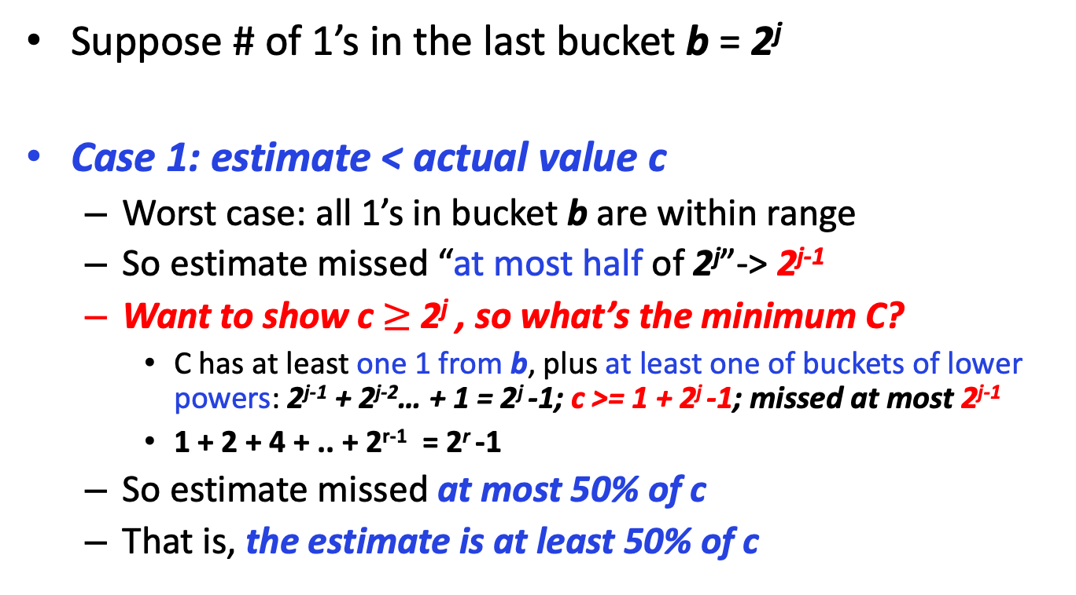
How close is the estimate?
Suppose # of 1’s in the last bucket b = 2^{j}
Case 1: estimate < actual value c
Worst case: all 1’s in bucket b are within range
So estimate missed “at most half of 2^{j}”-> 2^{j-1}
Want to show c $≥$ 2^{j} , so what’s the minimum C?
C has at least one 1 from b, plus at least one of buckets of lower powers: 2^{j-1} + 2^{j-2}… + 1 = 2^{j} -1; c >= 1 + 2^{j} -1; missed at most 2^{j-1}
1 + 2 + 4 + .. + 2^{r-1} = 2^{r} -1
So estimate missed at most 50% of c
That is, the estimate is at least 50% of c
Notes:
https://en.wikipedia.org/wiki/1_%2B_2_%2B_4_%2B_8_%2B_⋯

Slide 113
How close is the estimate?
Suppose # of 1’s in the last bucket b = 2^{j}
Case 2: estimate > actual value c
Worst case: only rightmost bit of b is within range
And only one bucket for each smaller power
c = 1 + 2^{j-1} + 2^{j-2} + … + 1 = 1 + 2^{j} -1 = 2^{j}
Estimate = 2^{j-1} (last bucket) + 2^{j-1} + … + 1
= 2^{j} – 1 (c minus the right most bit) + 2^{j-1} (last bucket)
2^{j-1} + 2^{j-2}… + 1 = 2^{j} -1
So estimate is no more than 50% greater than c

Slide 114
Extensions
Can we use the same trick to answer queries How many 1’s in the last k? where k < N?
A: Find earliest bucket B that at overlaps with k. Number of 1s is the sum of sizes of more recent buckets + ½ size of B
1001010110001011010101010101011010101010101110101010111010100010110010
k
Notes:
Yes, instead of bit counts keep partial sums

