Slide 1
Volume Rendering using Graphics Hardware
Travis Gorkin
GPU Programming and Architecture, June 2009

Slide 2
Agenda
Volume Rendering Background
  Volumetric Data
  Optical Model
  Accumulation Equations
Volume Rendering on the CPU
  Raymarching Algorithm
Volume Rendering on Graphics Hardware
  Slice-Based Volume Rendering
  Stream Model for Volume Raycasting
Volume Rendering in CUDA

Slide 3
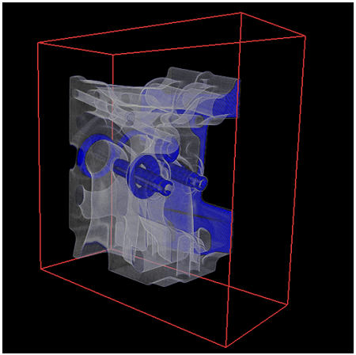
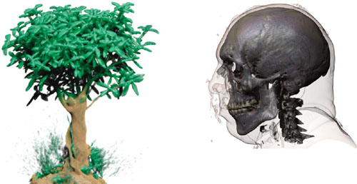
Volume Rendering Definition
Generate 2D projection of 3D data set
Visualization of medical and scientific data
Rendering natural effects - fluids, smoke, fire
Direct Volume Rendering (DVR)
  Done without extracting any surface geometry

Slide 4
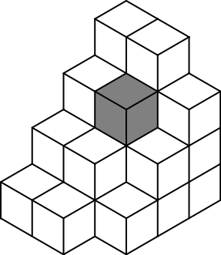
Volumetric Data
3D Data Set
  Discretely sampled on regular grid in 3D space
  3D array of samples
Voxel – volume element
  One or more constant data values
  Scalars – density, temperature, opacity
  Vectors – color, normal, gradient
  Spatial coordinates determined by position in data structure
Trilinear interpolation
  Leverage graphics hardware

Slide 5

Transfer Function
Maps voxel data values to optical properties
Glorified color maps
Emphasize or classify features of interest in the data
Piecewise linear functions, Look-up tables, 1D, 2D
GPU – simple shader functions, texture lookup tables

Slide 6
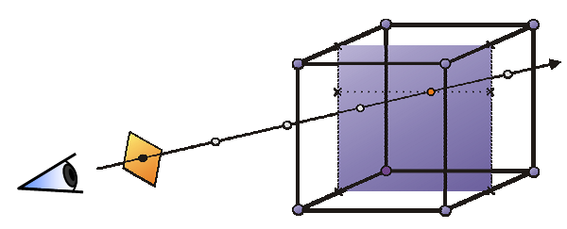
Volume Rendering Optical Model
Light interacts with volume ‘particles’ through:
  Absorption
  Emission
  Scattering
Sample volume along viewing rays
Accumulate optical properties

Slide 7
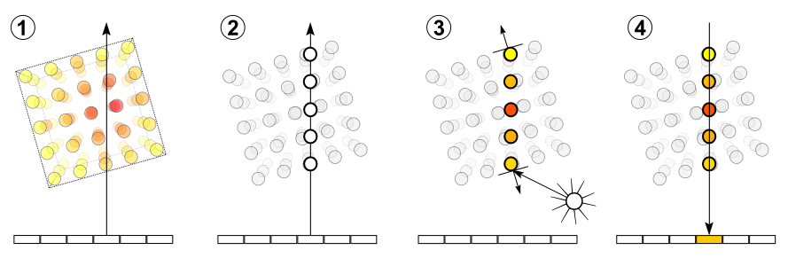
Volume Ray Marching
Raycast – once per pixel
Sample – uniform intervals along ray
Interpolate – trilinear interpolate, apply transfer function
Accumulate – integrate optical properties

Slide 8
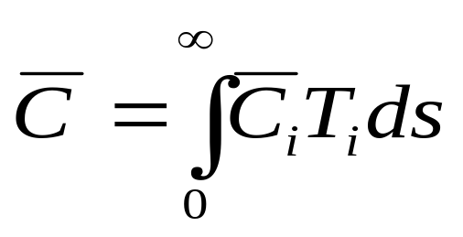

Ray Marching Accumulation Equations
Accumulation = Integral
Color
Transmissivity = 1 - Opacity
Total Color = Accumulation (Sampled Colors x Sampled Transmissivities)

Slide 9
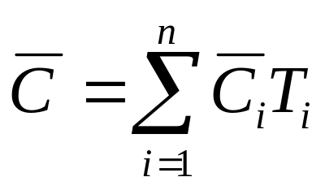
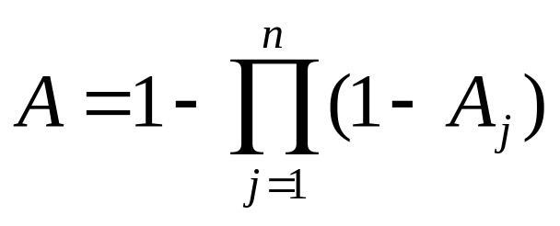
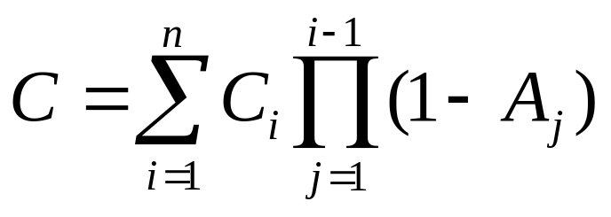
Ray Marching Accumulation Equations
Discrete Versions
Accumulation = Sum
Color
Opacity
Transmissivity = 1 - Opacity

Slide 10
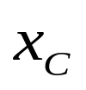

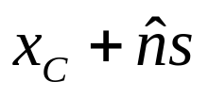
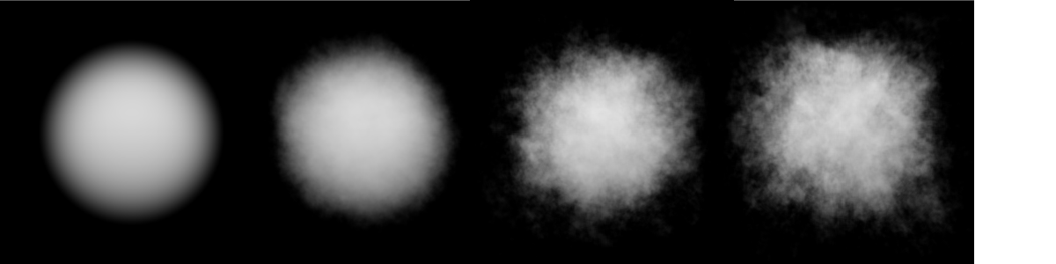
CPU Based Volume Rendering
Raycast and raymarch for each pixel in scene
  Camera (eye) location:
  For Each Pixel
    Look Direction:
    Cast Ray Along:
    Accumulate Color Along Line

Slide 11
CPU Based Volume Rendering
Sequential Process
Minutes or Hours per frame
Optimizations
  Space Partitioning
  Early Ray Termination

Slide 12
Volumetric Shadows
Light attenuated as passes through volume
‘Deeper’ samples receive less illumination
Second raymarch from sample point to light source
  Accumulate illumination from sample’s point of view
  Same accumulation equations
Precomputed Light Transmissivity
  Precalculate illumination for each voxel center
  Trilinearly interpolate at render time
  View independent, scene/light source dependent

Slide 13
GPU Based Volume Rendering
GPU Gems Volume 1: Chapter 39
  “Volume Rendering Techniques”
  Milan Ikits, Joe Kniss, Aaron Lefohn, Charles Hansen
IEEE Visualization 2003 Tutorial
  “Interactive Visualization of Volumetric Data on Consumer PC Hardware”
“Acceleration Techniques for GPU-Based Volume Rendering”
  J. Krugger and R. Westermann, IEEE Visualization 2003

Slide 14
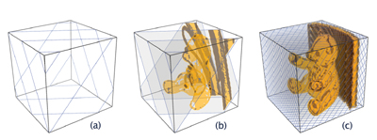
Slice-Based Volume Rendering (SBVR)
No volumetric primitive in graphics API
Proxy geometry - polygon primitives as slices through volume
Texture polygons with volumetric data
Draw slices in sorted order – back-to-front
Use fragment shader to perform compositing (blending)

Slide 15
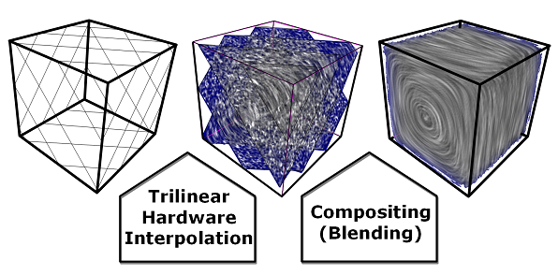
Volumetric Data
Voxel data sent to GPU memory as
  Stack of 2D textures
  3D texture
Leverage graphics pipeline
Instructions for setting up 3D texture in OpenGL
  http://gpwiki.org/index.php/OpenGL_3D_Textures

Slide 16
Proxy Geometry
Slices through 3D voxel data
3D voxel data = 3D texture on GPU
Assign texture coordinate to every slice vertex
  CPU or vertex shader

Slide 17
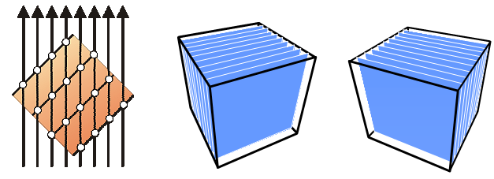
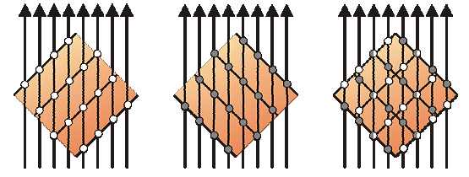
Proxy Geometry
Object-Aligned Slices
  Fast and simple
  Three stacks of 2D textures – x, y, z principle directions
  Texture stack swapped based on closest to viewpoint

Slide 18
Proxy Geometry
Issues with Object-Aligned Slices
  3x memory consumption
    Data replicated along 3 principle directions
  Change in viewpoint results in stack swap
    Image popping artifacts
    Lag while downloading new textures
  Sampling distance changes with viewpoint
    Intensity variations as camera moves

Slide 19
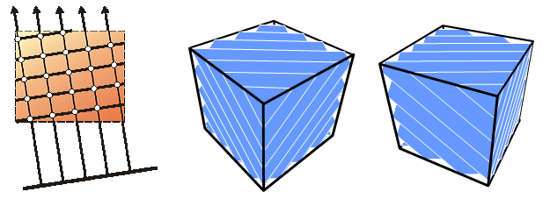
Proxy Geometry
View-Aligned Slices
  Slower, but more memory efficient
  Consistent sampling distance

Slide 20
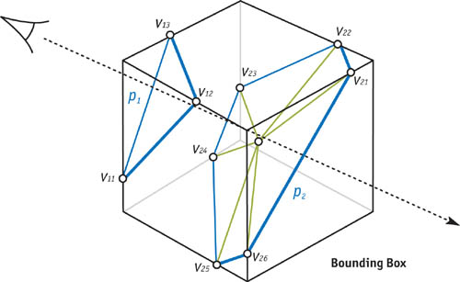
Proxy Geometry
View-Aligned Slices Algorithm
  Intersect slicing planes with bounding box
  Sort resulting vertices in (counter)clockwise order
  Construct polygon primitive from centroid as triangle fan

Slide 21
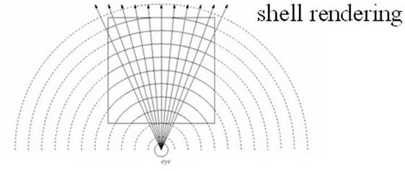
Proxy Geometry
Spherical Shells
  Best replicates volume ray casting
  Impractical – complex proxy geometry

Slide 22
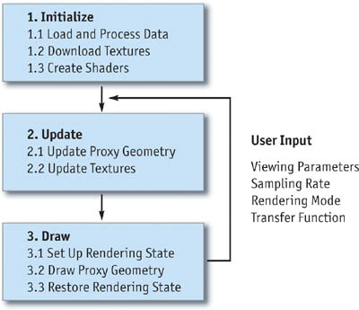
Sliced-Based Volume Rendering Steps

Slide 23
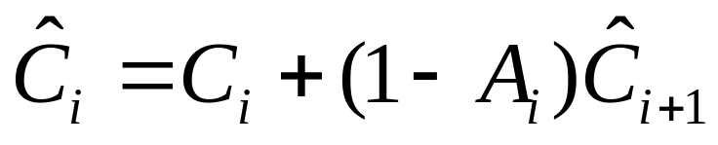
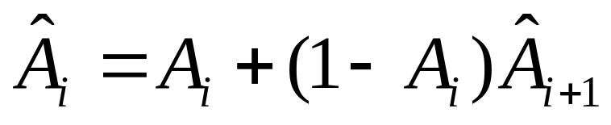
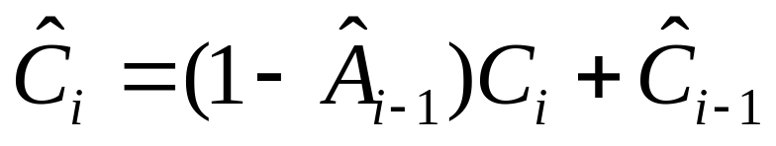
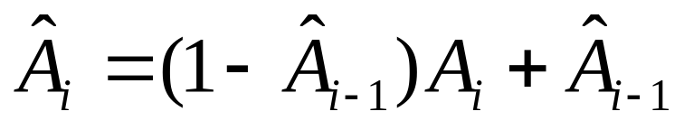
Rendering Proxy Geometry
Compositing
  Over operator – back-to-front order
  Under operator – front-to-back order

Slide 24
Rendering Proxy Geometry
Compositing = Color and Alpha Accumulation Equations
Easily implemented using hardware alpha blending
  Over
    Source = 1
    Destination = 1 - Source Alpha
  Under
    Source = 1 - Destination Alpha
    Destination = 1

Slide 25
Simple Volume Rendering Fragment Shader
void main( uniform float3 emissiveColor,
uniform sampler3D dataTex,
float3 texCoord : TEXCOORD0,
float4 color : COLOR)
{
float a = tex3D(texCoord, dataTex); // Read 3D data texture color = a * emissiveColor; // Multiply by opac
}

Slide 26
Fragment Shader with Transfer Function
void main( uniform sampler3D dataTex,
uniform sampler1D tfTex,
float3 texCoord : TEXCOORD0,
float4 color : COLOR
)
{
float v = tex3d(texCoord, dataTex); // Read 3D data color = tex1d(v, tfTex); // transfer function
}

Slide 27
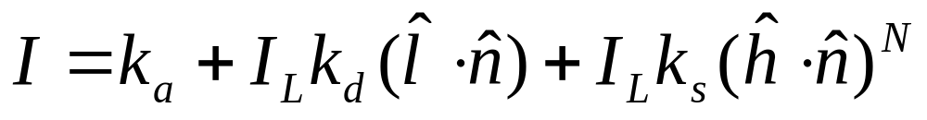
Local Illumination
Blinn-Phong Shading Model
Resulting = Ambient + Diffuse + Specular

Slide 28
Local Illumination
Blinn-Phong Shading Model
Requires surface normal vector
  Whats the normal vector of a voxel?
Resulting = Ambient + Diffuse + Specular

Slide 29
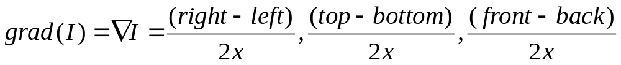
Local Illumination
Blinn-Phong Shading Model
Requires surface normal vector
  Whats the normal vector of a voxel? Gradient
  Central differences between neighboring voxels
Resulting = Ambient + Diffuse + Specular

Slide 30
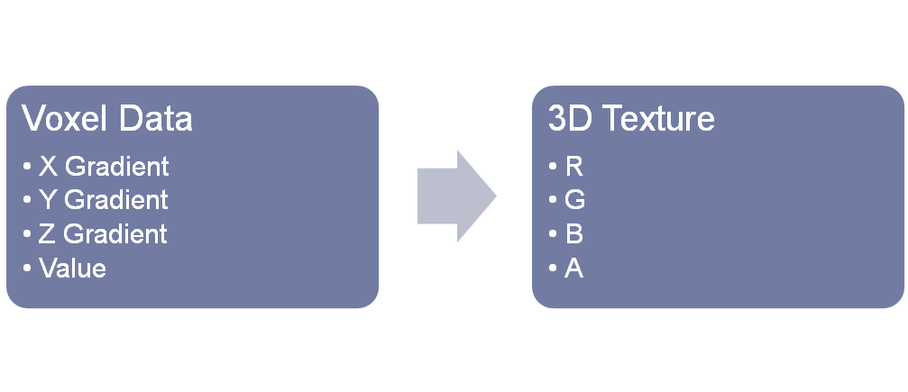
Local Illumination
Compute on-the-fly within fragment shader
  Requires 6 texture fetches per calculation
Precalculate on host and store in voxel data
  Requires 4x texture memory
  Pack into 3D RGBA texture to send to GPU

Slide 31
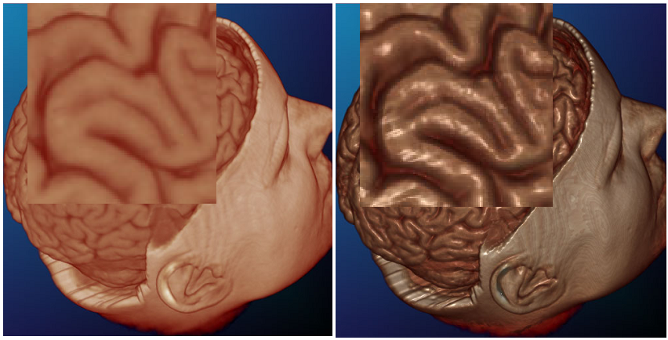
Local Illumination
Improve perception of depth
Amplify surface structure

Slide 32
Volumetric Shadows on GPU
Light attenuated from light’s point of view
CPU – Precomputed Light Transfer
  Secondary raymarch from sample to light source
GPU
  Two-pass algorithm
  Modify proxy geometry slicing
  Render from both the eye and the light’s POV
    Two different frame buffers

Slide 33
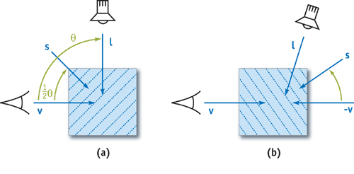
Two Pass Volume Rendering with Shadows
Slice axis set half-way between view and light directions
  Allows each slice to be rendered from eye and light POV
Render order for light – front-to-back
Render order for eye – (a) front-to-back
(b) back-to-front

Slide 34
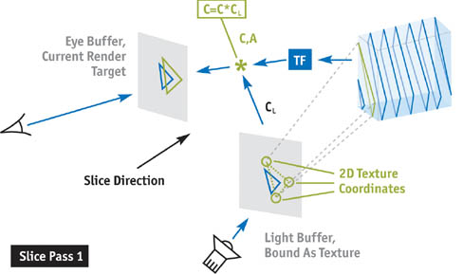
First Pass
Render from eye
Fragment shader
  Look up light color from light buffer bound as texture
  Multiply material color * light color

Slide 35
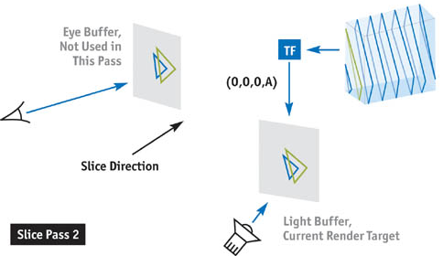
Second pass
Render from light
Fragment shader
  Only blend alpha values – light transmissivity

Slide 36
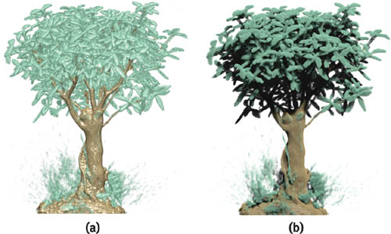
Volumetric Shadows

Slide 37
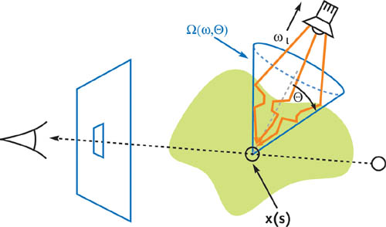
Scattering and Translucency
General scattering effects too complex for interactive rendering
Translucency result of scattering
  Only need to consider incoming light from cone in direction of light source

Slide 38
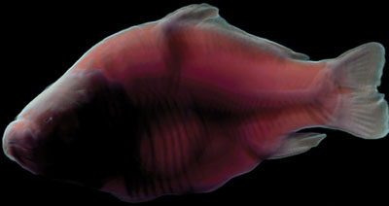
Scattering and Translucency
Blurring operation
  See GPU Gems Chap 39 for details

Slide 39
Performance and Limitations
Huge amount of fragment/pixel operations
  Texture access
  Lighting calculation
  Blending
Large memory usage
  Proxy geometry
  3D textures

Slide 40
Volume Raycasting on GPU
“Acceleration Techniques for GPU-Based Volume Rendering”
  Krugger and Westermann, 2003
Stream model taken from work in GPU Raytracing
Raymarching implemented in fragment program
  Cast rays of sight through volume
  Accumulate color and opacity
  Terminate when opacity reaches threshold

Slide 41
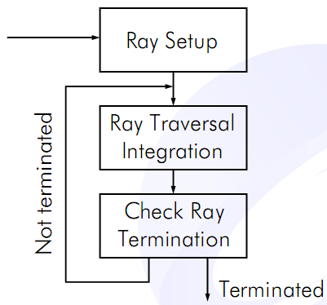
Volume Raycasting on GPU
Multi-pass algorithm
Initial passes
  Precompute ray directions and lengths
Additional passes
  Perform raymarching in parallel for each pixel
  Split up full raymarch to check for early termination

Slide 42
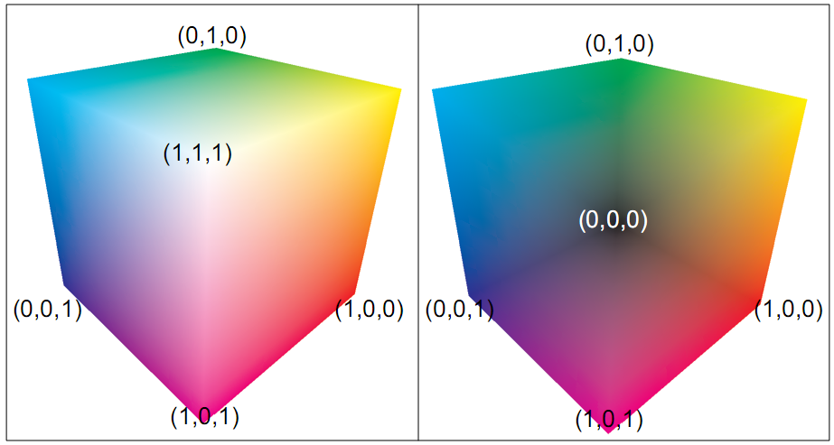
Step 1: Ray Direction Computation
Ray direction computed for each pixel
Stored in 2D texture for use in later steps
Pass 1: Front faces of volume bounding box
Pass 2: Back faces of volume bounding box
Vertex color components encode object-space principle directions

Slide 43
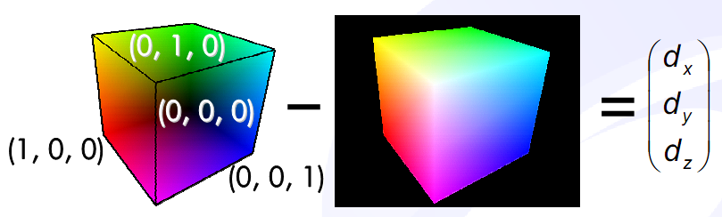
Step 1: Ray Direction Computation
Subtraction blend two textures
Store normalized direction – RGB components
Store length – Alpha component

Slide 44
Fragment Shader Raymarching
DIR[x][y] – ray direction texture
  2D RGBA values
P – per-vertex float3 positions, front of volume bounding box
  Interpolated for fragment shader by graphics pipeline
s – constant step size
  Float value
d – total raymarched distance, s x #steps
  Float value

Slide 45
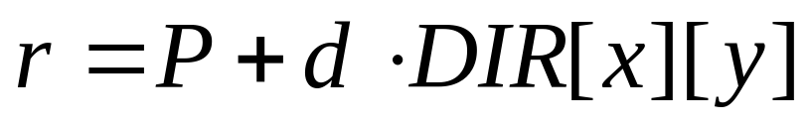
Fragment Shader Raymarching
DIR[x][y] – ray direction texture
  2D RGBA values
P – per-vertex float3 positions, front of volume bounding box
  Interpolated for fragment shader by graphics pipeline
s – constant step size
  Float value
d – total raymarched distance, s x #steps
  Float value
Parametric Ray Equation
  r – 3D texture coordinates used to sample voxel data

Slide 46
Fragment Shader Raymarching
Ray traversal procedure split into multiple passes
  M steps along ray for each pass
  Allows for early ray termination, optimization
Optical properties accumulated along M steps
  Simple compositing/blending operations
  Color and alpha(opacity)
Accumulation result for M steps blended into 2D result texture
  Stores overall accumlated values between multiple passes
Intermediate Pass – checks for early termination
  Compare opacity to threshold
  Check for ray leaving bounding volume

Slide 47
Optimizations
Early Ray Termination
  Compare accumulated opacity against threshold
Empty Space Skipping
  Additional data structure encoding empty space in volume
  Oct-tree
  Encode measure of empty within 3D texture read from fragment shader
  Raymarching fragment shader can modulate sampling distance based on empty space value

Slide 48
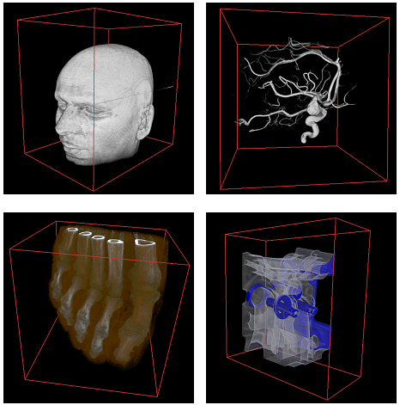
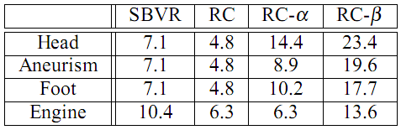
Performance and Limitations
More physically-based than slice-based volume rendering
  Guarantees equal sampling distances
Does not incorporate volumetric shadows
Reduced number of fragment operations
  Fragment programs made more complex
Optimizations work best for non-opaque data sets
  Early ray termination and empty space skipping can be applied

Slide 49
Volume Rendering in CUDA
NVIDIA CUDA SDK Code Samples
Example: Basic Volume Rendering using 3D Textures
http://developer.download.nvidia.com/compute/cuda/sdk/website/samples.html#volumeRender

Slide 50
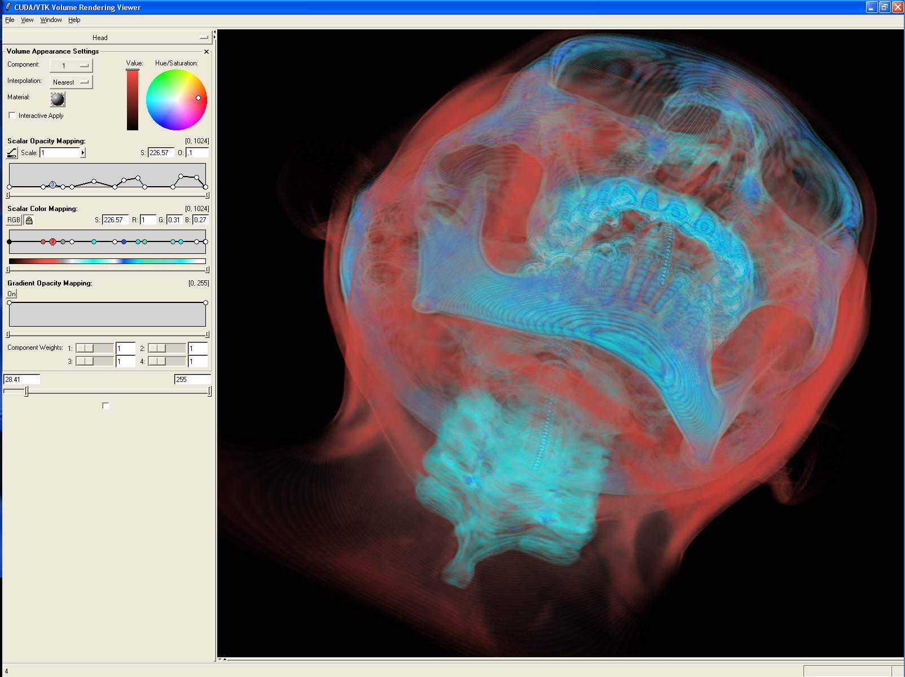
Volume Rendering in CUDA
3D Slicer – www.slicer.org
Open source software for visualization and image analysis
Funded by NIH, medical imaging, MRI data
Currently integrating CUDA volume rendering into Slicer 3.2

Slide 51
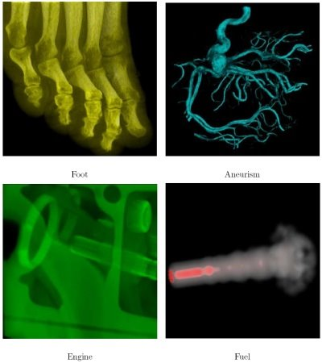
Volume Rendering in CUDA
“Volume Raycasting with CUDA”
  Jusub Kim, Ph.D. Dissertation, Univeristy of Maryland, College Park, 2008
  http://creator75.googlepages.com/cuda
Stream model for raycasting implemented in CUDA
Efficiently balance warps of threads and block sizes
  Single instruction execution within warp of threads
  Avoid memory conflicts with warps of threads

Slide 52
Agenda
Volume Rendering Background
  Volumetric Data
  Optical Model
  Accumulation Equations
Volume Rendering on the CPU
  Raymarching Algorithm
Volume Rendering on Graphics Hardware
  Slice-Based Volume Rendering
  Stream Model for Volume Raycasting
Volume Rendering in CUDA

Slide 53
References
“Chapter 39. Volume Rendering Techniques”, GPU Gems Volume 1, Ikits, Kniss, Lefohn, Hansen, 2003
  http://http.developer.nvidia.com/GPUGems/gpugems_ch39.html
  “Interactive Visualization of Volumetric Data on Consumer PC Hardware” IEEE Visualization 2003 Tutorial
    http://www.vis.uni-stuttgart.de/vis03_tutorial/
“Acceleration Techniques for GPU-Based Volume Rendering” J. Krugger and R. Westermann, IEEE Visualization 2003
  http://wwwcg.in.tum.de/Research/data/Publications/vis03-rc.pdf
  3D Slicer: Volume Rendering with CUDA
    http://www.slicer.org/slicerWiki/index.php/Slicer3:Volume_Rendering_With_Cuda

Slide 54
References
“Volume Raycasting with Cuda”, Jusub Kim, 2008
  http://creator75.googlepages.com/projects
  http://creator75.googlepages.com/cudachapter.pdf
“Production Volume Rendering”, Jerry Tessendorf, Slides presented at University of Pennsylvania, 2008
“Real-Time Volume Graphics”, SIGGRAPH 2004
  http://old.vrvis.at/via/resources/course-volgraphics-2004/

