Slide 1



CS224W: Machine Learning with Graphs Jure Leskovec, Stanford University
http://cs224w.stanford.edu

Slide 2
The class meets Tue and Thu 10:30-11:50am Pacific Time on Zoom.
Videos of the lectures will be recorded and posted on Canvas.
Structure of lectures:
  60 minutes of a prerecorded lecture.
  During this time we will be using Piazza Live Q&A
  20 minutes of a live Q&A session
1/13/21
Jure Leskovec, Stanford CS224W: Machine Learning with Graphs
1

Slide 3

CS224W: Machine Learning with Graphs Jure Leskovec, Stanford University
http://cs224w.stanford.edu

Slide 4
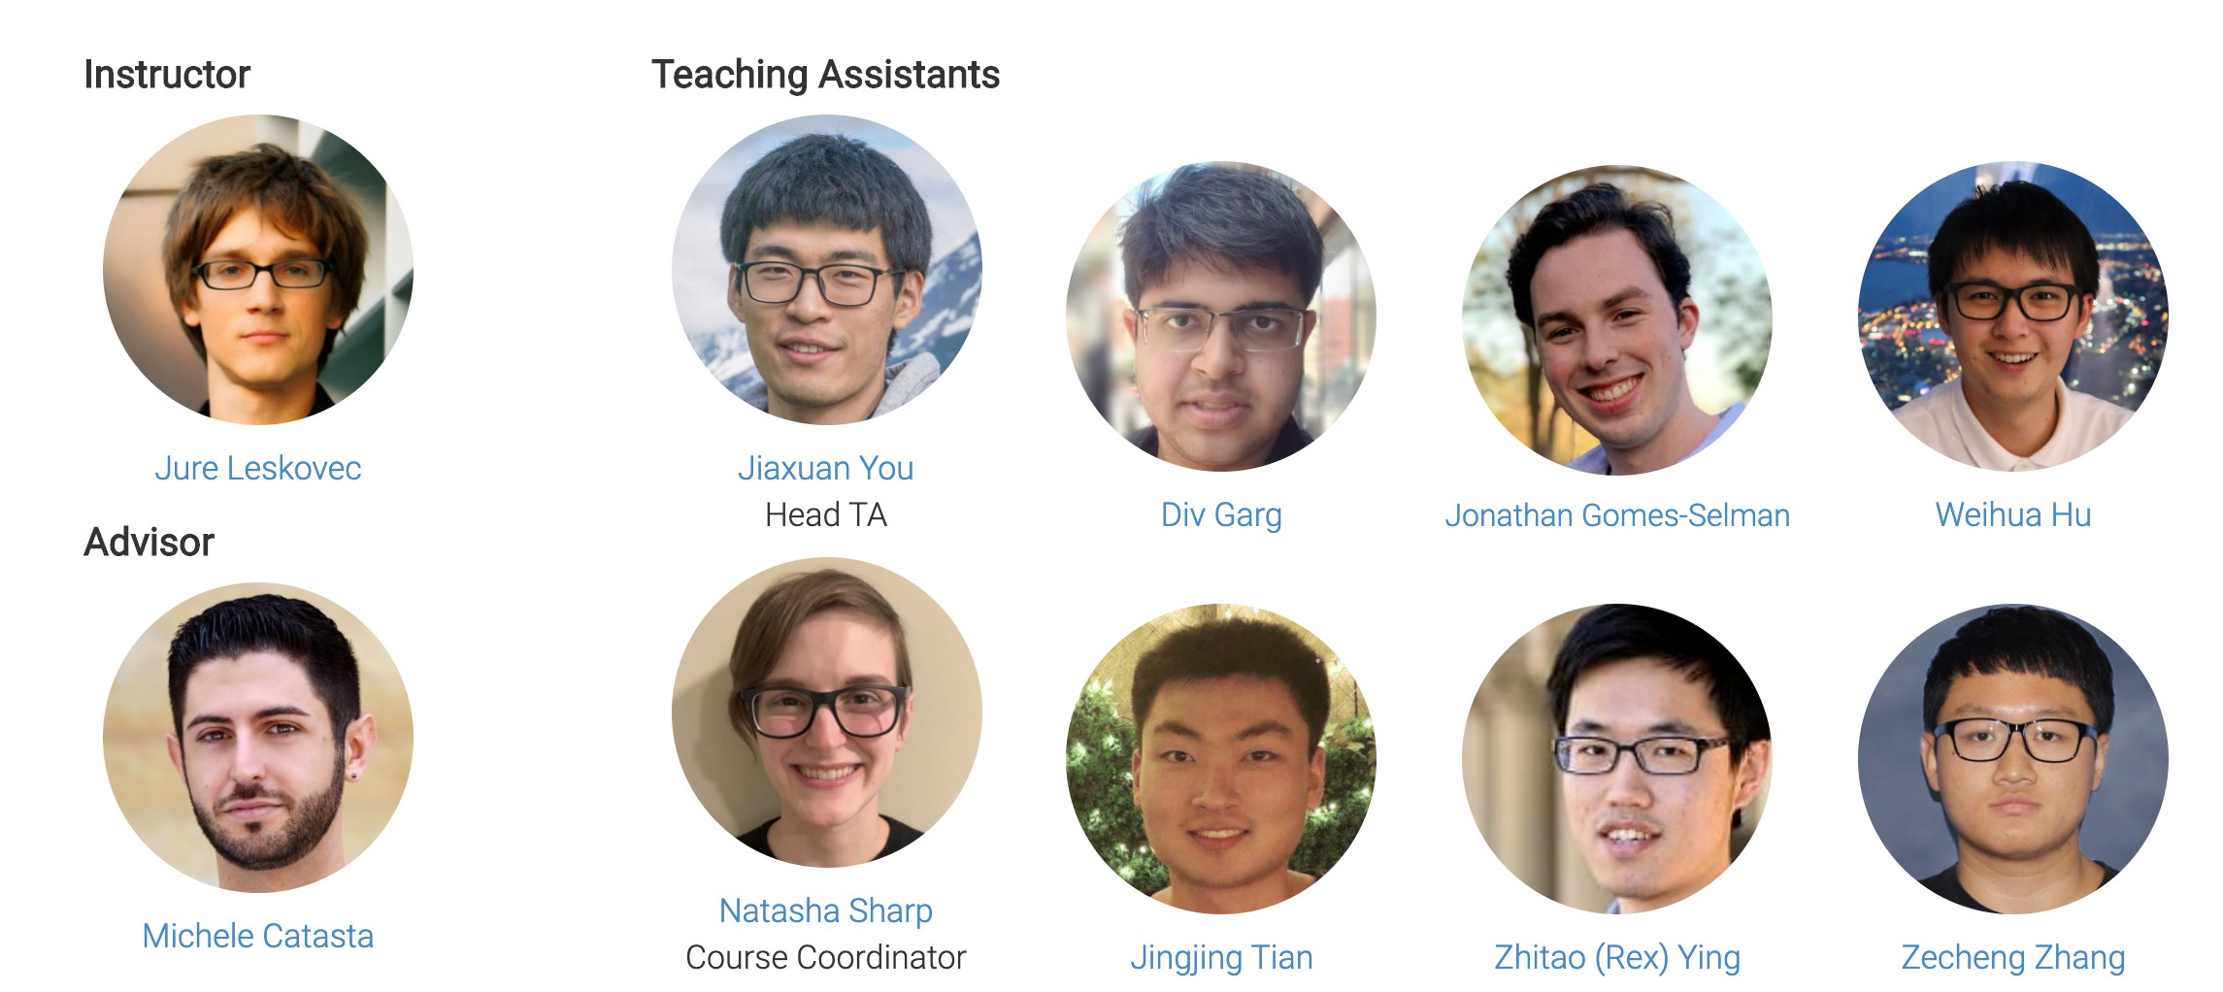
3

Slide 5

Date | Topic | Date | Topic
Tue, Jan 12 | Introduction; Machine Learning for Graphs | Tue, Feb 16 | Reasoning over Knowledge Graphs
Thu, Jan 14 | Traditional Methods for ML on Graphs | Thu, Feb 18 | Frequent Subgraph Mining with GNNs
Tue, Jan 19 | Node Embeddings | Tue, Feb 23 | Community Structure in Networks
Thu, Jan 21 | Link Analysis: PageRank | Thu, Feb 25 | Traditional Generative Models for Graphs
Tue, Jan 26 | Label Propagation for Node Classification | Tue, Mar 2 | Deep Generative Models for Graphs
Thu, Jan 28 | Graph Neural Networks 1: GNN Model | Thu, Mar 4 | Scaling Up GNNs
Tue, Feb 2 | Graph Neural Networks 2: Design Space | Tue, Mar 9 | Learning on Dynamic Graphs
Thu, Feb 4 | Applications of Graph Neural Networks | Thu, Mar 11 | GNNs for Computational Biology
Tue, Feb 9 | Theory of Graph Neural Networks | Tue, Mar 16 | GNNs for Science
Thu, Feb 11 | Knowledge Graph Embeddings | Thu, Mar 18 | Industrial Applications of GNNs
4

Slide 6

http://cs224w.stanford.edu
Slides posted before the class
Readings:
  Graph Representation Learning Book by Will Hamilton
  Research papers
Optional readings:
  Papers and pointers to additional literature
  This will be very useful for course projects
5

Slide 7
Piazza Q&A website:
http://piazza.com/stanford/win2021/cs224w
  Register with your @stanford.edu email
Please participate and help each other!
  Don’t post code, annotate your questions, search for answers before you ask
  Given COVID/virtual class, this will be the main mode of communication
To reach course staff (prof/TAs), always use:
  cs224w-win2021-staff@lists.stanford.edu
We will post course announcements to Piazza (make sure you check it regularly)
6

Slide 8
Final grade will be composed of:
Homework: 30%
  Homework 1, 2, 3, each worth 10%
Coding assignment: 30%
  5 Coding assignments using Google Colab, each worth 6%
Course project: 40%
  Proposal: 30%
  Final report: 70%
Extra credit: Piazza participation, code contribution
  Used if you are on the boundary between grades
7

Slide 9

Assignments are long and take time (~10h) Start early!
A combination of data analysis, algorithm design, and math
Generally due on Thursdays 23:59 Pacific Time
How to submit?
  Upload via Gradescope (http://gradescope.com)
    You will be automatically registered to Gradescope once you officially enroll in CS224W
    Each answer must start on a new page.
Read carefully the course info page!
  Both homework (including code) and project deliverables must be uploaded to Gradescope!
Total of 2 Late Periods (LP) per student:
  Max 1 late period per assignment (no LP for final report)
8

Slide 10

We strictly enforce the Stanford Honor Code
Make sure you read and understand it!
Violations of the Honor Code include:
  Copying or allowing another to copy from one’s own paper
  Unpermitted collaboration
  Plagiarism
  Giving or receiving unpermitted aid on a take-home examination
  Representing as one’s own work the work of another
  Giving or receiving aid on an assignment under circumstances in which a reasonable person should have known that such aid was not permitted
The standard sanction for a first offense includes a one- quarter suspension and 40 hours of community service.
9

Slide 11

Course project:
Make predictions on a network dataset
Performed in groups of up to 3 students:
  Fine to have groups of 1 or 2. The team size will be taken under consideration when evaluating the scope of the project in breadth and depth. But 3 person teams can be more efficient.
  Project is the important work for the class
  Teaching staff will help with problems and data
  More details to follow.
Read: http://cs224w.stanford.edu/info.html
10

Slide 12

Week | Assignment | Due on (11:59pm PT)
1 | Colab 0
1 | Colab 1 | Thu, Jan 28
2 | Homework 1 | Thu, Feb 4
3 | Colab 2 | Thu, Feb 11
 | Project Proposal | Thu, Feb 11
4 | Homework 2 | Thu, Feb 18
5 | Colab 3 | Thu, Feb 25
6 | Homework 3 | Thu, Mar 4
7 | Colab 4 | Thu, Mar 11
8 | Colab 5 | Thu, Mar 18
 | Project Report | Sun, Mar 21 (No Late Periods!)
11

Slide 13

The course is self-contained.
No single topic is too hard by itself.
But we will cover and touch upon many topics and this is what makes the course hard.
  Good background in:
    Machine Learning
    Algorithms and graph theory
    Probability and statistics
  Programming:
    You should be able to write non-trivial programs (in Python)
12

Slide 14
We use PyTorch Geometric (PyG)
We further recommend:
DeepSNAP: Library that assists deep learning on graphs.
  Flexible graph manipulation, standard data split pipeline, …
GraphGym: Platform for designing Graph Neural Networks.
  Modularized GNN implementation, simple hyperparameter tuning, flexible user customization
Both platforms are very helpful for the course project (save your time & provide advanced GNN functionalities)
Other network analytics tools: SNAP.PY, NetworkX
13

Slide 15
CS224W: Machine Learning with Graphs Jure Leskovec, Stanford University
http://cs224w.stanford.edu

Slide 16
Why Graphs?
Graphs are a general language for describing and analyzing entities with relations/interactions
15

Slide 17
16

Slide 18
Graph
17

Slide 19

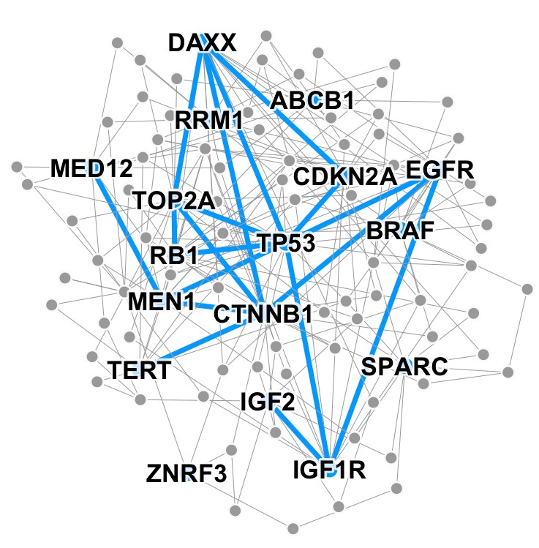
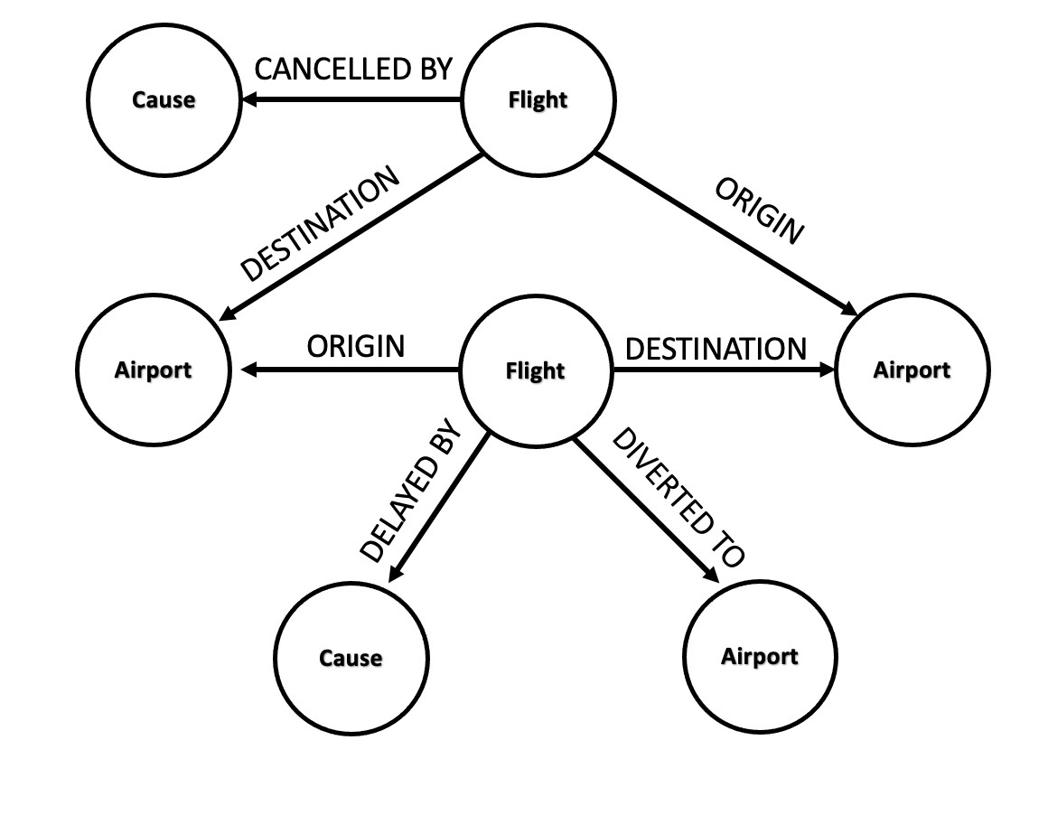
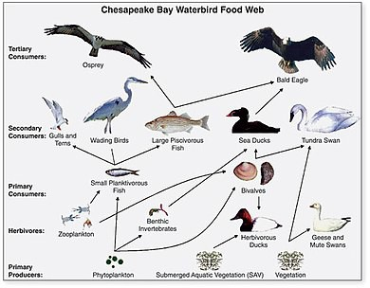
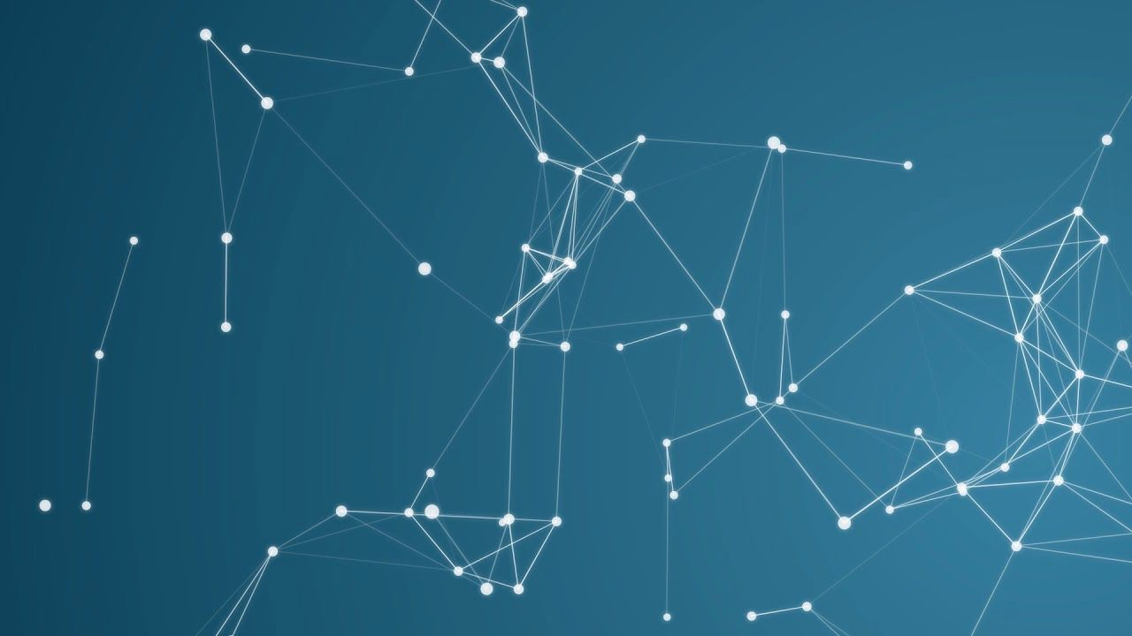
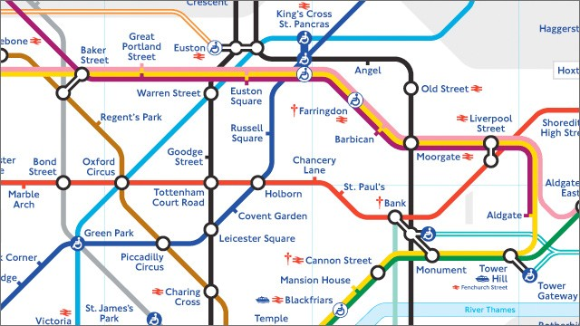
Image credit: SalientNetworks
Computer Networks
Event Graphs
Disease Pathways
Image credit: Wikipedia
Image credit: Pinterest
Particle Networks
Image credit: visitlondon.com
Underground Networks
Food Webs
18

Slide 20
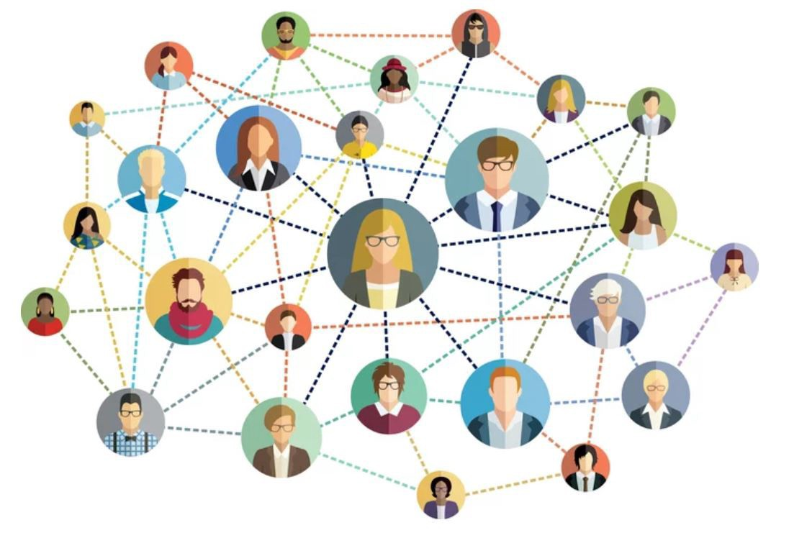
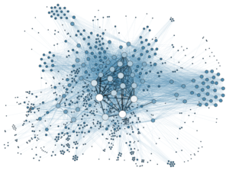
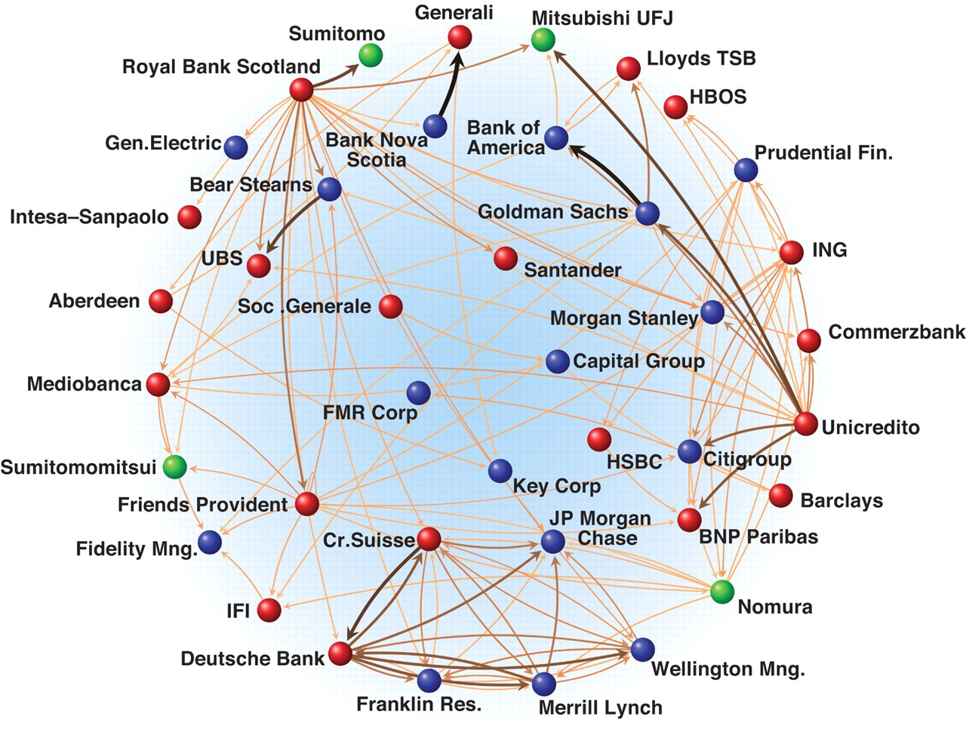
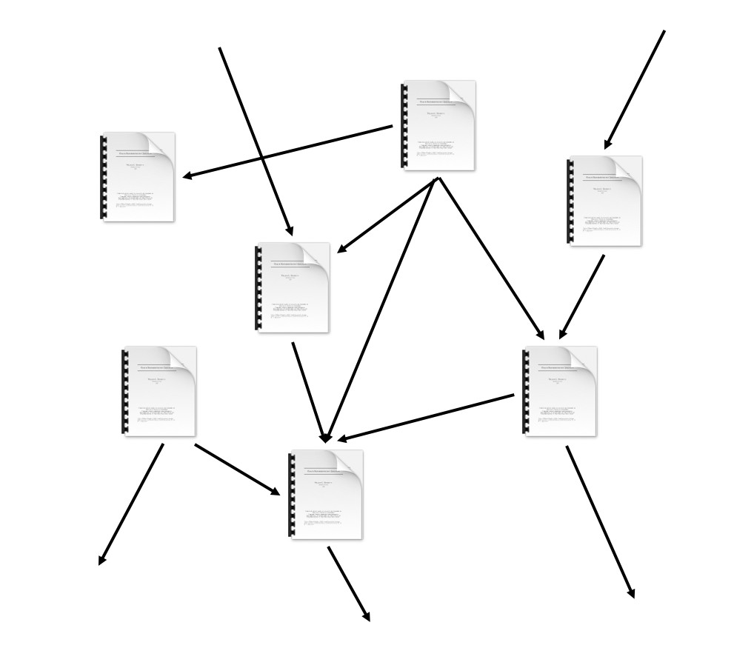

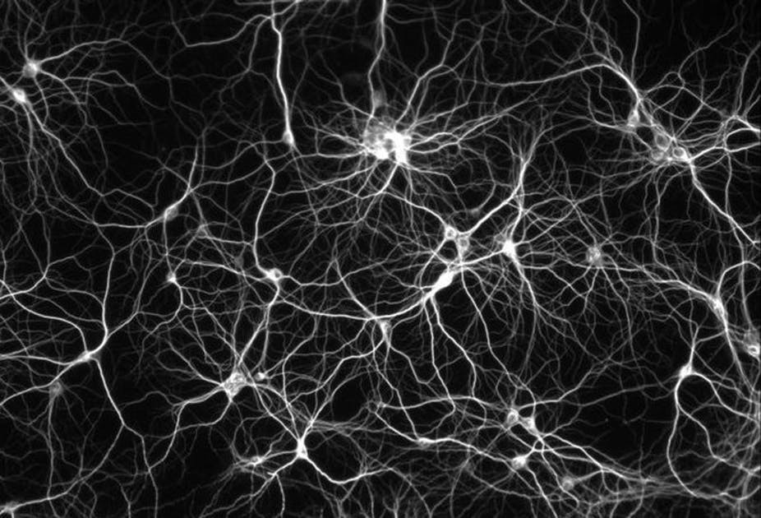
Image credit: Medium
Social Networks
Image credit: Science
Image credit: Lumen Learning
Economic Networks Communication Networks
Image credit: Missoula Current News
Internet
Image credit: The Conversation
Networks of Neurons
Citation Networks
10

Slide 21
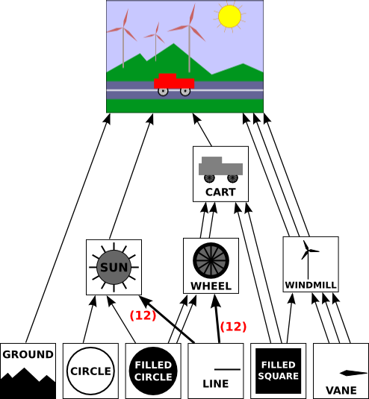
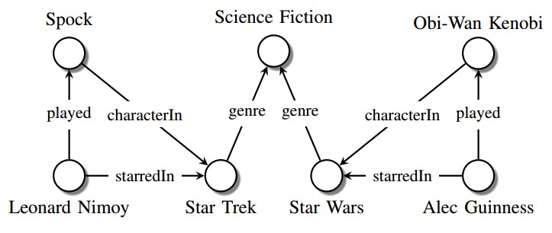
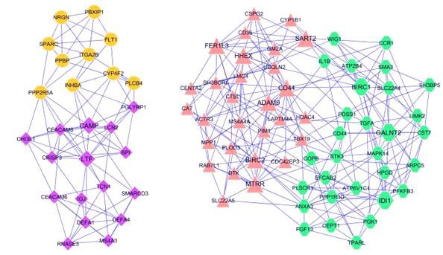
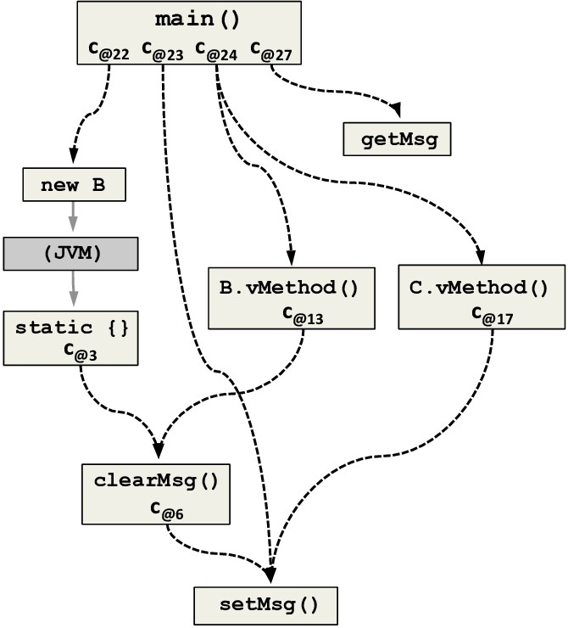
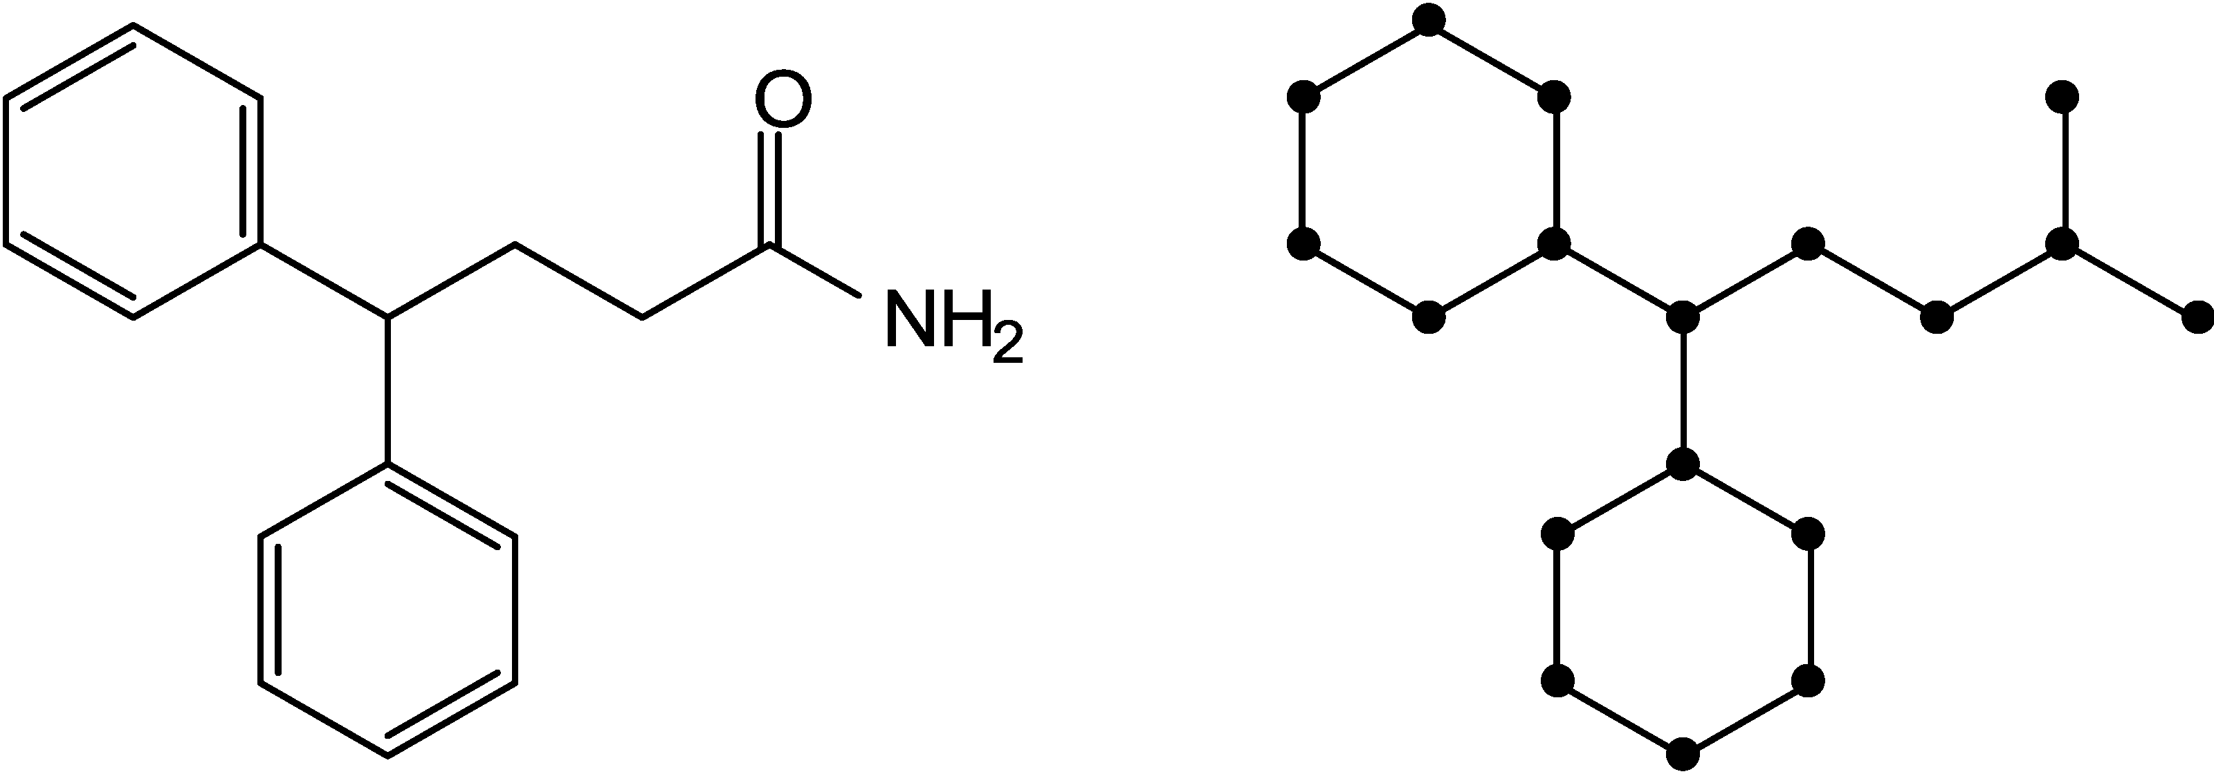
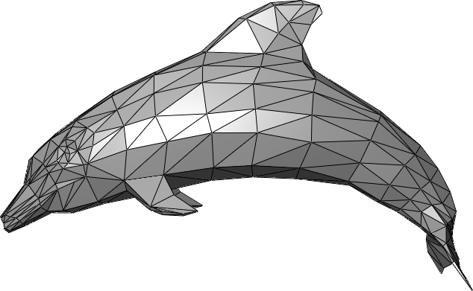
Image credit: Maximilian Nickel et al
Knowledge Graphs
Image credit: ese.wustl.edu
Regulatory Networks
Image credit: math.hws.edu
Scene Graphs
Image credit: ResearchGate
Code Graphs
Image credit: MDPI
Image credit: Wikipedia
Molecules
3D Shapes
20

Slide 22
Networks (also known as Natural Graphs):
Social networks:
  Society is a collection of 7+ billion individuals
Communication and transactions:
  Electronic devices, phone calls, financial transactions
Biomedicine:
  Interactions between genes/proteins regulate life
Brain connections:
  Our thoughts are hidden in the connections between billions of neurons

Slide 23
Graphs (as a representation):
Information/knowledge are organized and linked
Software can be represented as a graph
Similarity networks: Connect similar data points
Relational structures: Molecules, Scene graphs, 3D shapes, Particle-based physics simulations
Sometimes the distinction between networks & graphs is blurred

Slide 24
Main question: How do we take advantage of relational structure for better prediction? | ath.hws.edu
 | Grap
Image cred
it: Maximilian Nickel et al Image credit: ese.wustl.edu Image credit: m
^{ledge Graphs} Regulatory Networks Scene
Know
hs
Image credit: ResearchGate
Code Graphs
Image credit: MDPI
Image credit: Wikipedia
Molecules
3D Shapes

Slide 25
Complex domains have a rich relational structure, which can be represented as a relational graph
By explicitly modeling relationships we achieve better performance!

Slide 26
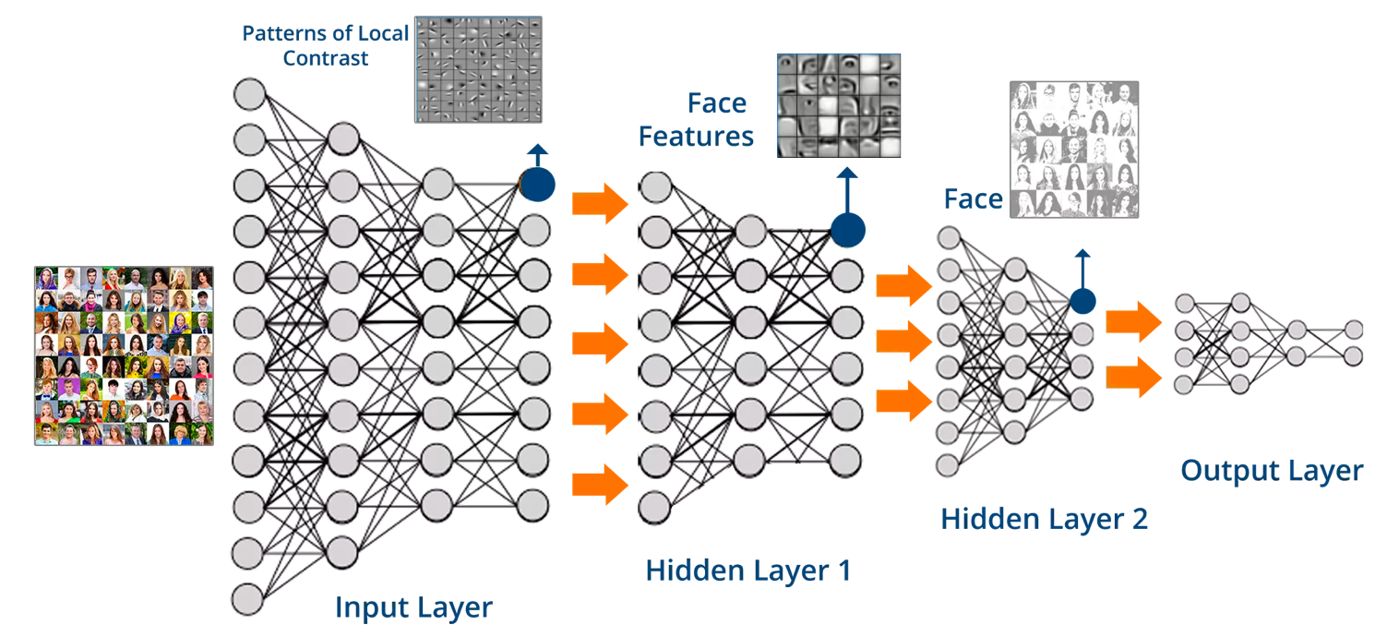
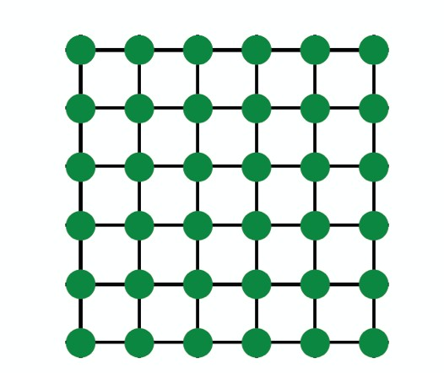
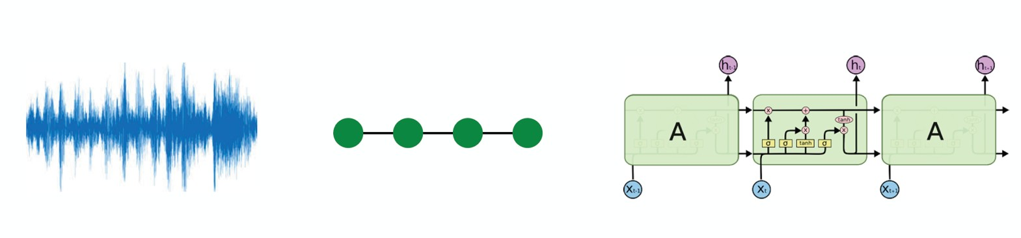
Images
Text/Speech
Modern deep learning toolbox is designed for simple sequences & grids

Slide 27

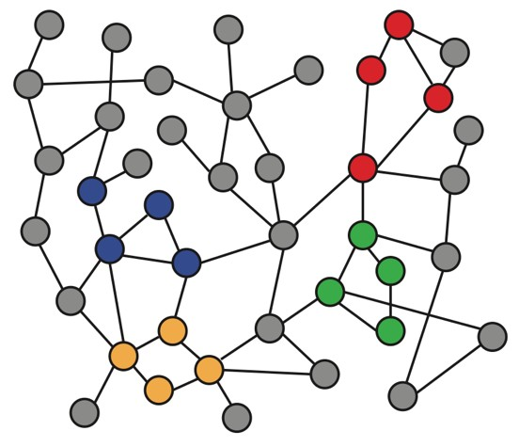
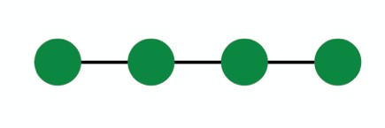
Networks are complex.
Arbitrary size and complex topological structure (i.e., no spatial locality like grids)
vs.
Text
Networks Images
No fixed node ordering or reference point
Often dynamic and have multimodal features

Slide 28

How can we develop neural networks that are much more broadly applicable?
Graphs are the new frontier of deep learning

Slide 29
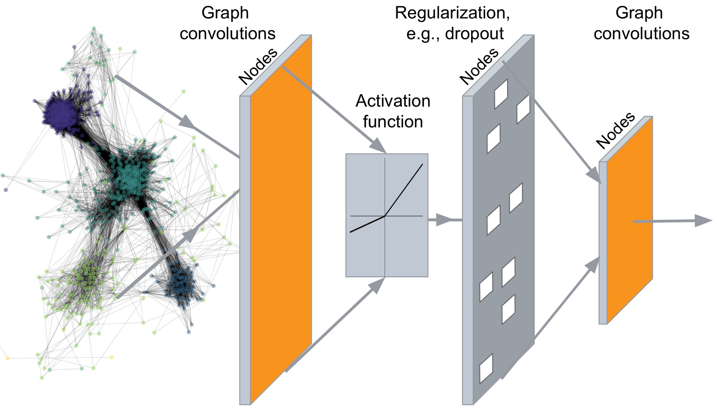
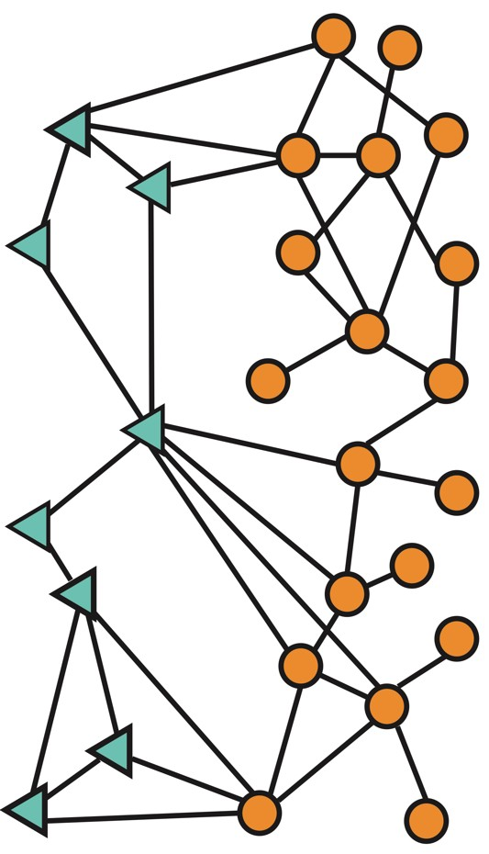
…
Predictions: Node labels, New links, Generated graphs and subgraphs
Input: Network

Slide 30
(Supervised) Machine Learning Lifecycle: This feature, that feature. Every single time!
Raw Data
Graph Data
Learning Algorithm
Model
Feature Engineering
Representation Learning -- Automatically learn the features
Downstream prediction task

Slide 31
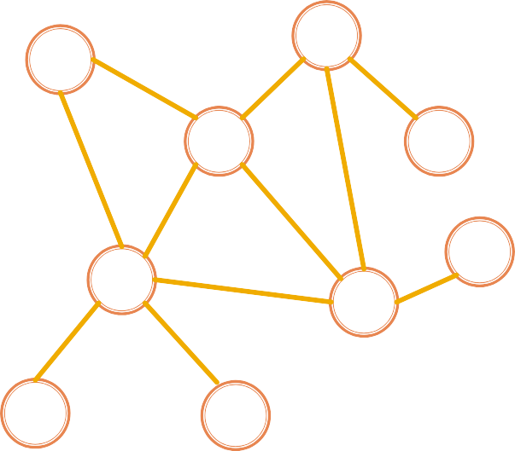
Map nodes to d-dimensional embeddings such that similar nodes in the network are embedded close together
node representation
u
Learn a neural network
𝒇: 𝑢 → ℝ!
_{ℝ}!
Feature representation, embedding
30

Slide 32
We are going to cover various topics in Machine Learning and Representation Learning for graph structured data:
Traditional methods: Graphlets, Graph Kernels
Methods for node embeddings: DeepWalk, Node2Vec
Graph Neural Networks: GCN, GraphSAGE, GAT, Theory of GNNs
Knowledge graphs and reasoning: TransE, BetaE
Deep generative models for graphs
Applications to Biomedicine, Science, Industry
31

Slide 33
Date | Topic | Date | Topic
Tue, Jan 12 | Introduction; Machine Learning for Graphs | Tue, Feb 16 | Reasoning over Knowledge Graphs
Thu, Jan 14 | Traditional Methods for ML on Graphs | Thu, Feb 18 | Frequent Subgraph Mining with GNNs
Tue, Jan 19 | Node Embeddings | Tue, Feb 23 | Community Structure in Networks
Thu, Jan 21 | Link Analysis: PageRank | Thu, Feb 25 | Traditional Generative Models for Graphs
Tue, Jan 26 | Label Propagation for Node Classification | Tue, Mar 2 | Deep Generative Models for Graphs
Thu, Jan 28 | Graph Neural Networks 1: GNN Model | Thu, Mar 4 | Scaling Up GNNs
Tue, Feb 2 | Graph Neural Networks 2: Design Space | Tue, Mar 9 | Learning on Dynamic Graphs
Thu, Feb 4 | Applications of Graph Neural Networks | Thu, Mar 11 | GNNs for Computational Biology
Tue, Feb 9 | Theory of Graph Neural Networks | Tue, Mar 16 | GNNs for Science
Thu, Feb 11 | Knowledge Graph Embeddings | Thu, Mar 18 | Industrial Applications of GNNs
32

Slide 34

CS224W: Machine Learning with Graphs Jure Leskovec, Stanford University
http://cs224w.stanford.edu

Slide 35
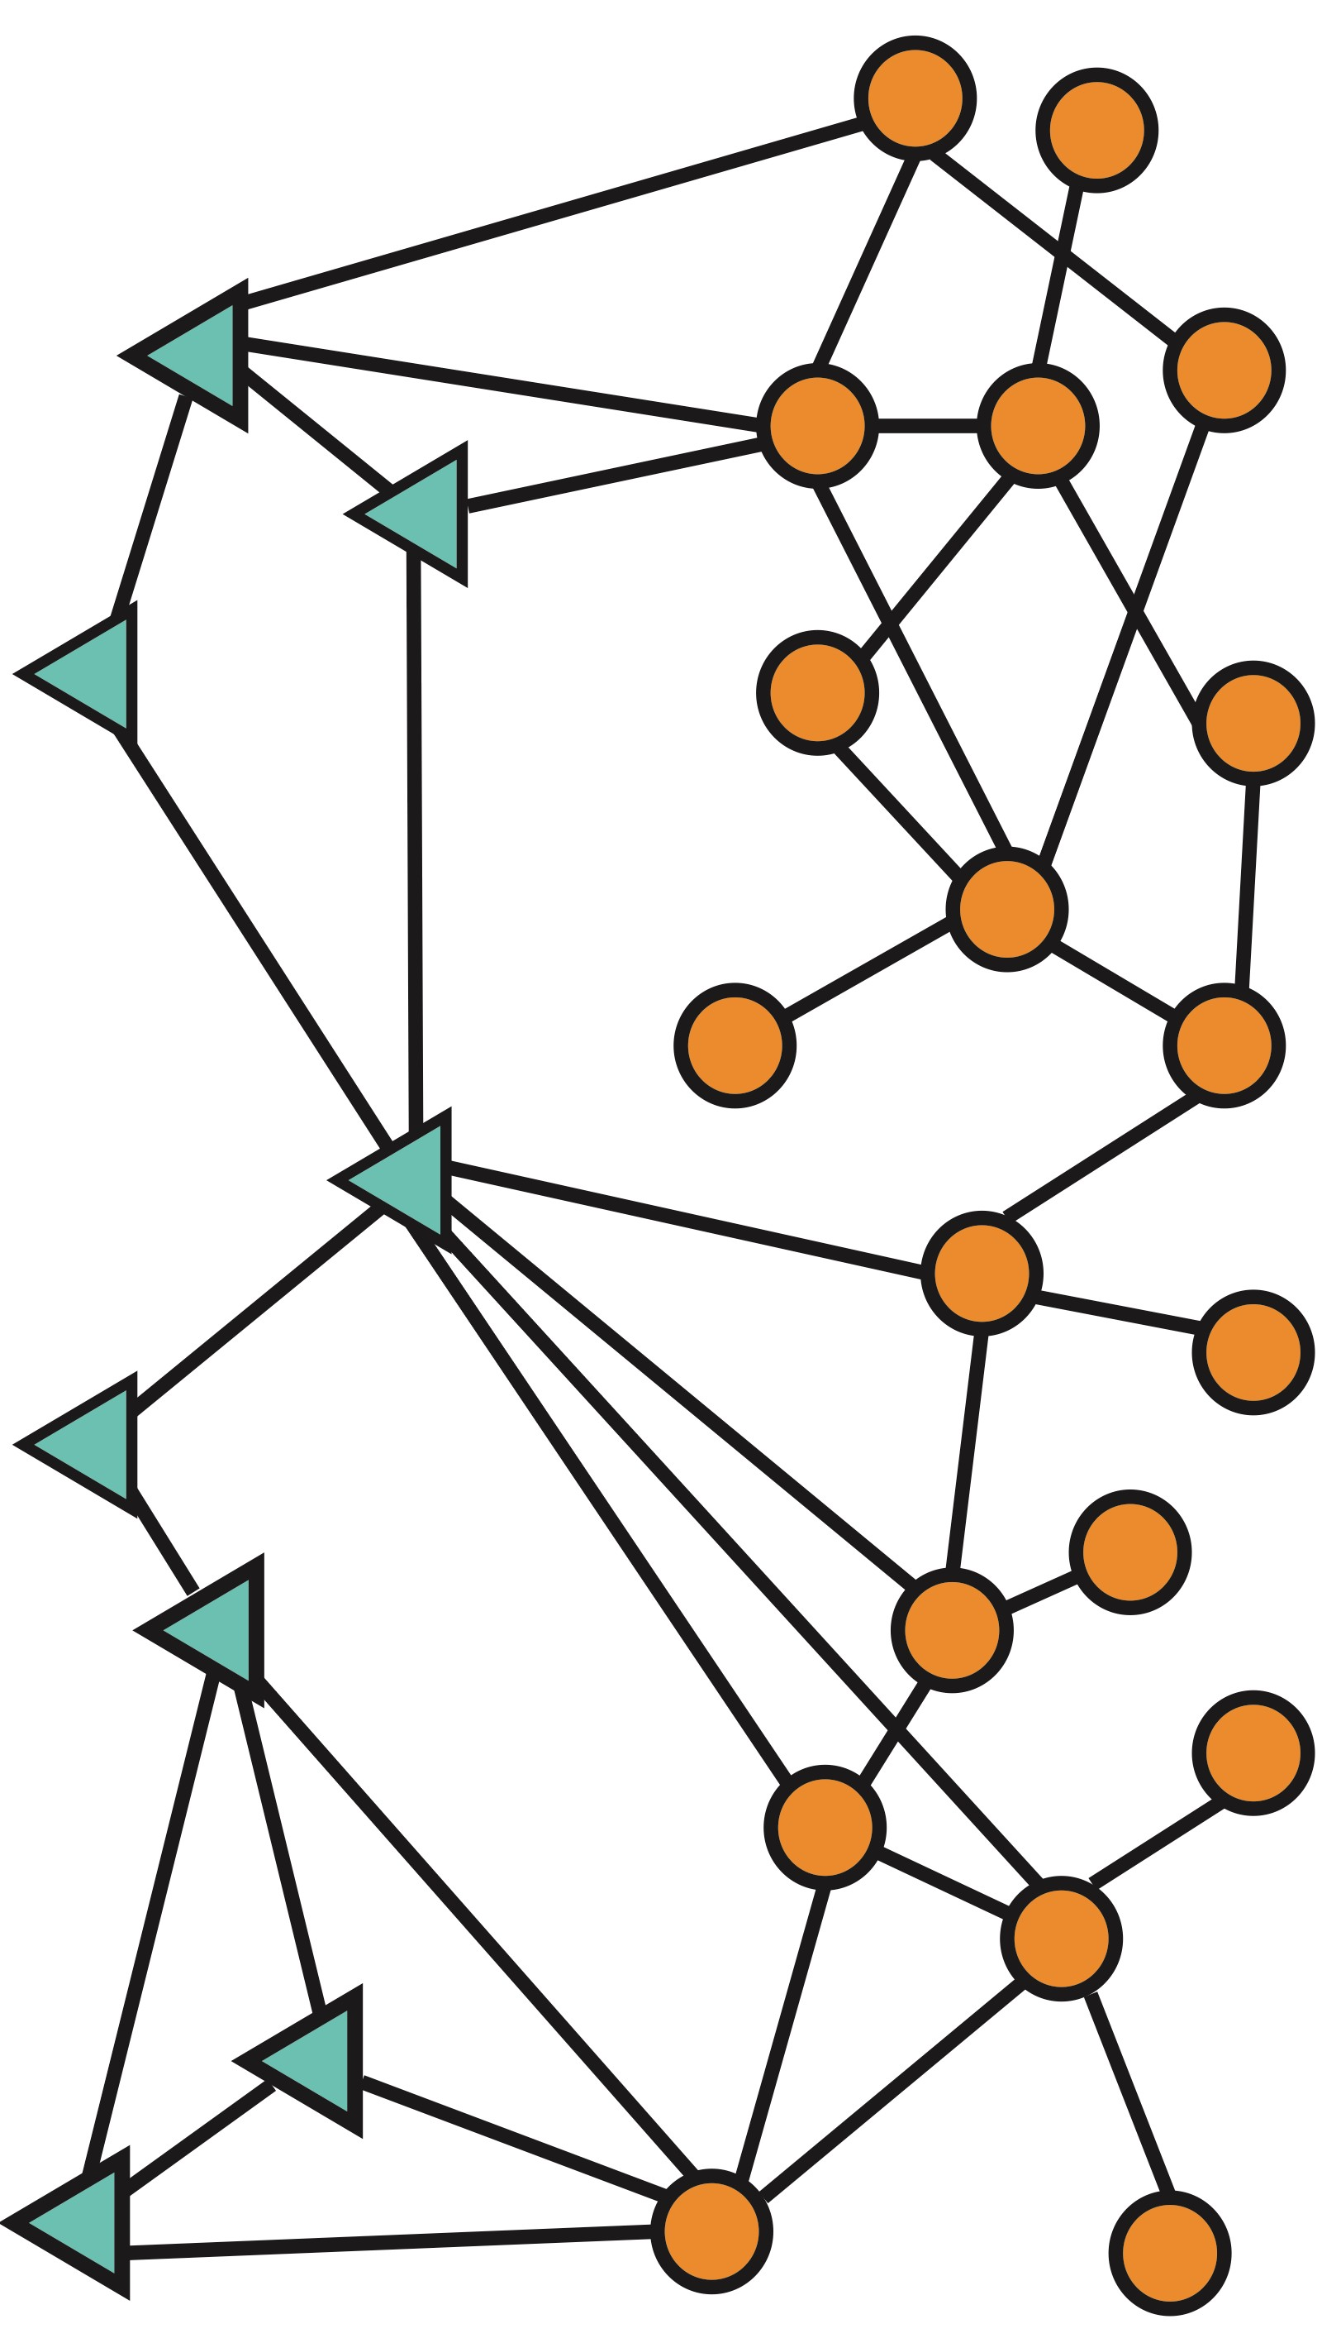
Node level
Graph-level prediction,
Graph generation
Community (subgraph)
level
Edge-level

Slide 36
Node classification: Predict a property of a node
Example: Categorize online users / items
Link prediction: Predict whether there are missing links between two nodes
  Example: Knowledge graph completion
Graph classification: Categorize different graphs
  Example: Molecule property prediction
Clustering: Detect if nodes form a community
  Example: Social circle detection
Other tasks:
  Graph generation: Drug discovery
  Graph evolution: Physical simulation

Slide 37
Node classification: Predict a property of a node
Example: Categorize online users / items
Link prediction: Predict whether there are missing links
  Exa
Grap These Graph ML tasks lead to phs
between two nodes
mple: Knowledge graph completion
h classification: Categorize different gra
mple: Molecule property prediction
ering: Detect if nodes form a communit
mple: Social circle detection
Exa
high-impact applications!
Clust y
Exa
Others:
  Graph generation: Drug discovery
  Graph evolution: Physical simulation

Slide 38


Slide 39
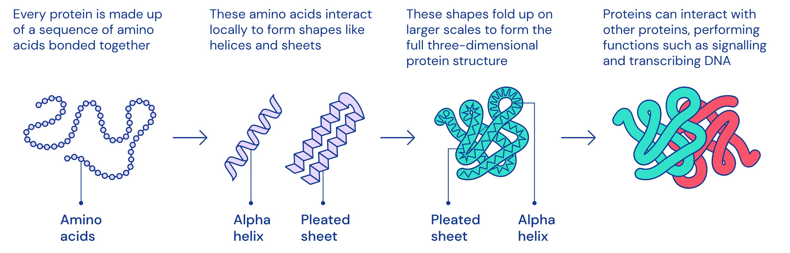
A protein chain acquires its native 3D structure
Image credit: DeepMind

Slide 40
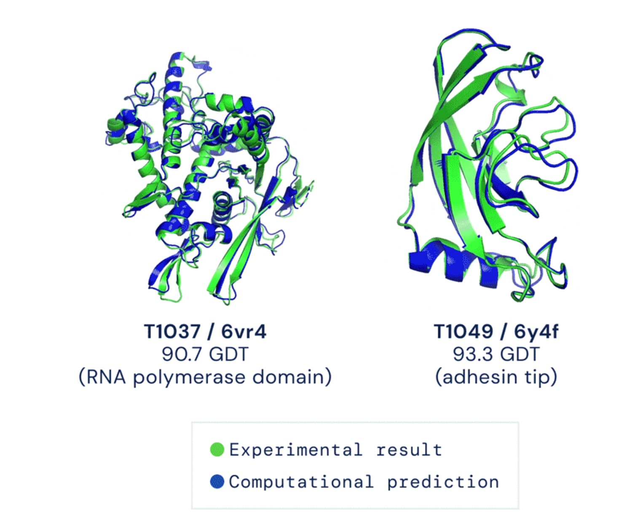
Computationally predict a protein’s 3D structure based solely on its amino acid sequence
Image credit: DeepMind

Slide 41

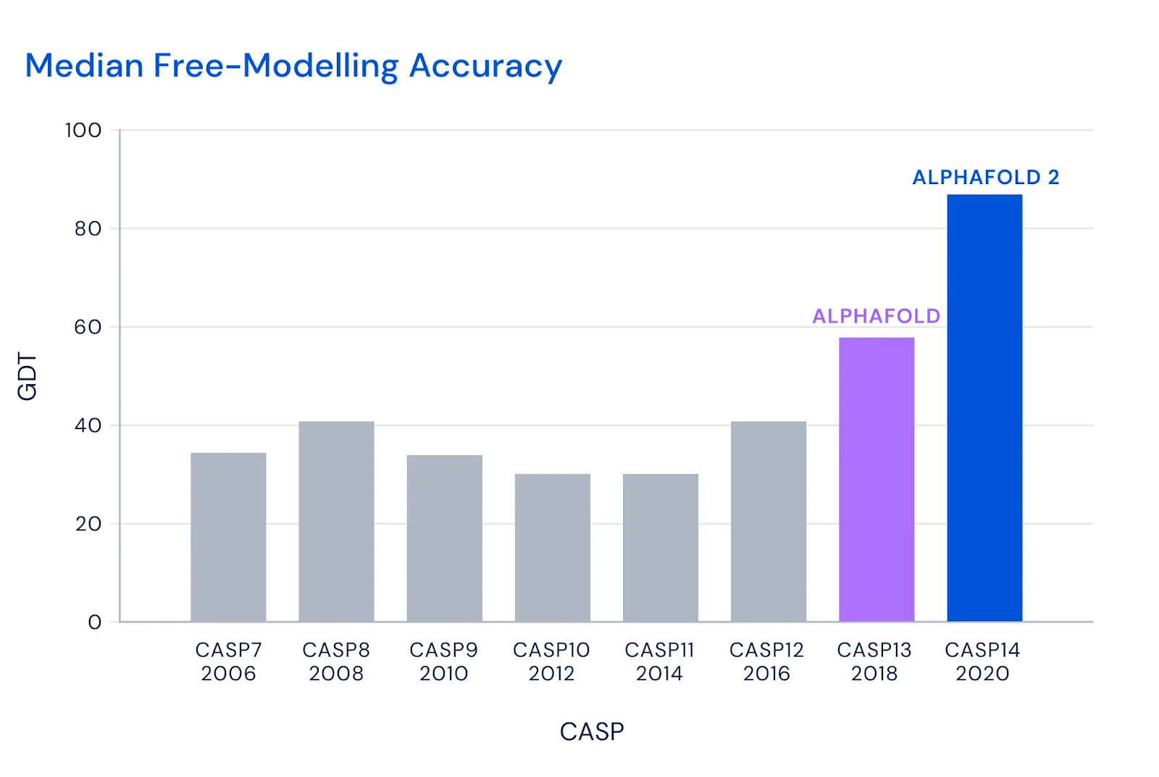
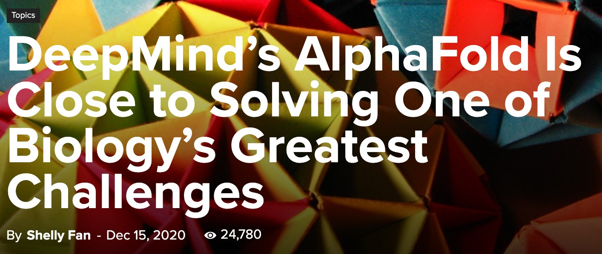
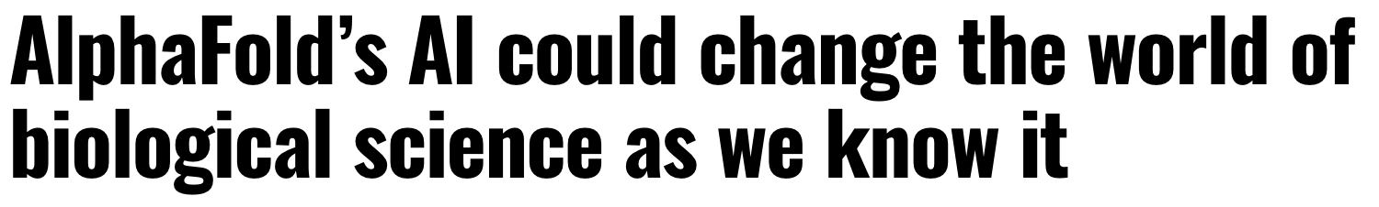
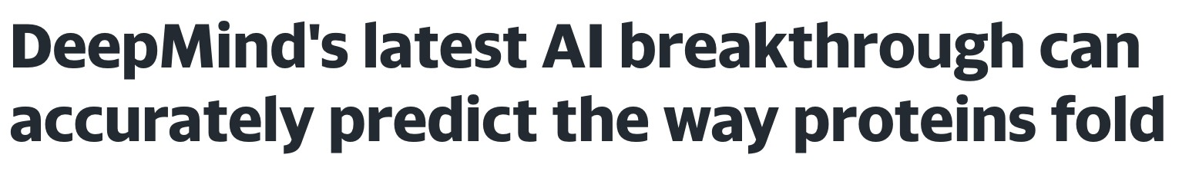


Image credit: DeepMind
Image credit: SingularityHub
40

Slide 42
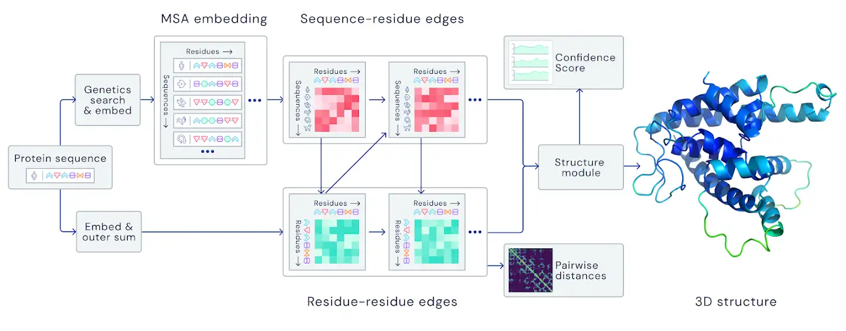
Key idea: “Spatial graph”
Nodes: Amino acids in a protein sequence
Edges: Proximity between amino acids (residues)
Image credit: DeepMind
Spatial graph
41

Slide 43


Slide 44


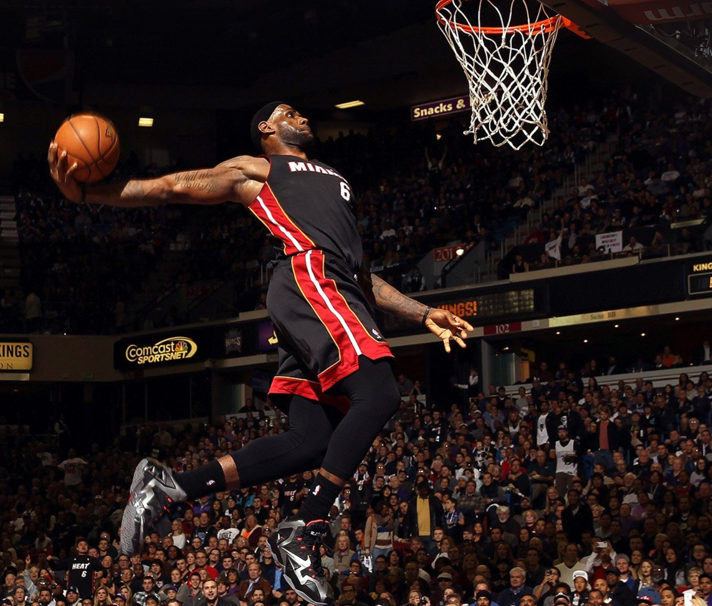


Users interacts with items
Watch movies, buy merchandise, listen to music
Nodes: Users and items
Edges: User-item interactions
Goal: Recommend items users might like
Users
Interactions
“You might also like”
Items
1/13/21
Jure Leskovec, Stanford CS224W: Machine Learning with Graphs
43

Slide 45
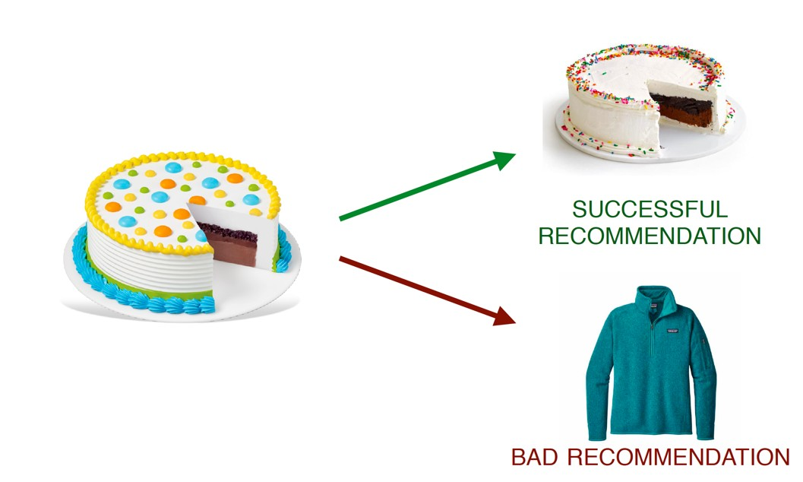




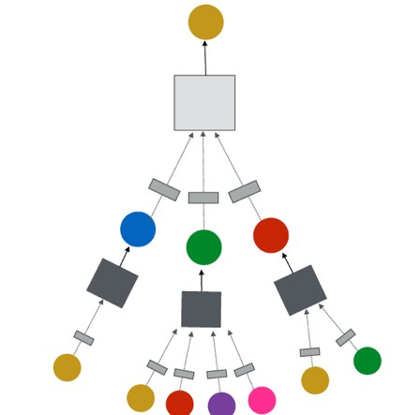
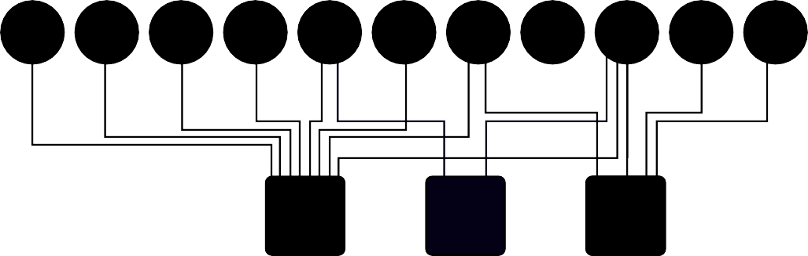

Task: Recommend related pins to users
Ying et al., Graph Convolutional Neural Networks for Web-Scale Recommender Systems, KDD 2018
Task: Learn node embeddings 𝑧! such that
^{𝑑 𝑧}"#$%&^{, 𝑧}"#$%'
^{< 𝑑(𝑧}"#$%&^{, 𝑧}()%#*%+⁾
Query pin
Predict whether two nodes in a graph are related
𝑧
1/13/21
Jure Leskovec, Stanford CS224W: Machine Learning with Graphs
8

Slide 46



Many patients take multiple drugs to treat complex or co-existing diseases:
46% of people ages 70-79 take more than 5 drugs
Many patients take more than 20 drugs to treat heart disease, depression, insomnia, etc.
Task: Given a pair of drugs predict
adverse side effects
,
30%
prob.
65%
prob.
45

Slide 47
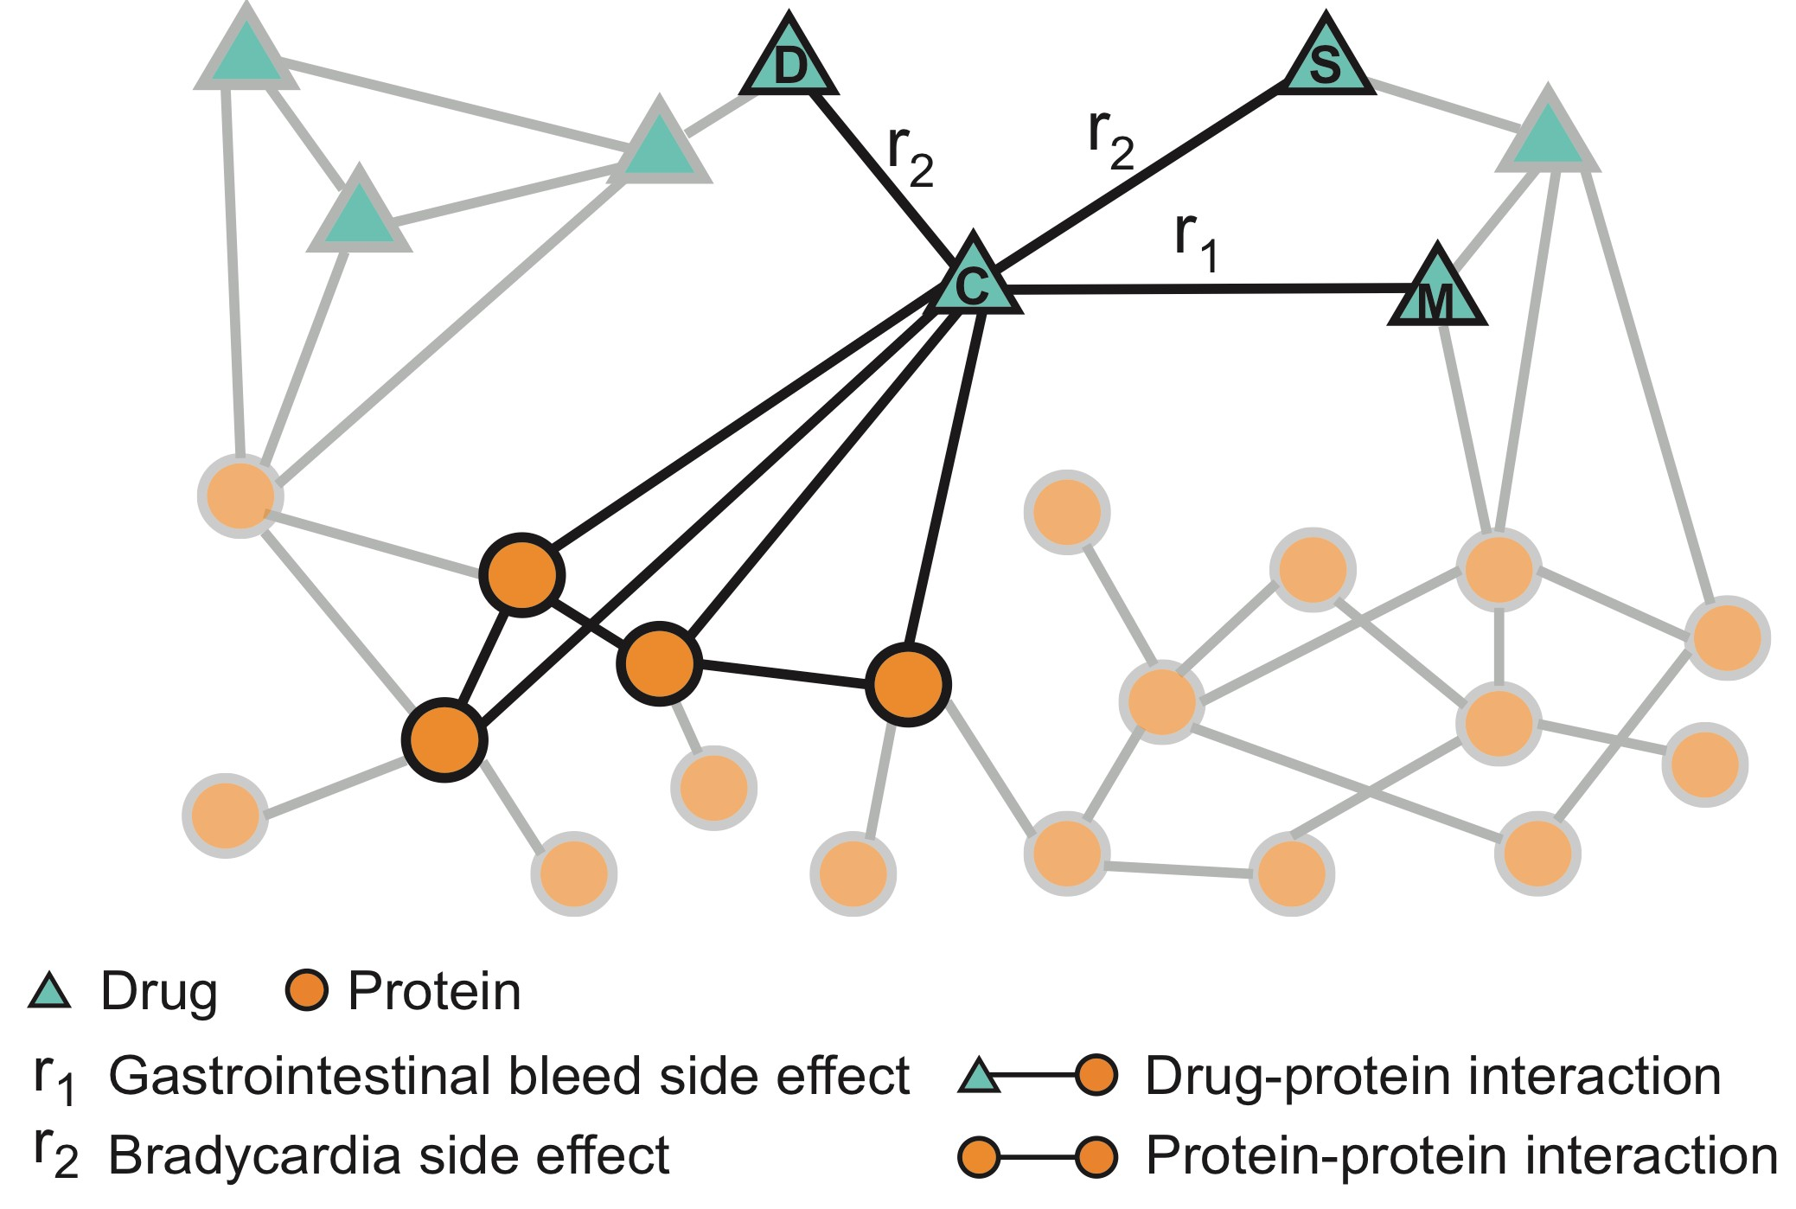
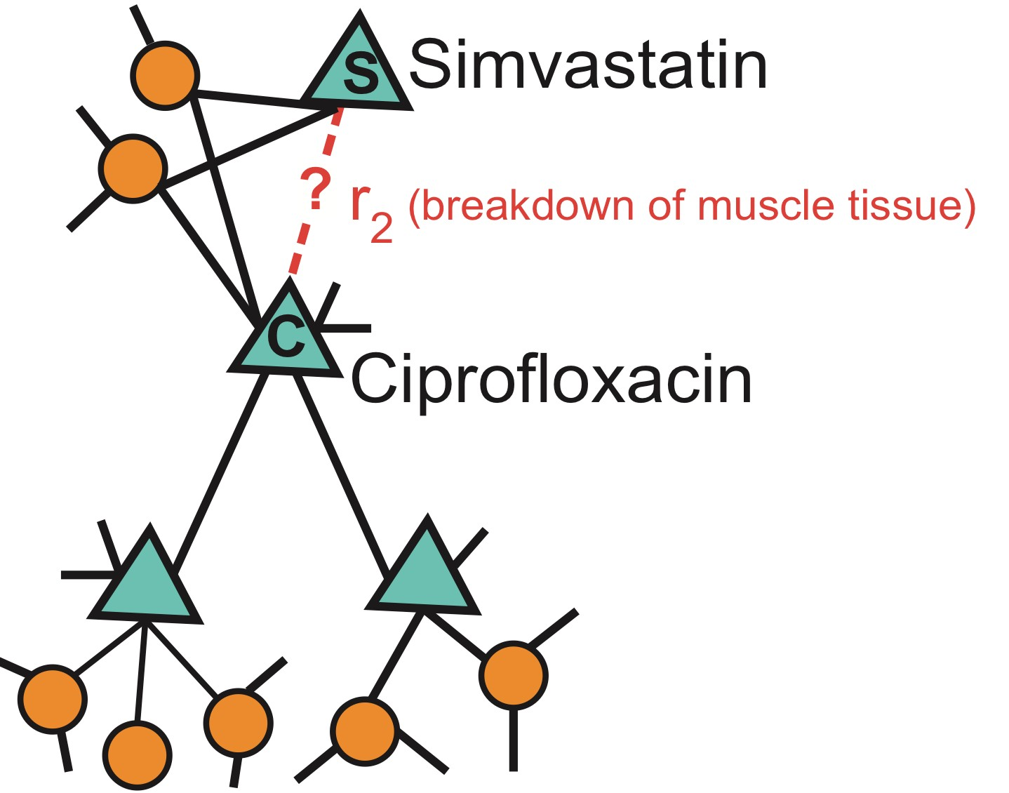
Nodes: Drugs & Proteins
Edges: Interactions
Zitnik et al., Modeling Polypharmacy Side Effects with Graph Convolutional Networks, Bioinformatics 2018
Query: How likely will Simvastatin and Ciprofloxacin, when taken together, break down muscle tissue?
46

Slide 48
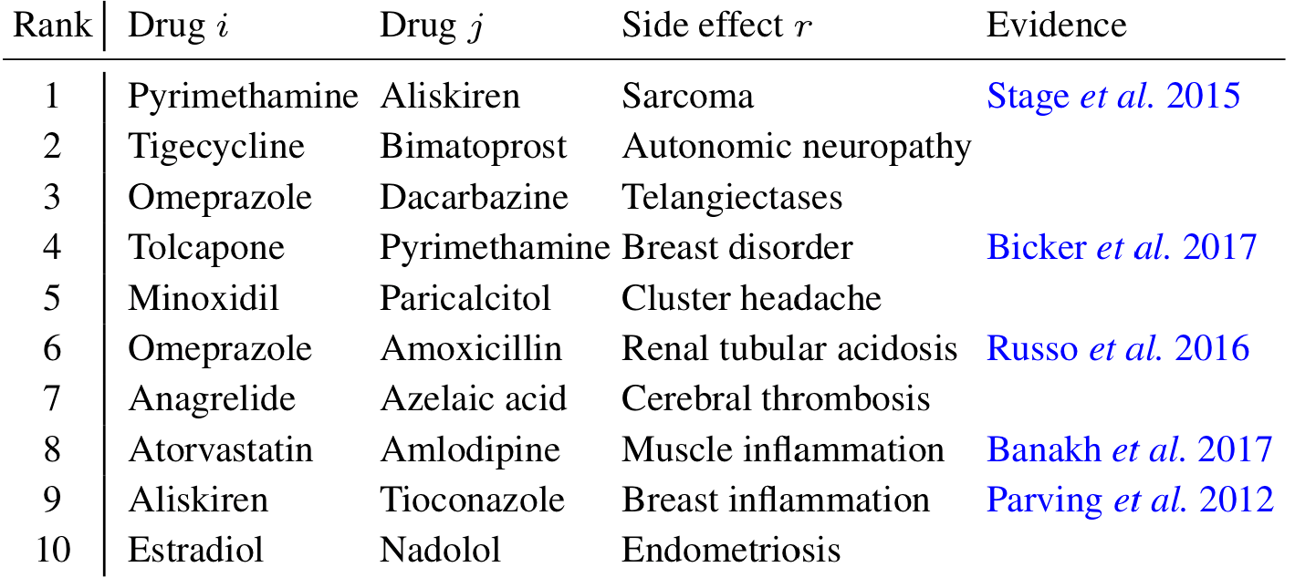
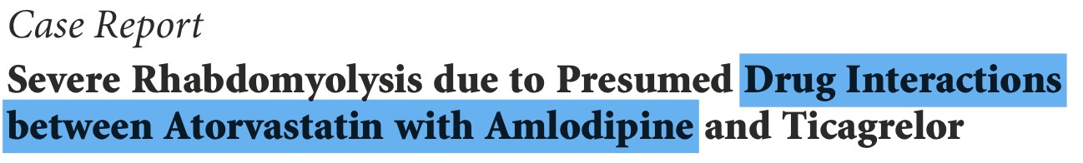
Drug c
Zitnik et al., Modeling Polypharmacy Side Effects with Graph Convolutional Networks, Bioinformatics 2018
Drug d
Evidence found
47

Slide 49


Slide 50
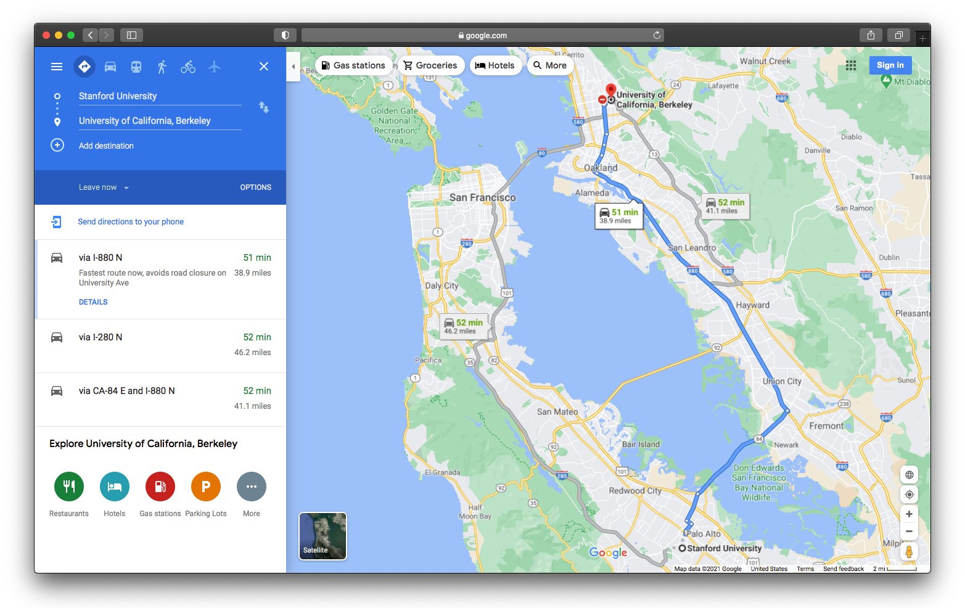
a
49

Slide 51
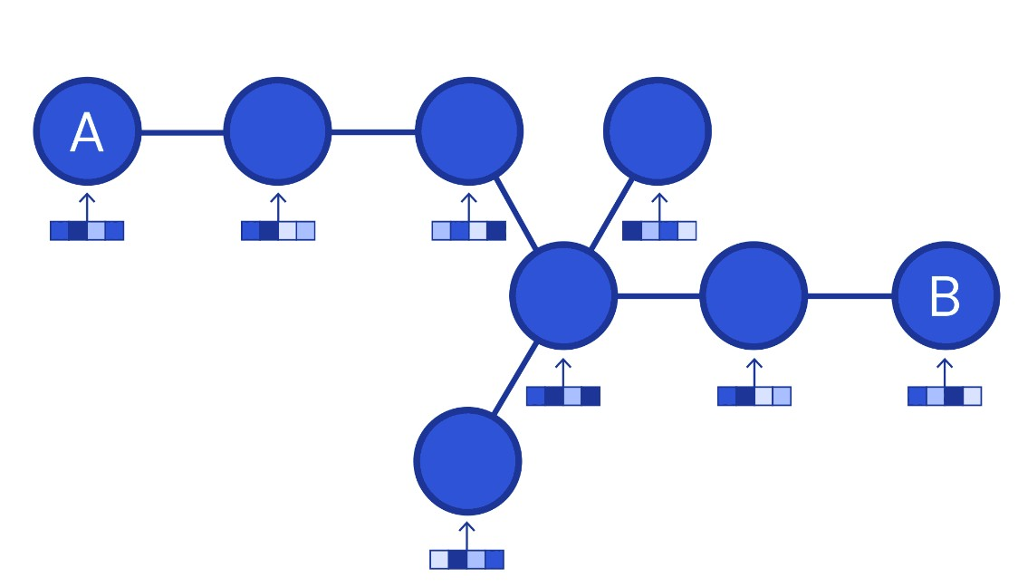
Nodes: Road segments
Edges: Connectivity between road segments
Image credit: DeepMind
59

Slide 52
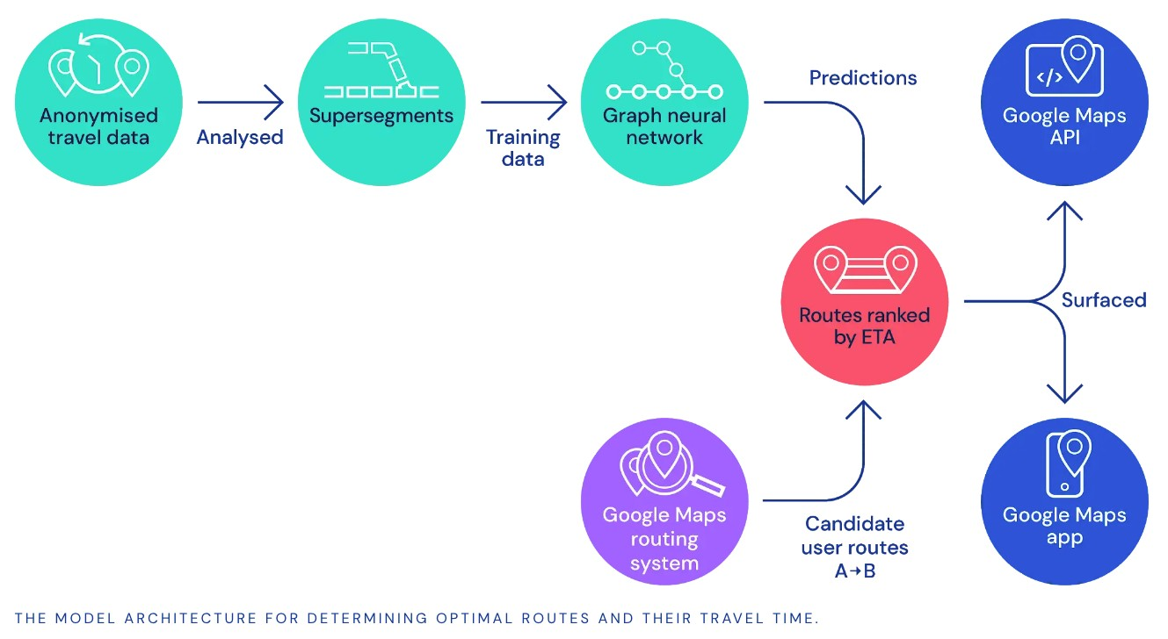
Predict via Graph Neural Networks
Used in Google Maps
Image credit: DeepMind
51

Slide 53


Slide 54
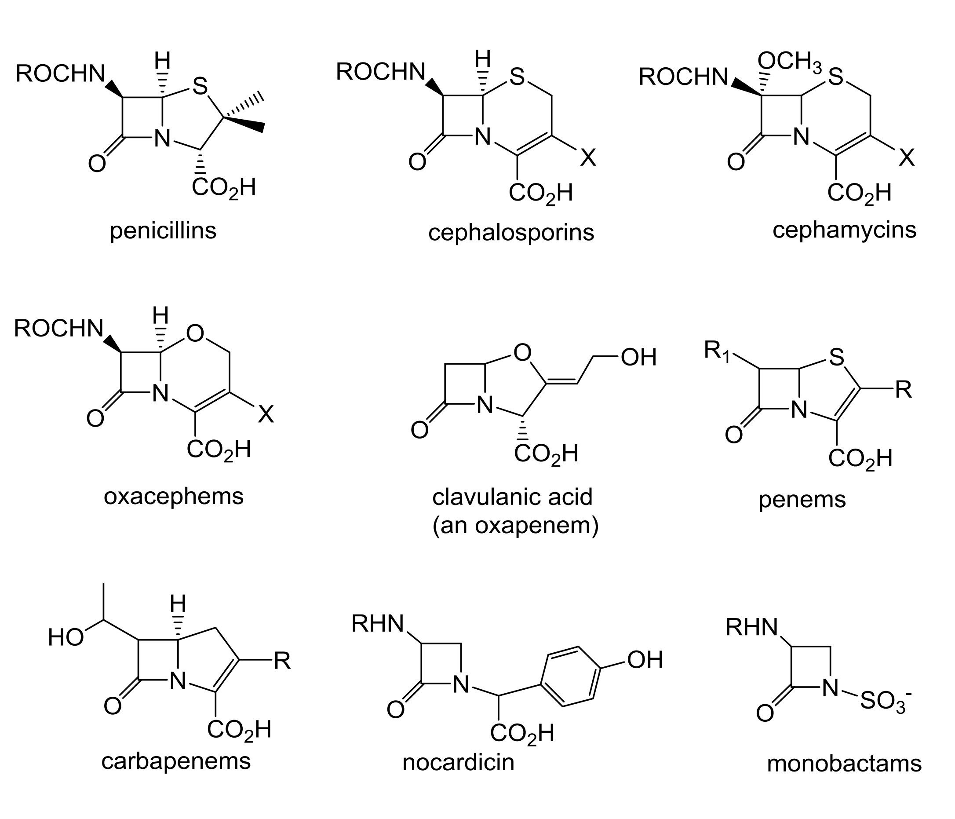
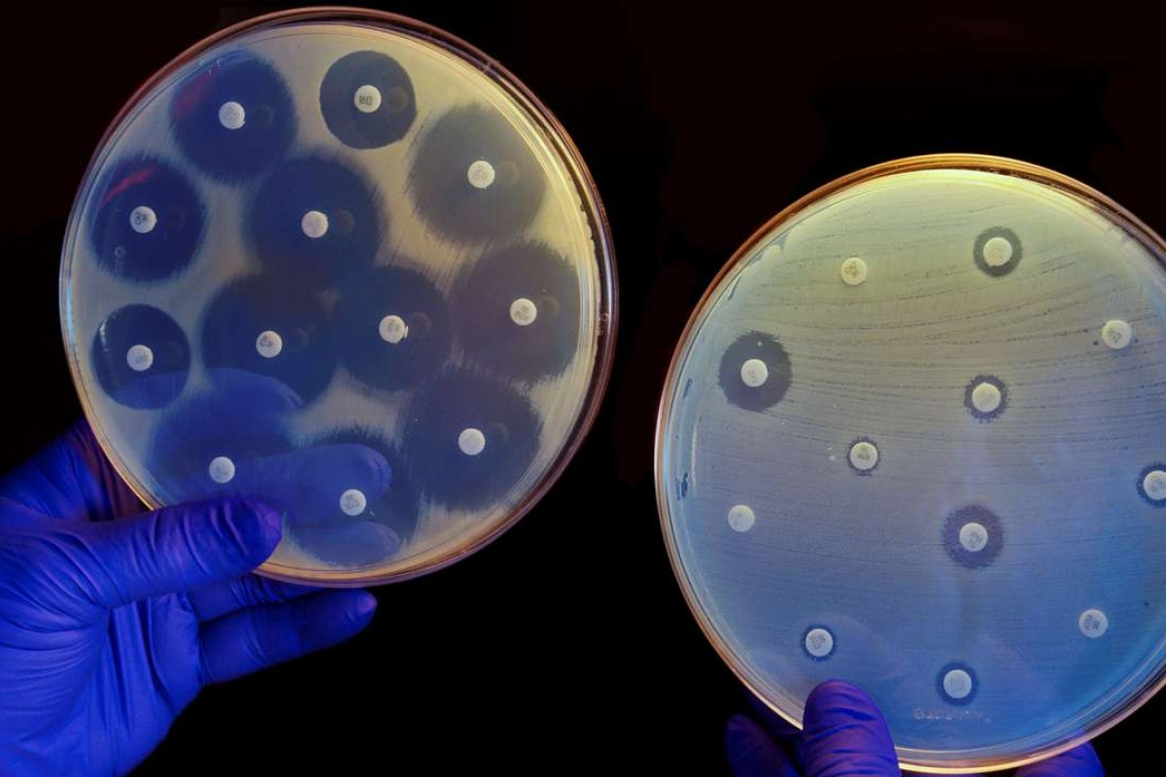
Antibiotics are small molecular graphs
Nodes: Atoms
Edges: Chemical bonds
Konaklieva, Monika I. "Molecular targets of β-lactam-based antimicrobials: beyond the usual suspects." Antibiotics 3.2 (2014): 128-142.
Image credit: CNN
53

Slide 55
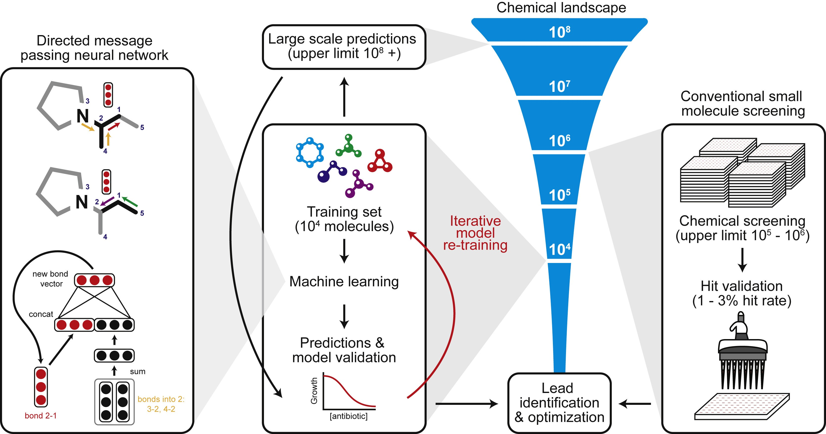
A Graph Neural Network graph classification model
Predict promising molecules from a pool of candidates
Stokes et al., A Deep Learning Approach to Antibiotic Discovery, Cell 2020
Stokes, Jonathan M., et al. "A deep learning approach to antibiotic discovery." Cell 180.4 (2020): 688-702.
54

Slide 56
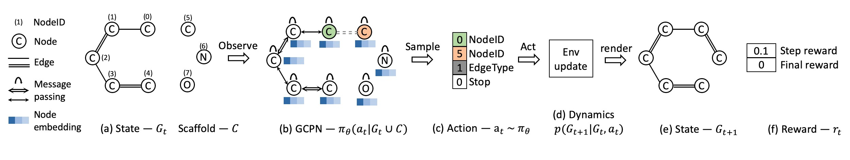
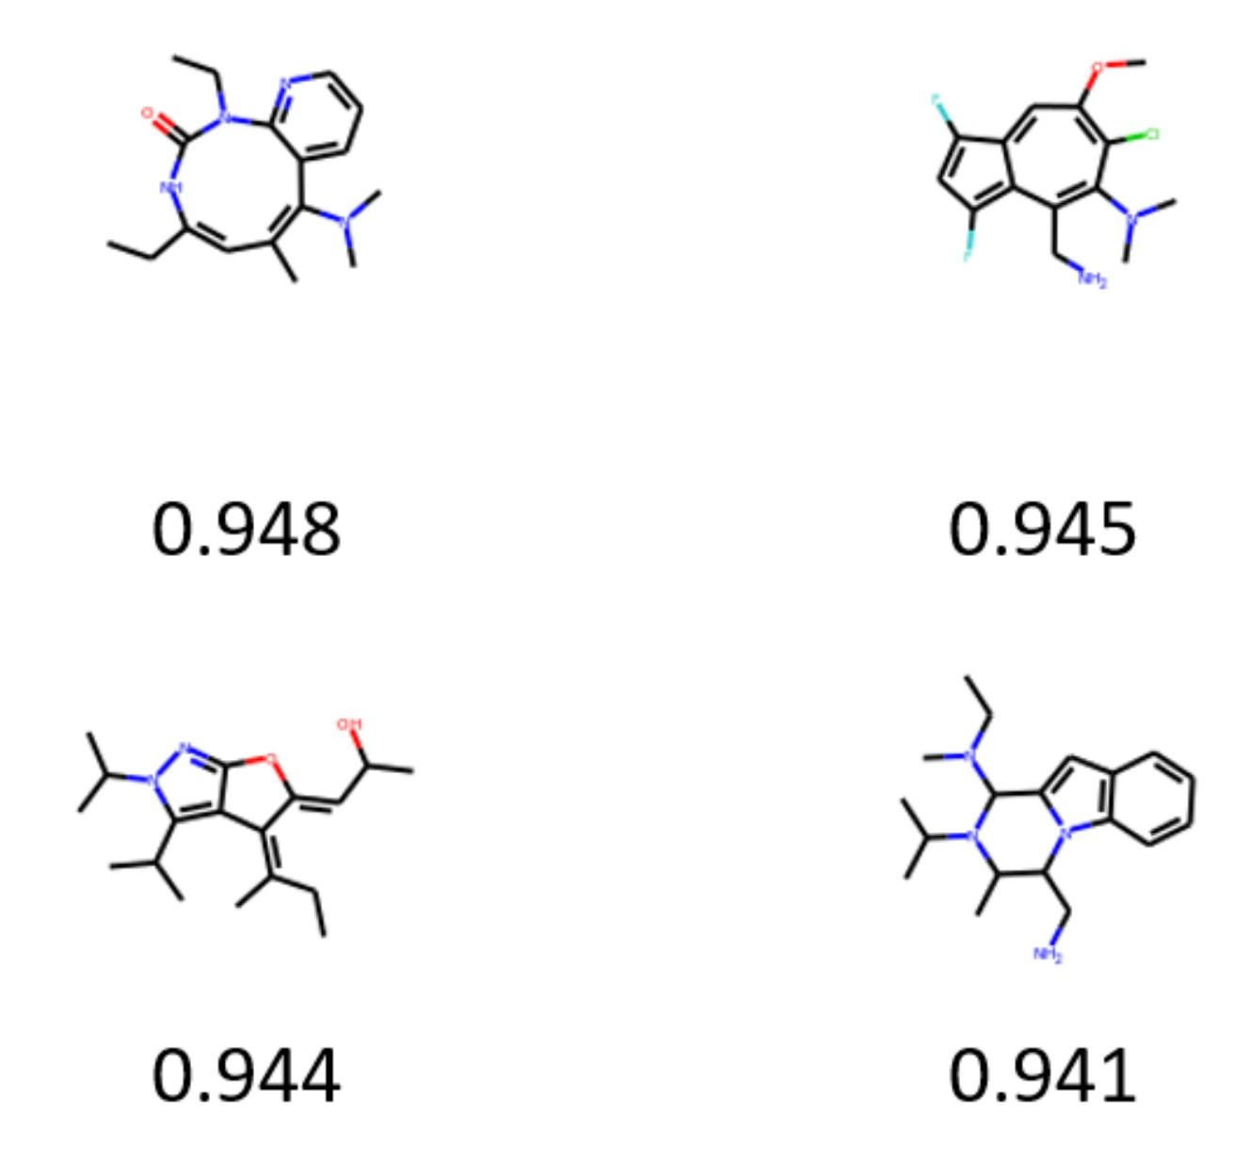
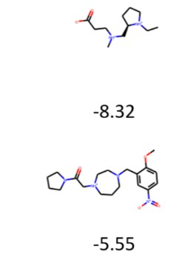

Graph generation: Generating novel molecules
You et al., Graph Convolutional Policy Network for Goal-Directed Molecular Graph Generation, NeurIPS 2018
Use case 1: Generate novel molecules with high drug likeness
Use case 2: Optimize existing molecules to have desirable properties
55

Slide 57






Physical simulation as a graph:
Nodes: Particles
Sanchez-Gonzalez et al., Learning to simulate complex physics with graph networks, ICML 2020
Edges: Interaction between particles
56

Slide 58

A graph evolution task:
Goal: Predict how a graph will evolve over
Sanchez-Gonzalez et al., Learning to simulate complex physics with graph networks, ICML 2020
time
57

Slide 59

CS224W: Machine Learning with Graphs Jure Leskovec, Stanford University
http://cs224w.stanford.edu

Slide 60








Objects: nodes, vertices
Interactions: links, edges
N E
G(N,E)
System: network, graph
1/13/21
Jure Leskovec, Stanford CS224W: Machine Learning with Graphs
59

Slide 61




Movie 1
Actor 2
friend
Actor 1
Mary
co-worker
Peter
Movie 3
Actor 4
Movie 2
Tom
brothers
friend
Actor 3
Albert
Protein 1
Protein 2
Protein 5
Protein 9
|N|=4
|E|=4
1/13/21
Jure Leskovec, Stanford CS224W: Machine Learning with Graphs
60

Slide 62


If you connect individuals that work with each other, you will explore a professional network
If you connect those that have a sexual relationship, you will be exploring sexual networks
Image credit: Euro Scientists
Image credit: ResearchGate
If you connect scientific papers that cite each other, you will be studying the citation network
If you connect all papers with the same word in the title, what will you be exploring? It is a network, nevertheless
61

Slide 63
How to build a graph:
What are nodes?
What are edges?
Choice of the proper network representation of a given domain/problem determines our ability to use networks successfully:
  In some cases there is a unique, unambiguous representation
  In other cases, the representation is by no means unique
  The way you assign links will determine the nature of the question you can study
62

Slide 64

Undirected
Directed
Links: directed (arcs)
B
C
Links: undirected (symmetrical, reciprocal)
L
A
F
D
D
M
I
B
G
G
E
A
H
F
C
Examples:
  Collaborations
  Friendship on Facebook
Examples:
  Phone calls
  Following on Twitter
63

Slide 65

k_{A} = 4
Node degree, k_{i}: the number of edges adjacent to node i
Undirected
A
2E N
1
N
Avg. degree:
k = k = _{N} ∑k_{i} =
i=1
In directed networks we define an in-degree and out-degree.
The (total) degree of a node is the sum of in- and out-degrees.
B
D
Directed
C
G
A
E
_{k} out
k ^{in} = 2
= 1 k = 3
F
C
k = ^{E}
C C
Source: Node with k^{in} = 0
Sink: Node with k^{out} = 0
_{k} in _{= k} out
N
64

Slide 66











Bipartite graph is a graph whose nodes can be divided into two disjoint sets U and V such that every link connects a node in U to one in V; that is, U and V are independent sets
A
B
C
Examples:
  Authors-to-Papers (they authored)
  Actors-to-Movies (they appeared in)
  Users-to-Movies (they rated)
  Recipes-to-Ingredients (they contain)
“Folded” networks:
  Author collaboration networks
  Movie co-rating networks
D
E
U
V
65

Slide 67



Projection V
Projection U
U
V
66

Slide 68








4
4
3
3
2
2
1
1
A_{ij} = 1
A_{ij} = 0
if there is a link from node i to node j
otherwise
⎛ 0 1 0 1⎞ ⎛ 0 0 0 1⎞
÷ ⎜ ÷
0 0 1÷ 0 0 0÷
0 0 ÷÷ 0 0 ÷÷
1 1 0 1 1 0
⎜
A = ^{⎜ 1}
A = ^{⎜ 1}
⎜ ₀
₁÷
⎜ ₀
₀÷
⎜_{⎜ 1}
⎜_{⎜ 0}
⎝ ⎠ ⎝ ⎠
Note that for a directed graph (right) the matrix is not symmetric.
67

Slide 69

















⎛0
1
0
0
1
0
1⎞
⎟
N
k_{i} = ∑A_{ij}
j =1
4
⎜1 0 1
⎜
Undirected
= ⎜
⎟
3
^{A}ij
0
0 1⎟
1 0⎠
⎜₁
⎟
N
k _{j} = ∑ A_{ij}
i=1
2
⎝
1
^{A}ij
^{A}ii
= A _{ji}
= 0
1
N
1
2
N
L = ∑k_{i}
=
∑ ^{A}ij
ij
² i=1
N
⎛ 0 0 0 1⎞
÷
0 0 0⎟
0 0 0⎟
X
⎜
k =
A
out
in
ij
4
i
Directed
A = ^{⎜ 1}
j=1
⎜ ₀
in
3
⎜⎜
N
k_{j} = ∑A_{ij}
out
i=1
⎝
0 1 1
_{0⎟}÷
2
⎠
1
N N
N
∑ ∑
∑
in
out
A ≠ A
L = k = k = A
ij
^{A}ii
ji
i=1
i
j=1
j
i, j
ij
= 0
68

Slide 70

69

Slide 71

Most real-world networks are sparse
E << E_{max} (or k << N-1)
Consequence: Adjacency matrix is filled with zeros!
(Density of the matrix (E/N²): WWW=1.51x10⁻⁵, MSN IM = 2.27x10⁻⁸)
70

Slide 72





Represent graph as a list of edges:
(2, 3)
(2, 4)
(3, 2)
(3, 4)
(4, 5)
(5, 2)
(5, 1)
2
1
3
5
4
71

Slide 73





Adjacency list:
Easier to work with if network is
  Large
  Sparse
Allows us to quickly retrieve all neighbors of a given node
  1:
  2: 3, 4
  3: 2, 4
  4: 5
  5: 1, 2
2
1
3
5
4
72

Slide 74
Possible options:
Weight (e.g., frequency of communication)
Ranking (best friend, second best friend…)
Type (friend, relative, co-worker)
Sign: Friend vs. Foe, Trust vs. Distrust
Properties depending on the structure of the rest of the graph: Number of common friends
73

Slide 75









Unweighted
(undirected)
Weighted
(undirected)
4
4
1
1
2
2
3
⎛0
⎜
3
⎛ 0
⎜
1 1
_{= ⎜}1 0 1 1÷
⎜1 1 0 0÷
⎝0 1 0 0⎠
A_{ii} = 0
N
2 0.5 0⎞
_{= ⎜} 2 0 1 4÷
⎜0.5 1 0 0÷
⎝ 0 4 0 0⎠
A_{ii} = 0 = A_{ji}
0⎞
÷
÷
A
A
ij
ij
⎜
÷
⎜
÷
^{A}ij ^{= A}ji
^{A}ij
1
2E N
N
E = ¹ ∑ nonzero( A )
_{k =} 2E
E =
∑ ^{A}ij
k =
2
ij
N
² i, j=1
i, j =1
Examples: Friendship, Hyperlink
Examples: Collaboration, Internet, Roads
74

Slide 76















Self-edges (self-loops)
(undirected)
4
Multigraph
(undirected)
4
1
1
2
2
3
⎛1
⎜
3
⎛0
⎜
1 1
_{= ⎜}1 0 1 1÷
⎜1 1 0 0÷
⎝0 1 0 1⎠
A_{ii} ≠ 0
2 1 0⎞
_{= ⎜}2 0 1 3÷
⎜1 1 0 0÷
⎝0 3 0 0⎠
A_{ii} = 0
0⎞
÷
÷
A
A
ij
ij
⎜
÷
⎜
÷
^{A}ij
= A_{ji}
^{A}ij
= A_{ji}
N
∑
N
A + ∑ A
N
E = ¹ ∑ nonzero( A )
_{k =} 2E
E = ¹
2
ij
ii
2
ij
N
i, j =1,i≠ j i=1
i, j =1
Examples: Proteins, Hyperlinks
Examples: Communication, Collaboration

Slide 77
Connected (undirected) graph:
Any two vertices can be joined by a path
A disconnected graph is made up by two or more connected components
B
B
A
Largest Component:
Giant Component
A
Isolated node (node H)
F
C
C
D
D
F
H
H
G
G

Slide 78




The adjacency matrix of a network with several components can be written in a block- diagonal form, so that nonzero elements are confined to squares, with all other elements being zero:
Disconnected
Connected

Slide 79
Strongly connected directed graph
has a path from each node to every other node and vice versa (e.g., A-B path and B-A path)
Weakly connected directed graph
  is connected if we disregard the edge directions
E
B
F
A
D
C
G
Graph on the left is connected but not strongly connected (e.g.,
there is no way to get from F to G by
following the edge directions).

Slide 80


Strongly connected components (SCCs) can be identified, but not every node is part of a nontrivial strongly connected component.
SCC
B
E
A
B
F
A
D
E
C
F
D
C
G
G
SCC
SCC
In-component: nodes that can reach the SCC,
Out-component: nodes that can be reached from the SCC.

Slide 81

Machine learning with Graphs
Applications and use cases
Different types of tasks:
  Node level
  Edge level
  Graph level
Choice of a graph representation:
  Directed, undirected, bipartite, weighted, adjacency matrix
80

