Slide 1



CS224W: Machine Learning with Graphs Jure Leskovec, Stanford University
http://cs224w.stanford.edu

Slide 2
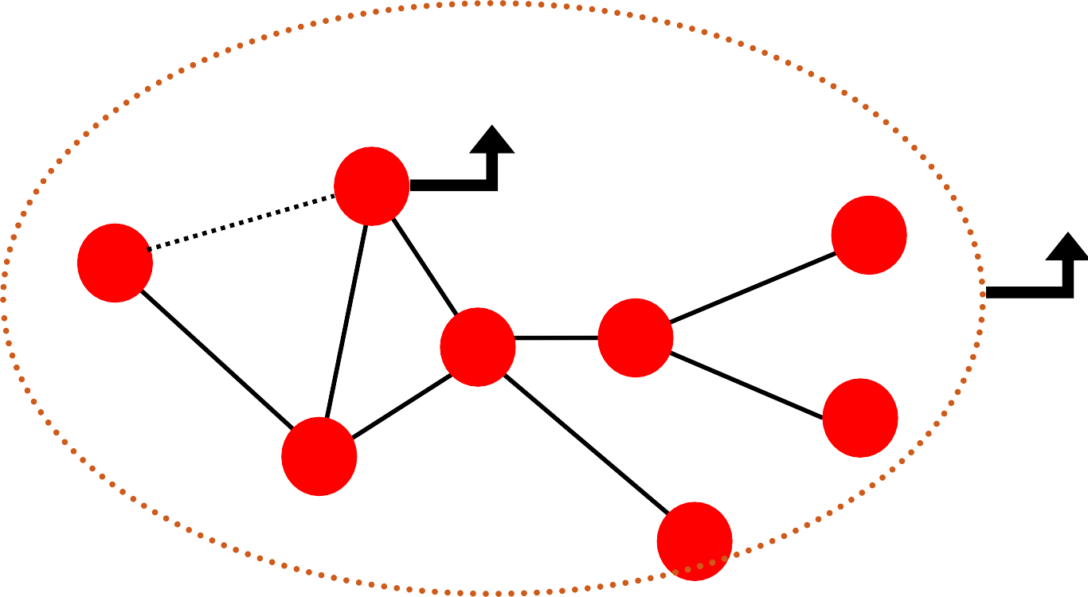
Node-level prediction
Link-level prediction
Graph-level prediction
? Node-level
Link-level
Graph-level
?
B
?
F
A
D
E
G
C
H
6

Slide 3
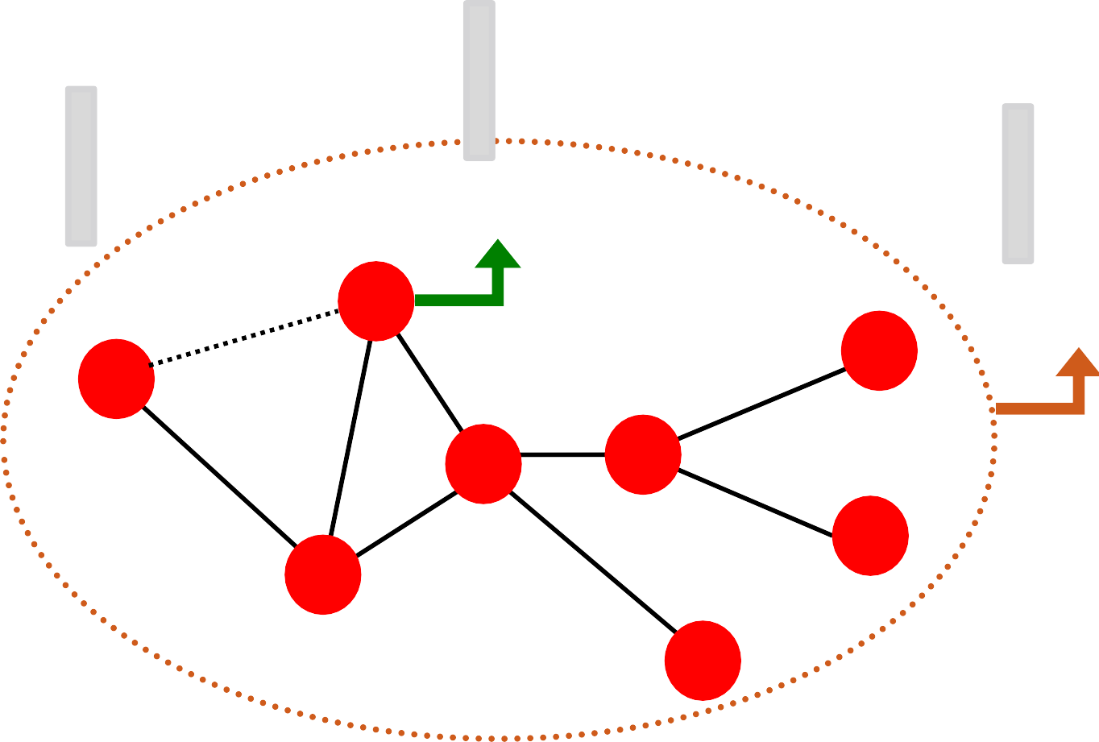
Design features for nodes/links/graphs
Obtain features for all training data
∈ ℝ!
∈ ℝ!
∈ ℝ!
Node features
B
Link features
A
Graph features
F
D
E
G
C
H
6

Slide 4
Apply the model:
  Given a new node/link/graph, obtain its features and make a prediction
Train an ML model:
  Random forest
  SVM
  Neural network, etc.
𝒙_{𝟏} 𝑦#
𝒙 𝑦
𝒙_{𝑵}
𝑦%
6

Slide 5
Using effective features over graphs is the key to achieving good test performance.
Traditional ML pipeline uses hand-designed features.
In this lecture, we overview the traditional features for:
  Node-level prediction
  Link-level prediction
  Graph-level prediction
For simplicity, we focus on undirected graphs.
6

Slide 6
Goal: Make predictions for a set of objects
Design choices:
Features: d-dimensional vectors
Objects: Nodes, edges, sets of nodes, entire graphs
Objective function:
  What task are we aiming to solve?
6

Slide 7
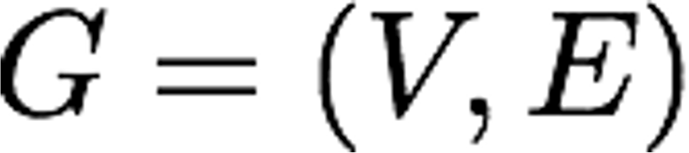
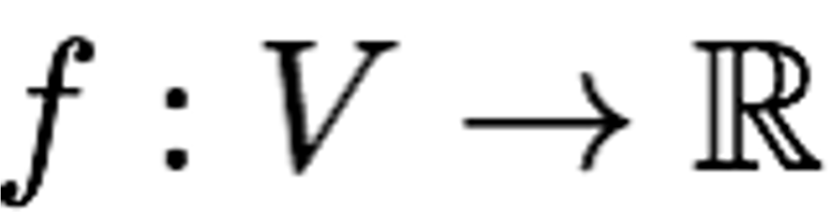
Machine learning in graphs:
Given:
Learn a function:
How do we learn the function?
6

Slide 8

CS224W: Machine Learning with Graphs Jure Leskovec, Stanford University
http://cs224w.stanford.edu

Slide 9



?
?
?
?
Machine Learning
?
Node classification
ML needs features.
9

Slide 10
Goal: Characterize the structure and position of a node in the network:
Node degree
Node centrality
Clustering coefficient
Graphlets
A
Node feature
B
F
D
E
G
C
H
Jure Leskovec, Stanford CS224W: Machine Learning with Graphs, http://cs224w.stanford.edu
10

Slide 11
The degree 𝑘! of node 𝑣 is the number of edges (neighboring nodes) the node has.
Treats all neighboring nodes equally.
𝑘' = 2
𝑘& = 1
A
B
𝑘! = 4
F
D
E
G
C
𝑘₍ = 3
H
19

Slide 12
Node degree counts the neighboring nodes without capturing their importance.
Node centrality 𝑐! takes the node importance in a graph into account
Different ways to model importance:
  Engienvector centrality
  Betweenness centrality
  Closeness centrality
  and many others…
19

Slide 13

Eigenvector centrality:
A node 𝑣 is important if surrounded by important neighboring nodes 𝑢 ∈ 𝑁(𝑣).
We model the centrality of node 𝑣 as the sum of the centrality of neighboring nodes:
₌ 1
+ 𝑐"
"∈$(!)
𝑐
!
𝜆
𝜆 is some positive constant
Notice that the above equation models centrality in a recursive manner. How do we solve it?
19

Slide 14
Eigenvector centrality:
Rewrite the recursive equation in the matrix form.
₌ 1
- 𝑐*
*∈%())
𝑐
𝜆𝒄 = 𝑨𝒄
𝑨: Adjacency matrix
𝑨_{*)}= 1 if 𝑢 ∈ 𝑁(𝑣)
𝒄: Centrality vector
)
𝜆
𝜆 is some positive constant
We see that centrality is the eigenvector!
The largest eigenvalue 𝜆_{()*} is always positive and unique (by Perron-Frobenius Theorem).
The leading eigenvector 𝒄_{()*} is used for centrality.
19

Slide 15

Betweenness centrality:
A node is important if it lies on many shortest paths between other nodes.
₋ #(shortest paths betwen 𝑠 and 𝑡 that contain 𝑣)
𝑐 =
)
#(shortest paths between 𝑠 and 𝑡)
/0)01
Example:
B
𝑐& = 𝑐' = 𝑐. = 0
𝑐₍ = 3
(A-C-B, A-C-D, A-C-D-E)
𝑐! = 3
(A-C-D-E, B-D-E, C-D-E)
A
D
E
C
19

Slide 16

Closeness centrality:
A node is important if it has small shortest path lengths to all other nodes.
1
∑_{*0)} shortest path length between 𝑢 and 𝑣
𝑐 =
)
Example:
B
𝑐& = 1/(2 + 1 + 2 + 3) = 1/8
(A-C-B, A-C, A-C-D, A-C-D-E)
A
D
E
𝑐 = 1/(2 + 1 + 1 + 1) = 1/5
!
(D-C-A, D-B, D-C, D-E)
C
19

Slide 17
Measures how connected 𝑣"𝑠 neighboring nodes are:
₌ #(edges among neighboring nodes) _{∈ [0,1]}
𝑒
)
2!
3
#(node pairs among 𝑘! neighboring nodes)
Examples:
𝑣
𝑣
𝑣
𝑒₎ = 1
𝑒₎ = 0.5
𝑒₎ = 0
19

Slide 18
Observation: Clustering coefficient counts the
#(triangles) in the ego-network
𝑣
𝑣
𝑣
𝑣
𝑒₎ = 0.5
3 triangles (out of 6 node triplets)
We can generalize the above by counting
#(pre-specified subgraphs, i.e., graphlets).
19

Slide 19
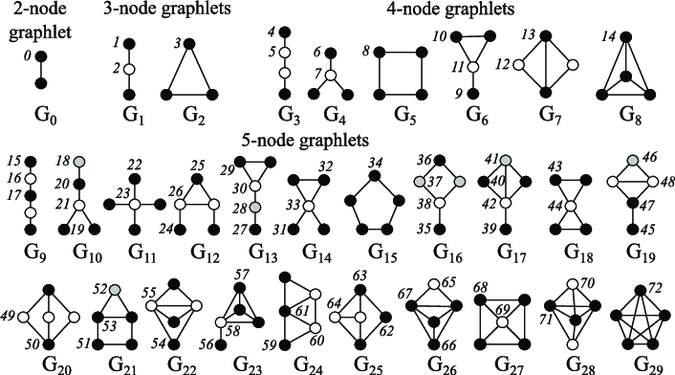
Graphlets: Rooted connected non-isomorphic subgraphs:
Przulj et al., Bioinformatics 2004
19

Slide 20
Graphlet Degree Vector (GDV): Graphlet-base features for nodes
Degree counts #(edges) that a node touches
Clustering coefficient counts #(triangles) that a node touches.
GDV counts #(graphlets) that a node touches
20

Slide 21
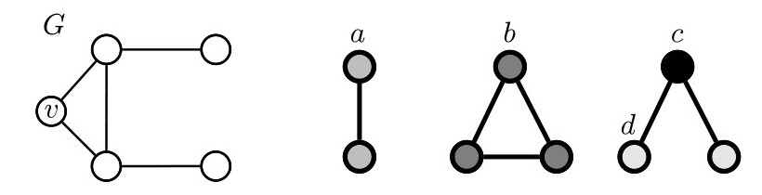
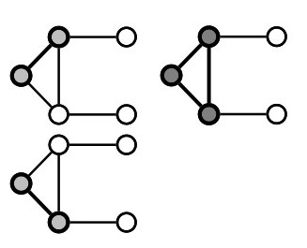
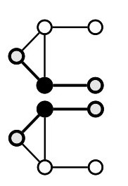
Graphlet Degree Vector (GDV): A count vector of graphlets rooted at a given node.
Example:
𝑣
List of graphlets
Graphlet instances:
𝑎 𝑐
𝑏
𝑑
GDV of node 𝑣:
𝑎, 𝑏, 𝑐, 𝑑
[2,1,0,2]
ttp://cs224w.stanford.edu
2/14/21
Jure Leskovec, S
tanford CS224W: Ma
chine Learning with Graphs, h
21

Slide 22
Considering graphlets on 2 to 5 nodes we get:
Vector of 73 coordinates is a signature of a node that describes the topology of node's neighborhood
Captures its interconnectivities out to a distance of 4 hops
Graphlet degree vector provides a measure of a node’s local network topology:
  Comparing vectors of two nodes provides a more detailed measure of local topological similarity than node degrees or clustering coefficient.
26

Slide 23
We have introduced different ways to obtain node features.
They can be categorized as:
Importance-based features:
  Node degree
  Different node centrality measures
Structure-based features:
  Node degree
  Clustering coefficient
  Graphlet count vector
26

Slide 24
Importance-based features: capture the importance of a node is in a graph
Node degree:
  Simply counts the number of neighboring nodes
Node centrality:
  Models importance of neighboring nodes in a graph
  Different modeling choices: eigenvector centrality, betweenness centrality, closeness centrality
Useful for predicting influential nodes in a graph
  Example: predicting celebrity users in a social network
26

Slide 25
Structure-based features: Capture topological properties of local neighborhood around a node.
Node degree:
  Counts the number of neighboring nodes
Clustering coefficient:
  Measures how connected neighboring nodes are
Graphlet degree vector:
  Counts the occurrences of different graphlets
Useful for predicting a particular role a node plays in a graph:
  Example: Predicting protein functionality in a protein-protein interaction network.
26

Slide 26

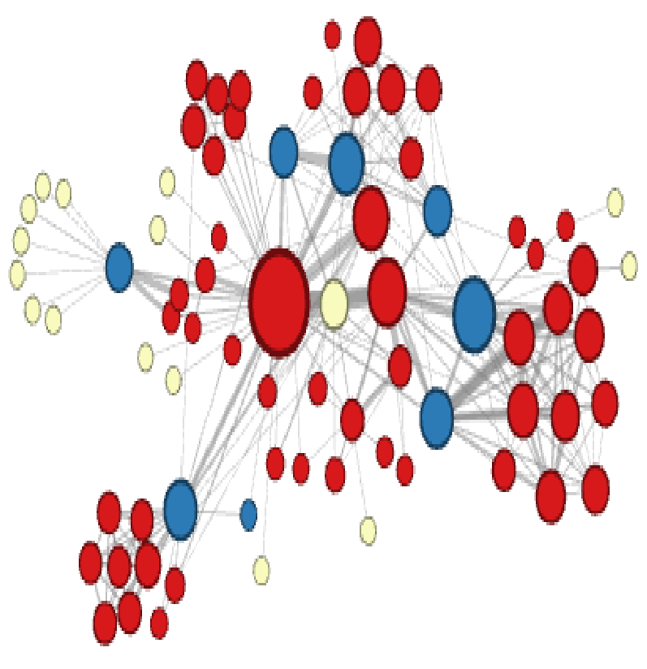
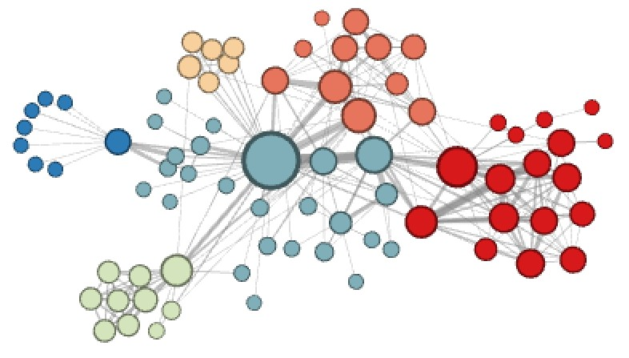
Different ways to label nodes of the network:
Node features defined so far would allow to distinguish nodes in the above example
However, the features defines so far would not allow for distinguishing the above node labelling
26

Slide 27

CS224W: Machine Learning with Graphs Jure Leskovec, Stanford University
http://cs224w.stanford.edu

Slide 28
The task is to predict new links based on existing links.
At test time, all node pairs (no existing links)
are ranked, and top 𝐾 node pairs are predicted.
The key is to design features for a pair of nodes.
?
B
F
A
D
E
G
C
?
H
Jure Leskovec, Stanford CS224W: Machine Learning with Graphs, http://cs224w.stanford.edu
29

Slide 29









Two formulations of the link prediction task:
1) Links missing at random:
Remove a random set of links and then aim to predict them
2) Links over time:
Given 𝐺[𝑡,, 𝑡⁻ ] a graph on edges
,
up to time
-
𝑡,,output a ranked list L
of links (not in 𝐺[𝑡,, 𝑡⁻ ]) that are
,
predicted to appear i
Evaluation:
-
𝐺[𝑡", 𝑡# ]
n 𝐺[𝑡 , 𝑡 ]
"
. .
_{$ 𝑡}#
𝐺[𝑡 , ]
$
n = |E_{new}|: # new edges that appear during
the test period [𝑡#, 𝑡⁵ ]
#
Take top n elements of L and count correct edges
Jure Leskovec, Stanford CS224W: Machine Learning with Graphs, http://cs224w.stanford.edu
29

Slide 30









Methodology:
For each pair of nodes (x,y) compute score c(x,y)
  For example, c(x,y) could be the # of common neighbors of x and y
Sort pairs (x,y) by the decreasing score c(x,y)
Predict top n pairs as new links
See which of these links actually
appear in 𝐺[𝑡 , 𝑡⁻]
X
. .
X
Jure Leskovec, Stanford CS224W: Machine Learning with Graphs, http://cs224w.stanford.edu
30

Slide 31
Distance-based feature
Local neighborhood overlap
Global neighborhood overlap
Link feature
A
B
F
D
E
G
C
H

Slide 32
Shortest-path distance between two nodes
Example:
B
F
𝑆₄₅ = 𝑆₄₆ = 𝑆₇₄ = 2
A
D
E
𝑆₄₈ = 𝑆₄₉ = 3
G
C
H
However, this does not capture the degree of
neighborhood overlap:
  Node pair (B, H) has 2 shared neighboring nodes, while pairs (B, E) and (A, B) only have 1 such node.

Slide 33
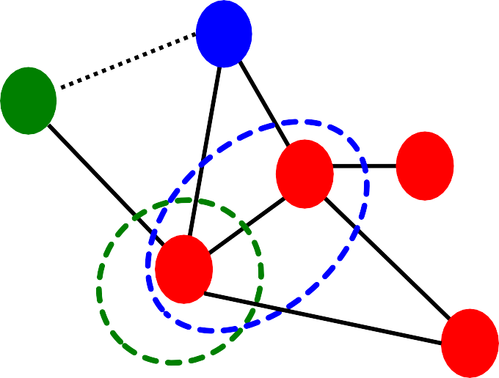
Captures # neighboring nodes shared between two nodes 𝒗_{𝟏} and 𝒗_{𝟐}:
Common neighbors: |𝑁 𝑣#
  Example: 𝑁 𝐴 ∩ 𝑁 𝐵 = 𝐶
∩ 𝑁 𝑣₃ |
= 1
Jaccard’s coefficient: ^{|% )" ∩% )# |}
|% )" ∪% )# |
B
% & ∩% ( {+}
$
Example: _{% & ∪% (} =
{+,.} ⁼ /
𝑁'
E
A
Adamic-Adar index:
D
$
∑0∈% !! ∩% !"
234(6#)
C
Example: # = #
𝑁
&
9:;(2$)
9:; <
F

Slide 34
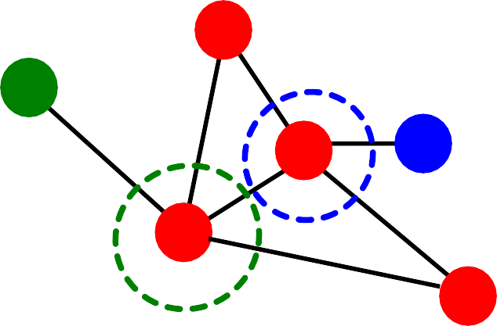
Limitation of local neighborhood features:
Metric is always zero if the two nodes do not have any neighbors in common.
B
𝑁.
A
D
E
𝑁₇ ∩ 𝑁₆ = 𝜙
|𝑁₇ ∩ 𝑁₆| = 0
C
𝑁&
F
However, the two nodes may still potentially be connected in the future.
Global neighborhood overlap metrics resolve
the limitation by considering the entire graph.

Slide 35
Katz index: count the number of paths of all lengths between a given pair of nodes.
Q: How to compute #paths between two nodes?
Use powers of the graph adjacency matrix!

Slide 36
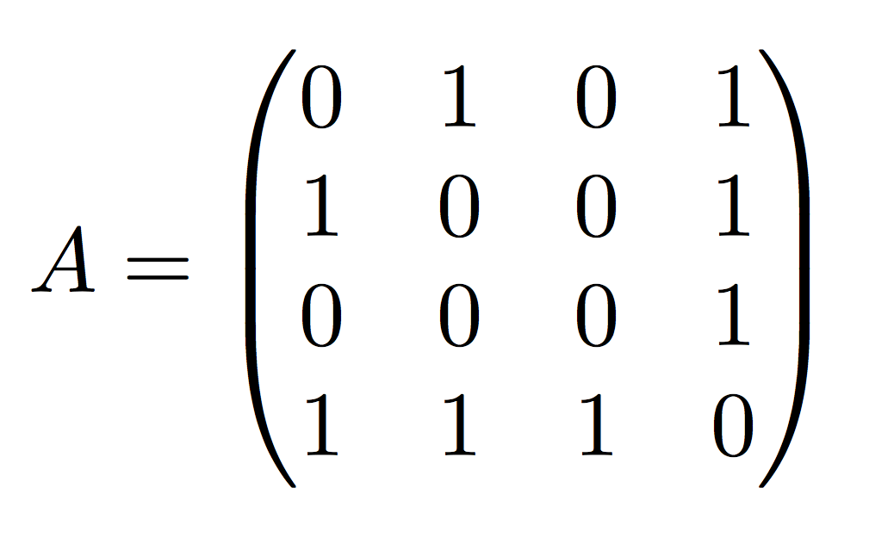




Computing #paths between two nodes
Recall: 𝑨"! = 1 if 𝑢 ∈ 𝑁(𝑣)
Let 𝑷^{(𝑲)} = #paths of length 𝑲 between 𝒖 and 𝒗
𝒖𝒗
We will show 𝑷^{(𝑲)} = 𝑨^{𝒌}
𝑷^{(𝟏)} = #paths of length 1 (direct neighborhood)
𝒖𝒗
between 𝑢 and 𝑣 = 𝑨_{𝒖𝒗}
_{𝑷}(𝟏) _{= 𝑨𝟏𝟐}
𝟏𝟐
4
3
2
1

Slide 37
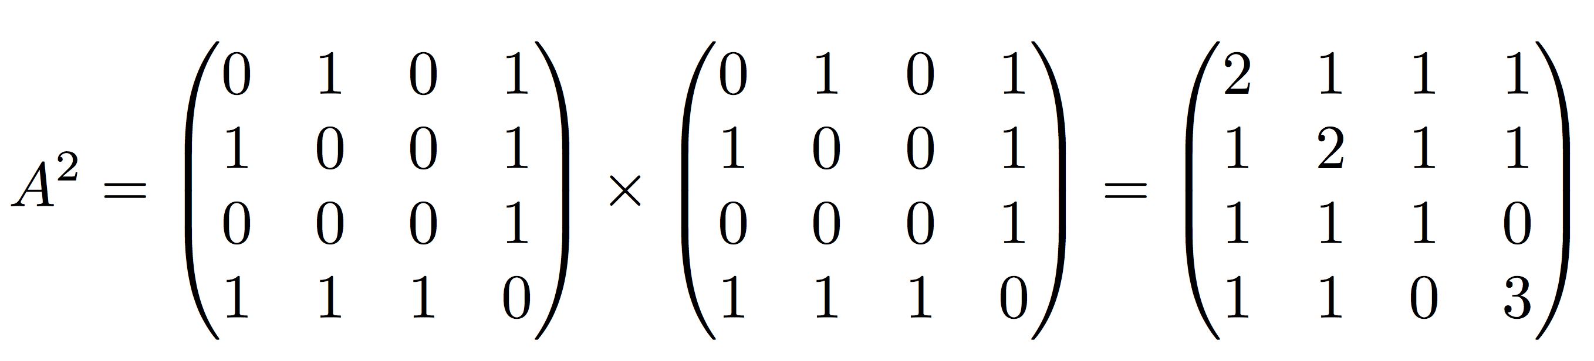
How to compute 𝑷^{(𝟐)} ?
𝒖𝒗
Step 1: Compute #paths of length 1 between each of 𝒖’s neighbor and 𝒗
Step 2: Sum up these #paths across u’s neighbors
𝑷^{(𝟐)} = ∑_{𝒊} 𝑨_{𝒖𝒊} ∗ 𝑷^{(𝟏)} = ∑_{𝒊} 𝑨_{𝒖𝒊} ∗ 𝑨_{𝒊𝒗} = 𝑨^{𝟐}
𝒖𝒗
𝒊𝒗
#paths of length 1 between Node 1’s neighbors and Node 2
𝒖𝒗
_{𝑷}(𝟐) _{= 𝑨3}
Node 1’s neighbors
𝟏𝟐
#3
Power of adjacency

Slide 38
Katz index: count the number of paths of all lengths between a pair of nodes.
How to compute #paths between two nodes?
Use adjacency matrix powers!
  𝑨"! specifies #paths of length 1 (direct neighborhood) between 𝑢 and 𝑣.
𝑨^{𝟐} specifies #paths of length 2 (neighbor of
"!
neighbor) between 𝑢 and 𝑣.
And, 𝑨^{𝒍}
specifies #paths of length 𝒍.
"!

Slide 39
Katz index between 𝑣₎ and 𝑣* is calculated as
Sum over all path lengths
L
𝑆!!!" = +
#paths of length 𝑙
between 𝑣# and 𝑣₃
_{𝛽}J
𝑨
J
! !
! "
^{JK.} 0 < 𝛽 < 1: discount factor
Katz index matrix is computed in closed-form:
L
𝑺 = + 𝛽^{M}𝑨^{M} = 𝑰 − 𝛽𝑨 ^{N.} − 𝑰,
MK.
= ∑^{A}
_{𝛽}>_{𝑨}>
>?@
by geometric series of matrices

Slide 40
Distance-based features:
Uses the shortest path length between two nodes but does not capture how neighborhood overlaps.
Local neighborhood overlap:
  Captures how many neighboring nodes are shared by two nodes.
  Becomes zero when no neighbor nodes are shared.
Global neighborhood overlap:
  Uses global graph structure to score two nodes.
  Katz index counts #paths of all lengths between two nodes.
Jure Leskovec, Stanford CS224W: Machine Learning with Graphs, http://cs224w.stanford.edu
40

Slide 41

CS224W: Machine Learning with Graphs Jure Leskovec, Stanford University
http://cs224w.stanford.edu

Slide 42

Goal: We want features that characterize the structure of an entire graph.
For example:
B
F
A
D
E
G
C
H
44

Slide 43
Kernel methods are widely-used for traditional ML for graph-level prediction.
Idea: Design kernels instead of feature vectors.
A quick introduction to Kernels:
Kernel 𝐾 𝐺, 𝐺⁻
∈ ℝ measures similarity b/w data
Kernel matrix 𝑲 = 𝐾 𝐺, 𝐺⁻
_{8,8!} must always be
positive semidefinite (i.e., has positive eigenvals)
There exists a feature representation 𝜙()) such that
𝐾 𝐺, 𝐺⁻ = 𝜙 G ^{O}𝜙 𝐺⁻
Once the kernel is defined, off-the-shelf ML model, such as kernel SVM, can be used to make predictions.
44

Slide 44
Graph Kernels: Measure similarity between two graphs:
Graphlet Kernel [1]
Weisfeiler-Lehman Kernel [2]
Other kernels are also proposed in the literature
(beyond the scope of this lecture)
  Random-walk kernel
  Shortest-path graph kernel
  And many more…
Shervashidze, Nino, et al. "Efficient graphlet kernels for large graph comparison." Artificial Intelligence and Statistics. 2009.
Shervashidze, Nino, et al. "Weisfeiler-lehman graph kernels." Journal of Machine Learning Research 12.9 (2011).
44

Slide 45
Goal: Design graph feature vector 𝜙 𝐺
Key idea: Bag-of-Words (BoW) for a graph
  Recall: BoW simply uses the word counts as features for documents (no ordering considered).
  Naïve extension to a graph: Regard nodes as words.
  Since both graphs have 4 red nodes, we get the same feature vector for two different graphs…
𝜙( ) = 𝜙
Jure Leskovec, Stanford CS224W: Machine Learning with Graphs, http://cs224w.stanford.edu
46

Slide 46
What if we use Bag of node degrees?
Deg1: Deg2: Deg3:
𝜙( ) = count(
𝜙( ) = count(
) = [1, 2, 1]
Obtains different features for different graphs!
) = [0, 2, 2]
Both Graphlet Kernel and Weisfeiler-Lehman (WL) Kernel use Bag-of-* representation of graph, where * is more sophisticated than node degrees!
Jure Leskovec, Stanford CS224W: Machine Learning with Graphs, http://cs224w.stanford.edu
46

Slide 47

Key idea: Count the number of different graphlets in a graph.
Note: Definition of graphlets here is slightly different from node-level features.
The two differences are:
  Nodes in graphlets here do not need to be connected (allows for isolated nodes)
  The graphlets here are not rooted.
  Examples in the next slide illustrate this.
49

Slide 48
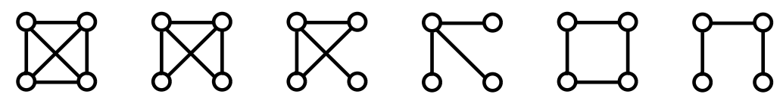
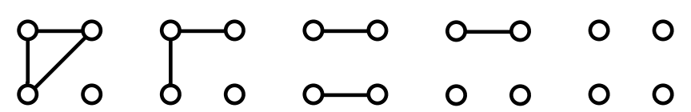
Let 𝓖_{𝒌} = (𝒈_{𝟏,} 𝒈_{𝟐}, … , 𝒈_{𝒏𝒌}) be a list of graphlets of size 𝒌.
For 𝑘 = 3 , there are 4 graphlets.
𝑔! 𝑔" 𝑔#
𝑔$
For 𝑘 = 4 , there are 11 graphlets.
Shervashidze et al., AISTATS 2011
49

Slide 49
Given graph 𝐺, and a graphlet list 𝒢. = (𝑔_{),} 𝑔*, … , 𝑔/"), define the graphlet count
vector 𝒇₀ ∈ ℝ/" as
(𝒇!)"= #(𝑔" ⊆ 𝐺) for 𝑖 = 1,2, … , 𝑛#.
49

Slide 50
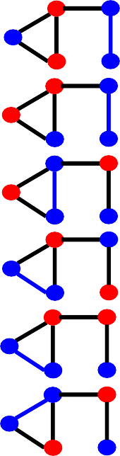
Example for 𝑘 = 3.
𝑔#
𝑔₃
𝑔_{C}
𝑔<
𝐺
𝒇₀ = (1,
3,
6,
0)¹
50

Slide 51

Given two graphs, 𝐺 and 𝐺", graphlet kernel is computed as
𝐾 𝐺, 𝐺" = 𝒇₀¹𝒇₀#
Problem: if 𝐺 and 𝐺" have different sizes, that will greatly skew the value.
Solution: normalize each feature vector
𝒇₈
O_{𝒉}
𝒉 =
𝐾 𝐺, 𝐺⁻ = 𝒉
8
Sum(𝒇₈)
8
8
!
52

Slide 52
Limitations: Counting graphlets is expensive!
Counting size-𝑘 graphlets for a graph with size 𝑛
by enumeration takes 𝑛..
This is unavoidable in the worst-case since subgraph isomorphism test (judging whether a
graph is a subgraph of another graph) is NP-hard.
If a graph’s node degree is bounded by 𝑑, an
𝑂(𝑛𝑑^{.2)}) algorithm exists to count all the graphlets of size 𝑘.
Can we design a more efficient graph kernel?
52

Slide 53
Goal: design an efficient graph feature descriptor 𝜙 𝐺
Idea: use neighborhood structure to iteratively enrich node vocabulary.
  Generalized version of Bag of node degrees since node degrees are one-hop neighborhood information.
Algorithm to achieve this:
Color refinement
52

Slide 54

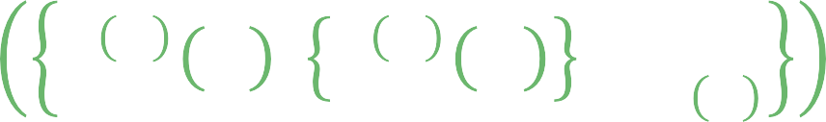
Given: A graph 𝐺 with a set of nodes 𝑉.
Assign an initial color 𝑐 ,
𝑣 to each node 𝑣.
Iteratively refine node colors by
𝑐 ^{PQ.} 𝑣 = HASH 𝑐 ^{P} 𝑣 , 𝑐 ^{P} 𝑢 ,
"∈$ !
where HASH maps different inputs to different colors.
After 𝐾 steps of color refinement, 𝑐 ^{R} 𝑣
summarizes the structure of 𝐾-hop neighborhood
Jure Leskovec, Stanford CS224W: Machine Learning with Graphs, http://cs224w.stanford.edu

Slide 55

Example of color refinement given two graphs
Assign initial colors
1
1 1
1
1
1
1
1
1 1
Aggregate neighboring colors
1
1
1,111
1,11
1,11
1,111
1,1111
1,111
1,1111
1,111
1,1
1,1
1,1
1,1
Jure Leskovec, Stanford CS224W: Machine Learning with Graphs, http://cs224w.stanford.edu

Slide 56
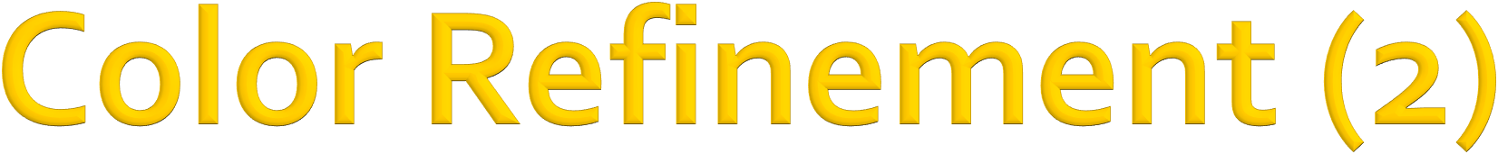
Example of color refinement given two graphs
Aggregated colors
1,111 1,11
1,11 1,111
1,1111
1,111
1,1111
1,111
1,1
1,1
1,1
1,1
Hash aggregated colors
Hash table
4
3
3
4
1,1 | --> | 2
1,11 | --> | 3
1,111 | --> | 4
1,1111 | --> | 5
5
4
5
4
2
2
2
2
Jure Leskovec, Stanford CS224W: Machine Learning with Graphs, http://cs224w.stanford.edu

Slide 57

Example of color refinement given two graphs
Aggregated colors
4
3
3 4
5
4
5
4
2 2
Hash aggregated colors
2
2
3,45
4,345
4,345
3,44
5,2244
4,345
5,2344
4,245
2,5
2,5
2,5
2,4
Jure Leskovec, Stanford CS224W: Machine Learning with Graphs, http://cs224w.stanford.edu

Slide 58

Example of color refinement given two graphs
Aggregated colors
3,45 4,345
4,345 3,44
5,2244
4,345
5,2344
4,245
2,5
2,5
2,5 2,4
Hash table
Hash aggregated colors
11
8
9
11
2,4 | --> | 6
2,5 | --> | 7
3,44 | --> | 8
3,45 | --> | 9
4,245 | --> | 10
4,345 | --> | 11
5,2244 | --> | 12
5,2344 | --> | 13
12
11
13
10
7
7
7
6
Jure Leskovec, Stanford CS224W: Machine Learning with Graphs, http://cs224w.stanford.edu

Slide 59
After color refinement, WL kernel counts number of nodes with a given color.
Colors 1,2,3,4,5,6,7,8,9,10,11,12,13
= [6,2,1,2,1,0,2,1,0, 0, 0, 2, 1]
Counts
𝜙(
𝜙(
)
)
1,2,3,4,5,6,7,8,9,10,11,12,13
= [6,2,1,2,1,1,1,0,1, 1, 1, 0, 1]
Jure Leskovec, Stanford CS224W: Machine Learning with Graphs, http://cs224w.stanford.edu

Slide 60
The WL kernel value is computed by the inner product of the color count vectors:
K( , )
!_{𝜙}
= 𝜙
= 49
Jure Leskovec, Stanford CS224W: Machine Learning with Graphs, http://cs224w.stanford.edu
60

Slide 61
WL kernel is computationally efficient
The time complexity for color refinement at each step is linear in #(edges), since it involves aggregating neighboring colors.
When computing a kernel value, only colors appeared in the two graphs need to be tracked.
  Thus, #(colors) is at most the total number of nodes.
Counting colors takes linear-time w.r.t. #(nodes).
In total, time complexity is linear in #(edges).
2/14/21
Jure Leskovec, Stanford CS224W: Machine Learning with Graphs, http://cs224w.stanford.edu
61

Slide 62
Graphlet Kernel
Graph is represented as Bag-of-graphlets
Computationally expensive
Weisfeiler-Lehman Kernel
  Apply 𝐾-step color refinement algorithm to enrich node colors
    Different colors capture different 𝐾-hop neighborhood structures
  Graph is represented as Bag-of-colors
  Computationally efficient
  Closely related to Graph Neural Networks (as we will see!)
Jure Leskovec, Stanford CS224W: Machine Learning with Graphs, http://cs224w.stanford.edu
62

Slide 63

Traditional ML Pipeline
Hand-crafted feature + ML model
Hand-crafted features for graph data
  Node-level:
    Node degree, centrality, clustering coefficient, graphlets
  Link-level:
    Distance-based feature
    local/global neighborhood overlap
  Graph-level:
    Graphlet kernel, WL kernel
Jure Leskovec, Stanford CS224W: Machine Learning with Graphs, http://cs224w.stanford.edu
62

