Slide 1

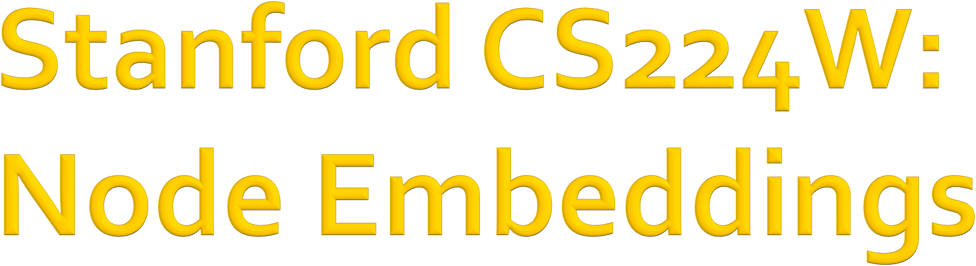

CS224W: Machine Learning with Graphs Jure Leskovec, Stanford University
http://cs224w.stanford.edu

Slide 2
Given an input graph, extract node, link and graph-level features, learn a model (SVM, neural network, etc.) that maps features to labels.
Input Graph
Structured Features
Learning Algorithm
Prediction
Feature engineering
(node-level, edge-level, graph- level features)
Downstream prediction task
5

Slide 3
Graph Representation Learning alleviates the need to do feature engineering every single time.
Input Graph
Structured Features
Learning Algorithm
Prediction
Feature Engineering
Representation Learning --
Automatically learn the features
Downstream prediction task
5

Slide 4
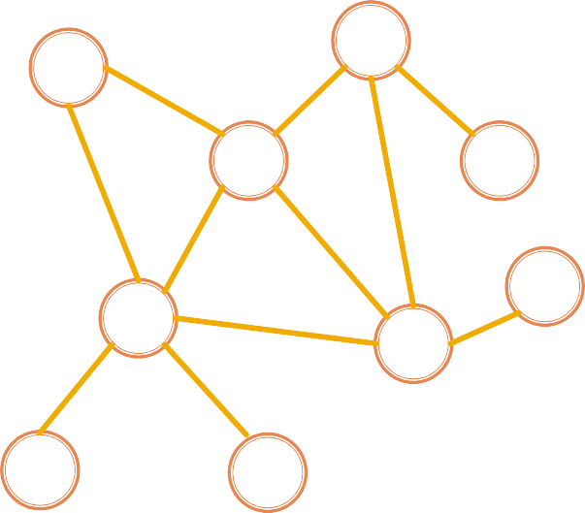
Goal: Efficient task-independent feature learning for machine learning with graphs!
node
𝑢
vector
𝑓: 𝑢 → ℝ!
_{ℝ}!
Feature representation, embedding
5

Slide 5

Task: map nodes into an embedding space
Similarity of embeddings between nodes indicates their similarity in the network. For example:
  Both nodes are close to each other (connected by an edge)
Encode network information
Potentially used for many downstream predictions
Vec
Tasks
Node classification
Link prediction
Graph classification
Anomalous node detection
Clustering
….
embeddings
ℝ
!
5

Slide 6
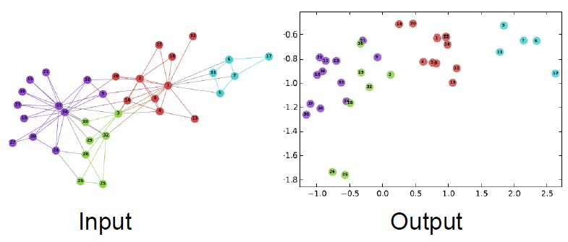
2D embedding of nodes of the Zachary’s Karate Club network:
Image from: Perozzi et al. DeepWalk: Online Learning of Social Representations. KDD 2014.
5

Slide 7
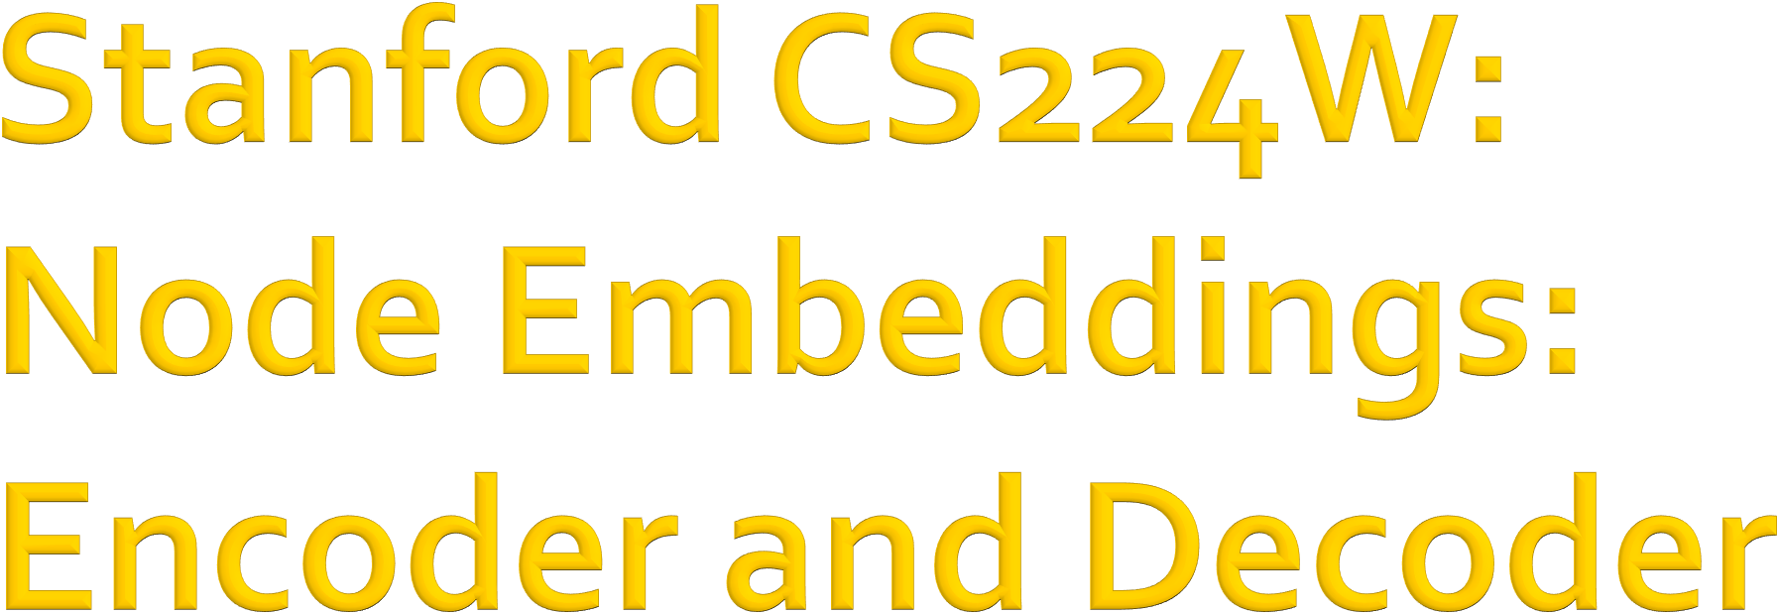
CS224W: Machine Learning with Graphs Jure Leskovec, Stanford University
http://cs224w.stanford.edu

Slide 8





Assume we have a graph G:
V is the vertex set.
A is the adjacency matrix (assume binary).
For simplicity: no node features or extra information is used
4
3
2
⎛ 0 1 0 1⎞
⎜ ÷
1 0 0 1
0 0 ÷÷
1 1 0
1
÷
V: {1, 2, 3, 4}
A = ⎜
⎜ ₀
₁÷
⎜_{⎜ 1}
⎝
⎠
8

Slide 9

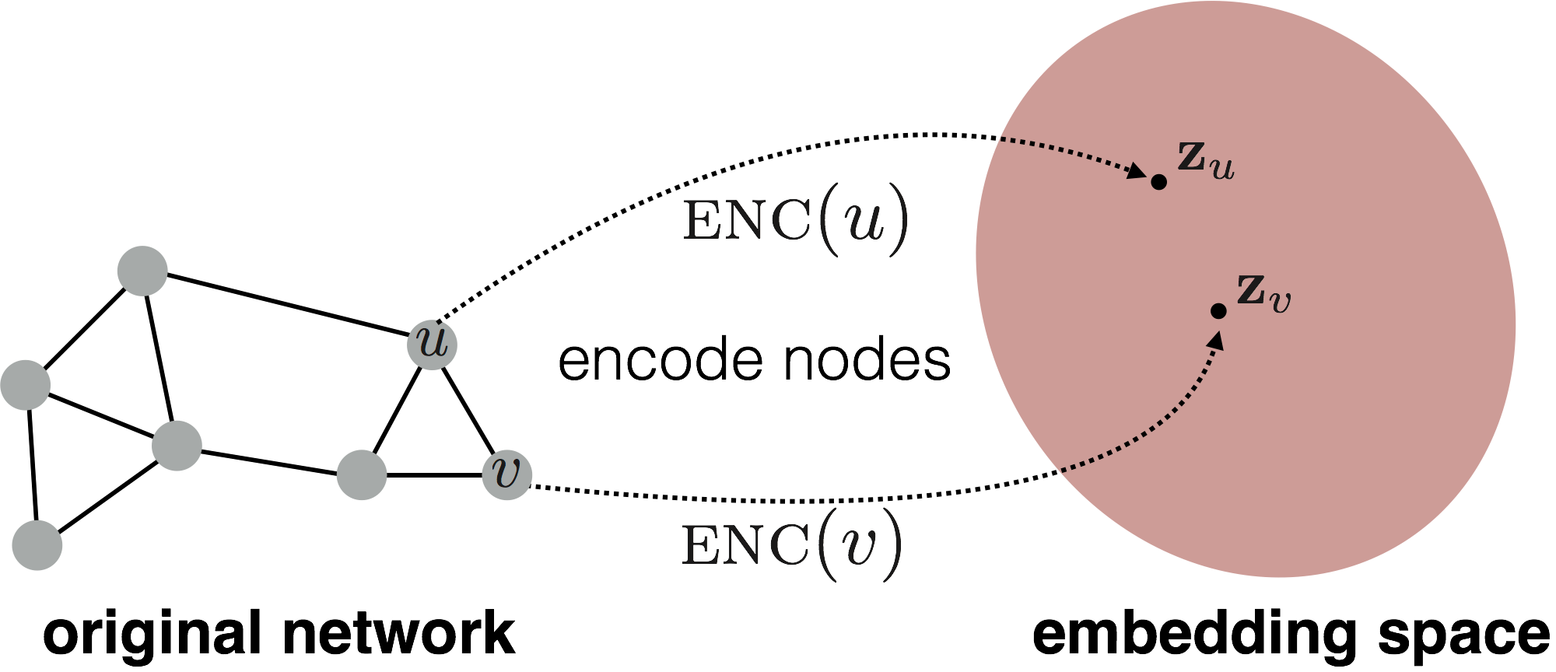
Goal is to encode nodes so that similarity in the embedding space (e.g., dot product) approximates similarity in the graph
8

Slide 10
similarity 𝑢, 𝑣
Goal:
≈ 𝐳#𝐳
" $
in the original network
Similarity of the embedding
Need to define!
10

Slide 11
1. Encoder maps from nodes to embeddings
Define a node similarity function (i.e., a measure of similarity in the original network)
Decoder 𝐃𝐄𝐂 maps from embeddings to the similarity score
Optimize the parameters of the encoder so
that:
similarity 𝑢, 𝑣
in the original network
𝐃𝐄𝐂(𝐳"𝐳 )
! #
≈ 𝐳#𝐳
" $
Similarity of the embedding

Slide 12
Encoder: maps each node to a low-dimensional
vector
d-dimensional embedding
ENC 𝑣 =
𝐳!
node in the input graph
Similarity function: specifies how the relationships in vector space map to the relationships in the original network
similarity 𝑢, 𝑣
Similarity of 𝑢 and 𝑣 in the original network
≈ 𝐳#𝐳
Decoder
" $
dot product between node embeddings

Slide 13

Simplest encoding approach: Encoder is just an embedding-lookup
ENC 𝑣
= 𝐳_{𝒗} = 𝐙 ⋅ 𝑣
_{𝚭 ∈ ℝ}!× 𝒱
matrix, each column is a node embedding [what we learn /
optimize]
indicator vector, all zeroes except a one in column indicating node v
𝑣 ∈ 𝕀 ^{𝒱}

Slide 14
Simplest encoding approach: encoder is just an embedding-lookup
embedding vector for a
embedding matrix
specific node
𝐙 =
Dimension/size of embeddings
one column per node

Slide 15
Simplest encoding approach: Encoder is just an embedding-lookup
Each node is assigned a unique embedding vector
(i.e., we directly optimize the embedding of each node)
Many methods: DeepWalk, node2vec

Slide 16

Encoder + Decoder Framework
Shallow encoder: embedding lookup
Parameters to optimize: 𝐙 which contains node embeddings 𝐳' for all nodes 𝑢 ∈ 𝑉
We will cover deep encoders (GNNs) in Lecture 6
Decoder: based on node similarity.
Objective: maximize 𝐳⁾𝐳
for node pairs (𝑢, 𝑣)
( '
that are similar

Slide 17
Key choice of methods is how they define node similarity.
Should two nodes have a similar embedding if they…
  are linked?
  share neighbors?
  have similar “structural roles”?
We will now learn node similarity definition that uses random walks, and how to optimize embeddings for such a similarity measure.

Slide 18
This is unsupervised/self-supervised way of learning node embeddings
We are not utilizing node labels
We are not utilizing node features
The goal is to directly estimate a set of coordinates (i.e., the embedding) of a node so that some aspect of the network structure (captured by DEC) is preserved
These embeddings are task independent
  They are not trained for a specific task but can be used for any task.

Slide 19

CS224W: Machine Learning with Graphs Jure Leskovec, Stanford University
http://cs224w.stanford.edu

Slide 20

Vector 𝐳!:
  The embedding of node 𝑢 (what we aim to find).
Probability 𝑃 𝑣 𝐳!) :
Our model prediction based on 𝐳#
The (predicted) probability of visiting node 𝑣 on random walks starting from node 𝑢.
Non-linear functions used to produce predicted probabilities
Softmax function
Turns vector of 𝐾 real values (model predic!tions) into
𝐾 probabilities that sum to 1: 𝜎(𝑧) =
# "
.
"
∑&
#!#
Sigmoid function:
#$%
S-shaped function that turns real values into the range of (0, 1).
Written as 𝑆 𝑥 =
'
.
'()!"

Slide 21



10
9
12
2
Step 3
Step 4
8
Step 5
1
3
11
Given a graph and a starting point, we select a neighbor of it at random, and move to this neighbor; then we select a neighbor of this point at random, and move to it, etc.
The (random) sequence of points visited this way is a random walk on the graph.
4
Step 1
Step 2
6
5
7

Slide 22
probability that u and v co-occur on a random walk over the graph
𝐳"𝐳 ≈
! #

Slide 23
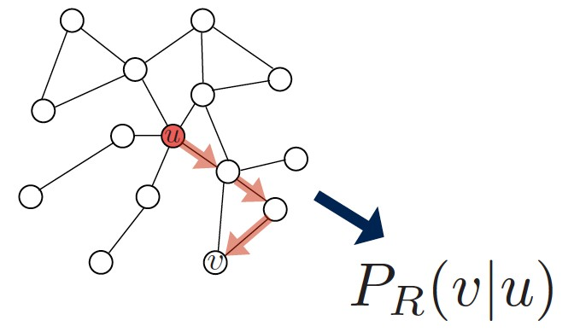
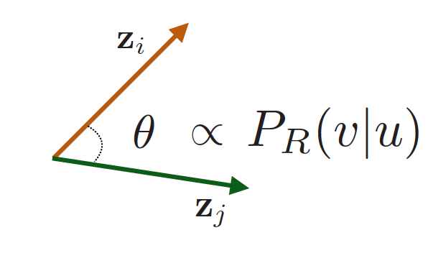
1. Estimate probability of visiting node 𝒗 on a random walk starting from node 𝒖 using some random walk strategy 𝑹
2. Optimize embeddings to encode these random walk statistics:
Similarity in embedding space (Here: dot product=cos(𝜃)) encodes random walk “similarity”

Slide 24

Expressivity: Flexible stochastic definition of node similarity that incorporates both local and higher-order neighborhood information Idea: if random walk starting from node 𝒖 visits 𝒗 with high probability, 𝒖 and 𝒗 are similar (high-order multi-hop information)
Efficiency: Do not need to consider all node pairs when training; only need to consider pairs that co-occur on random walks

Slide 25
Intuition: Find embedding of nodes in
𝑑-dimensional space that preserves similarity
Idea: Learn node embedding such that nearby nodes are close together in the network
Given a node 𝑢, how do we define nearby nodes?
  𝑁. 𝑢 … neighbourhood of 𝑢 obtained by some random walk strategy 𝑅

Slide 26
Given 𝐺 = (𝑉, 𝐸),
Our goal is to learn a mapping 𝑓: 𝑢 → ℝ$:
𝑓 𝑢 = 𝐳%
Log-likelihood objective:
max ' log P(𝑁₂(𝑢)| 𝐳')
/
' ∈1
𝑁%(𝑢) is the neighborhood of node 𝑢 by strategy 𝑅
Given node 𝑢, we want to learn feature representations that are predictive of the nodes in its random walk neighborhood 𝑁&(𝑢)

Slide 27
1. Run short fixed-length random walks starting from each node 𝑢 in the graph using some random walk strategy R
For each node 𝑢 collect 𝑁&(𝑢), the multiset* of nodes visited on random walks starting from 𝑢
Optimize embeddings according to: Given node 𝑢, predict its neighbors 𝑁'(𝑢)
max F log P(𝑁'(𝑢)| 𝐳$)
Maximum likelihood objective
(
$ ∈*
*𝑁!(𝑢) can have repeat elements since nodes can be visited multiple times on random walks

Slide 28
Equivalently,
ℒ = ( (
−log(𝑃(𝑣|𝐳₁))
1∈3 4∈5'(1)
Intuition: Optimize embeddings 𝑧$ to maximize the likelihood of random walk co-occurrences
Parameterize 𝑃(𝑣|𝐳_{𝑢}) using softmax:
Why softmax?
exp(𝐳⁺𝐳 )
$ "
We want node 𝑣 to be most similar to node 𝑢 (out of all nodes 𝑛).
Intuition: ∑" exp 𝑥" ≈
𝑃 𝑣 𝐳$ =
∑
exp(𝐳⁺𝐳 )
,∈*
$ ,
max exp(𝑥")
"

Slide 29
Putting it all together:
#
!∈#
#
$∈%₃(!)
exp(𝐳⁽𝐳 )
ℒ =
− log(
! $
)
∑
exp(𝐳⁽𝐳₎)
)∈#
!
sum over all nodes 𝑢
sum over nodes 𝑣 seen on random walks starting from 𝑢
predicted probability of 𝑢 and 𝑣 co-occuring on random walk
Optimizing random walk embeddings = Finding embeddings 𝐳_{𝒖} that minimize L
29

Slide 30
But doing this naively is too expensive!
ℒ = # #
!∈# $∈%₃(!)
exp(𝐳⁽𝐳 )
−log( ! $ )
∑
exp(𝐳⁽𝐳 )
)∈#
! )
Nested sum over nodes gives
O(|V|²) complexity!
39

Slide 31
But doing this naively is too expensive!
ℒ = # #
!∈# $∈%₃(!)
exp(𝐳⁽𝐳 )
−log( ! $ )
∑
exp(𝐳⁽𝐳₎)
)∈#
!
The normalization term from the softmax is the culprit… can we approximate it?

Slide 32

Solution: Negative sampling
Why is the approximation valid? Technically, this is a different objective. But Negative Sampling is a form of Noise Contrastive Estimation (NCE) which approx. maximizes the log probability of softmax.
New formulation corresponds to using a logistic regression (sigmoid func.) to distinguish the target node 𝑣 from nodes 𝑛! sampled from background distribution 𝑃".
More at https://arxiv.org/pdf/1402.3722.pdf
4
exp 𝐳'𝐳₍
log( ∑
)
4
_{9∈1} exp 𝐳'𝐳₉
_{− ∑}8
≈ log 𝜎 𝐳⁴𝐳
log 𝜎 𝐳⁴𝐳
, 𝑛 ~𝑃
' (
567
' 9!
5 1
sigmoid function
(makes each term a “probability”
random distribution over nodes
between 0 and 1)
Instead of normalizing w.r.t. all nodes, just normalize against 𝑘 random “negative samples” 𝑛.

Slide 33
exp 𝐳⁴𝐳
random distribution over nodes
log(
' (
)
∑
exp 𝐳⁴𝐳
9∈1
' 9
8
≈ log 𝜎 𝐳⁴𝐳 − '
log 𝜎 𝐳⁴𝐳
, 𝑛₅~𝑃₁
' (
' 9!
567
Sample 𝑘 negative nodes each with prob. proportional to its degree
Two considerations for 𝑘 (# negative samples):
  Higher 𝑘 gives more robust estimates
  Higher 𝑘 corresponds to higher bias on negative events In practice 𝑘 =5-20

Slide 34
After we obtained the objective function, how do we optimize (minimize) it?
ℒ = * *
8∈: ;∈<$(8)
−log(𝑃(𝑣|𝐳₈))
Gradient Descent: a simple way to minimize ℒ :
  Initialize 𝑧$ at some randomized value for all 𝑖.
  Iterate until convergence.
For all 𝑖, compute the derivative ^{$ℒ}.
𝜂: learning rate
$&$
For all 𝑖, make a step towards the direction of derivative:𝑧' ← 𝑧' − 𝜂 ^{$ℒ}.
$&$

Slide 35
Stochastic Gradient Descent: Instead of evaluating gradients over all examples, evaluate it for each individual training example.
Initialize 𝑧" at some randomized value for all 𝑖.
Iterate until convergence:
_{ℒ}(#) ₌
A −log(𝑃(𝑣|𝐳#))
!∈+%(#)
_{&ℒ}(")
Sample a node 𝑖, for all 𝑗 calculate the derivative _{&(#} .
&ℒ
(")
For all 𝑗, update:𝑧₎ ← 𝑧₎ − 𝜂
.
&(#

Slide 36
1. Run short fixed-length random walks starting from each node on the graph
For each node 𝑢 collect 𝑁&(𝑢), the multiset of nodes visited on random walks starting from 𝑢
Optimize embeddings using Stochastic Gradient Descent:
ℒ = 1 1
%∈6 7∈8&(%)
−log(𝑃(𝑣|𝐳%))
We can efficiently approximate this using negative sampling!

Slide 37
So far we have described how to optimize embeddings given a random walk strategy R
What strategies should we use to run these random walks?
  Simplest idea: Just run fixed-length, unbiased random walks starting from each node (i.e., DeepWalk from Perozzi et al., 2013)
    The issue is that such notion of similarity is too constrained
How can we generalize this?
Reference: Perozzi et al. 2014. DeepWalk: Online Learning of Social Representations. KDD.

Slide 38
Goal: Embed nodes with similar network neighborhoods close in the feature space.
We frame this goal as a maximum likelihood optimization problem, independent to the downstream prediction task.
Key observation: Flexible notion of network neighborhood 𝑁₉(𝑢) of node 𝑢 leads to rich node embeddings
Develop biased 2nd order random walk 𝑅 to generate network neighborhood 𝑁₉(𝑢) of node 𝑢
Reference: Grover et al. 2016. node2vec: Scalable Feature Learning for Networks. KDD.

Slide 39

















Idea: use flexible, biased random walks that can trade off between local and global views of the network (Grover and Leskovec, 2016).
s₁
s₂
s₈
s
BFS DFS
7
u
s₆
s₄
s₉
s
s₅
3

Slide 40
Two classic strategies to define a neighborhood
𝑵_{𝑹} 𝒖 of a given node 𝒖:
s₁
s₂
s₈
s
BFS DFS
7
u
s₆
s₄
s₉
s
s₅
3
Walk of length 3 (𝑁& 𝑢 of size 3):
^{𝑁}012 ^{𝑢}
^{𝑁}612 ^{𝑢}
= { 𝑠₃, 𝑠₄, 𝑠₅}
= { 𝑠₇, 𝑠₈, 𝑠₉}
Local microscopic view Global macroscopic view
40

Slide 41
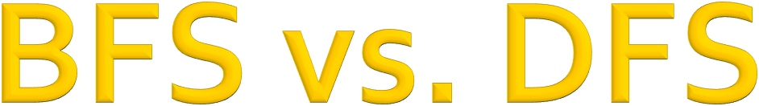
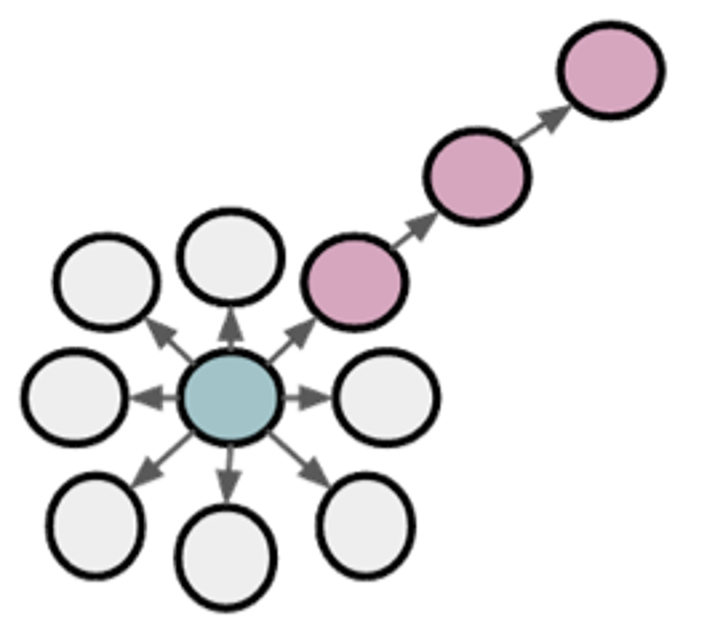
u
BFS:
Micro-view of neighbourhood
DFS:
Macro-view of neighbourhood

Slide 42
Biased fixed-length random walk 𝑹 that given a node 𝒖 generates neighborhood 𝑵_{𝑹} 𝒖
Two parameters:
Return parameter 𝒑:
  Return back to the previous node
In-out parameter 𝒒:
  Moving outwards (DFS) vs. inwards (BFS)
  Intuitively, 𝑞 is the “ratio” of BFS vs. DFS

Slide 43
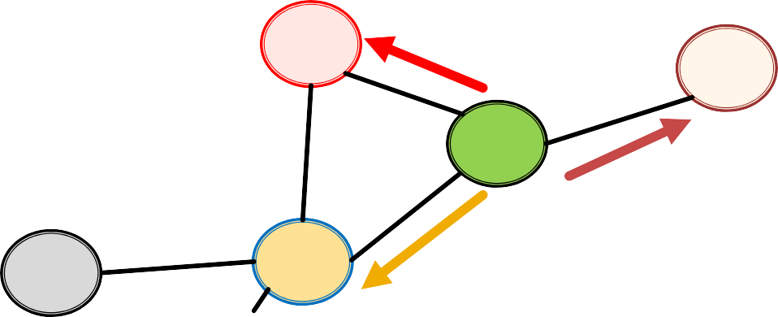
Biased 2nd-order random walks explore network neighborhoods:
Rnd. walk just traversed edge (𝑠₇, 𝑤) and is now at 𝑤
Insight: Neighbors of 𝑤 can only be:
Same distance to 𝒔_{𝟏}
s₂
s₃
Farther from 𝒔_{𝟏}
w
u
s₁
Back to 𝒔_{𝟏}
Idea: Remember where the walk came from

Slide 44
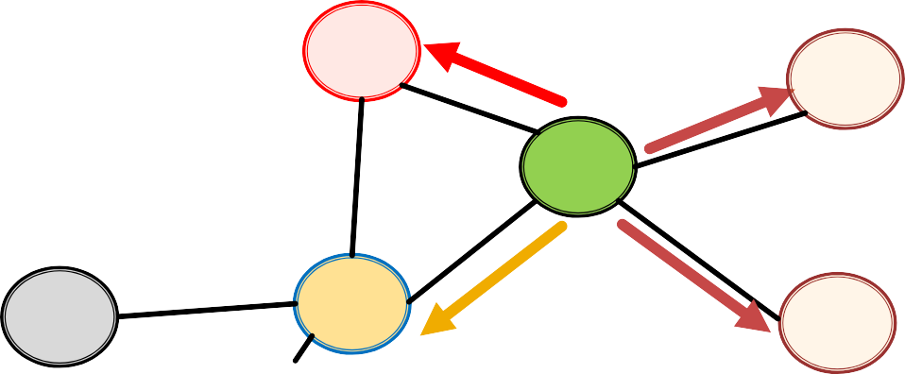
Walker came over edge (𝐬_{𝟏}, 𝐰) and is at 𝐰.
Where to go next?
s₂
1
1/𝑞
s
1/𝑝, 1/𝑞, 1 are unnormalized probabilities
3
w
1/𝑞
u
s₁
1/𝑝
s
4
𝑝, 𝑞 model transition probabilities
  𝑝 … return parameter
  𝑞 … ”walk away” parameter

Slide 45
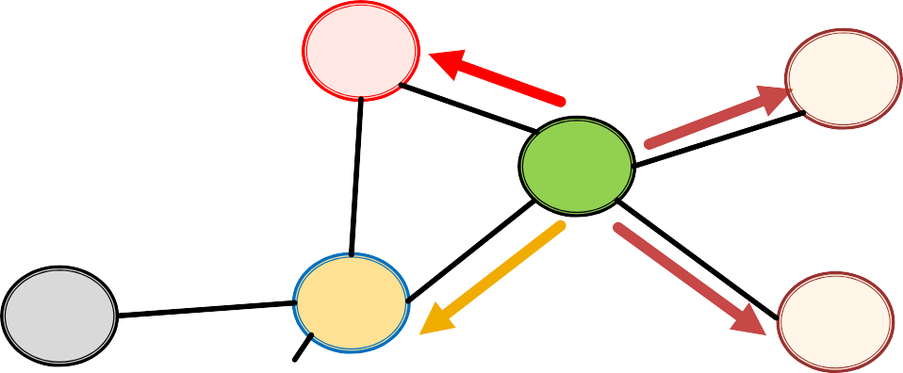
Walker came over edge (𝐬_{𝟏}, 𝐰) and is at 𝐰.
Where to go next?
Target 𝒕 Prob. Dist. (𝒔_{𝟏}, 𝒕)
0
1
2
2
s₂
1
1/𝑞 s
s₁ s₂ s₃ s₄
1/𝑝
1
1/𝑞
1/𝑞
3
w
w →
1/𝑞
u
s₁
1/𝑝
s
4
BFS-like walk: Low value of 𝑝
DFS-like walk: Low value of 𝑞
Unnormalized transition prob. segmented based on distance from 𝑠!
𝑁&(𝑢) are the nodes visited by the biased walk

Slide 46

1) Compute random walk probabilities
2) Simulate 𝑟 random walks of length 𝑙 starting from each node 𝑢
3) Optimize the node2vec objective using
Stochastic Gradient Descent
Linear-time complexity
All 3 steps are individually parallelizable

Slide 47
Different kinds of biased random walks:
Based on node attributes (Dong et al., 2017).
Based on learned weights (Abu-El-Haija et al., 2017)
Alternative optimization schemes:
  Directly optimize based on 1-hop and 2-hop random walk probabilities (as in LINE from Tang et al. 2015).
Network preprocessing techniques:
  Run random walks on modified versions of the original network (e.g., Ribeiro et al. 2017’s struct2vec, Chen et al. 2016’s HARP).

Slide 48

Core idea: Embed nodes so that distances in embedding space reflect node similarities in the original network.
Different notions of node similarity:
Naïve: similar if 2 nodes are connected
Neighborhood overlap (covered in Lecture 2)
Random walk approaches (covered today)

Slide 49
So what method should I use..?
No one method wins in all cases….
E.g., node2vec performs better on node classification while alternative methods perform better on link prediction (Goyal and Ferrara, 2017 survey)
Random walk approaches are generally more efficient
In general: Must choose definition of node similarity that matches your application!

Slide 50

CS224W: Machine Learning with Graphs Jure Leskovec, Stanford University
http://cs224w.stanford.edu

Slide 51
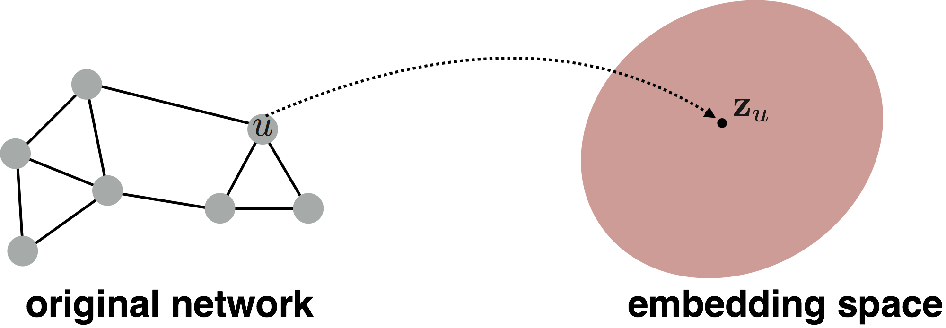
Goal: Want to embed a subgraph or an entire graph 𝐺. Graph embedding: 𝐳_{𝑮}.
𝒛"
Tasks:
  Classifying toxic vs. non-toxic molecules
  Identifying anomalous graphs

Slide 52

Simple idea 1:
Run a standard graph embedding technique on the (sub)graph 𝐺
Then just sum (or average) the node embeddings in the (sub)graph 𝐺
𝒛_{𝑮} = # 𝑧#
#∈%
Used by Duvenaud et al., 2016 to classify molecules based on their graph structure

Slide 53

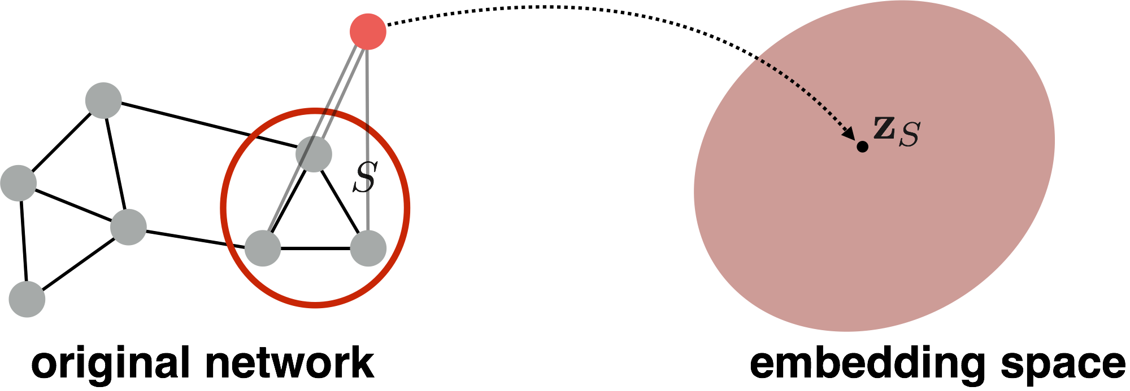
Idea 2: Introduce a “virtual node” to represent the (sub)graph and run a standard graph embedding technique
Proposed by Li et al., 2016 as a general technique for subgraph embedding

Slide 54
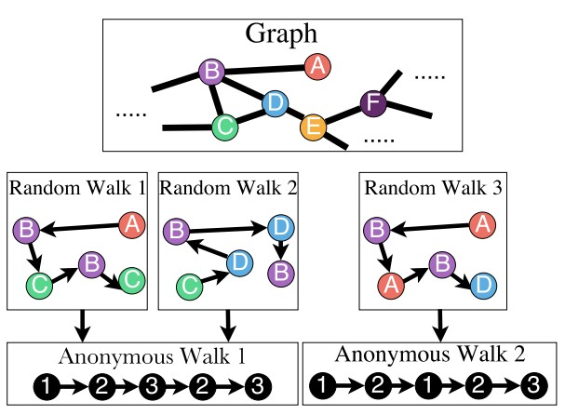
States in anonymous walks correspond to the index of the first time we visited the node in a random walk
Anonymous Walk Embeddings, ICML 2018 https://arxiv.org/pdf/1805.11921.pdf

Slide 55
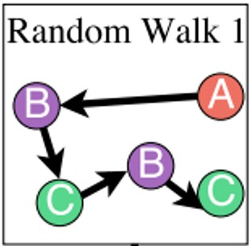
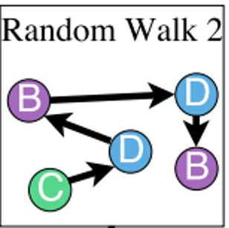
Agnostic to the identity of the nodes visited (hence anonymous)
Example RW1:
Step 1: node A
Step 2: node B
Step 3: node C
Step 4: node B
Step 5: node C
node 1
node 2 (different from node 1)
node 3 (different from node 1, 2) node 2 (same as the node in step 2) node 3 (same as the node in step 3)
Note: RW2 gives the same anonymous walk

Slide 56
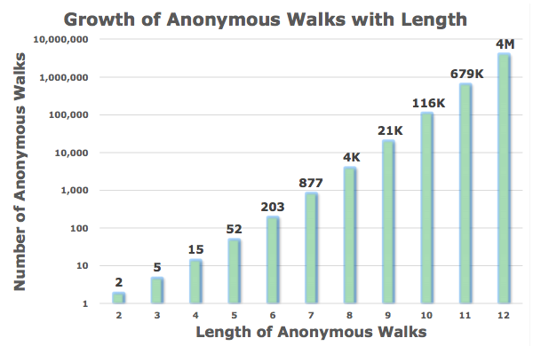
Number of anonymous walks grows exponentially:
There are 5 anon. walks 𝑤" of length 3:
𝑤*=111, 𝑤₊=112, 𝑤,= 121, 𝑤₋= 122, 𝑤.= 123

Slide 57
Simulate anonymous walks 𝑤. of 𝑙 steps and record their counts
Represent the graph as a probability
distribution over these walks
For example:
  Set 𝑙 = 3
  Then we can represent the graph as a 5-dim vector
    Since there are 5 anonymous walks 𝑤# of length 3: 111, 112,
121, 122, 123
  𝒁_{𝑮}[𝑖] = probability of anonymous walk 𝑤₅ in 𝐺

Slide 58
Sampling anonymous walks: Generate independently a set of 𝑚 random walks
Represent the graph as a probability distribution over these walks
How many random walks 𝑚 do we need?
  We want the distribution to have error of more than
𝜀 with prob. less than 𝛿:
For example:
There are 𝜂 = 877
anonymous walks of length
𝑙 = 7. If we set
𝜀 = 0.1 and 𝛿 = 0.01 then we need to generate
𝑚=122,500 random walks
𝑚 = ² (log 2^{I} − 2 − log 𝛿 )
_{𝜀}H
where: 𝜂 is the total number of anon. walks of length 𝑙.

Slide 59
Rather than simply represent each walk by the fraction of times it occurs, we learn embedding
𝒛_{𝒊} of anonymous walk 𝒘_{𝒊}
Learn a graph embedding 𝒁_{𝑮} together with all the anonymous walk embeddings 𝒛_{𝒊}
𝑍 = {𝑧.: 𝑖 = 1 … 𝜂}, where 𝜂 is the number of
sampled anonymous walks.
How to embed walks?
Idea: Embed walks s.t. the next walk can be predicted
59

Slide 60
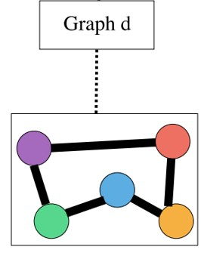
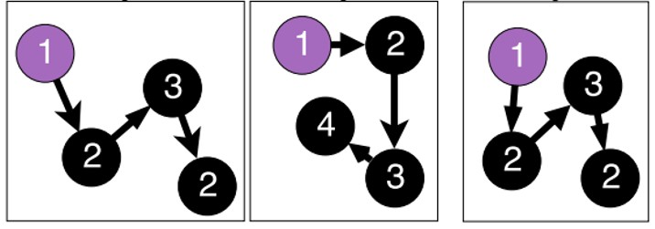
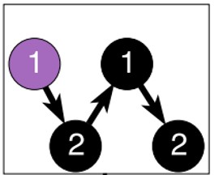
A vector parameter 𝒛_{𝑮} for input graph
The embedding of entire graph to be learned
Starting from node 1: Sample anonymous
random walks, e.g.
𝑤& 𝑤' 𝑤₍ 𝑤₎
Learn to predict walks that co-occur in 𝚫-size window (e.g. predict 𝑤; given 𝑤<, 𝑤₌ if Δ = 1)
Objective: ₂₃₁
max ? log 𝑃(𝑤/|𝑤_{/31}, … , 𝑤_{/41}, 𝒛_{𝑮})
Sum the objective over all nodes in the graph
/01
69

Slide 61
Run 𝑻 different random walks from 𝒖 each of length 𝒍:
𝑁. 𝑢 = 𝑤', 𝑤' … 𝑤'
7 H J
Learn to predict walks that co-occur in 𝚫-size window
Estimate embedding 𝑧₅ of anonymous walk 𝑤₅
Let 𝜂 be number of all possible walk embeddings
JPO
Objective:
max ¹ : log 𝑃 𝑤 {𝑤
, … , 𝑤_{NQO}, 𝒛_{𝑮} )
𝑇
N NPO
K,M
N6O
All possible walks
(require negative sampling)
𝑃 𝑤, {𝑤_{,-.}, … , 𝑤,/., 𝒛_{𝑮} ) = _{∑)}
123(4 5& )
123(4(5 ))
$'(
$
𝑦 𝑤,
= 𝑏 + 𝑈 ⋅ 𝑐𝑎𝑡( ⁷ ∑. _{-.} 𝑧' , 𝒛_{𝑮})
8.
'9
𝑐𝑎𝑡( * ∑,
-./,
𝑧₋ , 𝒛_{𝑮}) means an average of anonymous walk embeddings in window,
+,
concatenated with the graph embedding 𝒛
𝑮
𝑏 ∈ ℝ, 𝑈 ∈ ℝ¹ are learnable parameters. This represents a linear layer.
Anonymous Walk Embeddings, ICML 2018 https://arxiv.org/pdf/1805.11921.pdf

Slide 62
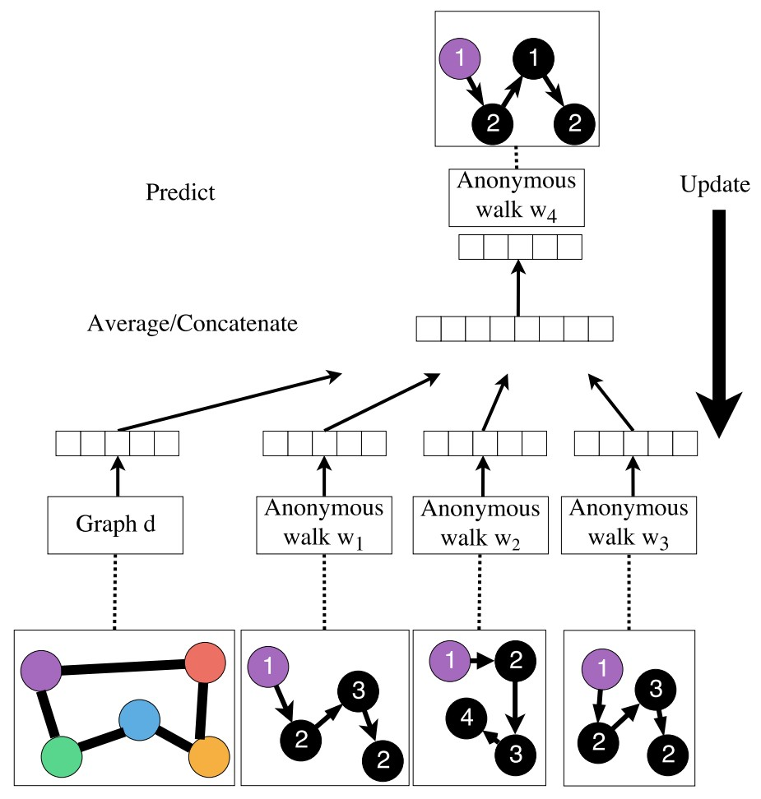
We obtain the graph embedding 𝒛_{𝑮} (learnable parameter) after optimization
Use 𝒛_{𝑮}to make predictions (e.g. graph classification)
Overall Architecture
Option1: Inner product
Kernel 𝒛² 𝒛_{𝑮} (Lecture 2)
𝑮_{𝟏}
𝟐
Option2: Use a neural network that takes 𝒛_{𝑮} as input to classify

Slide 63

We discussed 3 ideas to graph embeddings
Approach 1: Embed nodes and sum/avg them
Approach 2: Create super-node that spans the (sub) graph and then embed that node
Approach 3: Anonymous Walk Embeddings
  Idea 1: Sample the anon. walks and represent the graph as fraction of times each anon walk occurs
  Idea 2: Embed anonymous walks, concatenate their embeddings to get a graph embedding

Slide 64
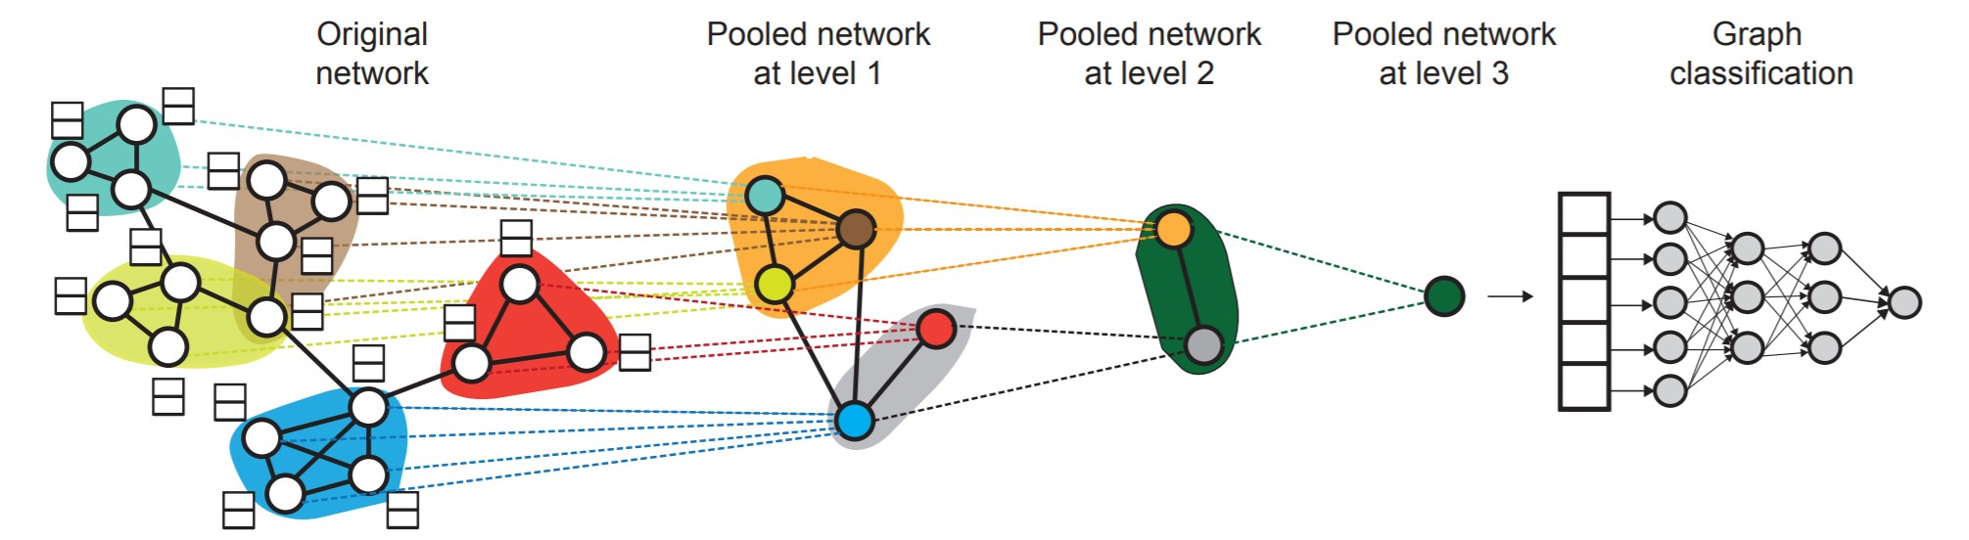
We will discuss more advanced ways to obtain graph embeddings in Lecture 8.
We can hierarchically cluster nodes in graphs, and sum/avg the node embeddings according
to these clusters.

Slide 65
How to use embeddings 𝒛_{𝒊} of nodes:
Clustering/community detection: Cluster points 𝒛_{𝒊}
Node classification: Predict label of node 𝑖 based on 𝒛_{𝒊}
Link prediction: Predict edge (𝑖, 𝑗) based on (𝒛_{𝒊}, 𝒛_{𝒋})
  Where we can: concatenate, avg, product, or take a difference between the embeddings:
    Concatenate: 𝑓(𝑧₂, 𝑧₃)= 𝑔([𝑧₂, 𝑧₃])
    Hadamard: 𝑓(𝑧₂, 𝑧₃)= 𝑔(𝑧₂ ∗ 𝑧₃) (per coordinate product)
    Sum/Avg: 𝑓(𝑧₂, 𝑧₃)= 𝑔(𝑧₂ + 𝑧₃)
    Distance: 𝑓(𝑧₂, 𝑧₃)= 𝑔(||𝑧₂ − 𝑧₃||₄)
Graph classification: graph embedding 𝒛_{𝑮} via aggregating node embeddings or anonymous random walks.
Predict label based on graph embedding 𝑧_{D}

Slide 66

We discussed graph representation learning, a way to learn node and graph embeddings for downstream tasks, without feature engineering.
Encoder-decoder framework:
  Encoder: embedding lookup
  Decoder: predict score based on embedding to match node similarity
Node similarity measure: (biased) random walk
  Examples: DeepWalk, Node2Vec
Extension to Graph embedding: Node embedding aggregation and Anonymous Walk Embeddings

