Slide 1



CS224W: Machine Learning with Graphs Jure Leskovec, Stanford University
http://cs224w.stanford.edu

Slide 2





In this lecture, we investigate graph analysis and learning from a matrix perspective.
Treating a graph as a matrix allows us to:
Determine node importance via random walk (PageRank)
Obtain node embeddings via matrix factorization (MF)
View other node embeddings (e.g. Node2Vec) as MF
Random walk, matrix factorization and node embeddings are closely related!
4
⎛ 0 1 0 1⎞
÷
0 0 1÷
0 0 ÷÷
1 1 0
⎜
3
A = ^{⎜ 1}
⎜ ₀
₁÷
2
⎜_{⎜ 1}
1
⎝
⎠
2/14/21
Jure Leskovec, Stanford CS224W: Machine Learning with Graphs, http://cs224w.stanford.edu
2

Slide 3

CS224W: Machine Learning with Graphs Jure Leskovec, Stanford University
http://cs224w.stanford.edu

Slide 4
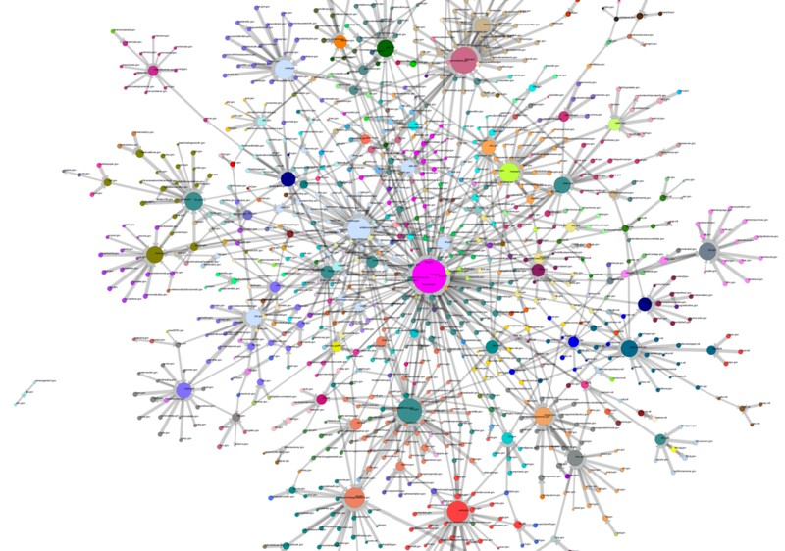
Q: What does the Web “look like” at a global level?
Web as a graph:
Nodes = web pages
Edges = hyperlinks
Side issue: What is a node?
  Dynamic pages created on the fly
  “dark matter” – inaccessible database generated pages
4

Slide 5









4

Slide 6

Networks.
Gates
Stanford
In early days of the Web links were navigational
Today many links are transactional (used not to navigate from page to page, but to post, comment, like, buy, …)
4

Slide 7
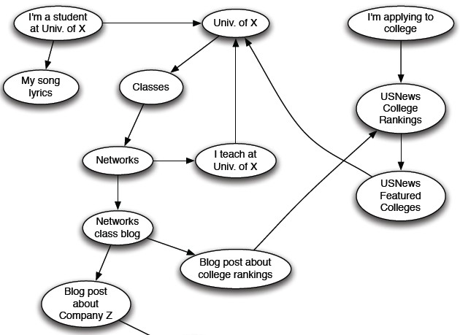
4

Slide 8
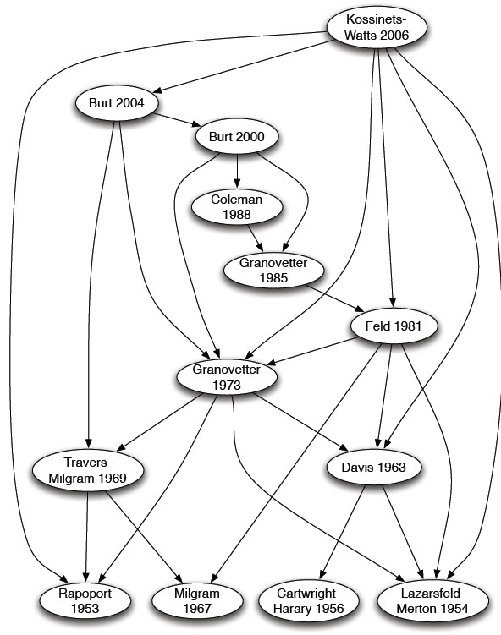
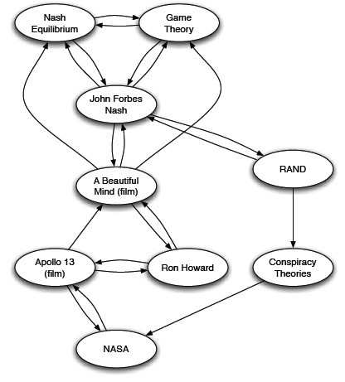
Citations
References in an Encyclopedia
4

Slide 9
How is the Web linked?
What is the “map” of the Web?
Web as a directed graph [Broder et al. 2000]:
Given node v, what nodes can v reach?
What other nodes can reach v?
E
B
F
A
D
C
G
4

Slide 10
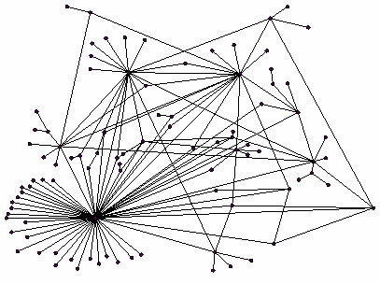
All web pages are not equally “important”
thispersondoesnotexist.com vs. www.stanford.edu
There is large diversity in the web-graph node connectivity.
So, let’s rank the pages
using the web graph link structure!
10

Slide 11
We will cover the following Link Analysis approaches to compute the importance of nodes in a graph:
PageRank
Personalized PageRank (PPR)
Random Walk with Restarts

Slide 12

Idea: Links as votes
Page is more important if it has more links
  In-coming links? Out-going links?
Think of in-links as votes:
  www.stanford.edu has 23,400 in-links
  thispersondoesnotexist.com has 1 in-link
Are all in-links equal?
  Links from important pages count more
  Recursive question!

Slide 13





























A “vote” from an important page is worth more:
i
k
r_{k} / 4
Each link’s vote is proportional to the importance of its source page
If page i with importance r_{i} has d_{i} out-links, each link gets r_{i} / d_{i} votes
Page j’s own importance r_{j} is the sum of the votes on its in- links
r_{i} / 3
j
r_{j} / 3
r_{j} / 3
r_{j} / 3
r_{j} = r_{i}/3 + r_{k}/4

Slide 14
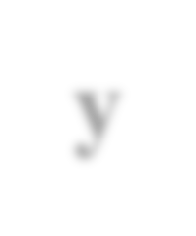

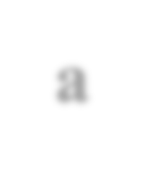



A page is important if it is pointed to by other important pages
Define “rank” r_{j} for node j
The web in 1839
r_{y}/2
y
r_{a}/2
𝑟"
r_{y}/2
𝑟 = #
"→!
r_{m}
!
𝑑
a
m
"
r_{a}/2
𝒅_{𝒊} … out-degree of node 𝒊
“Flow” equations:
r_{y} = r_{y} /2 + r_{a} /2
r_{a} = r_{y} /2 + r_{m} r_{m} = r_{a} /2
You might wonder: Let’s just use Gaussian elimination to solve this system of linear equations. Bad idea!

Slide 15
j
Stochastic adjacency matrix 𝑴
  Let page 𝒋 have 𝒅_{𝒋} out-links
i
₌ 𝟏
If 𝒋 → 𝒊, then 𝑴
𝒊𝒋
𝒅_{𝒋}
𝑴 is a column stochastic matrix
  Columns sum to 1
1/3
Rank vector 𝒓: An entry per page
  𝒓_{𝒊} is the importance score of page 𝒊
M
∑_{𝒊} 𝒓_{𝒊} = 𝟏
The flow equations can be written
𝒓 = 𝑴 ⋅ 𝒓
𝑟
𝑟! = # "
𝑑"
"→!

Slide 16




r_{y} r_{a} r_{m}
y
r_{y} r_{a} r_{m}
½ | ½ | 0
½ | 0 | 1
0 | ½ | 0
a
m
r_{y} = r_{y} /2 + r_{a} /2 r_{a} = r_{y} /2 + r_{m} r_{m} = r_{a} /2
r_{y} |  | ½ | ½ | 0 |  | r_{y}
r_{a} | = | ½ | 0 | 1 |  | r_{a}
r_{m} |  | 0 | ½ | 0 |  | r_{m}
𝒓 |  |  | 𝑴 |  |  | 𝒓
2/14/21
Jure Leskovec, Stanford C246: Mining Massive Datasets
16

Slide 17
Imagine a random web surfer:
  At any time 𝒕, surfer is on some page 𝑖
  At time 𝒕 + 𝟏, the surfer follows an out-link from 𝒊 uniformly at random
  Ends up on some page 𝒋 linked from 𝒊
  Process repeats indefinitely
Let:
i₁
i₂
i₃
j
r = ∑
r_{i}
j
d (i)
i→ j
out
𝒑(𝒕) … vector whose 𝑖^{th} coordinate is the prob. that the surfer is at page 𝑖 at time 𝑡
So, 𝒑(𝒕) is a probability distribution over pages

Slide 18
Where is the surfer at time t+1?
  Follow a link uniformly at random
𝒑 𝒕 + 𝟏 = 𝑴 ⋅ 𝒑(𝒕)
i₁
i₂
i₃
j
p(t +1) = M × p(t)
Suppose the random walk reaches a state
𝒑 𝒕 + 𝟏 = 𝑴 ⋅ 𝒑(𝒕) = 𝒑(𝒕)
then 𝒑(𝑡) is stationary distribution of a random walk
Our original rank vector 𝒓 satisfies 𝒓 = 𝑴 ⋅ 𝒓
  So, 𝒓 is a stationary distribution for the random walk

Slide 19




Recall from lecture 2 (eigenvector centrality), let
𝑨 ∈ 𝟎, 𝟏 ^{𝒏×𝒏} be an adj. matrix of undir. graph:
4
⎛ 0 1 0 1⎞
÷
0 0 1÷
0 0 ÷÷
1 1 0
⎜
3
A = ^{⎜ 1}
⎜ ₀
₁÷
2
⎜_{⎜ 1}
1
⎝ ⎠
Eigenvector of adjacency matrix: vectors satisfying 𝜆𝒄 = 𝑨𝒄
𝒄: eigenvector; 𝜆: eigenvalue
Note:
  This is the definition of eigenvector centrality (for undirected graphs).
  PageRank is defined for directed graphs

Slide 20
1 " 𝒓 = 𝑴 " 𝒓
The flow equation:
r_{y} |  | ½ | ½ | 0 |  | r_{y}
r_{a} | = | ½ | 0 | 1 |  | r_{a}
r_{m} |  | 0 | ½ | 0 |  | r_{m}
𝒓
𝑴
𝒓
So the rank vector 𝒓 is an eigenvector of the stochastic ajd. matrix 𝑴 (with eigenvalue 1)
  Starting from any vector 𝒖, the limit 𝑴(𝑴(… 𝑴(𝑴 𝒖)))
is the long-term distribution of the surfers.
    PageRank = Limiting distribution = principal eigenvector of 𝑀
    Note: If 𝒓 is the limit of the product 𝑴𝑴 … 𝑴𝒖, then 𝒓 satisfies the flow equation 1 ' 𝒓 = 𝑴𝒓
    So 𝒓 is the principal eigenvector of 𝑴 with eigenvalue 1
We can now efficiently solve for r!
  The method is called Power iteration
2/14/21
Jure Leskovec, Stanford C246: Mining Massive Datasets
20

Slide 21

PageRank:
Measures importance of nodes in a graph using the link structure of the web
Models a random web surfer using the stochastic adjacency matrix 𝑴
PageRank solves 𝒓 = 𝑴𝒓 where 𝒓 can be viewed as both the principle eigenvector of 𝑴 and as the stationary distribution of a random walk over the graph
2/14/21
Jure Leskovec, Stanford CS224W: Machine Learning with Graphs, http://cs224w.stanford.edu
21

Slide 22

CS224W: Machine Learning with Graphs Jure Leskovec, Stanford University
http://cs224w.stanford.edu

Slide 23
Given a graph with n nodes, we use an iterative procedure:
Assign each node an initial page rank
Repeat until convergence (∑" 𝑟^{()*} − 𝑟⁽
" "
  Calculate the page rank of each node
< 𝜖)
_{𝑟}(()
(()*)
_{= #} "
𝑟!
𝑑"
"→!
𝒅_{𝒊} …. out-degree of node 𝒊
Jure Leskovec, Stanford CS224W: Machine Learning with Graphs, http://cs224w.stanford.edu
2/14/21
23

Slide 24
Given a web graph with N nodes, where the nodes are pages and edges are hyperlinks
Power iteration: a simple iterative scheme
Initialize: 𝒓" = [1/𝑁, … . , 1/𝑁]^{𝑇}
_{𝑟}(')
Iterate: 𝒓
(𝒕%𝟏) (
_{= $} +
= 𝑴 5 𝒓
𝑟%
('())
𝑑₊
Stop when |𝒓 ^{𝒕%𝟏} – 𝒓⁽| < ε
+→%
1
𝑑_{𝑖} …. out-degree of node 𝑖
#
𝑥 = ∑ |𝑥 | is the L1 norm
" " "
Can use any other vector norm, e.g., Euclidean
About 50 iterations is sufficient to estimate the limiting solution.
2/14/21
Jure Leskovec, Stanford C246: Mining Massive Datasets
24

Slide 25




Power Iteration:
  Set 𝑟₋ ← 1/N
y
a
m
y
y a m
½ | ½ | 0
½ | 0 | 1
0 | ½ | 0
a
m
1: 𝑟′ ← ∑
0!
.→- _{1!}
-
2: If |𝑟 − 𝑟’| > 𝜀:
  𝑟 ← 𝑟′
3: go to 1
Example:
𝒓_{𝒚}
𝒓_{𝒂}
𝒓_{𝒎}
= 𝒓_{𝒚} /𝟐 + 𝒓_{𝒂} /𝟐
= 𝒓_{𝒚} /𝟐 + 𝒓𝒎
= 𝒓_{𝒂} /𝟐
r_{y}
r_{a} = r_{m}
1/3
1/3
1/3
1/3
3/6
1/6
5/12
1/3
3/12
9/24
11/24
1/6
6/15
… 6/15 3/15
Iteration 0, 1, 2, …
Jure Leskovec, Stanford CS224W: Machine Learning with Graphs, http://cs224w.stanford.edu

Slide 26
Power Iteration:
  Set 𝑟₋ ← 1/N
y
a
m
y
y a m
½ | ½ | 0
½ | 0 | 1
0 | ½ | 0
a
m
1: 𝑟′ ← ∑
0!
.→- _{1!}
-
2: If |𝑟 − 𝑟’| > 𝜀:
  𝑟 ← 𝑟′
3: go to 1
Example:
𝒓_{𝒚} = 𝒓_{𝒚} /𝟐 + 𝒓_{𝒂} /𝟐
𝒓_{𝒂} = 𝒓_{𝒚} /𝟐 + 𝒓𝒎
𝒓_{𝒎} = 𝒓_{𝒂} /𝟐
r_{y} |  | 1/3 | 1/3 | 5/12 | 9/24 |  | 6/15
r_{a} | = | 1/3 | 3/6 | 1/3 | 11/24 | … | 6/15
r_{m} |  | 1/3 | 1/6 | 3/12 | 1/6 |  | 3/15
Iteration 0, 1, 2, …
Jure Leskovec, Stanford CS224W: Machine Learning with Graphs, http://cs224w.stanford.edu

Slide 27
_{𝑟}(()
(()*)
_{= #} "
𝑟
or equivalently
𝑟 = 𝑀𝑟
!
𝑑"
"→!
Does this converge?
Does it converge to what we want?
Are results reasonable?

Slide 28

Two problems:
(1) Some pages are
dead ends (have no out-links)
Such pages cause importance to “leak out”
(2) Spider traps
(all out-links are within the group)
  Eventually spider traps absorb all importance

Slide 29





The “Spider trap” problem:
_{𝑟}(()
((%7)
_{= A} .
a
b
𝑟₋
𝑑.
.→-
Example:
Iteration: 0,
1, 2, 3…
r_{a} r_{b}
1 | 0 | 0 | 0
0 | 1 | 1 | 1
=

Slide 30
The “Dead end” problem:
_{𝑟}(()
((%7)
_{= A} .
a
b
𝑟₋
𝑑.
.→-
Example:
Iteration: 0,
1, 2, 3…
r_{a} r_{b}
1 | 0 | 0 | 0
0 | 1 | 0 | 0
=
30

Slide 31



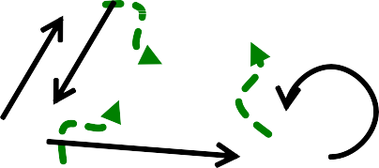



Solution for spider traps: At each time step, the random surfer has two options
With prob. β, follow a link at random
With prob. 1-β, jump to a random page
Common values for β are in the range 0.8 to 0.9
Surfer will teleport out of spider trap within a few time steps
y y
a a
m m

Slide 32




Teleports: Follow random teleport links with total probability 1.0 from dead-ends
  Adjust matrix accordingly
y
y
a
m
a
m
 | y | a | m | y a m
y | ½ | ½ | 0 | y
a | ½ | 0 | 0 | a
m | 0 | ½ | 0 | m
½ | ½ | ⅓
½ | 0 | ⅓
0 | ½ | ⅓

Slide 33
Why are dead-ends and spider traps a problem and why do teleports solve the problem?
Spider-traps are not a problem, but with traps PageRank scores are not what we want
Solution: Never get stuck in a spider trap by teleporting out of it in a finite number of steps
Dead-ends are a problem
  The matrix is not column stochastic so our initial assumptions are not met
  Solution: Make matrix column stochastic by always teleporting when there is nowhere else to go

Slide 34
Google’s solution that does it all:
At each step, random surfer has two options:
With probability β, follow a link at random
With probability 1-β, jump to some random page
PageRank equation [Brin-Page, 98]
𝑟 1
d_{i} … out-degree
of node i
𝑟 = ' 𝛽 " + (1 − 𝛽)
!
𝑑"
𝑁
"→!
This formulation assumes that 𝑴 has no dead ends. We can either preprocess matrix 𝑴 to remove all dead ends or explicitly follow random teleport links with probability 1.0 from dead-ends.

Slide 35

PageRank equation [Brin-Page, ‘98]
𝑟 1
𝑟 = # 𝛽
"
+ (1 − 𝛽)
!
𝑑"
𝑁
"→!
The Google Matrix G:
𝐺 = 𝛽 𝑀 + 1 − 𝛽
[1/N]_{NxN}…N by N matrix where all entries are 1/N
1
^{𝑁} -×-
We have a recursive problem: 𝒓 = 𝑮 ⋅ 𝒓
And the Power method still works!
What is β ?
  In practice β =0.8,0.9 (make 5 steps on avg., jump)

Slide 36






[1/N]_{NxN}
M
7/15
y
1/2 1/2 0
1/2 0 0
1
1/3 1/3 1/3
1/3 1/3 1/3
1/3 1/3 1/3
0.8
+ 0.2
0 1/2
7/15
1/15
7/15
1/15
y | 7/15 | 7/15 | 1/15
a | 7/15 | 1/15 | 1/15
m | 1/15 | 7/15 | 13/15
13/15
a
7/15
m
1/15
1/15
G
y
a = m
1/3 | 0.33 | 0.24 | 0.26 |  | 7/33
1/3 | 0.20 | 0.20 | 0.18 | . . . | 5/33
1/3 | 0.46 | 0.52 | 0.56 |  | 21/33

Slide 37

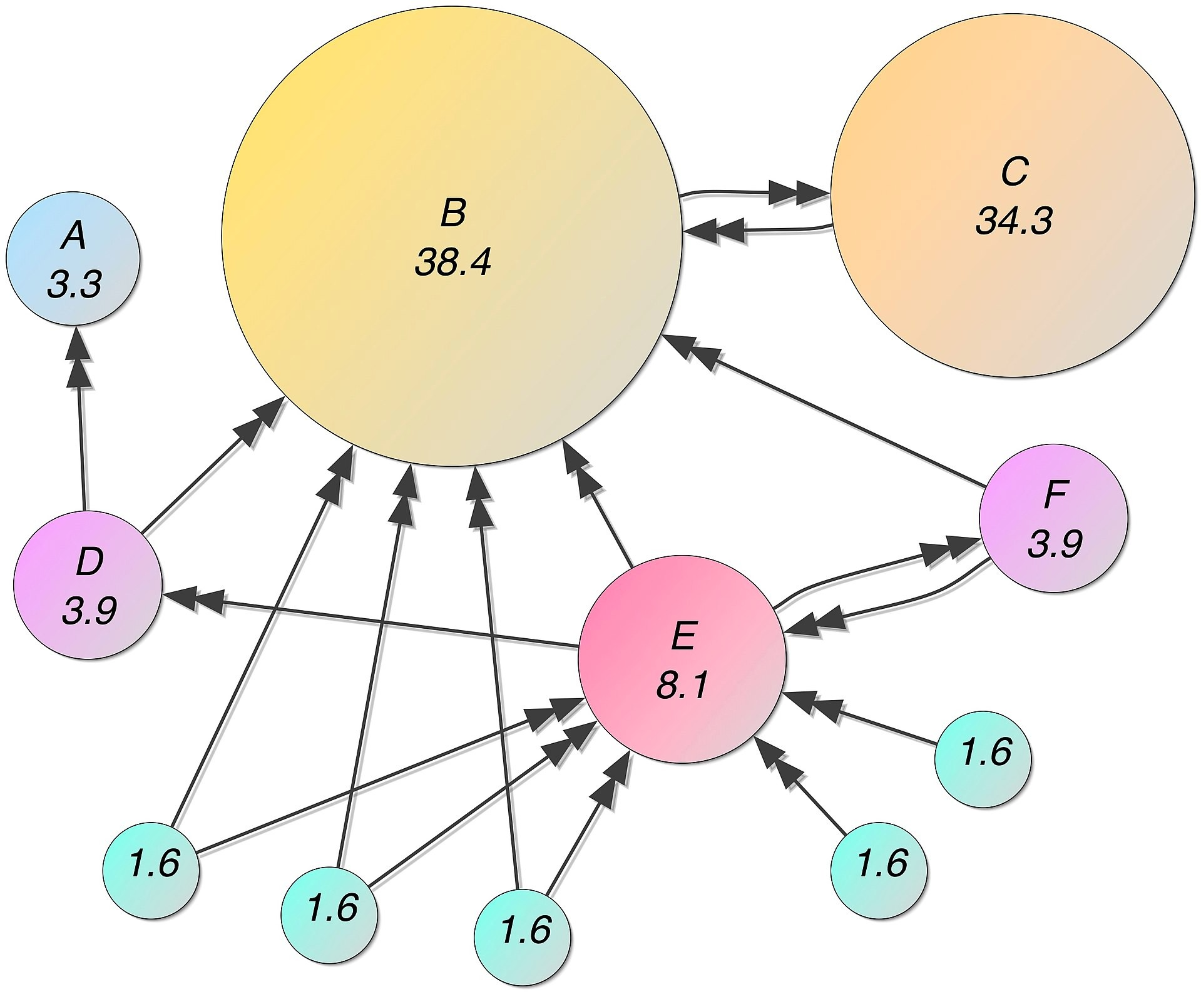
Image credit: Wikipedia

Slide 38
PageRank solves for 𝒓 = 𝑮𝒓 and can be efficiently computed by power iteration of the stochastic adjacency matrix (𝑮)
Adding random uniform teleportation solves issues of dead-ends and spider-traps

Slide 39

CS224W: Machine Learning with Graphs Jure Leskovec, Stanford University
http://cs224w.stanford.edu

Slide 40

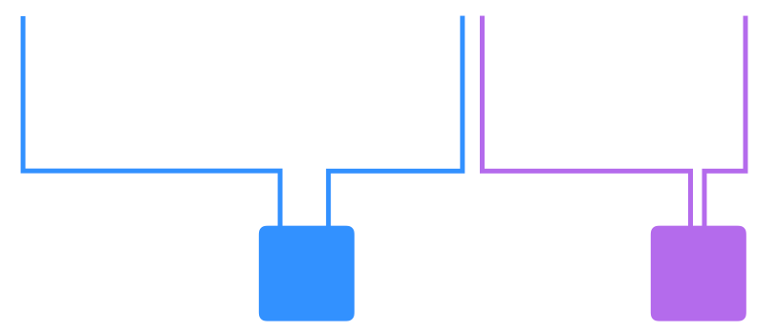
Given:
A bipartite graph representing user and item interactions (e.g. purchase)
Items
…
Users
2/14/21
Jure Leskovec, Stanford CS224W: Machine Learning with Graphs, http://cs224w.stanford.edu
40

Slide 41

Goal: Proximity on graphs
What items should we recommend to a user who interacts with item Q?
Intuition: if items Q and P are interacted by similar users, recommend P when user interacts with Q
Item Q
…
Jure Leskovec, Stanford CS224W: Machine Learning with Graphs, http://cs224w.stanford.edu

Slide 42





Which is more related A,A’ or B,B’?

Slide 43





Which is more related A,A’, B,B’ or C,C’?
Shortest path

Slide 44


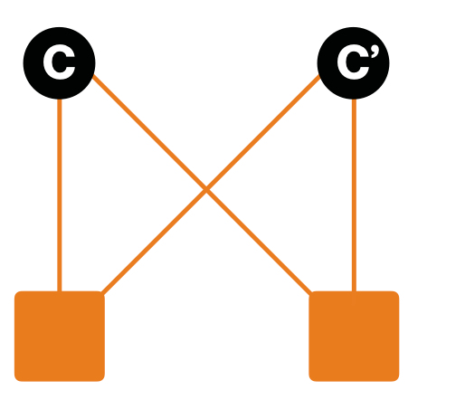



Which is more related A,A’, B,B’ or C,C’?
Shortest path
Common Neighbors

Slide 45





Which is more related A,A’, B,B’ or C,C’?
D
D’
Personalized Page Rank/Random Walk with Restarts

Slide 46

PageRank:
Ranks nodes by “importance”
Teleports with uniform probability to any node in the network
Personalized PageRank:
  Ranks proximity of nodes to the teleport nodes 𝑺
Proximity on graphs:
  Q: What is most related item to Item Q?
  Random Walks with Restarts
    Teleport back to the starting node: 𝑺 = {𝑸}

Slide 47
Idea
Every node has some importance
Importance gets evenly split among all edges and pushed to the neighbors:
Given a set of QUERY_NODES, we simulate a random walk:
  Make a step to a random neighbor and record the visit (visit count)
  With probability ALPHA, restart the walk at one of the QUERY_NODES
  The nodes with the highest visit count have highest proximity to the QUERY_NODES

Slide 48



Idea:
Every node has some importance
Importance gets evenly split among all edges and pushed to the neighbors
Given a set of QUERY NODES Q, simulate a random walk:
Q
Jure Leskovec, Stanford CS224W: Social and Information Network Analysis, http://cs224w.stanford.edu

Slide 49




Proximity to query node(s) Q:
Q
item = QUERY_NODES.sample_by_weight( ) for i in range( N_STEPS ):
user = item.get_random_neighbor( ) item = user.get_random_neighbor( )
item.visit_count += 1 if random( ) < ALPHA:
item = QUERY_NODES.sample.by_weight ( )
Q
Jure Leskovec, Stanford CS224W: Social and Information Network Analysis, http://cs224w.stanford.edu

Slide 50
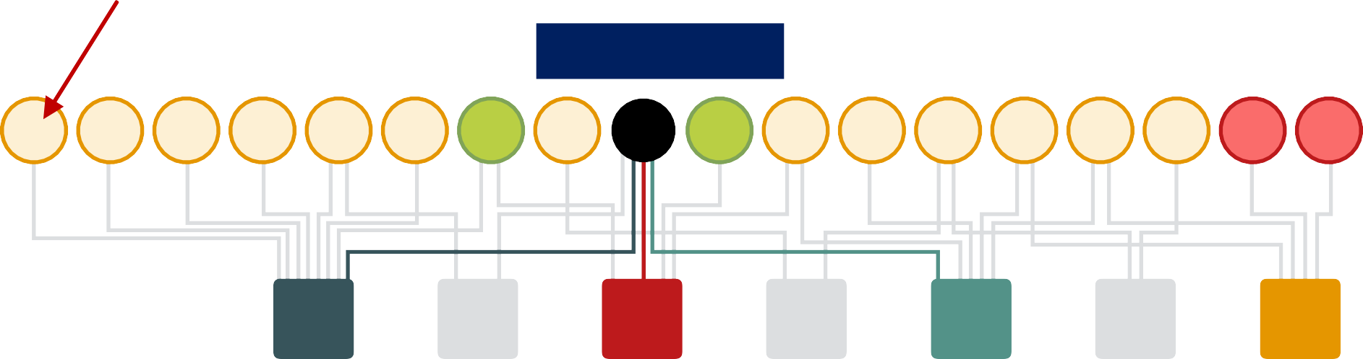
Proximity to query node(s) Q:
item = QUERY_NODES.sample_by_weight( ) for i in range( N_STEPS ):
user = item.get_random_neighbor( ) item = user.get_random_neighbor( )
item.visit_count += 1 if random( ) < ALPHA:
item = QUERY_NODES.sample.by_weight ( )
Query Item Q
5 5 5 5 5 5 14 9 Q 16 7 8 8 8 8 1 1 1
Q
Number of visits by random walks starting at Q
User 1
User 2
User 3
Yummm
Strawberries
Smoothies
Smoothie Madness!•!
User 4
Jure Leskovec, Stanford CS224W: Social and Information Network Analysis, http://cs224w.stanford.edu
50

Slide 51







Why is this a good solution?
Because the “similarity” considers:
Multiple connections
Multiple paths
Direct and indirect connections
Degree of the node
2/14/21
Jure Leskovec, Stanford CS224W: Machine Learning with Graphs, http://cs224w.stanford.edu
51

Slide 52
PageRank:
Teleports to any node
Nodes can have the same probability of the surfer landing:
𝑺 = [0.1, 0.1, 0.1, 0.1, 0.1, 0.1, 0.1, 0.1, 0.1, 0.1]
Topic-Specific PageRank aka Personalized PageRank:
  Teleports to a specific set of nodes
  Nodes can have different probabilities of the surfer landing there:
𝑺 = [0.1, 0, 0, 0.2, 0, 0, 0.5, 0, 0, 0.2]
Random Walk with Restarts:
  Topic-Specific PageRank where teleport is always to the same node:
𝑺 = [0, 0, 0, 0, 𝟏, 0, 0, 0, 0, 0, 0]
2/14/21
Jure Leskovec, Stanford C246: Mining Massive Datasets
52

Slide 53

A graph is naturally represented as a matrix
We defined a random walk process over the graph
Random surfer moving across the links and with random teleportation
Stochastic adjacency matrix M
PageRank = Limiting distribution of the surfer location represented node importance
  Corresponds to the leading eigenvector of transformed adjacency matrix M.
2/14/21
Jure Leskovec, Stanford CS224W: Machine Learning with Graphs, http://cs224w.stanford.edu
53

Slide 54

CS224W: Machine Learning with Graphs Jure Leskovec, Stanford University
http://cs224w.stanford.edu

Slide 55
Recall: encoder as an embedding lookup
embedding vector for a
embedding matrix
specific node
𝐙 =
Dimension/size of embeddings
one column per node
Objective: maximize 𝐳.𝐳
for node pairs (𝑢, 𝑣) that are similar
- /

Slide 56




Simplest node similarity: Nodes 𝑢, 𝑣 are similar if they are connected by an edge
This means: 𝐳/𝐳 = 𝐴
. 0 0,.
which is the (𝑢, 𝑣) entry of the graph adjacency matrix 𝐴
Therefore, 𝒁²𝒁 = 𝐴
_{𝒁}0
𝒁
4
⎛ 0 1 0 1⎞
⎜ ÷
1 0 0 1
0 0 ÷÷
1 1 0
3
÷
×
A = ⎜
⎜ ₀
₁÷
2
⎜_{⎜ 1}
1
⎝
⎠
𝐳/
𝐳₋

Slide 57
The embedding dimension 𝑑 (number of rows in 𝒁) is much smaller than number of nodes 𝑛.
Exact factorization 𝐴 = 𝑍⁾𝑍 is generally not possible
However, we can learn 𝒁 approximately
Objective:min ∥ A − 𝒁⁾𝒁 ∥₊
*
We optimize 𝒁 such that it minimizes the L2 norm (Frobenius norm) of A − 𝒁%𝒁
Note in lecture 3 we used softmax instead of L2. But the goal to approximate A with 𝒁%𝒁 is the same.
Conclusion: inner product decoder with node similarity defined by edge connectivity is equivalent to matrix factorization of 𝑨

Slide 58
DeepWalk and node2vec have a more complex node similarity definition based on random walks
DeepWalk is equivalent to matrix
factorization of the following complex matrix expression:
1
0
_{𝐷}3)
𝑙𝑜𝑔 𝑣𝑜𝑙(𝐺) _{𝑇} $
(𝐷³⁾𝐴)¹
− log 𝑏
12)
Explanation in next slide
Network Embedding as Matrix Factorization: Unifying DeepWalk, LINE, PTE, and node2vec, WSDM 18

Slide 59
Volume of graph
𝑣𝑜𝑙 𝐺 = A A 𝐴_{(,)}
( )
Diagonal matrix 𝐷
𝐷&,& = deg(𝑢)
_{1 A}'
log 𝑣𝑜𝑙(𝐺)
(𝐷^{("}𝐴)%
_{𝐷}("
− log 𝑏
𝑇
%&"
context window size
See Lec 3 slide 30:
𝑇 = |𝑁% 𝑢 |
Number of negative samples
Power of normalized adjacency matrix
Node2vec can also be formulated as a matrix factorization (albeit a more complex matrix)
Refer to the paper for more detailed proofs.
Network Embedding as Matrix Factorization: Unifying DeepWalk, LINE, PTE, and node2vec, WSDM 18

Slide 60






Limitations of node embeddings via matrix factorization and random walks
Cannot obtain embeddings for nodes not in the training set
4
3
2
1
5
A newly added node 5 at test time (e.g. new user in a social network)
Training set
Cannot compute its embedding with DeepWalk / node2vec. Need to recompute all node embeddings.
60

Slide 61










Cannot capture structural similarity:
3 13
4 5 10
2 12
1
11
Node 1 and 11 are structurally similar – part of one triangle, degree 2
However, they have very different embeddings
  It’s unlikely that a random walk will reach node 11 from node 1
DeepWalk and node2vec do not capture structural similarity

Slide 62





Cannot utilize node, edge and graph features
4
Feature vector
(e.g. protein properties in a
protein-protein interaction graph)
3
2
1
DeepWalk / node2vec embeddings do not incorporate such node features
Solution to these limitations: Deep Representation Learning and Graph Neural Networks
(To be covered in depth next week)

Slide 63
PageRank
Measures importance of nodes in graph
Can be efficiently computed by power iteration of adjacency matrix
Personalized PageRank (PPR)
  Measures importance of nodes with respect to a particular node or set of nodes
  Can be efficiently computed by random walk
Node embeddings based on random walks can be expressed as matrix factorization
Viewing graphs as matrices plays a key role in all above algorithms!

