Slide 1

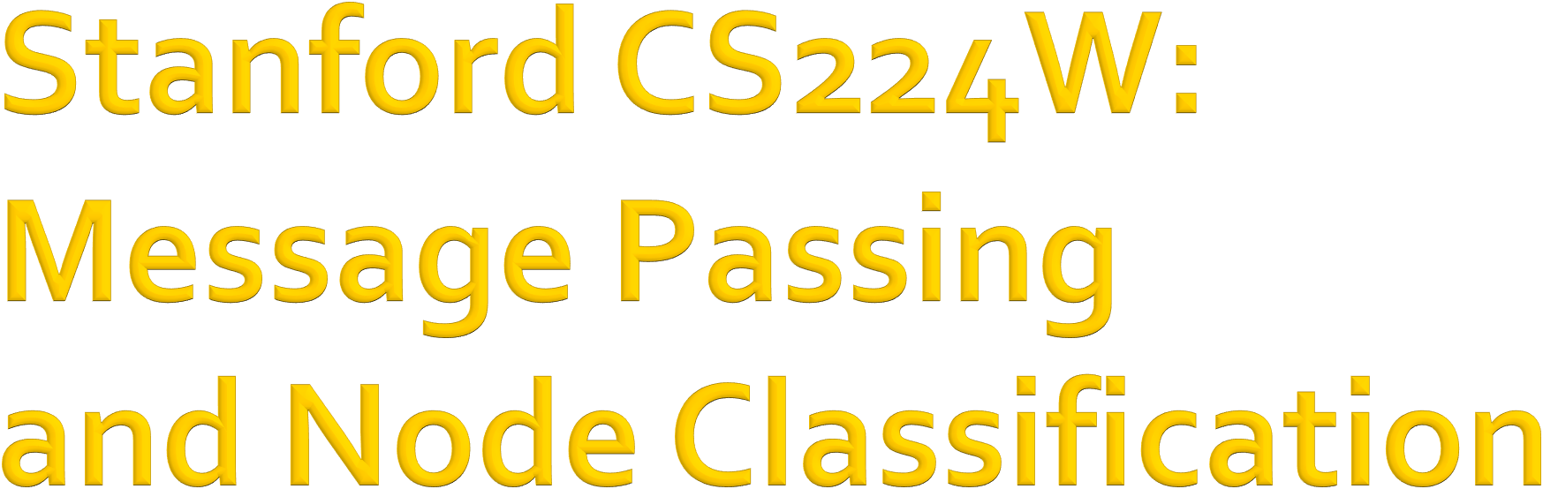

CS224W: Machine Learning with Graphs Jure Leskovec, Stanford University
http://cs224w.stanford.edu

Slide 2

Main question today: Given a network with labels on some nodes, how do we assign labels to all other nodes in the network?
Example: In a network, some nodes are fraudsters and some other nodes are fully trusted. How do you find the other fraudsters and trustworthy nodes?
We already discussed node embeddings as a method to solve this in Lecture 3
2/14/21
Jure Leskovec, Stanford CS224W: Machine Learning with Graphs, http://cs224w.stanford.edu
2

Slide 3


?
?
?
?
?
Given labels of some nodes
Let’s predict labels of unlabeled nodes
This is called semi-supervised node classification
2/14/21
3

Slide 4
Main question today: Given a network with labels on some nodes, how do we assign labels to all other nodes in the network?
Today we will discuss an alternative framework: message passing
Intuition: Correlations exist in networks.
  In other words: Similar nodes are connected
  Key concept is collective classification: Idea of assigning labels to all nodes in a network together
We will look at three techniques today:
  Relational classification
  Iterative classification
  Belief propagation
7

Slide 5
Individual behaviors are correlated in the network
Correlation: nearby nodes have the same color (belonging to the same class)
7

Slide 6
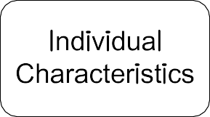
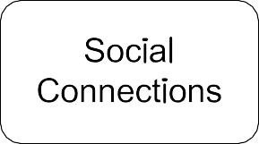

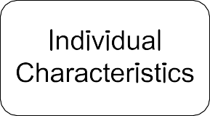
Main types of dependencies that lead to correlation:
Homophily Influence
7

Slide 7



Homophily: The tendency of individuals to associate and bond with similar others
Homophily
“Birds of a feather flock together”
It has been observed in a vast array of network studies, based on a variety of attributes (e.g., age, gender, organizational role, etc.)
Example: Researchers who focus on the same research area are more likely to establish a connection (meeting at conferences, interacting in academic talks, etc.)
7

Slide 8

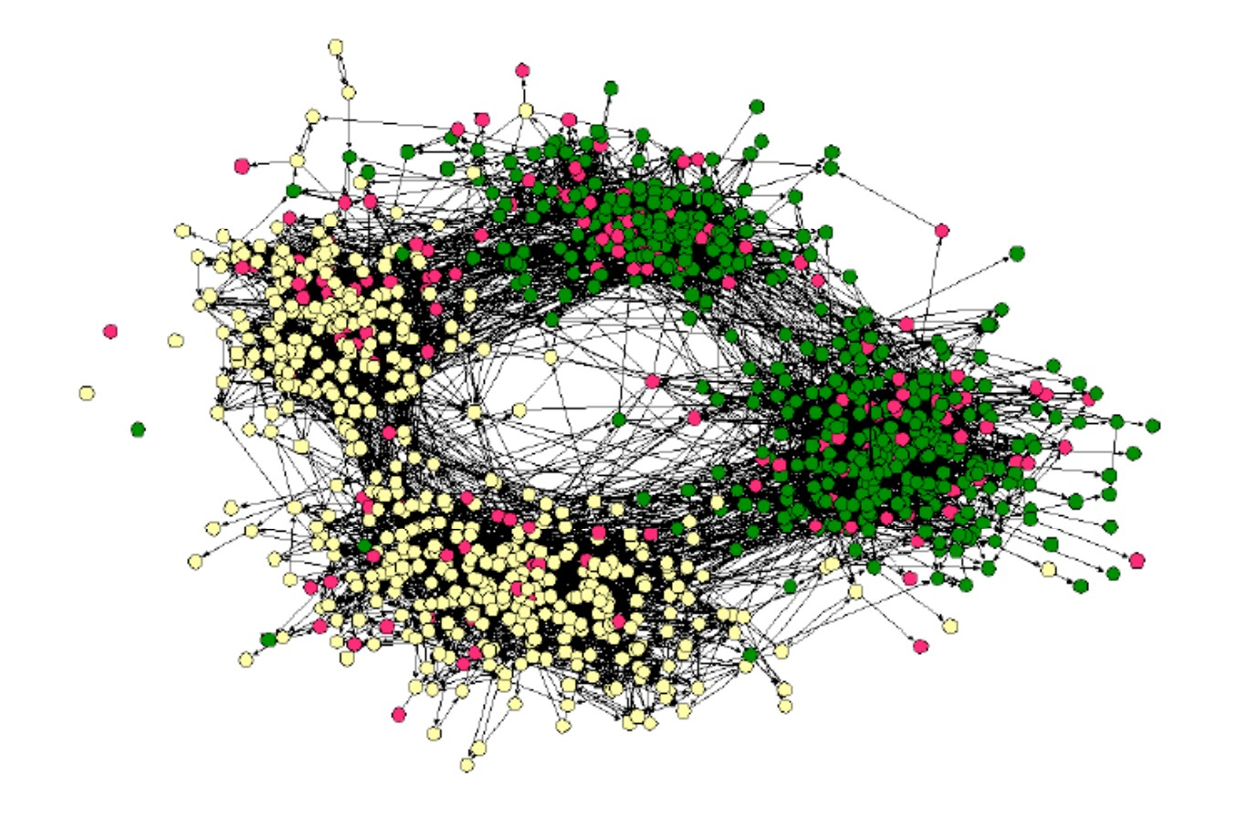
Example of homophily
Online social network
Nodes = people
Edges = friendship
Node color = interests (sports, arts, etc.)
People with the same
interest are more closely connected due to homophily
(Easley and Kleinberg, 2010)
7

Slide 9



Influence: Social connections can influence the individual characteristics of a person.
  Example: I recommend my musical preferences to my friends, until one of them grows to like my same favorite genres!
Influence
7

Slide 10
How do we leverage this correlation observed in networks to help predict node labels?
Label 1
3
7
5
Label 0
1
4
9
8
6
Label 1
2
Label 0
How do we predict the labels for the nodes in grey?
Jure Leskovec, Stanford CS224W: Machine Learning with Graphs, http://cs224w.stanford.edu
10

Slide 11

Similar nodes are typically close together or directly connected in the network:
  Guilt-by-association: If I am connected to a node with label 𝑋, then I am likely to have label 𝑋 as well.
  Example: Malicious/benign web page: Malicious web pages link to one another to increase visibility, look credible, and rank higher in search engines

Slide 12
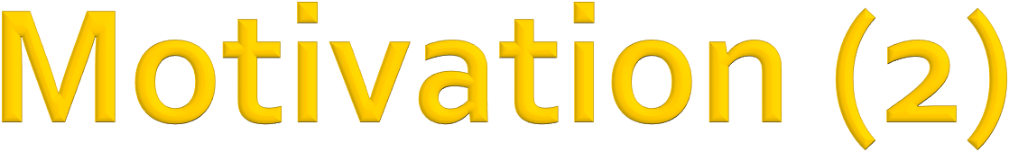
Classification label of a node 𝑣 in network may depend on:
  Features of 𝑣
  Labels of the nodes in 𝑣’s neighborhood
  Features of the nodes in 𝑣’s neighborhood

Slide 13
Given:
Graph
Few labeled nodes
Find: class (red/green) of remaining nodes
Main assumption: There is homophily in the network
?
?
?

Slide 14
Example task:
Let 𝑨 be a 𝑛×𝑛 adjacency matrix over 𝑛 nodes
Let Y = 0, 1 ! be a vector of labels:
  Y! = 1 belongs to Class 1
  Y! = 0 belongs to Class 0
  There are unlabeled node needs to be classified
Goal: Predict which unlabeled nodes are likely
Class 1, and which are likely Class 0

Slide 15
Many applications:
Document classification
Part of speech tagging
Link prediction
Optical character recognition
Image/3D data segmentation
Entity resolution in sensor networks
Spam and fraud detection

Slide 16
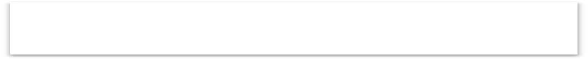
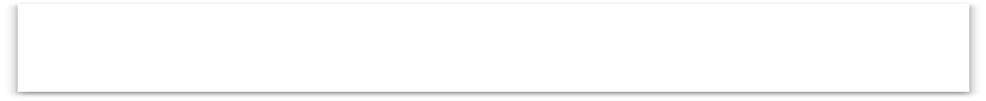
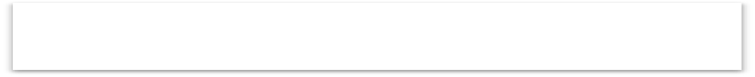



Intuition: Simultaneous classification of interlinked nodes using correlations
Probabilistic framework
Markov Assumption: the label 𝑌" of one node 𝑣
depends on the labels of its neighbors 𝑁_{𝑣}
𝑃(𝑌") = 𝑃 𝑌" 𝑁")
Collective classification involves 3 steps:
Local Classifier Relational Classifier Collective Inference
Assign initial labels
Capture correlations between nodes
Propagate correlations through network

Slide 17



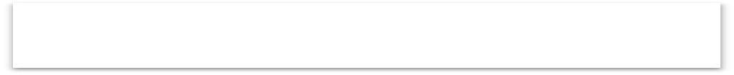


Local Classifier: Used for initial label assignment
Local Classifier
Predicts label based on node attributes/features
Standard classification task
Does not use network information
Assign initial labels
Relational Classifier
Relational Classifier: Capture correlations
Learns a classifier to label one node based on the labels and/or attributes of its neighbors
This is where network information is used
Capture correlations between nodes
Collective Inference: Propagate the correlation
Apply relational classifier to each node iteratively
Iterate until the inconsistency between neighboring labels is minimized
Network structure affects the final prediction
Collective Inference
Propagate correlations through network

Slide 18

How to predict the labels 𝑌" for the unlabeled nodes 𝑣 (in grey color)?
Each node 𝑣 has a feature vector 𝑓"
Labels for some nodes are given (1 for green,
0 for red)
Task: Find 𝑃(𝑌") given all features and the
network
𝑃(𝑌!) = ?
5
7
3
9
4
1
8
6
2

Slide 19
We focus on semi-supervised node classification
Intuition is based on homophily: Similar nodes
are typically close together or directly connected
Three techniques we will introduce:
  Relational classification
  Iterative classification
  Belief propagation

Slide 20
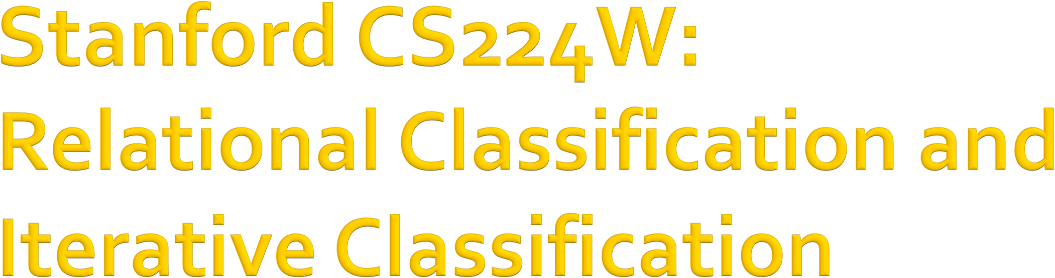
CS224W: Machine Learning with Graphs Jure Leskovec, Stanford University
http://cs224w.stanford.edu

Slide 21
Relational classifiers
Iterative classification
Loopy belief propagation

Slide 22
Basic idea: Class probability 𝑌" of node 𝑣 is a weighted average of class probabilities of its neighbors
For labeled nodes 𝑣, initialize label 𝑌" with
ground-truth label 𝑌∗
"
For unlabeled nodes, initialize 𝑌" = 0.5
Update all nodes in a random order until
convergence or until maximum number of iterations is reached

Slide 23
Update for each node 𝑣 and label 𝑐 (e.g. 0 or 1)
1
∑ !,# ∈% ^{𝐴}!,#
( 𝐴!,# 𝑃(𝑌# = 𝑐)
!,# ∈%
𝑃 𝑌! = 𝑐 =
If edges have strength/weight information, 𝐴!,# can be the edge weight between 𝑣 and 𝑢
𝑃 𝑌! = 𝑐 is the probability of node 𝑣 having label 𝑐
Challenges:
  Convergence is not guaranteed
  Model cannot use node feature information

Slide 24

Initialization:
All labeled nodes with their labels
All unlabeled nodes 0.5 (belonging to class 1 with probability 0.5)
Let 𝑃$" = 𝑃(𝑌% = 1)
𝑃_{!(} = 0.5
3
𝑃! = 1
7
𝑃 = 0.5
5
!
!'
9
𝑃 = 0.5
4
𝑃_{!)} = 0.5
1
!%
𝑃! = 0
6
𝑃!" = 1
$
8
𝑃! = 0.5
2
𝑃!# = 0
&

Slide 25
Update for the 1st Iteration:
For node 3, 𝑁₎ = {1, 2, 4}
𝑃(𝑌") =
0 + 0 + 0.5 /3 = 0.17
𝑃(𝑌#) = 1
7
𝑃(𝑌₍) = 0.5
5
3
9
𝑃(𝑌*) = 0.5
4
𝑃(𝑌₎) = 0.5
1
6
𝑃(𝑌$) = 1
𝑃(𝑌 ) = 0
8
𝑃(𝑌') = 0.5
&
2
𝑃(𝑌%) = 0

Slide 26
Update for the 1st Iteration:
For node 4, 𝑁₁ = {1, 3, 5, 6}
𝑃(𝑌#) = 1
7
𝑃(𝑌") = 0.17
3
𝑃(𝑌 ) = 0.5
(
5
9
𝑃(𝑌*) = 0.5
4
1
6
𝑃(𝑌$) = 1
𝑃(𝑌!)
= 0 + 0.17 + 0.5 + 1 /4
= 0.42
𝑃(𝑌 ) = 0
8
𝑃(𝑌') = 0.5
&
2
𝑃(𝑌%) = 0
After Node 3 is updated

Slide 27
Update for the 1st Iteration:
For node 5, 𝑁₂ = {4, 6, 7, 8}
𝑃(𝑌#) = 1
7
9
𝑃(𝑌*) = 0.5
8
𝑃(𝑌') = 0.5
After nodes 3 and 4 are updated
𝑃 𝑌"
= 1 + 0.5 + 1 + 0.42 /4
= 0.73
3
𝑃(𝑌 ) = 0.17
5
"
4
𝑃(𝑌₎) = 0.42
1
𝑃(𝑌 ) = 0
6
𝑃(𝑌$) = 1
&
2
𝑃(𝑌%) = 0

Slide 28
After Iteration 1 (a round of updates for all unlabeled nodes)
𝑃(𝑌#) = 1
7
𝑃(𝑌") = 0.17
𝑃(𝑌 ) = 0.73
(
3
5
9
𝑃(𝑌*) = 1
4
𝑃(𝑌₎) = 0.42
1
6
𝑃(𝑌$) = 1
𝑃(𝑌 ) = 0
8
𝑃(𝑌') = 0.91
&
2
𝑃(𝑌%) = 0

Slide 29
After Iteration 2
𝑃(𝑌#) = 1
7
𝑃(𝑌") = 0.14
3
𝑃(𝑌 ) = 0.85
(
5
9
𝑃(𝑌*) = 1
Converged
4
𝑃(𝑌₎) = 0.47
1
6
𝑃(𝑌$) = 1
𝑃(𝑌 ) = 0
&
8
𝑃(𝑌') = 0.95
2
𝑃(𝑌%) = 0

Slide 30
After Iteration 3
𝑃(𝑌#) = 1
7
𝑃(𝑌") = 0.16
3
𝑃(𝑌 ) = 0.86
(
5
9
𝑃(𝑌*) = 1
Converged
4
𝑃(𝑌₎) = 0.5
1
6
𝑃(𝑌$) = 1
𝑃(𝑌 ) = 0
&
8
𝑃(𝑌') = 0.95
Converged
2
𝑃(𝑌%) = 0
30

Slide 31
After Iteration 4
Converged
𝑃(𝑌") = 0.16
3
𝑃(𝑌#) = 1
7
Converged
𝑃(𝑌 ) = 0.86
(
5
9
𝑃(𝑌*) = 1
Converged
4
𝑃(𝑌₎) = 0.51
1
6
𝑃(𝑌$) = 1
𝑃(𝑌 ) = 0
&
8
𝑃(𝑌') = 0.95
Converged
2
𝑃(𝑌%) = 0

Slide 32

All scores stabilize after 4 iterations. We therefore predict:
Nodes 4, 5, 8, 9 belong to class 1 (𝑃_{&+} > 0.5)
Nodes 3 belong to class 0 (𝑃_{&+} < 0.5)
Converged
Converged
𝑃(𝑌#) = 1
7
𝑃(𝑌 ) = 0.16
𝑃(𝑌 ) = 0.86
"
(
3
5
9
𝑃(𝑌*) = 1
Converged
4
𝑃(𝑌₎) = 0.51
Converged
1
6
𝑃(𝑌$) = 1
𝑃(𝑌 ) = 0
&
8
𝑃(𝑌') = 0.95
Converged
2
𝑃(𝑌%) = 0

Slide 33
Relational classifiers
Iterative classification
Loopy belief propagation

Slide 34
Relational classifiers do not use node attributes. How can one leverage them?
Main idea of iterative classification: Classify node 𝑣 based on its attributes 𝒇_{𝒗} as well as labels 𝒛_{𝒗} of neighbor set 𝑵_{𝒗}

Slide 35
Input: Graph
𝑓! : feature vector for node 𝑣
Some nodes 𝑣 are labeled with 𝑌!
Task: Predict label of unlabeled nodes
Approach: Train two classifiers:
𝜙%(𝑓") = Predict node label based on node feature vector 𝑓"
𝜙' 𝑓", 𝑧" = Predict label based on node feature
vector 𝑓" and summary 𝑧" of labels of 𝑣’s neighbors.

Slide 36
How do we compute the summary 𝒛_{𝒗} of labels of
𝒗’s neighbors 𝑵_{𝒗}?
Ideas: 𝒛_{𝒗} = vector
  Histogram of the number (or fraction) of each label in
𝑁!
  Most common label in 𝑁!
  Number of different labels in 𝑁!
𝒇_{𝒗}, 𝒛_{𝒗}

Slide 37
Phase 1: Classify based on node attributes alone
On a training set, train classifier (e.g., linear classifier, neural networks, …):
𝜙₎(𝑓!) to predict 𝑌! based on 𝑓!
𝜙* 𝑓!, 𝑧! to predict 𝑌! based on 𝑓! and summary 𝑧! of labels
of 𝑣’s neighbors
Phase 2: Iterate till convergence
  On test set, set labels 𝑌! based on the classifier 𝜙₎, compute
𝑧! and predict the labels with 𝜙*
  Repeat for each node 𝑣
    Update 𝑧! based on 𝑌" for all 𝑢 ∈ 𝑁!
    Update 𝑌! based on the new 𝑧! (𝜙#)
  Iterate until class labels stabilize or max number of iterations is reached
  Note: Convergence is not guaranteed

Slide 38
Input: Graph of web pages
Node: Web page
Edge: Hyper-link between web pages
  Directed edge: a page points to another page
Node features: Webpage description
  For simplicity, we only consider 2 binary features
Task: Predict the topic of the webpage

Slide 39
Baseline: train a classifier (e.g., linear classifier) to classify pages based on binary node attributes.
Ground truth: 1
𝑓"
0
0
1
Ground truth: 1
Ground truth: 0
0
0
Node attribute
𝑓"
1
0
𝑓"
1
1
𝑓"
0
1
1
Ground truth: 1
Wrong! Can we improve?

Slide 40
Each node maintains vectors 𝒛_{𝒗} of neighborhood labels:
𝐼 = Incoming neighbor label information vector
𝑂= Outgoing neighbor label information vector
𝐼₋ = 1 if at least one of the incoming pages is labelled 0.
Similar definitions for 𝐼₎, 𝑂₋, and 𝑂₎
Ground truth: 1
𝑓"
0 | 0
0 | 1
1 | 0
𝐼
1
𝑧
" _{𝑂}
Ground truth: 1
Ground truth: 0
0
0
𝑓"
0 | 1
1 | 0
1 | 0
0 | 1
1 | 1
𝑓"
𝑓"
1 | 1
1 | 0
0 | 0
_{𝑧"} 𝐼
1
𝐼
_{𝑧} 𝐼
𝑂
0
1
𝑧
"
𝑂
"
𝑂
Ground truth: 1
Include network features
Jure Leskovec, Stanford CS224W: Machine Learning with Graphs, http://cs224w.stanford.edu
40

Slide 41
On a different training set, train two classifiers:
Node attribute vector only (green circles): 𝜙$
Node attribute and link vectors (red circles): 𝜙#
𝑓"
𝐼
𝑂
1 | 0
1 | 1
1 | 1
0 | 1
1 | 0
0 | 1
0
1
Train classifier
1.
Apply classifier to test set
Iterate
Update relational features 𝑧#
Update label 𝑌"
1 | 0
0 | 0
1 | 0
0 | 0
1 | 0
0 | 0
1 | 0
0 | 1
1 | 0
0
0
1

Slide 42
On the test set:
  Use trained node feature vector classifier 𝜙₎
to set 𝑌!
Train classifier
Apply classifier to test set
Iterate
Ground truth: 1
Update relational features 𝑧#
Update label 𝑌"
𝑓"
0
0
?
Ground truth: 1
Ground truth: 0
?
?
𝑓"
1
0
𝑓"
1
1
𝑓"
0
1
?
Ground truth: 1

Slide 43
On the test set:
  Use trained node feature vector classifier 𝜙₍to set 𝑌!
Train classifier
Apply classifier to test set
Iterate
Ground truth: 1
Update relational features 𝑧#
Update label 𝑌"
Ground truth: 0
𝑓"
0
0
1
Ground truth: 1
0
0
𝑓"
1
0
𝑓"
1
1
𝑓"
0
1
1
Wrong prediction using 𝜙₎
Ground truth: 1

Slide 44
Update 𝑧! for all nodes
Train classifier
Apply classifier to test
Iterate
1.
2. Update label 𝑌"
𝒛_{𝒗}
Ground truth: 1
Update relational features
𝑓
 | 0 | 0
 | 0 | 1
 | 1 | 0
"
1
_{𝑧"} 𝐼
𝑂
Ground truth: 1
Ground truth: 0
0
0
 | 0 | 1
 | 1 | 0
 | 0 | 1
 | 1 | 0
 | 0 | 1
 | 1 | 1
 | 1 | 1
 | 1 | 0
 | 0 | 0
𝑧"
1
𝑧
𝑧
"
"
Ground truth: 1

Slide 45
Re-classify all nodes with 𝜙₎
Train classifier
Apply classifier to test
Iterate
  Update relational features 𝑧#
2.
Ground truth: 1
Update label
𝑌"
𝑓
0 | 0
0 | 1
1 | 0
"
𝐼
𝑂
1
Ground truth: 1
Ground truth: 0
1
0
0 | 1
1 | 0
0 | 1
1 | 0
0 | 1
1 | 1
1 | 1
1 | 0
0 | 0
1
Ground truth: 1
Now it’s correct prediction!

Slide 46
Continue until convergence
Train classifier
Apply classifier to test
3.
Update 𝑧!
Update 𝑌!= 𝜙*(𝑓!, 𝑧!)
Ground truth: 1
Iterate
Update relational features 𝑧#
Update label 𝑌"
𝑓"
𝐼
𝑂
0 | 0
0 | 1
0 | 1
1
Ground truth: 1
Ground truth: 0
1
0
Changed
0 | 1
0 | 1
0 | 1
1 | 0
0 | 1
1 | 1
1 | 1
0 | 1
0 | 0
1
Ground truth: 1

Slide 47
Stop iteration
Train classifier
Apply classifier to test set
Iterate
  Update relational features 𝑧#
  Update label 𝑌"
After convergence or when maximum iterations are reached
Ground truth: 1
𝑓"
𝐼
𝑂
0 | 0
0 | 1
0 | 1
1
Ground truth: 1
Ground truth: 0
1
0
0 | 1
0 | 1
0 | 1
1 | 0
0 | 1
1 | 1
1 | 1
0 | 1
0 | 0
1
Ground truth: 1
Correct Now!

Slide 48

We talked about 2 approaches to collective classification
Relational classification
Iteratively update probabilities of node belonging to a label class based on its neighbors
Iterative classification
  Improve over collective classification to handle attribute/feature information
  Classify node 𝑖 based on its features as well as
labels of neighbors

Slide 49
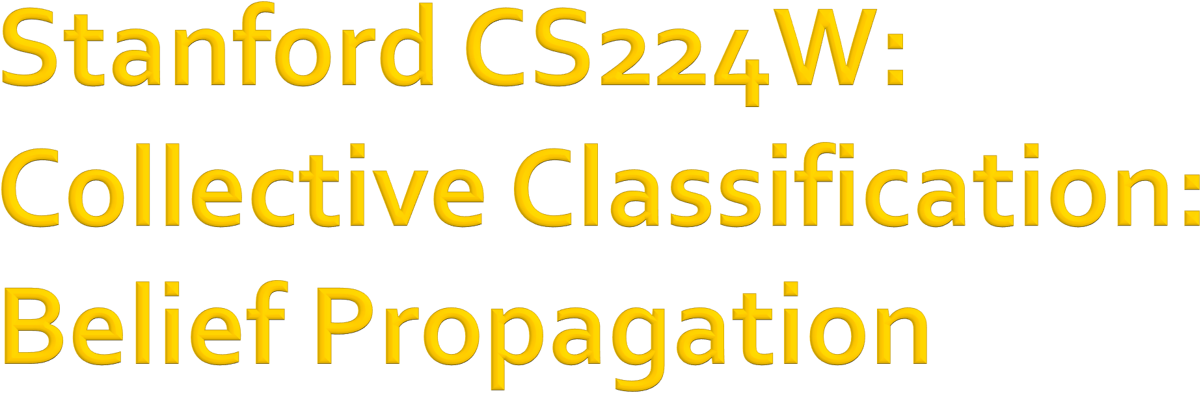
CS224W: Machine Learning with Graphs Jure Leskovec, Stanford University
http://cs224w.stanford.edu

Slide 50
Relational classifiers
Iterative classification
Loopy belief propagation

Slide 51
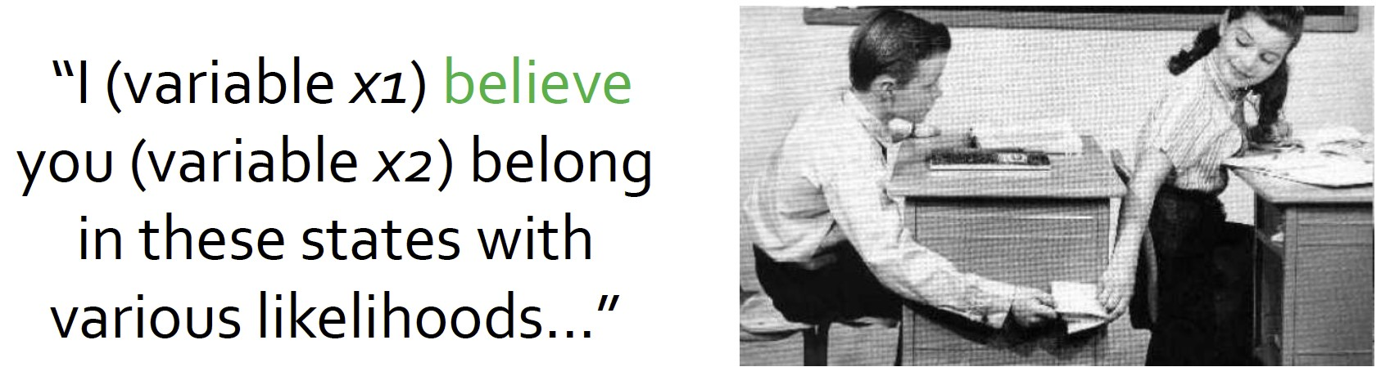
Belief Propagation is a dynamic programming approach to answering probability queries in a graph (e.g. probability of node 𝑣 belonging to class 1)
Iterative process in which neighbor nodes “talk” to each other, passing messages
“I (node v) believe you (node u) belong to class 1 with likelihood …”
When consensus is reached, calculate final belief

Slide 52
Task: Count the number of nodes in a graph*
Condition: Each node can only interact (pass message) with its neighbors
Example: path graph
6
5
4
3
2
1
* Potential issues when the graph contains cycles.
We’ll get back to it later!

Slide 53
Task: Count the number of nodes in a graph
Algorithm:
Define an ordering of nodes (that results in a path)
Edge directions are according to order of nodes
  Edge direction defines the order of message passing
For node 𝑖 from 1 to 6
  Compute the message from node 𝑖 to 𝑖 + 1 (number of nodes counted so far)
  Pass the message from node 𝑖 to 𝑖 + 1
6 5 4 3 2 1

Slide 54
Task: Count the number of nodes in a graph
Condition: Each node can only interact (pass message) with its neighbors
Solution: Each node listens to the message from its neighbor, updates it, and passes it forward
𝑚: the message
𝑚 = 5 node before
𝑚 = 4 node before
𝑚 = 3 node before
𝑚 = 2 node before
𝑚 = 1 node before
6
5
4
3
2
1
Update belief:
5 + 1 = 6
Update belief: 𝑚 + 1 nodes before me

Slide 55

We can perform message passing not only on a path graph, but also on a tree-structured graph
Define order of message passing from leaves to root
1
2
3
4
5
7
6

Slide 56
Update beliefs in tree structure
1
2
3
Update belief:
1 + 1 + 1 = 3
4
5
𝑚 = 1 descendant
𝑚 = 1 descendant
7
6

Slide 57
Update beliefs in tree structure
Update belief:
1 + 5 + 1 = 7
1
𝑚 = 5 descendants
𝑚 = 1 descendant
2
3
4
5
7
6

Slide 58

What message will 𝑖 send to 𝑗?
It depends on what 𝑖 hears from its neighbors
Each neighbor passes a
message to 𝑖 its beliefs of the state of 𝑖
𝑗
𝑘
𝑖
𝑢
𝑣
I (node 𝑖) believe that you (node 𝑗) belong to class 𝑌% with probability
…

Slide 59

Label-label potential matrix 𝝍 : Dependency between a node and its neighbor. 𝝍(𝑌₍, 𝑌₎) is
proportional to the probability of a node 𝑗 being in class 𝑌₎ given that it has neighbor 𝑖 in class 𝑌₍.
Prior belief 𝝓 : 𝜙(𝑌₍) is proportional to the probability of node 𝑖 being in class 𝑌₍.
𝑚_{(→)}(𝑌₎) is 𝑖’s message / estimate of 𝑗 being
in class 𝑌₎.
ℒ is the set of all classes/labels

Slide 60
1. Initialize all messages to 1
𝑗
2. Repeat for each node:
𝑚%→&(𝑌&)
𝑘
𝑖
𝑢
𝑚#→%(𝑌%)
𝑣
All messages sent by neighbors from previous round
Label-label potential
( &,∈ℒ | 𝜓 𝑌<, 𝑌> | 𝜙< 𝑌< | ^{< 𝑚}@→< ^{𝑌}< @∈A,\C
^{𝑚}<→> ^{𝑌}>
=
, ∀𝑌> ∈ ℒ
Sum over all states
Prior
60

Slide 61
After convergence:
𝑏₍ 𝑌₍ = node 𝑖’s belief of being in class 𝑌₍
𝑗
𝑚%→&(𝑌&)
𝑘
𝑖
𝑢
𝑚#→%(𝑌%)
𝑣
All messages from neighbors
Prior
𝑏₍ 𝑌₍ =
𝜙₍ | 𝑌₍ | ^{Π})∈,₈^{𝑚})→( | 𝑌₍ | ,
∀ 𝑌₍ ∈ ℒ

Slide 62
Now we consider a graph with cycles
There is no longer an ordering of nodes
We apply the same algorithm as in previous slides:
  Start from arbitrary nodes
  Follow the edges to update the neighboring nodes

Slide 63
What if our graph has cycles?
𝑗
Messages from different subgraphs are
no longer independent!
But we can still run BP, but it will pass messages in loops.
𝑖
𝑘
𝑢
𝑣

Slide 64
What if our graph has cycles?
𝑗
𝑚%→&(𝑌&)
𝑚&→#(𝑌#)
Messages from different subgraphs are
no longer independent!
𝑖
𝑘
But we can still run BP, but it will pass messages in loops.
𝑚
(𝑌 )
𝑚 (𝑌 )
'→% %
𝑢
#→' '
𝑚'→"(𝑌")
𝑣

Slide 65

Beliefs may not converge
Message 𝑚_{9→;}(𝑌;) is based on initial belief of 𝑖, not a separate evidence for 𝑖
The initial belief of 𝑖 (which could be incorrect) is reinforced by the cycle
𝑖 → 𝑗 → 𝑘 → 𝑢 → 𝑖
However, in practice, Loopy BP is still a good heuristic for complex graphs which contain many branches.
𝑗
𝑚%→&(𝑌&)
𝑚&→#(𝑌#)
𝑖
𝑘
𝑚'→%(𝑌%)
𝑚#→'(𝑌')
𝑢
𝑚'→"(𝑌")
𝑣

Slide 66
T
F
4
1
T
F
2
1
Messages loop around and around: 2, 4, 8, 16, 32, ... More and more convinced that these variables are T!
T
F
2
1
BP incorrectly treats this message as separate evidence that the variable is T (true).
Multiplies these two messages as if they were independent.
  But they don’t actually come from
independent parts of the graph.
  One influenced the other (via a cycle).
T
F
4
1
T 2
F 1
T
F
2
1
T
F
2
1
This is an extreme example. Often in practice, the cyclic influences are weak. (As cycles are long or include at least one weak correlation.)
66

Slide 67
Advantages:
Easy to program & parallelize
General: can apply to any graph model with any form of potentials
  Potential can be higher order: e.g. 𝝍(𝑌<, 𝑌>, 𝑌@, 𝑌! … )
Challenges:
  Convergence is not guaranteed (when to stop), especially if many closed loops
Potential functions (parameters)
  Require training to estimate

Slide 68
We learned how to leverage correlation in graphs to make prediction on nodes
Key techniques:
Relational classification
Iterative classification
Loopy belief propagation

