Slide 1



CS224W: Machine Learning with Graphs Jure Leskovec, Stanford University
http://cs224w.stanford.edu

Slide 2
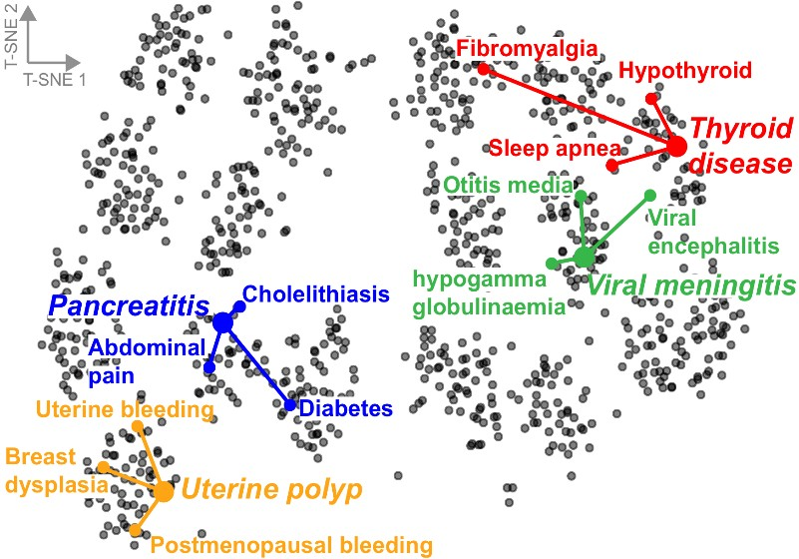
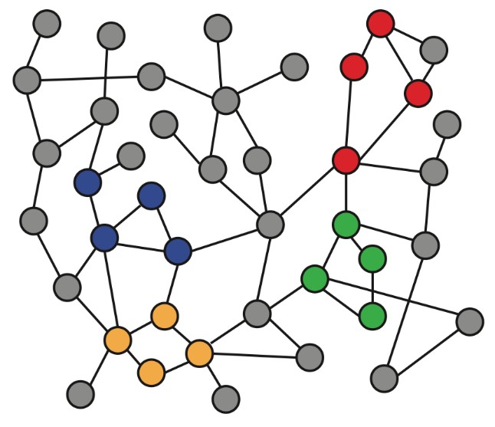
Intuition: Map nodes to 𝑑-dimensional embeddings such that similar nodes in the graph are embedded close together
f ( )=
Input graph 2D node embeddings
How to learn mapping function 𝒇?
2

Slide 3
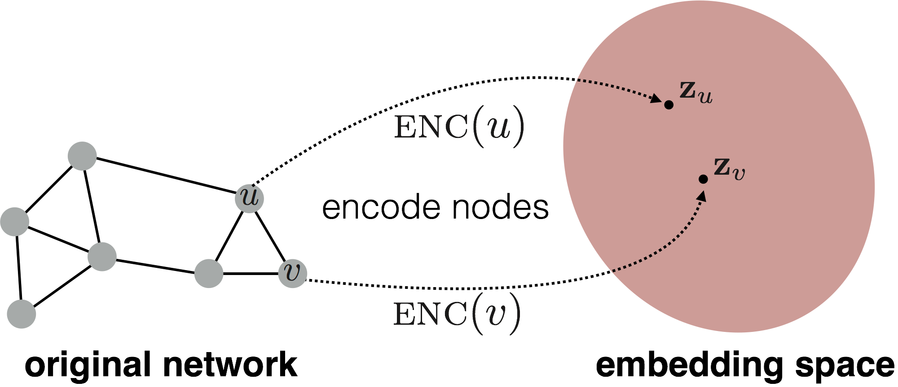
Goal:
similarity 𝑢, 𝑣
≈ 𝐳"𝐳
! #
Need to define!
d-dimensional embedding space
Input network
2

Slide 4
Encoder: maps each node to a low-dimensional
vector
d-dimensional embedding
ENC 𝑣 =
𝐳!
node in the input graph
Similarity function: specifies how the relationships in vector space map to the relationships in the original network
similarity 𝑢, 𝑣
Similarity of 𝑢 and 𝑣 in the original network
≈ 𝐳"𝐳
Decoder
! #
dot product between node embeddings
2/22/21
4

Slide 5
Simplest encoding approach: encoder is just an embedding-lookup
embedding vector for a
embedding matrix
specific node
𝐙 =
Dimension/size of embeddings
one column per node
2/22/21
4

Slide 6
Limitations of shallow embedding methods:
𝑶(|𝑽|) parameters are needed:
  No sharing of parameters between nodes
  Every node has its own unique embedding
Inherently “transductive”:
  Cannot generate embeddings for nodes that are not seen during training
Do not incorporate node features:
  Many graphs have features that we can and should leverage
6

Slide 7
Today: We will now discuss deep methods based on graph neural networks (GNNs):
multiple layers of
ENC 𝑣 =
non-linear transformations based on graph structure
Note: All these deep encoders can be combined with node similarity functions defined in the lecture 3
6

Slide 8

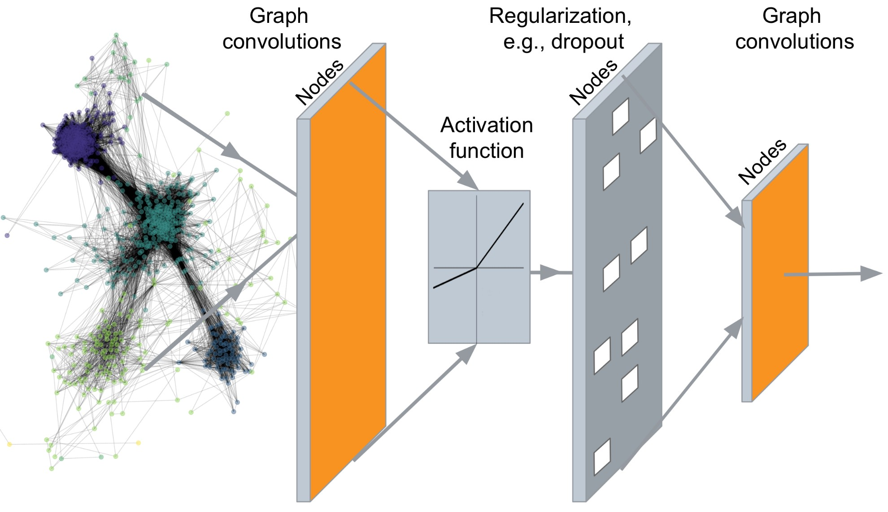
…
Output: Node embeddings. Also, we can embed subgraphs, graphs
6

Slide 9
Tasks we will be able to solve:
Node classification
Predict a type of a given node
Link prediction
  Predict whether two nodes are linked
Community detection
  Identify densely linked clusters of nodes
Network similarity
  How similar are two (sub)networks
Jure Leskovec, Stanford University
9

Slide 10
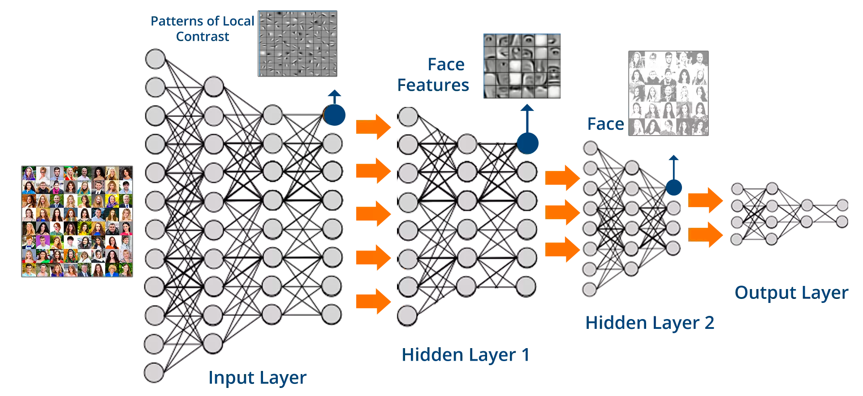
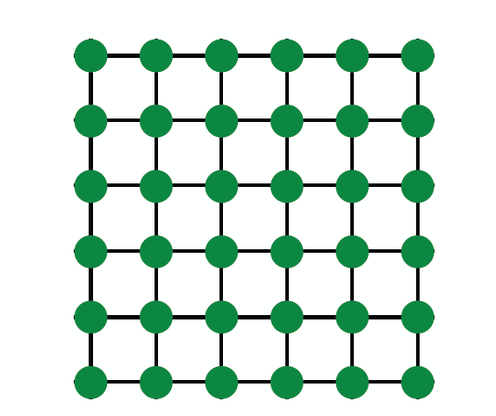
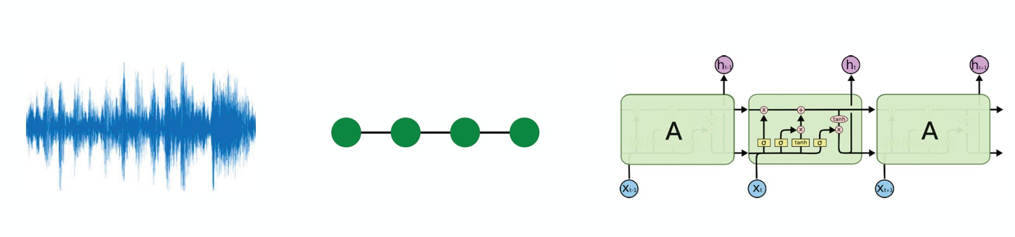
Images
Text/Speech
Modern deep learning toolbox is designed for simple sequences & grids
Jure Leskovec, Stanford University 10

Slide 11


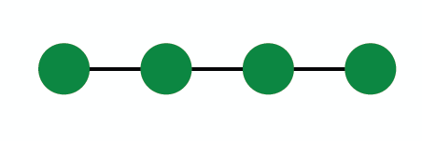
But networks are far more complex!
Arbitrary size and complex topological structure (i.e., no spatial locality like grids)
vs.
Text
Networks Images
No fixed node ordering or reference point
Often dynamic and have multimodal features
Jure Leskovec, Stanford University
11

Slide 12





1. Basics of deep learning
Deep learning for graphs
Graph Convolutional Networks and GraphSAGE
12/6/18
Jure Leskovec, Stanford CS224W: Machine Learning with Graphs, http://cs224w.stanford.edu
12

Slide 13

CS224W: Machine Learning with Graphs Jure Leskovec, Stanford University
http://cs224w.stanford.edu

Slide 14
Supervised learning: we are given input 𝒙, and the goal is to predict label 𝒚
Input 𝒙 can be:
Vectors of real numbers
Sequences (natural language)
Matrices (images)
Graphs (potentially with node and edge features)
We formulate the task as an optimization problem

Slide 15
Formulate the task as an optimization problem:
min ℒ(𝒚, 𝑓 𝒙 )
!
Objective function
Θ: a set of parameters we optimize
  Could contain one or more scalars, vectors, matrices …
  E.g. Θ = {𝑍} in the shallow encoder (the embedding lookup)
ℒ: loss function. Example: L2 loss
ℒ 𝒚, 𝑓 𝒙 = 𝑦 − 𝑓 𝑥
'
Other common loss functions:
  L1 loss, huber loss, max margin (hinge loss), cross entropy …
  See https://pytorch.org/docs/stable/nn.html#loss-functions

Slide 16
One common loss for classification: cross entropy (CE)
Label 𝒚 is a categorical vector (one-hot encoding)
e.g. 𝒚 =
0 | 0 | 1 | 0 | 0
𝑦 is of class “3”
𝑓 𝒙 = Softmax 𝑔 𝒙
"!(#)%
Recall from lecture 3: 𝑓 𝒙 =
,
𝑔 𝑥 ! denotes 𝑖-th coordinate of the vector output of func. 𝑔 𝑥
!
∑)
"!(#)&
&'(
where 𝐶 is the number of classes.
e.g. 𝑓 𝒙 =
0.1 | 0.3 | 0.4 | 0.1 | 0.1
CE 𝒚, 𝑓 𝒙
= − ∑$ (𝑦! log 𝑓(𝑥)!)
!"#
𝑦!, 𝑓(𝑥)! are the actual and predicted value of the 𝑖-th class.
Intuition: the lower the loss, the closer the prediction is to one-hot
Total loss over all training examples:
  ℒ = ∑ _{𝒙,𝒚 ∈𝒯} CE 𝒚, 𝑓 𝒙
  𝒯: training set containing all pairs of data and labels 𝒙, 𝒚

Slide 17
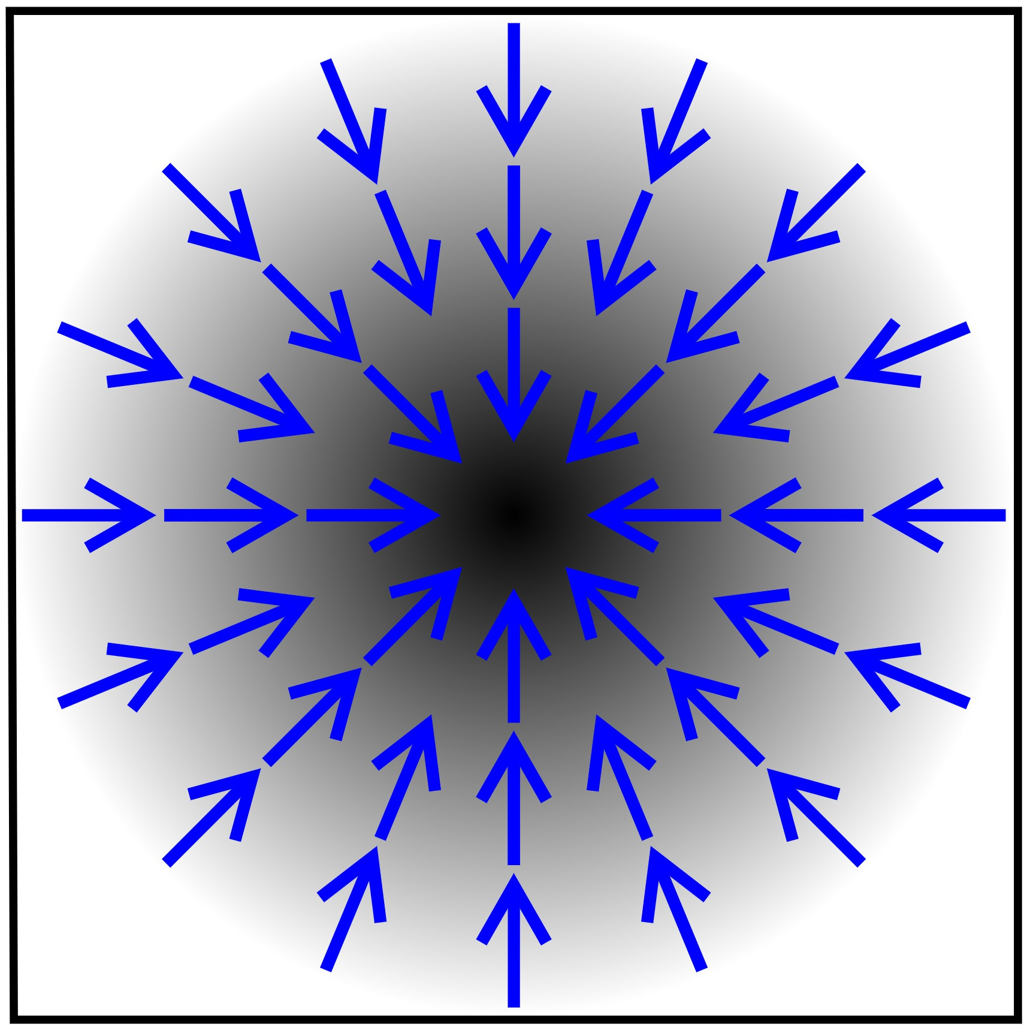
How to optimize the objective function?
Gradient vector: Direction and rate of fastest
increase
Partial derivative
∇ ℒ = ( ^{𝜕ℒ} , ^{𝜕ℒ} , … )
!
𝜕Θ₀ 𝜕Θ'
Θ#, Θ% … : components of Θ
https://en.wikipedia.org/wiki/Gradient
Recall directional derivative
of a multi-variable function (e.g. ℒ) along a given vector represents the instantaneous rate of change of the function along the vector.
Gradient is the directional derivative in the
direction of largest increase

Slide 18

Iterative algorithm: repeatedly update weights in the (opposite) direction of gradients until convergence
Θ ← Θ − 𝜂∇₋ℒ
Training: Optimize Θ iteratively
  Iteration: 1 step of gradient descent
Learning rate (LR) 𝜼:
  Hyperparameter that controls the size of gradient step
  Can vary over the course of training (LR scheduling)
Ideal termination condition: 0 gradient
  In practice, we stop training if it no longer improves performance on validation set (part of dataset we hold out from training)

Slide 19
Problem with gradient descent:
Exact gradient requires computing ∇₋ℒ(𝒚, 𝑓 𝒙 ), where 𝒙 is the entire dataset!
  This means summing gradient contributions over all the points in the dataset
  Modern datasets often contain billions of data points
  Extremely expensive for every gradient descent step
Solution: Stochastic gradient descent (SGD)
  At every step, pick a different minibatch 𝓑 containing a subset of the dataset, use it as input 𝒙

Slide 20

Concepts:
Batch size: the number of data points in a minibatch
  E.g. number of nodes for node classification task
Iteration: 1 step of SGD on a minibatch
Epoch: one full pass over the dataset (# iterations is equal to ratio of dataset size and batch size)
SGD is unbiased estimator of full gradient:
  But there is no guarantee on the rate of convergence
  In practice often requires tuning of learning rate
Common optimizer that improves over SGD:
  Adam, Adagrad, Adadelta, RMSprop …
20

Slide 21
Objective: min ℒ(𝒚, 𝑓 𝒙 )
$
In deep learning, the function 𝑓 can be very
complex
To start simple, consider linear function
𝑓 𝒙 = 𝑊 ⋅ 𝒙, Θ = {W}
If 𝑓 returns a scalar, then 𝑊 is a learnable vector
∇ 𝑓 = ( ^{𝜕𝑓} , ^{𝜕𝑓} , ^{𝜕𝑓} … )
%
𝜕𝑤& 𝜕𝑤' 𝜕𝑤₍
If 𝑓 returns a vector, then 𝑊 is the weight matrix
∇%𝑓 = 𝑊⁾
Jacobian matrix of 𝑓

Slide 22

How about a more complex function:
𝑓 𝒙 = 𝑊_{𝟐} 𝑊&𝒙 ,
Recall chain rule:
Θ = {W&, W'}
In other words:
𝑓 𝒙 = 𝑊_{𝟐} 𝑊.𝒙 ℎ(𝑥) = 𝑊.𝒙
g 𝑧 = 𝑊/𝑧
01 01 03
= B
02 03 02
,- _{B} ,(%&𝒙)
E.g. ∇_{𝒙}𝑓 =
,(%&𝒙) ,𝒙
Back-propagation: Use of chain rule to propagate gradients of intermediate steps, and finally obtain gradient of ℒ w.r.t. Θ

Slide 23
Example: Simple 2-layer linear network
𝑓 𝒙 = 𝑔 ℎ 𝑥
= 𝑊_{𝟐} 𝑊&𝒙
𝑊_{𝟏}
𝑊_{𝟐}
𝑥
!
𝑓(𝒙)
𝑥"
^{ℒ = ∑} 𝒙,𝒚 ∈𝓑
𝒚, −𝑓 𝒙
sums the L2 loss in
𝟐
a minibatch 𝓑
Hidden layer: intermediate representation for input 𝒙
  Here we use ℎ(𝑥) = 𝑊.𝒙 to denote the hidden layer
  𝑓 𝒙 = 𝑊/ℎ(𝑥)

Slide 24

Note that in 𝑓 𝒙 = 𝑊_{𝟐} 𝑊&𝒙 , 𝑊_{𝟐}𝑊& is another matrix (vector, if we do binary classification)
Hence 𝑓 𝒙 is still linear w.r.t. 𝒙 no matter how many weight matrices we compose
Introduce non-linearity:
  Rectified linear unit (ReLU)
𝑅𝑒𝐿𝑈 𝑥 = max(𝑥, 0)
  Sigmoid
𝑦
0
𝑥
1
𝑦
1
𝜎 𝑥 =
1 + 𝑒⁰¹
0
𝑥

Slide 25
Each layer of MLP combines linear transformation and non-linearity:
_{𝒙}(89.) _{= 𝜎(𝑊8𝒙} 8
+ 𝑏⁸)
where 𝑊$ is weight matrix that transforms hidden representation at layer 𝑙 to layer 𝑙 + 1
𝑏$ is bias at layer 𝑙, and is added to the linear transformation of 𝒙
𝜎 is non-linearity function (e.g., sigmod)
Suppose 𝒙 is 2-dimensional, with entries 𝑥# and 𝑥%
3-dimensional hidden representation
1-dimensional output
𝑥!
𝑥"
Every layer:
Linear transformation + non-linearity

Slide 26

Objective function:
min ℒ(𝒚, 𝑓 𝒙 )
$
𝑓 can be a simple linear layer, an MLP, or
other neural networks (e.g., a GNN later)
Sample a minibatch of input 𝒙
Forward propagation: compute ℒ given 𝒙
Back-propagation: obtain gradient ∇$ℒ using a chain rule
Use stochastic gradient descent (SGD) to optimize for Θ over many iterations

Slide 27

Basics of deep learning
Deep learning for graphs
Graph Convolutional Networks and GraphSAGE

Slide 28

CS224W: Machine Learning with Graphs Jure Leskovec, Stanford University
http://cs224w.stanford.edu

Slide 29

Local network neighborhoods:
Describe aggregation strategies
Define computation graphs
Stacking multiple layers:
  Describe the model, parameters, training
  How to fit the model?
  Simple example for unsupervised and supervised training
29

Slide 30

Assume we have a graph 𝑮:
𝑉 is the vertex set
𝑨 is the adjacency matrix (assume binary)
𝑿 ∈ ℝ^{:×|=|} is a matrix of node features
𝑣: a node in 𝑉; 𝑁 𝑣 : the set of neighbors of 𝑣.
Node features:
  Social networks: User profile, User image
  Biological networks: Gene expression profiles, gene functional information
  When there is no node feature in the graph dataset:
    Indicator vectors (one-hot encoding of a node)
    Vector of constant 1: [1, 1, …, 1]
39

Slide 31

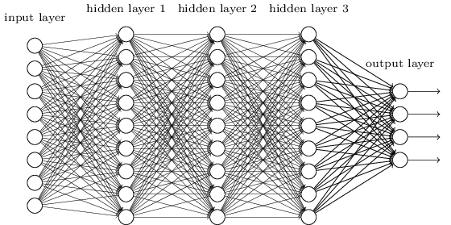
Join adjacency matrix and features
Feed them into a deep neural net:
• Done?
A B C D E
Feat
A | 0 | 1 | 1 | 1 | 0 | 1 | 0
B | 1 | 0 | 0 | 1 | 1 | 0 | 0
C | 1 | 0 | 0 | 1 | 0 | 0 | 1
D | 1 | 1 | 1 | 0 | 1 | 1 | 1
E | 0 | 1 | 0 | 1 | 0 | 1 | 0
?
A
B
E
C
D
▪ Issues with this idea:
Issues with this idea:
  𝑂(|𝑉|) parameters
  Not applicable to graphs of different sizes
  Sensitive to node ordering
31

Slide 32
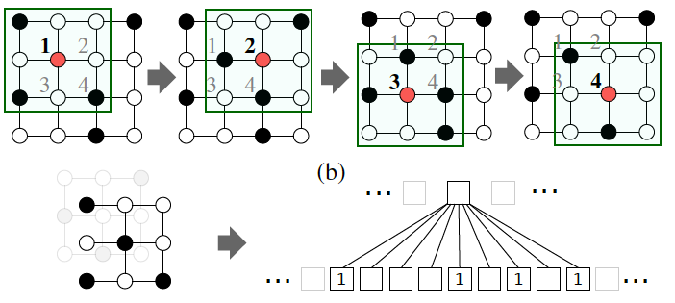
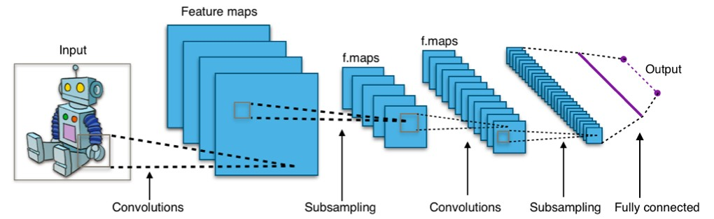
CNN on an image:
Goal is to generalize convolutions beyond simple lattices Leverage node features/attributes (e.g., text, images)
Jure Leskovec, Stanford University

Slide 33

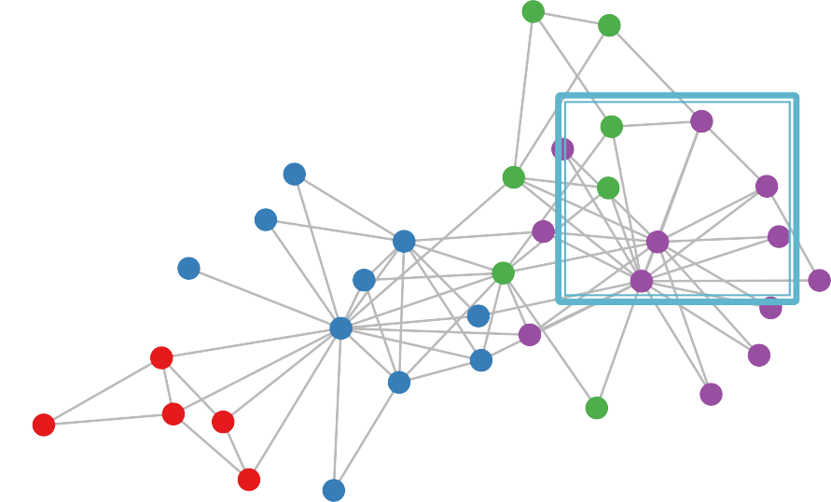
But our graphs look like this:
or this:
this:
There is no fixed notion of locality or sliding window on the graph
Graph is permutation invariant
Jure Leskovec, Stanford University

Slide 34
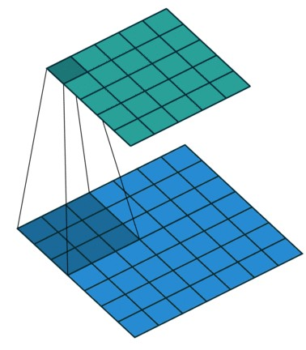
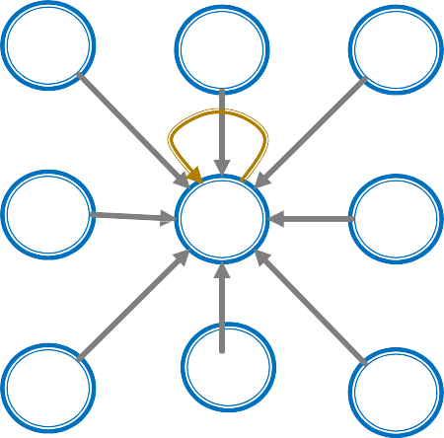
Single Convolutional neural network (CNN) layer with 3x3 filter:
(Animatio cent Dumo
Vin
Image Graph
Idea: transform information at the neighbors and combine it:
Transform “messages” ℎ$ from neighbors: 𝑊$ ℎ$
Add them up: ∑$ 𝑊$ ℎ$

Slide 35
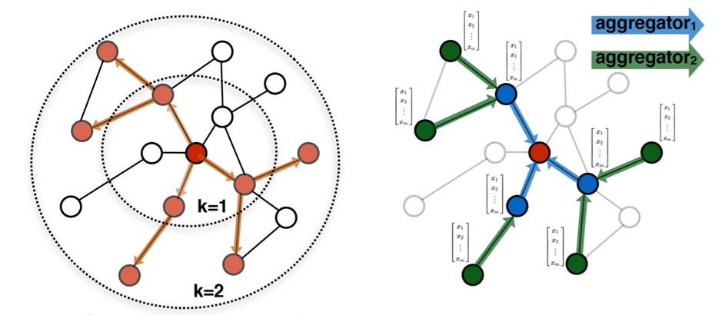
Idea: Node’s neighborhood defines a computation graph
[Kipf and Welling, ICLR 2017]
𝑖
𝑖
Determine node computation graph
Propagate and transform information
Learn how to propagate information across the graph to compute node features

Slide 36
Key idea: Generate node embeddings based on local network neighborhoods
A
TARGET NODE
B
B
C
A
B
A
C
A
C
F
E
D
F
E
D
INPUT GRAPH
A

Slide 37
Intuition: Nodes aggregate information from their neighbors using neural networks
A
TARGET NODE
B
B
C
A
B
A
C
A
C
E
F
F
D
E
INPUT GRAPH
D
A
Neural networks

Slide 38
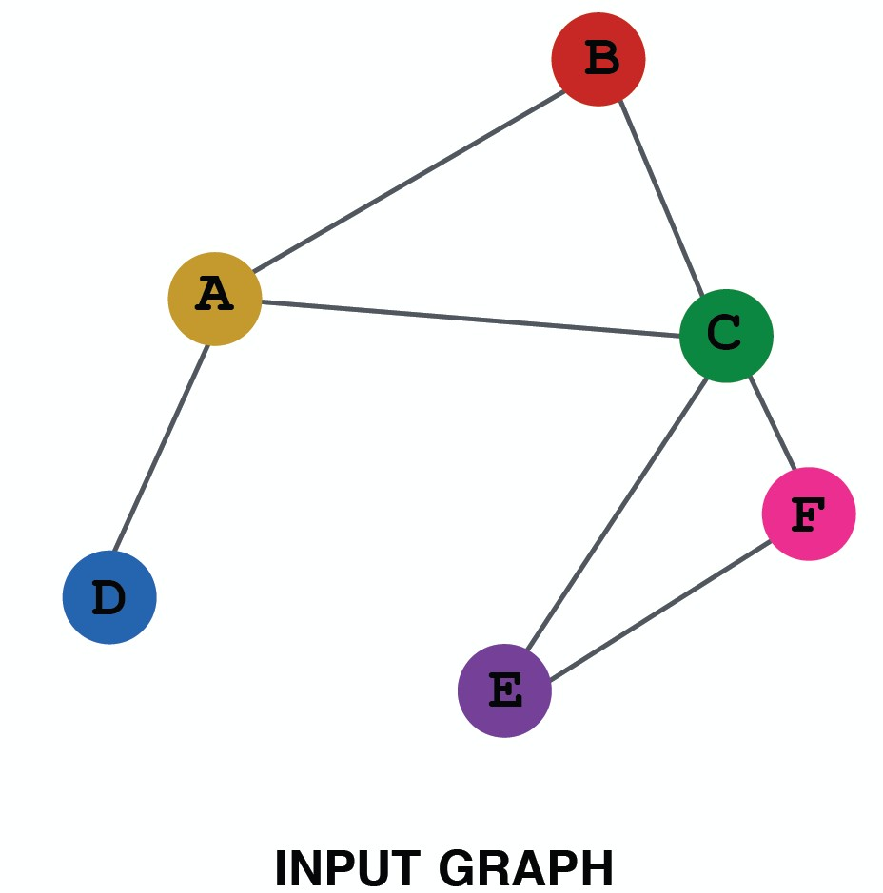
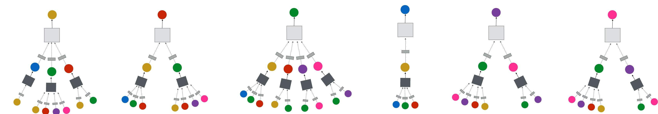
Intuition: Network neighborhood defines a computation graph
Every node defines a computation graph based on its neighborhood!

Slide 39
Model can be of arbitrary depth:
Nodes have embeddings at each layer
Layer-0 embedding of node 𝑢 is its input feature, 𝑥_{𝑢}
Layer-𝑘 embedding gets information from nodes that are K hops away
Layer-0
x_{A}
Layer-1
B
A
x_{C}
TARGET NODE
B
C
x_{A}
Layer-2
A
B
x_{B}
A
C
x
A
C
_{x}E
F
E
D
F
F
x_{A}
E
D
INPUT GRAPH
A

Slide 40
Neighborhood aggregation: Key distinctions are in how different approaches aggregate information across the layers
A
?
TARGET NODE
B
B
C
What is in the box?
A
A
C
B
?
?
A
C
F
E
D
F
E
D
?
INPUT GRAPH
A
40

Slide 41
Basic approach: Average information from neighbors and apply a neural network
(1) average messages from neighbors
A
TARGET NODE
B
B
C
A
B
A
C
A
C
F
E
D
F
E
D
INPUT GRAPH
(2) apply neural network
A
41

Slide 42
Basic approach: Average neighbor messages and apply a neural network
Initial 0-th layer embeddings are
h? = x
equal to node features
embedding of
𝑣 at layer 𝑙
> >
_{h}(8)
h> = 𝜎(W₈ I
A∈C(>)
(89.)
A
+ B h
(8)
>
), ∀𝑙 ∈ {0, … , − 1}
𝐿
N(𝑣)
8
_{z> = h}(@)
Average of neighbor’s previous layer embeddings
Non-linearity (e.g., ReLU)
Total number of layers
>
Embedding after L
layers of neighborhoo
d
aggregation

Slide 43

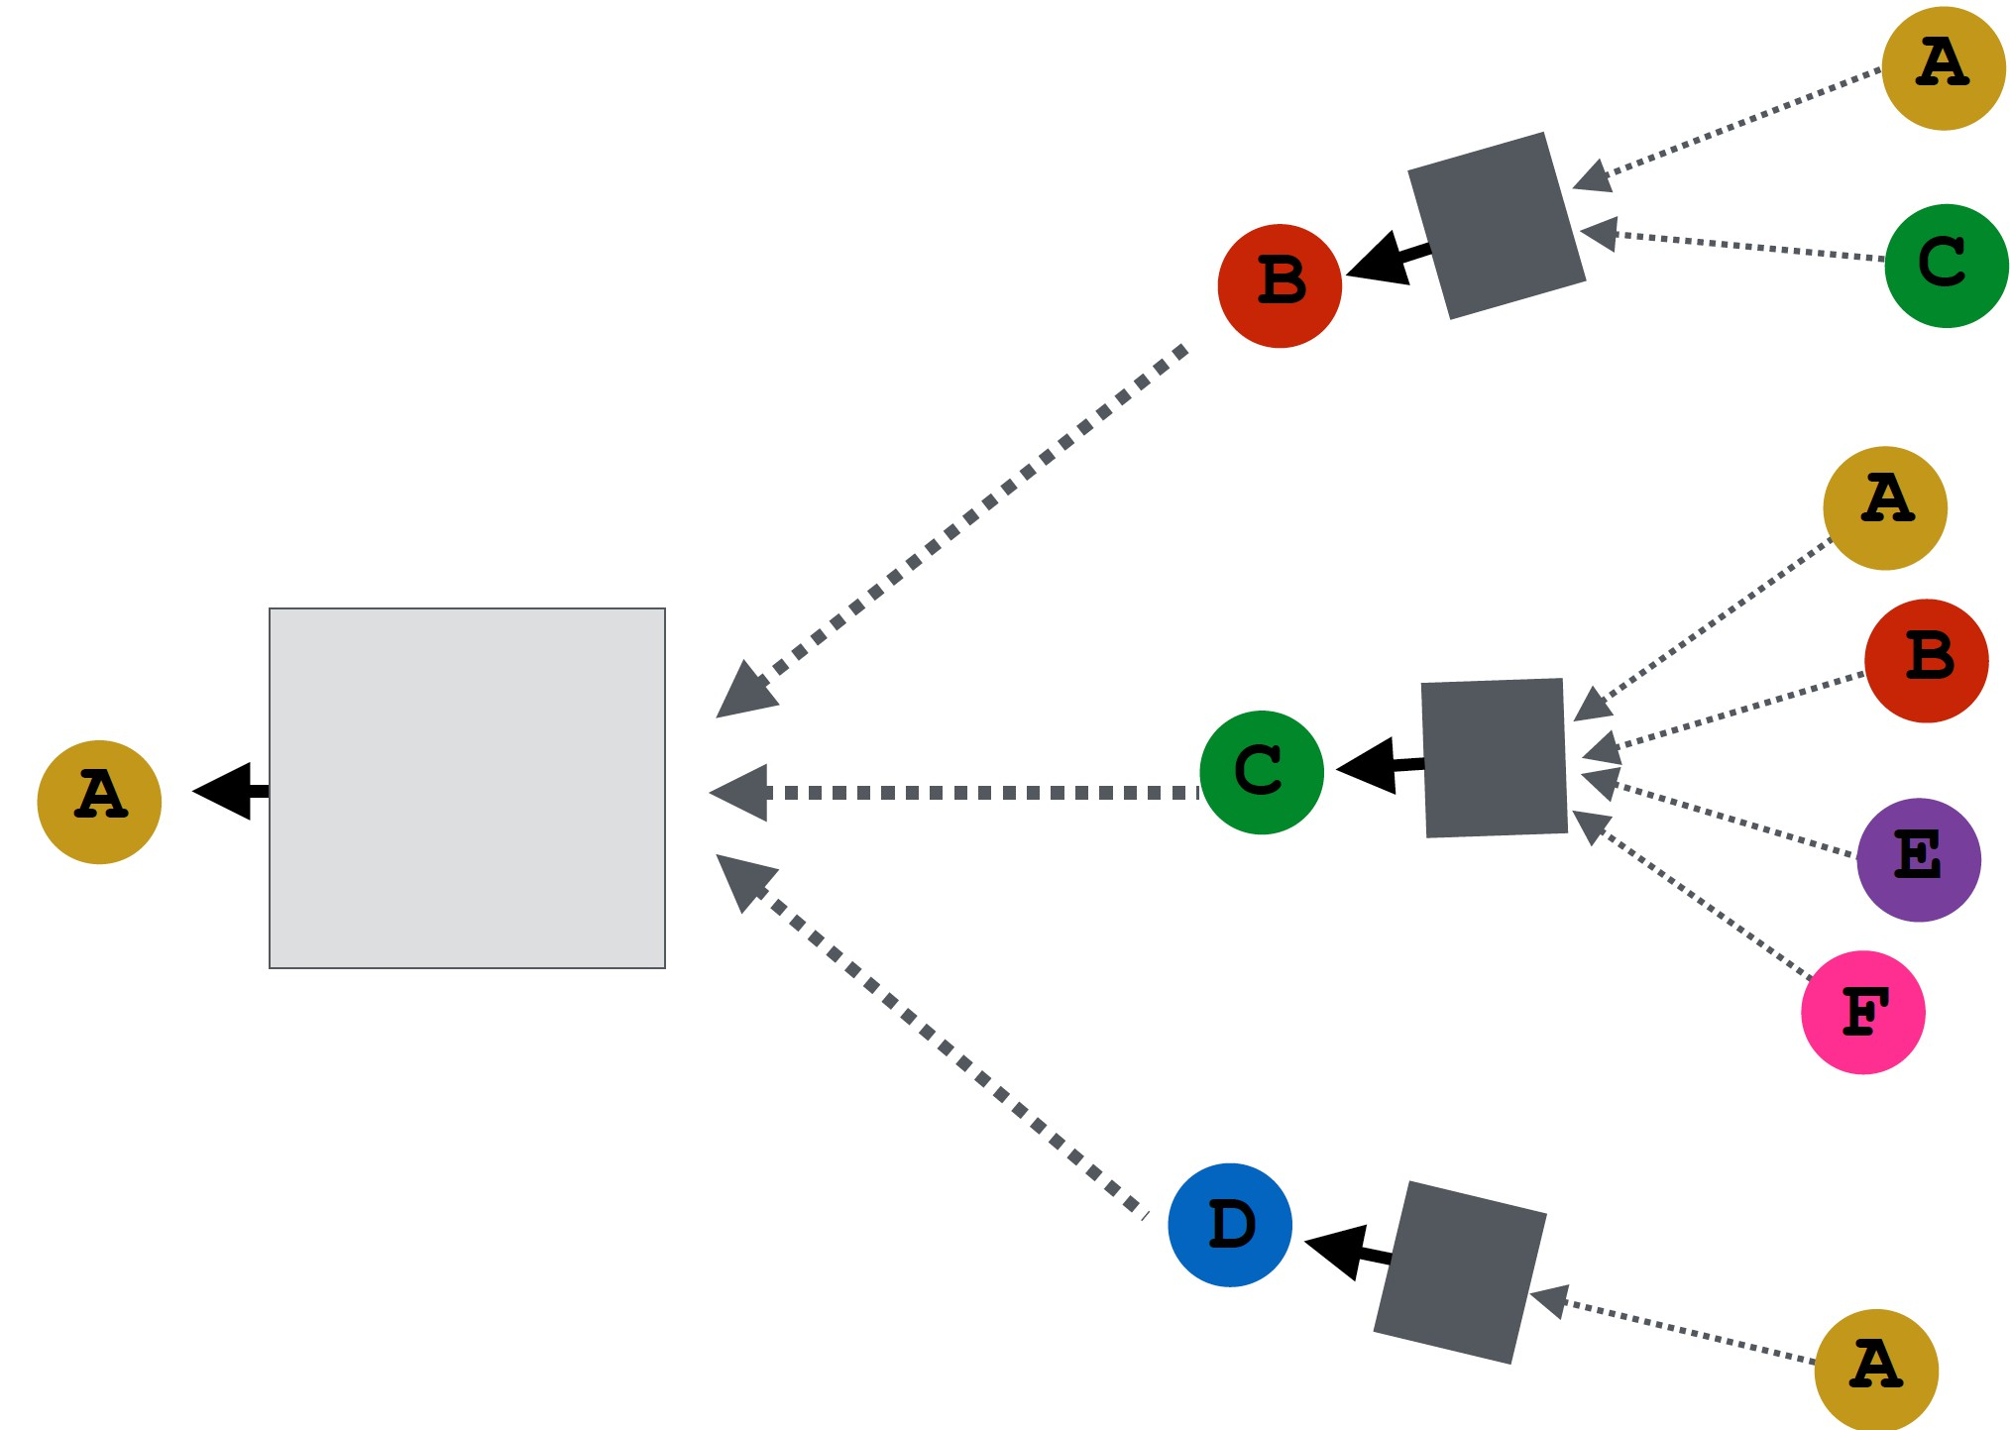
How do we train the model to generate embeddings?
𝒛_{D}
Need to define a loss function on the embeddings

Slide 44
_{h}(3) _{= x1}
Trainable weight matrices (i.e., what we learn)
1
_{h}(6)
_{h}(670) _{= 𝜎(W6}
8 ⁸ + B₆h⁽⁶⁾), ∀𝑙 ∈ {0, … , 𝐿 − 1}
1
N(𝑣)
1
_{= h}(5)
8∈:(1)
z
1
1
Final node embedding
We can feed these embeddings into any loss function
and run SGD to train the weight parameters
ℎ" : the hidden representation of node 𝑣 at layer 𝑙
!
𝑊#: weight matrix for neighborhood aggregation
𝐵#: weight matrix for transforming hidden vector of self

Slide 45
Many aggregations can be performed efficiently by (sparse) matrix operations
¡
^{Let} 𝐻⁽⁻⁾ = [ℎ⁽⁻⁾ … ℎ⁽⁻⁾]⁵
Matrix of hidden embeddings 𝐻%&!
2 |4|
Then: ∑
(-)
= H
(-)
*∈,% ^{ℎ}*
^{A}!,:
Let 𝐷 be diagonal matrix where
𝐷!,! = Deg 𝑣 = |𝑁 𝑣 |
  The inverse of 𝐷: 𝐷%& is also diagonal:
𝐷%& = 1/|𝑁 𝑣 |
𝒉'
%&!
','
Therefore,
(345)
; ℎ₀
|𝑁(𝑣)|
0∈1(2)
_{𝐻}(89.) _{= 𝐷}0._{𝐴𝐻}(8)

Slide 46
Re-writing update function in matrix form:
𝐻^{(89.)} = 𝜎(𝐴^{U}𝐻⁽⁸⁾𝑊^{I} + 𝐻 ⁸ 𝐵^{I})
8 8
where
𝐴^{U} = 𝐷^{0.}𝐴
Red: neighborhood aggregation
Blue: self transformation
𝐻^{($)} = [ℎ^{($)} … ℎ^{($)}]⁻
& |,|
In practice, this implies that efficient sparse matrix multiplication can be used (𝐴^{J} is sparse)
Note: not all GNNs can be expressed in matrix form, when aggregation function is complex

Slide 47
Node embedding 𝒛₁ is a function of input graph
Supervised setting: we want to minimize the loss
ℒ (see also slide 15):
min ℒ(𝒚, 𝑓 𝒛! )
$
𝒚: node label
ℒ could be L2 if 𝒚 is real number, or cross entropy if 𝒚 is categorical
Unsupervised setting:
  No node label available
  Use the graph structure as the supervision!

Slide 48

“Similar” nodes have similar embeddings
ℒ = 7 CE(𝑦*,!, DEC 𝑧*, 𝑧! )
6&,6%
Where 𝑦_{A,>} = 1 when node 𝑢 and 𝑣 are similar
CE is the cross entropy (slide 16)
DEC is the decoder such as inner product (lecture 4)
Node similarity can be anything from lecture 3, e.g., a loss based on:
  Random walks (node2vec, DeepWalk, struc2vec)
  Matrix factorization
  Node proximity in the graph

Slide 49

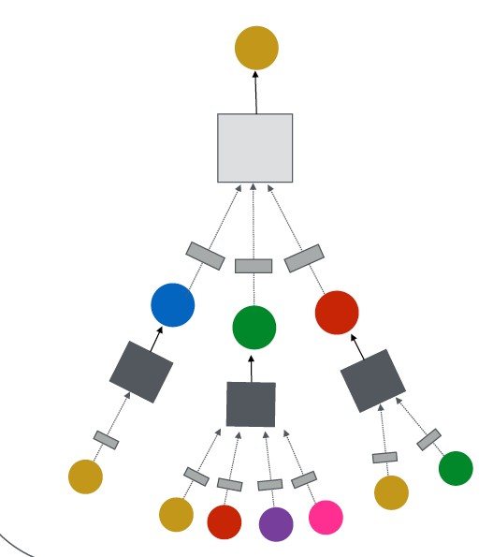
Directly train the model for a supervised task (e.g., node classification)
Safe or toxic drug?
Safe or toxic drug?
E.g., a drug-drug interaction network

Slide 50
Directly train the model for a supervised task (e.g., node classification)
Use cross entropy loss (slide 16)
ℒ = 8 𝑦₁log(𝜎
(z^{A} )) + 1 − 𝑦₁ log(1 − 𝜎
_{z}A
𝜃 )
1
𝜃
1
1∈@
Encoder output:
node embedding
Classification weights
Node class label
Safe or toxic drug?
50

Slide 51
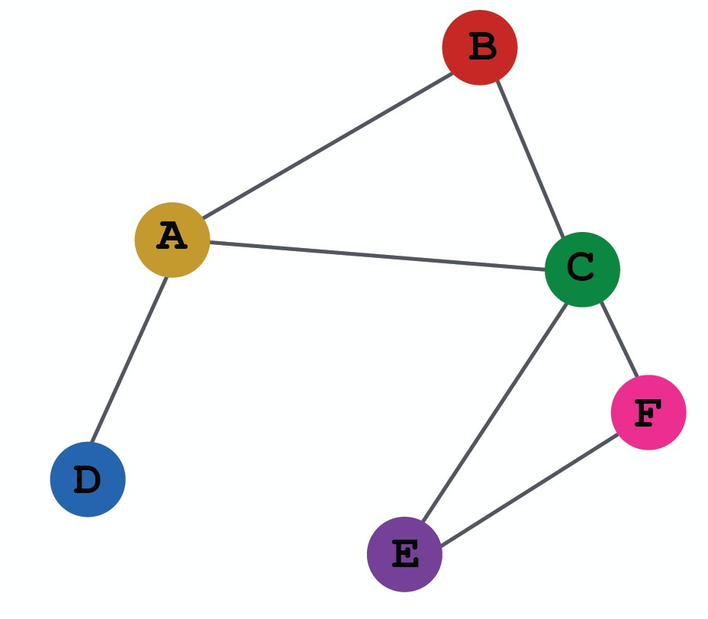
(1) Define a neighborhood aggregation function
𝒛₈
(2) Define a loss function on the embeddings

Slide 52
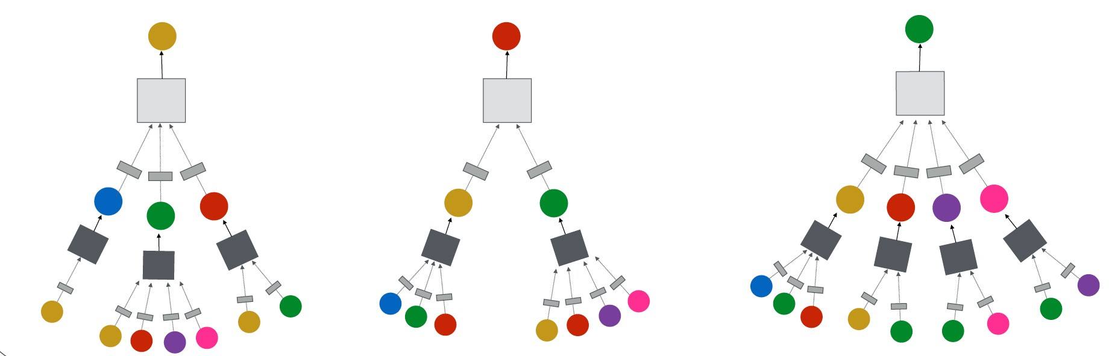
(3) Train on a set of nodes, i.e., a batch of compute graphs

Slide 53

(4) Generate embeddings for nodes as needed
Even for nodes we never trained on!

Slide 54

The same aggregation parameters are shared for all nodes:
The number of model parameters is sublinear in
|𝑉| and we can generalize to unseen nodes!
shared parameters
𝑊₉ 𝐵₉
shared parameters
B
A
C
F
D
E
INPUT GRAPH
Compute graph for node A
Compute graph for node B

Slide 55
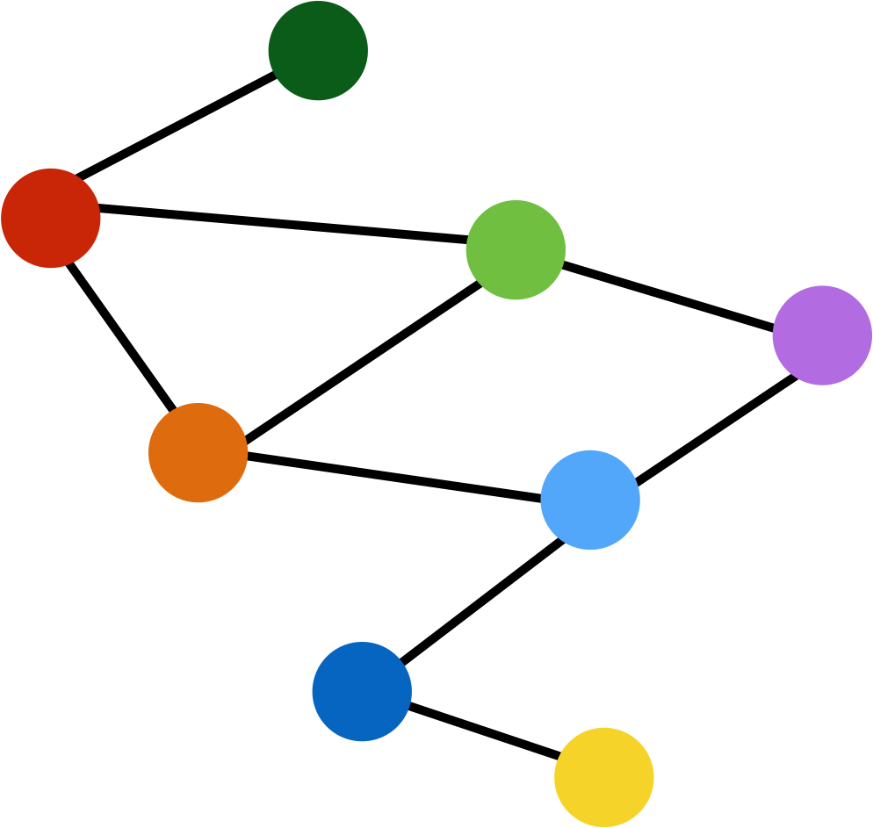
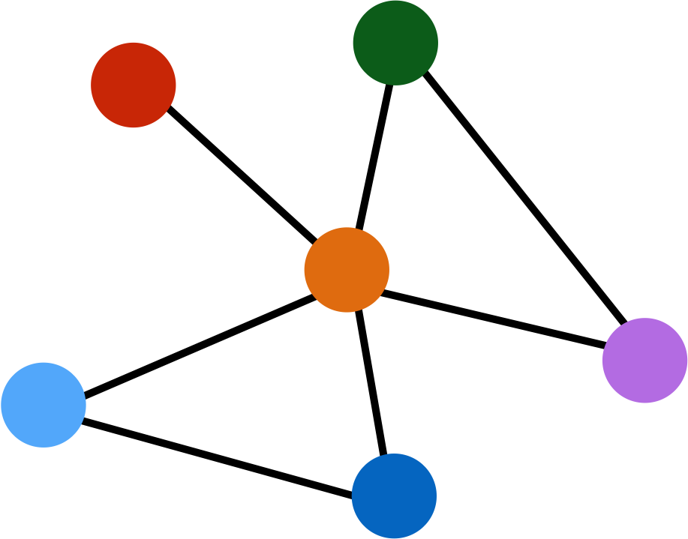
Train on one graph
z<
Generalize to new graph
Inductive node embedding Generalize to entirely unseen graphs
E.g., train on protein interaction graph from model organism A and generate embeddings on newly collected data about organism B

Slide 56
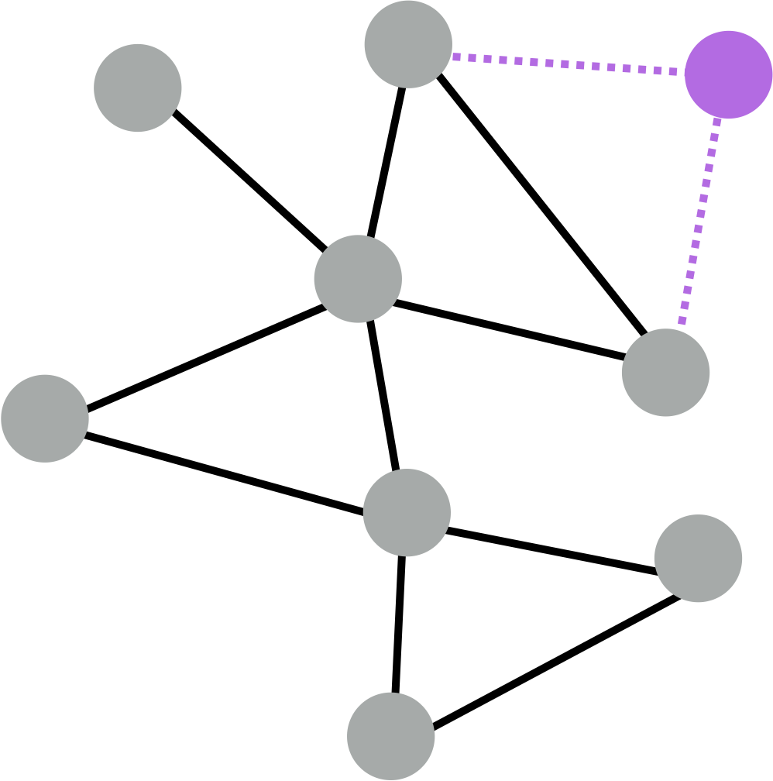
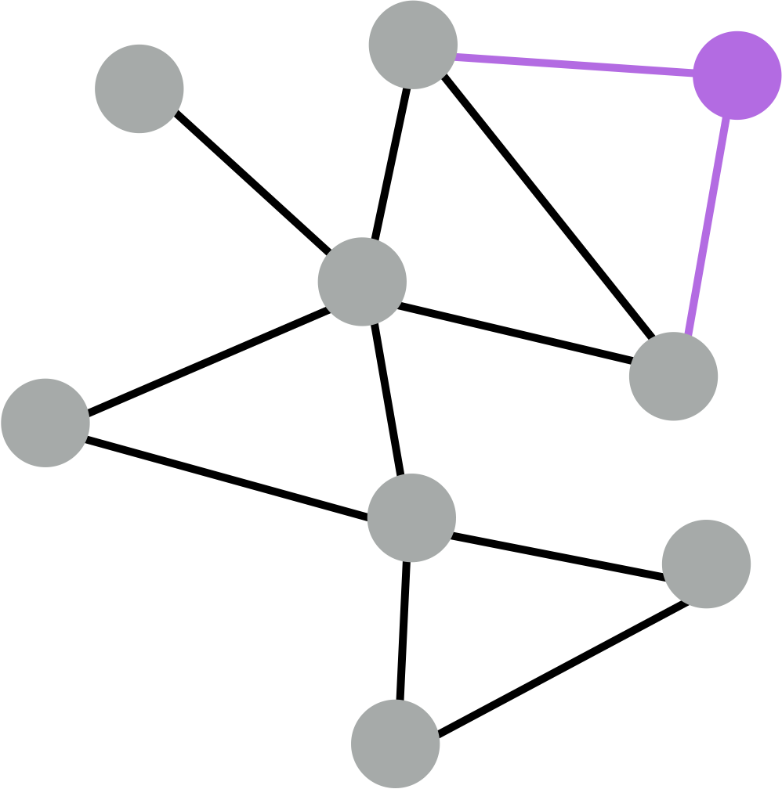
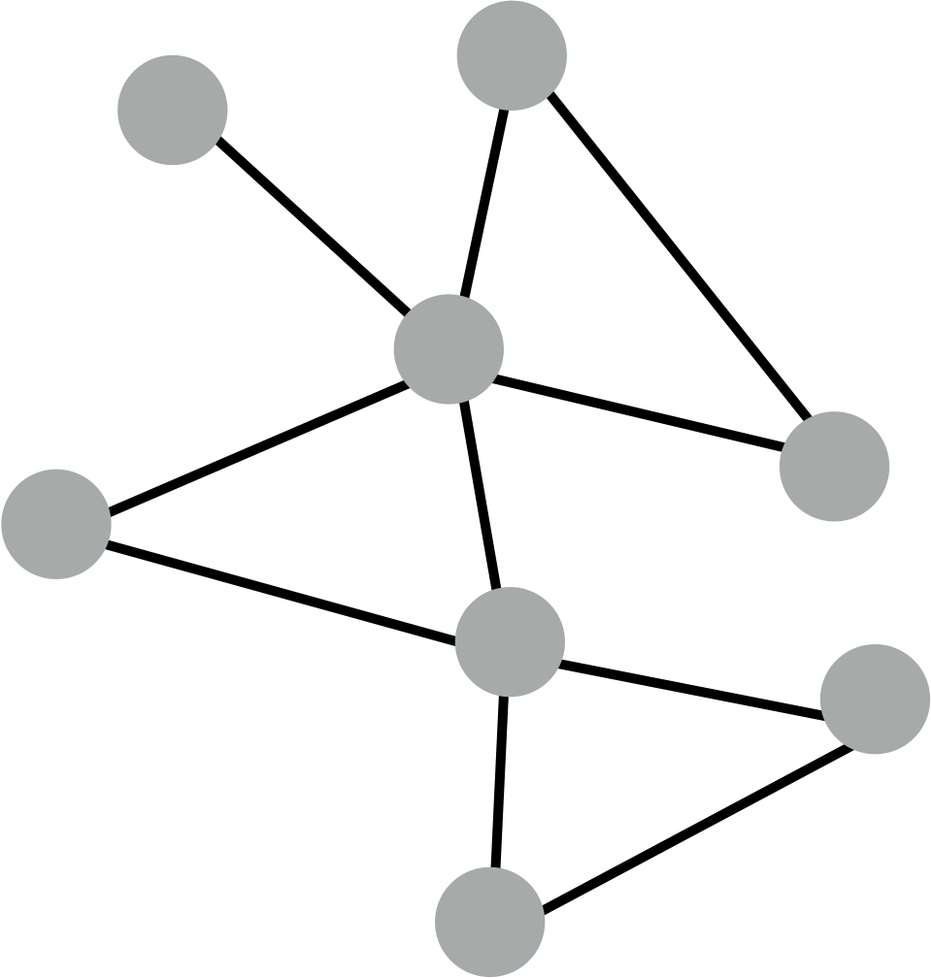
z<
Train with snapshot
New node arrives
Generate embedding for new node
Many application settings constantly encounter previously unseen nodes:
  E.g., Reddit, YouTube, Google Scholar
Need to generate new embeddings “on the fly”

Slide 57
Recap: Generate node embeddings by aggregating neighborhood information
We saw a basic variant of this idea
Key distinctions are in how different approaches aggregate information across the layers
Next: Describe GraphSAGE graph neural network architecture

Slide 58


Basics of deep learning
Deep learning for graphs
Graph Convolutional Networks and GraphSAGE

Slide 59

CS224W: Machine Learning with Graphs Jure Leskovec, Stanford University
http://cs224w.stanford.edu

Slide 60

So far we have aggregated the neighbor messages by taking their (weighted) average Can we do better?
[Hamilton et al., NIPS 2017]
A
?
TARGET NODE
B
B
C
A
A
C
B
?
?
A
C
F
E
D
F
E
D
?
INPUT GRAPH
A

Slide 61

Any differentiable function that maps set of vectors in 𝑁(𝑢) to a single vector
A
TARGET NODE
B
B
C
A
B
A
C
A
C
F
E
D
F
E
D
INPUT GRAPH
A
h⁽⁶⁷⁰⁾ = 𝜎([W₆ K AGG
h⁽⁶⁾, ∀𝑢 ∈ 𝑁 𝑣
, B₆h⁽⁶⁾])
1
8 1
How does this message passing architecture differ?

Slide 62
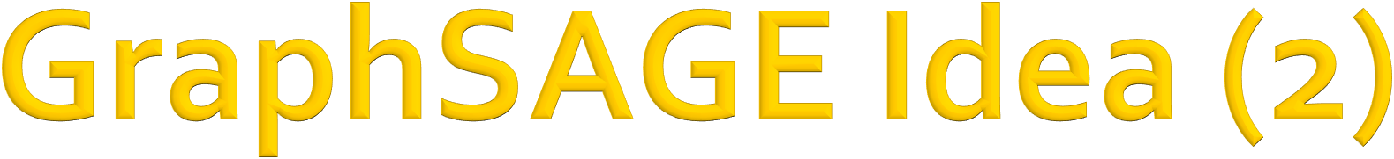
h⁽⁶⁷⁰⁾ = 𝜎([W₆ K AGG
h⁽⁶⁾, ∀𝑢 ∈ 𝑁 𝑣
, B₆h⁽⁶⁾])
1 8
1
Optional: Apply L2 normalization to h^{(*+!)} embedding at every layer
(
ℓ' Normalization:
,7
ℎ⁺ ← ⁶ ∀𝑣 ∈ 𝑉 where
𝑢 = ∑ 𝑢% (ℓ -norm)
*
,7
%
! !
%
6
8
Without ℓ% normalization, the embedding vectors have different scales (ℓ%-norm) for vectors
In some cases (not always), normalization of embedding results in performance improvement
After ℓ% normalization, all vectors will have the same ℓ%- norm

Slide 63
Simple neighborhood aggregation:
_{h}(9)
h! = 𝜎(W₉ Q
#∈;(!)
(9:&)
#
+ B h
(9)
)
𝑁(𝑣)
9
!
GraphSAGE:
Concatenate neighbor embedding and self embedding
h⁽⁶⁷⁰⁾ = 𝜎([W₆ K AGG
h⁽⁶⁾, ∀𝑢 ∈ 𝑁 𝑣
, B₆h⁽⁶⁾])
1
8
1
Flexible aggregation function instead of mean

Slide 64
Mean: Take a weighted average of neighbors
_{h}(9)
AGG = Q
#
𝑁(𝑣)
#∈;(!)
Pool: Transform neighbor vectors and apply symmetric vector function
Element-wise mean/max
AGG = 𝛾({MLP(h⁽⁶⁾), ∀𝑢 ∈ 𝑁(𝑣)})
8
LSTM: Apply LSTM to reshuffled of neighbors
AGG = LSTM([h⁽⁶⁾, ∀𝑢 ∈ 𝜋 𝑁 𝑣 ])
8

Slide 65
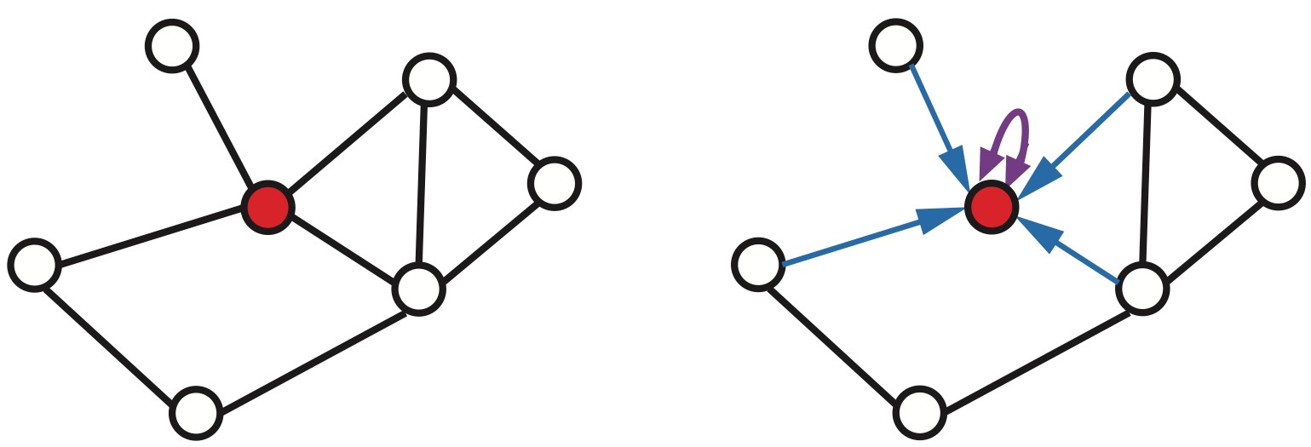
Key idea: Generate node embeddings based on local neighborhoods
Nodes aggregate “messages” from their neighbors using neural networks
Graph convolutional networks:
  Basic variant: Average neighborhood information and stack neural networks
GraphSAGE:
  Generalized neighborhood aggregation
𝑣
𝑣

Slide 66
In this lecture, we introduced
Basics of neural networks
  Loss, Optimization, Gradient, SGD, non-linearity, MLP
Idea for Deep Learning for Graphs
  Multiple layers of embedding transformation
  At every layer, use the embedding at previous layer as the input
  Aggregation of neighbors and self embeddings
Graph Convolutional Network
  Mean aggregation; can be expressed in matrix form
GraphSAGE: more flexible aggregation

