Slide 1
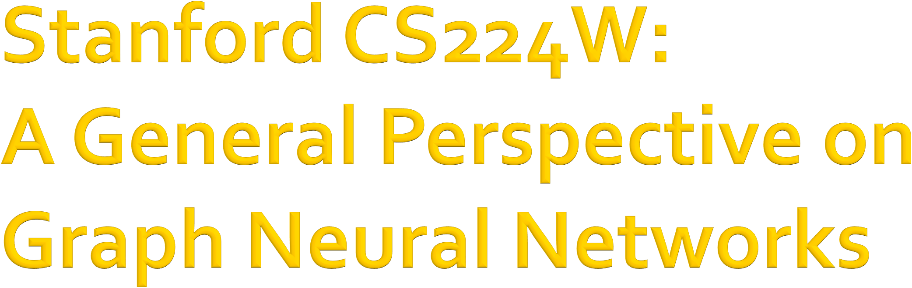

CS224W: Machine Learning with Graphs Jure Leskovec, Stanford University
http://cs224w.stanford.edu

Slide 2
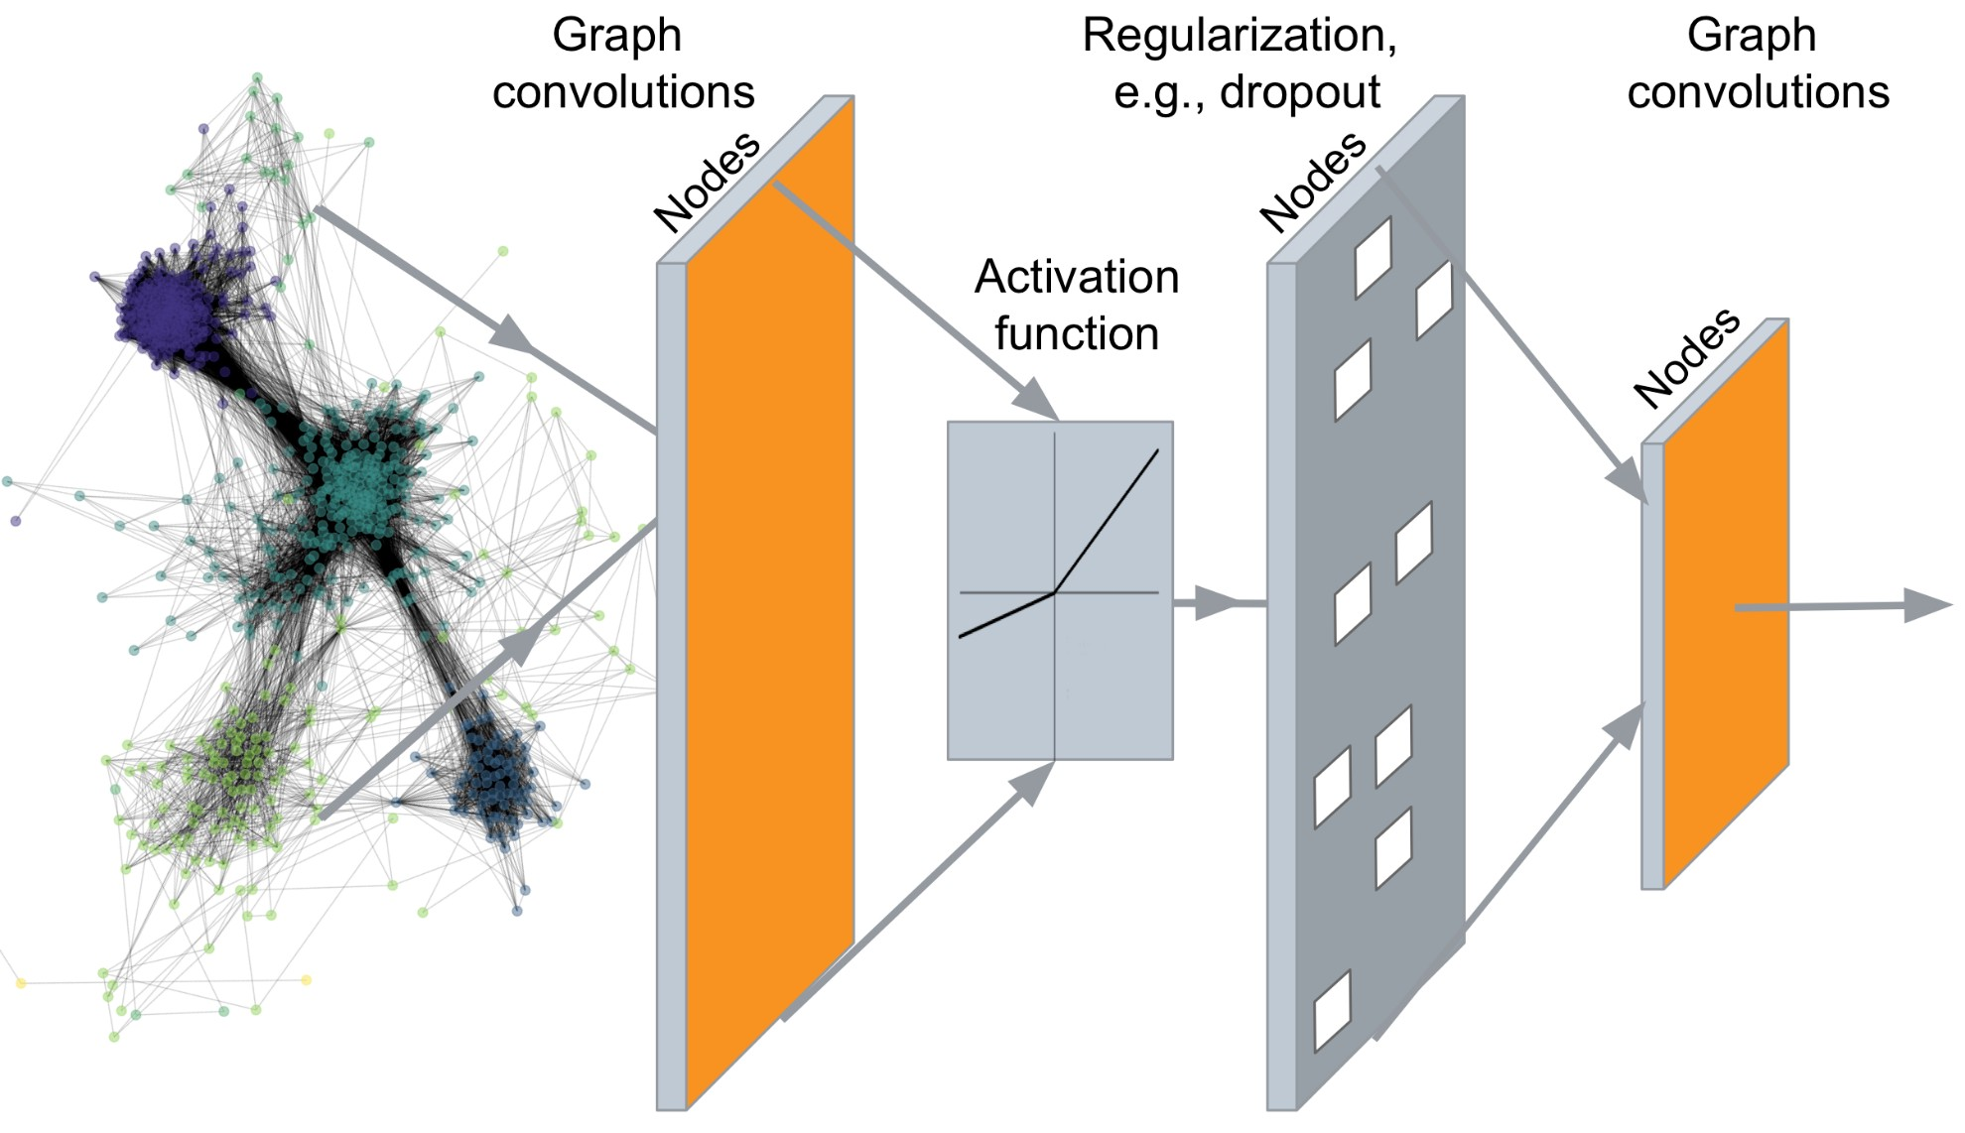
…
Output: Node embeddings. Also, we can embed subgraphs, graphs
2

Slide 3
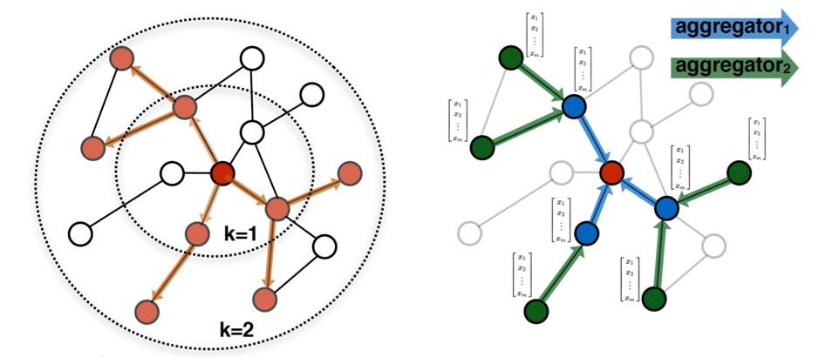
Idea: Node’s neighborhood defines a computation graph
𝑖
𝑖
Determine node computation graph
Propagate and transform information
Learn how to propagate information across the graph to compute node features
2

Slide 4
Intuition: Nodes aggregate information from their neighbors using neural networks
A
TARGET NODE
B
B
C
A
B
A
C
A
C
E
F
F
D
E
INPUT GRAPH
D
A
Neural networks
2

Slide 5
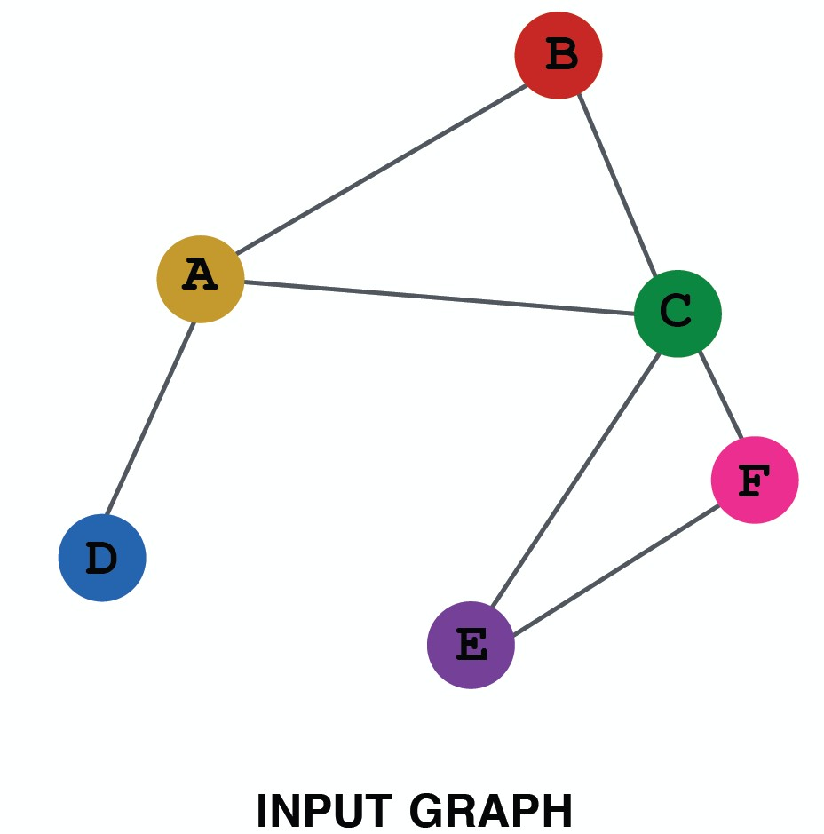
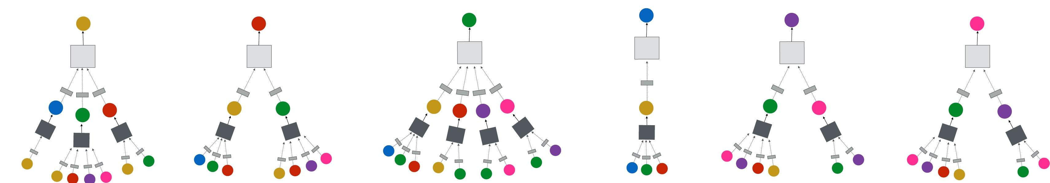
Intuition: Network neighborhood defines a computation graph
Every node defines a computation graph based on its neighborhood!
2

Slide 6
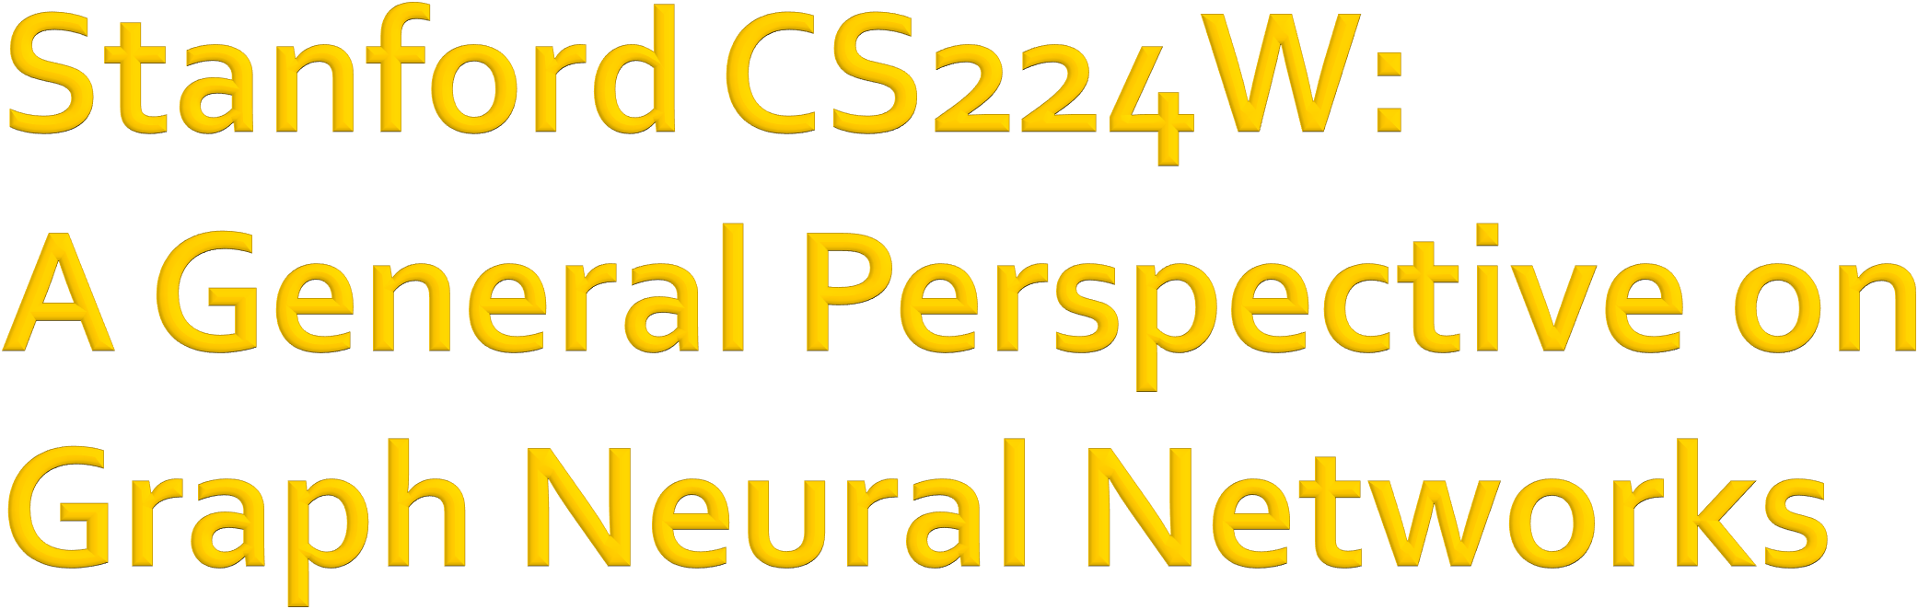

CS224W: Machine Learning with Graphs Jure Leskovec, Stanford University
http://cs224w.stanford.edu

Slide 7
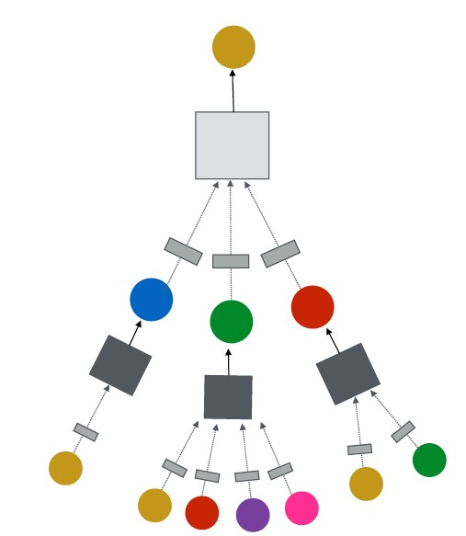
GNN Layer = Message + Aggregation
J.You, R.Ying, J. Leskovec. Design Space of Graph Neural Networks, NeurIPS 2020
TARGET NODE
B
Different instantiations under this perspective
GCN, GraphSAGE, GAT, …
A
C
D
E
F
INPUT GRAPH
(2) Aggregation
(1) Message
GNN Layer 1
7

Slide 8
Connect GNN layers into a GNN
J.You, R.Ying, J. Leskovec. Design Space of Graph Neural Networks, NeurIPS 2020
TARGET NODE
B
Stack layers sequentially
Ways of adding skip connections
A
C
D
E
F
GNN Layer 1
INPUT GRAPH
(3) Layer connectivity
GNN Layer 2
7

Slide 9
Idea: Raw input graph ≠ computational graph
J.You, R.Ying, J. Leskovec. Design Space of Graph Neural Networks, NeurIPS 2020
TARGET NODE
B
Graph feature augmentation
Graph structure augmentation
A
C
D
E
INPUT GRAPH
F
(4) Graph augmentation
7

Slide 10
J.You, R.Ying, J. Leskovec. Design Space of Graph Neural Networks, NeurIPS 2020
TARGET NODE
B
(5) Learning objective
A
C
D
E
INPUT GRAPH
F
How do we train a GNN
Supervised/Unsupervised objectives
Node/Edge/Graph level objectives
10

Slide 11
J.You, R.Ying, J. Leskovec. Design Space of Graph Neural Networks, NeurIPS 2020
TARGET NODE
B
(5) Learning objective
A
C
D
E
F
INPUT GRAPH
(2) Aggregation
(1) Message
GNN Layer 1
(3) Layer connectivity
GNN Layer 2
(4) Graph augmentation
11

Slide 12

CS224W: Machine Learning with Graphs Jure Leskovec, Stanford University
http://cs224w.stanford.edu

Slide 13

GNN Layer = Message + Aggregation
J.You, R.Ying, J. Leskovec. Design Space of Graph Neural Networks, NeurIPS 2020
TARGET NODE
B
Different instantiations under this perspective
GCN, GraphSAGE, GAT, …
A
C
D
E
F
INPUT GRAPH
(2) Aggregation
(1) Message
GNN Layer 1

Slide 14

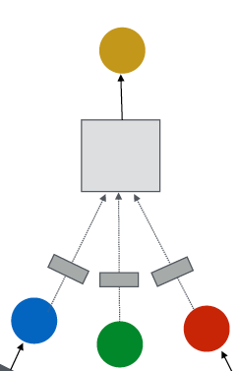
Idea of a GNN Layer:
Compress a set of vectors into a single vector
Two step process:
  (1) Message
Output node embedding 𝐡 "
(2) Aggregation
!
Node 𝒗
𝒍-th GNN Layer
(2) Aggregation
(1) Message
Input node embedding 𝐡 "#$
_{, 𝐡} "#$
!
%∈'(!)
(from node itself + neighboring nodes)

Slide 15

(1) Message computation
_{𝐡} $&'
Message function:
𝐦^{($)} = MSG $
" "
Intuition: Each node will create a message, which will be sent to other nodes later
Example: A Linear layer 𝐦^{(%)} = 𝐖 % 𝐡 ^{%'(}
# #
  Multiply node features with weight matrix 𝐖 !
Node 𝒗
TARGET NODE
B
(2) Aggregation
A
C
F
(1) Message
D
E
INPUT GRAPH

Slide 16

(2) Aggregation
Intuition: Each node will aggregate the messages from node 𝑣’s neighbors
𝐡^{(#)} = AGG #
𝐦 $ , 𝑢 ∈ 𝑁 𝑣
!
"
Example: Sum(⋅), Mean(⋅) or Max(⋅) aggregator
  𝐡 % = Sum({𝐦 % , 𝑢 ∈ 𝑁(𝑣)})
) #
TARGET NODE
B
Node 𝒗
A
C
(2) Aggregation
F
D
(1) Message
E
INPUT GRAPH

Slide 17
Issue: Information from node 𝑣 itself could get lost
Computation of 𝐡^{(%)} does not directly depend on 𝐡^{(%'()}
) )
Solution: Include 𝐡^{($&')} when computing 𝐡^{($)}
( (
(1) Message: compute message from node 𝒗 itself
  Usually, a different message computation will be performed
_{𝐦}(!) _{= 𝐖} ! _{𝐡} !%& _{𝐦}(!) _{= 𝐁} ! _{𝐡} !%& ' ' " "
(2) Aggregation: After aggregating from neighbors, we can
aggregate the message from node 𝒗 itself
  Via concatenation or summation
Then aggregate from node itself
_{𝐡} % _{𝐦} %
= CONCAT AGG
𝐦 % , 𝑢 ∈ 𝑁 𝑣 ,
) # )
First aggregate from neighbors

Slide 18
Putting things together:
(1) Message: each node computes a message
_{𝐡} $&'
𝐦^{($)} = MSG $
, 𝑢 ∈ {𝑁 𝑣 ∪ 𝑣}
" "
(2) Aggregation: aggregate messages from neighbors
𝐡^{(#)} = AGG # 𝐦 # , 𝑢 ∈ 𝑁 𝑣
, 𝐦 #
! % !
Nonlinearity (activation): Adds expressiveness
  Often written as 𝜎(⋅): ReLU(⋅), Sigmoid(⋅) , …
  Can be added to message or aggregation
(2) Aggregation
(1) Message

Slide 19
(1) Graph Convolutional Networks (GCN)
T. Kipf, M. Welling. Semi-Supervised Classification with Graph Convolutional Networks, ICLR 2017
_{𝐡} %'(
(%)
_{𝐖} %
G
#∈+ )
#
𝐡₎ = 𝜎
𝑁 𝑣
How to write this as Message + Aggregation?
Message
_{𝐡} %'(
𝐡₎ = 𝜎 G
#∈+ )
_{𝐖} %
(2) Aggregation
(%)
#
𝑁 𝑣
(1) Message
Aggregation

Slide 20
(1) Graph Convolutional Networks (GCN)
_{𝐡} %'(
𝐡₎ = 𝜎 G
#∈+ )
_{𝐖} %
(%)
#
(2) Aggregation
𝑁 𝑣
(1) Message
Message:
Each Neighbor: 𝐦#
Aggregation:
(
Normalized by node degree
(In the GCN paper they use a slightly different normalization)
(%)
%
%'(
𝐖 𝐡#
⁼ + )
Sum over messages from neighbors, then apply activation
𝐡 %
= 𝜎 Sum
𝐦 % , 𝑢 ∈ 𝑁 𝑣
)
#
20

Slide 21
(2) GraphSAGE
Hamilton et al. Inductive Representation Learning on Large Graphs, NeurIPS 2017
_{𝐡}(%) _{= 𝜎}
𝐖^{(%)} H CONCAT 𝐡 ^{%'(} , AGG 𝐡 ^{%'(} , ∀𝑢 ∈ 𝑁 𝑣
) ) #
How to write this as Message + Aggregation?
  Message is computed within the AGG ⋅
  Two-stage aggregation
    Stage 1: Aggregate from node neighbors
_{𝐡}(!)
← AGG 𝐡^{(!%&)}, ∀𝑢 ∈ 𝑁 𝑣
((")
'
Stage 2: Further aggregate over the node itself
𝐡^{(!)} ← 𝜎 𝐖^{(!)} ⋅ CONCAT(𝐡 !%& , 𝐡^{(!)} )
" "
((")

Slide 22
Mean: Take a weighted average of neighbors
_{𝐡}($&')
AGG =
Aggregation
7
"∈<(()
"
𝑁(𝑣)
Message computation
Pool: Transform neighbor vectors and apply symmetric vector function Mean(⋅) or Max(⋅)
AGG = Mean({MLP(𝐡^{($&')}), ∀𝑢 ∈ 𝑁(𝑣)})
"
Aggregation
Message computation
LSTM: Apply LSTM to reshuffled of neighbors
AGG = LSTM([𝐡^{($&')}, ∀𝑢 ∈ 𝜋 𝑁 𝑣 ])
"
Aggregation

Slide 23
ℓ! Normalization:
Optional: Apply ℓ, normalization to 𝐡^{(%)} at every layer
)
_{𝐡}(%)
��
(#)
← # ∀𝑣 ∈ 𝑉 where
𝑢 ' = ∑ 𝑢' (ℓ'-norm)
_{𝐡}(%)
! ( (
#
'
Without ℓ' normalization, the embedding vectors have different scales (ℓ'-norm) for vectors
In some cases (not always), normalization of embedding results in performance improvement
After ℓ' normalization, all vectors will have the same
ℓ'-norm

Slide 24
(3) Graph Attention Networks
_{𝛼("𝐖($)𝐡}($&')₎
𝐡^{($)} = 𝜎(∑
( "∈< (
"
Attention weights
In GCN / GraphSAGE
𝛼_{("} =
'
is the weighting factor (importance)
< (
of node 𝑢’s message to node 𝑣
⟹ 𝛼_{("} is defined explicitly based on the structural properties of the graph (node degree)
⟹ All neighbors 𝑢 ∈ 𝑁(𝑣) are equally important to node 𝑣

Slide 25
(3) Graph Attention Networks
_{𝛼("𝐖($)𝐡}($&')₎
𝐡^{($)} = 𝜎(∑
( "∈< ( "
Attention weights
Not all node’s neighbors are equally important
Attention is inspired by cognitive attention.
The attention 𝜶_{𝒗𝒖} focuses on the important parts of the input data and fades out the rest.
  Idea: the NN should devote more computing power on that small but important part of the data.
  Which part of the data is more important depends on the context and is learned through training.

Slide 26
Can we do better than simple neighborhood aggregation?
[Velickovic et al., ICLR 2018; Vaswani et al., NIPS 2017]
Can we let weighting factors 𝜶_{𝒗𝒖} to be learned?
Goal: Specify arbitrary importance to different neighbors of each node in the graph
Idea: Compute embedding 𝒉^{(%)} of each node in the
#
graph following an attention strategy:
Nodes attend over their neighborhoods’ message
Implicitly specifying different weights to different nodes in a neighborhood

Slide 27
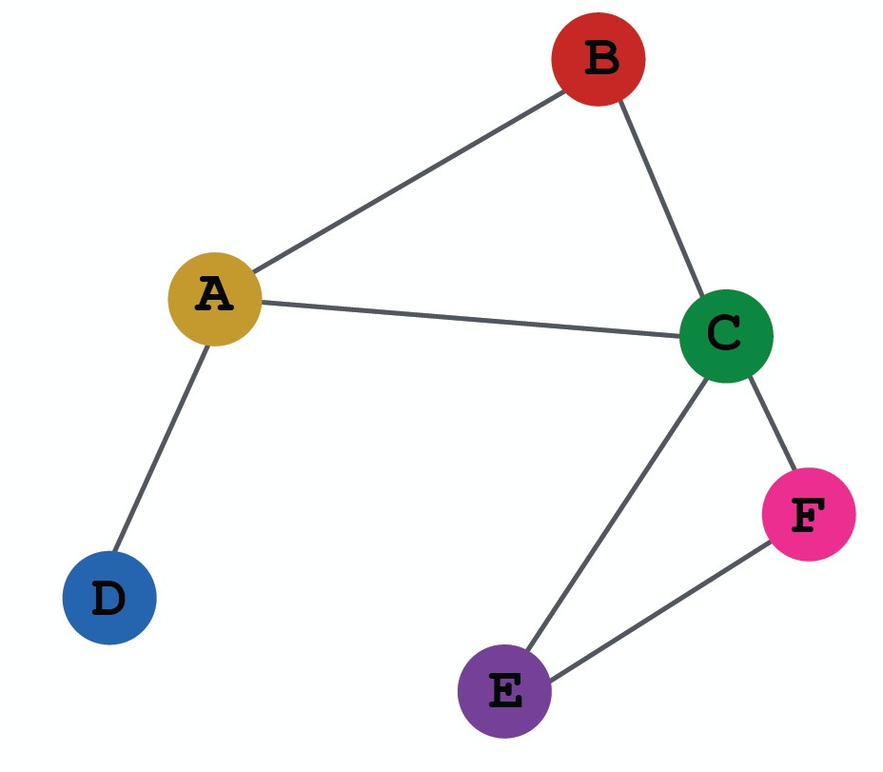
Let 𝛼"# be computed as a byproduct of an
attention mechanism 𝒂:
(1) Let 𝑎 compute attention coefficients 𝒆_{𝒗𝒖} across pairs of nodes 𝑢, 𝑣 based on their messages:
_{𝑒(" = 𝑎(𝐖($)𝐡}($&')_{, 𝐖($)𝒉}($&')₎
" (
  𝒆_{𝒗𝒖} indicates the importance of 𝒖/𝐬 message to node 𝒗
_{𝐡}("#$)
^{𝑒}*+
+
_{𝐡}("#$)
*
_{𝑒12 = 𝑎(𝐖(%)𝐡}(%'()_{, 𝐖(%)𝐡}(%'()₎
1 2

Slide 28
Normalize 𝑒_{("} into the final attention weight 𝜶_{𝒗𝒖}
Use the softmax function, so that ∑_{#∈+ )} 𝛼_{)#} = 1:
exp(𝑒!%)
∑_{)∈+ !} exp(𝑒_{!)})
𝛼 =
!%
Weighted sum based on the final attention weight
^{𝜶}𝒗𝒖
_{𝛼!%𝐖(%)𝐡}(#,-)₎
𝐡^{(#)} = 𝜎(∑
! %∈+ !
%
_{𝐡}("#$)
^{𝛼}*+
+
Weighted sum using 𝛼₁₂, 𝛼₁₄, 𝛼₁₅:
_{𝐡}(!) _{= 𝜎(𝛼)*𝐖(!)𝐡}(!%&)_{+𝛼)+𝐖(!)𝐡}(!%&)₊
^{𝛼}*,
) * +
_{𝐡}("#$)
_{𝛼),𝐖}(!)_{𝐡,}
(!%&)
)
^{𝛼}*-
,

Slide 29
What is the form of attention mechanism 𝒂?
The approach is agnostic to the choice of 𝑎
  E.g., use a simple single-layer neural network
    𝑎 have trainable parameters (weights in the Linear layer)
Concatenate
Linear
_{𝑒)* = 𝑎 𝐖(!)𝐡}(!%&)_{, 𝐖(!)𝐡}(!%&)
) *
^{𝑒})*
_{𝐡}("#$) _{𝐡}("#$)
* +
= Linear Concat 𝐖^{(!)}𝐡^{(!%&)}, 𝐖^{(!)}𝐡^{(!%&)}
) *
Parameters of 𝑎 are trained jointly:
  Learn the parameters together with weight matrices (i.e., other parameter of the neural net 𝐖^{(%)}) in an end-to-end fashion

Slide 30
Multi-head attention: Stabilizes the learning process of attention mechanism
Create multiple attention scores (each replica with a different set of parameters):
_{𝛼- 𝐖(#)𝐡}(#,-)₎
𝐡^{(#)}[1] = 𝜎(∑
!
%∈+ !
!%
%
_{𝛼' 𝐖(#)𝐡}(#,-)₎
𝐡^{(#)}[2] = 𝜎(∑
!
%∈+ !
!%
%
_{𝛼. 𝐖(#)𝐡}(#,-)₎
𝐡^{(#)}[3] = 𝜎(∑
! %∈+ !
!%
%
Outputs are aggregated:
  By concatenation or summation
  𝐡^{(%)} = AGG(𝐡^{(%)} 1 , 𝐡^{(%)} 2 , 𝐡^{(%)} 3 )
) ) ) )
30

Slide 31
Key benefit: Allows for (implicitly) specifying different importance values (𝜶_{𝒗𝒖}) to different neighbors
Computationally efficient:
Computation of attentional coefficients can be parallelized across all edges of the graph
Aggregation may be parallelized across all nodes
Storage efficient:
  Sparse matrix operations do not require more than
𝑂(𝑉 + 𝐸) entries to be stored
  Fixed number of parameters, irrespective of graph size
Localized:
  Only attends over local network neighborhoods
Inductive capability:
  It is a shared edge-wise mechanism
  It does not depend on the global graph structure

Slide 32
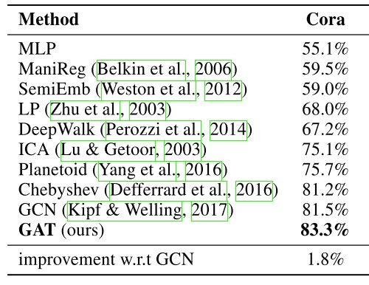
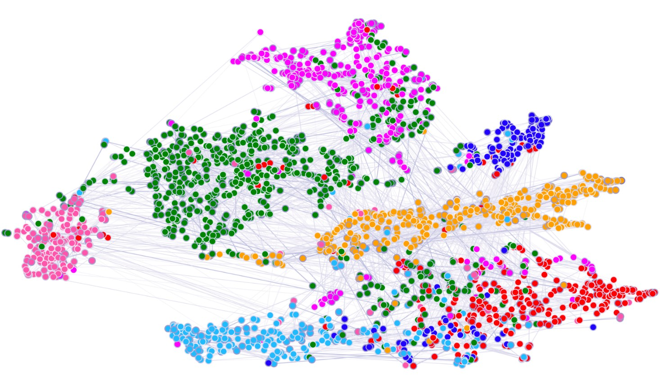
Attention mechanism can be used with many different graph neural network models
In many cases, attention leads to performance gains
t-SNE plot of GAT-based node embeddings:
  Node color: 7 publication classes
  Edge thickness: Normalized attention coefficients between
nodes 𝑖 and 𝑗, across eight attention heads, ∑₆(𝛼⁶ + 𝛼⁶)
78 87

Slide 33

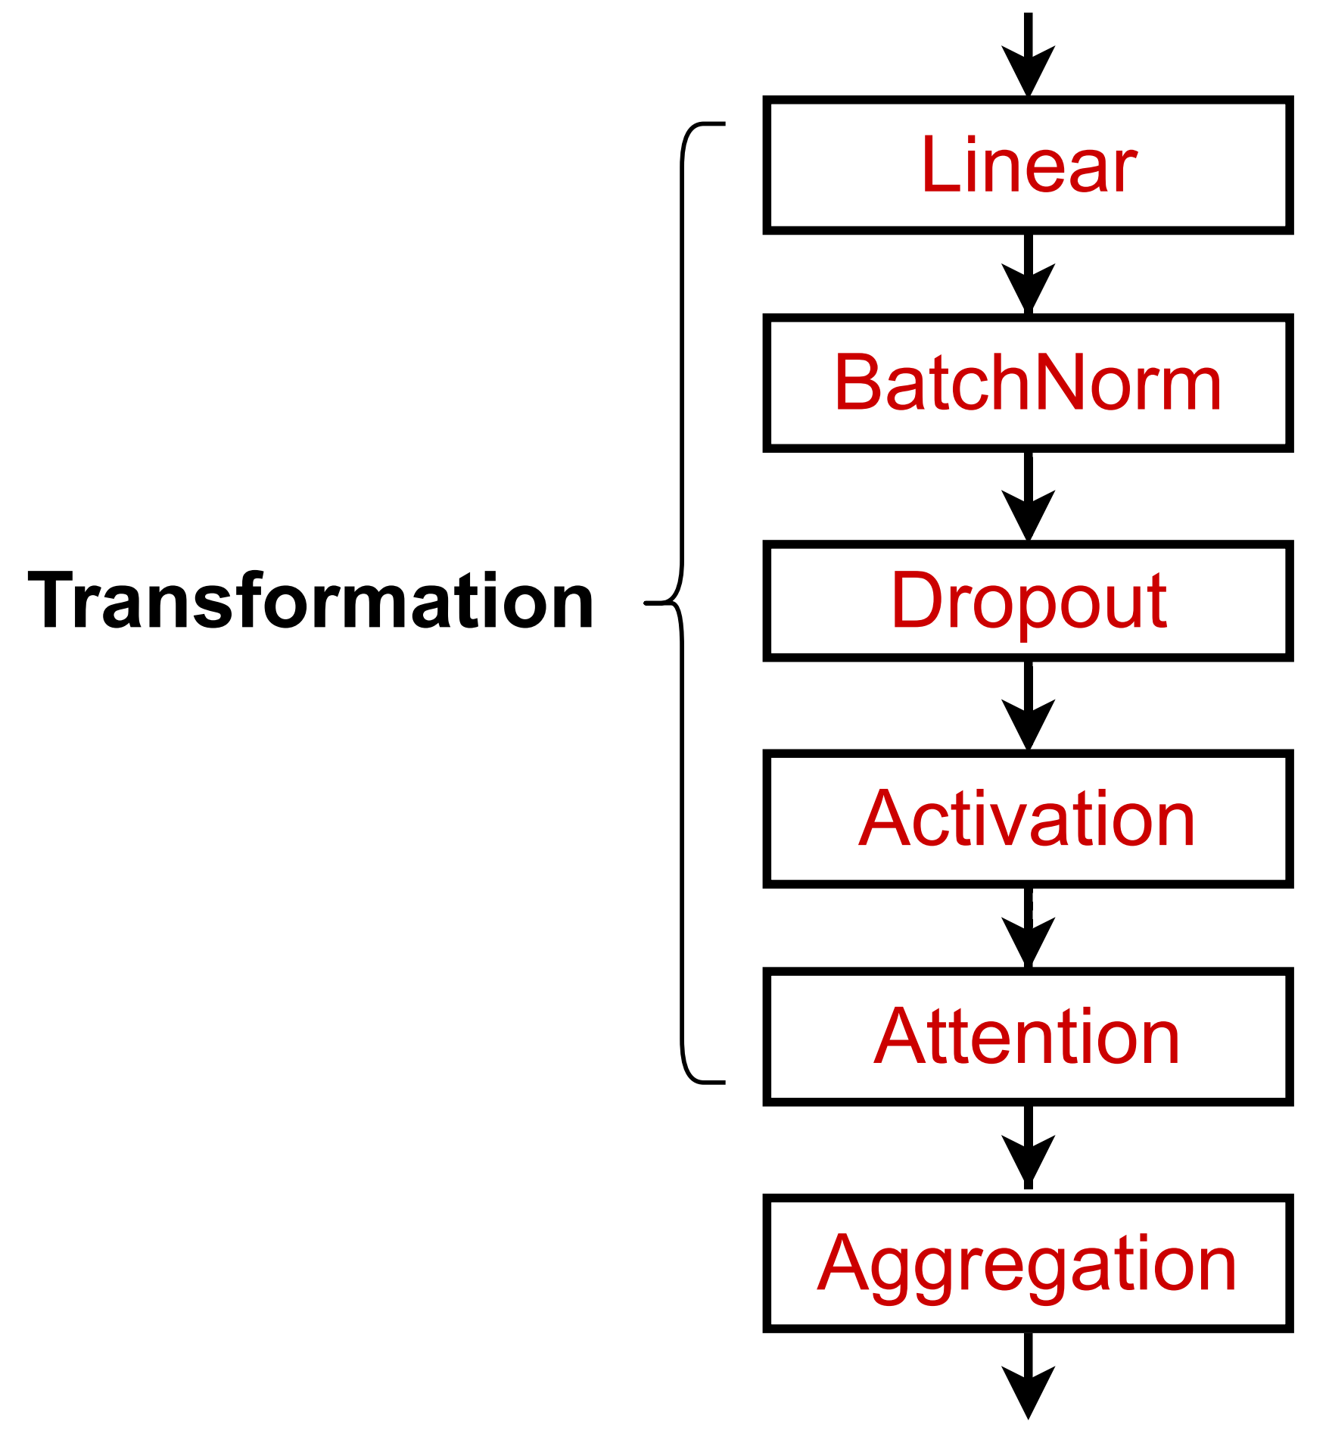
In practice, these classic GNN layers are a great starting point
J.You, R.Ying, J. Leskovec. Design Space of Graph Neural Networks, NeurIPS 2020
A suggested GNN Layer
We can often get better performance by considering a general GNN layer design
Concretely, we can include modern deep learning modules that proved to be useful in many domains

Slide 34
Many modern deep learning modules can be incorporated into a GNN layer
J.You, R.Ying, J. Leskovec. Design Space of Graph Neural Networks, NeurIPS 2020
Batch Normalization:
  Stabilize neural network training
Dropout:
  Prevent overfitting
Attention/Gating:
  Control the importance of a message
More:
  Any other useful deep learning modules
A suggested GNN Layer

Slide 35
Goal: Stabilize neural networks training
Idea: Given a batch of inputs (node embeddings)
S. Loffe, C.Szegedy. Batch Normalization: Accelerating Deep Network Training by Reducing Internal Covariate Shift, ICML 2015
Re-center the node embeddings into zero mean
Re-scale the variance into unit variance
'
Input: 𝐗 ∈ ℝ^{+×5}
𝑁 node embeddings
Step 1:
Compute the mean and variance
over 𝑵 embeddings
𝛍 = ¹ = 𝐗
.
𝑁
/,.
/0$ '
1
2
2
Trainable Parameters:
𝛄, 𝛃 ∈ ℝ⁵
Output: 𝐘 ∈ ℝ^{+×5}
Normalized node embeddings
𝛔 = = 𝐗
/,.
− 𝛍
.
.
𝑁
/0$
Step 2:
Normalize the feature using computed mean and variance
^{𝐗}/,. ^{− 𝛍}.
=
_{𝐗}B
/,.
𝛔² + 𝜖
.
^{𝐘}/,. ^{= 𝛄}.^{𝐗B}/,. ^{+ 𝛃}.

Slide 36

Goal: Regularize a neural net to prevent overfitting.
Idea:
Srivastava et al. Dropout: A Simple Way to Prevent Neural Networks from Overfitting, JMLR 2014
During training: with some probability 𝑝, randomly set neurons to zero (turn off)
During testing: Use all the neurons for computation
Dropout
Removed neurons

Slide 37
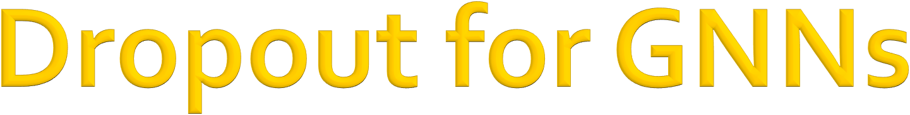
In GNN, Dropout is applied to the linear layer in the message function
(2) Aggregation
A simple message function with linear
(1) Message
layer: 𝐦^{($)} = 𝐖 $ 𝐡 $&'
" "
_{𝐖} %
Dropout
_{𝐡} %'(
_{𝐦}(%)
#
#
Visualization of a linear layer

Slide 38
Apply activation to 𝒊-th dimension of embedding 𝐱
Rectified linear unit (ReLU)
𝑦
𝑦 = 𝑥
ReLU 𝐱₇ = max(𝐱₇, 0)
Most commonly used
Sigmoid
0
𝑥
𝑦 𝑦 = 1
1
1 + 𝑒!"
1
𝜎 𝐱 =
7
1 + 𝑒^{'𝐱!}
Used only when you want to restrict the range of your embeddings
Parametric ReLU
PReLU 𝐱₇ = max 𝐱₇, 0 + 𝑎₇min(𝐱₇, 0)
𝑎₇ is a trainable parameter
  Empirically performs better than ReLU
0
𝑥
𝑦
𝑦 = 𝑥
0
𝑥
𝑦 = 𝑎𝑥

Slide 39
Summary: Modern deep learning modules can be included into a GNN layer for better performance
A GNN Layer
Designing novel GNN layers is still an active research frontier!
Suggested resources: You can explore diverse GNN designs or try out your own ideas in GraphGym

Slide 40

CS224W: Machine Learning with Graphs Jure Leskovec, Stanford University
http://cs224w.stanford.edu

Slide 41

How to connect GNN layers into a GNN?
J.You, R.Ying, J. Leskovec. Design Space of Graph Neural Networks, NeurIPS 2020
TARGET NODE
B
Stack layers sequentially
Ways of adding skip connections
A
C
D
E
F
GNN Layer 1
INPUT GRAPH
(3) Layer connectivity
GNN Layer 2

Slide 42
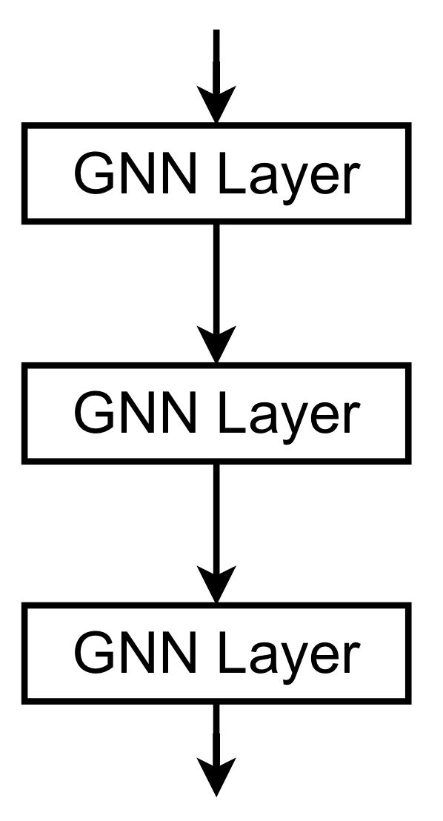
How to construct a Graph Neural Network?
The standard way: Stack GNN layers sequentially
Input: Initial raw node feature 𝐱₍
Output: Node embeddings 𝐡^{(M)} after 𝐿 GNN layers
(
_{𝐡}(-) _{= 𝐱"}
"
_{𝐡}(&)
"
_{𝐡}(.)
"
_{𝐡}(/)
"

Slide 43
The Issue of stacking many GNN layers
GNN suffers from the over-smoothing problem
The over-smoothing problem: all the node embeddings converge to the same value
  This is bad because we want to use node embeddings to differentiate nodes
Why does the over-smoothing problem happen?

Slide 44
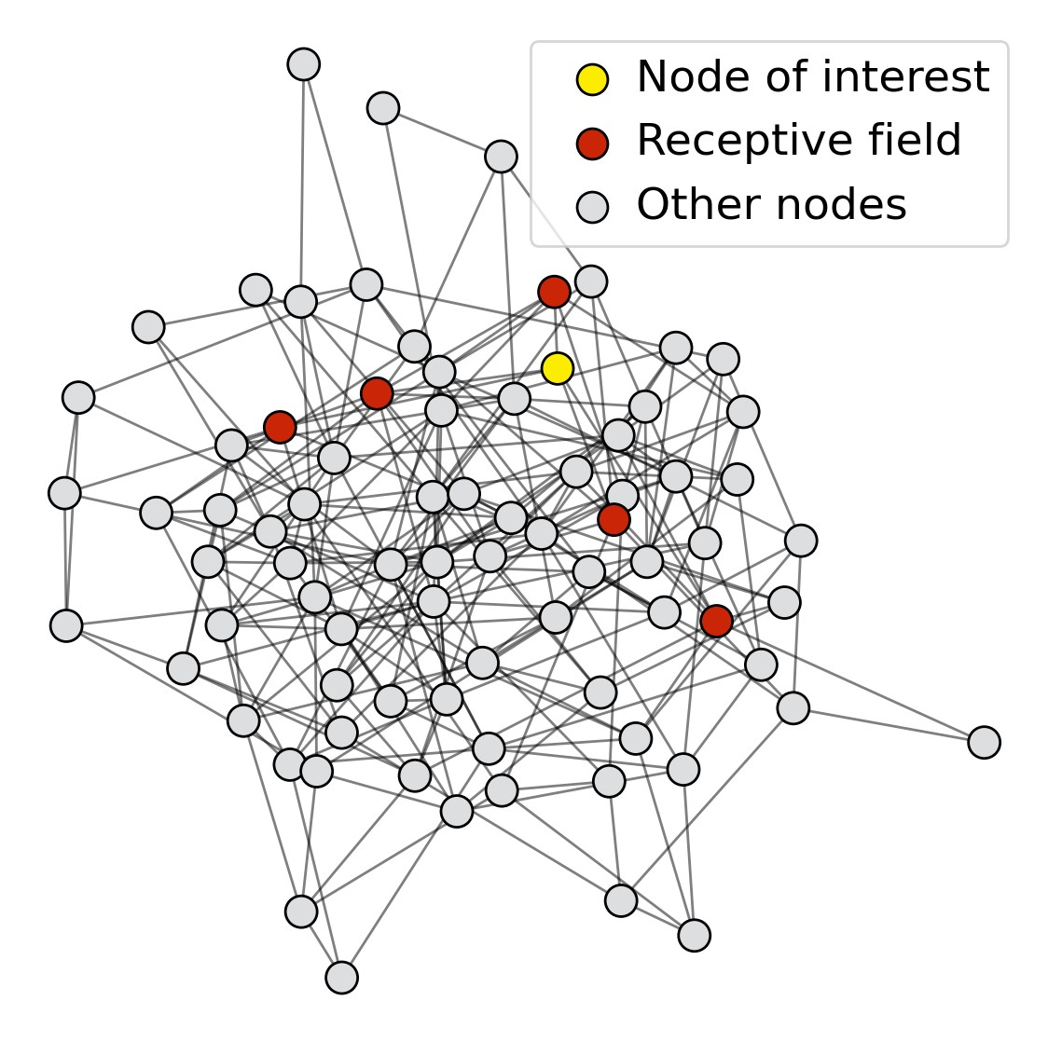
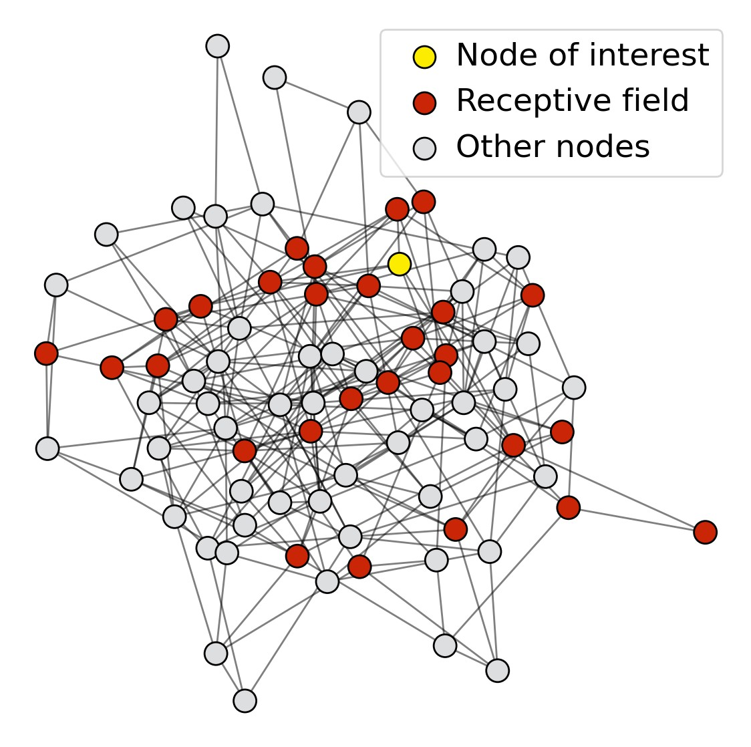
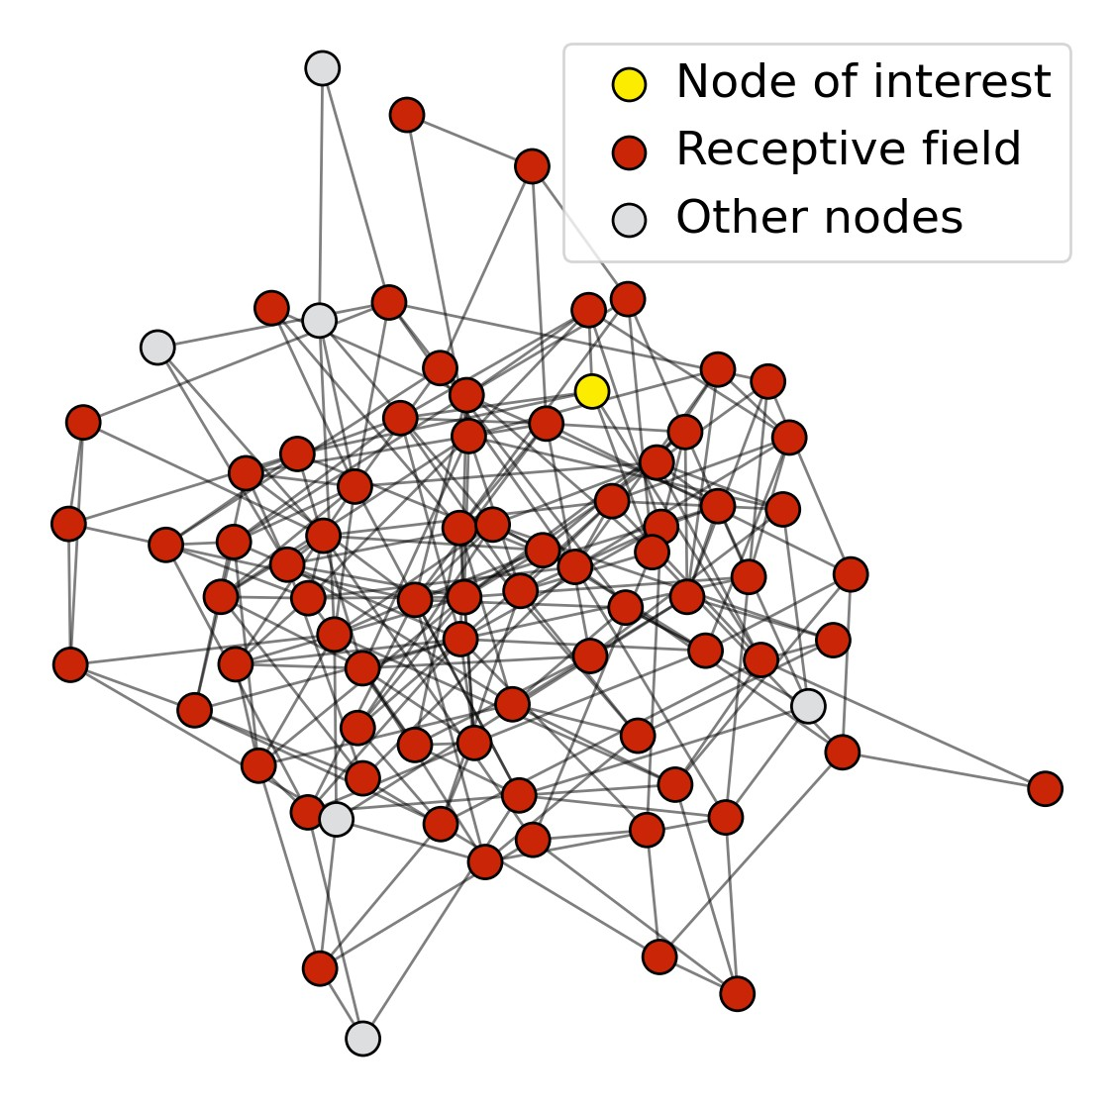
Receptive field: the set of nodes that determine the embedding of a node of interest
In a 𝑲-layer GNN, each node has a receptive field of
𝑲-hop neighborhood
Receptive field for 1-layer GNN
Receptive field for 2-layer GNN
Receptive field for 3-layer GNN

Slide 45
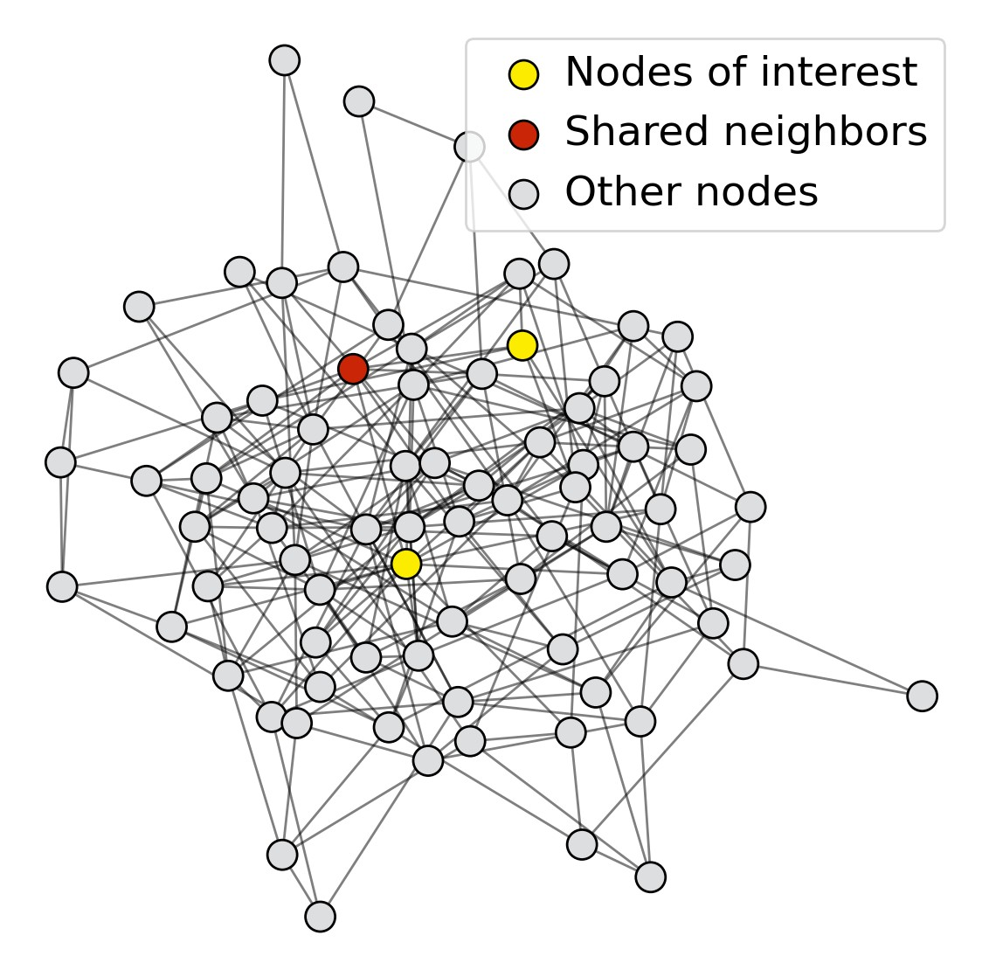
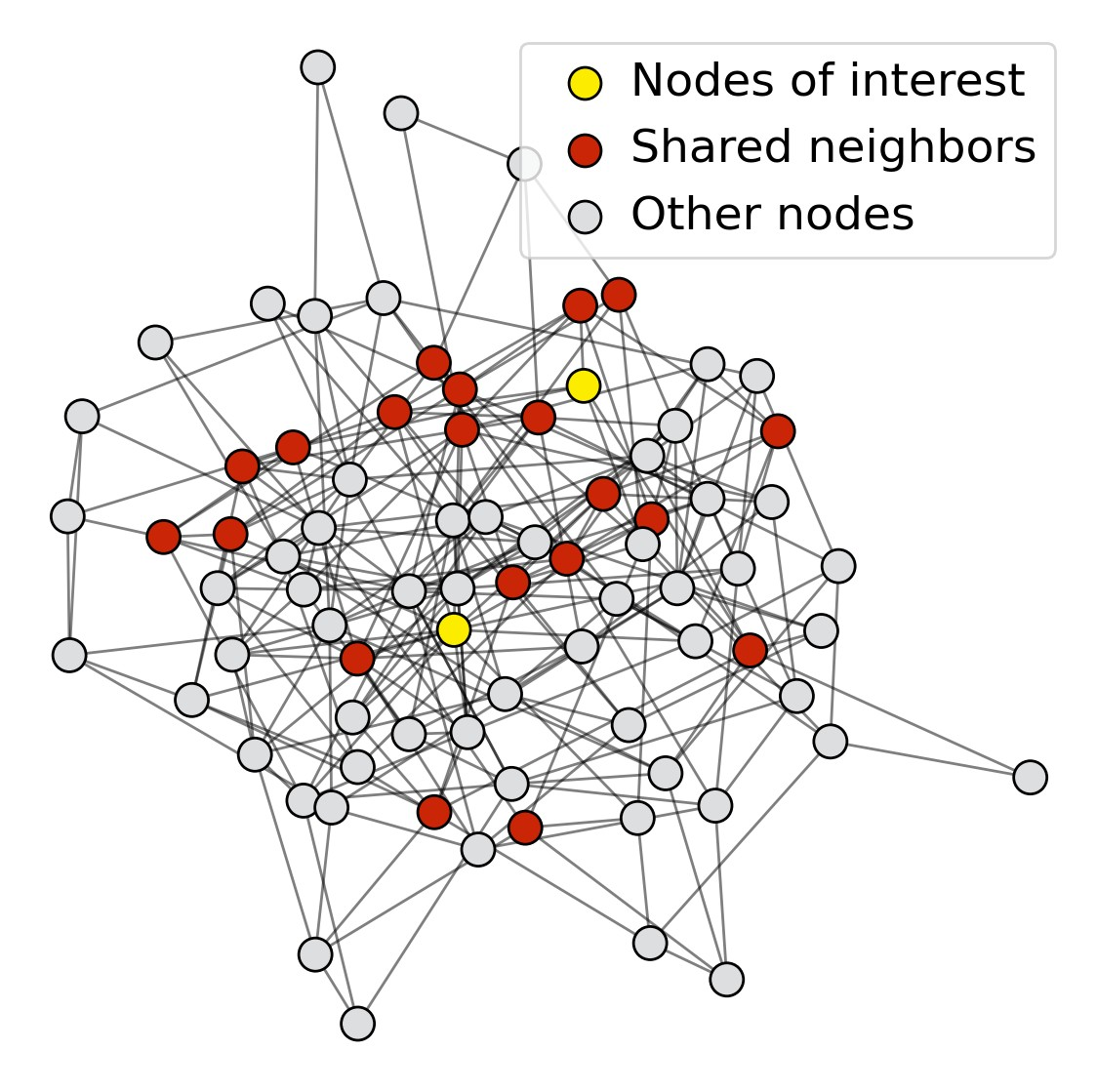
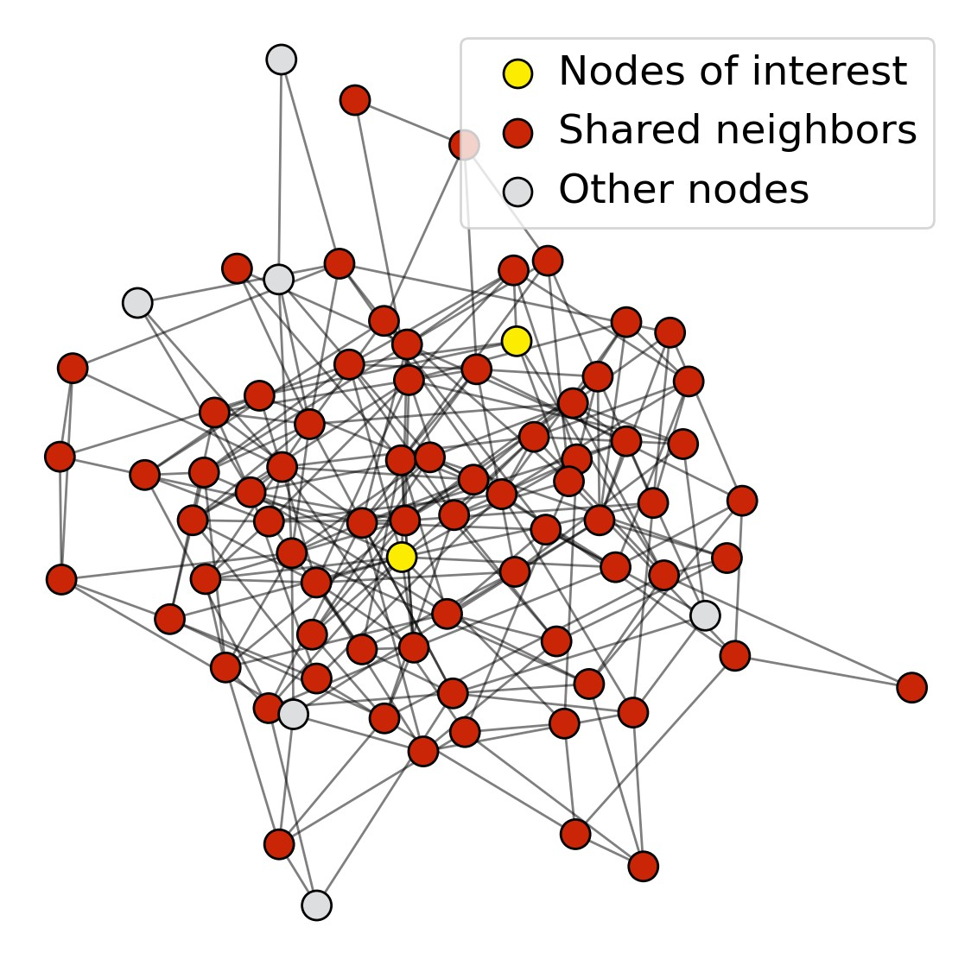
Receptive field overlap for two nodes
The shared neighbors quickly grows when we increase the number of hops (num of GNN layers)
1-hop neighbor overlap Only 1 node
2-hop neighbor overlap About 20 nodes
3-hop neighbor overlap Almost all the nodes!

Slide 46
We can explain over-smoothing via the notion of receptive field
We knew the embedding of a node is determined by its receptive field
  If two nodes have highly-overlapped receptive fields, then their embeddings are highly similar
Stack many GNN layers à nodes will have highly- overlapped receptive fields à node embeddings will be highly similar à suffer from the over- smoothing problem
Next: how do we overcome over-smoothing problem?

Slide 47
What do we learn from the over-smoothing problem?
Lesson 1: Be cautious when adding GNN layers
Unlike neural networks in other domains (CNN for image classification), adding more GNN layers do not always help
Step 1: Analyze the necessary receptive field to solve your problem. E.g., by computing the diameter of the graph
Step 2: Set number of GNN layers 𝐿 to be a bit more than the receptive field we like. Do not set 𝑳 to be unnecessarily large!
Question: How to enhance the expressive power of a GNN, if the number of GNN layers is small?

Slide 48
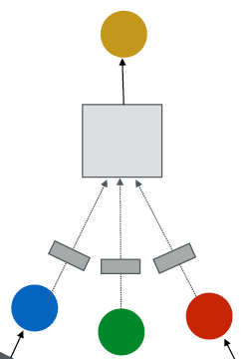
How to make a shallow GNN more expressive?
Solution 1: Increase the expressive power within each GNN layer
In our previous examples, each transformation or aggregation function only include one linear layer
We can make aggregation / transformation become a deep neural network!
If needed, each box could include a 3-layer MLP
(2) Aggregation
(1) Transformation

Slide 49
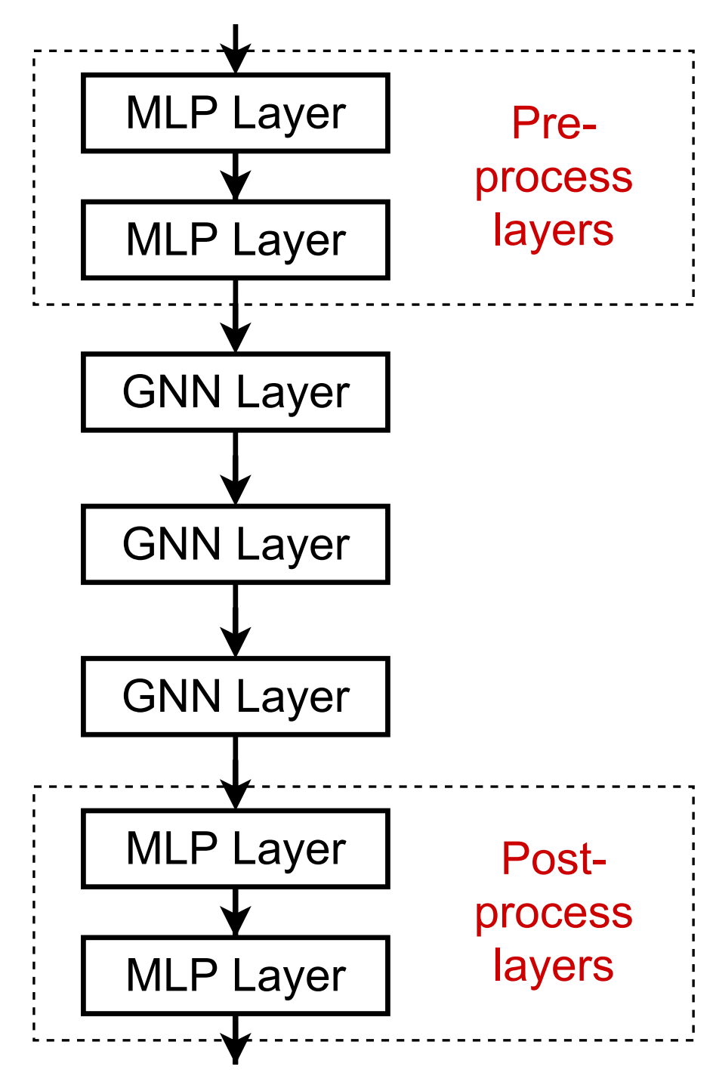
How to make a shallow GNN more expressive?
Solution 2: Add layers that do not pass messages
A GNN does not necessarily only contain GNN layers
  E.g., we can add MLP layers (applied to each node) before and after GNN layers, as pre-process layers and post-process layers
Pre-processing layers: Important when encoding node features is necessary.
E.g., when nodes represent images/text
Post-processing layers: Important when reasoning / transformation over node embeddings are needed
E.g., graph classification, knowledge graphs
In practice, adding these layers works great!

Slide 50
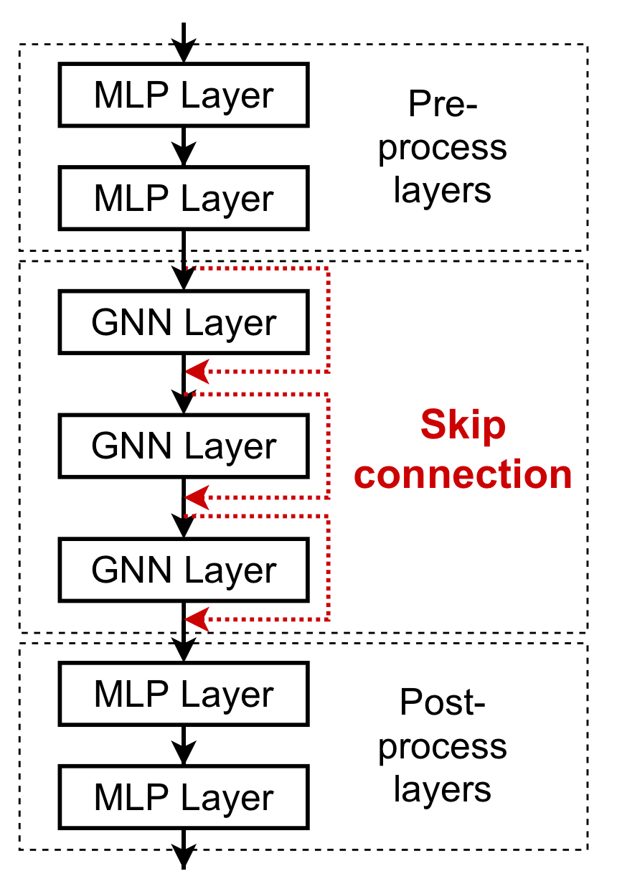
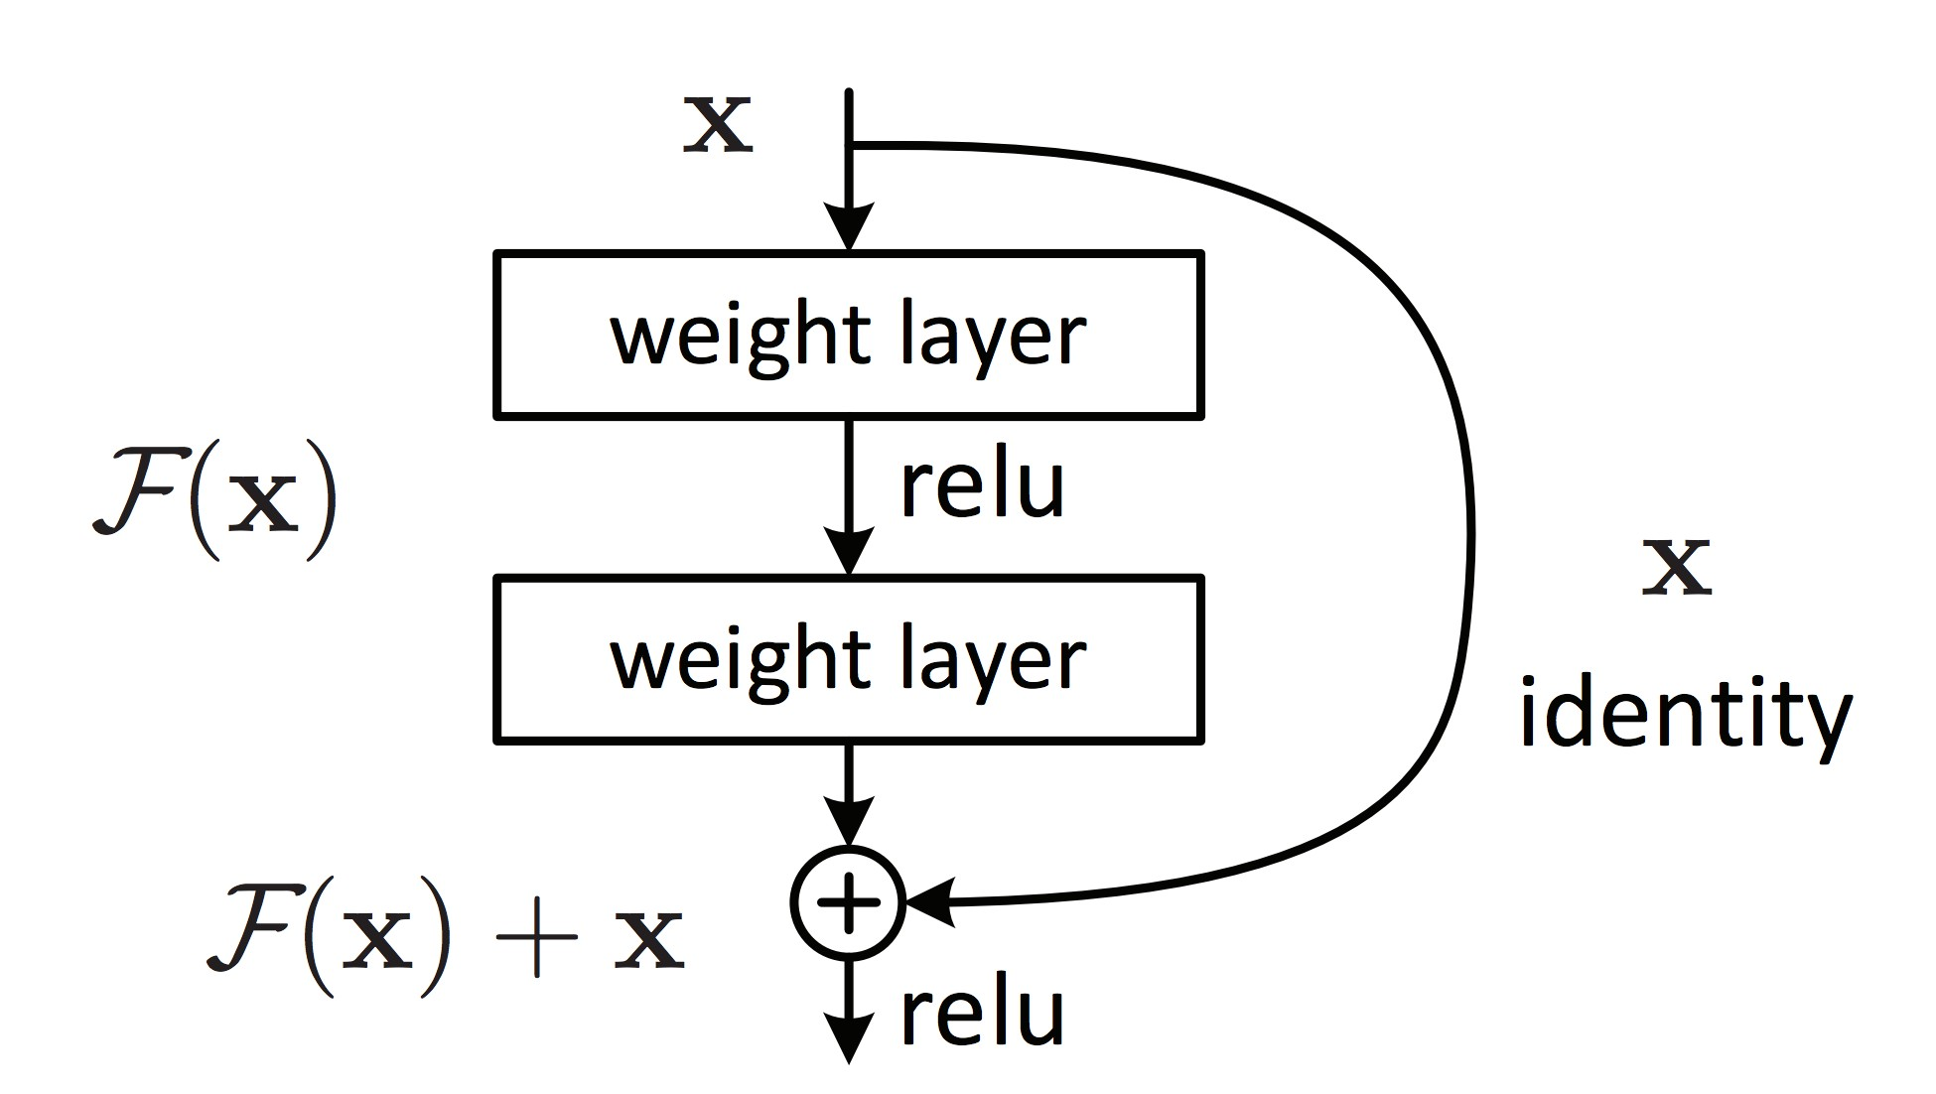
What if my problem still requires many GNN layers?
Lesson 2: Add skip connections in GNNs
He et al. Deep Residual Learning for Image Recognition, CVPR 2015
Observation from over-smoothing: Node embeddings in earlier GNN layers can sometimes better differentiate nodes
Solution: We can increase the impact of earlier layers on the final node embeddings, by adding shortcuts in GNN
Duplicate into two
branches
Idea of skip connections:
Before adding shortcuts:
𝑭 𝐱
After adding shortcuts:
𝑭 𝐱 + 𝐱
Sum two
branches
2/22/21
Jure Leskovec, Stanford CS224W: Machine Learning with Graphs, http://cs224w.stanford.edu
50

Slide 51
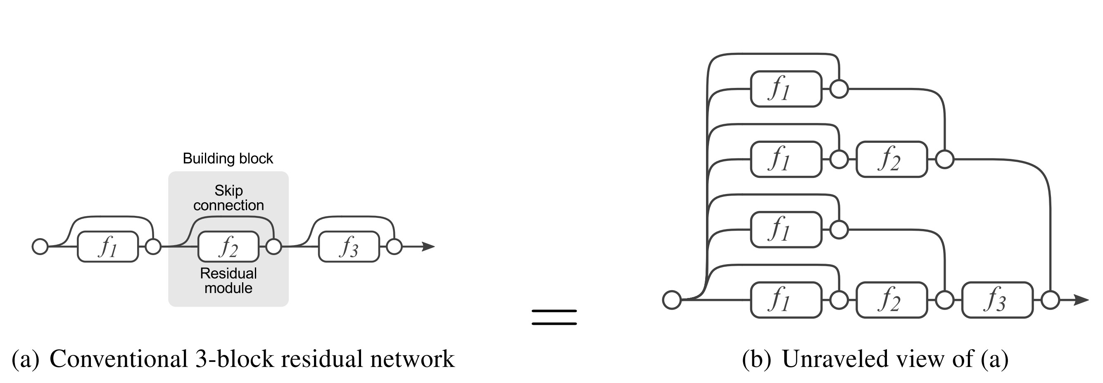
Why do skip connections work?
Intuition: Skip connections create a mixture of models
𝑁 skip connections à 2⁺ possible paths
Each path could have up to 𝑁 modules
We automatically get a mixture of shallow GNNs and deep GNNs
All the possible paths:
2 ∗ 2 ∗ 2 = 2³ = 8
Path 2: skip this module
Path 1: include this module
Veit et al. Residual Networks Behave Like Ensembles of Relatively Shallow Networks, ArXiv 2016

Slide 52
A standard GCN layer
(%)
_{𝐖} %
_{𝐡} +,-
𝐡₎ = 𝜎
∑
*
+ )
#∈+ )
This is our 𝑭 𝐱
A GCN layer with skip connection
(%)
_{𝐖} %
_{𝐡} +,-
_{𝐡}(%'()
𝐡₎ = 𝜎
∑
*
+ )
+
#∈+ )
)
𝑭(𝐱)
+
𝐱

Slide 53
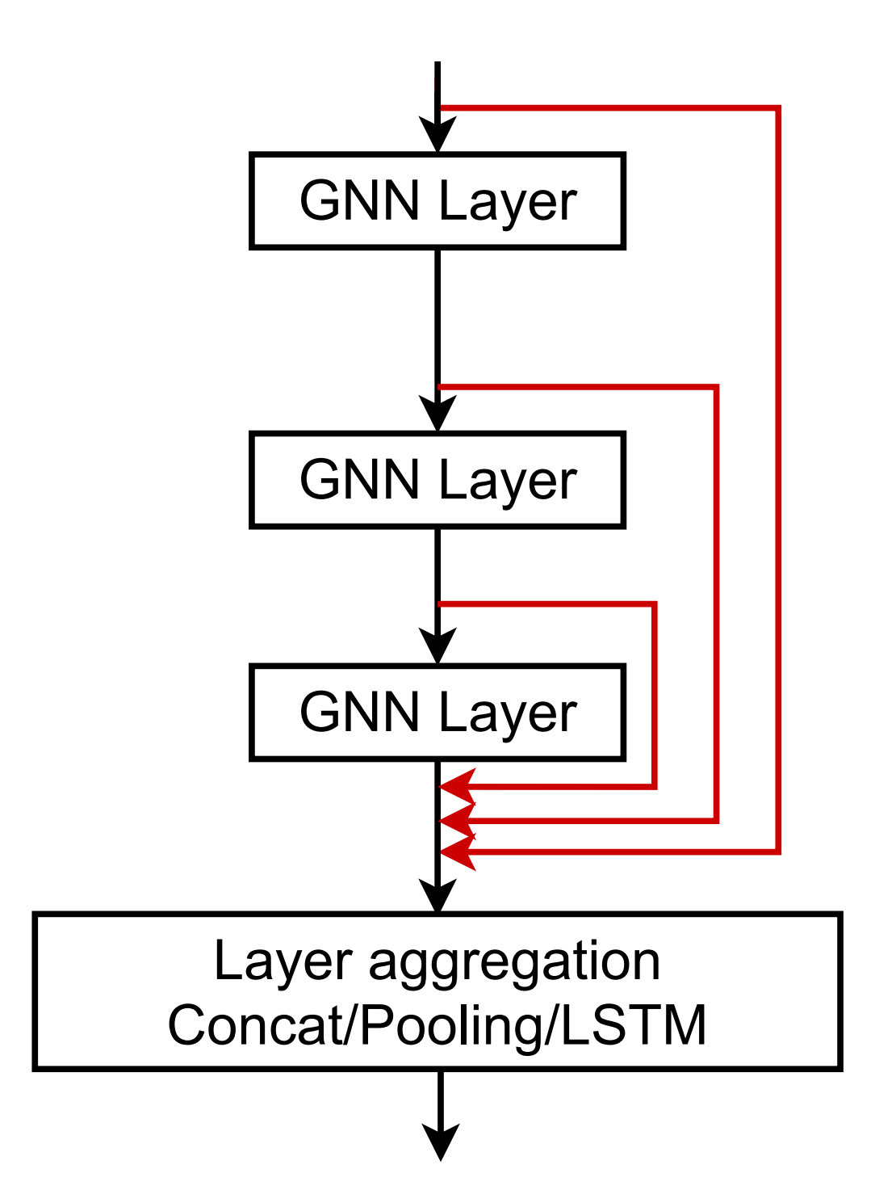
Xu et al. Representation learning on graphs with jumping knowledge networks, ICML 2018
Input: 𝐡^{(')}
!
Other options: Directly skip to the last layer
  The final layer directly aggregates from the all the node embeddings in the previous layers
_{𝐡}(#)
!
_{𝐡}(%)
!
_{𝐡}(&)
!
Output: 𝐡^{(()*+,)}
!

Slide 54

CS224W: Machine Learning with Graphs Jure Leskovec, Stanford University
http://cs224w.stanford.edu

Slide 55
Idea: Raw input graph ≠ computational graph
J.You, R.Ying, J. Leskovec. Design Space of Graph Neural Networks, NeurIPS 2020
TARGET NODE
B
Graph feature augmentation
Graph structure manipulation
A
C
D
E
INPUT GRAPH
F
(4) Graph manipulation

Slide 56
Our assumption so far has been
Raw input graph = computational graph Reasons for breaking this assumption
Feature level:
  The input graph lacks features à feature augmentation
Structure level:
  The graph is too sparse à inefficient message passing
  The graph is too dense à message passing is too costly
  The graph is too large à cannot fit the computational graph into a GPU
It’s just unlikely that the input graph happens to be the optimal computation graph for embeddings

Slide 57
Graph Feature manipulation
The input graph lacks features à feature augmentation
Graph Structure manipulation
  The graph is too sparse à Add virtual nodes / edges
  The graph is too dense à Sample neighbors when doing message passing
  The graph is too large à Sample subgraphs to compute embeddings
    Will cover later in lecture: Scaling up GNNs

Slide 58
Why do we need feature augmentation?
(1) Input graph does not have node features
This is common when we only have the adj. matrix
Standard approaches:
a) Assign constant values to nodes
1
1
1
1
1
1

Slide 59
Why do we need feature augmentation?
(1) Input graph does not have node features
This is common when we only have the adj. matrix
Standard approaches:
b) Assign unique IDs to nodes
  These IDs are converted into one-hot vectors
2
One-hot vector for node with ID=5
1
3
ID = 5
6
[0, 0, 0, 0, 1, 0]
Total number of IDs = 6
4
5

Slide 60
Feature augmentation: constant vs. one-hot
 | Constant node feature 1 1 ₁ ₁ 1 1 | One-hot node feature 2 1 ₃ ₄ 6 5
Expressive power | Medium. All the nodes are identical, but GNN can still learn from the graph structure | High. Each node has a unique ID, so node-specific information can be stored
Inductive learning (Generalize to unseen nodes) | High. Simple to generalize to new nodes: we assign constant feature to them, then apply our GNN | Low. Cannot generalize to new nodes: new nodes introduce new IDs, GNN doesn’t know how to embed unseen IDs
Computational cost | Low. Only 1 dimensional feature | High. 𝑂 𝑉 dimensional feature, cannot apply to large graphs
Use cases | Any graph, inductive settings (generalize to new nodes) | Small graph, transductive settings (no new nodes)
60

Slide 61
Why do we need feature augmentation?
(2) Certain structures are hard to learn by GNN
Example: Cycle count feature
  Can GNN learn the length of a cycle that 𝑣' resides in?
  Unfortunately, no
𝑣$ resides in a cycle with length 3
𝑣#
𝑣$ resides in a cycle with length 4
𝑣#

Slide 62
𝒗_{𝟏} cannot differentiate which graph it resides in
Because all the nodes in the graph have degree of 2
The computational graphs will be the same binary tree
𝑣$ resides in a cycle with length 3
𝑣#
𝑣$ resides in a cycle with length 4
The computational graphs for node 𝒗_{𝟏} are always the same
!!
𝑣%
𝑣$ resides in a cycle with infinite length
…
…
𝑣#
…

Slide 63
Why do we need feature augmentation?
(2) Certain structures are hard to learn by GNN
Solution:
  We can use cycle count as augmented node features
Augmented node feature for 𝒗_{𝟏}
[0, 0, 0, 1, 0, 0]
𝑣$ resides in a cycle with length 3
𝑣#
Augmented node feature for 𝒗_{𝟏}
[0, 0, 0, 0, 1, 0]
𝑣$ resides in a cycle with length 4
We start
from cycle
with length 0
𝑣#

Slide 64
Why do we need feature augmentation?
(2) Certain structures are hard to learn by GNN
Other commonly used augmented features:
  Clustering coefficient
  PageRank
  Centrality
  …
Any feature we have introduced in Lecture 2 can be used!

Slide 65








Motivation: Augment sparse graphs
(1) Add virtual edges
Common approach: Connect 2-hop neighbors via virtual edges
Intuition: Instead of using adj. matrix 𝐴 for GNN computation, use 𝐴 + 𝐴^{Q}
Authors Papers
Use cases: Bipartite graphs
  Author-to-papers (they authored)
  2-hop virtual edges make an author-author collaboration graph
A
B
C
D
E

Slide 66
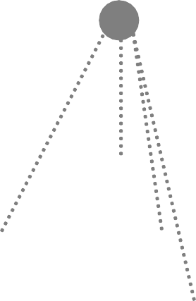
Motivation: Augment sparse graphs
(2) Add virtual nodes
The virtual node will connect to all the nodes in the graph
  Suppose in a sparse graph, two nodes have shortest path distance of 10
  After adding the virtual node, all the nodes will have a distance of 2
    Node A – Virtual node – Node B
Benefits: Greatly improves message passing in sparse graphs
The virtual node

Slide 67
Previously:
Hamilton et al. Inductive Representation Learning on Large Graphs, NeurIPS 2017
All the nodes are used for message passing
A
TARGET NODE
B B
C
A
B
A
C
A
C
F
E
D
F
E
D
INPUT GRAPH
A
New idea: (Randomly) sample a node’s neighborhood for message passing

Slide 68
For example, we can randomly choose 2 neighbors to pass messages
  Only nodes 𝐵 and 𝐷 will pass message to 𝐴
A
TARGET NODE
B
B
C
A
B
A
C
A
C
F
E
D
F
E
D
INPUT GRAPH
A

Slide 69
Next time when we compute the embeddings, we can sample different neighbors
  Only nodes 𝐶 and 𝐷 will pass message to 𝐴
A
TARGET NODE
B
B
C
A
B
A
C
A
C
F
E
D
F
E
D
INPUT GRAPH
A

Slide 70
In expectation, we can get embeddings similar to the case where all the neighbors are used
Ying et al. Graph Convolutional Neural Networks for Web-Scale Recommender Systems, KDD 2018
Benefits: greatly reduce computational cost
And in practice it works great!
A
TARGET NODE
B
B
C
A
B
A
C
A
C
F
E
D
F
E
D
INPUT GRAPH
A
70

Slide 71
Recap: A general perspective for GNNs
GNN Layer:
  Transformation + Aggregation
  Classic GNN layers: GCN, GraphSAGE, GAT
Layer connectivity:
  Deciding number of layers
  Skip connections
Graph Manipulation:
  Feature augmentation
  Structure manipulation
Next: GNN objectives, GNN in practice
71

