Slide 1

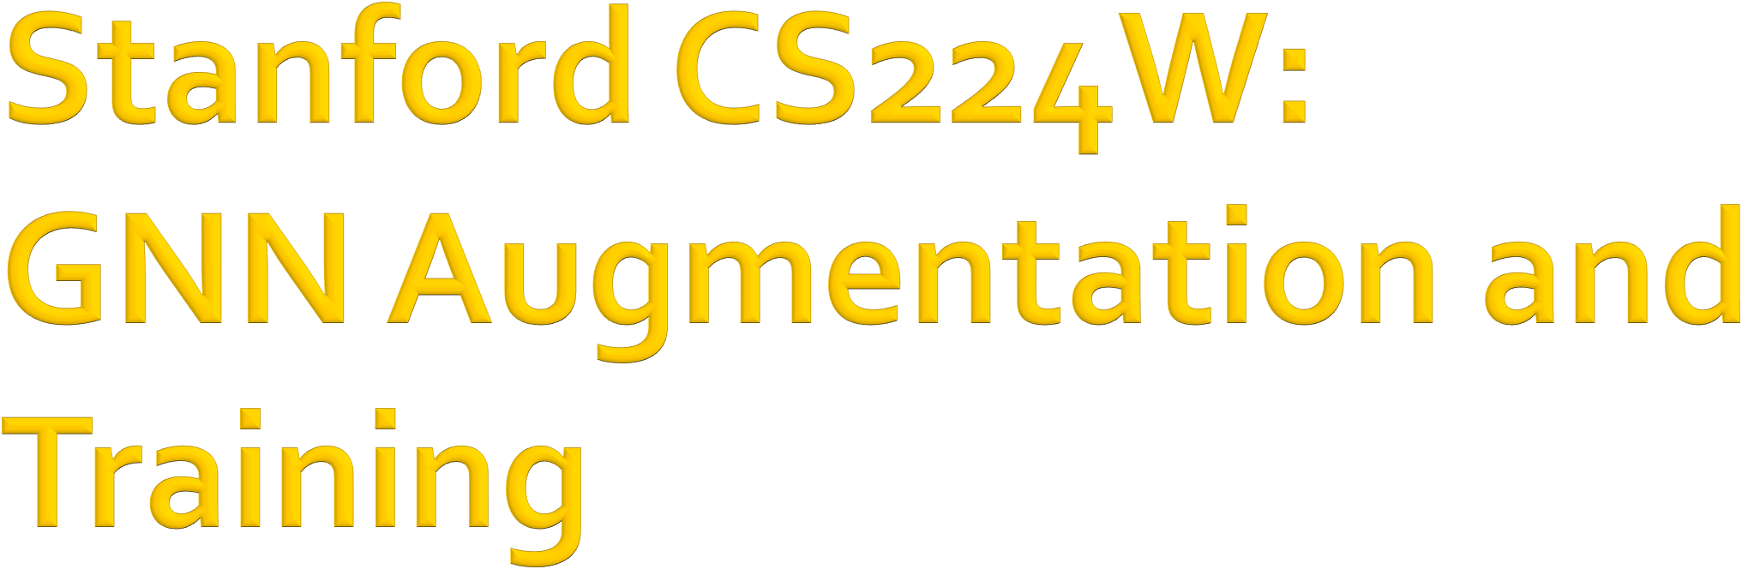

CS224W: Machine Learning with Graphs Jure Leskovec, Stanford University
http://cs224w.stanford.edu

Slide 2
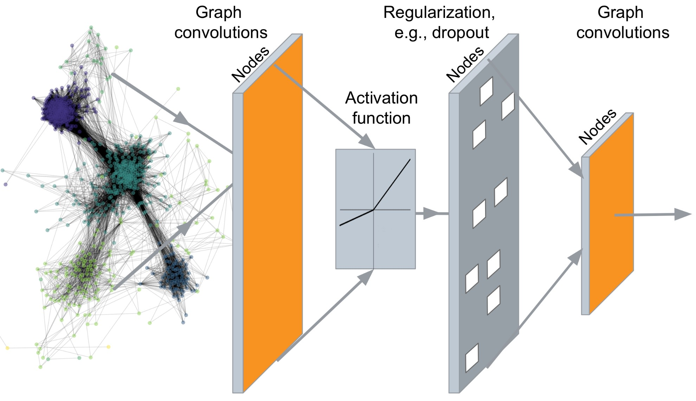
…
Output: Node embeddings. Also, we can embed subgraphs and entire graphs
2

Slide 3
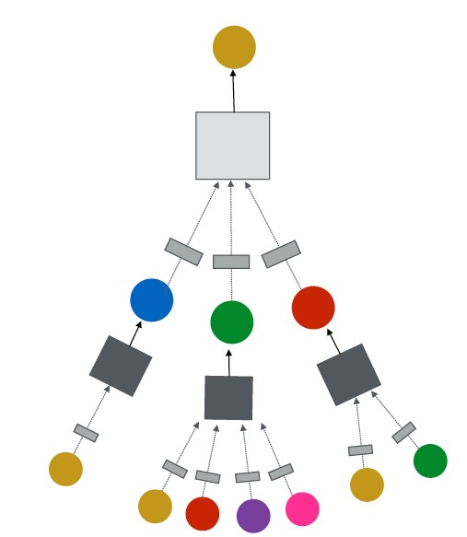
J.You, R.Ying, J. Leskovec. Design Space of Graph Neural Networks, NeurIPS 2020
TARGET NODE
B
(5) Learning objective
A
C
D
E
F
INPUT GRAPH
(2) Aggregation
(1) Message
GNN Layer 1
(3) Layer connectivity
GNN Layer 2
(4) Graph augmentation
2

Slide 4

CS224W: Machine Learning with Graphs Jure Leskovec, Stanford University
http://cs224w.stanford.edu

Slide 5
Idea: Raw input graph ≠ computational graph
J.You, R.Ying, J. Leskovec. Design Space of Graph Neural Networks, NeurIPS 2020
TARGET NODE
B
Graph feature augmentation
Graph structure augmentation
A
C
D
E
INPUT GRAPH
F
(4) Graph augmentation
5

Slide 6

Our assumption so far has been
Raw input graph = computational graph Reasons for breaking this assumption
Features:
  The input graph lacks features
Graph structure:
  The graph is too sparse à inefficient message passing
  The graph is too dense à message passing is too costly
  The graph is too large à cannot fit the computational graph into a GPU
It’s unlikely that the input graph happens to be the optimal computation graph for embeddings
5

Slide 7
Graph Feature augmentation
The input graph lacks features à feature augmentation
Graph Structure augmentation
  The graph is too sparse à Add virtual nodes / edges
  The graph is too dense à Sample neighbors when doing message passing
  The graph is too large à Sample subgraphs to compute embeddings
    Will cover later in lecture: Scaling up GNNs
5

Slide 8
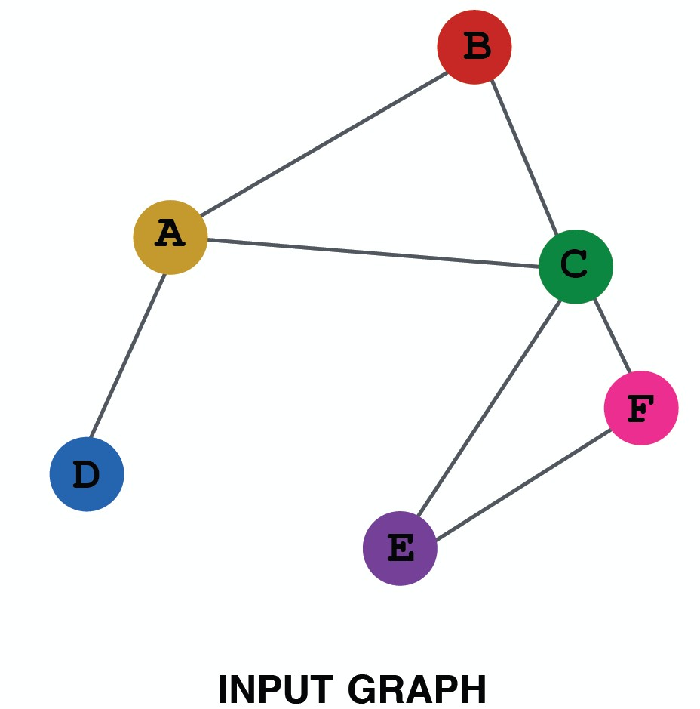
Why do we need feature augmentation?
(1) Input graph does not have node features
This is common when we only have the adj. matrix
Standard approaches:
a) Assign constant values to nodes
1
1
1
1
1
1
5

Slide 9
Why do we need feature augmentation?
(1) Input graph does not have node features
This is common when we only have the adj. matrix
Standard approaches:
b) Assign unique IDs to nodes
  These IDs are converted into one-hot vectors
2
One-hot vector for node with ID=5
1
3
ID = 5
6
[0, 0, 0, 0, 1, 0]
Total number of IDs = 6
4
5
5

Slide 10
Feature augmentation: constant vs. one-hot
 | Constant node feature 1 1 ₁ ₁ 1 1 | One-hot node feature 2 1 ₃ ₄ 6 5
Expressive power | Medium. All the nodes are identical, but GNN can still learn from the graph structure | High. Each node has a unique ID, so node-specific information can be stored
Inductive learning (Generalize to unseen nodes) | High. Simple to generalize to new nodes: we assign constant feature to them, then apply our GNN | Low. Cannot generalize to new nodes: new nodes introduce new IDs, GNN doesn’t know how to embed unseen IDs
Computational cost | Low. Only 1 dimensional feature | High. 𝑂 𝑉 dimensional feature, cannot apply to large graphs
Use cases | Any graph, inductive settings (generalize to new nodes) | Small graph, transductive settings (no new nodes)
10

Slide 11
Why do we need feature augmentation?
(2) Certain structures are hard to learn by GNN
J.You, J. Gomes-Selman, R.Ying, J. Leskovec. Identity-aware Graph Neural Networks, AAAI 2021
Example: Cycle count feature:
  Can GNN learn the length of a cycle that 𝑣! resides in?
  Unfortunately, no
𝑣! resides in a cycle with length 3
𝑣!
𝑣! resides in a cycle with length 4
𝑣!

Slide 12
𝒗_{𝟏} cannot differentiate which graph it resides in
Because all the nodes in the graph have degree of 2
The computational graphs will be the same binary tree
𝑣! resides in a cycle with length 3
𝑣!
𝑣! resides in a cycle with length 4
The computational graphs for node 𝒗_{𝟏} are always the same
!!
𝑣"
𝑣! resides in a cycle with infinite length
…
…
𝑣!
…
More about this topic later!

Slide 13
Why do we need feature augmentation?
(2) Certain structures are hard to learn by GNN
Solution:
  We can use cycle count as augmented node features
Augmented node feature for 𝒗_{𝟏}
[0, 0, 0, 1, 0, 0]
𝑣! resides in a cycle with length 3
𝑣!
Augmented node feature for 𝒗_{𝟏}
[0, 0, 0, 0, 1, 0]
𝑣! resides in a cycle with length 4
We start
from cycle
with length 0
𝑣!

Slide 14
Why do we need feature augmentation?
(2) Certain structures are hard to learn by GNN
Other commonly used augmented features:
  Node degree
  Clustering coefficient
  PageRank
  Centrality
  …
Any feature we have introduced in Lecture 2 can be used!

Slide 15








Motivation: Augment sparse graphs
(1) Add virtual edges
Common approach: Connect 2-hop neighbors via virtual edges
Intuition: Instead of using adj. matrix 𝐴 for GNN computation, use 𝐴 + 𝐴#
Authors Papers
Use cases: Bipartite graphs
  Author-to-papers (they authored)
  2-hop virtual edges make an author-author collaboration graph
A
B
C
D
E

Slide 16
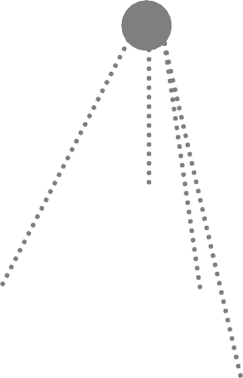
Motivation: Augment sparse graphs
(2) Add virtual nodes
The virtual node will connect to all the nodes in the graph
  Suppose in a sparse graph, two nodes have shortest path distance of 10
  After adding the virtual node, all the nodes will have a distance of two
    Node A – Virtual node – Node B
Benefits: Greatly improves message passing in sparse graphs
The virtual node

Slide 17
Previously:
Hamilton et al. Inductive Representation Learning on Large Graphs, NeurIPS 2017
All the nodes are used for message passing
A
TARGET NODE
B B
C
A
B
A
C
A
C
F
E
D
F
E
D
INPUT GRAPH
A
New idea: (Randomly) sample a node’s neighborhood for message passing

Slide 18
For example, we can randomly choose 2 neighbors to pass messages in a given layer
  Only nodes 𝐵 and 𝐷 will pass messages to 𝐴
A
TARGET NODE
B
B
C
A
B
A
C
A
C
F
E
D
F
E
D
INPUT GRAPH
A

Slide 19
In the next layer when we compute the embeddings, we can sample different neighbors
  Only nodes 𝐶 and 𝐷 will pass messages to 𝐴
A
TARGET NODE
B
B
C
A
B
A
C
A
C
F
E
D
F
E
D
INPUT GRAPH
A

Slide 20
In expectation, we get embeddings similar to the case where all the neighbors are used
Ying et al. Graph Convolutional Neural Networks for Web-Scale Recommender Systems, KDD 2018
Benefits: Greatly reduces computational cost
  Allows for scaling to large graphs (more about this later)
And in practice it works great!
A
TARGET NODE
B B
C
A
B
A
C
A
C
F
E
D
F
E
D
INPUT GRAPH
A
20

Slide 21

CS224W: Machine Learning with Graphs Jure Leskovec, Stanford University
http://cs224w.stanford.edu

Slide 22
J.You, R.Ying, J. Leskovec. Design Space of Graph Neural Networks, NeurIPS 2020
TARGET NODE
B
(5) Learning objective
A
C
D
E
INPUT GRAPH
F
Next: How do we train a GNN?

Slide 23

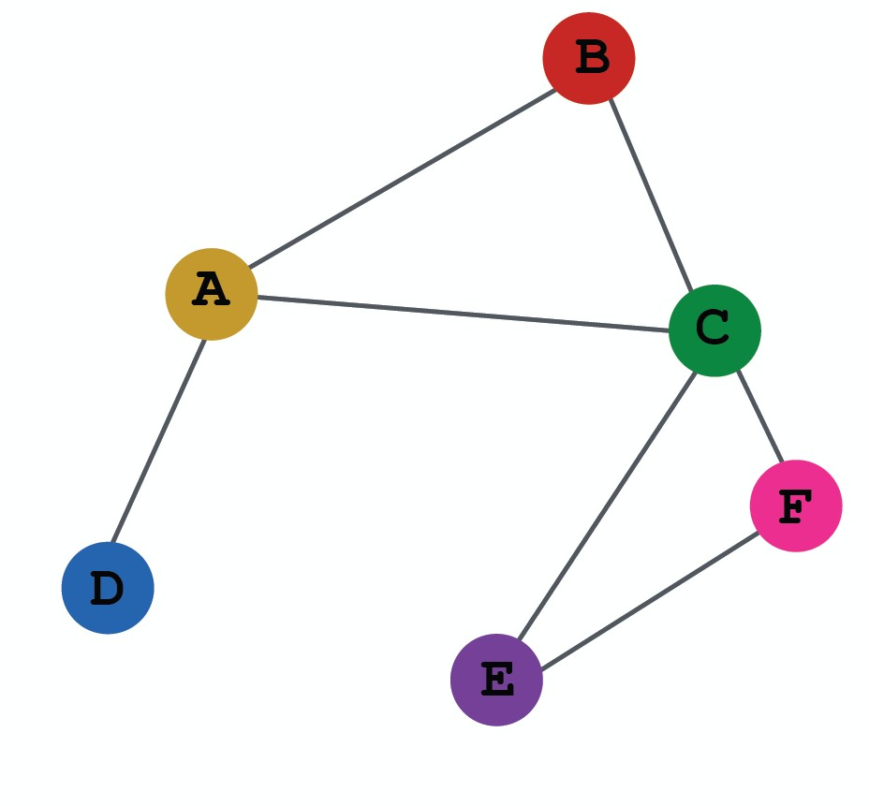
So far what we have covered
Evaluation metrics
Input Graph
Graph Neural Network
Node embeddings
Prediction head
Predictions
Labels
Loss function
Output of a GNN: set of node embeddings
{𝐡 ' , ∀𝑣 ∈ 𝐺}
&

Slide 24
Evaluation metrics
Input Graph
Graph Neural Network
Node embeddings
Prediction head
Predictions
Labels
Loss function
(1) Different prediction heads:
Node-level tasks
Edge-level tasks
Graph-level tasks

Slide 25
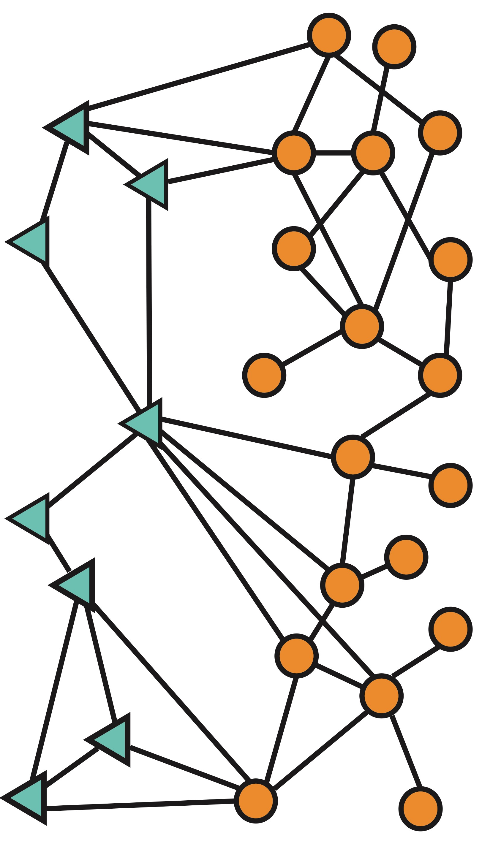
Idea: Different task levels require different prediction heads
Node-level prediction
Graph-level prediction
Edge-level prediction

Slide 26
Node-level prediction: We can directly make prediction using node embeddings!
After GNN computation, we have 𝑑-dim node
embeddings: {𝐡 " ∈ ℝ#, ∀𝑣 ∈ 𝐺}
!
Suppose we want to make 𝑘-way prediction
  Classification: classify among 𝑘 categories
  Regression: regress on 𝑘 targets
𝒚-_{𝒗} = Head_{%&'(}(𝐡 " ) = 𝐖^{(*)}𝐡^{(")}
! !
𝐖^{(%)} ∈ ℝ^{'∗)} : We map node embeddings from
𝐡⁽⁺⁾ ∈ ℝ⁾ to 𝒚-* ∈ ℝ' so that we can compute the
*
loss

Slide 27
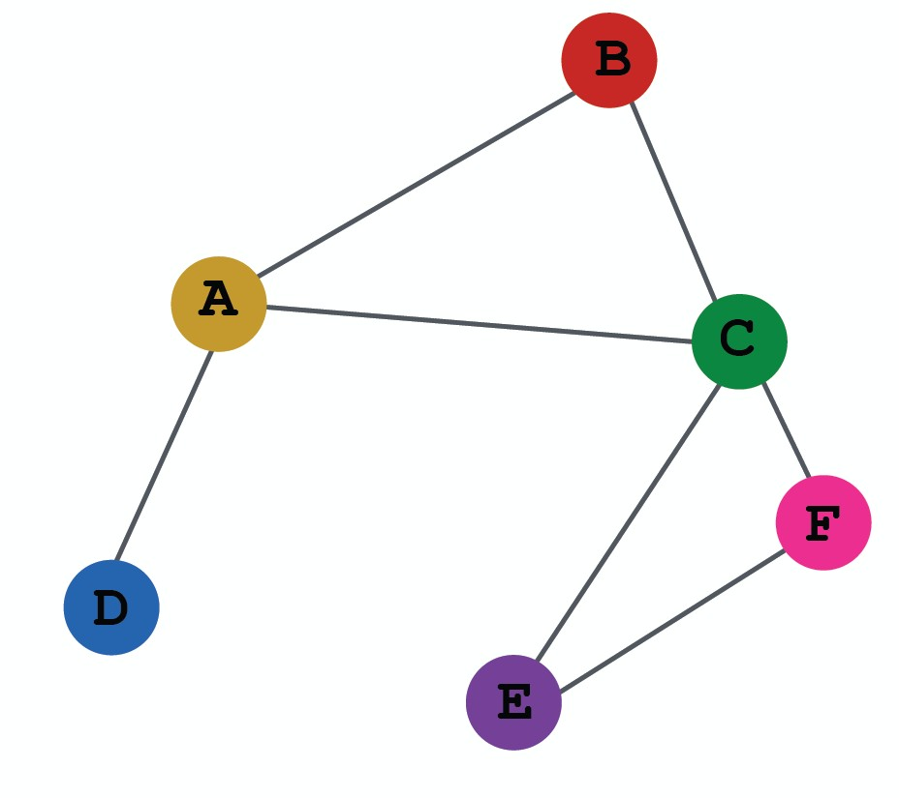
Edge-level prediction: Make prediction using pairs of node embeddings
Suppose we want to make 𝑘-way prediction
𝒚-_{𝒖𝒗} = Head_{('-.}(𝐡 " , 𝐡 " )
/ !
_{𝐡} '
(
_{𝐡} '
?
&
What are the options for Head_{('-.}(𝐡 " , 𝐡 " )?
/ !

Slide 28
Options for Head_{('-.}(𝐡 " , 𝐡 " ):
/ !
(1) Concatenation + Linear
  We have seen this in graph attention
Concatenate
Linear
^{𝒚*}(&
_{𝐡}(#$%) _{𝐡}(#$%)
! '
𝒚-_{𝒖𝒗} = Linear(Concat(𝐡 ⁺ , 𝐡 ⁺ ))
. *
Here Linear(⋅) will map 2𝑑-dimensional embeddings (since we concatenated embeddings) to 𝑘-dim embeddings (𝑘-way prediction)

Slide 29
Options for Head!"#$(𝐡 & , 𝐡 & ):
% '
(2) Dot product
  𝒚!_{𝒖𝒗} = (𝐡 $ )%𝐡 $
# &
  This approach only applies to 𝟏-way prediction (e.g., link prediction: predict the existence of an edge)
  Applying to 𝒌-way prediction:
    Similar to multi-head attention: 𝐖^{(#)}, … , 𝐖^{(%)} trainable
𝒚+^{(𝟏)} = (𝐡 * )⁺𝐖^{(#)}𝐡 *
𝒖𝒗 ) ,
…
𝒚+^{(𝒌)} = (𝐡 * )⁺𝐖^{(%)}𝐡 *
𝒖𝒗 ) ,
𝒚+_{),} = Concat(𝒚+^{(𝟏)}, … , 𝒚+^{(𝒌)}) ∈ ℝ%
𝒖𝒗 𝒖𝒗

Slide 30
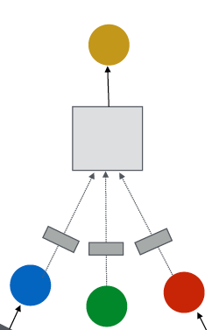
Graph-level prediction: Make prediction using all the node embeddings in our graph
Suppose we want to make 𝑘-way prediction
𝒚-₀ = Head₋₁₂₃₄({𝐡 " ∈ ℝ#, ∀𝑣 ∈ 𝐺})
!
Graph-level prediction
Head₋₁₂₃₄(⋅) is similar to
AGG(⋅) in a GNN layer!
(2) Aggregation
(1) Message
30

Slide 31
Options for Head₋₁₂₃₄({𝐡 "
K. Xu*, W. Hu*, J. Leskovec, S. Jegelka. How Powerful Are Graph Neural Networks, ICLR 2019
∈ ℝ#, ∀𝑣 ∈ 𝐺})
!
(1) Global mean pooling
𝒚-₀ = Mean({𝐡 " ∈ ℝ#, ∀𝑣 ∈ 𝐺})
!
(2) Global max pooling
𝒚-₀ = Max({𝐡 "
∈ ℝ#, ∀𝑣 ∈ 𝐺})
!
(3) Global sum pooling
𝒚-₀ = Sum({𝐡 " ∈ ℝ#, ∀𝑣 ∈ 𝐺})
!
These options work great for small graphs
Can we do better for large graphs?

Slide 32

Issue: Global pooling over a (large) graph will lose information
Toy example: we use 1-dim node embeddings
Node embeddings for 𝐺': {−1, −2, 0, 1, 2}
Node embeddings for 𝐺₍: {−10, −20, 0, 10, 20}
Clearly 𝐺' and 𝐺₍ have very different node embeddings
à Their structures should be different
If we do global sum pooling:
Prediction for 𝐺': 𝑦1₎ = Sum
Prediction for 𝐺₍: 𝑦1₎ = Sum
−1, −2, 0, 1, 2 = 0
−10, −20, 0, 10, 20 = 0
We cannot differentiate 𝐺' and 𝐺₍!

Slide 33
A solution: Let’s aggregate all the node embeddings hierarchically
Toy example: We will aggregate via ReLU Sum ⋅
  We first separately aggregate the first 2 nodes and last 3 nodes
  Then we aggregate again to make the final prediction
𝐺' node embeddings: {−1, −2, 0, 1, 2}
Round 1: 𝑦9. = ReLU Sum ReLU Sum 0,1, 2 = 3
Round 2: 𝑦9₀ = ReLU Sum
−1, −2
= 0, 𝑦9/ =
𝑦., 𝑦/ = 𝟑
𝐺₍ node embeddings: {−10, −20, 0, 10, 20}
Round 1: 𝑦9. = ReLU Sum
−10, −20
= 0, 𝑦9/ =
ReLU Sum 0,10, 20 = 30
Now we can differentiate
𝑮_{𝟏} and 𝑮_{𝟐} !
Round 2: 𝑦9₀ = ReLU Sum
𝑦., 𝑦/
= 𝟑𝟎

Slide 34
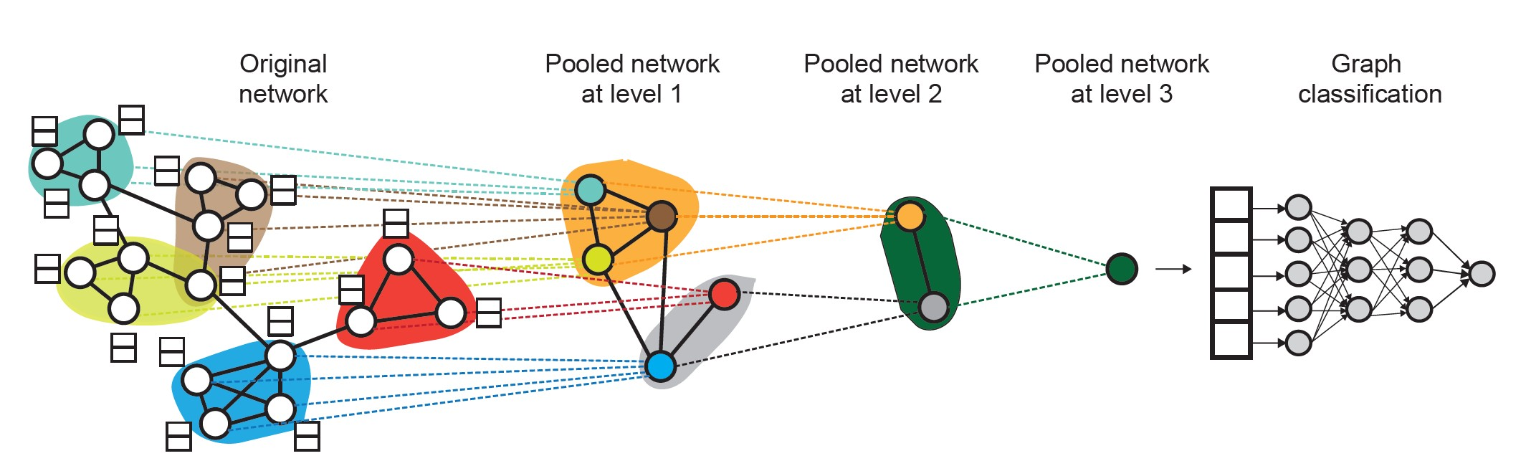
DiffPool idea:
  Hierarchically pool node embeddings
Ying et al. Hierarchical Graph Representation Learning with Differentiable Pooling, NeurIPS 2018
Leverage 2 independent GNNs at each level
  GNN A: Compute node embeddings
  GNN B: Compute the cluster that a node belongs to
GNNs A and B at each level can be executed in parallel

Slide 35
DiffPool idea:
For each Pooling layer
  Use clustering assignments from GNN B to aggregate node embeddings generated by GNN A
  Create a single new node for each cluster, maintaining edges between clusters to generated a new pooled network
Jointly train GNN A and GNN B

Slide 36

CS224W: Machine Learning with Graphs Jure Leskovec, Stanford University
http://cs224w.stanford.edu

Slide 37
(2) Where does ground-truth come from?
- Supervised labels
- Unsupervised signals
Evaluation metrics
Input Graph
Graph Neural Network
Node embeddings
Prediction head
Predictions
Labels
Loss function

Slide 38
Supervised learning on graphs
Labels come from external sources
  E.g., predict drug likeness of a molecular graph
Unsupervised learning on graphs
  Signals come from graphs themselves
    E.g., link prediction: predict if two nodes are connected
Sometimes the differences are blurry
  We still have “supervision” in unsupervised learning
    E.g., train a GNN to predict node clustering coefficient
  An alternative name for “unsupervised” is “self- supervised”

Slide 39
Supervised labels come from the specific use cases. For example:
Node labels 𝒚_{𝒗}: in a citation network, which subject area does a node belong to
Edge labels 𝒚_{𝒖𝒗}: in a transaction network, whether an edge is fraudulent
Graph labels 𝒚₎: among molecular graphs, the drug likeness of graphs
Advice: Reduce your task to node / edge / graph labels, since they are easy to work with
  E.g., we knew some nodes form a cluster. We can treat the cluster that a node belongs to as a node label

Slide 40
The problem: sometimes we only have a graph, without any external labels
The solution: “self-supervised learning”, we can
find supervision signals within the graph.
For example, we can let GNN predict the following:
Node-level 𝒚*. Node statistics: such as clustering coefficient, PageRank, …
Edge-level 𝒚.*. Link prediction: hide the edge between two nodes, predict if there should be a link
Graph-level 𝒚₀. Graph statistics: for example, predict if two graphs are isomorphic
These tasks do not require any external labels!
40

Slide 41
Evaluation metrics
Input Graph
Graph Neural Network
Node embeddings
Prediction head
Predictions
Labels
Loss function
(3) How do we compute the final loss?
Classification loss
Regression loss

Slide 42
The setting: We have 𝑁 data points
Each data point can be a node/edge/graph
Node-level: prediction 𝒚-⁽¹⁾, label 𝒚⁽¹⁾
* *
Edge-level: prediction 𝒚-⁽¹⁾, label 𝒚⁽¹⁾
.* .*
Graph-level: prediction 𝒚-⁽¹⁾, label 𝒚⁽¹⁾
0 0
We will use prediction 𝒚-⁽¹⁾, label 𝒚 ¹
predictions at all levels
to refer

Slide 43
Classification: labels 𝒚 ⁵
with discrete value
E.g., Node classification: which category does a node belong to
Regression: labels 𝒚 ⁵
with continuous value
E.g., predict the drug likeness of a molecular graph
GNNs can be applied to both settings
Differences: loss function & evaluation metrics

Slide 44
As discussed in lecture 6, cross entropy (CE) is a very common loss function in classification
𝐾-way prediction for 𝑖-th data point:
_{𝒚-}(1)
4
= − B 𝒚⁽¹⁾ log(𝒚-
𝒊-th data point
CE 𝒚⁽¹⁾,
(𝒊)
2
𝒋
⁾ 𝒋-th class
23!
where:
Label Prediction
E.g.
0 | 0 | 1 | 0 | 0
𝒚⁽¹⁾ 𝜖 ℝ⁴ = one-hot label encoding
𝒚-⁽¹⁾𝜖 ℝ⁴ = prediction after Softmax(⋅)
E.g.
0.1 | 0.3 | 0.4 | 0.1 | 0.1
Total loss over all 𝑁 training examples
-
Loss = 0
_{CE 𝒚}(*)_{, 𝒚3}(*)
*+,

Slide 45

For regression tasks we often use Mean Squared Error (MSE) a.k.a. L2 loss
𝐾-way regression for data point (i):
3
*
𝒊-th data point
𝒋-th target
MSE 𝒚^{(*)}, 𝒚&^{(*)}
= ( (𝒚^{(*)}− 𝒚&
₎4
2
2
2+,
where:
E.g.
1.4 | 2.3 | 1.0 | 0.5 | 0.6
𝒚^{(𝒊)} 𝜖 ℝ⁵ = Real valued vector of targets
𝒚&^{(𝒊)}𝜖 ℝ⁵ = Real valued vector of predictions
E.g.
Total loss over all 𝑁 training examples
3
Loss = J MSE 𝒚⁽¹⁾, 𝒚+⁽¹⁾
12#
0.9 | 2.8 | 2.0 | 0.3 | 0.8

Slide 46
(4) How do we measure the success of a GNN?
Accuracy
ROC AUC
Evaluation metrics
Input Graph
Graph Neural Network
Node embeddings
Prediction head
Predictions
Labels
Loss function

Slide 47
We use standard evaluation metrics for GNN
(Content below can be found in any ML course)
In practice we will use sklearn for implementation
Suppose we make predictions for 𝑁 data points
Evaluate regression tasks on graphs:
  Root mean square error (RMSE)
-
0
*+,
_{𝒚}(*) _{− 𝒚3}(*) 4
𝑁
Mean absolute error (MAE)
∑- _{𝒚}(*) _{− 𝒚3}(*)
*+,
𝑁

Slide 48
Evaluate classification tasks on graphs:
(1) Multi-class classification
We simply report the accuracy
1 argmax 𝒚!⁽⁺⁾
_{= 𝒚}(+)
𝑁
(2) Binary classification
  Metrics sensitive to classification threshold
    Accuracy
    Precision / Recall
    If the range of prediction is [0,1], we will use 0.5 as threshold
  Metric Agnostic to classification threshold
    ROC AUC

Slide 49
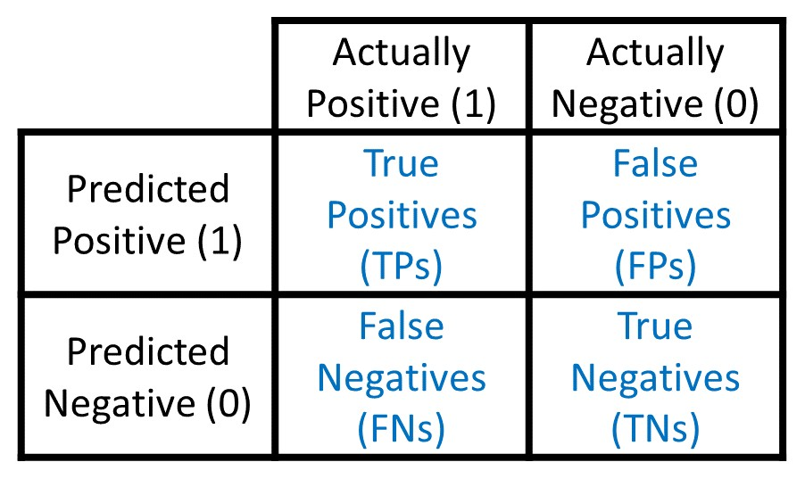
Accuracy:
TP + TN
₌ TP + TN
TP + TN + FP + FN
Precision (P):
TP
|Dataset|
Confusion matrix
TP + FP
Recall (R):
TP TP + FN
F1-Score:
2P ∗ R
P + R
Sklearn Classification Report

Slide 50
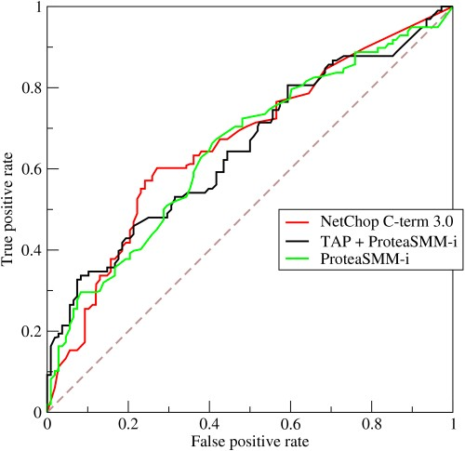
ROC Curve: Captures the tradeoff in TPR and FPR as the classification threshold is varied for a binary classifier.
TP
TPR = Recall =
TP + FN
TPR
FP
^{FPR =} FP + TN
Note: the dashed line represents performance of a random classifier
Image Credit: Wikipedia
FPR
50

Slide 51
Content Credit: Wikipedia
ROC AUC: Area under the ROC Curve.
Intuition: The probability that a classifier will rank a
randomly chosen positive instance higher than a randomly chosen negative one
51

Slide 52

CS224W: Machine Learning with Graphs Jure Leskovec, Stanford University
http://cs224w.stanford.edu

Slide 53
Evaluation metrics
Input Graph
Graph Neural Network
Node embeddings
Prediction head
Predictions
Labels
Loss function
(5) How do we split our dataset into train / validation / test set?
Dataset split

Slide 54
Fixed split: We will split our dataset once
Training set: used for optimizing GNN parameters
Validation set: develop model/hyperparameters
Test set: held out until we report final performance
A concern: sometimes we cannot guarantee that the test set will really be held out
Random split: we will randomly split our
dataset into training / validation / test
  We report average performance over different random seeds

Slide 55






Suppose we want to split an image dataset
Image classification: Each data point is an image
Here data points are independent
  Image 5 will not affect our prediction on image 1
Training Validation Test
2
1
3
6
5
4

Slide 56






Splitting a graph dataset is different!
Node classification: Each data point is a node
Here data points are NOT independent
  Node 5 will affect our prediction on node 1, because it will participate in message passing à affect node 1’s embedding
Training Validation Test
2
1
3
6
5
4
What are our options?

Slide 57






Solution 1 (Transductive setting): The input graph can be observed in all the dataset splits (training, validation and test set).
We will only split the (node) labels
At training time, we compute embeddings using the entire graph, and train using node 1&2’s labels
At validation time, we compute embeddings using the entire graph, and evaluate on node 3&4’s labels
Training
Validation Test
2
1
3
6
5
4

Slide 58
Solution 2 (Inductive setting): We break the edges between splits to get multiple graphs
Now we have 3 graphs that are independent. Node 5 will not affect our prediction on node 1 any more
At training time, we compute embeddings using the graph over node 1&2, and train using node 1&2’s labels
At validation time, we compute embeddings using the graph over node 3&4, and evaluate on node 3&4’s labels
Training
Validation Test
2
1
3
6
5
4

Slide 59
Transductive setting: training / validation / test sets are on the same graph
The dataset consists of one graph
The entire graph can be observed in all dataset splits, we only split the labels
Only applicable to node / edge prediction tasks
Inductive setting: training / validation / test sets are on different graphs
  The dataset consists of multiple graphs
  Each split can only observe the graph(s) within the split.
A successful model should generalize to unseen graphs
  Applicable to node / edge / graph tasks
59

Slide 60
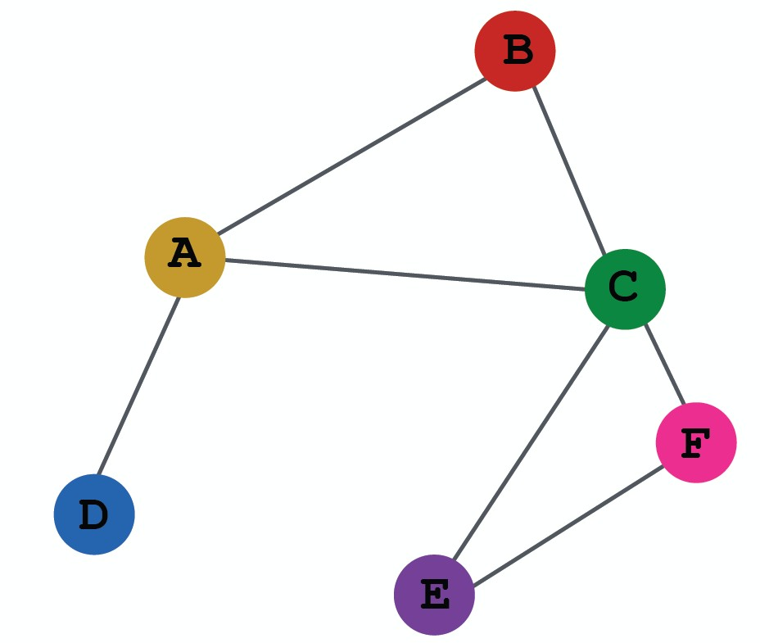
Transductive node classification
All the splits can observe the entire graph structure, but can only observe the labels of their respective nodes
Training
Validation Test
Inductive node classification
  Suppose we have a dataset of 3 graphs
  Each split contains an independent graph
Training Validation Test
60

Slide 61
Only the inductive setting is well defined for
graph classification
Because we have to test on unseen graphs
Suppose we have a dataset of 5 graphs. Each split will contain independent graph(s).
Training
Validation
Test

Slide 62















Goal of link prediction: predict missing edges
Setting up link prediction is tricky:
Link prediction is an unsupervised / self-supervised task. We need to create the labels and dataset splits on our own
Concretely, we need to hide some edges from the GNN and the let the GNN predict if the edges exist
2
2
2
1
3
1
3
1
3
?
4
5 4
Original graph
5 4
Input graph to GNN
5
Predictions made by GNN

Slide 63





2
1
3
Message edges
Supervision edges
5 4
Original graph
For link prediction, we will split edges twice
Step 1: Assign 2 types of edges in the original graph
  Message edges: Used for GNN message passing
  Supervision edges: Use for computing objectives
  After step 1:
    Only message edges will remain in the graph
    Supervision edges are used as supervision for edge predictions made by the model, will not be fed into GNN!

Slide 64















Step 2: Split edges into train / validation / test
Option 1: Inductive link prediction split
Suppose we have a dataset of 3 graphs. Each inductive split will contain an independent graph
2
7
12
1
3
6
8
11
13
𝐺!
𝐺$
𝐺%
15 14
Test set
5 4
Training set
10 9
Validation set
64

Slide 65
Step 2: Split edges into train / validation / test
Option 1: Inductive link prediction split
Suppose we have a dataset of 3 graphs. Each inductive split will contain an independent graph
In train or val or test set, each graph will have 2 types of edges: message edges + supervision edges
  Supervision edges are not the input to GNN
Message
2
7
12
edge
1
3
6
8
11
13
𝐺!
𝐺$
𝐺%
15 14
Test set
Supervision edge
5 4
Training set
10 9
Validation set

Slide 66





Option 2: Transductive link prediction split:
This is the default setting when people talk about link prediction
Suppose we have a dataset of 1 graph
2
1
3
5
4

Slide 67





Option 2: Transductive link prediction split:
By definition of “transductive”, the entire graph can be observed in all dataset splits
  But since edges are both part of graph structure and the supervision, we need to hold out validation / test edges
  To train the training set, we further need to hold out supervision edges for the training set
2
1
3
5 4
Next: we will show the exact settings

Slide 68




















Option 2: Transductive link prediction split:
2
1
3
5 4
The original graph
2
2
2
1
3
1
3
1
3
5
4
5
4
5
(3) At test time:
4
(1) At training time:
Use training message
edges to predict training supervision edges
(2) At validation time:
Use training message
edges & training supervision edges to predict validation edges
Use training message
edges & training supervision edges & validation edges to predict test edges

Slide 69
Option 2: Transductive link prediction split:
Why do we use growing number of edges?
After training, supervision edges are known to GNN. Therefore, an ideal model should use supervision edges in message passing at validation time.
The same applies to the test time.
2
2 2
1
3
1
3
1
3
5
4
5
4
5
(3) At test time:
4
(1) At training time:
Use training message
edges to predict training supervision edges
(2) At validation time:
Use training message
edges & training supervision edges to predict validation edges
Use training message
edges & training supervision edges & validation edges to predict test edges

Slide 70










Summary: Transductive link prediction split:
2
2
Training message edges Training supervision edges Validation edges
Test edges
1
3
1
3
Split
5 4
The original graph
5 4
Split Graph with 4 types of edges
Note: Link prediction settings are tricky and complex. You may find papers do link prediction differently. But if you follow our reasoning steps, this should be the right way to implement link prediction
Luckily, we have full support in DeepSNAP and GraphGym
70

Slide 71
Dataset split
Evaluation metrics
Input Graph
Graph Neural Network
Node embeddings
Prediction head
Predictions
Labels
Loss function
Implementation resources:
DeepSNAP provides core modules for this pipeline
GraphGym further implements the full pipeline to facilitate GNN design

Slide 72
We introduce a general perspective for GNNs
GNN Layer:
  Transformation + Aggregation
  Classic GNN layers: GCN, GraphSAGE, GAT
Layer connectivity:
  The over-smoothing problem
  Solution: skip connections
Graph Augmentation:
  Feature augmentation
  Structure augmentation
Learning Objectives
  The full training pipeline of a GNN

