Slide 1



CS224W: Machine Learning with Graphs Jure Leskovec, Stanford University
http://cs224w.stanford.edu

Slide 2
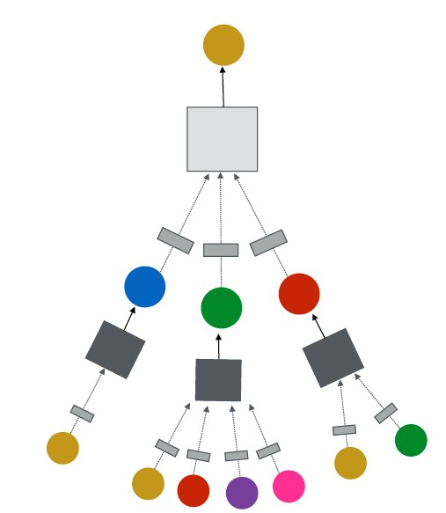
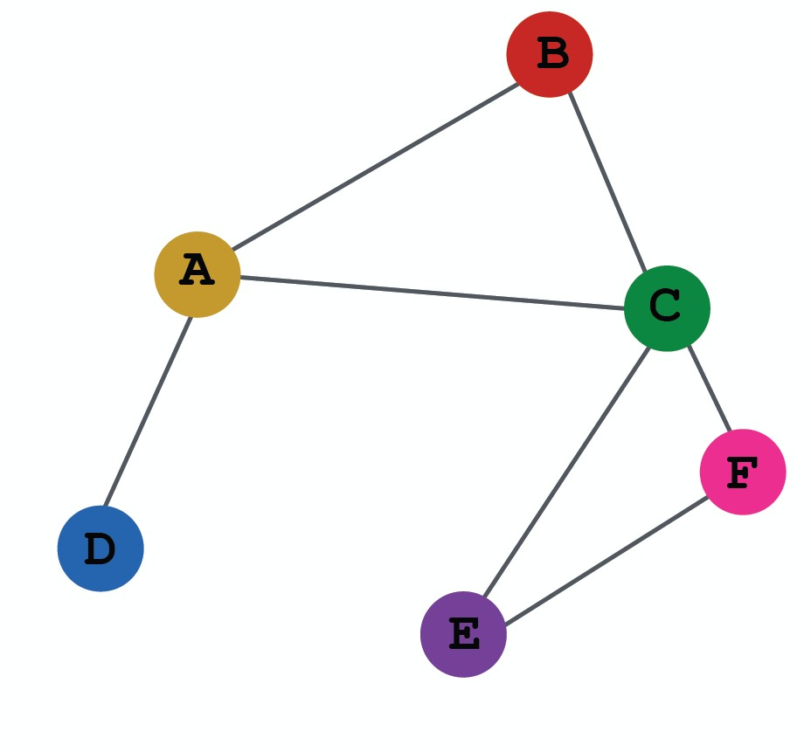
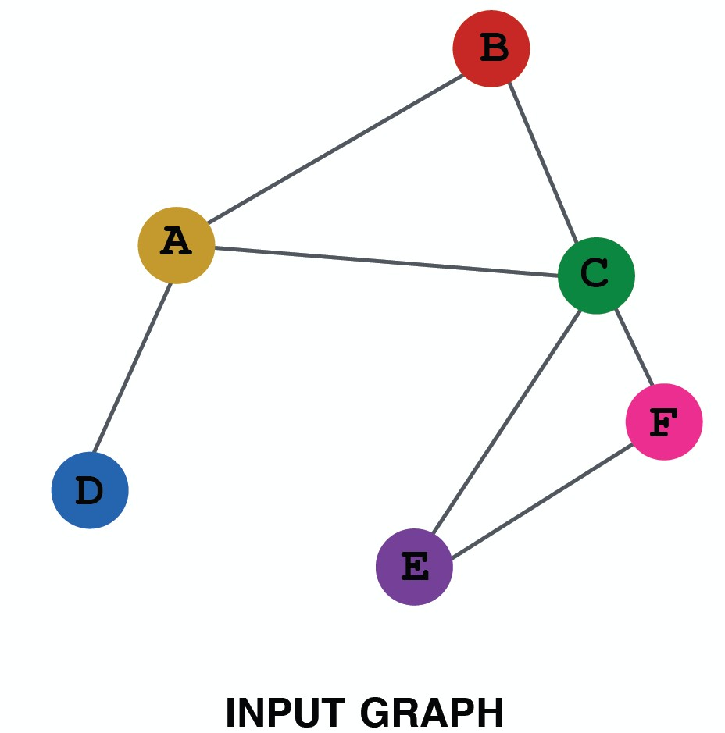
Evaluation metrics
Input Graph
Graph Neural Network
Node embeddings
Prediction head
Predictions
Labels
Loss function
(5) How do we split our dataset into train / validation / test set?
Dataset split
2

Slide 3
Fixed split: We will split our dataset once
Training set: used for optimizing GNN parameters
Validation set: develop model/hyperparameters
Test set: held out until we report final performance
A concern: sometimes we cannot guarantee that the test set will really be held out
Random split: we will randomly split our
dataset into training / validation / test
  We report average performance over different random seeds
2

Slide 4






Suppose we want to split an image dataset
Image classification: Each data point is an image
Here data points are independent
  Image 5 will not affect our prediction on image 1
Training Validation Test
2
1
3
6
5
4
2

Slide 5






Splitting a graph dataset is different!
Node classification: Each data point is a node
Here data points are NOT independent
  Node 5 will affect our prediction on node 1, because it will participate in message passing à affect node 1’s embedding
Training Validation Test
2
1
3
6
5
4
What are our options?
2

Slide 6






Solution 1 (Transductive setting): The input graph can be observed in all the dataset splits (training, validation and test set).
We will only split the (node) labels
At training time, we compute embeddings using the entire graph, and train using node 1&2’s labels
At validation time, we compute embeddings using the entire graph, and evaluate on node 3&4’s labels
Training
Validation Test
2
1
3
6
5
4
6

Slide 7
Solution 2 (Inductive setting): We break the edges between splits to get multiple graphs
Now we have 3 graphs that are independent. Node 5 will not affect our prediction on node 1 any more
At training time, we compute embeddings using the graph over node 1&2, and train using node 1&2’s labels
At validation time, we compute embeddings using the graph over node 3&4, and evaluate on node 3&4’s labels
Training
Validation Test
2
1
3
6
5
4
6

Slide 8
Transductive setting: training / validation / test sets are on the same graph
The dataset consists of one graph
The entire graph can be observed in all dataset splits, we only split the labels
Only applicable to node / edge prediction tasks
Inductive setting: training / validation / test sets are on different graphs
  The dataset consists of multiple graphs
  Each split can only observe the graph(s) within the split.
A successful model should generalize to unseen graphs
  Applicable to node / edge / graph tasks
8

Slide 9
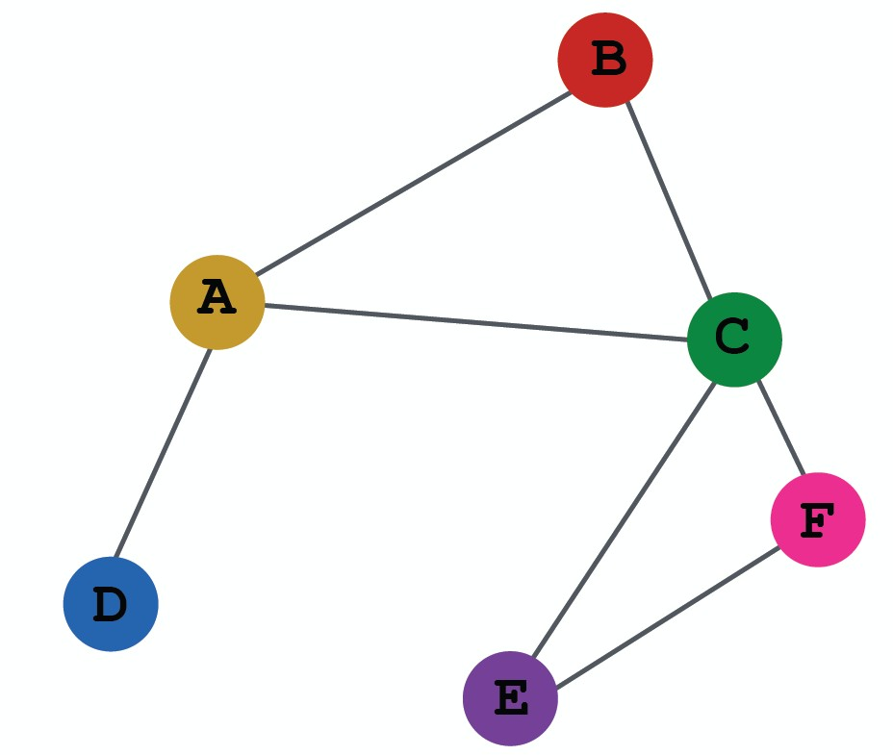
Transductive node classification
All the splits can observe the entire graph structure, but can only observe the labels of their respective nodes
Training
Validation Test
Inductive node classification
  Suppose we have a dataset of 3 graphs
  Each split contains an independent graph
Training Validation Test
8

Slide 10
Only the inductive setting is well defined for
graph classification
Because we have to test on unseen graphs
Suppose we have a dataset of 5 graphs. Each split will contain independent graph(s).
Training
Validation
Test
10

Slide 11















Goal of link prediction: predict missing edges
Setting up link prediction is tricky:
Link prediction is an unsupervised / self-supervised task. We need to create the labels and dataset splits on our own
Concretely, we need to hide some edges from the GNN and the let the GNN predict if the edges exist
2
2
2
1
3
1
3
1
3
?
4
5 4
Original graph
5 4
Input graph to GNN
5
Predictions made by GNN

Slide 12





2
1
3
Message edges
Supervision edges
5 4
Original graph
For link prediction, we will split edges twice
Step 1: Assign 2 types of edges in the original graph
  Message edges: Used for GNN message passing
  Supervision edges: Use for computing objectives
  After step 1:
    Only message edges will remain in the graph
    Supervision edges are used as supervision for edge predictions made by the model, will not be fed into GNN!

Slide 13















Step 2: Split edges into train / validation / test
Option 1: Inductive link prediction split
Suppose we have a dataset of 3 graphs. Each inductive split will contain an independent graph
2
7
12
1
3
6
8
11
13
𝐺!
𝐺"
𝐺#
15 14
Test set
5 4
Training set
10 9
Validation set
13

Slide 14
Step 2: Split edges into train / validation / test
Option 1: Inductive link prediction split
Suppose we have a dataset of 3 graphs. Each inductive split will contain an independent graph
In train or val or test set, each graph will have 2 types of edges: message edges + supervision edges
  Supervision edges are not the input to GNN
Message
2
7
12
edge
1
3
6
8
11
13
𝐺!
𝐺"
𝐺#
15 14
Test set
Supervision edge
5 4
Training set
10 9
Validation set

Slide 15





Option 2: Transductive link prediction split:
This is the default setting when people talk about link prediction
Suppose we have a dataset of 1 graph
2
1
3
5
4

Slide 16





Option 2: Transductive link prediction split:
By definition of “transductive”, the entire graph can be observed in all dataset splits
  But since edges are both part of graph structure and the supervision, we need to hold out validation / test edges
  To train the training set, we further need to hold out supervision edges for the training set
2
1
3
5 4
Next: we will show the exact settings

Slide 17




















Option 2: Transductive link prediction split:
2
1
3
5 4
The original graph
2
2
2
1
3
1
3
1
3
5
4
5
4
5
(3) At test time:
4
(1) At training time:
Use training message
edges to predict training supervision edges
(2) At validation time:
Use training message
edges & training supervision edges to predict validation edges
Use training message
edges & training supervision edges & validation edges to predict test edges

Slide 18
Option 2: Transductive link prediction split:
Why do we use growing number of edges?
After training, supervision edges are known to GNN. Therefore, an ideal model should use supervision edges in message passing at validation time.
The same applies to the test time.
2
2 2
1
3
1
3
1
3
5
4
5
4
5
(3) At test time:
4
(1) At training time:
Use training message
edges to predict training supervision edges
(2) At validation time:
Use training message
edges & training supervision edges to predict validation edges
Use training message
edges & training supervision edges & validation edges to predict test edges

Slide 19










Summary: Transductive link prediction split:
2
2
Training message edges Training supervision edges Validation edges
Test edges
1
3
1
3
Split
5 4
The original graph
5 4
Split Graph with 4 types of edges
Note: Link prediction settings are tricky and complex. You may find papers do link prediction differently. But if you follow our reasoning steps, this should be the right way to implement link prediction
Luckily, we have full support in DeepSNAP and GraphGym
19

Slide 20

Dataset split
Evaluation metrics
Input Graph
Graph Neural Network
Node embeddings
Prediction head
Predictions
Labels
Loss function
Implementation resources:
DeepSNAP provides core modules for this pipeline
GraphGym further implements the full pipeline to facilitate GNN design
20

Slide 21
We introduce a general perspective for GNNs
GNN Layer:
  Transformation + Aggregation
  Classic GNN layers: GCN, GraphSAGE, GAT
Layer connectivity:
  The over-smoothing problem
  Solution: skip connections
Graph Augmentation:
  Feature augmentation
  Structure augmentation
Learning Objectives
  The full training pipeline of a GNN
21

Slide 22
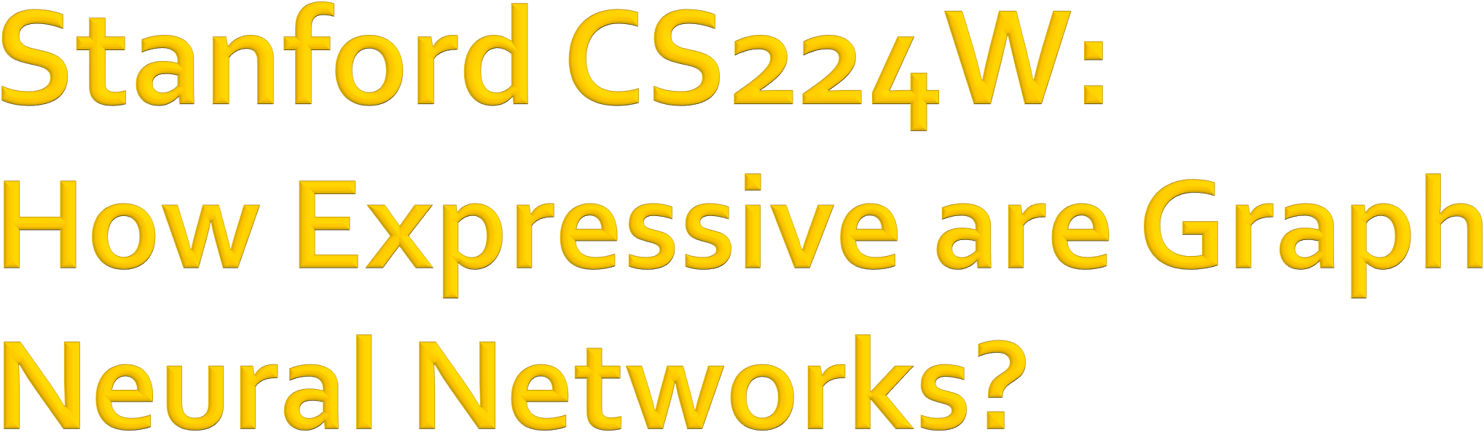

CS224W: Machine Learning with Graphs Jure Leskovec, Stanford University
http://cs224w.stanford.edu

Slide 23
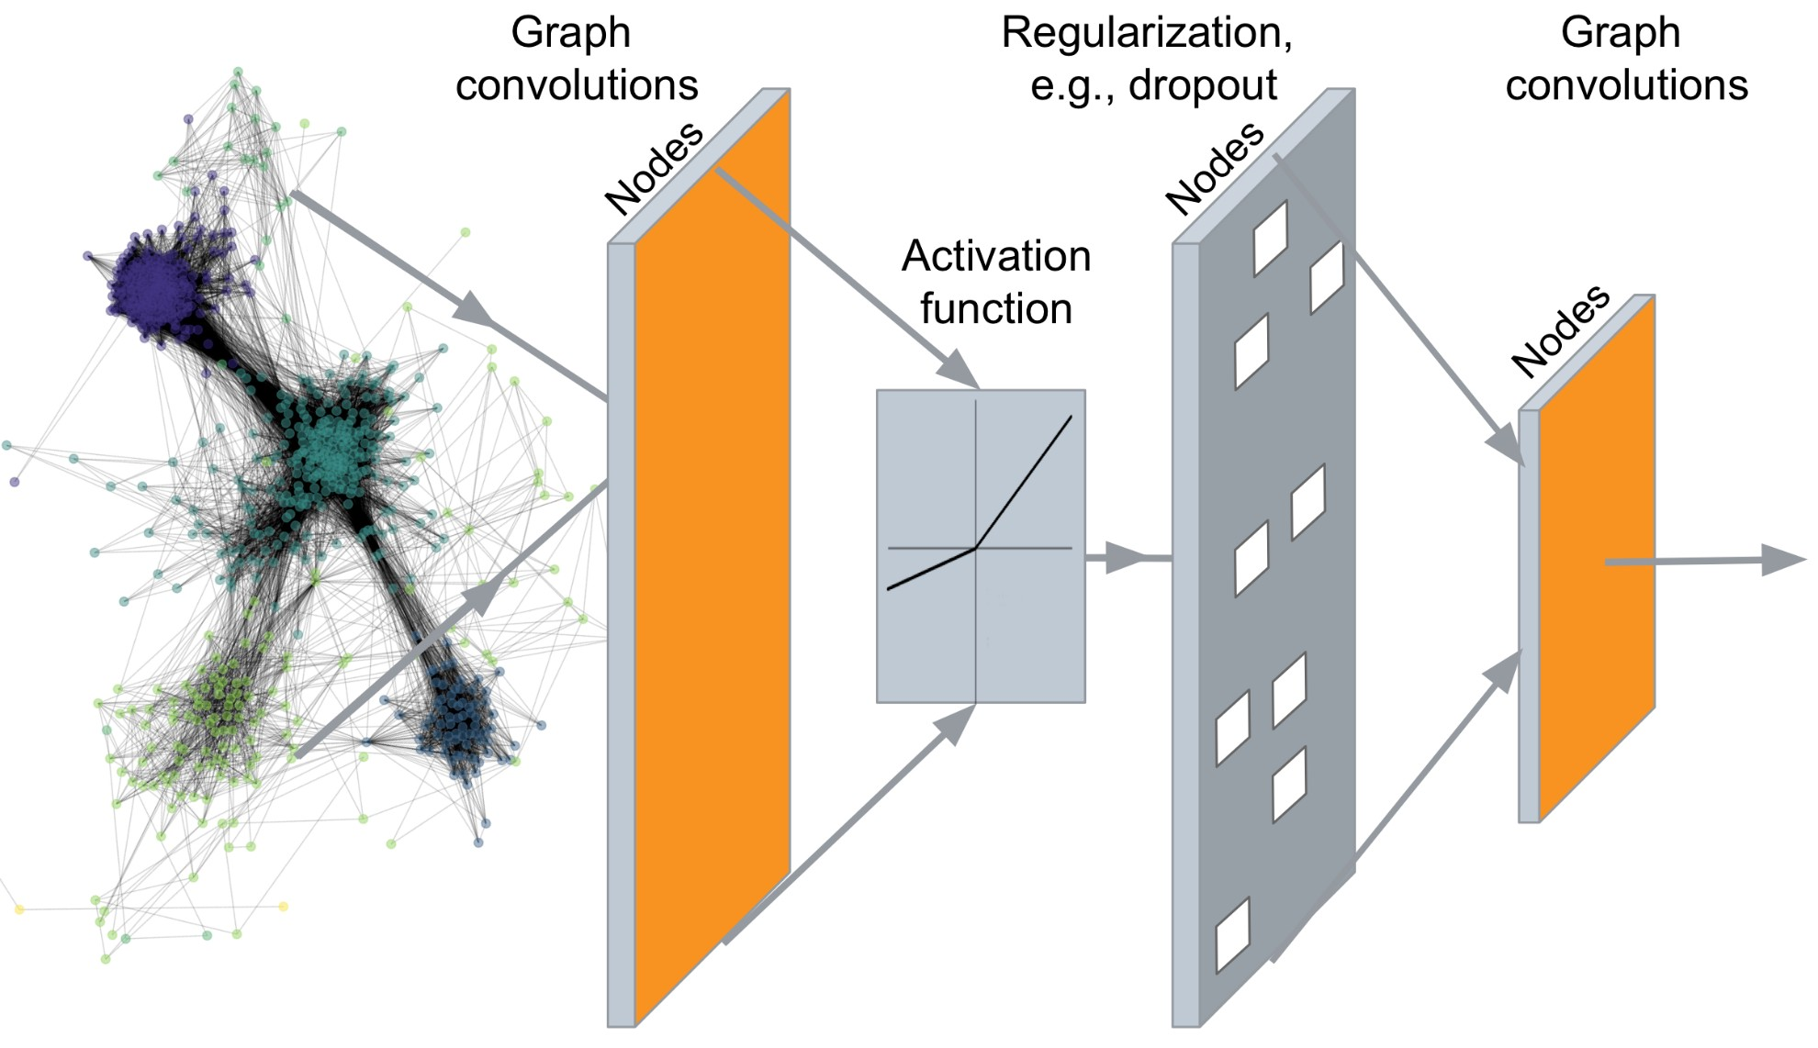
…
Output: Node embeddings.
We can also embed larger network structures, subgraphs, graphs

Slide 24
Key idea: Generate node embeddings based on local network neighborhoods
A
TARGET NODE
B
B
C
A
B
A
C
A
C
F
E
D
F
E
D
INPUT GRAPH
A

Slide 25
Intuition: Nodes aggregate information from their neighbors using neural networks
A
TARGET NODE
B
B
C
A
B
A
C
A
C
E
F
F
D
E
INPUT GRAPH
D
A
Neural networks

Slide 26
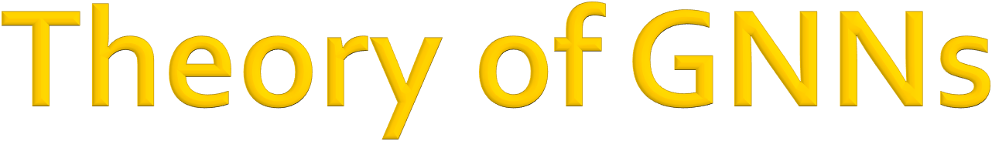
How powerful are GNNs?
Many GNN models have been proposed (e.g., GCN, GAT, GraphSAGE, design space).
What is the expressive power (ability to distinguish different graph structures) of these GNN models?
How to design a maximally expressive GNN model?

Slide 27
Many GNN models have been proposed:
GCN, GraphSAGE, GAT, Design Space etc.
?
A
TARGET NODE
B
B
C
A
B
A
?
C
A
?
C
F
E
D
F
E
?
D
INPUT GRAPH
A
Different GNN models use different neural networks in the box

Slide 28
GCN (mean-pool)
[Kipf and Welling ICLR 2017]
?
A
TARGET NODE
B
B
C
A
B
A
?
C
A
?
C
F
E
D
F
E
?
D
INPUT GRAPH
A
Element-wise mean pooling + Linear + ReLU non-linearity

Slide 29
GraphSAGE (max-pool)
[Hamilton et al. NeurIPS 2017]
?
A
TARGET NODE
B
B
C
A
B
A
?
C
A
?
C
F
E
D
F
E
?
D
INPUT GRAPH
A
MLP + element-wise max-pooling

Slide 30
We use node same/different colors to represent nodes with same/different features.
For example, the graph below assumes all the nodes share the same feature.
1
2
3
5 4
Key question: How well can a GNN distinguish different graph structures?
2/22/21 Jure Leskovec, Stanford CS224W: Machine Learning with Graphs, http://cs224w.stanford.edu
30

Slide 31
We specifically consider local neighborhood structures around each node in a graph.
Example: Nodes 1 and 5 have different
neighborhood structures because they have different node degrees.
1
2
3
5
4

Slide 32
We specifically consider local neighborhood structures around each node in a graph.
Example: Nodes 1 and 4 both have the same node
degree of 2. However, they still have different neighborhood structures because their neighbors have different node degrees.
1
2
3
5
4
Node 1 has neighbors of degrees 2 and 3.
Node 4 has neighbors of degrees 1 and 3.

Slide 33
We specifically consider local neighborhood structures around each node in a graph.
Example: Nodes 1 and 2 have the same
neighborhood structure because they are symmetric within the graph.
1
2
3
5 4
Node 1 has neighbors of degrees 2 and 3.
Node 2 has neighbors of degrees 2 and 3.
And even if we go a step deeper to 2nd hop neighbors, both nodes have the same degrees (Node 4 of degree 2)

Slide 34
Key question: Can GNN node embeddings distinguish different node’s local neighborhood structures?
If so, when? If not, when will a GNN fail?
Next: We need to understand how a GNN captures local neighborhood structures.
  Key concept: Computational graph

Slide 35
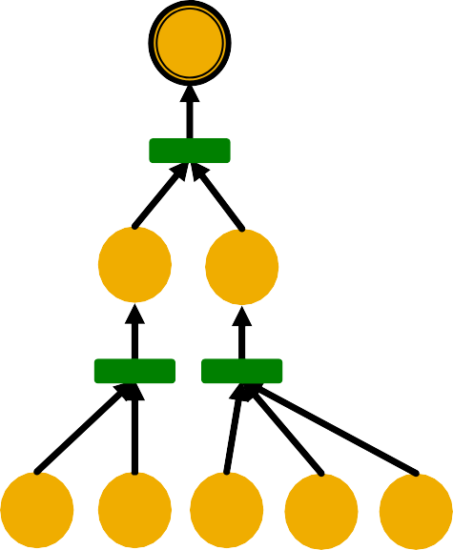
In each layer, a GNN aggregates neighboring node embeddings.
A GNN generates node embeddings through a
computational graph defined by the neighborhood.
Ex: Node 1’s computational graph (2-layer GNN)
1
1
2
3
2
5
5
4
1 5 1
2 4

Slide 36
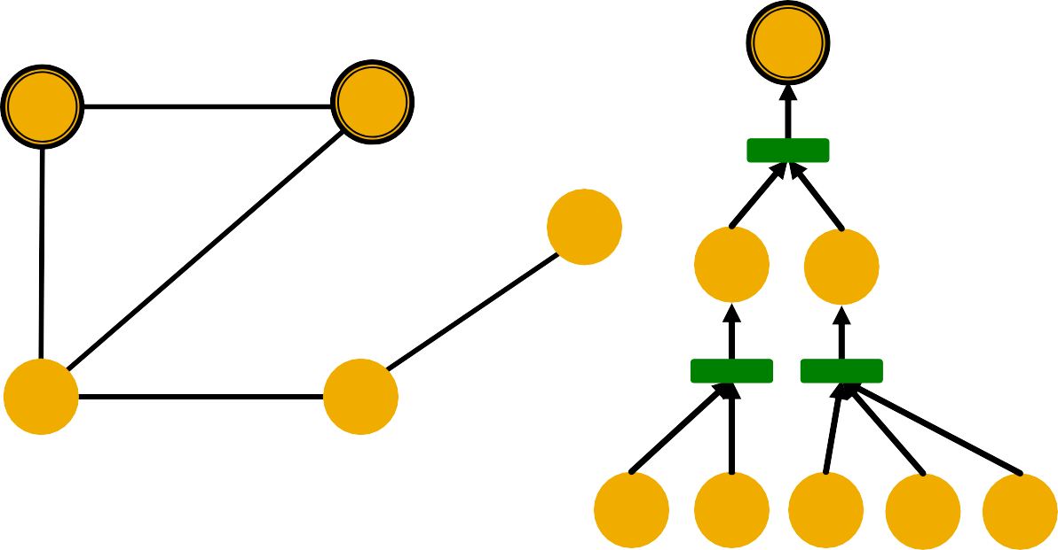
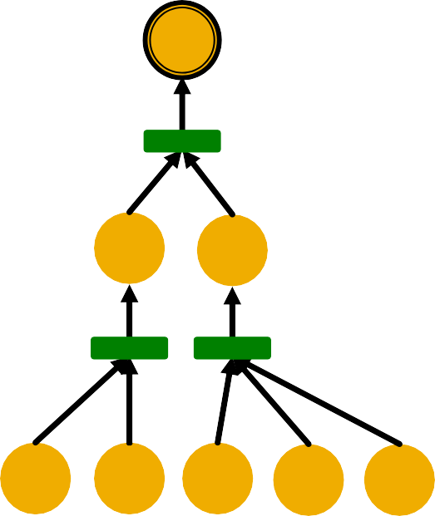
Ex: Nodes 1 and 2’s computational graphs.
1
2
1
2
3
2
5
1
5
5
4
1 5 1 2 4
2 5 1 2 4

Slide 37
Ex: Nodes 1 and 2’s computational graphs.
But GNN only sees node features (not IDs):
1
2
3
5
4

Slide 38


A GNN will generate the same embedding for nodes 1 and 2 because:
Computational graphs are the same.
Node features (colors) are identical.
1
2
Note: GNN does not
care about node ids, it just aggregates features vectors of different nodes.
2
1
3
5
4
GNN won’t be able to distinguish nodes 1 and 2

Slide 39

In general, different local neighborhoods define different computational graphs
1
2
3
5
4
1
2
3
4
5
2
5
1
5
4
3 5
1 2
4
1 5 1
2 4
2 5 1 2 4 3 5
4 1 2 4
2 5
1
5
3 5

Slide 40
Computational graphs are identical to rooted subtree structures around each node.
1
2
Rooted subtree structures
(defined by recursively unfolding neighboring nodes from the root nodes)
3
5
4
1
2
3
4
5
2
5
1
5
4
3 5
1 2
4
1 5 1
2 4
2 5 1 2 4 3 5
4 1 2 4
2 5
1
5
3 5
40

Slide 41
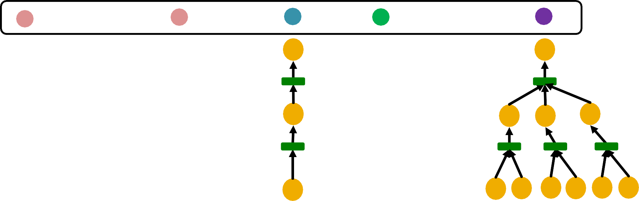
GNN‘s node embeddings capture rooted subtree structures.
Most expressive GNN maps different rooted subtrees into different node embeddings
(represented by different colors).
Embedding
1
2
3
4
5
2 5
1
5
4
3
5
1 2
4
1 5 1 2 4
2 5 1
2 4
5
4 1
2 4
2
5 1 5 3 5

Slide 42
Function 𝑓: 𝑋 → Y is injective if it maps different elements into different outputs.
Intuition: 𝑓 retains all the information about input.
𝑋
1
𝑌
D B
𝑓
2
C A
3

Slide 43
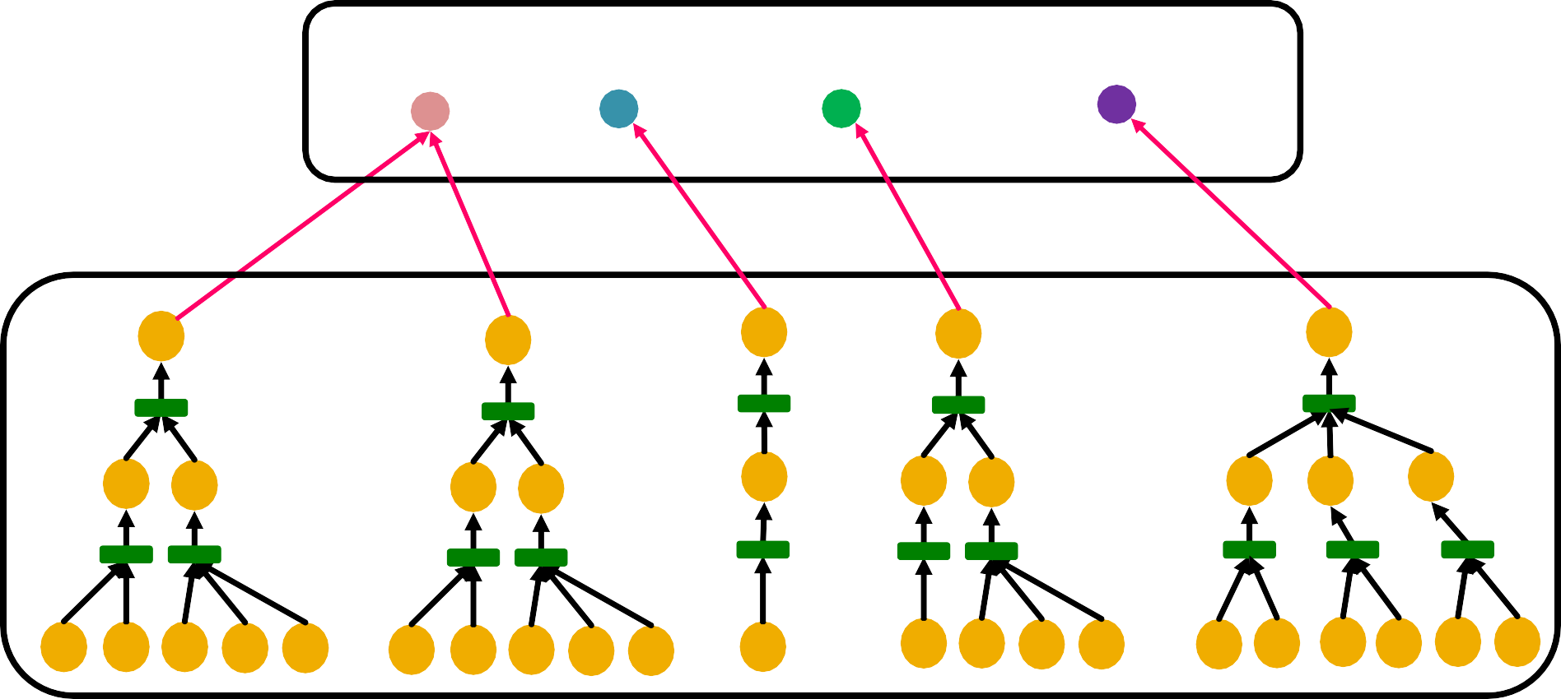
Most expressive GNN should map subtrees to the node embeddings injectively.
Embedding space
_{ℝ}"
Subtrees
1
2
3
4
5
2 5
1
5
4
3
5
1 2
4
1 5 1 2 4
2 5 1
2 4
5
4 1
2 4
2
5 1 5 3 5

Slide 44
Key observation: Subtrees of the same depth can be recursively characterized from the leaf nodes to the root nodes.
From leaves to the root
From leaves to the root
≠
1
(2 neighbors,
3 neighbors)
(1 neighbor,
3 neighbors)
4
2 5
3
5
2 neighbors
1 5 1
Input features are uniform
3 neighbors
2 4
1 neighbor
3 neighbors
4 1 2 4
Input features are uniform

Slide 45
If each step of GNN’s aggregation can fully retain the neighboring information, the generated node embeddings can distinguish different rooted subtrees.
Fully retain neighboring information
≠
1
(2 neighbors,
3 neighbors)
(1 neighbor,
3 neighbors)
4
2 5
3 5
2 neighbors 3 neighbors 1 neighbor 3 neighbors
Fully retain neighboring information
1 5 1 2 4
Input features are uniform
4 1 2 4
Input features are uniform

Slide 46
In other words, most expressive GNN would use an injective neighbor aggregation function at each step.
  Maps different neighbors to different embeddings.
Injective neighbor aggregation
1
4
3 5
4 1 2 4
2 5
Injective neighbor aggregation
1 5 1
2 4
Input features are uniform
Input features are uniform

Slide 47
Summary so far
To generate a node embedding, GNNs use a computational graph corresponding to a subtree rooted around each node.
Input graph
Computational graph
= Rooted subtree
1
Using injective neighbor aggregation
à distinguish
different subtrees
1
2
3
2 5
5 4
1 5 1 2 4
GNN can fully distinguish different subtree structures if every step of its neighbor
aggregation is injective.
Jure Leskovec, Stanford CS224W: Machine Learning with Graphs, http://cs224w.stanford.edu

Slide 48

CS224W: Machine Learning with Graphs Jure Leskovec, Stanford University
http://cs224w.stanford.edu

Slide 49
Key observation: Expressive power of GNNs can be characterized by that of neighbor aggregation functions they use.
A more expressive aggregation function leads to a more expressive a GNN.
Injective aggregation function leads to the most expressive GNN.
Next:
  Theoretically analyze expressive power of aggregation functions.
49

Slide 50

Observation: Neighbor aggregation can be abstracted as a function over a multi-set (a
set with repeating elements).
Equivalent
Examples of multi-set
Neighbor aggregation
Multi-set function
Same color indicates the same features.
59

Slide 51
Next: We analyze aggregation functions of two popular GNN models
GCN (mean-pool) [Kipf & Welling, ICLR 2017]
  Uses element-wise mean pooling over neighboring node features
Mean( 𝑥_{! !∈#(%)})
GraphSAGE (max-pool) [Hamilton et al. NeurIPS 2017]
  Uses element-wise max pooling over neighboring node features
Max( 𝑥! !∈# % )

Slide 52
GCN (mean-pool) [Kipf & Welling ICLR 2017]
Take element-wise mean, followed by linear function and ReLU activation, i.e., max(0, 𝑥).
Theorem [Xu et al. ICLR 2019]
  GCN’s aggregation function cannot distinguish different multi-sets with the same color proportion.
Failure case
Why?

Slide 53
For simplicity, we assume node colors are represented by one-hot encoding.
Example) If there are two distinct colors:
1
0
0
1
This assumption is sufficient to illustrate how GCN fails.

Slide 54
GCN (mean-pool) [Kipf & Welling ICLR 2017]
Failure case illustration
Same outputs!
Linear + ReLU
Linear + ReLU
0.5
0.5
0.5
0.5
Element-wise- mean-pool
1 | 0 | 1 | 1
0 | 1 | 0 | 0
0
1
0
1

Slide 55
GraphSAGE (max-pool) [Hamilton et al. NeurIPS 2017]
Apply an MLP, then take element-wise max.
Theorem [Xu et al. ICLR 2019]
  GraphSAGE’s aggregation function cannot distinguish different multi-sets with the same set of distinct colors.
Failure case
Why?

Slide 56
GraphSAGE (max-pool) [Hamilton et al. NeurIPS 2017]
Failure case illustration
The same outputs!
Element-wise- max-pool
1
1
1
1 |  |  |  | 1 |  |  | 1
 | 0 | 1 | 1 | 0 | 0 | 1 | 1
 | 1 | 0 | 0 | 1 | 1 | 0 | 0
For simplicity, assume the one- hot encoding after MLP.
1
0
0
1
MLP

Slide 57

We analyzed the expressive power of GNNs.
Main takeaways:
Expressive power of GNNs can be characterized by that of the neighbor aggregation function.
Neighbor aggregation is a function over multi-sets (sets with repeating elements)
GCN and GraphSAGE’s aggregation functions fail to distinguish some basic multi-sets; hence not injective.
Therefore, GCN and GraphSAGE are not maximally powerful GNNs.

Slide 58
Our goal: Design maximally powerful GNNs in the class of message-passing GNNs.
This can be achieved by designing injective neighbor aggregation function over multi- sets.
Here, we design a neural network that can model injective multiset function.

Slide 59
Theorem [Xu et al. ICLR 2019]
Any injective multi-set function can be expressed
as:
Some non- linear function
Some non- linear function
Φ - 𝑓(𝑥)
'∈(
Sum over multi-set
𝑆 : multi-set
Φ
𝑓
+ 𝑓 + 𝑓

Slide 60
Proof Intuition: [Xu et al. ICLR 2019]
𝑓 produces one-hot encodings of colors. Summation of the one-hot encodings retains all the information about the input multi-set.
Φ - 𝑓(𝑥)
'∈(
Example: _{Φ}
𝑓
+ 𝑓 + 𝑓
1
0
0
1
0
1
1
2
One-hot
+
+
=
60

Slide 61
How to model 𝜱 and 𝒇 in 𝜱 ∑_{𝒙∈𝑺} 𝒇(𝒙) ?
We use a Multi-Layer Perceptron (MLP).
Theorem: Universal Approximation Theorem
[Hornik et al., 1989]
  1-hidden-layer MLP with sufficiently-large hidden dimensionality and appropriate non-linearity 𝜎(⋅) (including ReLU and sigmoid) can approximate any continuous function to an arbitrary accuracy.
𝜎
𝑾! 𝑾"
Input
Output

Slide 62
We have arrived at a neural network that can model any injective multiset function.
- MLP*(𝑥)
'∈(
MLP₎
In practice, MLP hidden dimensionality of 100 to 500 is sufficient.

Slide 63
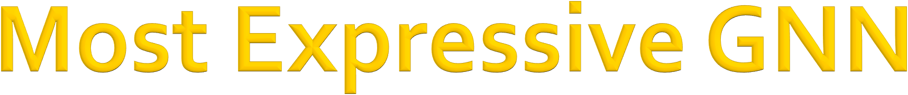
Graph Isomorphism Network (GIN) [Xu et al. ICLR 2019]
Apply an MLP, element-wise sum, followed by another MLP.
- MLP*(𝑥)
'∈(
MLP₎
Theorem [Xu et al. ICLR 2019]
  GIN‘s neighbor aggregation function is injective.
No failure cases!
GIN is THE most expressive GNN in the class of message-passing GNNs!

Slide 64

So far: We have described the neighbor aggregation part of GIN.
We now describe the full model of GIN by relating it to WL graph kernel (traditional way of obtaining graph-level features).
  We will see how GIN is a “neural network” version of the WL graph kernel.

Slide 65

Recall: Color refinement algorithm in WL kernel.
Given: A graph 𝐺 with a set of nodes 𝑉.
Assign an initial color 𝑐 ⁺
𝑣 to each node 𝑣.
Iteratively refine node colors by
_{𝑐} ,-.
𝑣 = HASH 𝑐 , 𝑣 , 𝑐 , 𝑢
,
!∈# %
where HASH maps different inputs to different colors.
After 𝐾 steps of color refinement, 𝑐 / 𝑣
summarizes the structure of 𝐾-hop neighborhood

Slide 66
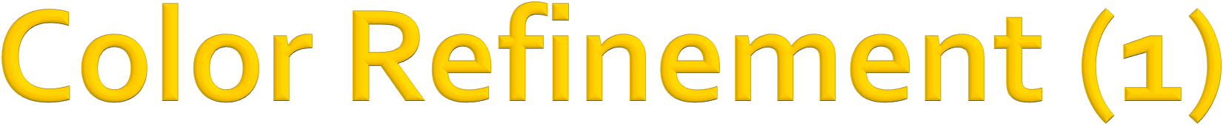
Example of color refinement given two graphs
Assign initial colors
1
1 1
1
1
1
1
1
1 1
Aggregate neighboring colors
1
1
1,111
1,11
1,11
1,111
1,1111
1,111
1,1111
1,111
1,1
1,1
1,1
1,1

Slide 67
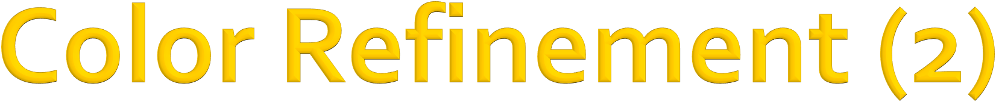
Example of color refinement given two graphs
Aggregated colors:
1,111 1,11
1,11 1,111
1,1111
1,111
1,1111
1,111
1,1
1,1
1,1
1,1
Injectively HASH the aggregated colors
HASH table: Injective!
4
3
3
4
1,1 | --> | 2
1,11 | --> | 3
1,111 | --> | 4
1,1111 | --> | 5
5
4
5
4
2
2
2
2

Slide 68
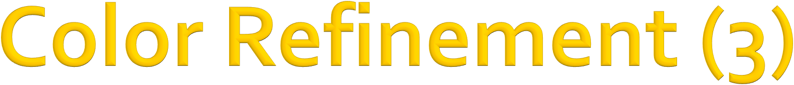
Example of color refinement given two graphs
Process continues until a stable coloring is reached
Two graphs are considered isomorphic if they have the same set of colors.
≠
11
8
9
11
12
11
13
10
7
7
7
6
2/22/21
Jure Leskovec, Stanford CS224W: Machine Learning with Graphs, http://cs224w.stanford.edu
68

Slide 69
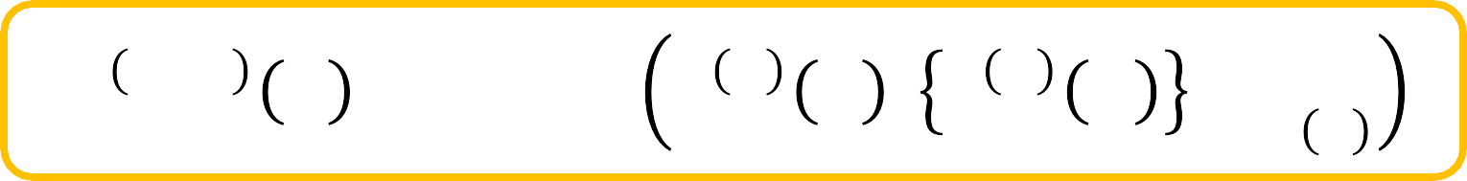
GIN uses a neural network to model the injective HASH function.
_{𝑐} ,-.
𝑣 = HASH 𝑐 , 𝑣 , 𝑐 , 𝑢
!∈# %
Specifically, we will model the injective function over the tuple:
(𝑐 $ 𝑣 , 𝑐 $ 𝑢
Root node features
%∈& ' ⁾
Neighboring node colors
69

Slide 70
Theorem (Xu et al. ICLR 2019)
Any injective function over the tuple
Root node _{(𝑐 ,}
₎ Neighboring
𝑣 , 𝑐 , 𝑢
feature
!∈# %
node features
can be modeled as
- MLP*(𝑐 , 𝑢 )
!∈# %
MLP₎
1 + 𝜖 ⋅ MLP*(𝑐 , (𝑣))) +
where 𝜖 is a learnable scalar.
79

Slide 71
If input feature 𝑐 ⁽ (𝑣) is represented as one- hot, direct summation is injective.
Example:
Φ
+
+
1
0
0
1
0
1
1
2
+
+
=
We only need Φ to ensure the injectivity.
GINConv
𝑐 | ! | 𝑣 | , | 𝑐 | ! | 𝑢 | "∈$ %
= MLP& 1 + 𝜖 ⋅ 𝑐 ! (𝑣) + C
"∈$ %
_{𝑐} !
𝑢
Root node
features
Neighboring node features
This MLP can provide “one-hot” input feature for the next layer.

Slide 72

GIN’s node embedding updates
Given: A graph 𝐺 with a set of nodes 𝑉.
Assign an initial vector 𝑐 ⁺
𝑣 to each node 𝑣.
Iteratively update node vectors by
𝑐 ^{,-.} 𝑣 = GINConv 𝑐 , 𝑣 , 𝑐 , 𝑢 ,
!∈# %
Differentiable color HASH function
where GINConv maps different inputs to different embeddings.
After 𝐾 steps of GIN iterations, 𝑐 /
𝑣 summarizes
the structure of 𝐾-hop neighborhood.

Slide 73
GIN can be understood as differentiable neural version of the WL graph Kernel:
 | Update target | Update function
WL Graph Kernel | Node colors (one-hot) | HASH
GIN | Node embeddings (low-dim vectors) | GINConv
Advantages of GIN over the WL graph kernel are:
  Node embeddings are low-dimensional; hence, they can capture the fine-grained similarity of different nodes.
  Parameters of the update function can be learned for the downstream tasks.

Slide 74
Because of the relation between GIN and the WL graph kernel, their expressive is exactly the same.
If two graphs can be distinguished by GIN, they can be also distinguished by the WL kernel, and vice versa.
How powerful is this?
  WL kernel has been both theoretically and empirically shown to distinguish most of the real- world graphs [Cai et al. 1992].
  Hence, GIN is also powerful enough to distinguish most of the real graphs!

Slide 75
We design a neural network that can model injective multi-set function.
We use the neural network for neighbor aggregation function and arrive at GIN---the
most expressive GNN model.
The key is to use element-wise sum pooling, instead of mean-/max-pooling.
GIN is closely related to the WL graph kernel.
Both GIN and WL graph kernel can distinguish most of the real graphs!

Slide 76


































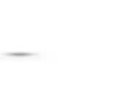
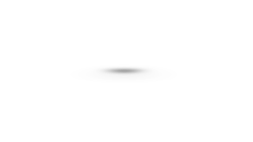
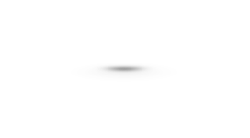
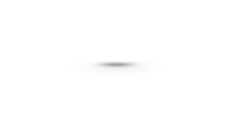









Failure cases for mean and max pooling:
A
B
B
A
vs.
B
vs.
^{A} vs.
(a) Mean and Max both fail
(b) Max fails
(c) Mean and Max both fail
Colors represent feature values
Ranking by discriminative power:
>
>
Input
sum - multiset
Jure Leskovec, Stanford University
mean - distribution
max - set
76

Slide 77
Can expressive power of GNNs be improved?
There are basic graph structures that existing GNN framework cannot distinguish, such as difference in cycles.
Graphs
A 𝑣'
Computational graphs for nodes 𝑣# and 𝑣$:
B 𝑣₍
GNNs’ expressive power can be improved to resolve the above problem. [You et al. AAAI 2021, Li et al. NeurIPS 2020]
2/22/21
Jure Leskovec, Stanford CS224W: Machine Learning with Graphs, http://cs224w.stanford.edu
77

