Slide 1



CS224W: Machine Learning with Graphs Jure Leskovec, Stanford University
http://cs224w.stanford.edu

Slide 2
Goal:
So far we only handle graphs with one edge type.
How to handle (directed) graphs with multiple edge types (a.k.a heterogeneous graphs)?
Heterogeneous Graphs
  Relational GCNs
  Knowledge Graphs
  Embeddings for KG Completion
2/22/21
Jure Leskovec, Stanford CS224W: Machine Learning with Graphs, http://cs224w.stanford.edu
2

Slide 3
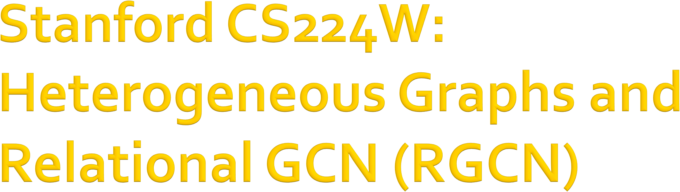
CS224W: Machine Learning with Graphs Jure Leskovec, Stanford University
http://cs224w.stanford.edu

Slide 4
A heterogeneous graph is defined as
𝑮 = 𝑽, 𝑬, 𝑹, 𝑻
Nodes with node types 𝑣! ∈ 𝑉
Edges with relation types 𝑣!, 𝑟, 𝑣" ∈ 𝐸
Node type 𝑇 𝑣!
Relation type 𝑟 ∈ 𝑅
6

Slide 5
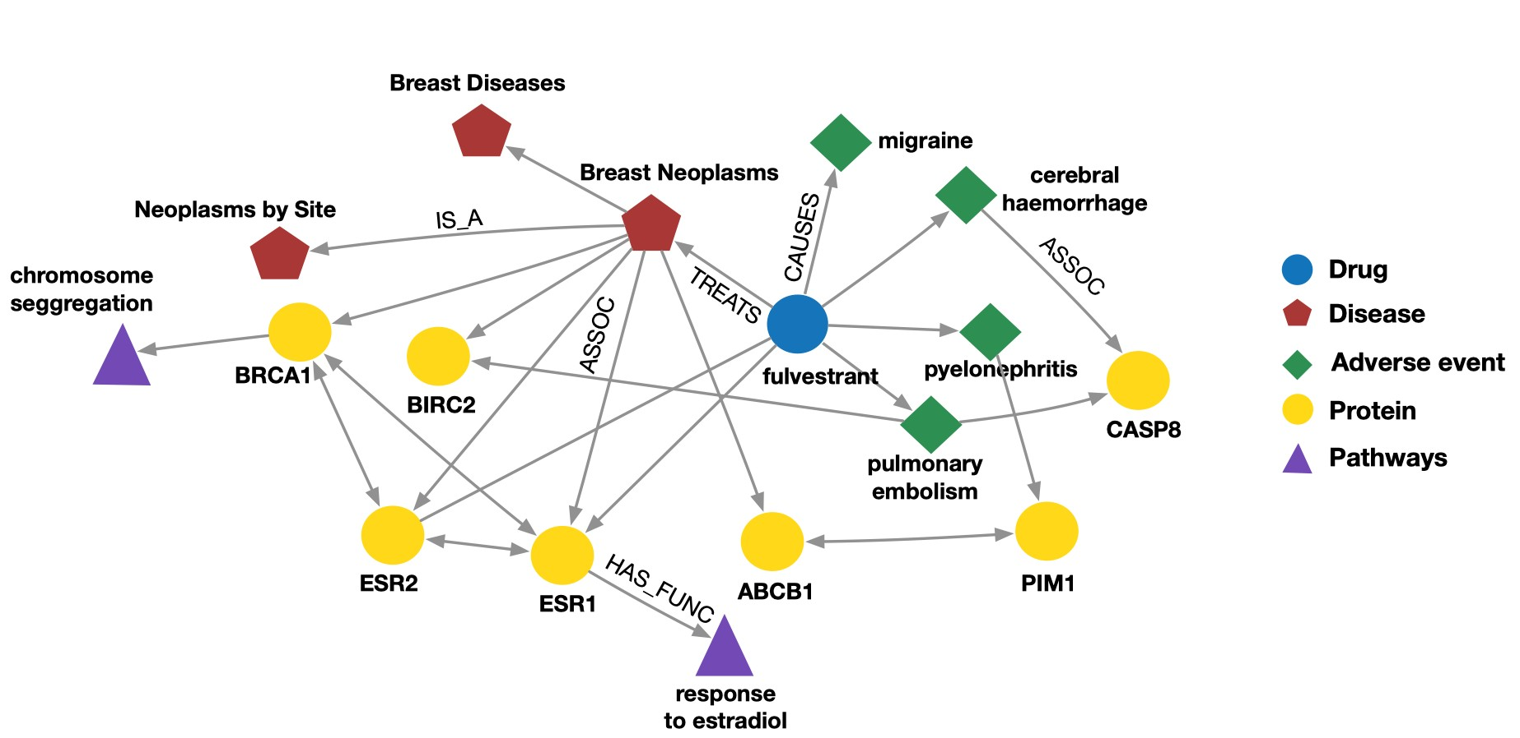
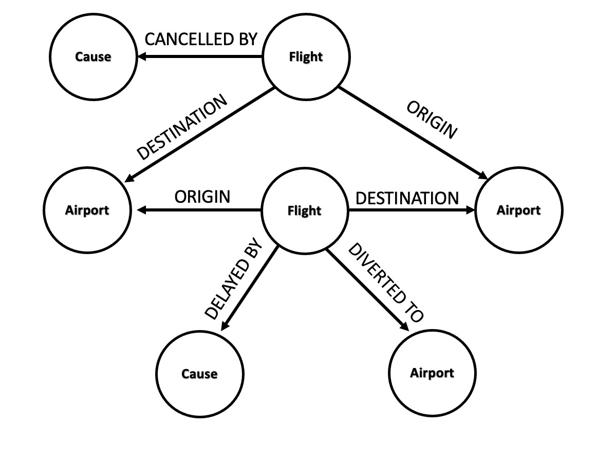
Event Graphs
Example node: SFO
Example edge: (UA689, Origin, LAX) Example node type: Flight
Example edge type (relation): Destination
Biomedical Knowledge Graphs
Example node: Migraine
Example edge: (fulvestrant, Treats, Breast Neoplasms) Example node type: Protein
Example edge type (relation): Causes
6

Slide 6

We will extend GCN to handle heterogeneous graphs with multiple edge/relation types
We start with a directed graph with one relation
Schlichtkrull et al., Modeling Relational Data with Graph Convolutional Networks, ESWC 2018
How do we run GCN and update the representation of the target node A on this graph?
Target Node
A
B
C
E
Input Graph
F
D
6

Slide 7
We will extend GCN to handle heterogeneous graphs with multiple edge/relation types
We start with a directed graph with one relation
How do we run GCN and update the representation of the target node A on this graph?
Target Node
A
B
Only pass messages along direction of edges
C
B
C
F
A
C
E
Input Graph
F
D
E
D
6

Slide 8
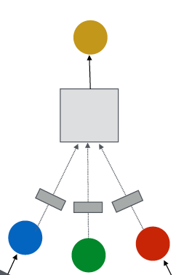
A single GNN layer:
(1) Message: each node computes a message
_{𝐡} %'(
𝐦^{(%)} = MSG %
, 𝑢 ∈ {𝑁 𝑣 ∪ 𝑣}
# #
(2) Aggregation: aggregate messages from neighbors
𝐡^{(#)} = AGG # 𝐦 # , 𝑢 ∈ 𝑁 𝑣
, 𝐦 #
! % !
Nonlinearity (activation): Adds expressiveness
  Often written as 𝜎(⋅): ReLU(⋅), Sigmoid(⋅) , …
  Can be added to message or aggregation
(2) Aggregation
(1) Message
6

Slide 9
(1) Graph Convolutional Networks (GCN)
Kipf and Welling. Semi-Supervised Classification with Graph Convolutional Networks, ICLR 2017
_{𝐡} #()
(#)
_{𝐖} #
2
%∈' !
%
𝐡! = 𝜎
𝑁 𝑣
How to write this as Message + Aggregation?
Message
_{𝐡} #()
𝐡! = 𝜎 2
%∈' !
_{𝐖} #
(2) Aggregation
(#)
%
𝑁 𝑣
(1) Message
Aggregation
6

Slide 10

What if the graph has multiple relation types?
𝑟₎
B
𝑟₊
C
Target node
A
𝑟
𝑟
)
*
𝑟
𝑟
*
F
+
D
E
𝑟₎
Input graph
10

Slide 11

What if the graph has multiple relation types?
Use different neural network weights for different relation types.
Weights 𝐖!! for 𝑟"
𝑟
B
Target node
A
𝑟₎
D
)
𝑟
+
𝑟
* _{𝑟+}
E
C
𝑟*
F
Weights 𝐖!" for 𝑟#
𝑟₎
Weights 𝐖!# for 𝑟$
Input graph

Slide 12

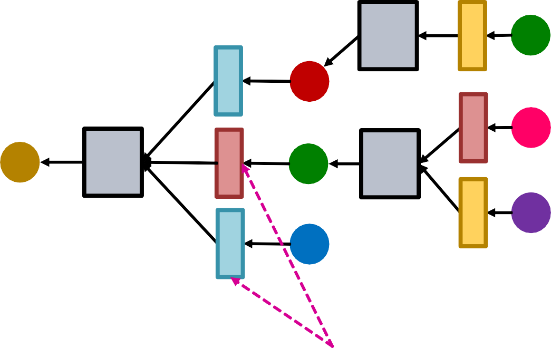
What if this graph has multiple relation types?
Use different neural network weights for
different relation types!
Aggregation
C
𝑟₎
Target node
A
B
𝑟
B
+
F
𝑟
C
A
C
𝑟
*
𝑟
𝑟
*
F
)
+
E
D
E
𝑟₎
D
Input graph
Neural networks

Slide 13
Relational GCN (RGCN):
_{𝐡} #.)
1
= 𝜎 % %
#
(#)
(#) (#)
𝐖 𝐡
+ 𝐖 𝐡
!
^{𝑐}!,/
/ %
2
!
/∈0 %∈'"
!
How to write this as Message + Aggregation?
Message:
  Each neighbor of a given relation:
Normalized by node degree
of the relation 𝑐%,! = 𝑁!
%
_{𝐦}(%) ₌
1
(%)
# !
%
𝐖 𝐡
!,#
^{𝑐}',#
Self-loop:
_{𝐦}(%) _{= 𝐖} % _{𝐡}(%)
' ( '
Aggregation:
Sum over messages from neighbors and self-loop, then apply activation
_{𝐡} %)* _{𝐦} %
= 𝜎 Sum , 𝑢 ∈ 𝑁 𝑣
∪ {𝑣}
'
!,#

Slide 14

Each relation has 𝐿 matrices: 𝐖!" , 𝐖!#
⋯ 𝐖!$
𝑑^{(")} is the hidden dimension in layer 𝑙
_{is 𝑑}(%'")_{×𝑑}(%)
The size of each 𝐖!%
Rapid # parameters growth w.r.t # relations!
  Overfitting becomes an issue
Two methods to regularize the weights 𝐖^{(𝒍)}
𝒓
(1) Use block diagonal matrices
(2) Basis/Dictionary learning

Slide 15
Key insight: make the weights sparse!
Use block diagonal matrices for 𝐖!
𝐖₄ =
Limitation: only nearby neurons/dimensions can interact through 𝑊
If use 𝐵 low-dimensional matrices, then # param
reduces from 𝑑^{(%'")}×𝑑^{(%)} to 𝐵× ^{+ &'(} × ^{+ &} .
, ,

Slide 16

Key insight: Share weights across different relations!
Represent the matrix of each relation as a linear combination of basis transformations
𝐖! = ∑, " 𝑎_{!-} ⋅ 𝐕₋, where 𝐕₋ is shared across
-.
all relations
𝐕₎ are the basis matrices
𝑎_{*)} is the importance weight of matrix 𝐕₎
Now each relation only needs to learn 𝑎_{!-} , ",
-.
which is 𝐵 scalars.

Slide 17
Goal: Predict the label of a given node
RGCN uses the representation of the final layer:
If we predict the class of node 𝑨 from 𝒌 classes.
Take the final layer (prediction head): 𝐡^{(,)} ∈ ℝ⁻,
+
each item in 𝐡^{(,)} represents the probability of that
+
class.
𝑟₎
B
𝑟₊
C
Target Node
A
𝑟
𝑟
)
*
𝑟
𝑟
*
F
+
D
E
𝑟₎
Input Graph

Slide 18










Link prediction split:
Every edge also has a relation type, this is independent of the 4 categories.
In a heterogeneous graph, the homogeneous graphs formed by every single relation also have the 4 splits.
2
2
1
3
1
3
Split
5 4
The original graph
5 4
Split Graph with 4 categories of edges
Training message edges for 𝒓_{𝟏} Training supervision edges for 𝒓_{𝟏} Validation edges for 𝒓_{𝟏}
Test edges for 𝒓_{𝟏}
Training message edges Training supervision edges Validation edges
Test edges
…..
Training message edges for 𝒓_{𝒏} Training supervision edges for 𝒓_{𝒏} Validation edges for 𝒓_{𝒏}
Test edges for 𝒓_{𝒏}

Slide 19
Assume 𝑬, 𝒓_{𝟑}, 𝑨 is Training supervision edge,
all the other edges are Training message edges
Use RGCN to score 𝑬, 𝒓_{𝟑}, 𝑨 !
Take the final layer of 𝐸 and 𝐴: 𝐡 * and 𝐡^{(*)} ∈ ℝ,
) +
Relation-specific score function 𝑓₋: ℝ,×ℝ, → ℝ
One example 𝑓#
𝐡., 𝐡/ = 𝐡⁰𝐖# 𝐡/, 𝐖#
_{∈ ℝ}1×1
)
.
) )
𝑟₎
B
𝑟₊
C
A
𝑟
𝑟
)
*
𝑟
𝑟
*
F
𝒓
+
𝟑
D
E
𝑟₎
Input Graph

Slide 20
Training:
𝑟₎
𝑟₊
C
Use RGCN to score the training supervision edge 𝑬, 𝒓_{𝟑}, 𝑨
Create negative edge by perturbing the supervision edge:
  Corrupt the tail of 𝑬, 𝒓_{𝟑}, 𝑨
e.g., 𝑬, 𝒓_{𝟑}, 𝑩 , 𝑬, 𝒓_{𝟑}, 𝑫
B
A
𝑟₎
D
𝑟
* _{𝑟+}
E
𝑟*
F
𝒓
𝟑
𝑟₎
Input Graph
training supervision edges: 𝑬, 𝒓_{𝟑}, 𝑨
training message edges: all the rest existing edges (solid lines)
(1) Use training message edges to predict training supervision edges
Note the negative edges should NOT belong to training message edges or training supervision edges!
e.g., 𝑬, 𝒓_{𝟑}, 𝑪
is NOT a negative edge
20

Slide 21
Training:
Use RGCN to score the training supervision edge 𝑬, 𝒓_{𝟑}, 𝑨
Create negative edge by perturbing the supervision edge 𝑬, 𝒓_{𝟑}, 𝑩
Use GNN model to score negative edge
Optimize a standard cross entropy loss (as discussed in Lecture 6)
  Maximize the score of training supervision edge
  Minimize the score of negative edge
𝑟₎
B
𝑟
+
A
𝑟
C
𝑟
*
𝑟
𝑟
*
F
)
𝒓
+
𝟑
D
E
𝑟
)
Input Graph
ℓ = − log 𝜎 𝑓*!
ℎ., ℎ₊
− log(1 − 𝜎 𝑓*!(ℎ., ℎ/))
Sigmoid function

Slide 22
Evaluation:
Validation time as an example, same at the test time
𝑟₎
B
𝑟
Evaluate how the model can predict the validation edges with the relation types. Let’s predict validation edge 𝑬, 𝒓_{𝟑}, 𝑫 Intuition: the score of 𝑬, 𝒓_{𝟑}, 𝑫 should be
higher than all 𝑬, 𝒓_{𝟑}, 𝒗 where 𝑬, 𝒓_{𝟑}, 𝒗 is NOT in the training message edges and training supervision edges, e.g., 𝑬, 𝒓_{𝟑}, 𝑩
+
A
𝑟
* _{𝑟+}
E
C
𝑟*
F
𝑟₎
D
𝑟
+
𝑟₎
𝒓_{𝟑}?
Input Graph
validation edges: 𝑬, 𝒓_{𝟑}, 𝑫
training message edges & training supervision edges: all existing edges (solid lines)
(2) At validation time:
Use training message edges & training supervision edges to predict validation edges

Slide 23
Evaluation:
Validation time as an example, same at the test time
𝑟₎
B
𝑟
Evaluate how the model can predict the validation edges with the relation types. Let’s predict validation edge 𝑬, 𝒓_{𝟑}, 𝑫 Intuition: the score of 𝑬, 𝒓_{𝟑}, 𝑫 should be
higher than all 𝑬, 𝒓_{𝟑}, 𝒗 where 𝑬, 𝒓_{𝟑}, 𝒗 is NOT in the training message edges and training supervision edges, e.g., 𝑬, 𝒓_{𝟑}, 𝑩
+
A
𝑟
* _{𝑟+}
E
C
𝑟*
F
𝑟₎
D
𝑟
+
𝑟₎
𝒓_{𝟑}?
Calculate the score of 𝑬, 𝒓_{𝟑}, 𝑫
Calculate the score of all the negative edges:
Input Graph
𝑬, 𝒓_{𝟑}, 𝒗
𝒗 ∈ 𝑩, 𝑭
, since 𝑬, 𝒓_{𝟑}, 𝑨 ,
𝑬, 𝒓_{𝟑}, 𝑪 belong to training message edges & training supervision edges
Obtain the ranking 𝑹𝑲 of 𝑬, 𝒓_{𝟑}, 𝑫 .
Calculate metrics
  Hits@𝒌: 𝟏 𝑹𝑲 ≤ 𝒌 . Higher is better
𝟏
2. Reciprocal Rank: . Higher is better
𝑹𝑲

Slide 24

Relational GCN, a graph neural network for
heterogeneous graphs
Can perform entity classification as well as link prediction tasks.
Ideas can easily be extended into RGNN (RGraphSAGE, RGAT, etc.)

Slide 25

CS224W: Machine Learning with Graphs Jure Leskovec, Stanford University
http://cs224w.stanford.edu

Slide 26
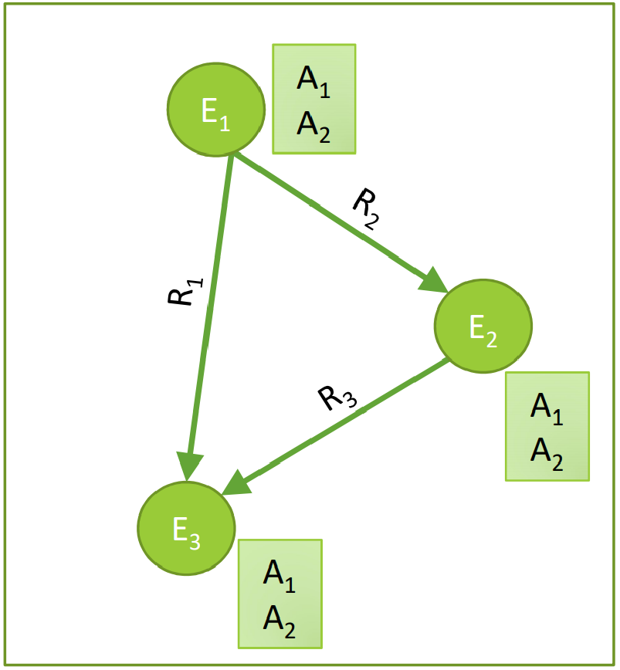
Knowledge in graph form:
Capture entities, types, and relationships
Nodes are entities
Nodes are labeled with their types
Edges between two nodes capture relationships
between entities
KG is an example of a heterogeneous graph
Jure Leskovec, Stanford CS224W: Machine Learning with Graphs, http://cs224w.stanford.edu

Slide 27
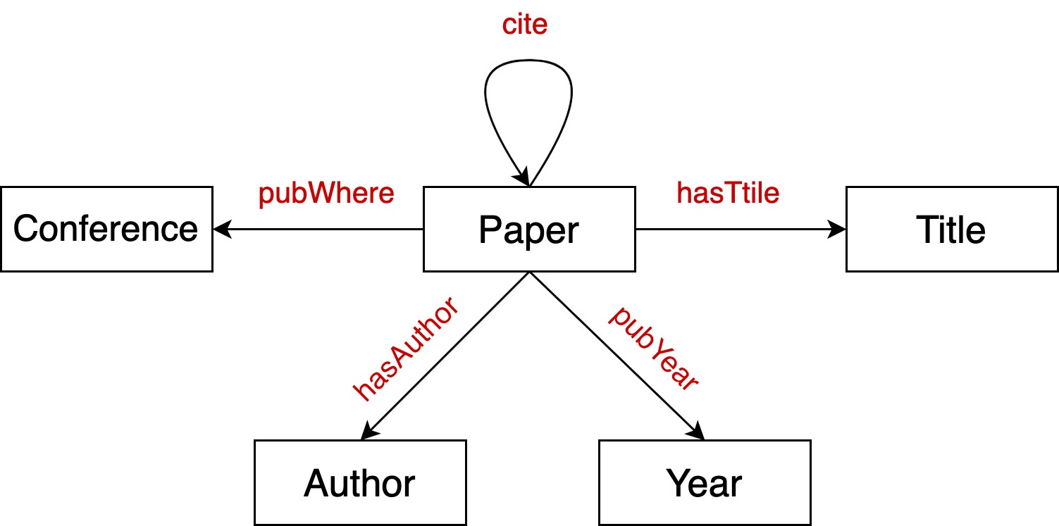
Node types: paper, title, author, conference, year
Relation types: pubWhere, pubYear, hasTitle, hasAuthor, cite
Jure Leskovec, Stanford CS224W: Machine Learning with Graphs, http://cs224w.stanford.edu

Slide 28
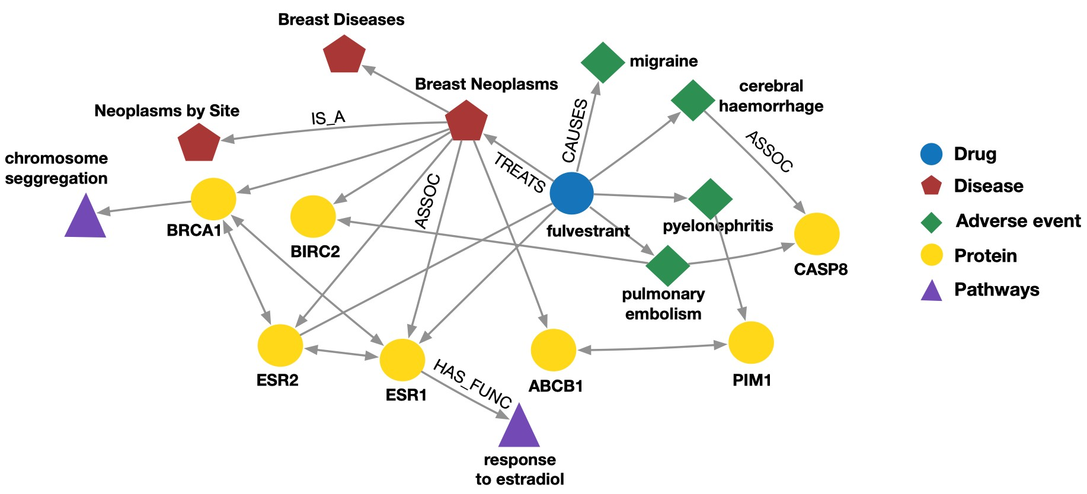
Node types: drug, disease, adverse event, protein, pathways
Relation types: has_func, causes, assoc, treats, is_a
Jure Leskovec, Stanford CS224W: Machine Learning with Graphs, http://cs224w.stanford.edu

Slide 29
Examples of knowledge graphs
Google Knowledge Graph
Amazon Product Graph
Facebook Graph API
IBM Watson
Microsoft Satori
Project Hanover/Literome
LinkedIn Knowledge Graph
Yandex Object Answer
Jure Leskovec, Stanford CS224W: Machine Learning with Graphs, http://cs224w.stanford.edu

Slide 30

Serving information
Image credit: Bing
Jure Leskovec, Stanford CS224W: Machine Learning with Graphs, http://cs224w.stanford.edu
30

Slide 31
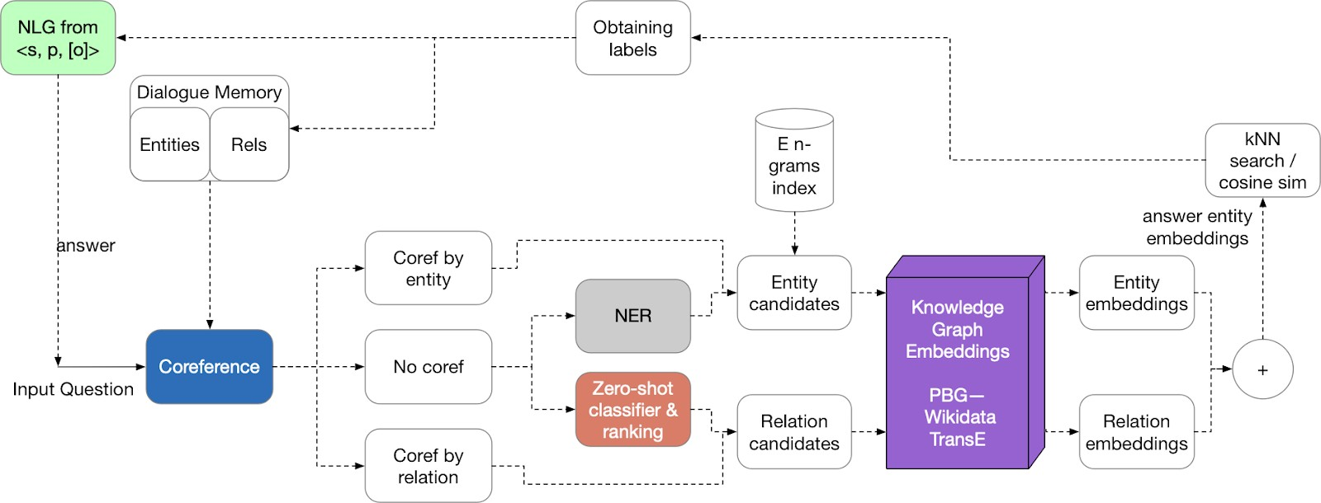
Question answering and conversation agents
Image credit: Medium
Jure Leskovec, Stanford CS224W: Machine Learning with Graphs, http://cs224w.stanford.edu

Slide 32
Publicly available KGs:
FreeBase, Wikidata, Dbpedia, YAGO, NELL, etc.
Common characteristics:
  Massive: millions of nodes and edges
  Incomplete: many true edges are missing
Given a massive KG, enumerating all the possible facts is intractable!
Can we predict plausible BUT missing links?
Jure Leskovec, Stanford CS224W: Machine Learning with Graphs, http://cs224w.stanford.edu

Slide 33



Freebase
~50 million entities
~38K relation types
~3 billion facts/triples
93.8% of persons from Freebase have no place of birth and 78.5% have no nationality!
Datasets: FB15k/FB15k-237
  A complete subset of Freebase, used by researchers to learn KG models
Paulheim, Heiko. "Knowledge graph refinement: A survey of approaches and evaluation methods." Semantic web 8.3 (2017): 489-508.
Min, Bonan, et al. "Distant supervision for relation extraction with an incomplete knowledge base." Proceedings of the 2013 Conference of the North American Chapter of the Association for Computational Linguistics: Human Language Technologies. 2013.
Jure Leskovec, Stanford CS224W: Machine Learning with Graphs, http://cs224w.stanford.edu

Slide 34
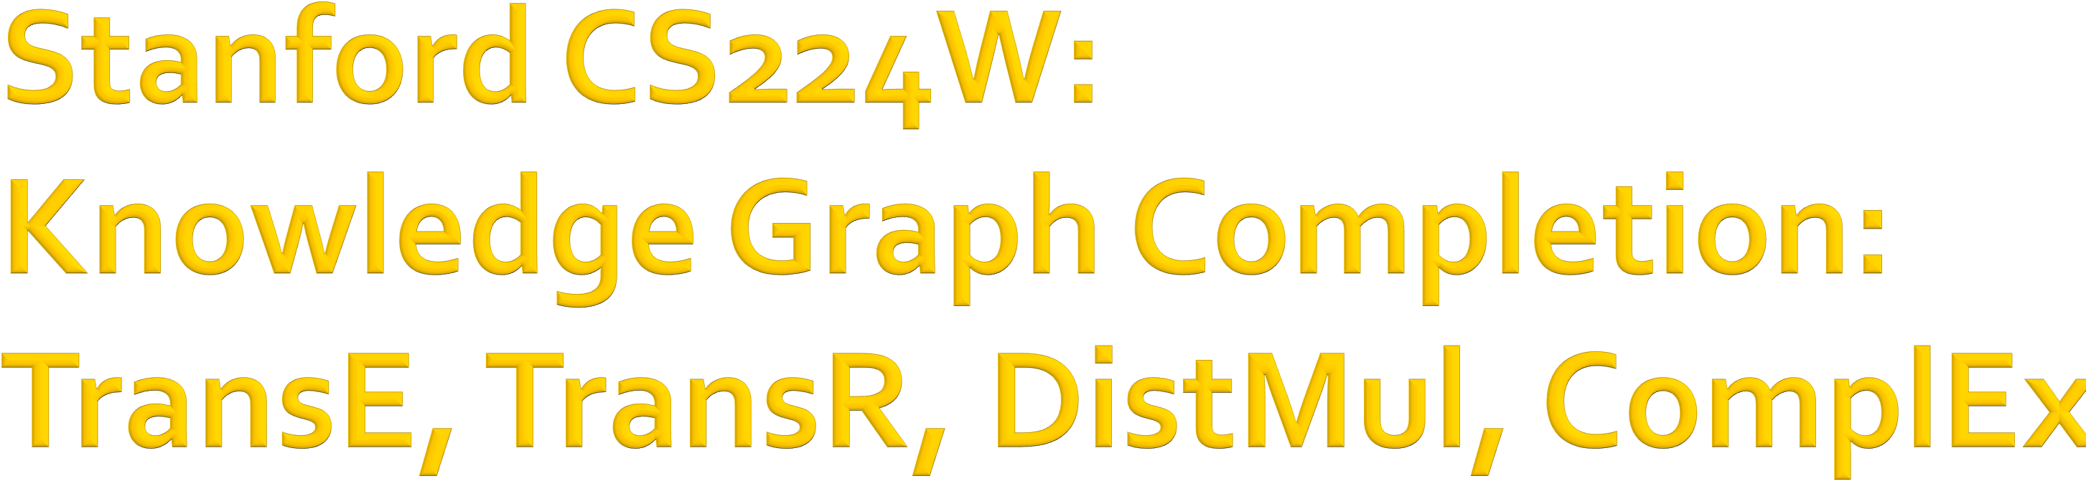
CS224W: Machine Learning with Graphs Jure Leskovec, Stanford University
http://cs224w.stanford.edu

Slide 35

Given an enormous KG, can we complete the KG?
For a given (head, relation), we predict missing tails.
  (Note this is slightly different from link prediction task)
J.R.R Tolkien
Science Fiction
missing relation:
genre
Example task: predict the tail “Science Fiction” for (“J.K. Rowling”, “genre”)
genre
genre
Influence
genre
Fantasy
Stephen King
genre
Influence
J.K. Rowling
Influence
Influence
C.S. Lewis
genre
Influence
Alan Poe
Tragicomedy
Lloyd Alexander

Slide 36
Simplest encoding approach: encoder is just an embedding-lookup
embedding vector for a
embedding matrix
specific node
Z =
Dimension/size of embeddings
one column per node

Slide 37

Edges in KG are represented as triples (ℎ, 𝑟, 𝑡)
head (ℎ) has relation 𝑟 with tail (𝑡)
Key Idea:
  Model entities and relations in the embedding/vector space ℝ⁶.
    Associate entities and relations with shallow embeddings
    Note we do not learn a GNN here!
  Given a true triple (ℎ, 𝑟, 𝑡), the goal is that the embedding of (ℎ, 𝑟) should be close to the embedding of 𝑡.
    How to embed ℎ, 𝑟 ?
    How to define closeness?

Slide 38

Translation Intuition:
For a triple (ℎ, 𝑟, 𝑡), 𝐡, 𝐫, 𝐭 ∈ ℝ⁺,
Bordes, et al., Translating embeddings for modeling multi-relational data, NeurIPS 2013.
embedding vectors will appear in boldface
𝐡 + 𝐫 ≈ 𝐭 if the given fact is true
else 𝐡 + 𝐫 ≠ 𝐭
Scoring function: 𝑓! ℎ, 𝑡
= −||𝐡 + 𝐫 − 𝐭||
𝐫
Nationality Obama
𝐡
𝐭
American

Slide 39
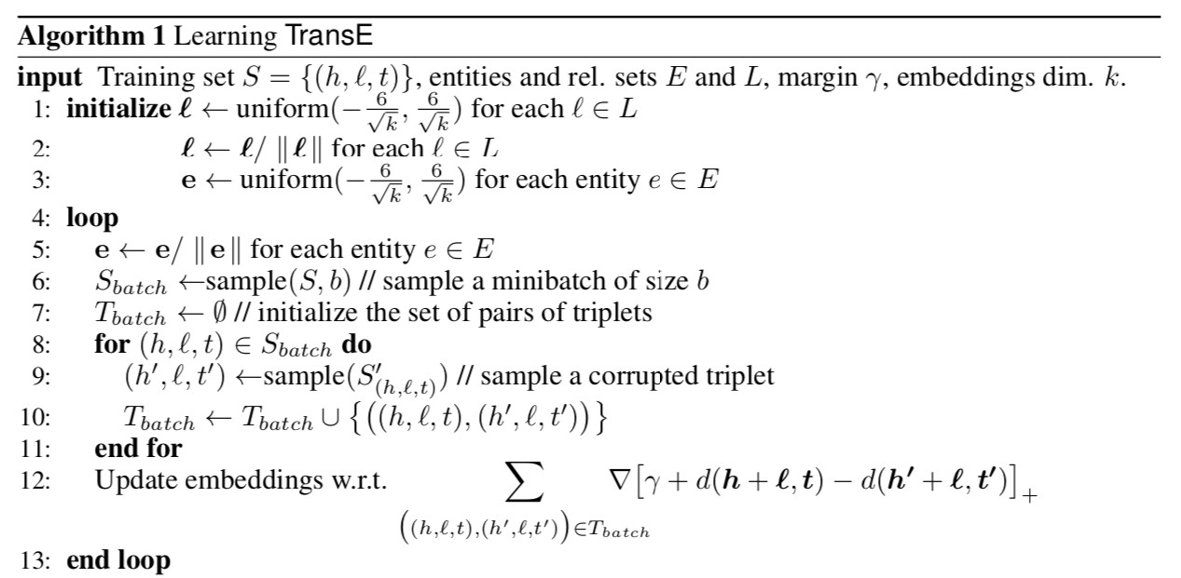
Entities and relations are initialized uniformly, and normalized
Negative sampling with triplet that does not appear in the KG
𝑑 represents distance (negative of score)
positive sample
negative sample
Contrastive loss: favors lower distance (or higher score) for valid triplets, high distance (or lower score) for corrupted ones

Slide 40
Relations in a heterogeneous KG have different properties
Example:
  Symmetry: If the edge (ℎ, "Roommate", 𝑡) exists in KG, then the edge (𝑡, "Roommate", ℎ) should also exist.
  Inverse relation: If the edge (ℎ, "Advisor", 𝑡) exists in KG, then the edge 𝑡, "Advisee", ℎ should also exist.
Can we categorize these relation patterns?
Are KG embedding methods (e.g., TransE) expressive enough to model these patterns?
40

Slide 41

Symmetric (Antisymmetric) Relations:
𝑟 ℎ, 𝑡 ⇒ 𝑟 𝑡, ℎ (𝑟(ℎ, 𝑡) ⇒ ¬𝑟(𝑡, ℎ)) ∀ℎ, 𝑡
Example:
  Symmetric: Family, Roommate
  Antisymmetric: Hypernym
Inverse Relations:
𝑟₇(ℎ, 𝑡) ⇒ 𝑟₍(𝑡, ℎ)
  Example : (Advisor, Advisee)
Composition (Transitive) Relations:
𝑟₍ 𝑥, 𝑦 ∧ 𝑟₇ 𝑦, 𝑧 ⇒ 𝑟₈ 𝑥, 𝑧
∀𝑥, 𝑦, 𝑧
Example: My mother’s husband is my father.
1-to-N relations:
𝑟 ℎ, 𝑡₍ , 𝑟 ℎ, 𝑡₇ , … , 𝑟(ℎ, 𝑡₉) are all True.
  Example: 𝑟 is “StudentsOf”

Slide 42
Antisymmetric Relations:
𝑟(ℎ, 𝑡) ⇒ ¬𝑟(𝑡, ℎ) ∀ℎ, 𝑡
Example: Hypernym
TransE can model antisymmetric relations ü
  𝐡 + 𝐫 = 𝐭, but 𝐭 + 𝐫 ≠ 𝐡
𝐫
𝐫
𝐡
𝐭

Slide 43
Inverse Relations:
𝑟#(ℎ, 𝑡) ⇒ 𝑟"(𝑡, ℎ)
Example : (Advisor, Advisee)
TransE can model inverse relations ü
  𝐡 + 𝐫_{𝟐} = 𝐭, we can set 𝐫₍ = −𝐫₇
𝐫_{𝟏}
𝐫_{𝟐}
𝐭
𝐡

Slide 44

Composition (Transitive) Relations:
𝑟" 𝑥, 𝑦 ∧ 𝑟# 𝑦, 𝑧 ⇒ 𝑟/ 𝑥, 𝑧
∀𝑥, 𝑦, 𝑧
Example: My mother’s husband is my father.
TransE can model composition relationsü
𝐫/ = 𝐫" + 𝐫#
𝐲
𝐫₍
𝐫₇
𝐱
𝐳
𝐫
8

Slide 45
Symmetric Relations:
𝑟 ℎ, 𝑡 ⇒ 𝑟 𝑡, ℎ ∀ℎ, 𝑡
Example: Family, Roommate
TransE cannot model symmetric relations û
only if 𝐫 = 0, 𝐡 = 𝐭
For all ℎ, 𝑡 that satisfy 𝑟(ℎ, 𝑡), 𝑟(𝑡, ℎ) is also True, which means 𝐡 + 𝐫 − 𝐭 = 0 and
𝐭 + 𝐫 − 𝐡 = 0. Then 𝐫 = 0 and 𝐡 = 𝐭,
𝐫
𝐭
however ℎ and 𝑡 are two different entities and should be mapped to different locations.
𝐡

Slide 46
1-to-N Relations:
Example: (ℎ, 𝑟, 𝑡₍) and (ℎ, 𝑟, 𝑡₇) both exist in the knowledge graph, e.g., 𝑟 is “StudentsOf”
TransE cannot model 1-to-N relations û
  𝐭₍ and 𝐭₇ will map to the same vector, although they are different entities
𝐭₎
𝐭*
𝐫
𝐭" = 𝐡 + 𝐫 = 𝐭#
𝐫
𝐭" ≠ 𝐭#
contradictory!
𝐡

Slide 47

TransE models translation of any relation in the same embedding space.
Lin, et al., Learning entity and relation embeddings for knowledge graph completion, AAAI 2015
Can we design a new space for each relation and do translation in relation-specific space?
TransR: model entities as vectors in the entity space ℝ⁺ and model each relation as vector in relation space 𝐫 ∈ ℝ⁰ with 𝐌! ∈ ℝ^{0×+} as the projection matrix.

Slide 48
TransR: model entities as vectors in the entity space ℝ⁶ and model each relation as vector in relation space 𝐫 ∈ ℝ⁷ with 𝐌₈ ∈ ℝ^{7×6} as the
projection matrix.
𝐡< = 𝐌/𝐡, 𝐭< = 𝐌/𝐭
Score function: 𝑓/ ℎ, 𝑡
Use 𝐌 to project from entity
𝒓
space ℝ^{𝒅} to relation space ℝ.!
= −||𝐡< + 𝐫 − 𝐭<||
Space of entities: ℝ^{𝒅}
𝐭
𝐡
Space of relation 𝒓: ℝ^{𝒌}
𝐌_{𝒓}
𝐫
𝐭<
𝐡<

Slide 49
Symmetric Relations:
𝑟 ℎ, 𝑡 ⇒ 𝑟 𝑡, ℎ ∀ℎ, 𝑡
Note different symmetric relations may have different 𝐌_{𝒓}
Example: Family, Roommate
TransR can model symmetric relations
𝐫 = 0, 𝐡₂ = 𝐌!𝐡 = 𝐌!𝐭 = 𝐭₂ü
Space of entities: ℝ^{𝒅}
𝐭
Space of relation 𝒓: ℝ^{𝒌}
We can map 𝒉 and 𝒕 to the same location on the space of relation 𝒓.
𝒉 and 𝒕 are still different in the entity space.
𝐌/
𝐡
𝐭<, 𝐡<

Slide 50
Antisymmetric Relations:
𝑟(ℎ, 𝑡) ⇒ ¬𝑟(𝑡, ℎ) ∀ℎ, 𝑡
Example: Hypernym
TransR can model antisymmetric relations
𝐫 ≠ 0, 𝐌!𝐡 + 𝐫 = 𝐌!𝐭,
Then 𝐌!𝐭 + 𝐫 ≠ 𝐌!𝐭ü
Space of entities: ℝ^{𝒅} Space of relation 𝒓: ℝ^{𝒌}
𝐭
𝐫
𝐭<
𝐡<
𝐌/
𝐫
𝐡
50

Slide 51
1-to-N Relations:
Example: If (ℎ, 𝑟, 𝑡₍) and (ℎ, 𝑟, 𝑡₇) exist in the knowledge graph.
TransR can model 1-to-N relations ü
  We can learn 𝐌* so that 𝐭< = 𝐌*𝐭₍ = 𝐌*𝐭₇
  Note that 𝐭. does not need to be equal to 𝐭/!
𝐭₎
𝐌/
𝐭
*
𝐡
<
𝐭<
𝐡
𝐫

Slide 52
Inverse Relations:
𝑟:(ℎ, 𝑡) ⇒ 𝑟;(𝑡, ℎ)
Example : (Advisor, Advisee)
TransR can model inverse relations
𝐫: = −𝐫;, 𝐌_{8?} = 𝐌_{8@}
Then 𝐌_{8?}𝐭 + 𝐫_{𝟏} = 𝐌_{8?}𝐡 and 𝐌_{8@}𝐡 + 𝐫_{𝟐} = 𝐌_{8@}𝐭ü
Space of entities: ℝ^{𝒅}
𝐭
𝐌/$ = 𝐌/%
𝐡
Space of relation 𝒓: ℝ^{𝒌}
𝐭<
𝐫_{𝟏}
𝐫_{𝟐}
𝐡<

Slide 53
Composition Relations:
𝑟" 𝑥, 𝑦 ∧ 𝑟# 𝑦, 𝑧 ⇒ 𝑟/ 𝑥, 𝑧
∀𝑥, 𝑦, 𝑧
Example: My mother’s husband is my father.
TransR cannot model composition relations
Each relation has a different space.
It is not naturally compositional for multiple
relations! û
Zero Distance
Intuition: The manifold {𝑧|∃𝑦, 𝑓*@
𝑥, 𝑦
= 0, 𝑓_{*A}
𝑦, 𝑧
= 0} is
high dimensional and may not be modeled using a single
𝐌_{*B} and 𝐫₈

Slide 54
So far: The scoring function 𝑓₈(ℎ, 𝑡) is negative of L1 / L2 distance in TransE and TransR
Another line of KG embeddings adopt bilinear
Yang et al, Embedding Entities and Relations for Learning and Inference in Knowledge Bases, ICLR 2015
modeling
DistMult: Entities and relations using vectors in ℝ⁷
Score funcMon: 𝑓₈ ℎ, 𝑡 =< 𝐡, 𝐫, 𝐭 > = ∑> 𝐡> ⋅ 𝐫> ⋅ 𝐭>
𝐡, 𝐫, 𝐭 ∈ ℝ⁷
𝑓!(ℎ, 𝑡)
Sum
𝐫
Product
𝐡
𝐭

Slide 55

DistMult: Entities and relations using vectors in ℝ⁷
Score funcMon: 𝑓₈ ℎ, 𝑡 =< 𝐡, 𝐫, 𝐭 > = ∑> 𝐡> ⋅ 𝐫> ⋅ 𝐭>
𝐡, 𝐫, 𝐭 ∈ ℝ⁷
Intuition of the score function: Can be viewed as a
cosine similarity between 𝐡 ⋅ 𝐫 and 𝐭
Example:
𝑓₈ ℎ, 𝑡;
< 0, 𝑓₈ ℎ, 𝑡: > 0
𝐭*
𝒉 ⋅ 𝒓
𝐭₎

Slide 56
1-to-N Relations:
Example: If (ℎ, 𝑟, 𝑡₍) and (ℎ, 𝑟, 𝑡₇) exist in the knowledge graph
Distmult can model 1-to-N relations ü
< 𝐡, 𝐫, 𝐭₍ > = < 𝐡, 𝐫, 𝐭# >
𝐭₎
𝐭*
𝐡 ⋅ 𝐫

Slide 57
Symmetric Relations:
𝑟 ℎ, 𝑡 ⇒ 𝑟 𝑡, ℎ ∀ℎ, 𝑡
Example: Family, Roommate
DistMult can naturally model symmetric relations ü
=< 𝐡, 𝐫, 𝐭 > = M 𝐡₃ ⋅ 𝐫₃ ⋅ 𝐭₃ =
3
< 𝐭, 𝐫, 𝐡 > = 𝑓!(𝑡, ℎ)
𝑓! ℎ, 𝑡

Slide 58
Antisymmetric Relations:
𝑟(ℎ, 𝑡) ⇒ ¬𝑟(𝑡, ℎ) ∀ℎ, 𝑡
Example: Hypernym
DistMult cannot model antisymmetric relations
𝑓! ℎ, 𝑡 =< 𝐡, 𝐫, 𝐭 > = < 𝐭, 𝐫, 𝐡 >= 𝑓!(𝑡, ℎ) û
  𝑟(ℎ, 𝑡) and 𝑟(𝑡, ℎ) always have same score!

Slide 59
Inverse Relations:
𝑟#(ℎ, 𝑡) ⇒ 𝑟"(𝑡, ℎ)
Example : (Advisor, Advisee)
DistMult cannot model inverse relations û
  If it does model inverse relations:
𝑓_{*3} ℎ, 𝑡 =< 𝐡, 𝐫₇, 𝐭 > = < 𝐭, 𝐫_{𝟏} , 𝐡 >= 𝑓_{*4}
This means 𝐫₇ = 𝐫₍
𝑡, ℎ
But semantically this does not make sense: The embedding of “Advisor” should not be the same with “Advisee”.

Slide 60

Composition Relations:
𝑟; 𝑥, 𝑦 ∧ 𝑟: 𝑦, 𝑧 ⇒ 𝑟? 𝑥, 𝑧
∀𝑥, 𝑦, 𝑧
Example: My mother’s husband is my father.
DistMult cannot model composition relations û
  Intuition: DistMult defines a hyperplane for each (head, relation), the union of the hyperplane induced by multi- hops of relations, e.g., (𝑟., 𝑟/), cannot be expressed using a single hyperplane.
𝐫₊
𝐫*
60

Slide 61

Based on Distmult, ComplEx embeds entities and relations in Complex vector space
ComplEx: model entities and relations using vectors in ℂ⁰
Trouillon et al, Complex Embeddings for Simple Link Prediction, ICML 2016
𝐮 ∈ ℂ.
𝐚 ∈ ℝ.
𝐛 ∈ ℝ.
Re(𝐮)
𝐮7 = 𝐚 − 𝐛𝑖
𝐮 = 𝐚 + 𝐛𝑖
𝐮7 is called a conjugate
Im(𝐮)

Slide 62
Based on Distmult, ComplEx embeds entities and relations in Complex vector space
ComplEx: model entities and relations using vectors in ℂ⁰
Score function 𝑓! ℎ, 𝑡 = Re(∑₃ 𝐡₃ ⋅ 𝐫₃ ⋅ 𝐭̅₃)
𝑓!(ℎ, 𝑡)
Sum
𝐫
Inner Product
𝐡
𝐭

Slide 63
Antisymmetric Relations:
𝑟(ℎ, 𝑡) ⇒ ¬𝑟(𝑡, ℎ) ∀ℎ, 𝑡
Example: Hypernym
ComplEx can model antisymmetric relations ü
  The model is expressive enough to learn
    High 𝑓/ ℎ, 𝑡 = Re(∑_{N} 𝐡_{N} ⋅ 𝐫_{N} ⋅ 𝐭̅_{N})
    Low 𝑓/ 𝑡, 𝑟 = Re(∑_{N} 𝒕_{N} ⋅ 𝐫_{N} ⋅ 𝒉^{O}_{N})
Due to the asymmetric modeling using complex conjugate.

Slide 64
Symmetric Relations:
𝑟 ℎ, 𝑡 ⇒ 𝑟 𝑡, ℎ ∀ℎ, 𝑡
Example: Family, Roommate
ComplEx can model symmetric relations ü
  When Im 𝐫 = 0, we have
    𝑓/ ℎ, 𝑡 = Re ∑_{N} 𝐡_{N} ⋅ 𝐫_{N} ⋅ 𝐭̅_{N} = ∑_{N} Re 𝐫_{N} ⋅ 𝐡_{N} ⋅ 𝐭̅_{N}
= ∑_{N} 𝐫_{N} ⋅ Re 𝐡_{N} ⋅ 𝐭̅_{N} = ∑_{N} 𝐫_{N} ⋅ Re 𝐡̅ _{N} ⋅ 𝐭_{N} = ∑_{N} ReQ𝐫_{N} ⋅ 𝐡̅ _{N} ⋅
𝐭_{N}R = 𝑓/(𝑡, ℎ)

Slide 65
Inverse Relations:
𝑟#(ℎ, 𝑡) ⇒ 𝑟"(𝑡, ℎ)
Example : (Advisor, Advisee)
ComplEx can model inverse relations ü
  𝐫₍ = 𝐫₇
  Complex conjugate of
𝐫₇ = argmax Re(< 𝐡, 𝐫, 𝐭̅ >) is exactly
𝐫₍ = argmax Re(< 𝐭, 𝐫, 𝐡̅ >).
𝐫
𝐫

Slide 66
Composition Relations:
𝑟" 𝑥, 𝑦 ∧ 𝑟# 𝑦, 𝑧 ⇒ 𝑟/ 𝑥, 𝑧
∀𝑥, 𝑦, 𝑧
Example: My mother’s husband is my father.
1-to-N Relations:
  Example: If (ℎ, 𝑟, 𝑡₍) and (ℎ, 𝑟, 𝑡₇) exist in the knowledge graph
ComplEx share the same property with
DistMult
  Cannot model composition relations
  Can model 1-to-N relations

Slide 67
Properties and expressive power of different KG completion methods:
Model | Score | Embedding | Sym. | Antisym. | Inv. | Compos. | 1-to-N
TransE | − 𝐡 + 𝐫 − 𝐭 | 𝐡, 𝐭, 𝐫 ∈ ℝ. | û | ü | ü | ü | û
TransR | −‖𝐖!𝐡 + 𝐫 − 𝐖!𝐭‖ | 𝐡, 𝐭, 𝐫 ∈ ℝ., 𝐖! ∈ ℝ. | ü | ü | ü | û | ü
DistMult | < 𝐡, 𝐫, 𝐭 > | 𝐡, 𝐭, 𝐫 ∈ ℝ. | ü | û | û | û | ü
ComplEx | Re(< 𝐡, 𝐫, 𝐭̅ >) | 𝐡, 𝐭, 𝐫 ∈ ℂ. | ü | ü | ü | û | ü

Slide 68
1. Different KGs may have drastically different relation patterns!
Sun et al, RotatE: Knowledge Graph Embedding by Relational Rotation in Complex Space, ICLR 2019
There is not a general embedding that works for all KGs, use the table to select models
Try TransE for a quick run if the target KG does not have much symmetric relations
Then use more expressive models, e.g.,
ComplEx, RotatE (TransE in Complex space)

Slide 69
Link prediction / Graph completion is one of the prominent tasks on knowledge graphs
Introduce TransE / TransR / DistMult / ComplEx models with different embedding space and expressiveness

Slide 70
¡END
70

