Slide 1

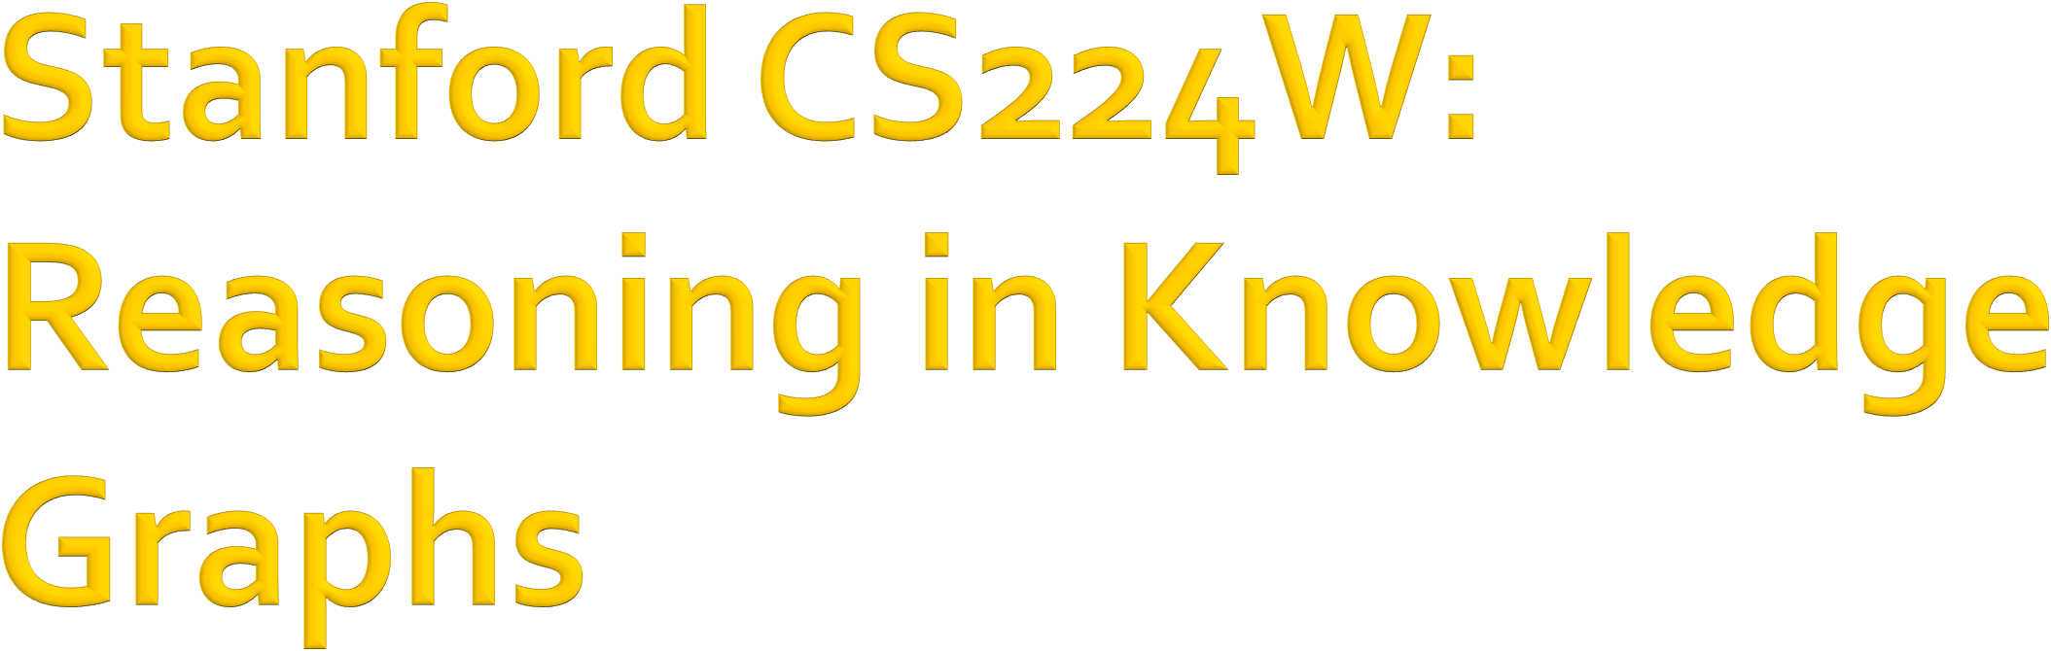

CS224W: Machine Learning with Graphs Jure Leskovec, Stanford University
http://cs224w.stanford.edu

Slide 2
Given an enormous KG, can we complete the KG?
For a given (head, relation), we predict missing tails.
  (Note this is slightly different from link prediction task)
J.R.R Tolkien
Science Fiction
missing relation:
genre
Example task: predict the tail “Science Fiction” for (“J.K. Rowling”, “genre”)
genre
genre
Influence
genre
Fantasy
Stephen King
genre
Influence
J.K. Rowling
Influence
Influence
C.S. Lewis
genre
Influence
Alan Poe
Tragicomedy
Lloyd Alexander
2

Slide 3
Goal:
  How to perform multi-hop reasoning over KGs?
Reasoning over Knowledge Graphs
  Answering multi-hop queries
    Path Queries
    Conjunctive Queries
  Query2box
2

Slide 4
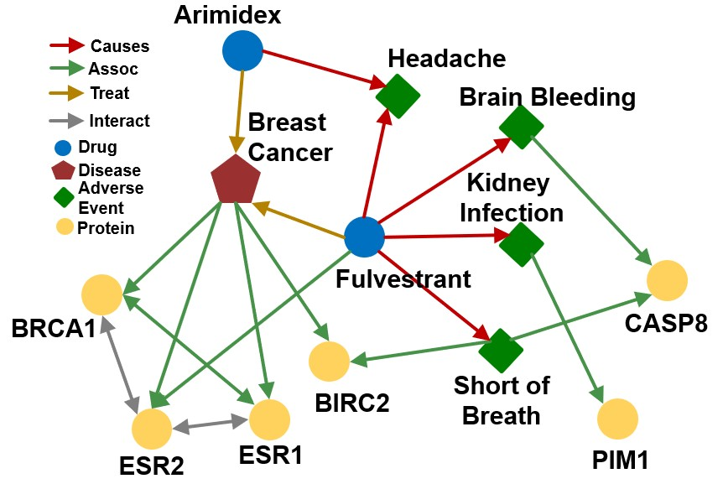
2

Slide 5
Can we do multi-hop reasoning, i.e., answer complex queries on an incomplete, massive KG?
Query Types | Examples: Natural Language Question, Query
One-hop Queries | What adverse event is caused by Fulvestrant? (e:Fulvestrant, (r:Causes))
Path Queries | What protein is associated with the adverse event caused by Fulvestrant? (e:Fulvestrant, (r:Causes, r:Assoc))
Conjunctive Queries | What is the drug that treats breast cancer and caused headache? ((e:BreastCancer, (r:TreatedBy)), (e:Migraine, (r:CausedBy))
In this lecture, we only focus on answering queries on a KG! The notation will be detailed next.
One-hop Queries
Path Queries
Conjunctive Queries
2

Slide 6
We can formulate knowledge graph completion problems as answering one-hop queries.
KG completion: Is link (ℎ, 𝑟, 𝑡) in the KG?
One-hop query: Is 𝑡 an answer to query (ℎ, (𝑟)?
  For example: What side effects are caused by drug Fulvestrant?
2

Slide 7
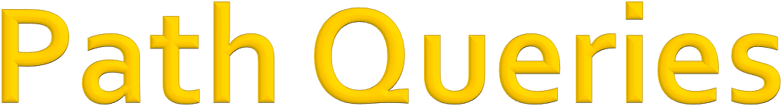
Generalize one-hop queries to path queries by adding more relations on the path.
An 𝑛-hop path query 𝑞 can be represented by
𝑞 = (𝑣!, 𝑟", … , 𝑟# )
𝑣! is an “anchor” entity, answers are denoted by 𝑞 $.
Query Plan of 𝑞:
𝑟#
𝑟$
…
𝑟%
𝑣"
𝑉?
Query plan of path queries is a chain.
2

Slide 8
“What proteins are associated with adverse events caused by Fulvestrant?”
𝑣! is e:Fulvestrant
𝑟", 𝑟# is (r:Causes, r:Assoc)
Query: (e:Fulvestrant, (r:Causes, r:Assoc))
Causes
Assoc
Fulvestrant
𝑉
𝑉?
2

Slide 9
“What proteins are associated with adverse events caused by Fulvestrant?”
Query: (e:Fulvestrant, (r:Causes, r:Assoc))
Given a KG, how to answer a path query?
2

Slide 10
Answer path queries by traversing the KG: “What proteins are associated with adverse events caused by Fulvestrant?”
Query: (e:Fulvestrant, (r:Causes, r:Assoc))
Fulvestrant
Start from the anchor node (Fulvestrant).
10

Slide 11
Answer path queries by traversing the KG: “What proteins are associated with adverse events caused by Fulvestrant?”
Query: (e:Fulvestrant, (r:Causes, r:Assoc))
Headache Brain Bleeding
Causes
Fulvestrant
Short of Breath
Start from the anchor node “Fulvestrant” and traverse the KG by the relation “Causes”, we reach entities {“Brain Bleeding”, “Short of Breath”, “Kidney Infection”, “Headache”}.
Kidney Infection
11

Slide 12
Answer path queries by traversing the KG: “What proteins are associated with adverse events caused by Fulvestrant?”
Query: (e:Fulvestrant, (r:Causes, r:Assoc))
Headache Brain Bleeding
CASP8
Causes
Fulvestrant
BIRC2
Short of Breath
Assoc
Start from the nodes {“Brain Bleeding”, “Short of Breath”, “Kidney Infection”, “Headache”} and traverse the KG by the relation “Assoc”, we reach entities {“CASP8”, “BIRC2”, “PIM1”}. These are the answers.
Kidney Infection
PIM1
Answers!

Slide 13
Answering queries seems easy: Just traverse the graph.
But, KGs are notoriously incomplete:
  Many relations between entities are missing or are incomplete
    For example, we lack all the biomedical knowledge
    Enumerating all the facts takes non-trivial time and cost, we cannot hope that KGs will ever be fully complete
Due to KG incompleteness, one is not able to identify all the answer entities

Slide 14
Answer path queries by traversing the KG: “What proteins are associated with adverse events caused by Fulvestrant?”
Query: (e:Fulvestrant, (r:Causes, r:Assoc))
Headache Brain Bleeding
CASP8
Causes
Fulvestrant
BIRC2
Short of Breath
Missing Answer!
Assoc
Kidney Infection
PIM1
Answers!

Slide 15
Can we first do KG completion and then traverse the completed (probabilistic) KG?
No! The “completed” KG is a dense graph!
  Most (ℎ, 𝑟, 𝑡) triples (edge on KG) will have some non- zero probability.
𝑣#
Time complexity of traversing a dense KG is exponential as a function of the path
𝑟
𝑣
$
#
𝑟#
𝑣$
… …
𝑣$
𝑣"
…
length 𝐿: 𝑂(𝑑& )
^{𝑣&}!"#
$!%
…
𝑣
&!"#

Slide 16
We need a way to answer path-based queries over an incomplete knowledge graph.
We want our approach to implicitly impute and account for the incomplete KG.
Task: Predictive queries
Want to be able to answer
Causes
Assoc
arbitrary queries while implicitly imputing for the missing information
Generalization of the link prediction task
Jure Leskovec, Stanford CS224W: Machine Learning with Graphs, http://cs22
𝑉
𝑉?
Fulvestrant
2/16/21
4w.stanford.edu 16

Slide 17
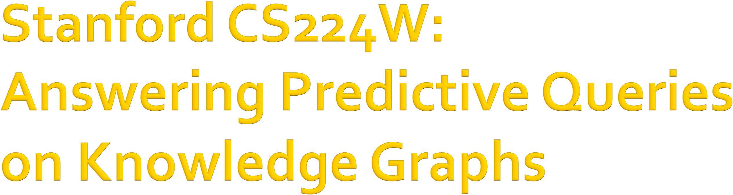
CS224W: Machine Learning with Graphs Jure Leskovec, Stanford University
http://cs224w.stanford.edu

Slide 18
Key idea: Embed queries!
Guu, et al., Traversing knowledge graphs in vector space, EMNLP 2015.
Generalize TransE to multi-hop reasoning.
Recap: TransE: Translate 𝐡 to 𝐭 using 𝐫 with score function 𝑓! ℎ, 𝑡 = −||𝐡 + 𝐫 − 𝐭||.
Another way to interpret this is that:
  Query embedding: 𝐪 = 𝐡 + 𝐫
  Goal: query embedding 𝐪 is close to the answer embedding 𝐭
𝑓'(𝑡) = − 𝐪 − 𝐭
𝐫
𝐪
Nationality Obama
^{𝐪} American
𝐡
𝐭
Distance (𝑞, 𝑡) is small

Slide 19
Key idea: Embed queries!
Generalize TransE to multi-hop reasoning.
Given a path query 𝒒 = 𝒗_{𝒂}, (𝒓_{𝟏}, … , 𝒓_{𝒏}) ,
𝐫"
𝐫#
𝐯_{𝒂}
𝐫$
…
𝐪
𝐪 = 𝐯! + 𝐫" + ⋯ + 𝐫*
The embedding process only involves vector addition, independent of # entities in the KG!

Slide 20
Embed path queries in vector space.
“What proteins are associated with adverse events caused by Fulvestrant?”
(e:Fulvestrant, (r:Causes , r:Assoc)) Follow the query plan:
Query Plan
Embedding Process
Fulvestrant
Fulvestrant
20

Slide 21
Embed path queries in vector space.
“What proteins are associated with adverse events caused by Fulvestrant?”
(e:Fulvestrant, (r:Causes , r:Assoc)) Follow the query plan:
Query Plan
Embedding Process
Fulvestrant
Brain Bleeding
Causes
Headache
Fulvestrant
Causes
Short of Breath
Kidney Infection

Slide 22
Embed path queries in vector space.
“What proteins are associated with adverse events caused by Fulvestrant?”
(e:Fulvestrant, (r:Causes , r:Assoc)) Follow the query plan:
Query Plan
Embedding Process
CASP8 _{𝐪}
Fulvestrant
Brain Bleeding
BIRC2
PIM1
Causes
Headache
Fulvestrant
Assoc
Answers!
Causes
Assoc
Short of Breath
Kidney Infection

Slide 23
Insights:
We can train TransE to optimize knowledge graph completion objective (Lecture 10)
Since TransE can naturally handle composition
relations, it can handle path queries by translating in the latent space for multiple hops using addition of relation embeddings.
For TransR / DistMult / ComplEx, since they cannot handle composition relations, they
cannot be easily extended to handle path queries.

Slide 24

Can we answer more complex queries with logic conjunction operation?
Conjunctive Queries: “What are drugs that cause Short of Breath and treat diseases associated with protein ESR2?”
((e:ESR2, (r:Assoc, r:TreatedBy)), (e:Short of Breath, (r:CausedBy))
Query plan:
ESR2
Intersection
Assoc
TreatedBy
Short of Breath
CausedBy
Intersection

Slide 25
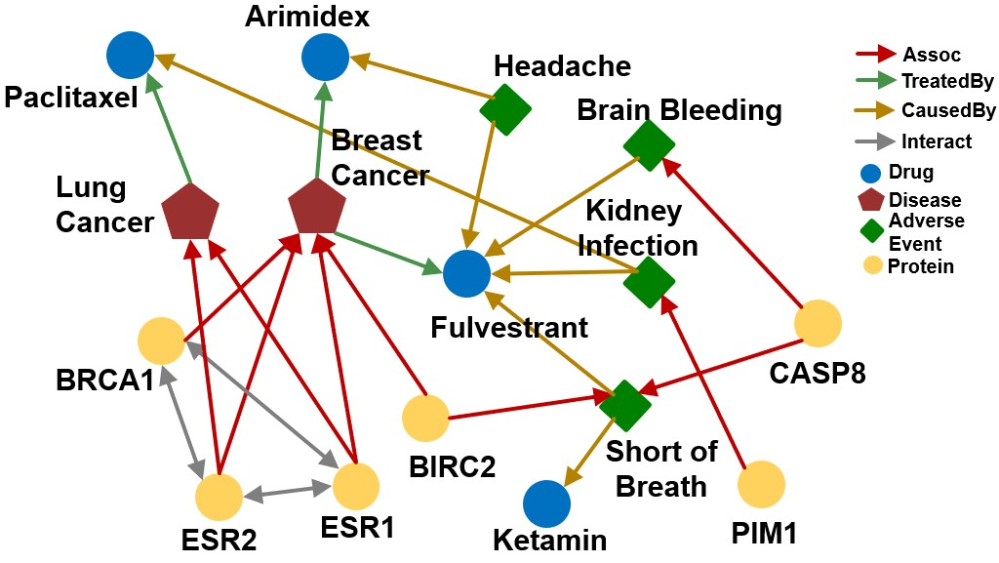
“What are drugs that cause Short of Breath and treat diseases associated with protein ESR2?”
((e:ESR2, (r:Assoc, r:TreatedBy)), (e:Short of Breath, (r:CausedBy))
How do we answer the question by KG traversal?

Slide 26
“What are drugs that cause Short of Breath and treat diseases associated with protein ESR2?”
((e:ESR2, (r:Assoc, r:TreatedBy)), (e:Short of Breath, (r:CausedBy))
Traverse KG from anchor nodes: ESR2 and Short of
Breath:
Lung Cancer
Traverse from the first anchor “ESR2” by relation “Assoc”, we achieve a set of entities {“Lung Cancer”, “Breast Cancer”}
Assoc
Breast Cancer
ESR2

Slide 27
“What are drugs that cause Short of Breath and treat diseases associated with protein ESR2?”
((e:ESR2, (r:Assoc, r:TreatedBy)), (e:Short of Breath, (r:CausedBy))
Traverse KG from anchor nodes: ESR2 and Short of
Breath:
Lung Cancer
Paclitaxel
Traverse from a set of entities
{“Lung Cancer”, “Breast Cancer”} by relation TreatedBy, we
achieve a set of entities
{“Paclitaxel”, “Arimidex”, “Fulvestrant”}
Assoc
Breast Cancer
Arimidex
ESR2
Fulvestrant
TreatedBy

Slide 28
“What are drugs that cause Short of Breath and treat diseases associated with protein ESR2?”
((e:ESR2, (r:Assoc, r:TreatedBy)), (e:Short of Breath, (r:CausedBy))
Traverse KG from anchor nodes: ESR2 and Short of Breath:
Paclitaxel
Traverse from the second anchor “Short of Breath” by relation “CausedBy”, we achieve a set of entities {“Fulvestrant”, “Ketamin”, “Paclitaxel”}
Fulvestrant
Short of Breath
Ketamin
CausedBy
Jure Leskovec, Stanford CS224W: Machine Learning with Graphs, http://cs224w.stanford.edu

Slide 29
“What are drugs that cause Short of Breath and treat diseases associated with protein ESR2?”
((e:ESR2, (r:Assoc, r:TreatedBy)), (e:Short of Breath, (r:CausedBy))
Traverse KG from anchor nodes: ESR2 and Short of
Breath:
Lung Cancer
Paclitaxel
We take intersection between the two sets and achieve the answers {“Fulvestrant”, “Paclitaxel”}
Assoc
Breast Cancer
Arimidex
ESR2
Fulvestrant
TreatedBy
Short of Breath
Ketamin
CausedBy
Jure Leskovec, Stanford CS224W: Machine Learning with Graphs, http://cs224w.stanford.edu

Slide 30
“What are drugs that cause Short of Breath and treat diseases associated with protein ESR2?”
((e:ESR2, (r:Assoc, r:TreatedBy)), (e:Short of Breath, (r:CausedBy))
Traverse KG from anchor nodes: ESR2 and Short of
Breath:
Lung Cancer
Paclitaxel
Assoc
Breast Cancer
Arimidex
ESR2
Fulvestrant
TreatedBy
If this link is missing, then we cannot find the answer
Short of Breath
Ketamin
Fulvestrant
2/16/21
CausedBy
Jure Leskovec, Stanford CS224W: Machine Learning with Graphs, http://cs224w.stanford.edu
30

Slide 31
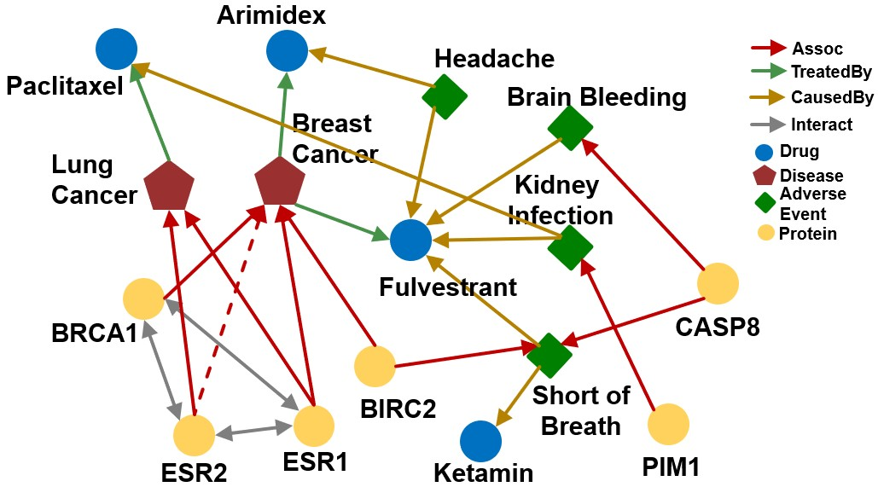
How can we use embeddings to implicitly impute the missing (ESR2, Assoc, Breast Cancer)?
Intuition: ESR2 interacts with both BRCA1 and ESR1.
Both proteins are associated with breast cancer.
Jure Leskovec, Stanford CS224W: Machine Learning with Graphs, http://cs224w.stanford.edu
31

Slide 32
“What are drugs that cause Short of Breath and treat diseases associated with protein ESR2?”
((e:ESR2, (r:Assoc, r:TreatedBy)), (e:Short of Breath, (r:CausedBy))
Query plan:
ESR2
Assoc
TreatedBy
Intersection
Short of Breath
CausedBy
Intersection
Each intermediate node represents a set of entities, how do we represent it? How do we define the intersection operation in
the latent space?
32

Slide 33
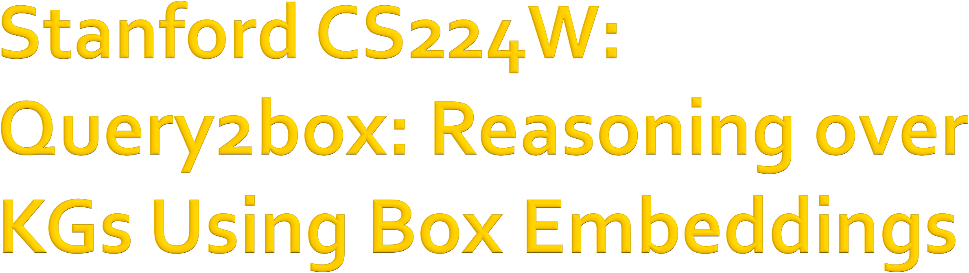
CS224W: Machine Learning with Graphs Jure Leskovec, Stanford University
http://cs224w.stanford.edu

Slide 34

Embed queries with hyper-rectangles (boxes)
𝐪 = (𝐶𝑒𝑛𝑡𝑒𝑟 𝑞 , 𝑂𝑓𝑓𝑠𝑒𝑡(𝑞))
Ren et al., Query2box: Reasoning over Knowledge Graphs in Vector Space Using Box Embeddings, ICLR 2020.
Short of Breath
𝑞
Headache
For example, we can embed the adverse events of Fulvestrant with a box that enclose all the answer entities.
Kidney Infection
Embedding Space

Slide 35
Intersection of boxes is well-defined!
When we traverse the KG to find the answers, each step produces a set of reachable entities.
How can we better model these sets?
  Boxes are a powerful abstraction, as we can project the center and control the offset to model the set of entities enclosed in the box
Short of Breath
Kidney
Infection
Headache

Slide 36
Things to figure out:
Entity embeddings (# params: 𝑑 𝑉 ):
  Entities are seen as zero-volume boxes
Relation embeddings (# params 2𝑑 𝑅 )
  Each relation takes a box and produces a new box
Intersection operator 𝒇 :
  New operator, inputs are boxes and output is a box
  Intuitively models intersection of boxes

Slide 37
Embed queries in vector space: “What are drugs that cause Short of Breath and treat diseases associated with protein ESR2?”
((e:ESR2, (r:Assoc, r:TreatedBy)), (e:Short of Breath, (r:CausedBy))
Traverse KG from anchor nodes: ESR2 and Short of Breath:
Query plan Embedding Space
ESR2
Assoc
?
ESR2

Slide 38


Projection Operator 𝓟
Intuition:
Take the current box as input and use the relation
embedding to project and expand the box!
𝒫 : Box × Relation → Box
𝐶𝑒𝑛 𝑞⁴ = 𝐶𝑒𝑛 𝑞 + 𝐶𝑒𝑛 𝑟
𝑂𝑓𝑓 𝑞⁴
= 𝑂𝑓𝑓 𝑞 + 𝑂𝑓𝑓(𝑟)
𝒒′
𝒓
𝒒

Slide 39
Embed queries in vector space: “What are drugs that cause Short of Breath and treat diseases associated with protein ESR2?”
Traverse KG from anchor nodes: ESR2 and Short of Breath:
Use projection operator again following the query plan.
Query Plan Embedding Space
Breast Cancer
ESR2
Lung Cancer
Assoc
Assoc
ESR2

Slide 40
“What is the drug that causes Short of Breath and treats disease associated with protein ESR2?”
((e:ESR2, (r:Assoc, r:TreatedBy)), (e:Short of Breath, (r:CausedBy))
Use projection operator again following the query plan.
Query Plan Embedding Space
Breast
TreatedBy
Cancer
Lung Cancer
ESR2
Assoc
TreatedBy
Assoc
Arimidex Paclitaxel
Fulvestrant
ESR2
40

Slide 41
“What is the drug that causes Short of Breath and treats disease associated with protein ESR2?”
((e:ESR2, (r:Assoc, r:TreatedBy)), (e:Short of Breath, (r:CausedBy))
Use projection operator again following the query plan.
Query Plan Embedding Space
Breast
TreatedBy
Cancer
Lung Cancer
ESR2
Assoc
TreatedBy
Assoc
 | Arimidex
 | Paclitaxel Fulvestrant
Ketamin
Short of Breath
CausedBy
ESR2
Short of Breath
CausedBy

Slide 42
“What is the drug that causes Short of Breath and treats disease associated with protein ESR2?”
((e:ESR2, (r:Assoc, r:TreatedBy)), (e:Short of Breath, (r:CausedBy))
How do we take intersection of boxes?
Query Plan Embedding Space
Breast
TreatedBy
Cancer
Lung Cancer
ESR2
Assoc
TreatedBy
Intersection
Assoc
 | Arimidex
 | Paclitaxel Fulvestrant
Ketamin
?
Short of Breath
CausedBy
Intersection
ESR2
Short of Breath
CausedBy

Slide 43


Geometric Intersection Operator 𝓘
Take multiple boxes as input and produce the intersection box
Intuition:
  The center of the new blox should be “close” to the centers of the input boxes
  The offset (box size) should shrink (since the size of the intersected set is smaller than the size of all the input set)
ℐ : Box × ⋯× Box → Box

Slide 44

Geometric Intersection Operator 𝓘
ℐ : Box × ⋯× Box → Box
Hadamard product (element-wise product)
^{𝐶𝑒𝑛 𝑞}+*,-.
= ? 𝒘₊ ⊙ 𝐶𝑒𝑛 𝑞₊
exp(𝑓 ⁺ (𝐶𝑒𝑛 𝑞 ))
𝐶𝑒𝑛 𝑞₍ ∈ ℝ⁾
_{𝒘( =} *+, (
𝒘 ∈ ℝ⁾
∑₋ exp(𝑓_{*+,}(𝐶𝑒𝑛(𝑞₋)))
(
Intuition: The center should be in the red region! Implementation: The center is a weighted sum of the input box centers
𝒘$ ∈ ℝ% is calculated by a neural network 𝑓_{&'(}
(with trainable weights)
𝒘$ represents a “self-attention” score for the center of each input 𝐶𝑒𝑛(𝑞$).

Slide 45
Geometric Intersection Operator 𝓘
ℐ : Box × ⋯× Box → Box
^{𝑂𝑓𝑓 𝑞}+*,-.
guarantees shrinking
= min 𝑂𝑓𝑓 𝑞" , … , 𝑂𝑓𝑓 𝑞*
⊙ 𝜎(𝑓_{/00}(𝑂𝑓𝑓(𝑞"), … , 𝑂𝑓𝑓(𝑞*)))
Sigmoid function:
squashes output in (0,1)
Intuition: The offset should be smaller than the offset of the input box
Implementation: We first take minimum of the offset of the input box, and then we make the model more expressive by introducing a new function 𝑓_{)**} to extract
the representation of the input boxes with a sigmoid function to guarantee shrinking.
𝑓_{)**} is a neural network (with trainable parameters) that extracts the representation of the input boxes to increase expressiveness

Slide 46

“What is the drug that causes Short of Breath and treats disease associated with protein ESR2?”
((e:ESR2, (r:Assoc, r:TreatedBy)), (e:Short of Breath, (r:CausedBy))
Use box intersection operator
Query Plan Embedding Space
Breast
TreatedBy
Cancer
Lung Cancer
ESR2
Assoc
TreatedBy
Intersection
Assoc
 | Arimidex
 | Paclitaxel Fulvestrant
Ketamin
Short of Breath
CausedBy
Intersection
ESR2
Short of Breath
The shadow box represents the final box embedding of the query
CausedBy

Slide 47
How do we define the score function 𝒇_{𝒒}(𝒗) (negative distance)? (𝒇_{𝒒}(𝒗) captures inverse distance of a node 𝒗 as answer to 𝒒)
Given a query box 𝐪 and entity embedding (box) 𝐯,
𝑑₆₇₈ 𝐪, 𝐯 = 𝑑_{79:} 𝐪, 𝐯 + 𝛼 ⋅ 𝑑_{(,}(𝐪, 𝐯)
where 0 < 𝛼 < 1.
Intuition: if the point is enclosed in the box, the distance should be
downweighted.
𝒇_{𝒒} 𝒗 = −𝒅_{𝒃𝒐𝒙}(𝐪, 𝐯)
𝑣
𝑑 (𝐪, 𝐯)
%&'
𝑑_{($}(𝐪, 𝐯)
𝐶𝑒𝑛(𝑞)

Slide 48
Can we embed complex queries with union?
E.g.: “What drug can treat breast cancer or
lung cancer?”
Conjunctive queries + disjunction is called Existential Positive First-order (EPFO) queries. We’ll refer to them as AND-OR queries.
Can we also design a disjunction operator and embed AND-OR queries in low-dimensional vector space?

Slide 49
Can we embed AND-OR queries in a low- dimensional vector space?
No! Intuition: Allowing union over arbitrary queries requires high-dimensional embeddings!
Example:
  Given 3 queries 𝑞", 𝑞#, 𝑞₎, with answer sets:
  𝑞" = 𝑣" , 𝑞# = 𝑣# , 𝑞₎ = 𝑣₎
  If we allow union operation, can we embed them in a
two-dimensional plane?

Slide 50
Example:
Given 3 queries 𝑞", 𝑞#, 𝑞₎, with answer sets:
𝑞" = 𝑣" , 𝑞# = 𝑣# , 𝑞₎ = 𝑣₎
If we allow union operation, can we embed them in two-dimensional plane?
𝐯,
We want red dots (answers) to be in the box while the blue dots (negative answers) to be outside the box
𝐯₊
𝐯
-
𝐪₊
50

Slide 51
Example:
Given 3 queries 𝑞", 𝑞#, 𝑞₎, with answer sets:
𝑞" = 𝑣" , 𝑞# = 𝑣# , 𝑞₎ = 𝑣₎
If we allow union operation, can we embed them in two-dimensional plane?
𝐯,
We want red dots (answers) to be in the box while the blue dots (negative answers) to be outside the box
𝐪,
𝐯₊
𝐯
-

Slide 52
Example:
Given 3 queries 𝑞", 𝑞#, 𝑞₎, with answer sets:
𝑞" = 𝑣" , 𝑞# = 𝑣# , 𝑞₎ = 𝑣₎
If we allow union operation, can we embed them in two-dimensional plane?
𝐯,
We want red dots (answers) to be in the box while the blue dots (negative answers) to be outside the box
𝐯₊
𝐯₋
𝐪₋

Slide 53
Example:
Given 3 queries 𝑞", 𝑞#, 𝑞₎, with answer sets:
𝑞" = 𝑣" , 𝑞# = 𝑣# , 𝑞₎ = 𝑣₎
If we allow union operation, can we embed them in two-dimensional plane?
𝐪₊ ∨ 𝐪,
𝐯,
We want red dots (answers) to be in the box while the blue dots (negative answers) to be outside the box
𝐯₊
𝐯
-

Slide 54
Example:
Given 3 queries 𝑞", 𝑞#, 𝑞₎, with answer sets:
𝑞" = 𝑣" , 𝑞# = 𝑣# , 𝑞₎ = 𝑣₎
If we allow union operation, can we embed them in two-dimensional plane?
𝐯,
𝐯₋
We want red dots (answers) to be in the box while the blue dots (negative answers) to be outside the box
𝐯₊
𝐪, ∨ 𝐪₋

Slide 55
Example:
Given 3 queries 𝑞", 𝑞#, 𝑞₎, with answer sets:
𝑞" = 𝑣" , 𝑞# = 𝑣# , 𝑞₎ = 𝑣₎
If we allow union operation, can we embed them in two-dimensional plane?
𝐯,
We want red dots (answers) to be in the box while the blue dots (negative answers) to be outside the box
𝐯₊
𝐯
-
𝐪₊ ∨ 𝐪₋

Slide 56
Example:
Given 3 queries 𝑞", 𝑞#, 𝑞₎, with answer sets:
𝑞" = 𝑣" , 𝑞# = 𝑣# , 𝑞₎ = 𝑣₎
If we allow union operation, can we embed them in two-dimensional plane?
For 3 points, 2-dimension is okay!
𝐯,
How about 4 points?
𝐯₊
𝐯
-

Slide 57
Example 2:
Given 4 queries 𝑞", 𝑞#, 𝑞₎, 𝑞* with answers:
𝑞" = 𝑣" , 𝑞# = 𝑣# , 𝑞₎ = 𝑣₎ , 𝑞* = 𝑣* ,
If we allow union operation, can we embed them in two-dimensional plane?
𝐯,
𝐯₊
𝐯
-
𝐯.

Slide 58
Example 2:
Given 4 queries 𝑞", 𝑞#, 𝑞₎, 𝑞* with answers:
𝑞" = 𝑣" , 𝑞# = 𝑣# , 𝑞₎ = 𝑣₎ , 𝑞* = 𝑣* ,
If we allow union operation, can we embed them in two-dimensional plane?
We cannot design a box embedding for 𝒒_{𝟐} ∨
𝒒_{𝟒}, that only 𝑣, and 𝑣. are in the box but 𝑣₊
𝐯,
and 𝑣₋ are outside the box.
𝐯₊
𝐯
-
𝐯.

Slide 59
Can we embed AND-OR queries in low- dimensional vector space?
Conclusion: Given any 𝑀 conjunctive queries
𝑞", … , 𝑞₁ with non-overlapping answers, we need dimensionality of Θ(𝑀) to handle all OR queries.
For real-world KG, such as FB15k, we find 𝑀 ≥ 13,365, where 𝑉 = 14,951.
Remember, this is for arbitrary OR queries.

Slide 60
Since we cannot embed AND-OR queries in low- dimensional space, can we still handle them?
Key idea: take all unions out and only do union
at the last step!
Original Query Plan
Converted Query Plan
𝑣₊
Push the union to the last step
Projection Projection
Intersection
𝑣₊
Union Intersection
Projection
Union
Projection
𝑣
-
Projection Union
Intersection
𝑣,
𝑣,
Projection
Intersection
Projection Projection
Union
Projection
Intersection
𝑣
-
Projection
𝑣₋
Intersection
60

Slide 61
Any AND-OR query can be transformed into equivalent DNF, i.e., disjunction of conjunctive queries.
Given any AND-OR query 𝒒,
𝑞 = 𝑞" ∨ 𝑞# ∨ ⋯ ∨ 𝑞$
where 𝑞₊ is a conjunctive query.
Now we can first embed all 𝑞₊ and then “aggregate” at the last step!

Slide 62
Distance between entity embedding and a DNF 𝑞 = 𝑞" ∨ 𝑞# ∨ ⋯ ∨ 𝑞$ is defined as:
𝑑_{2/%} 𝐪, 𝐯 = 𝑚𝑖𝑛(𝑑_{2/%} 𝐪", 𝐯 , … , 𝑑_{2/%}(𝐪$, 𝐯))
Intuition:
  As long as 𝑣 is the answer to one conjunctive query 𝑞₍, then 𝑣 should be the answer to 𝑞
  As long as 𝐯 is close to one conjunctive query 𝐪₍, then 𝐯 should be close to 𝐪 in the embedding space

Slide 63
Distance between entity embedding and a DNF
𝑞 = 𝑞" ∨ 𝑞# ∨ ⋯ ∨ 𝑞$ is defined as:
𝑑_{2/%} 𝐪, 𝐯 = 𝑚𝑖𝑛(𝑑_{2/%} 𝐪", 𝐯 , … , 𝑑_{2/%}(𝐪$, 𝐯))
The process of embedding any AND-OR query 𝒒
  Transform 𝑞 to equivalent DNF 𝑞" ∨ ⋯ ∨ 𝑞₊
  Embed 𝑞" to 𝑞₊
  Calculate the (box) distance 𝑑_{,%-}(𝐪₍, 𝐯)
  Take the minimum of all distance
5. The final score 𝑓. 𝑣 = −𝑑_{,%-}(𝐪, 𝐯)

Slide 64

Overview and Intuition (similar to KG completion):
Given a query embedding 𝐪, maximize the score 𝑓" 𝑣 for
answers 𝑣 ∈
𝑞 and minimize the score 𝑓"(𝑣′) for
negative answers 𝑣# ∉ 𝑞
Trainable parameters:
  Entity embeddings with 𝑑 𝑉 # params
  Relation embeddings with 2𝑑 𝑅 # params
  Intersection operator
How to achieve a query, its answers, its negative answers from the KG to train the parameters?
How to split the KG for query answering?

Slide 65

Training:
1. Randomly sample a query 𝑞 from the training graph
𝐺_{'/0($}, answer 𝑣 ∈
𝑞 _{1!"#$%}, and a negative sample
𝑣² ∉
^{𝑞 1}!"#$%.
Negative sample: Entity of same type as 𝑣 but not answer.
Embed the query 𝐪.
Calculate the score 𝑓.(𝑣) and 𝑓.(𝑣²).
Optimize the loss ℓ to maximize 𝑓.(𝑣) while minimize 𝑓.(𝑣²):
ℓ = − log 𝜎 𝑓. 𝑣
− log(1 − 𝜎 𝑓.(𝑣²) )

Slide 66
Generate queries from multiple query templates:

Slide 67
How can we generate a complex query?
We start with a query template
Query template can be viewed as an abstraction of the query
We generate a query by instantiating every variable with a concrete entity and relation from the KG
  E.g., instantiate Anchor1 with ESR2 (a node on KG)
  E.g., instantiate Rel1 with Assoc (an edge on KG)
How to instantiate query template given a KG?
Query
((e:ESR2, (r:Assoc, r:TreatedBy)), (e:Short of Breath, (r:CausedBy))
Query Template
((Anchor1, (Rel1, Rel2)), (Anchor2, (Rel3))
ESR2
Assoc
TreatedBy
Intersection
Projection
Projection
Intersection
Short of Breath
CausedBy
Intersection
Projection
Intersection

Slide 68
How to instantiate a query template given a KG?
Query Template
((Anchor1, (Rel1, Rel2)), (Anchor2, (Rel3))
Knowledge Graph
Lung Cancer
Paclitaxel
Projection
Projection Intersection
Assoc
Breast Cancer
Arimidex
Projection
Intersection
ESR2
Fulvestrant
TreatedBy
Overview:
Start from instantiating the answer node of the query template and then iteratively instantiate the other edges and nodes until we ground all the anchor nodes
Short of Breath
Ketamin
CausedBy

Slide 69
How to instantiate a query template given a KG?
Query Template
((Anchor1, (Rel1, Rel2)), (Anchor2, (Rel3))
Knowledge Graph
Lung Cancer
Paclitaxel
Projection
Projection Intersection
Assoc
Breast Cancer
Arimidex
Projection
Intersection
ESR2
Fulvestrant
TreatedBy
Fulvestrant
Short of Breath
Ketamin
Start from instantiating the root node of the query template.
CausedBy
Randomly pick one entity from KG as the root node, e.g., we pick Fulvestrant.

Slide 70
How to instantiate a query template given a KG?
Query Template
((Anchor1, (Rel1, Rel2)), (Anchor2, (Rel3))
Fulvestrant
Knowledge Graph
Lung Cancer
Paclitaxel
Projection
Projection Intersection
Assoc
Fulvestrant
Breast Cancer
Arimidex
Projection
Intersection
ESR2
Fulvestrant
Fulvestrant
TreatedBy
Short of Breath
Ketamin
Now we look at intersection. What we have is that the intersection of the sets of entities is Fulvestrant, then naturally the two sets should also contain
CausedBy
Fulvestrant.
2/16/21
70

Slide 71
How to instantiate a query template given a KG?
Query Template
((Anchor1, (Rel1, Rel2)), (Anchor2, (Rel3))
Fulvestrant
Knowledge Graph
Lung Cancer
Paclitaxel
Projection
Projection Intersection
Assoc
Fulvestrant
Breast Cancer
Arimidex
Projection
Intersection
ESR2
Fulvestrant
Fulvestrant
TreatedBy
TreatedBy
Short of Breath
Ketamin
We instantiate the Projection edge in the template by randomly sample one relation
CausedBy
associated with the current entity Fulvestrant. For example, we may select relation TreatedBy, and check what entities are connected to
Fulvestrant with TreatedBy: {Breast Cancer}.
71

Slide 72
How to instantiate a query template given a KG?
Query Template
((Anchor1, (Rel1, Rel2)), (Anchor2, (Rel3))
Breast Cancer
Fulvestrant
Knowledge Graph
Lung
Cancer
Paclitaxel
Projection
TreatedBy Intersection
Assoc
Fulvestrant
Breast Cancer
Arimidex
Projection
Intersection
ESR2
Fulvestrant
Fulvestrant
TreatedBy
Assoc
We first look at one branch and ground the Projection edge with the relation associated with Breast Cancer, e.g., Assoc. Then we check what entities are connected to Breast Cancer with Assoc:
{ESR2}.
Short of Breath
Ketamin
CausedBy
72

Slide 73
How to instantiate a query template given a KG?
Query Template
Knowledge Graph
Lung
((Anchor1, (Rel1, Rel2)), (Anchor2, (Rel3))
ESR2
Breast Cancer
Cancer
Fulvestrant
Intersection
Paclitaxel
Assoc
TreatedBy
Assoc
Fulvestrant
Breast Cancer
Arimidex
Projection
Intersection
Fulvestrant
CausedBy
Then we look at the second branch and ground the Projection edge with the relation associated with Fulvestrant, e.g., CausedBy. Then we check what entities are connected to Fulvestrant with CausedBy: {Short of Breath}.
ESR2
Fulvestrant
TreatedBy
Short of Breath
Ketamin
CausedBy

Slide 74
How to instantiate a query template given a KG?
Query Template
Knowledge Graph
Lung
((Anchor1, (Rel1, Rel2)), (Anchor2, (Rel3))
ESR2
Breast Cancer
Cancer
Fulvestrant
Intersection
Paclitaxel
Assoc
TreatedBy
Assoc
Fulvestrant
Breast Cancer
Arimidex
Short of Breath
CausedBy
Intersection
ESR2
Fulvestrant
Fulvestrant
TreatedBy
We select entity from {Short of Breath}, set it as the anchor node.
Short of Breath
Ketamin
CausedBy

Slide 75
How to instantiate a query template given a KG?
Query Template
((Anchor1, (Rel1, Rel2)), (Anchor2, (Rel3))
ESR2
Breast Cancer
Fulvestrant
Intersection
Assoc
TreatedBy
Fulvestrant
Short of Breath
CausedBy
Intersection
Fulvestrant
Now, we instantiated a query 𝒒!
𝒒: ((e:ESR2, (r:Assoc, r:TreatedBy)), (e:Short of Breath, (r:CausedBy))
The query 𝑞 must have answers on the KG and one of the answers is the instantiated answer node: Fulvestrant.
We may obtain the full set of answers
We can sample negative answers 𝑣" ∉
𝑞 ! by KG traversal.
𝑞 !

Slide 76

What do box embeddings actually learn?
Example: “List male instrumentalists who play string instruments”
We use t-SNE to reduce the embedding space to a 2-dimensional space, in order to visualize the query results

Slide 77

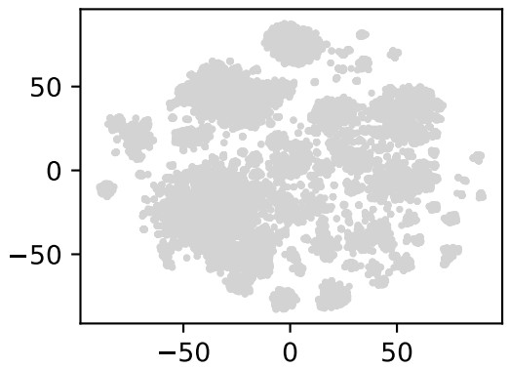
Embedding of 14951 entities
“List male instrumentalists who play string instruments”
String
Instrument
Projection Projection Intersection
Projection
Intersection
Male

Slide 78
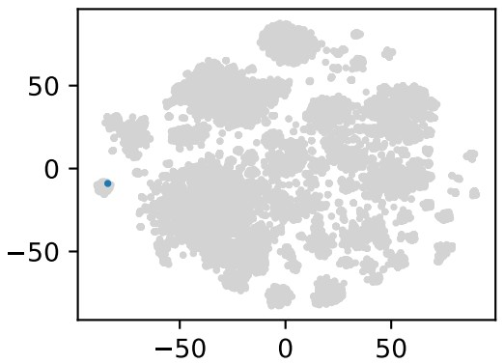
Anchor
“List male instrumentalists who play string instruments”
String Instrument

Slide 79
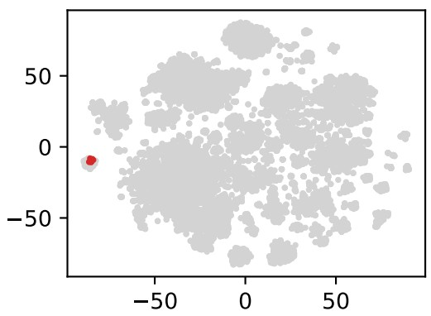
# of string instruments: 10
TP FN FP TN
TPR: 100%
FPR: 0%
“List male instrumentalists who play string instruments”
String
Instrument
Projection

Slide 80
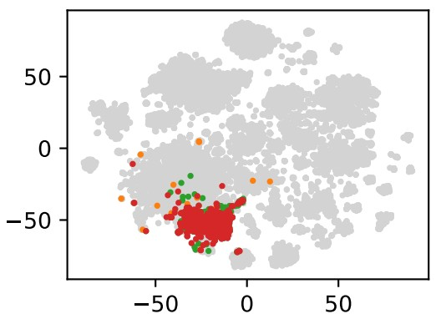
# of instrumentalists: 472
TP FN FP TN
TPR: 98.4%
FPR: 0.01%
“List male instrumentalists who play string instruments”
String
Instrument
Projection Projection
80

Slide 81
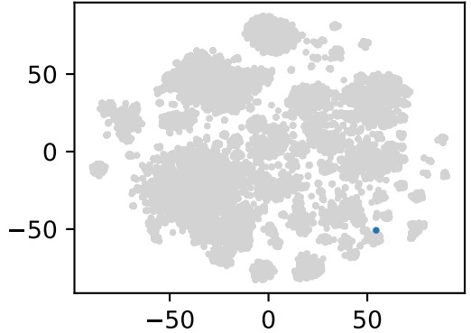
Anchor
“List male instrumentalists who play string instruments”
Male
Jure Leskovec, Stanford CS224W: Machine Learning with Graphs, http://cs224w.stanford.edu

Slide 82
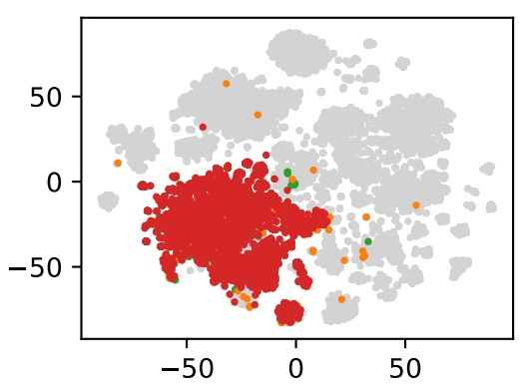
# of men: 3555
TP FN FP TN
TPR: 97.9%
FPR: 0.01%
“List male instrumentalists who play string instruments”
Projection
Male
Jure Leskovec, Stanford CS224W: Machine Learning with Graphs, http://cs224w.stanford.edu

Slide 83

# of answers: 396
TP FN FP TN
TPR: 99.4%
FPR: 0.01%
“List male instrumentalists who play string instruments”
String
Instrument
Projection Projection Intersection
Projection
Intersection
Male

Slide 84

We introduce answering predictive queries on large knowledge graphs.
The key idea is to embed queries by navigating the embedding space!
  We embed the query by composing learned operators
  Embedding of the query is close to its answers in the embedding space

