Slide 1



CS224W: Machine Learning with Graphs Jure Leskovec, Stanford University
http://cs224w.stanford.edu

Slide 2

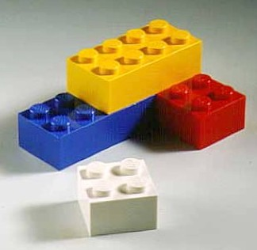
Subgraphs are the building blocks of networks:
They have the power to characterize and
discriminate networks
2

Slide 3
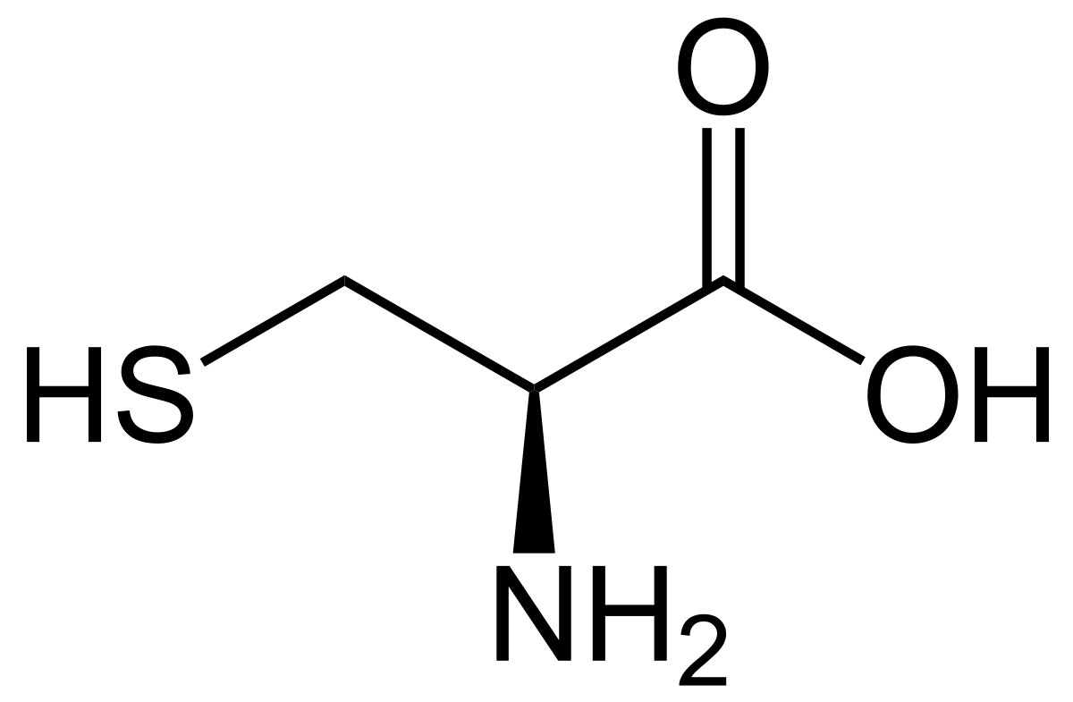
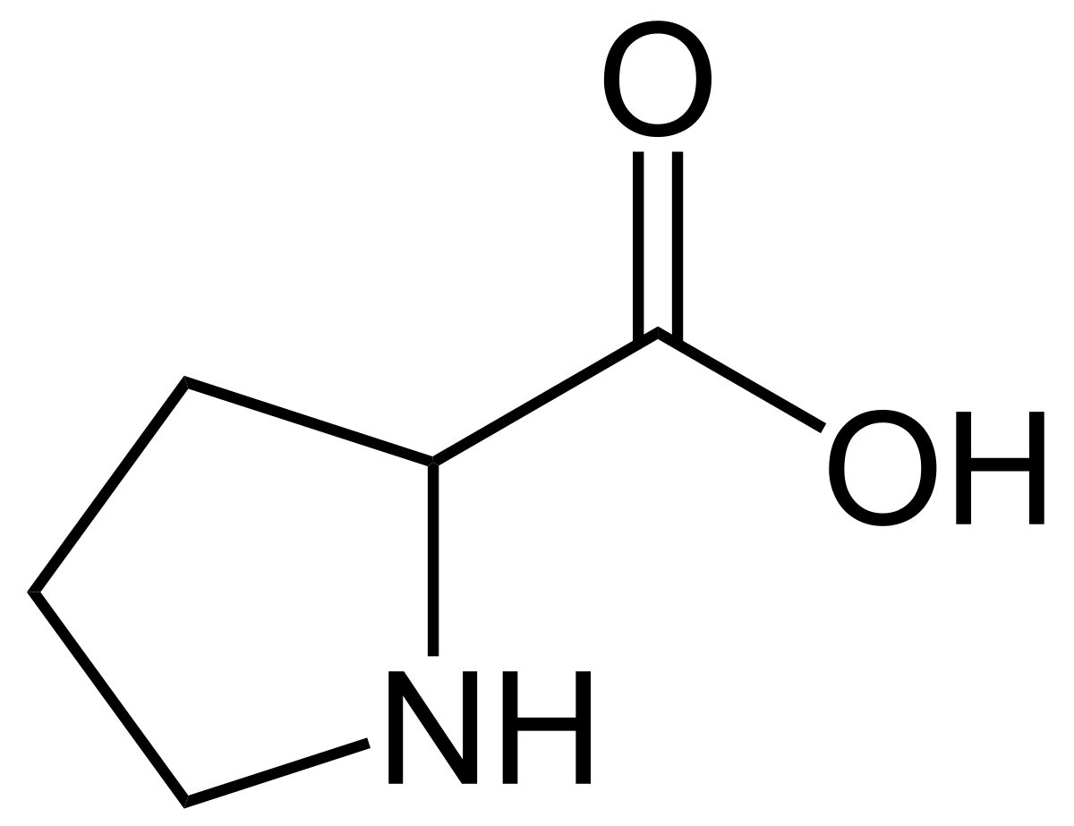
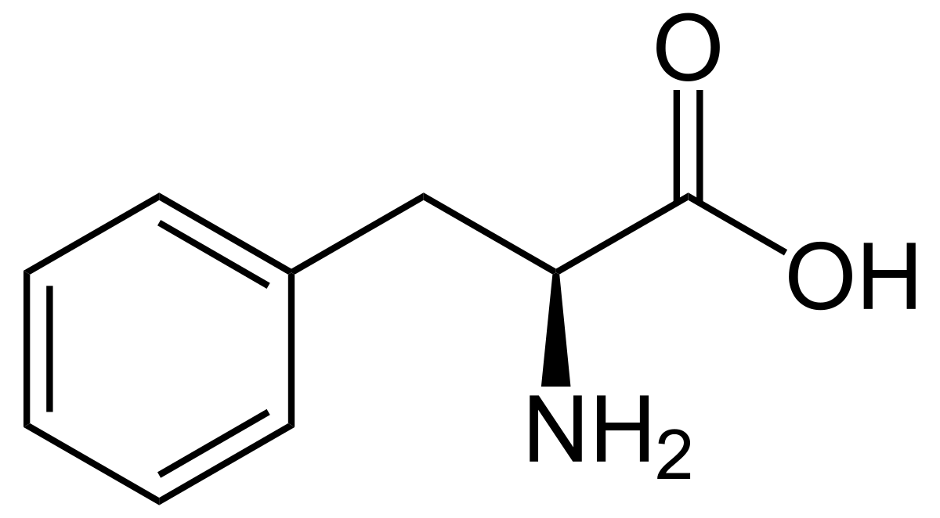
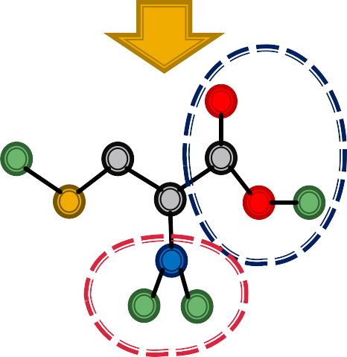
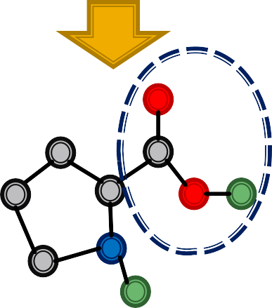
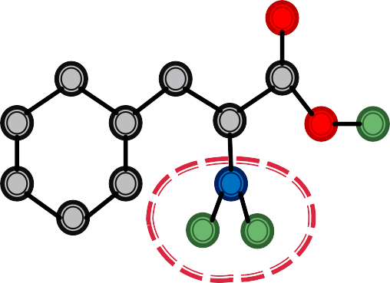
In many domains, recurring structural components determine the function or behavior of the graph
Carboxyl group = Acidic
2

Slide 4


1) Subgraphs and motifs
Defining Subgraphs and Motifs
Determining Motif Significance
Neural Subgraph Representations
Mining Frequent Motifs
2

Slide 5

CS224W: Machine Learning with Graphs Jure Leskovec, Stanford University
http://cs224w.stanford.edu

Slide 6
Two ways to formalize "network building blocks"
Given graph 𝑮 = (𝑽, 𝑬):
Def 1. Node-induced subgraph: Take subset of the nodes and all edges induced by the nodes:
  𝐺′ = (𝑉′, 𝐸′) is a node induced subgraph iff
    𝑉! ⊆ 𝑉
    𝐸′ = {(𝑢, 𝑣) ∈ 𝐸 | 𝑢, 𝑣 ∈ 𝑉′}
    𝐺′ is the subgraph of 𝐺 induced by 𝑉′
Alternate terminology: "induced subgraph"
6

Slide 7
Two ways to formalize "network building blocks"
Given graph 𝑮 = (𝑽, 𝑬):
Def 2. Edge-induced subgraph: Take subset of the edges and all corresponding nodes
  𝐺′ = (𝑉′, 𝐸′) is an edge induced subgraph iff
    𝐸′ ⊆ 𝐸
    𝑉′ = {𝑣 ∈ 𝑉 | (𝑣, 𝑢) ∈ 𝐸′ for some 𝑢}
Alternate terminology: "non-induced subgraph" or just "subgraph"
6

Slide 8
Two ways to formalize "network building blocks"
The best definition depends on the domain!
Examples:
  Chemistry: node-induced (functional groups)
  Knowledge graphs: Often edge-induced (focus is on edges representing logical relations)
6

Slide 9
The preceding definitions define subgraphs when
𝑉′ ⊆ 𝑉 and 𝐸′ ⊆ 𝐸, i.e. nodes and edges are taken from the original graph G.
What if 𝑽′ and 𝑬′ come from a totally different graph? Example:
A B X Z
W
C Y
𝐺! 𝐺"
We would like to say that 𝑮_{𝟏} is “contained in” 𝑮_{𝟐}
6

Slide 10

Graph isomorphism problem: Check whether two graphs are identical:
𝐺₁ = (𝑉₁, 𝐸₁) and 𝐺₂ = (𝑉₂, 𝐸₂) are isomorphic if there exists a bijection 𝑓: 𝑉₁ → 𝑉₂ such that (𝑢, 𝑣) ∈
𝐸₁ iff 𝑓 𝑎 , 𝑓 𝑏 ∈ 𝐸₂
  𝑓 is called the isomorphism:
Isomorphic!
Not isomorphic!
We do not know if graph isomorphism is NP-hard, nor is any polynomial algorithm found for solving graph isomorphism.
10

Slide 11
𝐺! is subgraph-isomorphic to 𝐺" if some subgraph of 𝐺! is isomorphic to 𝐺"
We also commonly say 𝐺! is a subgraph of 𝐺"
We can use either the node-induced or edge-induced definition of subgraph
This problem is NP-hard
𝑉₁ | 𝑉_{𝟐}
A | X
B | Y
C | Z
A B
X
Z
W
𝑓:
C
𝐺!
Y
𝐺"
A-B-C matches with X-Y-Z: There is a subgraph isomorphism between G1 and G2.

Slide 12
All non-isomorphic, connected, undirected graphs of size 4

Slide 13
All non-isomorphic, connected, directed graphs of size 3
#1
#2
#3
#4
#5
#6
#7
#8
#9
#10
#11
#12
#13

Slide 14

Network motifs: “recurring, significant patterns of interconnections”
How to define a network motif:
  Pattern: Small (node-induced) subgraph
  Recurring: Found many times, i.e., with high frequency How to define frequency?
  Significant: More frequent than expected, i.e., in randomly generated graphs?
How to define random graphs?

Slide 15
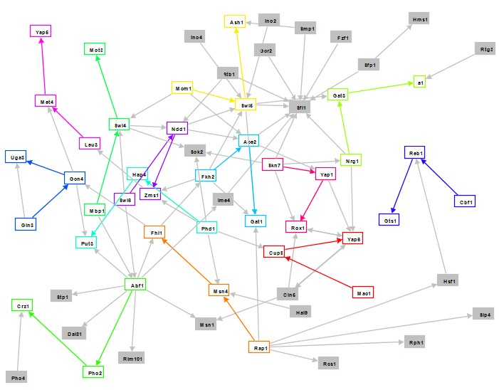
Induced subgraph of interest (aka Motif):
No match!
(not induced)
Match!
(induced)

Slide 16
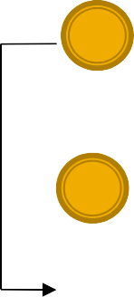
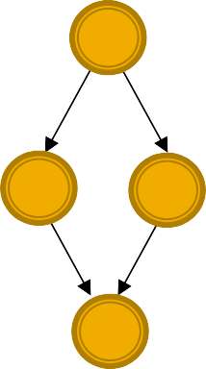
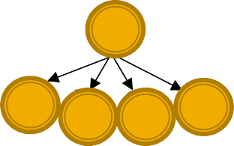
Motifs:
Help us understand how graphs work
Help us make predictions based on presence or lack of presence in a graph dataset
Examples:
Feed-forward loop
Feed-forward loops: found in networks of neurons, where they neutralize “biological noise”
Parallel loops: found in food webs
Single-input modules: found in gene control networks
Single-input module
Parallel loop

Slide 17
Let 𝐺$ be a small graph and 𝐺% be a target graph dataset.
Graph-level Subgraph Frequency Definition
Frequency of 𝐺$ in 𝐺%: number of unique subsets of nodes 𝑉% of 𝐺% for which the subgraph of 𝐺% induced by the nodes 𝑉% is isomorphic to 𝐺$
𝑮_{𝑻}
𝑮_{𝑸}
𝑮_{𝑻}
𝑮_{𝑸}: Star Subgraph
Degree 100
Frequency: 2
Frequency:
𝟏𝟎𝟎
𝟔

Slide 18
Let 𝐺$ be a small graph, 𝑣 be a node in 𝐺$ (the “anchor”) and 𝐺% be a target graph dataset.
Node-level Subgraph Frequency Definition:
The number of nodes 𝑢 in 𝐺% for which some subgraph of 𝐺% is isomorphic to 𝐺$ and the
isomorphism maps 𝑢 to 𝑣
Let (𝐺$, 𝑣) be called a node-anchored subgraph
Robust to outliers
𝑮_{𝑸}
Anchor 𝑣
𝑮_{𝑻}
𝑮_{𝑸}: Star subgraph
Anchor
Degree 100
Frequency: 𝟏
2/18/21
Jure LLeeskovec, Stanford CS224W: Machine Learning with Graphs, cs224w.stanford.edu
18

Slide 19
What if the dataset contains multiple graphs, and we want to compute frequency of subgraphs in the dataset?
Idea: Treat the dataset as a giant graph 𝐺#
with disconnected components corresponding to individual graphs.
10

Slide 20
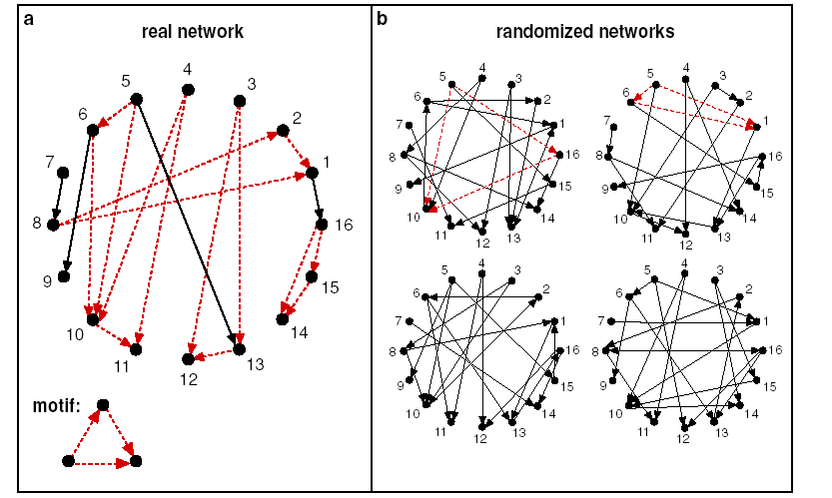
To define significance we need to have a null- model (i.e., point of comparison)
Key idea: Subgraphs that occur in a real network much more often than in a random
network have functional significance
Milo et. al., Science 2002
20

Slide 21
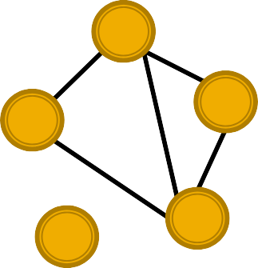
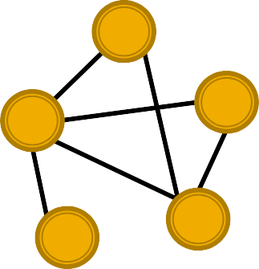
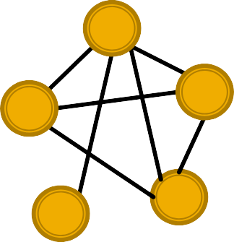
Erdős–Rényi (ER) random graphs
𝑮_{𝒏,𝒑}: undirected graph on 𝑛 nodes where each edge (𝑢, 𝑣) appears i.i.d. with probability 𝑝
Can be disconnected:
Three random graphs drawn from 𝑮_{𝟓,𝟎.𝟔}

Slide 22







Goal: Generate a random graph with a given degree sequence k₁, k₂, … k_{N}
Useful as a “null” model of networks:
We can compare the real network 𝐺!"#$ and a “random”
𝐺!#%& which has the same degree sequence as 𝐺!"#$
Configuration model:
A
A
C
C
B
D
A B C
D
B
D
Randomly pair up “mini”-n0des
We ignore double edges and self-loops when creating the final graph

Slide 23
Start from a given graph 𝑮
Repeat the switching step 𝑄 ⋅ |𝐸| times:
Select a pair of edges AàB, CàD at random
Exchange the endpoints to give AàD, CàB
  Exchange edges only if no multiple edges or self-edges are generated
C
A
B
D
A
C
Result: A randomly rewired graph:
  Same node degrees, randomly rewired edges
B
D
𝑄 is chosen large enough (e.g., 𝑄 = 100) for the process to converge

Slide 24
Intuition: Motifs are overrepresented in a network when compared to random graphs:
Step 1: Count motifs in the given graph (𝐺$%&')
Step 2: Generate random graphs with similar statistics (e.g. number of nodes, edges, degree sequence), and count motifs in the random graphs
Step 3: Use statistical measures to evaluate how significant is each motif
  Use Z-score

Slide 25
𝑍₍ captures statistical significance of motif 𝒊:
𝑍₍ = (𝑁$%&'−𝑁^{($&)*})/std(𝑁^{$&)*})
( ( (
𝑁^{,-./} is #(motif 𝑖) in graph 𝐺^{,-./}
+
𝑁^{4,.01} is average #(motifs 𝑖) in random graph instances
+
Network significance profile (SP):
𝑆𝑃₊ = 𝑍₊/ : 𝑍"
2
2
𝑆𝑃 is a vector of normalized Z-scores
The dimension depends on number of motifs considered
𝑆𝑃 emphasizes relative significance of subgraphs:
  Important for comparison of networks of different sizes
  Generally, larger graphs display higher Z-scores

Slide 26

For each subgraph:
z-score metric is capable of classifying the subgraph “significance”:
  Negative values indicate under-representation
  Positive values indicate over-representation
We create a network significance profile:
  A feature vector with values for all subgraph types
Next: Compare profiles of different graphs with
random graphs:
  Regulatory network (gene regulation)
  Neuronal network (synaptic connections)
  World Wide Web (hyperlinks between pages)
  Social network (friendships)
  Language networks (word adjacency)

Slide 27
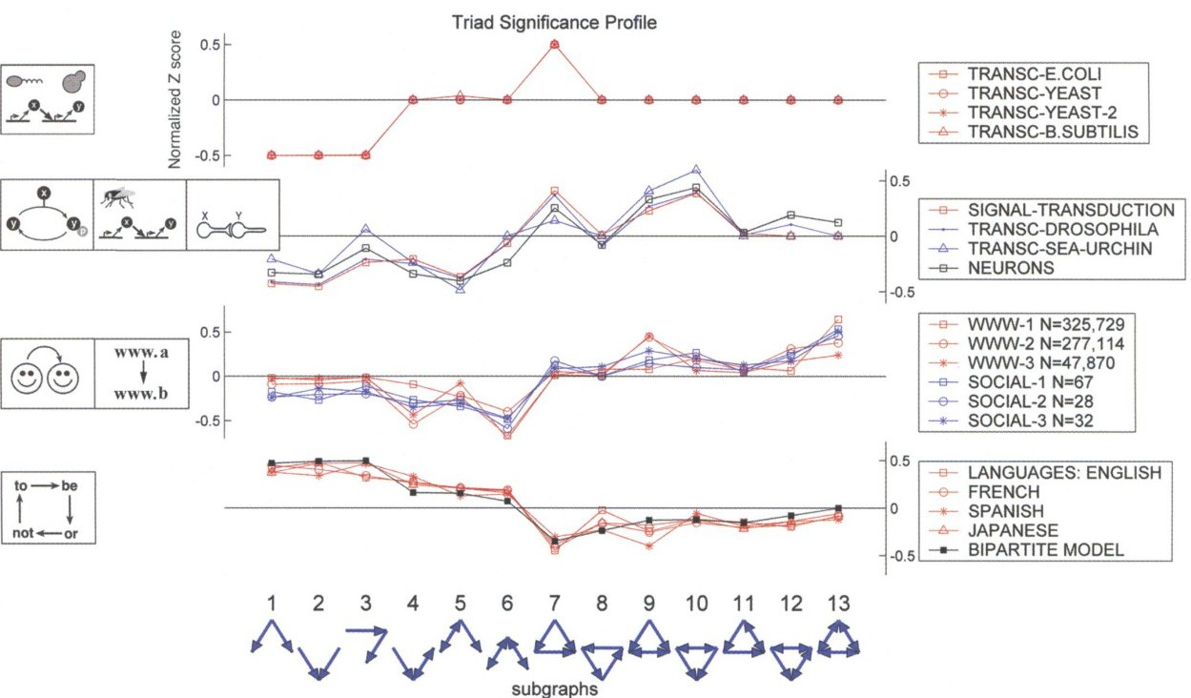
Network significance profile
Gene regulation networks
Neurons
Web and social
Word connectivity
Milo et al., Science 2004
Networks from the same domain have similar significance profiles

Slide 28
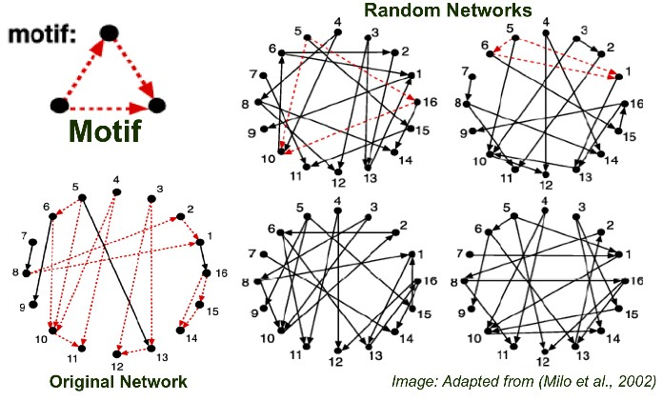
Count subgraphs 𝑖 in 𝐺$%&'
Count subgraphs 𝑖 in random graphs 𝐺^{$&)*}:
Null model: Each 𝐺^{)*+,} has the same #(nodes),
#(edges) and degree distribution as 𝐺^{)-*.}
Assign Z-score to motif 𝑖:
  𝑍/ = (𝑁^{)-*.}−𝑁^{9)*+,})/std(𝑁^{)*+,})
/ / /
  High Z-score: Subgraph 𝑖
is a network motif of 𝑮

Slide 29
Extensions:
Original Network
1 2
3
3-Subgraph
Directed and undirected
Colored and uncolored
Temporal and static motifs
0
4 5
1 2
1 2
3
3
0
0
4 5
{3,4,5}
4 5
{0,4,5}
Occurrence
Variations on the concept:
  Different frequency concepts
  Different significance metrics
Not an occurrence!
Blogs
Conservative Liberal
Under-Representation (anti-motifs)
Motif C Motif D Motif E Motif F
Different null models
Overrepresentation of C E is overrepresented much larger than D F is underrepresented

Slide 30

Subgraphs and motifs are the building blocks
of graphs
Subgraph isomorphism and counting are NP-hard
Understanding which motifs are frequent or significant in a dataset gives insight into the unique characteristics of that domain
Use random graphs as null model to evaluate the significance of motif via Z-score
30

Slide 31

CS224W: Machine Learning with Graphs Jure Leskovec, Stanford University
http://cs224w.stanford.edu

Slide 32
1) Subgraphs and Motifs
Defining Subgraphs and Motifs
Determining Motif Significance
Neural Subgraph Representations
Mining Frequent Motifs

Slide 33

Given:
Large target graph (can be disconnected)
Query graph (connected)
Decide:
Is query graph a subgraph in the target graph?
Query Target
A subgraph?
Node colors indicate the correct mapping of the nodes

Slide 34
Large target graph (can be disconnected)
Query graph (connected)
Use GNN to predict subgraph isomorphism
Query Target
A subgraph?
Intuition: Exploit the geometric shape of embedding space to capture the properties of subgraph isomorphism

Slide 35

Consider a binary prediction: Return True if query is isomorphic to a subgraph of the target graph, else return False
Query
Target
True
Finding all pairs of correspondences is another challenging problem, which will not be covered in this lecture.

Slide 36
(1) We are going to work with node-anchored definitions:
Query
Anchor
Embedding of
True / False
Embedding of
Anchor
Target

Slide 37
(2) We are going to work with node-anchored neighborhoods:
Query
Anchor
1st hop edge
2nd hop edge
Anchor
Target
Neighborhoods around anchors

Slide 38
Use GNN to obtain representations of 𝑢 and 𝑣
Predict if node 𝒖’s neighborhood is isomorphic to node 𝒗’s neighborhood:
Query
Anchor
1st hop edge
Embedding of
GNN
2nd hop edge
True / False
Embedding of
GNN
Anchor
Neighborhoods around anchors
How to use embeddings to make predictions?
Target

Slide 39

Recall node-level frequency definition:
The number of nodes 𝑢 in 𝐺! for which some subgraph of 𝐺! is isomorphic to 𝐺" and the isomorphism maps 𝑢 to 𝑣
We can compute embeddings for 𝑢 and 𝑣 using GNN
Use embeddings to decide if neighborhood of 𝑢 is isomorphic to subgraph of neighborhood of 𝑣
We not only predict if there exists a mapping, but also a identify corresponding nodes (𝑢 and 𝑣)!

Slide 40
For each node in 𝑮_{𝑻}:
Obtain a k-hop neighborhood around the anchor
Can be performed using breadth-first search (BFS)
The depth 𝑘 is a hyper-parameter (e.g. 3)
  Larger depth results in more expensive model
Same procedure applies to 𝐺, to obtain the
neighborhoods
We embed the neighborhoods using a GNN
  By computing the embeddings for the anchor nodes in their respective neighborhoods
40

Slide 41
Map graph 𝐴 to a point 𝑧₋ into a high- dimensional (e.g. 64-dim) embedding space, such that 𝑧₋ is non-negative in all dimensions Capture partial ordering (transitivity):
We use
≼ to denote that the embedding
of is less than or equal to
in all of its
Embedding space
coordinates
If ≼ ,
≼ then ≼
Intuition: subgraph is to the
lower-left of its supergraph (in 2D)
O

Slide 42
Neighborhood
Anchor node 𝒕
Order Embedding space
Example Query 1
𝑮_{𝑻}
GNN
Anchor
Example Query 2
O
Anchor
By comparing the embedding, we find that ≼ but ≼ , Indicating that only query 1 is a subgraph of the neighborhood of 𝑡

Slide 43
Subgraph isomorphism relationship can be nicely encoded in order embedding space
Transitivity: if 𝐺₀ is a subgraph of 𝐺₁, 𝐺₁ is a subgraph of 𝐺₂, then 𝐺₀ is a subgraph of 𝐺₂
Anti-symmetry: if 𝐺₀ is a subgraph of 𝐺₁, and 𝐺₁ is a subgraph of 𝐺₀, then 𝐺₀ is isomorphic to 𝐺₁
Closure under intersection: the trivial graph of 1 node is a subgraph of any graph
All properties have their counter-parts in the order embedding space

Slide 44
Subgraph isomorphism relationship can be nicely encoded in order embedding space
Transitivity: if ≼ ,
≼ then ≼
≼ and
Anti-symmetry: if
≼ , then =
Closure under intersection: the 0 embedding satisfies 0 ≼
for any order embedding
since all dimensions of order
embedding are non-negative
Corollary: if ≼ and ≼ then
Transitivity
has a valid embedding
Closure under intersection
Anti-symmetry
O
2/18/21
O O
Jure Leskovec, Stanford CS224W: Machine Learning with Graphs, cs224w.stanford.edu
44

Slide 45

We use a GNN to learn to embed neighborhoods and preserve the order embedding structure
What loss function should we use, so that the learned order embedding reflects the subgraph
relationship?
We design loss functions based on the order constraint:
  Order constraint specifies the ideal order embedding property that reflects subgraph relationships

Slide 46

We specify the order constraint to ensure that the subgraph properties are preserved in the order embedding space
Embedding dimension
∀* ₎𝑧₊ 𝑖 ≤ 𝑧, 𝑖
iff 𝐺₋ ⊆ 𝐺.
trained with max-margin loss
'(
Query embedding
Target embedding
Subgraph Relation
Embedding space
Subgraph anchored
of the one anchored at
is subgraph
at
O

Slide 47
GNN Embeddings are learned by minimizing a max- margin loss
Define 𝐸 𝐺₄, 𝐺₅ = ∑⁷ ₀(max(0, 𝑧₄[𝑖] − 𝑧₅[𝑖]))¹ as
/6
the “margin” between graphs 𝐺₄ and 𝐺₅
Embedding space
𝐺#
𝐺$
Embedding space
𝐺#
𝐺$
O
O
𝐸 𝐺 , 𝐺 = 0
𝐸 𝐺 , 𝐺 > 0
$ #
$ #
According to the order embedding,
𝐺$ is a subgraph of 𝐺#!
According to the order embedding,
𝐺$ is not a subgraph of 𝐺#!

Slide 48

Embeddings are learned by minimizing a max- margin loss
Let 𝐸 𝐺#, 𝐺$ = ∑⁽ '(max(0, 𝑧#[𝑖] − 𝑧$[𝑖]))⁾ be
%&
the “margin” between graphs 𝐺# and 𝐺$
To learn the correct order embeddings, we want to learn 𝒛_{𝒒}, 𝒛_{𝒕} such that
𝐸 𝐺#, 𝐺$
𝐸 𝐺#, 𝐺$
= 0 when 𝐺# is a subgraph of 𝐺$
> 0 when 𝐺# is not a subgraph of 𝐺$

Slide 49
To learn such embeddings, construct training examples (𝐺., 𝐺/) where half the time, 𝐺. is a subgraph of 𝐺/, and the other half, it is not
Train on these examples by minimizing the
following max-margin loss:
For positive examples: Minimize 𝐸(𝐺₄, 𝐺₅) when
𝐺₄ is a subgraph of 𝐺₅
For negative examples:
Minimize max(0, 𝛼 − 𝐸 𝐺₄, 𝐺₅ )
  Max-margin loss prevents the model from learning the degenerate strategy of moving embeddings further and further apart forever

Slide 50
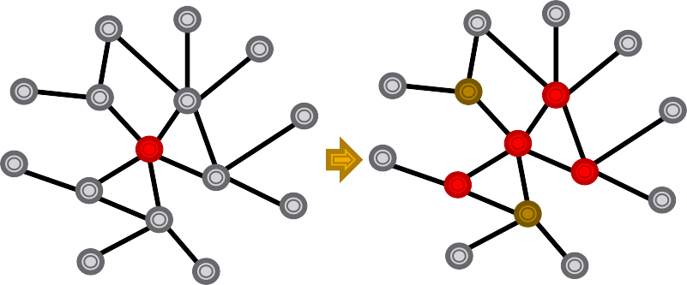
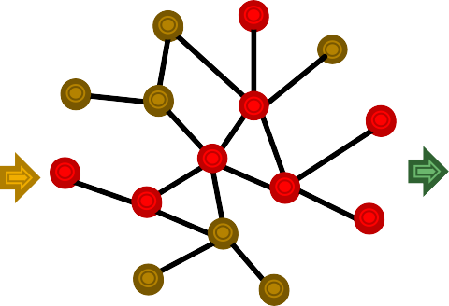
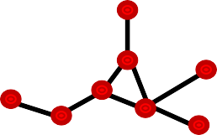
Need to generate training queries 𝐺$ and targets 𝐺% from the dataset 𝐺
Get 𝐺% by choosing a random anchor 𝑣 and taking all nodes in 𝐺 within distance 𝐾 from 𝑣 to be in 𝐺%
Use BFS sampling to get 𝐺$. Sample induced subgraph of 𝐺%:
  Initialize 𝑆 = 𝑣 , 𝑉 = ∅
  Let 𝑁(𝑆) be all neighbors of nodes in S. At every step, sample 10% of the nodes in 𝑁 𝑆 ∖ 𝑉 and place them in 𝑆. Place the remaining nodes of 𝑁 𝑆 in 𝑉.
  After 𝐾 steps, take the subgraph of 𝐺 induced by 𝑆 anchored at 𝑞
For negative examples (𝐺$ not subgraph of 𝐺%), “corrupt” 𝐺$ by
adding/removing nodes/edges so it’s no longer a subgraph
BFS sampling
S
V
Not yet visited
𝐺%
2/18/21
Jure Leskovec, Stanford CS224W: Machine Learning with Graphs, cs224w.stanford.edu
50

Slide 51

How many training examples to sample?
At every iteration, we sample new training pairs
Benefit: Every iteration, the model sees different subgraph examples
Improves performance and avoids overfitting – since there are exponential number of possible subgraphs to sample from
How deep is the BFS sampling?
  A hyper-parameter that trades off runtime and performance
  Usually use 3-5, depending on size of the dataset
51

Slide 52
Given: query graph 𝐺. anchored at node 𝑞, target graph 𝐺/ anchored at node 𝑡
Goal: output whether the query is a node- anchored subgraph of the target
Procedure:
If 𝐸 𝐺₄, 𝐺₅
< 𝜖, predict “True”; else “False”
𝜖 is a hyper-parameter
To check if 𝐺, is isomorphic to a subgraph of
𝐺# , repeat this procedure for all 𝑞 ∈ 𝐺,, 𝑡 ∈
𝐺#. Here 𝐺. is the neighborhood around node
𝑞 ∈ 𝐺,.

Slide 53
Neural subgraph matching uses a machine learning- based approach to learn the NP-hard problem of subgraph isomorphism
Given query and target graph, it embeds both graphs into an order embedding space
Using these embeddings, it then computes 𝐸 𝐺;, 𝐺< to determine whether query is a subgraph of the target
Embedding graphs within an order embedding space allows subgraph isomorphism to be efficiently represented and tested by the relative positions of graph embeddings

Slide 54

CS224W: Machine Learning with Graphs Jure Leskovec, Stanford University
http://cs224w.stanford.edu

Slide 55
1) Subgraphs and Motifs
Defining Subgraphs and Motifs
Determining Motif Significance
Neural Subgraph Representations
Mining Frequent Subgraphs

Slide 56
Finding the most frequent size-𝑘 motifs requires solving two challenges:
1) Enumerating all size-k connected subgraphs
2) Counting #(occurrences of each subgraph type)
Possible size-3 motifs
count # of triangle motifs

Slide 57

Just knowing if a certain subgraph exists in a graph is a hard computational problem!
  Subgraph isomorphism is NP-complete
Computation time grows exponentially as the size of the subgraphs increases
  Feasible motif size for traditional methods is relatively small (3 to 7)

Slide 58
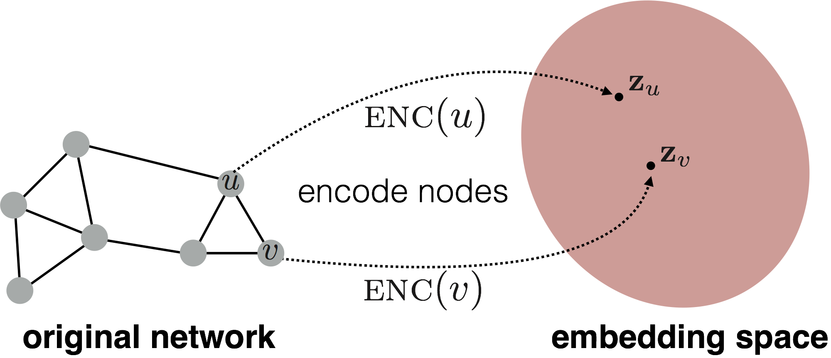
Finding frequent subgraph patterns is
computationally hard
Combinatorial explosion of number of possible patterns
Counting subgraph frequency is NP-hard
Representation learning can tackle these challenges:
  Combinatorial explosion à organize the search space
  Subgraph isomorphism à prediction using GNN
Jure LLeeskovec, Stanford CS224W: Machine Learning with Graphs, cs224w.stanford.edu

Slide 59
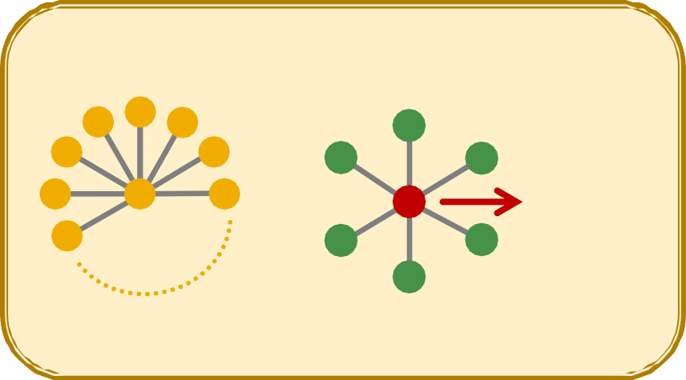
Target graph (dataset) 𝐺%, size parameter 𝑘
Desired number of results 𝑟
Goal: Identify, among all possible graphs of 𝑘 nodes, the 𝑟 graphs with the highest frequency in 𝐺%.
We use the node-level definition:
The number of nodes 𝑢 in 𝐺% for which some subgraph of 𝐺% is isomorphic to 𝐺$ and the
isomorphism maps 𝑢 to 𝑣.
𝑮_{𝑻}
𝑮_{𝑸}: Star Subgraph
Anchor
Degree 100
Frequency: 𝟏
Jure LLeeskovec, Stanford CS224W: Machine Learning with Graphs, cs224w.stanford.edu

Slide 60







SPMiner: a neural model to identify frequent motifs
Decompose: overlapping
node-anchored neighborhoods
Encoder: Embed subgraphs into order embedding space
Search Procedure: find frequent subgraphs by growing patterns
Input 𝐺&
Step 1
Step 2
…
Step 9
…
=
𝐶𝑆
Step 10
….
O
Same as neural subgraph matching
Jure LLeeskovec, Stanford CS224W: Machine Learning with Graphs, cs224w.stanford.edu
60

Slide 61

Decompose input graph 𝐺# into neighborhoods
Embed neighborhoods into an order embedding space
Key benefit of order embedding:
We can quickly find out the frequency of a given subgraph 𝐺,
2/18/21
Jure Leskovec, Stanford CS224W: Machine Learning with Graphs, cs224w.stanford.edu
61

Slide 62
Given: Set of subgraphs (“node-anchored neighborhoods”) 𝐺_{E#} of 𝐺% (sampled randomly)
Key idea: Estimate frequency of 𝐺$ by counting the number of 𝐺_{E#} such that their embeddings 𝑧_{E#} satisfy
𝑧$ ≤ 𝑧_{E#}
Consequence of the order embedding space property
Embedding Space
“Super-graph” region:
All points in the red shaded region correspond to neighborhoods in 𝐺% that contain 𝐺$
Benefit: Super fast subgraph frequency counting!
Node-anchored neighborhood
Motif
2/18/21
O
Jure Leskovec, Stanford CS224W: Machine Learning with Graphs, cs224w.stanford.edu
62

Slide 63
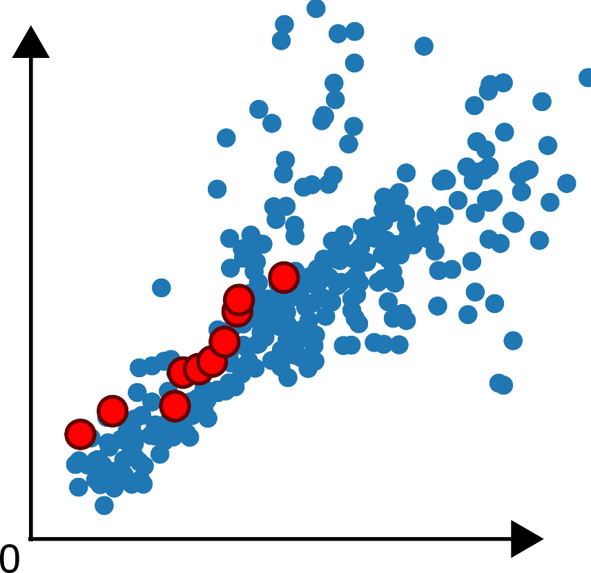


Initial step: Start by randomly picking a starting node 𝑢
in the target graph. Set 𝑆 = {𝑢}
Each point in the shaded region represents a neighborhood in target graph that contains the motif pattern
Walk in Embedding Space
Neighborhood embeddings
Motif walk
Step 1
𝑢
Initially, all neighborhoods contain the trivial subgraph
Step 1

Slide 64
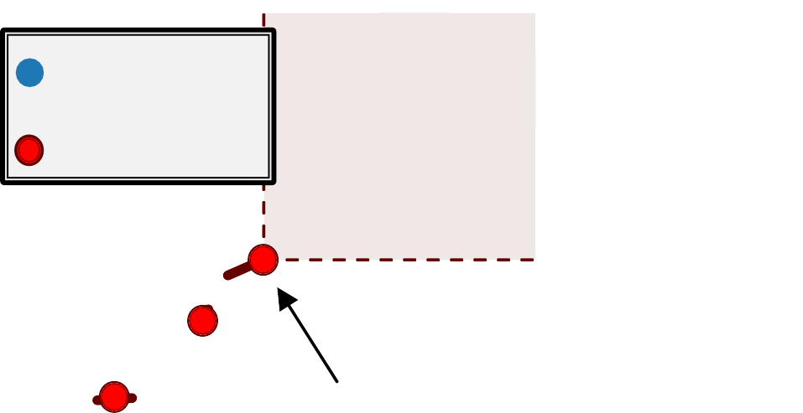
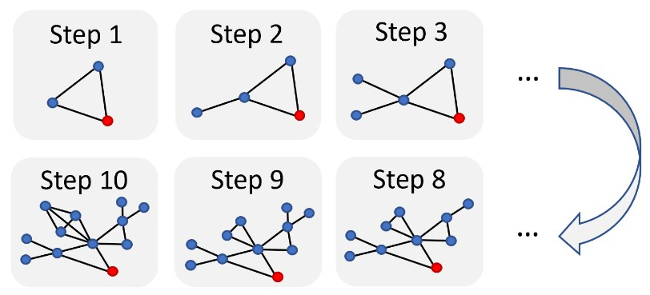









Iteratively: Grow a motif by iteratively choosing a neighbor of a node in 𝑆, and adding that node to 𝑆 We want to grow motifs to find larger motifs!
Walk in Embedding Space
Neighborhood embeddings
Motif walk
Small motifs grow by adding neighbors
Their embeddings correspond to red points on the left
Step 3 Step 4 Step 5
…
Step 12
Step 12
_{Step 12} Step 11 Step 10
Step 11
Step 10
Step 12
Goal: maximize number of neighborhoods in red shaded area after 𝑘 step!
…
Step 3
Frequent Subgraph Mining by Walking in Order Embedding Space

Slide 65



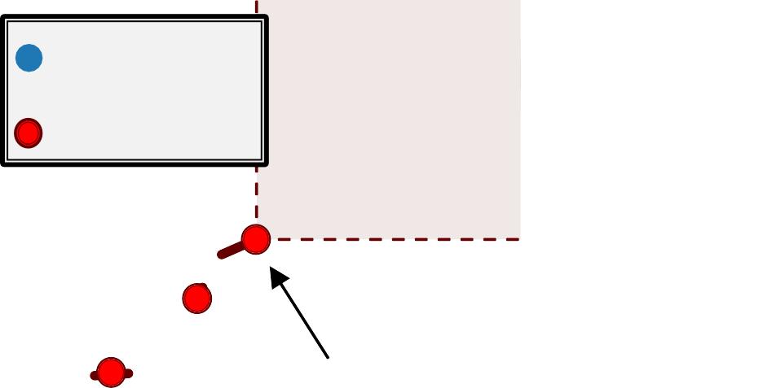



Termination: Upon reaching a desired motif size, take the subgraph of the target graph induced by 𝑆
Walk in Embedding Space
Step 3 Step 4 Step 5
Neighborhood embeddings
Motif walk
Step 12
Step 11
Step 10
Identified frequent motif of size 12:
It has the largest number of blue
Step 12
points in super-graph region, among all embeddings of possible subgraphs of size 12
…
Step 3
Frequent Subgraph Mining by Walking in Order Embedding Space

Slide 66
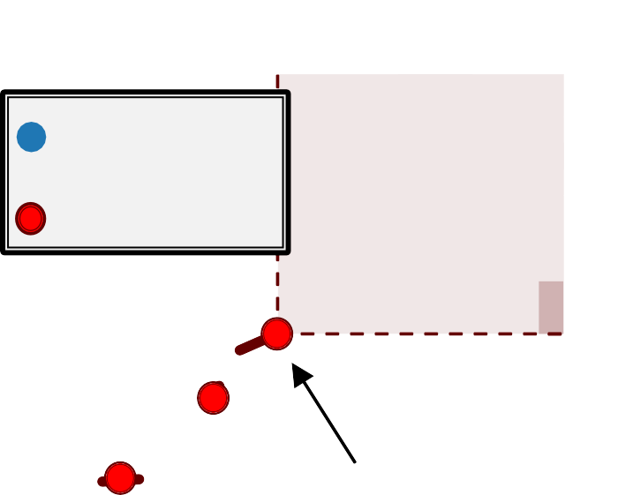
How to pick which node to add at each step?
Total violation of a subgraph 𝐺: the number of neighborhoods
that do not contain 𝐺.
The number of neighborhoods 𝐺_{=$}
that do not satisfy 𝑧> ≼ 𝑧₌
Walk in Embedding Space
Neighborhood embeddings
Motif walk
$
Minimizing total violation =
maximizing frequency
Greedy strategy (heuristic):
At every step, add the node that results in the smallest total
violation
Step 12
…
Step 1

Slide 67
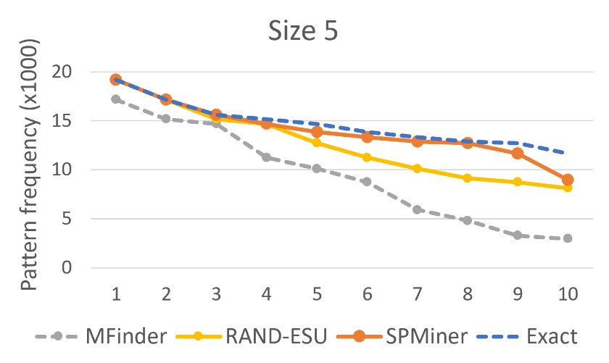
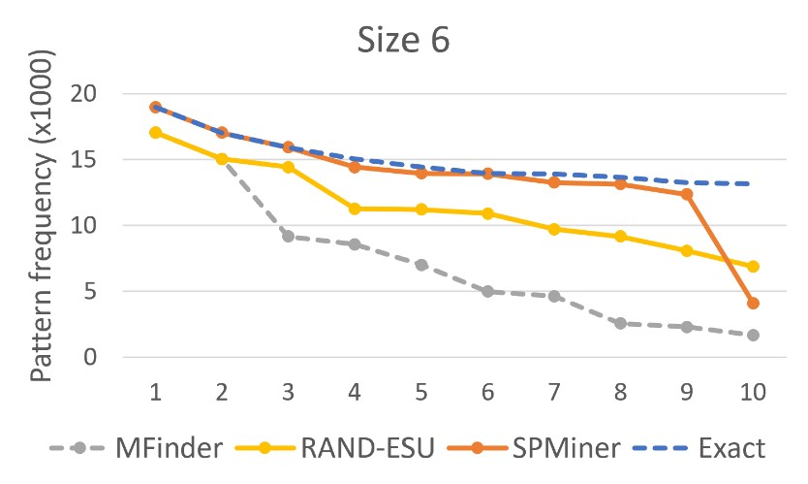
Ground truth: find most frequent 10 motifs in dataset by brute-force exact enumeration (expensive)
Question: Can the model identify frequent motifs?
Result: The model identifies 9 and 8 of the top 10 motifs, respectively.
Traditional methods
Groundtruth

Slide 68
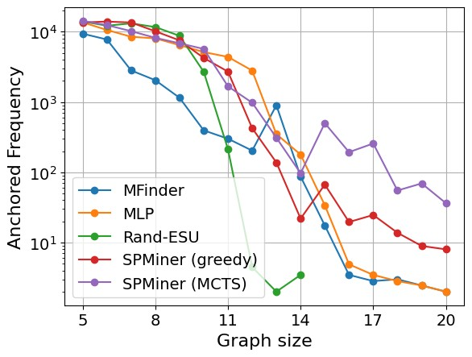
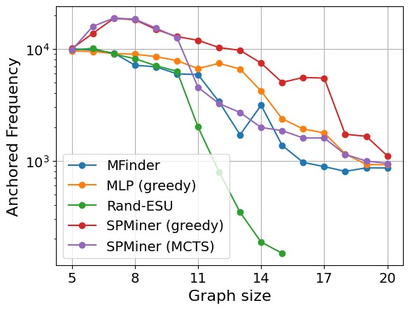
Question: how do the frequencies of the identified motif compare?
Result: SPMiner identifies motifs that appear 10-100x more frequently than the baselines
COX2 ENZYMES
𝑘
𝑘
Molecule dataset
Protein dataset

Slide 69

Subgraphs and motifs are important concepts that provide insights into the structure of graphs. Their counts can be used as features for nodes and graphs.
We covered neural approaches to prediction subgraph isomorphism relationship.
Order embeddings have desirable properties and can be used to encode subgraph relations
Neural embedding-guided search in order embedding space can enable ML model to identify motifs much more frequent than existing methods

