Slide 1



CS224W: Machine Learning with Graphs Jure Leskovec, Stanford University
http://cs224w.stanford.edu

Slide 2
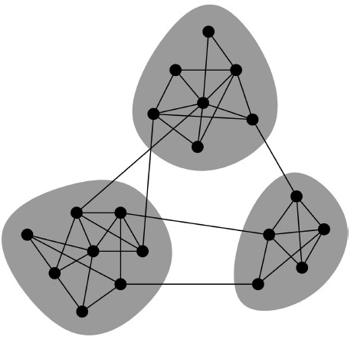
We often think of networks “looking” like this:
What led to such a conceptual picture?
2

Slide 3
How does information flow through the network?
People are “embedded” in a social network.
There are different links (“short” vs. “long”) in the network, through which information flows.
Social network
Information flow
: person
: “short” link
: “long” link
2

Slide 4
How do people find out about new jobs?
Mark Granovetter, part of his PhD in 1960s
People find the information through personal contacts
But: Contacts were often acquaintances
rather than close friends
  This is surprising: One would expect your friends to help you out more than casual acquaintances
Why is it that acquaintances are most helpful?
Personal contact network
: “close-friend” link
: “acquaintance” link
2

Slide 5
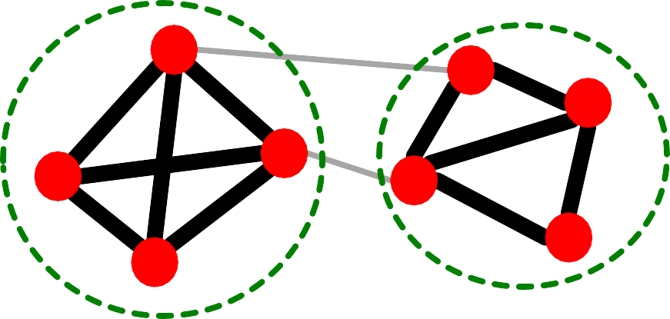
Two perspectives on friendships:
[Granovetter ‘73]
Structural: Friendships span different parts of the network
Interpersonal: Friendship between two people is either strong or weak
Interpersonal
Structural
Weak
Strong
2

Slide 6
Granovetter makes a connection between the social and structural role of an edge
First point: Structure
Structurally embedded (tightly-connected) edges are also socially strong
Long-range edges spanning different parts of the network are socially weak
Second point: Information
  Long-range edges allow you to gather information from different parts of the network and get a job
Structurally embedded edges are heavily redundant in terms of information access
Weak
S
Strong
S
W S
b
a
S
2

Slide 7

How community (tightly-connected cluster of nodes) forms?
Which edge is more likely, a-b or a-c?
a
If two people in a network have a friend in common, then there is an increased likelihood they will become friends themselves.
b
c
2

Slide 8
Triadic closure = High clustering coefficient Reasons for triadic closure:
If 𝑩 and 𝑪 have a friend 𝑨 in common, then:
𝑩 is more likely to meet 𝑪
B
(since they both spend time with 𝑨)
𝑩 and 𝑪 trust each other
  (since they have a friend in common)
𝑨 has incentive to bring 𝑩 and 𝑪 together
A
C
(since it is hard for 𝑨 to maintain two disjoint relationships)
Empirical study by Bearman and Moody:
  Teenage girls with low clustering coefficient are more likely to contemplate suicide
2

Slide 9
For many years Granovetter’s theory was not tested
But, today we have large who-talks-to-whom graphs:
Email, Messenger, Cell phones, Facebook
Onnela et al. 2007:
  Cell-phone network of 20% of EU country’s population
  Edge weight: # phone calls
2

Slide 10

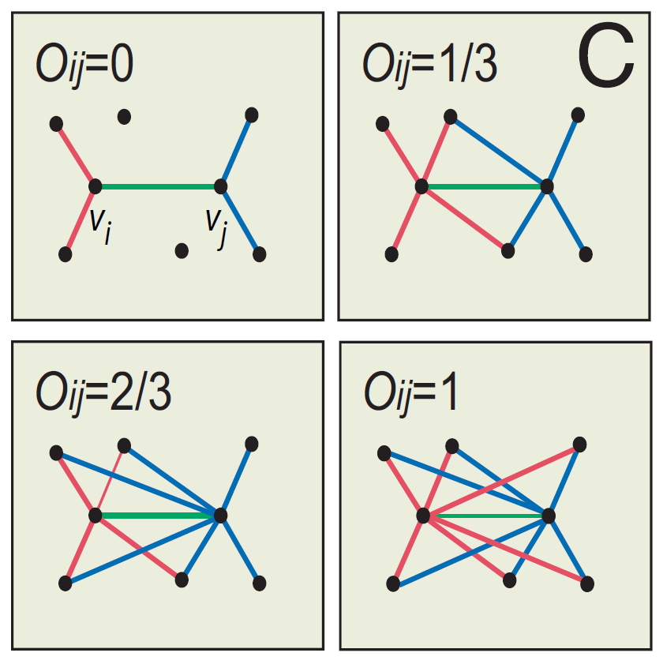

Edge overlap:
^{𝑂}!"
₌ |(𝑁(𝑖) ⋂ 𝑁 𝑗 ) − {𝑖, 𝑗}|
|(𝑁(𝑖) ⋃ 𝑁 𝑗 ) − {𝑖, 𝑗}|
𝑁(𝑖) … the set of neighbors of node 𝑖
Note: Overlap = 𝟎 when an edge is a local bridge
10

Slide 11
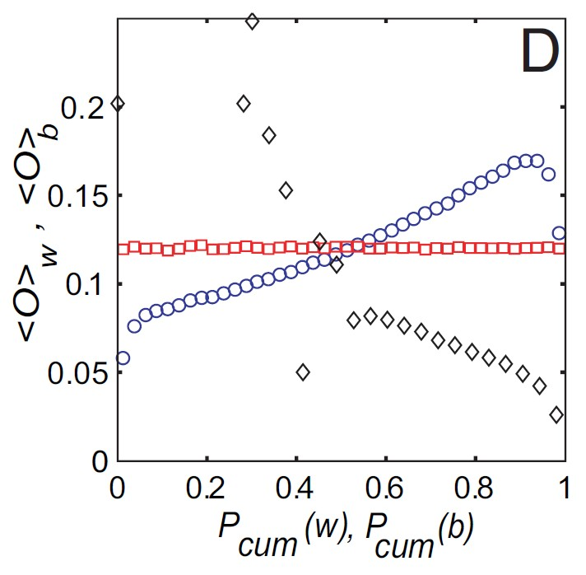
Cell-phone network
Observation:
Highly used links have high overlap!
Legend:
  True: The data
  Permuted strengths: Keep the network structure
but randomly reassign edge strengths
True
Neighborhood overlap
Permuted strengths
Edge strength (#calls)

Slide 12
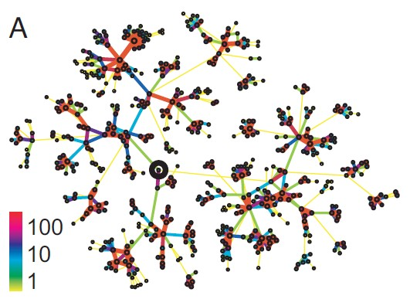
Real edge strengths in mobile call graph
  Strong ties are more embedded (have higher overlap)

Slide 13
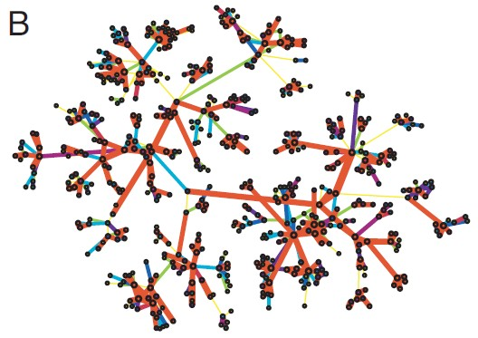
Same network, same set of edge strengths
but now strengths are randomly shuffled

Slide 14
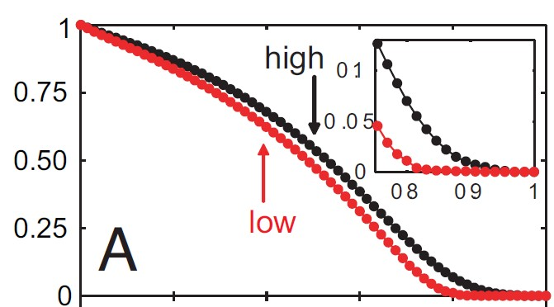
Removing edges based on strength (#calls)
Low to high
High to low
Size of largest component
Low disconnects the network sooner
Conceptual picture of network structure
Fraction of removed edges
Jure Leskovec, Stanford CS224W: Machine Learning with Graphs

Slide 15
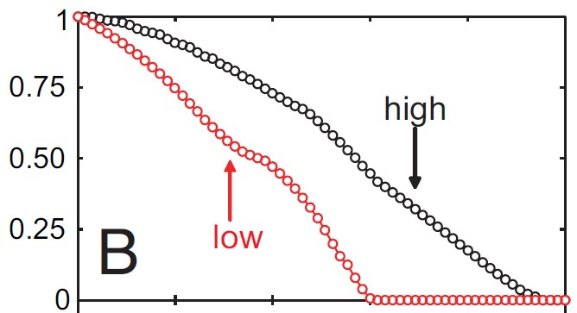
Removing edges based on edge overlap
Low to high
High to low
Size of largest component
Low disconnects the network sooner
Conceptual picture of network structure
Fraction of removed edges
Jure Leskovec, Stanford CS224W: Machine Learning with Graphs

Slide 16
Granovetter’s theory leads to the following conceptual picture of networks
Strong ties/edges
Weak ties/edges
16

Slide 17

CS224W: Machine Learning with Graphs Jure Leskovec, Stanford University
http://cs224w.stanford.edu

Slide 18
Granovetter’s theory suggests that networks are composed of tightly connected
sets of nodes
Communities, clusters, groups, modules
Network communities:
Sets of nodes with lots of internal connections and
few external ones (to the rest of the network).

Slide 19
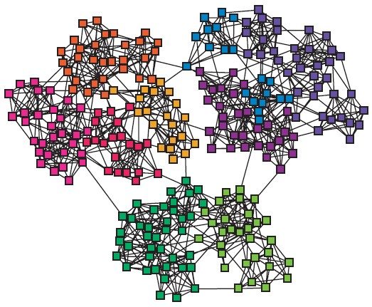
How do we automatically find such densely connected groups of nodes?
Ideally such automatically detected clusters would then correspond to real groups
For example:
Communities, clusters, groups, modules

Slide 20
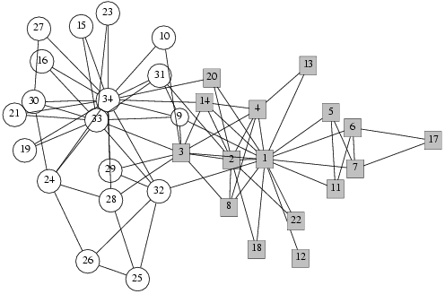
Zachary’s Karate club network:
Observed social ties & rivalries in a university karate club
During the study, conflicts led the group to split
Split could be explained by a minimum cut in the network
20

Slide 21
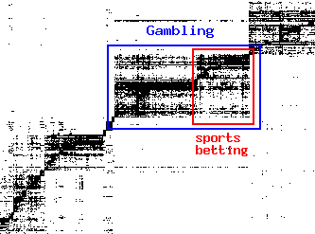
Find micro-markets by partitioning the “query-to-advertiser” graph in web search:
query
advertiser
Nodes: advertisers and queries/keywords; Edges: Advertiser advertising on a keyword.
21

Slide 22

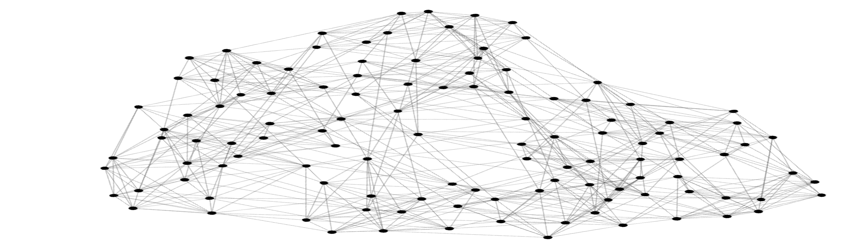



Can we identify node groups? (communities, modules, clusters)
Nodes: Teams
Edges: Games played

Slide 23
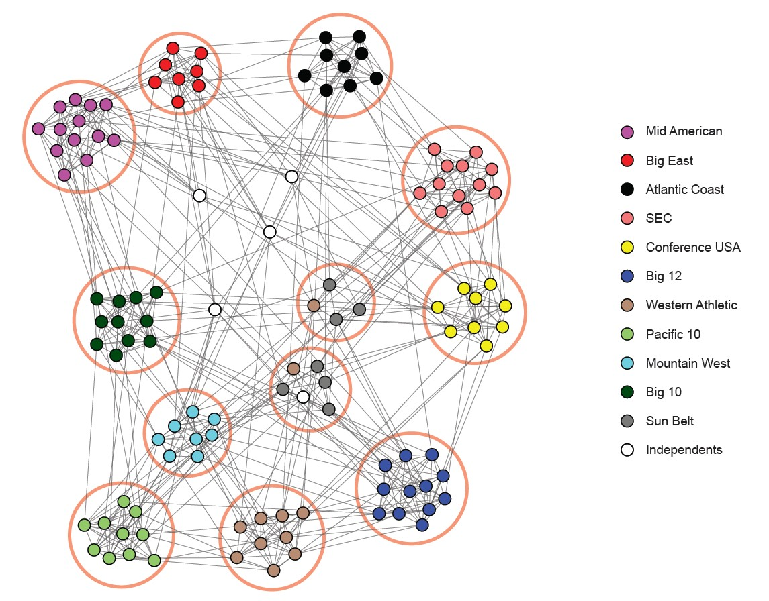
NCAA conferences
Nodes: Teams
Edges: Games played

Slide 24
Communities: sets of
tightly connected nodes
Define: Modularity 𝑸
  A measure of how well a network is partitioned into communities
  Given a partitioning of the network into groups disjoint 𝒔 ∈ 𝑺:
Q μ ∑_{s∈ S} [ (# edges within group s) –
(expected # edges within group s) ]
Need a null model

Slide 25
Given real 𝑮 on 𝒏 nodes and 𝒎 edges,
construct rewired network 𝑮’
Same degree distribution but uniformly random connections
𝑘!
i
j
𝑘"
Consider 𝑮’ as a multigraph (multiple edges exist between nodes)
The expected number of edges between nodes
𝒌 ₌ 𝒌_{𝒊}𝒌_{𝒋}
𝒊 and 𝒋 of degrees 𝒌_{𝒊} and 𝒌_{𝒋} equals: 𝒌_{𝒊} ⋅
𝒋
𝟐𝒎 𝟐𝒎
There are 2𝑚 directed edges (counting i->j and j->i) in total.
For each of 𝑘! out-going edges from node 𝑖, the chance of it landing to node 𝑗 is 𝑘"/2𝑚, hence 𝑘!𝑘"/2𝑚.

Slide 26
The expected number of edges between nodes
𝒌 ₌ 𝒌_{𝒊}𝒌_{𝒋}
𝒊 and 𝒋 of degrees 𝒌_{𝒊} and 𝒌_{𝒋} equals: 𝒌_{𝒊} ⋅
𝒋
𝟐𝒎 𝟐𝒎
The expected number of edges in (multigraph) G’:
𝒌_{𝒊}𝒌_{𝒋 =} 𝟏 ⋅
𝟏 ∑
§ = ^{𝟏} ∑
∑
𝒌_{𝒊} ∑ 𝒌_{𝒋} =
𝟐
𝒊∈𝑵 𝒋∈𝑵 _{𝟐𝒎}
𝟐 𝟐𝒎
𝒊∈𝑵 𝒋∈𝑵
Note:
! 𝑘# = 2𝑚
#∈%
§ = ^{𝟏} 𝟐𝒎 ⋅ 𝟐𝒎 = 𝒎
𝟒𝒎
Under null model, both the degree distribution and the total number of edges are preserved.
Notice: This model applies to both weighted and unweighted networks. For weighted networks we use the weighted degree (sum of the edge weights).

Slide 27

Modularity of partitioning S of graph G:
Q μ ∑_{s∈ S} [ (# edges within group s) –
(expected # edges within group s) ]
𝟏
₋ 𝒌_{𝒊}𝒌_{𝒋}
𝑸 𝑮, 𝑺 =
∑𝒔∈𝑺 ∑𝒊∈𝒔 ∑𝒋∈𝒔
𝑨
𝒊𝒋
𝟐𝒎 𝟐𝒎
Normalizing const.: −1 ≤ 𝑄 ≤ 1
Modularity values take range [−1,1]
A_{ij} = 1 if i→j,
0 otherwise
(if G is weighted
then A_{ij} is the
It is positive if the number of edges within ^{edge weight)}
groups exceeds the expected number
Q greater than 0.3-0.7 means significant community structure
Notice Modularity applies to weighted and unweighted networks.

Slide 28

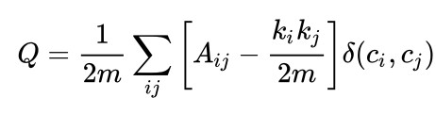
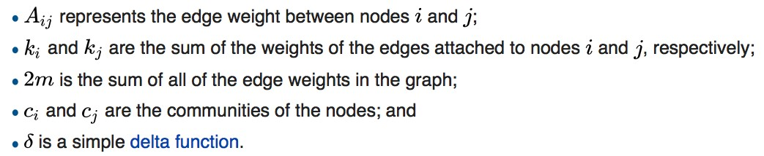
𝒌_{𝒊}𝒌_{𝒋}
For each group s
𝟏 ;
; ;
𝒊∈𝒔 𝒋∈𝒔
𝑸 𝑮, 𝑺 =
𝑨_{𝒊𝒋} − _{𝟐𝒎}
𝟐𝒎
𝒔∈𝑺
Equivalently modularity can be written as:
is an indicator function 𝛿 𝑐!, 𝑐"
= 1 𝑖𝑓 𝑐! = 𝑐" 𝑒𝑙𝑠𝑒 0
Idea: We can identify communities by maximizing modularity

Slide 29
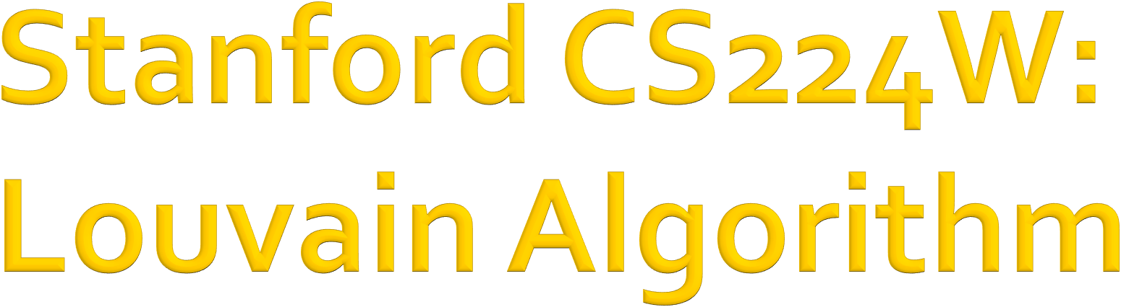
CS224W: Machine Learning with Graphs Jure Leskovec, Stanford University
http://cs224w.stanford.edu

Slide 30

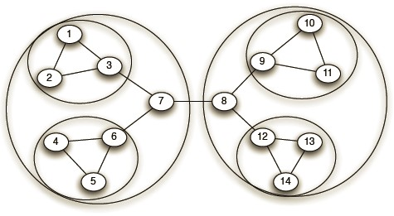
Greedy algorithm for community detection
𝑂(𝑛 log 𝑛) run time
Supports weighted graphs
Provides hierarchical communities
Network and communities:
Widely utilized to study large networks because:
  Fast
  Rapid convergence
  High modularity output (i.e., “better communities”)
Dendrogram:
3/6/21 Jure Leskovec, Stanford CS224W: Machine Lear
“Fast unfolding of communities in large networks” Blondel et al. (2008)
ning with Graphs 30

Slide 31
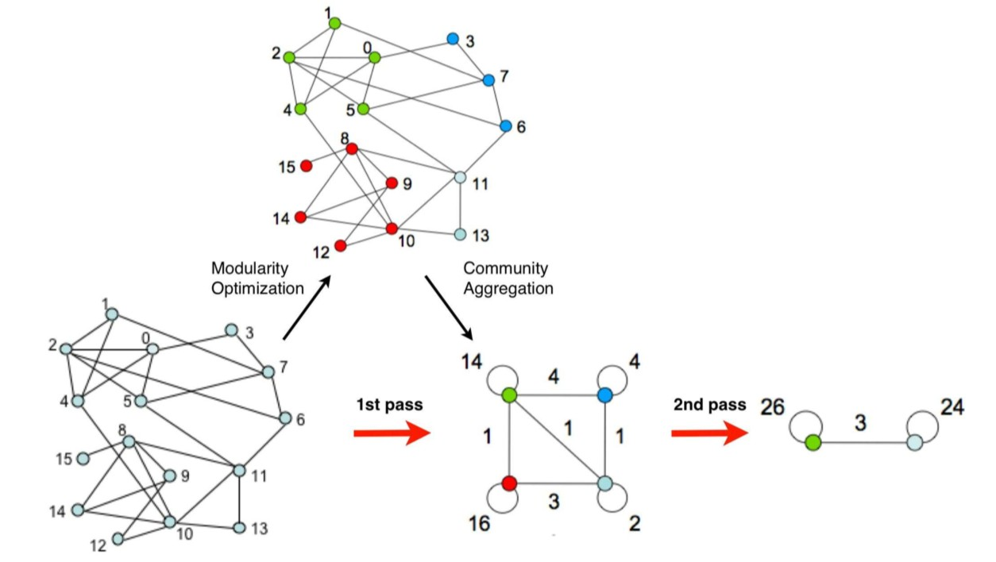
Louvain algorithm greedily maximizes modularity
Each pass is made of 2 phases:
Phase 1: Modularity is optimized by allowing only local changes to node-communities memberships
Phase 2: The identified communities are aggregated into super-nodes to build a new network
Goto Phase 1
The passes are repeated iteratively until no increase of modularity is possible.

Slide 32
Louvain algorithm considers graphs as weighted
  The original graph can be unweighted (i.e., edge weights are all 1)
  As the communities get identified and aggregated into super-nodes, weighted graphs are created (weights count the number of edges in the original graph)
  Weighted version of Modularity is applied

Slide 33
Put each node in a graph into a distinct community (one node per community)
For each node 𝑖, the algorithm performs two calculations:
Compute the modularity delta (∆𝑄) when putting node 𝑖 into the community of some neighbor 𝑗
Move 𝑖 to a community of node 𝑗 that yields the largest gain in ∆𝑄
Phase 1 runs until no movement yields a gain
This first phase stops when a local maxima of the modularity is attained, i.e., when no individual node move can improve the modularity.
Note that the output of the algorithm depends on the order in which the nodes are considered.
Research indicates that the ordering of the nodes does not have a significant influence on the overall modularity that is obtained.

Slide 34
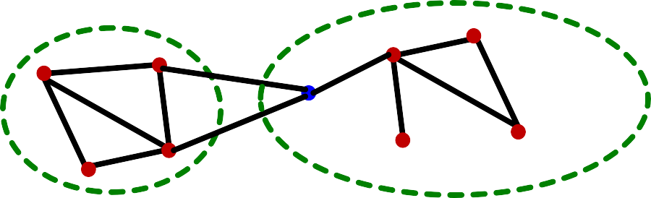
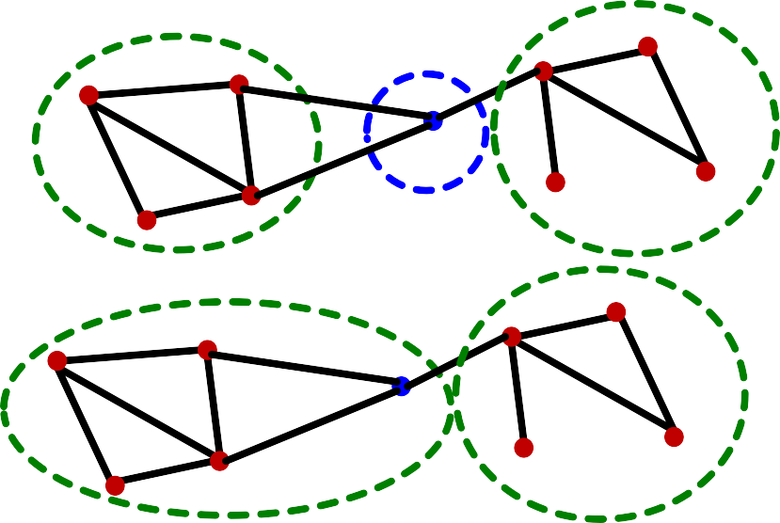
What is 𝚫𝑸 if we move node 𝒊 to community 𝑫 to 𝑪?
Δ𝑄(𝐷 → 𝑖 → 𝐶) = Δ𝑄 𝐷 → 𝑖 + Δ𝑄 𝑖 → 𝐶
Before:
𝑫
𝑪
𝑖
Removing 𝑖 from 𝐷
Δ𝑄 𝐷 → 𝑖
Intermediate:
𝑪
community of node 𝑖
𝑫 − {𝒊}
𝑖
Merging 𝑖 into 𝐶
Δ𝑄 𝑖 → 𝐶
After:
𝑪 + {𝒊}
𝑫 − {𝒊}
𝑖

Slide 35

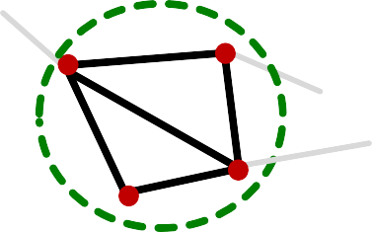
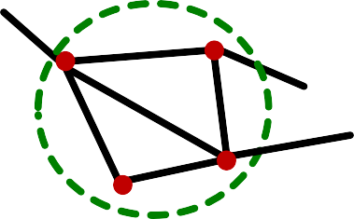
Let’s derive 𝜟𝑸 𝒊 → 𝑪
First, we derive modularity within 𝑪, i.e., 𝑄 𝐶 .
Define:
  𝜮_{𝒊𝒏} ≡ ∑_{!,"∈2} 𝐴!"… sum of link weights between nodes in 𝐶
  𝜮_{𝒕𝒐𝒕} ≡ ∑_{!∈2} 𝑘!… sum of all link weights of nodes in 𝐶
𝜮_{𝒊𝒏}:
𝑪
^{𝜮}𝒕𝒐𝒕:
𝑪
Σ!# = 10
Σ$%$ = 13

Slide 36
Let’s derive 𝜟𝑸 𝒊 → 𝑪
First, we derive modularity within 𝑪, i.e., 𝑄 𝐶 .
Define:
  𝜮_{𝒊𝒏} ≡ ∑_{!,"∈2} 𝐴!"… sum of link weights between nodes in 𝐶
  𝜮_{𝒕𝒐𝒕} ≡ ∑_{!∈2} 𝑘!… sum of all link weights of nodes in 𝐶
Then, we have
1
𝑘!𝑘"
2 𝐴 −
!,"∈9
^{Σ}!,"∈2^{𝐴}!" ^{Σ}!∈2^{𝑘}! ^{Σ}"∈2^{𝑘}"
= −
𝑄 𝐶 ≡
!"
2𝑚
2𝑚
2𝑚
2𝑚 :
^{Σ}!; ^{Σ}<=<
2𝑚 2𝑚
:
=
Links within the community
−
Total links
𝑸 𝑪
is large when most of the total links are within-community links

Slide 37
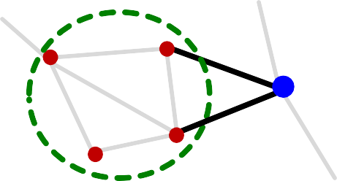
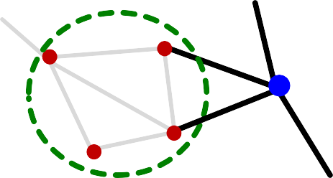
Further define:
𝒌_{𝒊,𝒊𝒏} ≡ ∑_{"∈2} 𝐴!" + ∑_{"∈2} 𝐴"!… sum of link weights between node 𝑖 and 𝐶
𝒌_{𝒊}… sum of all link weights (i.e., degree) of node 𝑖
^{𝒌}𝒊,𝒊𝒏 :
𝒌_{𝒊} :
𝑪
𝑪
𝑖
𝑖
^{𝑘}!,!# ⁼ ⁴
𝑘! = 4

Slide 38
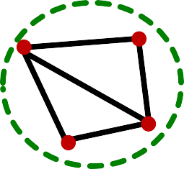
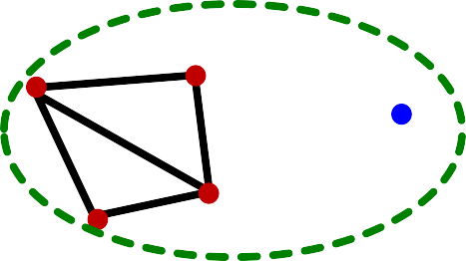


Before merging
𝑪
After merging
𝑪 + {𝒊}
Isolated community of node 𝑖
𝑖
𝑖
𝑄_{&'()*'} = 𝑄 𝐶 + 𝑄 𝑖
+ 0 −
𝑄_{?@ABC} = 𝑄 𝐶 + 𝑖
^{Σ}+, ^{Σ}-.-
/
𝑘₊
/
“Σ!#” of 𝑪 + {𝒊}
“Σ$%$” of 𝑪 + {𝒊}
= _{2𝑚} −
^{Σ}<=< ^{+ 𝑘}!
:
2𝑚
2𝑚
^{Σ}!; ^{+ 𝑘}!,!;
2𝑚
=
−
2𝑚
Recall: 𝑘!,!; :
𝑘! :
𝑪
𝑪
𝑖
𝑖
^{𝑘}!,!# ⁼ ⁴
𝑘! = 4

Slide 39
Δ𝑄 𝑖 → 𝐶
^{= 𝑄}()*+, ^{− 𝑄}-+).,+
/!"⁰¹!,!" ₋
2
=
/$%$⁰¹!
23
23
/!" ₋
2
−
1!
2
−
/$%$
23 23 23
Δ𝑄 𝐷 → 𝑖
can be derived similarly.
In summary, we can compute:
Δ𝑄(𝐷 → 𝑖 → 𝐶) = Δ𝑄 𝐷 → 𝑖 + Δ𝑄 𝑖 → 𝐶

Slide 40
Iterate until no node moves to a new community:
For each node 𝑖 ∈ 𝑉 currently in community 𝐶, compute the best community 𝐶′:
𝐶² = argmax₃₂ Δ𝑄 𝐶 → 𝑖 → 𝐶′
If Δ𝑄 𝐶 → 𝑖 → 𝐶′ > 0, then update the community:
  𝐶 ← 𝐶 − {𝑖}
  𝐶′ ← 𝐶′ + {𝑖}
40

Slide 41
The communities obtained in the first phase are contracted into super-nodes, and the network is created accordingly:
Super-nodes are connected if there is at least one edge between the nodes of the corresponding communities
The weight of the edge between the two super- nodes is the sum of the weights from all edges between their corresponding communities
Phase 1 is then run on the super-node network

Slide 42
Super nodes are constructed by merging nodes in the same community.
Community assignment obtained after 1st phase
𝐶_{E}
, 𝐴!"
!,"∈%!
𝐶_{E}
,
!∈%!,"∈%#
^{𝐴}!"
𝐶:
,
!∈%!,"∈%"
^{𝐴}!"
𝐶
F
𝐶:
, 𝐴!"
!,"∈%#
,
!∈%","∈%#
^{𝐴}!"
𝐶
F
, 𝐴!"
!,"∈%"

Slide 43
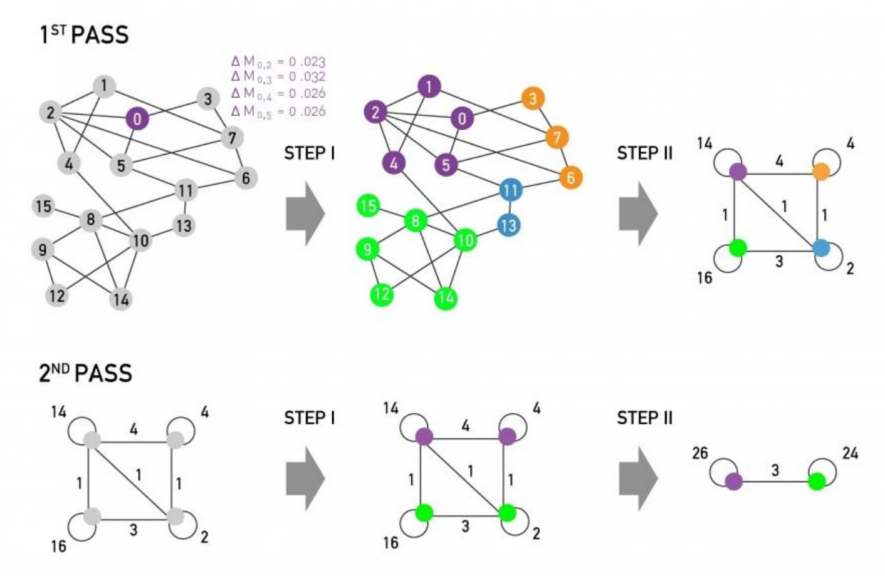
3/6/21
Jure Leskovec, Stanford CS246: Mining Massive Datasets
43

Slide 44
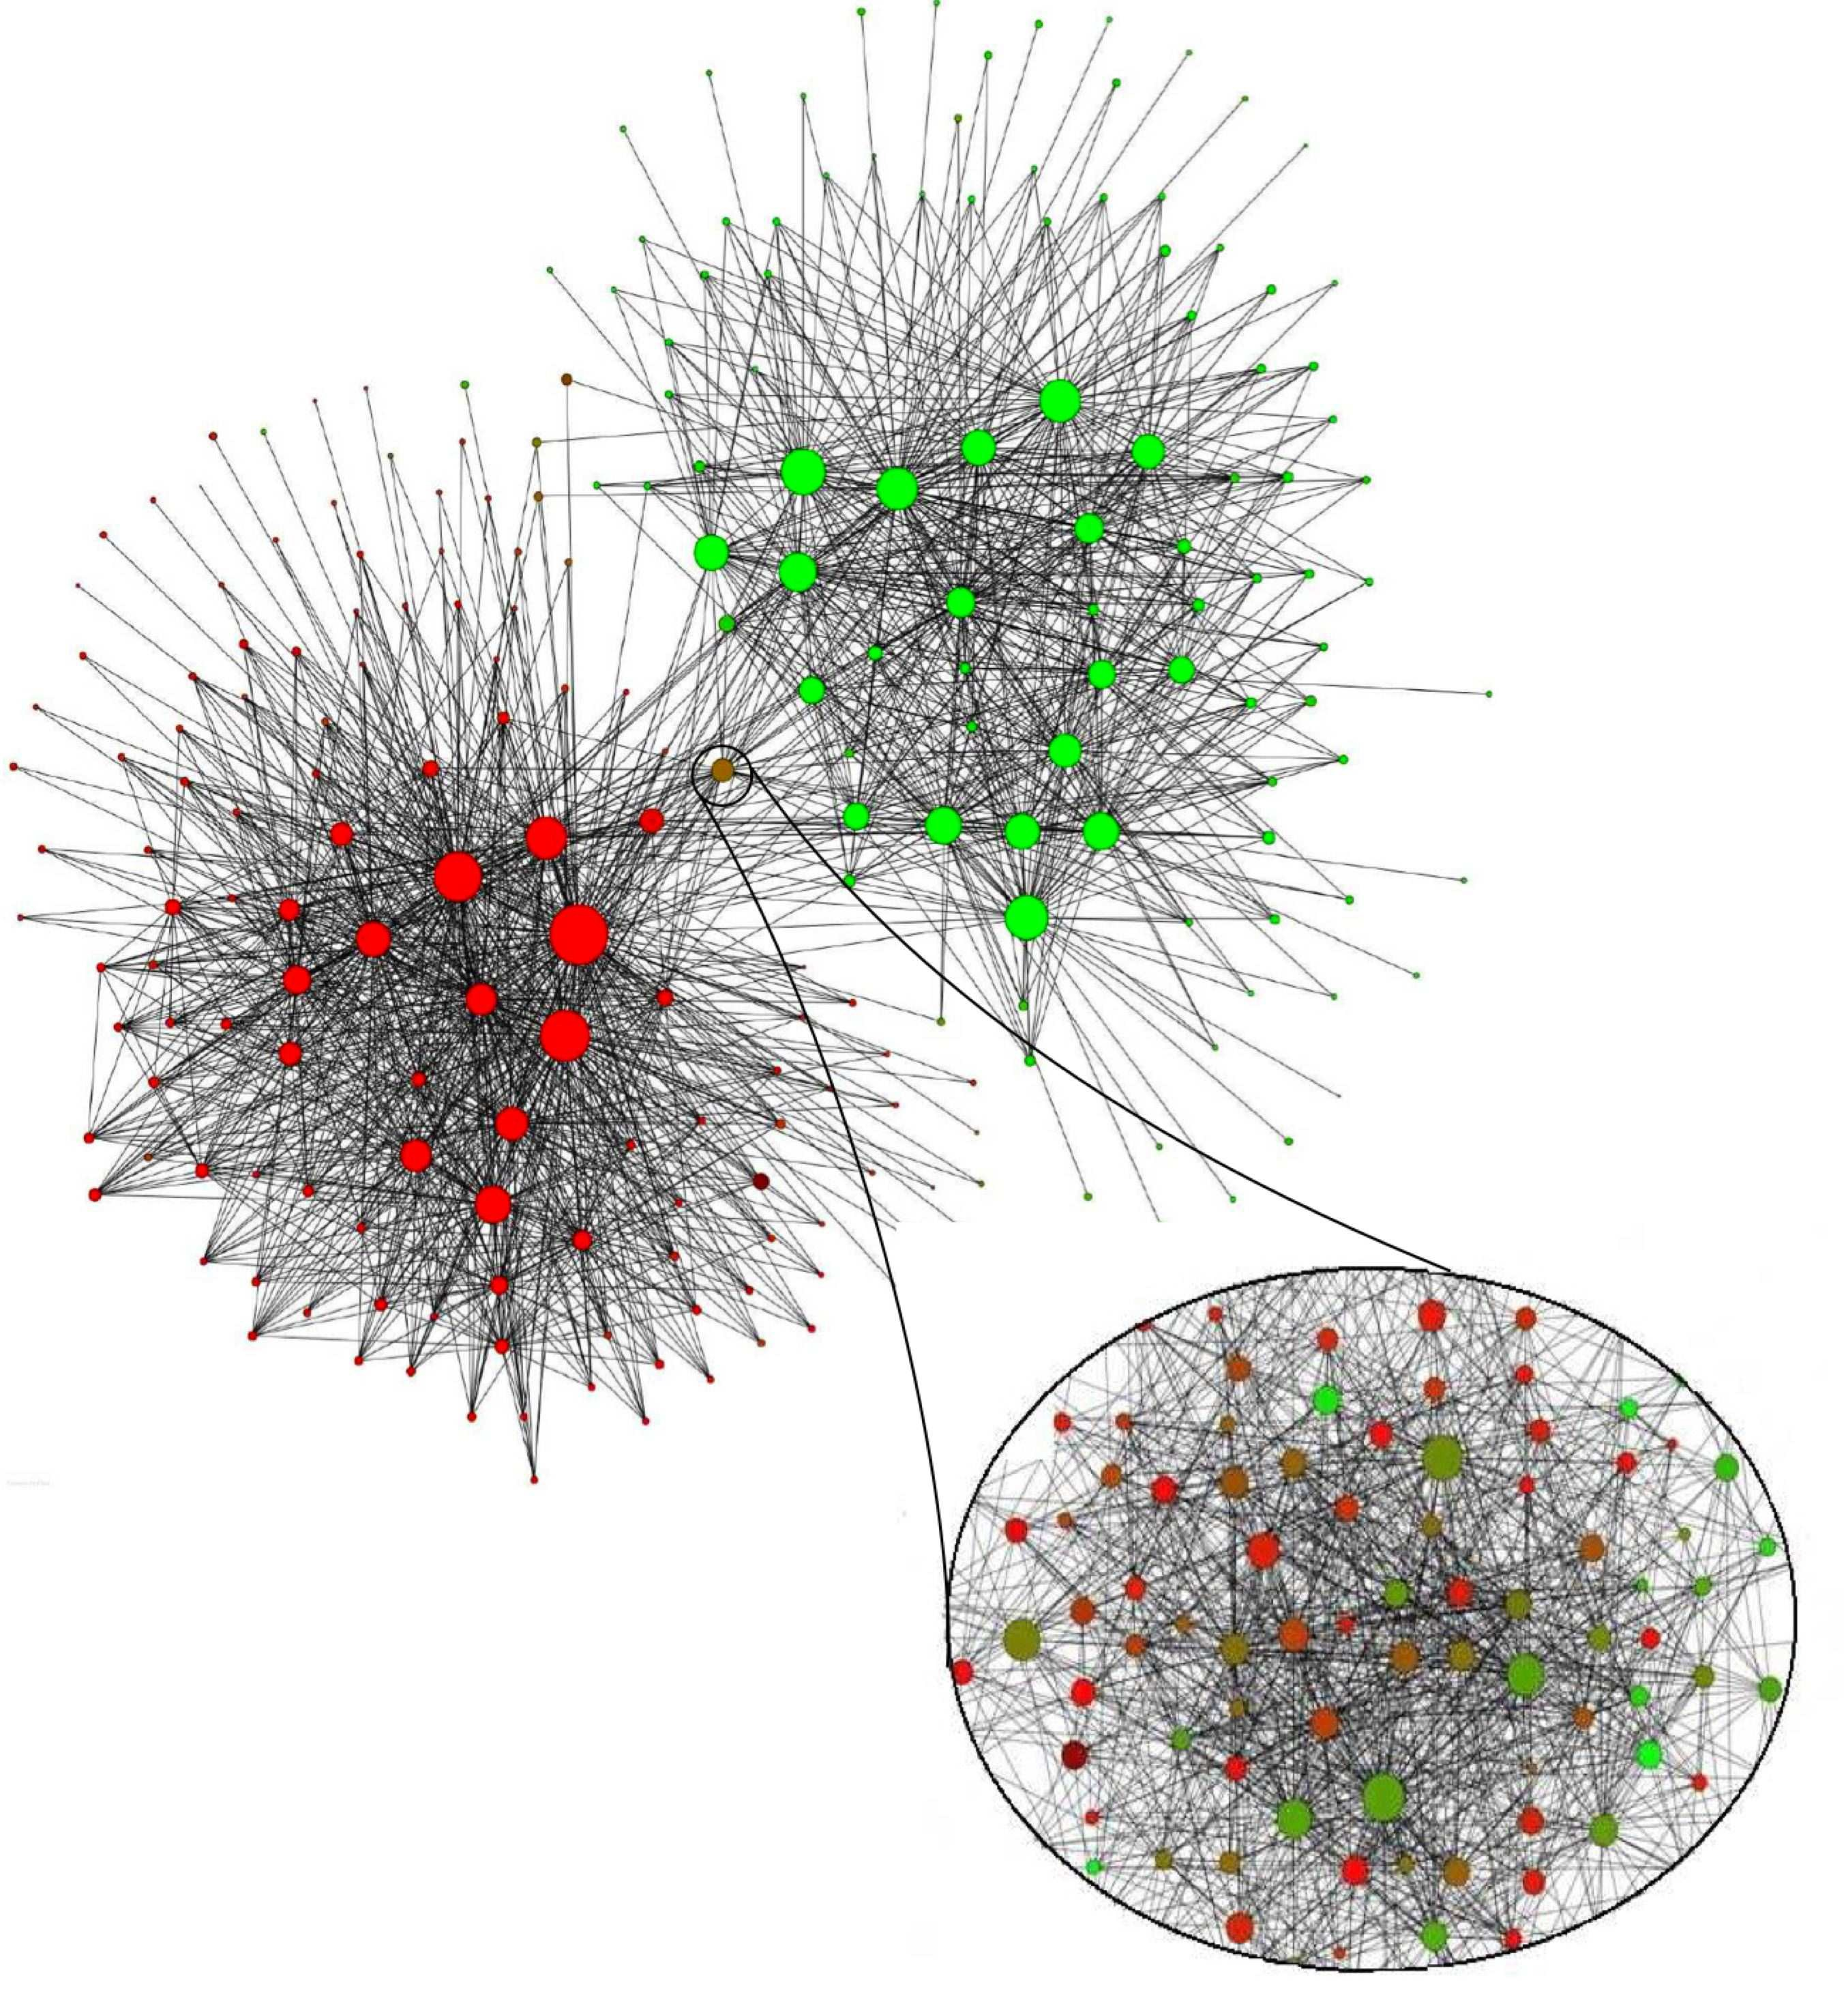
2M nodes
Red nodes: French speakers
Green nodes:
Dutch speakers
Adopted from Blondel et al. 2008.

Slide 45

Modularity:
Overall quality of the partitioning of a graph into communities
Used to determine the number of communities
Louvain modularity maximization:
  Greedy strategy
  Great performance, scales to large networks

Slide 46

CS224W: Machine Learning with Graphs Jure Leskovec, Stanford University
http://cs224w.stanford.edu

Slide 47
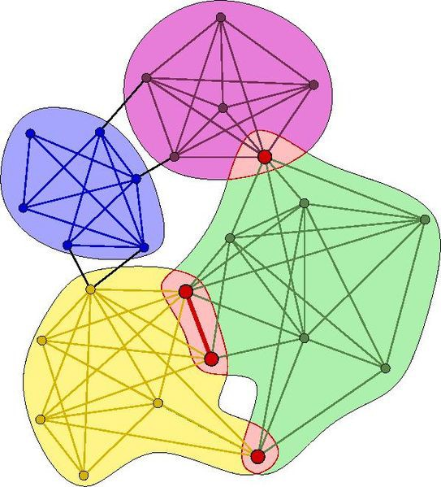
Non-overlapping vs. overlapping communities
3/6/21
Jure Leskovec, Stanford CS224W: Machine Learning with Graphs
47

Slide 48
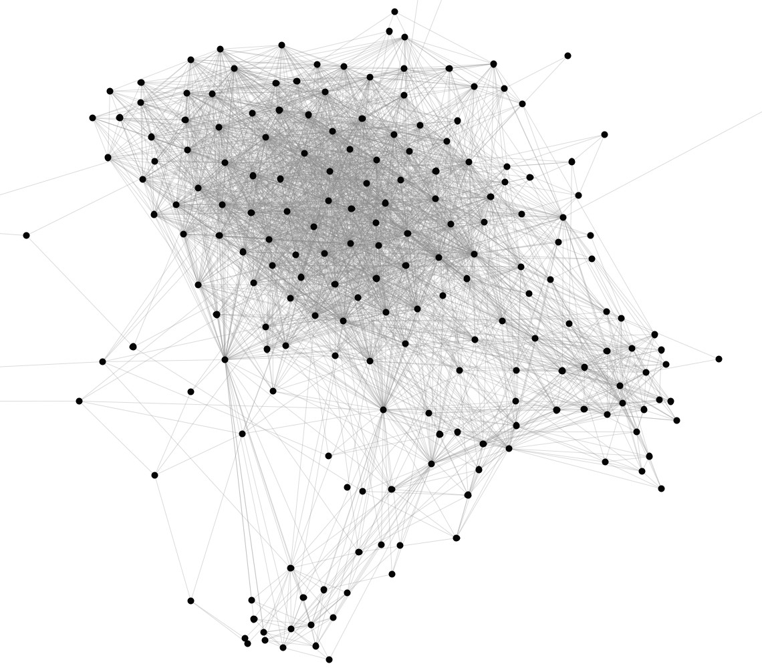
Can we identify social communities?
Nodes: Users Edges: Friendships
3/6/21
Jure Leskovec, Stanford CS224W: Machine Learning with Graphs
48

Slide 49
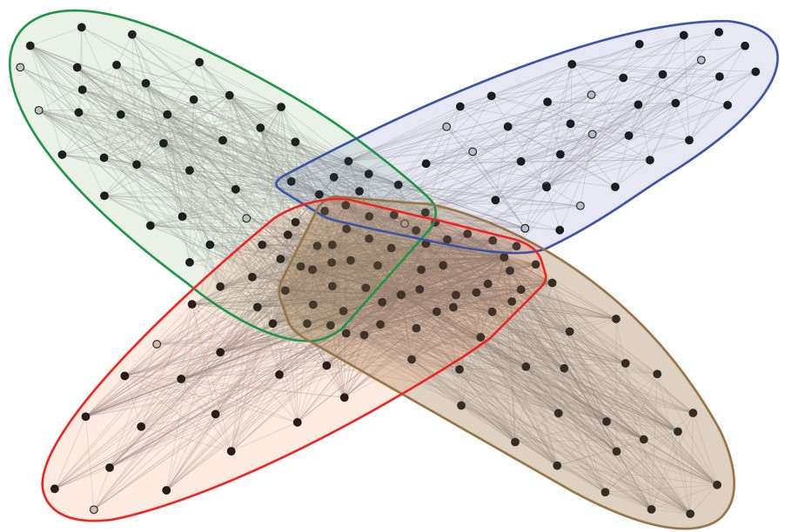
High school
Company
Stanford (Basketball)
Stanford (Squash)
Nodes: Users Edges: Friendships
Social communities
3/6/21
Jure Leskovec, Stanford CS224W: Machine Learning with Graphs
49

Slide 50
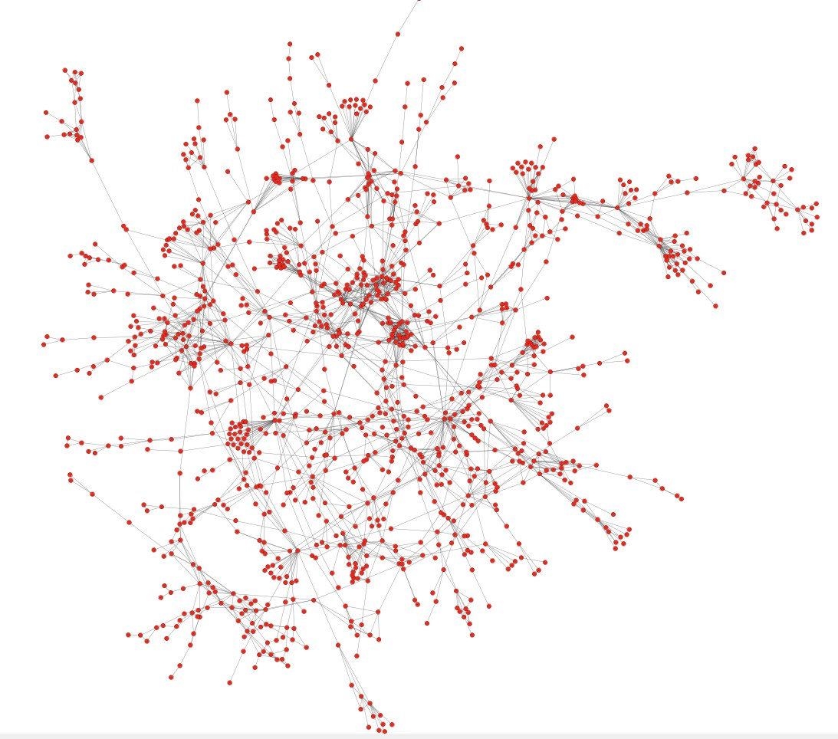
Can we identify functional modules?
Nodes: Proteins
Edges: Interactions

Slide 51
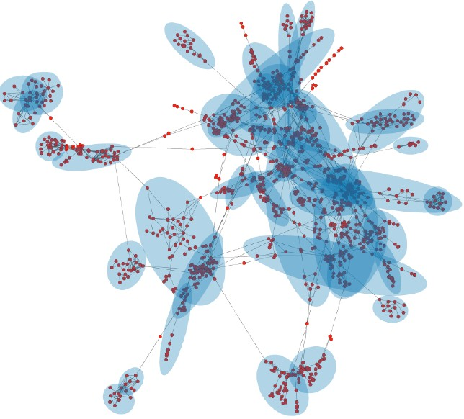
Functional modules
Nodes: Proteins
Edges: Interactions

Slide 52

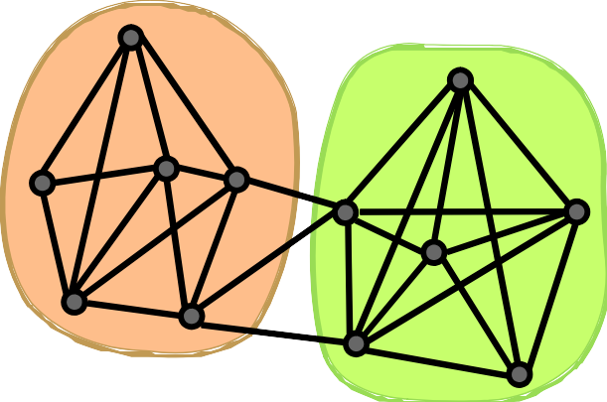
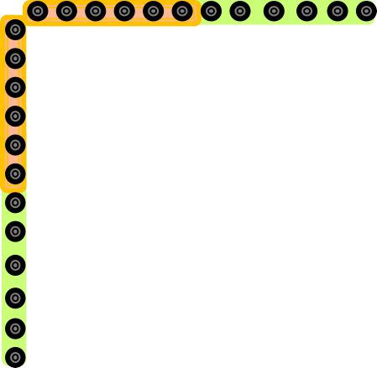
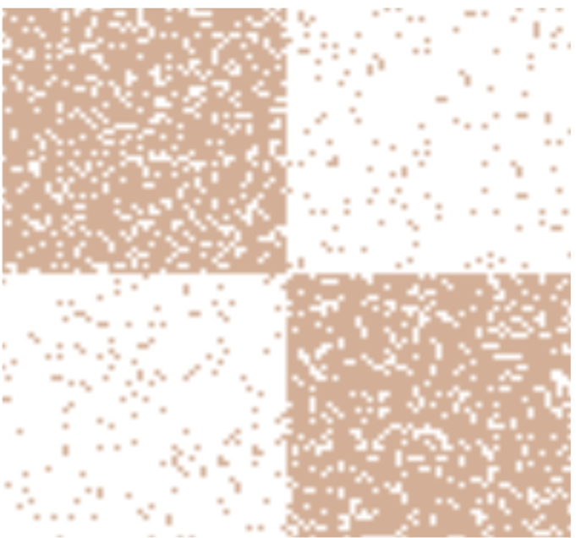
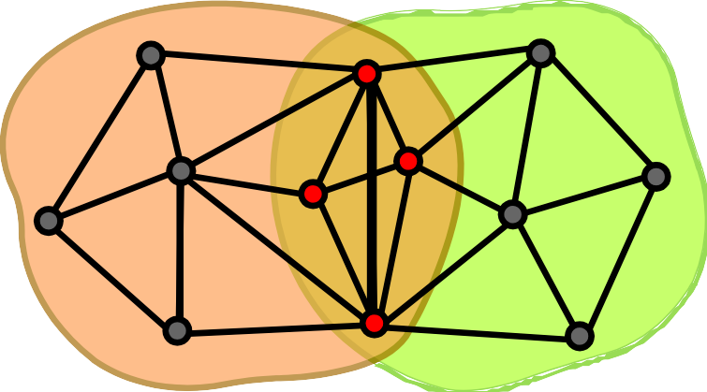
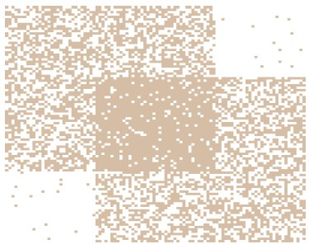
Nodes
Non-overlapping
Nodes
Network
Adjacency matrix
Overlapping

Slide 53

Step 1)
Define a generative model for graphs that is based on node community affiliations
Community Affiliation Graph Model (AGM)
Step 2)
Given graph 𝐺, make the assumption that 𝐺 was generated by AGM
Find the best AGM that could have generated 𝐺
And this way we discover communities

Slide 54



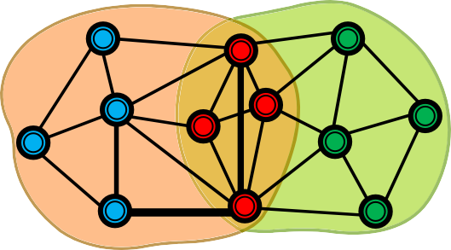
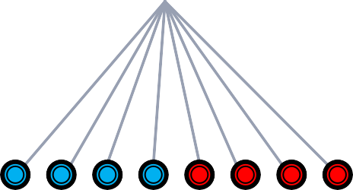
Communities, C
p_{A}
p_{B}
Model
Memberships, M
Nodes, V
Community Affiliation Network
Generative model: How is a network generated from community affiliations?
Model parameters:
  Nodes V, Communities C, Memberships M
  Each community c has a single probability p_{c}

Slide 55



Communities, C
p_{A}
p_{B}
Model
Memberships, M
Nodes, V
Community Affiliation
Given parameters (V, C, M, {p_{c}})
Network
Nodes in community c connect to each other by flipping a coin with probability p_{c}
Nodes that belong to multiple communities have multiple coin flips
  If they “miss” the first time, they get another chance through the next community
Note: If nodes u and v have no communities in common, then p(u,v)=0. We resolve this by having a background “epsilon” community that every node is a member of.

Slide 56

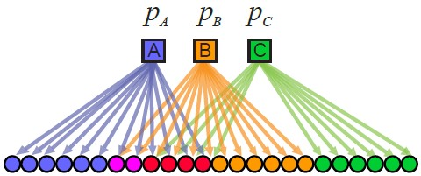
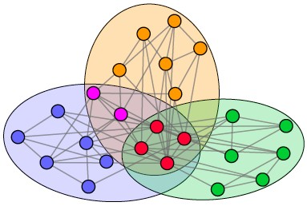


Model
Network

Slide 57

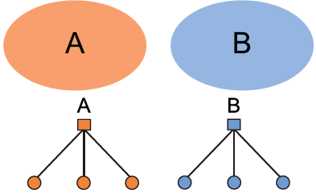
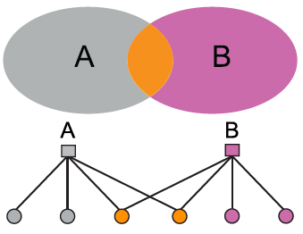
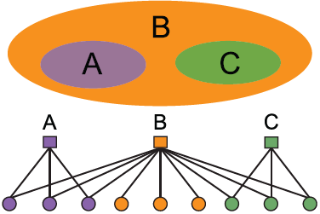
[icdm ‘12]
AGM can express a variety of community structures:
Non-overlapping, Overlapping, Nested
3/6/21
Jure Leskovec, Stanford CS224W: Machine Learning with Graphs
57

Slide 58
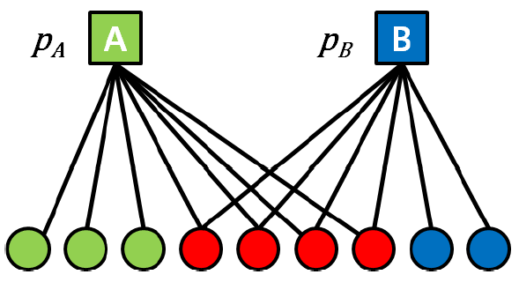


Detecting communities with AGM:
Given a Graph, find the model 𝑭
Affiliation graph M
Number of communities C
Parameters p_{c}
Jure Leskovec, Stanford CS224W: Machine Learning with Graphs
3/6/21
58

Slide 59

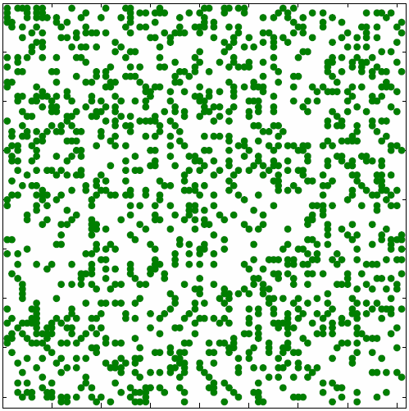
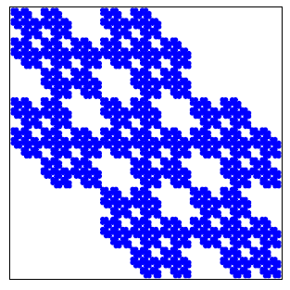
How to estimate model parameters 𝑭 given a 𝑮?
Maximum likelihood estimation
Given real graph 𝐺
Find model/parameters 𝐹 which
P( | )
𝑮
𝐹
Model
arg max
𝐹
To solve this we need to:
  Efficiently calculate 𝑷(𝑮|𝑭)
  Then maximize over 𝑭 (e.g., using gradient descent)
3/6/21
Jure Leskovec, Stanford CS224W: Social and Information Network Analysis, http://cs224w.stanford.edu
59

Slide 60
Given G and F we calculate likelihood that F generated G: P(G|F)
[ICML ‘07]
G
0.25 | 0.10 | 0.10 | 0.04
0.05 | 0.15 | 0.02 | 0.06
0.05 | 0.02 | 0.15 | 0.06
0.01 | 0.03 | 0.03 | 0.09
1 | 0 | 1 | 1
0 | 1 | 0 | 1
1 | 0 | 1 | 1
1 | 1 | 1 | 1
𝐹
𝑃(𝑢, 𝑣): Edge prob. of edge (𝑢, 𝑣)
G
P(G|F)
O 𝑃(𝑢, 𝑣)
4,6 ∈7
O (1 − 𝑃 𝑢, 𝑣 )
4,6 ∉7
𝑃 𝐺 𝐹 =
Likelihood of edges in the graph Likelihood of edges not in the graph
Jure Leskovec, Stanford CS224W: Social and Information Network Analysis, http://cs224w.stanford.edu
3/6/21
60

Slide 61
“Relax” the AGM: Memberships have strengths
[wsdm ‘13]
^{𝐹}49
^{𝐹}6:
𝑢 𝑣
𝐹₄₉: The membership strength of node 𝑢
to community 𝑨 (𝐹₄₉ = 𝟎: no membership)

Slide 62
For community 𝐶, we model the probability of
𝑢 and 𝑣 being connected as
𝑷_{𝑪} 𝒖, 𝒗 = 𝟏 − 𝒆𝒙𝒑(−𝑭_{𝒖𝑪} ⋅ )
Non-negative membership strength
^{𝑭}𝒗𝑪
𝑃; 𝑢, 𝑣 satisfies 0 ≤ 𝑃;
𝑢, 𝑣
≤ 1 (valid
probability) because 𝐹_{4;} ⋅ 𝐹_{6;} ≥ 0.
𝑃₂ 𝑢, 𝑣
= 0 iff 𝐹_{L2} ⋅ 𝐹_{M2} = 0 (i.e., 𝐹_{L2} = 0 or 𝐹_{M2} = 0)
Nodes 𝑢 or 𝑣 are not connected via 𝐶 iff at least one of them has zero membership strength for 𝐶.
𝐶
𝑃₂ 𝑢, 𝑣 ≈ 1 iff 𝐹_{L2} ⋅ 𝐹_{M2} is large.
  Nodes 𝑢 or 𝑣 are connected via 𝐶 iff both 𝑢 and 𝑣
have nigh membership strength for 𝐶.
^{𝐹}*+
^{𝐹},+
𝑢
𝑣
𝑃₊(𝑢, 𝑣)

Slide 63
Nodes 𝑢 and 𝑣 can connected via multiple communities ∈ Γ (a set of all communities).
𝐶:
𝐶_{F}
…
𝐶_{E}
^{𝐹},+
^{𝐹}*+'
&
^{𝐹}*+&
^{𝐹},+'
𝑢 𝑣
𝑃(𝑢, 𝑣)
Probability that 𝑢 and 𝑣 are connected by at
least one of the communities:
Probability that 𝑢 and 𝑣 are not connected by any communities
𝑃 𝑢, 𝑣 = 1 −
∏_{;∈C} 1 − 𝑃; 𝑢, 𝑣

Slide 64
Expanding 𝑷 𝒖, 𝒗 :
= 1 − O 1 −
;∈C
𝑃 𝑢, 𝑣
𝑃; 𝑢, 𝑣
1 − exp(−𝐹_{L2} ⋅ 𝐹_{M2})
= 1 − D exp −𝐹_{L2} ⋅ 𝐹_{M2}
2∈N
= 1 − exp
− 2 𝐹_{L2} ⋅ 𝐹_{M2}
O∈N
= 1 − exp −𝑭^{Q}𝑭
𝑭_{𝒖𝑪}: A vector of {𝐹_{)*}}*∈,
𝑭_{𝒗𝑪}: A vector of {𝐹.*}*∈,
𝒖 𝒗
Inner product

Slide 65

Prob. of nodes 𝒖, 𝒗 linking is proportional to the strength of shared memberships:
𝐏 𝒖, 𝒗 = 𝟏 − 𝐞𝐱𝐩(−𝑭^{𝑻}𝑭 )
𝒖 𝒗
Given a network 𝑮(𝑽, 𝑬), we maximize the
likelihood (probability) of 𝑮 under our model
𝑃 𝐺 𝑭 =
D 𝑃(𝑢, 𝑣) D (1 − 𝑃 𝑢, 𝑣 )
L,M ∈U L,M ∉U
= D 𝟏 − 𝐞𝐱𝐩(−𝑭^{𝑻}𝑭 ) D 𝐞𝐱𝐩(−𝑭^{𝑻}𝑭 )
𝒖 𝒗 𝒖 𝒗
L,M ∈U L,M ∉U

Slide 66
Likelihood involves a product of many small probabilities à Numerically unstable.
We consider the log likelihood:
log(𝑃 𝐺 𝑭 )
O 𝟏 − 𝐞𝐱𝐩(−𝑭^{𝑻}𝑭 )
4,6 ∈D
O 𝐞𝐱𝐩(−𝑭^{𝑻}𝑭 )
4,6 ∉D
= 𝐥𝐨𝐠
𝒖 𝒗
𝒖 𝒗
= a log 1 − exp −𝑭^{H}𝑭
4,6 ∈D
− a 𝑭^{H}𝑭
4,6 ∉D
𝒖 𝒗
𝒖 𝒗
≡ ℓ(𝑭): Our objective

Slide 67
Optimizing ℓ(𝑭)
Start with random membership 𝑭
Iterate until convergence
  For 𝑢 ∈ 𝑽
    Update membership 𝑭_{𝒖} for node 𝑢 while fixing the memberships of all other nodes
    Specifically, we do gradient ascent, where we make small changes to 𝑭_{𝒖} that lead to increase in log-likelihood.
Partial derivative w.r.t. 𝑭_{𝒖}
= a
6∈𝒩(4)
exp(−𝑭^{H}𝑭 )
a
6∉𝒩(4)
∇ℓ 𝑭
𝒖 𝒗
𝑭_{𝒗} −
𝑭_{𝒗}
1 − exp(−𝑭^{H}𝑭 )
𝒖 𝒗

Slide 68
Time complexity of gradient ascent:
Linear in the degree of 𝑢 (fast)
Linear in #nodes (slow)
-
% exp(−𝑭_{𝒖}𝑭_{𝒗})
1 − exp(−𝑭_{𝒖}𝑭_{𝒗}) ^{⋅ 𝑭𝒗}
-
&∈𝒩(*)
∇ℓ 𝑭 = −
Naïve gradient ascent is slow! However:
Can be efficiently updated!
% 𝑭_{𝒗}
&∉𝒩(*)
%
&∉𝒩(*)
𝐹& = − 𝑭_{𝒖} − % 𝑭_{𝒗}
&∈𝒩(*)
% 𝑭_{𝒗}
&
∑_{M} 𝑭_{𝒗} can be computed at the beginning and efficiently updated whenever 𝑭_{𝒖} is updated.
The gradient step takes linear time in the degree of 𝑢!

Slide 69



BigCLAM defines the model to generate a network with overlapping community structure.
Model
Network
Given a graph, BigCLAM’s parameters (membership strength of each node) can be estimated by maximizing the log-likelihood of generating the graph under the model.

