Slide 1



CS224W: Machine Learning with Graphs Jure Leskovec, Stanford University
http://cs224w.stanford.edu

Slide 2

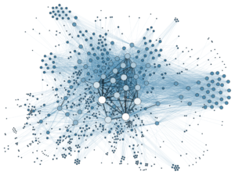
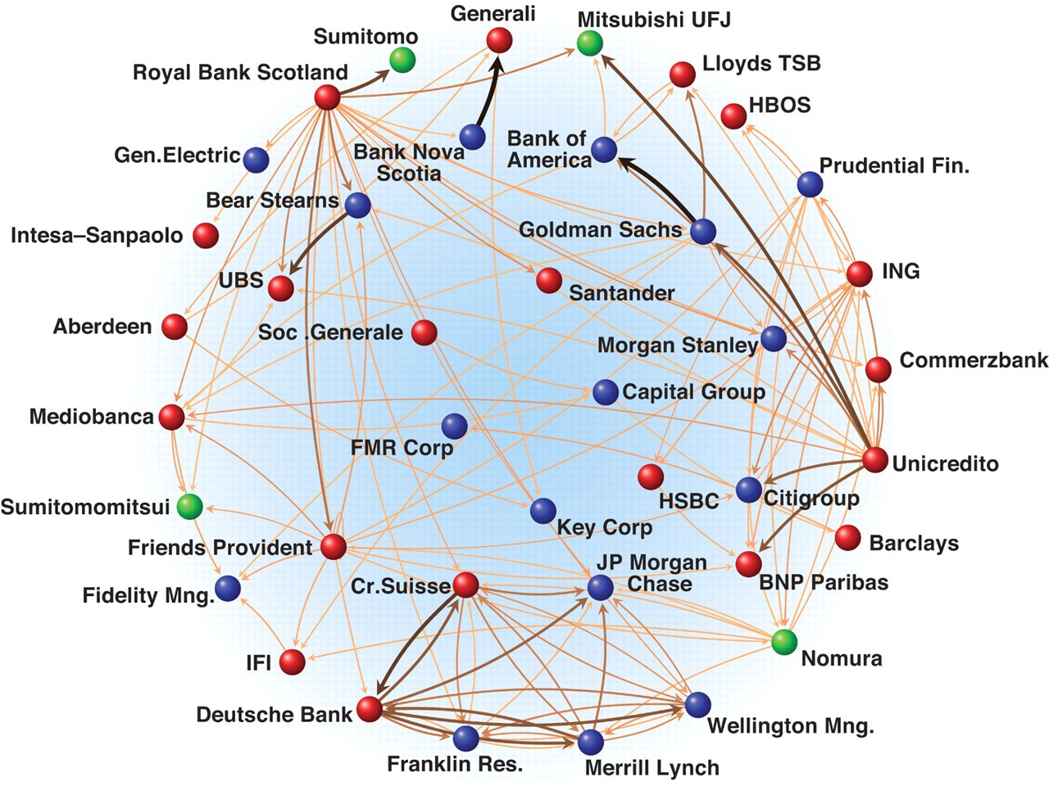
So far, we have been learning from graphs
  We assume the graphs are given
Image credit: Science
Image credit: Medium Image credit: Lumen Learning
Social Networks Economic Networks Communication Networks
But how are these graphs generated?
2

Slide 3
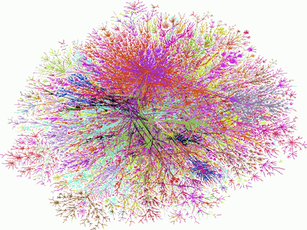
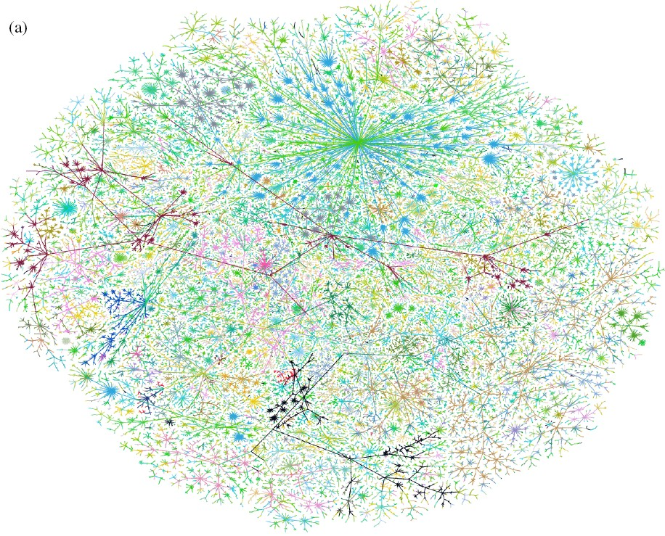
We want to generate realistic graphs, using
graph generative models
Graph Generative Model
which is
Generate
similar to
~
Synthetic graph
Real graph
2

Slide 4
Insights – We can understand the formulation of graphs
Predictions – We can predict how will the graph further evolve
Simulations – We can use the same process to general novel graph instances
Anomaly detection - We can decide if a graph
is normal / abnormal
2

Slide 5
Step 1: Properties of real-world graphs
A successful graph generative model should fit these properties
Step 2: Traditional graph generative models
  Each come with different assumptions on the graph formulation process
Step 3: Deep graph generative models
  Learn the graph formulation process from the data
  Cover in the next lecture
2

Slide 6

CS224W: Machine Learning with Graphs Jure Leskovec, Stanford University
http://cs224w.stanford.edu

Slide 7
We will characterize graphs by:
Degree distribution: P(k) Clustering coefficient: C Connected components: s Path length: h
We have introduced these notions in Lecture 1&2. Here we give a quick recap.
7

Slide 8

Degree distribution P(k): Probability that a randomly chosen node has degree k
N_{k} = # nodes with degree k
Normalized histogram:
P(k) = N_{k} / N
➔ plot
P(k)
0.6
0.5
0.4
0.3
0.2
0.1
1 2 3 4
k
7

Slide 9
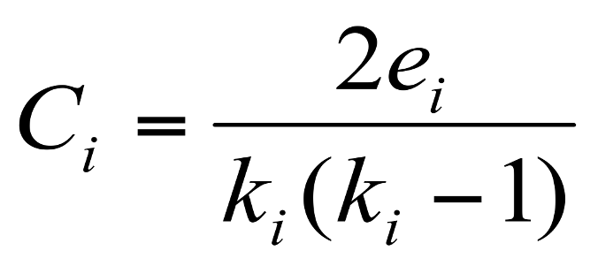
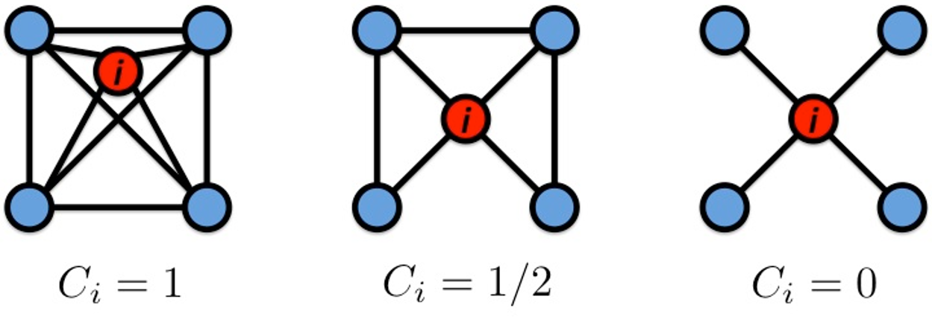
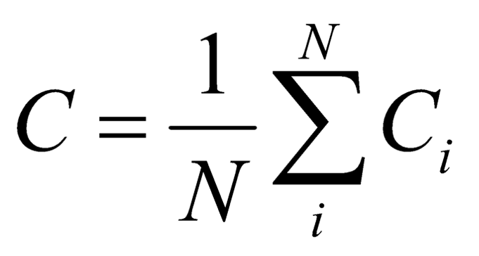
Clustering coefficient:
How connected are i’s neighbors to each other?
Node i with degree k_{i}
where e_{i} is the number of edges
between the neighbors of node i
C_{i} ∈ [0,1]
Graph clustering coefficient:
  Take average over all the nodes
7

Slide 10

Size of the largest connected component
Largest set where any two vertices can be joined by a path
Largest component = Giant component
B
A
How to find connected components:
Start from random node and perform Breadth First Search (BFS)
Label the nodes that BFS visits
If all nodes are visited, the network is connected
Otherwise find an unvisited node and repeat BFS
F
C
D
H
G
10

Slide 11

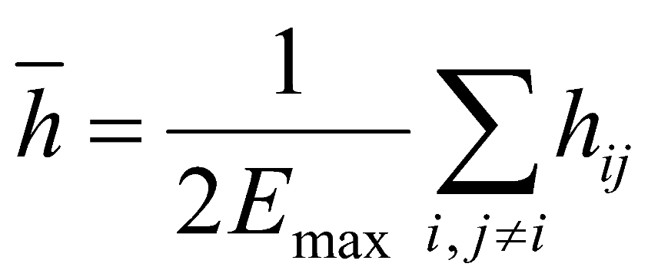
Diameter: The maximum (shortest path) distance between any pair of nodes in a graph
Average path length for a connected graph or a strongly connected directed graph
  h_{ij} is the distance from node i to node j
  E_{max} is the max number of edges (total number of node pairs) = n(n-1)/2
Many times we compute the average only over the connected pairs of nodes (that is, we ignore “infinite” length paths)
14

Slide 12

MSN Messenger:
1 month of activity
245 million users logged in
180 million users engaged in conversations
More than 30 billion conversations
More than 255 billion exchanged messages
14

Slide 13
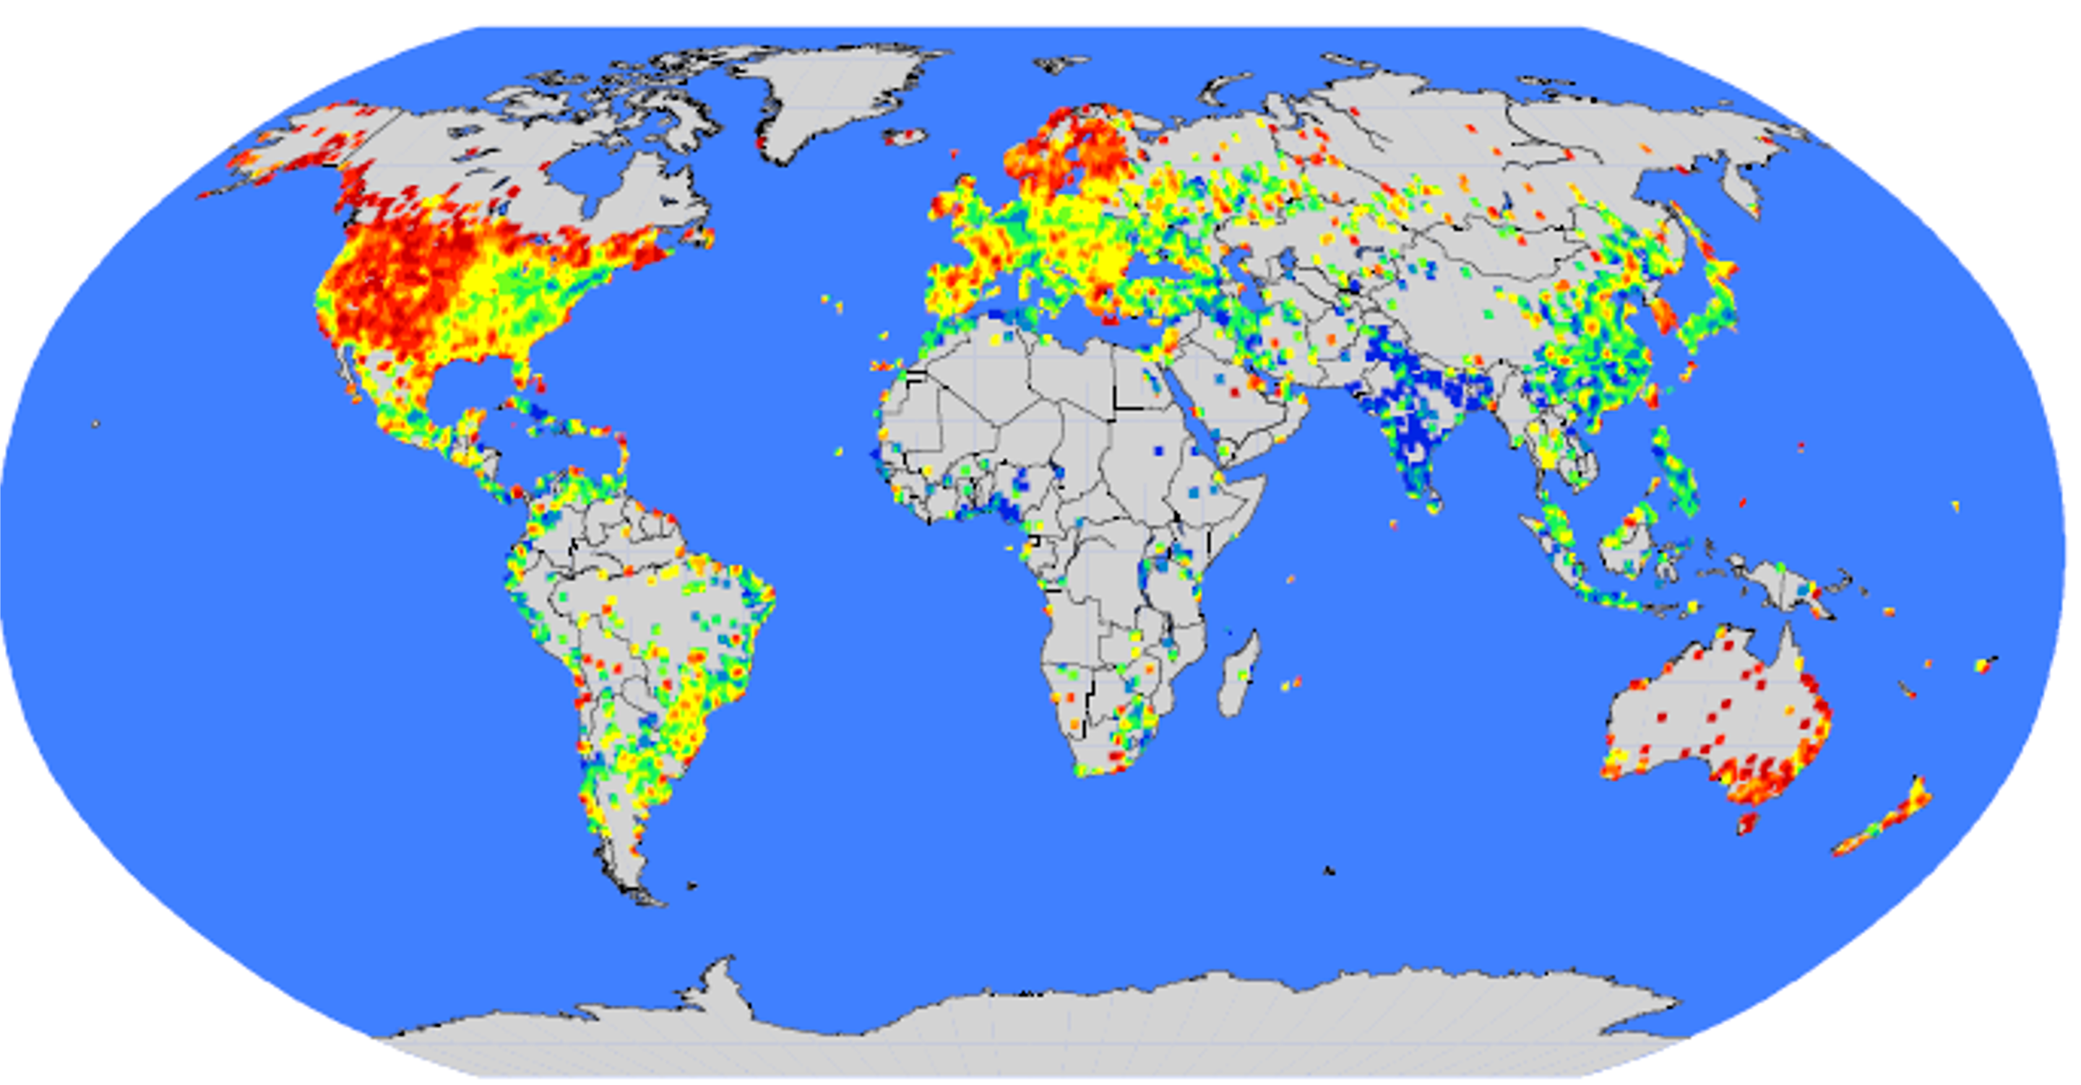
Network: 180M people, 1.3B edges
14

Slide 14
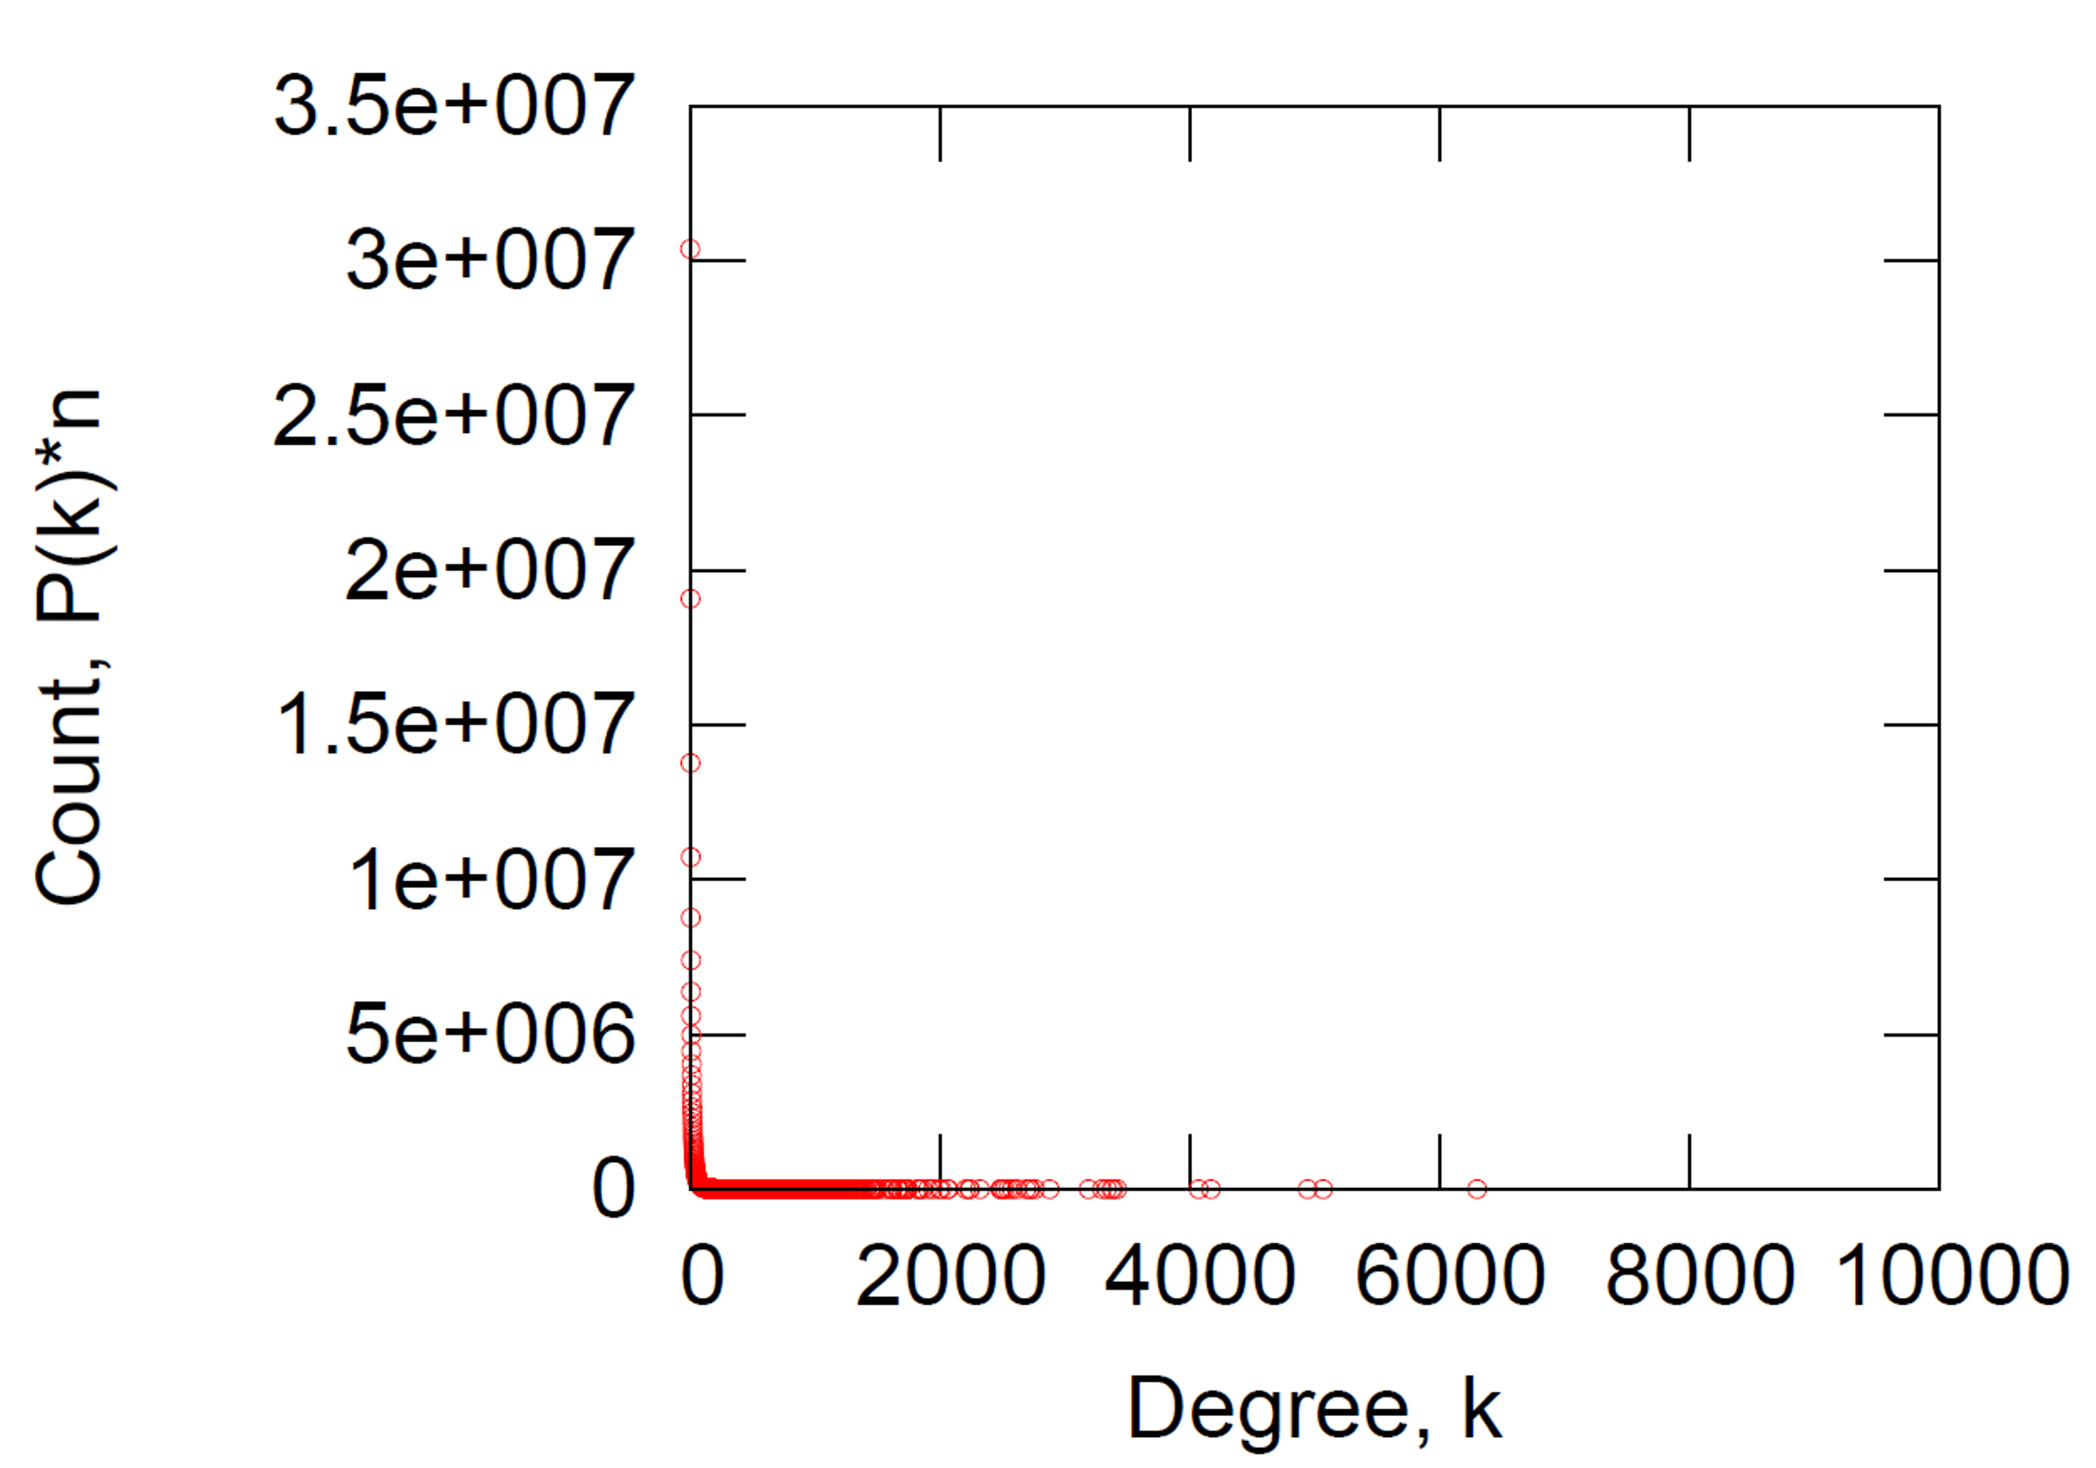
14

Slide 15
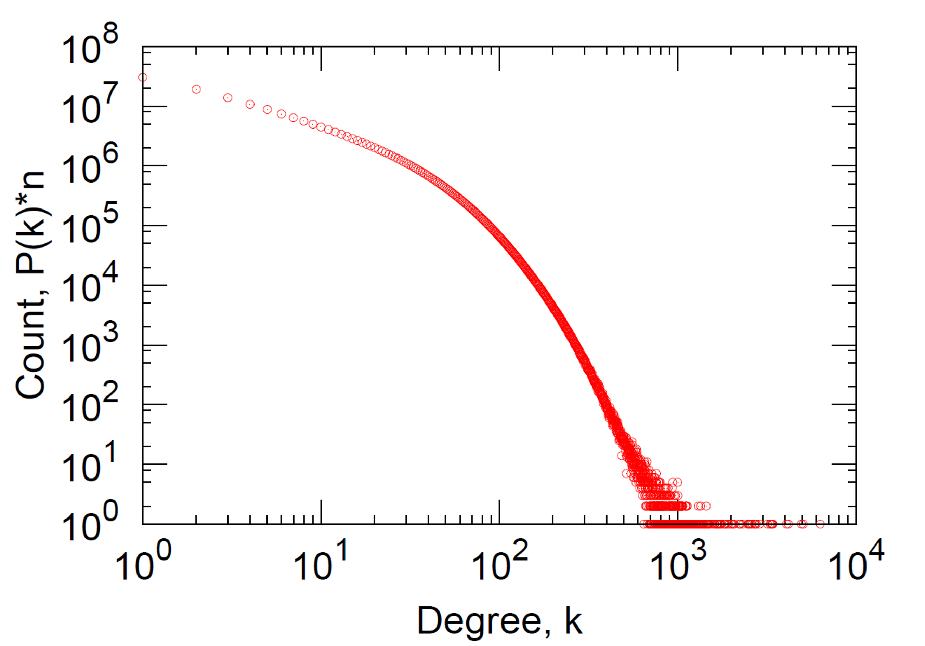
Note: We plotted the same data as on the previous slide, just the axes are now logarithmic.
14

Slide 16

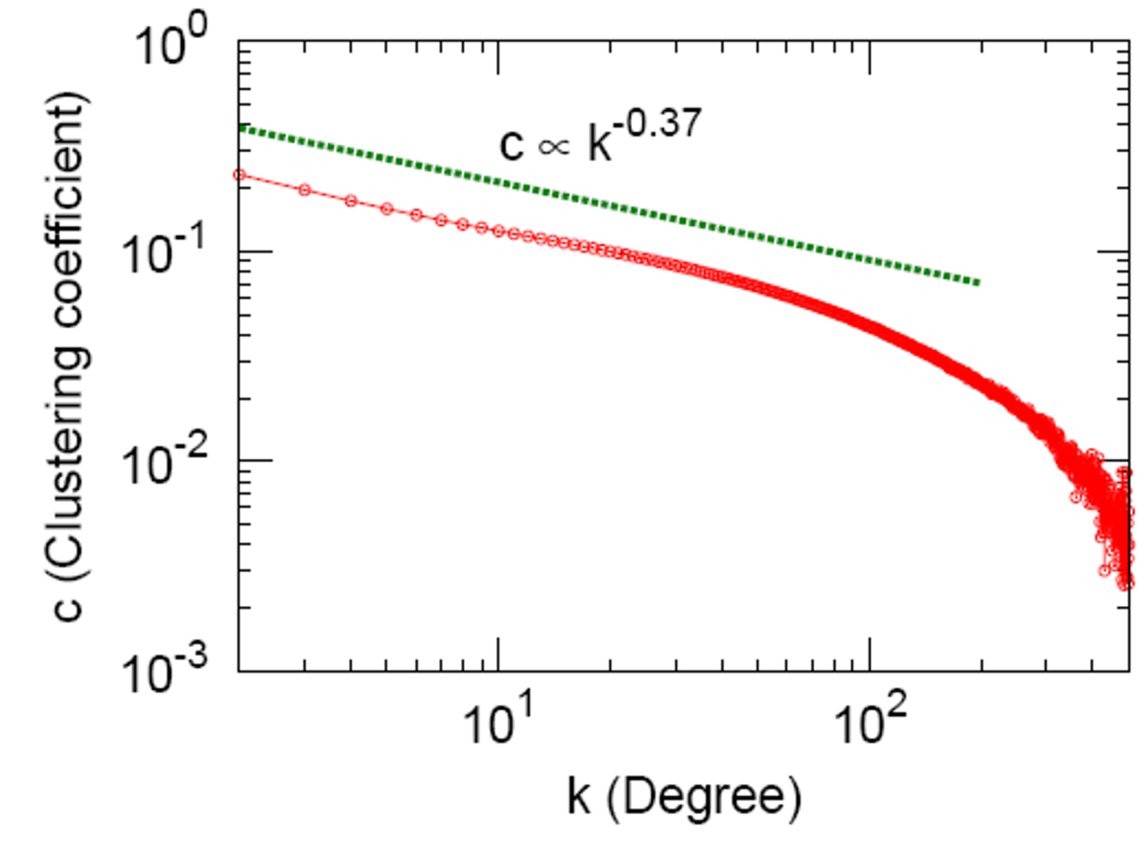
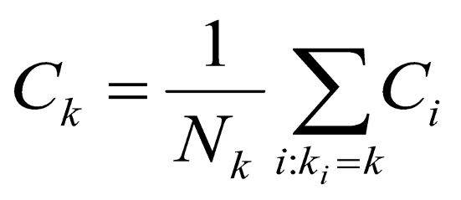
Avg. clustering of the MSN:
C = 0.1140
C_{k}: average C_{i} of nodes i of degree k:
14

Slide 17
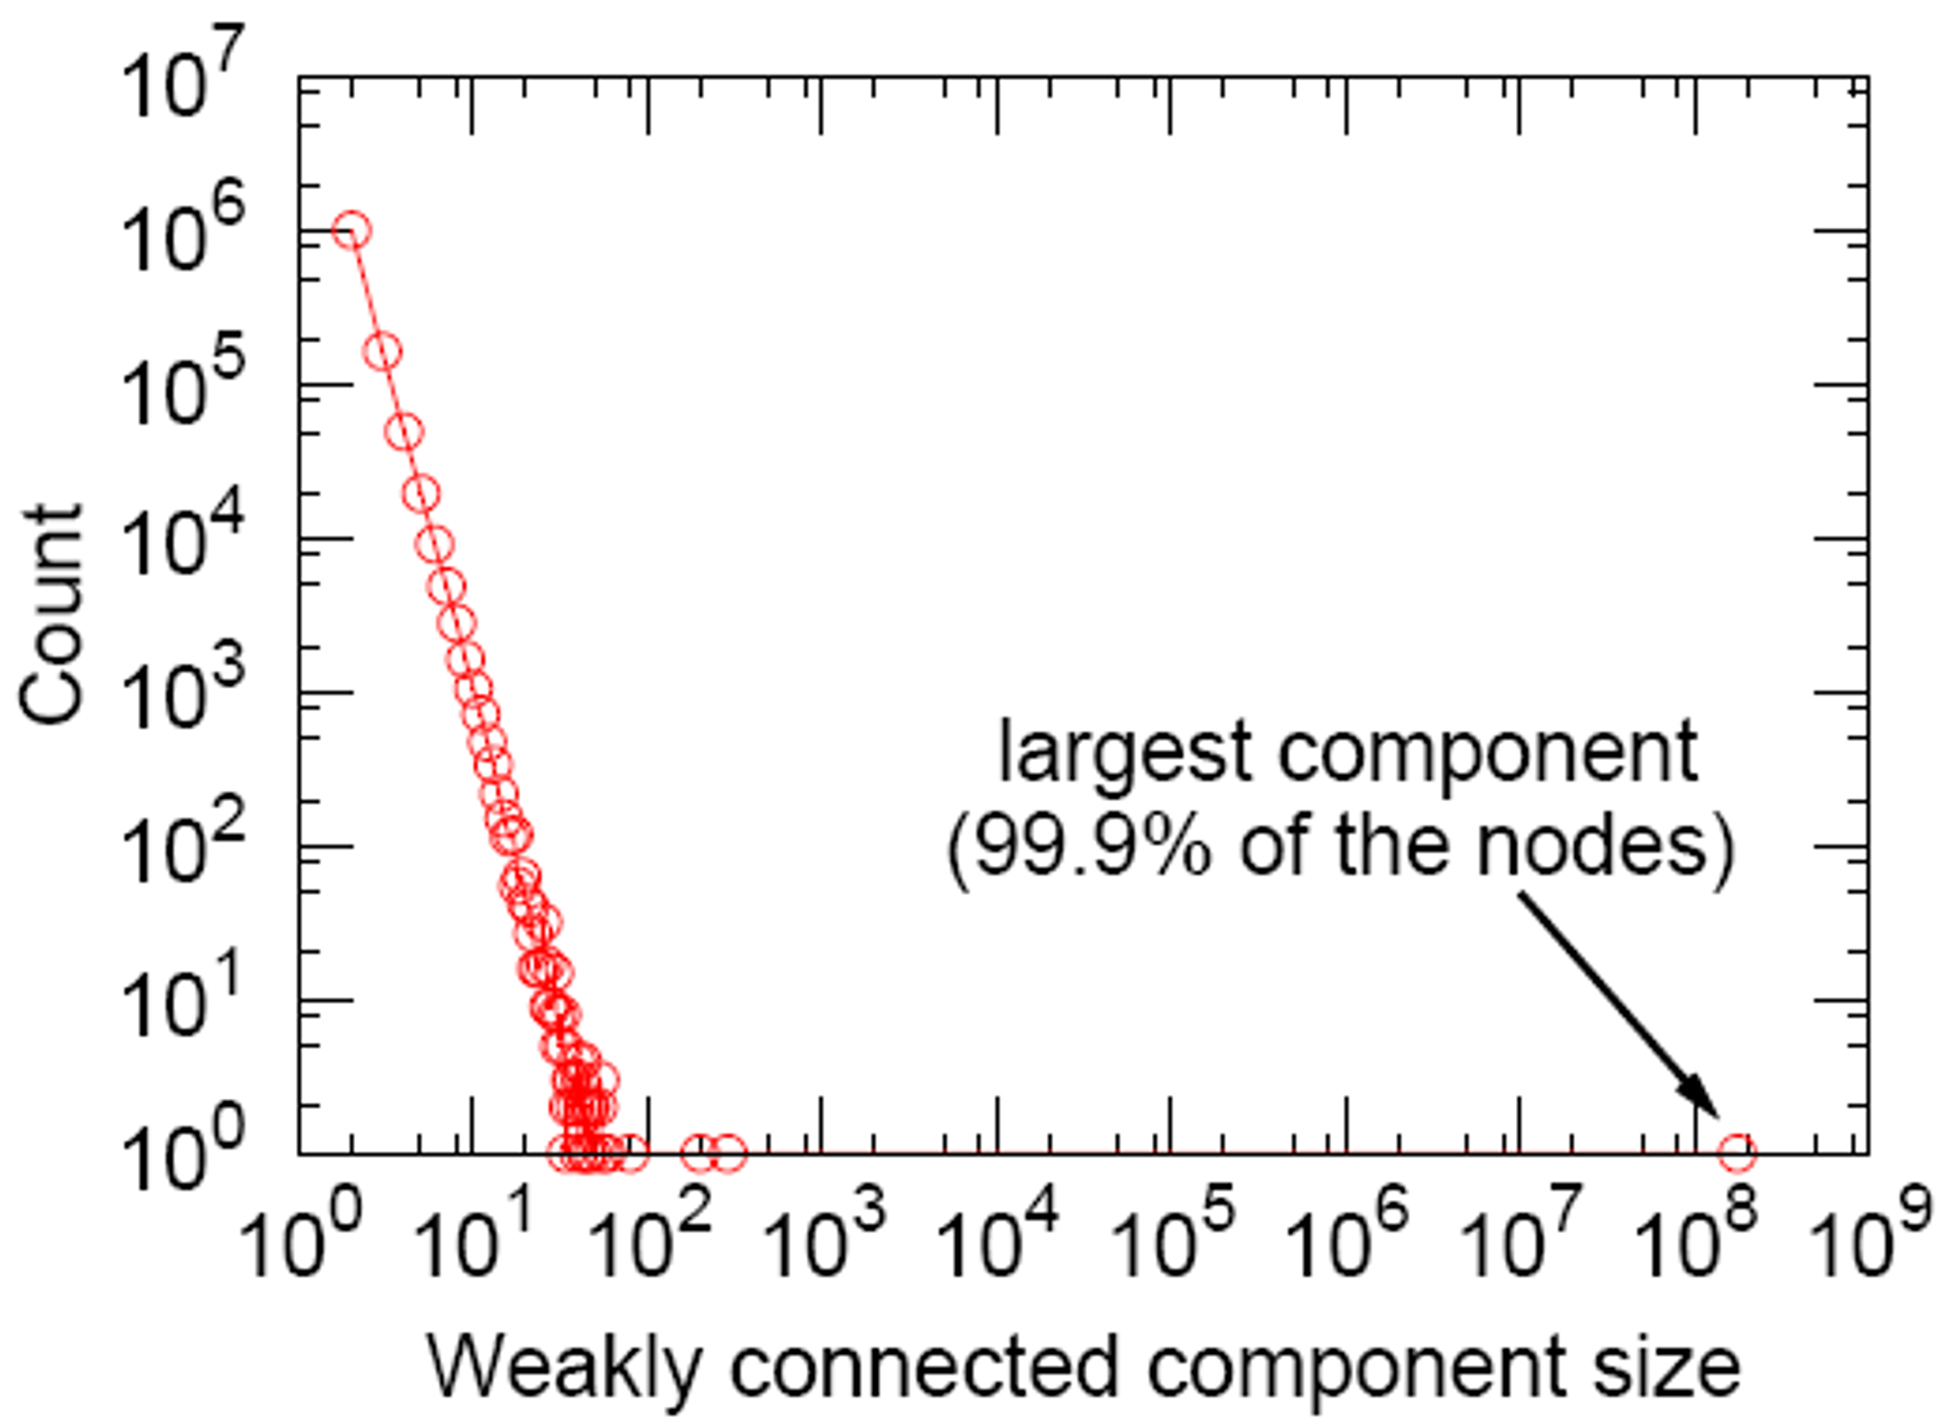
14

Slide 18

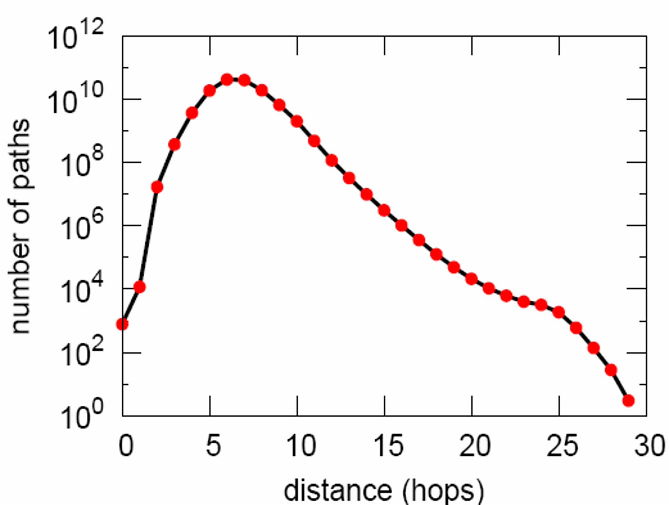
Steps
#Nodes
0
1
1
10
2
78
3
3,96
4
8,648
# nodes as we do BFS out of a random node
5
3,299,252
Number of links between pairs of nodes in the largest connected component
6
28,395,849
7
79,059,497
8
52,995,778
9
10,321,008
10
1,955,007
11
518,410
12
149,945
13
44,616
14
13,740
15
4,476
16
1,542
17
536
18
167
19
71
20
29
Avg. path length 6.6
90% of the nodes can be reached in < 8 hops
Jure Leskovec, Stanford CS224W: Machine Learning with Graphs, cs224w.stanford.edu
21
16
22 | 10
23 | 3
24 | 2
25 | 3
2/25/21
18

Slide 19
Degree distribution:
Heavily skewed; avg. degree = 14.4
0.11
Clustering coefficient:
Connectivity: Path length:
giant component
6.6
Are these values “expected”?
Are they “surprising”?
To answer this, we need a model!
Jure Leskovec, Stanford CS224W: Machine Learning with Graphs, cs224w.stanford.edu
2/25/21
19

Slide 20

CS224W: Machine Learning with Graphs Jure Leskovec, Stanford University
http://cs224w.stanford.edu

Slide 21



Erdös-Renyi Random Graphs [Erdös-Renyi, ‘60]
  Two variants:
G_{np}: undirected graph on n nodes where each edge (u,v) appears i.i.d. with probability p
G_{nm} : undirected graph with n nodes, and
m edges picked uniformly at random
What kind of networks do such models produce?

Slide 22

n and p do not uniquely determine the graph!
The graph is a result of a random process
We can have many different realizations given the same n and p
n = 10
p= 1/6

Slide 23




Degree distribution: P(k) Clustering coefficient: C Path length: h
What are the values of these properties for G_{np}?

Slide 24
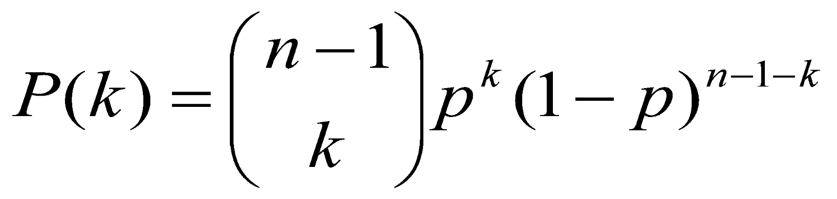
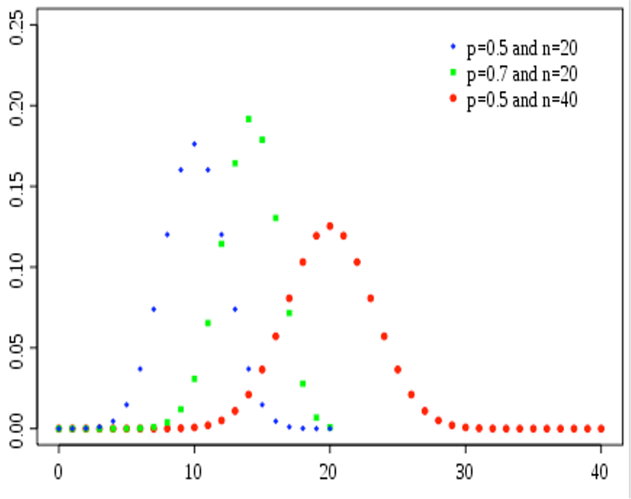
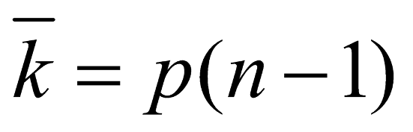
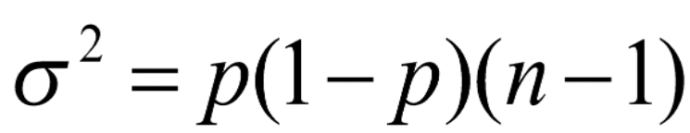
Fact: Degree distribution of G_{np} is binomial.
Let P(k) denote the fraction of nodes with degree k:
Probability of missing the rest of the n-1-k edges
Select k nodes out of n-1
Probability of having k edges
Mean, variance of a binomial distribution
P(k)
k

Slide 25
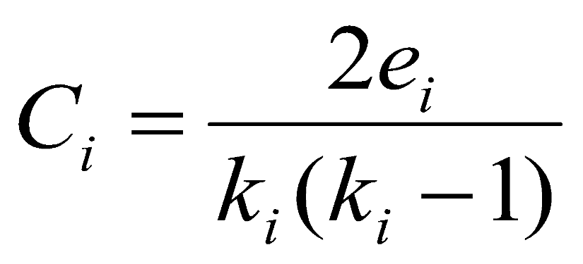
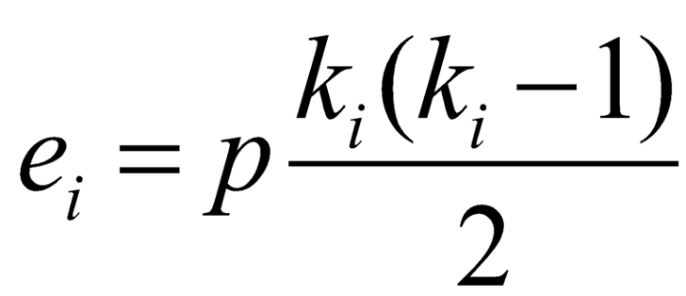
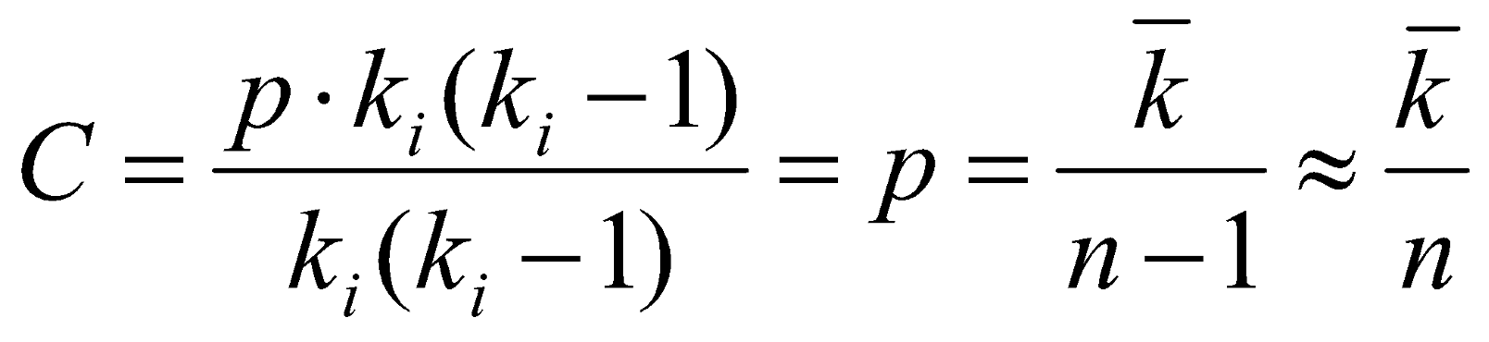
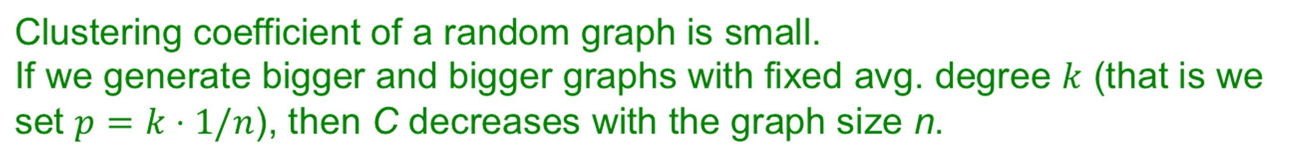
Where e_{i} is the number of edges between i’s neighbors
Remember:
Edges in G_{np} appear i.i.d. with prob. p
So, expected E[e_{i}] is:
Number of distinct pairs of neighbors of node i of degree k_{i}
Each pair is connected with prob. p
Then E[C_{i}]:

Slide 26
Graph structure of G_{np} as p changes:
Avg deg = 1
p=
1/(n-1)
Giant component appears
c/(n-1)
Avg. deg const. Lots of isolated nodes.
log(n)/(n-1) Fewer isolated nodes.
2*log(n)/(n-1)
No isolated nodes.
0
Empty
graph
1
Complete
graph
Emergence of a giant component:
avg. degree k=2E/n or p=k/(n-1)
  Degree k=1-ε: all components are of size Ω(log n)
  Degree k=1+ε: 1 component of size Ω(n), others have size
Ω(log n)
    Each node has at least one edge in expectation

Slide 27
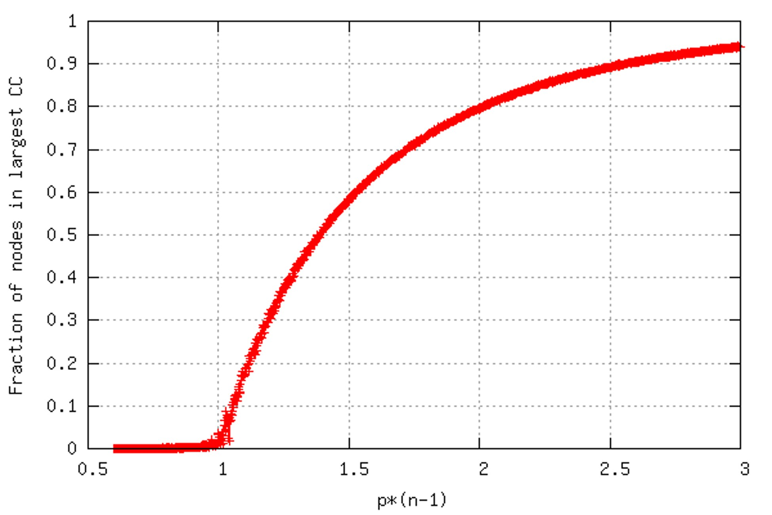
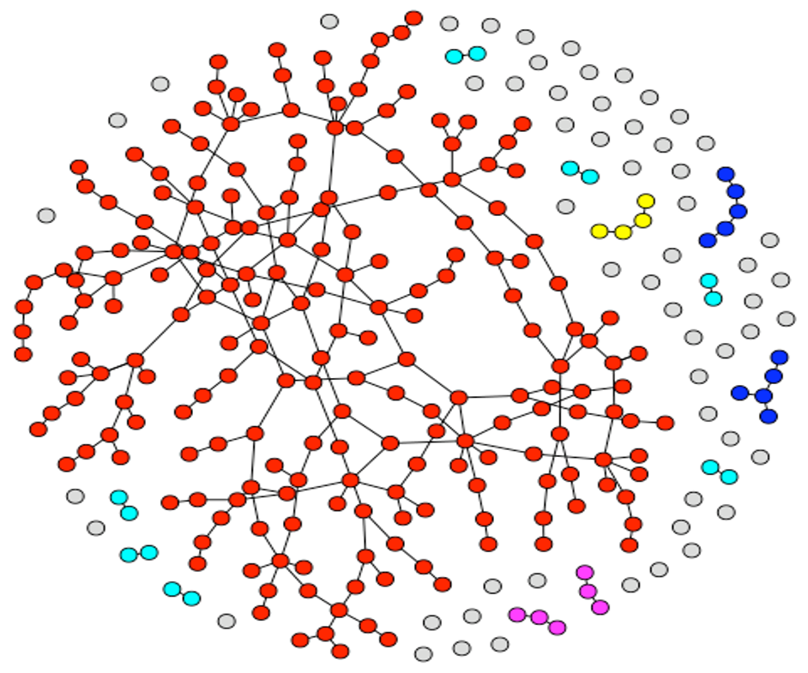
p*(n-1)=1
Fraction of nodes in the largest component
G_{np}, n=100,000, k=p(n-1) = 0.5 … 3

Slide 28

Degree distribution: Clustering coefficient: Connectivity:
⎛ n −1⎞
k
n−1−k
P(k) = ⎜_{⎜ k} ÷÷ p (1− p)
⎝ ⎠
C=p=k/n
GCC exists when k>1.
next!
Path length:
Jure Leskovec, Stanford CS224W: Analysis of Networks, http://cs224w.stanford.edu

Slide 29

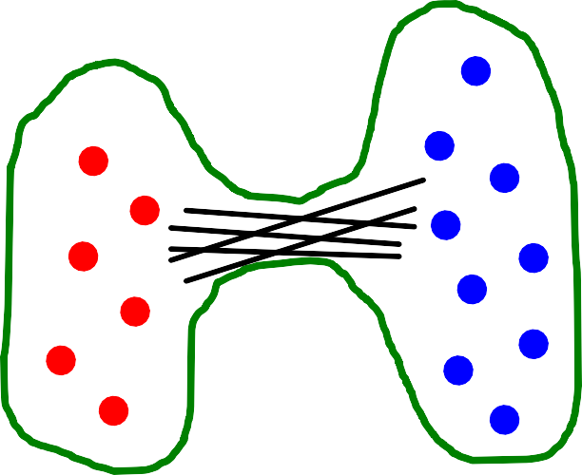
# of edges leaving S ≥ α× min(|S|,|V\S|)
Graph G(V, E) has expansion α: if″ S ⊆ V:
Or equivalently:
_{α = min} # edges leaving S
min(| S |,| V \ S |)
V \ S
S ⊆V
S
Jure Leskovec, Stanford CS224W: Analysis of Networks, http://cs224w.stanford.edu

Slide 30
Expansion is measure of robustness:
_{α = min}# edges leaving S
S ⊆V
min(| S |,| V \ S |)
To disconnect l nodes, we need to cut ≥ α× l edges
Low expansion:
High expansion:
Social networks:
  “Communities”
Jure Leskovec, Stanford CS224W: Analysis of Networks, http://cs224w.stanford.edu
30

Slide 31
Fact: In a graph on n nodes with expansion α for all pairs of nodes there is a path of lehth O((log n)/α).
Random graph G_{np}:
For log n > np > c, diam(G_{np}) = O(log n / log (np))
Random graphs have good expansion so it takes a logarithmic number of steps for BFS to visit all nodes
s
S nodes
α·S edges
S’ nodes
α·S’ edges
Jure Leskovec, Stanford CS224W: Analysis of Networks, http://cs224w.stanford.edu
31

Slide 32
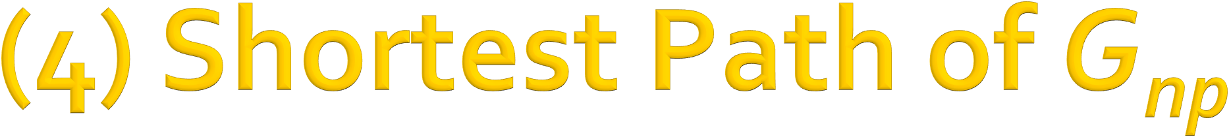
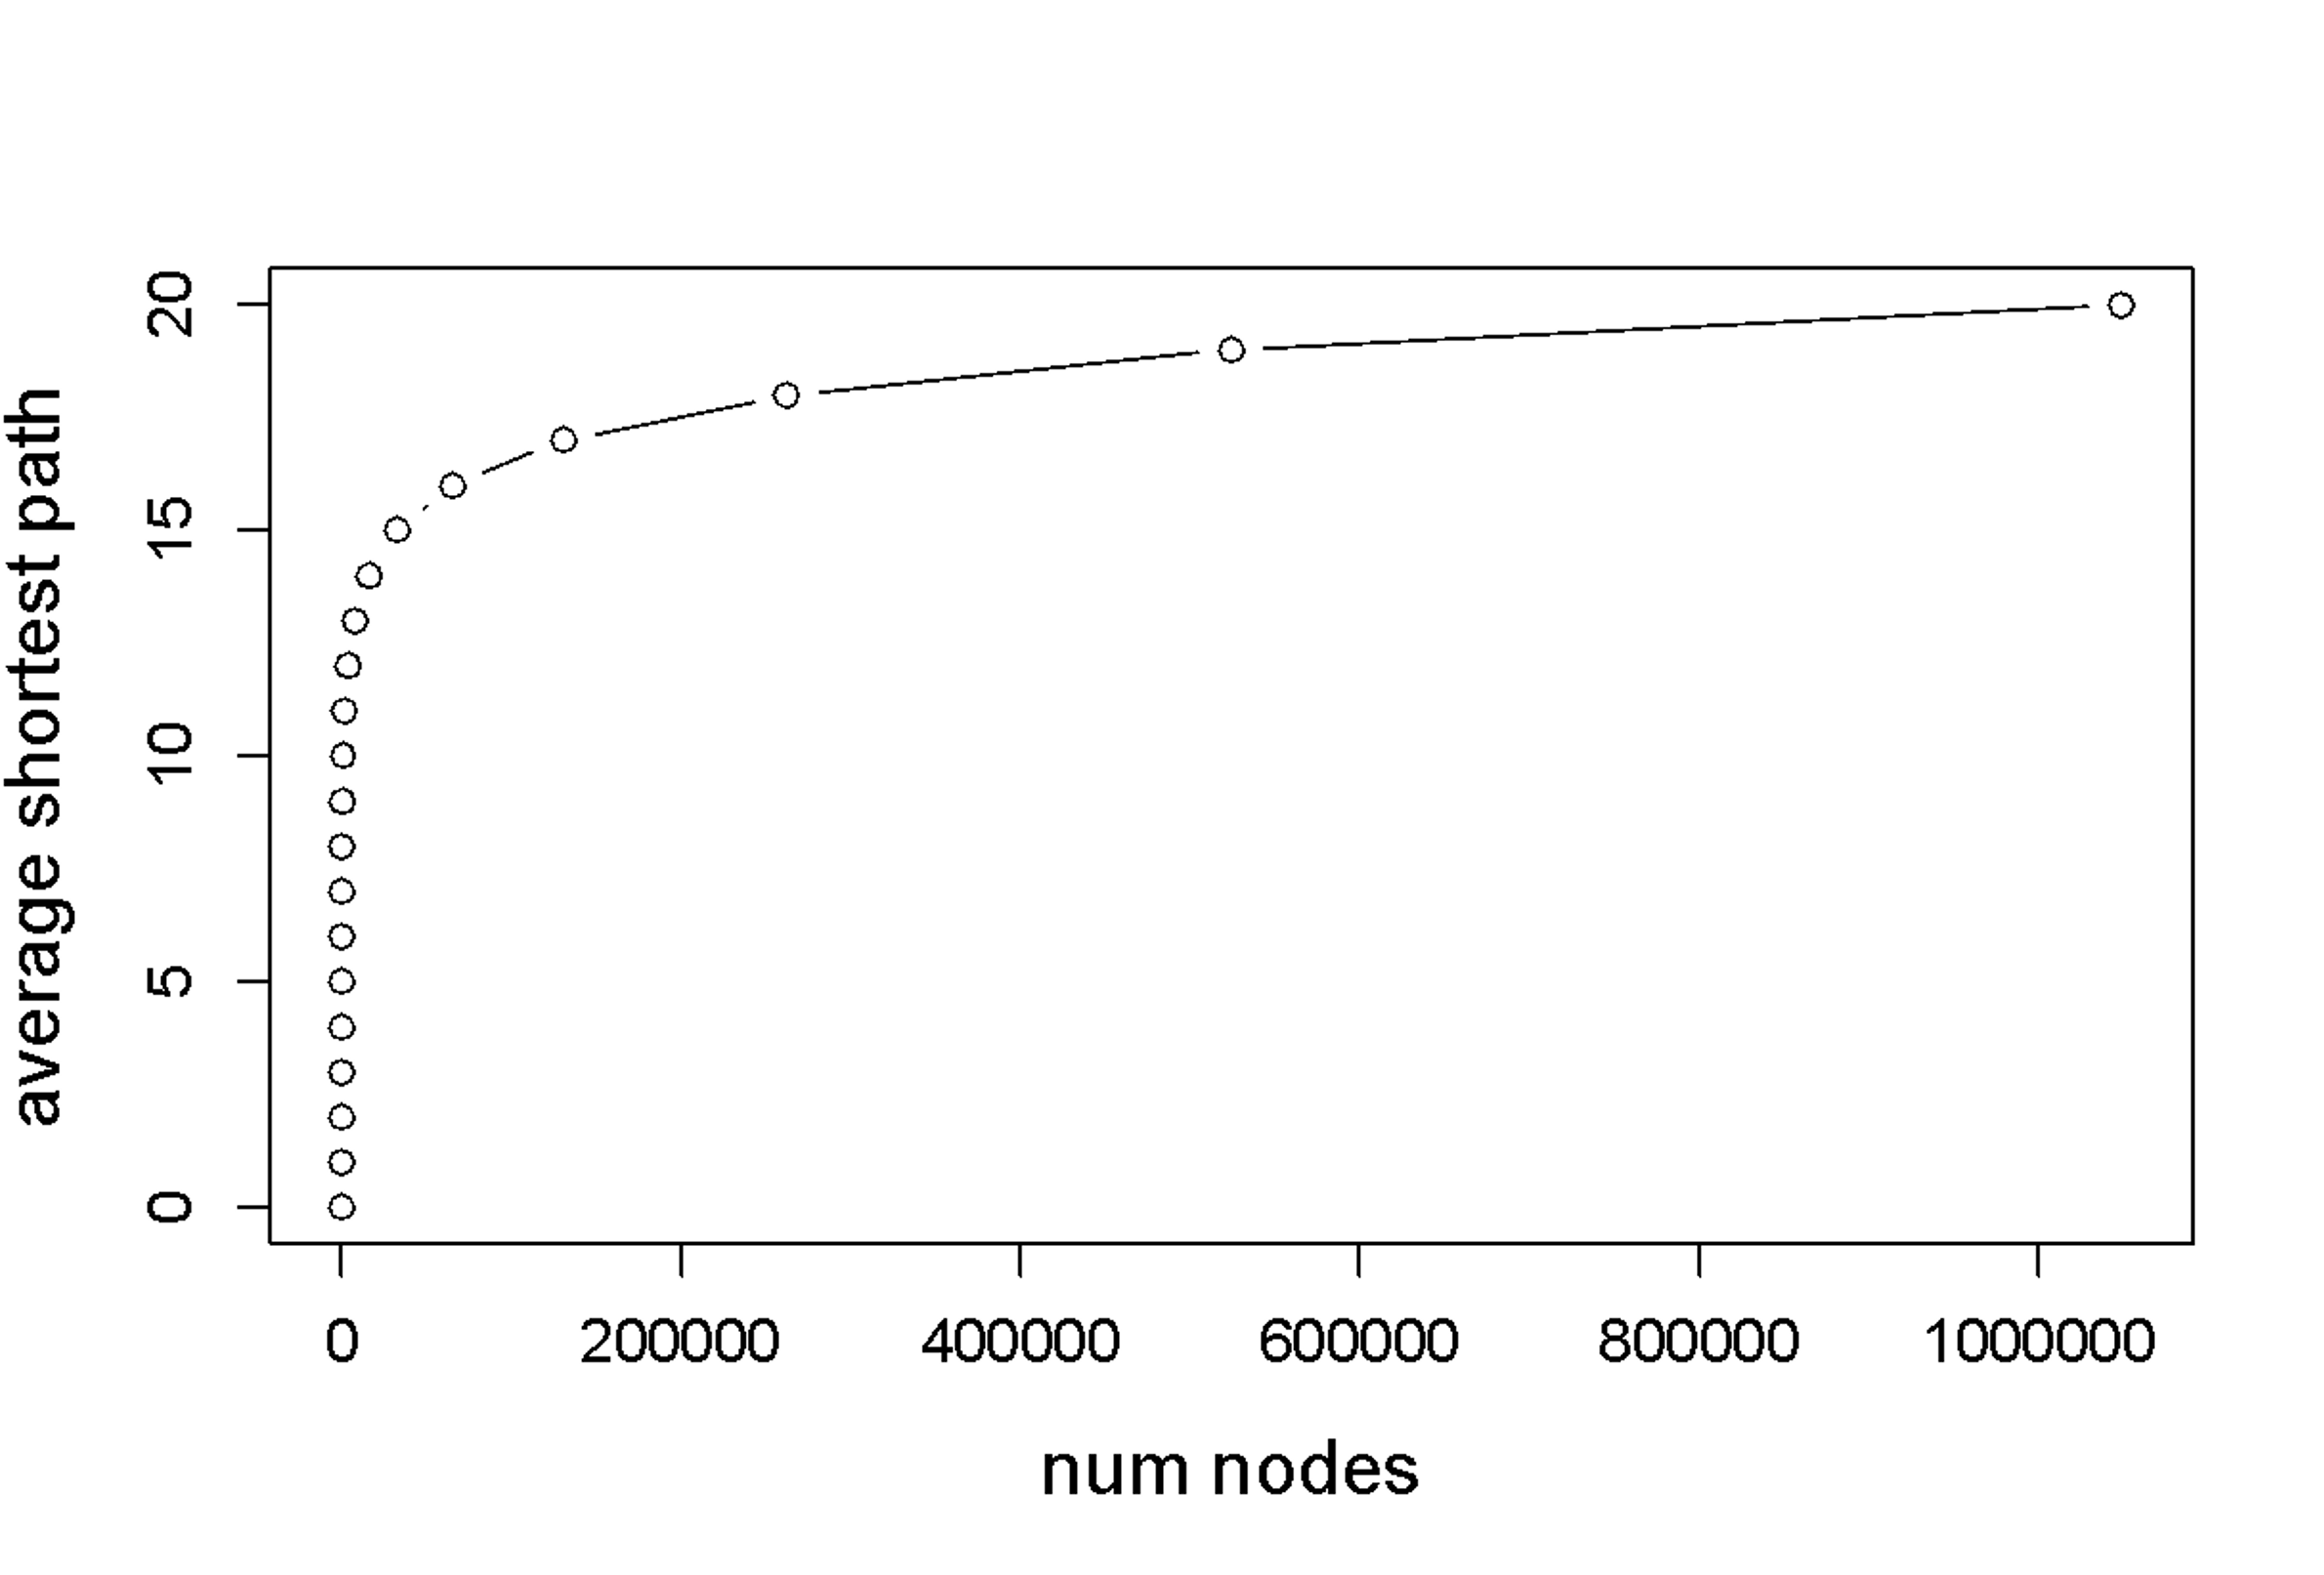
Erdös-Renyi Random Graph can grow very large but nodes will be just a few hops apart
Shortest Path length follows
O(log n)
Here we control the average degree to be constant

Slide 33

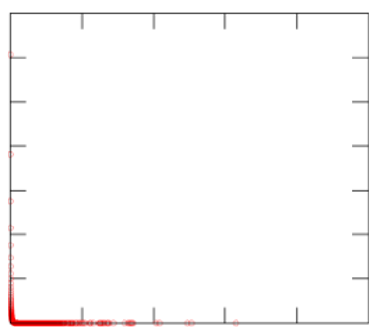
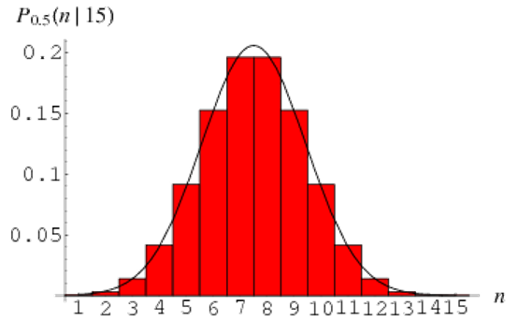
MSN
^{G}np
n=180M
🗷
Degree distribution:
Avg. path length: 6.6 Avg. clustering coef.: 0.11
O(log n) 🗹
h ≈ 8.2
k / n
C ≈ 8·10⁻⁸
GCC exists when k>1. k ≈ 14.
🗷
🗹
Largest Conn. Comp.: 99%

Slide 34



Are real networks like random graphs?
Giant connected component: ☺
Average path length: ☺
Clustering Coefficient: ☹
Degree Distribution: ☹
Problems with the random networks model:
  Degree distribution differs from that of real networks
  Giant component in most real networks does NOT emerge through a phase transition
  No local structure – clustering coefficient is too low
Most important: Are real networks random?
  The answer is simply: NO!

Slide 35

CS224W: Machine Learning with Graphs Jure Leskovec, Stanford University
http://cs224w.stanford.edu

Slide 36
MSN
Avg. path length: 6.6 Avg. clustering coef.: 0.11
^{G}np
n=180M
O(log n) !
h ≈ 8.2
k / n
"
C ≈ 8·10⁻⁸
Can we have high clustering while also having short paths?
Vs.
Regular lattice graph: High clustering coefficient High diameter
G_{np} random graph:
Low clustering coefficient
Low diameter
36

Slide 37
Real networks have high clustering:
MSN network has 7 orders of magnitude larger clustering than the corresponding G_{np}!
Other examples:
Avg. path length Clustering coefficients
Network | Nodes | Degree | hactual | hrandom | Cactual | Crandom
Film actor collaborations | 225,226 | 61.00 | 3.65 | 2.99 | 0.79 | 0.00027
Power Grid | 4,941 | 2.67 | 18.70 | 12.40 | 0.080 | 0.005
C. elegans | 282 | 14.00 | 2.65 | 2.25 | 0.28 | 0.05
“actual” … real network
“random” … random graph with same avg. degree
36

Slide 38

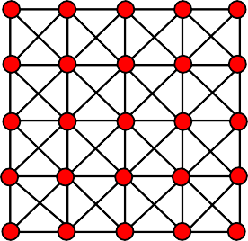
Consequence of expansion:
Short paths: O(log n)
  This is the smallest diameter we can get if we keep the degree constant.
But clustering is low!
But networks have “local” structure:
  Triadic closure:
Friend of a friend is my friend
  High clustering but diameter is also high
How can we have both?
G_{np} random graph: Low clustering coefficient
Low diameter
Regular lattice graph: High clustering coefficient High diameter
36

Slide 39

Idea: Interpolate between regular lattice graphs and G_{np} random graph
Interpolate
Regular lattice graph: High clustering coefficient High diameter
Small-world graph:
High clustering coefficient Low diameter
G_{np} random graph: Low clustering coefficient
Low diameter
How do we interpolate between these two graphs?
36

Slide 40
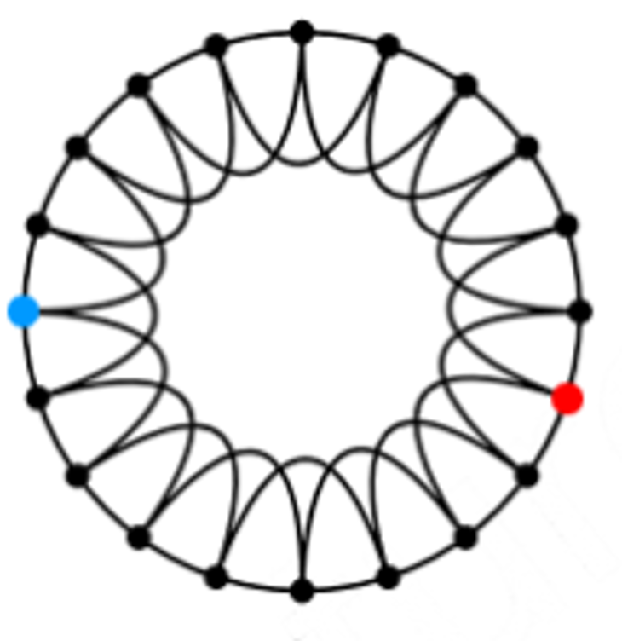
Small-World Model
Two components to the model:
[D. Wattts and S. Strogatz, Collective dynamics of ’small-world’networks, Nature]
(1) Start with a low-dimensional regular lattice
  (In our case we are using a ring as a lattice)
  Has high clustering coefficient
40

Slide 41
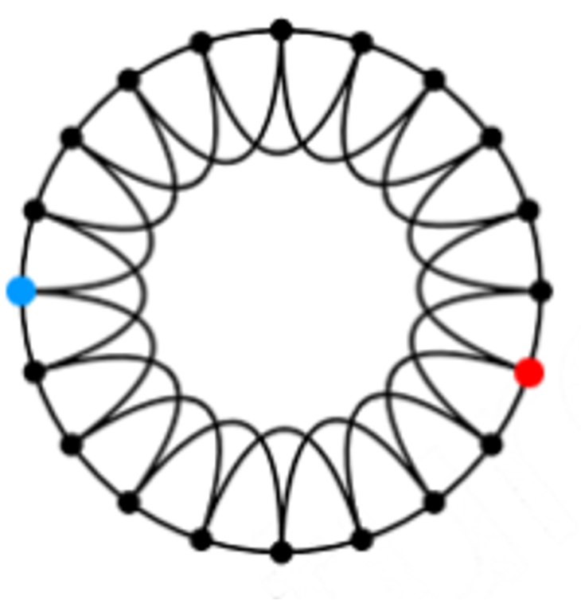
Small-World Model
Two components to the model:
[D. Wattts and S. Strogatz, Collective dynamics of ’small-world’networks, Nature]
(2) Rewire: Introduce randomness (“shortcuts”)
  Add/remove edges to create shortcuts to join remote parts of the lattice
  For each edge, with prob. p, move the other endpoint to a random node

Slide 42
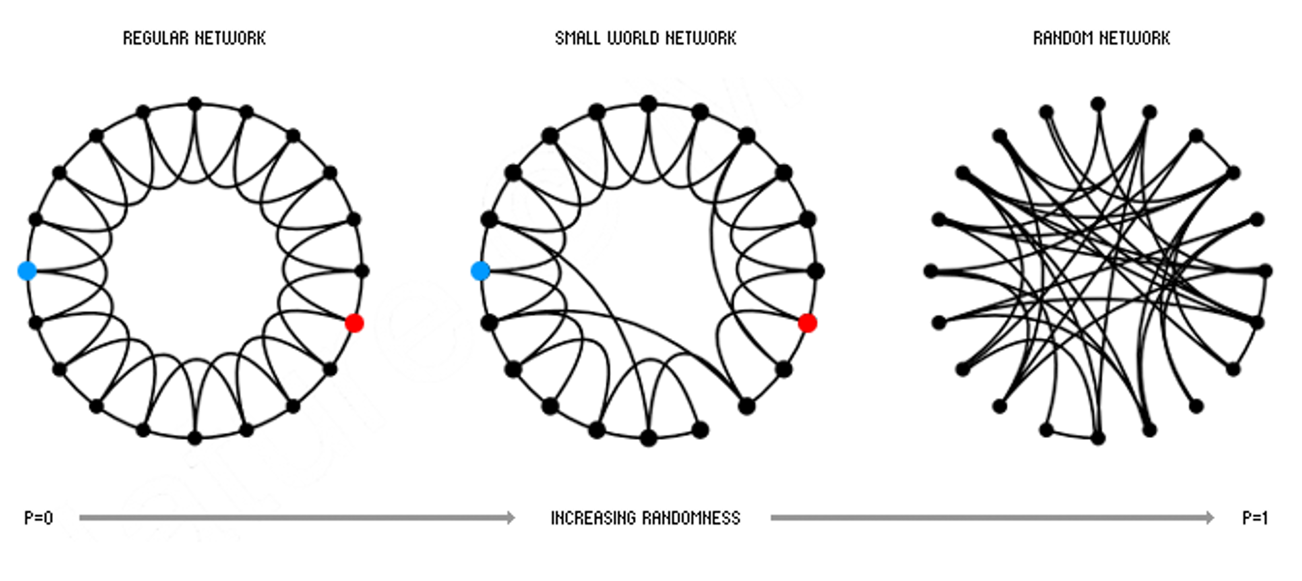







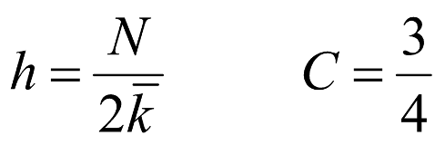
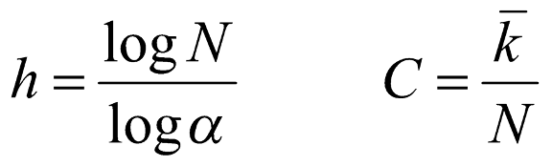
[D. Wattts and S. Strogatz, Collective dynamics of ’small-world’networks, Nature]
High clustering High diameter
High clustering Low diameter
Low clustering Low diameter
1 2
Rewiring allows us to “interpolate” between a regular lattice and a random graph

Slide 43
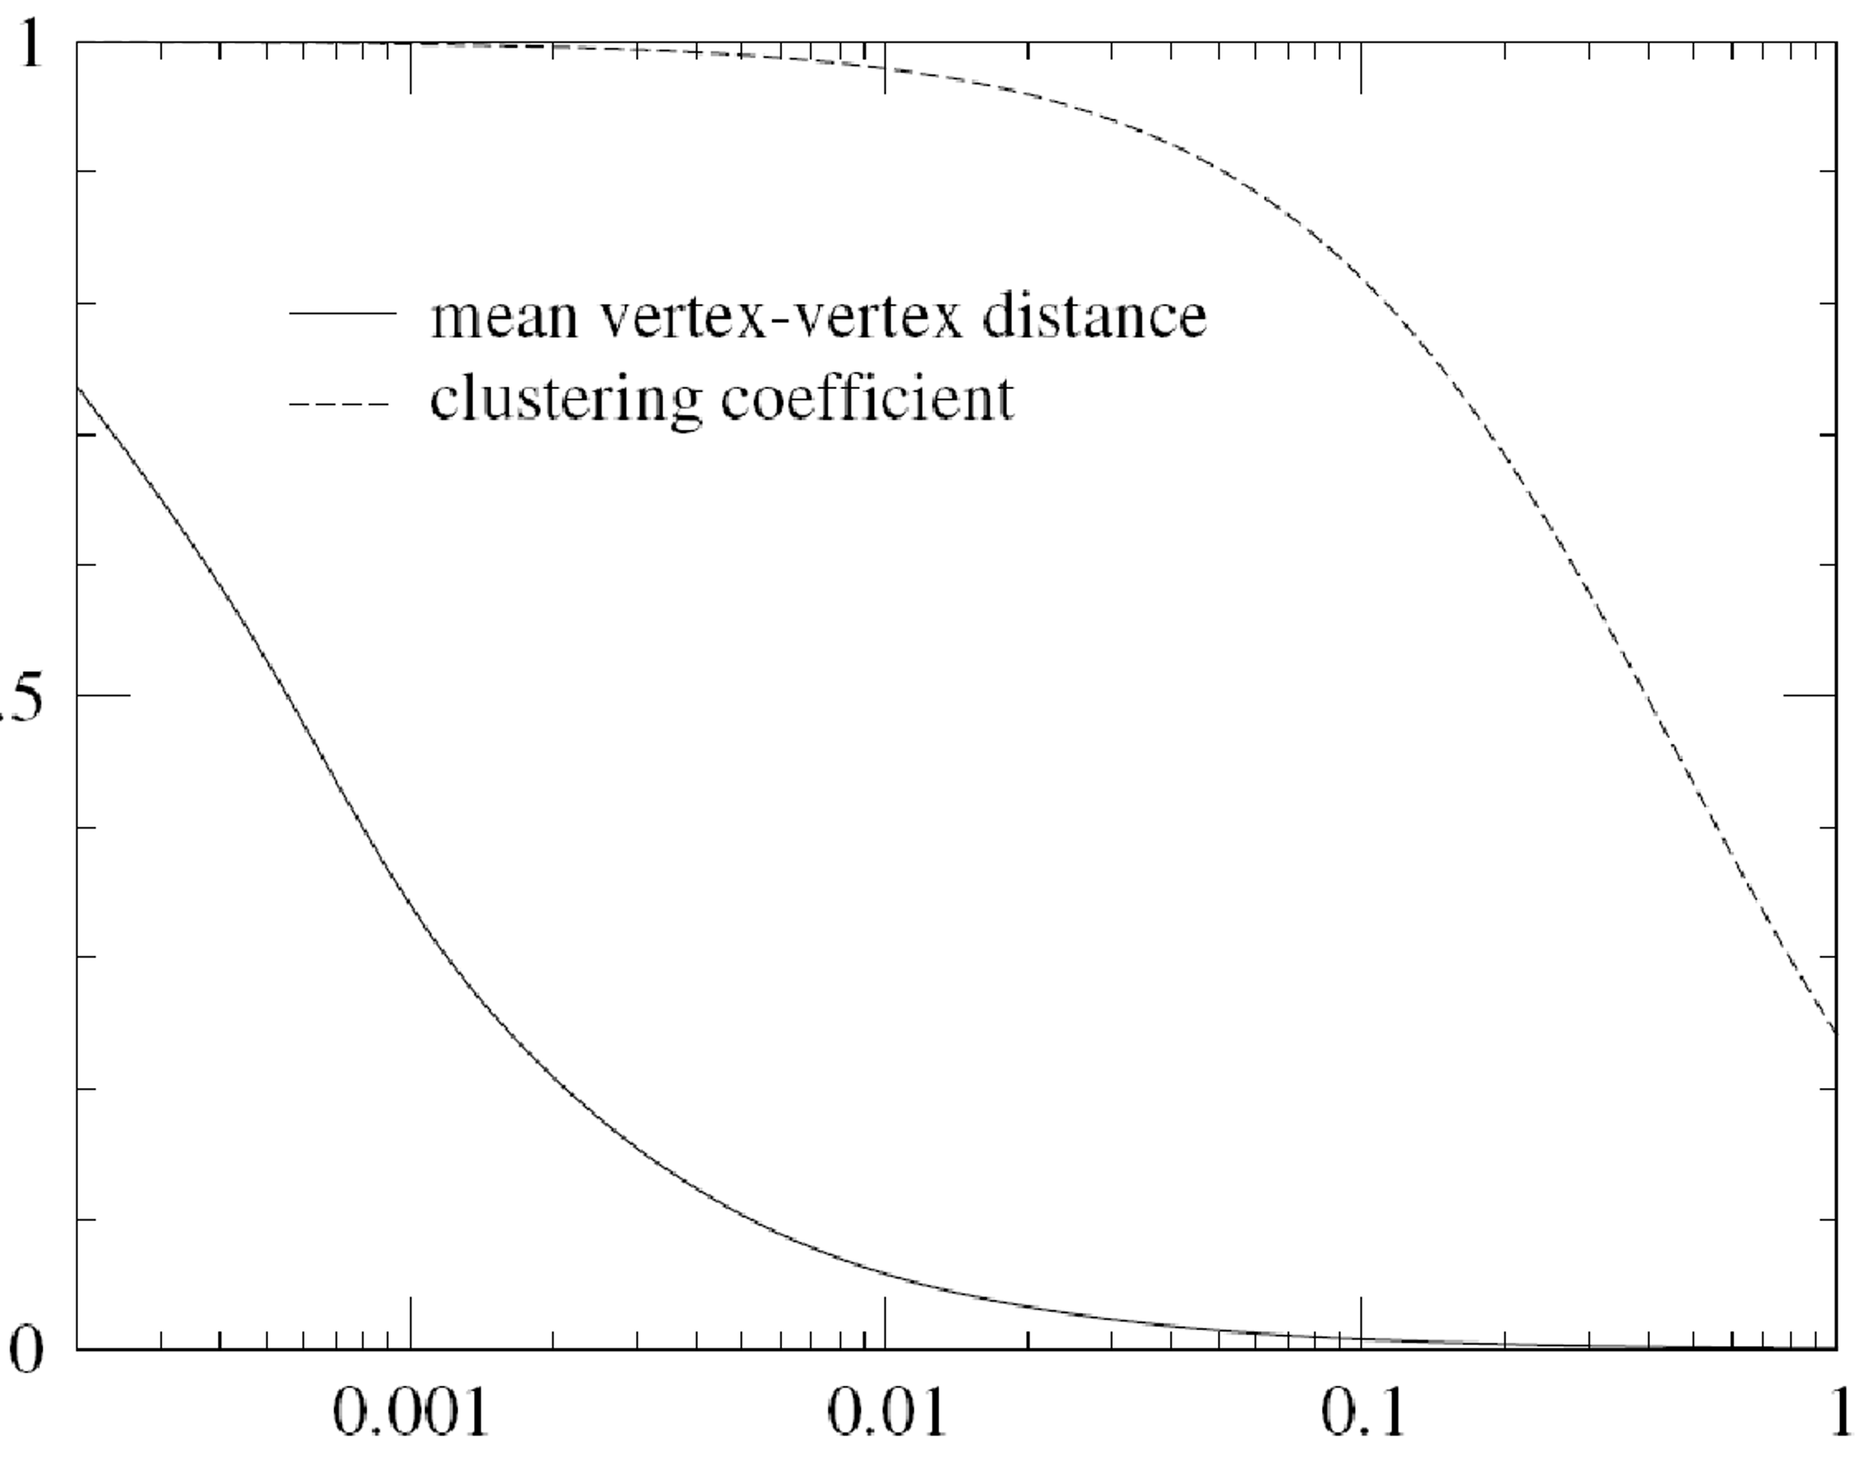
Intuition: It takes a lot of randomness to ruin the clustering, but a very small amount to create shortcuts.
Clustering coefficient, C
(scaled) Average Path Length
Parameter region of high clustering and low path length
Prob. of rewiring, p

Slide 44
Could a network with high clustering be at the same time a small world?
Yes! You don’t need more than a few random links
The Small-World Model:
  Provides insight on the interplay between clustering and the small-world
  Captures the structure of many realistic networks
  Accounts for the high clustering of real networks
  Does not lead to the correct degree distribution

Slide 45

CS224W: Machine Learning with Graphs Jure Leskovec, Stanford University
http://cs224w.stanford.edu

Slide 46
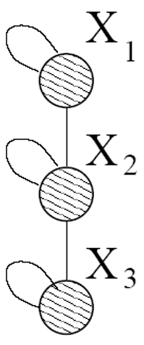
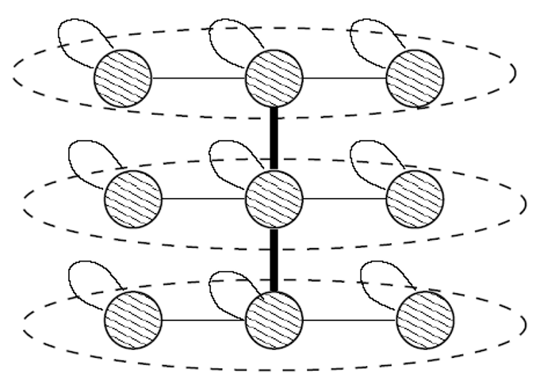
How can we think of network structure recursively? Intuition: Self-similarity
Object is similar to a part of itself: the whole has the same shape as one or more of the parts
Mimic recursive graph/community growth:
Initial graph Recursive expansion
Kronecker product is a way of generating
self-similar matrices

Slide 47

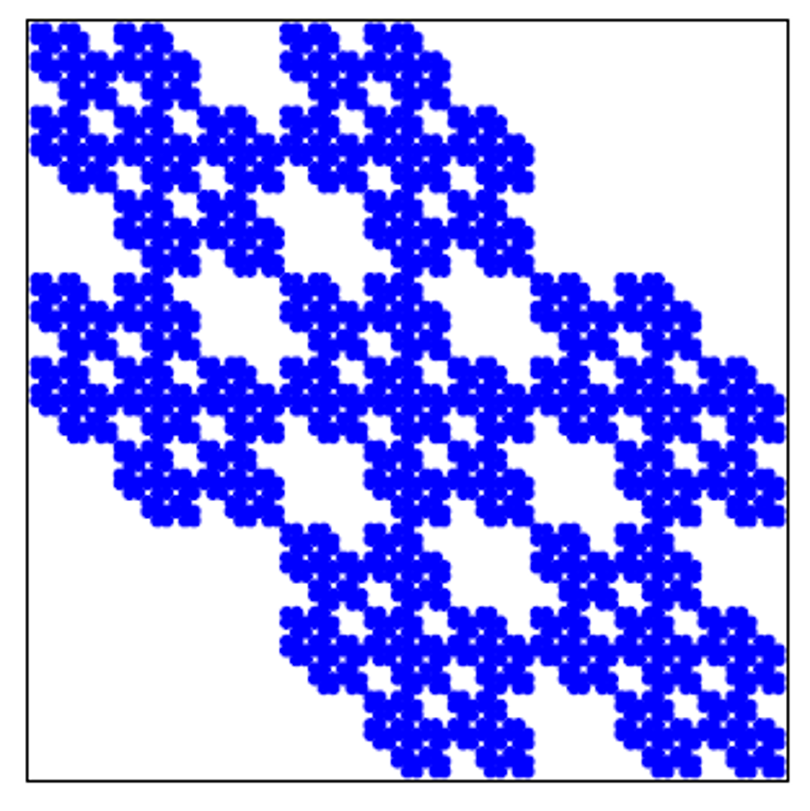
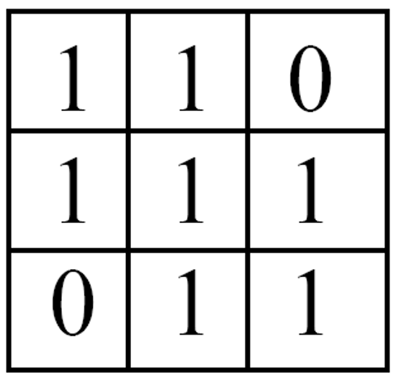
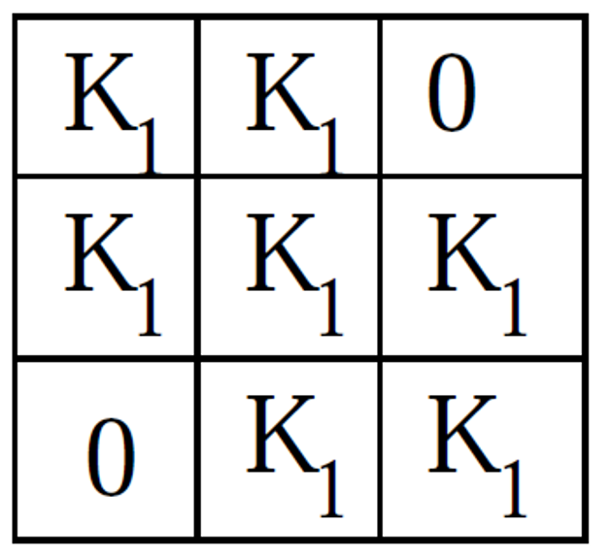
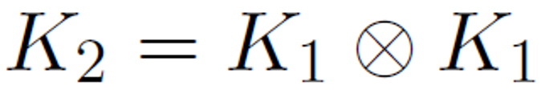
Kronecker graphs:
  A recursive model of network structure
[PKDD ‘05]
K₁
3 x 3
9 x 9
81 x 81 adjacency matrix

Slide 48
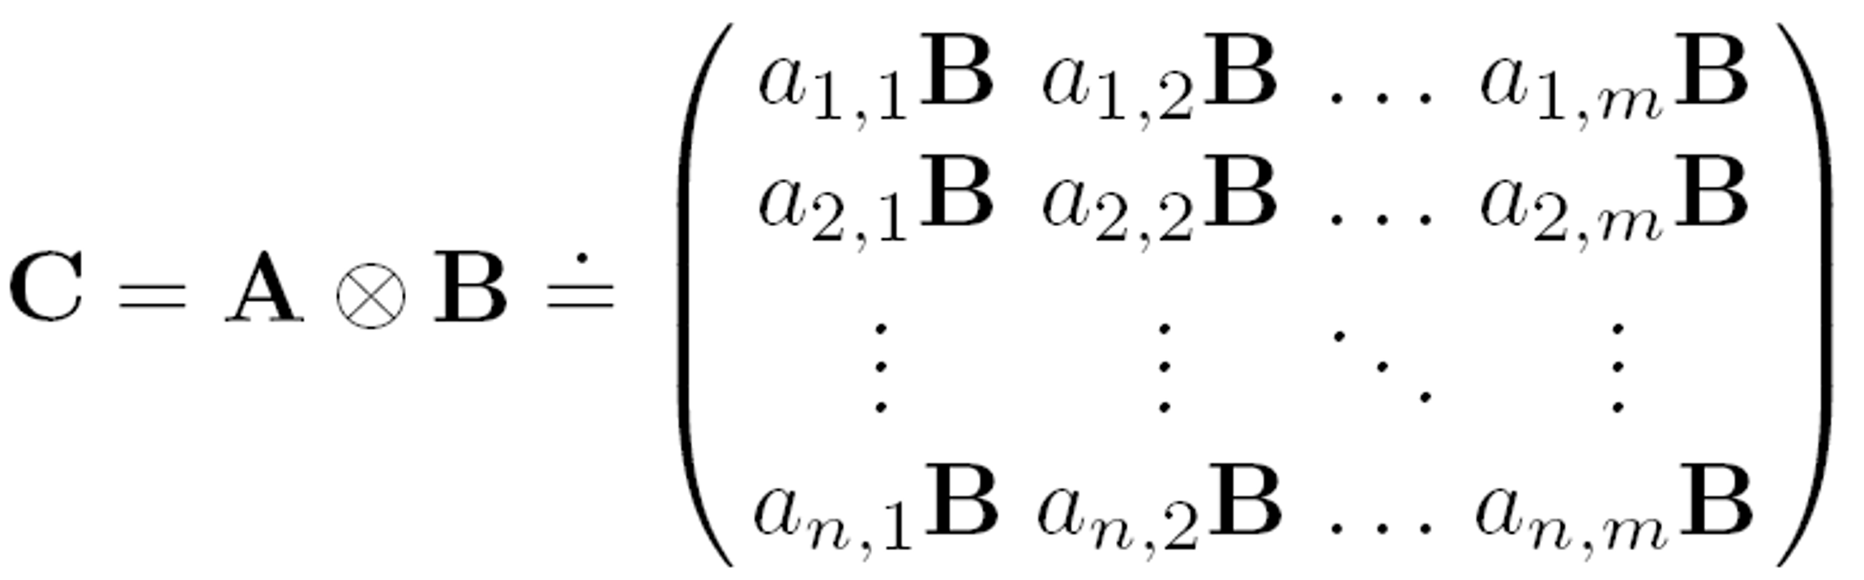
Kronecker product of matrices A and B is given by
N x M K x L
N*K x M*L
Define a Kronecker product of two graphs as a Kronecker product of their adjacency matrices

Slide 49

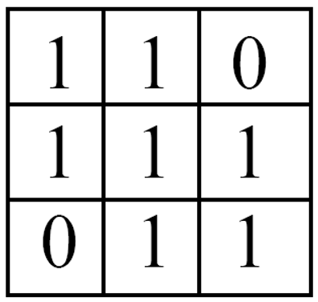
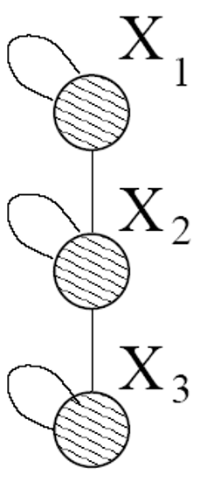
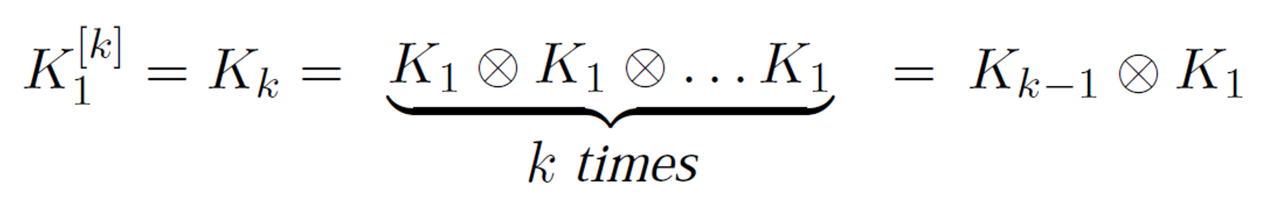
Kronecker graph is obtained by growing sequence of graphs by iterating the Kronecker product over the initiator matrix K₁:
[PKDD ‘05]
[m]
m
m-1
m
K₁
Note: One can easily use multiple initiator matrices (K₁', K₁'', K₁''') (even of different sizes)

Slide 50
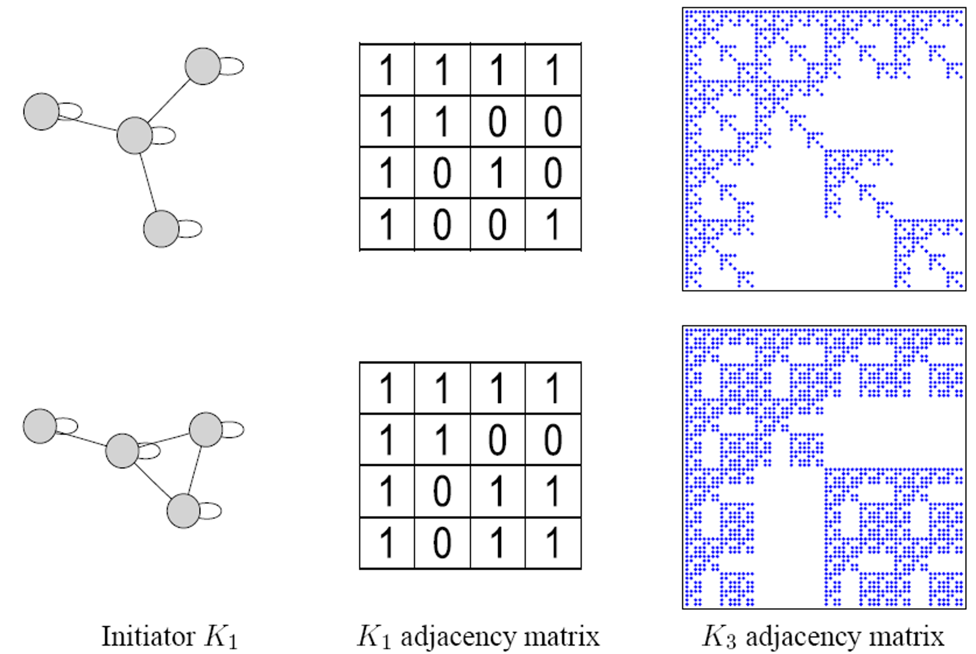
[PKDD ‘05]
50

Slide 51
Step 1: Create N₁ x N₁ probability matrix Θ₁
Step 2: Compute the 𝑘!" Kronecker power Θ#
[PKDD ‘05]
Step 3: For each entry p_{uv} of Θ# include an edge
(u, v) in K_{k} with probability p_{uv}
Probability of edge p_{uv}
Kronecker
0.25 | 0.10 | 0.10 | 0.04
0.05 | 0.15 | 0.02 | 0.06
0.05 | 0.02 | 0.15 | 0.06
0.01 | 0.03 | 0.03 | 0.09
0.5 | 0.2
0.1 | 0.3
multiplication
Instance
matrix K₂
Θ₁
Flip biased coins
Θ₂= Θ₁⊗ Θ₁

Slide 52

How do we generate an instance of a (Directed) stochastic Kronecker graph?
0.25 | 0.10 | 0.10 | 0.04
0.05 | 0.15 | 0.02 | 0.06
0.05 | 0.02 | 0.15 | 0.06
0.01 | 0.03 | 0.03 | 0.09
Flip biased coins
1 | 1 | 0 | 0
0 | 1 | 0 | 1
1 | 0 | 1 | 1
0 | 1 | 0 | 1
Probability of edge p_{uv}
Is there a faster way? YES!
Idea: Exploit the recursive structure of Kronecker graphs
  “Drop” edges onto the graph one by one

Slide 53
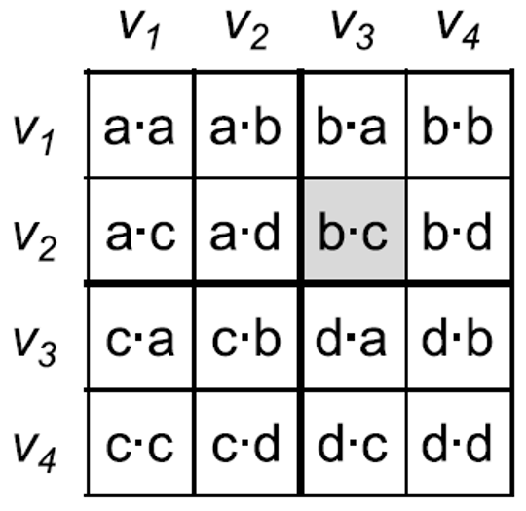
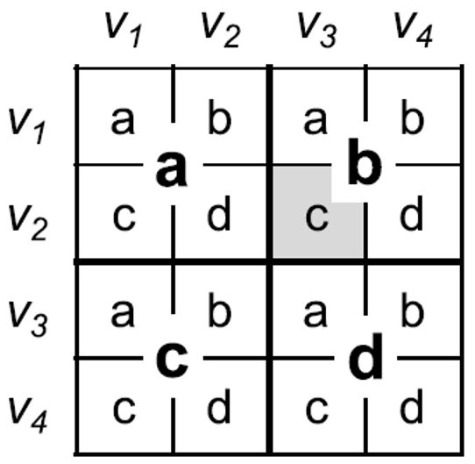




A faster way to generate Kronecker graph
=
Θ ⊗ Θ
How to “drop” an edge into a graph G on
n=2^{m} nodes
Adjacency matrix G
53

Slide 54
A faster way to generate Kronecker graph
=
Θ ⊗ Θ
How to “drop” an edge into a graph G on
n=2^{m} nodes
a b
c
d
Adjacency matrix G
54

Slide 55
A faster way to generate Kronecker graph
=
Θ ⊗ Θ
How to “drop” an edge into a graph G on
n=2^{m} nodes
a b
_{c}a b
d
c
d
Adjacency matrix G
54

Slide 56
A faster way to generate Kronecker graph
=
Θ ⊗ Θ
How to “drop” an edge into a graph G on
n=2^{m} nodes:
We may get a few edges colliding. We simply reinsert them.
a b
_{c}aa b
_{d}b
c
d
c d
Adjacency matrix G
56

Slide 57

Fast Kronecker generator algorithm:
For generating directed graphs
Insert 1 edge on graph G on n = 2^{m} nodes:
  Create normalized matrix 𝑳_{𝒖𝒗} = 𝜣_{𝒖𝒗}/(∑_{𝒐𝒑} 𝜣_{𝒐𝒑})
  For 𝒊 = 𝟏 … 𝒎
Start with 𝒙 = 𝟎, 𝒚 = 𝟎
Pick a row/column (𝒖, 𝒗) with prob. 𝑳_{𝒖𝒗}
Descend into quadrant (𝒖, 𝒗) at level 𝒊 of 𝑮
  This means: 𝒙 += 𝒖 ) 𝟐^{𝒎"𝒊}, 𝒚 += 𝒗 ) 𝟐^{𝒎"𝒊}
a b
Add an edge 𝒙, 𝒚 to 𝑮
c d
57

Slide 58


Leskovec et al., Kronecker graphs: an approach to modeling networks., JMLR
Real and Kronecker are very close:
0.99 | 0.54
0.49 | 0.13
57

Slide 59
Today: Traditional graph generative models
Erdös-Renyi graphs
Small-world graphs
Kronecker graphs
All these models have prior assumption of the graph generation processes
Next: Deep graph generative models
  Learn the graph generation process from raw data
57

