Slide 1



CS224W: Machine Learning with Graphs Jure Leskovec, Stanford University
http://cs224w.stanford.edu

Slide 2
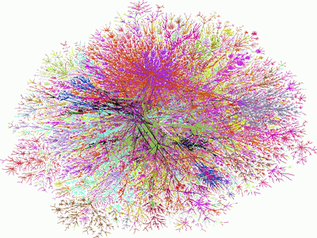
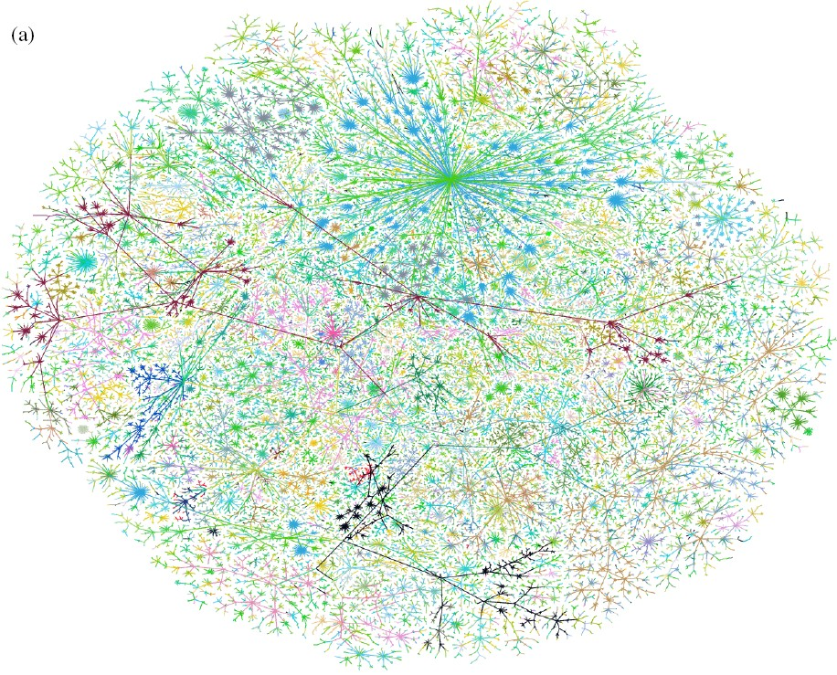
We want to generate realistic graphs, using
graph generative models
Graph Generative Model
which is
Generate
similar to
~
Synthetic graph
Real graph
Jure Leskovec, Stanford CS224W: Machine Learning with Graphs, cs224w.stanford.edu
2

Slide 3
Step 1: Properties of real-world graphs
A successful graph generative model should fit these properties
Step 2: Traditional graph generative models
  Each come with different assumptions on the graph formulation process
Step 3: Deep graph generative models
  Learn the graph formation process from the data
  This lecture!
Jure Leskovec, Stanford CS224W: Machine Learning with Graphs, cs224w.stanford.edu
2

Slide 4

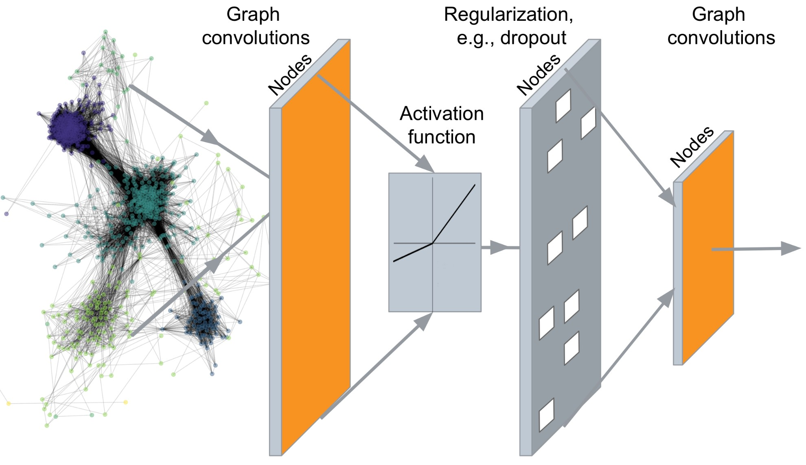
…
Output: node embeddings
4

Slide 5
…
Output: Graph Structure!
4

Slide 6
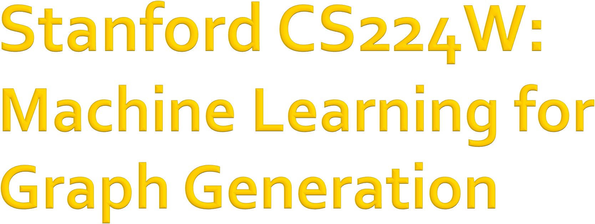
CS224W: Machine Learning with Graphs Jure Leskovec, Stanford University
http://cs224w.stanford.edu

Slide 7
Task 1: Realistic graph generation
Generate graphs that are similar to a given set of graphs [Focus of this lecture]
Task 2: Goal-directed graph generation
Generate graphs that optimize given objectives/constraints
  E.g., Drug molecule generation/optimization
7

Slide 8
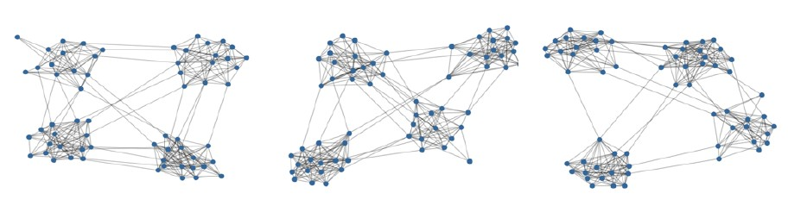
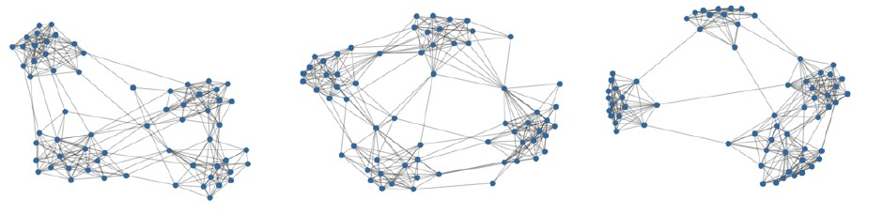
Given: Graphs sampled from 𝑝!"#"(𝐺)
Goal:
Learn the distribution 𝑝$%!&'(𝐺)
Sample from 𝑝$%!&'(𝐺)
𝑝!"#"(𝐺)
Learn & Sample
^{𝑝}$%!&'^{(𝐺)}
7

Slide 9
Setup:
Assume we want to learn a generative model from a set of data points (i.e., graphs) {𝒙!}
𝑝!"#"(𝒙) is the data distribution, which is never known to us, but we have sampled 𝒙$ ~ 𝑝!"#"(𝒙)
𝑝_{%&!'(}(𝒙; 𝜃) is the model, parametrized by 𝜃, that we use to approximate 𝑝!"#"(𝒙)
Goal:
  (1) Make 𝑝_{%&!'(} 𝑥; 𝜃 close to 𝑝!"#" 𝑥 (Density estimation)
  (2) Make sure we can sample from 𝑝_{%&!'(} 𝑥; 𝜃
(Sampling)
    We need to generate examples (graphs) from 𝑝!"#$% 𝒙; 𝜃
7

Slide 10
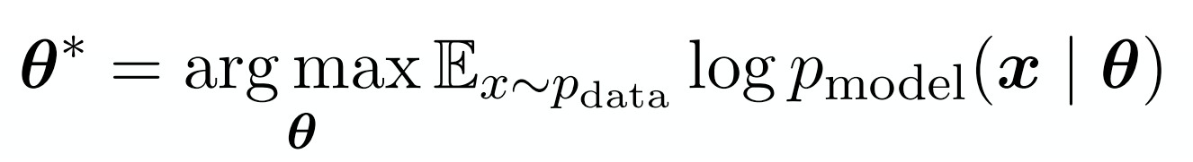
(1) Make 𝒑_{𝒎𝒐𝒅𝒆𝒍} 𝒙; 𝜽 close to 𝒑_{𝒅𝒂𝒕𝒂} 𝒙
Key Principle: Maximum Likelihood
Fundamental approach to modeling distributions
Find parameters 𝜃∗, such that for observed data points 𝒙₎~𝑝!"#", ∑₎ log 𝑝$%!&' 𝒙₎; 𝜃∗ has the highest value, among all possible choices of 𝜃
  That is, find the model that is most likely to have generated the observed data 𝑥
10

Slide 11
(2) Sample from 𝒑_{𝒎𝒐𝒅𝒆𝒍} 𝒙; 𝜽
Goal: Sample from a complex distribution
The most common approach:
  (1) Sample from a simple noise distribution
𝒛₎~𝑁(0,1)
  (2) Transform the noise 𝑧₎ via 𝑓(⋅)
𝒙₎ = 𝑓(𝒛₎; 𝜃)
Then 𝒙₎ follows a complex distribution
Q: How to design 𝒇(⋅)?
A: Use Deep Neural Networks, and train it using the data we have!

Slide 12
Auto-regressive models:
𝒑_{𝒎𝒐𝒅𝒆𝒍} 𝒙; 𝜽 is used for both density estimation and sampling (remember our two goals)
Other models like Variational Auto Encoders (VAEs), Generative Adversarial Nets (GANs) have 2 or more models, each playing one of the roles
Idea: Chain rule. Joint distribution is a product of conditional distributions:
)
= ' 𝑝!"#$%(𝑥&|𝑥₍, … , 𝑥_{&*(}; 𝜃)
&'(
^{𝑝}!"#$% ^{𝒙; 𝜃}
E.g., 𝒙 is a vector, 𝑥& is the 𝑡-th dimension;
𝒙 is a sentence, 𝑥& is the 𝑡-th word.
In our case: 𝑥& will be the 𝑡-th action (add node, add edge)

Slide 13

CS224W: Machine Learning with Graphs Jure Leskovec, Stanford University
http://cs224w.stanford.edu

Slide 14

Generating graphs via sequentially adding nodes and edges
[You et al., ICML 2018]
Graph 𝐺
1 3
5
2 4
Generation process 𝑆*
1
1 1
2 2
3 1 3 1 3
2 4 2 4
5
GraphRNN: Generating Realistic Graphs with Deep Auto-regressive Models. J. You, R. Ying, X. Ren, W. L. Hamilton, J. Leskovec. International Conference on Machine Learning (ICML), 2018.

Slide 15
Graph G with node ordering π can be uniquely mapped into a sequence of node and edge additions S⁾
Graph 𝐺 with node ordering 𝜋:
1 3
2 4
5
Sequence 𝑆*:
1 1 1
3 1
3
1
3
5
2
2
2
4
2
4
_{𝑆}+ _{𝑆}+
_{𝑆}+
_{𝑆}+
_{𝑆}+
)
𝑆⁺ = (
,
, -
,
,
/
(
,
.

Slide 16
The sequence 𝑆⁽ has two levels (𝑆 is a sequence of sequences):
Node-level: add nodes, one at a time
Edge-level: add edges between existing nodes
Node-level: At each step, a new node is added
1 1 1 3 1 3 1 3
5
2 2 2 4 2 4
_{𝑆}+ _{𝑆}+
_{𝑆}+
𝑆⁺ =
(
, , - …,
𝑆⁺ 𝑆⁺
)
(
,
.
,
/
“Add node 1”
“Add node 5”

Slide 17
The sequence 𝑆⁽ has two levels:
Each Node-level step is an edge-level sequence
Edge-level: At each step, add a new edge
1 3
2 4
_{𝑆}+
.
_{𝑆}+
_{𝑆}+
_{𝑆}+
)
𝑆⁺ = (
,
,
.,-
.
.,(
.,,
“Not connect 4, 1”
0
“Connect 4, 2”
1
“Connect 4, 3”
1

Slide 18
Summary: A graph + a node ordering = A sequence of sequences
Node ordering is randomly selected (we will come back to this)
Node-level sequence
1
3
0 | 1 | 1 | 0 | 0
1 | 0 | 0 | 1 | 0
1 | 0 | 0 | 1 | 1
0 | 1 | 1 | 0 | 1
0 | 0 | 1 | 1 | 0
5
⇔
Edge-level sequence
2
4
Graph 𝐺
Adjacency matrix

Slide 19
We have transformed graph generation problem into a sequence generation problem
Need to model two processes:
  1) Generate a state for a new node (Node-level sequence)
  2) Generate edges for the new node based on its state (Edge-level sequence)
Approach: Use Recurrent Neural Networks
(RNNs) to model these processes!
Jure Leskovec, Stanford CS224W: Machine Learning with Graphs, http://cs224w.stanford.edu

Slide 20
RNNs are designed for sequential data
RNN sequentially takes input sequence to update its hidden states
The hidden states summarize all the information input to RNN
The update is conducted via RNN cells
Output sequence:
𝑦₍ 𝑦,
RNN
cell
RNN
cell
Hidden states: 𝑠₁
𝑠₍
𝑠, …
Input sequence:
𝑥₍ 𝑥,
3/2/21
Jure Leskovec, Stanford CS224W: Machine Learning with Graphs, cs224w.stanford.edu
20

Slide 21
𝑠₎: State of RNN after step 𝑡
𝑥₎: Input to RNN at step 𝑡
In our case
𝑠!, 𝑥! and 𝑦!
are scalars
𝑦₎: Output of RNN at step 𝑡
RNN cell: 𝑊, 𝑈, 𝑉: Trainable parameters
𝑦&
The RNN cell:
Update hidden state:
𝑠# = 𝜎(𝑊 ⋅ 𝑥# + 𝑈 ⋅ 𝑠_{#+,})
Output prediction:
𝑦# = 𝑉 ⋅ 𝑠#
(2)
(1)
RNN
cell
𝑠
𝑠
&*(
&
𝑥&
More expressive cells: GRU, LSTM, etc.

Slide 22
GraphRNN has a node-level RNN and an edge-level RNN
Relationship between the two RNNs:
  Node-level RNN generates the initial state for edge-level RNN
  Edge-level RNN sequentially predict if the new node will connect to each of the previous node

Slide 23
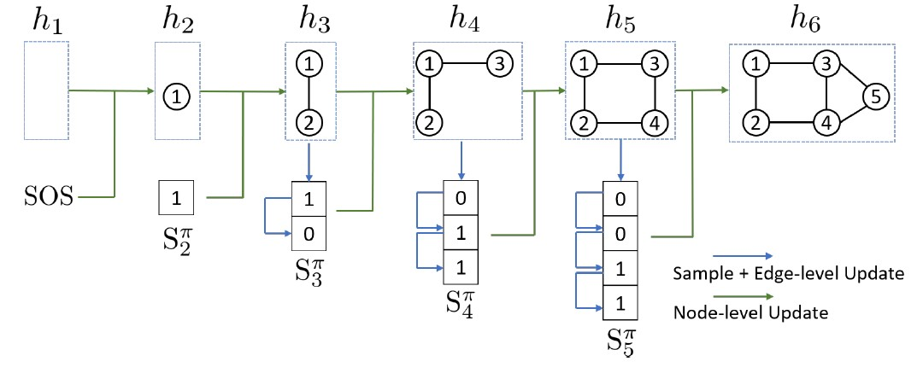
Node-level RNN generates the initial state for edge-level RNN
Edge-level RNN sequentially predict if the new node will connect to each of the previous node

Slide 24
Node-level RNN generates the initial state for edge-level RNN
Next: How to generate a sequence with RNN?
Edge-level RNN generates edges for the new node,
then update Node-level RNN state using generated results

Slide 25
Q: How to use RNN to generate sequences?
A: Let 𝑥_{#0,} = 𝑦#! (Use the previous output as input)
Q: How to initialize the input sequence?
A: Use start of sequence token (SOS) as the initial input
  SOS is usually a vector with all zero/ones
Q: When to stop generation?
A: Use end of sequence token (EOS) as an extra RNN output
  If output EOS=0, RNN will continue generation
  If output EOS=1, RNN will stop generation

Slide 26
Use the previous output as input
𝑦₍ 𝑦,
Stop generation
𝐸𝑂𝑆 = 1
RNN
cell
RNN
cell
RNN
cell
𝑠
𝑠₍
𝑠, …
^{𝑠}2*(
1
𝑥₍ = 𝑆𝑂𝑆
Initialize input
𝑥,= 𝑦₍
𝑥₋ = 𝑦,
This is good, but this model is deterministic

Slide 27
Remember our goal: Use RNN to model
∏3
, 𝑝$%!&'(𝑥#|𝑥,, … , 𝑥_{#+,}; 𝜃)
12
Let 𝑦# = 𝑝$%!&'(𝑥#|𝑥,, … , 𝑥_{#+,}; 𝜃)
Then we need to sample 𝑥_{#0,} from 𝑦#: 𝑥_{#0,}~𝑦#
  Each step of RNN outputs a probability of a single edge
  We then sample from the distribution, and feed sample to next step:
𝑦₍ 𝑦, 𝑦₋
RNN
cell
RNN
cell
RNN
cell
_{𝑠-} …
𝑠
𝑠₍
𝑠,
1
𝑥₍ = 𝑆𝑂𝑆
𝑥,~𝑦₍
𝑥₋~𝑦,

Slide 28

Suppose we already have trained the model
𝑦# is a scalar, following a Bernoulli distribution
means value 1 has prob. 𝑝, value 0 has prob. 1 − 𝑝
𝑝
𝑦₍ = 𝑦, = 𝑦₋ =
0.9
0.4
0.7
RNN
cell
RNN
cell
RNN
cell
_{𝑠-} …
𝑠₁ = 𝑆𝑂𝑆
𝑠₍
𝑠,
𝑥₍ = 𝑆𝑂𝑆
𝑥, ~
𝑥, =
𝑥₋ ~
𝑥₋ =
0.9
0.4
1
1
How do we use training data 𝒙_{𝟏}, 𝒙_{𝟐}, … , 𝒙_{𝒏}?

Slide 29

Training the model:
We observe a sequence 𝑦∗ of edges [1,0,…]
Principle: Teacher Forcing -- Replace input and output by the real sequence
Compute loss
𝑦∗ = 𝑦∗ = 𝑦∗ =
(
𝑦₍ =
1
,
𝑦, =
0
-
𝑦₋ =
1
0.9
0.4
0.7
RNN
cell
RNN
cell
RNN
cell
𝑠₁ = 𝑆𝑂𝑆
𝒔₍
𝑠,
𝑠₋
𝑥₍ = 𝑆𝑂𝑆
𝑥, =
1
𝑥₋ =
0
29

Slide 30
Loss 𝐿 : Binary cross entropy
Minimize:
𝐿 = −[𝑦∗log(𝑦₊) + (1 − 𝑦∗)log(1 − 𝑦₊)]
+ +
Compute loss
𝑦∗ =
,
𝑦, =
1
0.9
If 𝑦∗ = 1, we minimize −log(𝑦,), making 𝑦, higher
,
If 𝑦∗ = 0, we minimize −log(1 − 𝑦,), making 𝑦, lower
,
This way, 𝑦, is fitting the data samples 𝑦∗
,
Reminder: 𝑦, is computed by RNN, this loss will adjust RNN parameters accordingly, using back propagation!

Slide 31
Our Plan:
Add a new node: We run Node RNN for a step, and use it output to initialize Edge RNN
Add new edges for the new node: We run Edge RNN to predict if the new node will connect to each of the
previous node
Add another new node: We use the last hidden state of Edge RNN to run Node RNN for another step
Stop graph generation: If Edge RNN outputs EOS at step 1, we know no edges are connected to the new node.
We stop the graph generation.
12/6/18

Slide 32
Assuming Node 1 is in the graph Now adding Node 2
3
2
0 | 1 | 1
1 | 0 | 0
1 | 0 | 0
1
Observed graph
Node
RNN
𝑆𝑂𝑆
Start the node RNN
12/6/18

Slide 33
Edge RNN predicts how
Node 2 connects to Node 1
3
2
0 | 1 | 1
1 | 0 | 0
1 | 0 | 0
1
Observed graph
0.5
Edge
RNN
𝑆𝑂𝑆
Start the edge RNN
Will node 2 connect to node 1?
Node
RNN
𝑆𝑂𝑆
12/6/18

Slide 34
Update Node RNN using
Edge RNN’s hidden state
3
2
0 | 1 | 1
1 | 0 | 0
1 | 0 | 0
1
Observed graph
0.5
Edge RNN
𝑆𝑂𝑆
Node RNN
Node RNN
𝑆𝑂𝑆
12/6/18

Slide 35
Edge RNN predicts how Node 3 tries to connects to Nodes 1, 2
3
2
0 | 1 | 1
1 | 0 | 0
1 | 0 | 0
1
0.4
Edge
RNN
0
Observed graph
Will node 3
Teacher forcing: node 3 won’t connect to node 2
𝑆𝑂𝑆
connect to node 1?
0.5
Edge
RNN
𝑆𝑂𝑆 0.6
Edge
RNN
Will node 3
connect to node 2?
Node
RNN
Node
RNN
𝑆𝑂𝑆
12/6/18

Slide 36
Update Node RNN using
Edge RNN’s hidden state
3
2
0 | 1 | 1
1 | 0 | 0
1 | 0 | 0
1
0.4
Edge RNN
0
Observed graph
0.5
Edge
RNN
0.6
Edge RNN
𝑆𝑂𝑆
𝑆𝑂𝑆
Node
RNN
Node RNN
Node RNN
𝑆𝑂𝑆
12/6/18

Slide 37
Stop generation since we know node 4 won’t connect to any nodes
3
2
0 | 1 | 1
1 | 0 | 0
1 | 0 | 0
1
4
0.4
Edge
RNN
0
Observed graph
𝐸𝑂𝑆
0.5
Edge
RNN
𝑆𝑂𝑆
0.6
Edge
RNN
𝑆𝑂𝑆
0.4
Edge
RNN
𝑆𝑂𝑆
Node
RNN
Node
RNN
Node
RNN
𝑆𝑂𝑆
12/6/18

Slide 38
For each prediction, we get supervision from the ground truth
3
2
0 | 1 | 1
1 | 0 | 0
1 | 0 | 0
1
0.4
Edge
RNN
0
Observed graph
1
𝐸𝑂𝑆
0.5
Edge
RNN
𝑆𝑂𝑆
0.6
Edge
RNN
𝑆𝑂𝑆
0.4
Edge
RNN
𝑆𝑂𝑆
1
0
Node
RNN
Node
RNN
Node
RNN
𝑆𝑂𝑆
12/6/18

Slide 39
Backprop through time: Gradients are accumulated across time steps
3
2
0 | 1 | 1
1 | 0 | 0
1 | 0 | 0
1
0.4
Edge RNN
0
Observed graph
1
𝐸𝑂𝑆
Edge RNN
Edge RNN
Edge RNN
0.5
𝑆𝑂𝑆
0.6
𝑆𝑂𝑆
0.4
𝑆𝑂𝑆
1
0
Node RNN
Node RNN
Node RNN
𝑆𝑂𝑆
12/6/18

Slide 40
Test time: (1) Sample edge connectivity based on predicted distribution
3
2
0 | 1 | 1
1 | 0 | 0
1 | 0 | 0
(2) Replace input at each step by GraphRNN’s own predictions
1
0.8
~
Edge RNN
0
Observed graph
1
Edge RNN
Edge RNN
Edge RNN
0.9
~
𝑆𝑂𝑆
0.2
~
𝑆𝑂𝑆
0.5
𝑆𝑂𝑆
~
1
0
𝐸𝑂𝑆
Node RNN
Node RNN
Node RNN
𝑆𝑂𝑆
12/6/18
40

Slide 41
Quick Summary of GraphRNN:
Generate a graph by generating a two level sequence
Use RNN to generate the sequences
Next: Making GraphRNN tractable, proper evaluation
Node-level RNN
1
3
0 | 1 | 1 | 0 | 0
1 | 0 | 0 | 1 | 0
1 | 0 | 0 | 1 | 1
0 | 1 | 1 | 0 | 1
0 | 0 | 1 | 1 | 0
5
⇔
Edge-level RNN
2
4
Graph 𝐺
Adjacency matrix
41

Slide 42

Any node can connect to any prior node
Too many steps for edge generation
Need to generate full adjacency matrix
Complex too-long edge dependencies
“Recipe” to generate the left graph:
- Add node 1
1 3
5 4
Add node 2
Add node 3
Connect 3 with 2 and 1
Add node 4
- …
2
Random node ordering:
Node 5 may connect to any/all previous nodes
How do we limit this complexity?

Slide 43
Breadth-First Search node ordering
“Recipe” to generate the left graph:
1 3
2 4
BFS ordering
Add node 1
Add node 2
Connect 2 with 1
Add node 3
Connect 3 with 1
Add node 4
Connect 4 with 3 and 2
5
BFS node ordering:
  Since Node 4 doesn’t connect to Node 1
  We know all Node 1’s neighbors have already been traversed
  Therefore, Node 5 and the following nodes will never connect to node 1
  We only need memory of 2 “steps” rather than n − 1 steps

Slide 44
Breadth-First Search node ordering
BFS node ordering: Node 5 will never connect to node 1
(only need memory of 2 “steps” rather than 𝑛 − 1 steps)
1 3
2 4
BFS ordering
5
Benefits:
  Reduce possible node orderings
    From 𝑂(𝑛!) to number of distinct BFS orderings
  Reduce steps for edge generation
    Reducing number of previous nodes to look at

Slide 45
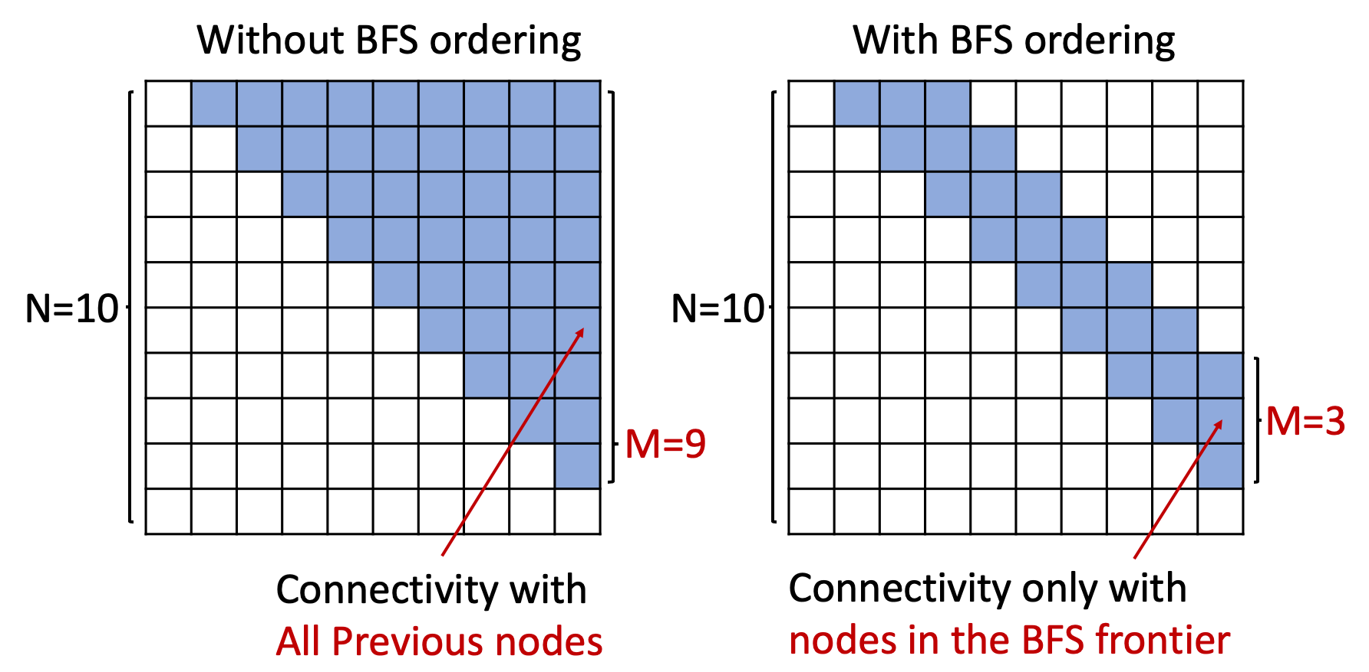
BFS reduces the number of steps for edge generation
Adjacency matrices

Slide 46
Task: Compare two sets of graphs
How similar?
Goal: Define similarity metrics for graphs
Solution
  (1) Visual similarity
  (2) Graph statistics similarity

Slide 47

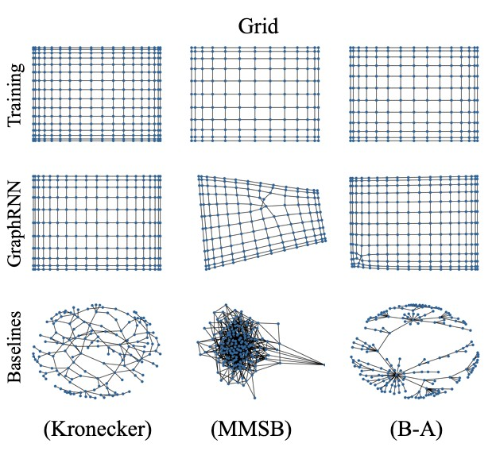

Slide 48
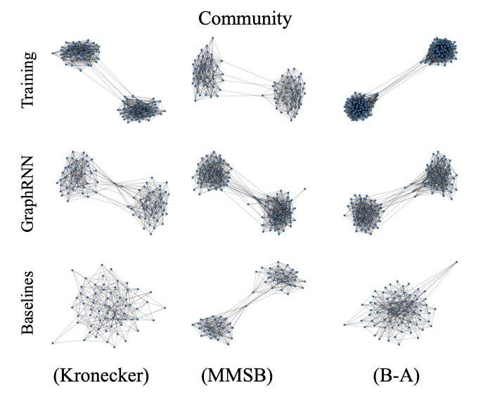

Slide 49
Can we do more rigorous comparison?
Issue: Direct comparison between two graphs is hard (isomorphism test is NP)!
Solution: Compare graph statistics!
Typical Graph Statistics:
  Degree distribution (Deg.)
  Clustering coefficient distribution (Clus.)
  Orbit count statistics (Orbit)
Note: Each statistic is a probability distribution
Jure Leskovec, Stanford CS224W: Machine Learning with Graphs, cs224w.stanford.edu
49

Slide 50
Issue: want to compare sets of training graph statistics and generated graph statistics
How similar?
Solution:
Step 1: How to compare two graph statistics
  Earth Mover Distance (EMD)
Step 2: How to compare sets of graph statistics
  Maximum Mean Discrepancy (MMD) based on EMD
Jure Leskovec, Stanford CS224W: Machine Learning with Graphs, cs224w.stanford.edu
59

Slide 51
Step 1: Earth Mover Distance (EMD)
Compare similarity between 2 distributions
Intuition: Measure the minimum effort that move earth from one pile to the other
High EMD
Low EMD
Degree dist. A
Degree dist. B
Degree dist. A
Degree dist. C
Jure Leskovec, Stanford CS224W: Machine Learning with Graphs, cs224w.stanford.edu

Slide 52
Step 2: Maximum Mean Discrepancy (MMD)
Compare similarity between 2 sets, based on the similarity between set elements
High MMD _{{6,1,2}}
{2,3,5}
{2,3,5} ^{Low MMD} {5,4,2}
Similarity between set elements: L2 distance
(Each element is a scalar)
Recall: We compare 2 sets of graph statistics (distributions)
MMD
{
} { }
Similarity between set elements: EMD
(Each element is a distribution)
Jure Leskovec, Stanford CS224W: Machine Learning with Graphs, cs224w.stanford.edu

Slide 53
Putting things together
How similar?
Compute graph statistics
Report MMD: set distance
where similarity between set elements are computed by EMD distribution distance
Jure Leskovec, Stanford CS224W: Machine Learning with Graphs, cs224w.stanford.edu

Slide 54
Example
How similar?
Compute cluster coefficient distribution
Report MMD:
set distance
 | Erdos-Renyi | Kronecker | GraphRNN
MMD score | 1.24 | 1.67 | 0.002
Jure Leskovec, Stanford CS224W: Machine Learning with Graphs, cs224w.stanford.edu

Slide 55

CS224W: Machine Learning with Graphs Jure Leskovec, Stanford University
http://cs224w.stanford.edu

Slide 56
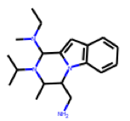
[You et al., NeurIPS 2018]
Question: Can we learn a model that can generate valid and realistic molecules with optimized property scores?
Model
output
that optimizes
Property
e.g., drug_likeness=0.95
Graph Convolutional Policy Network for Goal-Directed Molecular Graph Generation. J. You, B. Liu, R. Ying, V. Pande, J. Leskovec. Neural Information Processing Systems (NeurIPS), 2018.

Slide 57
Generating graphs that:
Optimize a given objective (High scores)
  e.g., drug-likeness
Obey underlying rules (Valid)
  e.g., chemical validity rules
Are learned from examples (Realistic)
  Imitating a molecule graph dataset
    We have just covered this part

Slide 58

Generating graphs that:
Optimize a given objective (High scores)
  e.g., drug-likeness
Obey underlying rules (Valid)
  e.g., chemical validity rules
▪ Are learned from examples (Realistic)
▪ Imitating a molecule graph dataset
▪ Covered this part when introducing GraphRNN
Including “Black-box” in ML:
Objectives like drug-likeness are governed by physical law, which are assumed to be unknown to us!

Slide 59


A ML agent observes the environment, takes an action to interact with the environment, and receives positive or negative reward
The agent then learns from this loop
Key idea: Agent can directly learn from environment, which is a blackbox to the agent
ML Agent
Observation, Reward
Action
Environment
60

Slide 60

Graph Convolutional Policy Network (GCPN)
combines graph representation + RL
Key component of GCPN:
Graph Neural Network captures graph structural information
Reinforcement learning guides the generation
towards the desired objectives
Supervised training imitates examples in given datasets
61

Slide 61

Commonality of GCPN & GraphRNN:
Generate graphs sequentially
Imitate a given graph dataset
Main Differences:
  GCPN uses GNN to predict the generation action
    Pros: GNN is more expressive than RNN
    Cons: GNN takes longer time to compute than RNN
  GCPN further uses RL to direct graph generation to our goals
    RL enables goal-directed graph generation
Jure Leskovec, Stanford CS224W: Machine Learning with Graphs, cs224w.stanford.edu

Slide 62
Sequential graph generation
GraphRNN: predict action based on RNN hidden states
0 1 1
1 3 1
3
Node
RNN
Edge
RNN
Edge
RNN
Edge
RNN
2 2 4
RNN hidden state captures the generated graph so far
GCPN: predict action based on GNN node embeddings
Recall the link prediction head:
1
3
1
3
1
3
GNN
Head!"#$(𝐡 & , 𝐡 & ):=
% '
2
4
2 4
Node embeddings
2 4
Linear(Concat(𝐡 & , 𝐡 & ))
% '
Predict potential links using node embeddings
Jure Leskovec, Stanford CS224W: Machine Learning with Graphs, cs224w.stanford.edu

Slide 63
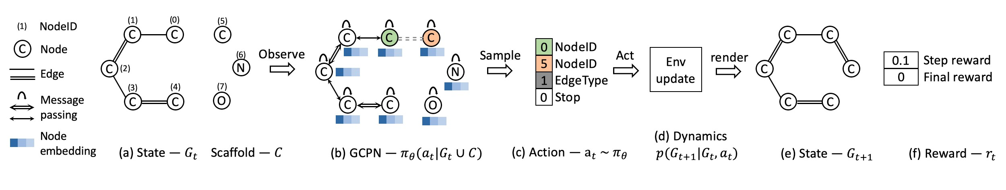
(a) Insert nodes
(b,c) Use GNN to predict which nodes to connect
(d) Take action (check chemical validity)
(e, f) Compute reward

Slide 64
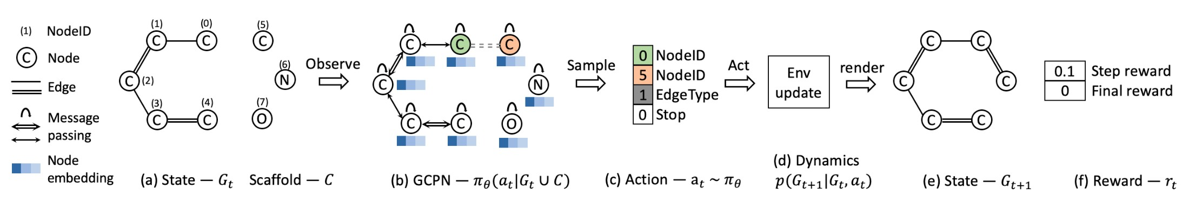
Step reward: Learn to take valid action
At each step, assign small positive reward for valid action
Final reward: Optimize desired properties
  At the end, assign positive reward for high desired property
Reward = Final reward + Step reward

Slide 65
Two parts:
(1) Supervised training: Train policy by imitating the action given by real observed graphs. Use gradient.
We have covered this idea in GraphRNN
(2) RL training: Train policy to optimize rewards.
Use standard policy gradient algorithm
  Refer to any RL course, e.g., CS234

Slide 66

Gradient
Real
∗
graph !"#$
Query dataset
C C
C
Supervised Training
C
0.6
Cross entropy loss
Generated graph !"#$
C N
Graph !"
C
Run one step
C
C
GCPN
C
C
Generated
graph !∗
RL
Training
Run until stop
%
N
0.1
1
Step reward Final reward
C
Environment
C
N
C
C
Policy gradient

Slide 67
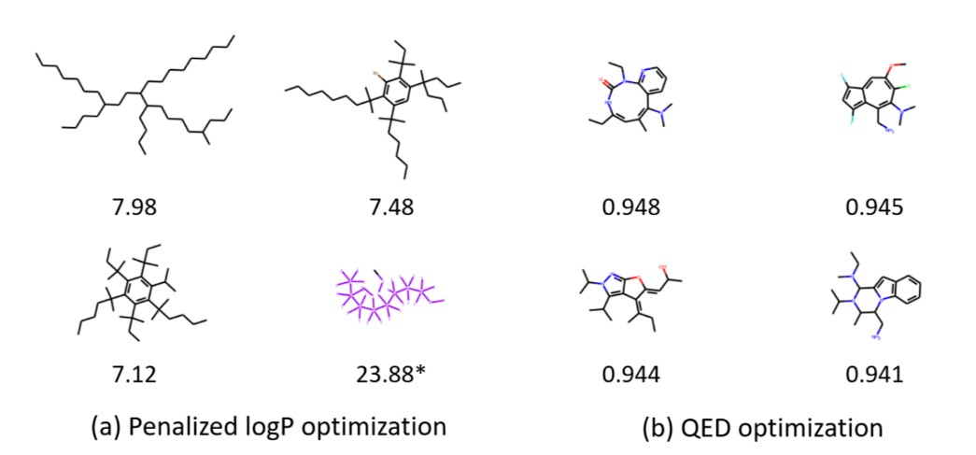
Visualization of GCPN graphs:
Property optimization Generate molecules with high specified property score

Slide 68
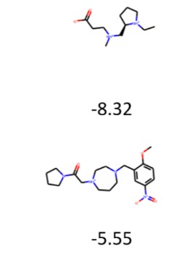
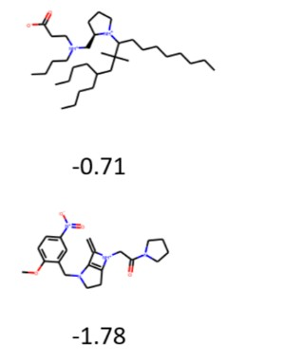

Visualization of GCPN graphs:
Constrained optimization: Edit a given molecule for a few steps to achieve higher property score
Starting structure Finished structure
Increase the solubility in octanol
3/2/21
Jure Leskovec, Stanford CS224W: Machine Learning with Graphs, http://cs224w.stanford.edu
69

Slide 69
Complex graphs can be successfully generated via sequential generation using deep learning
Each step a decision is made based on hidden state, which can be
Implicit: vector representation, decode with RNN
Explicit: intermediate generated graphs, decode with GCN
Possible tasks:
  Imitating a set of given graphs
  Optimizing graphs towards given goals
3/2/21
Jure Leskovec, Stanford CS224W: Machine Learning with Graphs, http://cs224w.stanford.edu
70

