Slide 1

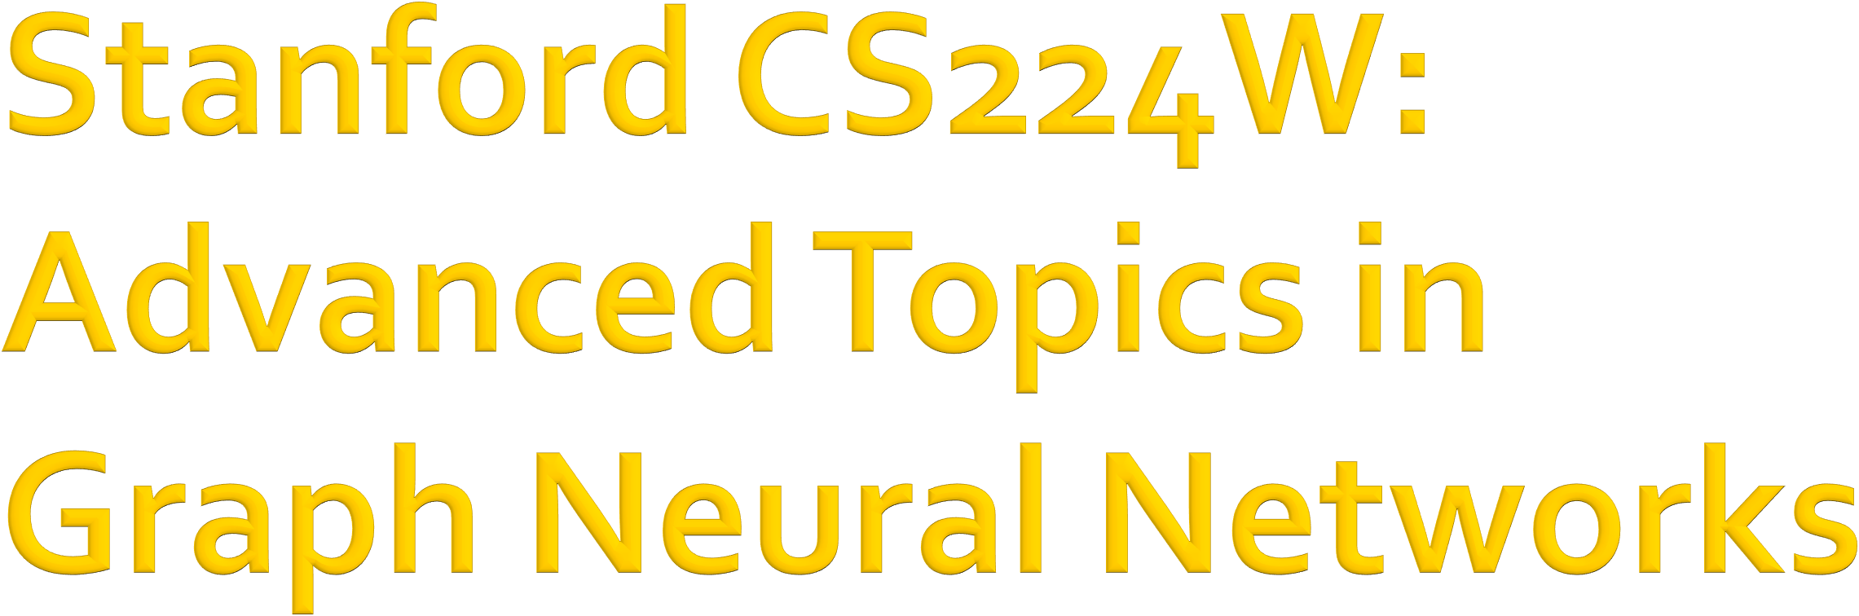

CS224W: Machine Learning with Graphs Jure Leskovec, Stanford University
http://cs224w.stanford.edu

Slide 2
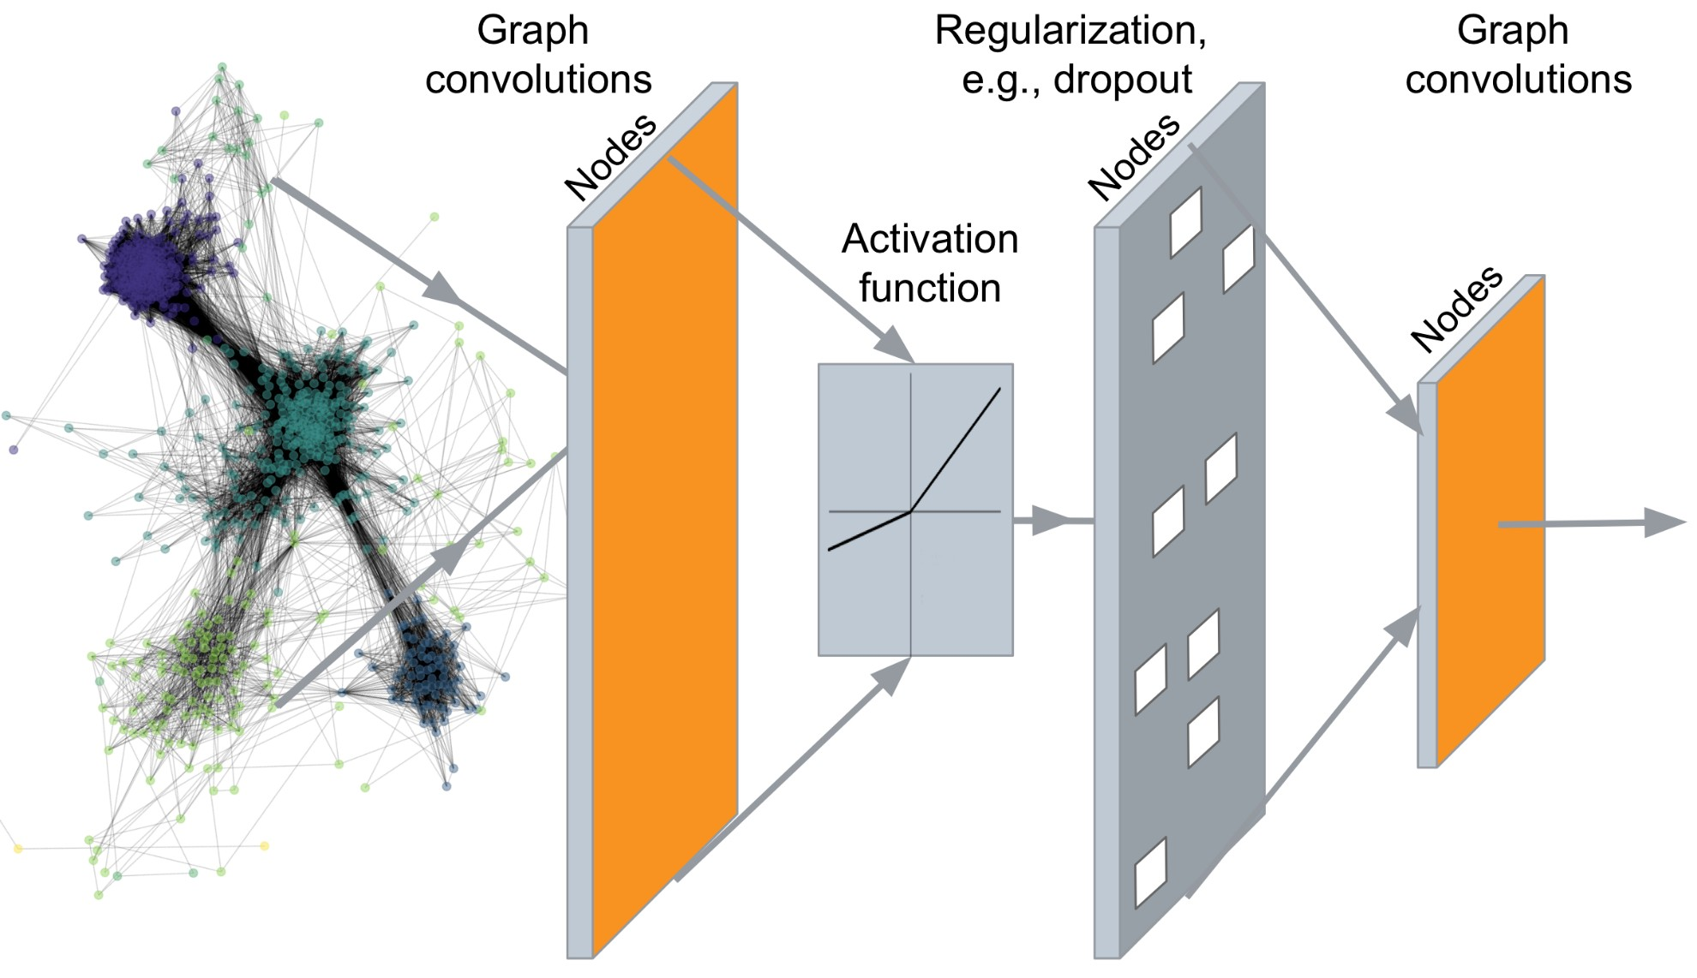
…
Output: Node embeddings.
We can also embed larger network structures, subgraphs, graphs
Jure Leskovec, Stanford CS224W: Machine Learning with Graphs, hBp://cs224w.stanford.edu
3/4/21
2

Slide 3
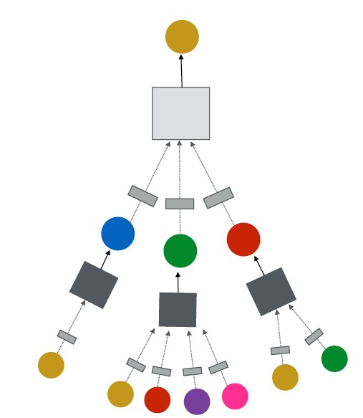
J.You, R.Ying, J. Leskovec. Design Space of Graph Neural Networks, NeurIPS 2020c
TARGET NODE
B
(5) Learning objective
A
C
D
E
F
INPUT GRAPH
(2) Aggregation
(1) Message
GNN Layer 1
(3) Layer connectivity
GNN Layer 2
(4) Graph augmentation
Jure Leskovec, Stanford CS224W: Machine Learning with Graphs, http://cs224w.stanford.edu
3

Slide 4
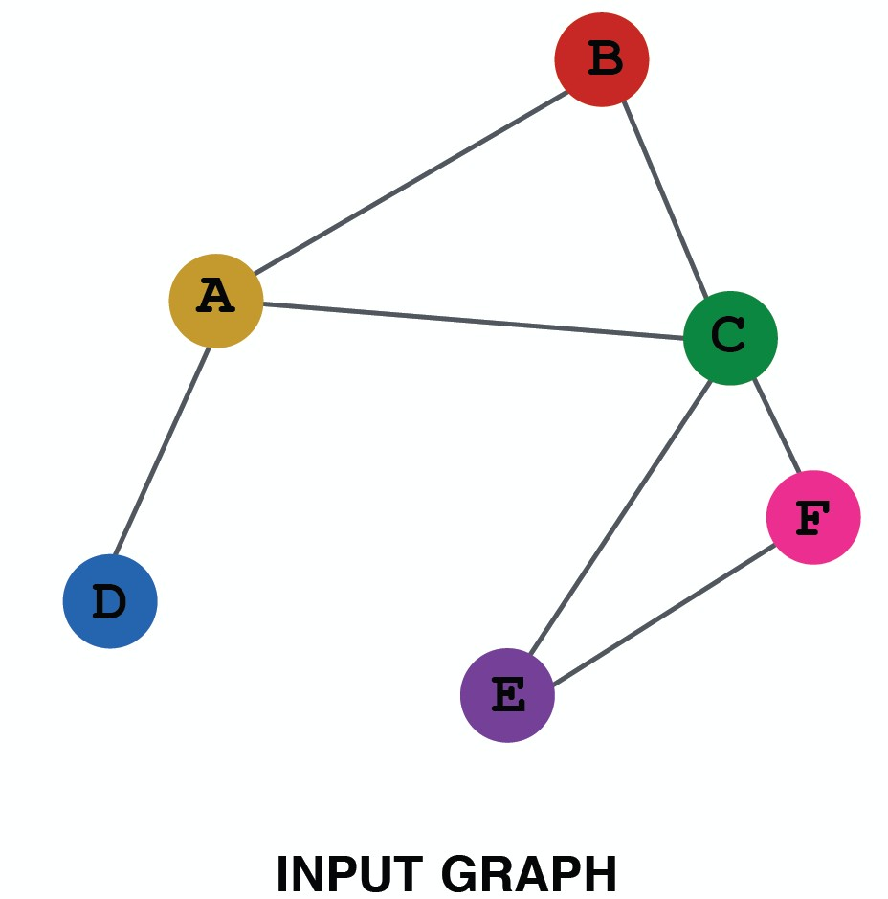
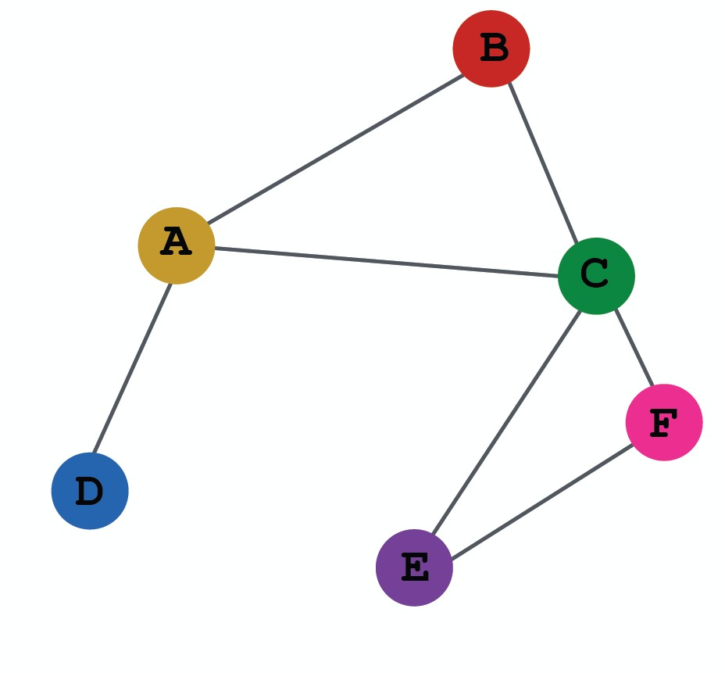
Dataset split
Evalua:on metrics
Input Graph
Graph Neural Network
Node embeddings
Prediction head
Predictions
Labels
Loss function
Today’s lecture: Can we make GNN representation more expressive?
Jure Leskovec, Stanford CS224W: Machine Learning with Graphs, http://cs224w.stanford.edu
3

Slide 5
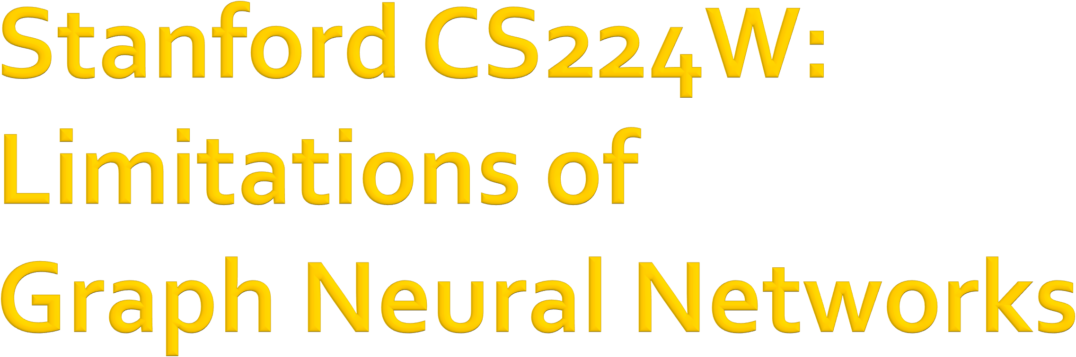
CS224W: Machine Learning with Graphs Jure Leskovec, Stanford University
http://cs224w.stanford.edu

Slide 6
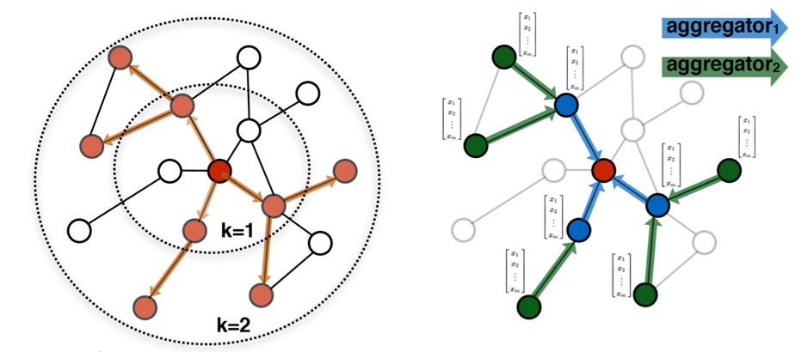
A thought experiment: What should a perfect GNN do?
A 𝑘-layer GNN embeds a node based on the 𝐾-hop neighborhood structure
A perfect GNN should build an injective function between neighborhood structure (regardless of hops) and node embeddings
6

Slide 7
Therefore, for a perfect GNN:
Observation 1: If two nodes have the same neighborhood structure, they must have the same embedding
ℎ!$ = ℎ!%
𝑣! 𝑣"
Observation 2: If two nodes have different neighborhood structure, they must have different embeddings
ℎ!$ ≠ ℎ!&
𝑣! 𝑣#
6

Slide 8
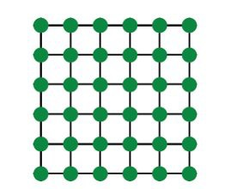
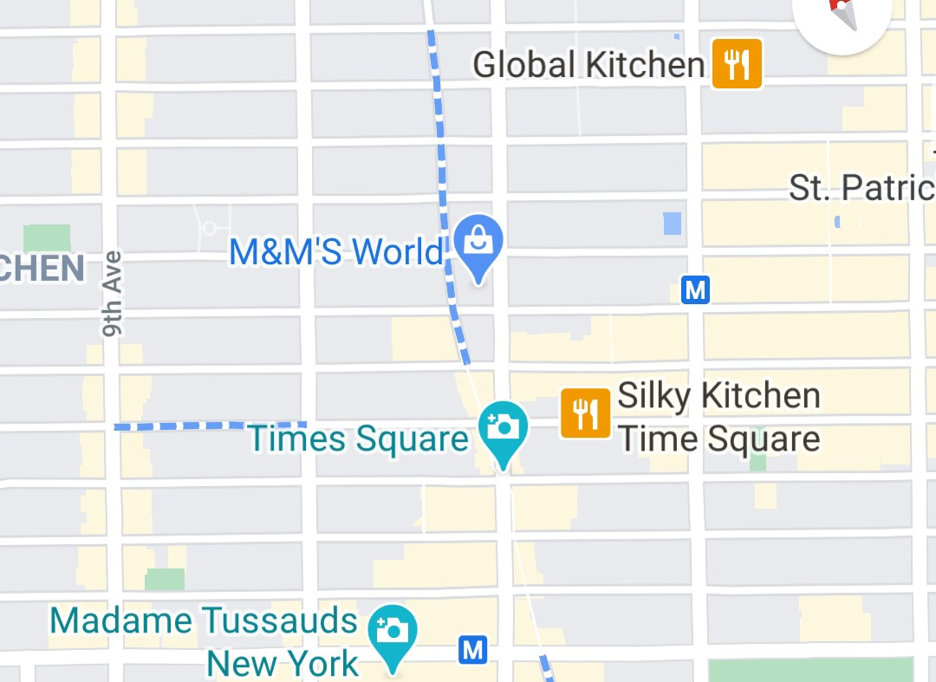
However, Observations 1 & 2 are imperfect
Observation 1 could have issues:
J.You, R.Ying, J. Leskovec. Postion-aware Graph Neural Networks, ICML 2019
Even though two nodes may have the same neighborhood structure, we may want to assign different embeddings to them
Because these nodes appear in different positions in the graph
We call these tasks Position-aware tasks
Even a perfect GNN will fail for these tasks:
𝑣#
𝑣#
𝑣"
𝑣"
A grid graph
NYC road network
6

Slide 9
Observation 2 often cannot be satisfied:
J.You, J. Gomes-Selman, R.Ying, J. Leskovec. Identity-aware Graph Neural Networks, AAAI 2021
The GNNs we have introduced so far are not perfect
In Lecture 9, we discussed that their expressive power is upper bounded by the WL test
For example, message passing GNNs cannot count cycle length:
The computational graphs for nodes 𝒗_{𝟏} and 𝒗_{𝟐} are
𝑣! resides in a cycle with length 3
𝑣!
𝑣" resides in a cycle with length 4
always the same
!!
𝑣"
…
3/4/21
Jure Leskovec, Stanford CS224W: Machine Learning with Graphs
9

Slide 10
We will resolve both issues by building more expressive GNNs
Fix issues in ObservaBon 1:
Create node embeddings based on their posiDons in the graph
Example method: PosiDon-aware GNNs
Fix issues in ObservaBon 2:
  Build message passing GNNs that are more expressive than WL test
  Example method: IdenDty-aware GNNs

Slide 11

We use the following thinking:
Two different inputs (nodes, edges, graphs) are labeled differently
A “failed” model will always assign the same embedding to them
A “successful” model will assign different embeddings to them
Embeddings are determined by GNN computational graphs:
A !!
B
!"
Two inputs: nodes 𝑣# and 𝑣$
Different labels: A and B
Goal: assign different embeddings to 𝑣# and 𝑣$

Slide 12
A naïve solution: One-hot encoding
Encode each node with a different ID, then we can always differentiate different nodes/edges/graphs
1000 0100
A !!
1000
B
!"
Input graphs
0001
0100
0010
0001
0100
!!
0001
0010
!!
0100
Computational graphs are clearly different if each node has a
Computational graphs
…
…
different ID
12

Slide 13
A naïve solution: One-hot encoding
Encode each node with a different ID, then we can always differentiate different nodes/edges/graphs
1000 0100
A !!
1000
B
!"
Input graphs
0001
0100 0010 0001
Issues:
  Not scalable: Need 𝑂(𝑁) feature dimensions (𝑁 is the number of nodes)
§ Not inductive: Cannot generalize to new nodes/graphs
Jure Leskovec, Stanford CS224W: Machine Learning with Graphs
13

Slide 14

CS224W: Machine Learning with Graphs Jure Leskovec, Stanford University
http://cs224w.stanford.edu

Slide 15
There are two types of tasks on graphs
J.You, R.Ying, J. Leskovec. Postion-aware Graph Neural Networks, ICML 2019
Structure-aware task
Nodes are labeled by their structural roles in the graph
A !"
A
B B
!#
A
A
Nodes are labeled by their positions in the graph
Position-aware task
A !"
!#
B
A B
A
B

Slide 16
GNNs often work well for structure-aware tasks
Structure-aware task
GNNs work J
Can differentiate 𝑣% and
𝑣& by using different computational graphs
A !"
A
B
!#
B
A
A
A !"
!# B
≠
…
…
…
…

Slide 17
GNNs will always fail for position-aware tasks
GNNs fail L
Position-aware task
𝑣% and 𝑣& will always have the same computational graph, due to structure symmetry
Can we define deep learning methods that are position-aware?
A !"
!#
B
A
B
A
B
A !"
!# B
=
…
…
…
…

Slide 18
Randomly pick a node 𝑠% as an anchor node
Represent 𝑣% and 𝑣& via their relative distances w.r.t. the anchor 𝑠%, which are different
An anchor node serves as a coordinate axis
  Which can be used to locate nodes in the graph
Relative
Distances
A ^{𝑣}#
𝑣_{$ B}
A B
𝑠#
 | 𝑠#
𝑣# | 1
𝑣$ | 2
A
B
Anchor

Slide 19
Pick more nodes 𝑠%, 𝑠& as anchor nodes
Observation: More anchors can better characterize node position in different regions of the graph
Many anchors –> Many coordinate axes
Relative Distances
A ^{𝑣}#
𝑣_{$ B}
 | 𝑠# | 𝑠$
𝑣# | 1 | 2
𝑣$ | 2 | 1
A
𝑠#
B
𝑠$
A
B
Anchor
Anchor

Slide 20
Generalize anchor from a single node to a set of nodes
We define distance to an anchor-set as the minimum distance to all the nodes in the ancho-set
Observation: Large anchor-sets can sometimes provide more precise position estimate
  We can save the total number of anchors
Relative Distances
A ^{𝑣}#
B
A
𝑠#
𝑠%
Size-2
B
𝑠$
 | 𝑠# | 𝑠$ | 𝑠%
𝑣# | 1 | 2 | 1
𝑣% | 1 | 2 | 0
A ^{𝑣}%
B
Anchor
Anchor-set
Anchor 𝑠!, 𝑠" cannot differentiate node 𝑣!, 𝑣%, but anchor-set 𝑠% can
20

Slide 21
Position encoding for graphs: Represent a node’s position by its distance to randomly selected anchor-sets
  Each dimension of the position encoding is tied to an anchor-set
A ^{𝑣}#
B
 | 𝑠# | 𝑠$ | 𝑠%
𝑣# | 1 | 2 | 1
𝑣% | 1 | 2 | 0
A
𝑠#
𝑠%
Size-2
B
𝑠$
𝑣!’s Position encoding
𝑣#’s Position encoding
A ^{𝑣}%
B
Anchor
Anchor-set
21

Slide 22
The simple way: Use position encoding as an augmented node feature (works well in practice)
Issue: since each dimension of position encoding is tied to a random anchor, dimensions of positional encoding can be randomly permuted, without changing its meaning
Imagine you permute the input dimensions of a normal NN, the output will surely change
21

Slide 23
The rigorous solution: requires a special NN that can maintain the permutation invariant property of position encoding
Permuting the input feature dimension will only result in the permutation of the output dimension, the value in each dimension won’t change
Refer to the Position-aware GNN paper for more details
21

Slide 24

CS224W: Machine Learning with Graphs Jure Leskovec, Stanford University
http://cs224w.stanford.edu

Slide 25
We learned that GNNs would fail for position-aware tasks
But can GNN perform perfectly in structure- aware tasks?
J.You, J. Gomes-Selman, R.Ying, J. Leskovec. Identity-aware Graph Neural Networks, AAAI 2021
Unfortunately, NO
GNNs exhibit three levels of failure cases in structure-aware tasks:
  Node level
  Edge level
  Graph level
25

Slide 26
Different Inputs but the same computational graph à GNN fails
A 𝑣!
B ^{𝑣}"
Example input graphs
Existing GNNs’ computational graphs
𝑣!
A
=
B
𝑣"
…
…
25

Slide 27
Different Inputs but the same computational graph à GNN fails
𝑣" 𝑣#
Example input graphs
A
B
Edge A and B share node 𝑣&
We look at embeddings for 𝑣! and 𝑣"
𝑣$
Existing GNNs’ computational graphs
A =
𝑣"
B
𝑣#
…
…
25

Slide 28
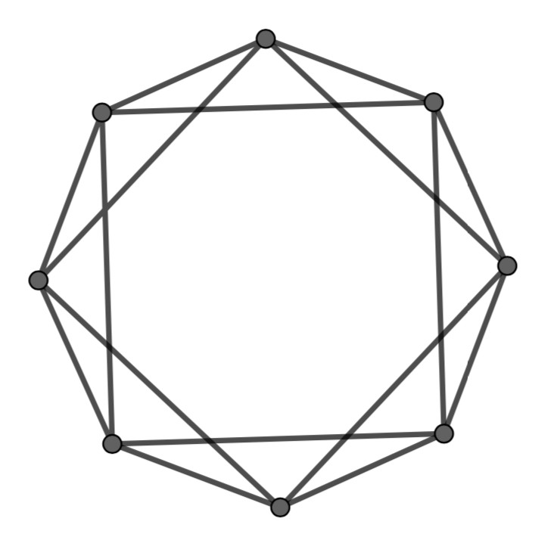
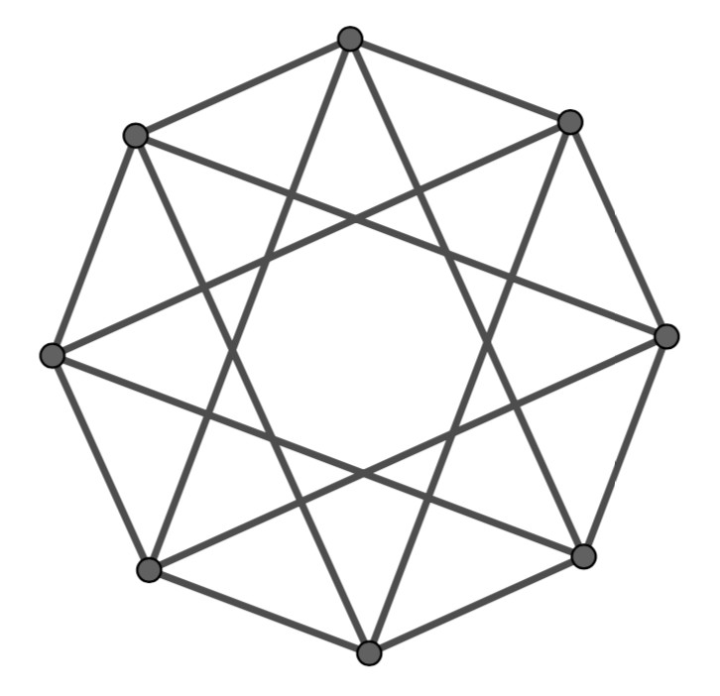
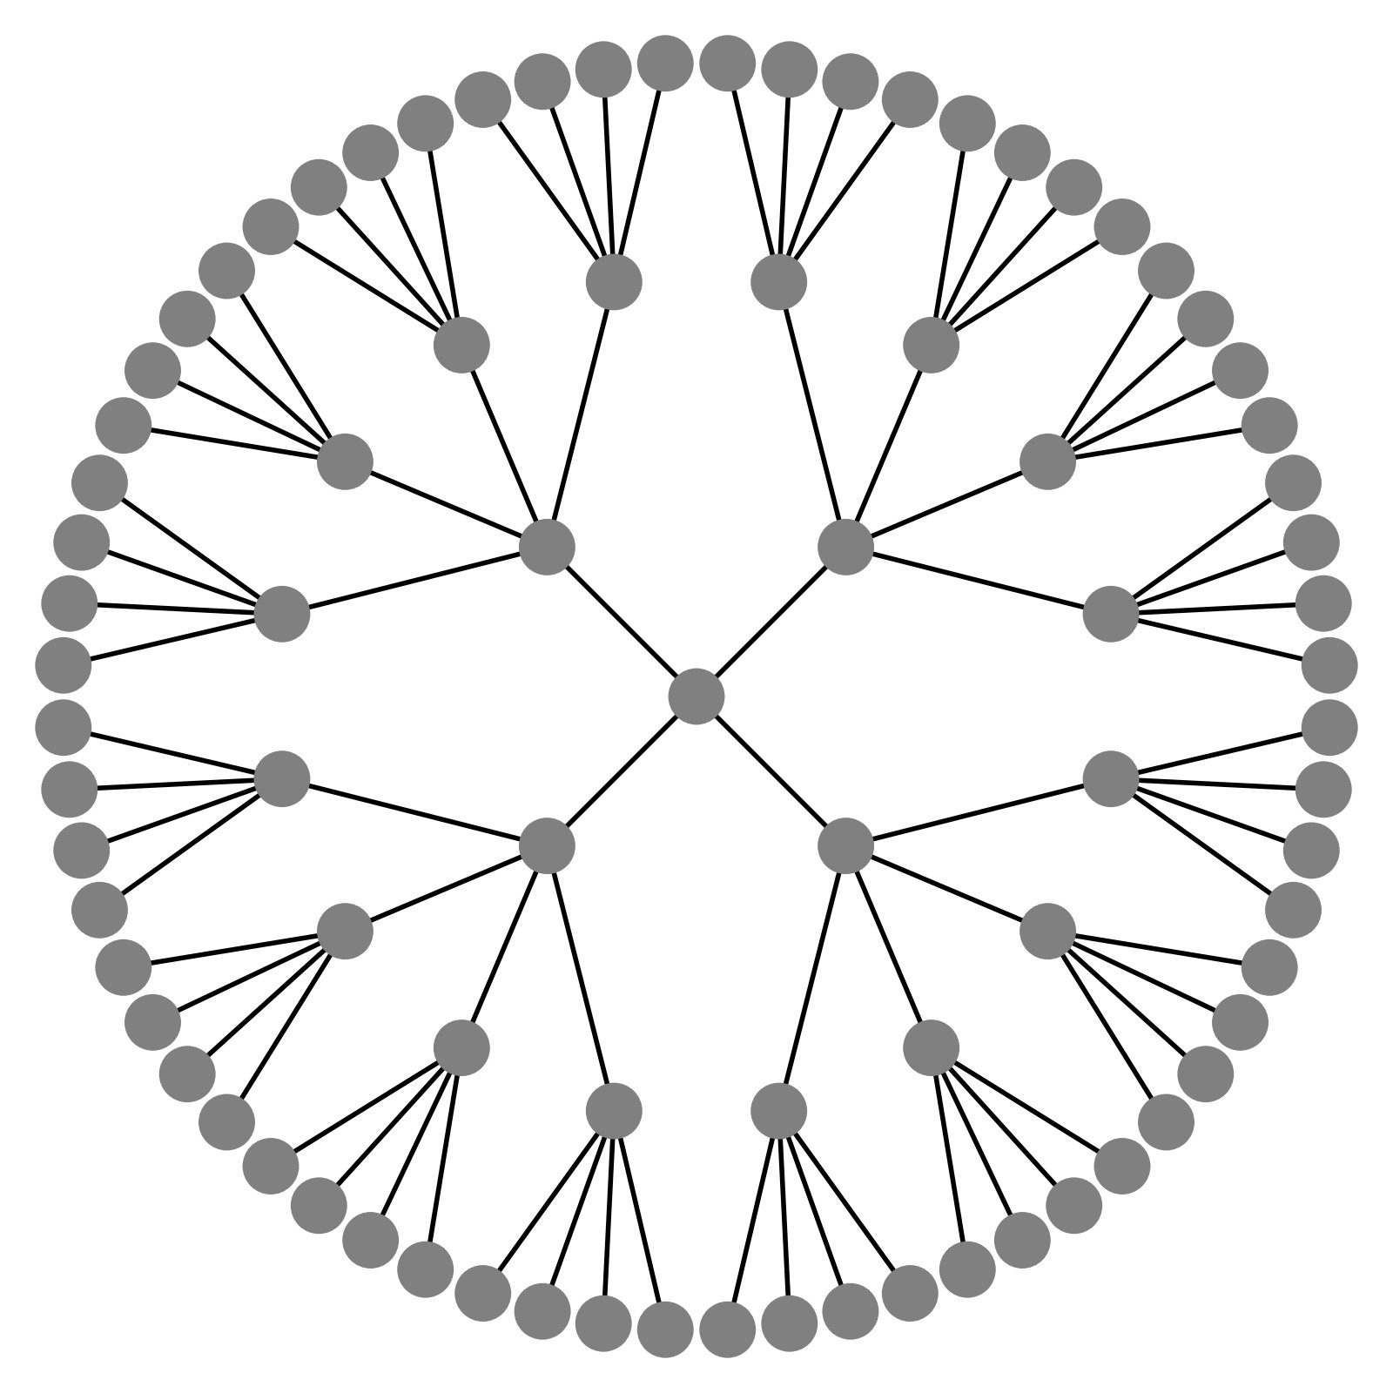
Different Inputs but the same computational graph à GNN fails
A B
Example input graphs
We look at embeddings for each node
For each node:
For each node:
A
B
Existing GNNs’ computational graphs
=
25

Slide 29
Idea: We can assign a color to the node we want to embed
The node we want to embed
The rest of nodes
𝑣! 𝑣!
Input graph 𝑣#
To assist understanding, we label the nodes
𝑣"
𝑣!
𝑣!
𝑣" 𝑣#
𝑣! 𝑣# 𝑣" 𝑣!
Computational graph
…
𝑣" 𝑣# 𝑣! 𝑣" 𝑣# 𝑣! 𝑣" 𝑣#
…
25

Slide 30
This coloring is inductive:
It is invariant to node ordering/identities
The node we want to embed The rest of nodes
𝑣! 𝑣!
Input graph 𝑣#
𝑣"
𝑣"
Permute the node ordering 𝑣#
between 𝑣" and 𝑣#
𝑣!
𝑣!
𝑣"
𝑣! 𝑣# 𝑣"
𝑣#
𝑣#
𝑣"
Computational graph
𝑣!
𝑣" 𝑣#
𝑣!
𝑣"
𝑣#
𝑣!
𝑣" 𝑣# 𝑣! 𝑣" 𝑣# 𝑣!
𝑣# 𝑣" 𝑣! 𝑣# 𝑣" 𝑣! 𝑣# 𝑣"
…
…
The computational graph stays the same
30

Slide 31
Inductive node coloring can help node classification
Node classification
A !!
B
!"
Example input graphs
Different computational graphs à Successfully differentiate nodes
We color root nodes with identity
!!
A B
!"
≠
ID-GNNs’
computational graphs
…
…
node with augmented identity
node without augmented identity
Two types of nodes:
32

Slide 32
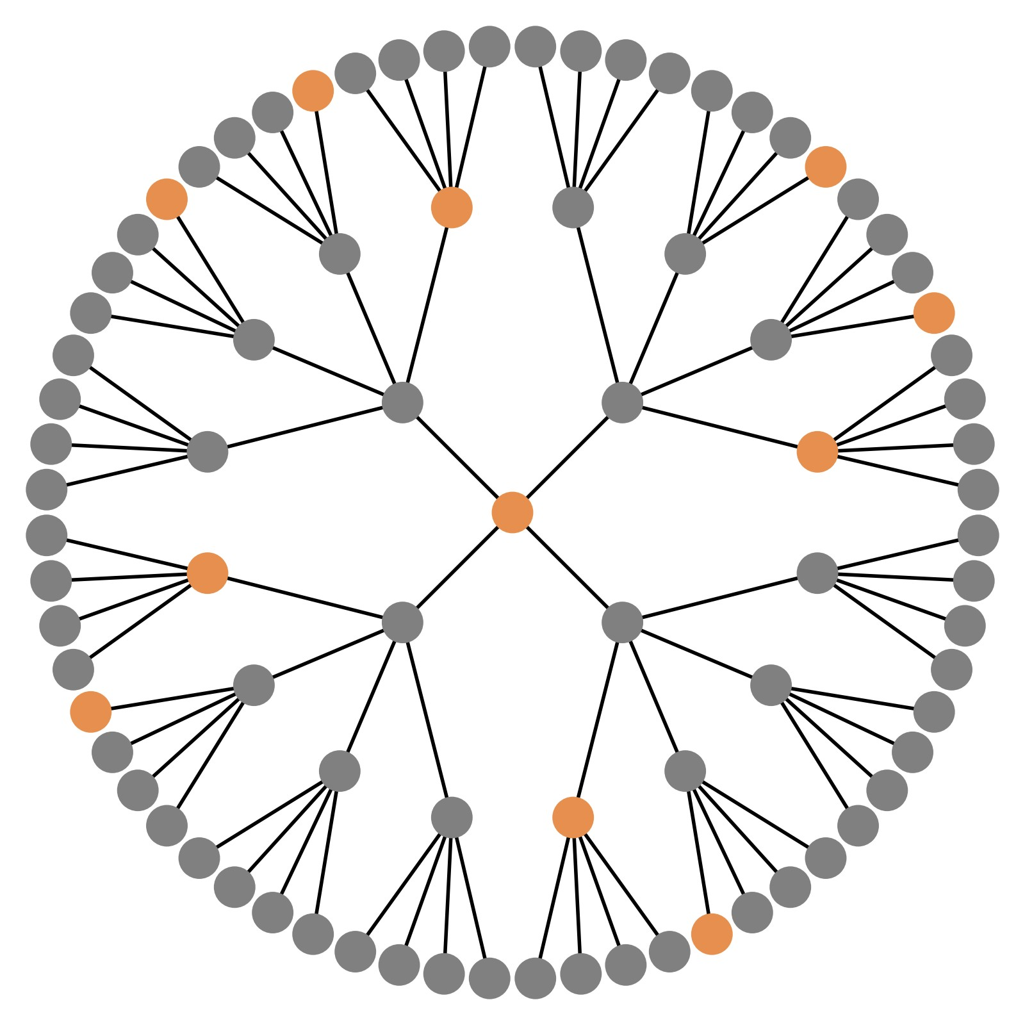
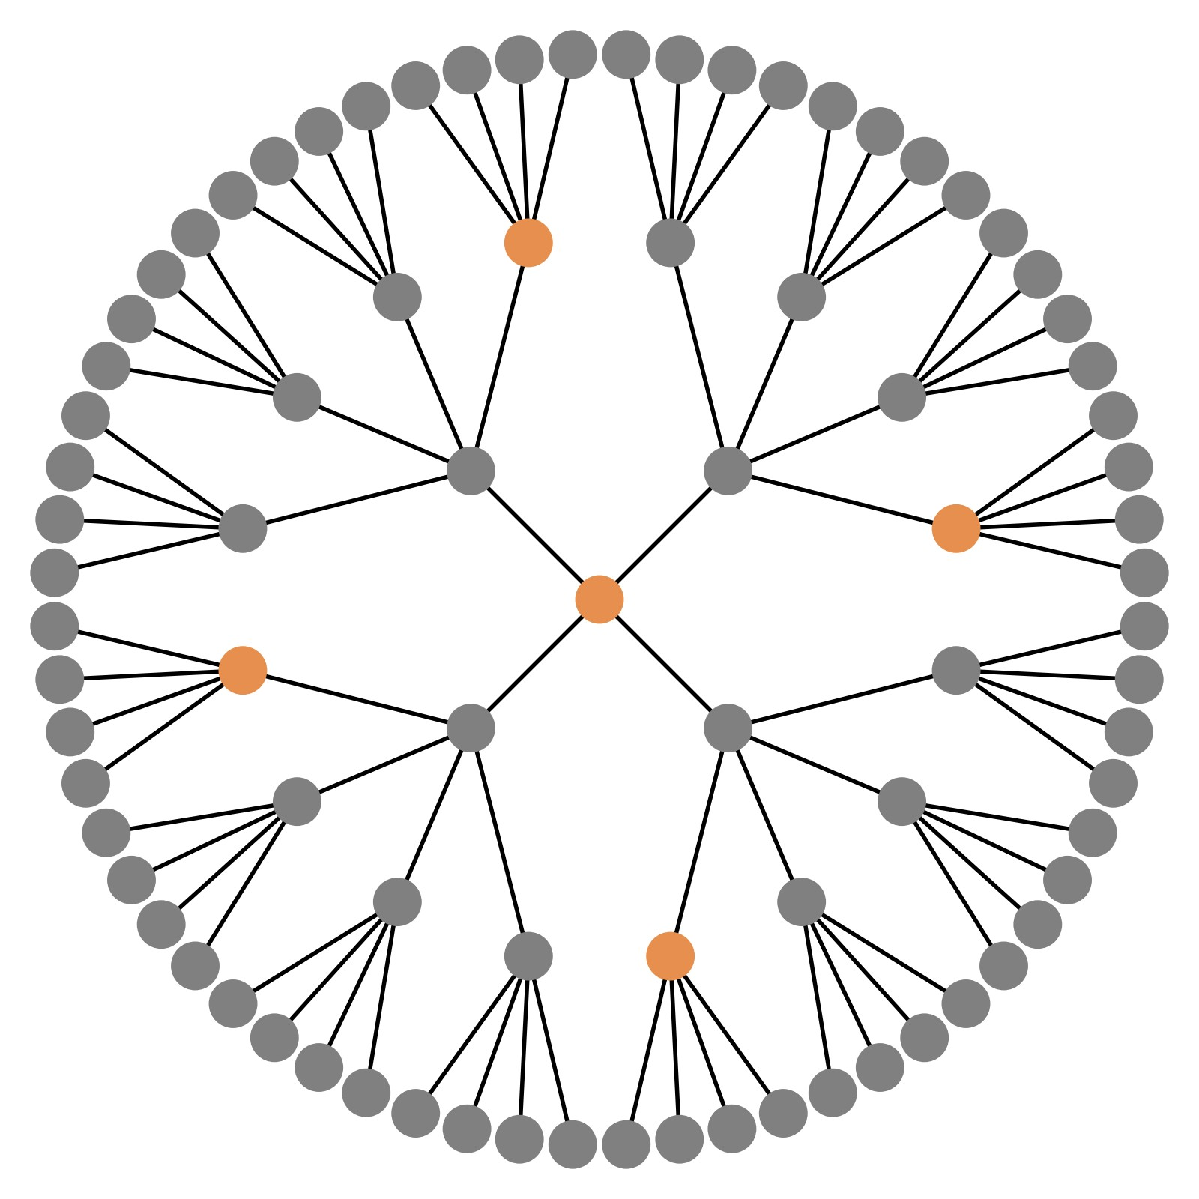
Inductive node coloring can help graph classification
Graph classification
A B
Example input graphs
Different computational graphs à Successful differentiate graphs
We color root nodes with identity
For each node:
A
For each node:
B
ID-GNNs’
computational graphs
≠
node with augmented identity
node without augmented identity
Two types of nodes:
32

Slide 33
Inductive node coloring can help link prediction
Link prediction
!" !#
Example input graphs
A
An edge-level task involves classifying a pair of nodes:
We color one of the node (v&)
We then embed the other node in the
node pair (v! or v")
We use the node embedding for v! or v" conditioned on 𝑣& being colored or not to make edge-level prediction
B
!!
!"
A
≠
B
!#
ID-GNNs’
computational graphs
…
…
Different computational graphs à Successfully differentiate edges
node with augmented identity node without augmented identity
Two types of nodes:
33

Slide 34
Inductive node coloring can help link prediction
Link prediction
!" !#
Example input graphs
A
An edge-level task involves classifying a pair of nodes:
We color one of the node (v&)
We then embed the other node in the
node pair (v! or v")
We use the node embedding for v! or v" conditioned on 𝑣& being colored or not to make edge-level prediction
B
!!
!"
A
≠
B
!#
ID-GNNs’
computational graphs
… …
Different
computational g
node with augmented identity _{à Successful ov}
types of nodes:
node without augmented identity GNN failure case
raphs
How to build a GNN using node coloring?
ercome
Two
33

Slide 35

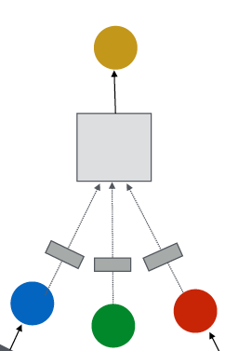
Utilize inductive node coloring in embedding computation
J.You, J. Gomes-Selman, R.Ying, J. Leskovec. Identity-aware Graph Neural Networks, AAAI 2021
Idea: Heterogenous message passing
  Normally, a GNN applies the same message/aggregation computation to all the nodes
(2) Aggregation
Neural Net A
(1) Message
𝑣!
GNN: At a given layer, we apply the same message/aggregation to each node
36

Slide 36
Idea: Heterogenous message passing
Heterogenous: different types of message passing is applied to different nodes
An ID-GNN applies different message/aggregation to nodes with different colorings
(2) Aggregation
Neural Net A
Neural Net B
(2) Aggregation
(1) Message
(1) Message
𝑣!
ID-GNN: At a given layer, different message/aggregation to nodes with different colorings
36

Slide 37
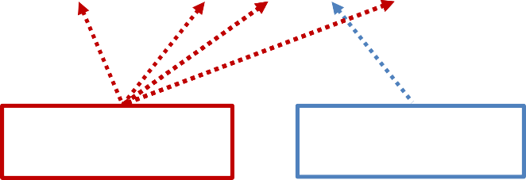
Why does heterogenous message passing work:
Suppose two nodes 𝑣#, 𝑣$ have the same computational graph structure, but have different node colorings
Since we will apply different neural network for embedding computation, their embeddings will be different
𝑣!
𝑣"
Neural Net A
Neural Net A
Neural Net B
39

Slide 38

A !!
B !"
A !!
B !"
Goal: classify !! and !"
GNN computational graph
ID-GNN rooted subtrees
!! A
=
B !"
!! A
≠
B !"
…
…
… …
From the node coloring, we can tell that:
𝑣!: length-3 cycles = 2 𝑣": length-3 cycles = 0
Why does ID-GNN work better than GNN?
Intuition: ID-GNN can count cycles originating from a given node, but GNN cannot
39

Slide 39
A !!
B !"
𝑣!
𝑣"
y !! and !"
1
ID-GNN rooted subtrees
1
!! A
≠
B !"
Cycle count at each level
0
0
2
2
2
0
… …
length-3 cycles = 2 length-3 cycles = 0
Based on the intuition, we propose a simplified version
ID-GNN-Fast
  Include identity information as an augmented node feature
(no need to do heterogenous message passing)
  Use cycle counts in each layer as an augmented node feature. Also can be used together with any GNN
39

Slide 40
Summary of ID-GNN: A general and powerful extension to GNN framework
We can apply ID-GNN on any message passing GNNs (GCN, GraphSAGE, GIN, …)
  ID-GNN provides consistent performance gain in node/edge/graph level tasks
ID-GNN is more expressive than their GNN counterparts. ID-GNN is the first message passing GNN that is more expressive than 1-WL test
We can easily implement ID-GNN using popular GNN tools (PyG, DGL, …)
40

Slide 41

CS224W: Machine Learning with Graphs Jure Leskovec, Stanford University
http://cs224w.stanford.edu

Slide 42
Recent years have seen impressive performance of deep learning models in a variety of applications.
Ex) In computer vision, deep convolutional networks have achieved human-level performance on ImageNet (image category classification)
Are these models ready to be deployed in real world?
3/4/21
Jure Leskovec, Stanford CS224W: Machine Learning with Graphs
42

Slide 43

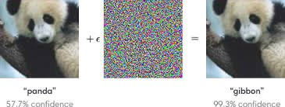
Deep convolutional neural networks are vulnerable to adversarial attacks:
Imperceptible noise changes the prediction.
Adversarial example
Adopted from Goodfellow et al. ICLR 2015
Carefully- calculated noise
Adversarial examples are also reported in natural language processing [Jia & Liang et al. EMNLP 2017] and audio processing [Carlini et al. 2018] domains.
3/4/21 Jure Leskovec, Stanford CS224W: Machine Learning with Graphs, http://cs224w.stanford.edu
43

Slide 44
The existence of adversarial examples prevents the reliable deployment of deep learning models to the real world.
Adversaries may try to actively hack the deep learning models.
The model performance can become much worse than we expect.
Deep learning models are often not robust.
  In fact, it is an active area of research to make these models robust against adversarial examples
3/4/21
Jure Leskovec, Stanford CS224W: Machine Learning with Graphs
44

Slide 45
This lecture: How about GNNs? Are they robust to adversarial examples?
Premise: Common applications of GNNs involve public platforms and monetary
Zügner et al. Adversarial Attacks on Neural Networks for Graph Data, KDD 2018
interests.
Recommender systems
Social networks
Search engines
Adversaries have the incentive to manipulate input graphs and hack GNNs’ predictions.
Jure Leskovec, Stanford CS224W: Machine Learning with Graphs, http://cs224w.stanford.edu
45

Slide 46
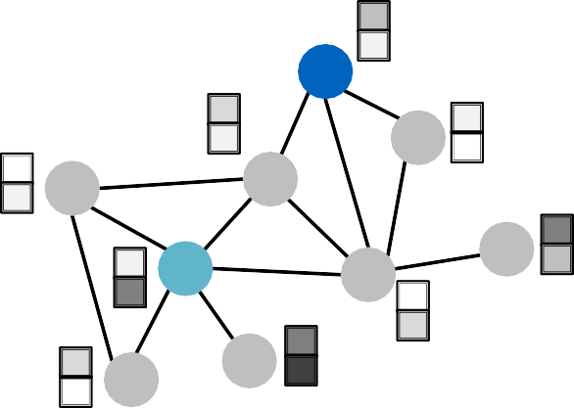
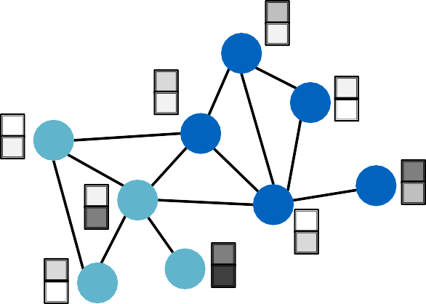
To study the robustness of GNNs, we specifically consider the following setting:
Task: Semi-supervised node classification
Model: GCN [Kipf & Welling ICLR 2017]
?: Unlabeled
Predict labels of
?
unlabeled nodes
?
?
?
?
?
?

Slide 47

We ﬁrst describe several real-world
adversarial aQack possibiliBes.
We then review the GCN model that we are going to aMack (knowing the opponent).
We mathemaNcally formalize the aQack problem as an opBmizaBon problem.
We empirically see how vulnerable GCN’s predicBon is to the adversarial aQack.

Slide 48
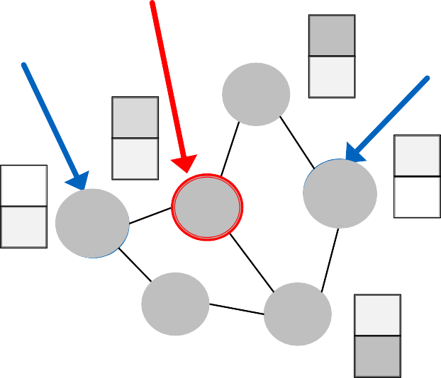
What are the attack possibilities in real world?
Target node 𝑡 ∈ 𝑉: node whose label prediction we want to change
Attacker nodes 𝑆 ⊂ 𝑉: nodes the attacker can
modify
Target node
Attacker node
Attacker node

Slide 49

Direct Attack: Attacker node is the target
node: 𝑺 = 𝒕
Modify target node feature
  Ex) Change website content
Add connections to target
  Ex) Buy likes/followers
Remove connections from target
  Ex) Unfollow users

Slide 50
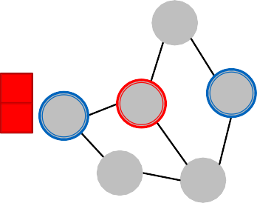
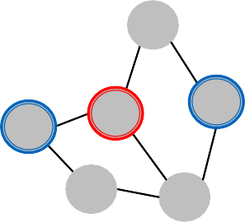
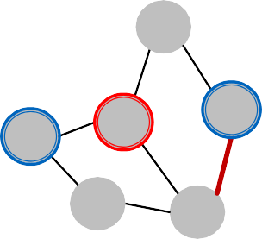
Indirect Attack: The target node is not in the attacker nodes: 𝒕 ∉ 𝑺
Modify attacker node features
  Ex) Hijack friends of targets
Add connections to attackers
  Ex) Create a link, link farm
Remove connections from attackers
  Ex) Delete undesirable link
50

Slide 51
Objective for the attacker:
Maximize (change of target node label prediction)
Subject to (graph manipulation is small)
If graph manipulation is too large, it will easily be detected. Successful attacks should change the target prediction with “unnoticeably-small” graph manipulation.
Perform small graph
Learn GCN model
Change in predicted class label
manipulation
1
1
1
Target node
1
0
1
1
1 | 0
0
?
1
0
0
0
0
1
1
GCN
Class 1 Class 2
Class 3
Graph

Slide 52
Original graph:
𝑨: adjacency matrix, 𝑿: feature matrix
Manipulated graph (aXer adding noise):
  𝑨': adjacency matrix, 𝑿': feature matrix
AssumpBon: 𝑨', 𝑿' ≈ (𝑨, 𝑿)
Graph manipula;on is unno7ceably small.
  Preserving basic graph staRsRcs (e.g,. degree distribuRon) and feature staRsRcs.
Graph manipula;on is either direct (changing the feature/connec;on of target nodes) or indirect.

Slide 53
Target node: 𝑣 ∈ 𝑉
GCN learned over the original graph
𝜽∗ = argmin_{𝜽}ℒ#$%&' 𝜽; 𝑨, 𝑿
GCN’s original prediction on the target node:
𝑐∗ = 𝐚𝐫𝐠𝐦𝐚𝐱 𝑓 ∗ 𝑨, 𝑿
( * 𝜽 (,*
Predict the class 𝑐∗ of vertex 𝒗 that has
'
the highest predicted probability

Slide 54
GCN learned over the manipulated graph
𝜽^{∗(} = argmin_{𝜽}ℒ#$%&' 𝜽; 𝑨′, 𝑿′
GCN’s prediction on the target node 𝒗:
𝑐∗' = argmax 𝑓 ∗" 𝑨′, 𝑿′
( *
𝜽
(,*
We want the prediction to change after the graph is manipulated:
_{𝑐}∗( _{≠ 𝑐}∗
) )

Slide 55
Change of predicBon on target node 𝑣:
𝚫 𝑣; 𝑨⁽, 𝑿⁽ =
log 𝑓_{𝜽}∗" 𝑨′, 𝑿′ _{),+}∗" − log 𝑓_{𝜽}∗"
𝑨′, 𝑿′ _{),+}∗
#
#
Predicted (log) probability of the newly-predicted
Predicted (log) probability of the originally-predicted
class 𝑐∗,
class 𝑐∗
*
*
Want to increase this term
Want to decrease this term

Slide 56
Final opBmizaBon objecBve:
argmax_{𝑨}"_{,𝑿}"𝚫(𝑣; 𝑨′, 𝑿′)
subject to 𝑨⁽, 𝑿⁽ ≈ (𝑨, 𝑿)
Challenges in opBmizing the objecBve
  Adjacency matrix 𝑨, is a discrete object: gradient-based opRmizaRon cannot be used.
  For every modiﬁed graph 𝑨, and 𝑿,, GCN needs to be re- trained (this is computaRonally expensive):
    𝜽∗, = argmin_{𝜽}ℒ_{./012} 𝜽; 𝑨′, 𝑿′
Several approximaRons are proposed to make the opRmizaRon tractable [Zügner et al. KDD2018].

Slide 57
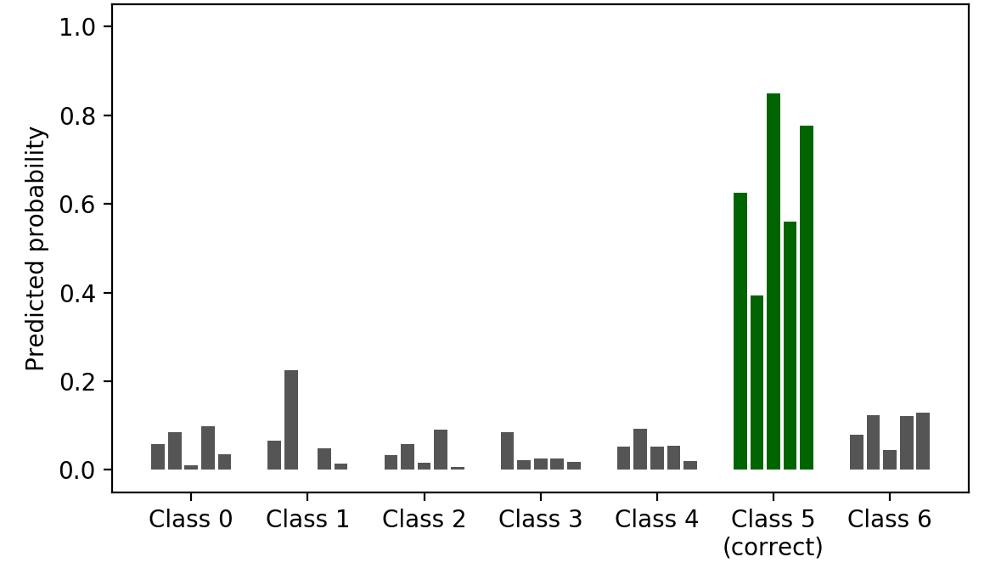
Semi-supervised node classification with GCN on a paper citation network (2,800 nodes, 8,000 edges).
Predicted probabilities over 5 re-trainings
(without graph manipulation, i.e., clean graph)
GCN is able to correctly classify the target node with high confidence.
Classification margin
> 0: Correct classification
< 0: Incorrect classification
Class 1 Class 2 Class 3 Class 4 Class 5 Class 6 Class 7
(correct)

Slide 58
GCN’s prediction after carefully modifying just 5 edges attached to the target node (direct adversarial attack).
Predicted probabilities over 5 re-trainings
(with adversarial attacks)
The model confidently makes the wrong prediction
Class 1
Class 2
Class 3
Class 4
Class 5
Class 6 Class 7
(correct)

Slide 59
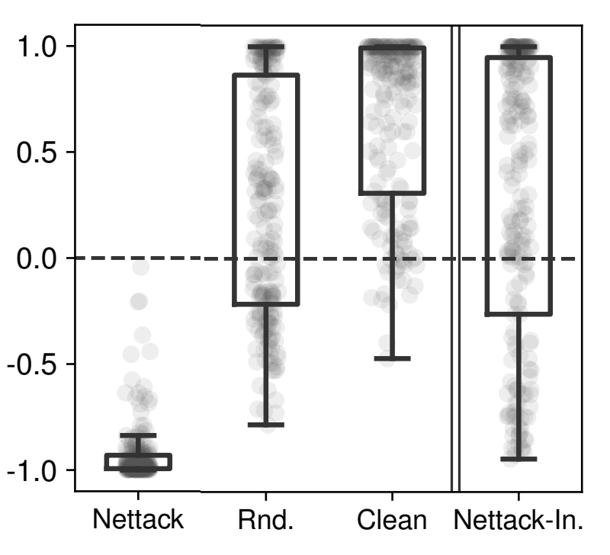
Adversarial direct attack is the strongest attack, significantly worsening GCN’s performance (compared to no attack).
Random attack is much weaker than adversarial
Each dot indicates one attack trial.
No
Indirect
Direct attack
attack attack
Classification margin
attack.
Indirect attack is more challenging than direct attack.
Mis-
^{classification} Adversarial Randomly
Clean
Adversarial indirect attack
direct attack
add edges between
target nodes and nodes with different labels.
Adopted from Zügner et al. KDD 2018 59
3/4/21
Jure Leskovec, Stanford CS224W: Machine Learning with Graphs

Slide 60

We study the adversarial robustness of GCN applied to semi-supervised node classification.
We consider different attack possibilities on
graph-structured data.
We mathematically formulate the adversarial attack as an optimization problem.
We empirically demonstrate that GCN’s prediction
performance can be significantly harmed by adversarial attacks.
GCN is not robust to adversarial attacks but it is somewhat robust to indirect attacks and random
noise.
3/4/21
Jure Leskovec, Stanford CS224W: Machine Learning with Graphs
60

