Slide 1

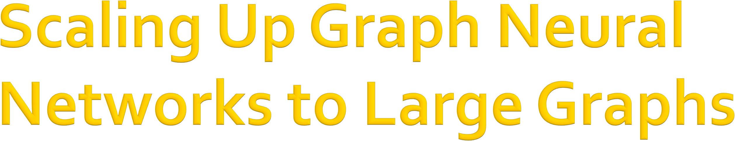

CS224W: Machine Learning with Graphs Jure Leskovec, Stanford University
http://cs224w.stanford.edu

Slide 2
Recommender systems:
Amazon
YouTube
Pinterest
Etc.
ML tasks:
  Recommend items
(link prediction)
  Classify users/items
(node classification)
Users
100M~1B
Products/Videos
10M ~ 1B
Bought/saw
7

Slide 3
Social networks:
Facebook
Twitter
Instagram
Etc.
ML tasks:
  Friend recommendation (link-level)
  User property prediction (node-level)
Users
300M~3B
Friend/follow
7

Slide 4
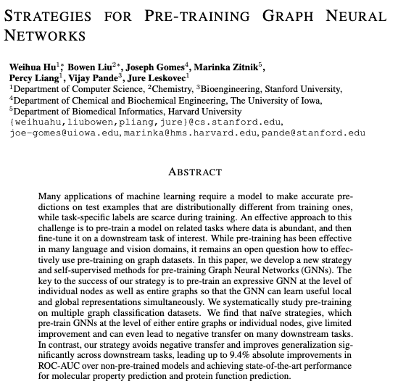
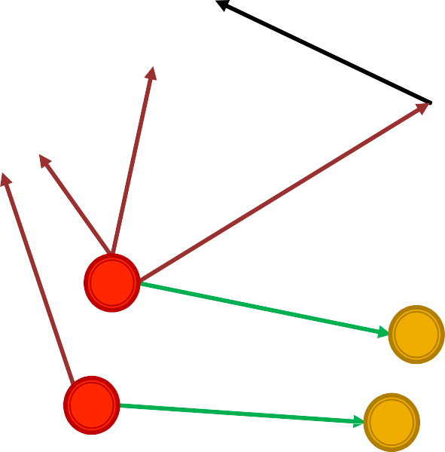
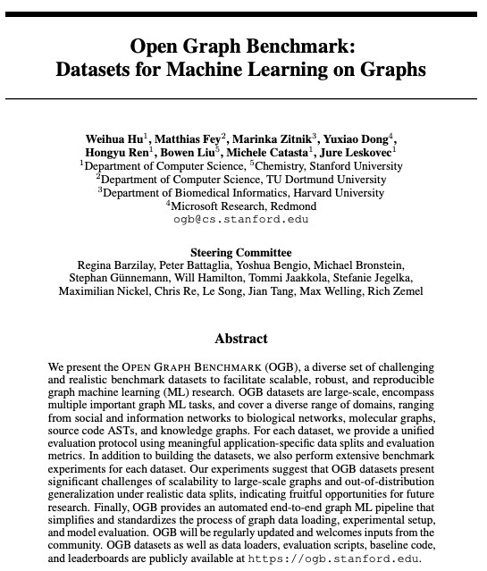
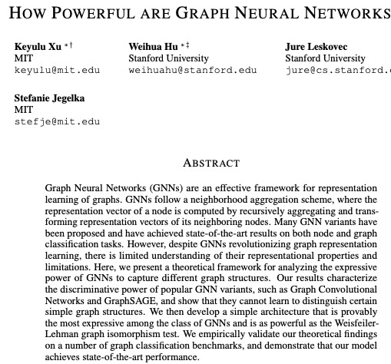
Academic graph:
Microsoft Academic Graph
ML tasks:
  Paper categorization
(node classification)
  Author collaboration recommendation
  Paper citation recommendation
Papers
120M
Authors
120M
Paper
cites
writes
Institution
affiliated with
(link prediction)
Author
7

Slide 5
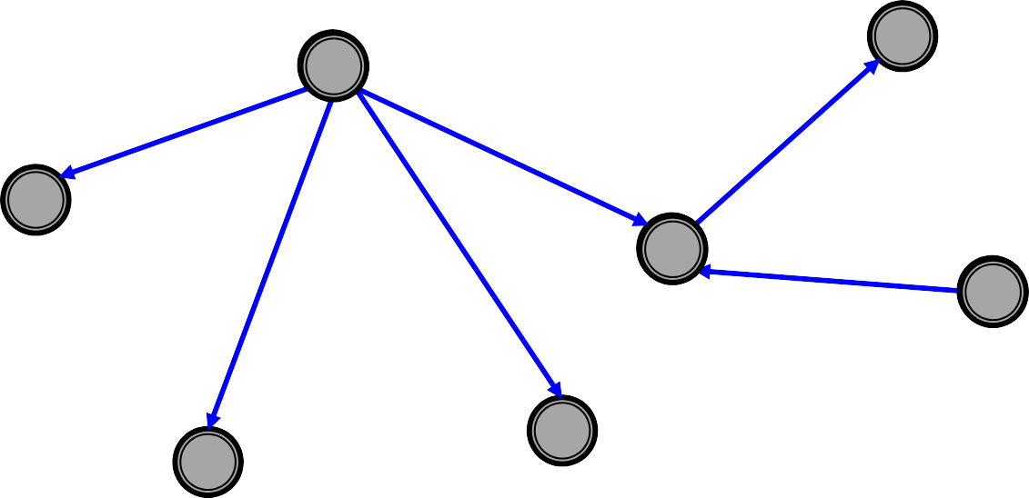
Knowledge Graphs (KGs):
Wikidata
Entities
Freebase
ML tasks:
  KG completion
  Reasoning
80M—90M
Geoffrey Hinton
Canada
born in
affiliated wtih
located in
graduated from
UK
is a
Graduated from
University of Toronto
Paul Martin
King’s College, Cambridge
Person
7

Slide 6
Large-scale:
#nodes ranges from 10M to 10B.
#edges ranges from 100M to 100B.
Tasks
  Node-level: User/item/paper classification.
  Link-level: Recommendation, completion.
Todays’ lecture
  Scale up GNNs to large graphs!
7

Slide 7

Recall: How we usually train an ML model on large data (𝑵=#data is large)
Objective: Minimize the averaged loss
$%&
ℓ 𝜽 = ¹ ' ℓ 𝜽
𝑁
!
!"#
𝜽: model parameters, ℓ! 𝜽 : loss for 𝑖-th data point.
We perform Stochastic Gradient Descent (SGD).
  Randomly sample 𝑀 (<< 𝑁) data (mini-batches).
  Compute the ℓ"#$(𝜽) over the 𝑀 data points.
  Perform SGD: 𝜽 ← 𝜽 − ∇ℓ"#$(𝜽)
7

Slide 8
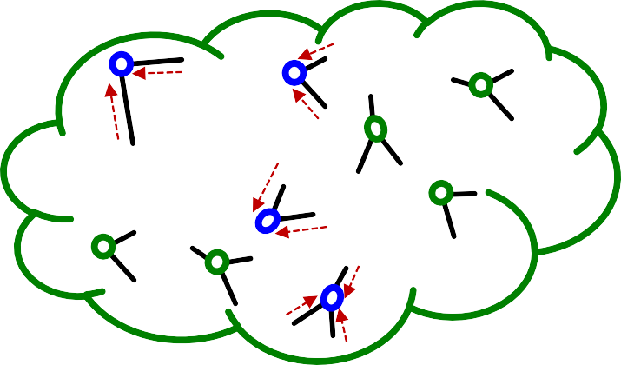
What if we use the standard SGD for GNN?
In mini-batch, we sample 𝑴 (<<𝑵) nodes independently:
X
X
X
: Sampled nodes
X
X
X
X
Entire nodes
Sampled nodes tend to be isolated from each other.
Recall: GNN generate node embeddings by aggregating neighboring node features.
  GNN does not access to neighboring nodes within the mini-batch!
Standard SGD cannot effectively train GNNs.
X
X
7

Slide 9
Naïve full-batch implementation: Generate embeddings of all the nodes at the same time.
Given all node embeddings at layer K
Perform message- passing
Load the entire graph and features
At each GNN layer:
  Compute embeddings of all nodes using all the node embeddings from the previous layer.
Compute the loss
Perform gradient descent
Obtain all node embeddings at layer K+1
7

Slide 10
However, Full-batch implementation is not feasible for a large graphs. Why?
Because we want to use GPU for fast training, but GPU memory is extremely limited (only
10GB--20GB).
The entire graph and the features cannot be loaded on GPU.
Slow computation, large memory
Fast computation, limited memory
CPU
1TB—10TB
GPU
10GB—20GB
10

Slide 11

We introduce three methods for scaling up GNNs:
Two methods perform message-passing over small subgraphs in each mini-batch; only the subgraphs need to be loaded on a GPU at a time.
  Neighbor Sampling [Hamilton et al. NeurIPS 2017]
  Cluster-GCN [Chiang et al. KDD 2019]
One method simplifies a GNN into feature- preprocessing operation (can be efficiently performed even on a CPU)
  Simplified GCN [Wu et al. ICML 2019]
11

Slide 12
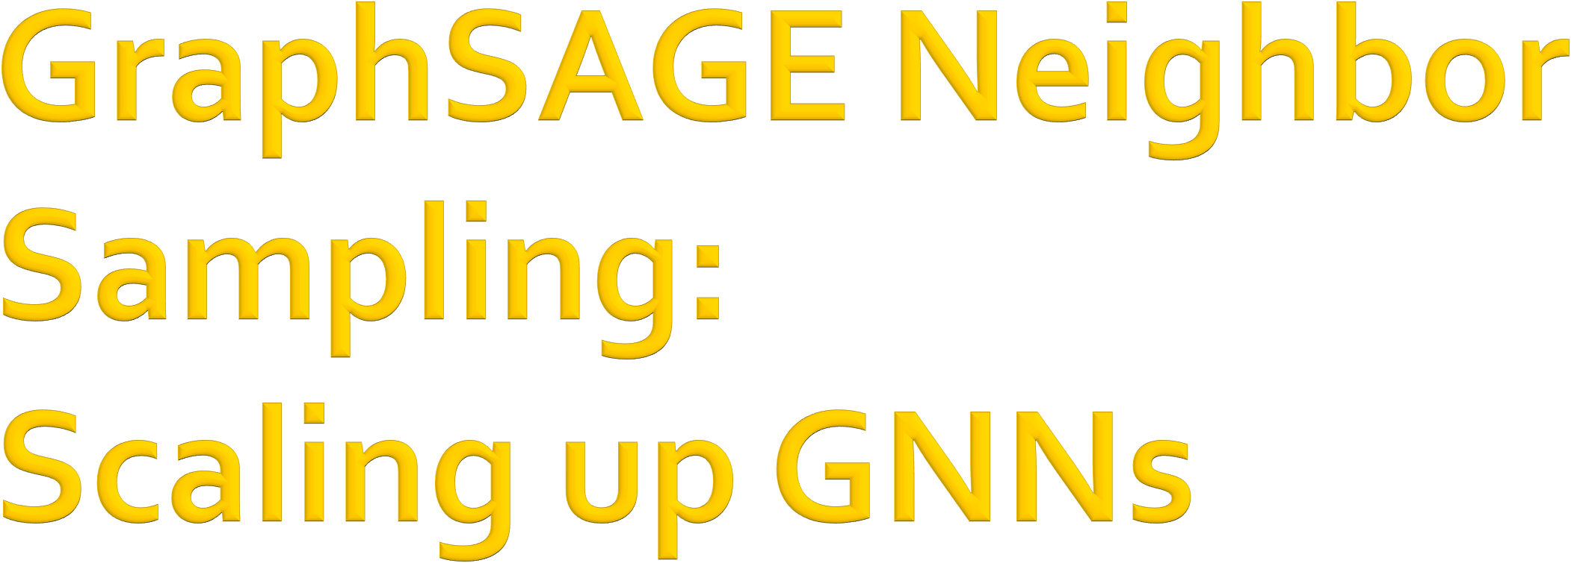
CS224W: Machine Learning with Graphs Jure Leskovec, Stanford University
http://cs224w.stanford.edu

Slide 13
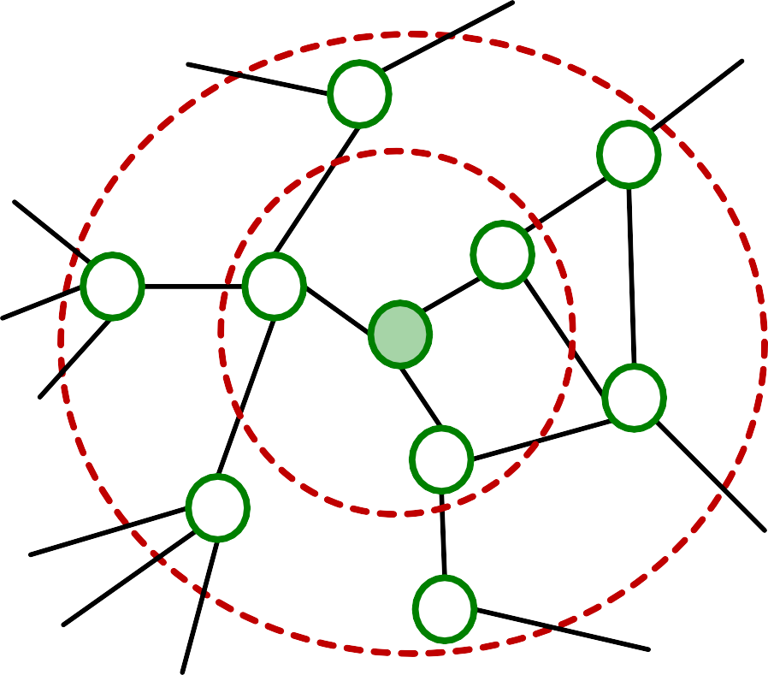
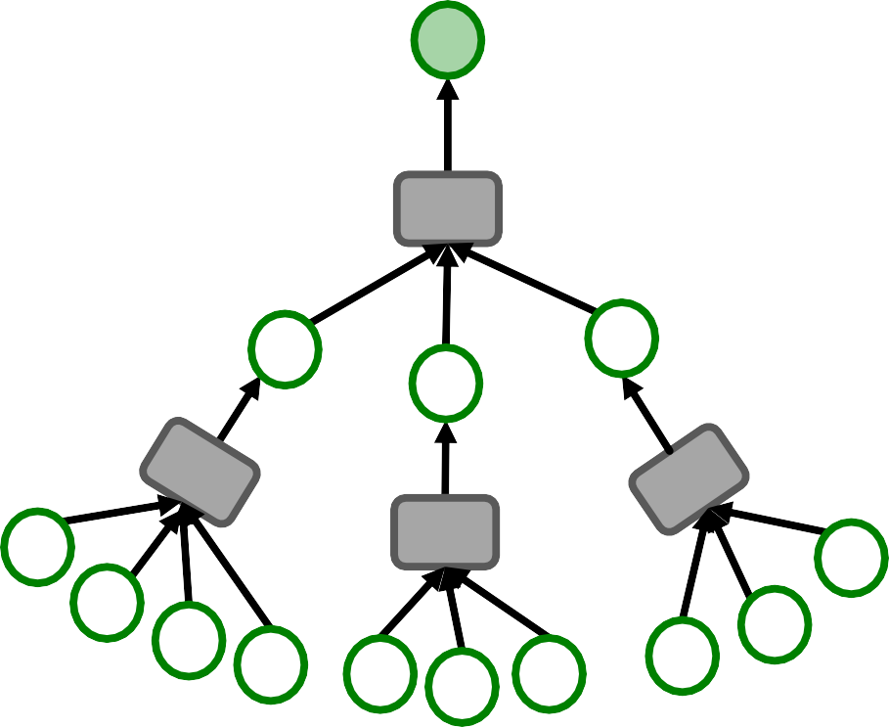
Recall: GNNs generate node embeddings via neighbor aggregation.
Represented as a computational graph (right).
0
4
9
Neighbor aggr
3
5
1
0
1
3
Neighbor aggr
2
8
2
6
0
9
4
8
5
6
0
7
0
7
8
13

Slide 14
Observation: A 2-layer GNN generates embedding of node “0” using 2-hop neighborhood structure and features.
2-hop neighborhood
0
4
9
Neighbor aggr
3
5
1
0
1
3
2
8
2
6
0
9
4
8
5
6
0
7
0
7
8

Slide 15
Observation: More generally, 𝐾-layer GNNs generate embedding of a node using 𝐾-hop neighborhood structure and features.
2-hop neighborhood
0
4
9
Neighbor aggr
3
5
1
0
1
3
2
8
2
6
0
9
4
8
5
6
0
7
0
7
8

Slide 16
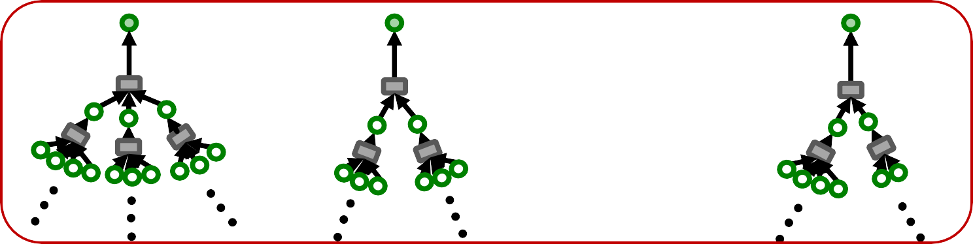
Key insight: To compute embedding of a single node, all we need is the 𝑲-hop neighborhood (which defines the computation graph).
Given a set of 𝑀 different nodes in a mini-batch, we can generate their embeddings using 𝑀 computational graphs. Can be computed on GPU!
Comp. graph for 1-st node
Comp. graph for 2-nd node
Comp. graph for 𝑀-th node
Mini-batch
…

Slide 17
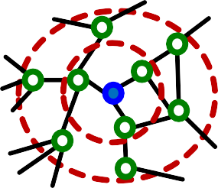
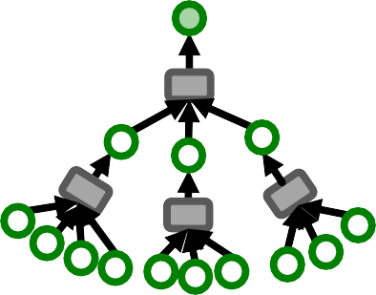
We can now consider the following SGD
strategy for training 𝑲-layer GNNs:
Randomly sample 𝑀 (<< 𝑁) nodes.
For each sampled node 𝑣:
  Get 𝑲-hop neighborhood, and construct the
computation graph.
  Use the above to generate 𝑣’s embedding.
Compute the loss ℓ"#$(𝜽) averaged over the 𝑀 nodes.
Perform SGD: 𝜽 ← 𝜽 − ∇ℓ"#$(𝜽)
𝑲-hop neighborhood
Computational graph

Slide 18
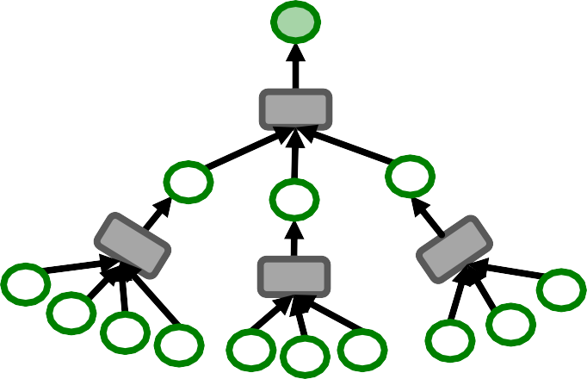
For each node, we need to get the entire
𝑲-hop neighborhood and pass it through the computation graph.
We need to aggregate lot of information
just to compute one node embedding.
Computationally expensive.

Slide 19
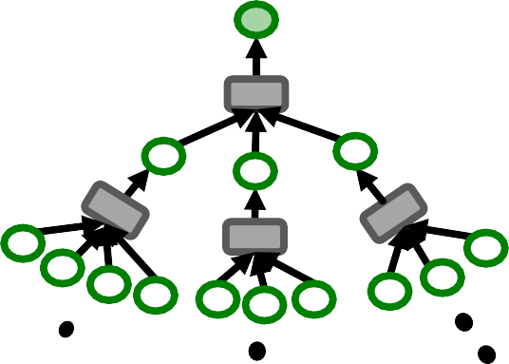
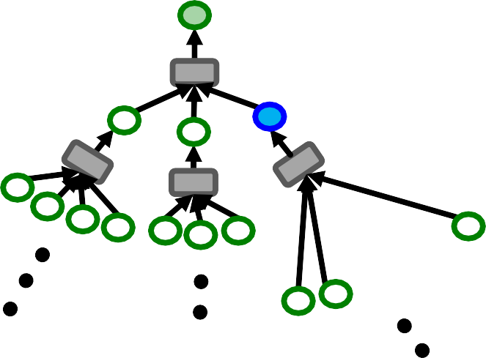
More details:
Computation graph becomes exponentially large with respect to the layer size 𝐾.
Computation graph explodes when it hits a hub node (high-degree node).
Next: Make the comp. graph more compact!
Exponential growth
Hub node

Slide 20

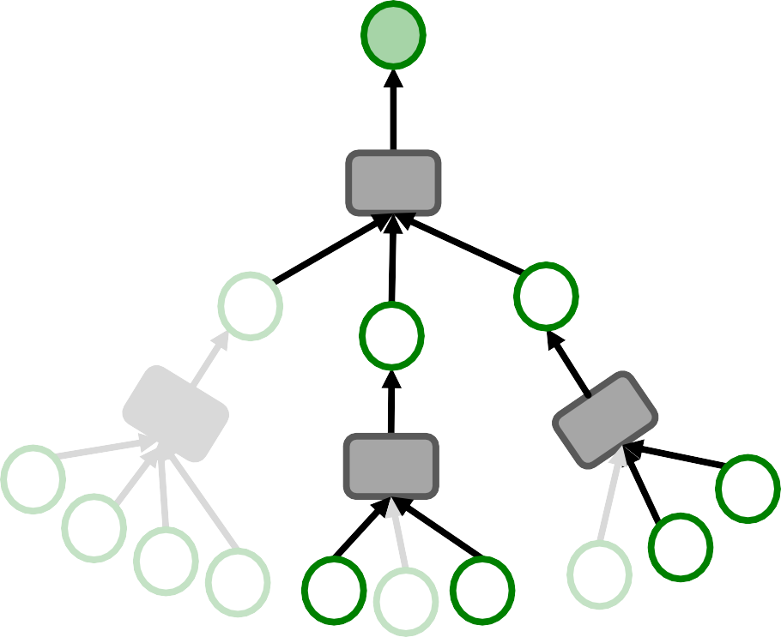
Key idea: Construct the computational graph by (randomly) sampling at most 𝐻 neighbors at each
hop.
Example (𝑯 = 𝟐):
First, sample 2 and 3
(drop node 1)
1st-hop
Sample neighborhood from the root to leaves
0
1
3
neighborhood
2
2nd-hop neighborhood
0
9
4
8
5
6
0
0
7
8
Sample 0 and 8
(drop 7)
Sample 8 and 9
(drop 0)
20

Slide 21

We can use the pruned computational graph to more efficiently compute node embeddings.
0
1
3
2
0
9
4
8
5
6
0
0
7
8

Slide 22
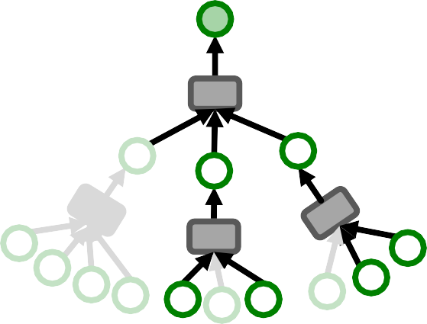
Neighbor sampling for 𝑲-layer GNN
For 𝑘 = 1, 2, … , 𝐾:
For each node in 𝑘-hop neighborhood:
(Randomly) sample at most 𝐻% neighbors:
0
1st-hop neighborhood
2nd-hop neighborhood
Sample 𝐻! = 2
neighbors
Sample 𝐻" = 2
neighbors
1
2
3
0
9
4 ₅ ₆
₀ 8
0 7 8
𝐾-layer GNN will at most involve
∏⁽ & 𝐻' leaf nodes in comp. graph.
'"

Slide 23
Remark 1: Trade-off in sampling number 𝑯
Smaller 𝐻 leads to more efficient neighbor aggregation, but results in more unstable training due to the larger variance in neighbor aggregation.
Remark 2: Computational time
  Even with neighbor sampling, the size of the computational graph is still exponential with respect to number of GNN layers 𝑲.
  Increasing one GNN layer would make computation 𝐻 times more expensive.

Slide 24
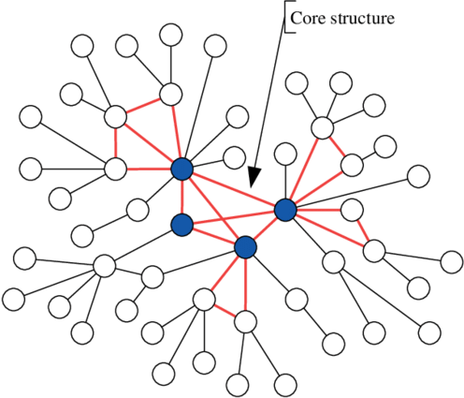
Remark 3: How to sample the nodes
Random sampling: fast but many times not optimal (may sample many “unimportant” nodes)
Random Walk with Restarts:
  Natural graphs are “scale free”, sampling random neighbors, samples many low degree “leaf” nodes.
  Strategy to sample important nodes:
    Compute Random Walk with Restarts score
𝑅! starting at the green node
    At each level sample 𝐻 neighbors 𝑖 with the highest 𝑅!
  This strategy works much better in practice.

Slide 25
A computational graph is constructed for each node in a mini-batch.
In neighbor sampling, the comp. graph is pruned/sub-sampled to increase
computational efficiency.
The pruned comp. graph is used to generate a node embedding.
However, computational graphs can still become large, especially for GNNs with many message-passing layers.

Slide 26
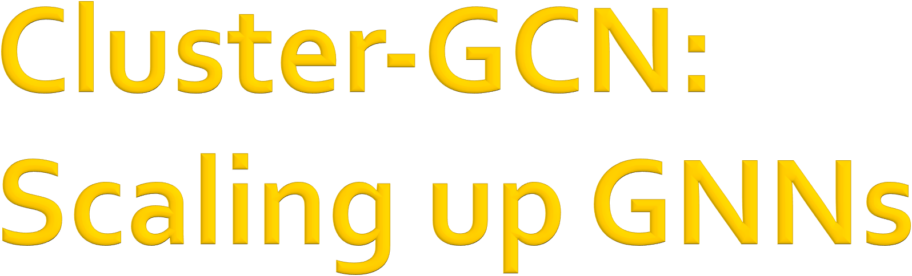
CS224W: Machine Learning with Graphs Jure Leskovec, Stanford University
http://cs224w.stanford.edu

Slide 27
The size of computational graph becomes exponentially large w.r.t. the #GNN layers.
Computation is redundant, especially when nodes in a mini-batch share many neighbors.
Input graph Computational A B
graph
A B
C
C
D
C D
E
D
E
Same comp. graph (except for sampling)
Same comp. graph (except for sampling)

Slide 28
In full-batch GNN implementation, all the node embeddings are updated together using embeddings of the previous layer.
Update for all 𝒗 ∈ 𝑽
Message
_{𝒉} ℓ-𝟏
ℎ^{(ℓ)} = 𝐶𝑂𝑀𝐵𝐼𝑁𝐸 ℎ ^{ℓ-.} , 𝐴𝐺𝐺𝑅
) )
In each layer, only 2*#(edges) messages need to be computed.
For 𝐾-layer GNN, only 2𝐾*#(edges) messages need to be computed.
GNN’s entire computation is only linear
in #(edges) and #(GNN layers). Fast!
𝒖
#∈2())
Message passing

Slide 29
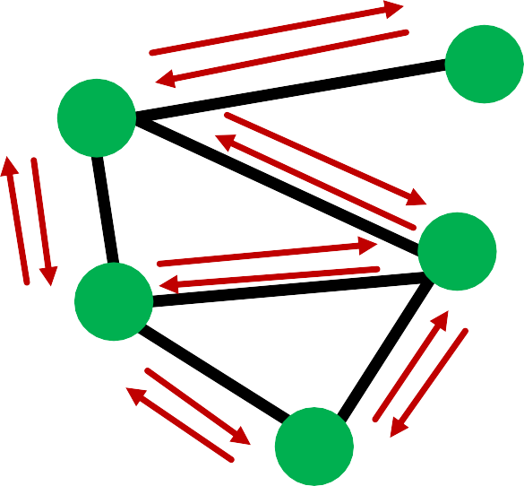
The layer-wise node embedding update allows the re-use of embeddings from the
previous layer.
This significantly reduces the
computational redundancy of neighbor sampling.
  Of course, the layer-wise update is not feasible for a large graph due to limited GPU memory.
Layer-wise update

Slide 30

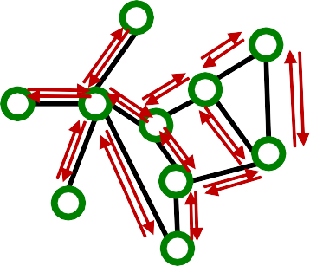
Key idea: We can sample a small subgraph of the large graph and then perform the efficient layer-wise node embeddings update over the subgraph.
Large graph
Sampled subgraph
(small enough to be put on a GPU)
Layer-wise
node embeddings update on the GPU
30

Slide 31
Key question: What subgraphs are good for training GNNs?
Recall: GNN performs node embedding by passing messages via the edges.
  Subgraphs should retain edge connectivity structure of the original graph as much as possible.
  This way, the GNN over the subgraph generates embeddings closer to the GNN over the original graph.
3/13/21

Slide 32
Which subgraph is good for training GNN?
Subgraphs (both 4-node induced subgraph)
Left Right
Original graph
v.s.
Left subgraph retains the essential community structure among the 4 nodes à Good
Right subgraph drops many connectivity patterns, even leading to isolated nodes à Bad
3/13/21

Slide 33
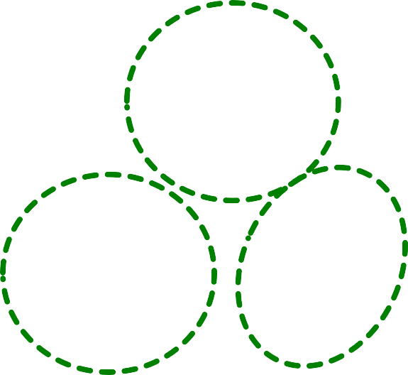
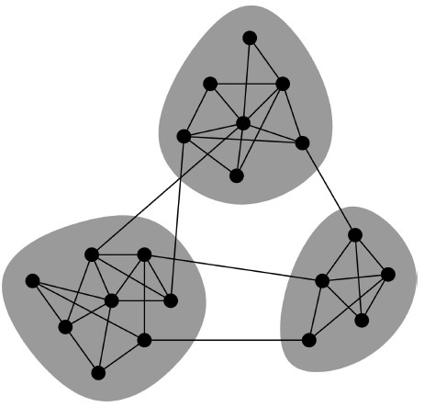
Real-world graph exhibits community structure
A large graph can be decomposed into many small communities.
Key insight [Chiang et al. KDD 2019]: Sample a community as a subgraph. Each subgraph retains essential local connectivity pattern of the original graph.
3/13/21

Slide 34
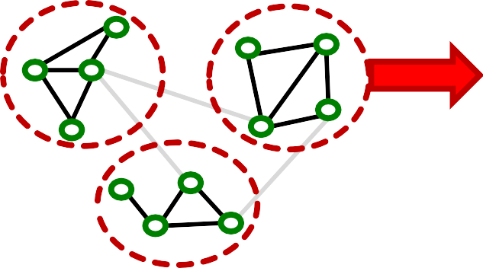
We first introduce “vanilla” Cluster-GCN.
Cluster-GCN consists of two steps:
Pre-processing: Given a large graph, partition it into groups of nodes (i.e., subgraphs).
Mini-batch training: Sample one node group at a time. Apply GNN’s message passing over the induced subgraph.
Mini-batch training Message-passing
over induced subgraph
to compute the loss
Sample
Input large graph
Partitioning
3/13/21

Slide 35
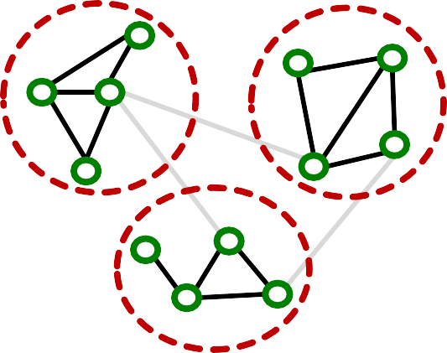
Given a large graph 𝐺 = (𝑉, 𝐸), partition its nodes 𝑽 into 𝑪 groups: 𝑽_{𝟏}, … , 𝑽_{𝑪}.
We can use any scalable community detection methods, e.g., Louvain, METIS [Karypis et al. SIAM 1998].
𝑉&, … , 𝑉₊ induces 𝐶 subgraphs, 𝐺&, … , 𝐺₊,
  Recall: 𝐺₃ ≡ (𝑉₃, 𝐸₃),
where 𝐸₃ = { 𝑢, 𝑣 |𝑢, 𝑣 ∈ 𝑉₃}
Notice: Between-group edges are not included in
𝑮_{𝟏}, … , 𝑮_{𝑪}.
𝐺&
𝐺'
𝐺₍
3/13/21

Slide 36
For each mini-batch, randomly sample a node group 𝑽_{𝒄}.
Construct induced subgraph 𝑮_{𝒄} = (𝑽_{𝒄}, 𝑬_{𝒄})
Sampled node group 𝑽_{𝒄}
Induced subgraph 𝑮_{𝒄}
3/13/21

Slide 37
Apply GNN’s layer-wise node update over 𝑮_{𝒄} to obtain embedding 𝒉₋ for each node 𝑣 ∈ 𝑉..
Compute the loss for each node 𝑣 ∈ 𝑉. and take
average: ℓ_{/01} 𝜽 = (1/|𝑉.|) ⋅ ∑_{-∈3!} ℓ₋(𝜽)
Update params: 𝜽 ← 𝜽 − ∇ℓ_{/01}(𝜽)
Induced subgraph 𝑮_{𝒄}
Embedding
Layer-wise node embedding update
3/13/21

Slide 38
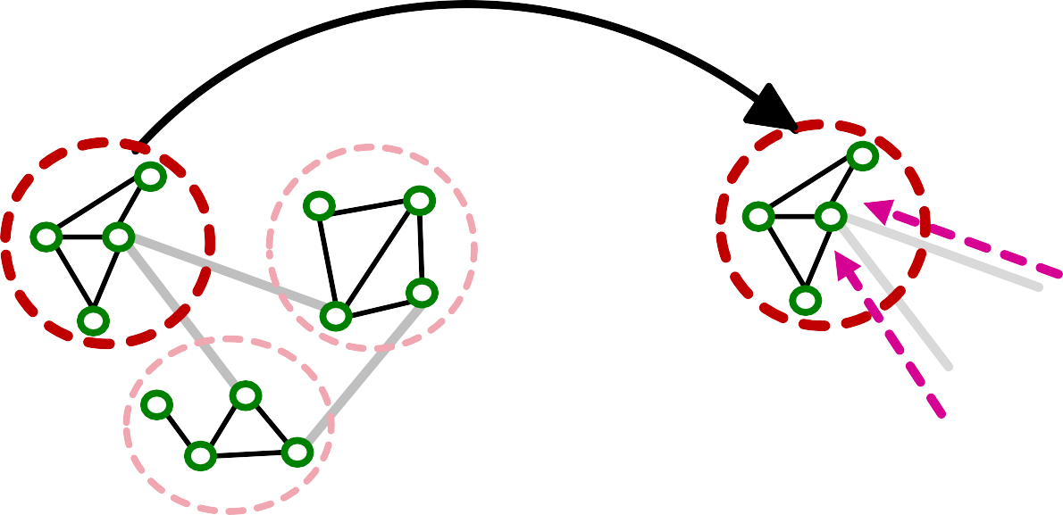
The induced subgraph removes between- group links.
As a result, messages from other groups will
be lost during message passing, which could hurt the GNN’s performance.
Induced subgraph
Between- group links are removed
Lost messages
3/13/21

Slide 39
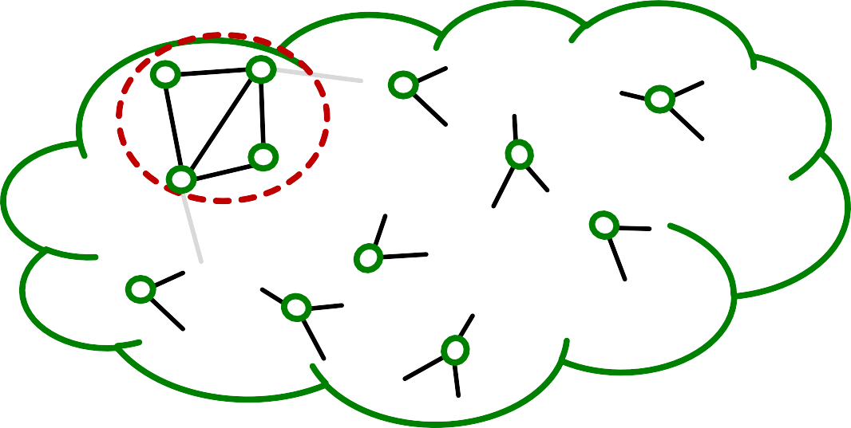
Graph community detection algorithm puts similar nodes together in the same group.
Sampled node group tends to only cover the small-concentrated portion of the entire data.
Sampled node group
Entire nodes
3/13/21

Slide 40
Sampled nodes are not diverse enough to be represent the entire graph structure:
As a result, the gradient averaged over the
sampled nodes, unreliable.
&
∑_{-∈3} ∇ℓ₋(𝜽), becomes
|3!|
!
Fluctuates a lot from a node group to another.
In other words, the gradient has high variance.
Leads to slow convergence of SGD
40

Slide 41
Solution: Aggregate multiple node groups per mini-batch.
Partition the graph into relatively-small groups of nodes.
For each mini-batch:
  Sample and aggregate multiple node groups.
  Construct the induced subgraph of the aggregated
node group.
  The rest is the same as vanilla Cluster-GCN (compute node embeddings and the loss, update parameters)

Slide 42
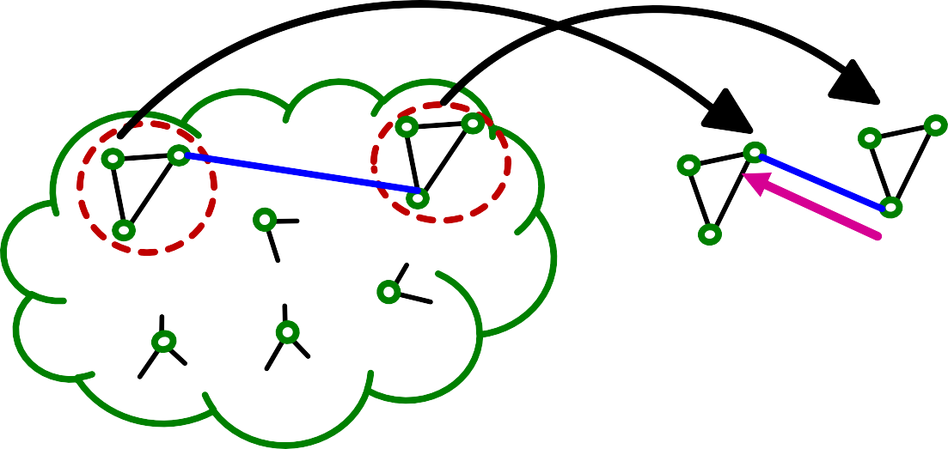
Why does the solution work?
Sampling multiple node groups
à Makes the sampled nodes more representative of the entire nodes. Leads to less variance in gradient estimation.
The induced subgraph over aggregated node groups
à Includes between-group edges
à Message can flow across groups.

Slide 43
Similar to vanilla Cluster-GCN, advanced Cluster-GCN also follows 2-step approaches. Pre-processing step:
Given a large graph 𝐺 = (𝑉, 𝐸), partition its nodes 𝑉 into 𝐶 relatively-small groups:
𝑉&, … , 𝑉₊.
𝑉., … , 𝑉₅ needs to be small so that even if multiple of them are aggregated, the resulting group would not be too large.

Slide 44
Mini-batch training:
For each mini-batch, randomly sample a set of
𝒒 node groups: {𝑉_{5"}, … , 𝑉_{5#}} ⊂ {𝑉&, … , 𝑉₊}.
Aggregate all nodes across the sampled node groups: 𝑉₆₇₇₈ = 𝑉_{5"} ∪ ⋯ ∪ 𝑉_{5#}
Extract the induced subgraph
^{𝑮}𝒂𝒈𝒈𝒓 ^{= 𝑽}𝒂𝒈𝒈𝒓^{, 𝑬}𝒂𝒈𝒈𝒓 ,
where 𝐸₆₇₇₈ = { 𝑢, 𝑣 | 𝑢, 𝑣 ∈ 𝑉₆₇₇₈}
  𝑬_{𝒂𝒈𝒈𝒓} also includes between-group edges!

Slide 45
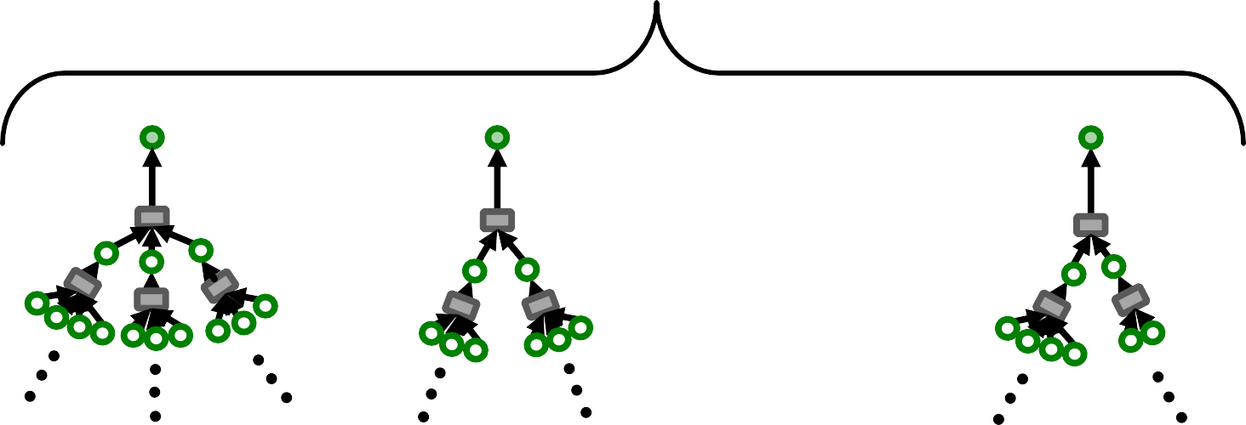
Generate 𝑴 (<< 𝑵) node embeddings using
𝑲-layer GNN (𝑵 : #all nodes).
Neighbor-sampling (sampling 𝐻 nodes per layer):
  For each node, the size of 𝐾-layer computational graph is 𝐻⁶.
  For 𝑀 nodes, the cost is 𝑴 ⋅ 𝑯^{𝑲}
𝑴 computational graphs
_{𝐻}, _{𝐻}, _{𝐻},
…

Slide 46
Generate 𝑴 (<< 𝑵) node embeddings using
𝑲-layer GNN (𝑵 : #all nodes).
Cluster-GCN:
  Perform message passing over a subgraph induced by the 𝑀 nodes.
  The subgraph contains 𝑀 ⋅ 𝐷_{9):} edges, where
^{𝐷}9):
is the average node degree.
𝐾-layer message passing over the subgraph costs at most 𝑲 ⋅ 𝑴 ⋅ 𝑫_{𝒂𝒗𝒈}.

Slide 47
In summary, the cost to generate embeddings for 𝑀 nodes using 𝐾-layer GNN is:
Neighbor-sampling (sample 𝑯 nodes per layer):
𝑴 ⋅ 𝑯^{𝑲}
Cluster-GCN: 𝑲 ⋅ 𝑴 ⋅ 𝑫_{𝒂𝒗𝒈}
Assume 𝑯 = 𝑫_{𝒂𝒗𝒈}/𝟐. In other words, 50% of neighbors are sampled.
  Then, Cluster-GCN (cost: 𝟐𝑴𝑯𝑲) is much more efficient than neighbor sampling (cost: 𝑴𝑯^{𝑲}).
  Linear (instead of exponential) dependency w.r.t. 𝑲.

Slide 48
Cluster-GCN first partitions the entire nodes into a set of small node groups.
At each mini-batch, multiple node groups are sampled, and their nodes are aggregated.
GNN performs layer-wise node embeddings update over the induced subgraph.
Cluster-GCN is more computationally efficient
than neighbor sampling, especially when #(GNN layers) is large.
But Cluster-GCN leads to systematically biased gradient estimates (due to missing cross-community edges)

Slide 49
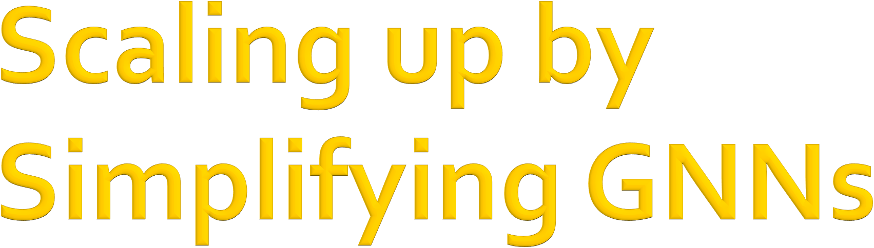
CS224W: Machine Learning with Graphs Jure Leskovec, Stanford University
http://cs224w.stanford.edu

Slide 50
We start from Graph Convolutional Network
(GCN) [Kipf & Welling ICLR 2017].
We simplify GCN by removing the non-linear activation from the GCN [Wu et al. ICML 2019].
  Wu et al. demonstrated that the performance on benchmark is not much lower by the simplification.
Simplified GCN turns out to be extremely
scalable by the model design.
3/13/21
Jure Leskovec, Stanford CS224W: Machine Learning with Graphs
50

Slide 51
Given: Graph 𝐺 = (𝑉, 𝐸) with input node features
X₋ for 𝑣 ∈ 𝑉, where 𝑬 includes the self-loop:
𝒗, 𝒗 ∈ 𝑬 for all 𝒗 ∈ 𝑽.
𝑣
Set input node embeddings: ℎ^{(#)} = 𝑋! for 𝑣 ∈ 𝑉.
!
For 𝑘 ∈ 0, … , 𝐾 − 1 :
  For all 𝑣 ∈ 𝑉, aggregate neighboring information as
ℎ^{(%>.)} = ReLU
𝑾_{𝒌}
. _{∑ ℎ}(%)
_{|2 ) |} #∈2 ) #
)
Trainable weight matrices
(i.e., what we learn)
Mean-pooling
Final node embedding: 𝑧₋ = ℎ⁽⁽⁾
-
12/6/18
Jure Leskovec, Stanford CS224W: Machine Learning with Graphs, http://cs224w.stanford.edu

Slide 52
GCN aggregations can be formulated as matrix
vector product:
Matrix of hidden embeddings 𝑯⁽⁽⁾
Let 𝑯^{(.)} = [ℎ^{(&)} … ℎ^{(.)}]²
& |1|
Let 𝑨 be the adjacency matrix (w/ self-loop)
Then: ∑_{3∈5(6)} ℎ^{(.)} = 𝐴_{6,:}𝑯^{(.)}
3
Let 𝑫 be diagonal matrix where
𝐷_{6,6} = Deg 𝑣 = |𝑁 𝑣 |
_{ℎ}(%)
#$
The inverse of 𝐷: 𝐷 is also diagonal:
#
𝐷#$ = 1/|𝑁 𝑣 |
%,%
Therefore,
¹ (.)
|𝑁 𝑣 | ^{= ℎ3}
3∈5 6
_{𝑫}-._{𝑨𝑯}(%)
12/6/18
Jure Leskovec, Stanford CS224W: Machine Learning with Graphs, http://cs224w.stanford.edu

Slide 53
GCN’s neighbor aggregation:
&
_{ℎ}(')
ℎ^{('?&)} = ReLU 𝑾_{𝒌}
∑
-
In matrix form:
0∈$ - 0
|$ - |
𝑯^{(%>.)} = ReLU 𝑨^{S}𝑯^{(%)}𝑾^{H}
𝒌
where 𝑨^{S} = 𝑫^{-.}𝑨.
Note: The original GCN uses re-normalized version: 𝑨^{V} = 𝑫^{%&/B}𝑨𝑫^{%&/B}.
  Empirically, this version of 𝑨^{S} often gives better performance than 𝑫^{-.}𝑨.

Slide 54

Simplify GCN by removing ReLU non-linearity:
_{𝑯}('?&) _{= 𝑨V𝑯}(')_{𝑾}C
𝒌
The final node embedding matrix is given as
_{𝑯}(6) _{= 𝑨}S _{𝑯}(6-.) _{𝑾}H
𝑲-𝟏
_{= 𝑨}S _{𝑨}S_{𝑯}(6-I)_{𝑾}K
_{𝑾}H
𝑲-𝟐 𝑲-𝟏
_{𝑾}H
⋯ = 𝑨^{S} 𝑨^{S} ⋯ (𝑨^{S}
𝑯^{(L)} 𝑾^{H}) ⋯ 𝑾^{H}
𝟎
𝑲-𝟐
𝑲-𝟏
= 𝑨^{S6}
𝑿 𝑾^{H} ⋯ 𝑾^{H}
𝟎
𝑲-𝟏
Composition of linear transformation is still linear!
= 𝑨^{S6} 𝑿 𝑾^{H}
where 𝑾 ≡ 𝑾_{𝑲:𝟏} ⋯ 𝑾_{𝟎}

Slide 55

Removing ReLU significantly simplifies GCN!
_{𝑯}(() _{= 𝑨}V( _{𝑿 𝑾}C
Notice 𝑨^{V(} 𝑿 does not contain any learnable parameters; hence, it can be pre-computed.
  Efficiently computable as a sequence of sparse- matrix vector products:
  Do 𝑿 ← 𝑨^{S} 𝑿 for 𝐾 times.

Slide 56
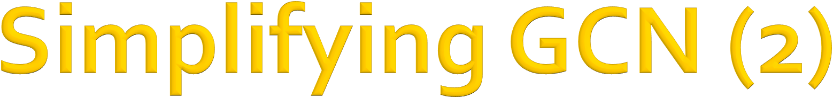
Let 𝑿^{V} = 𝑨^{V(} 𝑿 be pre-computed matrix.
Simplified GCN’s final embedding is
_{𝑯}(() _{= 𝑿V 𝑾}C
It’s just a linear transformation of pre- computed matrix!
Back to the node embedding form:
_{ℎ}(() _{= 𝑾}
_{𝑿}V_{𝒗}
-
Pre-computed feature vector for node 𝑣
Embedding of node 𝑣 only depends on its own (pre-processed) feature!

Slide 57

Once 𝑿^{V} is pre-computed, embeddings of 𝑀
nodes can be generated in time linear in 𝑀:
Given 𝑀 nodes {𝑣$, 𝑣%, … , 𝑣&}, their embeddings are
ℎ^{(,)} = 𝑾𝑿^{A}₆ ,
6!
!
ℎ^{(,)} = 𝑾𝑿^{A}₆ ,
6"
…
"
ℎ^{(,)} = 𝑾𝑿^{A}₆ .
6#
#

Slide 58
In summary, simplified GCN consists of two steps:
Pre-processing step:
  Pre-compute 𝑿^{A} = 𝑨^{A,} 𝑿. Can be done on CPU.
Mini-batch training step:
  For each mini-batch, randomly-sample 𝑀 nodes
{𝑣&, 𝑣', … , 𝑣<}.
  Compute their embeddings by
ℎ^{(,)} = 𝑾𝑿^{A}₆ , ℎ^{(,)} = 𝑾𝑿^{A}₆ ,…, ℎ^{(,)} = 𝑾𝑿^{A}₆
6! 6"
6#
! " #
Use the embeddings to make prediction and compute the loss averaged over the 𝑀 data points.
Perform SGD parameter update.

Slide 59
Compared to neighbor sampling:
Simplified GCN generates node embeddings much more efficiently (no need to construct the giant computational graph for each node).
Compared to Cluster-GCN:
  Mini-batch nodes of simplified GCN can be sampled completely randomly from the entire nodes (no need to sample from multiple groups as Cluster-GCN does)
  Leads to lower SGD variance during training.
But the model is much less expressive (next).

Slide 60
Compared to the original GNN models, simplified GCN’s expressive power is limited due to the lack of non-linearity in generating node embeddings.
60

Slide 61
Surprisingly, in semi-supervised node classification benchmark, simplified GCN works comparably to the original GNNs despite being less expressive.
Why?

Slide 62

Many node classification tasks exhibit homophily structure, i.e., nodes connected by edges tend to share the same target labels.
Examples:
Paper category classification in paper-citation network
  Two papers tend to share the same category if one cites another.
Movie recommendation for users in social networks
  Two users tend to like the same movie if they are friends in a social network.

Slide 63
Recall the preprocessing step of the simplified GCN: Do 𝑿 ← 𝑨^{V} 𝑿 for 𝑲 times.
Pre-processed features are obtained by iteratively averaging their neighboring node
features.
As a result, nodes connected by edges tend to have similar pre-processed features.
Average

Slide 64
Premise: Model uses the pre-processed node features to make prediction.
Nodes connected by edges tend to get similar pre-processed features.
à Nodes connected by edges tend to be predicted the same labels by the model
Simplified SGC’s prediction aligns well with
the graph homophily in many node classification benchmark datasets.

Slide 65
Simplified GCN removes non-linearity in GCN and reduces to the simple pre-processing of node features.
Once the pre-processed features are obtained,
scalable mini-batch SGD can be directly applied to optimize the parameters.
Simplified GCN works surprisingly well in
node classification benchmark.
  The feature pre-processing aligns well with graph homophily in real-world prediction tasks.

