Slide 1

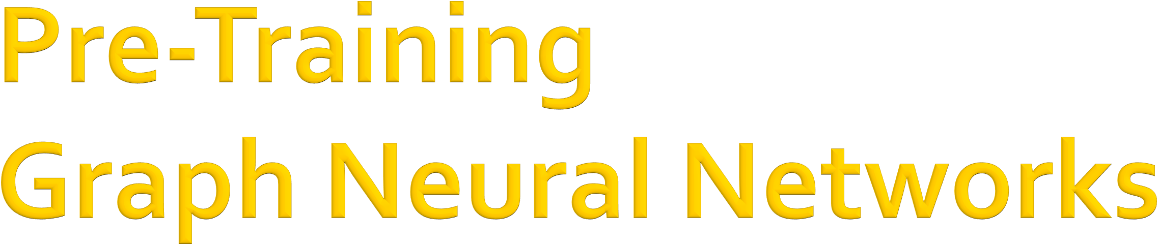

CS224W: Machine Learning with Graphs Jure Leskovec, Stanford University
http://cs224w.stanford.edu

Slide 2
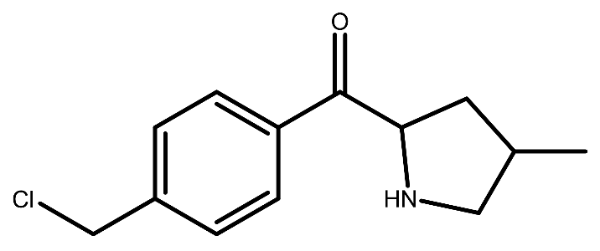
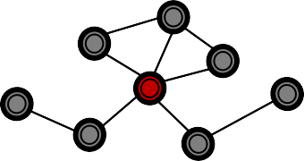
Chemistry: Molecular graphs
  Molecular property prediction
Our running example today
f( )
= toxic?
Biology: Protein-protein association graphs
  Protein function prediction
f(
) = biological activity?
2

Slide 3
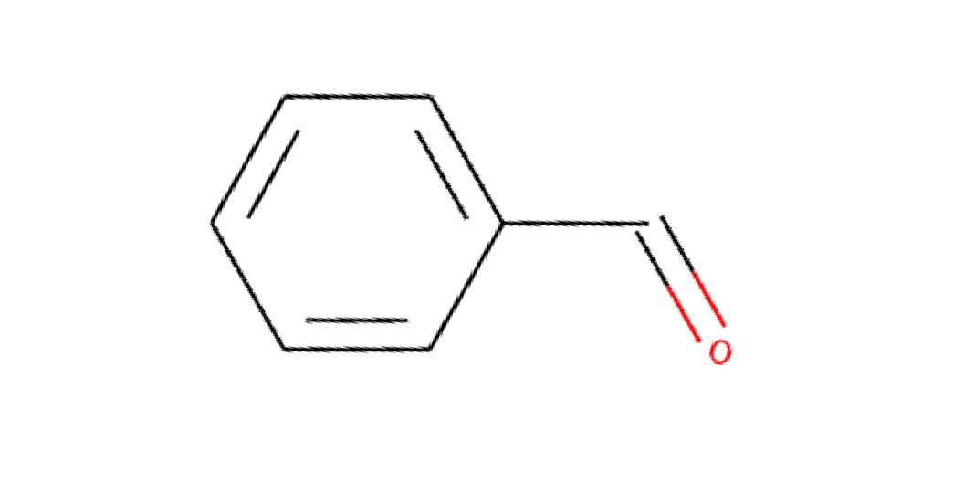


GNNs obtain an embedding of an entire graph by following two steps
Iteratively aggregate neighboring information to obtain node embeddings
Pool node embeddings to obtain a graph embedding
Iterative neighbor aggregation
𝑾 toxic?
Pool
Molecule
2

Slide 4
Node embeddings capture local neighborhood structure
The embedding of an entire graph is a global aggregation of such node embeddings
Globally-
Capture local neighborhood structure
aggregate local features
Molecule
2

Slide 5
Two fundamental challenges in applying ML to scientific domains
Scarcity of labeled data
  Obtaining labels requires expensive lab experiments
à GNNs overfit to small training data
Out-of-distribution prediction
  Test examples tend to be very different from training examples
à GNNs extrapolate poorly
2

Slide 6
Deep learning models have a lot parameters to train (e.g., in the order of millions).
#(Labeled training data) << #(Parameters)
Deep learning models are extremely prone to overfitting on small labeled data.
2

Slide 7
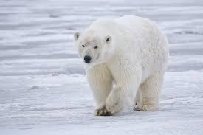
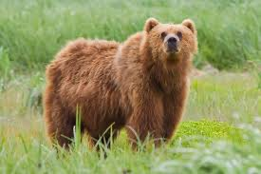
Deep learning models extrapolate poorly
Models often make predictions based on spurious correlations in a dataset [Sagawa et al. ICML 2020]
Ex) Image classification between “polar bear” and “brown bear”
Adapted from
During training:
  Most “polar bears” have the snow background
  Most “normal bears” have the grass background
  Model can learn to make prediction based on the image background, rather than the animal itself.
At test time, what if we see “polar bear” on the grass?
Wikipedia
2

Slide 8
Goal: Improve model’s out-of-distribution prediction performance even with limited data.
Key idea: Inject domain knowledge into a model before training on scarcely-labeled tasks!
The model already knows the domain knowledge before training on data
So that the model can
  Generalize well without much task-specific labeled data
  Extract essential (non-spurious) pattern that allows better extrapolation.
2

Slide 9
We pre-train a model relevant tasks, where data is abundant.
After pre-training, the model parameters already contain domain knowledge.
For downstream tasks (what we care about, typically with small #labeled data)
  We start from the pre-trained parameters and fine- tuning them.
Pre-training
Fine-tuning on downstream tasks
Raw input
Output embedding
Model
𝜽
Model
^{𝜽}!"#
2

Slide 10
Pre-training has been hugely successful in computer vision and natural language processing.
Pre-training improves label-efficiency.
Pre-training improves out-of-distribution performance [Hendrycks et al. ICML 2019]
Pre-training is a powerful solution to the two ML challenges in scientific applications
  Scarce labels
  Out-of-distribution prediction
10

Slide 11
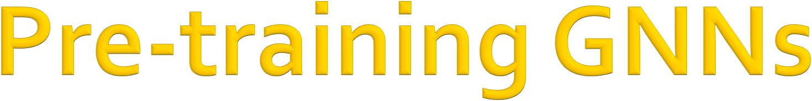
Let’s consider pre-training GNNs!
We design GNN pre-training strategies and systematically investigate
Hu et al. ICLR 2020
Q1. How effective is pre-training GNNs?
Q2. What is the effective pre-training strategy?

Slide 12
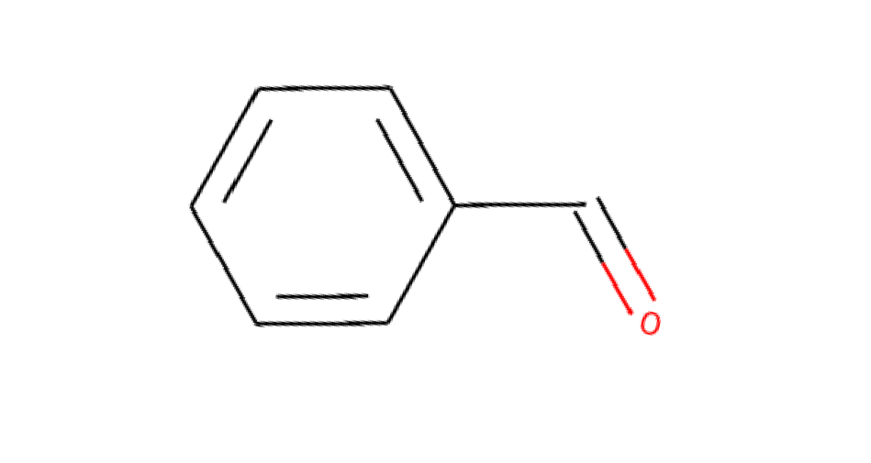


Let’s think about molecular property prediction for drug discovery.
Naïve strategy
Multi-task supervised pre-training on relevant labels.
Diverse pre-training labels from chemical database
Toxicity A?
Toxicity B?
Iterative neighbor aggregation
⋯
Pool
Bioactivity A? Bioactivity B?
Molecule
⋯

Slide 13
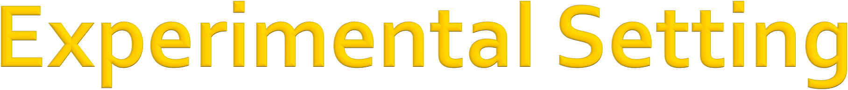
Molecule classification
Task: Binary classification. ROC-AUC as metric
f( ) = {0,1}
Supervised pre-training data
  1310 diverse binary bioassays annotated over ~450K molecules
Downstream task (what we care about!)
  8 molecular classification datasets (relatively-small, 1K— 100K molecules)
Data split: Scaffold (test molecules are out-of- distribution)

Slide 14


Naïve strategy:
Multi-task supervised pre-training on relevant labels. à Limited performance improvement on downstream tasks. Often leads to negative transfer
Molecule classification performance
16.0
14.0
12.0
10.0
8.0
6.0
4.0
2.0
0.0
-2.0
: Naïve strategy
ROCAUC
improvement over no pre-training
Non pre-trained GNNs
Negative transfer
Downstream datasets

Slide 15

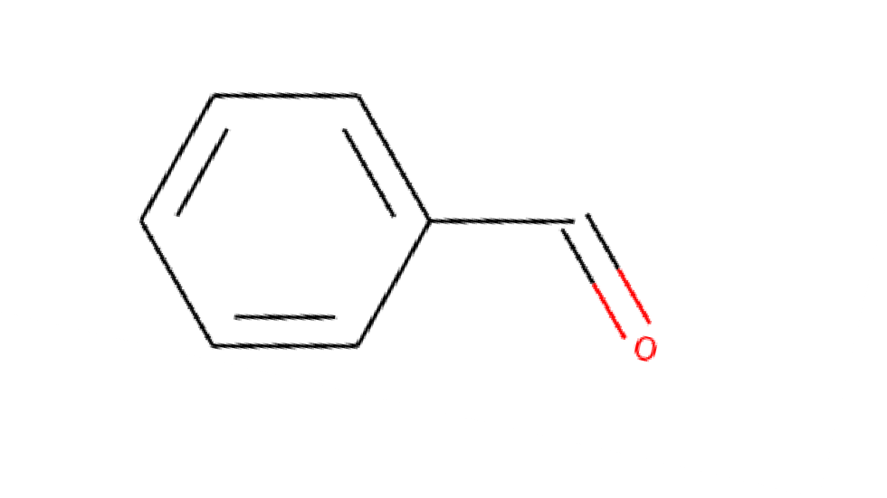

Key idea: Pre-train both node and graph embeddings.
à GNN can capture domain-specific knowledge of both local and global structure
Pre-training on graph labels
Toxicity A?
Pre-training on node labels
Toxicity B?
Capture Global structure
⋯
Capture local neighborhood structure
Bioactivity A? Bioactivity B?
⋯

Slide 16
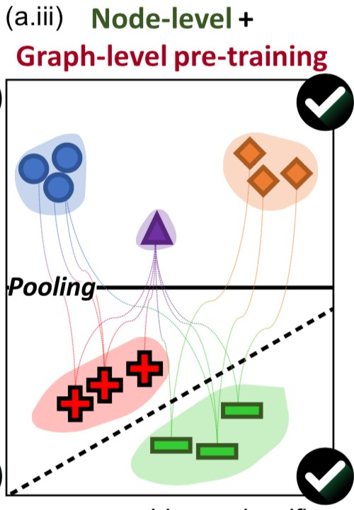
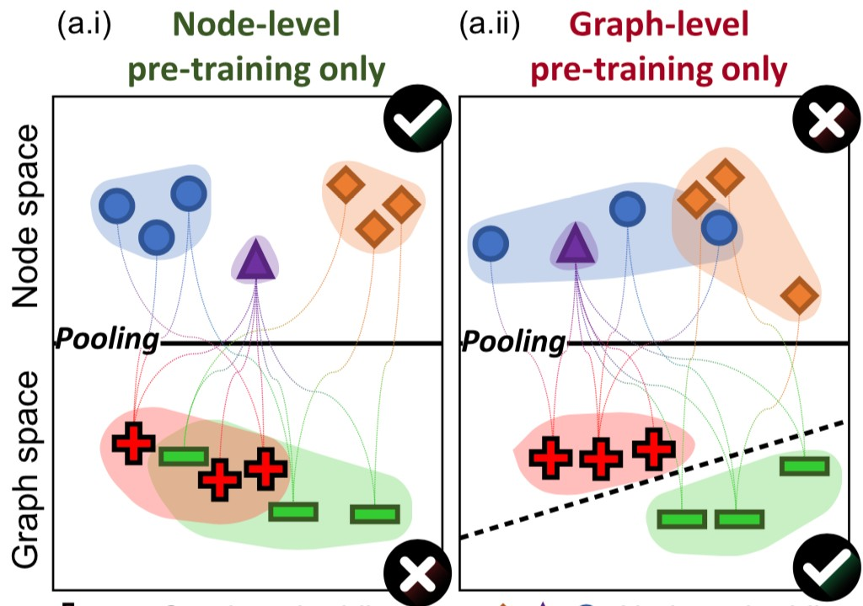
Key idea: Pre-train both node and graph embeddings.
Embedding illustration
Naïve strategies

Slide 17
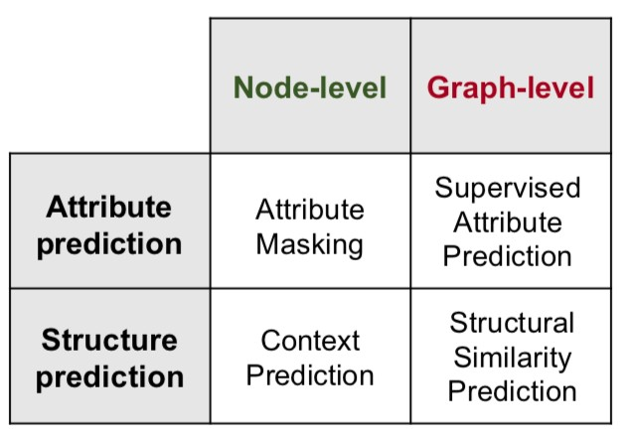
Self-supervised
(No need for external labels)

Slide 18
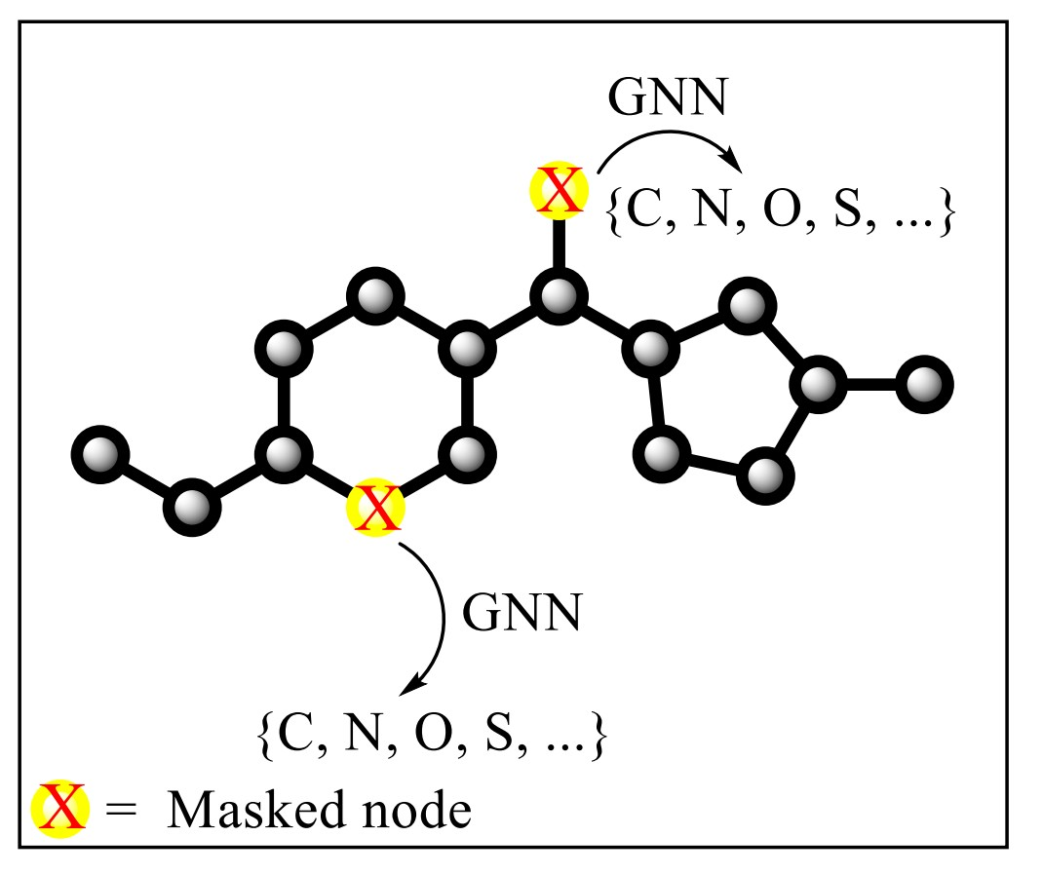
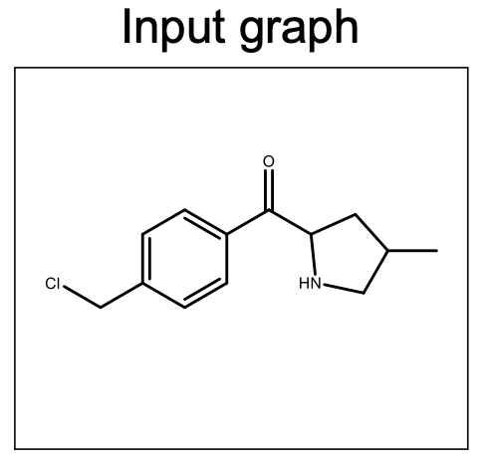
Mask node attributes
Use GNNs to generate node embeddings.
Use the embeddings to predict masked attributes.

Slide 19
Intuition
Through solving the masked attribute
prediction task, a GNN is forced to learn domain knowledge, .e.g., chemical rules.

Slide 20
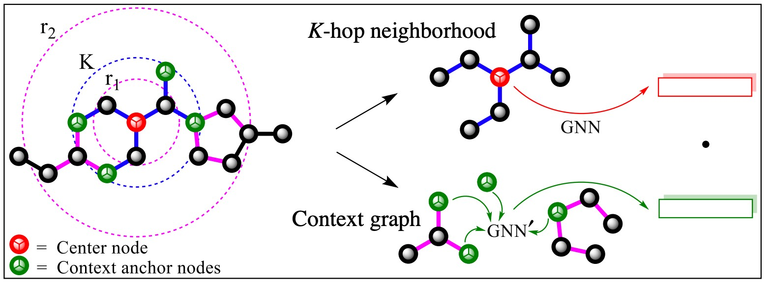
For each graph, sample one center node.
Extract neighborhood and context graphs.
Use GNNs to encode neighborhood and context graphs into vectors.
Maximize/minimize the inner product between true/false (neighborhood, context) pairs.
20

Slide 21
Intuition
Subgraphs that are surrounded by similar contexts are semantically similar.
In natural language processing, this is called distributional hypothesis, and is exploited in the word2vec model [Mikolov et al. NIPS 2013].

Slide 22



Multi-task supervised training on many relevant labels.
Pre-training on graph labels
Toxicity A?
Iterative neighbor aggregation
Toxicity B?
Bioactivity A? Bioactivity B?
⋯
⋯

Slide 23

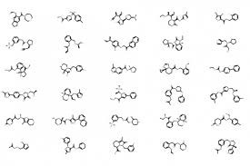
1. Node-level pre-training
Graph-level pre-training
Fine-tuning on downstream tasks
1
Self-supervised node-level pre-training
Downstream task 1
Node pre-train
3
Fine-tune
GNN
⋯
2
Supervised graph-level pre-training
Toxicity A?
Bioactivity A?
Bioactivity B?
Downstream task N
Graph pre-train
Toxicity B?

Slide 24


Avoids negative transfer.
Significantly improve the performance.
Molecule classification performance
16.0
14.0
12.0
10.0
8.0
6.0
4.0
2.0
0.0
-2.0
: Our strategy
: Naïve strategy
ROCAUC
improvement over no pre-training
o n
r e
ov
t
n
eg
min
ein
ov_{tr}
a
r
-
p_{e}
m ipr
C
U
A C
RO
Avoids negative transfer
Non pre- trained GNNs
Downstream datasets

Slide 25
When different GNN models are pre-trained, the most expressive model (GIN) benefits the most from pre-training.
Intuition: Expressive model can learn to
capture more domain knowledge than less expressive models.
 | Chemistry |  |  | Biology
 | Non-pre-trained | Pre-trained | Gain | Non-pre-trained | Pre-trained | Gain
GIN | 67.0 | 74.2 | +7.2 | 64.8 ± 1.0 | 74.2 ± 1.5 | +9.4
GCN | 68.9 | 72.2 | +3.4 | 63.2 ± 1.0 | 70.9 ± 1.7 | +7.7
GraphSAGE | 68.3 | 70.3 | +2.0 | 65.7 ± 1.2 | 68.5 ± 1.5 | +2.8
GAT | 66.8 | 60.3 | -6.5 | 68.2 ± 1.1 | 67.8 ± 3.6 | -0.4

Slide 26
GNNs have important applications in scientific applications, but they present challenges of
  Label scarcity
  Out-of-distribution prediction
Pre-training is promising to tackle the challenges.
However, naïve pre-training strategy gives sub- optimal performance and even leads to negative transfer.
Our strategy: Pre-train both node and graph
embeddings à Leads to significant performance gain on downstream tasks.

Slide 27
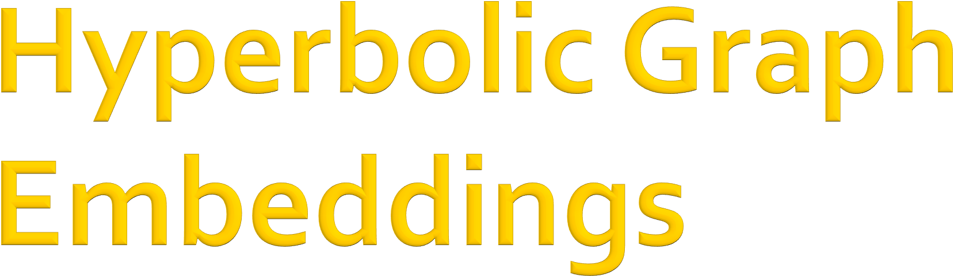
CS224W: Machine Learning with Graphs Jure Leskovec, Stanford University
http://cs224w.stanford.edu

Slide 28
In previous lectures, we focus on graph representation learning in Euclidean embedding spaces ℝ$
However, Euclidean embeddings cannot always capture complex graph structures
Example: Tree structure
Often Exponential increase in number of nodes as depth increases
Tree-like graphs: graphs that are similar to a tree, but can contain very few cycles
3/18/21
Jure Leskovec, Stanford CS224W: Machine Learning with Graphs
28

Slide 29
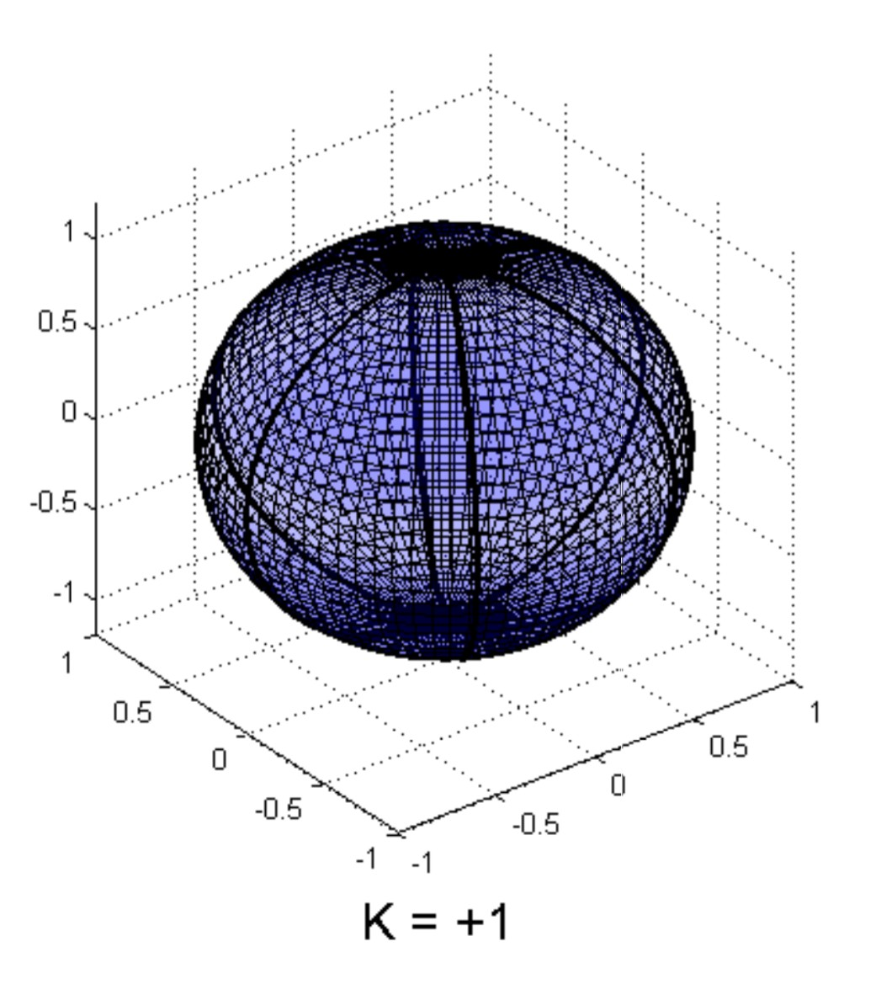
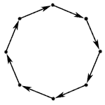
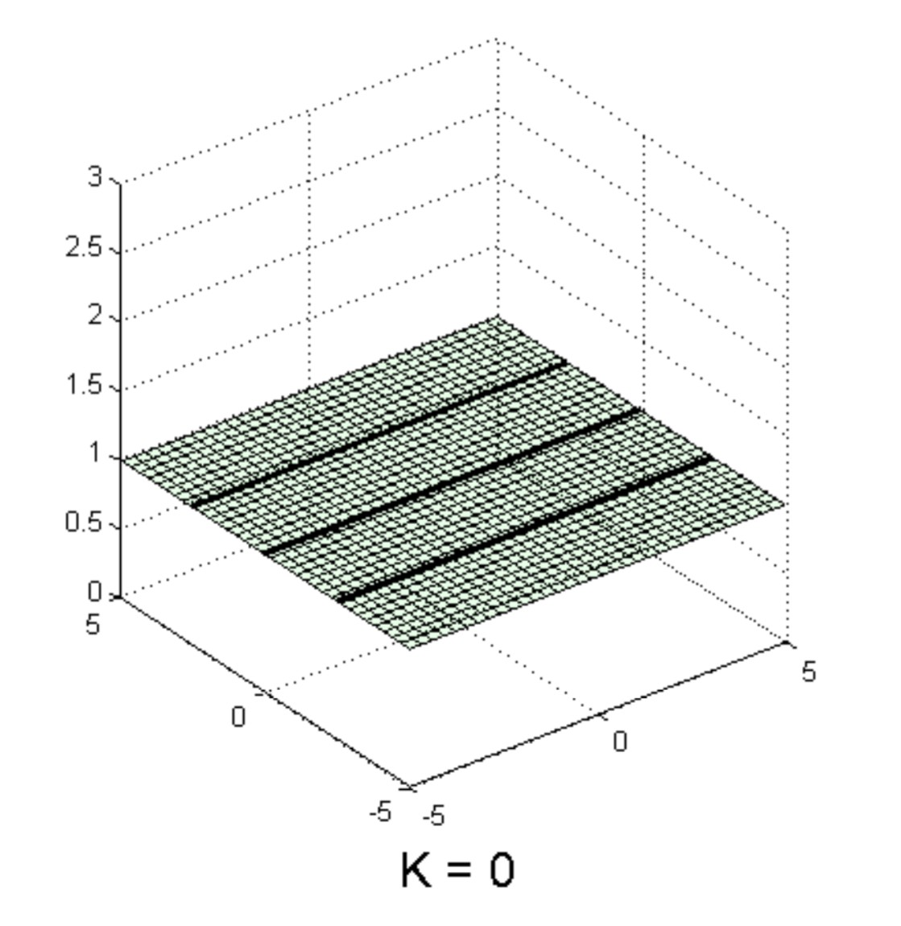
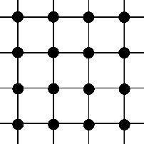
Graphs with many large cycles
  Best with spherical space embeddings
Embed
+ curvature
Grid-like graphs
  Best with Euclidean space embeddings
Embed
0 curvature
Hierarchical, tree-like graphs?

Slide 30
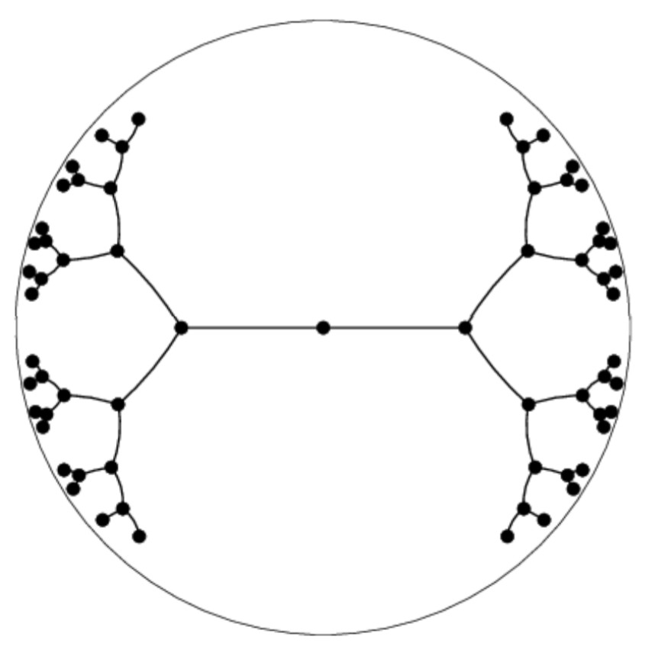
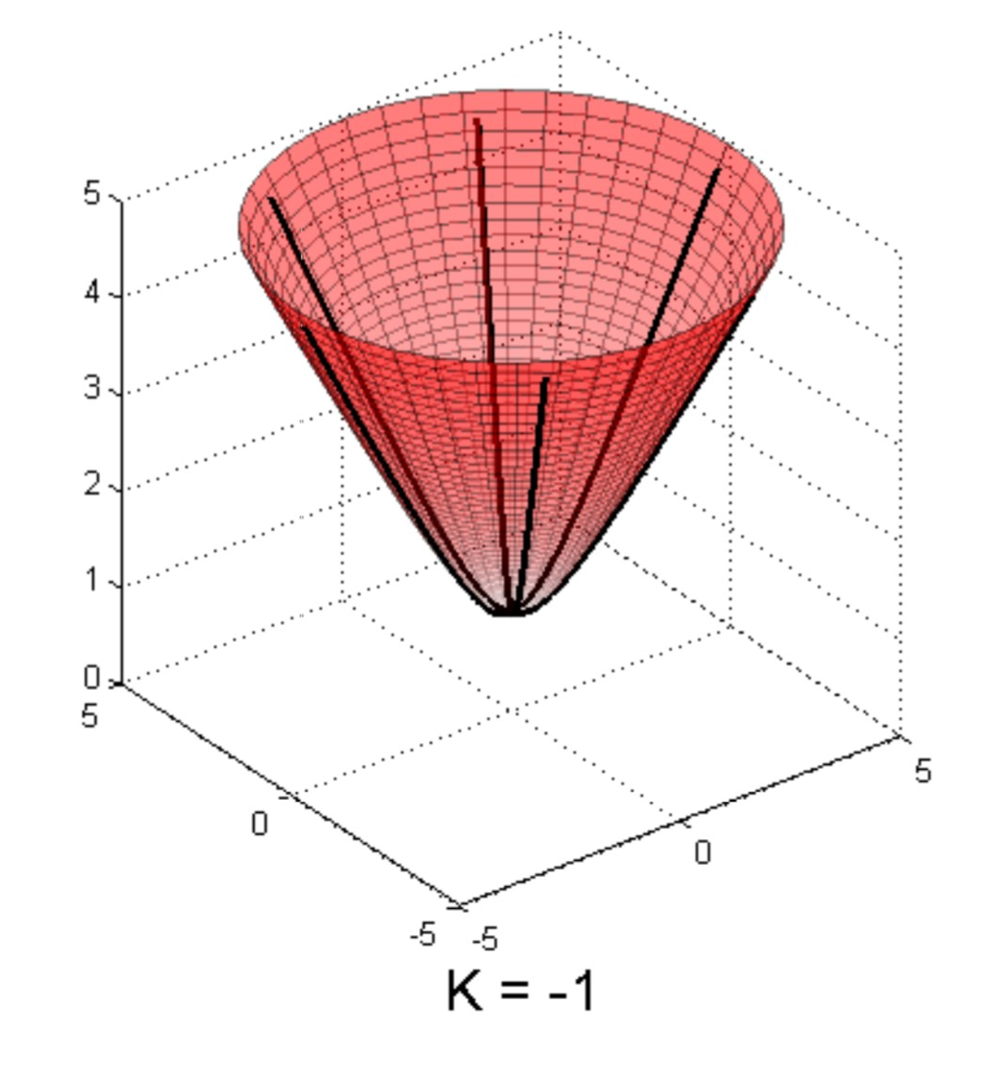
Modeling Hierarchical, tree-like graphs
Hyperbolic space: an alternative embedding space to model embeddings for trees with tree-like structure
Advantage: hyperbolic embedding properties (explained later) allow it to naturally model trees
Challenges: existing deep learning and optimization toolkits can only be applied to
hyperbolic embeddings
Embed
- curvature

Slide 31
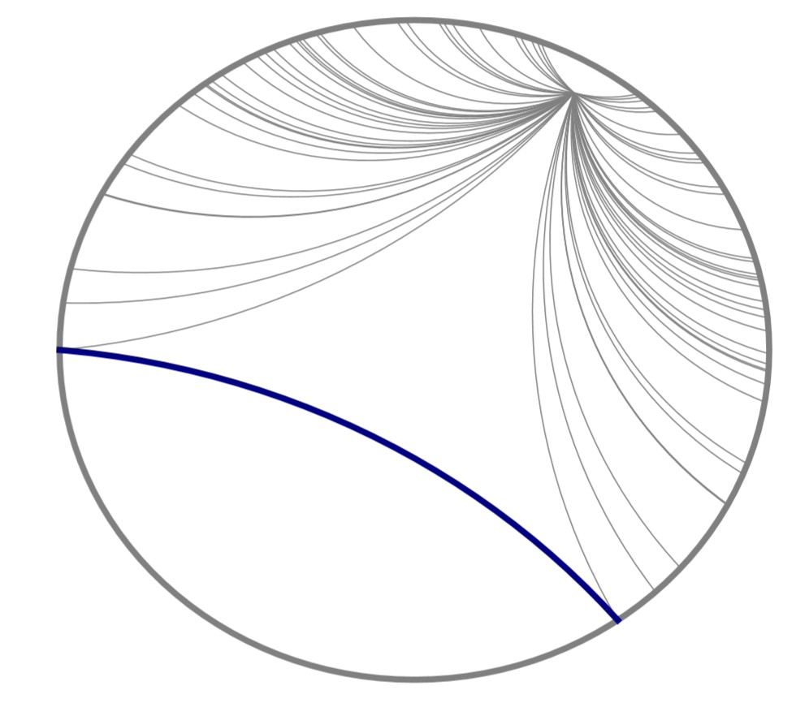
Hierarchical, tree-like graphs
Hyperbolic geometry differs from Euclidean geometry by the parallel postulate (5th axiom)
In Euclidean geometry:
In a plane, given a line and a point not on it, at most one line parallel to the given line can be drawn
through the point.
However, in hyperbolic geometry, there are infinite number of lines parallel to the given line through the point
Set of geodesic lines from the red point to boundary of the Poincare ball that are parallel to the blue line

Slide 32
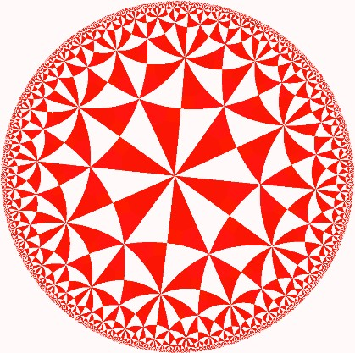
Hyperbolic space cannot be naturally represented in Euclidean space due to its special properties
We commonly use 2 geometry models to represent or visualize hyperbolic spaces
They are equivalent: there exists mappings between these spaces
Poincaré Model
Radius proportional to 𝐾
(𝐾: inverse of curvature)
Open ball (exclude boundary)
Each triangle in the figure has the same area
Poincaré model: intuitive visualization

Slide 33

Hyperboloid Model (Lorentz Model)
Upper sheet of 2-sheet hyperboloid
Subset of Euclidean space
Hyperboloid Model is numerically stable
In comparison, Poincaré Model needs to represent exponentially many embedding points close to the boundary of the Poincare ball
Hyperboloid: numerically more stable, simpler formula

Slide 34
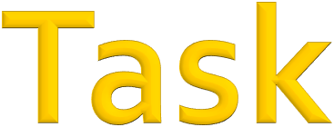
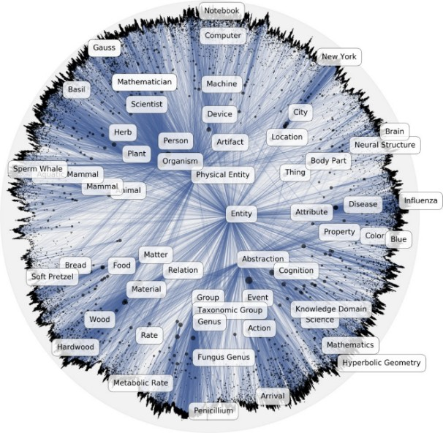
Graph representation learning on hierarchical
graphs
Link Prediction
Node Classification
Nodes in high hierarchy
Nodes in low hierarchy
Poincaré embedding (Nickel et. al.)

Slide 35
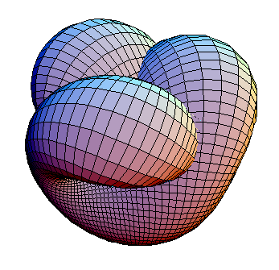
Manifold: high-dimensional surface
Riemannian Manifold
Equipped with
Inner product
. , . : metric space
Tangent space 𝒯! : an ℝ" that approximates the manifold at any point 𝑥
Both functions vary smoothly (differentiable) on the manifold

Slide 36
Geodesic: shortest path in manifold
Analogous to straight lines in ℝ!
Hyperbolic space is a Riemannian manifold with
constant negative curvature − %, where (𝐾 > 0)
&
Becomes Euclidean when 𝐾 → ∞
The more negative is the curvature, the more curved the space is
How does curvature affect the embedding space?
3/18/21
Jure Leskovec, Stanford CS224W: Machine Learning with Graphs
36

Slide 37
We use − " to denote the curvature
!
𝐾 is also the radius of the Poincaré ball
Hyperboloid model as a Riemannian manifold:
  Constant Minkowski inner product
. , .
_{ℒ ∶ ℝ}()%_{×ℝ}()% _{→ ℝ}
𝒙, 𝒚 = −𝑥 𝑦 + 𝑥 𝑦 + … + 𝑥 𝑦 = − ¹
𝐾 > 0
ℒ " " # # $ $
𝐾
Time-like Space-like
Distance between two hyperbolic points 𝑥, 𝑦:

Slide 38
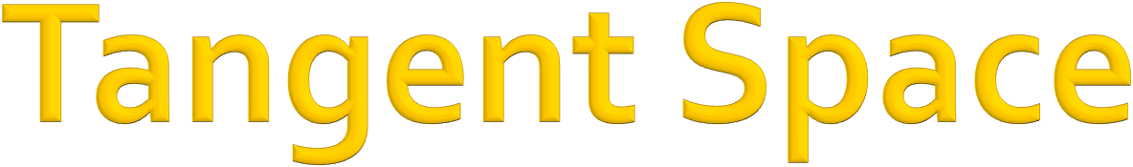
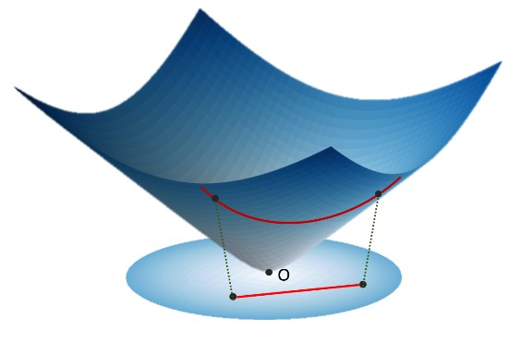
Tangent space expression under hyperboloid model
𝒯*ℍ^{(,&} = {𝒗 ∈ ℝ^{()%}:
𝒗, 𝒙 _{ℒ} = 0}
Hyperboloid model
𝒅: hyperbolic space dimension
𝑲: negative inverse of curvature
Tangent space at north pole

Slide 39
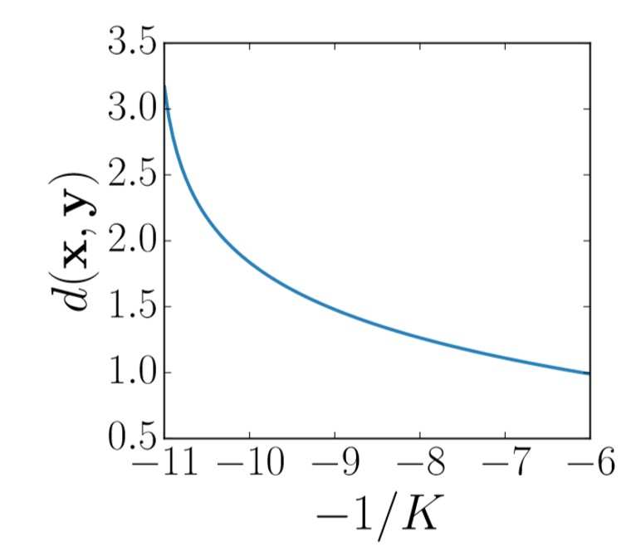
Geodesic distance in hyperbolic space is analogous to the shortest path distance in Euclidean space
“Straight line” in hyperbolic space
The more negative the curvature:
  the more geodesics bends inward
  distance between x and y also increases:
Distance between 𝒙 and 𝒚 increases as curvature becomes more negative

Slide 40
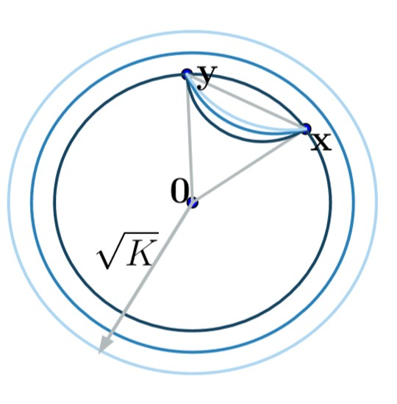
Geodesic distance between two hyperbolic points will bend inward more as curvature becomes more negative
Larger curvature results in smaller radius of the Poincare ball
Distance between the same coordinates
(𝑥, 𝑦) increases as the radius gets smaller
Dark blue: high curvature boundary and geodesics
Light blue: low curvature boundary and geodesics
3/18/21
Jure Leskovec, Stanford CS224W: Machine Learning with Graphs
40

Slide 41
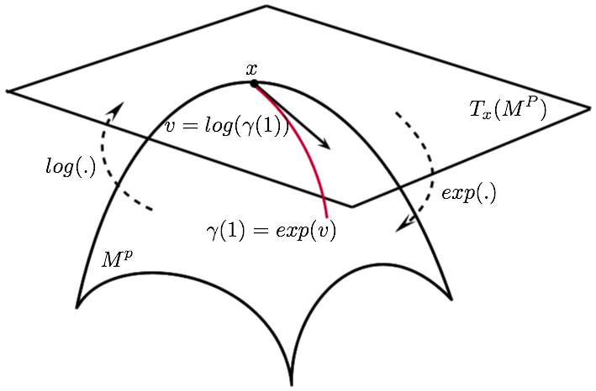
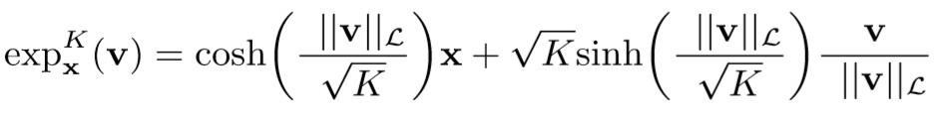
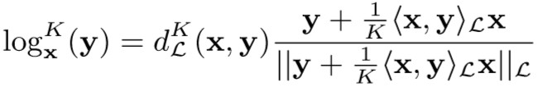
Exponential map: from tangent space (Euclidean) to manifold
Logarithmic map: inverse operation of exponential map
Norm
𝑣 _{ℒ} = 𝑣, 𝑣 _{ℒ}
point in tangent space
Hyperbolic trigonometry
Exp map
𝒗
𝒚: point in
hyperbolic space
Log map

Slide 42
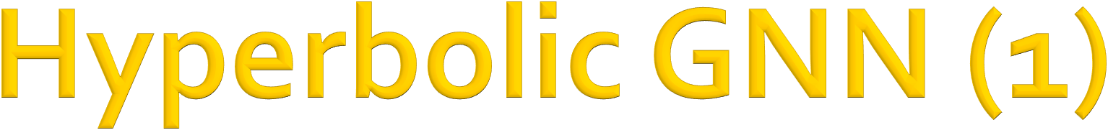
Challenges
Input node features are usually
Euclidean
Perform hyperbolic aggregation for message passing
Choose hyperbolic spaces with the right amount of curvature at every layer of the GNN
Hyperbolic Graph Convolutional Neural Networks, NeurIPS 2019

Slide 43

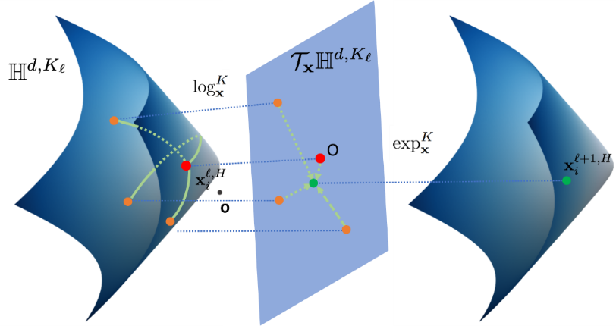
_{𝒉}$,& _{= Msg 𝒙}$'!,&
¡
Message
# #
_{𝒉}$,&
𝒚$,& = AGG"!"#
Aggregation
#
#
𝒙$,& = Update"!"#,"!(𝒚$,&) Update
# #
𝐾%: curvature at layer 𝑙
At every layer:
Message
Aggregation
Update
Hyperbolic Graph Convolutional Neural Networks, NeurIPS 2019

Slide 44
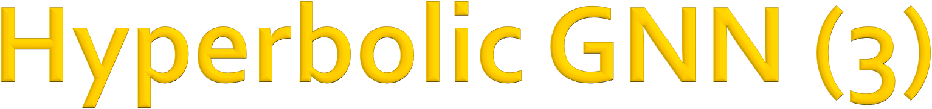
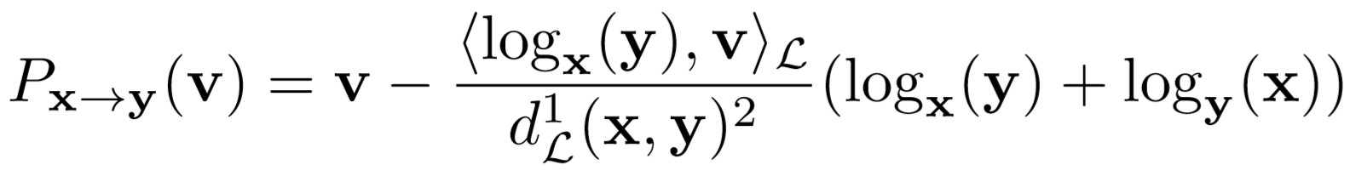
Input Transformation: 𝒙^{,,-} ≔ exp&( 0, 𝒙,,/ )
.
_{𝑊}1 ⊗&_{!"# 𝒙}12%,-
⊕&!"# _{𝒃}¹
Message: 𝒉^{1,-} =
0 0
Hyperbolic linear: 𝑊 ⊗⁴ 𝒙^{5,6} ≔ exp⁴(𝑊 log⁴(𝒙^{5,6}))
7
7
𝒃 )
Parallel Transport
Mobius addition: 𝒙⁶ ⊕⁴ 𝒃 ≔ exp⁴ (𝑃⁴
!!
7→𝒙^{𝑯}
Aggregation: 𝐴𝐺𝐺 𝑥$ % ≔
exp' ( ∑ 𝑤 log' (𝒙$))
(
Attention weights
_{𝒙}# _{𝒙}#
(∈𝒩(%)
%(
"
"
Update: Update'$%&,'$
_{𝒙}$
'
'
≔ exp (𝜎 log
𝒙$ )
$
$%&
𝒐
𝒐
Trainable curvature

Slide 45
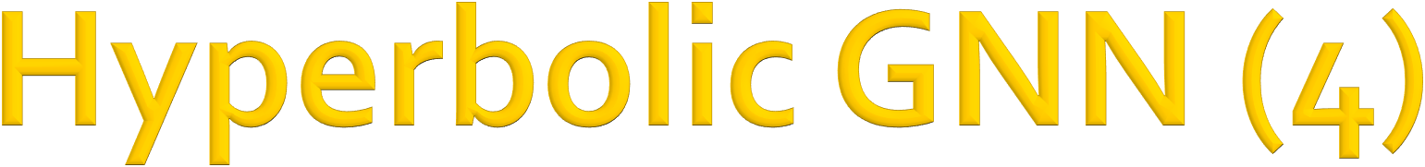
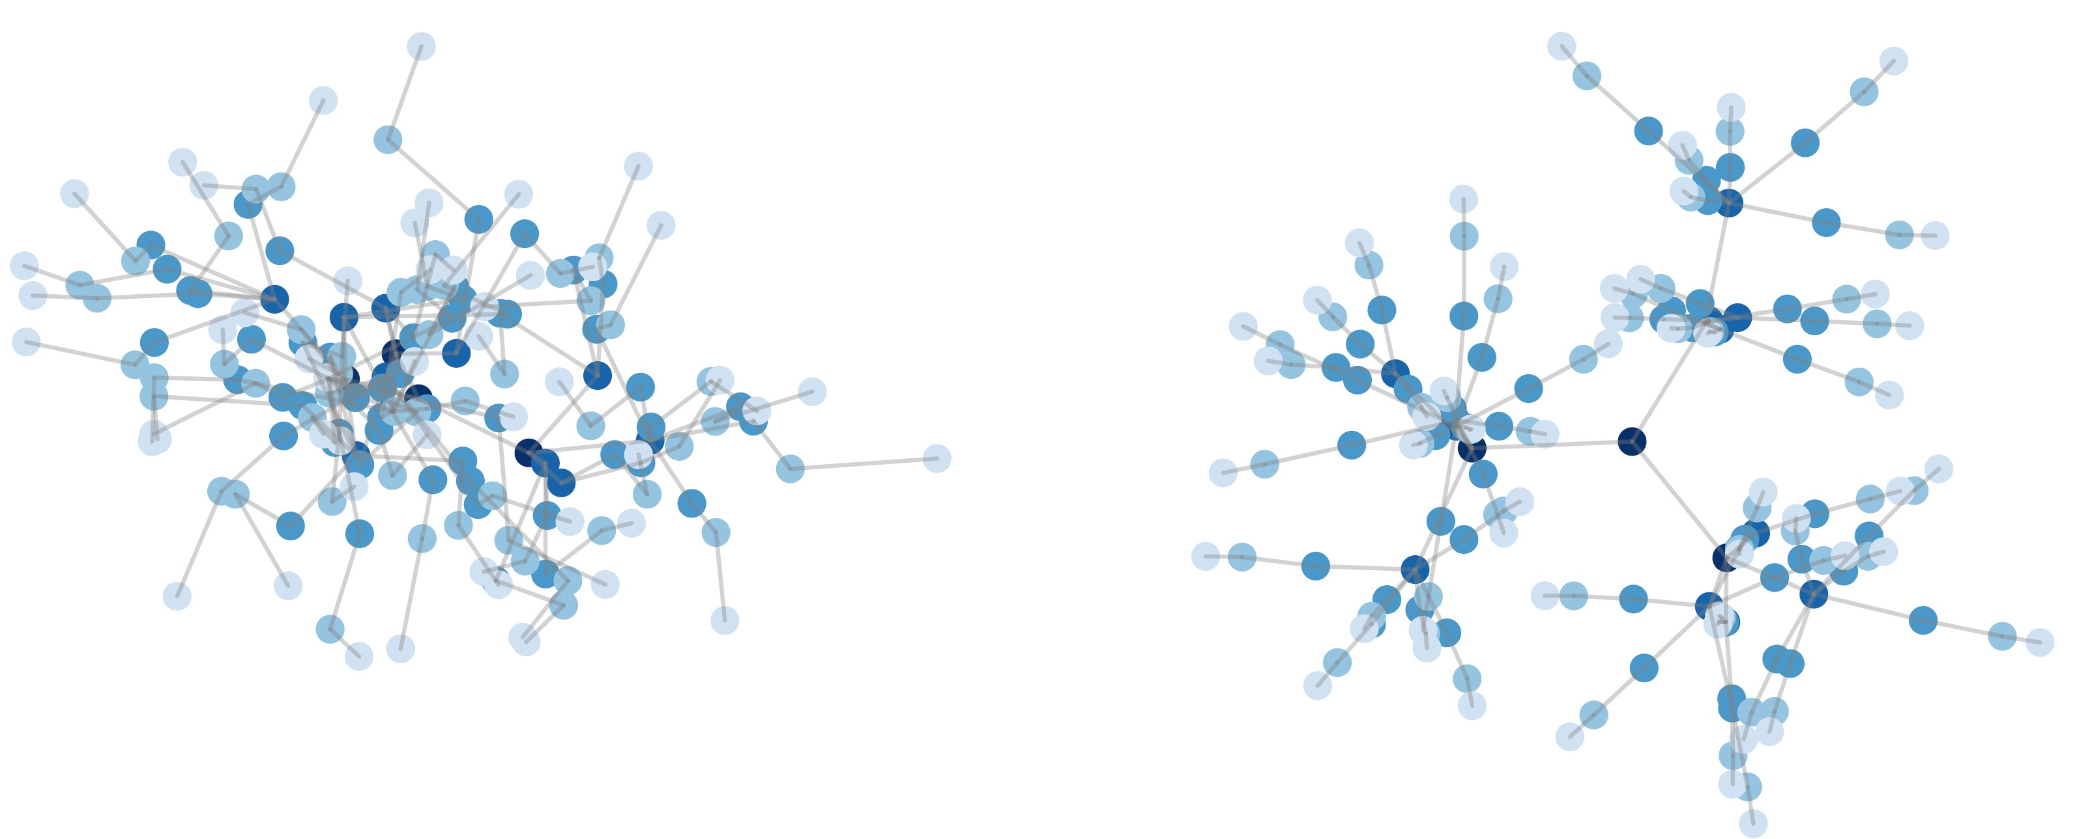
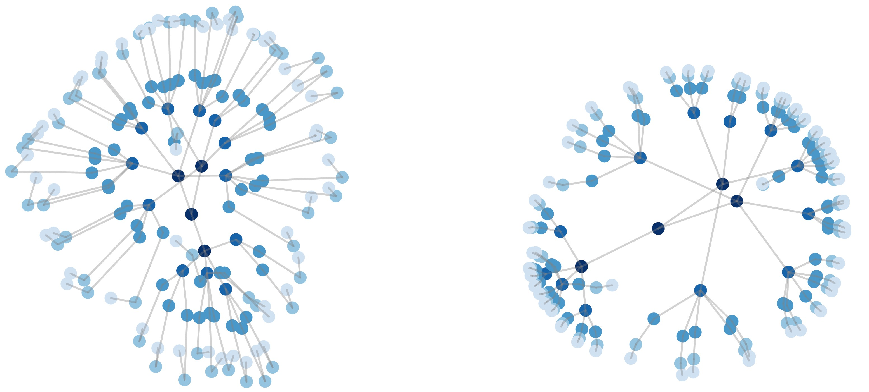
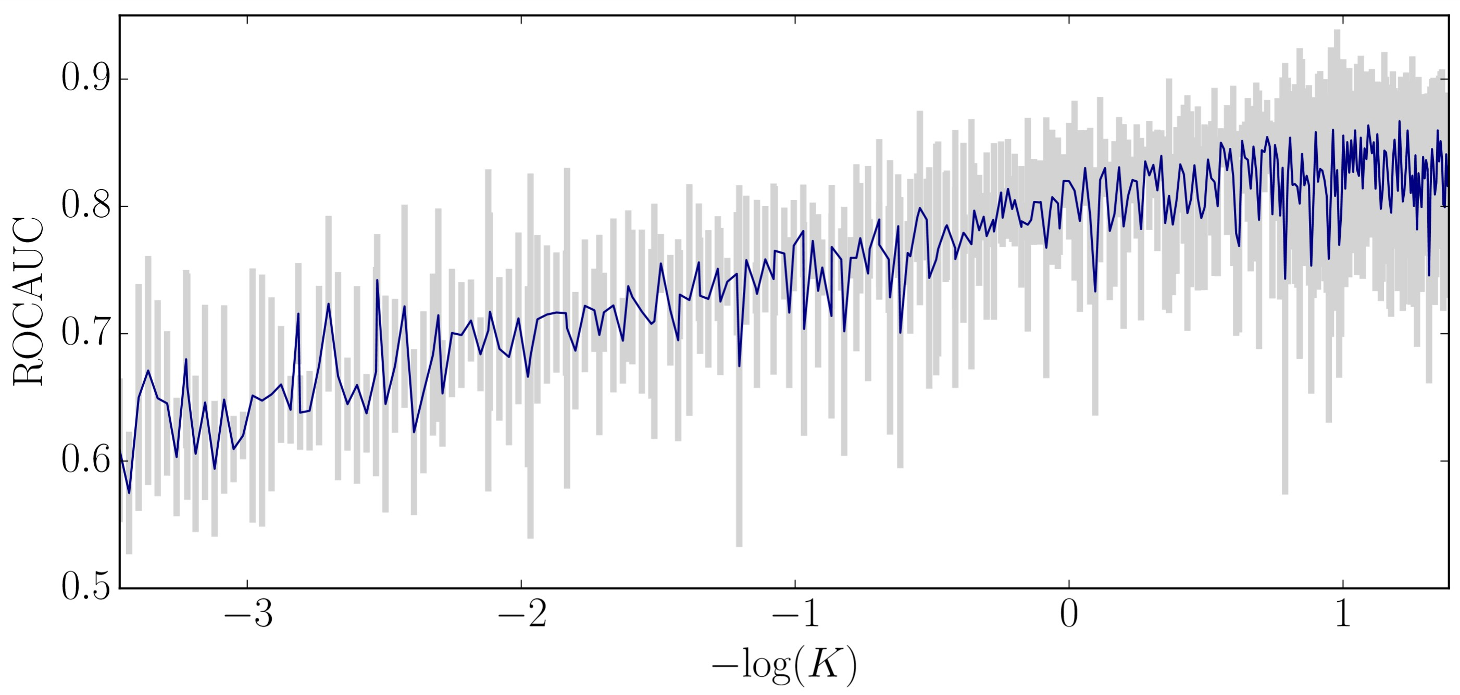
HGNN
GNN
Node Classification (tree)
Disease spreding graph: 1044 nodes, 2 classes
Layer 1
Layer 2
Layer 1
Layer 2
Predict: whether a person is infected
Groundtruth: FIR disease spreading model
Low distortion
Almost Euclidean
Sweet spot
Curvature is important!
Too hyperbolic (unstable)

Slide 46
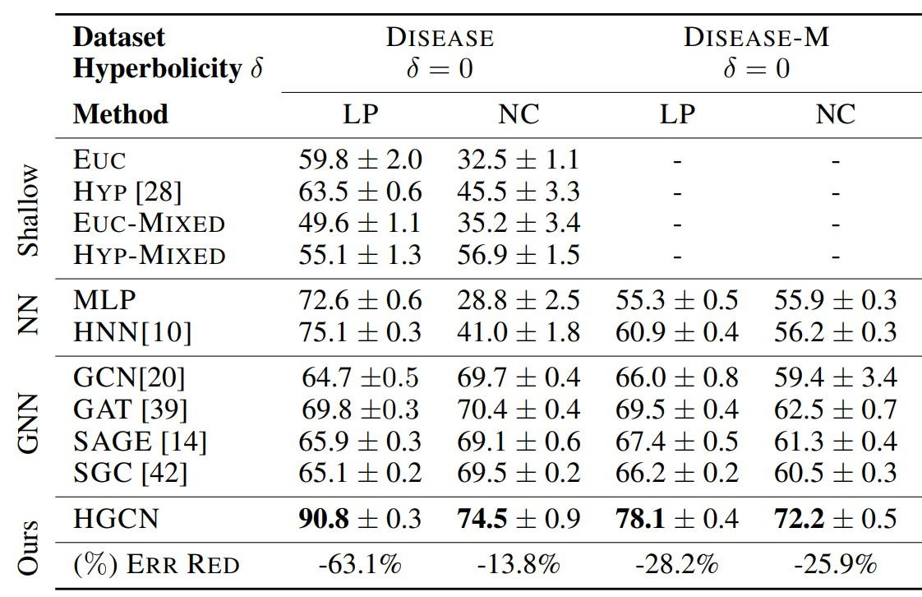
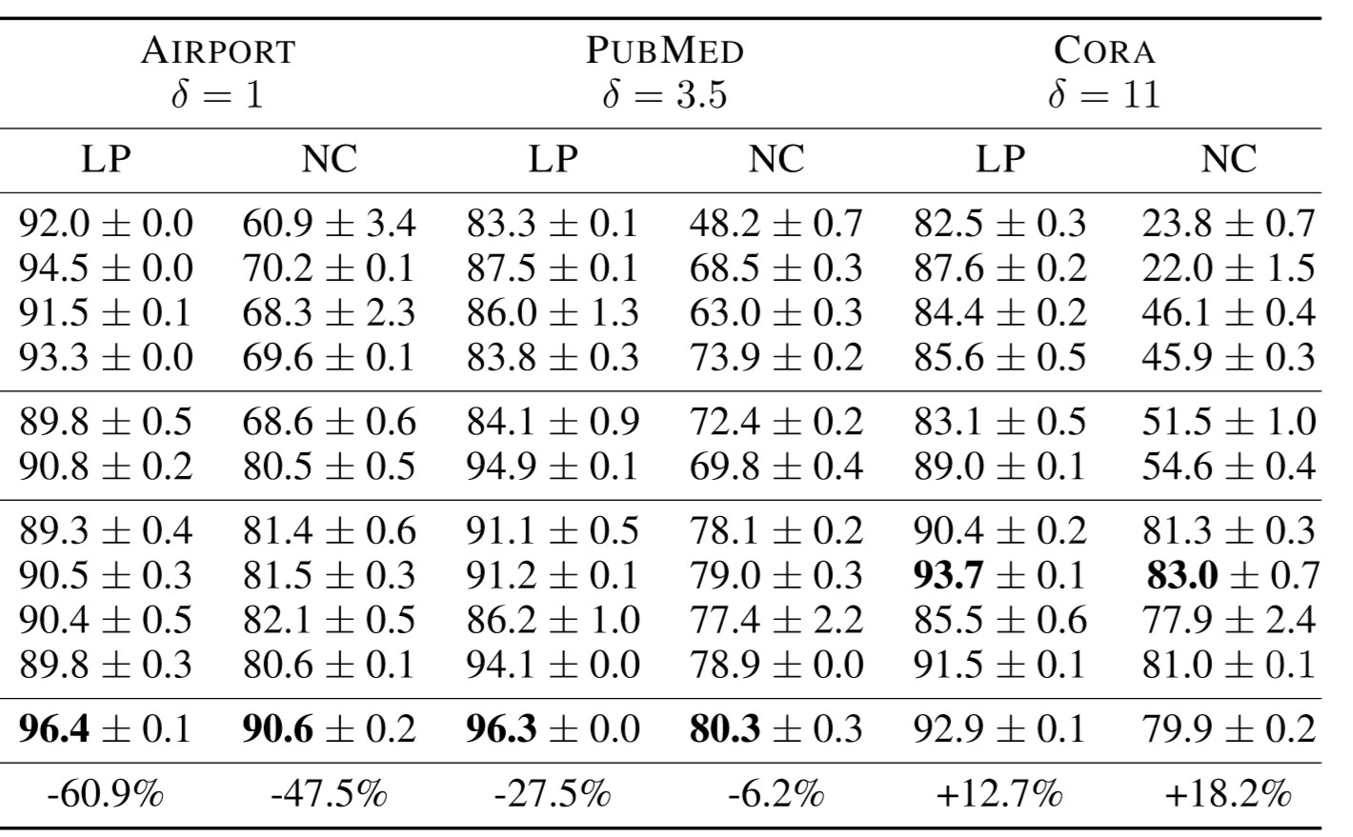
Performance on a variety of datasets
We use hyperbolicity 𝜹 to measure whether a graph dataset is tree-like and hierarchical
See Gromov et al. 1987 for its formula, and an implementation can be found here
Lower value of hyperbolicity: graph is more tree-like
Non-hierarchical
Inductive task
dataset

Slide 47
We introduce hyperbolic geometry as the embedding space to embed hierarchical, tree-like graphs
2 models for representing hyperbolic space:
Poincaré ball model and hyperboloid model
Use exponential and logarithmic map to map points to and from tangent spaces where neural network operations can be performed
Learnable curvature allows the model to learn a tradeoff between performance and stability
3/18/21
Jure Leskovec, Stanford CS224W: Machine Learning with Graphs
47

Slide 48

CS224W: Machine Learning with Graphs Jure Leskovec, Stanford University
http://cs224w.stanford.edu

Slide 49
GNN architectural design:
J.You, R.Ying, J. Leskovec. Design Space of Graph Neural Networks, NeurIPS 2020
How to find a good GNN design for a specific GNN task?
Important but challenging:
  GNNs have been very successful in various applications
  Domain experts want to use SOTA GNN on their specific tasks, however...
    There are tons of possible GNN models
    Best design in one task can perform badly for another task
    Redo grid search for each new task is NOT feasible
Our key contribution:
  The first systematic study for the GNN design space and task space
  GraphGym, a powerful platform for exploring different GNN designs and tasks
49

Slide 50
Design: a concrete model instantiation
E.g., a 4-layer GraphSAGE
Design dimensions characterize a design
  E.g., the number of layers L ∈ {2, 4, 6, 8}
Design choice is the actual selected value in the design dimension
  E.g., L = 2
Design space consists of a Cartesian product of design dimensions
Task: A specific task of interest
  E.g., node classification on Cora, graph classification on ENZYMES
Task space consists of multiple tasks
59

Slide 51
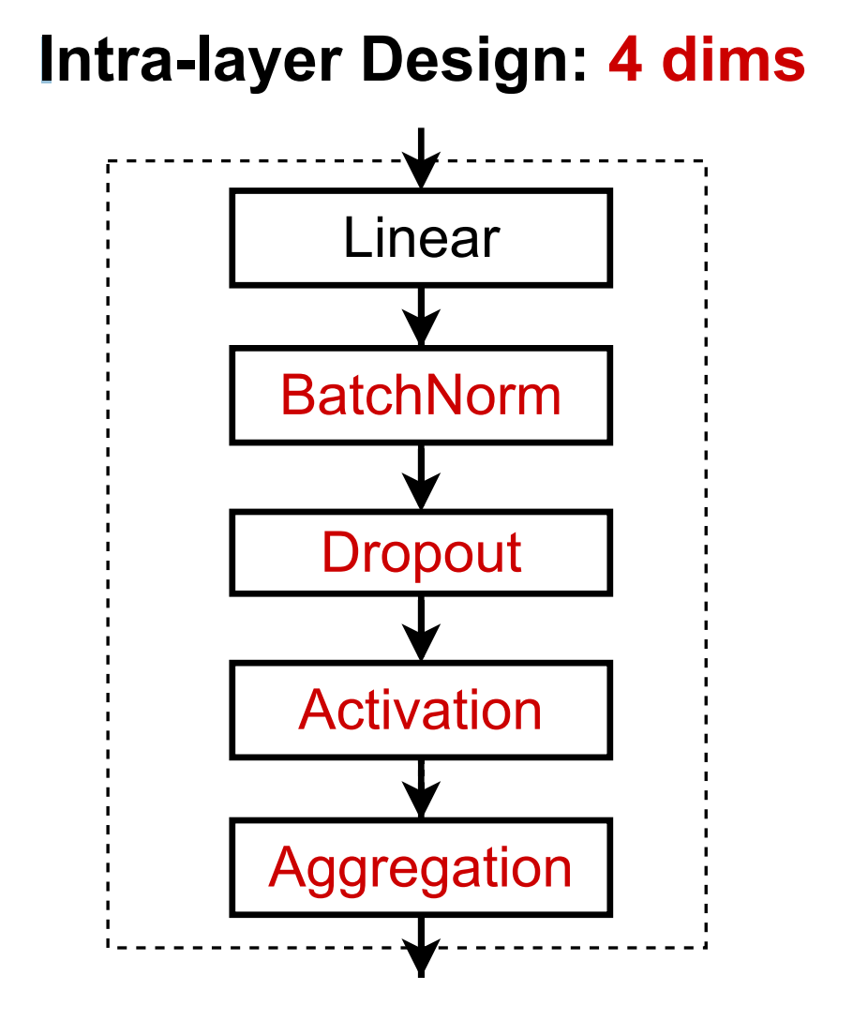
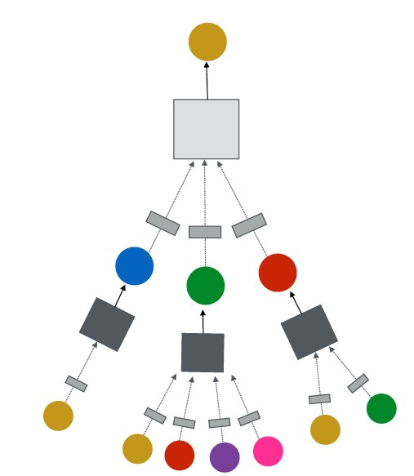
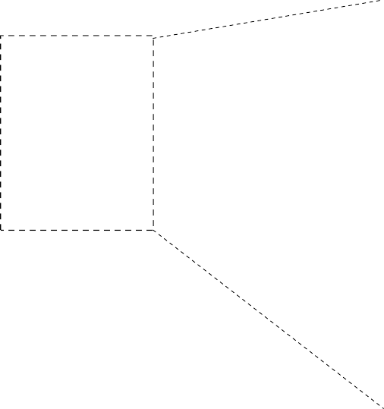
Intra-layer Design:
GNN Layer = Transformation + Aggregation
We propose a general instantiation under this perspective
GNN
Transformation

Slide 52
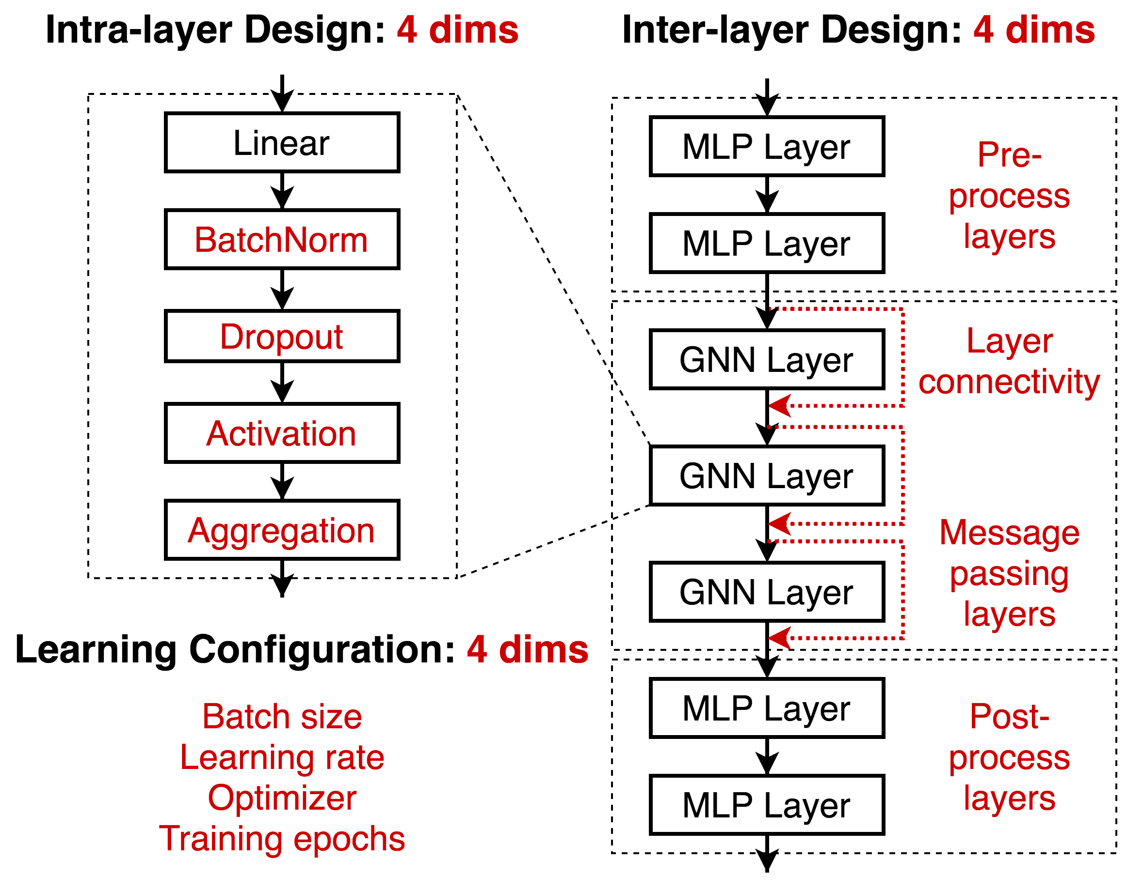
Inter-layer Design
We explore different ways of organizing GNN layers
Pre-process layers:
Important when expressive node feature encoder is needed
E.g., when nodes are images/text
Skip connections:
Improve deep GNN’s performance
Post-process layers: Important when reasoning or transformation over node embeddings are needed E.g., graph classification, knowledge graphs

Slide 53
Learning configurations
Often neglected in current literature
But we found they have high impact on performance

Slide 54


Overall: A GNN design space
  Intra-layer design
Inter-layer design
Learning configuration
In total: 315K possible designs
Our Purpose:
  We don’t want to (and we cannot) cover all the possible designs
  We want to demonstrate that studying a design space is more effective than studying individual GNN designs

Slide 55
Categorizing GNN tasks
Common practice: node / edge / graph level task
Reasonable but not precise
  Node prediction: predict clustering coefficient vs. predict a node’s subject area – completely different task
But creating a precise taxonomy of GNN tasks is very hard!
  Novel GNN applications can always emerge
Our innovation: a quantitative task similarity metric
  Purpose: understand GNN tasks, transfer the best GNN models across tasks

Slide 56
Innovation: quantitative task similarity metric
1) Select “anchor” models (𝑀₉, … , 𝑀:)
2) Characterize a task by ranking the performance of anchor models
3) Tasks with similar rankings are considered as similar
Task Similarity Metric
 | Anchor Model Performance ranking |  |  |  |  | Similarity to Task 𝐴
Task 𝐴 | 𝑀! | 𝑀" | 𝑀# | 𝑀$ | 𝑀% | 1.0
Task 𝐵 | 𝑀! | 𝑀# | 𝑀" | 𝑀$ | 𝑀% | 0.8
Task 𝐶 | 𝑀% | 𝑀! | 𝑀$ | 𝑀# | 𝑀" | -0.4
Task 𝐴 is similar to Task 𝐵
Task 𝐴 is not similar to Task 𝐶
How do we select the anchor models?

Slide 57
Selecting the anchor models
1) Select a small dataset
  E.g., node classification on Cora
2) Randomly sample 𝑵 models from our design space, run on the dataset
  E.g., we sample 100 models
3) Sort these models based on their performance, evenly select 𝑀 models as the anchor models, whose performance range from the worst to the best
  E.g., we sample 12 models in our experiments
Intuition: a bad model in one task could be great for another task
Sorted by performance
𝑀#
𝑀&
𝑀'
𝑁 = 100
models
…
𝑀
#"
^{𝑀}##
^{𝑀}#&

Slide 58

We collect 32 tasks: node / graph classification
(We include link prediction results in the Appendix)
6 Real-world node classification tasks
12 Synthetic node classification tasks
Predict node properties:
Clustering coefficient
PageRank
6 Real-world graph classification tasks 8 Synthetic node classification tasks
Predict graph properties:
- Average path length

Slide 59
Evaluating a design dimension:
“Is BatchNorm generally useful for GNNs?”
The common practice:
  (1) Pick one model (e.g., a 5-layer 64-dim GCN)
  (2) Compare two models, with BN = True / False
Our approach:
  Note that we have defined 315K models ∗ 32 (tasks) ≈ 𝟏𝟎𝐌 model-task combinations
  (1) Sample from 10M possible model-task combinations
  (2) Rank the models with BN = True / False
How do we make it scalable & convincing?

Slide 60
Evaluating a design dimension: controlled random search
a) Sample random model-task configurations, perturb BatchNorm = [True, False]
Here we control the computational budget for all the models
  Controlled Random Search
GNN Design Space |  |  |  |  | GNN Task Space
BatchNorm | Activation | … | Message layers | Layer Connectivity | Task level | dataset
True | relu | … | 8 | skip_sum | node | CiteSeer
False | relu | … | 8 | skip_sum | node | CiteSeer
True | relu | … | 2 | skip_cat | graph | BZR
False | relu | … | 2 | skip_cat | graph | BZR
…
True | prelu | … | 4 | stack | graph | scale free
False | prelu | … | 4 | stack | graph | scale free
60

Slide 61

b) Rank BatchNorm = [True, False] by their performance （lower ranking is better）
c) Plot Average / Distribution of the ranking of
BatchNorm = [True, False]
(b) Rank Design Choices by Performance
(c) Ranking Analysis
GNN Design Space
BatchNorm
True
False
True
False
True
False
Experimental Results
Val. Accuracy | Design Choice Ranking
0.75 | 1
0.54 | 2
0.88 | 1 (a tie)
0.88 | 1 (a tie)
0.89 | 1
0.36 | 2
Summary: Convincingly evaluate any new design dimension, e.g., a new GNN layer

Slide 62

Certain design choices exhibit clear advantages
Explanation:
GNNs are hard to optimize
Explanation:
This is our new finding!
Explanation:
GNNs experience underfitting more often
Explanation:
Sum is the most expressive aggregator

Slide 63


Certain design choices exhibit clear advantages
Optimal number of layers is hard to decide Highly dependent on the task
Explanation:
Skip connection enable hierarchical node representation

Slide 64

Certain design choices exhibit clear advantages
Optimal batch size and learning rate is hard to decide Highly dependent on the task
Explanation:
Adam is more robust
More training epochs is better

Slide 65


Best GNN designs in different tasks vary significantly
  Motivate that studying a task space is crucial

Slide 66


Build a GNN task space
Recall how we compute task similarity
 | Anchor Model Performance ranking |  |  |  |  | Similarity to Task 𝐴
Task 𝐴 | 𝑀! | 𝑀" | 𝑀# | 𝑀$ | 𝑀% | 1.0
Task 𝐵 | 𝑀! | 𝑀# | 𝑀" | 𝑀$ | 𝑀% | 0.8
Task 𝐶 | 𝑀% | 𝑀! | 𝑀$ | 𝑀# | 𝑀" | -0.4
Task similarity computation is cheap:
Using 12 anchor
models is a good approximation!
Pairwise similarities between GNN tasks

Slide 67
Proposed GNN task space is informative
Group 1
Group 1:
Tasks rely on feature information
Node/graph classification tasks, where input graphs have high- dimensional features
Cora graph has 1000+ dim node feature
Group 2
Group 2:
Tasks rely on structural information
Nodes have few features Predictions are highly dependent on graph structure
Predicting clustering coefficients
Pairwise similarities between GNN tasks

Slide 68

Proposed GNN task space is informative
Group 2 Group 1
PCA
!
"
#
Similar tasks have similar best architectures
 | Best GNN Designs Found in Different Tasks
 |  | Pre layers | MP layers | Post layers | Connectivity | AGG
 | Task 𝐴 | 2 | 8 | 2 | skip-sum | sum
 | Task 𝐵 | 1 | 8 | 2 | skip-sum | sum
 | Task 𝐶 | 2 | 6 | 2 | skip-cat | mean

Slide 69

Case study: generalize best models to unseen
OGB ogbg-molhiv task
ogbg-molhiv is unique from other tasks: 20x larger, imbalanced (1.4% positive) and requires out-of-distribution generalization
Concrete steps for applying to a novel task:
  Step 1: Run 12 anchor models on the new task
  Step 2: Compute similarity between the new task and existing tasks
  Step 3: Recommend the best designs from
Task "
existing tasks with high similarity
Task !

Slide 70
Our task space can guide best model transfer to novel tasks!
Findings:
We pick 2 tasks:
Task A: Similar to OGB Task B: Not similar to OGB
Transfer the best model from Task A achieves SOTA on OGB
Transfer the best model from Task B performs badly on OGB
Task "
 | Task 𝑨: graph- scalefree-const-path | Task 𝑩: node- CoauthorPhysics
Best design in our design space | (1, 8, 3, skipcat, sum) | (1, 4, 2, skipcat, max)
Task Similarity with ogbg-molhiv | 0.47 | -0.61
Performance after transfer to ogbg-molhiv | 0.785 | 0.736
Task !
Previous SOTA: 0.771
70

Slide 71



The first systematic investigation of:
General guidelines for GNN design
Understandings of GNN tasks
Transferring best GNN designs across tasks
GraphGym: Easy-to-use code platform for GNN
(a) GNN Design Space
(b) GNN Task Space
(c) Controlled Random Search
GNN Design Space |  |  |  |  | GNN Task Space
BatchNorm | Act | … | MP layers | Connectivity | level | dataset
True | relu | … | 8 | skip_sum | node | CiteSeer
False | relu | … | 8 | skip_sum | node | CiteSeer
True | relu | … | 2 | skip_cat | graph | BZR
False | relu | … | 2 | skip_cat | graph | BZR
…
!
"
#
(d) Rank Design Choices by Performance
(e) Ranking Analysis
Experimental Results
Val. Accuracy | Design Choice Ranking
0.75 | 1
0.54 | 2
0.88 | 1 (a tie)
0.86 | 1 (a tie)
…
Best GNN Designs Found in Different Tasks
 | Pre layers | MP layers | Post layers | Connectivity | AGG
Task ! | 2 | 8 | 2 | skip-sum | sum
Task " | 1 | 8 | 2 | skip-sum | sum
Task # | 2 | 6 | 2 | skip-cat | mean
71

