Slide 1



liGraph: n Extremely Large Scale Graph Representation Learning in Practice
Xiaoyong Liu Hongxia Yang Wei Lin
Alibaba Group

Slide 2
Part 1: bout libaba

Slide 3
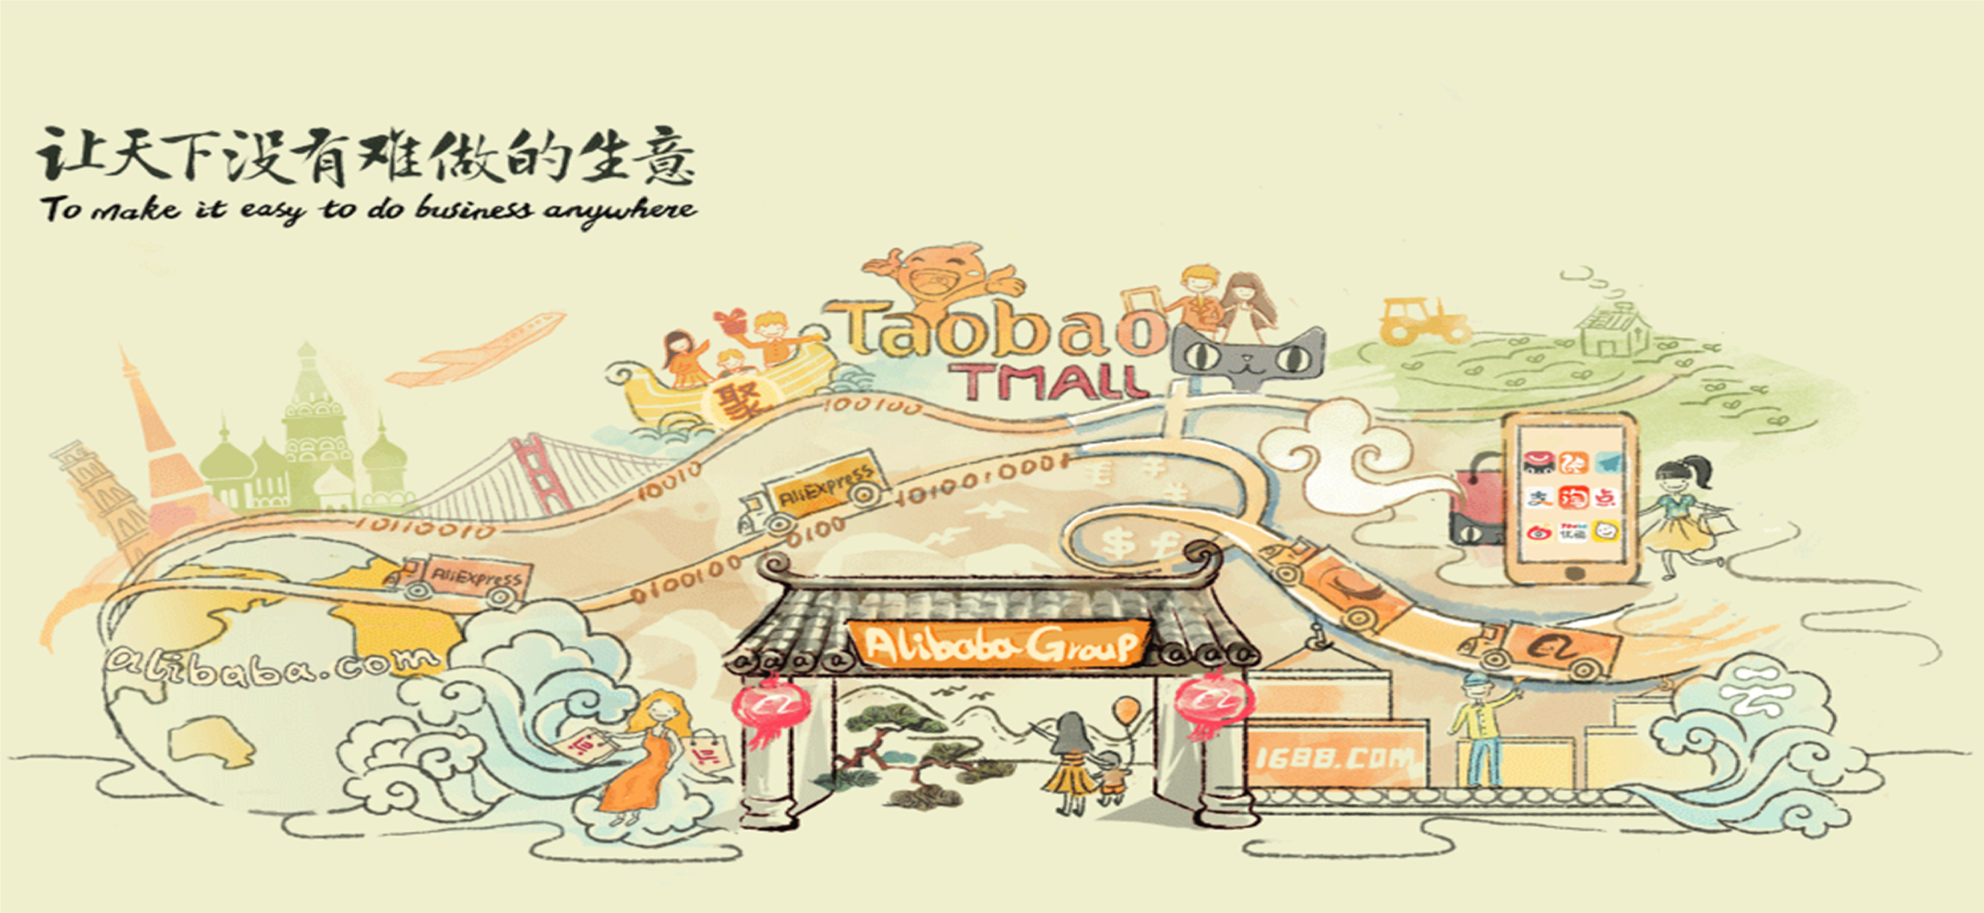
ur Mission

Slide 4



MEET
Our ision
WORK
Empowering our customers with data and infrastructure to manage their business
LIVE
To become central to the everyday lives of our customers
Enabling millions of commercial and
social interactions
@ Alibaba

Slide 5
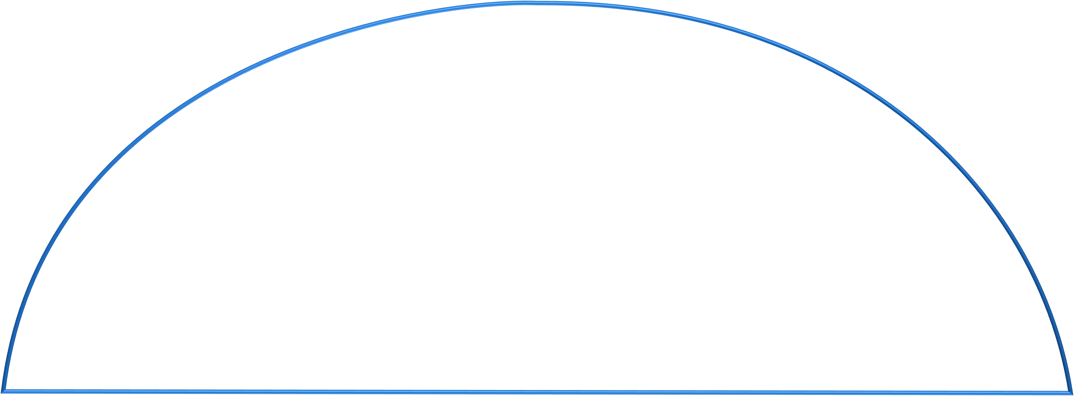

















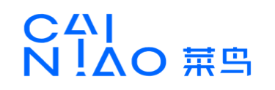








libaba Ecosystem
Weibo
Soc-&l Med-&
Loc&t-on B&sed
Profess-on&l Serv-ce Prov-ders
Mob-le Browser
M&rket-ng
D-g-t&l Entert&-nment
F-n&nc-ng & P&yment Solut-on
SELLERS
BUYERS
Log-st-cs
＄
Online and Mobile Commerce Platform
TECHNOLOGY
D T
TE M
CLOUD COMPUT$NG
OPER T$NG SYSTEM

Slide 6
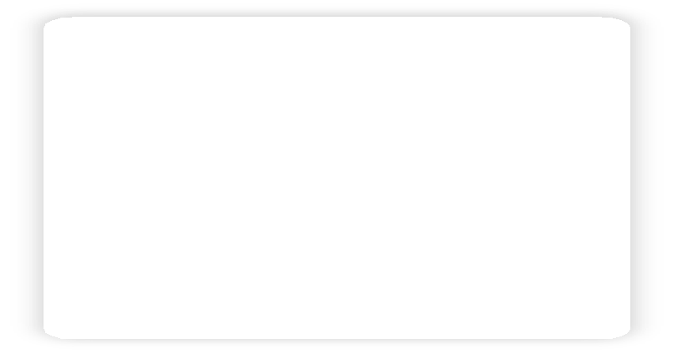
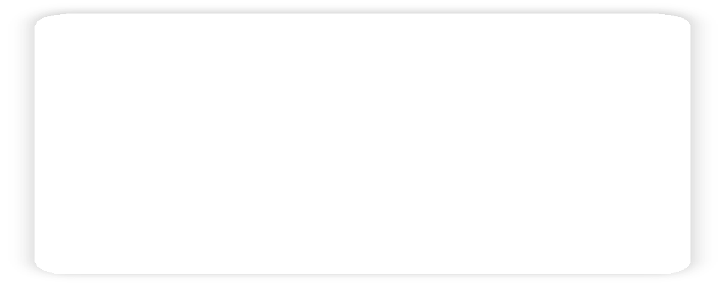
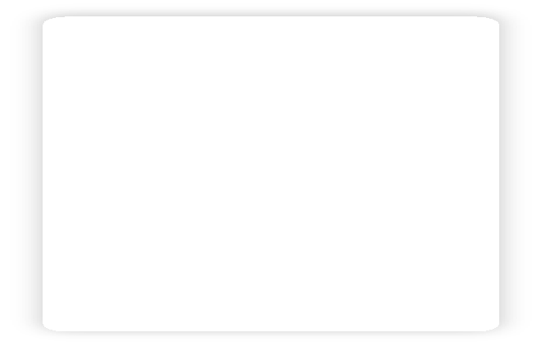
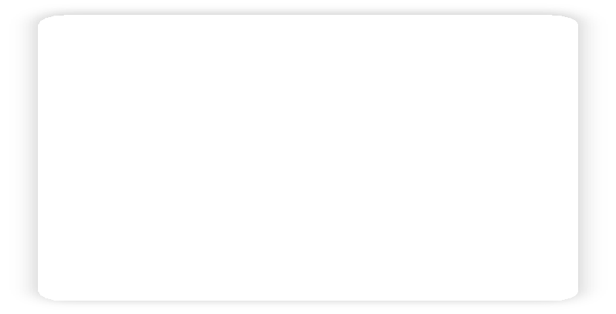
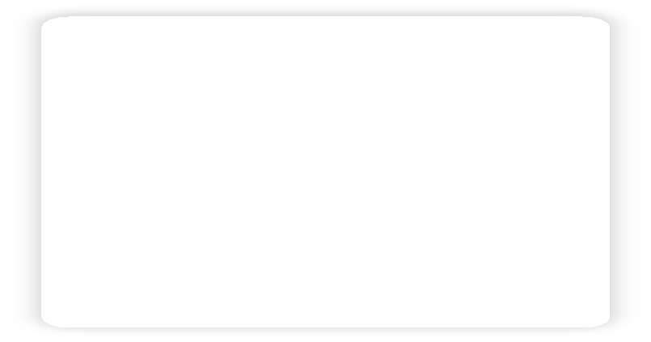














Our Marketplaces are etworked
Retail Marketplaces
Retail Sellers
Wholesale Marketplaces
Wholesale Sellers
Buyers
Chinese Consumers
Traffic
Small Sellers
Chinese Wholesalers & Manufacturers
Global Consumers
Branded Sellers
Global Wholesalers &
Manufacturers
Global Wholesale Buyers
Buying
Selling
Buying
Selling
Cross Promotion Across Our China Retail Marketplaces
Strong Synergies Between Our Retail & Wholesale Marketplaces

Slide 7
Part 2:Why G and Two works

Slide 8
Why Graph and Graph mbedding?
)C2ph comput:n8 models 2Ce GeCy popul2C :n b:8 d2t2 comp2n:es, espec:2lly I. comp2n:es, 2s they 2Ce the most stC2:8htfoCw2Cd solut:ons to m2ny pC2ct:c2l pCoblems
.C2d:t:on2l Cecommend2t:on 2nd (.-/(/- pCed:ct:on pCoblems c2n be eBu:G2lently modeled w:th the 2ttC:buted useC-:tem b:p2Ct:te 8C2phs
Object:Ge funct:ons 2Ce moCe 8eneC2l: 8lob2l opt:m:z2t:on Gs cond:t:on2l :ndependent opt:m:z2t:on
IntCoduc:n8 h:8h-leGel pCoI:m:ty s2mples 2nd the:C model:n8 bC:n8s both C:sks (e.8., no:se 2nd benef:ts (e.8., moCe 8eneC2l:z2t:on 2nd eIploC2t:on, pCed:ct:Ge 8C2ph ch2n8es
,uCe deep le2Cn:n8 :s m2tuCe, 8C2ph embedd:n8 th2t comb:nes both deep le2Cn:n8 2nd 8C2ph comput:n8 :nte8C2t:n8 end-to-end le2Cn:n8 w:th :nduct:Ge Ce2son:n8, wh:ch :s eIpected to solGe the Cel2t:on2l Ce2son:n8 th2t deep le2Cn:n8 c2nnot peCfoCm^{0l1}.
^{0l1} -el2t:on2l :nduct:Ge b:2ses, deep le2Cn:n8 2nd 8C2ph netwoCks, B2tt28l:2 etc, 2CI:G, 20l8.

Slide 9
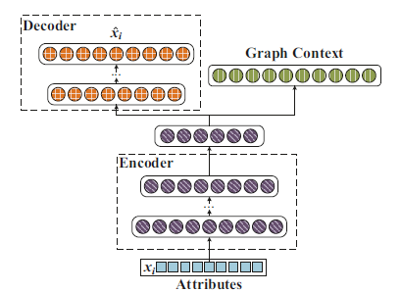
RepreAent1t8De Work: Gr1ph E;2edd8ng 8n Fr1Cd Detect8on^{[10}
Ch,llen2es of mo-ile fr,ud detection:
Billions of mo-ile lo22in2 records :er d,B
Device ids ,re missin2
Devices ,re ,-norm,l:
  Du,l sim c,rds du,l st,nd-B: one device h,s tAo imei, imsi^{[2]} Aith r,ndom sAitchin2
  Re:l,ce the sim c,rd: one device corres:onds to multi:le imsi
  SBstem Restore: One device corres:onds to multi:le device ids
  Simul,tor: One device corres:onds to , l,r2e num-er of device ids
  Cott,2e m,chine: , l,r2e num-er of devices sh,re one s,me id
Devices cont,in rich ,ttri-utes
We :ro:ose , distri-uted dee: le,rnin2 -,sed re:resent,tion le,rnin2 model, ANRL, Ahich m,:s nodes in the 2r,:h to re:resent,tion vectors in loA dimension,l s:,ce to f,cilit,te su-sequent :rocessin2 of rel,ted t,sks
  Com-inin2 -oth netAork structure ,nd node ,ttri-ute inform,tion to -etter m,int,in netAork
ch,r,cteristics
  Neur,l netAorks c,n mine dee:er correl,tions -etAeen the tAo
^{[10} A,RL: Attr82Cted ,etEork RepreAent1t8on Le1rn8ng D81 Deep ,eCr1: ,etEorkA, IJCAI 2 18
^{[20} 8;e8: 8ntern1t8on1: ;o28:e eqC8p;ent 8dent8tF; 8;A8: 8ntern1t8on1: ;o28:e AC2Acr82er 8dent8tF

Slide 10
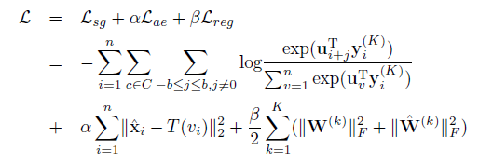
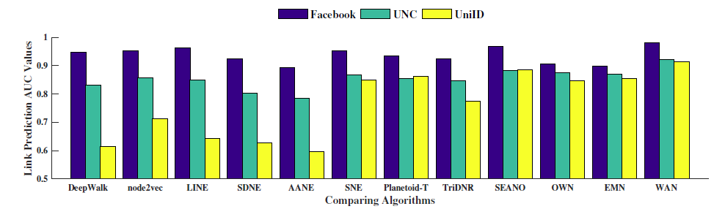
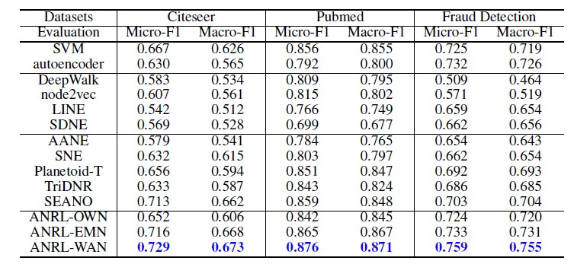
Representative Work: Graph Embedding in Fraud etection
Objective Functions:
Existing methods generally incorporate attribute information into representation learning by matrix decomposition or by adding auxiliary nodes. This shallow level model can't capture the deep inner relationship between the two.
Compared with the existing state-of-the-art method, our model ANRL has a certain degree of improvement in tasks such as ink prediction and node classification by using the deep learning model.

Slide 11
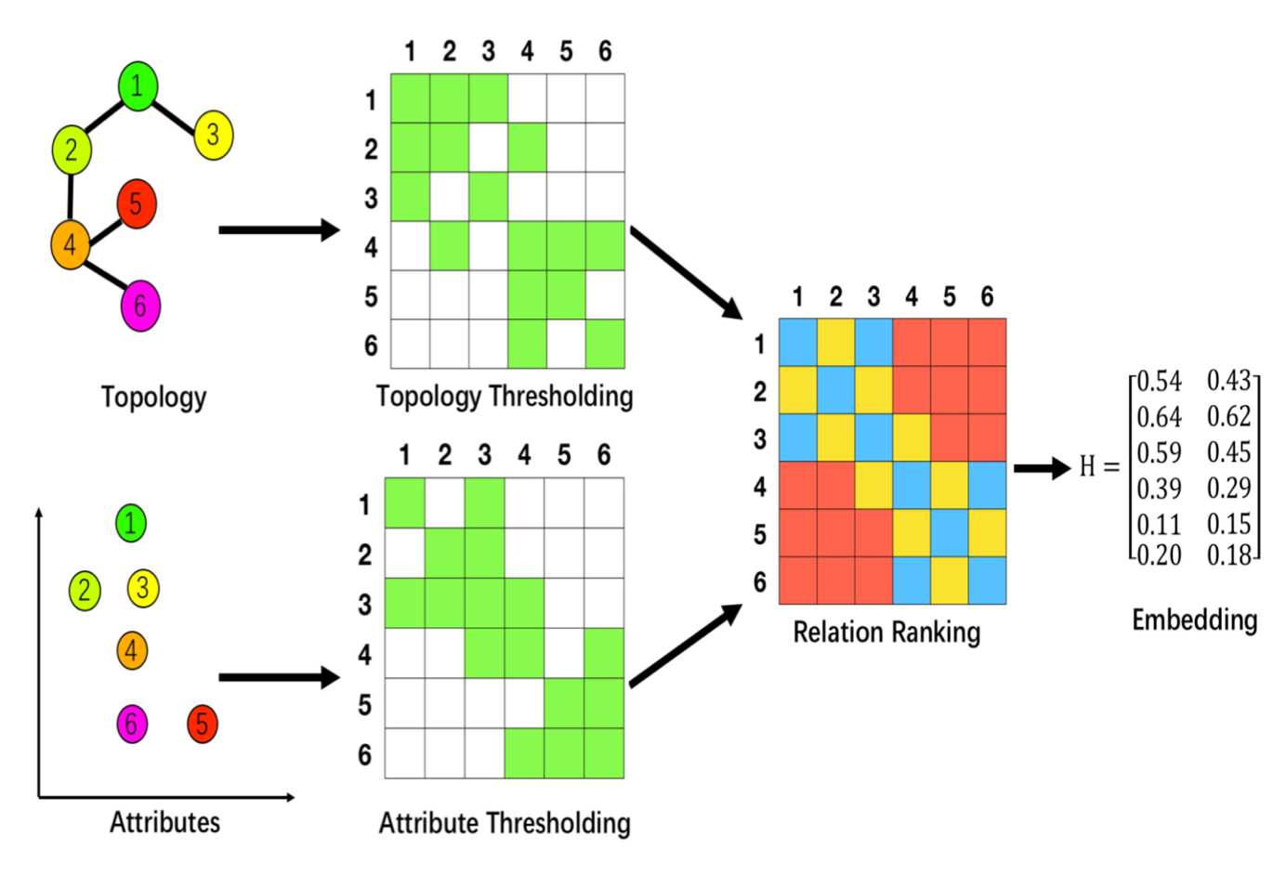
Representative ,or8: Graph E:0e22ing in Entity Re1ognition^{[1]}
Ch,llenges of mo-ile entitB re.ognition:
D,t, .ont,ins l,rge-s.,le s:,rse network stru.ture inform,tion ,nd ri.h nodes.
,ttri-ute inform,tion
Both inform,tion .,n -e used to des.ri-e the rel,tionshi: ,mong the nodes, however dist,n.e me,sures of the two ,re :ro-,-lB not monotoni.,llB in.re,sing or de.re,sing of the s,me nodes
Consider , non-:ositive rel,tionshi:, we .,n .,:ture more inform,tion to hel: im:rove the le,rning :erform,n.e
We :ro:ose to investig,te ,ttri-uted network em-edding through
t,king un.orrel,tion -etween to:ologB stru.ture ,nd ,ttri-ute into ,..ount ,nd m,ke the following
.ontri-utions.
We re.ogniCe the un.orrel,tion :henomenon -etween to:ologB stru.ture ,nd ,ttri-ute whi.h ,ffe.ts the
,.tu,l :roximitB ,mong nodes in the em-edding s:,.e.
We :ro:ose , (erson,liCed node )el,tion ),nking Em-edding (())E model su.h th,t the resulting network em-edding .,n .,:ture the un.orrel,tion ,s well ,s :reserve good :roximitB ,mong nodes.
S,m:ling with Mini--,t.h Gr,dient Des.ent for effi.ient iter,tion ,nd u:d,te.
^{[1]} PRRE: PersonaliEe2 Relation Ran8ing E:0e22ing for Attri0Ate2 NetCor8s, CIKM 2 18

Slide 12
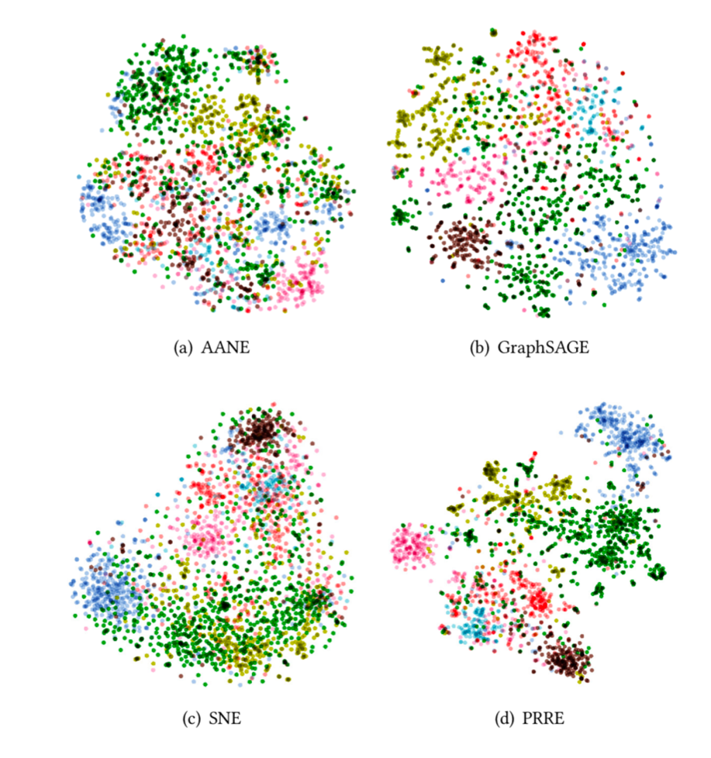
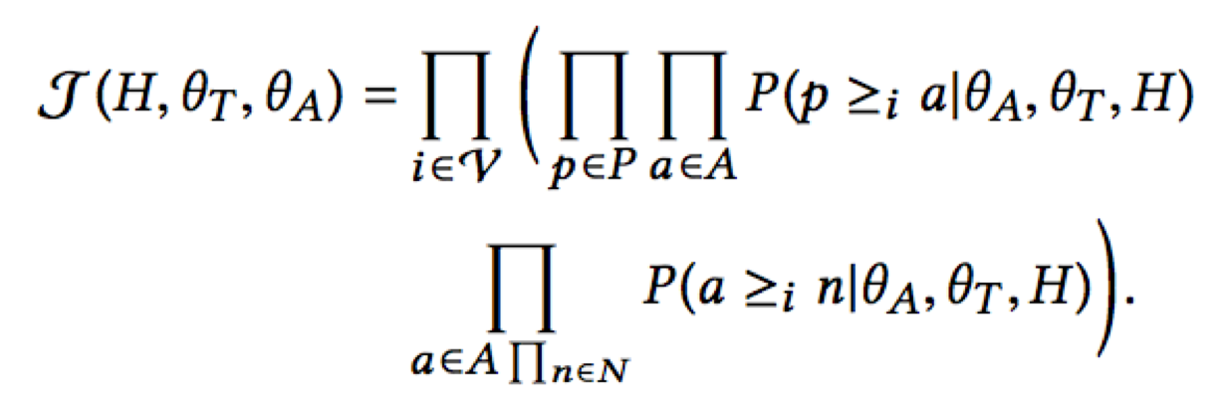
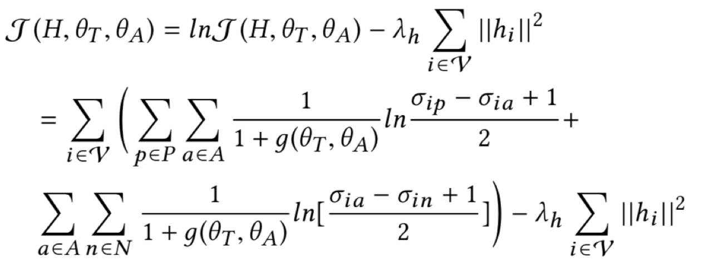
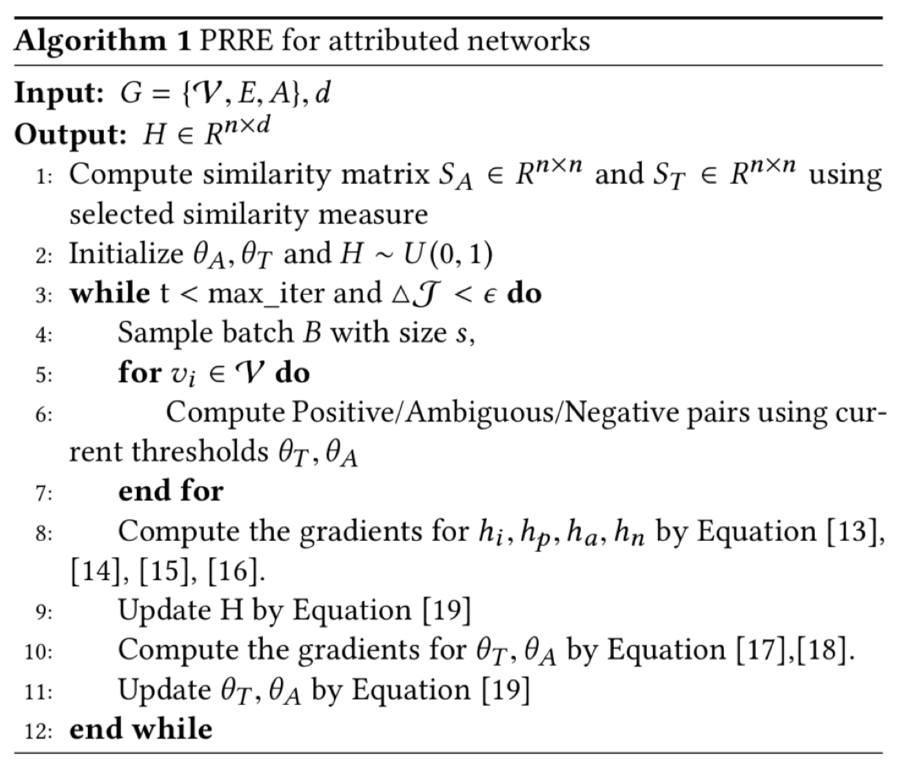
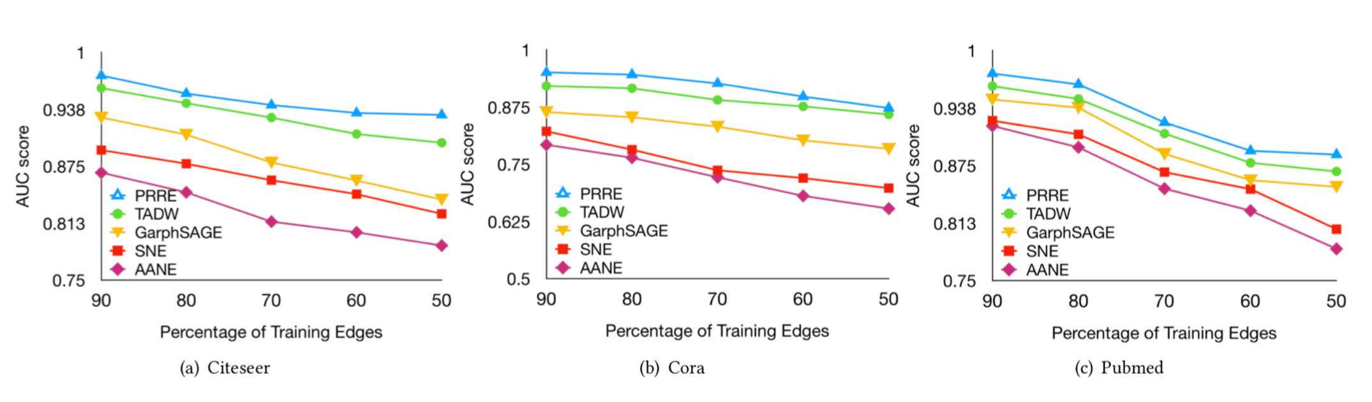
Representative Work: Graph mbedding in ntity Recognition
Objective function and algorithm framework
N-des are mapped int- the -D space 2sing t-SNE with learned embeddings

Slide 13
)t1e8 G8,71 Embe..2n0 Re78esent,t2ve Wo8ks
SSBGPApH-ASGLEMRED PARH 1LBEDDIMG FNP SELAMRIC ?sEP SEAPCH NM 4EREPNGEMENSs SNCIAK :ERUNPJ, WWW, 201).
-:R8: -RRPIBSRED :ERUNPJ REpPEsEMRARINM 8EAPMIMG TIA 0EEp :ESPAK :ERUNPJs, 56C-5, 201).
-DTEPsAPIAK 0ERECRINM UIRH 9NDEK 5MREPpPERARINM. (DD, 2018.
SP-RC: SEKF-PACED :ERUNPJ REpPEsEMRARINM FNP 2EU-SHNR RAPE CAREGNPW CHAPACREPIzARINM. (DD, 2018.
9NBIKE ACCEss PECNPD PEsNKSRINM NM KAPGE-sCAKE IDEMRIFIEP-KIMJAGE GPApHs. (DD, 2018.
5MREPACRITE PARHs 1LBEDDIMG FNP SELAMRIC PPNxILIRW SEAPCH NM 4EREPNGEMENSs 3PApHs. (DD, 2018.
(. PRR1: PEPsNMAKIzED REKARINM RAMJIMG 1LBEDDIMG FNP -RRPIBSRED :ERUNPJ. 2(RH -C9 5MREPMARINMAK CNMFEPEMCE NM 5MFNPLARINM AMD 7MNUKEDGE 9AMAGELEMR (C579 , 201).
). 4EREPNGEMENSs 1LBEDDIMG PPNpAGARINM FNP 8APGE-sCAKE 1-
CNLLEPCE ?sEP -KIGMLEMR, 201) 5111 5MREPMARINMAK CNMFEPEMCE NM 0ARA 9IMIMG (5C09 , 201)
8NCAK -KGNPIRHL FNP ?sEP -CRINM PPEDICRINM TNUAPDs 0IspKAW -Ds. 23PD -C9 S53700 CNMFEPEMCE NM 7MNUKEDGE 0IsCNTEPW AMD 0ARA 9IMIMG ((DD , 2017.
4WBPID 2PALEUNPJ FNP TExR 9NDEKIMG UIRH CNMTNKSRINMAK R::. 23PD -C9 S53700 CNMFEPEMCE NM 7MNUKEDGE 0IsCNTEPW AMD 0ARA 9IMIMG ((DD , 2017.
.AWEsIAM 4EREPNsCEDAsRIC 9ARPIx 2ACRNPIzARINM FNP CNMTEPsINM RARE PPEDICRINM. 26RH -C9 5MREPMARINMAK CNMFEPEMCE NM 5MFNPLARINM AMD 7MNUKEDGE 9AMAGELEMR (C579 , 201(.
WIKK TPIADIC CKNsSPE SRPEMGRHEM TIEs IM SNCIAK :ERUNPJs,, -C9 TPAMsACRINMs NM 7MNUKEDGE 0IsCNTEPW FPNL 0ARA (T700 , 201(.

Slide 14
Part :PAI - AliGraph Algorithm Sy-tem

Slide 15
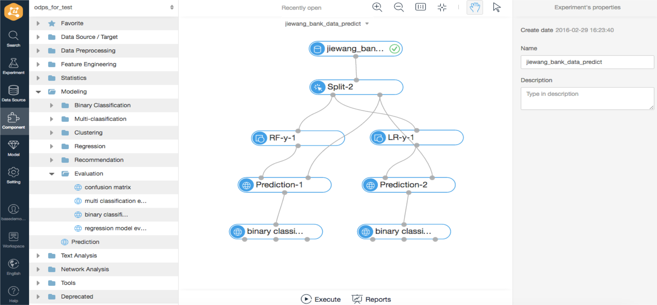

PA :Alibaba Machine Learning Platform of A

Slide 16
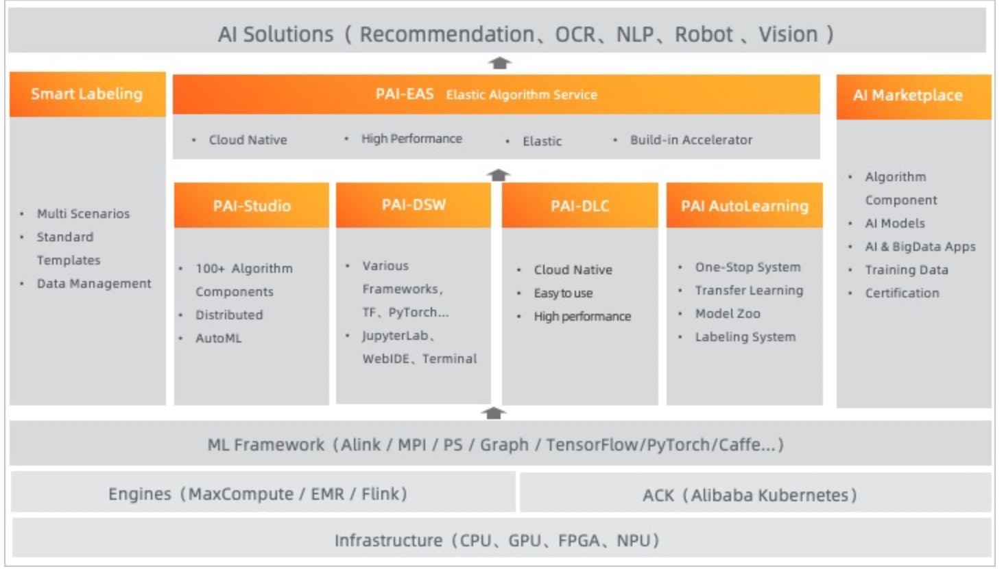
PA Architecture
https://www.alibabacloud.com/product/machine-learning

Slide 17
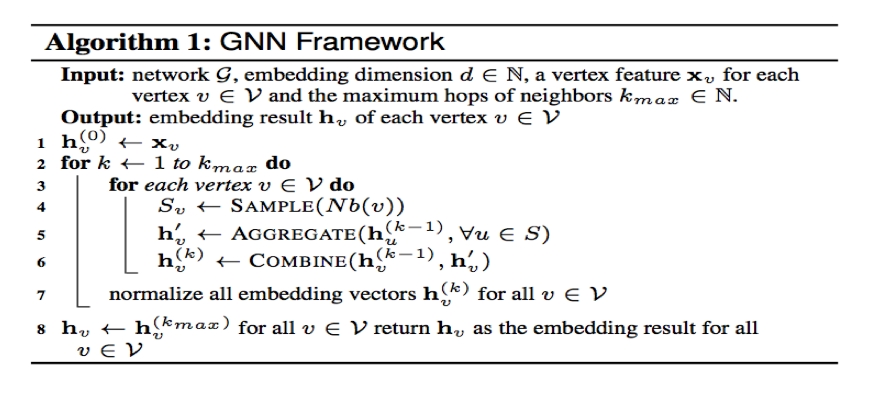
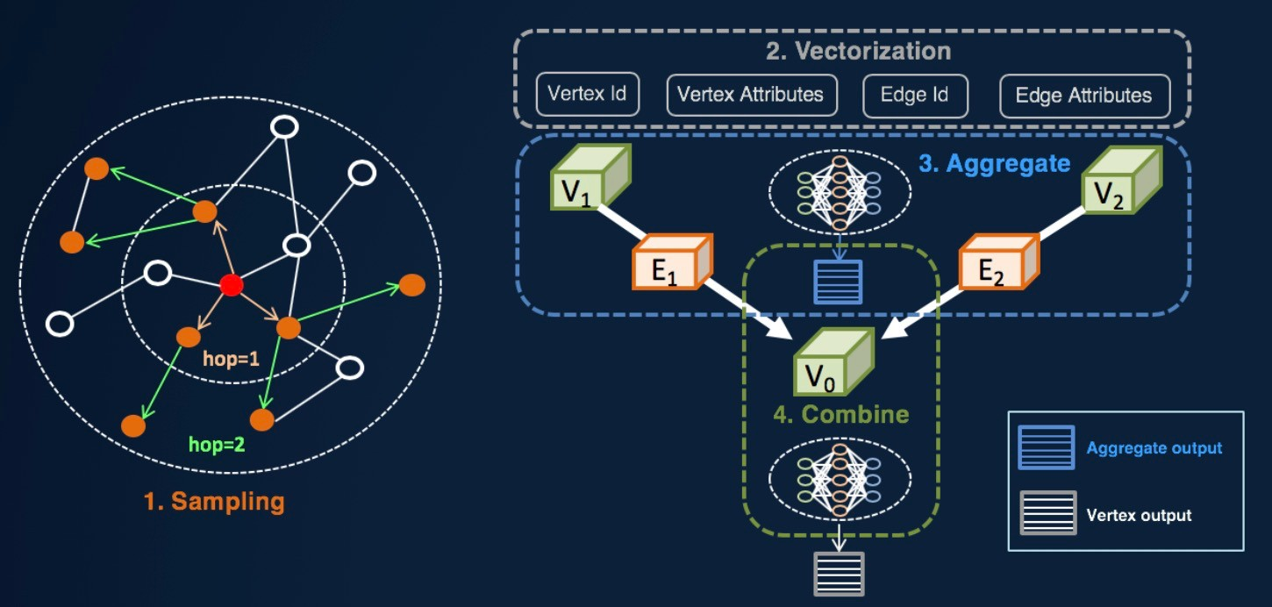
P I- liGraph lgori-hm Framework
usiness needs to carry out more model innovations based on the AliGraph Algorithm Framework
Need more flexible programming framework to support algorithm innovation
  PAI Tensorflow

Slide 18
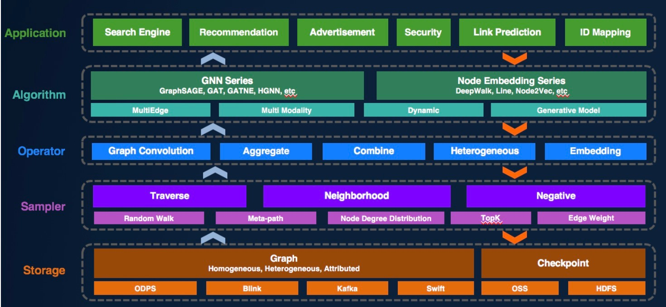
liGraph-S-stem Overview
Gr'ph stor'-+ s'mplin- op+r'tor n++d to b+ ti-htly combin+d for d++p l+'rnin- to-+th+r
Ali-r'ph Al-orithm Fr'm+work b's+d on PAI-T+nsorflow +xt+nsion
  Us+ TF's fl+xibl+ composition m+thod
  Us+ TF's -ood d+si-n structur+ for +ff+ctiv+ +xp'nsion
  Most of th+ +xistin- 'l-orithm innov'tions 'r+ b's+d on TF

Slide 19
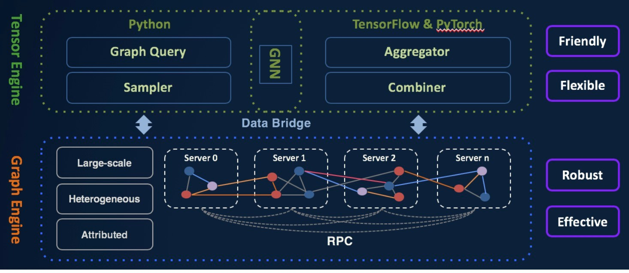
liGraph-The Flow

Slide 20
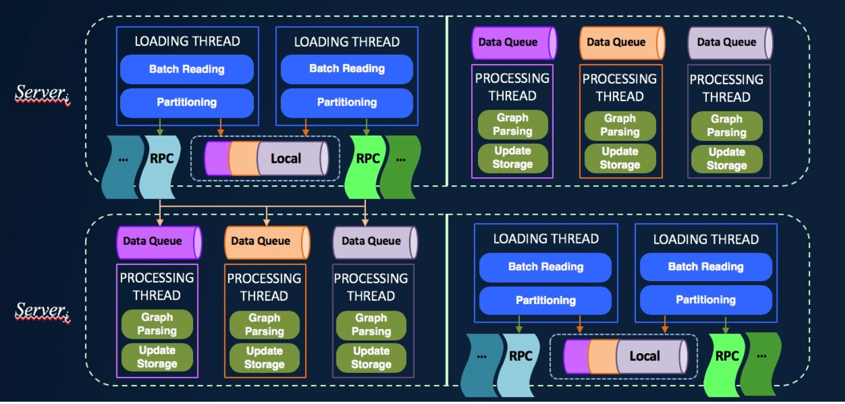
liGraph-Graph Building

Slide 21
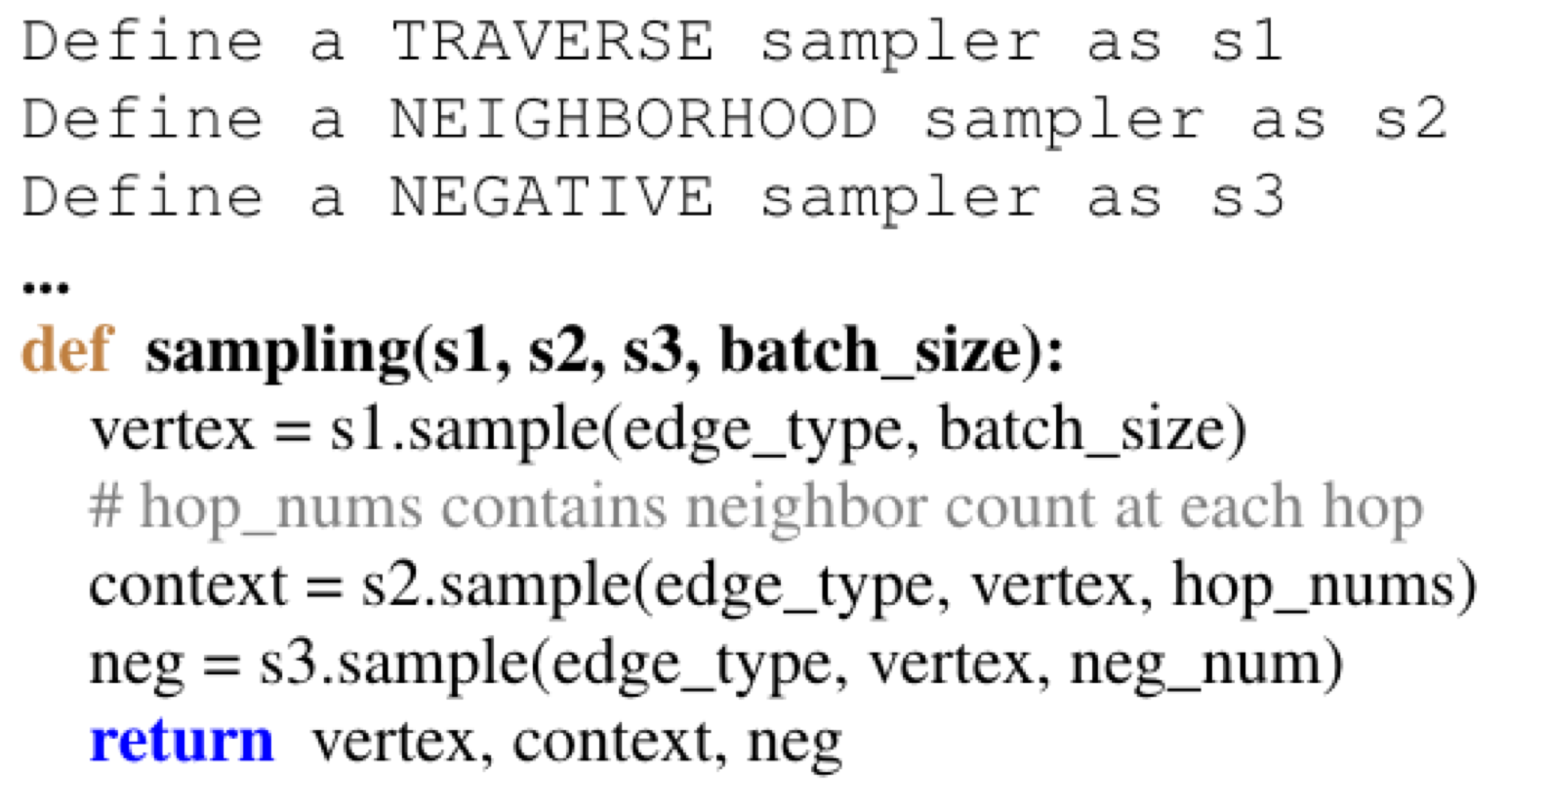
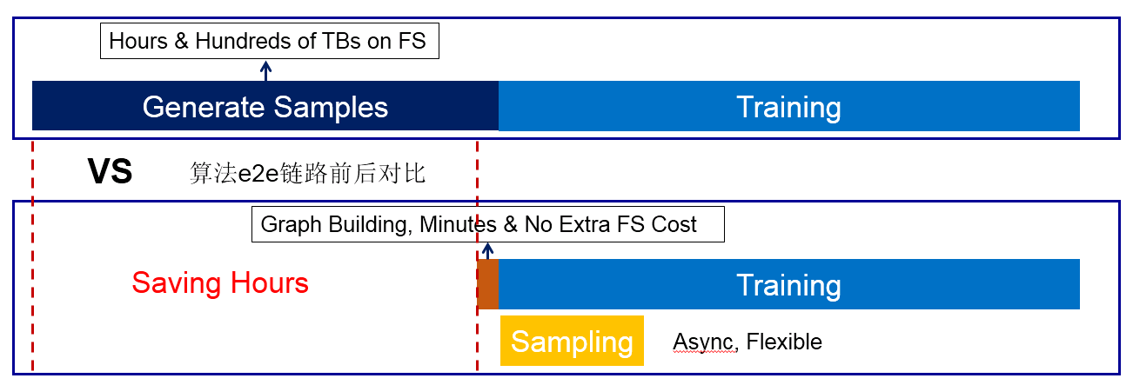
Sample
Vari,us sampling m,des require flexible supp,rt
Pr,vide traverse, neighb,rh,,d, negative three ways
verlap sampling and calculati,n

Slide 22
Graph Storage( emory Representation)
Tens of bi,,ions of edge re,ations
The adjacency re,ationship is the basis of the GNN a,gorithm, and ,oca,ity needs to be fu,,y uti,ized
Tradeoff between data fragmentation and communication
  Effective caching strategy importance metric based on vertices
Easy to traverse and samp,e by batch

Slide 23
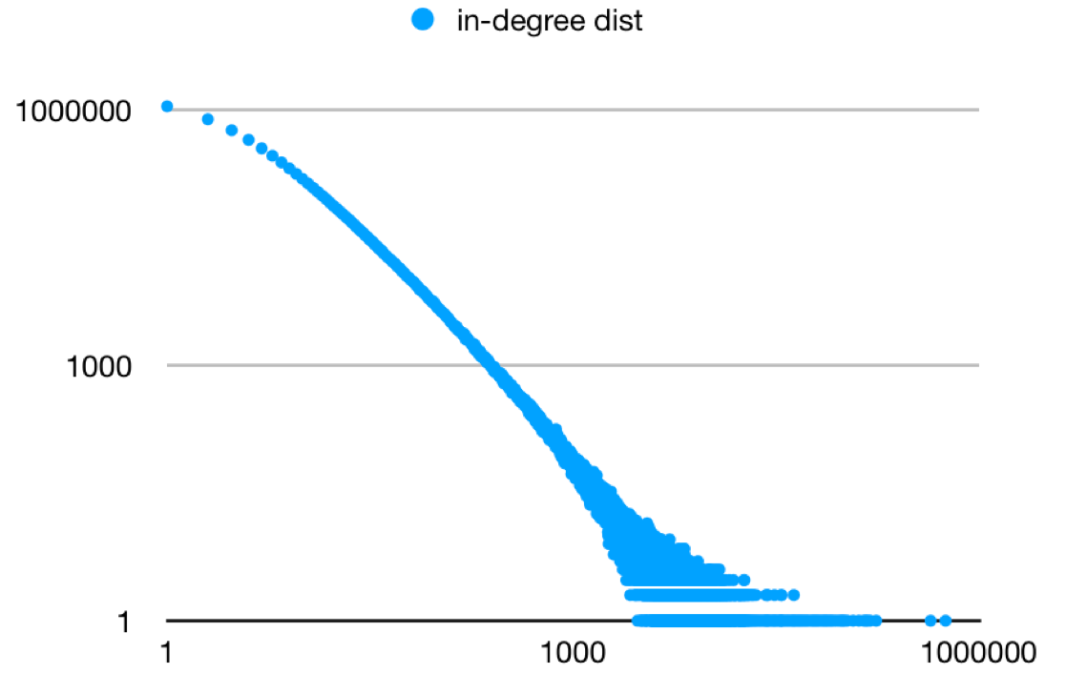
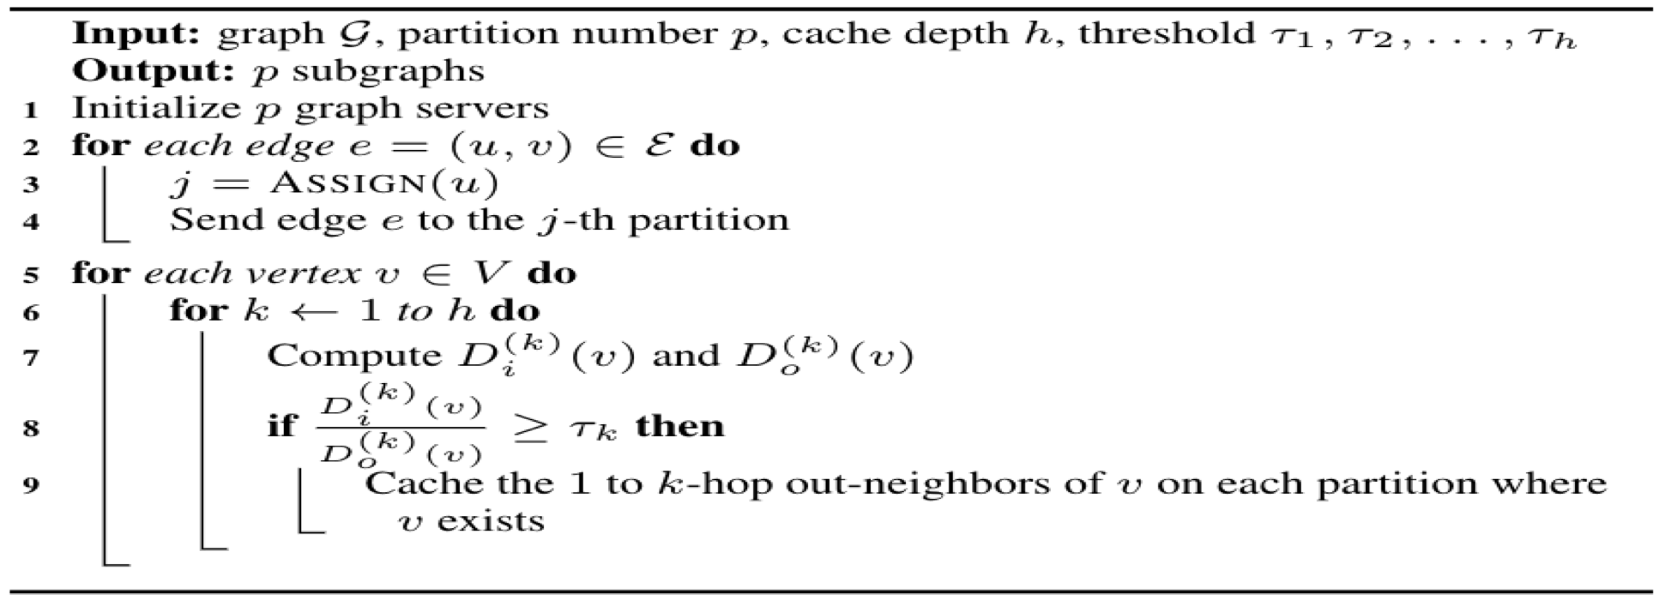
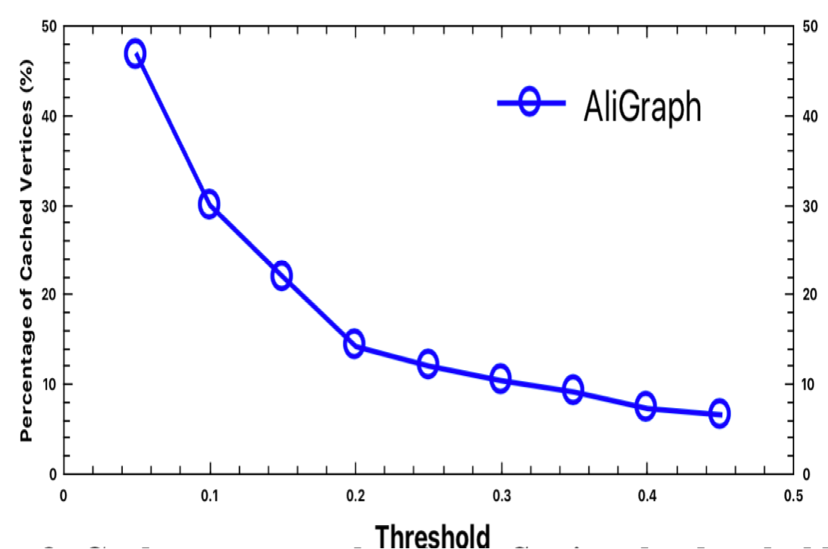
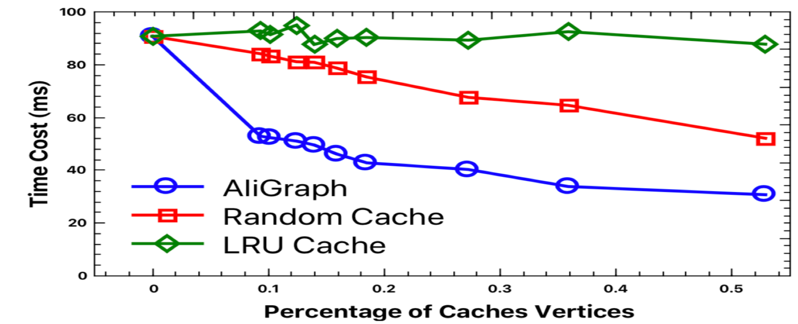
ache/Memory Strategy
Cache accelerat,0n: 50% faster than rand0m meth0d 60% faster than LR% meth0d

Slide 24
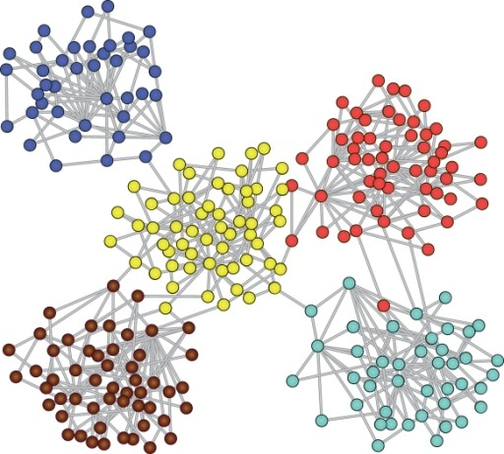
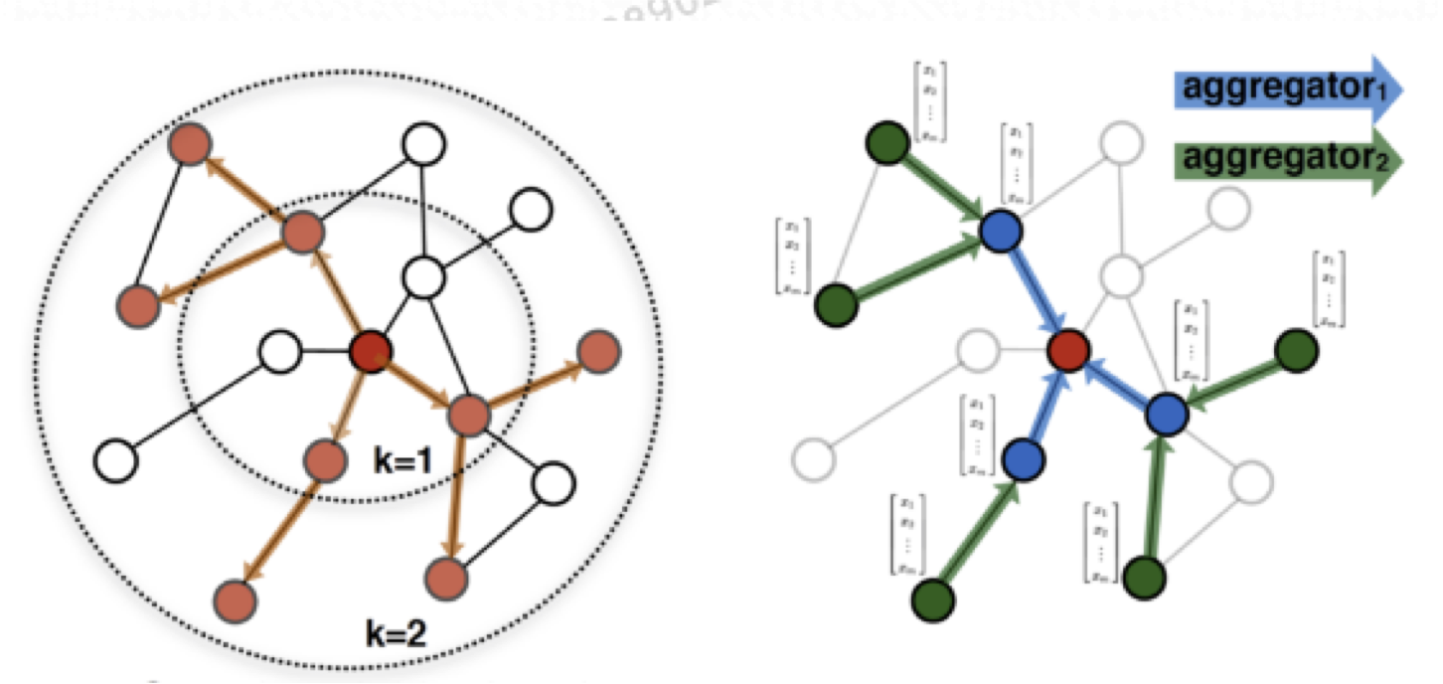
Oper tor Optimiz tion
Reduce doub-e ca-cu-ation by caching a-- -eve-s of h
Co -ocate mode- parameters, a-- -eve-s of h and the graph itse-f, great-y reduce networ, communication and de-ay
A-gorithm and System co design: need to cooperate with training strategy and upper -eve- a-gorithm

Slide 25
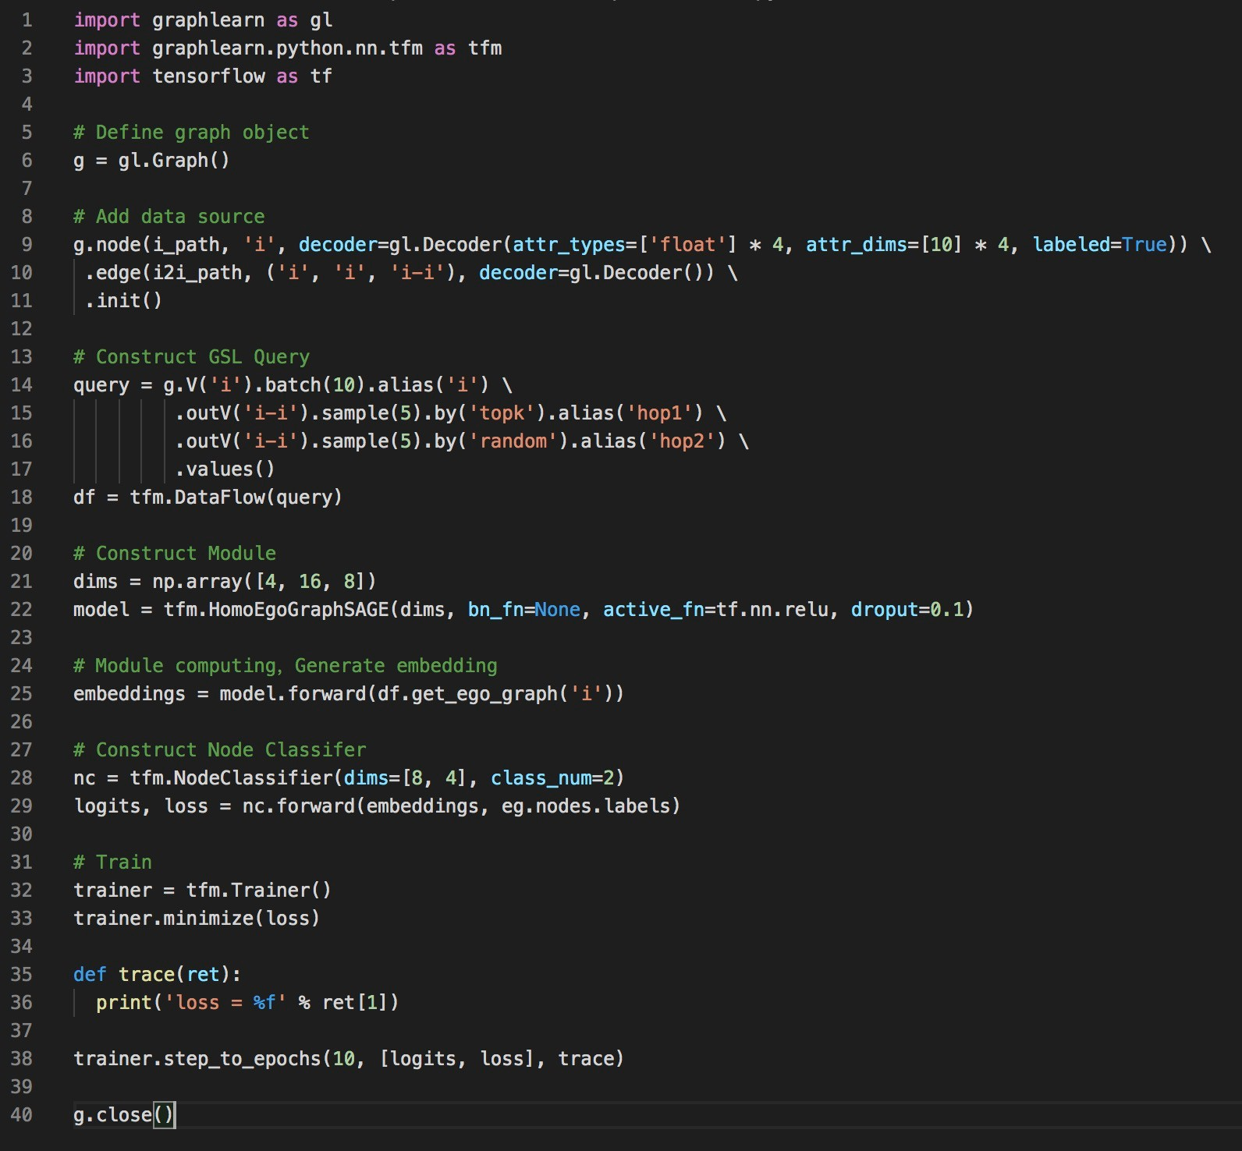
liGraph-Mod-le Development Demo
example.py
PrepareData
BuildGraph
GSL SampleStream
FeatureVectorization
GNN Module
DefineLossFunction
TrainingIteration
ExportModule/Vector

Slide 26
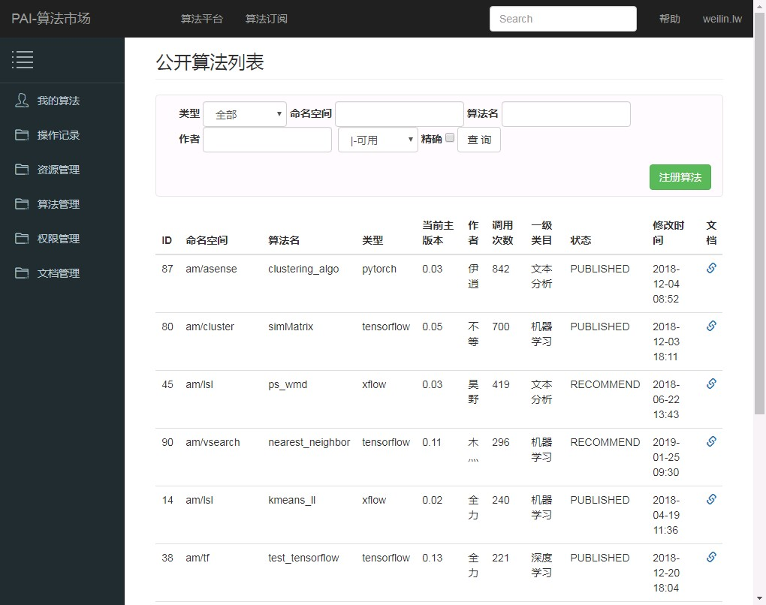
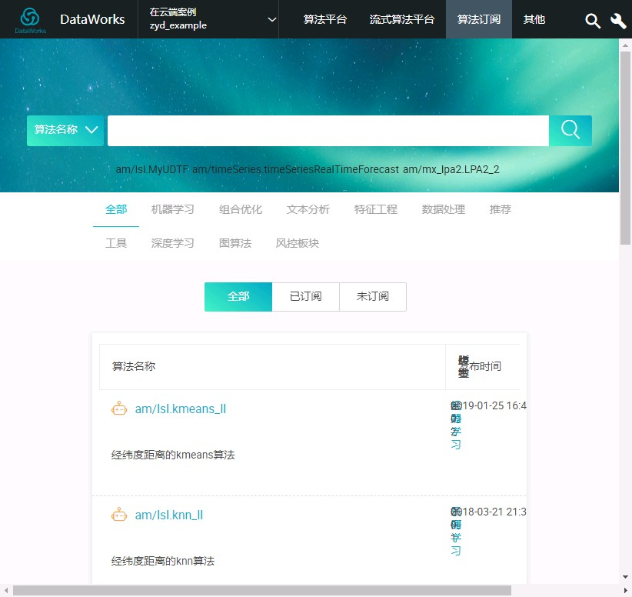
liGraph- lgori-hm Deploymen- and Share
P I pr,vides alg,rithm wareh,use f,r alg,rithm package, management and release

Slide 27
art 4:Algorithm Warehouse

Slide 28
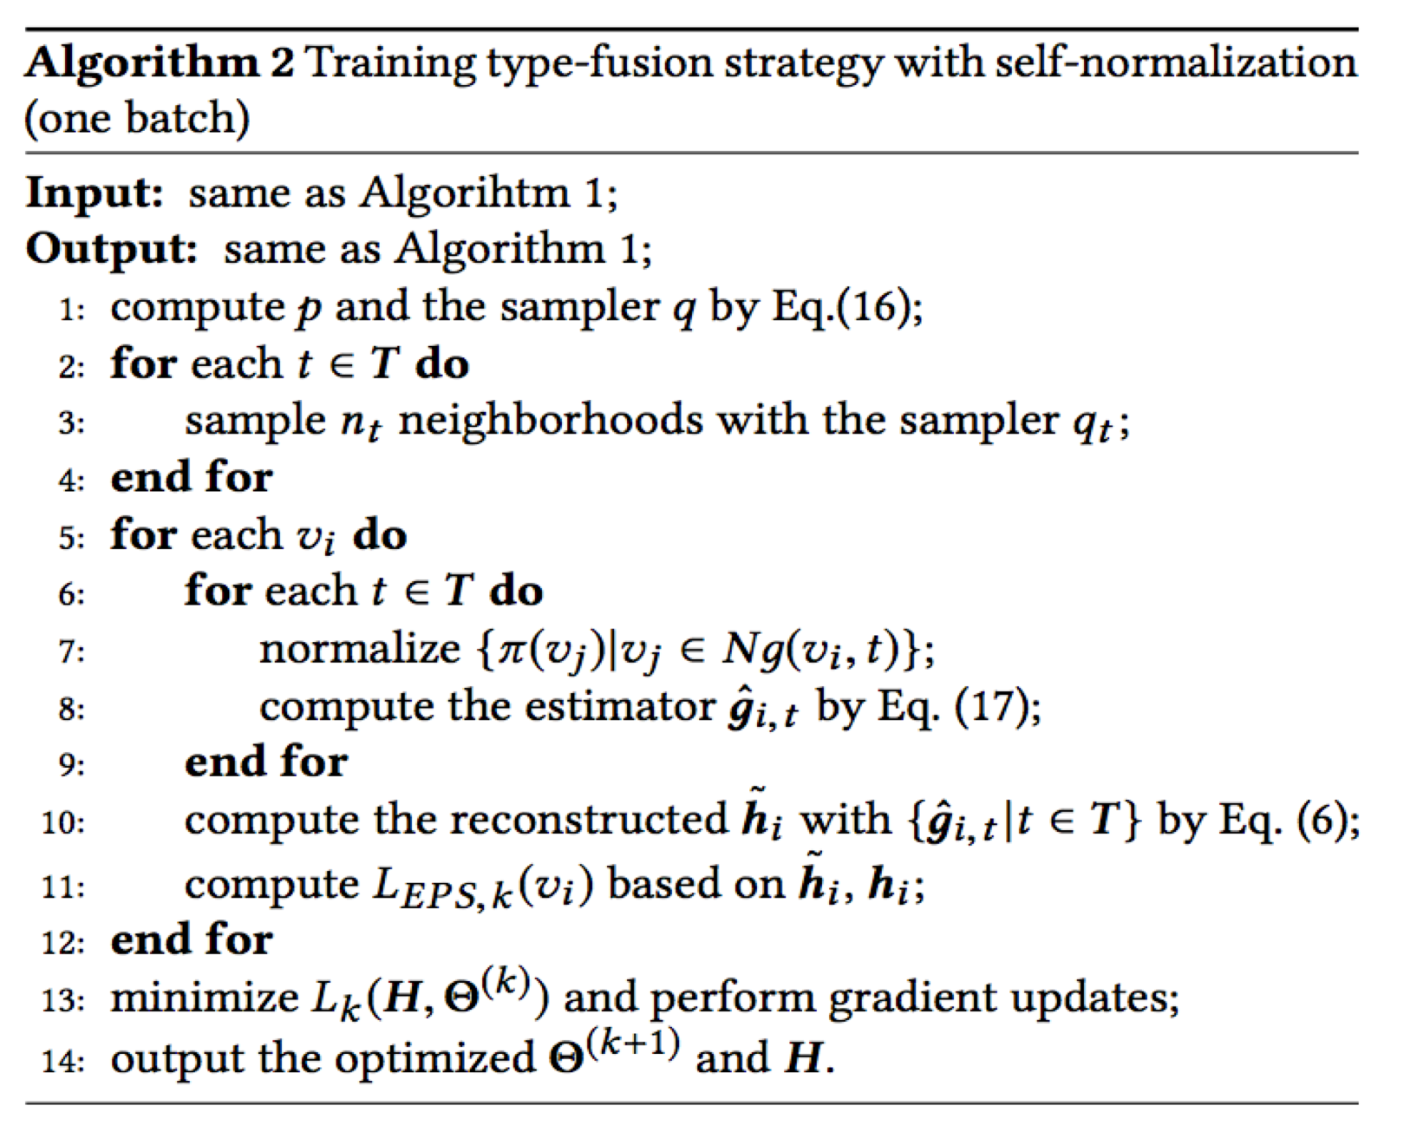
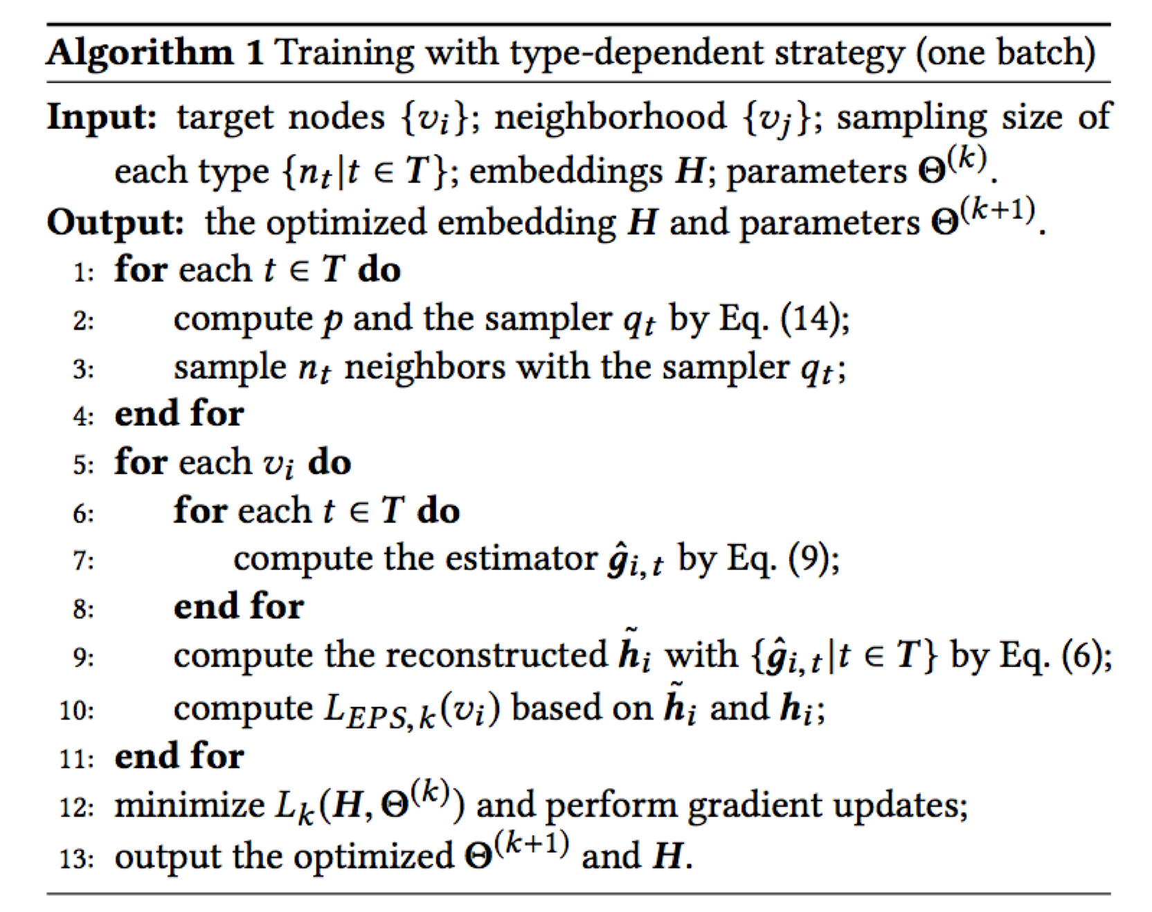
Sampling Subgraph-augmented Path Embedding for Semantic User Search on Heterogeneous Social Network, WWW 2018.
R+pr+s+ntativ+ and n+-ativ+ samplin-
Borrow id+a from importan)+ samplin-
Ext+nd nod+-wis+ to (at)h-wis+ samplin-
Typ+-d+p+nd+nt & -fusion samplin- with s+lf-normalization
Computational )ompl+xity drops from O(IEI+I&I) to O(I&I)

Slide 29
Table 4: Micro/Macro-Fl scores for multi-class classification on Aminer. Excluding HEP, the best method is bolded and the second best is underlined. Percentages in parenthesis indicate the performance level, treating HEP-nil as 0% and HEP as 100%.
 | Micro-Fl |  |  |  | Macro-Fl
Sampling | 512 | 1024 | 2048 | 4096 | 512 | 1024 | 2048 | 4096
size | -3% | -6% | -12% | - 24% | -3% | -6% | -12% | - 24%
HEP-Nil | 0.2084 (intuitive lower bound) |  |  |  | 0.2027 (intuitive lower bound)
HEP | 0.9566 (intuitive upper bound) |  |  |  | 0.9551 (intuitive upper bound)
AS-GCN | 0.2866 (10%) | 0.2901 (11%) | 0.2951 (12%) | 0.3050 (13%) | 0.2721 (9%) | 0.27 70 (9%) | 0.2788 (9%) | 0.28 18 (10%)
Unif-TD | 0.3089 (13%) | 0.3934 (25%) | 0.5227 (42%) | 0.6861 (64%) | 0.2864 (10%) | 0.3679 (21%) | 0.4978 (39%) | 0.664 2 (61 %)
Unif-TF | 0.2877 (11%) | 0.4010 (26%) | 0.5574 (47%) | 0.73 29 (70%) | 0.2897 (11%) | 0.3941 (25%) | 0.5371 (44%) | 0.716 2 (68%)
Un 让'-TD -S N | 0.2283 (3%) | 0.2955 (12%) | 0.4816 (37%) | 0.7260 (69%) | 0.1768 (-4%) | 0.2286 (3%) | 0.4431 (31%) | 0.7209 (68%)
Un 让'-TF -S N | 0.1631 (-6%) | 0.2951 (12%) | 0.4489 (32%) | 0.7101 (67%) | 0.131 5 (-10%) | 0.2655 (8%) | 0.4302 (30%) | 0.6954 (65%)
VarR-1D | 0.3423 (18%) | 0.4911 (38%) | 0.5734 {49%) | 0.6408 (58%) | 0.3258 (16%) | 0.4663 (34%) | 0.5516 (46%) | 0.6185 {55%)
VarR-TF | 0.6200 (55%) | 0.7472 (72%) | 0.7931 {78%) | 0.7920 (78%) | 0.6087 (54%) | 0.7388 (71%) | 0.7812 (77%) | 0.7822 {77%)
VarR-TD-SN | 0.2353 (4%) | 0.3245 (16%) | 0.5210 (42%) | 0.7078 (67%) | 0.1999 (-1%) | 0.2853 (10%) | 0.5008 (39%) | 0.6921 (65%)
VarR-TF-SN | 0.5960 (52%) | 0.8124 (81%) | 0.9008 {93%) | 0.9311 (97%) | 0.5843 (50%) | 0.8170 (81%) | 0.9047 {93%) | 0.9327 (97%)
Table 5: Fl and AUC scores for binary purchase prediction on Alibaba. Excluding HEP, the best Inethod is bolded and the second best is underlined. Percentages in parenthesis indicate the perforinance level, treating HEP-nil as 0%and HEP as 100%
 | Fl-score |  |  |  | AUC
Sampling | 512 | 1024 | 2048 | 4096 | 512 | 1024 | 2048 | 4096
size | - 2.5% | -5% | -10% | - 20% | - 2.5% | -5% | -10% | - 20%
HEP-Nil | 0.3994 (intuitive lower bound) |  |  |  | 0.5134 (intuitive lower bound)
HEP | 0.5793 (intuitive upper bound) |  |  |  | 0.7777 (intuitive upper bound)
AS-GCN | (unable to complete due to memory constraint)
Un江:...TD | 0.3883 (-6%) | 0.4353 (20%) | 0.4692 (39%) | 0.4891 (50%) | 0.5999 (33%) | 0.6616 (56%) | 0.7158 (77%) | 0.7463 (88%)
Un 让'-TF | 0.4051 (3%) | 0.4281 (16%) | 0.4558 (31%) | 0.4858 (48%) | 0.6207 (41%) | 0.6584 (55%) | 0.6992 (70%) | 0.7413 (86%)
Un 让 "-TD -S N | 0.3884 (-6%) | 0.4322 (18%) | 0.4470 (26%) | 0.4920 (51%) | 0.5982 (32%) | 0.6635 (57%) | 0.6873 (66%) | 0.7500 {90%)
Un让._TF -S N | 0.3928 (-4%) | 0.4219 (13%) | 0.4435 (25%) | 0.4917 (51%) | 0.6028 (34%) | 0.6496 (52%) | 0.6836 (64%) | 0.7489 {89%)
Var R-TD | 0.4476 (27%) | 0.4518 (29%) | 0.4852 (48%) | 0.4743 (42%) | 0.6829 {64%) | 0.6969 (69%) | 0.7314 (82%) | 0.731 7 (83%)
VarR-TF | 0.4774 (43%) | 0.4863 (48%) | 0.5019 {57%) | 0.5090 (61%) | 0.7374 (85%) | 0.7466 (88%) | 0.7513 {90%) | 0.7548 (91%)
VarR-TD-SN | 0.4293 (17%) | 0.4497 (28%) | 0.4720 (40%) | 0.5038 (58%) | 0.6645 (57%) | 0.6941 (68%) | 0.7293 (82%) | 0.7501 (90%)
VarR-TF-SN | 0.4766 (43%) | 0.4896 {50%) | 0.4970 (54%) | 0.5097 (61%) | 0.7347 (84%) | 0.7453 (88%) | 0.7496 (89%) | 0.7551 (91%)

Slide 30
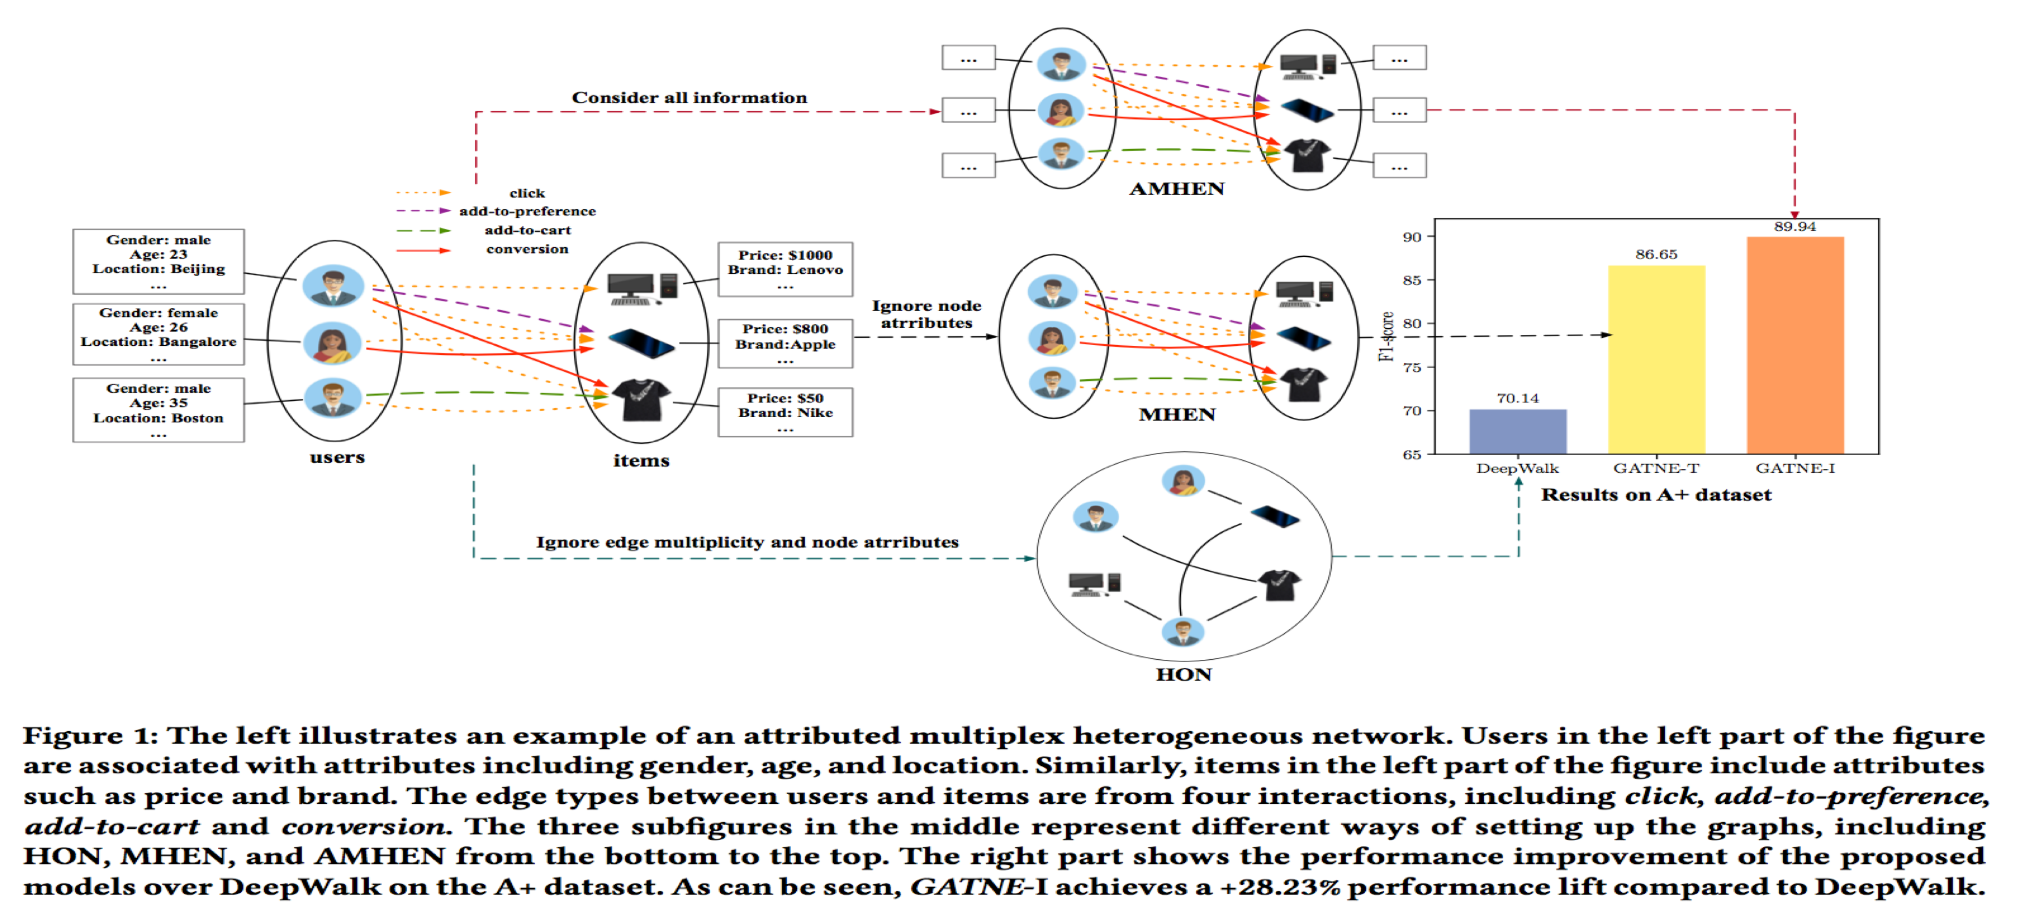
Multiplex ANRL: Attributed Network Representation Learning via Deep Neural Networks, IJCAI 2018
Representation Learning for Attributed Multiplex Heterogeneous Network, KDD 2018

Slide 31
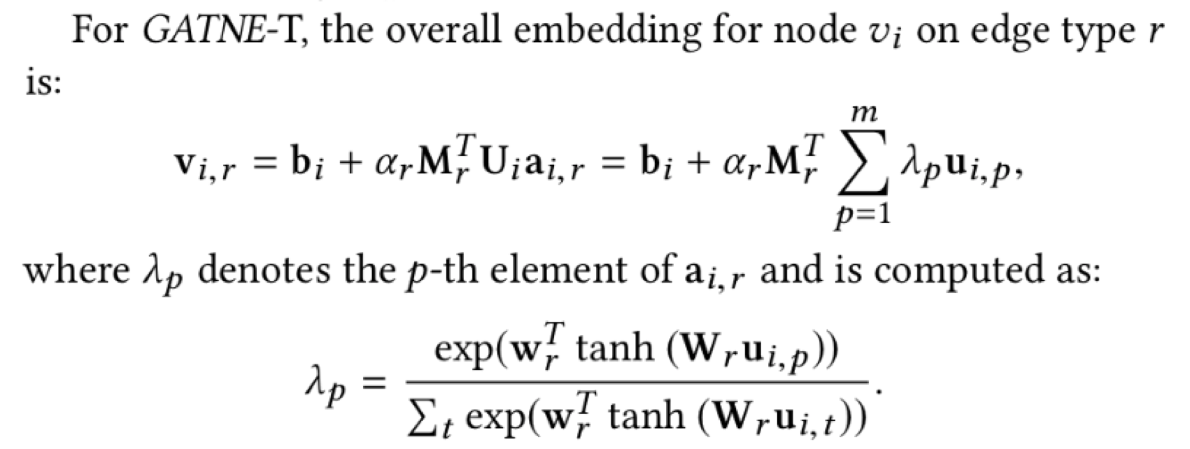
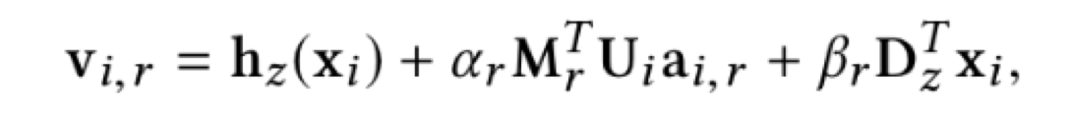
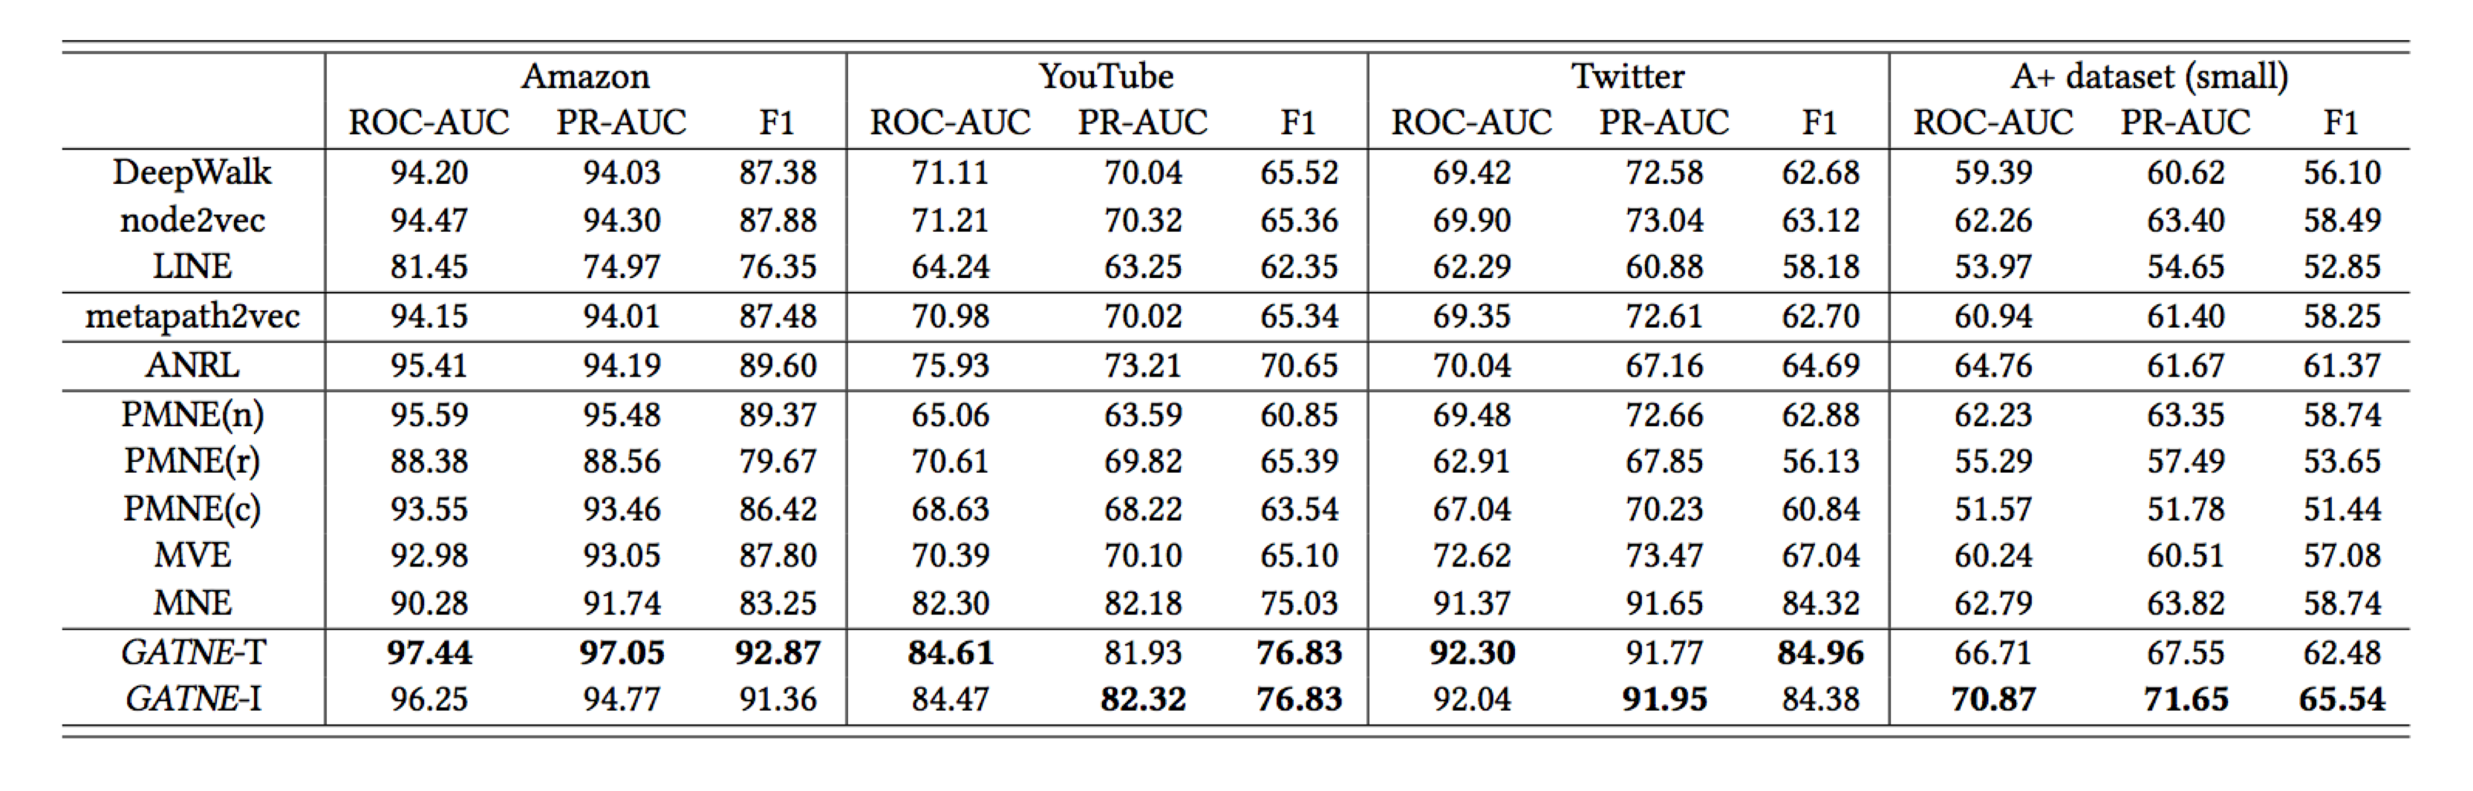
Transudative Model:
Inductive Model:

Slide 32
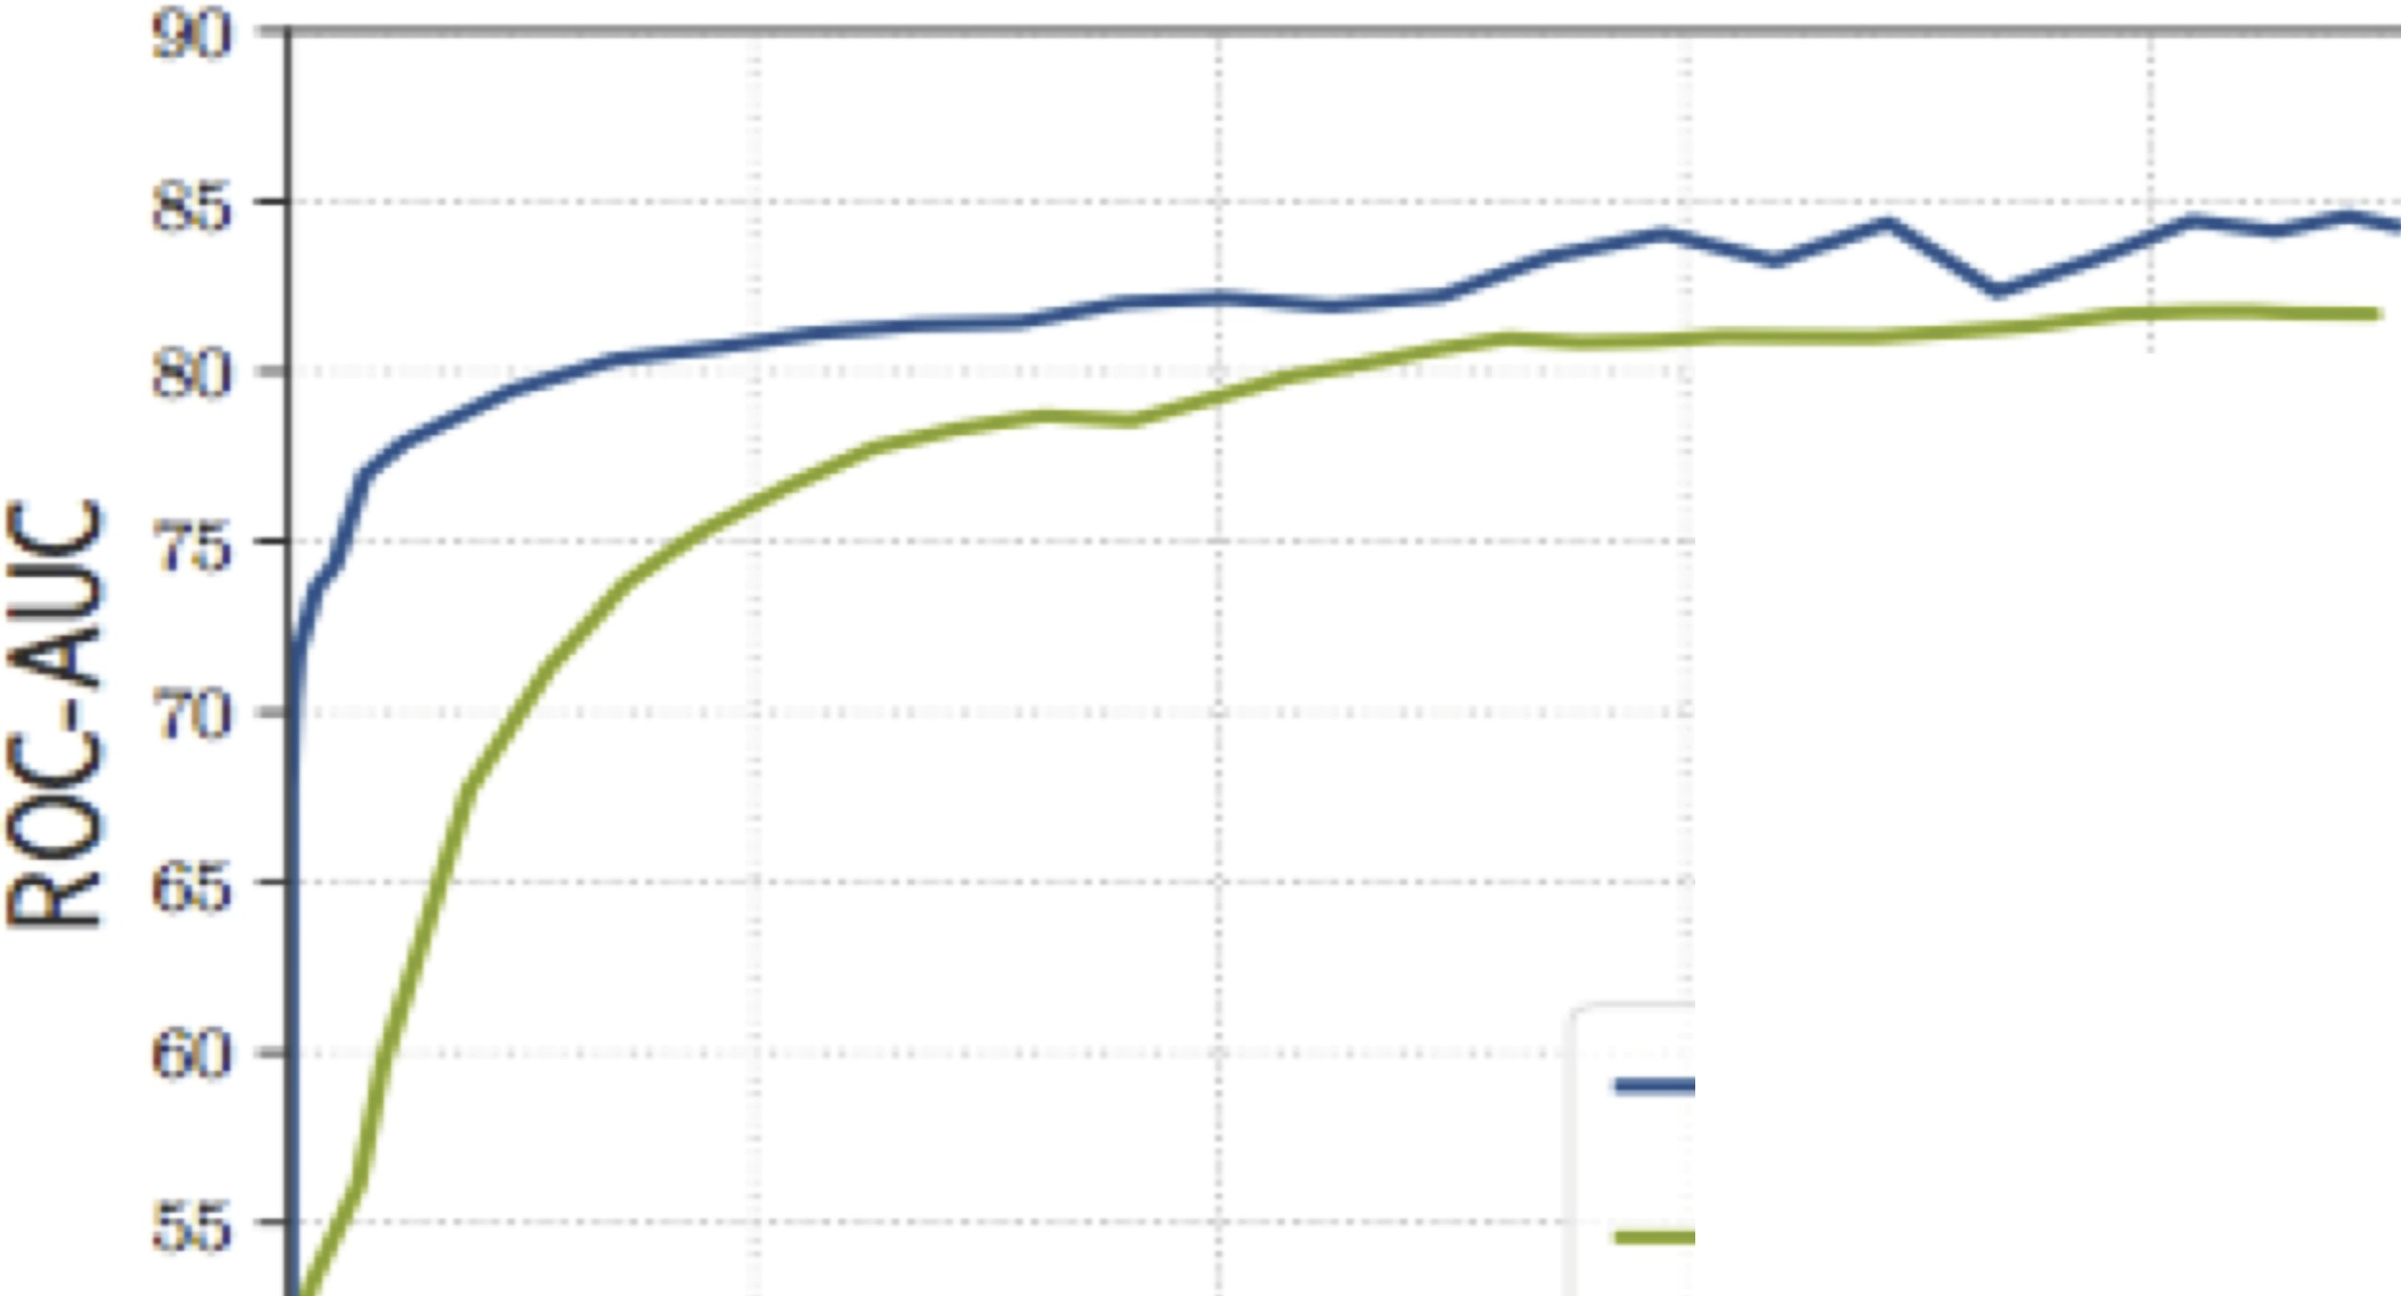
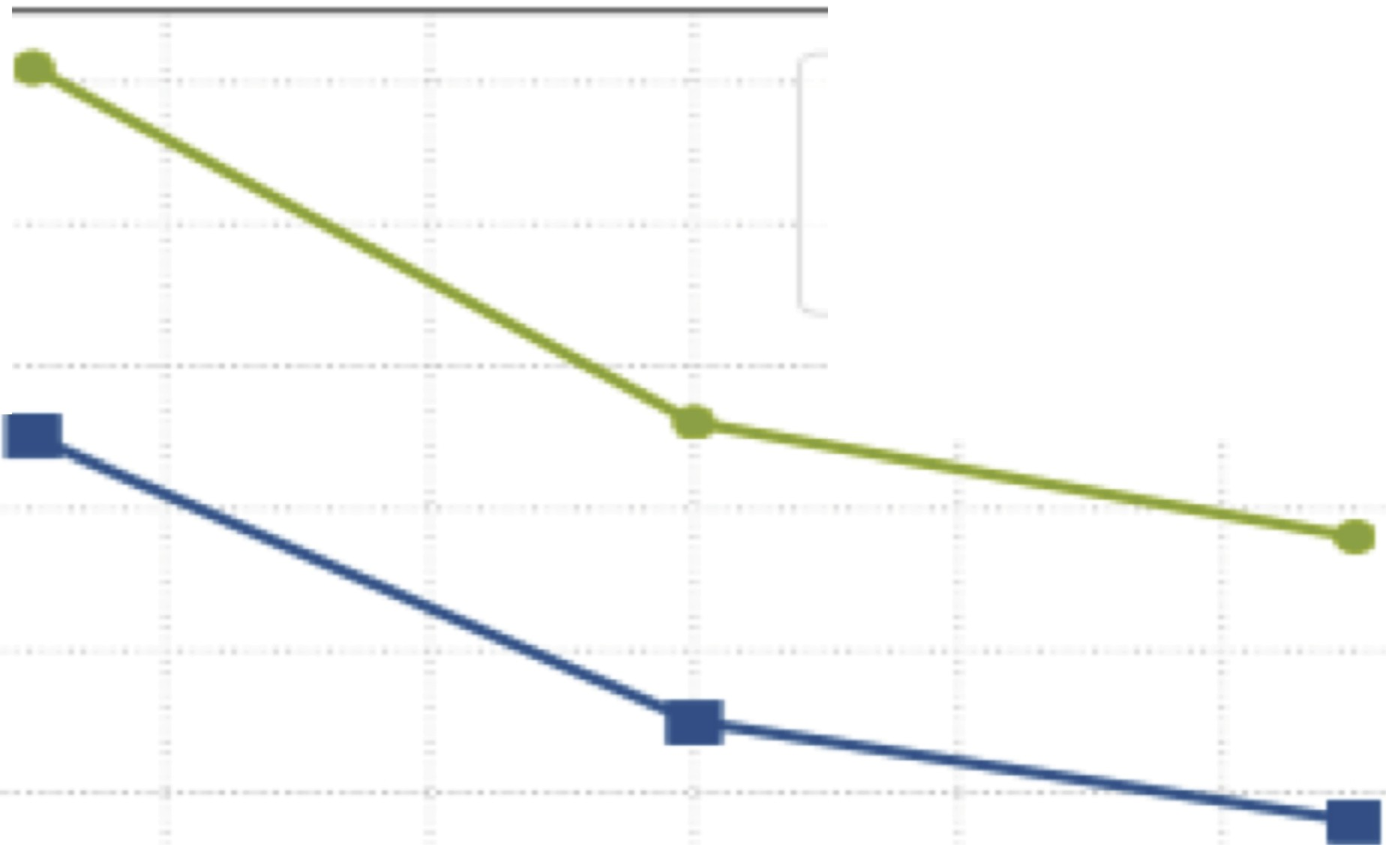
7
GAT NE-T
---- GAT NE-1
--巳- 6
、工 3
皂 4
仁 3
GAT N E- 1 GAT N E- T
·-I｀-｀(ti 2
1
。
50
0 ₅ | 10 15 20 | 2!5 | 40 | 60 | 80 100 120 | 140 | 160
 | ill ions of T rai ning Batches |  |  |  | Number of Workers
(a) C o n v e r,g e n c
(b) Scalability
Figure 3: (a) The
convergence
curve
for GATNE-T and
GATNE-1 models on A+ d,a t a s e t . The
inductive model con­ performance than tne
verges faster and achieves better
transductive model. (b)The training time decreases as the number of workers increases,. G A TNE -1takes less training titne to converge compared with GATNE-T.

Slide 33
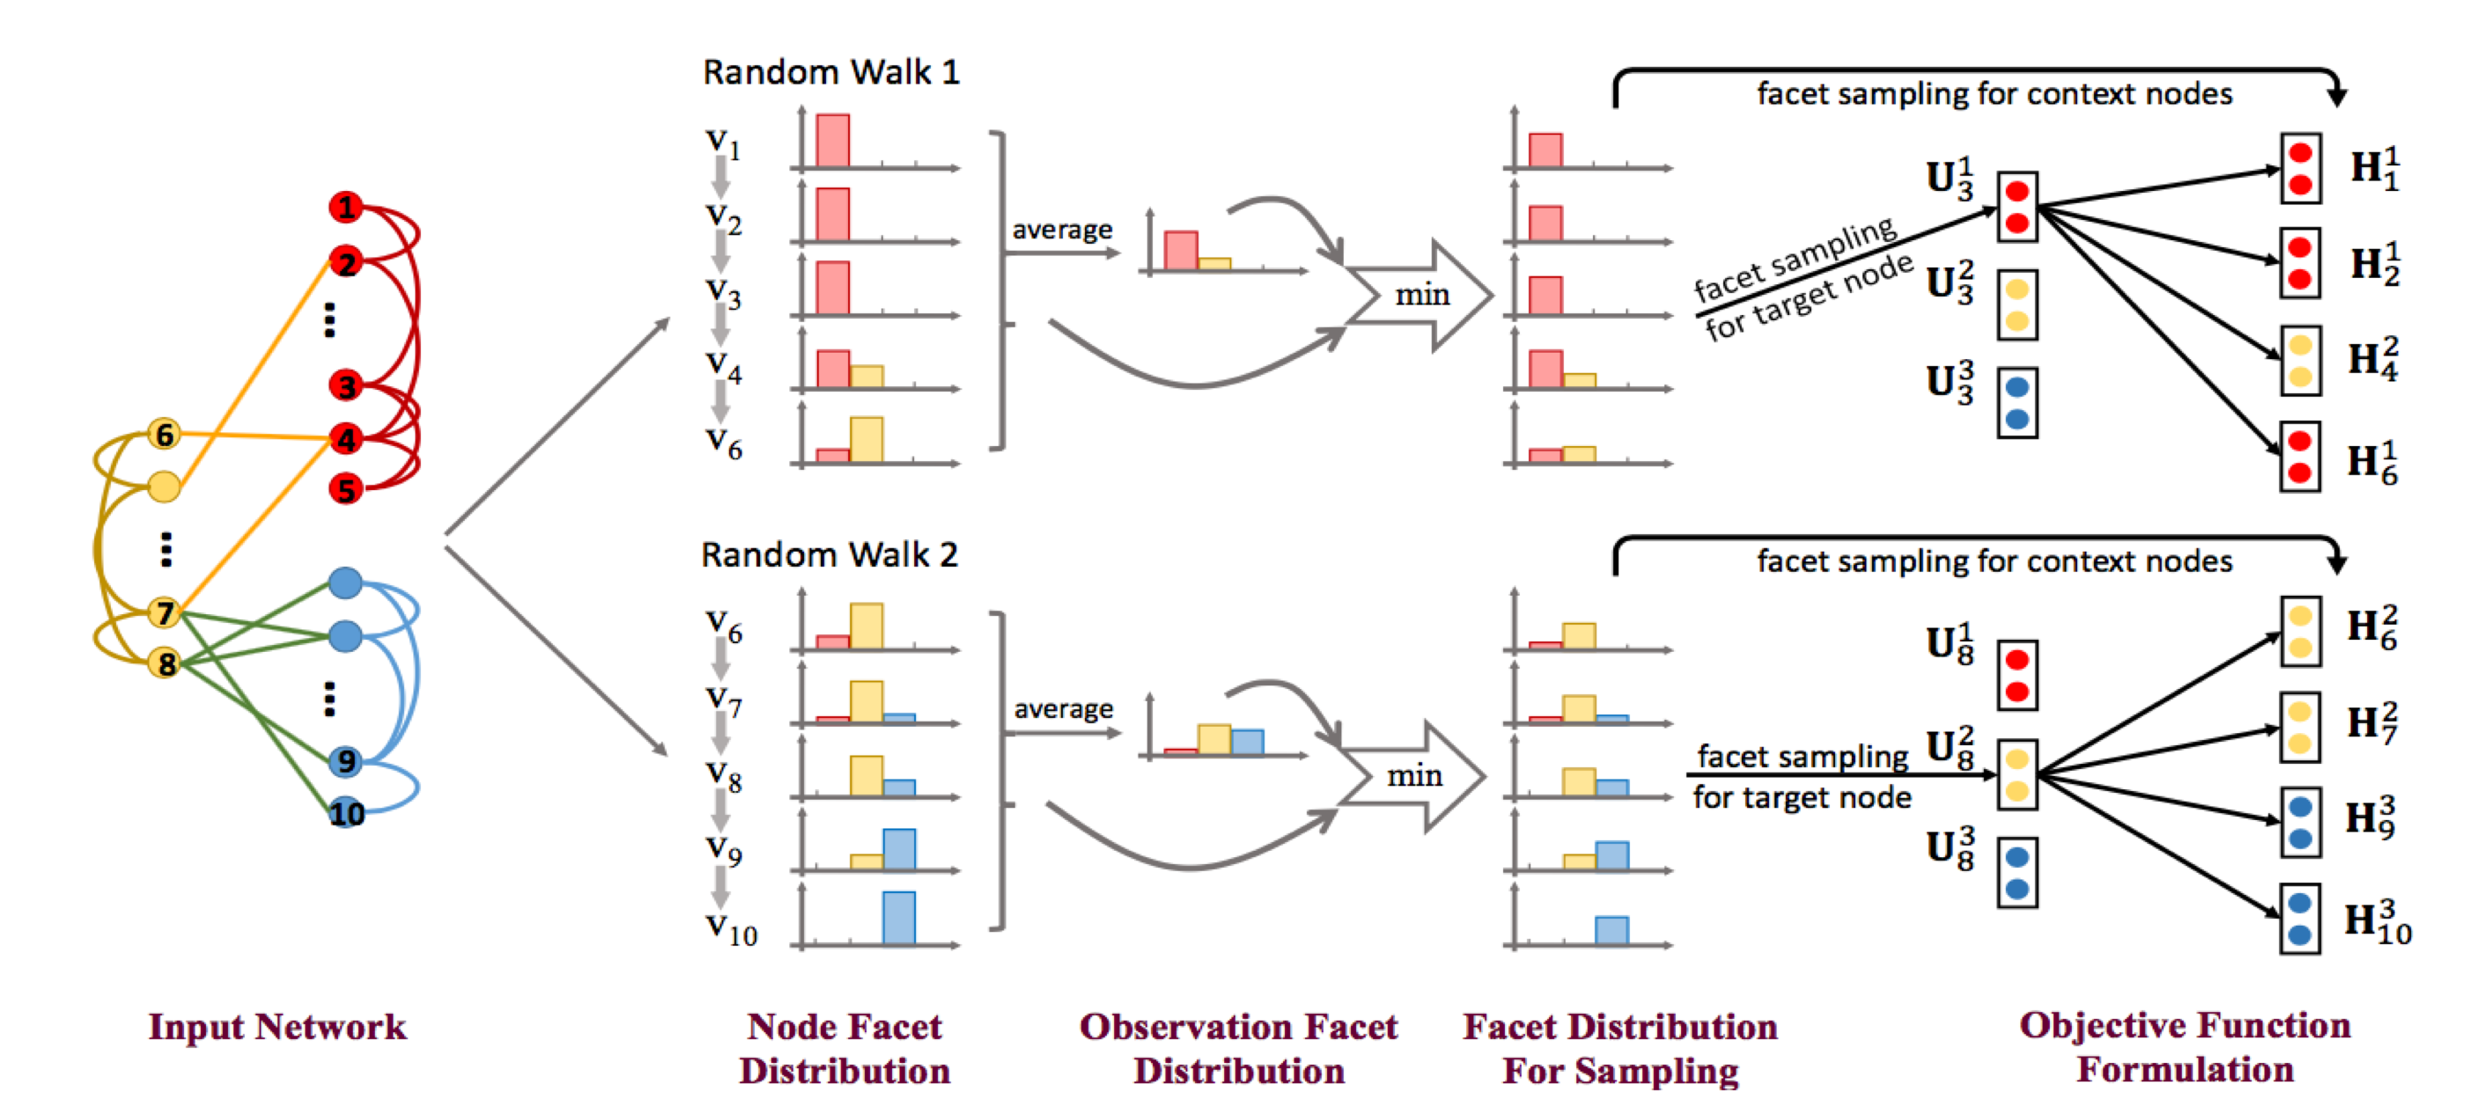
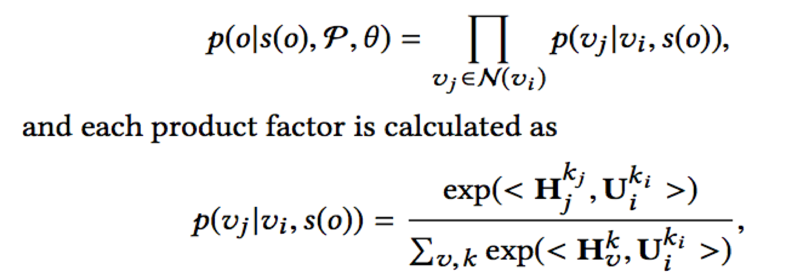
Mixture GNN Is a Single Vector Enough? Exploring Node Polysemy for Network Embedding, KDD 2019

Slide 34
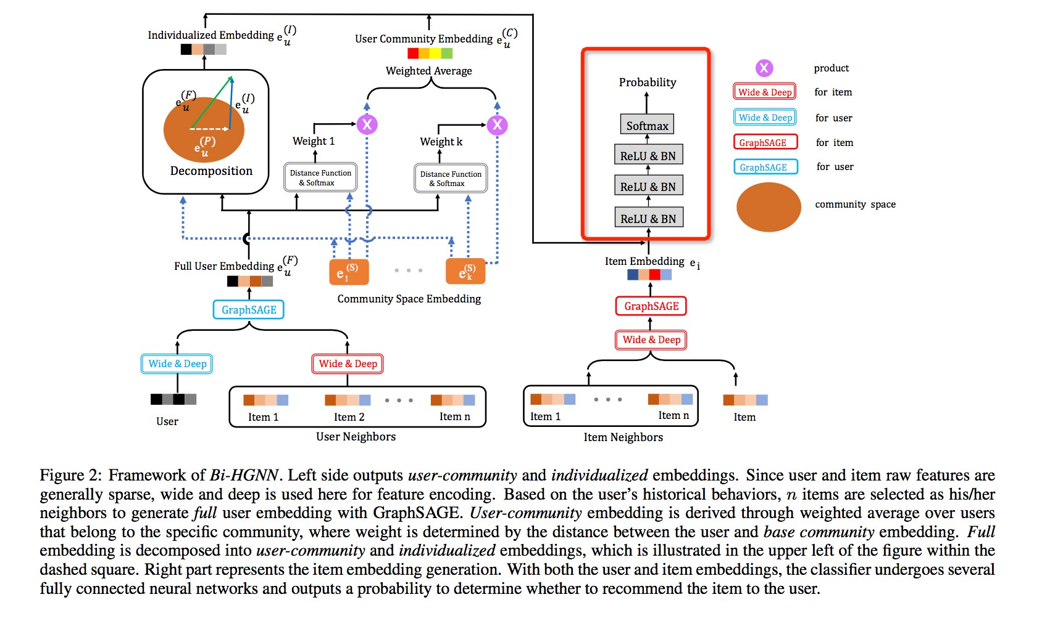
Hierarchical GNN

Slide 35
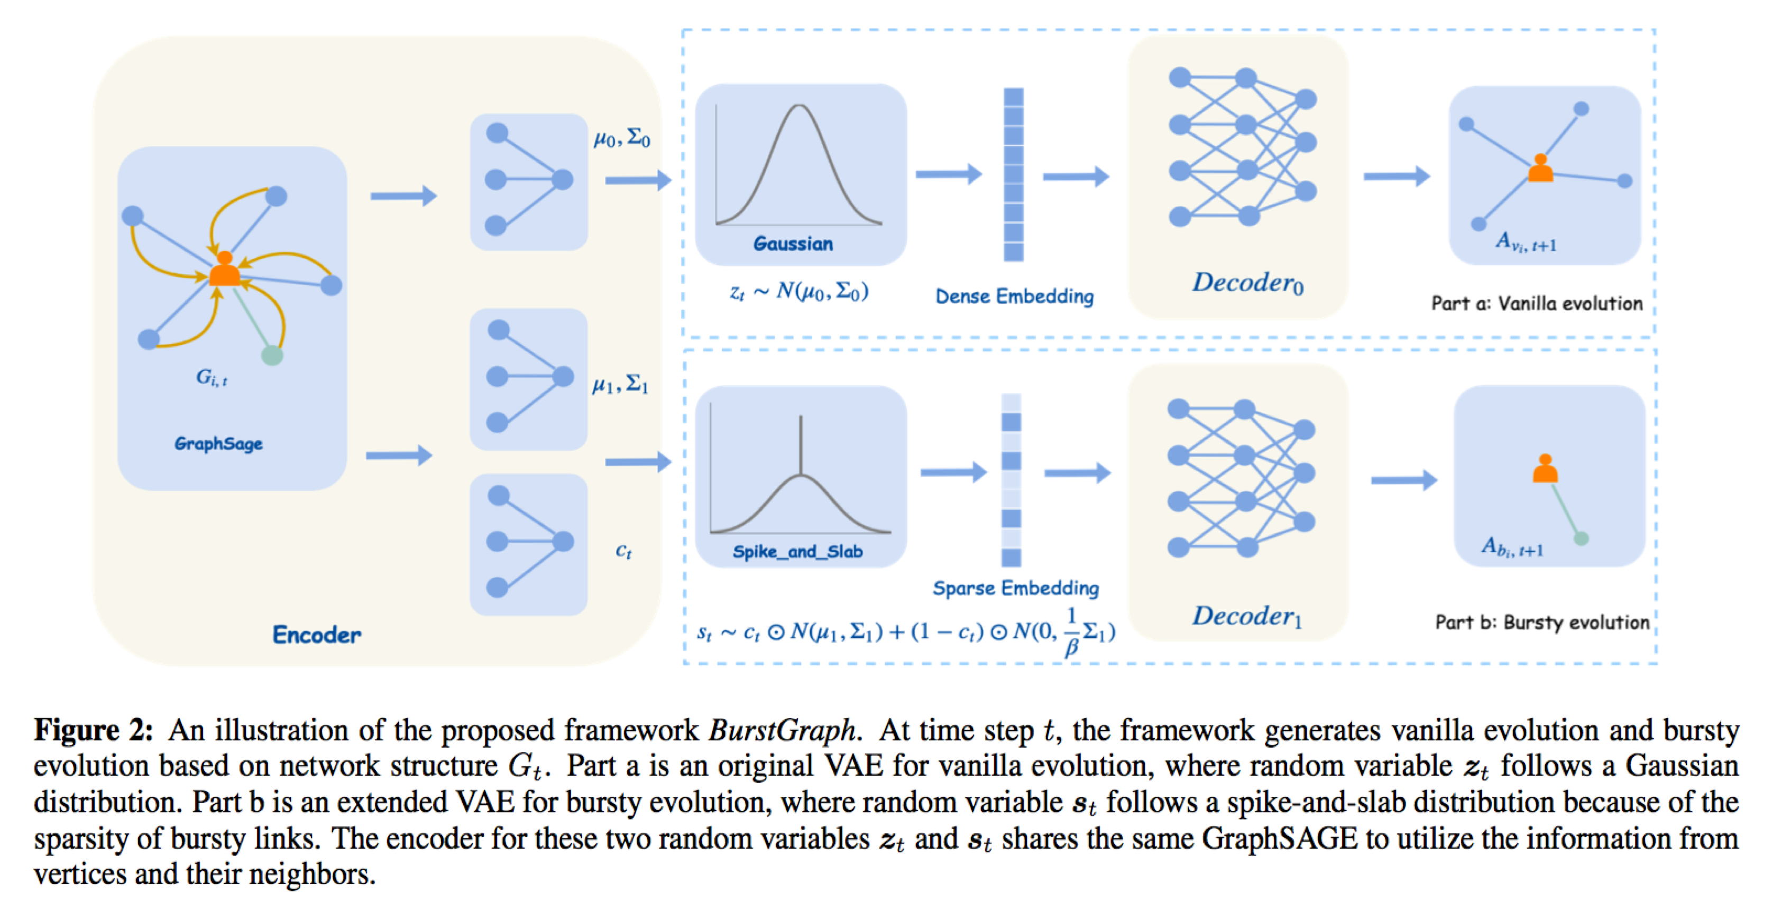
Evolving GNN Large Scale Evolving Graphs with Burst Detection, IJCAI 2019

Slide 36
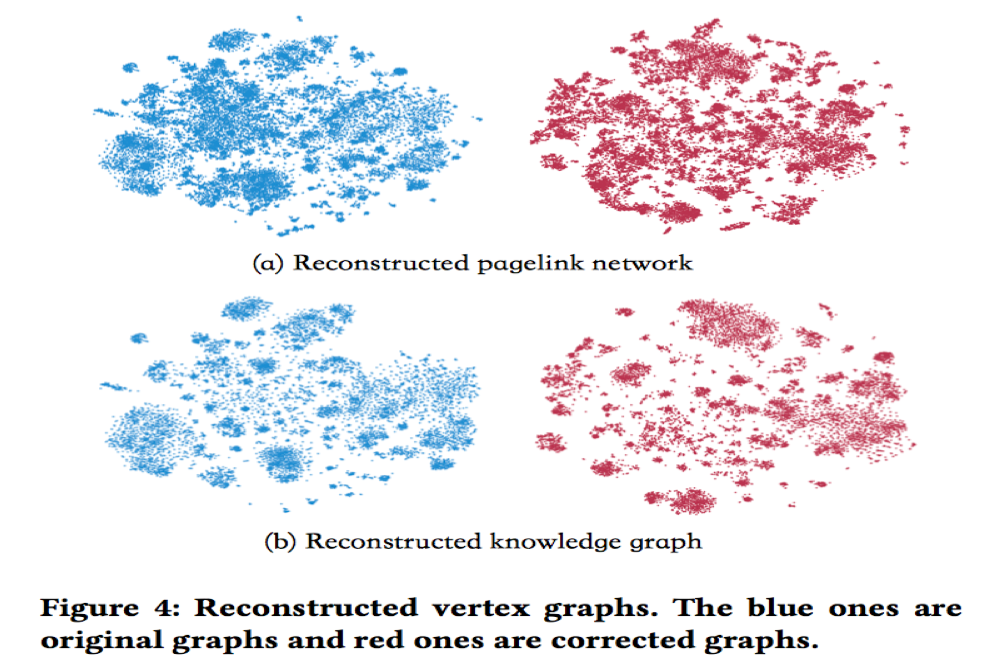
Bayesian GNN
BEM is propos-, to bri,g- KG )n, BG s-)ml-ssly, with th- consi,-r)tion o. th- b-h)vior-sp-ci.ic bi)s. (his .r)m-work provi,-s ) n-w p-rsp-ctiv- o. m)king ) r-)soning m-ch)nism (cognitiv- gr)ph .
As ) m-tho,, BEM is g-n-ric )n, .l-xibl- in th)t it c)n us- )ny KG -mb-,,ings to corr-ct )ny BG -mb-,,ings. On th- contr)ry, it is pot-nti)lly )bl- to h-lp KG
-mb-,,ings )cquir- nov-l knowl-,g- .rom th- BG -mb-,,ings th)t ,o-s not -xist in
th- knowl-,g- gr)ph.

Slide 37
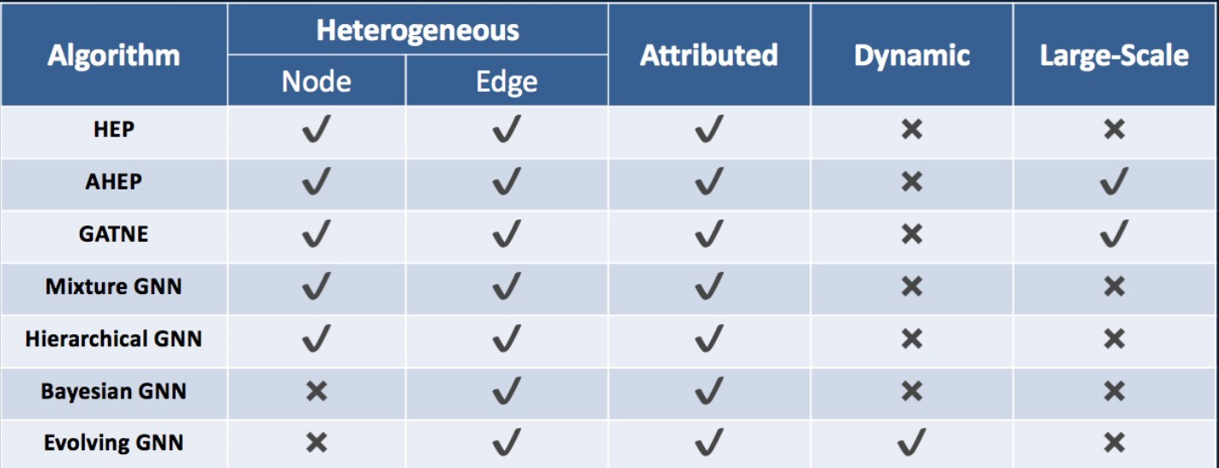
Supported Algorithms
Algorithms Proposed

Slide 38
Part 5: urrent Focus in Practice

Slide 39
Search-Recomme-datio- Platform
Busi-ess Solutio-
Search/RecommendaAion/ Ads
BBsiness InAelligenA
FraBd DeAecAion/ Risk ConArol
ID Mapping and Profile
CroDd MarkeAing
EColBAional/Online BpdaAing
Transfer Learning/ ReinforcemenA Learning
Service
IndeE/Rank
Training/Inference
ABAoML
AI
Algorithm
NaABral LangBage UndersAanding
Machine Learning/ Deep Learning
Image Processing
/ideo Processing
CogniAiCe Graph
Global User Profile
Global Seller Profile
Online Offline Info InAegraAion
Ecommerce CogniAiCe Graph
BBsiness OperaAion KnoDledge
Data
System
DisAribBAed CompBAing
SAream CompBAing
Graph CompBAing
Online Learning and Inference
HeAerogeneoBs CompBAing

Slide 40






Cloud Theme
from Sin/le Product Recommendation to Group Meet Place、cultivate metal up/rade
Meetin/ Place for Personalized Groups
SPR
Reasoning
Knowledge Card
Tips
Ad Embedding On Scene
Video recommendation
Natural Lan/ua/e Understandin/
Ima/e Processin/
Video Processin/
Machine Learnin//
eep Learnin/
Graph Embeddin/
Algorithm

Slide 41
Clo2d The-e The Flow
S1age
S1age 2
Prod2c1-Side
Tree ased Clusterin/ learnin/ user interest cate/ory
Personalized cloud theme Knowled/e card and strate/y
/eneration
GNN Model Generation Embeddin/
Minin/ Correspondin/ cate/ory keywords/phrase
Generate Personalized themes and ima/es
User-Side
Embeddin/ Recall Related Users
Group personalization User Profile minin/

Slide 42



User nterest Categories
GCN Model generate embedding
Hierarchical clustering, each layer is divided
As the number of layers deepens,
the granularity of the division becomes finer, and the semantics gradually emerge
Commodity Aggregation
Lipstick
Eye shadow Lip gloss Hair mask
......
Woolen coat jeans Leggings Wool sweater
……

Slide 43




Cloud Theme Ti-le Au-o-Genera-ion
Now
thousands of online cloud themes, mostly manual verification,
many unmaintained
The main and subtitles of the cloud theme are too plain to attract users to click
Future:
Automatically generate cloud topics through
algorithms, produce them in batches by algorithms, and automatically iteratively optimize.
Learn to produce scene-oriented, attractive main and subtitles.
ex:
1st cloud theme
Main Title: The coolest "digital" baby
Subtitle: Immersive game experience
2nd cloud theme
Main Title: Baby winter Heater
Subtitle: Provide warm sleep for your baby
Led Monitor
Cotton Quilt

Slide 44
Cloud Theme Title uto-Generation
TAOTips
Article Collection
Methodl: retrieval model
Civic 10th gen modification Civic Modification Angkerra Modification
Fit modification
Retrieval Model
Rank by PV
Candidate TAOTips Title
Merchandise Set
Candidate Querys
Cate Distribution
+ manual rules
+ cate distribution
Appearance of 10^{th-}gen Civic is modified to make it even more exciting. The new Civic changes, turn your car into a wild horse.
Nothing is born perfect, a Civic modified car fits you. The new Civic is modified to play a high-powered style.
The 205-horsepower grocery shopping car, the Civic is so handsome. Upgrade the Civic to create a savage calf.
0.5712
0.5845
0.4561
0.3381
0.4324
0.5325
Candidate Cloud Theme Title
IDF Values
Rank by IDF
Turn your car into a wild horse Make the car more exciting Nothing is born perfect
create a savage calf
0.4532
0.3312
0.2545
0.1124
……
Sorted Result Set

Slide 45


Cloud Theme Title uto-Generation
Main Title
SubTitle
Category
Baby’s small heater in winter
Provide warm sleep for your baby

Slide 46

Cloud Theme Title uto-Generation
Method2: generative model
卸下校服,轻… Get这些厨具… 含绒量超高…
脚暖身体才能热…
…
Expert Writing
Lace design is simple and elegant
Lace design is simple and elegant
很多MM在六月… 越来越多的男生.. 羽绒服作为冬季… 冬天出门会忘记…
…
Short titile
Cloud theme title
context
579845811167,
575858885796,
…
Simple round neck long sleeve shirt , The lace design is simple and elegant , Slim fit is more attractive ,…

Slide 47

Cloud Theme Title uto-Generation

Slide 48






Cloud Theme Main Image uto-Gene-ation
Cloud theme cover image
Template Puzzle
TOP5/TOP7 Popularity selection from the cutout
Commodity Cutout
Detect and filter non-white background product images
Extract the TopN product map of each cloud-themed product

Slide 49

loud Theme Knowledge ard/Guide Generation
Tfidf textrank word embedding Part of speech
…
Step1: Training data mining
tfidf
Context-based query embedding
&
Query item bipartite Graph embedding

Slide 50








loud Theme Knowledge ard/Guide Generation
Knitwear category: Query clustering result display

Slide 51




loud Theme Knowledge ard/Guide Generation
NLG model
PGN:
Soft template

Slide 52


loud Theme Knowledge ard/Guide Generation
Product embedding
Currently, items are retrieved through query cluster, keywords, question, and knowledge card;
Query cluster: Autumn suit, female student, fresh, college style... Keywords: campus, in the Mood for Love, golden years Question: Do you know the style of female students?
Knowledge card: We are at the border of immaturity and maturity. If we want to be a campus goddess, of course we have to choose what suits us. To become a dazzling scenery, we should live the most beautiful look. Come to the small society of university...

Slide 53



loud Theme Knowledge ard/Guide Generation

Slide 54
Part 6:What is next

Slide 55
Current ocus and Challenges
RecAmmendaFiAn BiBeline fAD Alibaba: billiAnE Af GEeDE and BDAdGcFE IiFh AHeD FDilliAnE Af ed:eE and exFDemelK Dich aFFDibGFeE
  Al:ADiFhm + SKEFem CA-ABFimiLaFiAn
)DaBh embeddin: & infeDence fAD aFFDibGFed heFeDA:eneAGE neFIADk
HeFeDA:eneAGE nAdeE IiFh aFFDibGFeE
&iffeDenF FKBeE Af ed:eE, eaEK FA inFe:DaFe knAIled:e ,nAIled:e )DaBh and )DaBh Embeddin:)
(AD each EBecific FaEk, beEF chAice Af ed:e FKBe & nAde aFFDibGFeE
MGlFi-mAdaliFK & Scalable BaKeEian &eeB -eaDnin:
• +nFDAdGcin: hi:h CGaliFK daFa labelE
  Hi:h CGaliFK Eide infADmaFiAn, EGch aE hi:h HalGable GEeDE and meDchandiEe
  TaD:eFed BAEiFiHe and ne:aFiHe EamBleE, nAde & ed:e imBADFance Iei:hFE
Online +nfeDence
  NeI daFa inflAI, Deal-Fime :DaBh GBdaFe
  Can handle EeCGenFial infADmaFiAn
Ali)DaBh EchA SKEFem On ClAGd

Slide 56

AliGr-ph Open Source
,elcome to T9y out
SYS+EM+ALGORI+HM
Co/e:
https://github.com/alibaba/graph-learn
Q/A:
graph-learn@list.alibaba-inc.com
Paper:
Al2G9ap1: A Comp9e1en:2ve G9ap1 Neu9al Netwo9k Plat0o9m, VLDB 2 19

Slide 57


Thank.
Xia-y-ng Liu : xia-y-ng liu@alibaba-inc c-m
H.-gxia Ya-g : ya-g yhx@alibaba-i-c c.m Wei Li- : weili- wl@alibaba-i-c c.m

Slide 58
art Appendix: Cognitive

Slide 59







Master Context
Channels Page
Taobao xperience
XiaoHongShu

Slide 60
Merchandise Context
Wei ao
Product itle
Product details

Slide 61
User Context
valuation
Asking veryone
Query

Slide 62
Value, ,,lication and Landing of NLG
Result Display:
Which one is Machine Generated?
中长款女童保暖呢子外套这款毛呢大衣,表面纯色和内里色调形成气质撞色,整体看上去 尽显气质和个性,如果家中的宝宝正是一个特别有想法的孩子,个性十足,那么这款外套千 万不能错过!作为基础款大衣,这款的不同之处就在与颜色,搭配黑色毛衣,炫酷一姐!
小公主韩版加厚毛呢大衣这款黑色毛衣采用了经典的圆领设计,穿起来非常显气质,衣服 的袖口和衣摆都做了螺纹收口,穿着更加舒适.衣身两侧的大口袋装饰,给衣服增加了一点 童趣的味道,穿上很有气质哦.
Mid-length girl's warm woolen coat, this woolen coat, the surface solid color and the inner tone form a temperament contrast, the overall look is full of temperament and personality, if the baby in the family is a particularly thoughtful child, full of personality, then Don't miss this coat! As a basic coat, the difference between this one lies in the color, with a black sweater, and a cool sister!
Little princess Korean thick woolen coat. This black sweater adopts a classic round neck design, which is very elegant to wear. The cuffs and hem of the clothes have threaded closures, making it more comfortable to wear. The large pockets on both sides of the body are decorated, It adds a little childlike taste to the clothes, and it is very temperamental.
春装新款的中长款羊绒呢大衣,这款大衣采用优质的羊绒面料,柔软舒适,穿着舒适.双排扣 的设计,简约大方,时尚百搭.搭配一条简单的牛仔裤,就可以美美的出门了.
型色续纷的春装新款.韩版气质的羊绒呢大衣,中长款不挑身材,3d立体剪裁,纽扣设计别 致,贴布精致,不可或缺的一款.搭配尖头方扣浅口单鞋,绒面粗跟简直爱不释手,颜色也是 很春天的颜色.
The new mid-length cashmere coat for spring. This coat is made of high-quality cashmere fabric, soft and comfortable, and comfortable to wear. The double- breasted design, simple and elegant, fashionable and versatile. With a simple pair of jeans, you can go out beautifully .
A new style of colorful spring clothes. Korean style of temperament cashmere coat, medium and long models do not pick up the figure, 3D three-dimensional tailoring, button design unique, delicate patch, an indispensable one. With pointed square button shallow shoes, velvet The thick noodles are simply too much to put it down, and the colors are also very spring colors.
Note:Generate Chinese then translate to Engli

Slide 63

Short video front desk servi e
Guess you like the video recommendation
aobao experience video content
Wow video
猜你喜欢视频推荐
猜你喜欢视频承接页推荐

Slide 64
Video produ t dete tion

Slide 65
ideo product detection---image target detection
l From t+e expert v,deos t+e v,deos w,t+ +,g+er products are selected as tra,n,ng data
l Generate a mult,-product category data set w,t+ a s,ngle product ,mage model
l Weak superv,sed ob-ect detect,on+ V,deo descr,pt,on ,nfor
l Manual mark,ng +few s+ot learn,ng

Slide 66
Video summary generation-
l ideo text description is the basic input information for video understanding
lEvaluate a large number of undescriptive and unclear descriptions in the video

Slide 67

Video summary generation-
lVideo + seq2seq model
lVideo co2te2t + review text co2te2t
+ product attributes produce s,ort video abstracts
lLo2+ se2te2ces s,ort
lLo2+ s,ort se2te2ces
lAdd Product Subject
lMa2ually filter t,e trai2i2+ data set from t,e videos wit, ,i+, views a2d
,i+, likes of users
Kid Toy Album
Develop the cerebellum to improve concentration toys
Variety of styles and counter quality

Slide 68
Video summary generation-
lYouku: Fil, a-d televisio- co,prehe-sive video slices,
auto,atically ge-erate slice title
s
lTrai-i-g data: high quality short video pool with co,plete titles
lTags Auxiliary title ge-eratio-

Slide 69

Person lized content themes
lGenerate persona,ized content the-es co-posed of products graphics and videos
lThe video qua,ity eva,uation -ode, auto-atica,,y se,ects products fro- You+u short videos
+ hand--ade short videos
lGag reca,, content-re,ated reca,,
lVideo sorting video product -ixing

