Slide 1

Graph Neural Networks in Computational Biology
Marinka Zitnik - https://zitniklab.hms.harvard.edu - March 11, 2021
Marinka Zitnik
Department of Biomedical Informatics Broad Institute of Harvard and MIT Harvard Data Science
marinka@hms.harvard.edu
zitniklab.hms.harvard.edu
1

Slide 2







Graph ML for Computational Biology
Marinka Zitnik - https://zitniklab.hms.harvard.edu - March 11, 2021
There has been a surge of interest in leveraging GNNs for learning meaningful representations of biology
GNNs have been used to learn representations that enabled critical predictions in downstream applications
Interconnected biomedical data
Input networks
Graph machine learning
Graph transformations
Graph transformations
Predictions
Output predictions
Machine learning for biomedical networks: Advancements, challenges, and opportunities, 2021 (to appear)
2

Slide 3
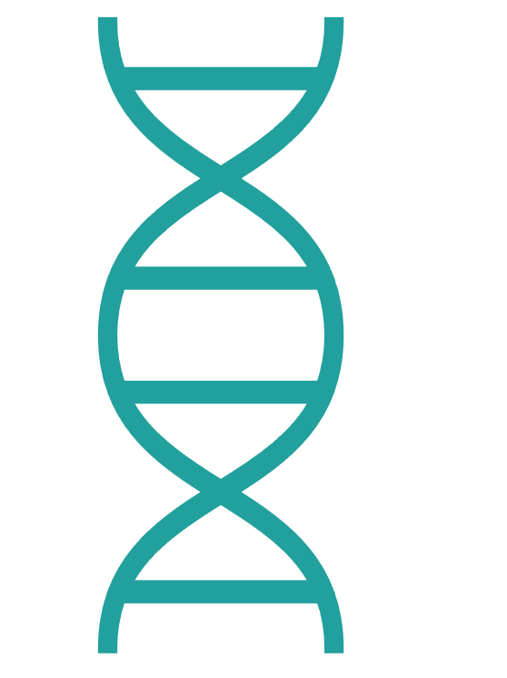

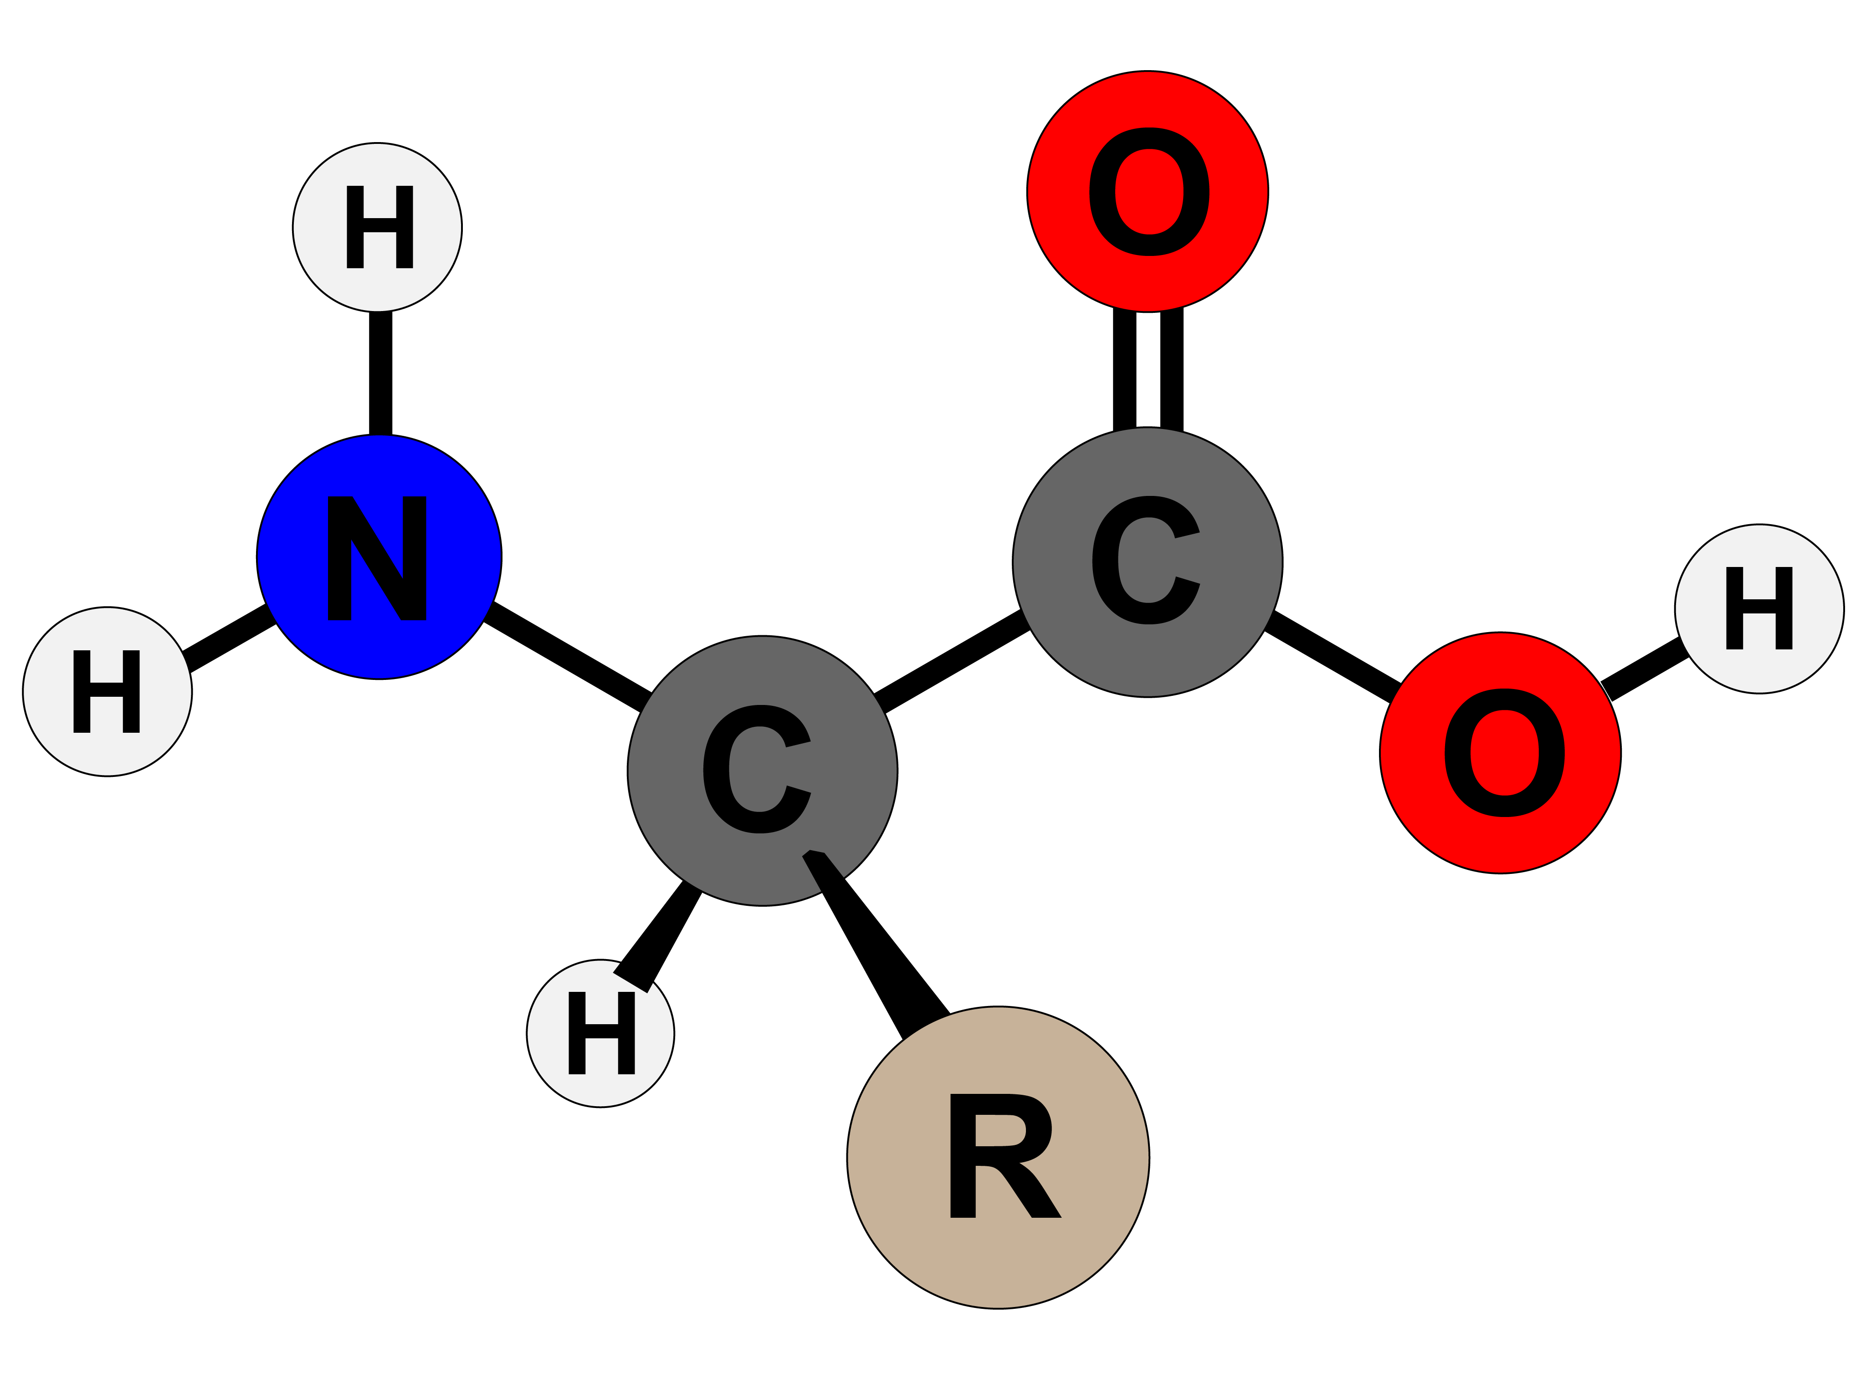
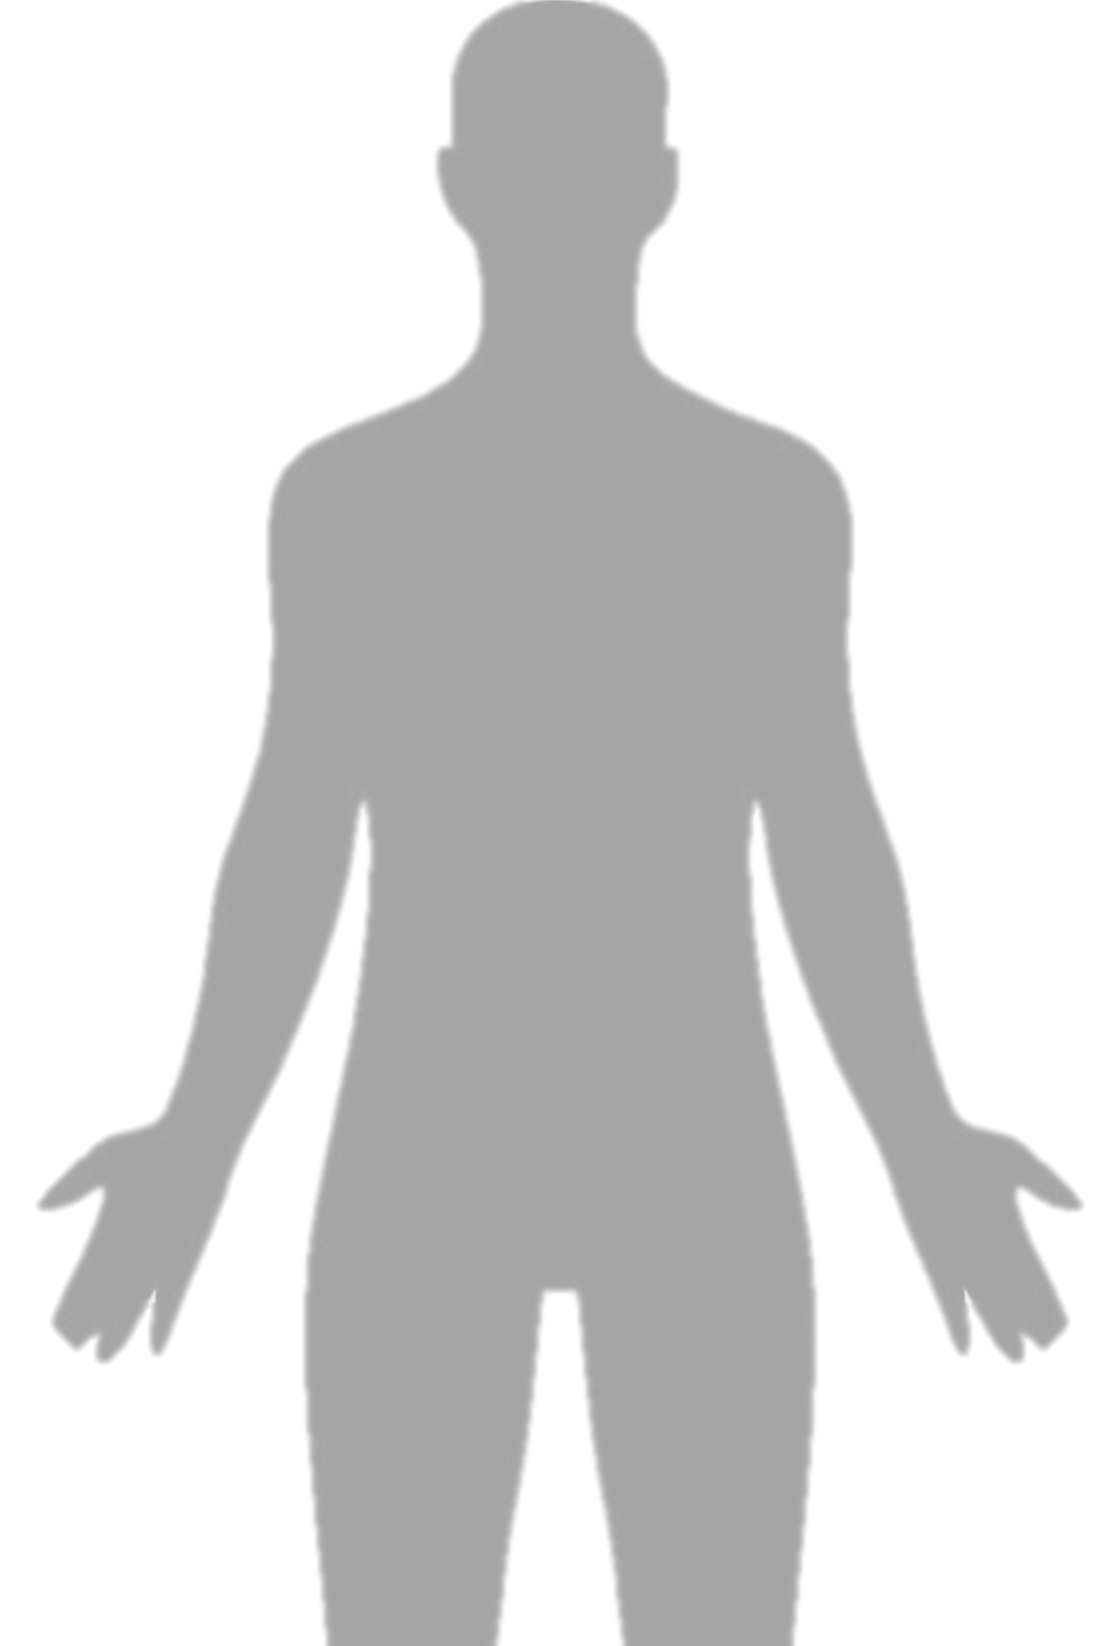

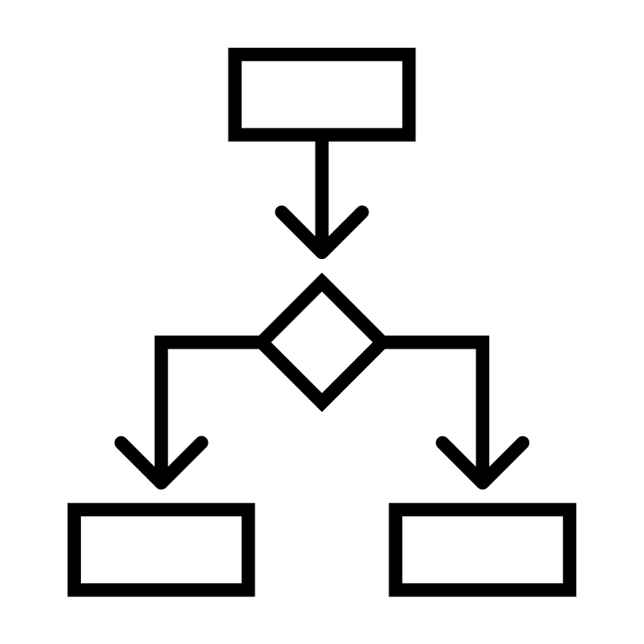

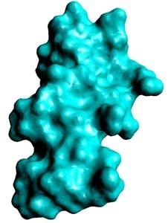

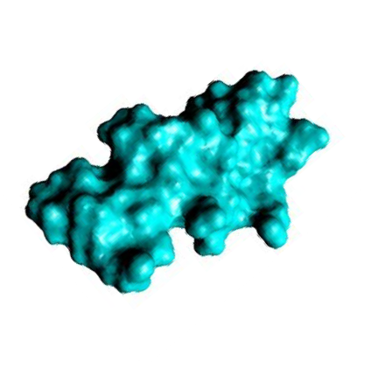
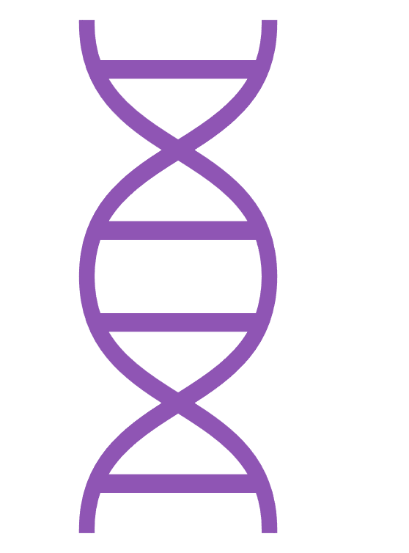

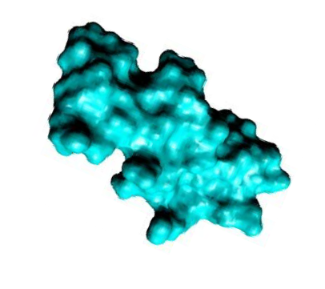












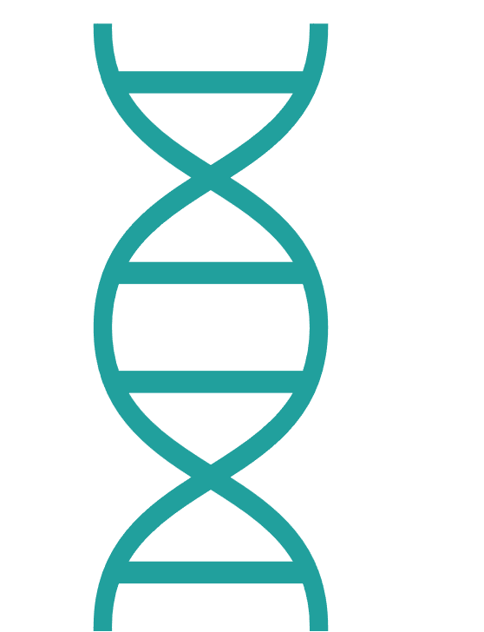

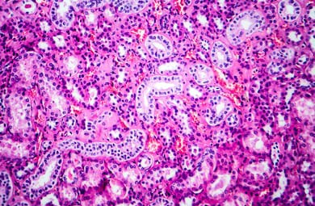
Biology is Interconnected!
Marinka Zitnik - https://zitniklab.hms.harvard.edu - March 11, 2021
Coding
Neurological disease
Small compound
Protein
Electronic Health Records
Noncoding
Cardiovascular disease
OC1=NC=NC2=C1C=NN2
Kidney
The effects of ddrisuorgdser are not limited to the molecules to which they directly bind in the body. Instead, these effects spread throughout biological networks in which they act.
Therefore, the effect of a drug on_{Me}a_{dic}d_{al}is_{im}e_{a}a_{ge}se is
inherently a network phenomenon
Coding
Noncoding RNA
Machine learning for biomedical networks: Advancements, challenges, and opportunities, 2021 (to appear)
2

Slide 4
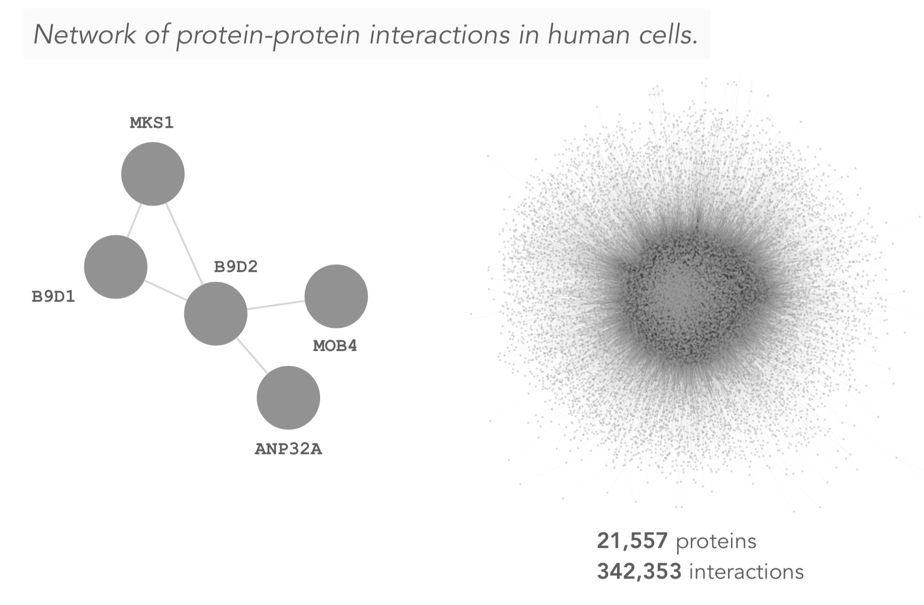
Why Networks in Biology?
Marinka Zitnik - https://zitniklab.hms.harvard.edu - March 11, 2021
4

Slide 5
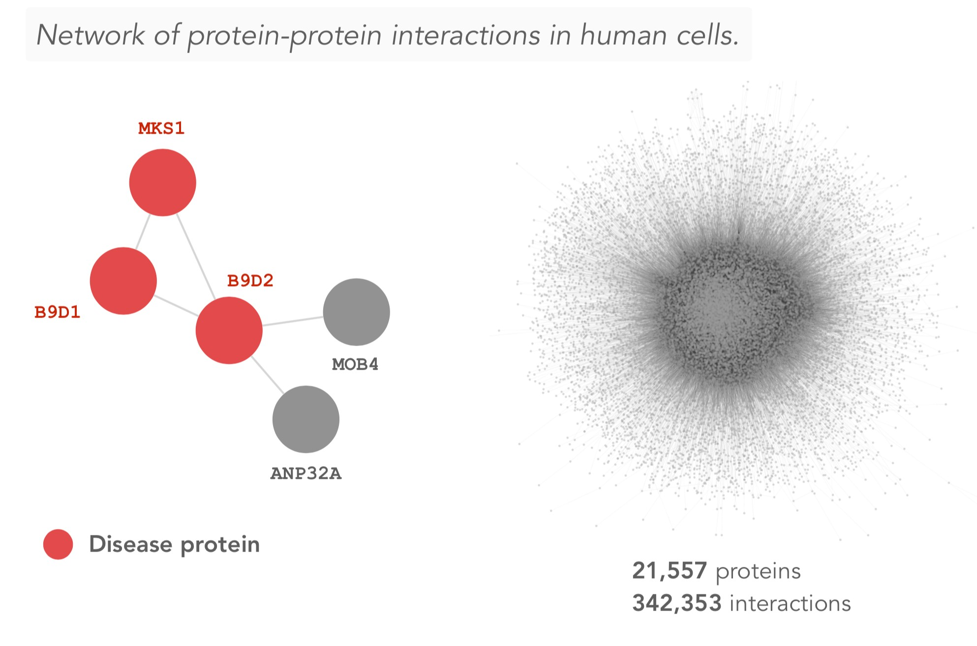
Why Networks in Biology?
Marinka Zitnik - https://zitniklab.hms.harvard.edu - March 11, 2021
4

Slide 6
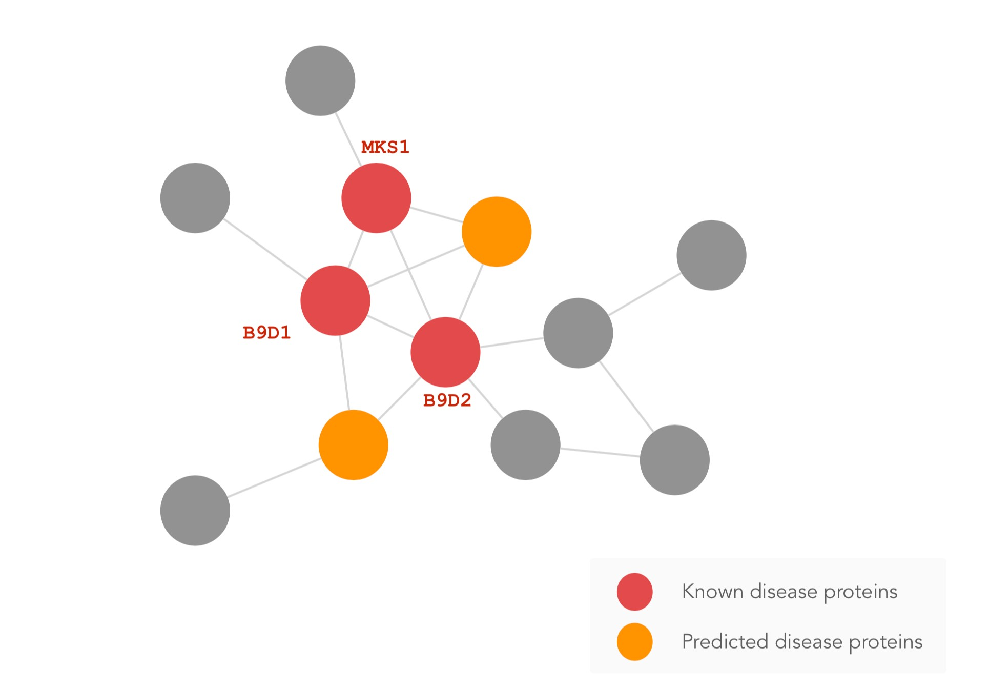
Why Networks in Biology?
Marinka Zitnik - https://zitniklab.hms.harvard.edu - March 11, 2021
Long-standing Paradigm: “Local Hypothesis”
Proteins involved in the same disease have an increased tendency to interact with each other
Corollary of the Local Hypothesis
Mutations in interacting proteins often lead to similar diseases
Network medicine: a network-based approach to human disease, Nature Reviews Genetics, 2011
4

Slide 7

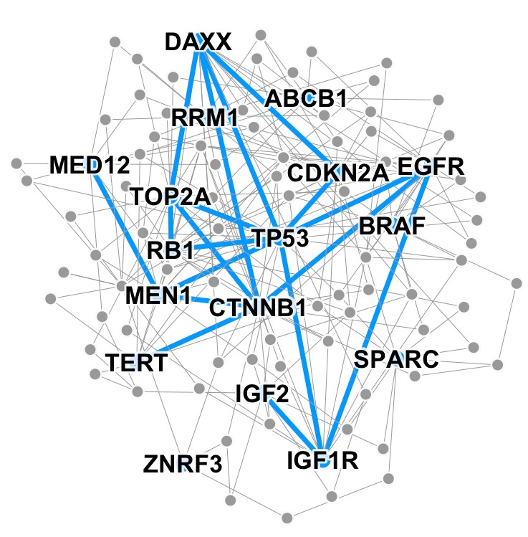
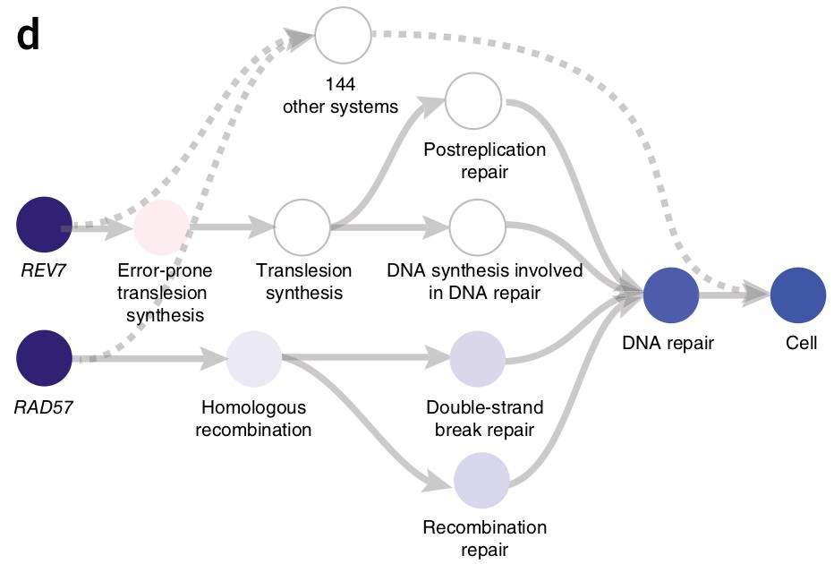
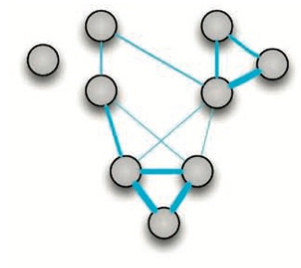
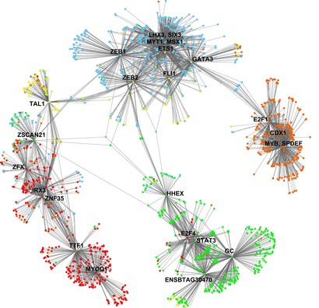
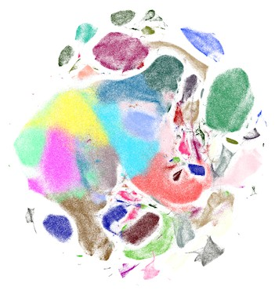
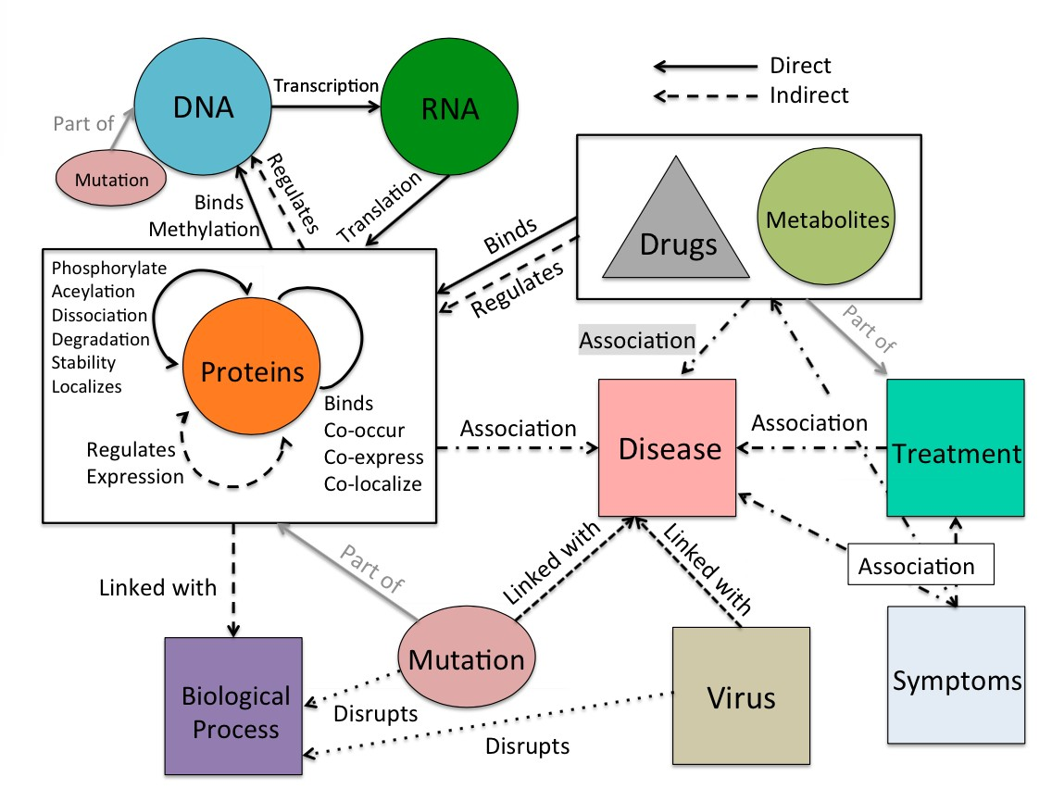
Similar findings apply to a broad range of biological networks
Marinka Zitnik - https://zitniklab.hms.harvard.edu - March 11, 2021
Cellular components associated with a specific disease (phenotype) show a tendency to cluster in the same network neighborhood
GNNs are well-suited for
the analysis of biological networks
Patient networks Hierarchies of cell systems Disease pathways
Biomedical knowledge graphs
Gene interaction networks
Cell-cell similarity networks
Machine learning for biomedical networks: Advancements, challenges, and opportunities, 2021 (to appear)
Machine learning for integrating data in biology and medicine: Principles, practice, and opportunities, Information Fusion 201₇ 9

Slide 8
Why are Biological Networks Challenging?
Marinka Zitnik - https://zitniklab.hms.harvard.edu - March 11, 2021
Networks involve heterogeneous interactions that span from molecules to whole populations
  The challenge is how to computationally operationalize these data and make them amenable to ML
Networks contain data from diverse sources, including experimental readouts, curated annotations, metadata
  No single data type can capture all the factors necessary to understand a phenomenon such as a disease
Networks are noisy due to inherent natural variations and limitations of measurement platforms
  Missing data, repeated measurements, and contradictory observations can plague the analysis
Machine learning for biomedical networks: Advancements, challenges, and opportunities, 2021 (to appear)
8

Slide 9





Plan for Today
Marinka Zitnik - https://zitniklab.hms.harvard.edu - March 11, 2021
Safe drugs and drug combinations
Methods: Multi-relational link prediction on KGs
Patient outcomes & disease classification
Methods: Subgraph embeddings
Effective disease treatments
Methods: Few-shot learning for graphs
9

Slide 10
Poly-Therapy
Marinka Zitnik - https://zitniklab.hms.harvard.edu - March 11, 2021
Patients take multiple drugs to treat complex or co-existing diseases
46% of people over 65 years take more than 5 drugs
Many take more than 20 drugs to treat heart diseases, depression or cancer
15% of the U.S. population affected by unwanted side effects
Annual costs in treating side effects exceed $177 billion in the U.S. alone
Modeling Polypharmacy Side Effects with Graph Convolutional Networks, Bioinformatics, 2018

Slide 11




Unexpected Drug Interactions
Marinka Zitnik - https://zitniklab.hms.harvard.edu - March 11, 2021
Co-prescribed drugs
Side Effects
Task: How likely will a particular
combination of drugs lead to a
particular side effect?
?
,
3% 2%
prob. prob.
Modeling Polypharmacy Side Effects with Graph Convolutional Networks, Bioinformatics, 2018

Slide 12


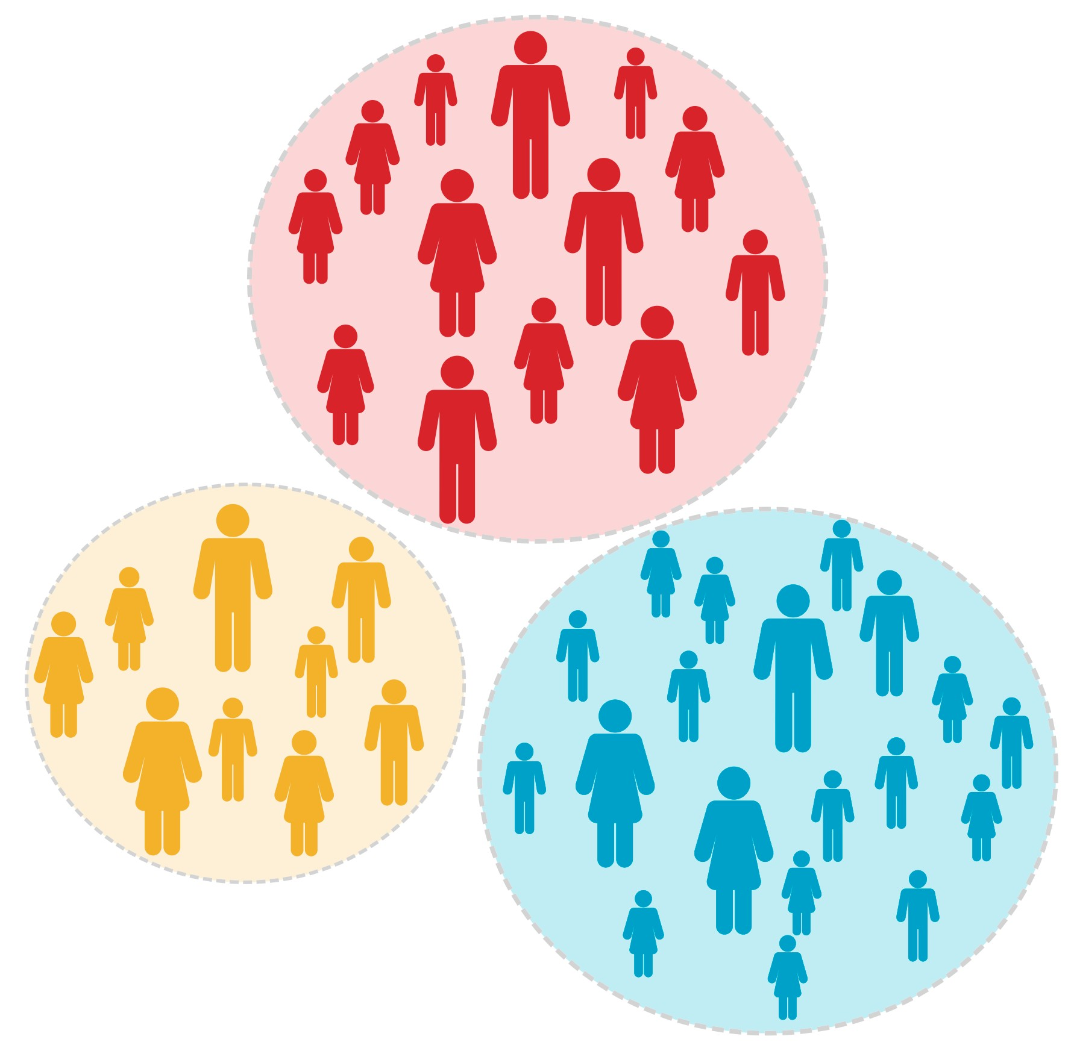
Why is modeling drug combinations chalenging?
Marinka Zitnik - https://zitniklab.hms.harvard.edu - March 11, 2021
Combinatorial explosion
>13 million possible combinations of 2 drugs
>20 billion possible combinations of 3 drugs
Non-linear & non-additive interactions
Different effect than the additive effect of individual drugs
+
≠
Small subsets of patients
Side effects are interdependent
No info on drug combinations not yet used in patients
Modeling Polypharmacy Side Effects with Graph Convolutional Networks, Bioinformatics, 2018

Slide 13


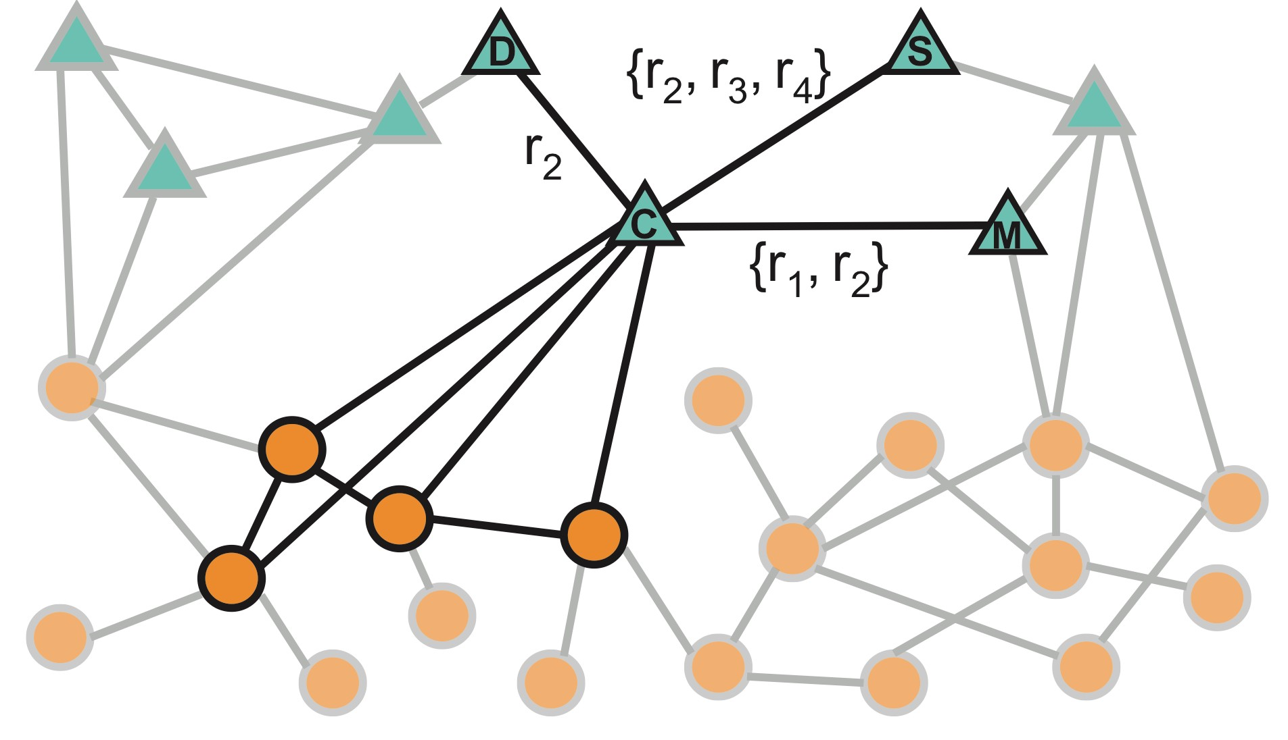
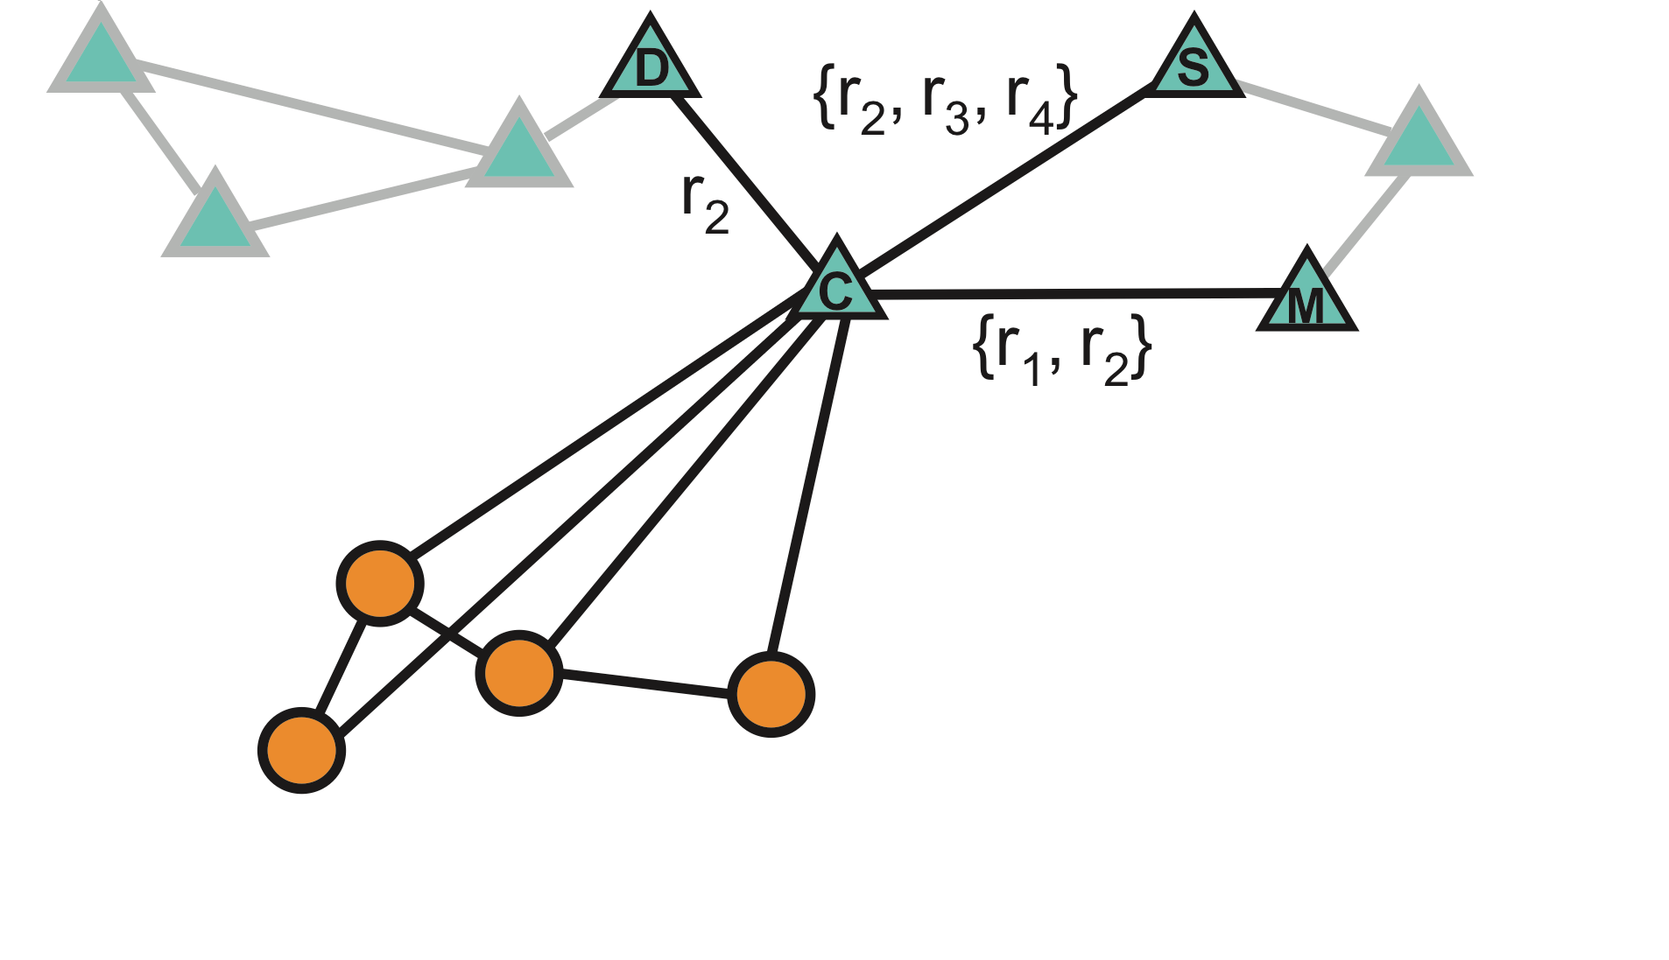
Polypharmacy Knowledge Graph
Marinka Zitnik - https://zitniklab.hms.harvard.edu - March 11, 2021
𝑟' Edge type 𝑖
Node types
E.g., Specific type of drug- drug interaction (𝑟!)
𝑟#
𝑟"
𝑟$
Mode 1
e.g., drugs
𝑟%
𝑟%
𝑟%
E.g., drug-target interaction (𝑟 )
"
𝑟%
𝑟&
Mode 2
e.g., proteins
E.g., protein-protein interaction (𝑟#)
Modeling Polypharmacy Side Effects with Graph Convolutional Networks, Bioinformatics, 2018

Slide 14
Approach: Decagon
Marinka Zitnik - https://zitniklab.hms.harvard.edu - March 11, 2021
1. Encoder: Take a multimodal network and learn an embedding for every node
Embedding
2. Decoder: Use the learned embeddings to predict labeled edges between nodes
Embedding
r_{i}
?
Embedding
Training the model: Feed embeddings into any loss function and run stochastic gradient descent to train weight parameters:
Use a loss based on e.g., random walks, node proximity in the graph
Directly train the model for a supervised task (e.g., node classification)
Modeling Polypharmacy Side Effects with Graph Convolutional Networks, Bioinformatics, 2018

Slide 15
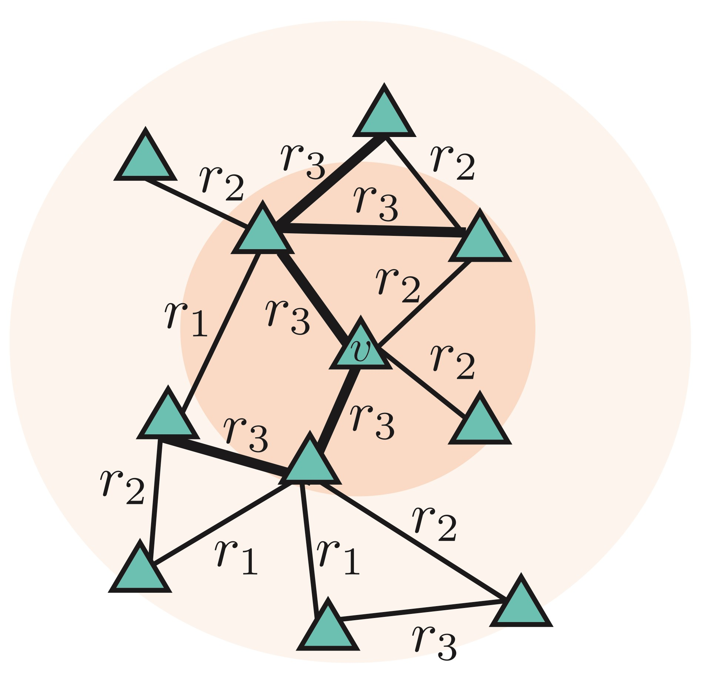
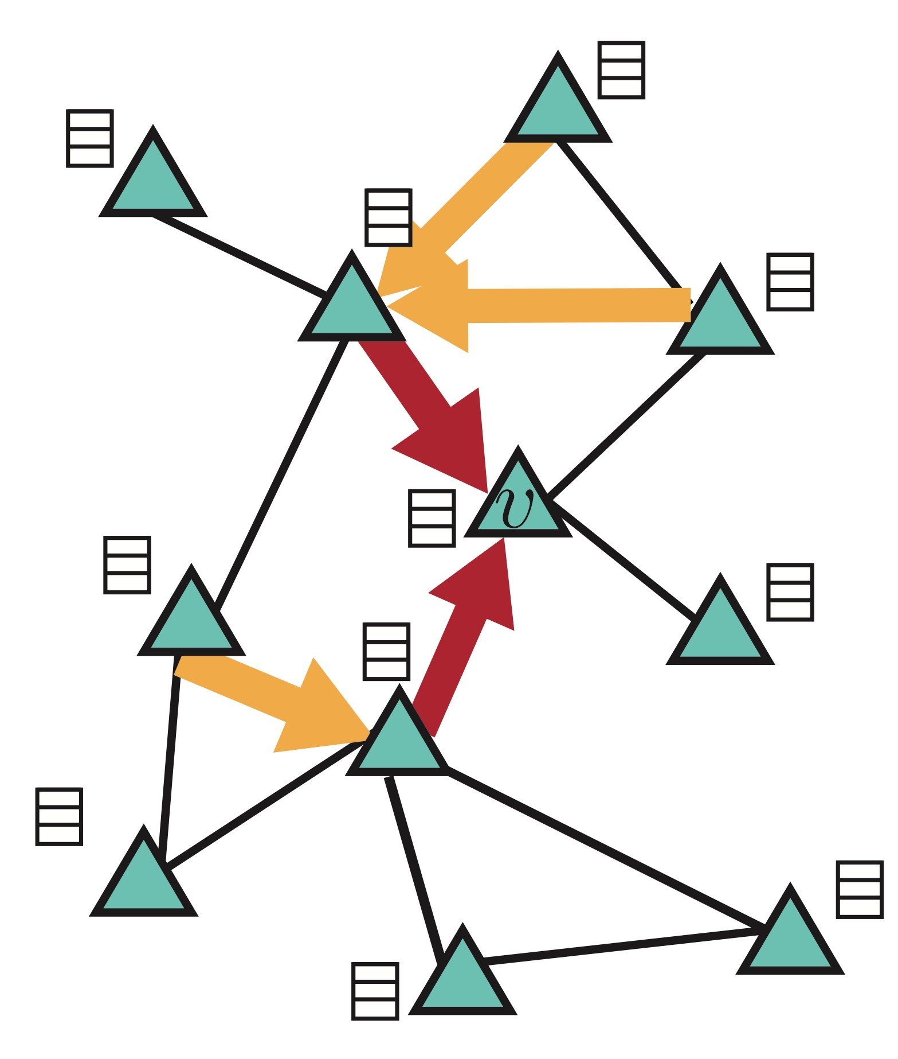
Key Idea: Aggregate Neighbors
Marinka Zitnik - https://zitniklab.hms.harvard.edu - March 11, 2021
Generate embeddings based on local network neighborhoods separated by edge type
1) Determine a node’s computation graph for each edge type
2) Learn how to transform and propagate information across computation graph
Example for edge type 𝑟$:
1st order neighbor of 𝑣
2nd order neighbor of 𝑣
Modeling Polypharmacy Side Effects with Graph Convolutional Networks, Bioinformatics, 2018

Slide 16
Multirelational Graph Encoder
Marinka Zitnik - https://zitniklab.hms.harvard.edu - March 11, 2021
Key element: Each node’s computation graph defines a neural network with a different architecture
Initial 0-th layer embeddings are equal to node features:
Aggregate neighbor’s previous-layer embeddings, separated by edge type
Per-layer update of node embeddings:
Ability to integrate side information about nodes
Previous-layer embedding of 𝑣
Embeddings after 𝐾 layers of neighborhood aggregation:
Normalization constant, fixed
e.g., 1/|𝑁"|, or learned
Parameter weight! matrices
Modeling Polypharmacy Side Effects with Graph Convolutional Networks, Bioinformatics, 2018

Slide 17
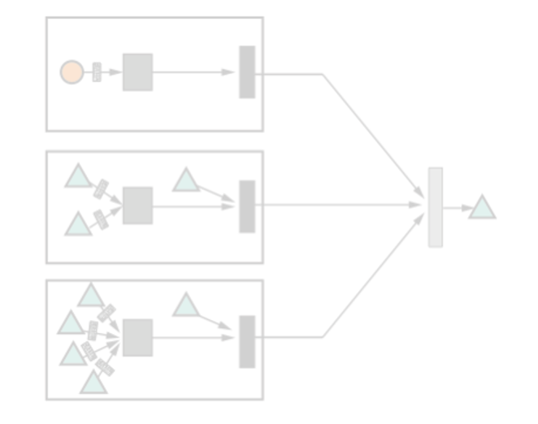
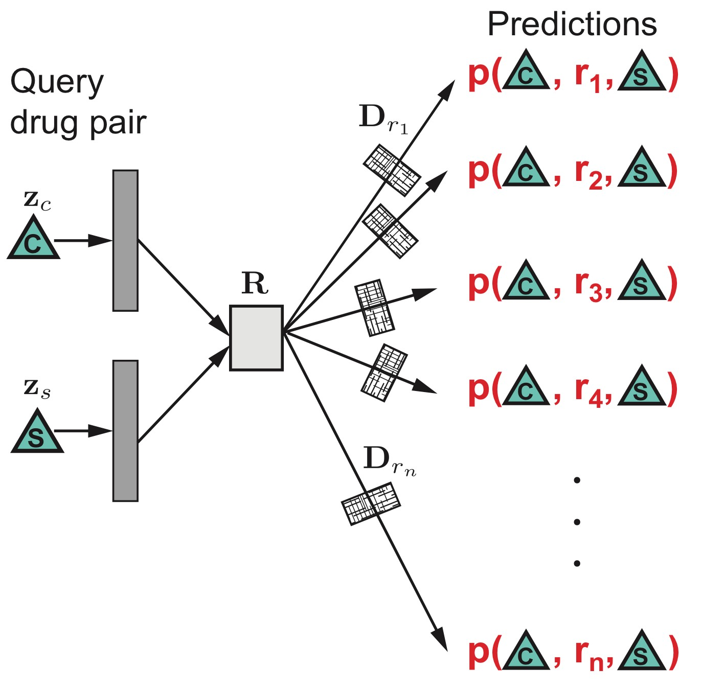



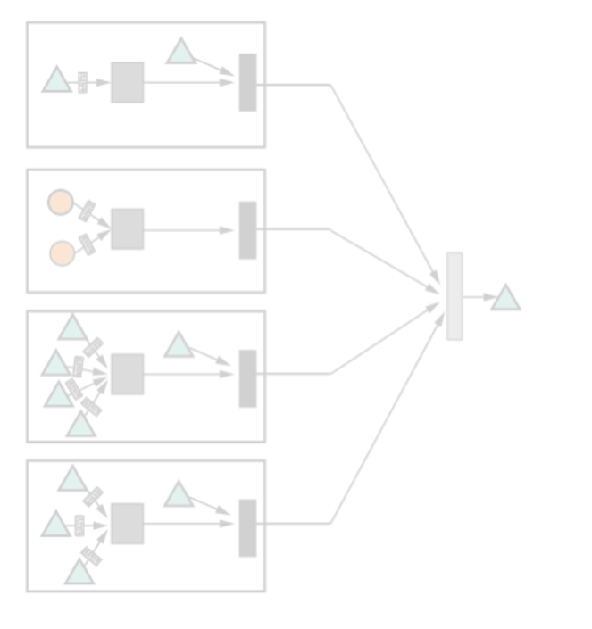


Heterogeneous Edge Decoder
Marinka Zitnik - https://zitniklab.hms.harvard.edu - March 11, 2021
Output: Predicted edges, new discovered relationships
Input: Embeddings of two nodes, 𝐶 and 𝑆
Probability that 𝐶 and 𝑆 are linked by an edge of type 𝑟"
Tensor factorized model captures dependences between different edge types
Parameter weight matrices
Modeling Polypharmacy Side Effects with Graph Convolutional Networks, Bioinformatics, 2018

Slide 18
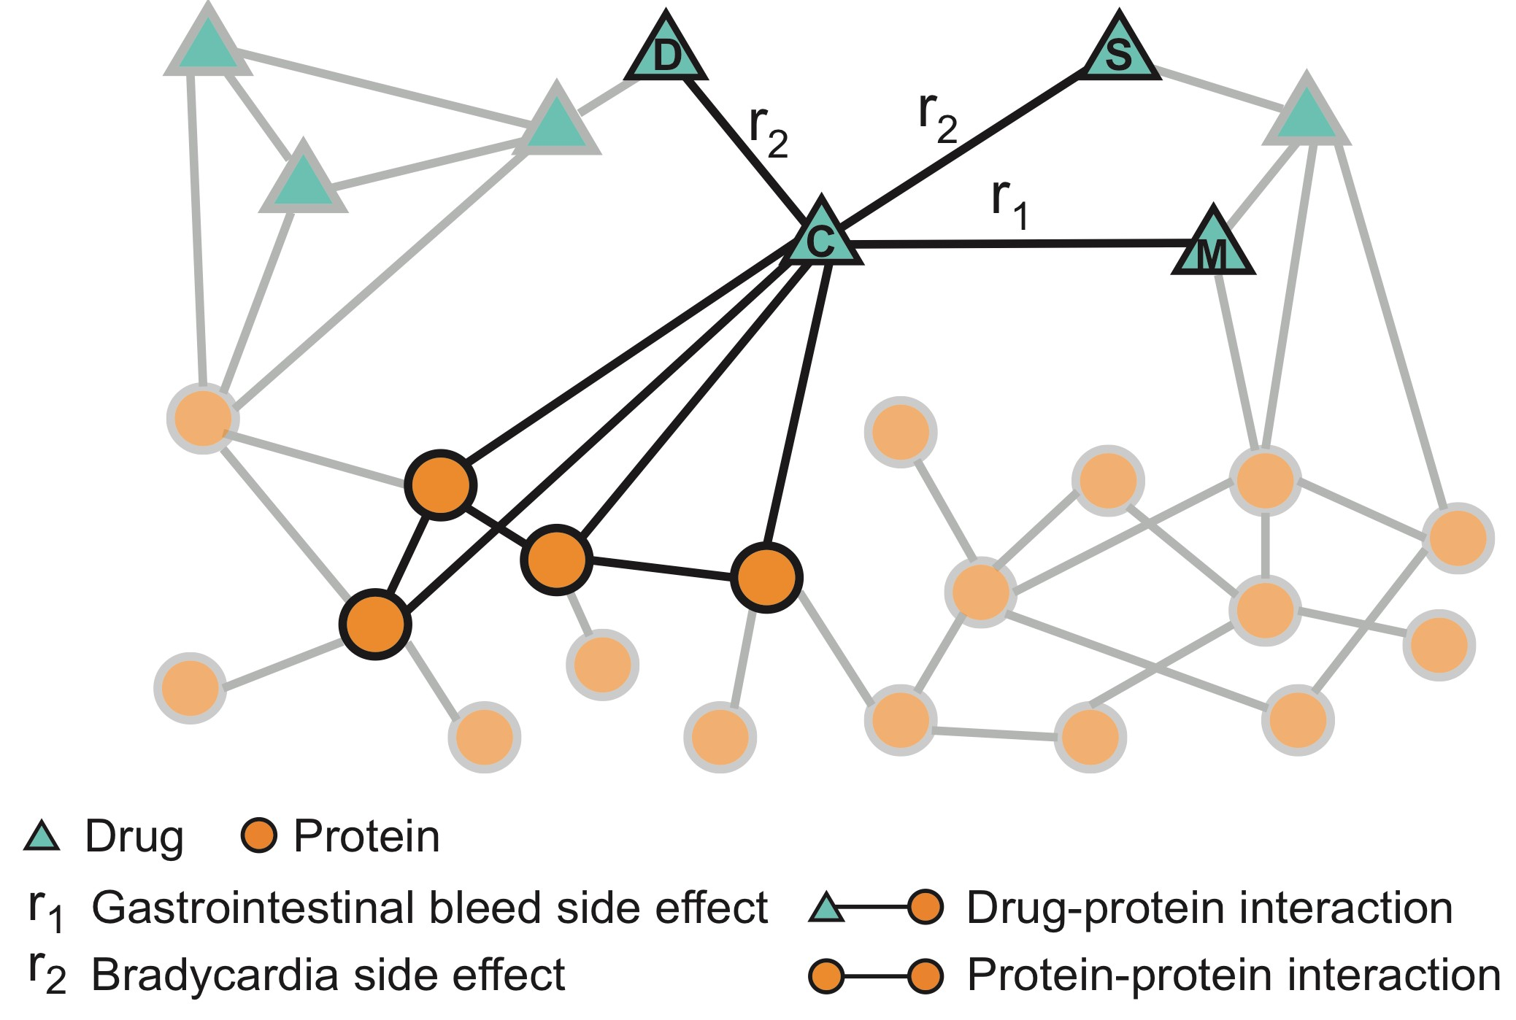
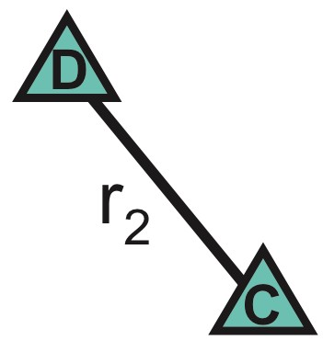
We need Polypharmacy Dataset
Marinka Zitnik - https://zitniklab.hms.harvard.edu - March 11, 2021
Objecti r
all drug
ve: Capture molecular, drug, and patient data fo s prescribed in the U.S.
d a unique dataset:
51,131 drug-drug edges: Patient data from adverse ent system, tested for confounders [FDA]
596 drug-protein edges
9,402 protein-protein edges: Physical, metabolic enzyme upled, and signaling interactions
ug and protein features: drugs’ chemical structure, teins’ membership in pathways
Drug-drug
We buil
4,6
ev
Drug-protein
18,
71 co
Dr
-
Protein-protein
pro
Gives multimodal network with over 5 million edges separated into 1,000 different edge types
Modeling Polypharmacy Side Effects with Graph Convolutional Networks, Bioinformatics, 2018

Slide 19
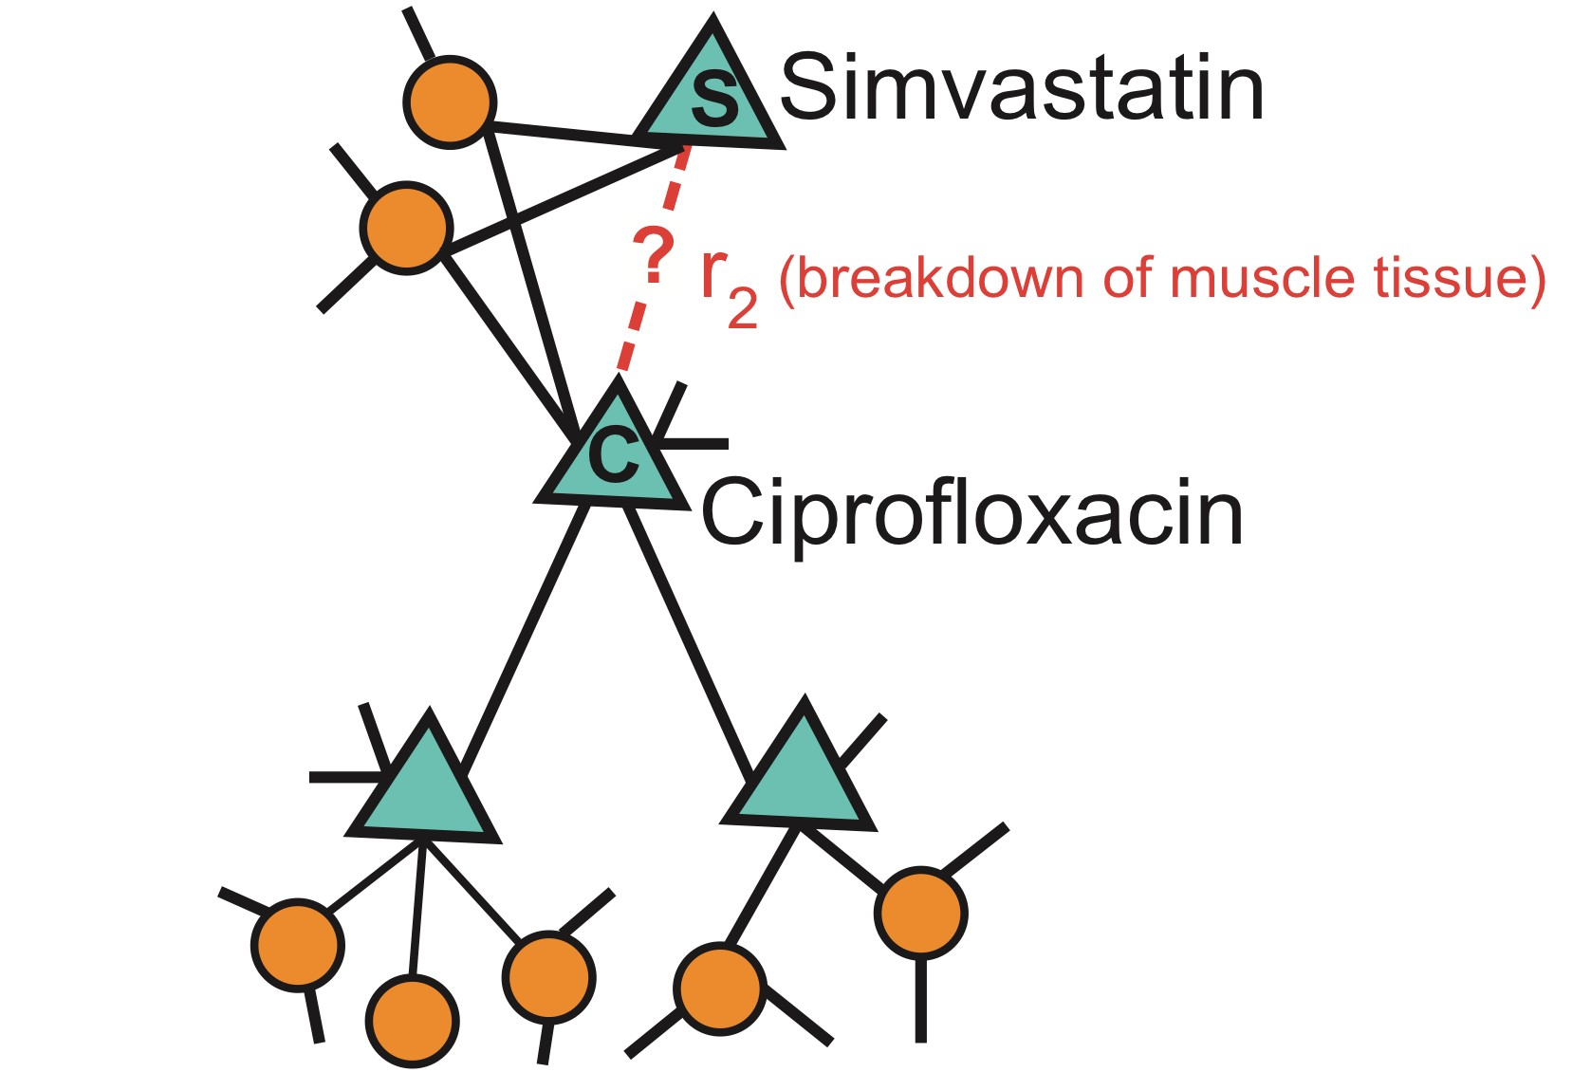
Marinka Zitnik - https://zitniklab.hms.harvard.edu - March 11, 2021
We apply Decagon to the polypharmacy network
E.g.: How likely will Simvastatin and Ciprofloxacin, when taken together, break down muscle tissue?
Modeling Polypharmacy Side Effects with Graph Convolutional Networks, Bioinformatics, 2018

Slide 20
Results: Side Effect Prediction
Marinka Zitnik - https://zitniklab.hms.harvard.edu - March 11, 2021
0.9
0.8
0.7
0.6
0.5
0.4
0.3
0.2
0.1
0
0.834
_{0.693 0.705} 0.725
0.731
0.643
0.567
0.476
AUROC
Our method (Decagon)
RESCAL Tensor Factorization [Nickel et al., ICML'11]
AP@50
Multi-relational Factorization [Perros, Papalexakis et al., KDD'17] Shallow Network Embedding [Zong et al., Bioinformatics'17]
Modeling Polypharmacy Side Effects with Graph Convolutional Networks, Bioinformatics, 2018

Slide 21
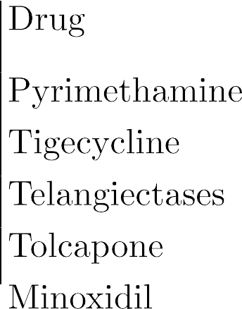









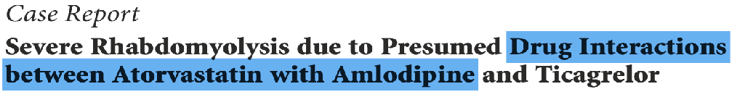


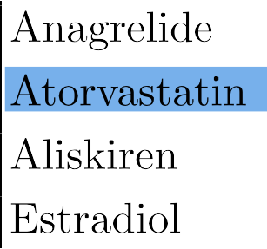





New Predictions
Marinka Zitnik - https://zitniklab.hms.harvard.edu - March 11, 2021
Approach:
Train deep model on data generated prior to 2012
How many predictions have been confirmed after 2012?
Modeling Polypharmacy Side Effects with Graph Convolutional Networks, Bioinformatics, 2018

Slide 22
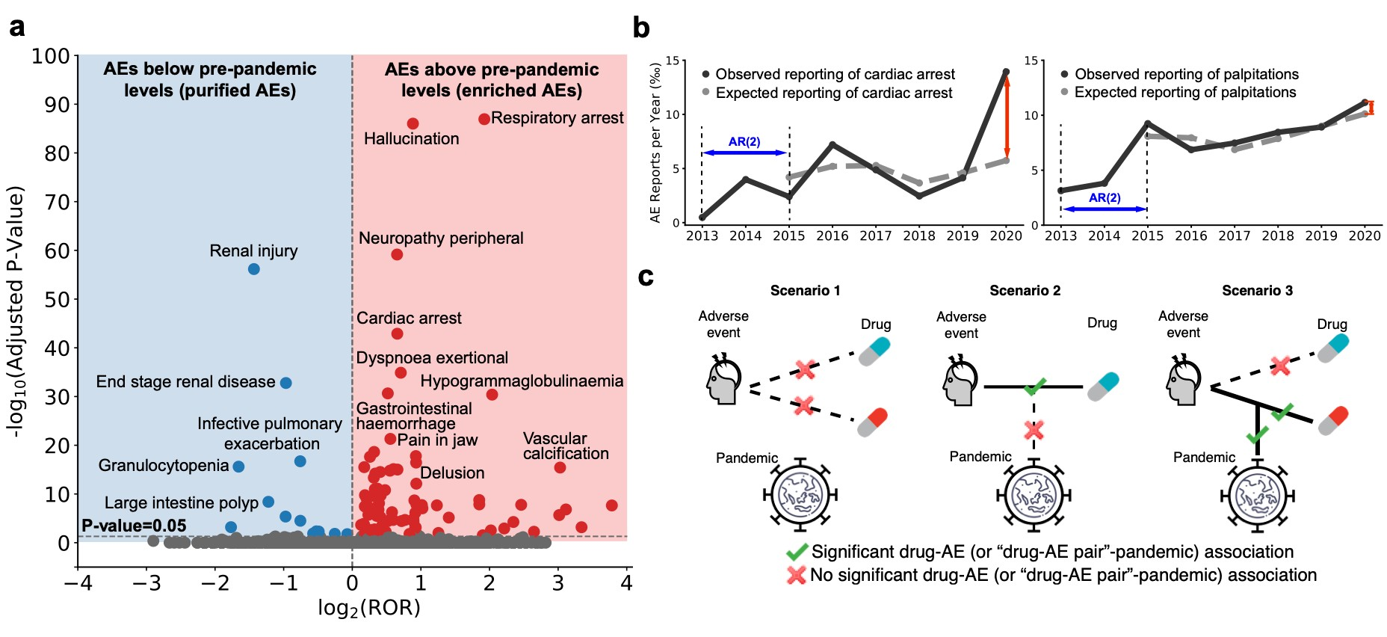
Follow-Up: Adverse Events for Patient Groups
Marinka Zitnik - https://zitniklab.hms.harvard.edu - March 11, 2021
Population-scale patient safety data reveal inequalities in adverse events before and during COVID-19 pandemic, medRxiv: 2021.01.17.21249988
22

Slide 23





Plan for Today
Marinka Zitnik - https://zitniklab.hms.harvard.edu - March 11, 2021
Safe drugs and drug combinations
Methods: Multi-relational link prediction on KGs
Patient outcomes & disease classification
Methods: Subgraph embeddings
Effective disease treatments
Methods: Few-shot learning for graphs
23

Slide 24


Disease Diagnosis
Marinka Zitnik - https://zitniklab.hms.harvard.edu - March 11, 2021
Phenotypes are observable characteristics resulting from interactions between genotypes, as well as environment
  Physicians utilize standardized vocabulary of phenotypes to describe human diseases.
  By modeling diseases as collections of associated phenotypes, we can diagnose patients based on their presenting symptoms
Medical History:
Has asthma?
Other chronic issues?
……
Symptoms:
Severe Cough Wheezing
…..
Machine learning for biomedical networks: Advancements, challenges, and opportunities, 2021 (to appear)

Slide 25
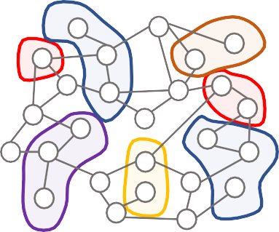
Diagnosis Task
Marinka Zitnik - https://zitniklab.hms.harvard.edu - March 11, 2021
Graph: Consider a graph 𝐺 built from the standardized vocabulary of phenotypes:
  Nodes: phenotypes; edges: relationships between phenotypes
  Patient is a set of phenotypes, a subgraph 𝑆 in 𝐺
Learning Task: Predict the disease (label) most consistent with the phenotype subgraph 𝑆
Disease phenotypes
HPO network
Graph ML model
Disease subgraph predictions
Disease 1: HPO-…
Disease 2: HPO-…
Disease 3: HPO-…
Disease 4: HPO-…
Disease 5: HPO-…
… Disease N: HPO-…
Lysosomal
Glycosylation
Carbohydrate
Lipid
Carbohydrate
Graph machine learning
Prediction Task:
Subgraph Classification
Disease N
Machine learning for biomedical networks: Advancements, challenges, and opportunities, 2021 (to appear)

Slide 26
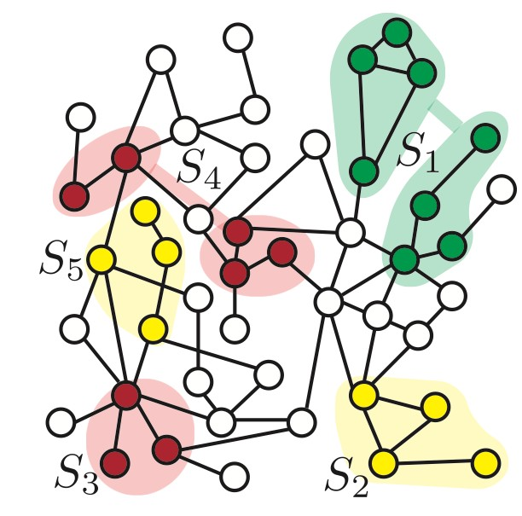
Problem Formulation
Marinka Zitnik - https://zitniklab.hms.harvard.edu - March 11, 2021
Goal: Learn subgraph embeddings such that the likelihood of preserving subgraph topology is maximized in the embedding space
  𝑆' and 𝑆₊ with similar subgraph topology should be embedded close together in the embedding space
𝑧""
𝑧"!
Input
Embedding space
Subgraph Neural Networks, NeurIPS 2020

Slide 27
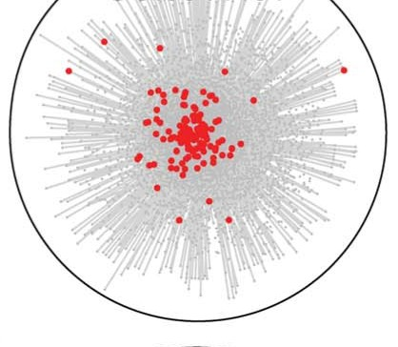
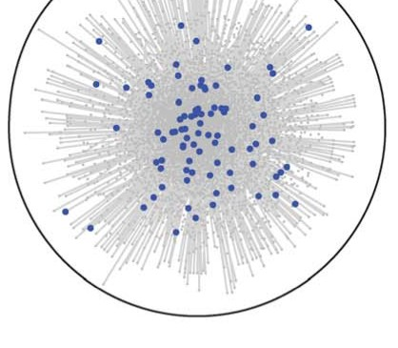
_{Why a}Marinka_{r}Zitn_{e}ik - https://zitn_{s}iklab.hm_{u}s.harvard._{b}edu - Mar_{g}ch 11, 202_{r}1
aphs
challenging?
Need to predict over structures of varying size:
  How to represent subgraphs that are not 𝑘-hop neighborhoods?
Rich connectivity patterns, both internally a externally through interactions with the rest of 𝐺:
  How to inject this information into a GNN?
Subgraphs can be:
  Localized and reside in our region of the graph
  Distributed across multiple local neighborhoods
nd
Subgraph Neural Networks, NeurIPS 2020

Slide 28
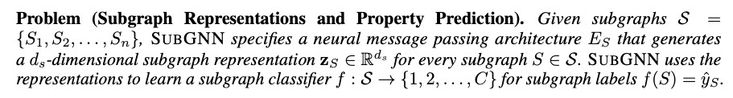
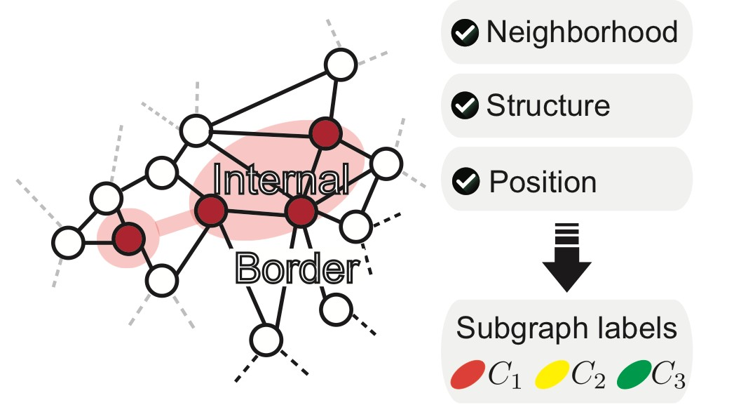
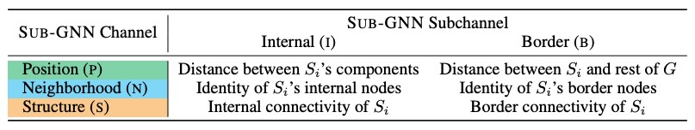
Subgraph Neural Networks
Marinka Zitnik - https://zitniklab.hms.harvard.edu - March 11, 2021
28

Slide 29
A Note on Problem Formulation
Marinka Zitnik - https://zitniklab.hms.harvard.edu - March 11, 2021
SubGNN puts forward a definition of a subgraph prediction learning task
It is different from other canonical tasks on graphs:
  Node prediction: Predict property of a node
  Link prediction: Predict property of a node pair
  Graph prediction: Predict property of an entire graph
Subgraph Neural Networks, NeurIPS 2020

Slide 30
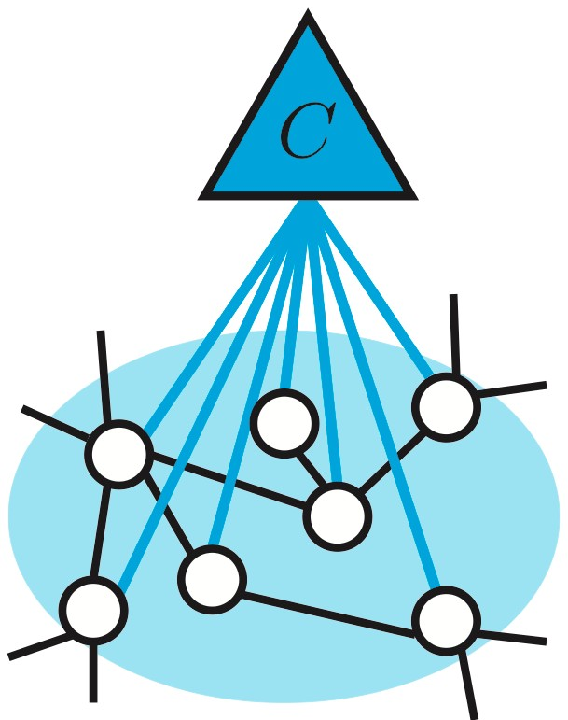
SubGNN: Overview
Marinka Zitnik - https://zitniklab.hms.harvard.edu - March 11, 2021
Part 1: Hierarchically propagate messages in 𝐺:
  Propagate messages from anchor patches to
subgraphs
Aggregate information from subgraphs
Aggregate messages into a final subgraph embedding
Neural
Messages
Part 2: Route messages through 3 channels to capture subgraph topology: position, neighborhood, structure
𝑗
𝑖
Aggregate information from neighbors
Subgraph Neural Networks, NeurIPS 2020

Slide 31
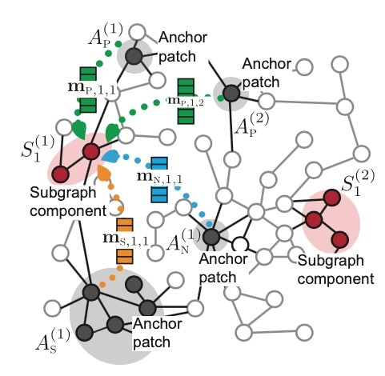

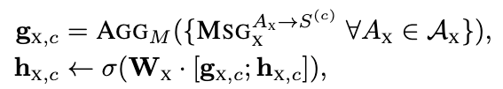
#1: Subgraph Message Passing
Marinka Zitnik - https://zitniklab.hms.harvard.edu - March 11, 2021
Property 𝑥-specific messages 𝑚# are propagated from anchor patches to subgraph components
Anchor patches are helper subgraphs randomly sampled from 𝐺; patches 𝐴$, 𝐴%, and 𝐴" for position, neighborhood and structure
similarity function between subgraph
component and an anchor patch
property-specific representation of subgraph component at the previous layer that gets updated
Subgraph Neural Networks, NeurIPS 2020

Slide 32
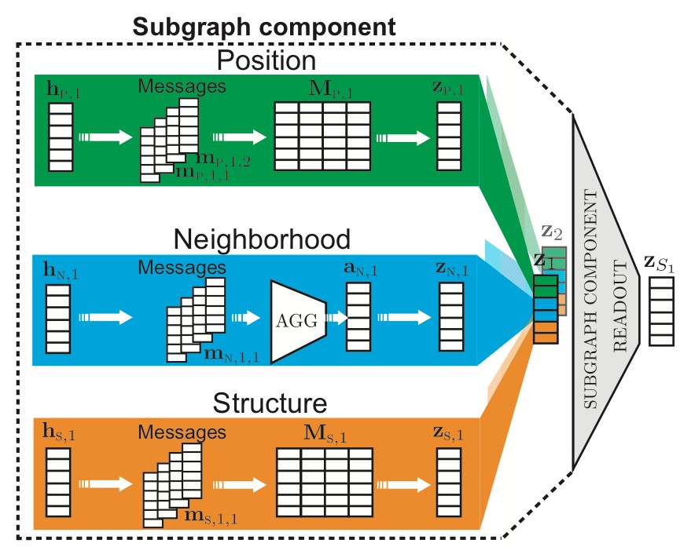
#2: Property-aware Routing
Marinka Zitnik - https://zitniklab.hms.harvard.edu - March 11, 2021
SubGNN specifies three channels for position, neighborhood, and structure
Each channel 𝑥 has three key elements:
§
Similarity function 𝛾!: 𝑆 " , 𝐴! →
[0,1] to weigh messages exchanged between patches and subgraph components
Anchor patch sampling function
𝜑!: 𝐺, 𝑆 " → 𝐴! to sample patches from underlying graph
Anchor patch encoder 𝜓!: 𝐴! →
𝑎! to encode patches into embeddings 𝑎!
These functions can be learned or pre-defined
Subgraph Neural Networks, NeurIPS 2020

Slide 33
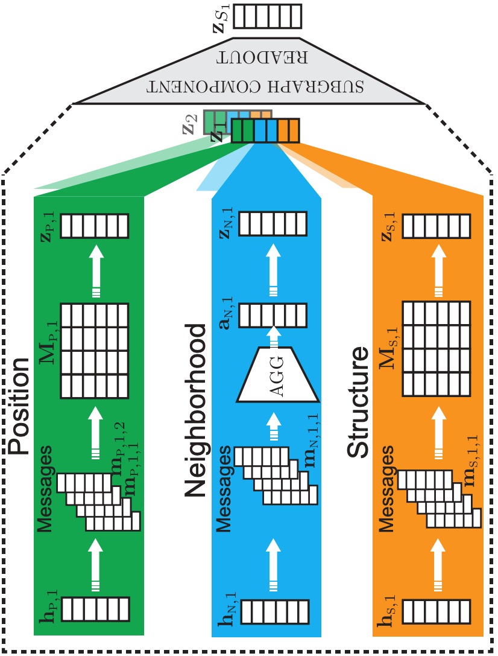
SubGNN: Recap
Channel outputs 𝒛% are concatenated to produce a final subgraph representation 𝒛_{𝑺}
Marinka Zitnik - https://zitniklab.hms.harvard.edu - March 11, 2021
Aggregate information from subgraphs
Neural
Messages
𝑗
𝑖
Aggregate information from neighbors
Subgraph Neural Networks, NeurIPS 2020

Slide 34
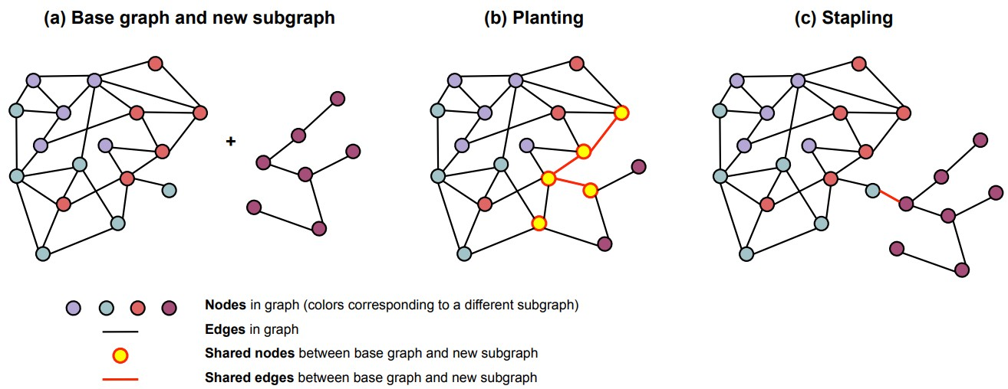
Setup: Subgraph Datasets
Marinka Zitnik - https://zitniklab.hms.harvard.edu - March 11, 2021
Subgraph labels: Binned values of a metric act as subgraph labels
Metrics:
DENSITY tests if a method can capture the internal structure of subgraphs
CUT RATIO tests if a method can capture border structure
CORENESS tests if a method can capture border structure and position
COMPONENT tests if a method can capture internal and external position

Slide 35
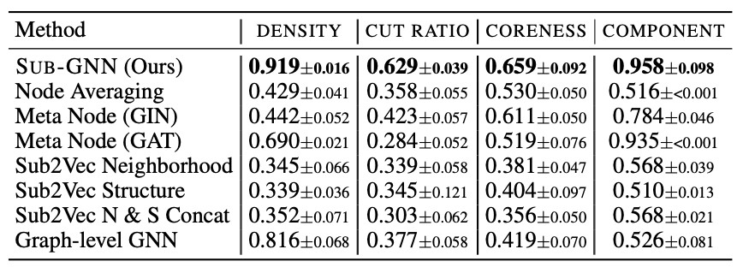
Results: Synthetic Data
Marinka Zitnik - https://zitniklab.hms.harvard.edu - March 11, 2021
Conclusion: SubGNN can capture well different aspects of subgraph topology (position, neighborhood, structure)
Shown are Micro-F1 scores + std across 100 runs
SubGNN outperforms baselines by 75.4%; the strongest baseline by 17%
Graph classification (GC) methods:
  perform quite well on DENSITY (internal structure), as expected
  perform poorly on datasets requiring a notion of position or border connectivity
Meta-node methods:
  perform well on COMPONENT dataset

Slide 36
Real-World Datasets
Marinka Zitnik - https://zitniklab.hms.harvard.edu - March 11, 2021
Four real world datasets
Each consists of a base graph and subgraphs with associated labels
  HPO-METAB and HPO-NEURO are clinical diagnostic tasks
  They ask the following: What is the subcategory of metabolic/neurological disease consistent with the phenotypes (i.e., phenotype subgraph)?

Slide 37
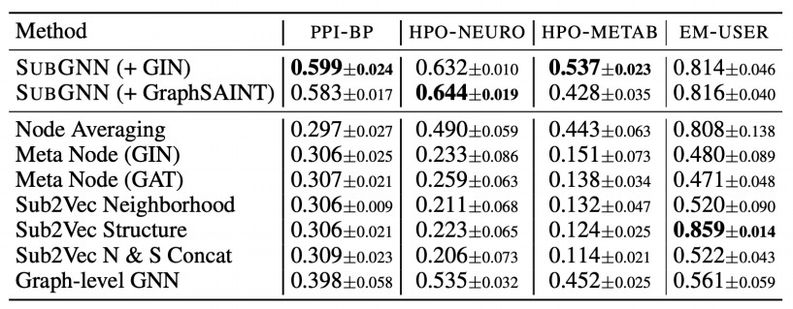
Results: Real-World Datasets
Marinka Zitnik - https://zitniklab.hms.harvard.edu - March 11, 2021
SubGNN outperforms baselines by an average of 77% on synthetic and 125% on real-world datasets
SubGNN channels encode their intended properties
Standard deviations from runs with 10 random seeds

Slide 38
Plan for Today
Marinka Zitnik - https://zitniklab.hms.harvard.edu - March 11, 2021
Safe drugs and drug combinations
Methods: Multi-relational link prediction on KGs
Patient outcomes & disease classification
Methods: Subgraph embeddings
Effective disease treatments
Methods: Few-shot learning for graphs

Slide 39

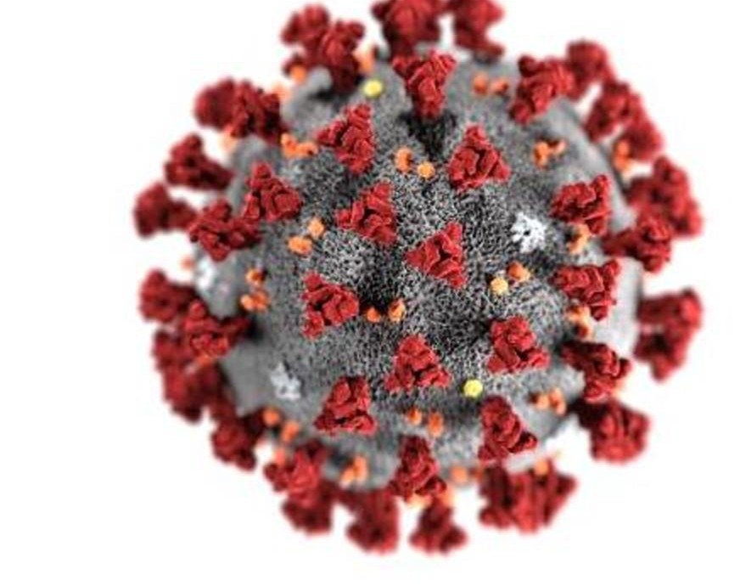


Finding Cures for Emerging Diseases
Marinka Zitnik - https://zitniklab.hms.harvard.edu - March 11, 2021
The traditional approach of iterative development, experimental testing, clinical validation, and approval of new drugs are not feasible.
A more realistic strategy relies on drug repurposing, requiring us to identify clinically approved drugs that have a therapeutic effect in COVID-19 patients.
Network Medicine Framework for Identifying Drug Repurposing Opportunities for Covid-19, arXiv:2004.07229
39

Slide 40
Marinka Zitnik - https://zitniklab.hms.harvard.edu - March 11, 2021
40

Slide 41




What drug treats what disease?
Drugs Diseases
Marinka Zitnik - https://zitniklab.hms.harvard.edu - March 11, 2021
Goal: Predict what diseases a new molecule might treat
?
?
“Treats” relationship
Unknown drug-disease relationship
?
40

Slide 42


Why is finding treatments for a new disease challenging?
Marinka Zitnik - https://zitniklab.hms.harvard.edu - March 11, 2021
Generalizing to new phenomena is hard:
Prevailing methods require abundant label information
However, labeled examples are scarce
Examples: Novel drugs in development, emerging diseases, rare diseases, hard-to-diagnose patients
What prevailing methods assume
What happens in real world
40

Slide 43

Background: Meta Learning
Marinka Zitnik - https://zitniklab.hms.harvard.edu - March 11, 2021
Meta-learning model
  Trained over a variety of learning tasks
  Optimized for best performance on a distribution of tasks, including potentially unseen tasks
Each task is associated with a dataset 𝐷, containing both feature vectors and true labels
The optimal model parameters are:
It looks very similar to a normal learning task,
but one dataset is considered as one data sample
40

Slide 44

Background: Few-Shot Learning
Marinka Zitnik - https://zitniklab.hms.harvard.edu - March 11, 2021
Meta-Training
At test time, we need to^{M}b^{e}u^{t}iªld^{-T}a^{e}“^{s}d^{ti}u^{n}c^{g}k vs. dolphin vs. chicken” classifier. However, we only 2 examples of ducks, 2 examples of dolphins, and 2 examples of chicken!
Few-shot learning makes this possible.
Goal: How to make predictions on a new graph or a new label set when we have only a handful of labels?
An example of 2-shot 3-way image classification
Few-shot learning: Instantiation of meta learning in the field of supervised learning
K-shot N-class classification: K labeled examples for each of N classes
44

Slide 45


Problem Formulation: G-Meta
Marinka Zitnik - https://zitniklab.hms.harvard.edu - March 11, 2021
Meta-learner needs to classify an unseen label set by observing other label sets in the same graph
Each task is a batch of a few nodes/edges from a different label set in the same graph
Graph Meta Learning via Local Subgraphs, NeurIPS 2020
45

Slide 46
G-Meta: Overview
Marinka Zitnik - https://zitniklab.hms.harvard.edu - March 11, 2021
Meta-Training
Meta-Testing
Node 1 Node 2 Node 3
Node 4 Node 5 Node 6
Node 7
Node 8 Node 9
Node 13 Node 14 Node 15
Node 16 Node 17 Node 18
Node 10 Node 11 Node 12
Node a Node b Node c
Node d Node e Node f
Node g Node h
Node i
Label set 1
Label set 2
Label set 3
~
single graph
46

Slide 47

Key Idea: Local Subgraphs
Marinka Zitnik - https://zitniklab.hms.harvard.edu - March 11, 2021
Neural routing across subgraphs (not entire graphs!)
Subgraph signature functions learn how to map the structure of a sampled subgraphs to an effective initialization for a GNN
We consider a distribution over subgraphs as the distribution over tasks from which a global set of parameters are learnt
Deploy this strategy to train GNNs few-shot link prediction
G-Meta: Subgraph signature functions
Extract subgraphs that enclose labels
Apply GNN to each subgraph individually
Graph Meta Learning via Local Subgraphs, NeurIPS 2020
47

Slide 48

What is the value of subgraphs?
Marinka Zitnik - https://zitniklab.hms.harvard.edu - March 11, 2021
Query subgraph embedding
Two sources of GNN power:
Support subgraph
embedding
Label propagation: Nodes with the same label are nearby in the graph
Structure similarity: Nodes with the same label have similar network shapes in their local neighborhoods
When labels are scarce:
  Label propagation is not sufficient
    When only a handful of nodes are labeled, it is challenging to efficiently propagate labels through the entire graph
    Graph-level embeddings cannot capture structure of large graphs
  Need to better leverage structural equivalence
    Local subgraphs capture structural information
    G-Meta learns a metric to classify query subgraph using the closest point from the support set [It compares query subgraph embedding to the support subgraph embedding]
Graph Meta Learning via Local Subgraphs, NeurIPS 2020

Slide 49


Theoretical Motivation for G-Meta
Marinka Zitnik - https://zitniklab.hms.harvard.edu - March 11, 2021
The influence of a node on the target node decays exponentially as we go further away from the target
TL;DR:
Local subgraphs around target nodes contain all the relevant information
Local subgraphs preserve near the same feature information as the entire graph
High Influence
v
u
Low Influence
v
u
Graph Meta Learning via Local Subgraphs, NeurIPS 2020

Slide 50

COVID-19 Repurposing Dataset
Marinka Zitnik - https://zitniklab.hms.harvard.edu - March 11, 2021
How to represent COVID-19? Network neighborhood of human PPI network targeted by SARS-CoV2 virus
Viral Disease Module: Gordon et al., Nature 2020 expressed 26 of the 29 SARS-CoV2 proteins and used AP-MS to identify 332 human proteins to which viral proteins bind
Network Medicine Framework for Identifying Drug Repurposing Opportunities for Covid-19, arXiv:2004.07229

Slide 51

Results: Embedding Space
Marinka Zitnik - https://zitniklab.hms.harvard.edu - March 11, 2021
Network Medicine Framework for Identifying Drug Repurposing Opportunities for Covid-19, arXiv:2004.07229

Slide 52

Results: COVID-19 Repurposing
Marinka Zitnik - https://zitniklab.hms.harvard.edu - March 11, 2021
B
Individual ROC
We test each pipeline’s ability to recover drugs currently in clinical trials for COVID-19 (67 drugs from ClinicalTrials.gov).
The best individual ROC curves are obtained by the AI-based methods.
The second-best performance is provided by the proximity P3. Close behind is P1 with AUC = 0.68 and AUC = 0.58.
Diffusion methods offer ROC between 0.55-0.56.
True positive rate
False positive rate
Network Medicine Framework for Identifying Drug Repurposing Opportunities for Covid-19, arXiv:2004.07229

Slide 53



Results: Experimental Validation of
Marinka Zitnik - https://zitniklab.hms.harvard.edu - March 11, 2021
Predictions
Ranked lists of drugs
New algorithms:
Prioritizing Network Communities, Nature Communications 2018
Subgraph Neural Networks, NeurIPS 2020
Graph Meta Learning via Local Subgraphs, NeurIPS 2020
Results: 918 compounds screened for their efficacy against SARS-CoV-2 in VeroE6 cells:
77 showed strong/weak effect being active over a broad range of concentrations
An order of magnitude higher hit rate among top 100 drugs than prior work
National Emerging Infectious Diseases Laboratories (NEIDL)
Network Medicine Framework for Identifying Drug Repurposing Opportunities for Covid-19, arXiv:2004.07229

Slide 54


Results: Network Drugs
Marinka Zitnik - https://zitniklab.hms.harvard.edu - March 11, 2021
76/77 drugs that successfully reduced viral infection
do not bind proteins targeted by SARS-CoV-2:
  These drugs rely on network-based actions that cannot be identified by docking-based strategies
Direct target drugs (D1-2)
58/77 drugs with positive experimental outcome are among top 750 ranked drugs
Network drugs (D3)

Slide 55



Transfer Learning Across Graphs:
_{Brief v}M_{i}ar_{g}ink_{n}a Z_{e}itn_{t}ik_{t}-_{e}https_{i}:_{n}//zi_{t}tn_{o}iklab_{c}.hm_{r}s_{o}.ha_{s}rv_{s}ard₋.e_{g}du_{r}-_{a}M_{p}arc_{h}h 11,_{l}2_{e}02_{a}1 _{rning}
Tree-of-Life Dataset
Network of an eukaryotic species
Network of a bacterial species
Motivation: How can we leverage PPI networks of model organisms to complete human PPI network?
Zitnik, Marinka, Marcus W. Feldman, and Jure Leskovec. "Evolution of resilience in protein interactomes across the tree of life." PNAS (2019): 4426-4433.

Slide 56

Problem Formulation: G-Meta
_{Brief v}M_{i}ar_{g}ink_{n}a Z_{e}itn_{t}ik_{t}-_{e}https_{i}:_{n}//zi_{t}tn_{o}iklab_{c}.hm_{r}s_{o}.ha_{s}rv_{s}ard₋.e_{g}du_{r}-_{a}M_{p}arc_{h}h 11,_{l}2_{e}02_{a}1 _{rning}
Meta-learner needs to make predictions on a new graph by learning from other graphs with the same label set
Each task is a batch of a few nodes/edges from the same label set but from a different graph
Graph Meta Learning via Local Subgraphs, NeurIPS 2020
56

Slide 57
Few-Shot Learning across Graphs
_{Brief v}M_{i}ar_{g}ink_{n}a Z_{e}itn_{t}ik_{t}-_{e}https_{i}:_{n}//zi_{t}tn_{o}iklab_{c}.hm_{r}s_{o}.ha_{s}rv_{s}ard₋.e_{g}du_{r}-_{a}M_{p}arc_{h}h 11,_{l}2_{e}02_{a}1 _{rning}
Meta-Training
Meta-Testing
Node 1 Node 2 Node 3
Node 4 Node 5 Node 6
Node 7
Node 8
Node 9
Node 13 Node 14 Node 15
Node 16 Node 17 Node 18
Node 10 Node 11 Node 12
Node a Node b Node c
Node d Node e Node f
Node g
Node h Node i
Label set 1
Label set 1
Label set 1
~ Graph 1
~ Graph 2
~ Graph 3
57

Slide 58

G-Meta: Results
_{Brief v}M_{i}ar_{g}ink_{n}a Z_{e}itn_{t}ik_{t}-_{e}https_{i}:_{n}//zi_{t}tn_{o}iklab_{c}.hm_{r}s_{o}.ha_{s}rv_{s}ard₋.e_{g}du_{r}-_{a}M_{p}arc_{h}h 11,_{l}2_{e}02_{a}1 _{rning}
G-Meta can successfully learn in challenging, few-shot learning settings: up to 29.9 % over previous works and 16.3 % over other meta learning methods
G-Meta scales to large graphs: on our new Tree-of-Life dataset comprising of 1,840 graphs, 100x increase in graph size relative to prior work
Reported is multi-class classification accuracy (five-fold average) and standard deviation. N/A means
the method does not apply.
Graph Meta Learning via Local Subgraphs, NeurIPS 2020
58

Slide 59
Plan for Today
Marinka Zitnik - https://zitniklab.hms.harvard.edu - March 11, 2021
Safe drugs and drug combinations
Methods: Multi-relational link prediction on KGs
Patient outcomes & disease classification
Methods: Subgraph embeddings
Effective disease treatments
Methods: Few-shot learning for graphs
59

