Slide 1
How to Solve NP-hard Problems in Linear Time
David Tse
Stanford University

Slide 2
Information
Theory
Computational Genomics

Slide 3


The communication problem
C.E. Shannon 1948: Figure 1
Computation:
Information:
Let’s find the
information limit first.
Maximum-likelihood decoding
is NP-hard

Slide 4
Information before computation
probability
of error
1
capacity
data rate
Capacity-achieving codes that can be efficiently decoded are
discovered (after 70 years).

Slide 5
Computational genomics
De novo genome assembly
Bresler, Bresler &T., BMC Bioinformatics, 2013.
Shomorony, Courtade &T., Bioinformatics, 2016.
Kamath, Shomorony, Xia, Courtade & T., Genome Research 2017.
De novo transcriptome assembly
Kannan, Pachter & T., 2016.
Haplotype phasing
Chen, Kamath, Suh & T., ICML 2016.

Slide 6
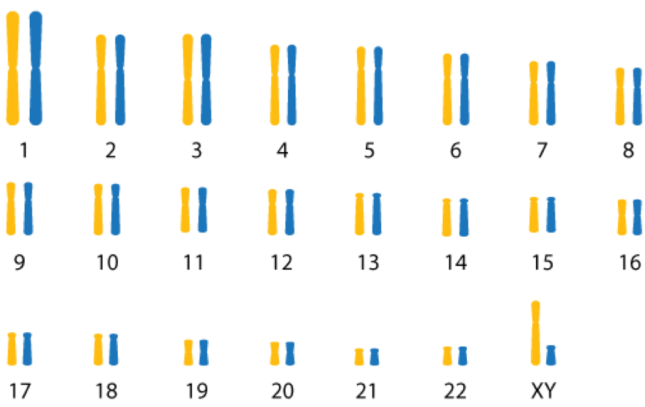
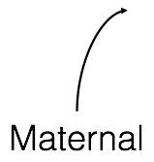
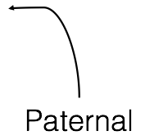
23 Pairs of Chromosome
Haplotype

Slide 7
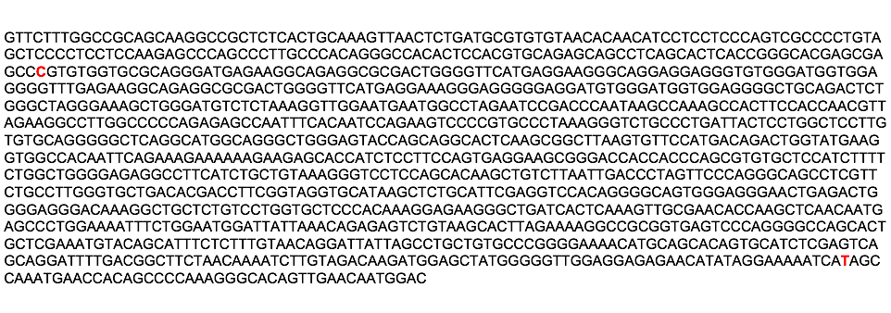

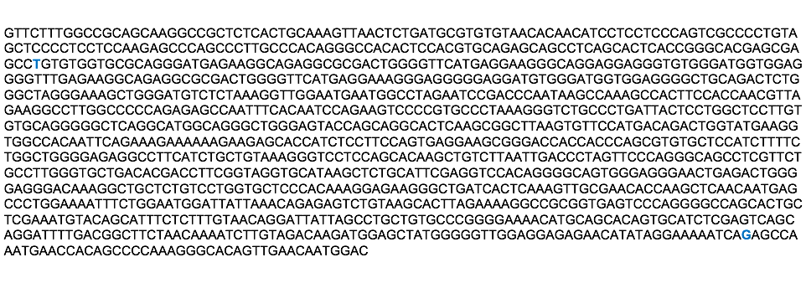
Maternal sequence
major allele
Paternal sequence
minor allele
SNP

Slide 8
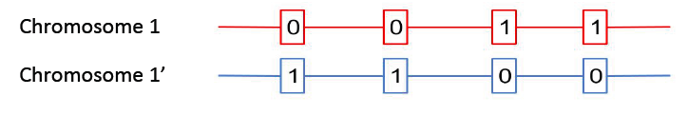
Haplotype phasing
major allele
minor allele

Slide 9
High-Throughput Sequencing
read
Read length << inter-SNP distance
Don’t know which chromosome each read comes from and
also no linking information!

Slide 10
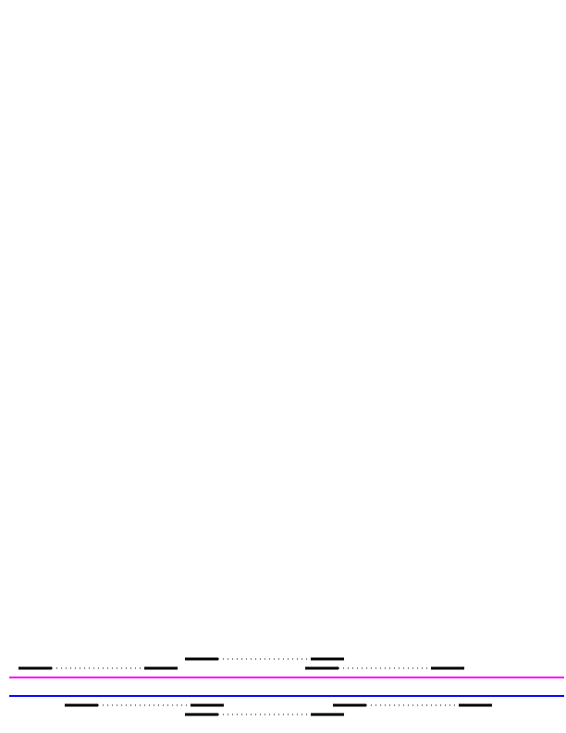
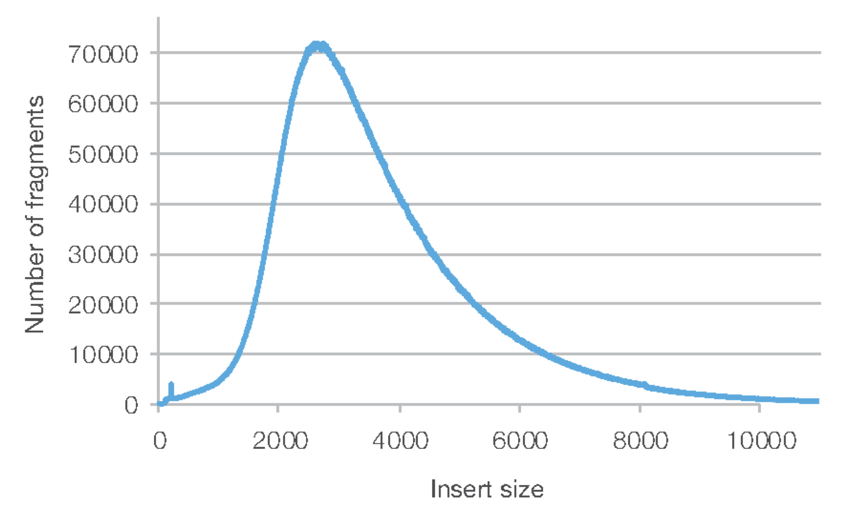
Linking Information
Some types of reads come in a pair.
mate pair reads
10X generate bar-coded reads that are 10’s to 100’s of SNPs apart.
Long reads like PacBio or ONT can also provide linking information.
each pair
a few SNPs apart

Slide 11
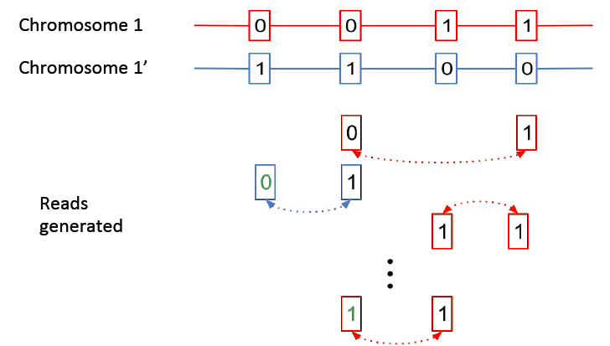
Haplotype phasing with
noisy linking reads
Each pair of linked reads gives noisy parity information.

Slide 12
Information before computation
How many reads are needed to phase reliably?
How to phase efficiently?

Slide 13
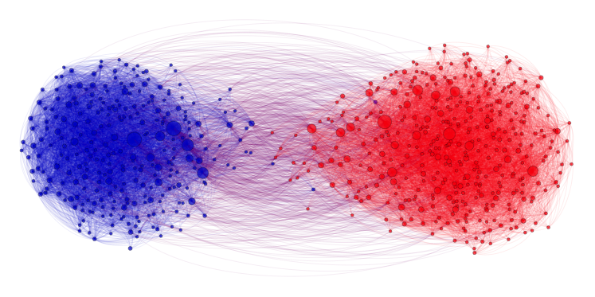
Haplotype Phasing
Community Recovery
=
Adamic & Glance 2005
Chen, Kamath, Suh, T. , “Community recovery for graphs with locality”, ICML 2016.

Slide 14
Back to Example
Community a
Community b

Slide 15
Combinatorial optimization approach
Maximum likelihood community recovery is NP-hard.
Reduction from MAXCUT.
Hajek, Wu & Xu, “Achieving Exact Cluster Recovery Threshold via Semidefinite Programming, Trans. Info. Theory, 2016.

Slide 16
Information theoretic approach
Uniform linking model:
Linking reads are equally likely to be between any pair of SNPs.
Information limit:
Optimal number of reads for phasing n >> 1 SNPs:
p = error rate
Hajek, Wu & Xu, “Achieving Exact Cluster Recovery Threshold via Semidefinite Programming, Trans. Info. Theory, 2016.

Slide 17
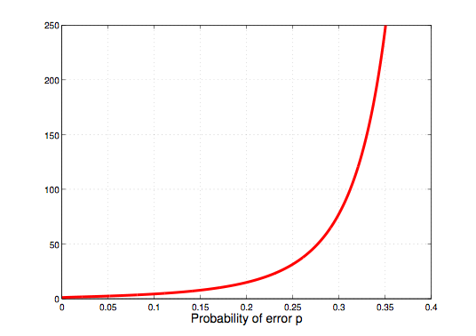
Coverage depth vs error rate

Slide 18
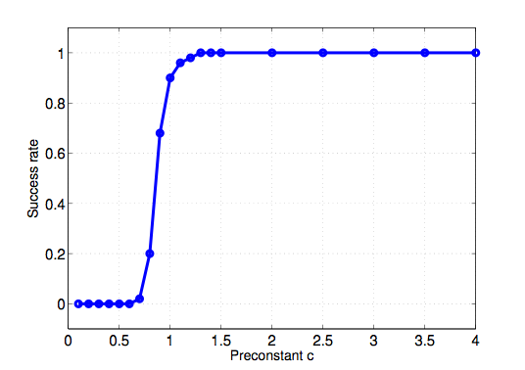
Simulations
n = 100,000 SNPs
information limit
# of reads
100 Monte Carlo runs to get each point.
Each run takes ~ 15 seconds on a Mac Air

Slide 19

Genie-aided lower bound
# of linking reads >
Suppose a genie tells you the correct community of all SNPs
except one:

Slide 20
Efficient approximate recovery
Community a
Community b
a
b
a
b

Slide 21
Two-step Algorithm
Step I: approximate recovery using spectral algorithm.
Step II: refinement using majority vote for each SNP.

Slide 22
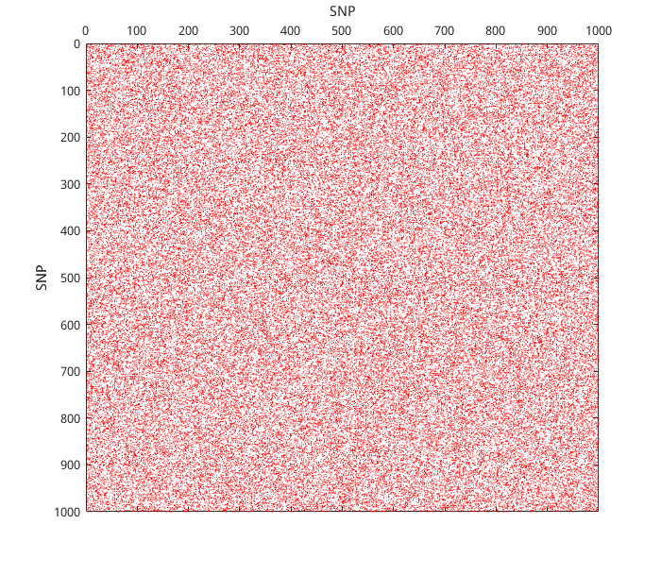
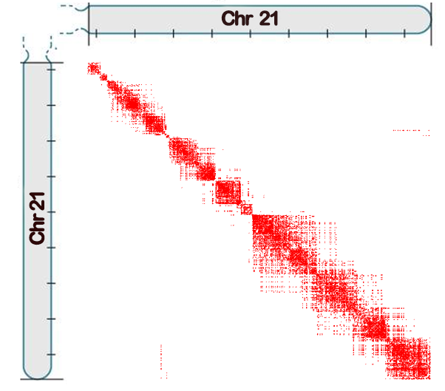
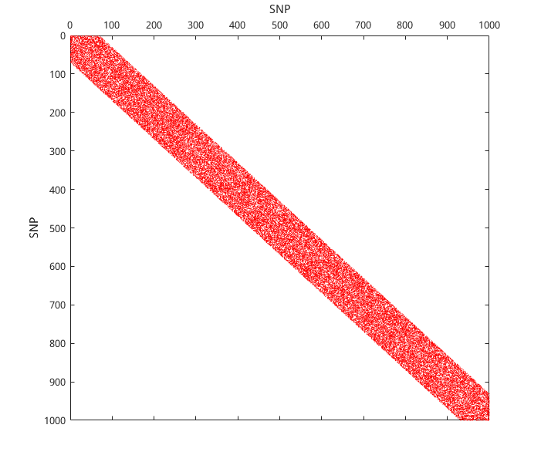
Contact maps
uniform linking
model
10X data
Zheng et al, Nature Biotech, 2016
local linking
model
Chen et al, ICML, 2016

Slide 23
Spectral-Stitching Algorithm
Step I: approximate recovery on overlapping blocks
via the spectral algorithm
Step II: stitching across blocks

Slide 24
Spectral-Stitching Algorithm
Step I: approximate recovery on overlapping blocks
via spectral algorithm.
Step II: stitching across blocks
Step III: refinement using majority vote for each SNP

Slide 25
Evaluation on 10X data
Deligiannis, Jiang, Zhu & T.
Dataset: NA12878_WGS
4 metrics:
# of unphased SNPs
N50 of phased blocks
short switch error rate
long switch error rate
Zheng et al, Nature Biotech, 2016

Slide 26
N50 of phased blocks
50% SNP
Chromosome
Phased blocks
N50

Slide 27
Switch errors within a phased block
Short switch error
Long switch error
Output
0
0
0
0
1
0
0
0
Ground truth
0
1
0
1
0
1
1
1

Slide 28
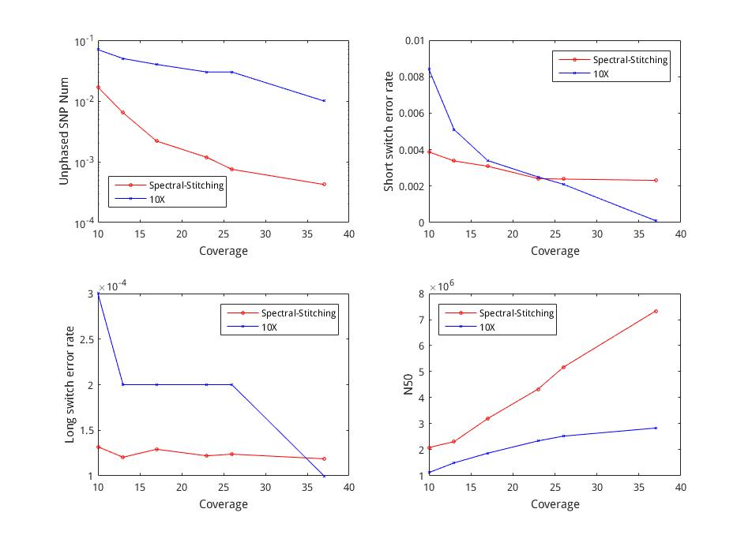

Slide 29
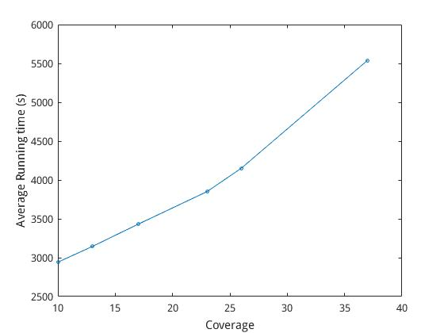
Runtimes of spectral stitching
Single core Intel i7-5500U CPU @ 2.40GHz

Slide 30
Conclusion
Many computational genomics problems have NP-hard combinatorial optimization formulation.
But often there are efficient alternatives to get to the information limit.
Haplotype phasing is a case study.
Optimality on theoretical models translates to benefits on real data.

