Slide 1
MM Bus Ticket

Slide 2
Background: MM Bus Ticket (MBT)
B2B platform for coach bus operators to sell and manage seat inventory for inter-city trips
Accessed by bus operators & travel agents
MBT does not operate its own buses
Market leader by transaction volume (i.e. tickets sold) and value
2018:
~ 4.4m transactions
~ 7.1m seats sold

Slide 3
Transaction sources
Direct (B2C)
50+ bus operators
Indirect
(B2B)
mmbusticket.com
Mobile wallets
Wave Money
KBZPay
MAB
CBPay
Travel agents

Slide 4
Why this project? → Opportunity to…
work with a real dataset
97 tables
11.9m rows, 62 attributes in just one of the main tables
experience “going in blind” to work with existing set-up
no data dictionary or ER diagram
provide new business insights
simplistic dashboards only for day-to-day operational needs
little to no further analysis of data

Slide 5
Objective
Business objective:
What are the best performing routes to consider if MBT wants to start running buses?
Data Science problem:
What are the top 10 routes by volume of ticket sales?
What are the best predictors for ticket sales?

Slide 6
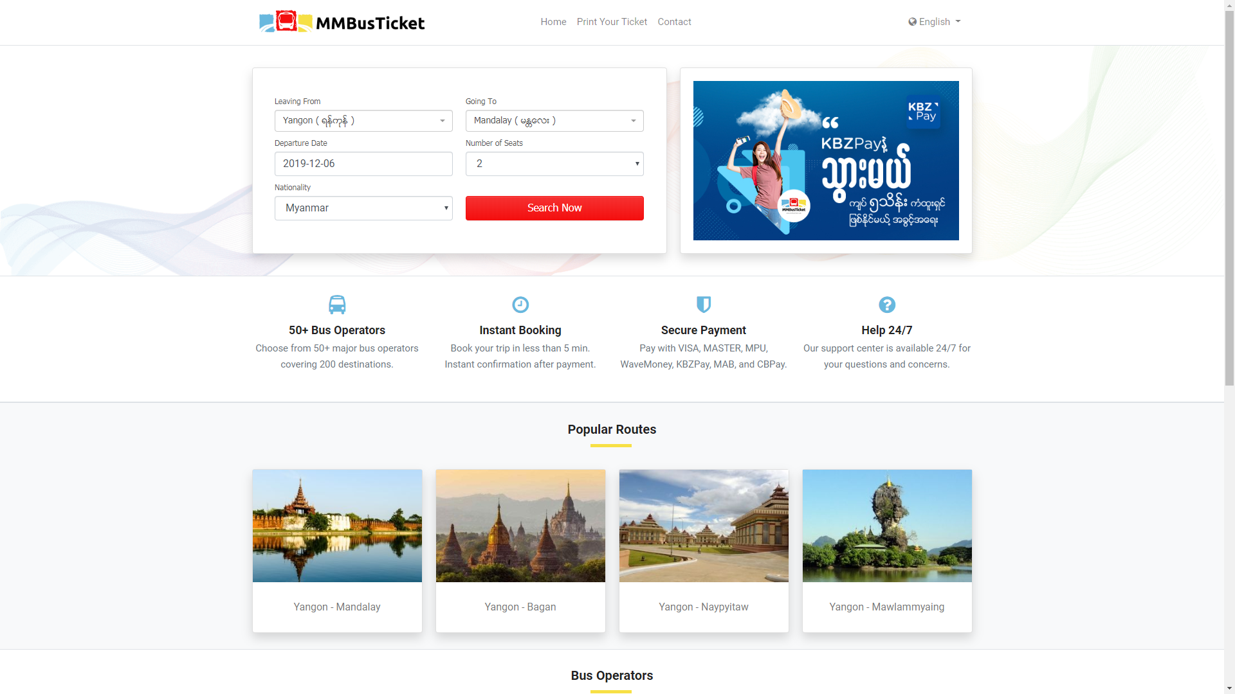

Slide 7
EDA + Pre-processing

Slide 8
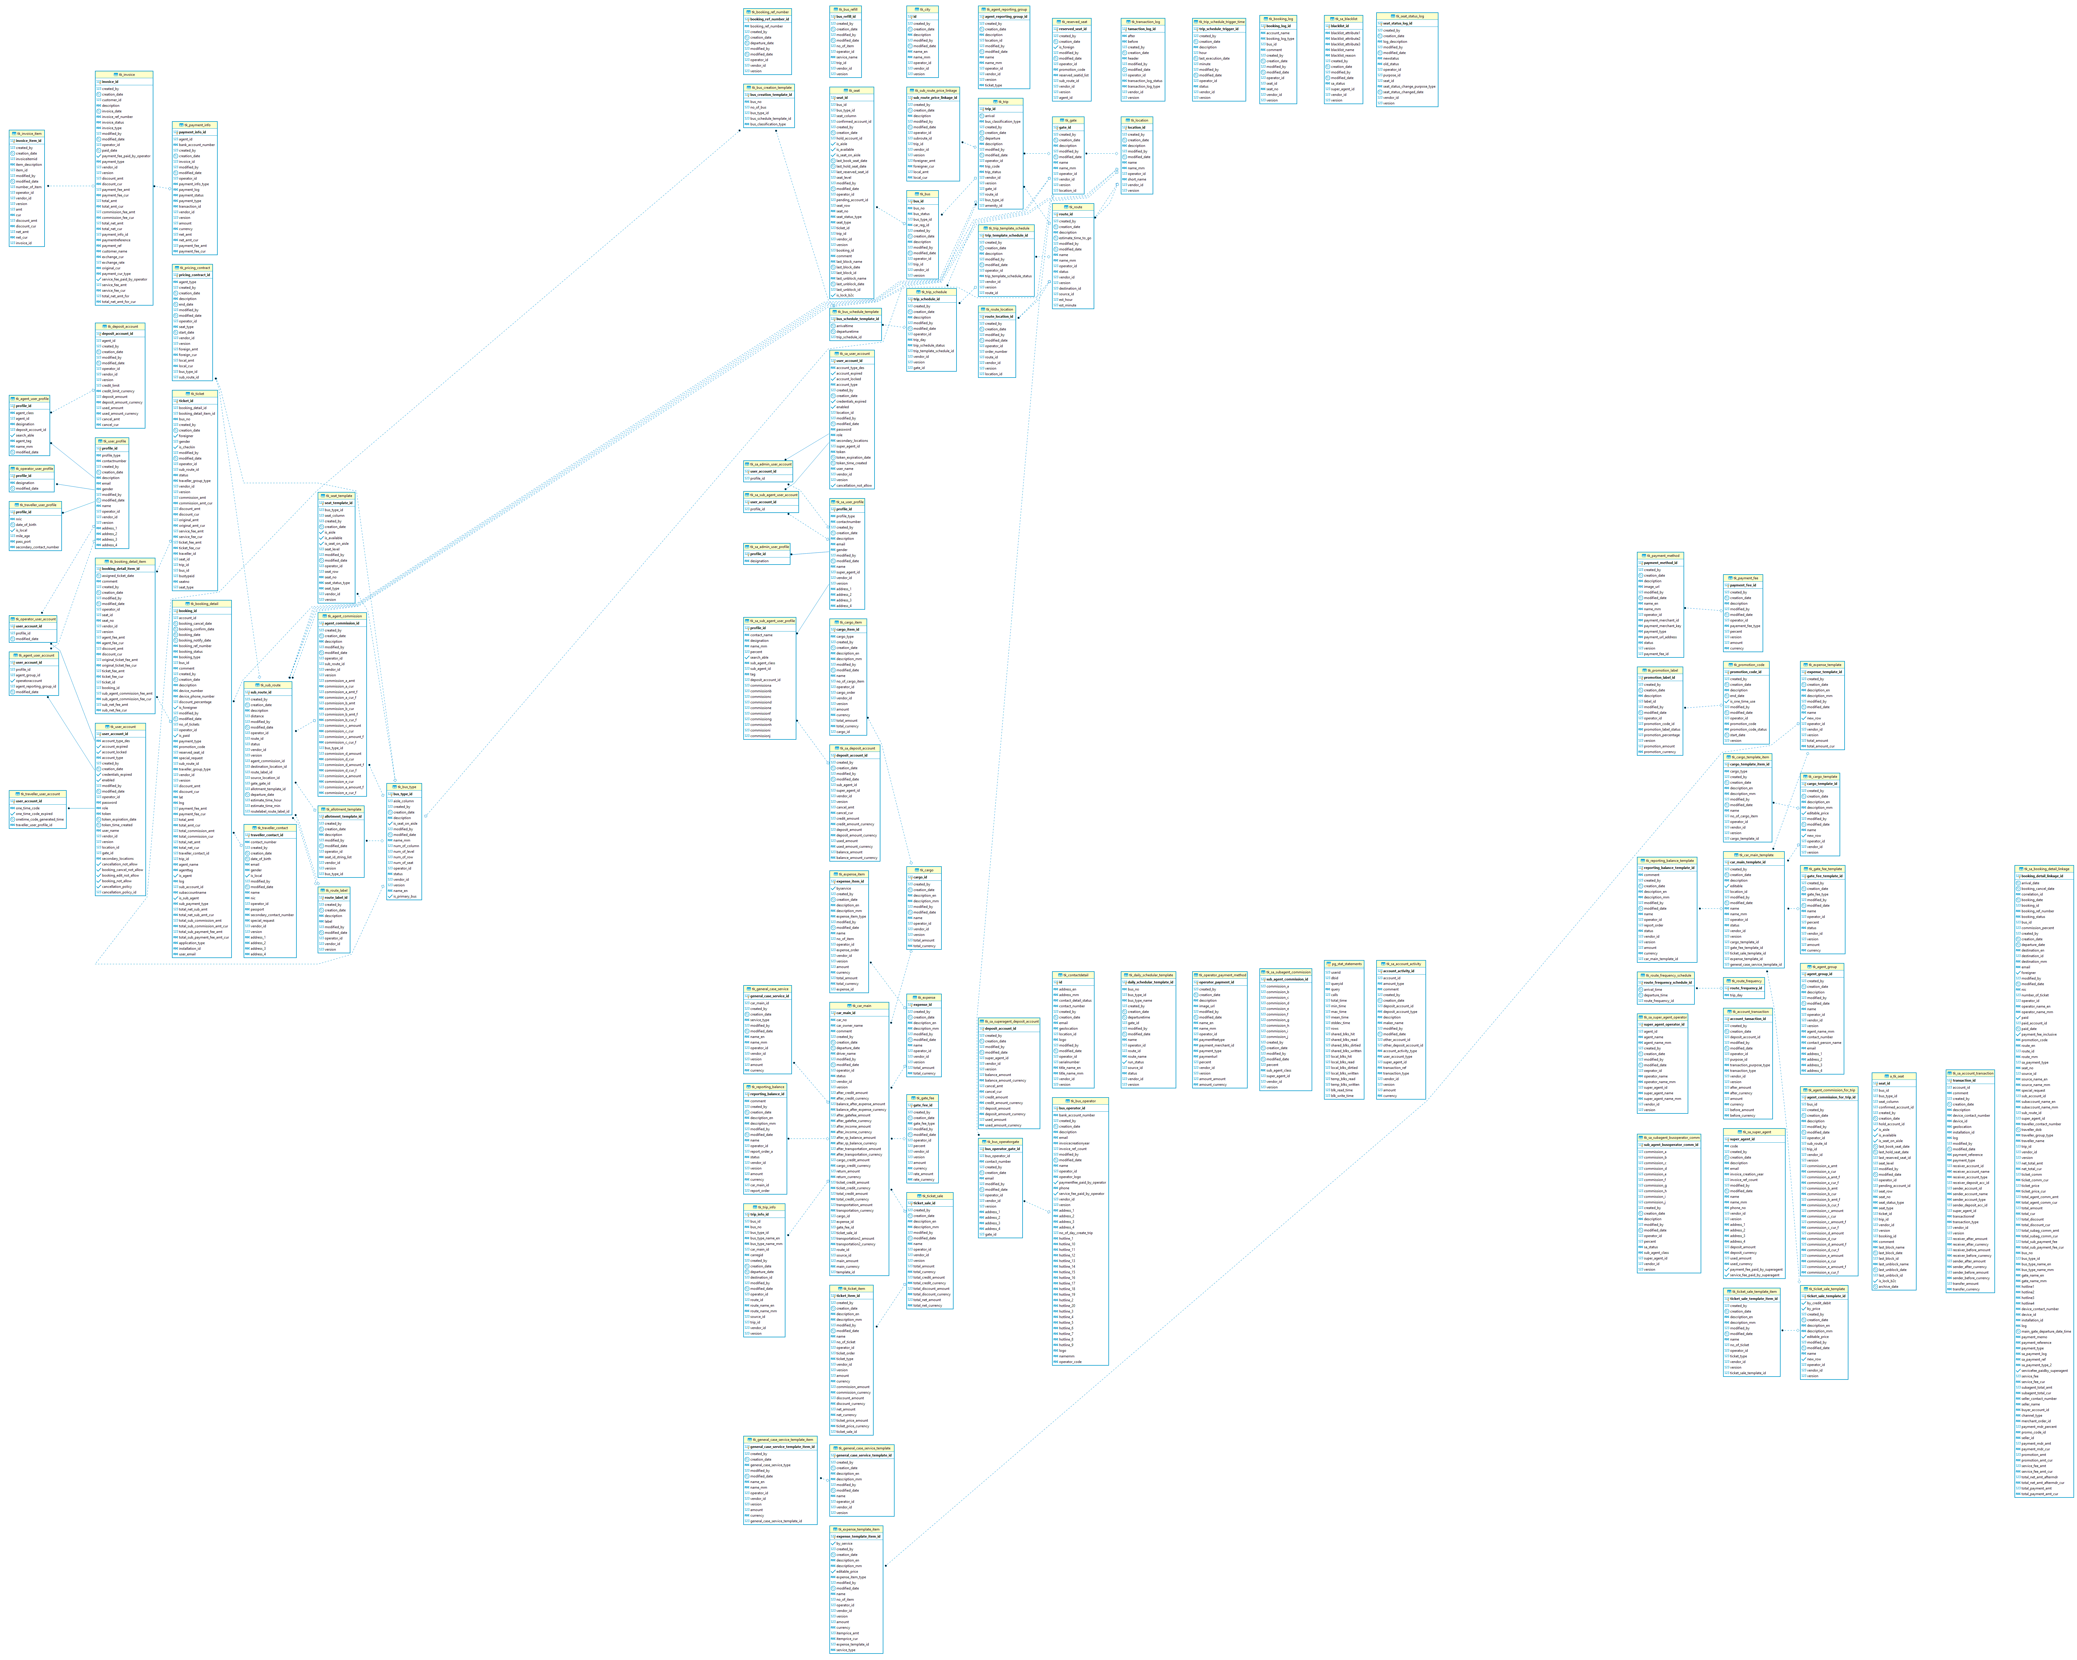
Started with
97 tables
explored
tk_ticket
tk_booking_detail
tk_booking_detail_item
tk_trip
tk_route
tk_subroute
tk_location
tk_bus_type

Slide 9
Challenges
lack of ER diagram and data dictionary
~two weeks just to understand dataset
unable to discuss face-to-face (client is based in Burma)
lag time waiting for one another’s replies
assumptions made not always correct

Slide 10
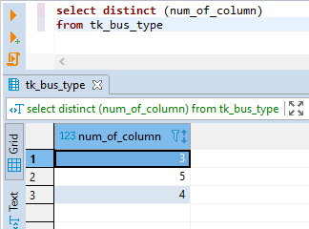
Challenges
business logic unfamiliar / not-intuitive
local norms
arbitrary decisions
E.g. seat occupancy not tracked for multi-stop journeys
E.g. no seat categories, only bus categories based on seat layout
1 + 1
1 + 2
2 + 2

Slide 11
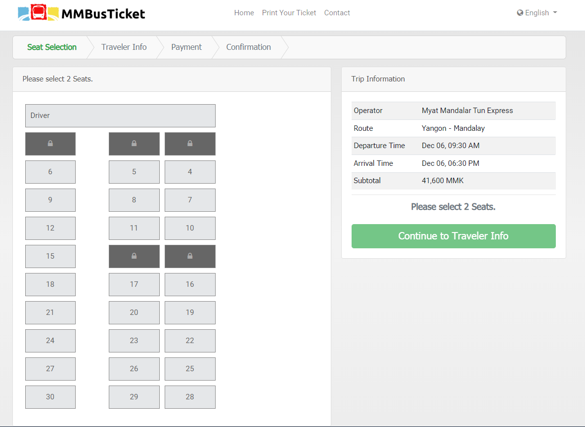
Challenges
business logic unfamiliar / not-intuitive
local norms
arbitrary decisions
E.g. seat occupancy not tracked for multi-stop journeys
E.g. no seat categories, only bus categories based on seat layout
1 + 1
1 + 2
2 + 2

Slide 12
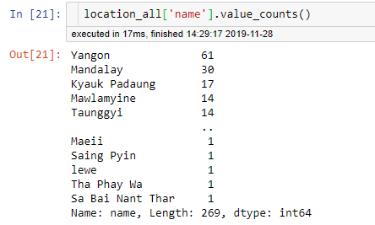
Challenges
short-term, operations-focused data decisions
Typos, duplicates
tk_locations, tk_subroutes etc subject to whim of bus operators
→ unable to run analysis easily
'Inle'
'Shwe Nyaung’
'Shwe Nyaung(Inle)'
'ShweNyaung(Inle)'

Slide 13
Process
Generate ER diagram using DBeaver
Explore data
Clarify data
Clean data
Join tables for analysis
Discover more anomalies

Slide 14
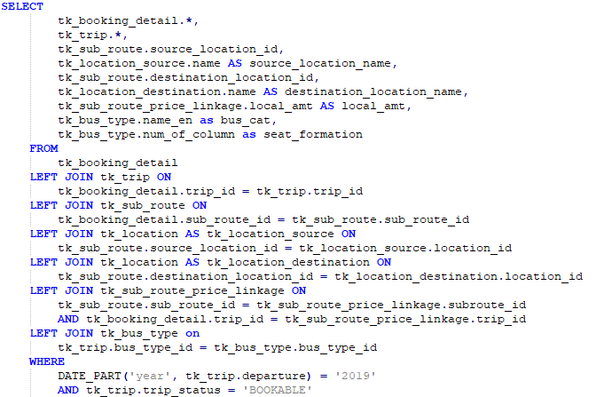
Working dataframes
7 tables
2018 (train + val) 4,364,693 x 87
2019 (test) 4,321,920 x 87

Slide 15
Feature engineering
Consolidated location names
Created subroute names
Created granular datetime features
e.g. hour of departure, month of trip, duration
Derived bus_class
Binned hour of departure into depart_period
morn, aft, night

Slide 16
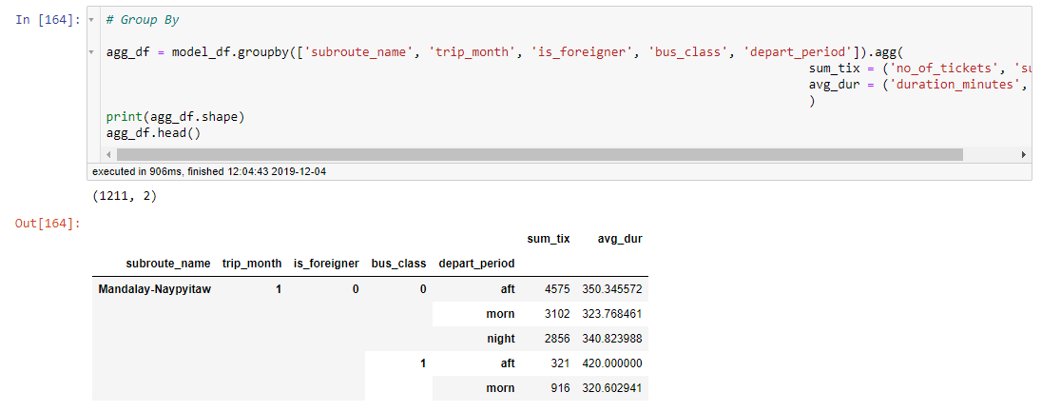
Feature engineering
one-hot-encoding on subroute_name and depart_period

Slide 17
Preliminary analysis

Slide 18
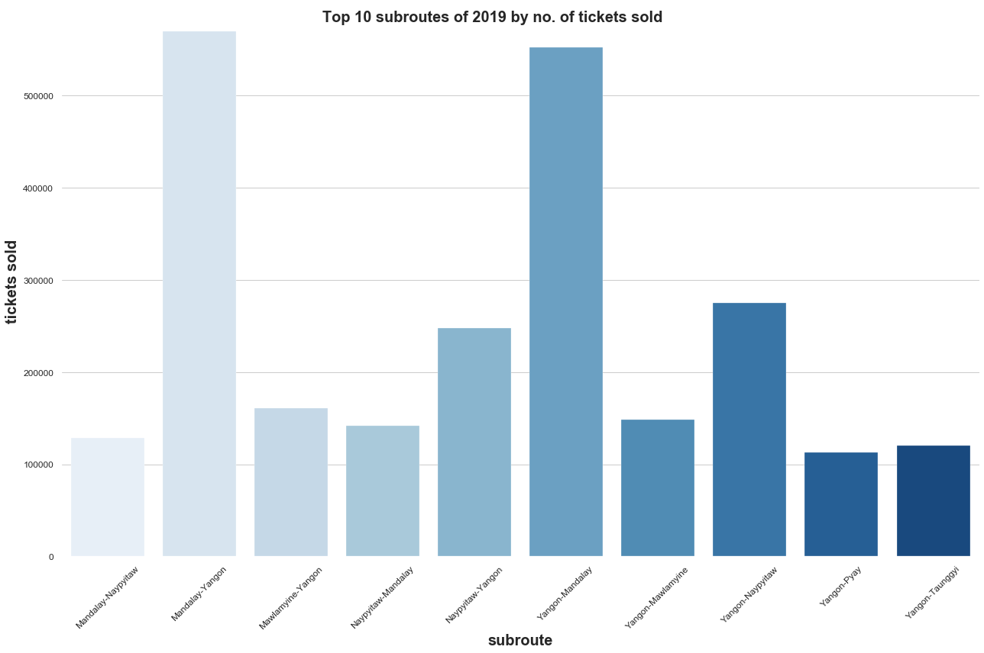

Slide 19
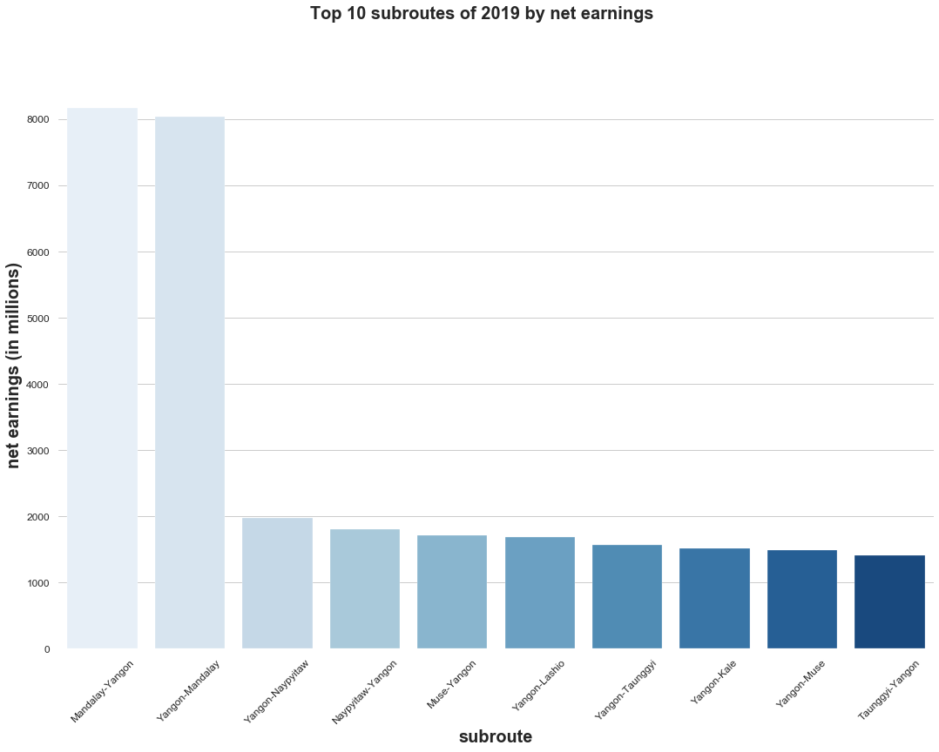

Slide 20
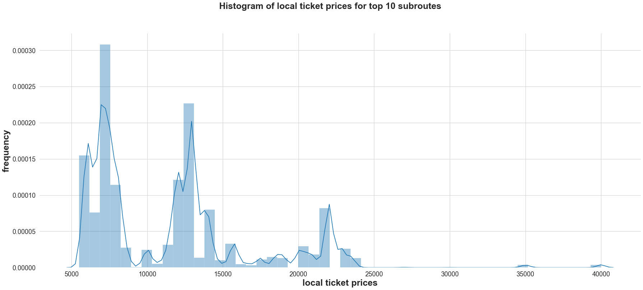

Slide 21
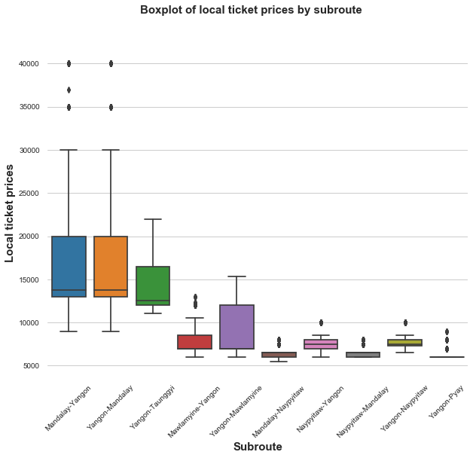
Premium + Biz class buses
predominantly ply
Yangon-Mandalay routes

Slide 22
Models tried
Linear Regression
Lasso (dropped features that had zero-ed coefficients)
Polynomial Features
Random Forest Regressor
Decision Tree Regressor (to interpret data)

Slide 23
Models tried
}
Linear Regression
Lasso (dropped features that had zero-ed coefficients)
Polynomial Features
Random Forest Regressor 0.861, {'max_depth': 8, 'n_estimators': 100}
Decision Tree Regressor 0.8278 {'max_depth': 6}
R^{2 :} 0.2 – 0.6

Slide 24
Top 3 predictors
is_foreigner [0: local; 1: foreigner]
bus_class [0: economy, 1: premium, 2: business]
avg_dur [average duration of journey]

Slide 25
Top 3 predictors
is_foreigner <= 0.5
bus_class <= 0.5
bus_class <= 0.5
depart_period_night <= 0.5 (morn / aft)
subroute_name_Naypyitaw-Yangon <= 0.5
avg_dur <= 523.15 (8 2/3h)
avg_dur <= 515.90 (~8.5h)
local
foreigner
economy
premium
or biz
economy
premium
or biz

Slide 26
What’s next
Examine seasonality of data
Predict when a trip would hit 80% occupancy → trigger marketing campaign
Further analysis
How do local ticket sales fluctuate across the year?
How do foreigner ticket sales fluctuate across the year?
What are the peak months?
Which time periods are more popular?
Experiment with creating a cleaning/pre-processing pipeline for visualisation on Tableau

