Slide 1

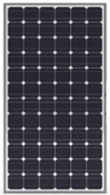

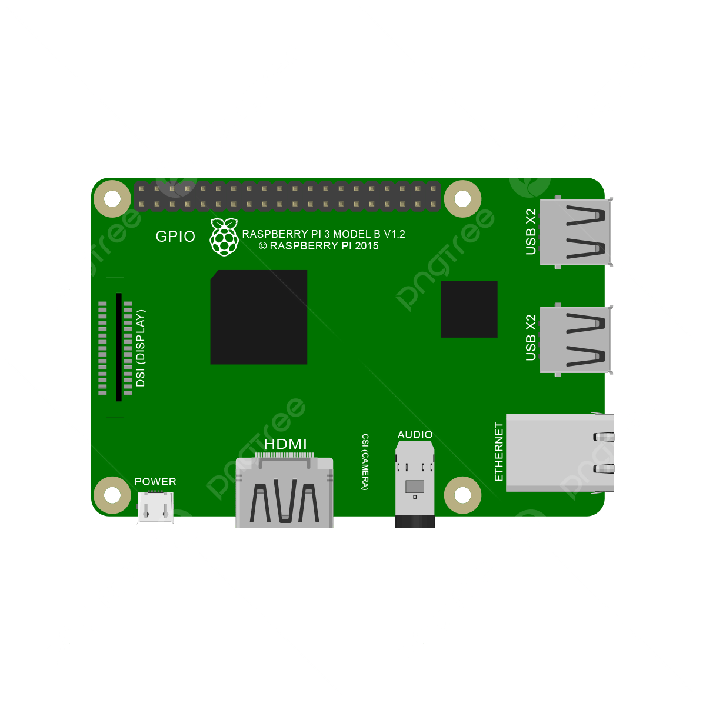

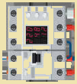







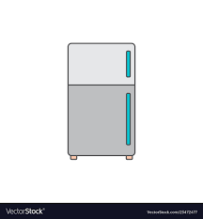



eRouter - Model I：Smart Panel
Controller
1
BOX
Software Defined EMS
2
4
Home Assistant
Panel
Micro
Inverter
Virtual
Power
Plant
Home Automation Platform
3
5
Hybrid
BMS
ESPHome
Notes:
HomeGrid_Standardization_Initiative, 2024-08-28

