Slide 1

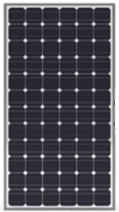

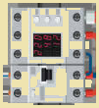

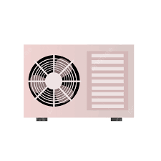
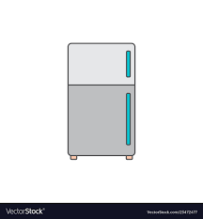


Generation
Energy Management
Grid
CCU
Central
Control
Unit
Micro
Inverter
Smart
Meter
AC Bus
Smart
Plug
Smart
Plug
Smart
Electric
Panel
PCS
Resource
Manager
BMS
ESS:
Power
Station
...
Consumption
Air
Conditioner
EV
Charger
Storage
Refrigerator
Notes:
2024-04-18

Slide 2
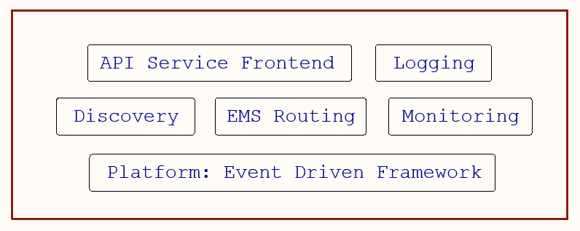
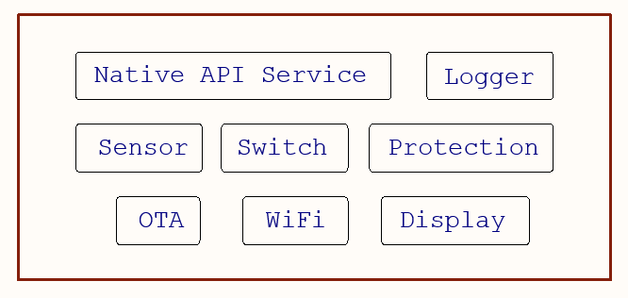
Energy Management
CCU
Central
Control
Unit
Micro
Inverter
Smart Devices
PCS
Resource
Manager
BMS
ESS:
Power
Station
...
Notes:
2024-04-18

