Slide 1

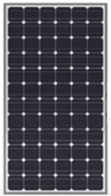

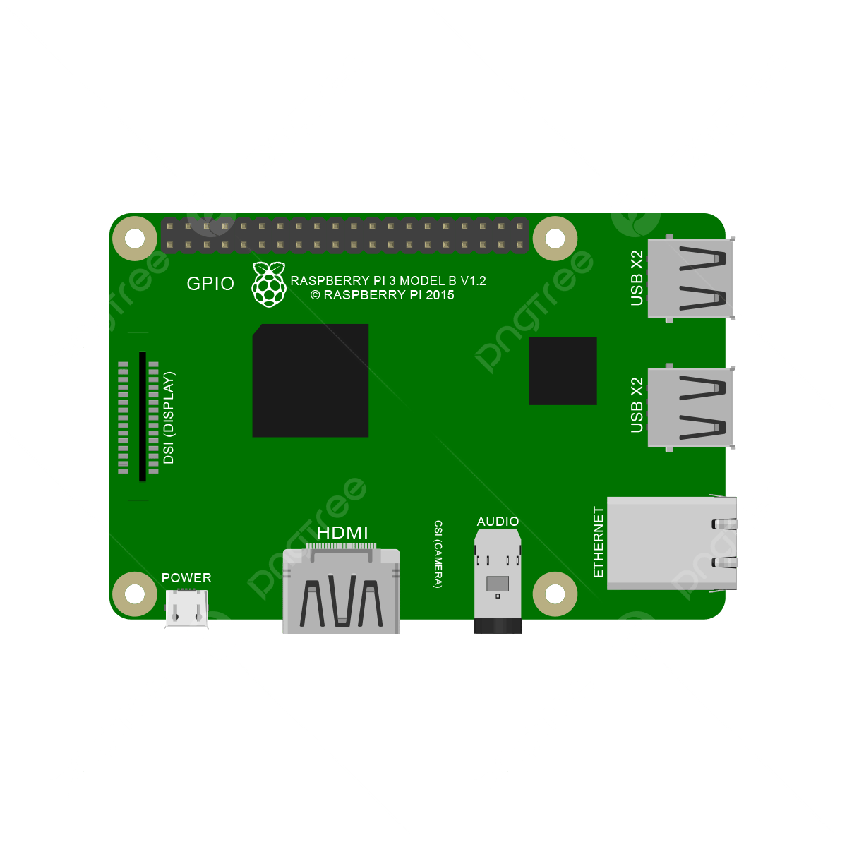

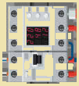











eRouter - Model I (Smart Panel)
Controller
1
Software Defined EMS
4
Home Assistant
2
Virtual
Power
Plant
Micro
Inverter
Panel
Home Automation Platform
3
5
Hybrid
BMS
ESPHome
Notes:
HomeGrid_Standardization_Initiative, 2024-08-28

