Slide 1

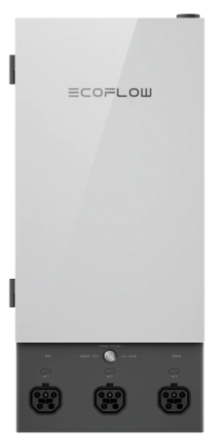

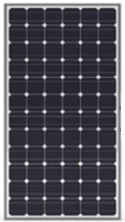

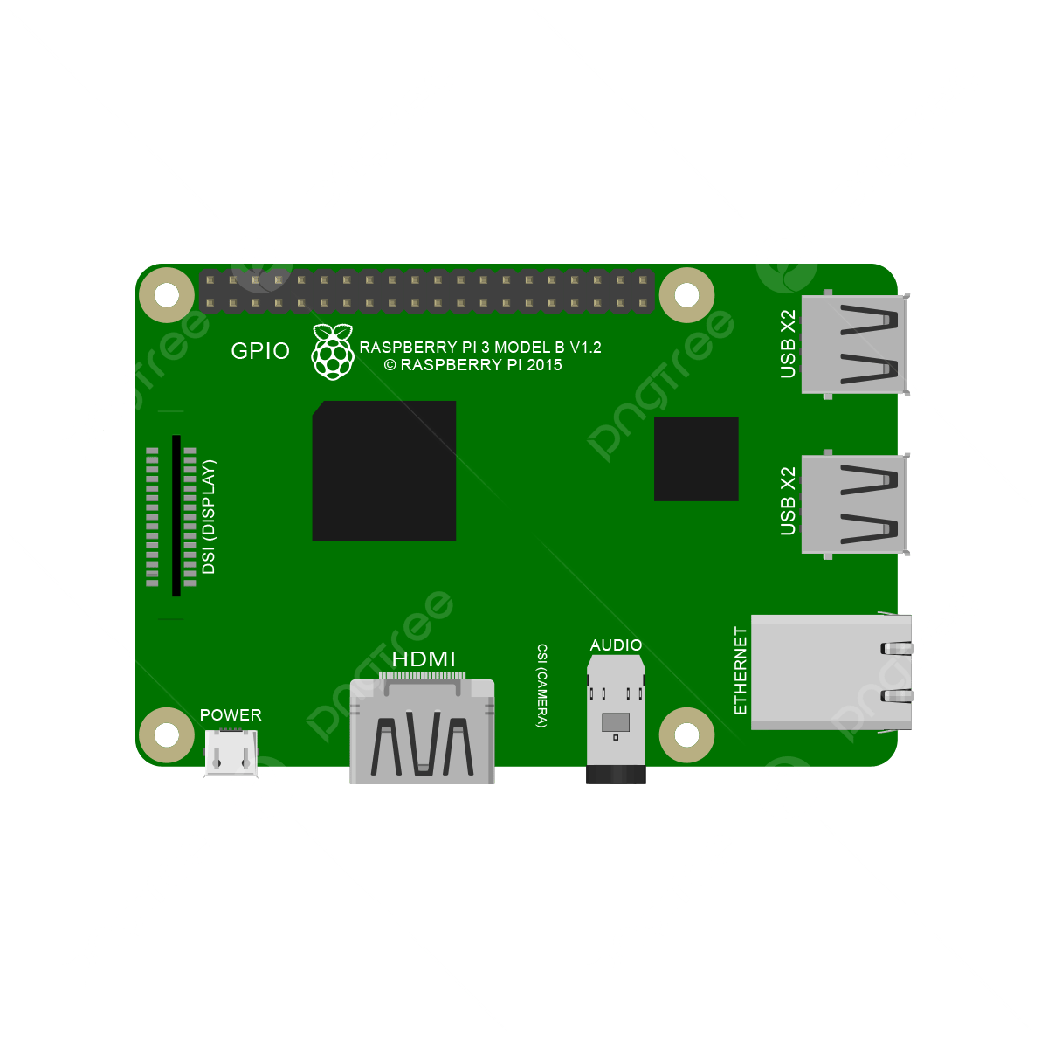

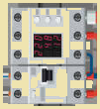



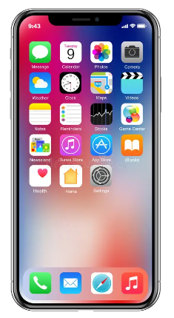

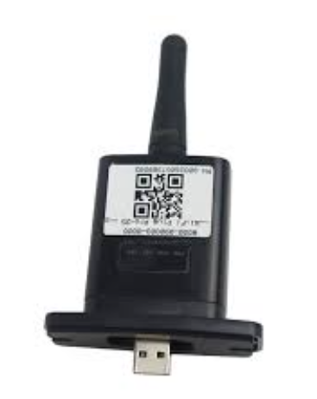



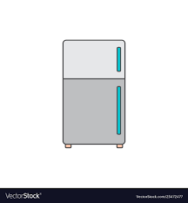



5
Cloud Maintenance Monitoring
eRouter - Model I：Smart Panel
Controller
1
BOX
eRouter
Software Defined EMS
2
4
Home Assistant
Panel
Micro
Inverter
Virtual
Power
Plant
Home Automation Platform
3
6
Hybrid
BMS
ESPHome
Notes:
2025-11-21
Refer to：EcoFlow Smart Home Panel 2

