Slide 1

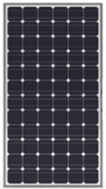

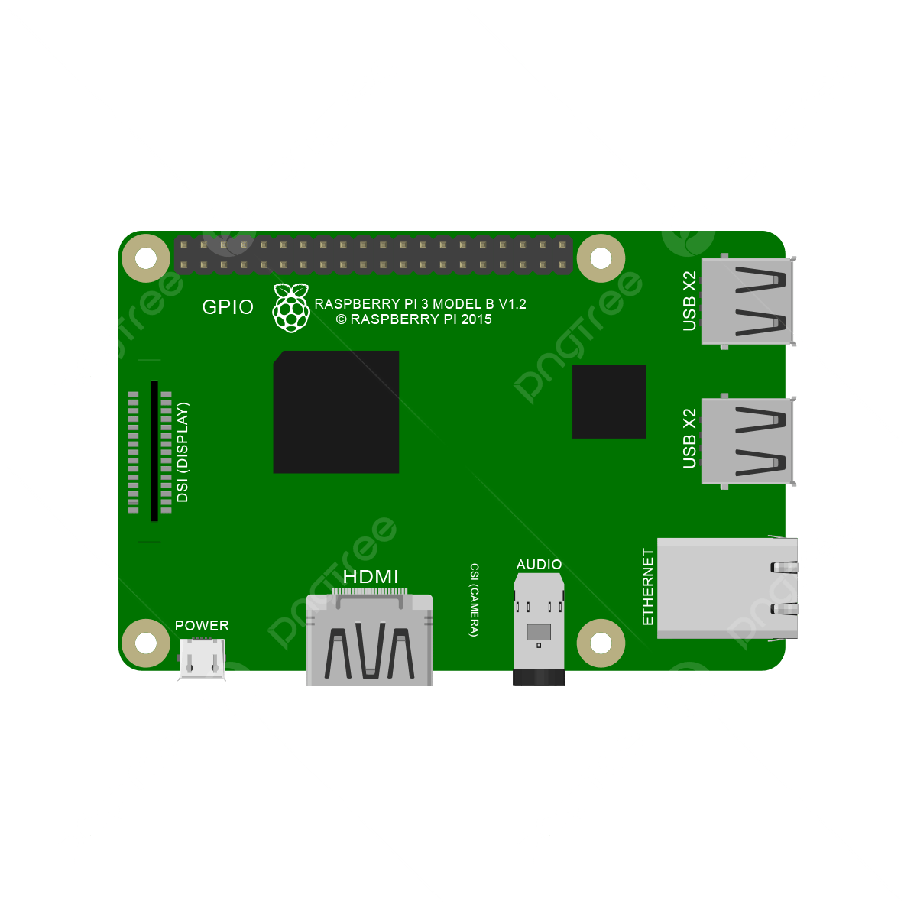





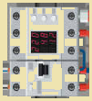


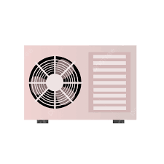
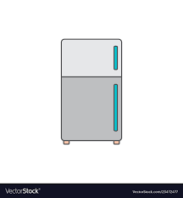



Energy Management System
Home Assistant
Micro
Inverter
3
1
Home Automation Platform
2
4
Hybrid
BMS
Notes:
HomeGrid_Standardization_Initiative, 2024-08-28

