Slide 1
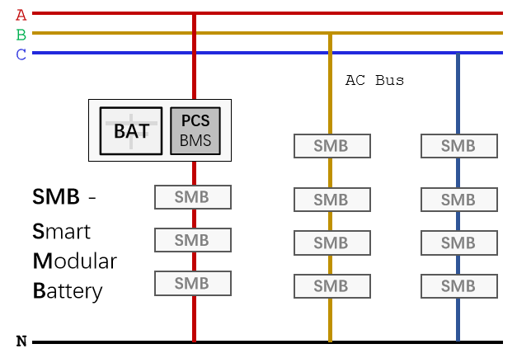
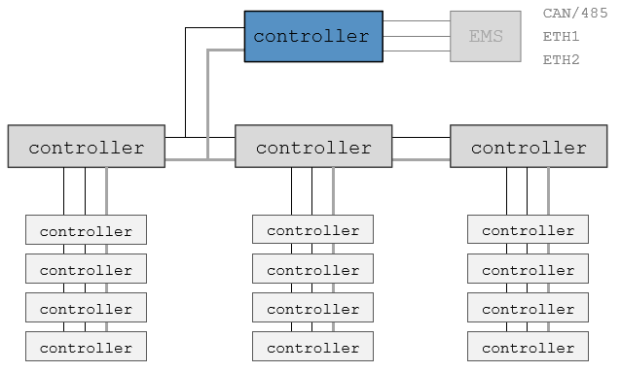
Architecture
1) Multi level Cascaded PCS
2) Use MOSFET instead of IGBT
3) Combine PCS with BMS
Advantages
1) Native Equalization, Safer.
2) Lower Cost, Longer Life Cycle.
3) Higher Efficiency
4) Scale, Higher Power and Capacity
The ORES Implementation
Energy Router - “AC Battery” Technology Based Innovation and Standardization for Home Grid
Implementation &
Standardization
1) Standalone ESS
AC Coupling
2) Energy Router
All in One Box
Hybrid

Slide 2
A
B
C
CAN/485
ETH1
ETH2
controller
EMS
AC Bus
BAT
PCS
BMS
controller
controller
controller
SMB
SMB
SMB -
Smart
Modular
Battery
SMB
SMB
SMB
controller
controller
controller
SMB
SMB
SMB
controller
controller
controller
SMB
SMB
SMB
controller
controller
controller
controller
controller
controller
N

