Slide 1
data preprocess
feature:
empty
.csv column[4:]
edge feature:
np.vstack([np.zeros(feat.shape[1])[np.newaxis, :], feat]) e.g., Wikipedia:[15474, 172] to [15475, 172]
node feature:
np.zeros((max_idx + 1, 172))

Slide 2
data preprocess
val timestamp: 0.7
test timestamp: 0.85
Create train data:
Random choose 10% data as new nodes which appears at test time (to test inductiveness) and remove them
Timestamp <= val timestamp
Create validation data:
val timestamp < Timestamp <= test timestamp
Create test data:
Timestamp > test timestamp
Create validation data (has new node that not in train data):
val timestamp < Timestamp <= test timestamp
In 10% data that is distracted from train data

Slide 3
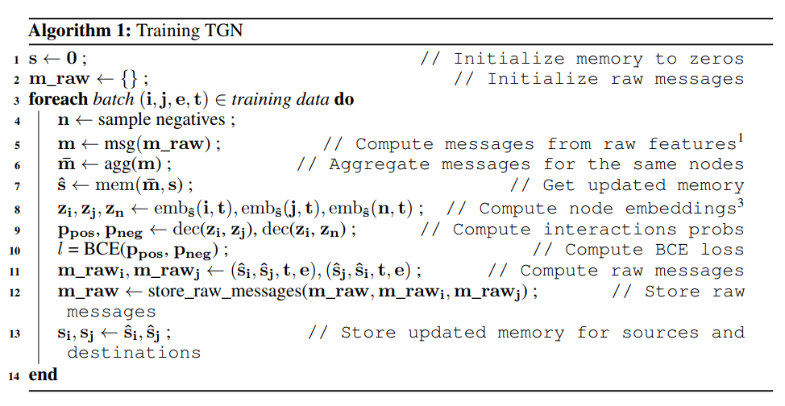
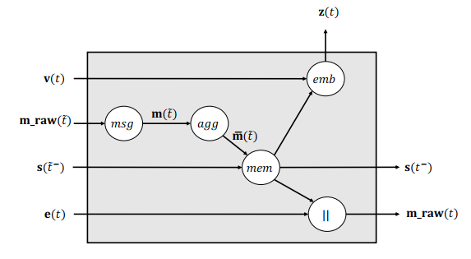
Training procedure
Sampling batch according to the time sequence
The current message is calculated using the raw messages of the previous batch to avoid information leakage.
Update the states and calculate the node embeddings.
Transfer node embeddings to edge probabilities
Calculate the loss and update TGN

Slide 4
Validation set
Early stop: if model doesn’t improve for 5 epoch, then it will stop training and start evaluating
The model that has best performance in validation set is defined as the best model, and will be used to evaluate in test set.
Obtain memory (which has seen validation edges) so that it can also be used when testing on unseen nodes.

Slide 5
Detailed procedure
Sample negatives
Compute edge probabilities
Compute temporal embeddings
Memory
Aggregate (Only keep the last message for each node)
Update (GRU)
Compute embedding
Get node feature and edge feature
Time encoder
Find neighbors
extracts all neighbors, interactions indexes and timestamps of all interactions of user happening before cut_time
If uniform: random choose 10 neighbors and resort based on time
Else if most recent: find the most recent 10 neighbors
Compute neighbors embedding
Attention (q, k, v)
Update memory (same as 1)
Get raw message and store into raw store
Transfer the embeddings to edge probabilities
Linear
Relu
Linear

Slide 6
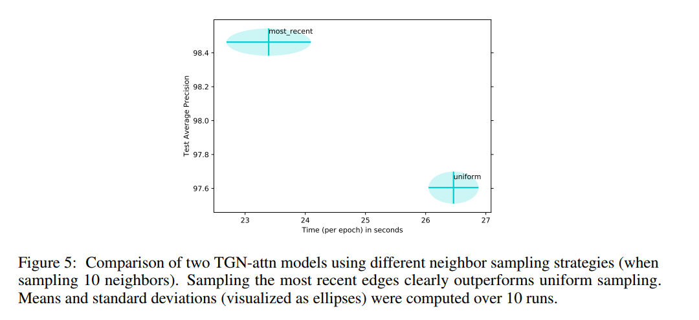
Neighborhood sampling
Static: Uniform
random choose 10 neighbors and resort based on time
Dynamic: Most Recent
find the most recent 10 neighbors

Slide 7
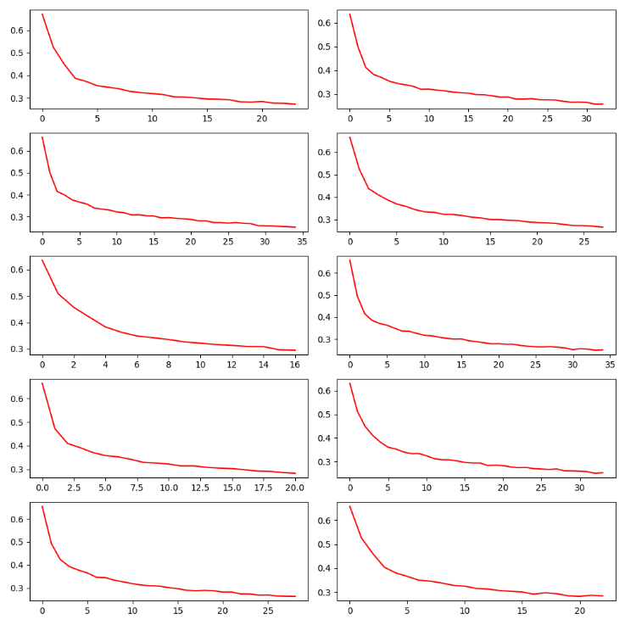
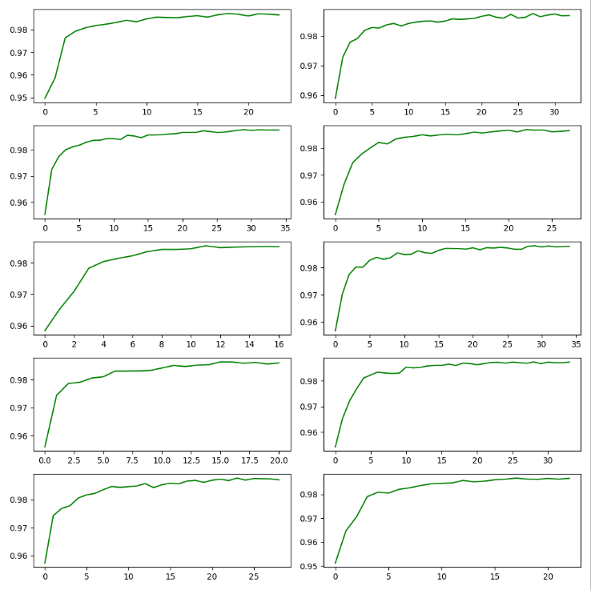
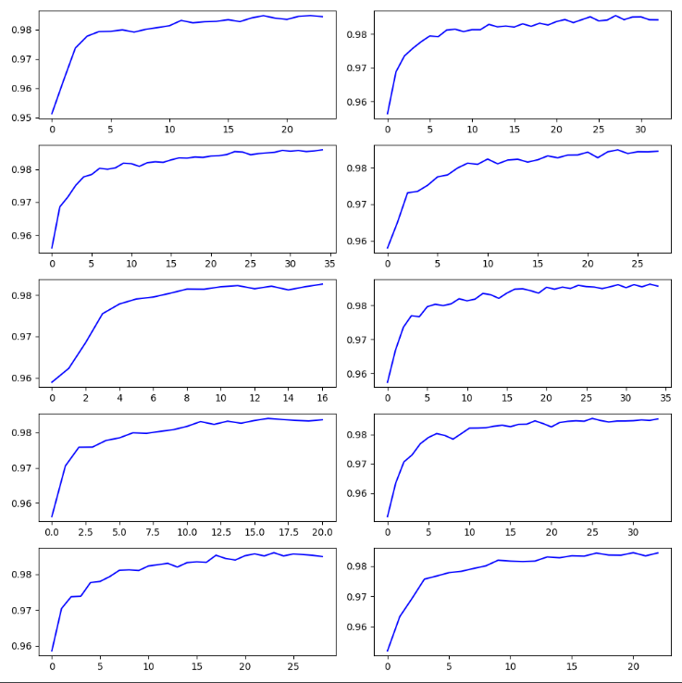
Results
Train loss
Val average precision
Val (new node) average precision

