Slide 1
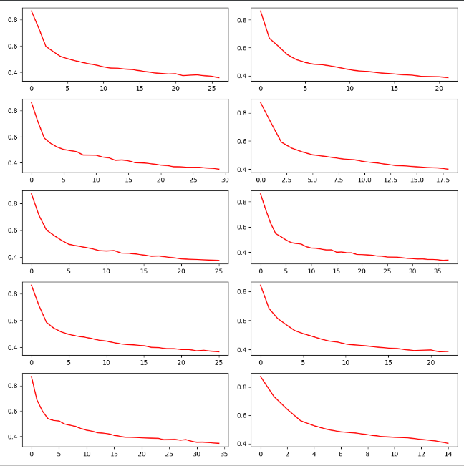
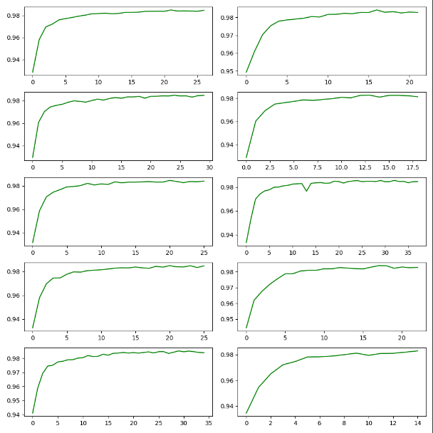
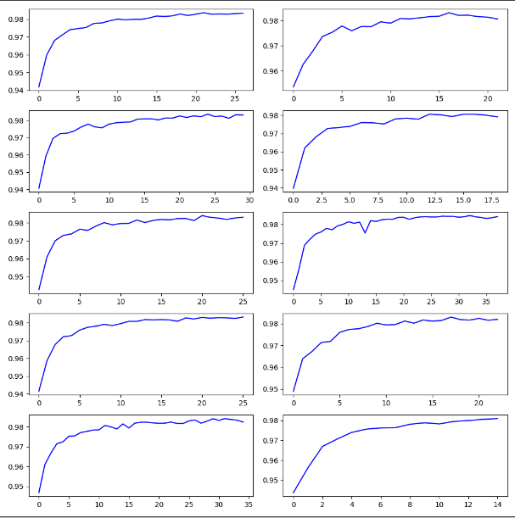
Reduce the training set in half by sampling every 2 points

Slide 2
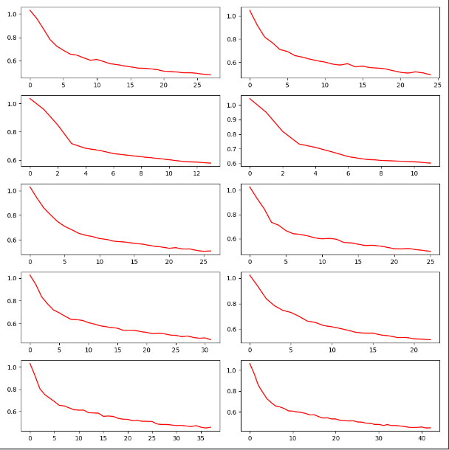
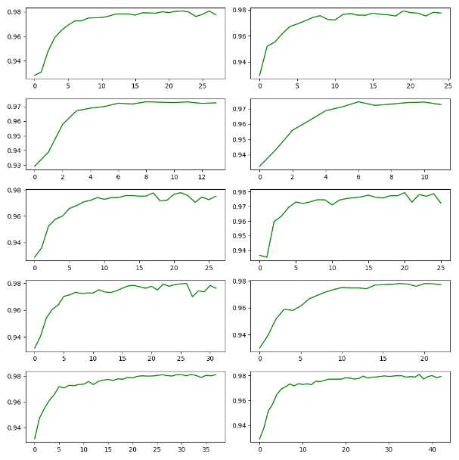
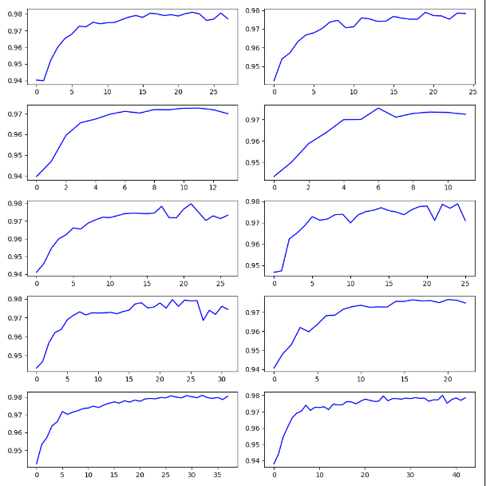
Reduce the training set by sampling every 4 points

Slide 3
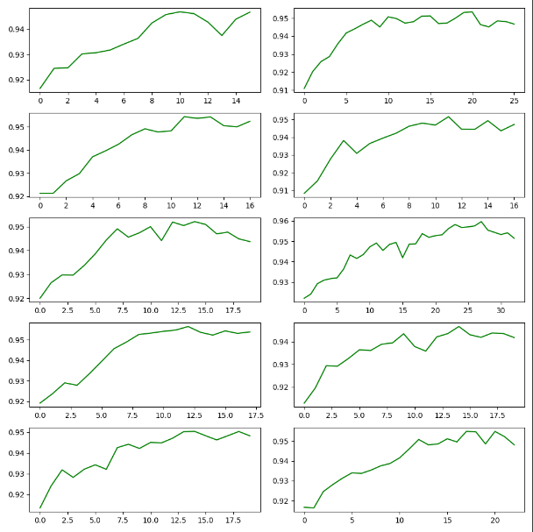
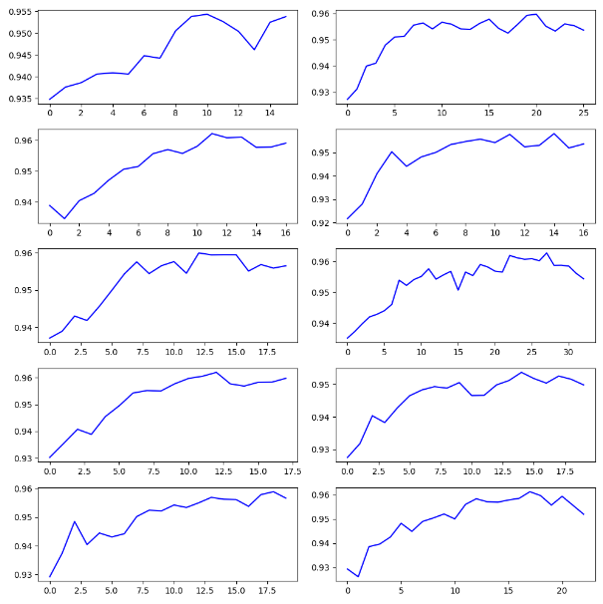
Reduce the training set by sampling every 16 points

Slide 4
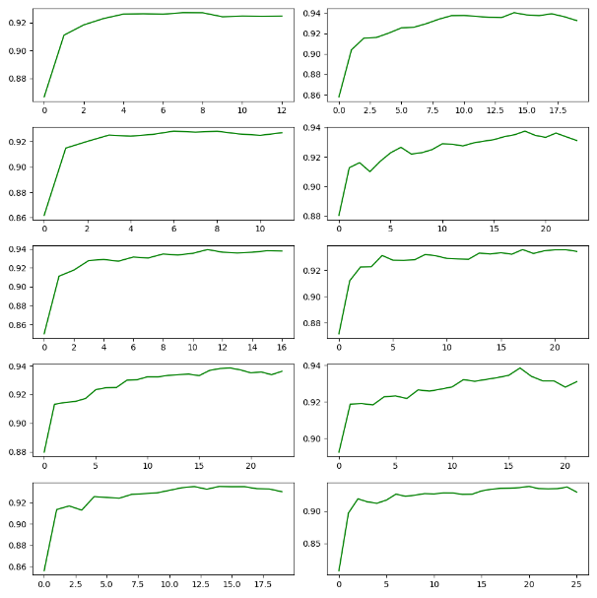
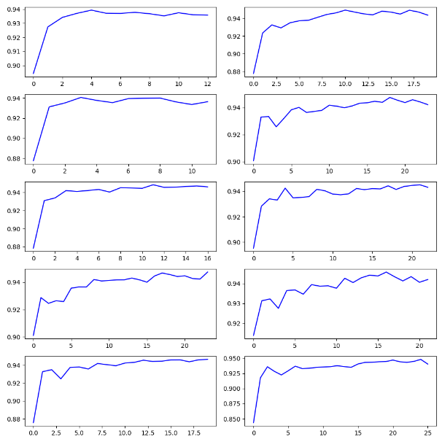
Reduce the training set by sampling every 32 points

Slide 5
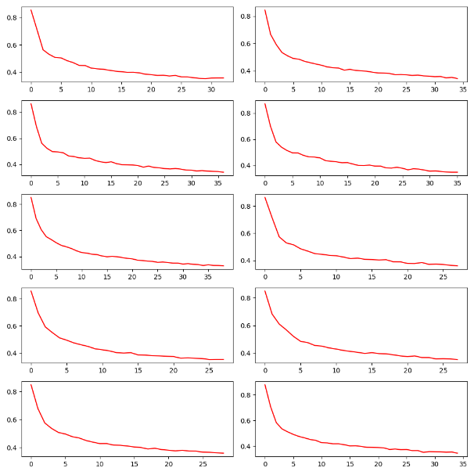
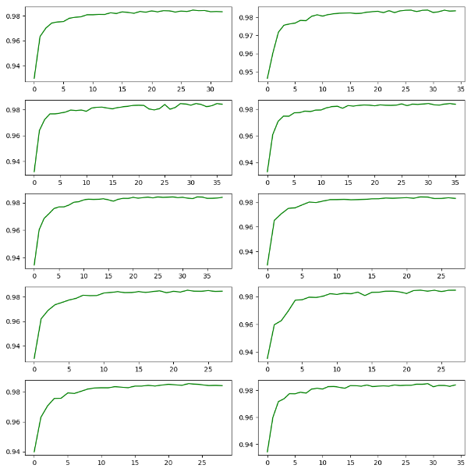
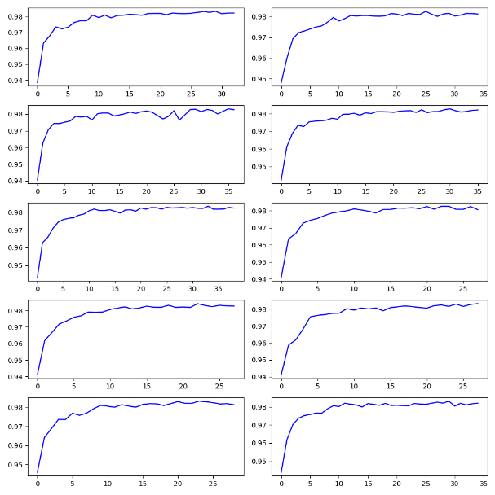
Reduce the training set by sampling every 2 points (random sampling fixed)
Test average precision = 0.9812

Slide 6
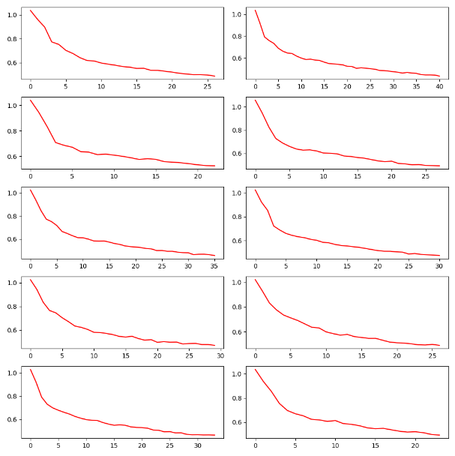
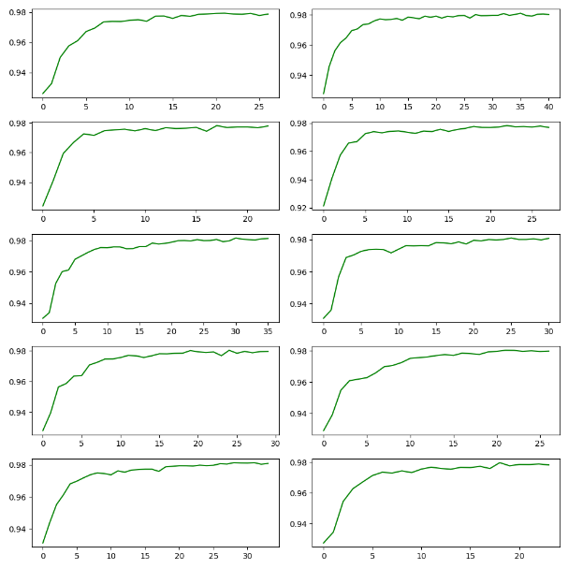
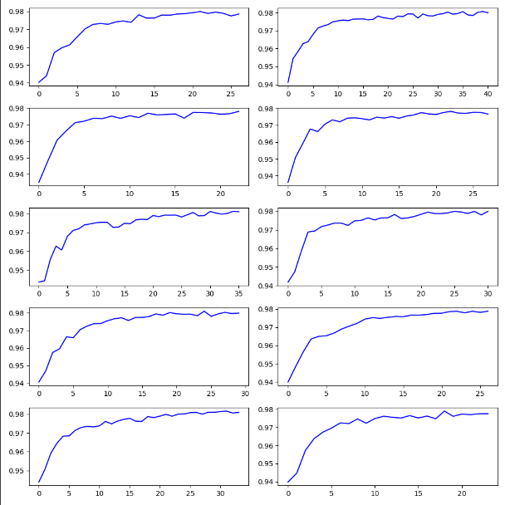
Reduce the training set by sampling every 4 points (random sampling fixed)
Test average precision = 0.9743

Slide 7
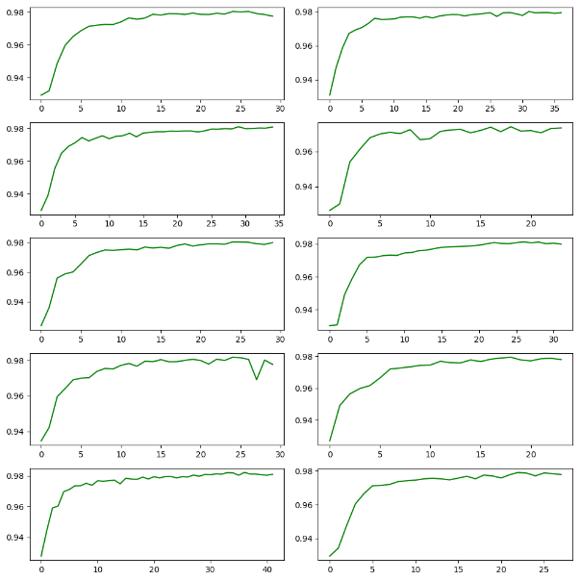
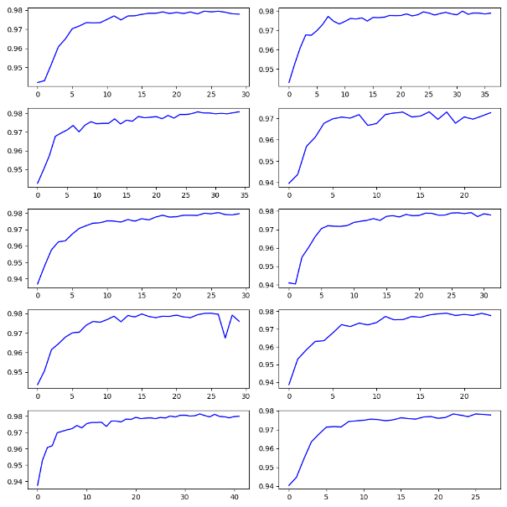
Reduce the training set by sampling every 4 points (random sampling)
Test average precision = 0.9746

Slide 8
Reduce the training set by sampling
Sample | Test precision (no random sample) | Test precision (random sample fixed) | Test precision (random sample not fixed)
2 | 0.9809 | 0.9812 | 0.9790
4 | 0.9718 | 0.9743 | 0.9746
16 | 0.9355 | 0.9254
32 | 0.9190 | 0.9184

Slide 9
Batch size & test accuracy & training time
Batch size | Test average precision | Training time
100 | 0.9862 | 125.73
200 | 0.9846 | 33.458
400 | 0.9837 | 46.886

Slide 10
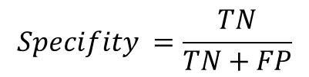
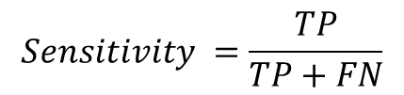
Evaluation metrics
Precision | F1 | Accuracy | Specificity | Sensitivity
0.9852 | 0.9329 | 0.9326 | 0.9282 | 0.9370
$$Sensitivity =\frac{TP}{TP+FN}$$
The sensitivity quantifies the ability to avoid false negatives (Recall)
$$Specifity =\frac{TN}{TN+FP}$$
The specificity quantifies the ability to avoid false positives
 | Predicted Class
Actual Class |  | Yes | No
 | Yes | TP | FN
 | No | FP | TN

