Slide 1
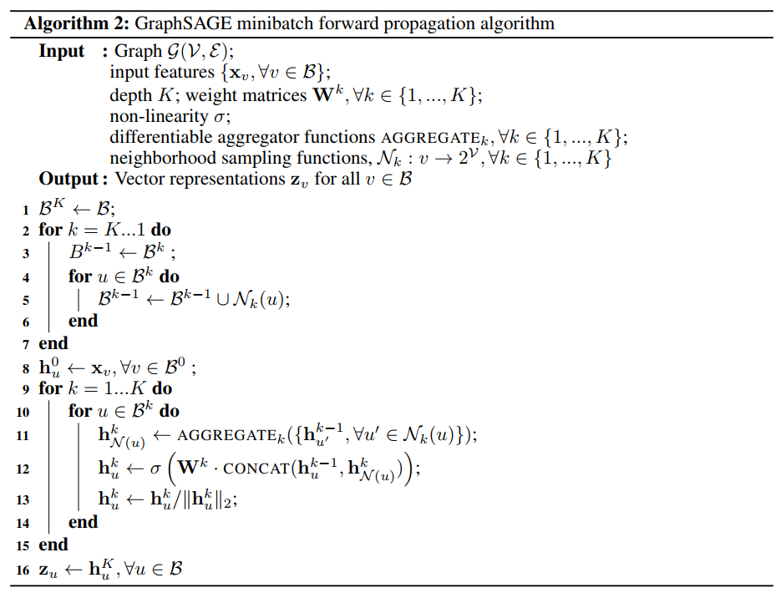
Minibatch

Slide 2

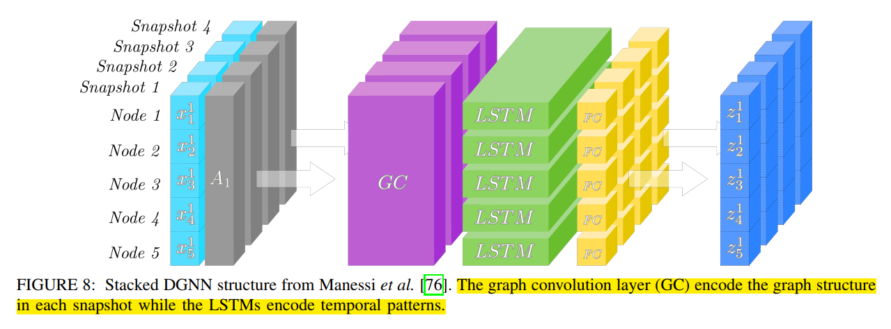
DGNN
Discrete DGNN
Stacked DGNN

Slide 3
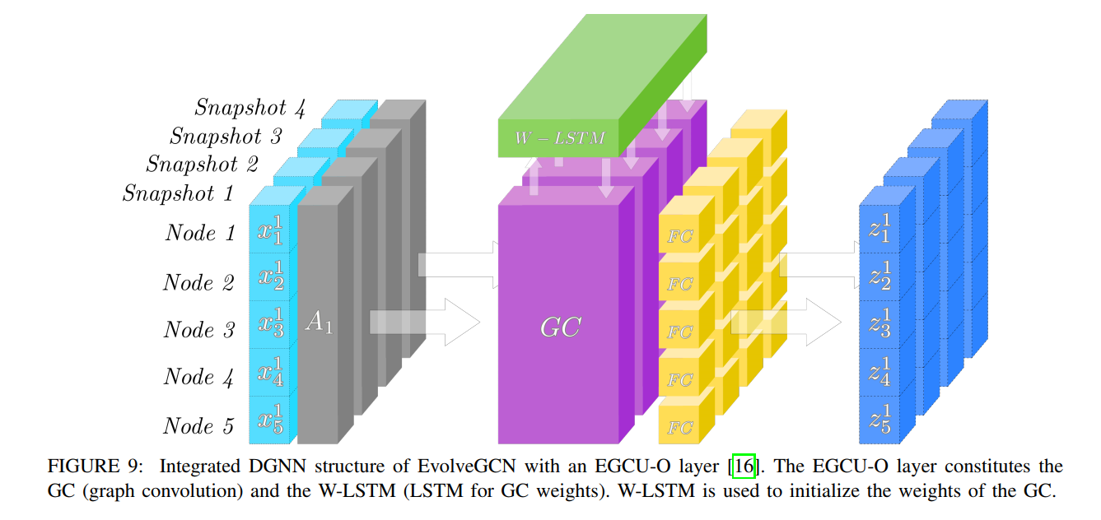
Discrete DGNN
Integrated DGNN
combine GNNs and RNNs in one layer and thus combine modelling of the spatial and the temporal domain in that one layer
Continuous DGNN
RNN based models: node embeddings are maintained by an RNN based architecture
Temporal point based (TPP) models: temporal point processes are parameterized by a neural network
Time embedding based models: positional embedding of the time is used to represent time as a vector

Slide 4
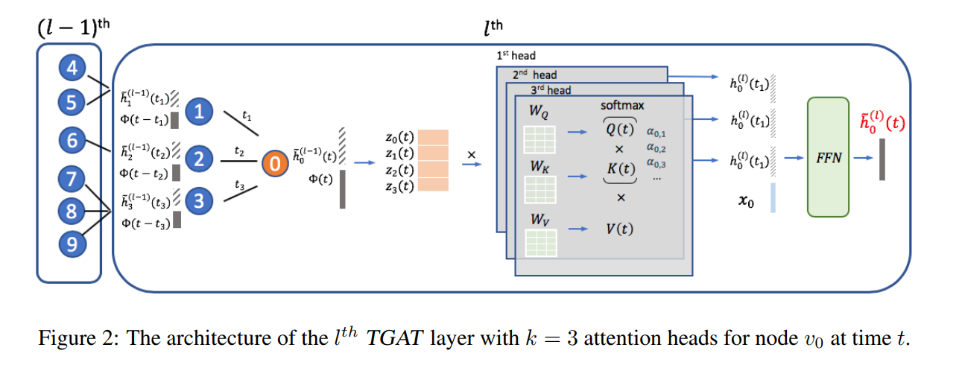
TGAT
Time Encoding

Slide 5
TGAT
TGAT layer
Extension to incorporate edge features

Slide 6
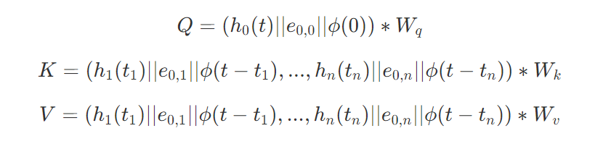


TGAT
TGAT layer
self attention

Slide 7
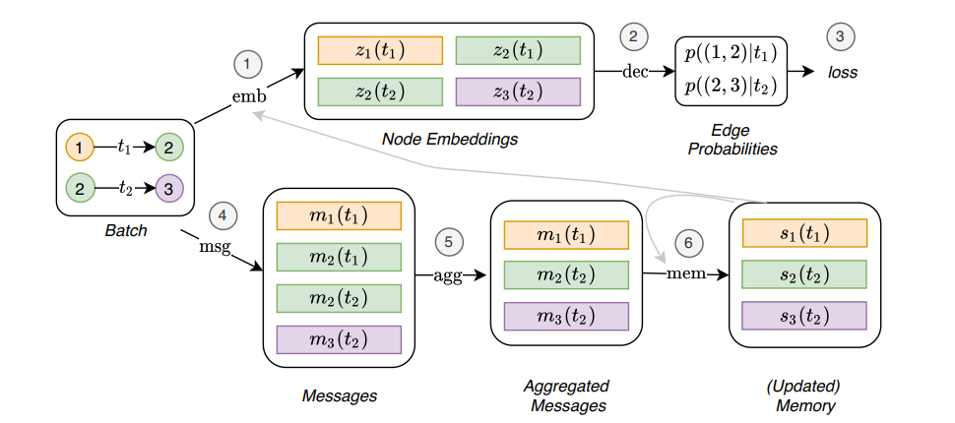
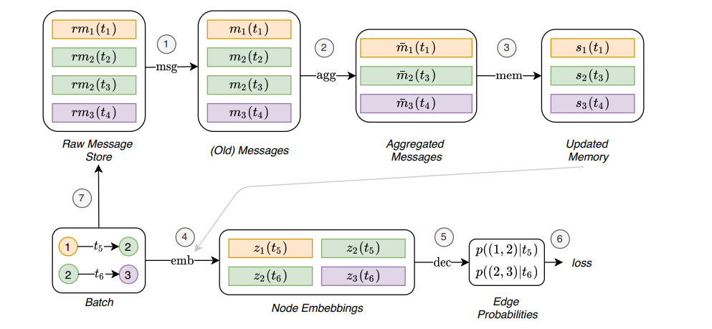
TGN

Slide 8

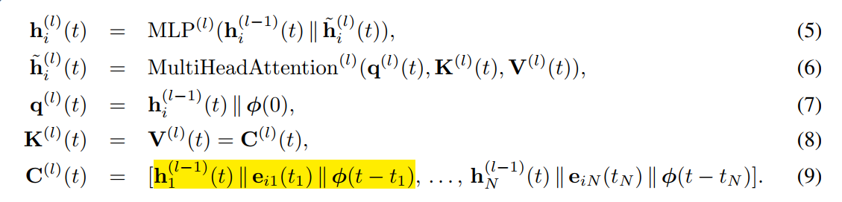
TGN
1. Initialize the memory as the zero vector or store the updated memory from the last batch
2. Combine the memory and the original feature of node
3. Obtain the embedding (TGAT) and calculate the loss

Slide 9



TGN
4. Obtain the message
5. Message aggregate (most recent message or mean message)
6. Update the memory (RNN or GRU) and stored in the raw message store

