Slide 1
SpRDA: An Efficient Sparse Accelerator for Robotics Diffusion Model
Renda Jian, Yuzhou Chen, Pan Zhao, Yitian Chen, Zhican Wang, Xueling Wang, Chen Zhang, Guanghui He
Shanghai Jiao Tong University, Shanghai, China

Slide 2
Introduction and Challenges

Slide 3

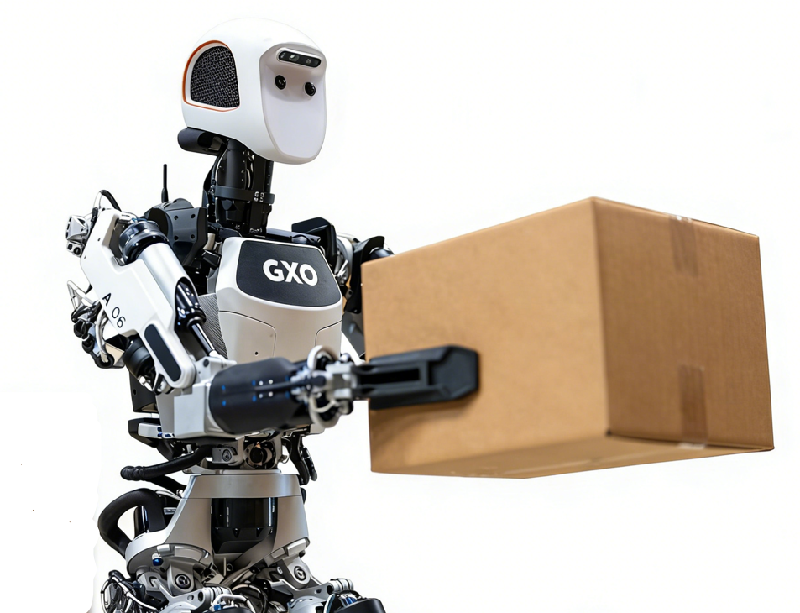
Embodied Artificial Intelligence: Bridging AI with the Physical World
Rule-based Traditional Robots
Limited to easy tasks
Limited generalizability to unknown scenarios
Embodied AI
Generate actions to control robots to interact with environment
Autonomously tackle an ever-widening range of complex tasks
Hard to achieve real-time control in resource-constrained robot platform

Slide 4
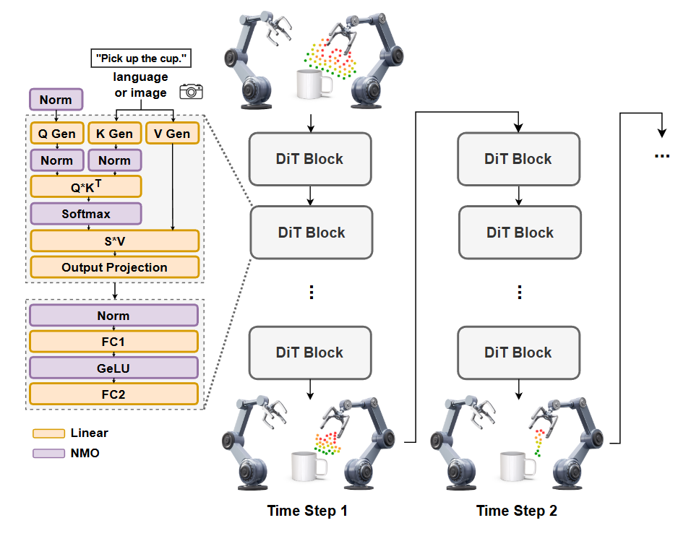
Robotics Diffusion Models
Strong ability to handling multi-modal action distributions and high-dimensional action spaces
But suffer from iterative computing feature: several sequential denoising steps (up to 100)
Model | Denoising Step | Frequency on GPU
Diffusion Policy | 10 | 10 Hz
RDT | 5 | 6 Hz
Real-time: > 30 Hz
Notes:
Diffusion Transformer

Slide 5
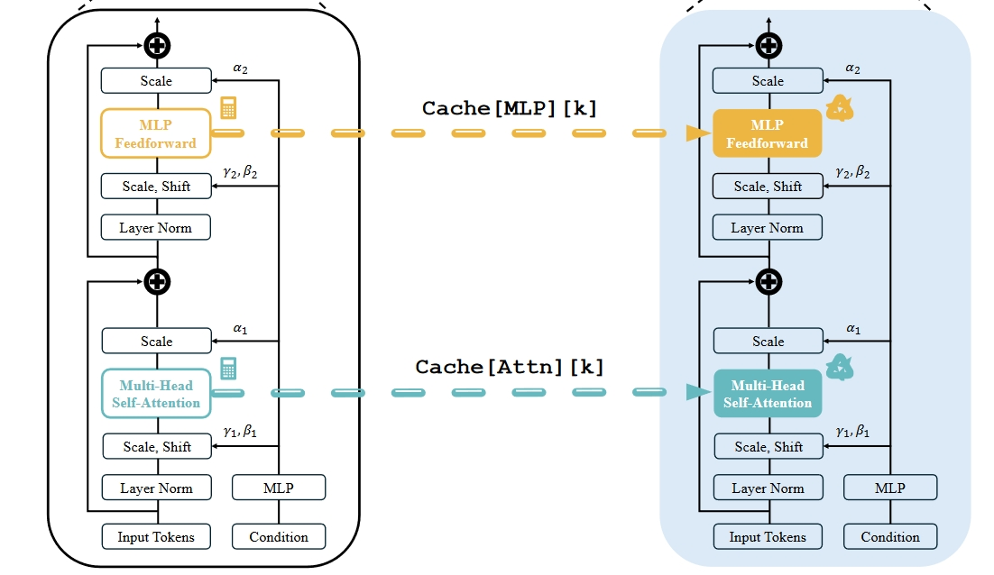
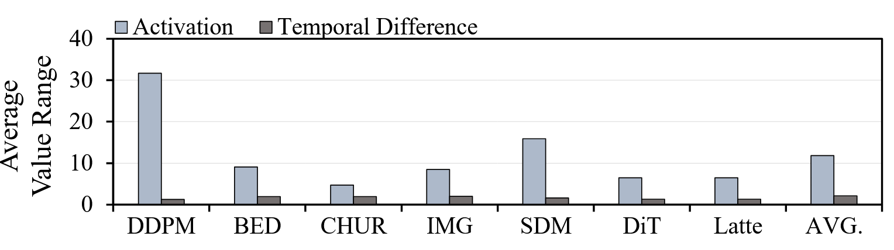
Efficient Diffusion Models
Cache
Differential Computing
Differential computing constrains input differences to a narrower range, enabling low-bit computation.
It introduces extra memory access overhead and can only quantize 50–90% of these differences into half-precision format.
Directly reuse the results of attention and FFN every 𝑁 steps
The parameter 𝑁 is hard to tune and applying cache to robotics diffusion leads to a sharp reduction of average success rate
Sparse computing serves as a more efficient approach for diffusion model acceleration, yet it is plagued by critical issues.
Notes:
Existing acceleration for diffusion models mainly focus on image and video generation.

Slide 6
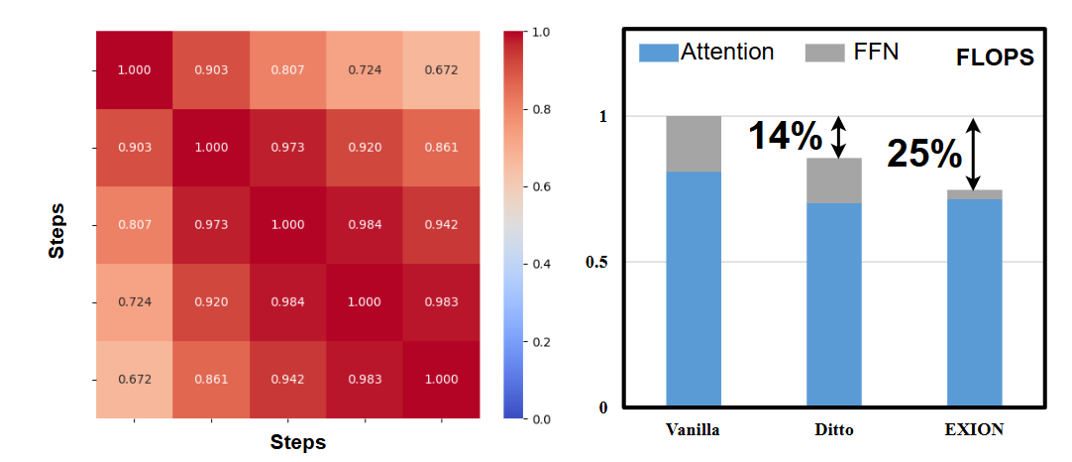
Challenge 1： High Similarity to High Sparsity
Existing works found high similarity between adjacent time steps, but failed to fully leverage the similar characteristics, resulting in lower overall network sparsity.

Slide 7
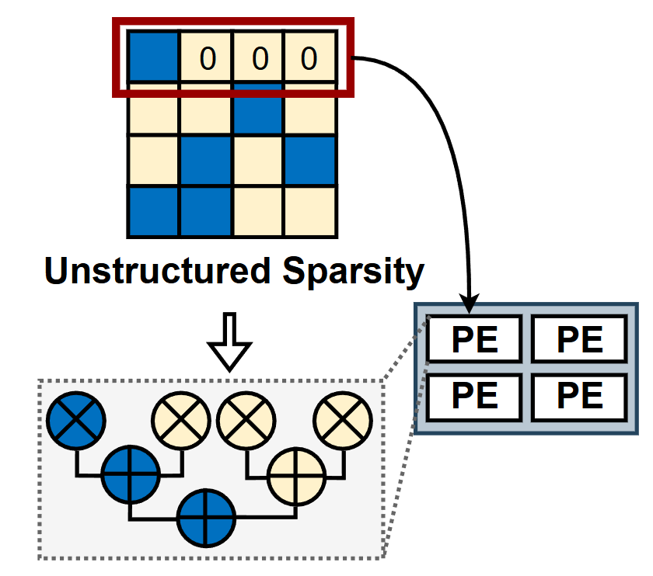
Challenge 2: High Sparsity to High Efficiency
High unstructured sparsity fails to translate into substantial hardware speedup, primarily due to the low utilization of PEs.
GPUs: fixed sparse mode(2:4), not flexible enough for algorithm
ASICs: workload imbalance among PEs; high overhead in merging and dataflow control

Slide 8
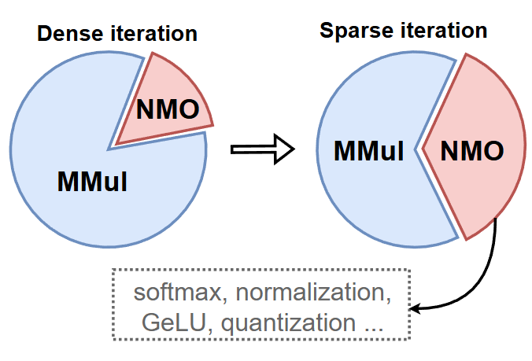
Challenge 3: High Overhead of NMOs
There are a variety of non-matrix-multiplication operators (NMOs) with high overhead of floating-point arithmetic in diffusion models.
As matrix multiplication grow sparser, NMOs account for an increasing proportion of overall latency, a factor always overlooked by prior sparse accelerators.

Slide 9
Contributions: Algorithm-Architecture Co-Design
We propose a fine-grained and difference-aware cache algorithm to ach-ieve over 90% sparsity with less than 1% performance degradation.
We introduce two-level group sparsity adjusting to bridge sparse algorithm and hardware.
We conduct a detailed analysis of the computation of all involved NMOs and design a graph-based vector processing array.
Compared with the prior state-of-the-art accelerators, our work achieves 1.56-2.60× speedup and 6.45-7.85× improvement on energy efficiency.

Slide 10
Sparsification Strategy for Robotics Diffusion Models

Slide 11
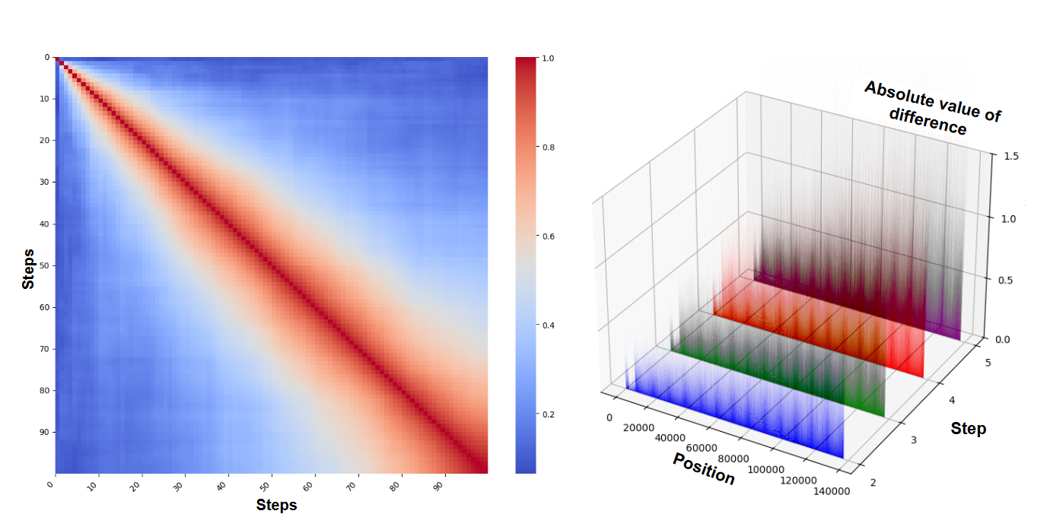
Motivation
Similarity in Diffusion Model
Bottleneck Analysis
Unlike image and video generation models, robotics diffusion models involve fewer tokens.
Over 99% matrix multiplication is linear computation ( input × weight )
Computation redundancy: each step in fact contributes only a small part of change.
The distribution of input differences between each step and first step is also similar.
Notes:
The positions with larger difference in second step tend to continue increasing the difference in next steps.

Slide 12
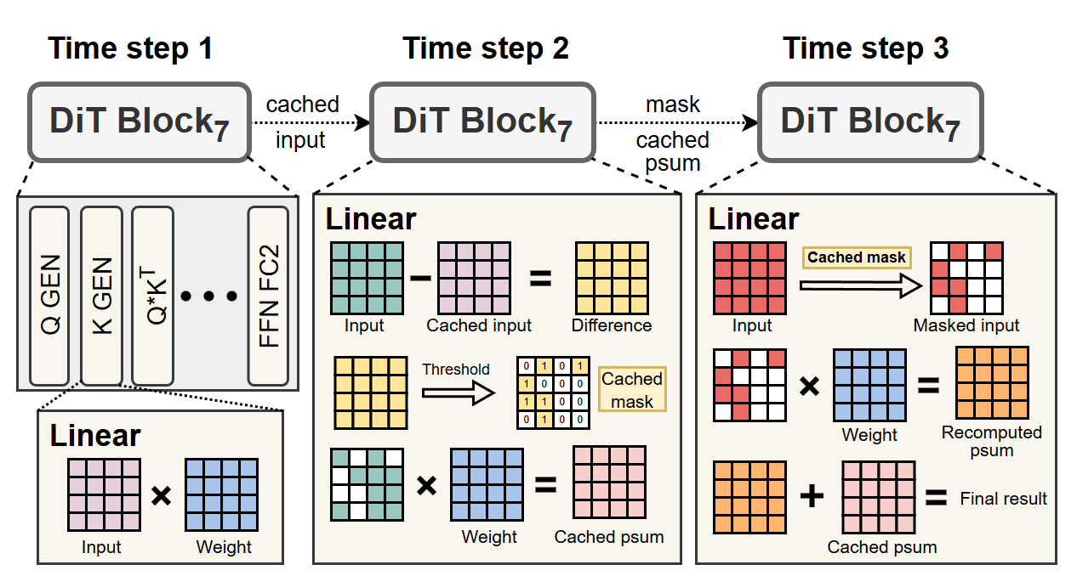
Fine-Grained and Difference-Aware Cache
Inputs with minimal differences can be seen unnecessary.
FDC is applied in all linear layers.

Slide 13
Two-Level Group Sparsity Adjusting
0
2
1
2
1
3
0
1
index
Unstructured Sparsity
Two-Level Sparsity: Flexible and Hardware-Friendly
GPU: Tensor Core only support 2:4
ASIC: extra network/architecture support
1st level: multiple groups with varying sparsity
2nd level: each tile in a group with consistent pattern
TGSA only changes the method of generating mask and almost has no impact on sparsity and model performance.
TGSA only saves non-zero values and their position index.
Notes:
The first-level flexible groups align with the sparse feature of algorithm, while second level tiles with fixed pattern facilitate high hardware efficiency

Slide 14
Efficient Sparse Accelerator

Slide 15
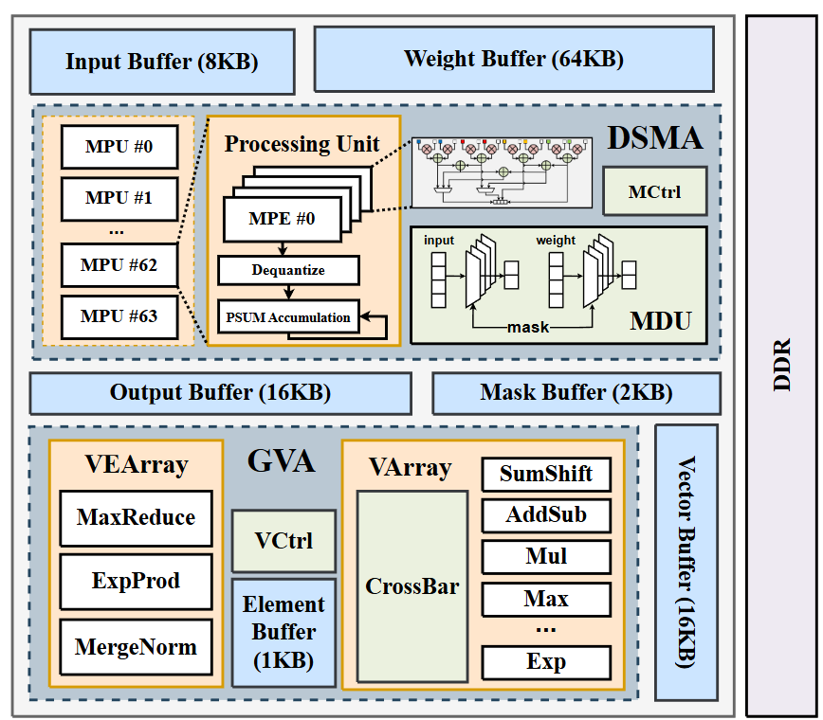
Overview of Architecture
DSMA (dynamic sparsity-aware matrix processing array): 64*4 PE + MDU (mask decodeing unit) support both dense and sparse matrix multiplication
GVA (graph-based vector processing array): VEArray (element) + VArray (vector) for NMOs
SRAM: 112KB

Slide 16
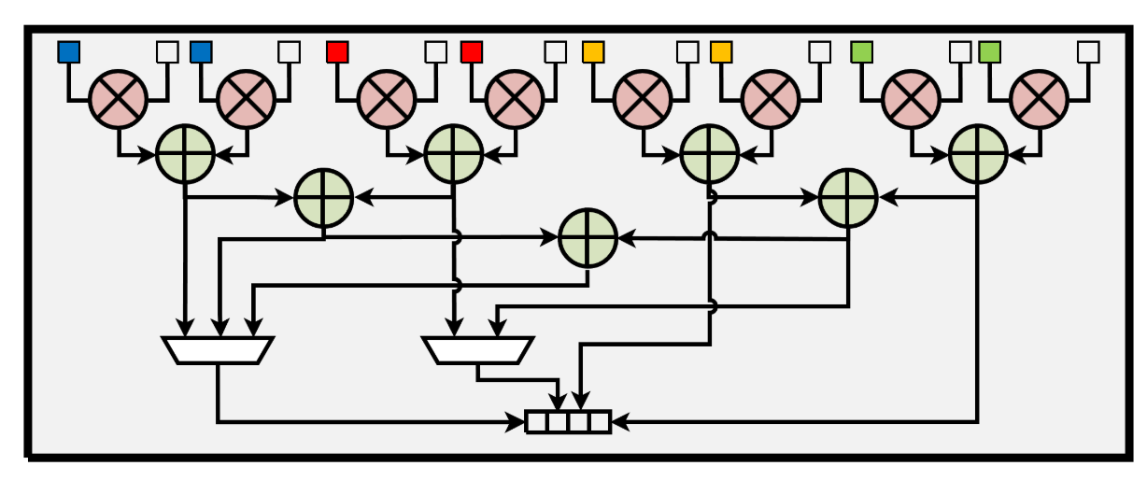
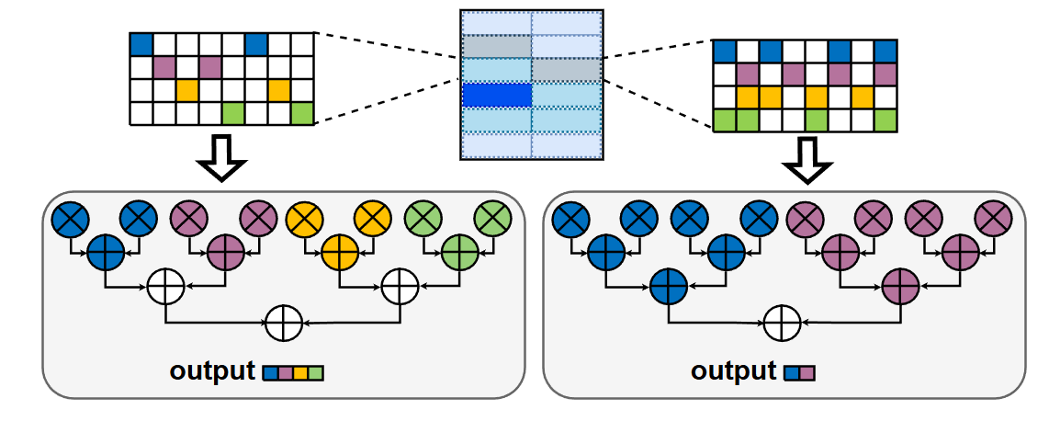
Dynamic Sparsity-Aware Matrix Processing Array
Num of non-zero value | Num of multipliers | Layer of adder | cycle
0 | Skipping |  | 0
2 | 2 | 1 | 1
4 | 4 | 2 | 2
8 (dense) | 8 | 3 | 4
Configurable PE design to support both two-level sparse and dense matrix multiplication with dynamically allocated multipliers and forwarding paths in the adder tree.

Slide 17
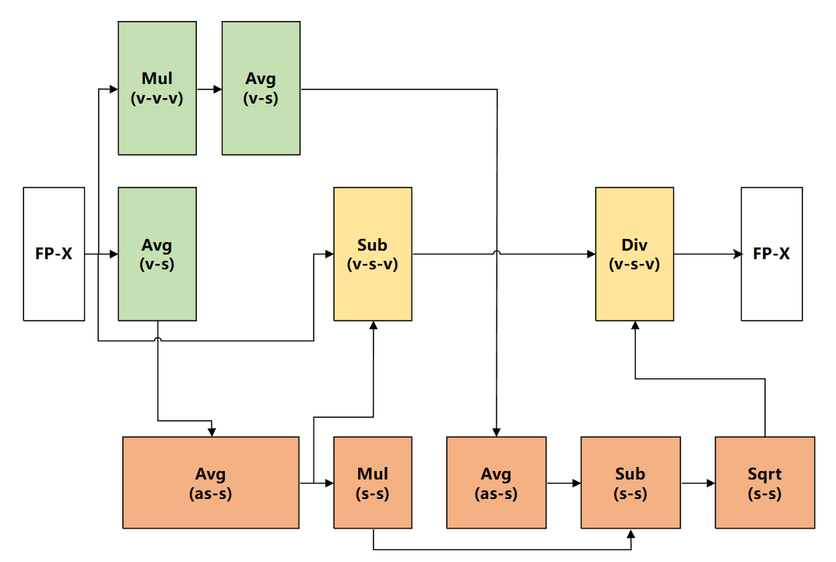
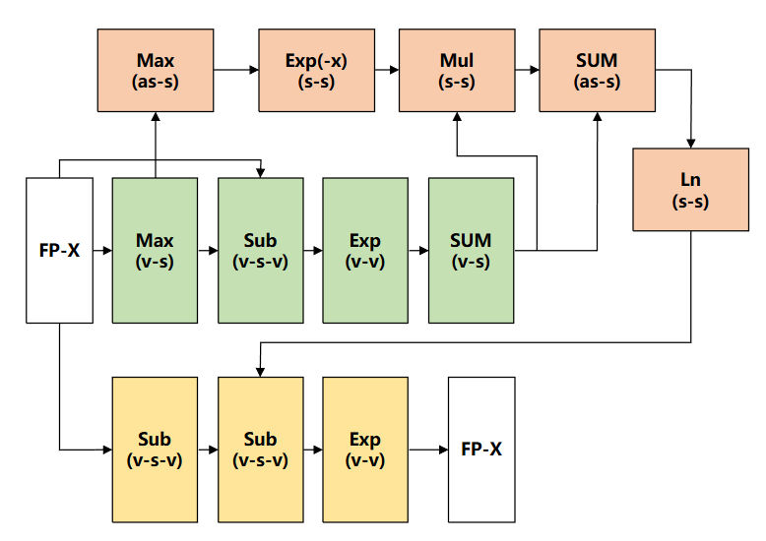
Graph-Based Vector Processing Array
Vector Units | Number | Delay
SumShift | 2 | 6
Max | 1 | 2
Min | 1 | 2
AddSub | 3 | 1
Sub | 1 | 1
Add | 1 | 1
Div | 1 | 4
Mul | 1 | 1
FP2INT | 1 | 1
Exp | 1 | 5
LayerNorm
Softmax
Decompose all involved NMOs into several basic vector floating-point operations
These basic units can be shared when processing different NMOs
GVP organize function units into a dataflow graph with a configurable interconnection

Slide 18
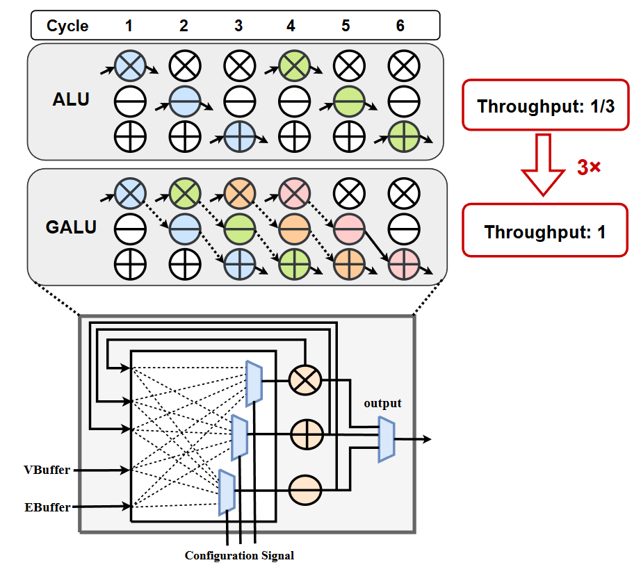
Graph-Based Vector Processing Array
Graph-based ALU (GALU) achieves higher throughput than traditional ALU.
Compared to special function unit designed for certain operators, GVA excels in higher flexibility and lower area.

Slide 19
Evaluation

Slide 20
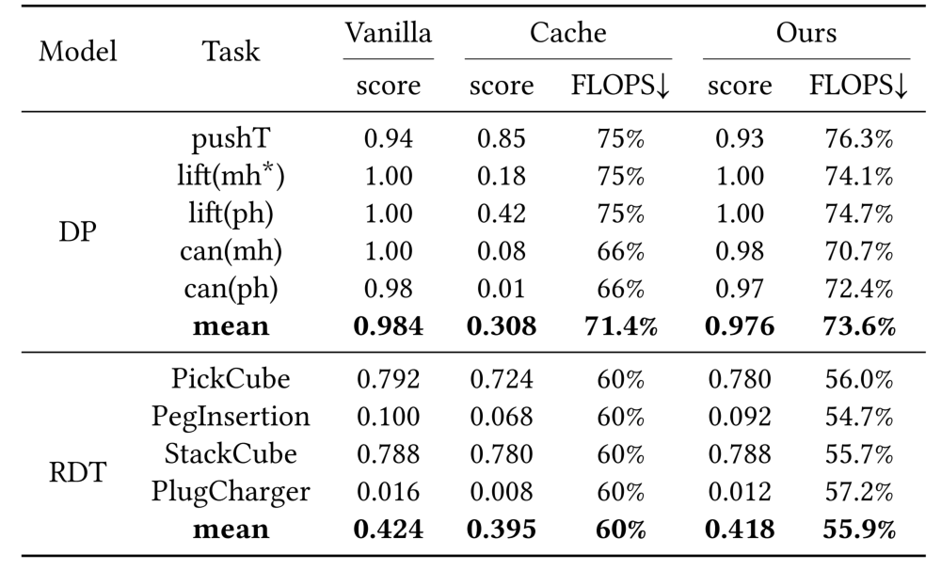
Evaluation on Proposed Algorithm
Compared to coarse-grained cache acceleration, FDC increases average score by 66.8% in DP and 2.3% in RDT with comparable FLOPS reduction.

Slide 21
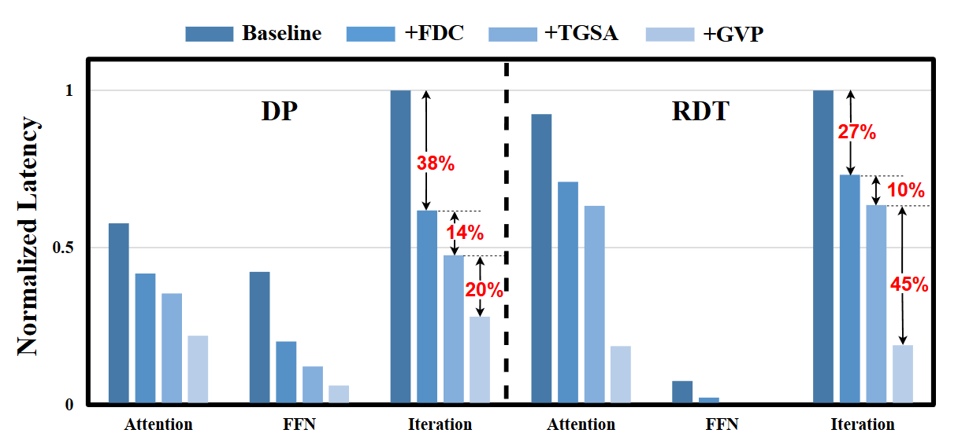
Evaluation on Proposed Accelerator

Slide 22
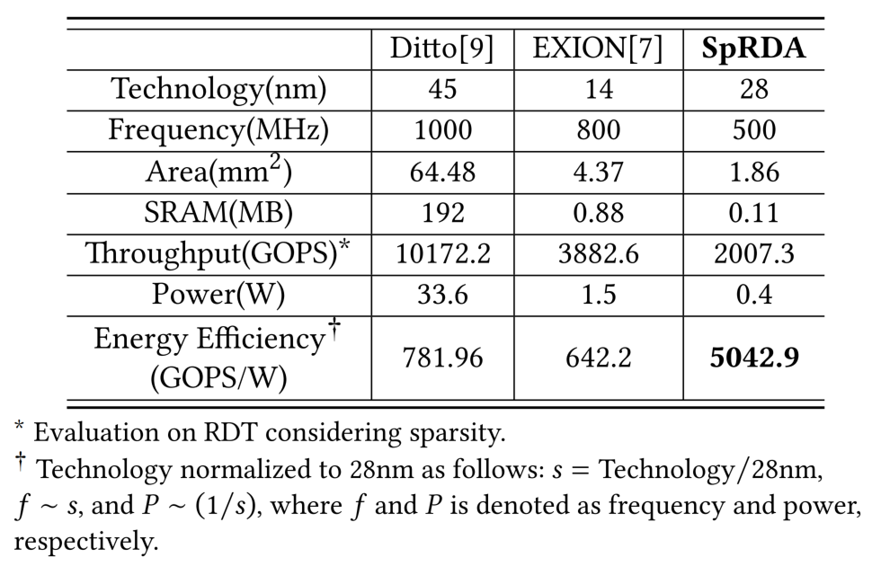
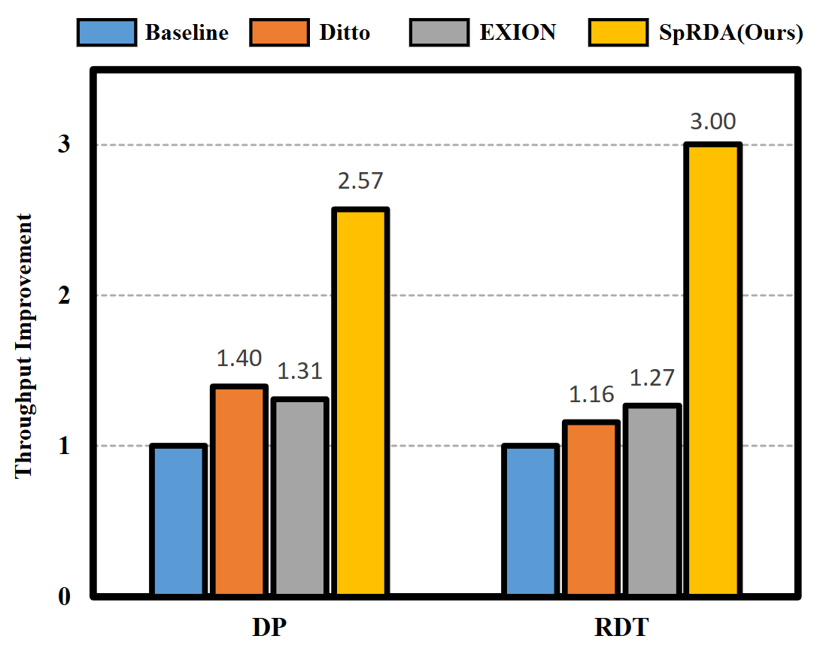
Evaluation on Proposed Accelerator
Compared to SOTA diffusion accelerators, SpRDA achieves 1.56-2.60× speedup and 6.45-7.85× energy efficiency improvement.

Slide 23

Thanks

