Slide 1
PipeGS: Unlocking 3DGS Pipeline Parallelism via Hierarchical Reuse and Dynamic Partitioning
Algorithm-Architecture Co-Design for Efficient 3D Gaussian Splatting
Speaker: Xueling Wang
Collaborators: Shanghai Jiao Tong University & Tsinghua University
Event: DAC '26, Long Beach, CA

Slide 2
Motivation: The Pipeline Efficiency Gap in 3DGS

Slide 3
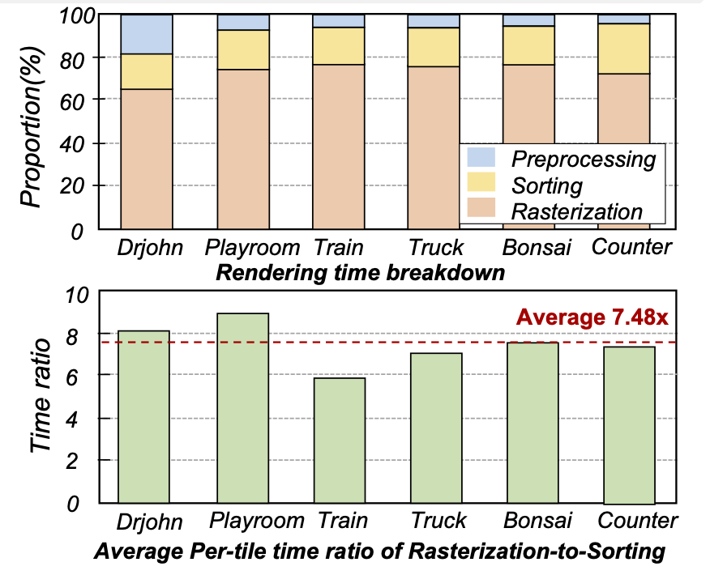
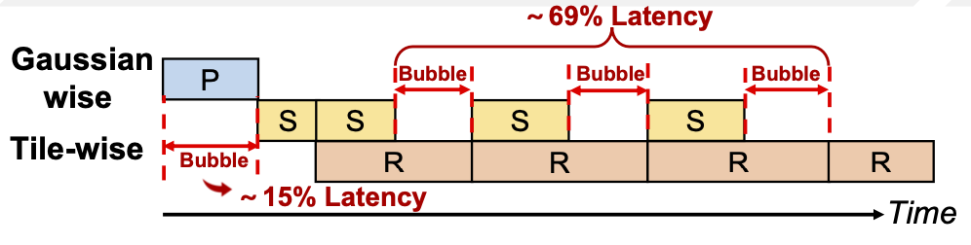
Analysis of 3DGS Pipeline Bottlenecks
Workflow: Preprocessing, Sorting, and Rasterization.
Challenge I: Insufficient overlap due to the latency gap between sorting and rasterization.
Challenge II: Pipeline parallelism is constrained by globally serialized preprocessing.
Original 3DGS Pipeline
Up to 69% pipeline bubbles observed on high-end GPUs！

Slide 4
Proposed Solutions: HGR and DOP

Slide 5
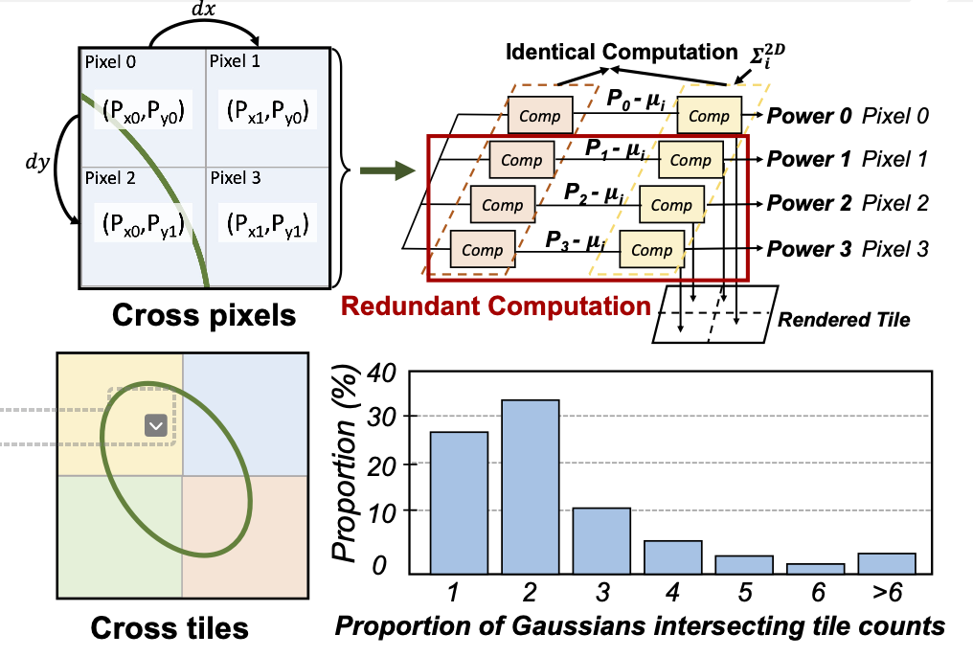
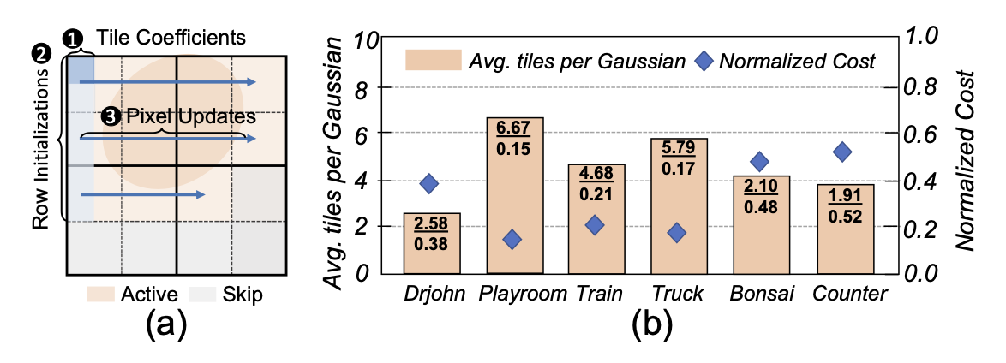
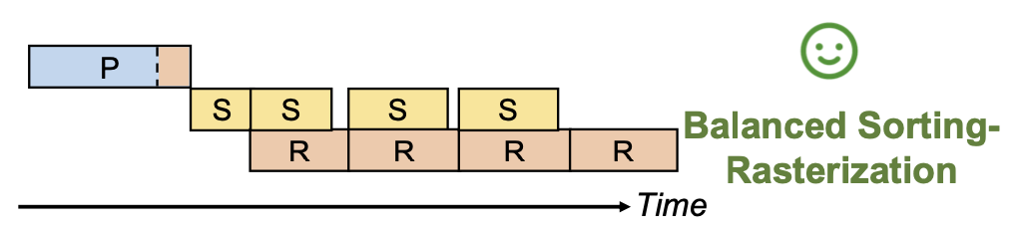
Solution I: Hierarchical Gaussian Reuse (HGR)
Goal: Eliminate redundant computations at pixel and tile levels.
Differential Power Computation (DPC): Exploits spatial coherence to reduce multiplications by 96.2%.
Tile-Shared Power Precomputation (TSPP): Shifts alpha computation to preprocessing to balance stages.
Result: Reduces 76.2% of pipeline bubbles.

Slide 6
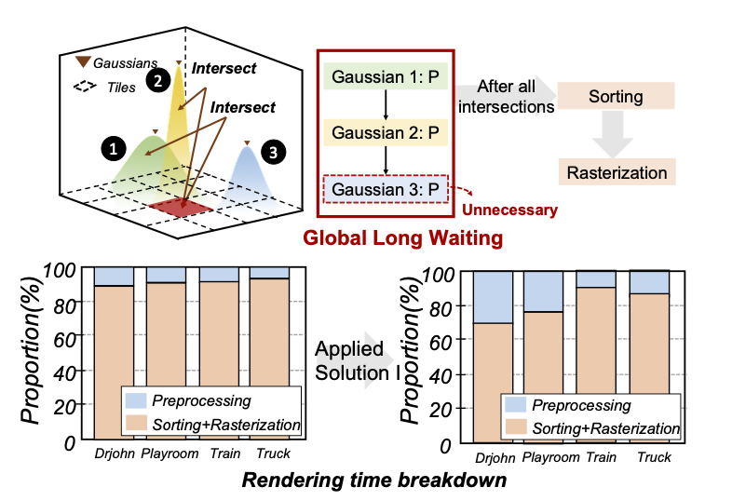
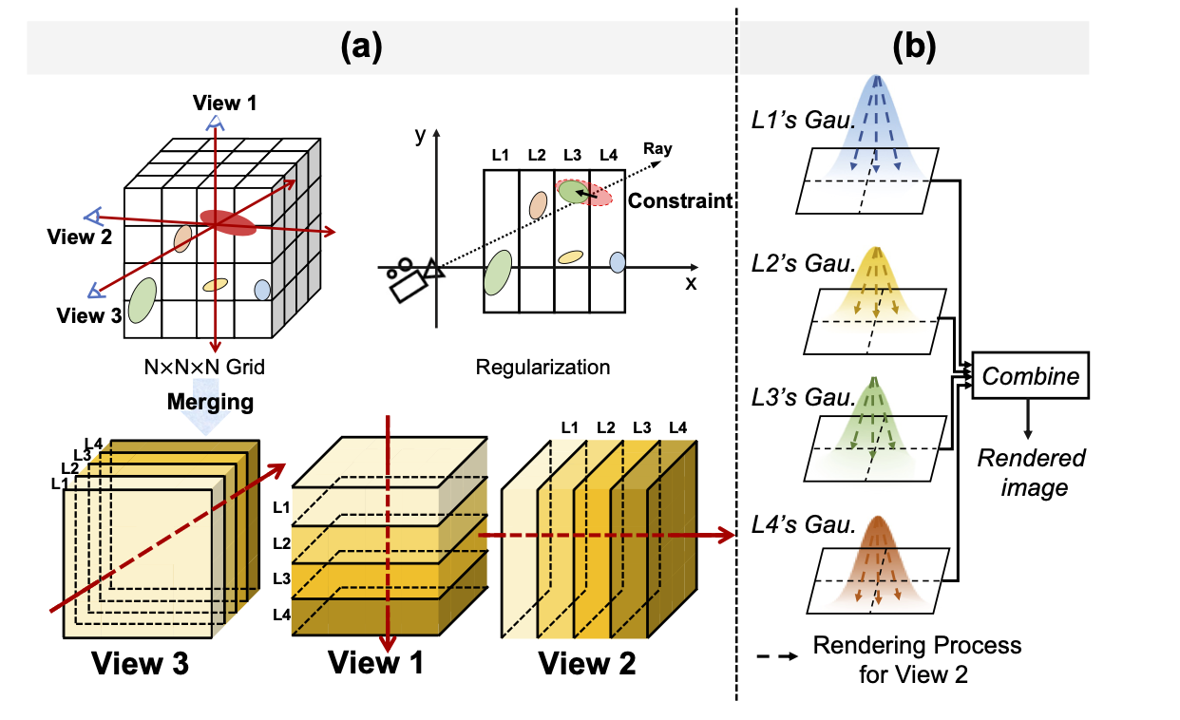
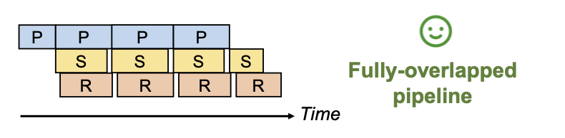
Solution II: Dynamic Orthogonal Partitioning (DOP)
Concept: Decomposes global preprocessing into independent layers based on camera view.
Mechanism: Enables inter-layer pipeline scheduling, hiding 63% of preprocessing latency.
CLDR Regularization: Ensures depth ordering and prevents cross-layer spillover during training

Slide 7
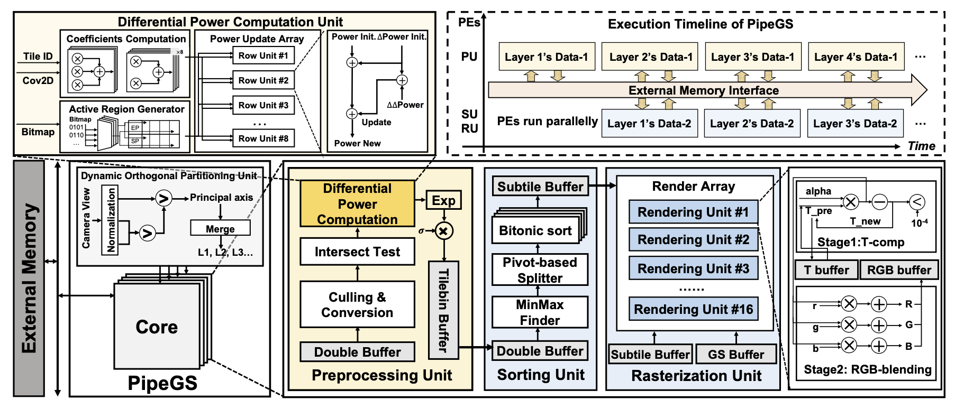
PipeGS: Layer-wise Pipelined Architecture
Four Dedicated Units: DOPU, PU, SU, and RU for concurrent execution.
Concurrency: While layer i is being sorted/rasterized, layer i+1 is being preprocessed.
Buffer Design: Double buffers for Gaussian parameters to maximize hardware utilization
Overview of PipeGS architecture.

Slide 8
Evaluation and Key Takeaways

Slide 9
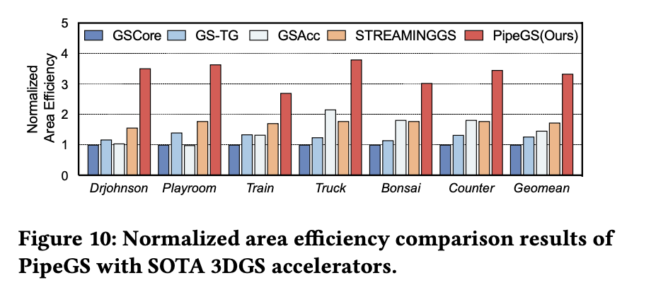
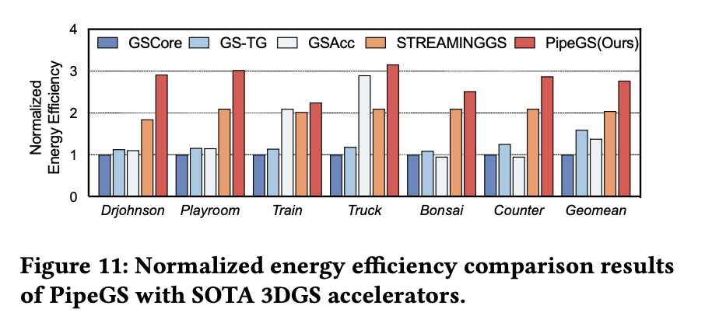
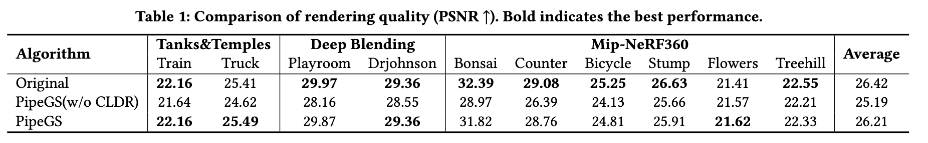
Experimental Results and Efficiency
Throughput: Achieves up to 2.85x end-to-end speedup over baseline.
Area Efficiency: 1.96–3.34x improvement compared to SOTA 3DGS accelerators.
Energy Efficiency: 1.20–2.77x higher than existing designs.
Quality: Maintains high fidelity with PSNR degradation within 1%

Slide 10
Conclusion: PipeGS unlocks full pipeline parallelism for 3DGS on edge platforms through algorithm-hardware co-design.

Slide 11

Thanks!

