Slide 1
Objectives
How to handle missing data in Python?
Explore data using graphics
Linear regression in Python
Cross-validation, create training and testing data in Python
Lasso in Python

Slide 2
Quality of a regression model
How to judge the quality of a regression model?
We look at two criteria:
Accuracy of prediction on future data: a bad model leads to poor prediction
Interpretation of the model: the simpler the model, the easier to explain the relationship between the response and features/predictors.
If accuracy of a model is bad can we really trust the interpretation?

Slide 3
Why We All Need Validation
Business Reasons
Need to choose the best model.
Measure accuracy/power of selected model.
Statistical Reasons
Model Building techniques are inherently designed to minimize “loss” or “bias”.
To an extent, a model will always fit “noise” as well as “signal”.
➔ If you just fit a bunch of models on a given dataset and choose the “best” one, it will likely be overly “optimistic”.

Slide 4
The Problem of Overfitting
Left to their own devices, modeling techniques will “overfit” the data.
Classic Example: multiple regression
Every time you add a variable to the regression, the model’s R² goes up.
Naïve interpretation: every additional predictive variable helps explain yet more of the target’s variance.
But that can’t be true!
Left to its own devices, Multiple Regression will fit too many patterns.
A reason why modeling requires subject-matter expertise.

Slide 5
The Perils of Optimism
Error on the dataset used to fit the model can be misleading
Doesn’t predict future performance.
Too much complexity can diminish model’s accuracy on future data.
Sometimes called the Bias-Variance Tradeoff.

Slide 6
The Bias-Variance Tradeoff
Complex model:
Low “bias”:
the model fit is good on the training data.
i.e., the model value is close to the data’s expected value.
High “Variance”:
Model more likely to make a wrong prediction.
Bias alone is not the name of the game.

Slide 7
The Bias-Variance Tradeoff
The tradeoff is quite generic.
Regression
# variables
Decision Trees
size of tree
K-NN
# neighbors k

Slide 8
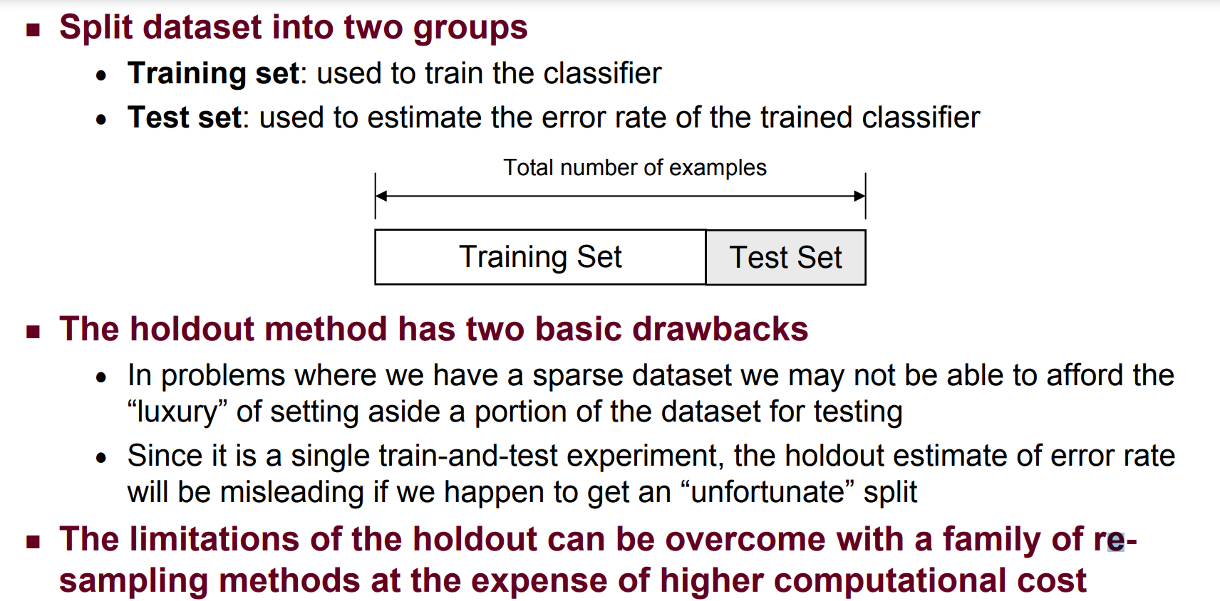
The holdout method

Slide 9
Cross-Validation
What if we don’t have enough data to set aside a test dataset?
Cross-Validation:
Each data point is used both as train and test data.
Basic idea:
E.g., Fit model on 90% of the data; test on other 10%.
Now do this on a different 90/10 split.
Cycle through all 10 cases.
10 “folds” a common rule of thumb.

Slide 10
Ten Easy Pieces
Divide data into 10 equal pieces P₁…P₁₀.
Fit 10 models, each on 90% of the data.
Each data point is treated as an out-of-sample data point by exactly one of the models.

Slide 11
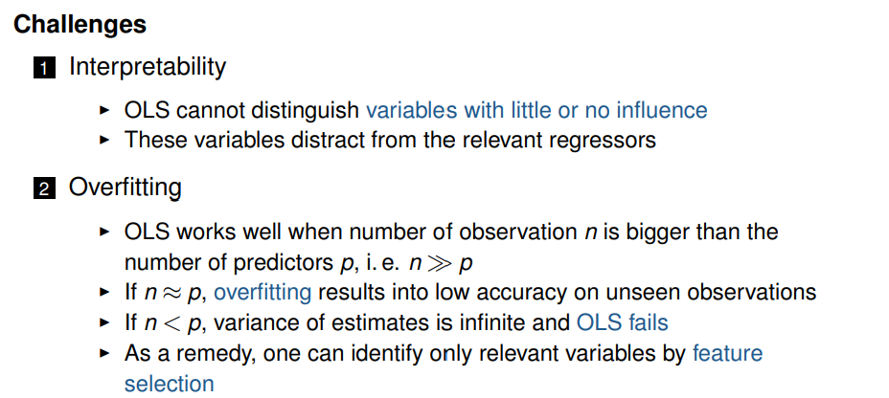
Motivation for Regularization
Linear models are frequently favorable due to their interpretability and
often good predictive performance
Yet, Ordinary Least Squares (OLS) estimation faces challenges

Slide 12
Fitting techniques as alternatives to OLS
Subset selection
Pick only a subset of all p variables which is assumed to be relevant
Estimate model with least squares using these reduced set of variables
Dimension reduction
Project p predictors into a d-dimensional subspace with d < p
These d features are used to fit a linear model by least squares
Shrinkage methods, also named regularization
Fit model with all p variables
However, some coefficients are shrunken towards zero
Has the effect of reducing variance

Slide 13
Regularization Methods
Fit linear models with least squares but impose constraints on the
coefficients
Instead, alternative formulations add a penalty in the OLS formula
Best known are ridge regression and LASSO (least absolute shrinkage
operator)
Ridge regression can shrink parameters close to zero
LASSO models can shrink some parameters exactly to zero
→ Performs implicit variable selection

Slide 14
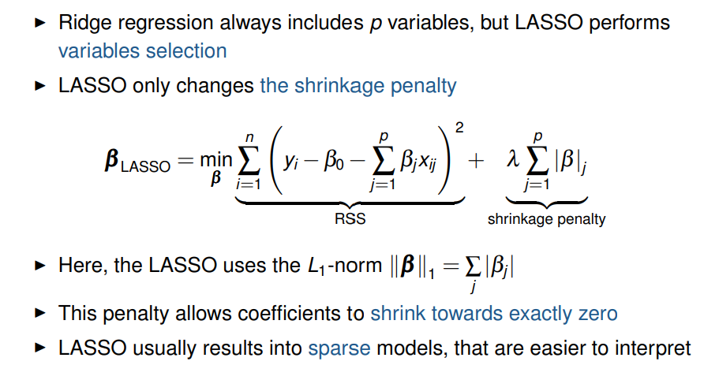
Least Absolute Shrinkage and Selection Operator (LASSO)

Slide 15
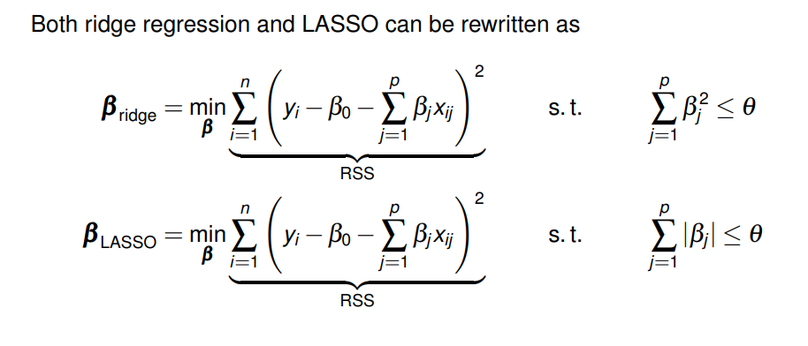
Comparison

Slide 16
Summary
Regularization methods
Regularization methods bring advantages beyond OLS
Cross validation chooses tuning parameter λ
LASSO performs variable selection
Cross validation finds the best approach for a given dataset

