Slide 1
Application of Artificial Intelligence in Predictive Maintenance
Bc. Jan Lukány
Supervisor: Ing. Tomáš Borovička
Department of Applied Mathematics
Faculty of Information Technology
Czech Technical University in Prague
June 17, 2020
Notes:
Vazena komise

Slide 2
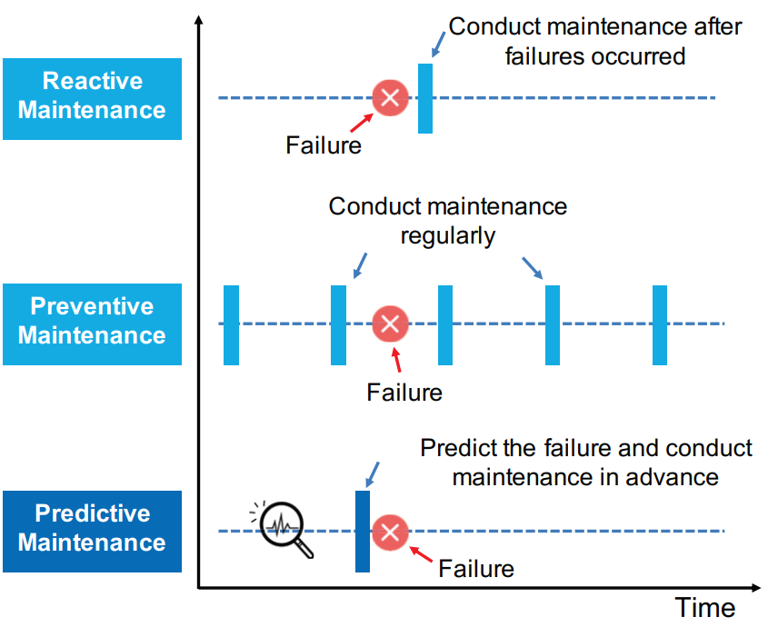
Motivation I
Why PdM?
Reduce costs
Avoid downtime
Why AI in PdM?
Automate subject’s condition assessment
Notes:
Strategie planovani, kde....
Oproti klasickym strategiim jako… setri naklady… a hlavne zabranuje prostojům

Slide 3
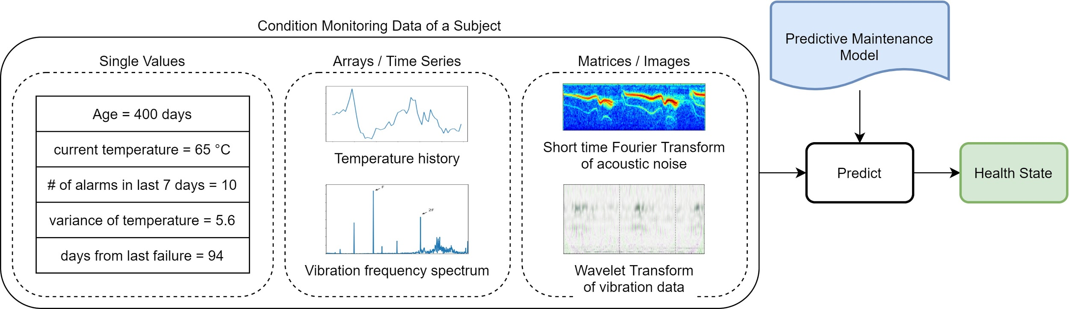
Motivation II
Use historical data to build a machine learning model that predicts condition of a subject.
Notes:
Pomocí UI… prediktivní model, který na základě zdravotních dat… predikuje stav subjektu subjektu - tedy jestli trpí závadou, zbývající životnost...

Slide 4
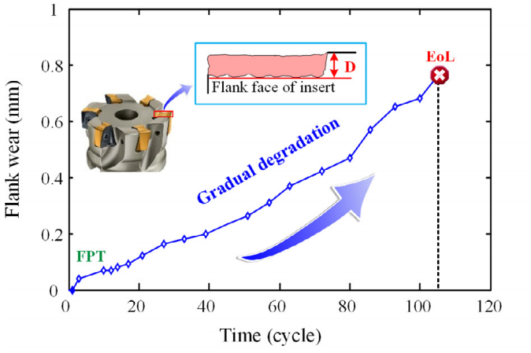
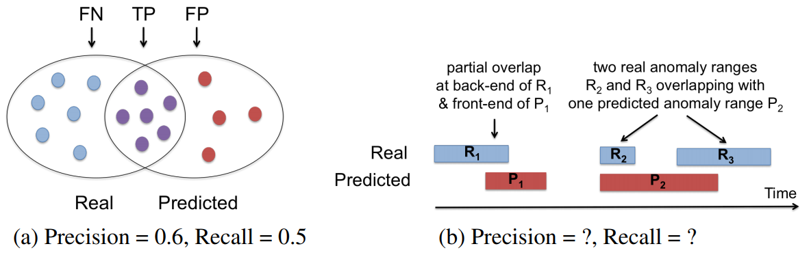
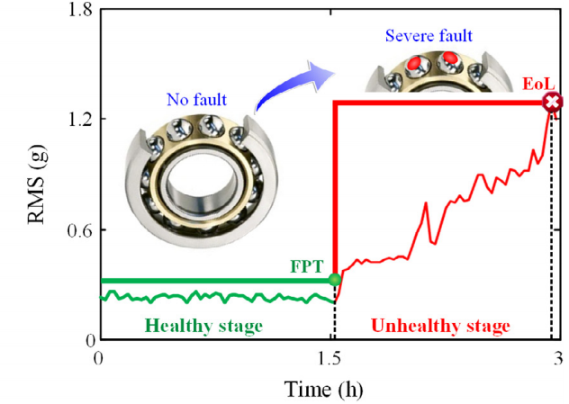
Challenges of AI in PdM
operational profiles of subjects can differ
different type of data is available
run-to-failure vs healthy/faulty
non-trivial evaluation
Notes:
Existují různé typy degradace / operační profily….
K dispozici může být různý typ dat - běh do selhání
Najednou se zacne projevovat

Slide 5
Goals of the Thesis
Review approaches to predictive maintenance
AI modeling techniques
Evaluation metrics
Conduct experiments on real-world publicly available data sets
Demonstrate the approaches
Compare their evaluation metrics

Slide 6
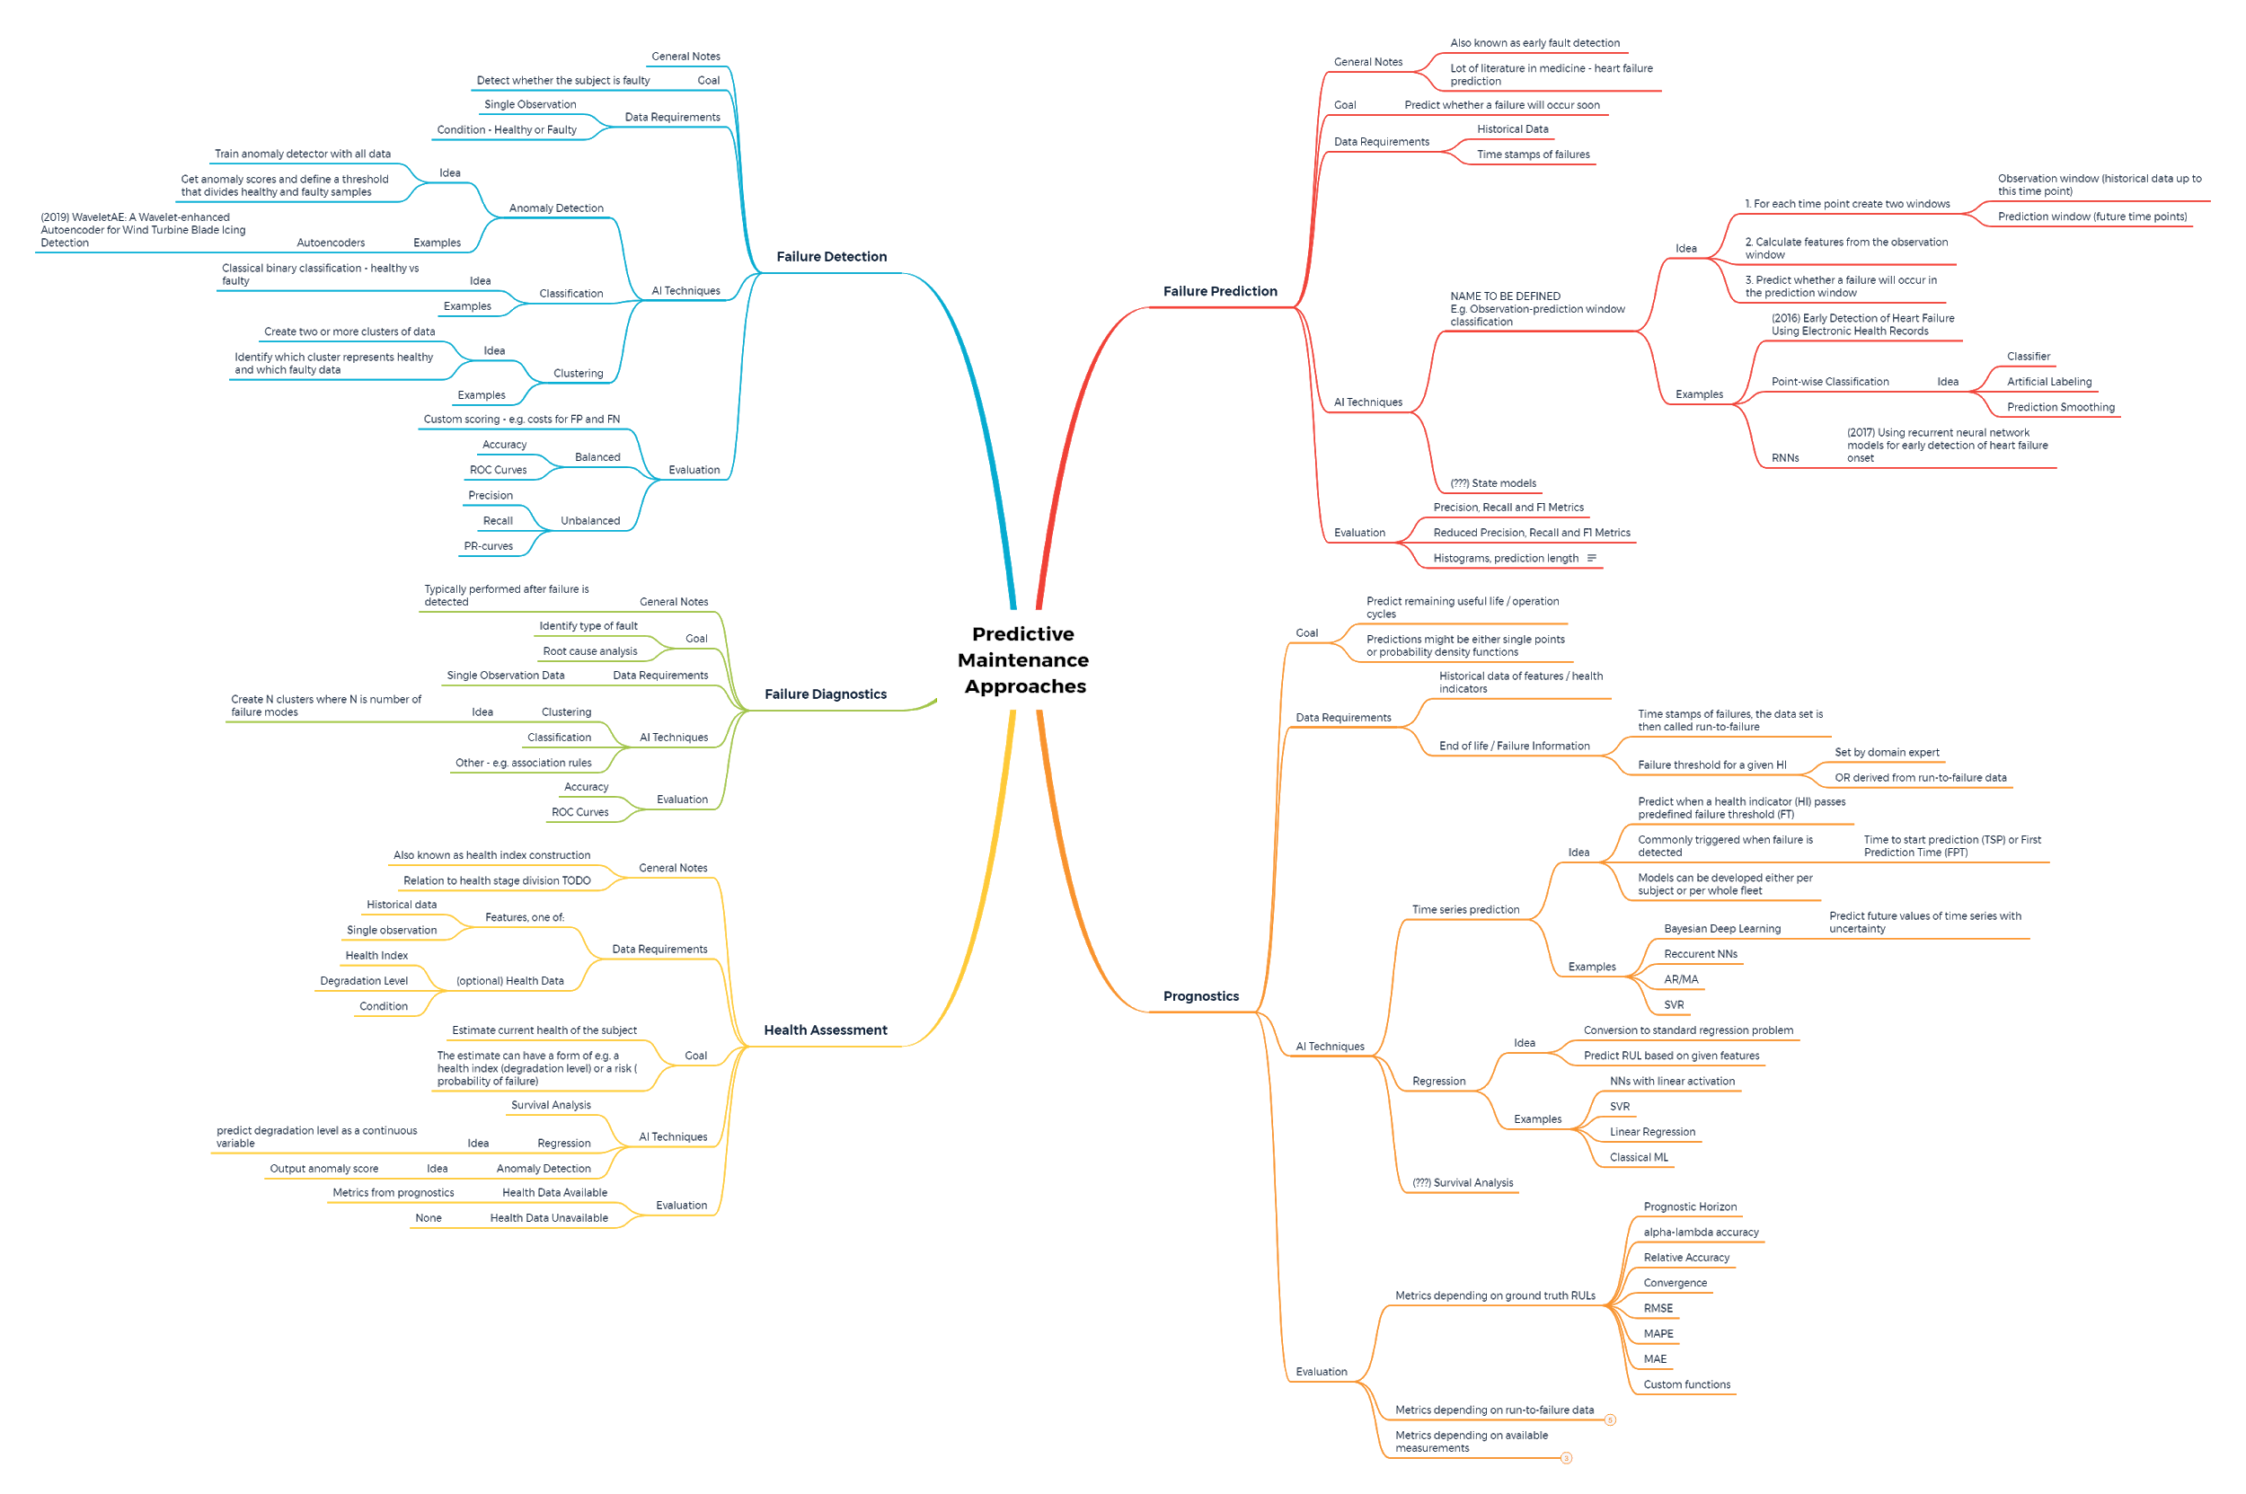
Literature review
Over 50 related articles
No consent in terminology
Multiple approaches using the same modeling techniques and vice versa
Unified into three main categories:
Fault detection
Failure prediction
Remaining useful life prediction
Notes:
Zduraznit, ze unifikace a definovani trech kategorii bylo soucasti prace - vcetne data requirements modeling techniques

Slide 7
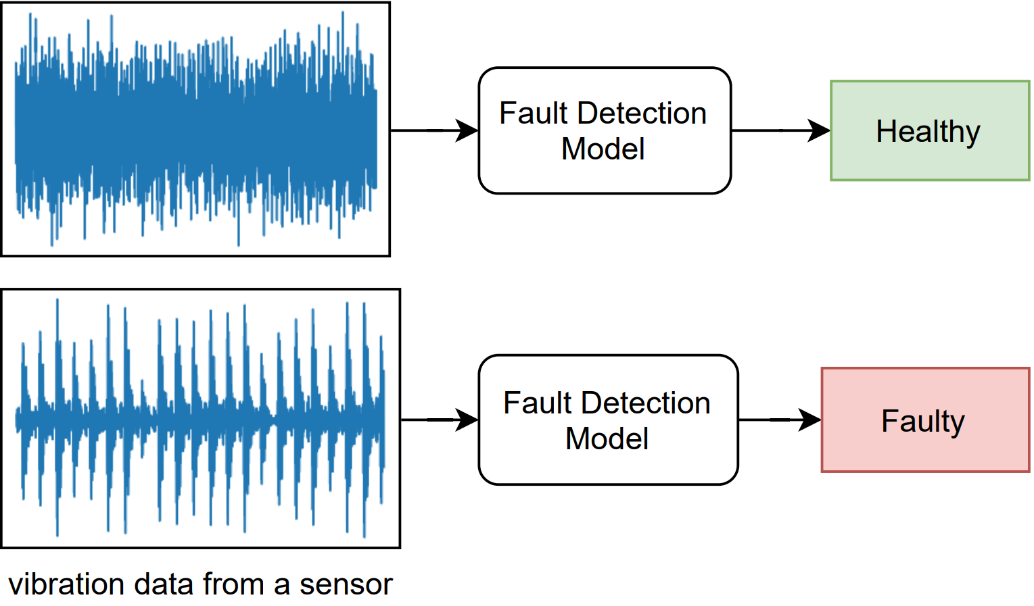
A) Fault Detection
Question
Is the subject malfunctioning?
Data
healthy/faulty samples
Modeling
binary classification
anomaly detection
Evaluation
precision and recall
AUROC, AUPR(G)

Slide 8
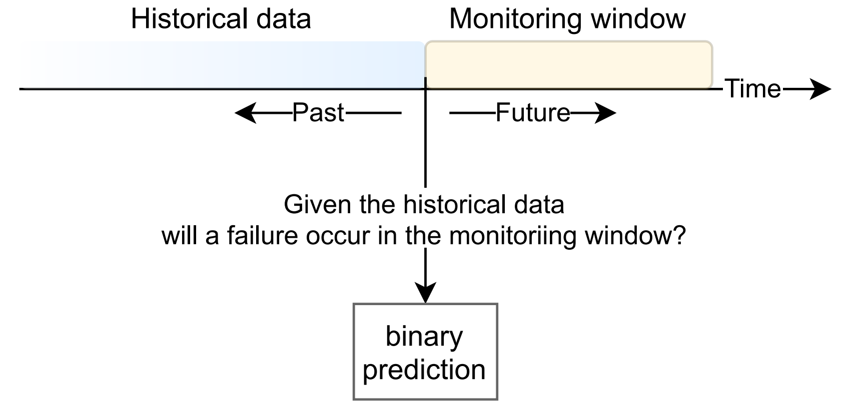
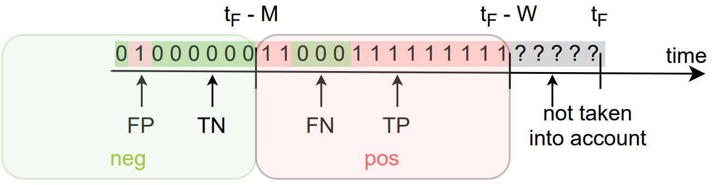
B) Failure Prediction
Question
Will the subject fail soon?
Data
run-to-failure
Modeling
classification with artificial labeling
Evaluation
modified precision and recall
proposal of new metrics
time of failure
Notes:
Obrazek zjednodusit
Predstavte si … jak daleko olabelovat

Slide 9
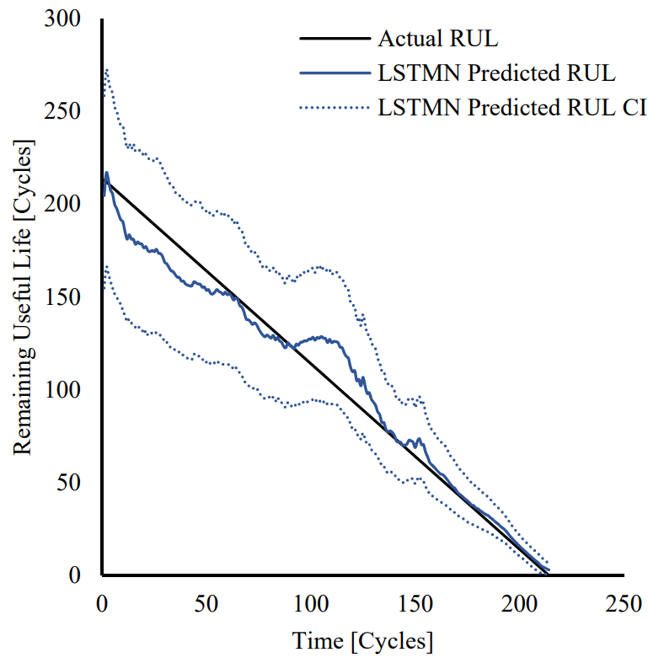
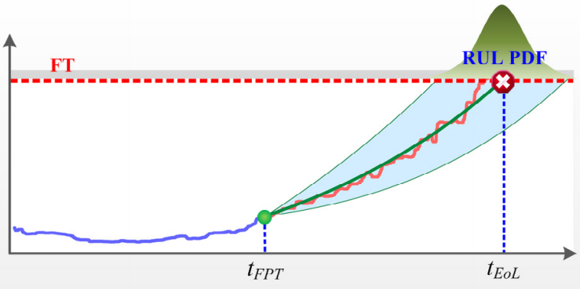
C) Remaining useful life prediction
Question
How much time is left until a failure?
Data
run-to-failure
health index with failure threshold
Modeling
regression
time series prediction
Evaluation
MAE, RMSE, MAPE
metrics relative to RUL

Slide 10
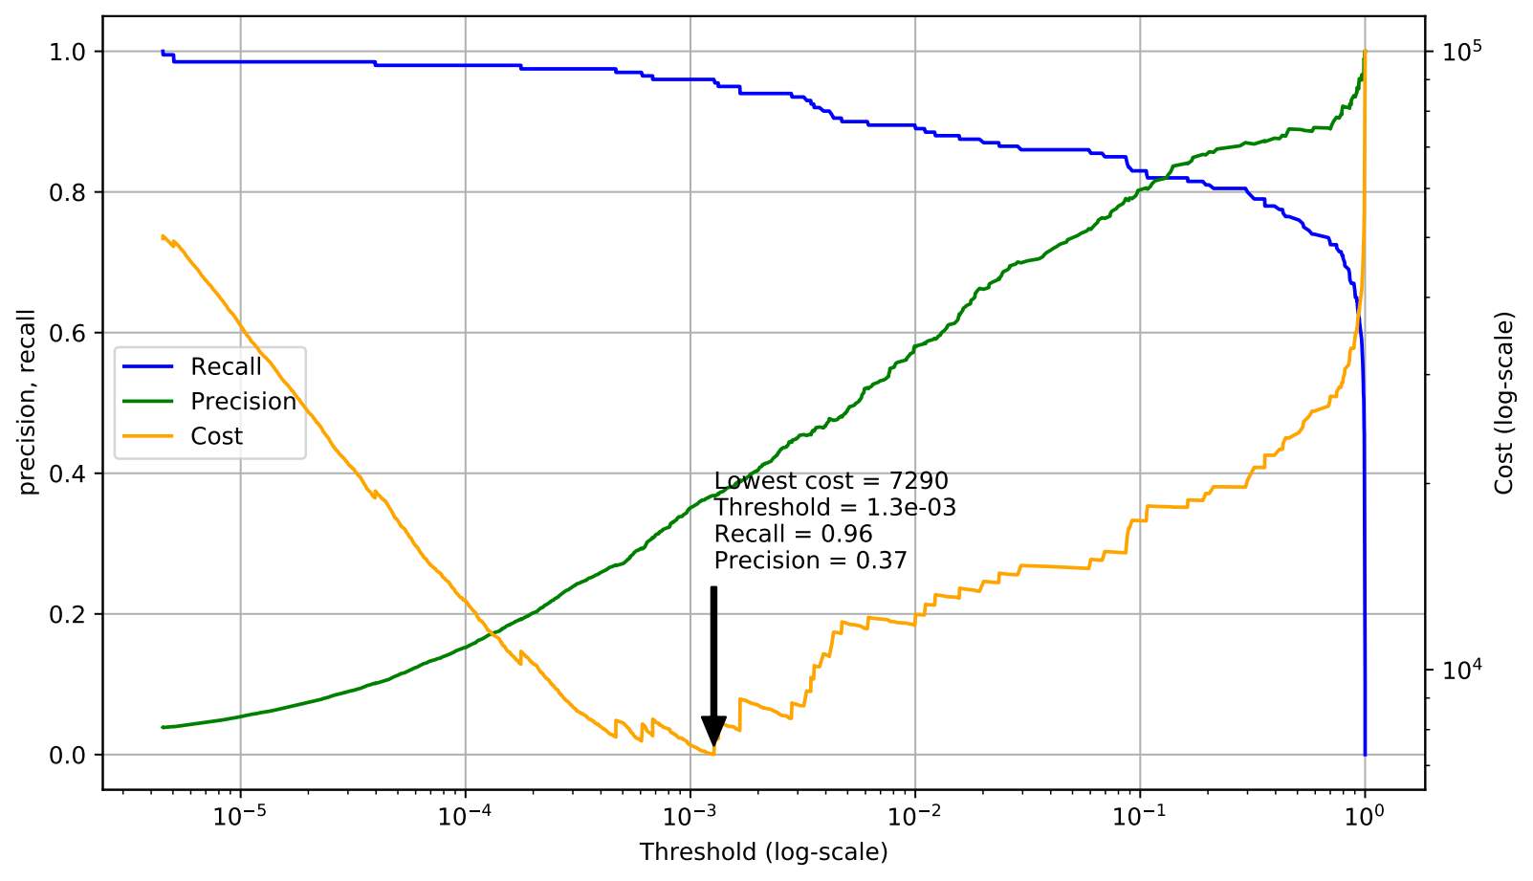
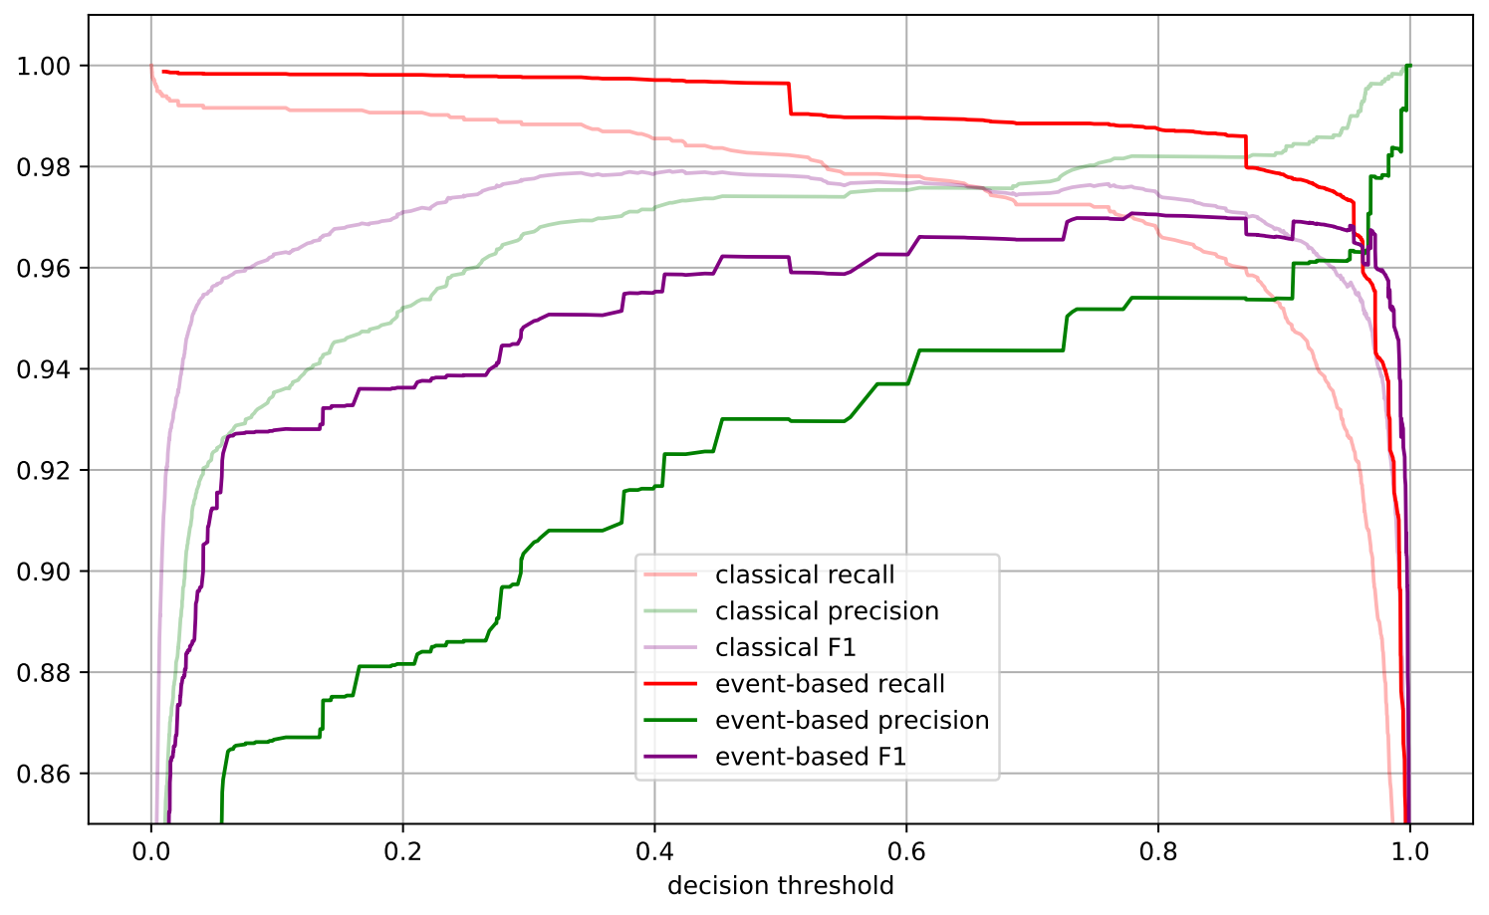
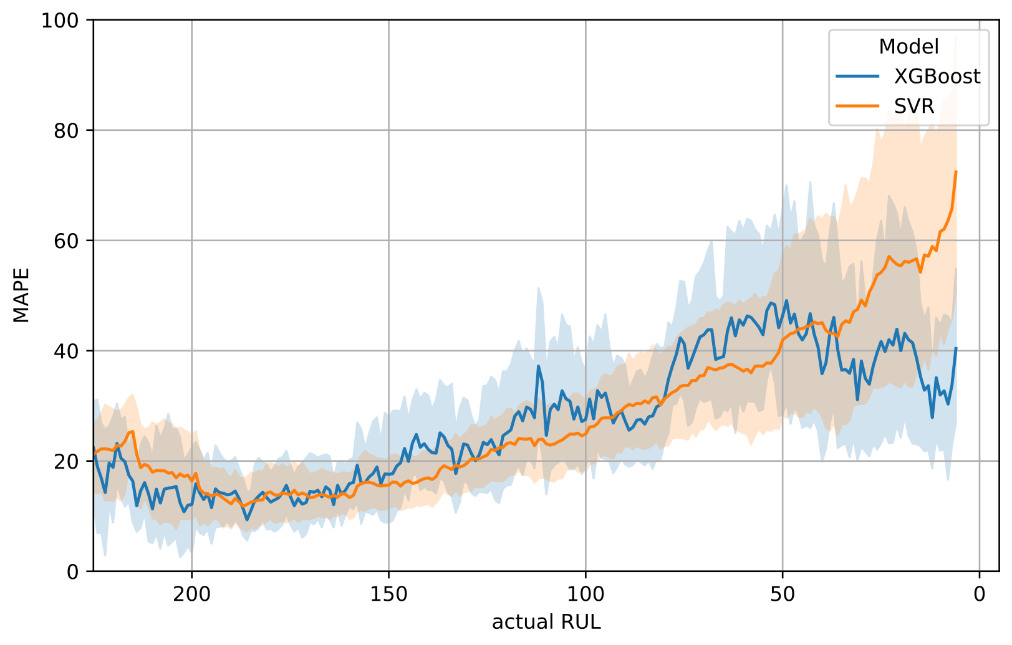
Experiments
Suitable dataset for every approach
real-world publicly available
Demonstration of the approaches
Comparison of evaluation metrics
ranking of multiple models
decision threshold selection / RUL prediction
Notes:
Vpravo dole, separate slide

Slide 11
Experiments: Example

Slide 12
Conclusion
Reviewed tens of articles about AI in PdM
Identified three main approaches
AI modeling techniques
evaluation metrics, proposal of new metrics for failure prediction
Experiments
demonstration on real-world publicly available datasets
comparison of evaluation metrics
Future research
analyze behaviour of the metrics with respect to
their parameters (e.g. existence vs overlap)
more datasets (when available)
different families of ML algorithms
Notes:
Domnivam se, ze zkoumane metriky by mohly vykazovat ruzne chovani pro ruzne rodiny algoritmu strojoveho uceni. Navic je u nekterych metrik, hlavne u metrik pro failure prediction, vicero parametru, jejich senzitivita na konkretni problemy by

Slide 13
Reviewer’s Questions
Q: Existují i další dostupné datasety, nebo jste v experimentech využil všechny, které jste našel?
Q: Nechystáte se práci publikovat?
Notes:
Existuji, ale je jich opravdu malo a mnohdy nejsou kvalitni. Proto jsem peclive zvazil, ktere v experimentech pouziji a domnivam se, ze pridanim dalsich by se nezvysila kvalita prace.

Slide 14
Discussion

