Slide 1

A Source-Code-Level Debugging Tool for Operating Systems Supporting the Rust Language
Chen Zhiyang (Presenter)
Beijing Technology and Business University
GitHub：https://github.com/chenzhiy2001/code-debug
Notes:
Hi everyone, I’m Chen Zhiyang from Beijing Technology and Business University and today I’m going to introduce the project we’re doing, which is a source-level debugging tool for operating systems supporting the rust language.

Slide 2

1
System Framework
2
Key Problems Solved
CONTENTS
3
Implementation
4
Application Cases
Notes:
And I will explain what we’re doing in four parts. The first being system framework, then key problems we have solved, after that we will explain 3 implementation techniques, finally then will introduce three impl

Slide 3
System Framework
Key Problems Solved
Implementation
I
Implementation II
Implementation III
Application Cases
Introduction
Research Background:
In the current field of Rust OS development, there is a lack of a source-code-level debugging tool. This results in high costs for setting up experimental environments, a steep learning curve, and poses challenges for learning and developing Rust OS kernel work.
Design Objective:
Develop a source-code-level debugging tool that supports Rust OS kernel development.
It should offer static breakpoint debugging (across both user space and kernel space) plus dynamic tracing.
The system is based on a client/server remote debugging and integrated development environment, supporting both Qemu and actual hardware.
Notes:
首先说下我们的研究背景，就是
我们的设计目标是
那这个调试工具是可以支持
最后，我们希望这套调试工具是
这个地方要讲通顺，不能结巴

Slide 4
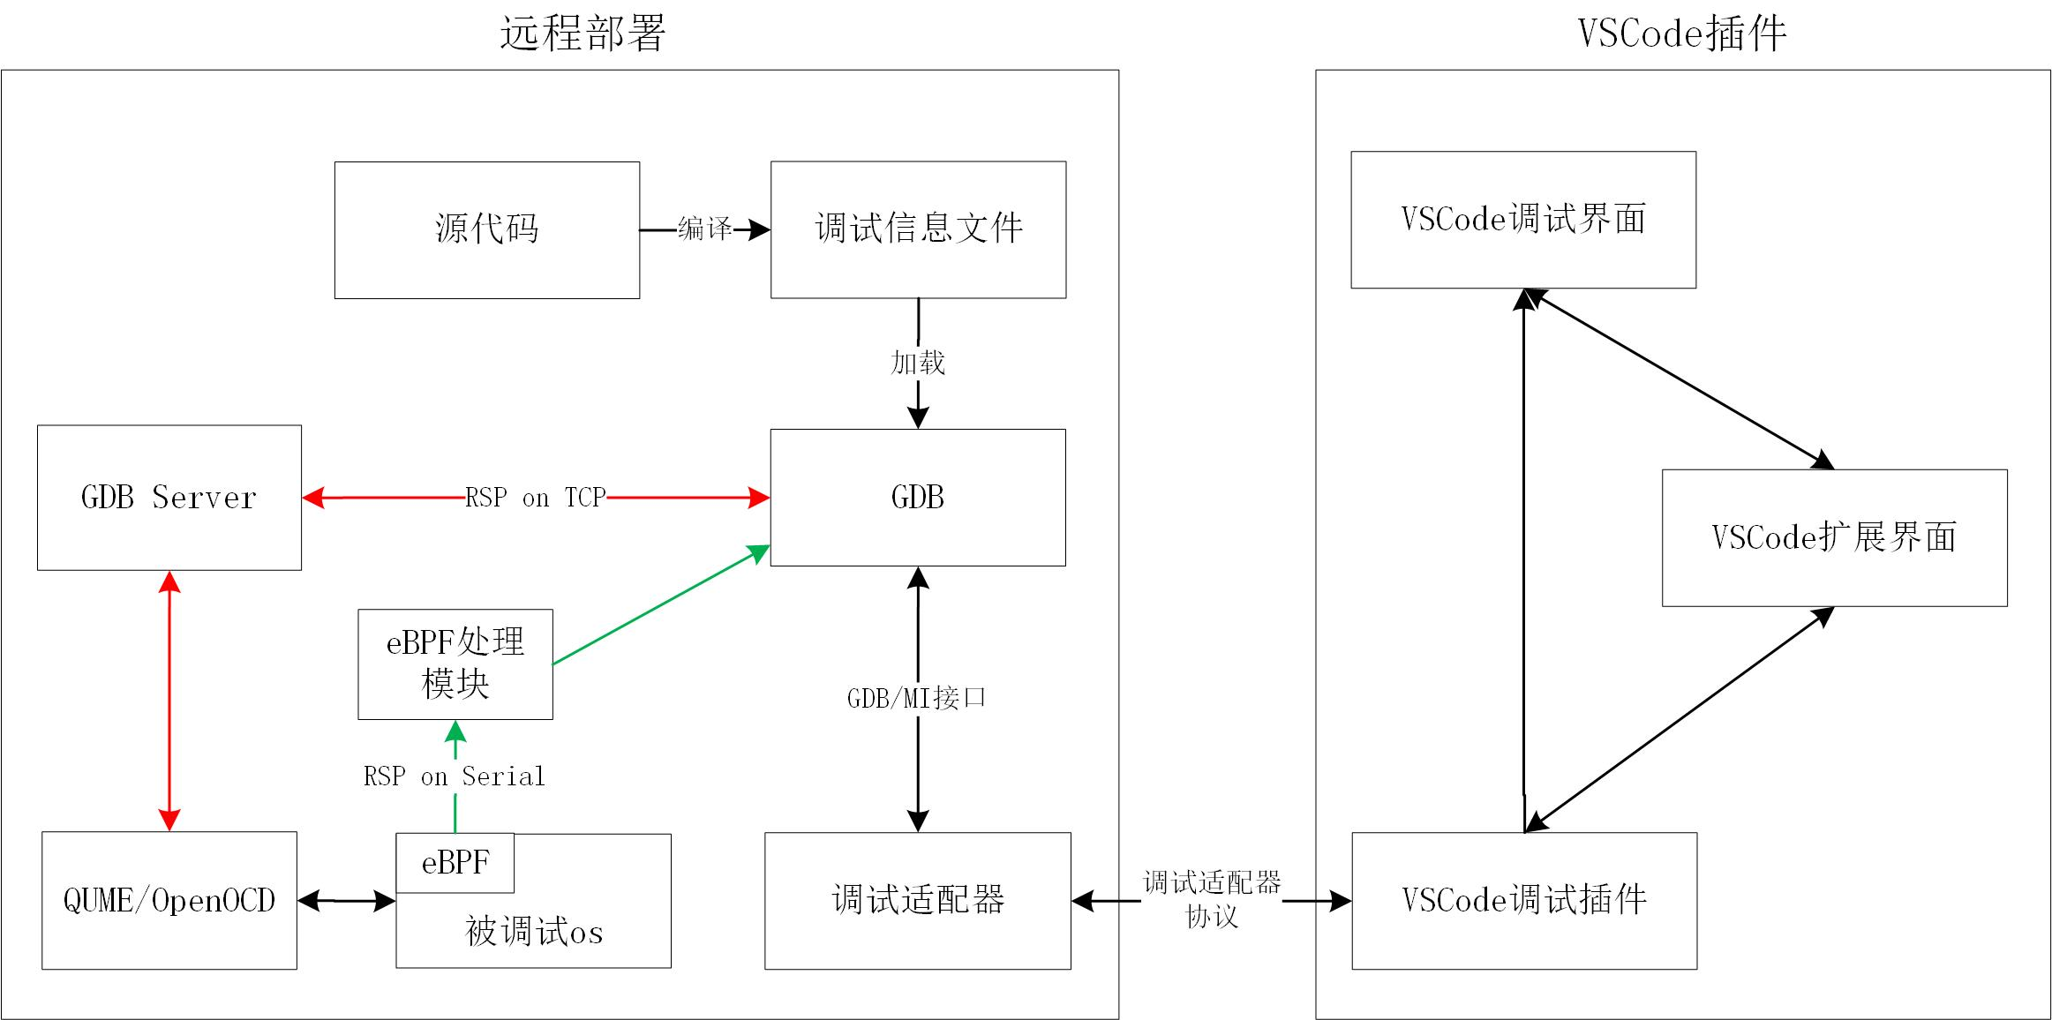
System Framework
Key Problems Solved
Implementation
I
Implementation II
Implementation III
Application Cases
System Framework:
1.Remote Development Environment
2. Server:
Qemu/Hardware
GDB
Source Code
3. Client (Browser):
Code Caching
Debugging Interface
Notes:
接下来我讲一下本项目的系统框架结构。我们是一个远程开发环境，所以在服务器上部署…
客户端是一个网页版VSCode，里面保存了缓存的代码，还有我们通过一个VSCode插件实现的调试界面
那这里面比较特别的是，我们有两种调试技术，就是GDB断点和 eBPF 同时使用。大家可以看红色这条线是GDB的，绿色这条路径是eBPF调试技术。
被调试的OS有eBPF。如果没有的话，也可以用GDB断点，二者互补。

Slide 5
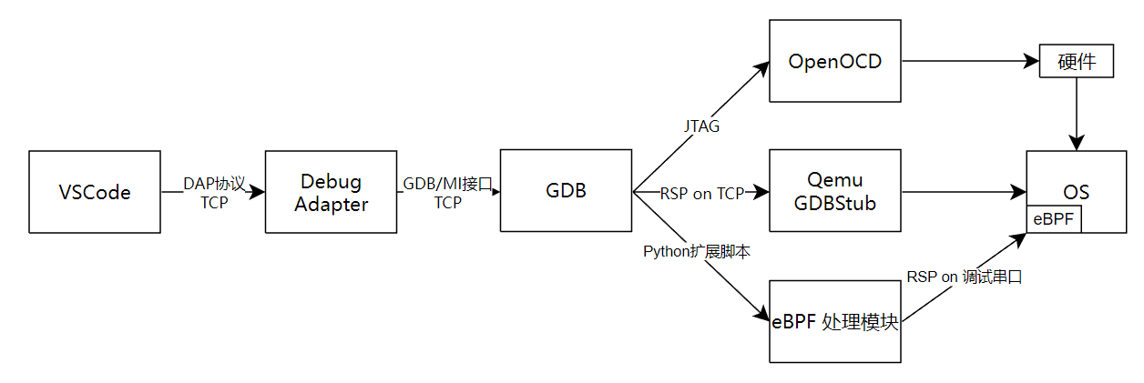
System Framework
Key Problems Solved
Implementation
I
Implementation II
Implementation III
Application Cases
System Framework Structure:
4. Integration of Data Flow between VSCode, GDB, and eBPF
Notes:
然后就是，我们在VSCode内整合了刚才提到的两种调试技术发送的调试信息。比如在这张图里面。一个GDB可以同时连接两个gdbserver. 这样就可以同时使用多种调试技术。这里，eBPF，OpenOCD和Qemu都作为一个GDBServer，通过RSP协议进行通信

Slide 6
System Framework
Key Problems
Implementation
I
Implementation II
Implementation III
Application Cases
Key Problems Solved
1、Based on QEMU and GDB, support source-code-level tracing and debugging across kernel space and user space;
breakpoint group switching, privilege level detection, multiprocess support, and configuration parameterization
2、Using eBPF, enable performance analysis and detection across kernel and user space on development boards;
porting the eBPF virtual machine, kprobe, and uprobe to rCore-Tutorial and modularizing uprobe
3、Construct a remote development environment based on VSCode that integrates breakpoint debugging and performance detection.
Integrate data flows among VSCode, GDB, and eBPF while supporting both Qemu and actual hardware

Slide 7
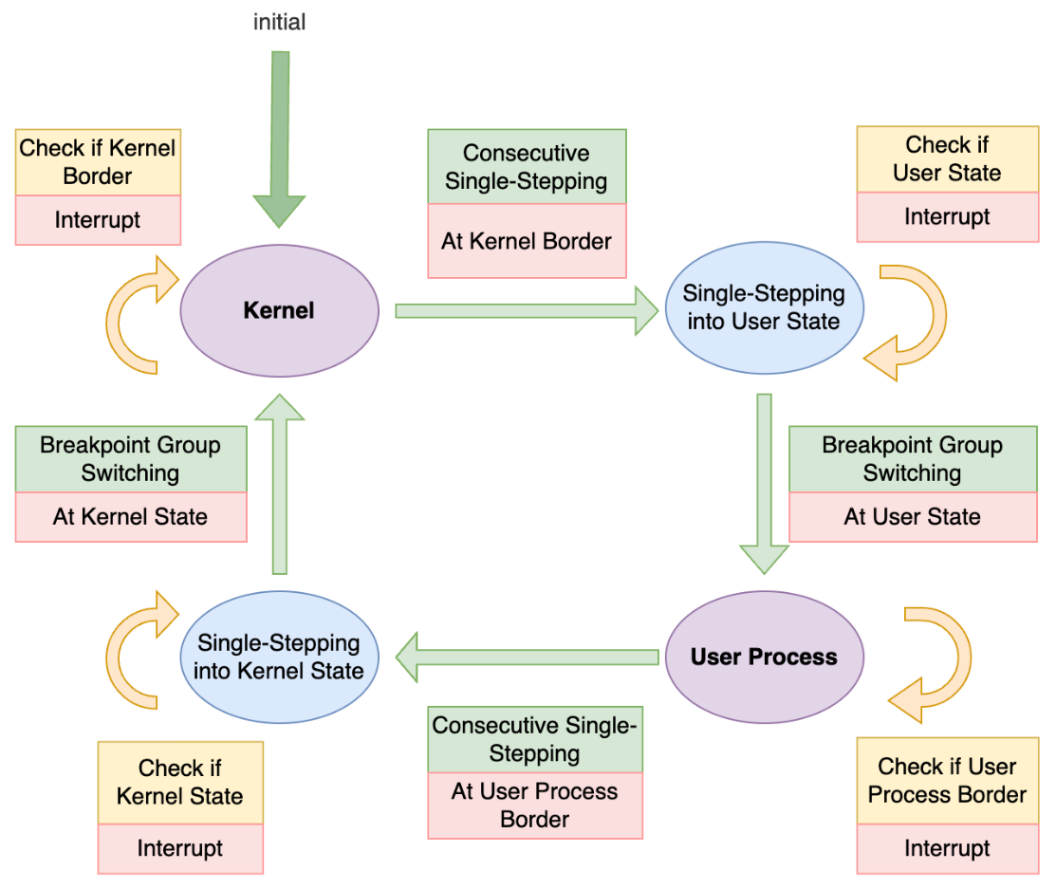
System Framework
Key Problems Solved
Implementation
I
Implementation II
Implementation III
Application Cases
Based on QEMU and GDB, support source-code-level tracing and debugging across kernel space and user space
Breakpoint groups
Exit breakpoints
Hook breakpoints
Breakpoint Group Management Module
Switching the symbol table is based on the process name; therefore, it is necessary to obtain the name of the next process to be executed.
A hook breakpoint is set before the privilege level switch, and after stepping over, both the symbol table and breakpoints are switched, thereby circumventing GDB’s single address space limitation.
Notes:
设计断点组功能，实现内核态与用户态的符号表动态切换
Breakpoint groups 断点组功能与多进程支持
Exit breakpoints
Hook breakpoints
特权级切换时，符号表和断点都切换
“多个用户进程的符号表切换”是其中的一个工作
在调试多进程中，符号表的切换需要根据进程名称来切换，要进行进程切换，就要获取下一个要执行进程的名称。
在内核切换到用户态之前的最后几行代码设断点，单步执行，切换符号表和断点，从而绕过GDB的单地址空间限制

Slide 8
System Framework
Key Problems Solved
Implementation
I
Implementation II
Implementation III
Application Cases
Based on eBPF, support performance analysis and detection across kernel and user space on development boards；
Porting work of eBPF in rCore-Tutorial (porting the eBPF virtual machine to execute eBPF bytecode)
Porting of kprobe (which supports kernel function instrumentation) and uprobe (which supports user space function instrumentation)
Modularization of uprobe, with attempts to address the challenge of multi-OS support
eBPF Data Output:
In order to debug eBPF on the debugging interface, eBPF debugging data needs to be output to VSCode.
A dedicated serial port is used for information output, which minimally impacts the OS.
To work together with the existing GDB breakpoints, the eBPF debugging data is fed into GDB, which then transfers it to VSCode.
Code Implementation:
QEMU: Modify the initialization code to support a second serial port.
SBI: Relax physical memory protection (PMP).
OS: Implement an MMIO-based serial port output function
GDB: Use a Python extension script to receive eBPF data.
Notes:
1. 在“双页表”设计的OS中，内核访问用户地址空间需要通过用户程序页表进行地址转换
2. 不同OS的页表管理API不同
有的以页区间为单位，有的以地址区间为单位
有的内存区间是左闭右开的，有的则是闭区间
3. Uprobe需要获取PCB，而PCB在一些OS中是独占借用，uprobe可能“借不到”
解决办法：调整内核代码中的借用顺序
4. TrapContext保存尽量多的寄存器

Slide 9
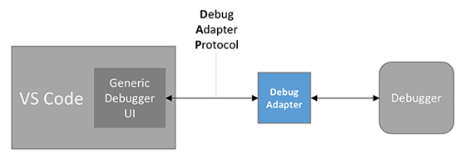
System Framework
Key Problems Solved
Implementation
I
Implementation II
Implementation III
Application Cases
A remote development environment is built on VSCode, combining breakpoint debugging and performance detection functionalities.
1. GDB integrates debugging information from Qemu/OpenOCD and eBPF (via a Python extension script) and transmits it to the Debug Adapter.
2. The Debug Adapter analyzes the data packets received from GDB, identifies the type of debugging information based on identifiers within the packets, and sends it to the corresponding processing module in the VSCode plugin.
A remote development environment based on VSCode is built, combining breakpoint debugging and performance detection.
Notes:
展开讲Debug Adapter怎么适配两种调试技术的
“异步消息”容易造成歧义，不用

Slide 10
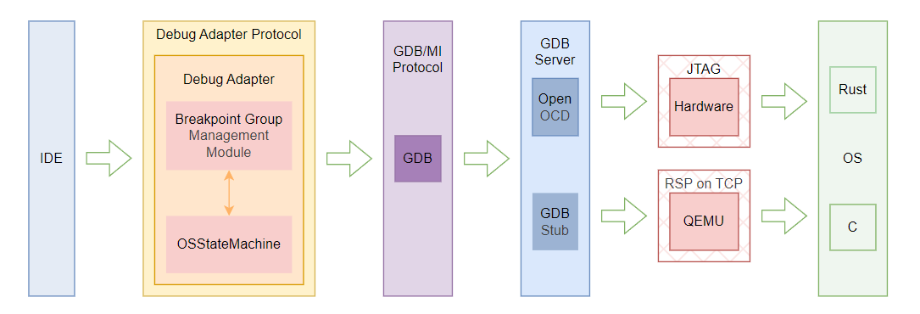
System Framework
Key Problems Solved
Implementation
I
Implementation II
关键术3
Application Cases
Implementation III
A remote development environment is built on VSCode, combining breakpoint debugging and performance detection functionalities.
2. Supporting Both QEMU and Actual Hardware
QEMU Debugging Support: Perform OS debugging on the virtual machine via the GDBStub (GDBServer) provided by QEMU.
Actual Hardware Debugging: Use the GDBServer provided by OpenOCD for debugging on real hardware.

Slide 11
System Framework
Key Problems Solved
Implementation
I
Implementation II
Implementation III
Application Cases
Application Case Demonstration:
Example: HTTP Server Application
Bug Description: Multiple tabs in the same browser request the same webpage from the server, but some tabs fail to display the page.
Debug Process: Use a combination of static breakpoint debugging and dynamic tracing to narrow down the issue and ultimately pinpoint the faulty code.
Video Demonstration
Notes:
讲清楚bug再放视频。

Slide 12
Thank You！

