Slide 1

A Source-Level Debugging Tool for Operating Systems Supporting the Rust Language
Chen Zhiyang (Presenter)
Beijing Technology and Business University
GitHub：https://github.com/chenzhiy2001/code-debug
Notes:
“Good morning. I’m Zhiyang Chen from Beijing Technology and Business University. Today I present our project, ‘A Source-Level Debugging Tool for Operating Systems Supporting the Rust Language.’ If you want to try it later, the code is already on GitHub—link’s right here.
Hi everyone, I’m Chen Zhiyang from Beijing Technology and Business University and today I’m going to introduce the project we’re doing, which is a source-level debugging tool for operating systems supporting the rust language.
33

Slide 2

1
System framework
2
Key problems
CONTENTS
3
Implementation
4
Application
Notes:
I will first share the system framework, then the key problems we had to solve, next the implementation, and finally a quick application case. I’ll begin with why we started this work

Slide 3
System Framework
Key Problems Solved
Implementation
I
Implementation II
Implementation III
Application
Introduction
Research Background:
lack of convenient Rust-OS debugger;
Inconvenient environment setup.
Design Objective:
A source-code-level debugging tool that supports Rust OS kernel development.
Dynamic tracing and consistent breakpoint debugging across kernel and user space processes.
Remote, browser-based IDE; works on QEMU & real boards..
Notes:
Rust is getting popular for OS work, but there’s still no handy debugger for full Rust kernels. Also, Setting up development environments like toolchains is painful, and debuggers will break whenever the OS switches between kernel mode and user mode. So those obstacles make our goal clear: We wanma build a tool that gives source-code breakpoints plus live tracing, works in both kernel and user processes, and runs inside a browser-based VS Code window—on QEMU or real RISC-V boards.
首先说下我们的研究背景，就是
我们的设计目标是
那这个调试工具是可以支持
最后，我们希望这套调试工具是
这个地方要讲通顺，不能结巴

Slide 4
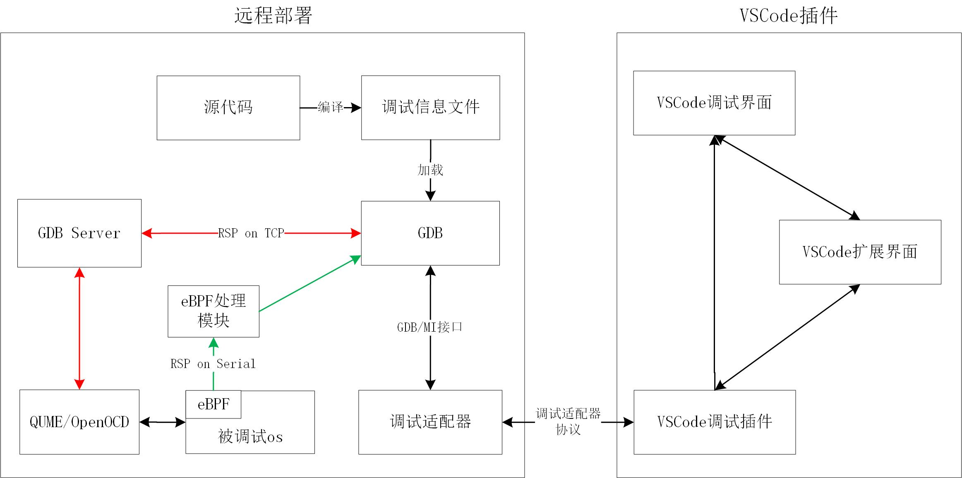
System Framework
Key Problems Solved
Implementation
I
Implementation II
Implementation III
Application
System Framework:
1.Remote
Development
Environment
2. Server:
Qemu/Hardware
GDB
Source code
3. Client (Browser):
Cached code
Debug UI
Remote Deploy
VSCode Extension
Source
Code
Debug
Symbol
VSCode
Debug UI
Compile
Load
GDBServer
VSCode
WebView
eBPF
GDBServer
GDB/MI
QEMU/
OpenOCD
Debug
Adapter
DAP
VSCode
Debug Module
OS
Notes:
Here’s the big picture of our project. On a remote dev box we run QEMU—or real hardware through OpenOCD—plus GDB and the source code. In the browser we have the VS Code. The two sides talk through our Debug Adapter. This means no heavyweight local install; you just open the page and debug.
接下来我讲一下本项目的系统框架结构。我们是一个远程开发环境，所以在服务器上部署…
客户端是一个网页版VSCode，里面保存了缓存的代码，还有我们通过一个VSCode插件实现的调试界面
那这里面比较特别的是，我们有两种调试技术，就是GDB断点和 eBPF 同时使用。大家可以看红色这条线是GDB的，绿色这条路径是eBPF调试技术。
被调试的OS有eBPF。如果没有的话，也可以用GDB断点，二者互补。

Slide 5
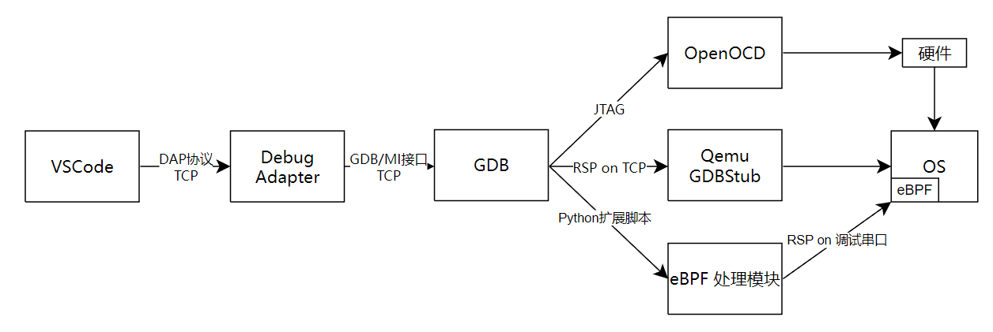
System Framework
Key Problems Solved
Implementation
I
Implementation II
Implementation III
Application
System Framework Structure:
4. Integration of Data Flow between VSCode, GDB, and eBPF
Hardware
DAP
over
TCP
GDB/MI
over
TCP
Python
script
RSP on serial
eBPF
GDBServer
Notes:
Here is another way of showing our project, here you can see one GDB instance connecting multiple GDBServers at the same time, we have implemented this so that we can use multiple debugging methods like GDB breakpoints and eBPF profiling at the same time.
然后就是，我们在VSCode内整合了刚才提到的两种调试技术发送的调试信息。比如在这张图里面。一个GDB可以同时连接两个gdbserver. 这样就可以同时使用多种调试技术。这里，eBPF，OpenOCD和Qemu都作为一个GDBServer，通过RSP协议进行通信

Slide 6
System Framework
Key Problems
Implementation
I
Implementation II
Implementation III
Application
Key Problems Solved
1、Based on QEMU and GDB, support source-level debugging across kernel/user state;
breakpoint group switching, multiprocess support & configuration parameterization
2、Using eBPF, enable performance analysis and detection across kernel and user state on development boards;
porting the eBPF virtual machine, kprobe, and uprobe to rCore-Tutorial & modularizing uprobe
3、Construct a remote development environment based on VSCode that integrates breakpoint debugging and performance analysis.
Integrate data flows among VSCode, GDB, and eBPF while supporting Qemu & real hardware
Notes:
Our debugging tool solves three key issues:
First, we enabled debugging across the kernel and user processes, solving the issue of debugging context changing when page table switches.
Second, we used eBPF to add dynamic tracing and performance analysis.
Third, we built everything into one IDE. It integrates breakpoint debugging, dynamic tracing, and performance analysis, and it works consistently whether you’re debugging in QEMU or on actual hardware.

Slide 7
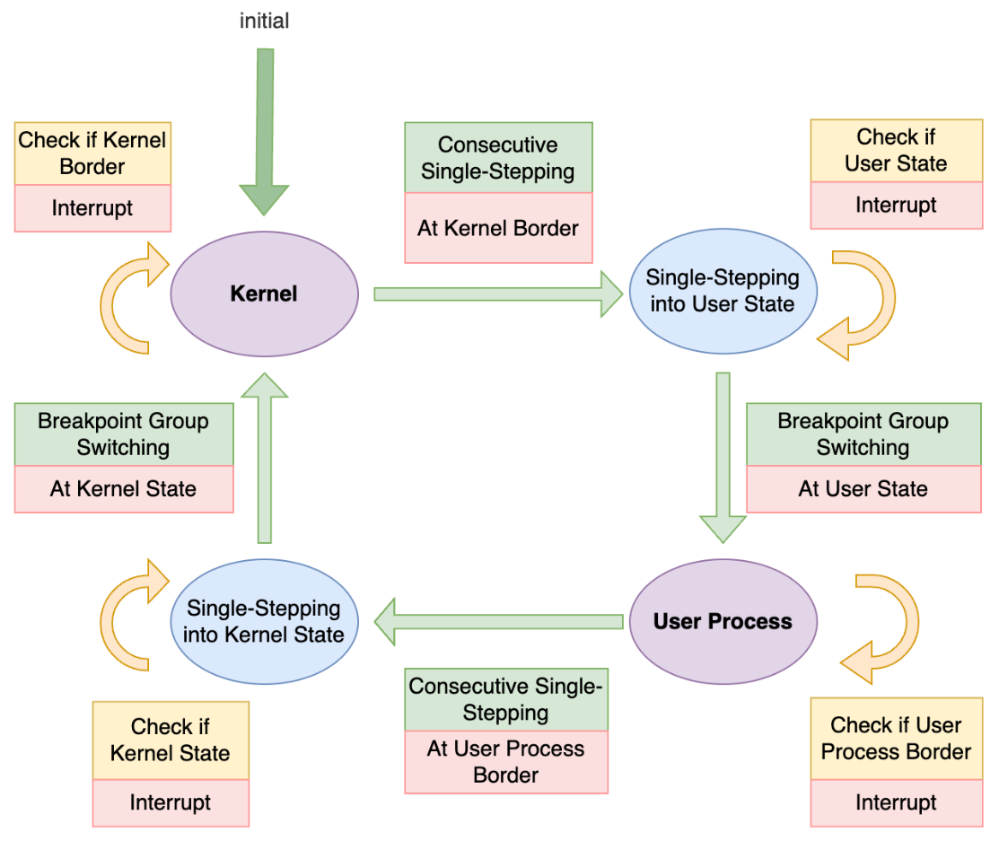
System Framework
Key Problems Solved
Implementation
I
Implementation II
Implementation III
Application
Based on QEMU and GDB, support source-level debugging across kernel/user state
Breakpoint Group Management Module
Breakpoint groups
Avoid GDB’s limitation of cross-pagetable debugging
Exit breakpoints
Enable breakpoint group switching
Hook breakpoints
Get next process name in advance;
Vital for multiprocess debugging
Notes:
Let me explain how we handle breakpoints between kernel and user space. We have explained this issue in detail in our paper. I’ll give you an overview here.
Normally, GDB can't handle debugging across different page tables. To overcome this, we designed the "Breakpoint Group Management" module.
We group breakpoints based on their address spaces. When switching between kernel and user-space processes, we use special breakpoints called "Exit breakpoints" as a signal to switch these groups. Switching breakpoint groups and their corresponding symbol tables is based on the process name; so, it is necessary to obtain the name of the next process to be executed before it was being switched. That’s why we have "Hook breakpoints“. It will fetch kernel context to helps us automatically figure out the next process to debug. This way, we can smoothly debug multi-process scenarios without limitations.
A hook breakpoint is set before the privilege level switch, and after stepping over, both the symbol table and breakpoints are switched, thereby circumventing GDB’s single address space limitation.
设计断点组功能，实现内核态与用户态的符号表动态切换
Breakpoint groups 断点组功能与多进程支持
Exit breakpoints
Hook breakpoints
特权级切换时，符号表和断点都切换
“多个用户进程的符号表切换”是其中的一个工作
在调试多进程中，符号表的切换需要根据进程名称来切换，要进行进程切换，就要获取下一个要执行进程的名称。
在内核切换到用户态之前的最后几行代码设断点，单步执行，切换符号表和断点，从而绕过GDB的单地址空间限制

Slide 8
System Framework
Key Problems Solved
Implementation
I
Implementation II
Implementation III
Application
Using eBPF, enable performance analysis and detection across kernel and user state on development boards；
eBPF Data Output:
eBPF debugging data needs to be sent to VSCode without interfering with default serial port
A dedicated serial port is used for information output, which minimally impacts the OS.
To work together with the existing GDB breakpoints, the eBPF debugging data is fed into GDB, which then transfers it to VSCode.
Code Implementation:
QEMU: Modify the initialization code to support a second serial port.
SBI: Modify physical memory protection (PMP).
OS: Implement an MMIO-based serial port output function
GDB: Use a Python extension script to receive eBPF data.
Notes:
Next, we use eBPF for dynamic tracing and performance checks on real hardware.
Since eBPF debugging data needs its own channel without interfering with default output, we added an extra serial port to QEMU specifically for eBPF outputs. We modified the hardware initialization code and memory protection (PMP) settings to support this new port., and GDB receives these data packets through a Python script. This approach is clean and doesn't affect normal OS execution.
1. 在“双页表”设计的OS中，内核访问用户地址空间需要通过用户程序页表进行地址转换
2. 不同OS的页表管理API不同
有的以页区间为单位，有的以地址区间为单位
有的内存区间是左闭右开的，有的则是闭区间
3. Uprobe需要获取PCB，而PCB在一些OS中是独占借用，uprobe可能“借不到”
解决办法：调整内核代码中的借用顺序
4. TrapContext保存尽量多的寄存器

Slide 9
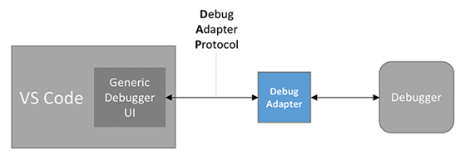
System Framework
Key Problems Solved
Implementation
I
Implementation II
Implementation III
Application
Construct a remote development environment based on VSCode that integrates breakpoint debugging and performance analysis
GDB integrates debugging information from
Qemu/OpenOCD
eBPF
The Debug Adapter
receives data packets from GDB
distribute to different modules in the VSCode plugin.
Notes:
Then, we integrated all this functionality into VSCode to create a complete remote debugging solution.
GDB collects debugging data from both QEMU/OpenOCD and eBPF. The Debug Adapter inside VSCode then organizes and distributes this data to different modules in the VSCode interface. This integration lets developers perform breakpoint debugging and dynamic tracing conveniently through one consistent UI.
展开讲Debug Adapter怎么适配两种调试技术的
“异步消息”容易造成歧义，不用

Slide 10
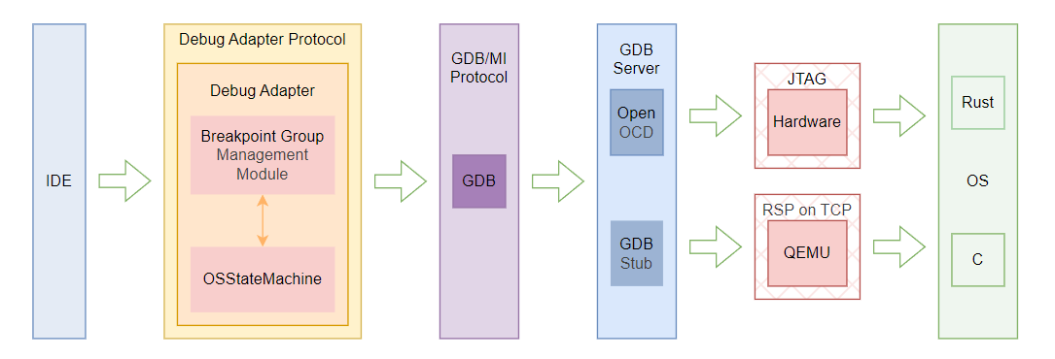
System Framework
Key Problems Solved
Implementation
I
Implementation II
关键术3
Application
Implementation III
Construct a remote development environment based on VSCode that integrates breakpoint debugging and performance analysis.
Supporting both QEMU and Real Hardware
QEMU Debugging Support: QEMU GDBStub.
Actual Hardware Debugging: OpenOCD JTAG GDBServer.
Notes:
This solution works seamlessly with both virtual and real environments.
When debugging on QEMU, we use its built-in GDBStub. For real hardware, we rely on OpenOCD with JTAG. Because of this design, users get exactly the same debugging experience no matter if they are using virtual machines or actual hardware.

Slide 11
System Framework
Key Problems Solved
Implementation
I
Implementation II
Implementation III
Application
Application Case Demonstration:
Example: HTTP Server Application
Bug Description: Multiple tabs in the same browser request the same webpage from the server, but some tabs fail to display the page.
Debug Process: Use a combination of breakpoint debugging and dynamic eBPF tracing to narrow down the issue and pinpoint the wrong codes.
Video
Notes:
To show how effective our tool is, let me share a quick example.
We tested it with an HTTP server application. The bug was tricky—when users opened multiple browser tabs requesting the same webpage, some tabs failed to load. Using our debugger, we combined static breakpoints and dynamic eBPF tracing. This allowed us to pinpoint exactly which part of the code caused the issue.
(Due to time constraints, I won't show the video here, but you can visit out github repo for that.)
讲清楚bug再放视频。

Slide 12
Thank You！
Notes:
Thank you very much for your attention! You can find our project on GitHub through the link here. I'm happy to answer any questions you might have.

