Slide 1
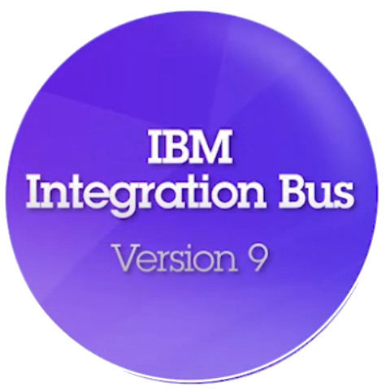
IBM Integration Bus Version 9
WebSphere ESB Conversion
Ben Thompson – IBM Integration Bus Architect – bthomps@uk.ibm.com

Slide 2
WESB Conversion Tool
A Strategic Reminder
Transfer Licensing and Modes of Operation
Possible Timelines
Integration Services and Architectural Concepts
Conversion Tool Walkthrough
Extensions and Advanced Topics

Slide 3
A Strategic Reminder
IBM Integration Bus is a natural evolution for WebSphere Message Broker users
  Significant innovation and evolution of WMB technology base
Designed to incorporate WebSphere Enterprise Service Bus use cases
  Capabilities of WESB are folded in to IBM Integration Bus over time
  Conversion tools for initial use cases built in to IIB from day one
  WESB technology remains in market, supported. Migrate to Integration Bus when ready
WESB
remains in market
Q4 2012
Q2 2013
. . .
use cases
implemented in
0. WESB Transfer Licensing
1. Import WESB flows
Service Mapping
2. Import WESB maps
WAS
Message
Broker
3. Import WESB data
gives visibility to
IBM Integration Bus

Slide 4
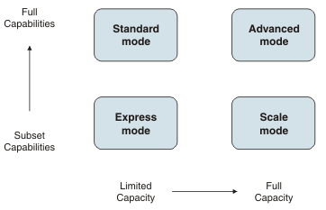
Transfer Licensing and Modes of Operation
Express: A limited set of nodes are enabled for use within a single execution group. Message flows are unlimited.
Scale: A limited set of nodes are enabled for use within unlimited execution groups. Message flows are unlimited.
Standard: All features are enabled for use with a single execution group. The number of message flows that you can deploy are unlimited.
Advanced: All features are enabled and no restrictions or limits are imposed. This mode is the default mode, unless you have the Developer Edition.
New
IBM Integration Bus
Advanced
license
Standard
license
WESB
Transfer
license
Express
license
Advanced mode
Standard mode
Scale mode
Express mode
Notes:
The following modes are supported:
Express Edition mode. A limited set of nodes are enabled for use within a single execution group. Message flows are unlimited.
Scale mode. A limited set of nodes are enabled for use within unlimited execution groups. Message flows are unlimited.
Standard Edition mode. All features are enabled for use with a single execution group. The number of message flows that you can deploy are unlimited.
Advanced mode. All features are enabled and no restrictions or limits are imposed. This mode is the default mode, unless you have the Developer Edition.
=============================================
Developer Edition mode. All features are enabled, but you can use the product for evaluative purposes only. Developer Edition is available on Windows x86-64 and Linux x86-64 operating systems.
Trial Edition mode. All features are enabled, but you can use the product for only 90 days after installation. Trial Edition is available on all distributed platforms in WebSphere® Message Broker Version 8.0.0.0, but has been replaced by the Developer Edition from Version 8.0.0.1 onwards.
Remote Adapter Deployment mode. Only adapter-related features are enabled, and the types of node that you can use, and the number of execution groups that you can create, are limited.

Slide 5
Possible Timelines for Conversion
WESB v6.2
Extended support
Announced EOS
WESB v7.0
Extended support
Best guess (normal practice)
WESB v7.5.1
Extended support
Best guess (normal practice)
WMB v6.1
Extended support
Announced EOS
WMB v7.0
Extended support
Best guess (normal practice)
WMB v8
Extended support
Best guess (normal practice)
IBM Integration Bus v9
Extended support
Best guess (normal practice)
2009
2010
2011
2012
2013
2014
2015
2016
2017
2018
2019
2020
2021

Slide 6
WESB Conversion Tool Delivery Phases
First release
Second phase
Third phase
Phase | Mediation Flows | Transformation Maps | Custom Data
Scenario | Import WESB project and convert flows / primitives | Convert XML and Business Object maps | Convert custom data models
Key features | Common flow primitives automatically converted Flow structure maintained Service container used where appropriate TODO list summarizes remaining manual tasks Resulting flows can be modified and deployed | XML and Business Object maps converted into Graphical Data Maps Additional flow primitives converted Additional Export and Import bindings converted Extensions for bespoke conversion rules | WESB dynamic properties from SMO data models converted Additional support for WESB custom mediations Additional support for WESB custom bindings Some complex use cases will still require manual conversion

Slide 7
Integration Services: Interfaces, Operations and Bindings
Integration Service
Integration Service
Binding Style
Consumer
Provider
Client
Web
Service
SOAP / HTTP
Operation subflow
Operation subflow
WSDL
Interface (WSDL)
WSDL
An interface is described using a WSDL document
An interface consists of one or more operations and a binding style.
The binding style specifies the protocol and data format of the operation.
An operation is a description of an action implemented by the service.
Each operation in the interface defines the data that is passed between the Consumer and the Provider when the operation is invoked.
Each operation may have one or more faults to handle error conditions.

Slide 8
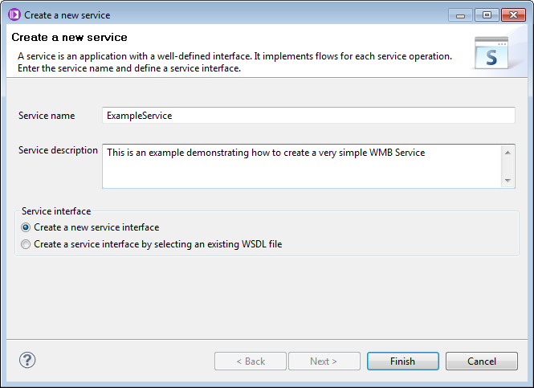
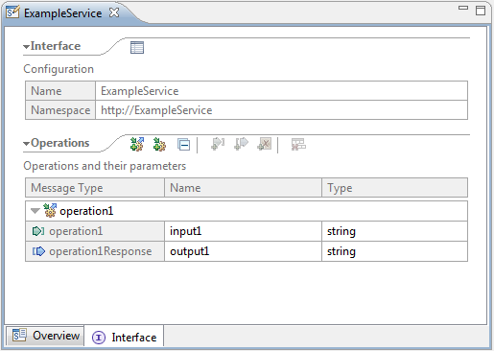
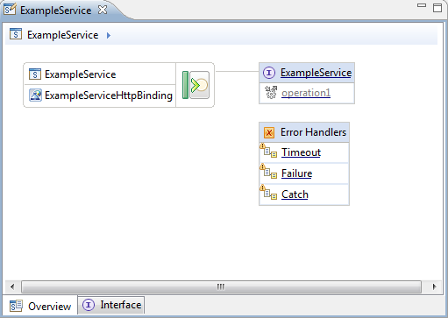
Creating an Integration Service
Operation

Slide 9
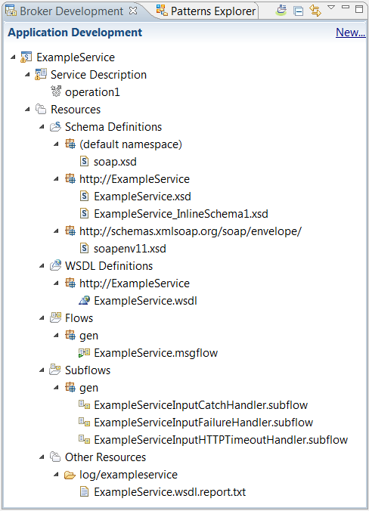
Generated Resources
Service
Descriptor
XML Schema
WSDL
Message Flow
Subflows
Log file

Slide 10








Architectural Concepts
Web Service
Provider 1
Subflow: Operation 1 Request_Response
Web Service
Client
Web Service
Provider 2
Subflow: Operation 2 Request_Response
Flow
WMB Service
Export
Mediation Flow Component
Import
Web Service
Provider 1
Binding
Operation 1 Request
Web Service
Client
Binding
Operation 1 Response
Web Service
Provider 2
Binding
Function
Selector
Operation 2 Request
Operation 2 Response
Import

Slide 11
Resource Comparisons
WESB Terminology | WMB Terminology | Description
Mediation Module | Broker Archive File | The unit of deployment mediation capability
Mediation Primitive | Message Flow Primitive Node | An individual discrete piece of function applied to a message.
Export component | Message Flow (“concrete” input node in main flow) | Provides inbound receipt of requests and sending responses
Import component | Message Flow (“concrete” output node in main flow) | Provides outbound sending of requests and receipt of responses
Flow component | Message Flow | Contains request, response, fault and error flows
Reference | No equivalent | Point of exit from a component, can be wired to services of other components
Service | No equivalent | Point of entry into a component
Interface | Interface (WSDL – but no strong typing on individual nodes) | Collection of operations with defined input, output and fault messages
Operation | Data held in LocalEnvironment tree | An individual operation with input, optional output and optional fault messages
Input message | Message | The (schema-defined) request message usually received at an export
Output message | Message | The (schema-defined) response message usually received at an import
Fault message | Message | The (schema-defined) fault message usually received at an import
Qualifier | No equivalent | Quality of service indicator associated with a component reference or interface.
Binding | Input / output node | Protocol / transport specific configuration associated with an import or export
Function Selector | Route node | Pluggable logic which identifies the operation from a wire format message
Fault Selector | Route node | Pluggable logic which identifies the fault name from a wire format message
Business Object | Payload | Memory representation of an input / output / fault message
Service Message Object | Message tree | Memory representation of a Business Object plus additional contextual information (transport headers, correlation information, user context)

Slide 12
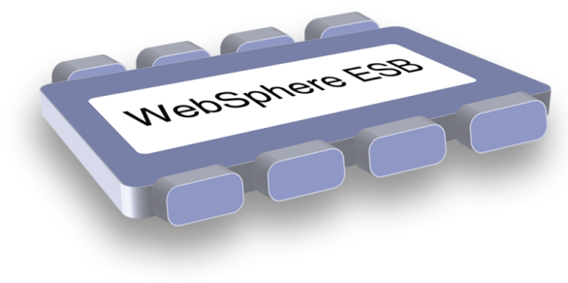
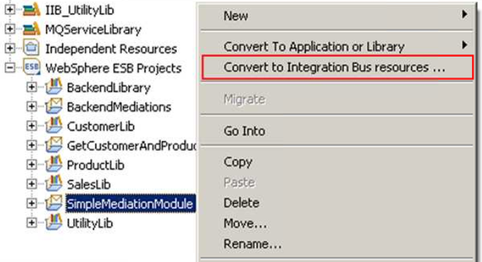
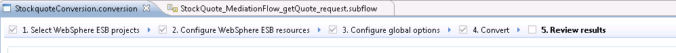
Conversion from WebSphere Enterprise Service Bus
Built-in conversion tools for WESB source assets
  Initial emphasis on web services use cases (e.g. StockQuote)
  Advanced use cases over time; convert when appropriate for your installation
  Open framework for user and partner extensions
Simple workflow creates IB resources
  Export WESB PI from IID
  Import mediations into Eclipse Toolkit
  Right-click “convert” task to start conversion
  Follow guided editor to generate resources
  Task List will identify remaining manual steps
  Iterate as necessary
Open Conversion Framework
  Extensibility means more WESB primitives and resource types can be converted over time
    No minimum version requirement of WESB source
    Builds directly into WESB conversion editor
  Design allows for future assisted resource creation from non-Integration Bus sources, e.g.
    eGate Java collaborations and Event Type Definition, exploiting existing JAXB support
    ICS collaborations, including ASBO and GBO model, exploiting new GDM pattern enablement

Slide 13
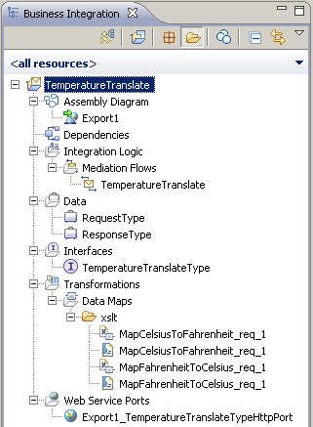
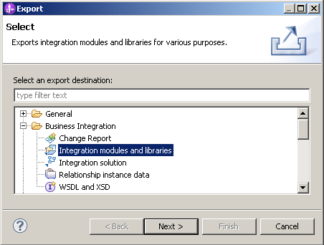
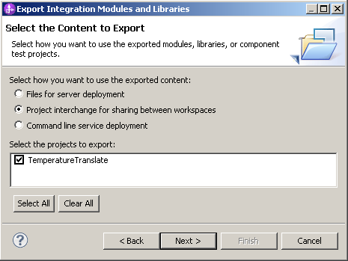
Export: IBM Integration Designer and WebSphere Integration Developer
Decide the resources (integration modules and libraries) for export
Export to Project Interchange file
Screenshots show a simple example with a single project

Slide 14
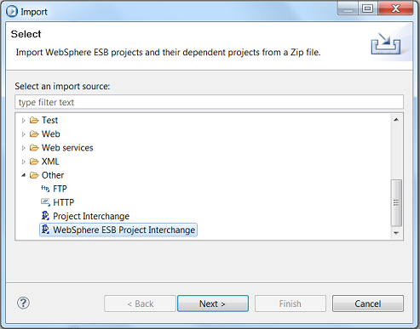
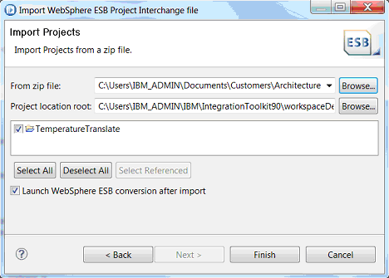
Conversion Tool Launch points
Two step process:
  Import WESB Mediations and Libraries using a WESB Project Interchange file.
    Note the separate (new) Import source.
    The IIB import process changes the Eclipse project natures
  Run the Conversion tool
    Can be launched automatically from the WESB PI import dialog
    Can be launched later from WESB Projects (right-click menu)

Slide 15
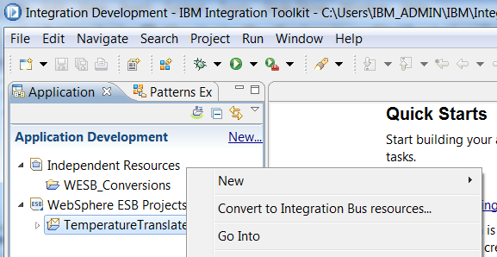
Conversion Tool Launch points
Two step process:
  Import WESB Mediations and Libraries using a WESB Project Interchange file.
    Note the separate (new) Import source.
    The IIB import process changes the Eclipse project natures
  Run the Conversion tool
    Can be launched automatically from the WESB PI import dialog
    Can be launched later from WESB Projects (right-click menu)

Slide 16
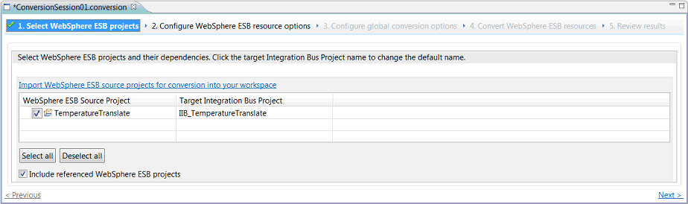
Simple Example Walkthrough – 1. Select WebSphere ESB projects
Conversion session file (.conversion)
Stores state of decisions made during the conversion process
Contains a persisted record of manual To-Do tasks completed after automated conversion.
Can use iteratively with different WESB project combinations - results merged or overwritten.
1
2
3
4
5
Select one or more WebSphere ESB projects for conversion
Target Integration Bus project name is configurable (recommend to use the default suggestion of prefixing with “IIB_”)
Referenced WebSphere ESB projects converted at the same time by default
More granular view and options on individual resource conversion provided by next page of the conversion editor

Slide 17
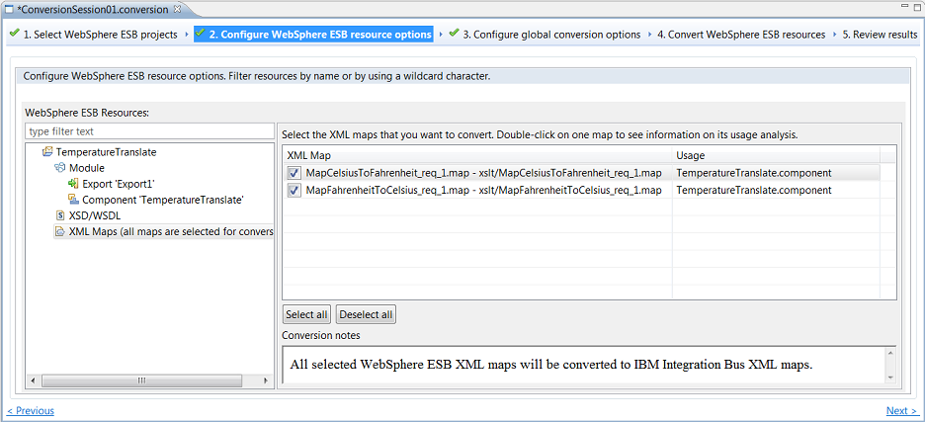
Simple Example Walkthrough – 2. Configure WebSphere ESB resource options

Slide 18
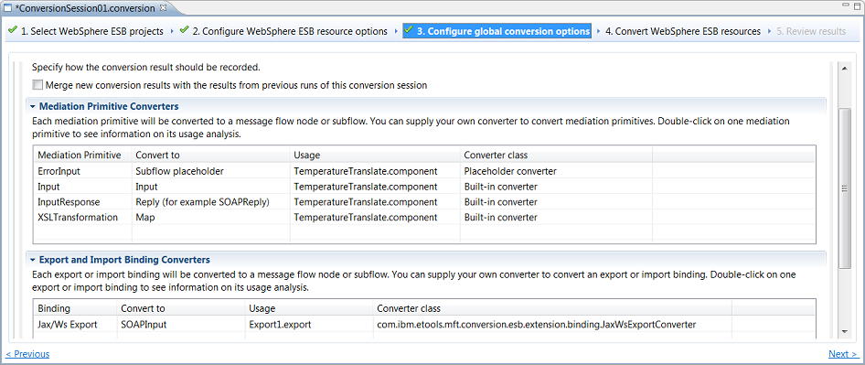
Simple Example Walkthrough – 3. Configure global conversion options

Slide 19
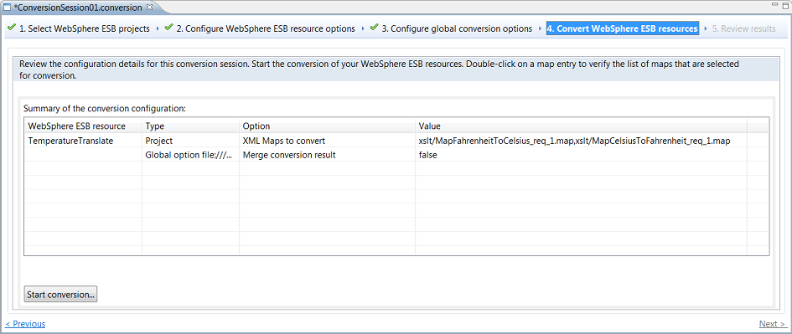
Simple Example Walkthrough – 4. Convert WebSphere ESB resources

Slide 20
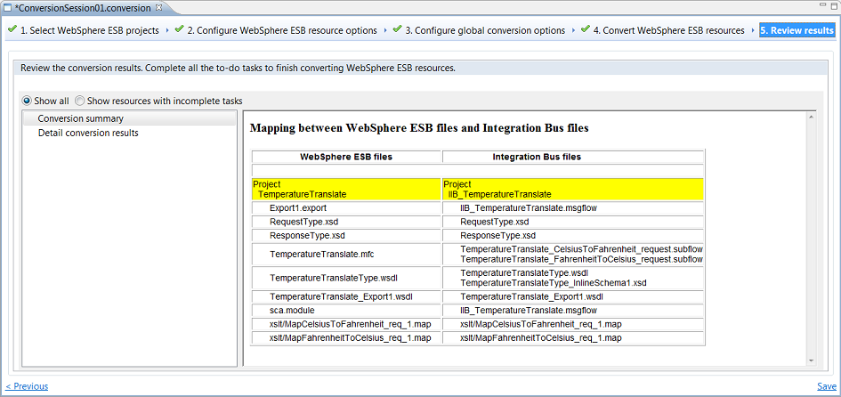
Simple Example Walkthrough – 5. Review results

Slide 21
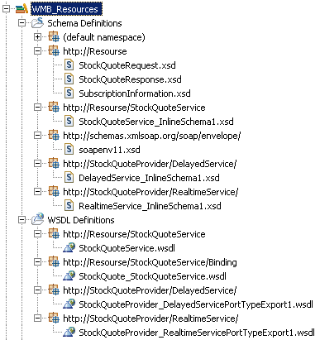
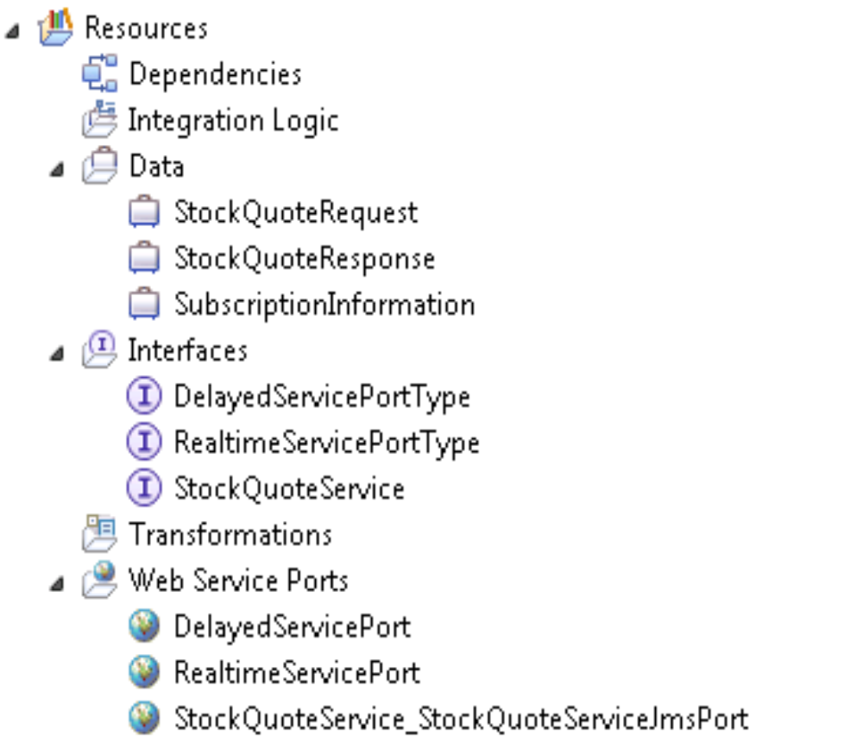
Library Conversion

Slide 22
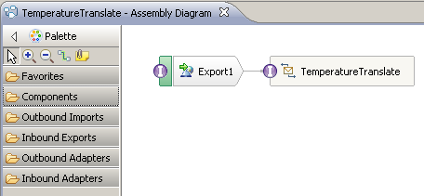
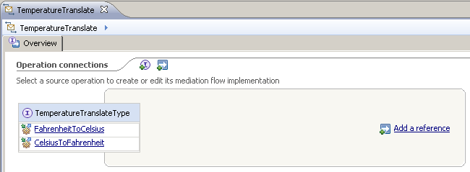
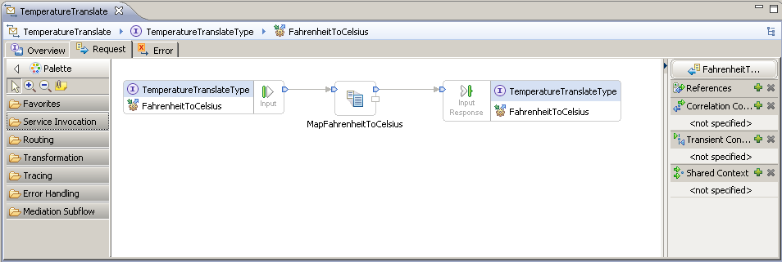
Conceptual compare - IBM Integration Designer and IBM Integration Toolkit

Slide 23
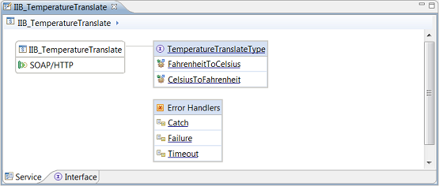
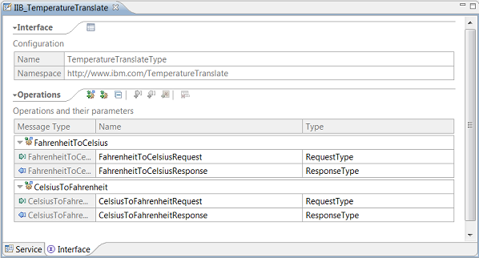
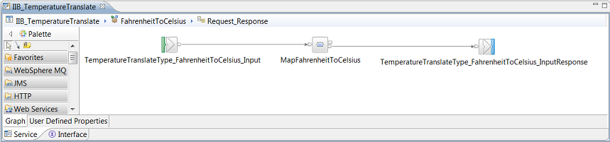
Conceptual compare - IBM Integration Designer and IBM Integration Toolkit
IIB Integration Services have been specifically designed for their display in Toolkit to be familiar to WESB developers who are used to interacting with IBM Integration Designer
  In IBM Integration Designer you can navigate to the mediation flow representing a particular operation by clicking its hyperlink.
  In IBM Integration Toolkit, you can navigate to the subflow representing a particular operation by clicking its hyperlink.

Slide 24
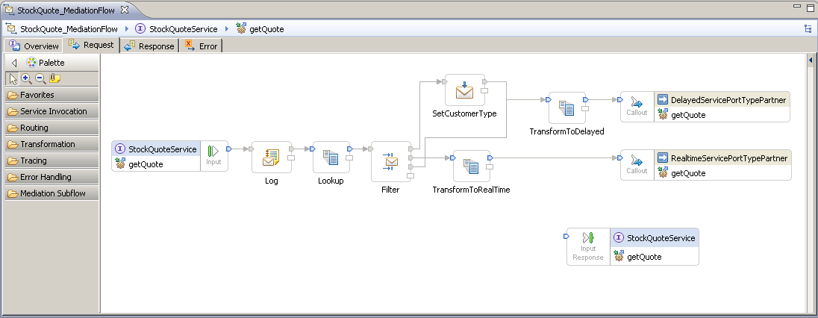
WebSphere ESB StockQuote Request
Points for discussion
  MessageElementSetter primitives
  Correlation context

Slide 25
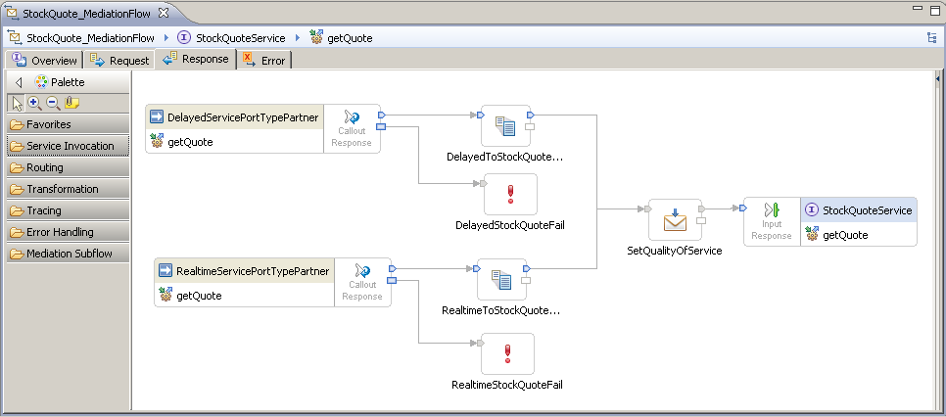
WebSphere ESB StockQuote Response
Points for discussion
  Fail primitives

Slide 26
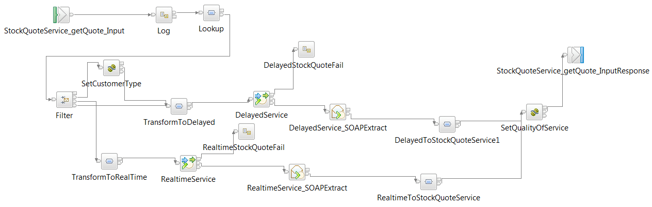








IBM Integration Bus StockQuote
Callout SOAPRequest + SOAPExtract
XSLTransformation Mapping
MessageElementSetter JavaCompute (JAXB)
MessageFilter Route

Slide 27
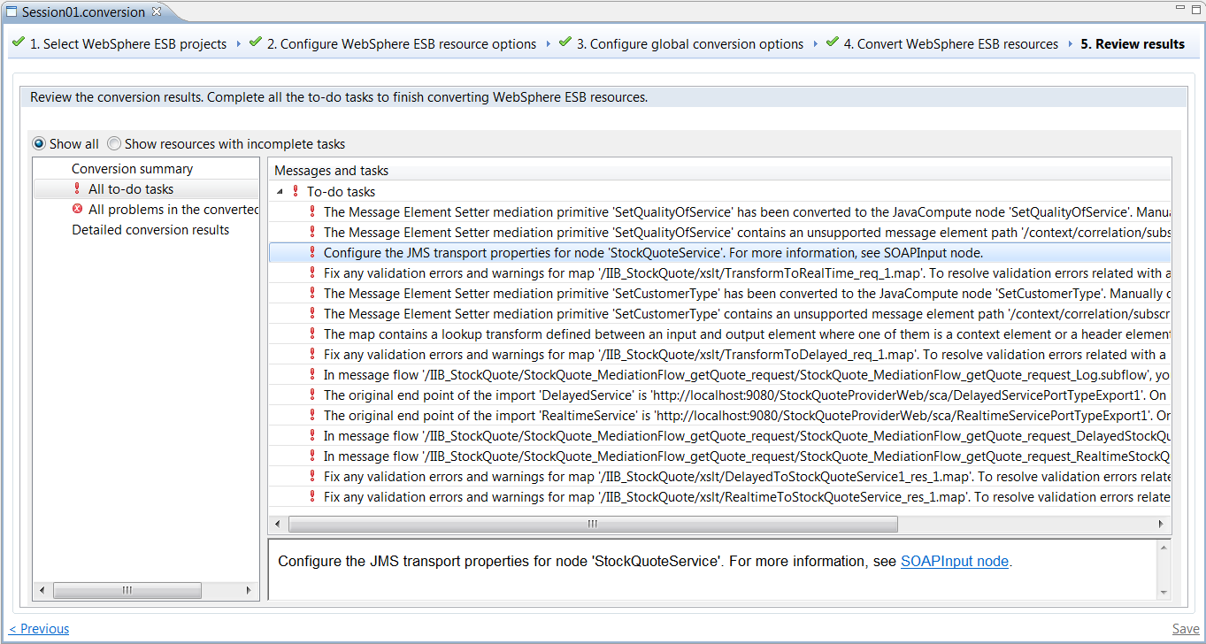
To-do tasks

Slide 28


Extension points
Some mediation primitives are handled by a Built-in Converter class out of the box
By default, mediation primitives which are not yet converted will have a subflow placed into the target message flow at the relebant point.
The replacement subflow will have input and output nodes representing the original terminals of the mediation primitive, so the wiring of the mediation flow component is still preserved even in these situations.
The generated subflow contains an IIB Passthrough message flow node
You can create a Java converter class which extends AbstractMediationPrimitiveConverter, which will provide a conversion capability for mediation primitive nodes which the core tool does not yet handle.

Slide 29
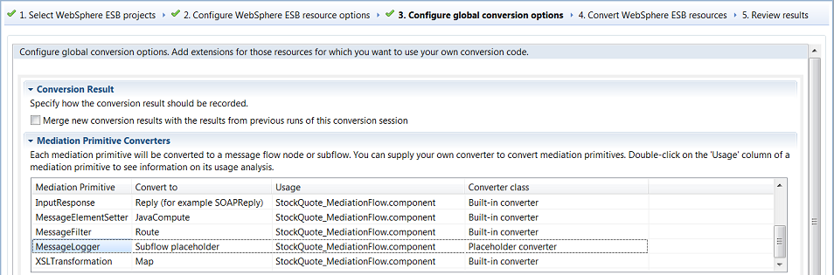
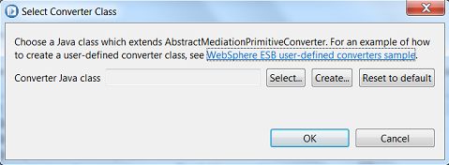
Extending the Conversion Tool

Slide 30
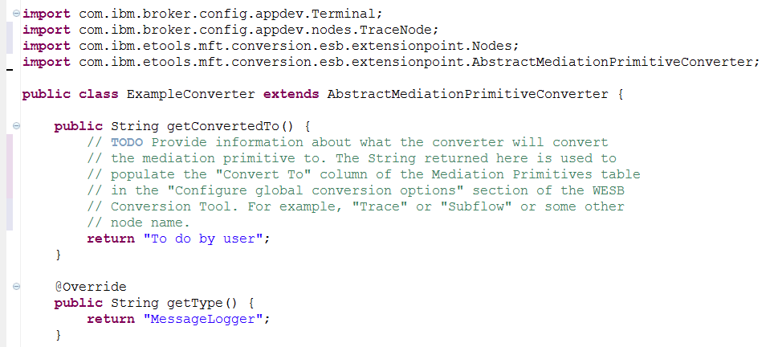
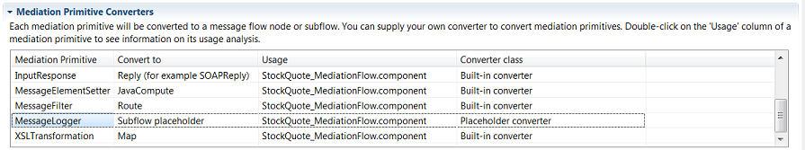
AbstractMediationPrimitiveConverter Template

Slide 31
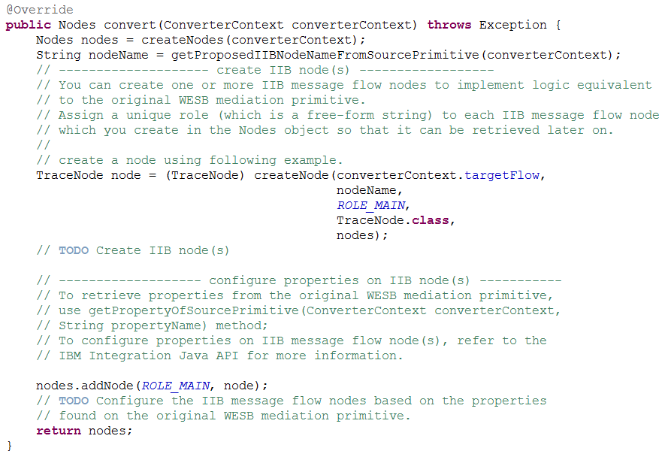
Simple Template Example

Slide 32
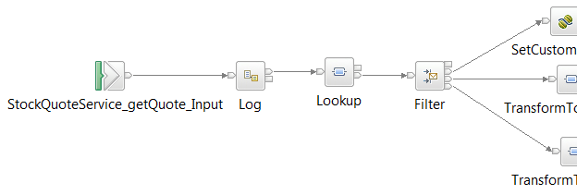


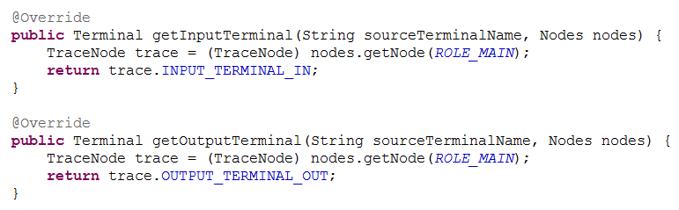
Specifying the wiring for a mediation primitive extension

Slide 33

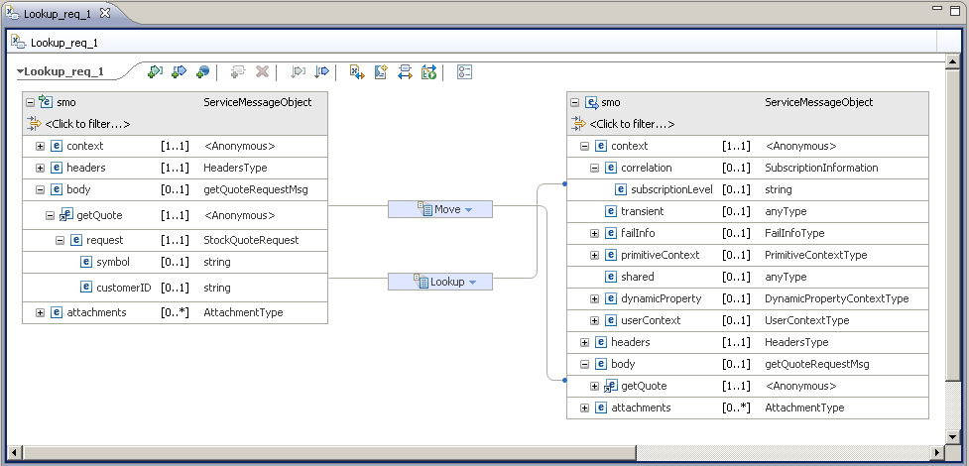
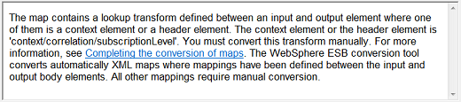

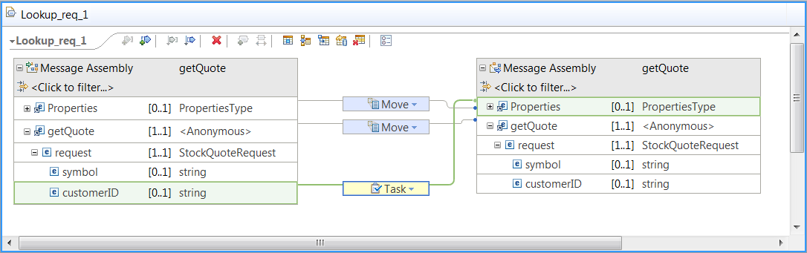
Map Lookup Transform

Slide 34
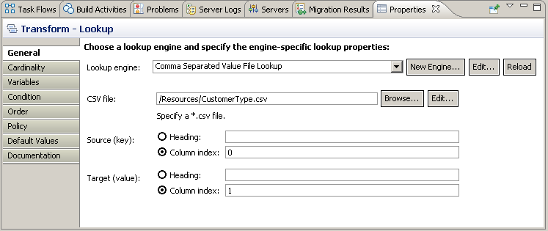
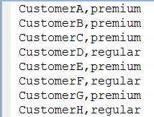

Map Lookup Transform
WESB Mediation Flow
IIB Message Flow
IIB Message Flow Alternate

Slide 35
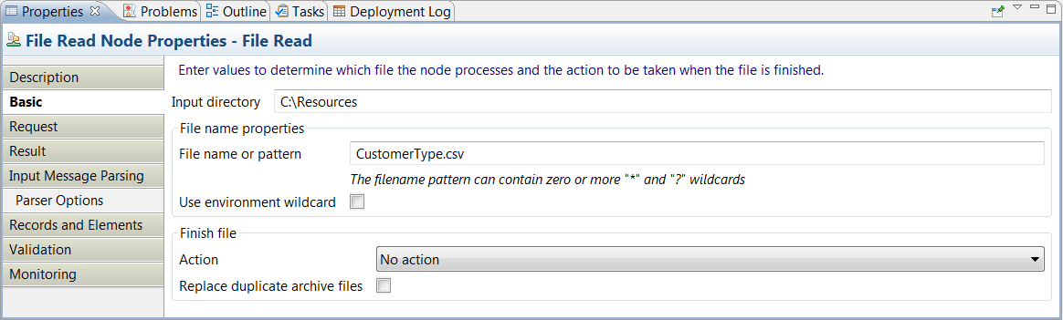
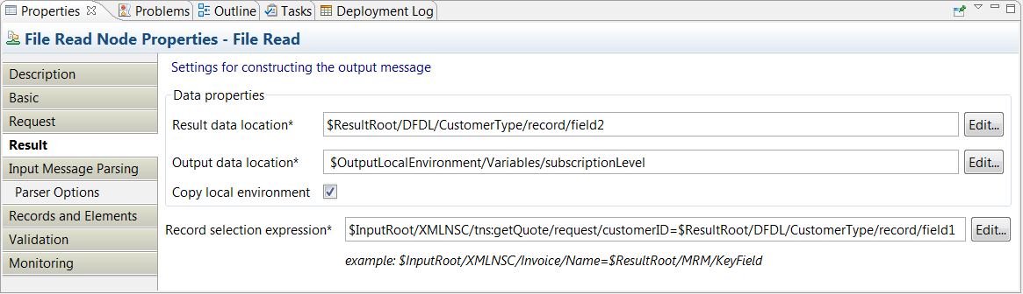
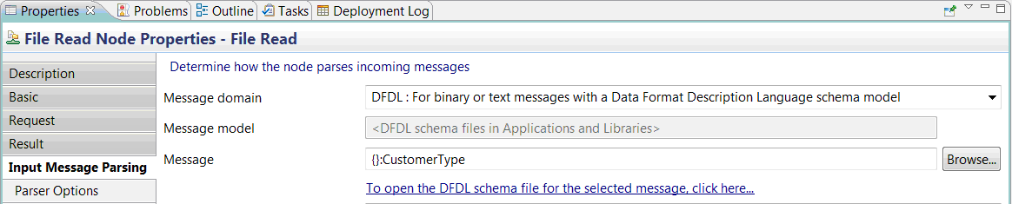
Map Lookup Transform

Slide 36
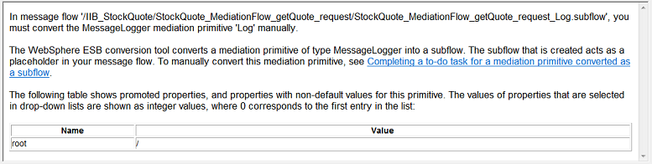
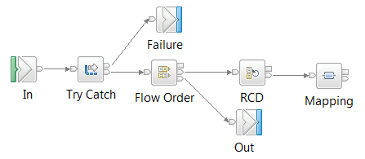
MessageLogger
WESB Mediation Flow
IIB Message Flow

Slide 37
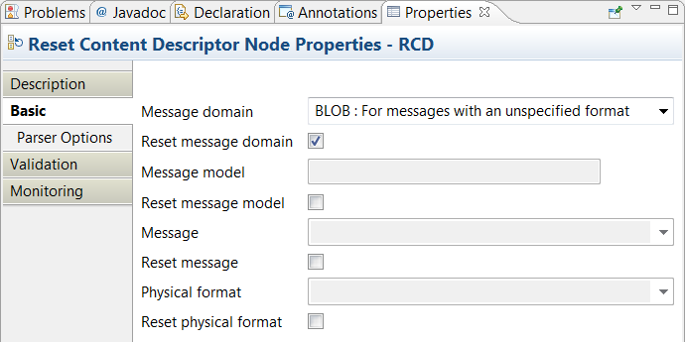


MessageLogger

Slide 38


WMQ Binding Extension

Slide 39





WMQ Binding Extension

Slide 40
Summary
Phase 1 of the IIB WESB Conversion tool provides structural conversion of WESB resources
Web Services Bindings, Basic primitives, XML Transformation maps
To-Do list and guidance for manual actions
Extension capability built-in to the tool for currently unsupported primitives and bindings
More to come!

Slide 41


Slide 42
System of Awareness
Starting point
  Service Clients are configured to interact with a particular Web Service
Service
Client
Service
Provider
Service
Provider
Service
Client
Mapping
Service
Service
Provider

Slide 43
Distribution of Events from a Mapping Service
Mapping Service
  A local mapping service can be defined via admin commands or the admin console to intercept all invocations bound for a particular service
  [Interception happens on the thread of execution of the Service client invocation]
Service
Client
Mapping
Service
Service
Provider
It is not mandatory for the Mapping Service to have a Service Map associated with it
  The service map effectively defaults to a ‘no-op’ – ie the configured service provider is invoked
In this state, the Mapping Service adds the following behaviour
  The mapping service can be started or stopped
  The mapping service can be configured by the administrator to publish service interaction events to a JMS topic

Slide 44
Service Mapping
Invocation Points
WAS
8.5.5
WAS
8.5.5
Pre-map request
Post-map request
Service
Client
Mapping
Service
Service
Provider
Post-map response
Pre-map response
Four conceivable event points: two currently supported
Event emission can be configured by the WAS administrator
Events are published using JMS Pub/Sub to a structured topic space
  <cell>/<cluster || node.server>/<mapping service>/<operation>
  This can optionally be overridden
Event messages contain;
  Information about where they are emitted from
  Request/Response/Fault differentiation
  (optionally) message content
The event message schema is published as part of the Mapping Service documentation

Slide 45

WAS
Pre-map request
Post-map request
Service
Client
Mapping
Service
Service
Provider
Post-map response
Pre-map response
IBM Integration Bus
1. Publish
Topic Space
Data
Capture
3. Record for later replay or analysis
Configure and subscribe
Configure and subscribe
2. Configure and subscribe
Cluster
Service
Operation

Slide 46

IIB Data Capture Store

