Slide 1
RAG for Enhancing ODQA Systems with External Knowledge
Zhuo Chen
zhuochen@berkeley.edu
Notes:
Hello everyone, today I am going to demo the research project I did for this course. I am specifically interested in the Retrieval augmented generation, or RAG to enhance the modern large language models nowadays. There is particular reason of doing so, first large language models relies mainly on the internal knowledge that built in the model’s parameters. This requires large amount of time and resources to perform pre-training and fine-tuning the models to build knowledge. It has several limitations when using LLMs as well, one is the context window size, for example GPT 3.5 or GPT 4 has 8,192 tokens context window size. There is newer release models such as Google Gimini 1.5 supports up to 1M context window size but that’s a different research direction of making LLMs more powerful. Another limitation is the knowledge coverage and adaptivity, for example, ChatGPT could answer the general questions pretty well, but with domain-specific knowledge, it may not have that coverages, another example is the LLMs knowledge cutoff date, that means LLMs will not answer the questions correctly happened yesterday because it hasn’t been trained by those data. All those limitations can be improved by using the retrieved external knowledge enhancement generation framework.
In this particular project, I built a knowledge enhanced RAG system by using the external knowledge dataset, retrieves the answers from that dataset and feed to the varies LLMs to generate answers on the Open domain question answers benchmarks to evaluate the effectiveness of RAG.

Slide 2
Project Overview
Build a retrieval-augmented generation (RAG) systems (LlamaIndex APIs, Pinecone vector database)
Build a knowledge source: Create embeddings of open-domain question answering (ODQA) knowledge (PAQ dataset)
Answer questions with retrieved knowledge in nq_open validation set
Try multiple LLMs with and without RAG and compare performance
Notes:
Here is the project overview:
First I built a retrieval augmented generations systems (LlamaIndex APIs, Pinecore vector database): To build the knowledge source, I created embeddings of the open-domain question answering knowledge dataset called PAQ, this is a research project that someone retrieves the question answer pairs from wikipedia's pages. And it serves as the knowledge source of the RAG framework here.
Second: I chose varies large language models and answer the open domain questions based on the nq_open validation dataset, this is another dataset hosted in HuggingFace with the same format of open domain questions.
Last: I compare the performance of different models with and without the RAG enhancement.

Slide 3
Dataset
Knowledge source:
PAQ: 65 Million Probably-Asked Questions and What You Can Do With Them
Use PAQ-L1 version with 14.1M question-answer pairs
Evaluation:
nq_open validation dataset with 3,610 question answer pairs
https://huggingface.co/datasets/nq_open/viewer/nq_open/validation
Performance metrics: Exact Match (EM), F1 score and Rouge scores
Notes:
So dataset, as just mentioned. PAQ comes from a research paper that retrieved 65m probably-asked questions from Wikipedia. Because of the size of the dataset, I chose to use a lighter version called PAQ-L1, it has a little over 14 million question answer paris, 4 times fewer than the full version of PQA. But it still covers around 90% of the questions in the full version.
For evaluation, I used nq_open validation dataset which has 3,610 question answer pairs with the same format. The dataset can be found in huggingface by this link. And for the performance metrics, I used Exact Match (EM scores) as well F1 score and Rouge scores to report the effectiveness of the approach.

Slide 4
LLMs
Flan-T5-base: 220M parameter – fine tuned version from T5-base (baseline)
Flan-T5-large: 770M parameter – slightly better than baseline model
Llama-2-13B-chat: 13B parameter Llama 2 model, with dialog capability
GPT-3.5-Turbo: OpenAI’s ChatGPT, knowledge cut-off time, Sep, 2021
Notes:
For the LLMs:
I chose 4 pairs of LLMs, each has the original version and the verison enhanced by the RAG framework.
The baseline model is called Flan-T5-base, it’s a variation of T5-base, with the same model size: 220M parameters. The differences is it was fine tuned by 1000 more tasks and can understand user’s instructions. It serves perfect as the baseline model’s with RAG enhancement.
The second model is Flan-T5-large, slightly better than Flan-T5-base with a larger size, which has 770M parameters.
The third model is LLama 2 13B chat, a variant of Meta’s Llama 2 model, it is open sourced, a lot of researchers use it. I just realized Meta releases LLama 3 today, but I can’t use it, and it’s just too late, but will be interesting to test its performance in the future.
The last model is GPT-3.5-Turbo, also known as ChatGPT, knowledge cut-off time for this particular model is Sep 2021.

Slide 5
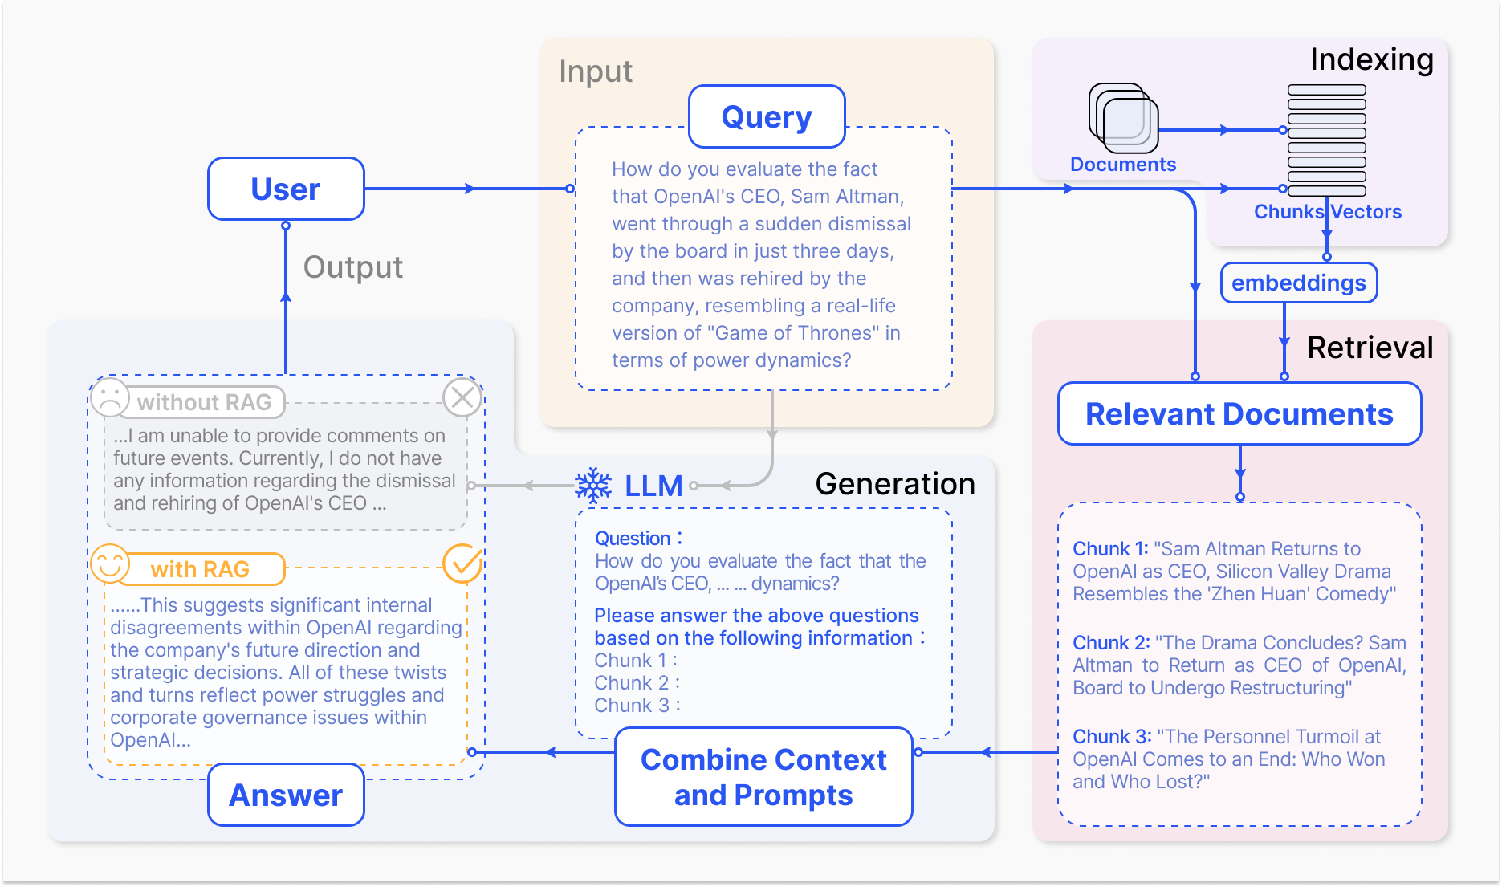
RAG procedure
Notes:
This is the picture of the RAG framework. As you can see here, in the normal approach, user directly asks the LLMs and LLMs may not generate a satisfactory answer. With RAG, user’s question will first by embedded into a query vector, and it searches the documents, in my case, the PAQ question answers pairs, which are already been embedded into the vector database. It’s like a search engine if you imagine. Then the top most relevant information will be feed together with the original question into the LLMs. For example: with the prompt: Please answer the above questions based on the following information: [information 1], [information 2] and [information 3]

Slide 6
Module 1: Knowledge building
Process 14.1M question-answer pairs from PAQ (knowledge source)
Use embedding model: BAAI/bge-small-en (embedding size = 384) to embed QA pairs
Store embedded QA pairs into Pinecore (a vector database vendor, known for vector storage and fast search)
Perform similarity search on existing knowledge for new questions.

Slide 7
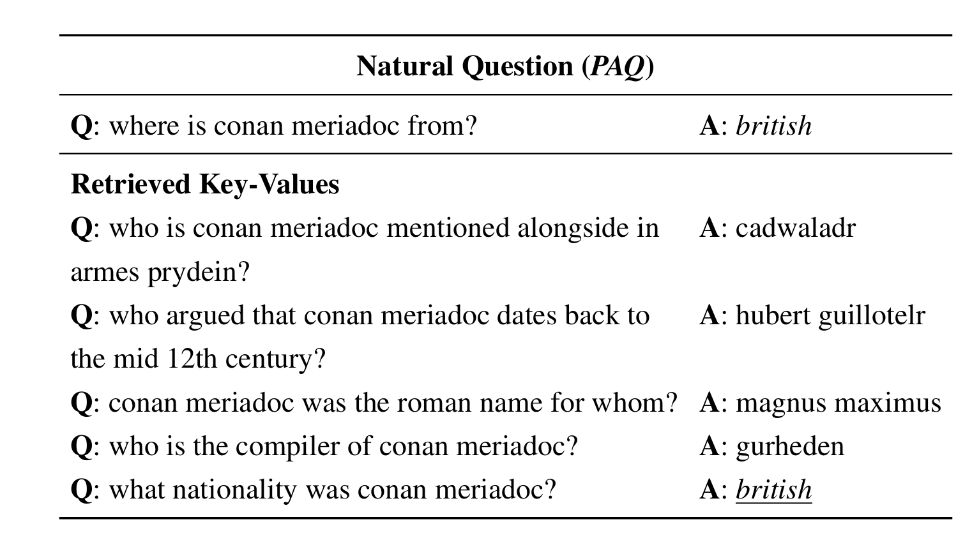
Module 1: Knowledge building (example)

Slide 8
Module 2: Evaluation multiple LLMs
Evaluate original version of LLMs, to answer questions, without help of RAG
Evaluate LLMs+RAG enhancement
Create performance metrics

Slide 9
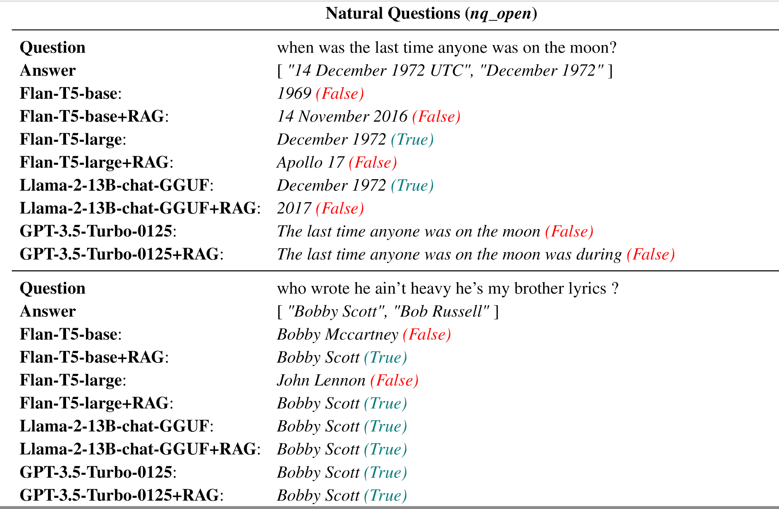

Slide 10
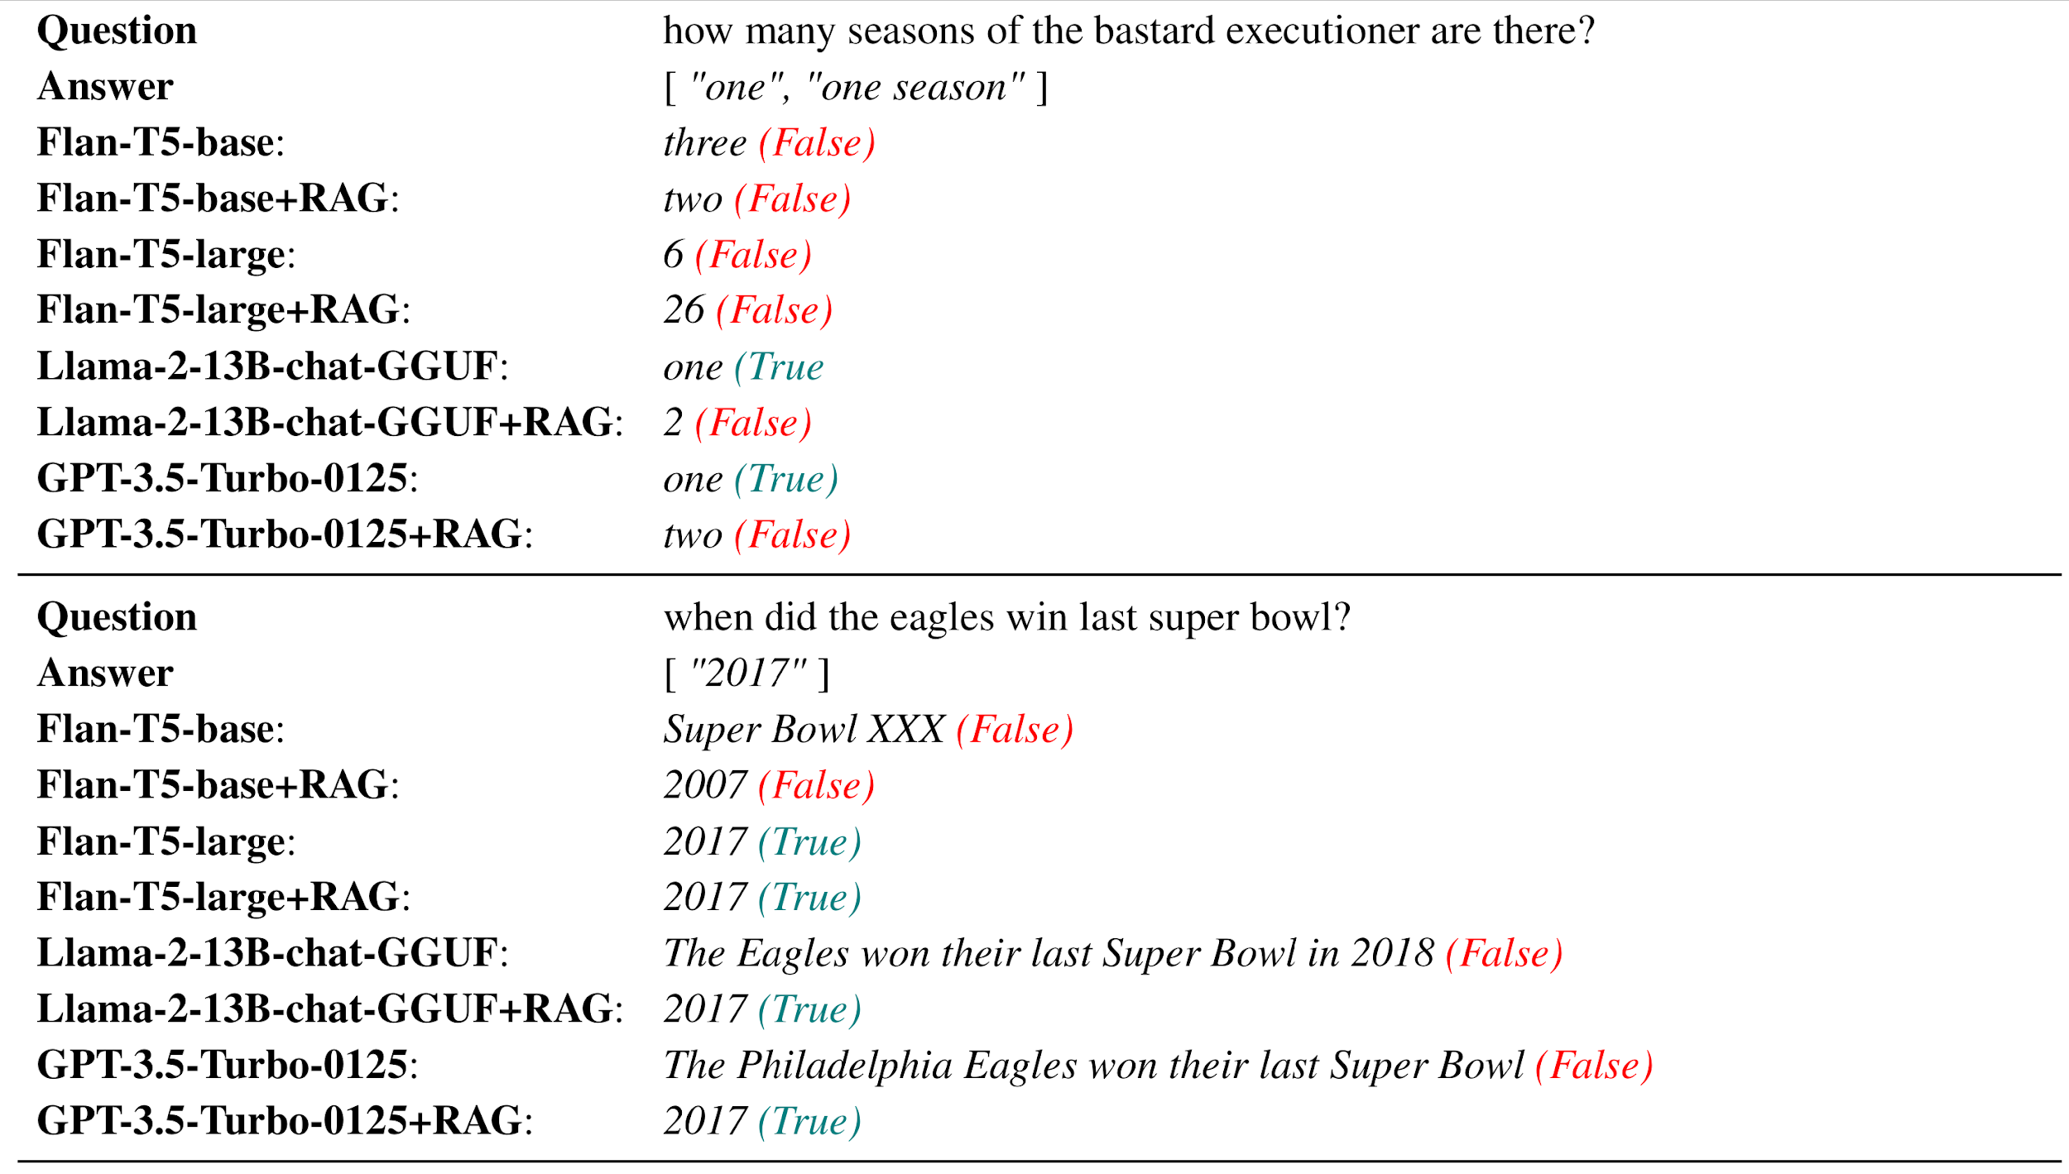

Slide 11
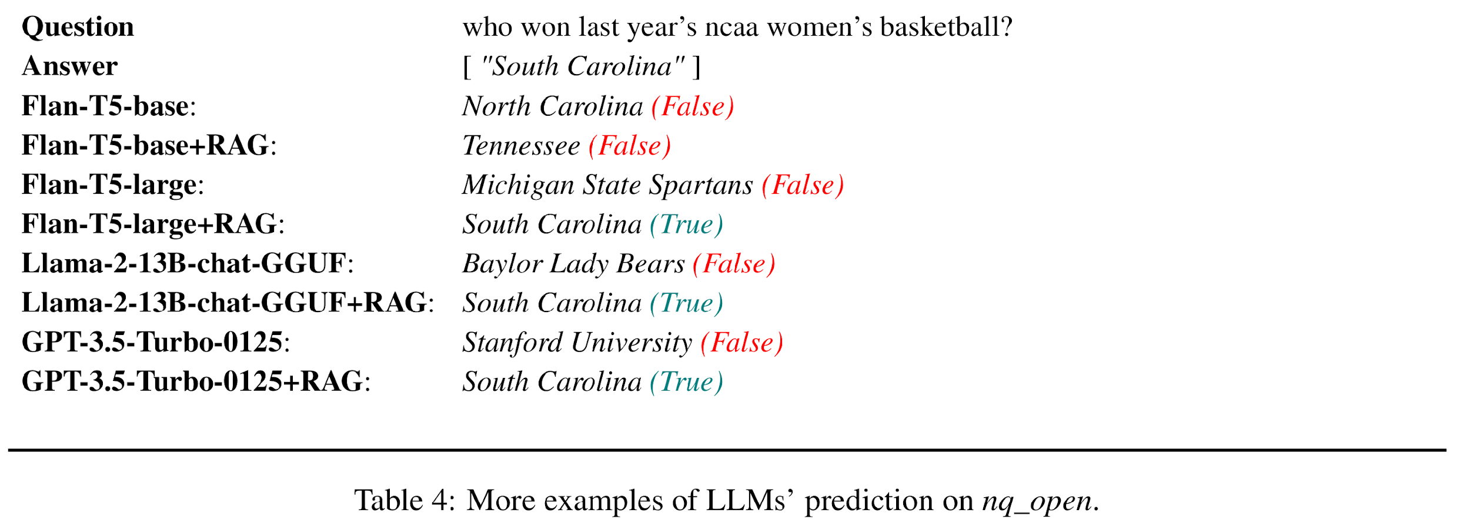

Slide 12
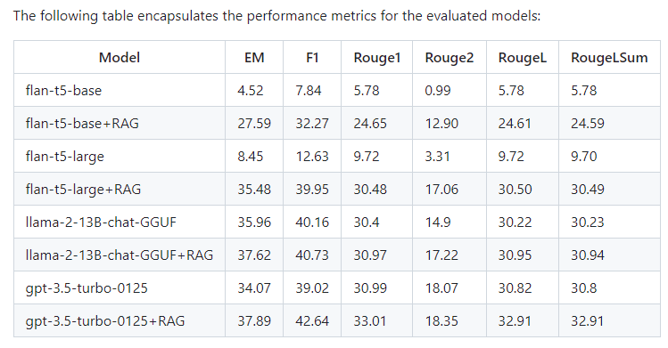
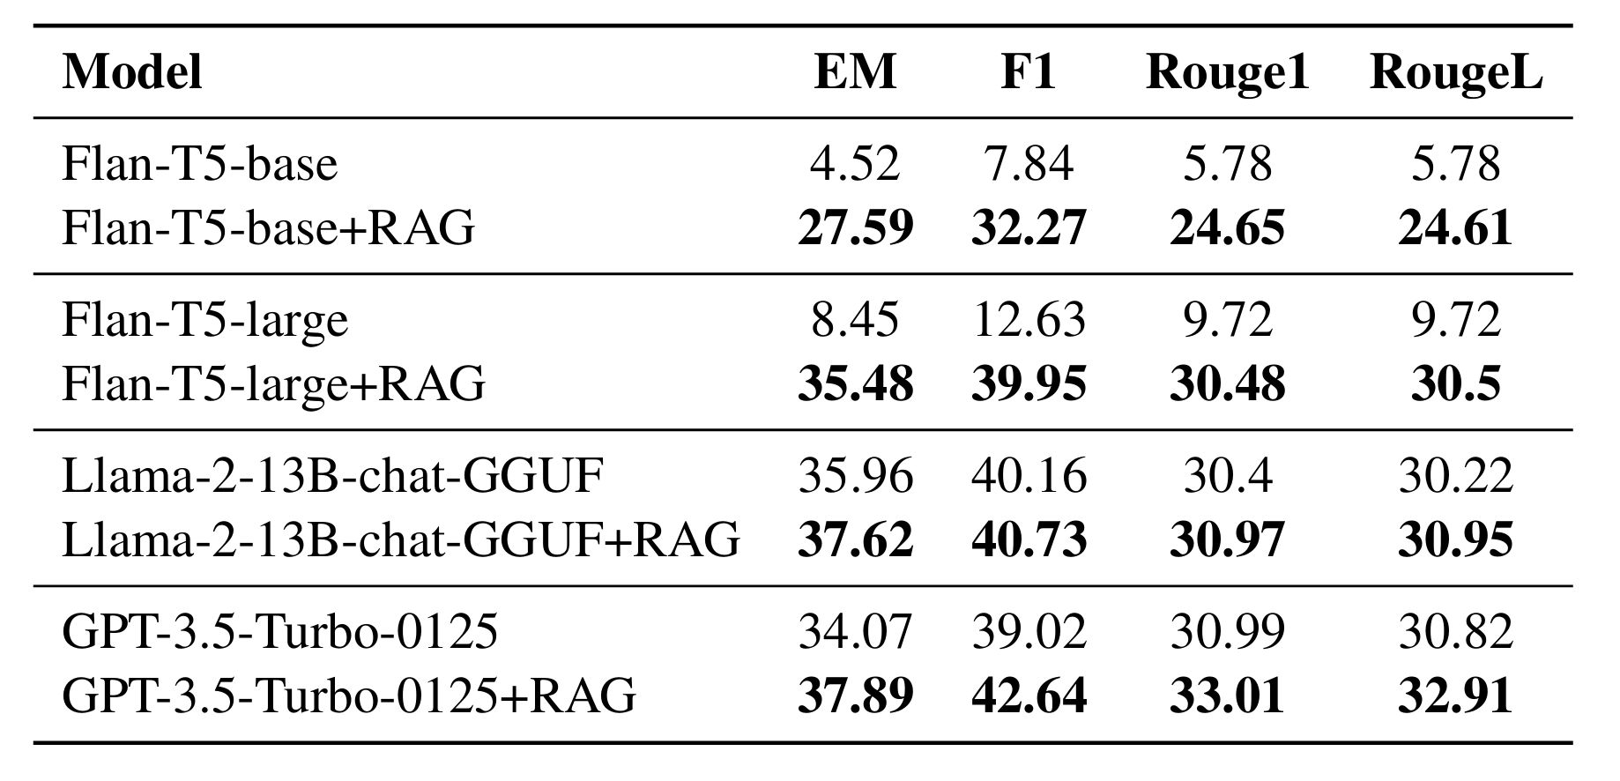
Results and Conclusion

Slide 13
Limitations
Limited computation resource:
Google Colab Pro – T4 GPU is being used.
Limit to use light version of embedding model
A100 or T100 will provide more memory and computing speed
Quality of knowledge source:
Might not cover all questions in nq_open
Knowledge cutoff time
A better knowledge source + better embedding model will help the RAG quality

Slide 14
Future works
Exploring advanced embedding models
sentence-transformer
openai/text-embedding-3-small (1536 embedding size)
Diversifying data sources
NaturalQuestions (NQ), TriviaQA (TQA), WebQuestions (WQ)
Optimizing data precision
Reduce embedding from 32-bit integer to 8-bit
Will reduce 75% GPU memory and embedding computing time, as well 4 times less database size
Rethinking Retrieval Mechanisms
Introduce sequence-to sequence search or attention mechanisms

Slide 15
Thank you!
Github repo: https://github.com/chenzhuo1005/datasci-w266-nlp-project
Paper: https://github.com/chenzhuo1005/datasci-w266-nlp-project/blob/main/paper/datasci_266_project_zhuochen.pdf

