Slide 1
CPP Concurrency in Action
Ken Chen
2014/02/16

Slide 2
TOC
Hello World concurrency
Managing threads
Sharing data between threads
Synchronizing concurrent operations
The C++ memory model and operations on atomic types

Slide 3
Hello World concurrency
Why concurrency
separation of concerns
performance
Task parallelism: break big task into small parts and run each in parallel
Data parallelism: each thr works on different part of data

Slide 4
Managing thread
Caveats
Make sure the thread is either detached or joined before the thread object is destroyed. Thread’s dtor calls std::terminate()
Note that you only have to make this decision before the std::thread object is destroyed -- the thread itself may have finished long before you join with it or detach it, and if you detach it, then the thread may continue running long after the std::thread object is destroyed
If a thread is detached, make sure it only access valid data (Note the thread object itself may have long gone)

Slide 5
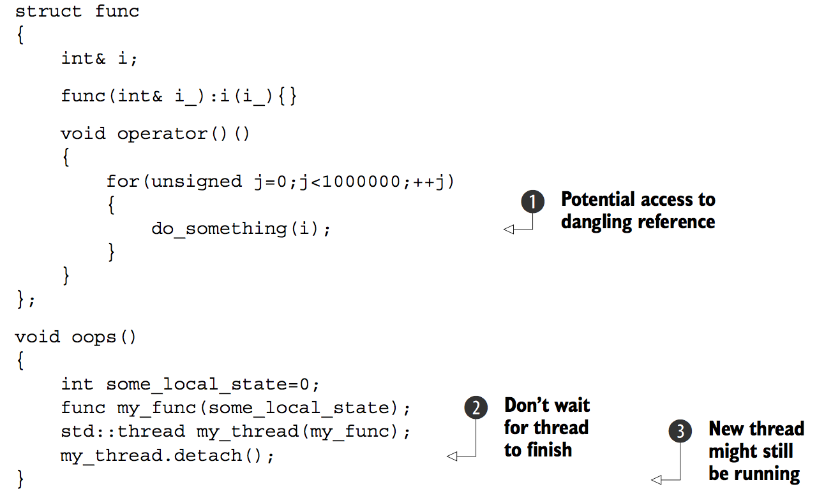
Managing thread
Example

Slide 6
Managing thread
Common Solution
One common way to handle this scenario is to make the thread function self- contained and copy the data into the thread rather than sharing the data.
std::thread.join()
The act of calling join() also cleans up any storage associated with the thread, so the std::thread object is no longer associated with the now- finished thread; it isn’t associated with any thread.
This means that you can call join() only once for a given thread. once you’ve called join(), the std::thread object is no longer joinable, and joinable() will return false.
The call to join() is liable to be skipped if an exception is thrown after the thread has been started but before the call to join().

Slide 7
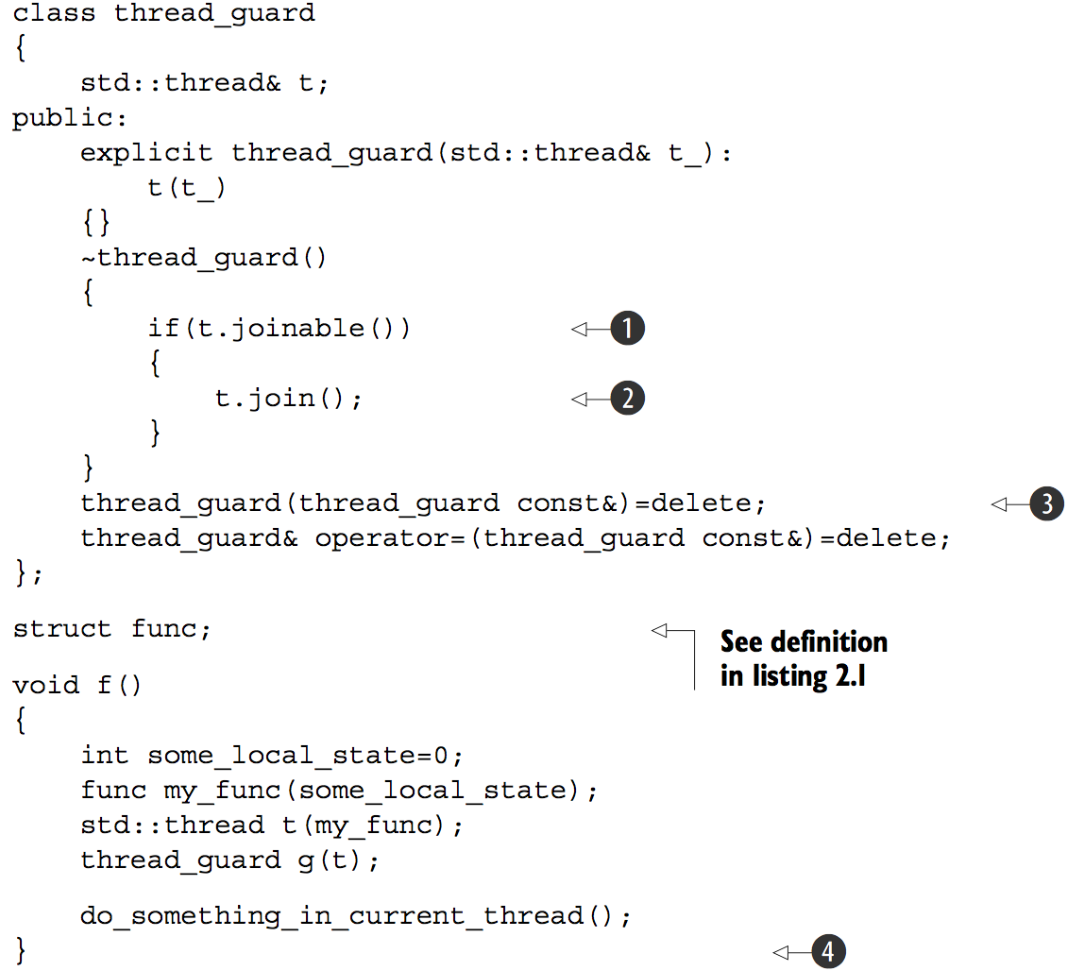
Managing thread
RAII to make sure thread is correctly joined
Notes:
RAII to make sure thread is correctly joined

Slide 8
Managing thread
Detached thread
Detached threads truly run in the background; ownership and control are passed over to the C++ Run- time Library, which ensures that the resources associated with the thread are correctly reclaimed when the thread exits.
It is not joinable
Thread arguments
By default, the function arguments passed to thread’s ctor are copied to into internal storage, where they can be accessed by the newly created thread of execution, even if the corresponding parameter in the function is expecting a reference
Notes:
RAII to make sure thread is correctly joined

Slide 9
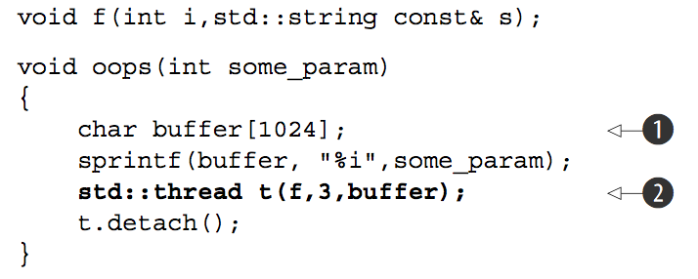
Managing thread
Thread arguments example
there’s a significant chance that the function oops will exit before the buffer has been converted to a std::string on the new thread, thus leading to undefined behavior. The solution is to cast to std::string before passing the buffer to the std::thread constructor
std::thread t(f,3,std::string(buffer));
Notes:
RAII to make sure thread is correctly joined

Slide 10
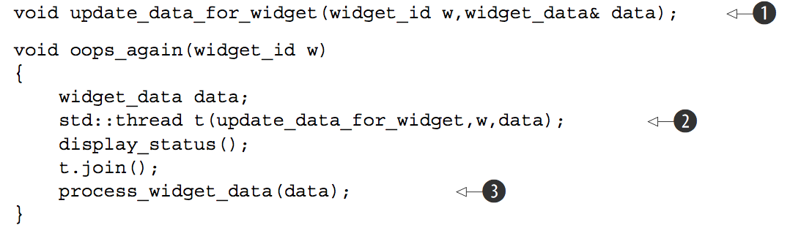
Managing thread
Thread arguments example 2
Because it is copying arguments, widget_data& data in step (1) is referencing a copy instead of the one in function oops_again.
Solution: std::thread t(update_data_for_widget, w, std::ref(data));
Notes:
RAII to make sure thread is correctly joined

Slide 11
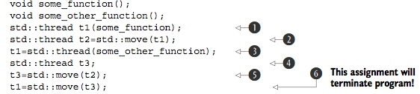
Managing thread
Transferring ownership
In step 6, t1 already had an associated thread (which was running some_other_function), so std::terminate() is called to terminate the program. This is done for consistency with the std::thread destructor
Make sure a thread is correctly joined or detached before dtor is called is also applied to assignment
Notes:
RAII to make sure thread is correctly joined

Slide 12
Managing thread
Be aware of non-associative types for specific operator
For e,g “float” and “double” is not associative for operator “+”. This may be a issue when we do divide and conquer.
Notes:
RAII to make sure thread is correctly joined

Slide 13
Sharing data between threads
Guide
Don’t pass pointers and references to protected data outside the scope of the lock, whether by returning them from a function, storing them in externally visible memory, or passing them as arguments to user-supplied functions.
Don’t wait for another thread if there’s a chance it’s waiting for you (assume two threads are calling join() with the other).
Avoid nested locks
Avoid calling user-supplied code while holding a lock
Acquire locks in a fixed order
Use a lock hierachy
If need join threads, join threads in a hierachy way
Notes:
RAII to make sure thread is correctly joined

Slide 14
Sharing data between threads
std::unique_lock
std::unique_lock<std::mutex> lock_a(lhs.m,std::defer_lock); std::unique_lock<std::mutex> lock_b(rhs.m,std::defer_lock); std::lock(lock_a,lock_b);
std::unique_lock takes more space and is a fraction slower to use than std::lock_guard. The flexibility of allowing a std::unique_lock instance not to own the mutex comes at a price: this information has to be stored, and it has to be updated.
It has interfaces unlock, so we can release the lock when necessary
When there is need to transfer ownership of a lock from one scope to another scope
Double Checked Locking (is not safe)
C++11 “std::call_once(std::once_flag, …) or local static variable” solves this problem (what if the callback throws ?)
Notes:
RAII to make sure thread is correctly joined

Slide 15
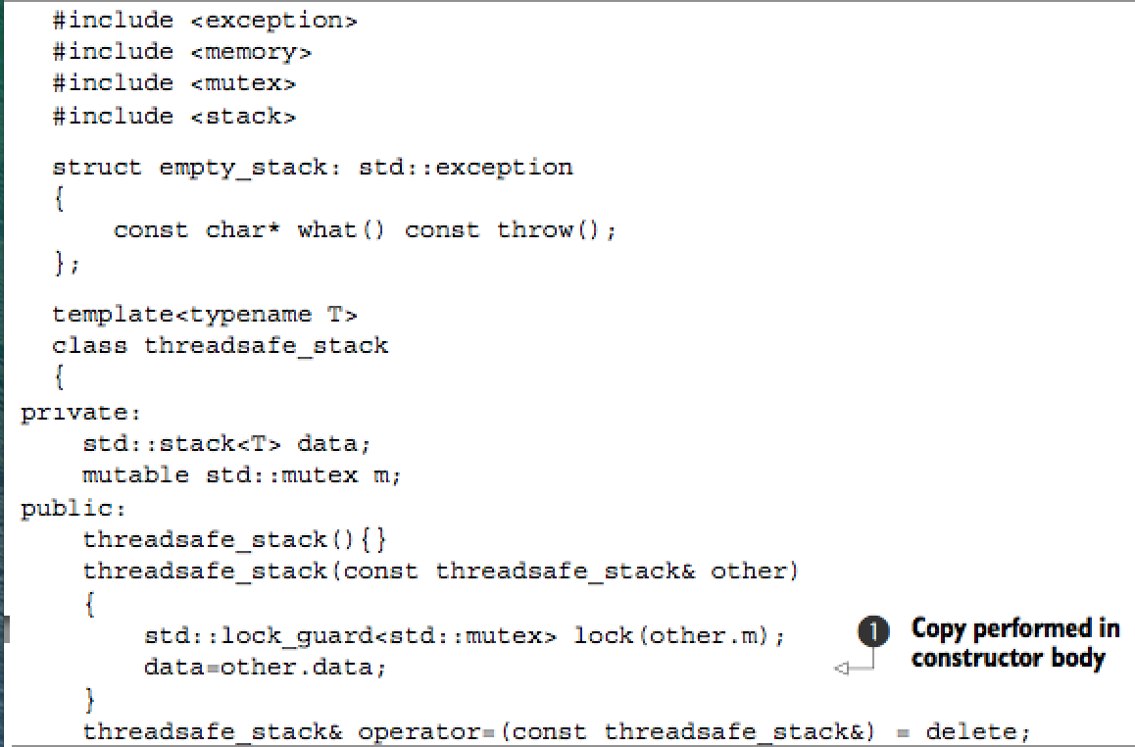
Sharing data between threads
A thread safe stack
Notes:
RAII to make sure thread is correctly joined

Slide 16
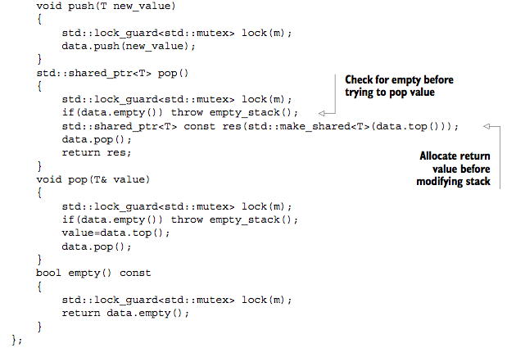
Sharing data between threads
A thread safe stack (cont.)
Notes:
RAII to make sure thread is correctly joined

Slide 17
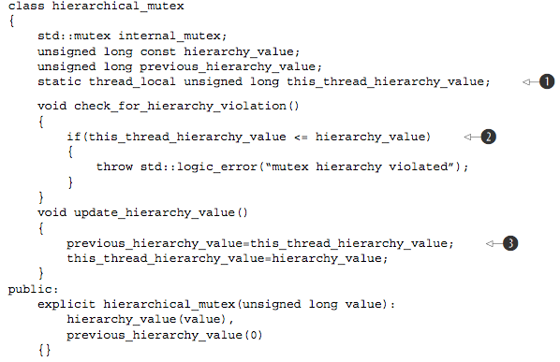
Sharing data between threads
Hierarchical mutex
Notes:
RAII to make sure thread is correctly joined

Slide 18
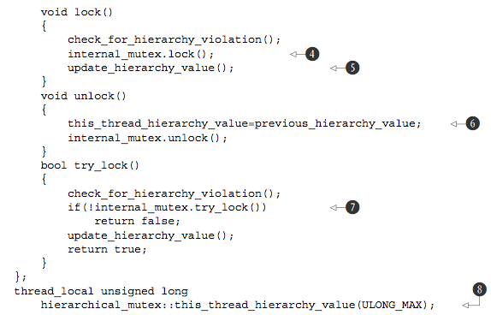
Sharing data between threads
Hierarchical mutex (cont.)
Notes:
RAII to make sure thread is correctly joined

Slide 19
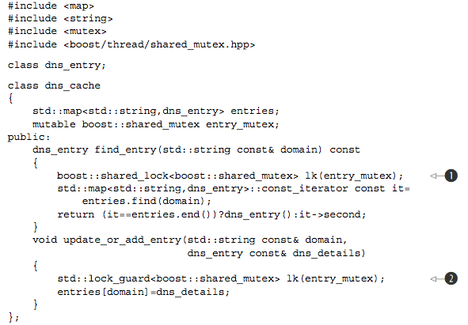
Sharing data between threads
Use boost:shared_mutex to implement r/w lock
Notes:
RAII to make sure thread is correctly joined

Slide 20
Sharing data between threads
Guide
Most of the time, if you think you want a recursive mutex, you probably need to change your design
When designing thread safe class interfaces and one class method calls another class method (both methods are guarded by lock),a quick and dirty change to make the code work is to modify the lock recursive.But this is almost a bad design. A probable working solution is extract the common private function without locking, and both the public interfaces calls the private one to do the work
Notes:
RAII to make sure thread is correctly joined

Slide 21
Synchronizing concurrent operations
Guide
Please note that the side effects of the callback provided to condition_variable.wait(lock, callback). Because the callback may be called indeterminate times (spurious wake), it isn’t advisable to use a function with side effects for the condition check. If you do so, you must be prepared for the side effects to occur multiple times
Notes:
RAII to make sure thread is correctly joined

Slide 22
Synchronizing concurrent operations
Guide
Please note that the side effects of the callback provided to condition_variable.wait(lock, callback). Because the callback may be called indeterminate times (spurious wake), it isn’t advisable to use a function with side effects for the condition check. If you do so, you must be prepared for the side effects to occur multiple times
Notes:
RAII to make sure thread is correctly joined

Slide 23
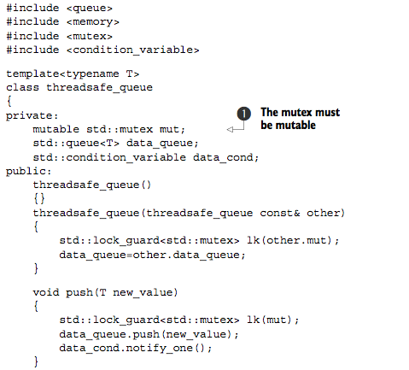
Synchronizing concurrent operations
Thread safe queue
Notes:
RAII to make sure thread is correctly joined

Slide 24
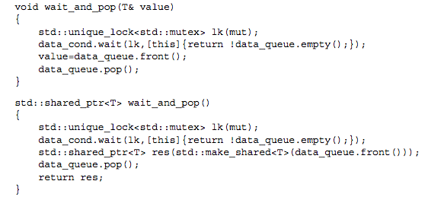
Synchronizing concurrent operations
Thread safe queue (Cont.)
Notes:
RAII to make sure thread is correctly joined

Slide 25
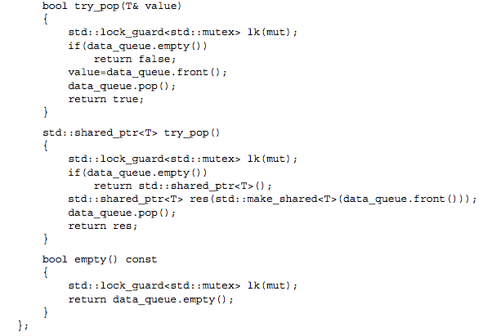
Synchronizing concurrent operations
Thread safe queue (Cont.)
Notes:
RAII to make sure thread is correctly joined

Slide 26
Synchronizing concurrent operations
Waiting for one-off events
std::future<>, only one thread can wait for its result
std::shared_future<>, multi-threads can wait for the result
std::async
Associate a task with a future
std::packaged_task<> ties a future to a function or a callable object. When it is invoked, it calls the associated function or callable object and makes the future ready, with the return value stored as the associated data
It is a callable object. When it is called, it routes to the contained function, and the return value is stored as the asynchronous result in the std::future obtained from get_future()
Notes:
RAII to make sure thread is correctly joined

Slide 27
Synchronizing concurrent operations
std::async
If the function call invoked as part of std::async throws an exception, that exception is stored in the future in place of a stored value, the future becomes ready, and a call to get() rethrows that stored exception. Note: the standard leaves it unspecified whether it is the original exception object that’s rethrown or a copy; different compilers and libraries make different choices on this matter
The same happens if you wrap the function in a std::packaged_task—when the task is invoked, if the wrapped function throws an exception, that exception is stored in the future in place of the result, ready to be thrown on a call to get()
By default (if not explicitly specifying flags), whether it spawns new thread depends on implementation
std::promise<>
Provides a means of setting a value of type T, which can later be read through an associated std::future<T> object
promise<>::set_value() get the associated future ready. promise<>::get_future() returns associated future<>
If promise<> is destroyed without setting a value, an exception is stored instead
Notes:
RAII to make sure thread is correctly joined

Slide 28
Synchronizing concurrent operations
std::promise<> (cont.)
extern std::promise<double> some_promise; try { some_promise.set_value(calculate_value()); } catch(...) { some_promise.set_exception(std::current_exception()); }
some_promise.set_exception(std::copy_exception(std::logic_error("foo "))); is preferred if the type of the exception is known. Not only it simplifies the code, but it also provides the compiler with greater opportunity to optimize the code
If destroy the std::promise or std::packaged_task associated with the future without calling either of the set functions on the promise or invoking the packaged task, the destructor of the std::promise or std::packaged_task will store a std::future_error exception with an error code of std::future_errc::broken_promise in the associated state if the future isn’t already ready. If the compiler didn’t store anything in the future in this case, waiting threads could potentially wait forever.
Notes:
RAII to make sure thread is correctly joined

Slide 29
Synchronizing concurrent operations
std::future<>
Itself is not synced, not thread safe
Once retrieved (get()), no value left
std:shared_future<>
Itself is not synced, not thread safe
Each thread make its own copy and than access the state against the copy is recommended
shared_future<> sf (move(future<>))
Notes:
RAII to make sure thread is correctly joined

Slide 30
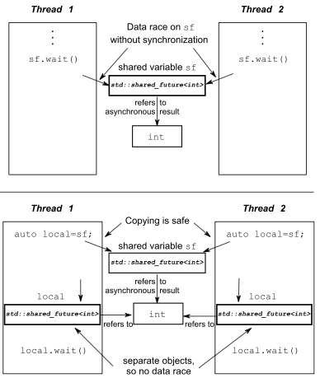
Synchronizing concurrent operations
Notes:
RAII to make sure thread is correctly joined

Slide 31
Synchronizing concurrent operations
std::future<>
Itself is not synced, not thread safe
Once retrieved (get()), no value left
future<>::shared()
std:shared_future<>
Itself is not synced, not thread safe
Each thread make its own copy and than access the state against the copy is recommended
shared_future<> sf (move(future<>))
Notes:
RAII to make sure thread is correctly joined

Slide 32
Synchronizing concurrent operations
Function programming (FP)
Pure function produces no side effects, the output purely depends on input parameters
FP is popular in concurrent programming, coz it is easier, no shared state
Separate the code into pure and impure functions, impure functions indeed modify shared state, we can focus on these impure function while doing concurrent programming
Notes:
RAII to make sure thread is correctly joined

Slide 33
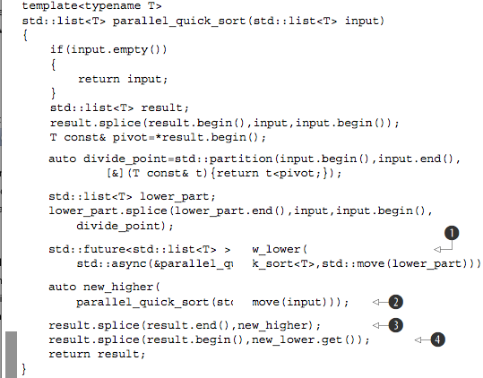
Synchronizing concurrent operations
Parallel quicksort
Notes:
RAII to make sure thread is correctly joined

Slide 34
Synchronizing concurrent operations
CSP (Communicating Sequential Processes)
Erlang’s paradigm
There has no shared data, with all communication passed through the message queues
In C++, if we are doing CSP, it’s our responsibility to enforce there is no shared data between threads
Notes:
RAII to make sure thread is correctly joined

Slide 35
The C++ memory model
Memory Model
The basic structural aspects, which relate to how things are laid out in memory
Concurrency aspects
Objects and memory locations
Every variable is an object, including those that are members of other objects.
Every object occupies at least one memory location.
Variables of fundamental type such as int or char are exactly one memory location, whatever their size, even if they’re adjacent or part of an array.
Adjacent bit fields are part of the same memory location.
If multiple threads (r/w) access to the same memory location, there will be data race
Notes:
RAII to make sure thread is correctly joined

Slide 36
The C++ memory model
std::atomic<>
load(), store(), exchange()
compare_exchange_weak(), compare_exchange_strong()
atomic<> operations
Store
memory_order_relaxed, memory_order_release, or memory_order_seq_cst
Load
memory_order_relaxed, memory_order_consume,
memory_order_acquire, or memory_order_seq_cst
Read-modify-write
memory_order_relaxed, memory_ order_consume, memory_order_acquire,
memory_order_release, memory_order_ acq_rel, or memory_order_seq_cst
The default ordering for all operations is memory_order_seq_cst.
Notes:
RAII to make sure thread is correctly joined

Slide 37
The C++ memory model
std:atomic<> convention
It is a common pattern with the atomic types: the assignment operators they support return values (of the corresponding nonatomic type) rather than references. If a reference to the atomic variable was returned, any code that depended on the result of the assignment would then have to explicitly load the value, potentially getting the result of a modifi- cation by another thread. By returning the result of the assignment as a nonatomic value, you can avoid this additional load, and you know that the value obtained is the actual value stored.
Notes:
RAII to make sure thread is correctly joined

Slide 38
The C++ memory model
std:atomic<bool>
compare_exchange_weak(), the store might not be successful even if the original value was equal to the expected value, in which case the value of the variable is unchanged and the return value of compare_exchange_weak() is false. This is most likely to happen on machines that lack a single compare-and-exchange instruction, if the processor can’t guarantee that the operation has been done atomically—possibly because the thread performing the operation was switched out in the middle of the necessary sequence of instructions and another thread scheduled in its place by the operating system where there are more threads than processors. This is called a spurious failure, because the reason for the failure is a function of timing rather than the values of the variables.
Because compare_exchange_weak() can fail spuriously, it must typically be used in a loop: bool expected=false; extern atomic<bool> b; // set somewhere else while(!b.compare_exchange_weak(expected,true) && !expected);
Notes:
RAII to make sure thread is correctly joined

Slide 39
The C++ memory model
The synchronizes-with relationship
The synchronizes-with relationship is something that you can get only between operations on atomic types
The basic idea is this: a suitably tagged atomic write operation W on a variable x synchronizes-with a suitably tagged atomic read operation on x that reads the value stored by either that write (W), or a subsequent atomic write operation on x by the same thread that performed the initial write W, or a sequence of atomic read-modify-write operations on x (such as fetch_add() or compare_exchange_weak()) by any thread, where the value read by the first thread in the sequence is the value written by W
Notes:
RAII to make sure thread is correctly joined

Slide 40
The C++ memory model
The happens-before relationship
it specifies which operations see the effects of which other operations
If the operations occur in the same statement, in general there’s no happens-before relationship between them, because they’re unordered. This is just another way of say- ing that the ordering is unspecified
if operation A in one thread synchronizes-with operation B in another thread, then A inter-thread happens- before B. It’s also a transitive relation: if A inter-thread happens-before B and B inter- thread happens-before C, then A inter-thread happens-before C
Inter-thread happens-before also combines with the sequenced-before relation: if operation A is sequenced before operation B, and operation B inter-thread happens- before operation C, then A inter-thread happens-before C. Similarly, if A synchronizes- with B and B is sequenced before C, then A inter-thread happens-before C.
Notes:
RAII to make sure thread is correctly joined

Slide 41
The C++ memory model
Memory ordering for atomic operations
sequentially consistent ordering (most stringent and by default)
memory_order_seq_cst
acquire-release ordering
memory_order_consume, memory_order_acquire,
memory_order_release, memory_order_acq_rel
relaxed ordering
memory_order_relaxed
These distinct memory-ordering models can have varying costs on different CPU architectures.
Notes:
RAII to make sure thread is correctly joined

Slide 42
The C++ memory model
sequentially consistent ordering
If all operations on instances of atomic types are sequentially consistent, the behavior of a multithreaded program is as if all these operations were performed in some particular sequence by a single thread.
Operations can’t be reordered; if your code has one operation before another in one thread, that ordering must be seen by all other threads.
From the point of view of synchronization, a sequentially consistent store synchronizes-with a sequentially consistent load of the same variable that reads the value stored.
you must use sequentially consistent operations on all your threads in order to get its benifit
On a weakly ordered machine with many processors, it can impose a noticeable performance penalty, because the overall sequence of operations must be kept consistent between the processors, possibly requiring extensive (and expensive!) synchronization operations between the processors
Notes:
RAII to make sure thread is correctly joined

Slide 43
The C++ memory model
Non-sequentially consistent ordering
there’s no longer a single global order of events. This means that different threads can see different views of the same operations
threads don’t have to agree on the order of events
It’s not just that the compiler can reorder the instructions. Even if the threads are running the same bit of code, they can disagree on the order of events because of operations in other threads in the absence of explicit ordering constraints, because the different CPU caches and internal buffers can hold different values for the same memory. It’s so important I’ll say it again: threads don’t have to agree on the order of events
In the absence of other ordering constraints, the only requirement is that all threads agree on the modification order of each individual variable
Notes:
RAII to make sure thread is correctly joined

Slide 44
The C++ memory model
Relaxed ordering (Strongly suggest avoiding using this)
Operations on atomic types performed with relaxed ordering don’t participate in synchronizes-with relationships. Operations on the same variable within a single thread still obey happens-before relationships, but there’s almost no requirement on ordering relative to other threads. The only requirement is that accesses to a single atomic variable from the same thread can’t be reordered; once a given thread has seen a particular value of an atomic variable, a subsequent read by that thread can’t retrieve an earlier value of the variable. Without any additional synchronization, the modification order of each variable is the only thing shared between threads that are using memory_order_relaxed.
Relaxed operations on different variables can be freely reordered provided they obey any happens-before relationships they’re bound by (for example, within the same thread). They don’t introduce synchronizes-with relationships.
They must be used in combination with atomic operations that feature stronger ordering semantics in order to be useful for inter-thread synchronization.
Notes:
RAII to make sure thread is correctly joined

Slide 45
The C++ memory model
Acquire-releasing ordering
atomic loads are acquire operations (memory_order_acquire), atomic stores are release operations (memory_order_release), and atomic read-modify-write opera- tions (such as fetch_add() or exchange()) are either acquire, release, or both (memory_order_acq_rel)
Synchronization is pairwise, between the thread that does the release and the thread that does the acquire.
A release operation synchronizes-with an acquire operation that reads the value written. This means that different threads can still see different orderings, but these orderings are restricted
Notes:
RAII to make sure thread is correctly joined

Slide 46
The C++ memory model
Mixed memory ordering
If you mix acquire-release operations with sequentially consistent operations, the sequentially consistent loads behave like loads with acquire semantics, and sequentially consistent stores behave like stores with release semantics. Sequentially consistent read- modify-write operations behave as both acquire and release operations. Relaxed operations are still relaxed but are bound by the additional synchronizes-with and consequent happens-before relationships introduced through the use of acquire-release semantics.
The acquire and release operations have to be on the same variable to ensure an ordering
Notes:
RAII to make sure thread is correctly joined

Slide 47
The C++ memory model
Data dependency and memory_order_consume
dependency-ordered-before
Can apply between threads. It’s introduced by using atomic load operations tagged with memory_order_consume. This is a special case of memory_order_acquire that limits the synchronized data to direct dependencies; a store operation A tagged with memory_order_release, memory_order_acq_rel, or memory_order_seq_cst is dependency-ordered-before a load operation B tagged with memory_order_consume if the consume reads the value stored.
if A is dependency- ordered-before B, then A also inter-thread happens-before B.
carries-a-dependency-to
Just like sequenced-before, carries-a-dependency-to applies strictly within a single thread and essentially models the data dependency between operations; if the result of an operation A is used as an operand for an operation B, then A carries-a-dependency-to B
std::kill_dependency() to explicitly break the dependency chain
std::kill_dependency() to explicitly break the dependency chain
Notes:
RAII to make sure thread is correctly joined

Slide 48
The C++ memory model
Fences (enfore ordering)
Also called memory barriers, nd they get their name because they put a line in the code that certain operations can’t cross
Fences are global operations and affect the ordering of other atomic operations in the thread that executed the fence
Relaxed operations on separate variables can usually be freely reordered by the compiler or the hardware. Fences restrict this freedom and introduce happens-before and synchronizes-with relationships that weren’t present before.
general idea with fences: if an acquire operation sees the result of a store that takes place after a release fence, the fence synchronizes-with that acquire operation; and if a load that takes place before an acquire fence sees the result of a release operation, the release operation synchronizes-with the acquire fence.
std::atomic_thread_fence(memory_order_release/acquire)
Notes:
RAII to make sure thread is correctly joined

Slide 49
The C++ memory model
Ordering nonatomic operations
Ordering of nonatomic operations through the use of atomic operations is where the sequenced-before part of happens-before becomes so important. If a nonatomic operation is sequenced-before an atomic operation, and that atomic operation happens-before an operation in another thread, the nonatomic operation also happens-before that operation in the other thread.
Notes:
RAII to make sure thread is correctly joined

