Slide 1
CPP Concurrency in Action
Ken Chen
2014/02/16

Slide 2
TOC
Hello World concurrency
Managing threads
Sharing data between threads
Synchronizing concurrent operations
The C++ memory model and operations on atomic types

Slide 3
Hello World concurrency
Why concurrency
separation of concerns
performance
Task parallelism: break big task into small parts and run each in parallel
Data parallelism: each thr works on different part of data

Slide 4
Managing thread
Caveats
Make sure the thread is either detached or joined before the thread object is destroyed. Thread’s dtor calls std::terminate()
Note that you only have to make this decision before the std::thread object is destroyed -- the thread itself may have finished long before you join with it or detach it, and if you detach it, then the thread may continue running long after the std::thread object is destroyed
If a thread is detached, make sure it only access valid data (Note the thread object itself may have long gone)

Slide 5
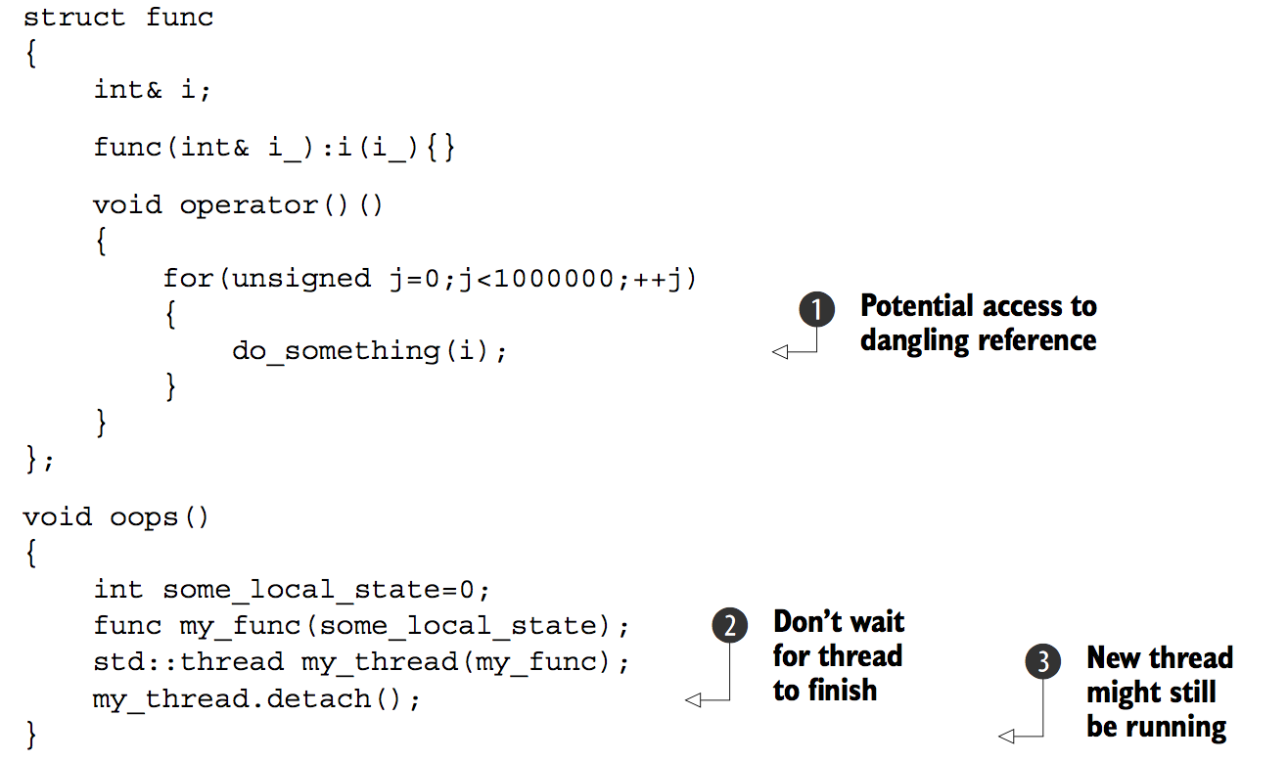
Managing thread
Example

Slide 6
Managing thread
Common Solution
One common way to handle this scenario is to make the thread function self- contained and copy the data into the thread rather than sharing the data.
std::thread.join()
The act of calling join() also cleans up any storage associated with the thread, so the std::thread object is no longer associated with the now- finished thread; it isn’t associated with any thread.
This means that you can call join() only once for a given thread. once you’ve called join(), the std::thread object is no longer joinable, and joinable() will return false.
The call to join() is liable to be skipped if an exception is thrown after the thread has been started but before the call to join().

Slide 7
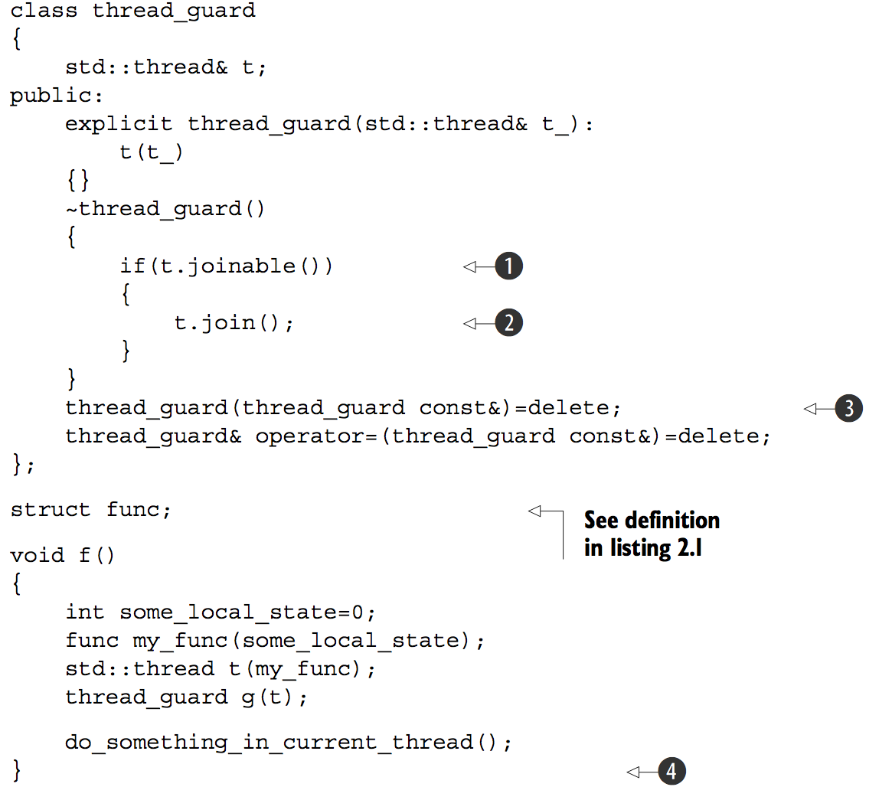
Managing thread
RAII to make sure thread is correctly joined
Notes:
RAII to make sure thread is correctly joined

Slide 8
Managing thread
Detached thread
Detached threads truly run in the background; ownership and control are passed over to the C++ Run- time Library, which ensures that the resources associated with the thread are correctly reclaimed when the thread exits.
It is not joinable
Thread arguments
By default, the function arguments passed to thread’s ctor are copied to into internal storage, where they can be accessed by the newly created thread of execution, even if the corresponding parameter in the function is expecting a reference
Notes:
RAII to make sure thread is correctly joined

Slide 9
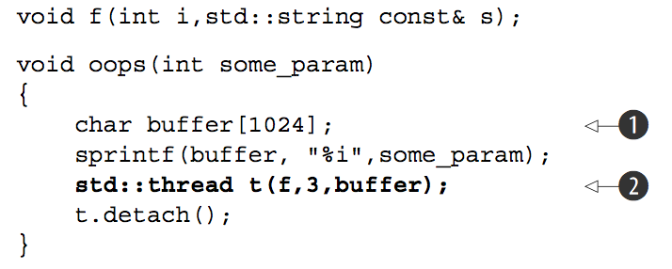
Managing thread
Thread arguments example
there’s a significant chance that the function oops will exit before the buffer has been converted to a std::string on the new thread, thus leading to undefined behavior. The solution is to cast to std::string before passing the buffer to the std::thread constructor
std::thread t(f,3,std::string(buffer));
Notes:
RAII to make sure thread is correctly joined

Slide 10
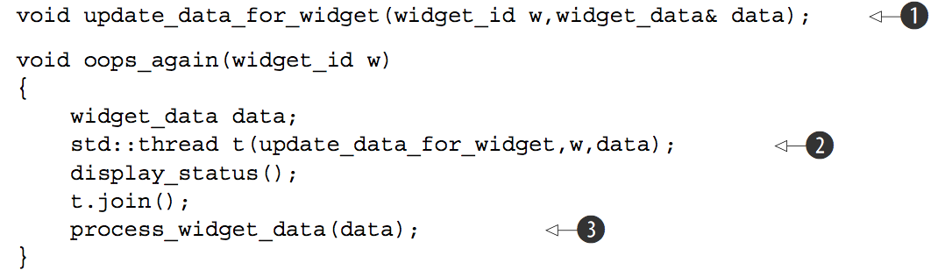
Managing thread
Thread arguments example 2
Because it is copying arguments, widget_data& data in step (1) is referencing a copy instead of the one in function oops_again.
Solution: std::thread t(update_data_for_widget, w, std::ref(data));
Notes:
RAII to make sure thread is correctly joined

Slide 11
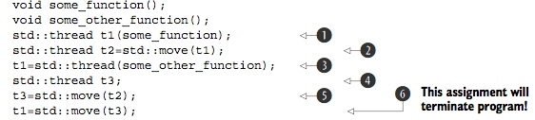
Managing thread
Transferring ownership
In step 6, t1 already had an associated thread (which was running some_other_function), so std::terminate() is called to terminate the program. This is done for consistency with the std::thread destructor
Make sure a thread is correctly joined or detached before dtor is called is also applied to assignment
Notes:
RAII to make sure thread is correctly joined

Slide 12
Managing thread
Be aware of non-associative types for specific operator
For e,g “float” and “double” is not associative for operator “+”. This may be a issue when we do divide and conquer.
Notes:
RAII to make sure thread is correctly joined

Slide 13
Sharing data between threads
Guide
Don’t pass pointers and references to protected data outside the scope of the lock, whether by returning them from a function, storing them in externally visible memory, or passing them as arguments to user-supplied functions.
Don’t wait for another thread if there’s a chance it’s waiting for you (assume two threads are calling join() with the other).
Avoid nested locks
Avoid calling user-supplied code while holding a lock
Acquire locks in a fixed order
Use a lock hierachy
If need join threads, join threads in a hierachy way
Notes:
RAII to make sure thread is correctly joined

Slide 14
Sharing data between threads
std::unique_lock
std::unique_lock<std::mutex> lock_a(lhs.m,std::defer_lock); std::unique_lock<std::mutex> lock_b(rhs.m,std::defer_lock); std::lock(lock_a,lock_b);
std::unique_lock takes more space and is a fraction slower to use than std::lock_guard. The flexibility of allowing a std::unique_lock instance not to own the mutex comes at a price: this information has to be stored, and it has to be updated.
It has interfaces unlock, so we can release the lock when necessary
When there is need to transfer ownership of a lock from one scope to another scope
Double Checked Locking (is not safe)
C++11 “std::call_once(std::once_flag, …) or local static variable” solves this problem (what if the callback throws ?)
Notes:
RAII to make sure thread is correctly joined

Slide 15
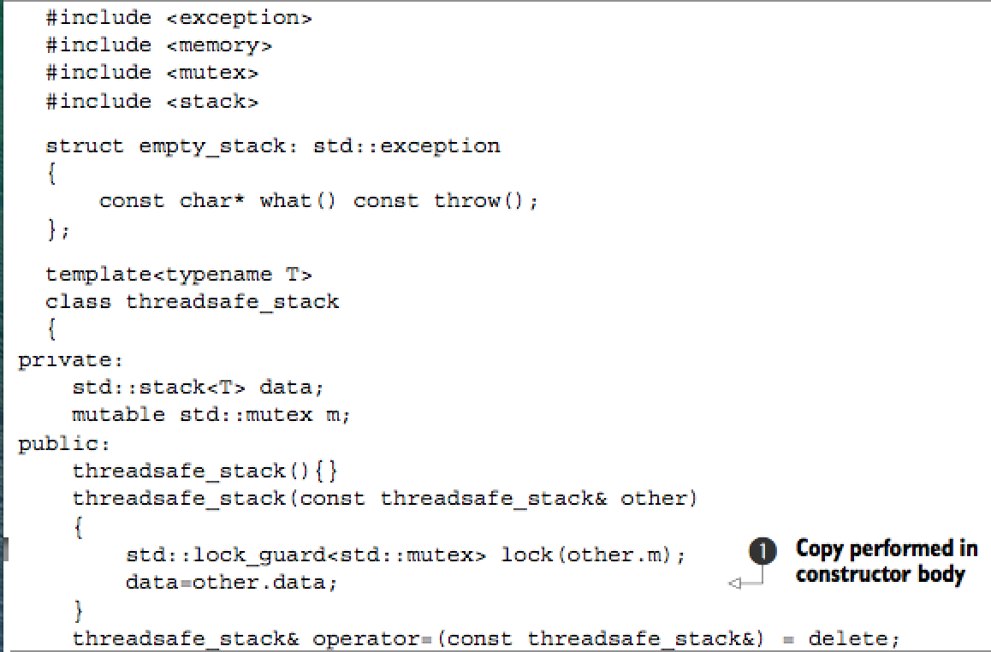
Sharing data between threads
A thread safe stack
Notes:
RAII to make sure thread is correctly joined

Slide 16
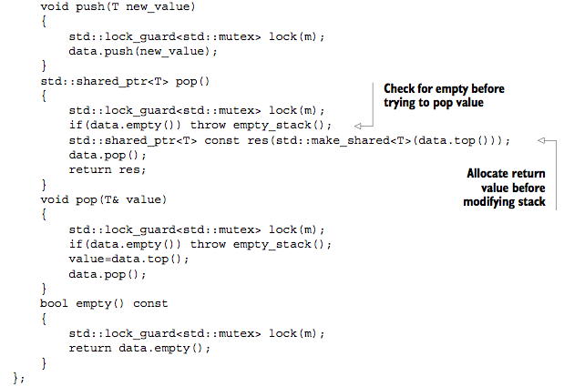
Sharing data between threads
A thread safe stack (cont.)
Notes:
RAII to make sure thread is correctly joined

Slide 17
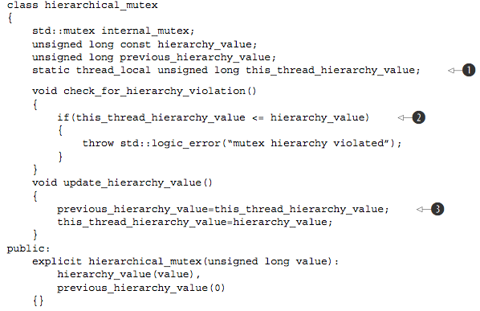
Sharing data between threads
Hierarchical mutex
Notes:
RAII to make sure thread is correctly joined

Slide 18
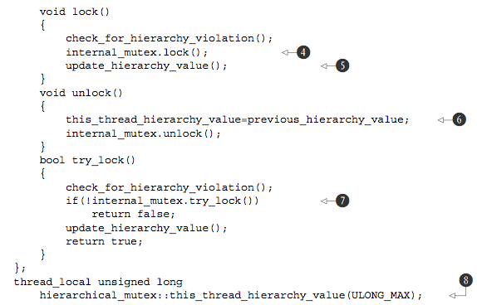
Sharing data between threads
Hierarchical mutex (cont.)
Notes:
RAII to make sure thread is correctly joined

Slide 19
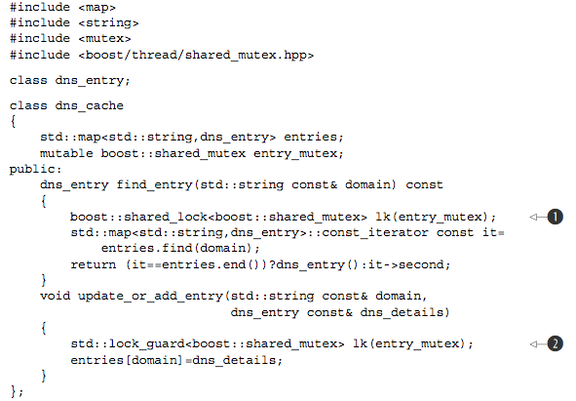
Sharing data between threads
Use boost:shared_mutex to implement r/w lock
Notes:
RAII to make sure thread is correctly joined

Slide 20
Sharing data between threads
Guide
Most of the time, if you think you want a recursive mutex, you probably need to change your design
When designing thread safe class interfaces and one class method calls another class method (both methods are guarded by lock),a quick and dirty change to make the code work is to modify the lock recursive.But this is almost a bad design. A probable working solution is extract the common private function without locking, and both the public interfaces calls the private one to do the work
Notes:
RAII to make sure thread is correctly joined

Slide 21
Synchronizing concurrent operations
Guide
Please note that the side effects of the callback provided to condition_variable.wait(lock, callback). Because the callback may be called indeterminate times (spurious wake), it isn’t advisable to use a function with side effects for the condition check. If you do so, you must be prepared for the side effects to occur multiple times
Notes:
RAII to make sure thread is correctly joined

Slide 22
Synchronizing concurrent operations
Guide
Please note that the side effects of the callback provided to condition_variable.wait(lock, callback). Because the callback may be called indeterminate times (spurious wake), it isn’t advisable to use a function with side effects for the condition check. If you do so, you must be prepared for the side effects to occur multiple times
Notes:
RAII to make sure thread is correctly joined

Slide 23
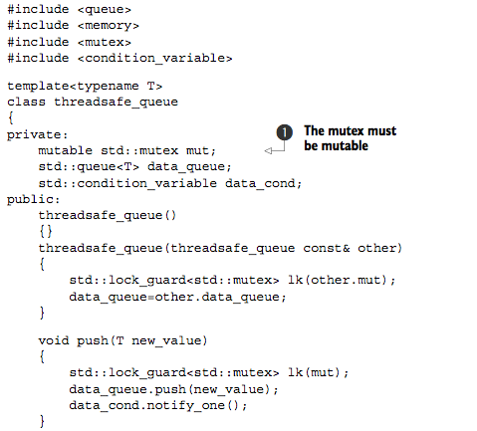
Synchronizing concurrent operations
Thread safe queue
Notes:
RAII to make sure thread is correctly joined

Slide 24
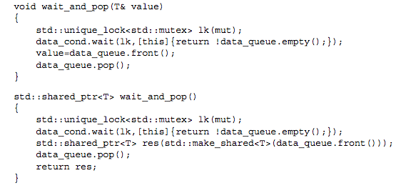
Synchronizing concurrent operations
Thread safe queue (Cont.)
Notes:
RAII to make sure thread is correctly joined

Slide 25
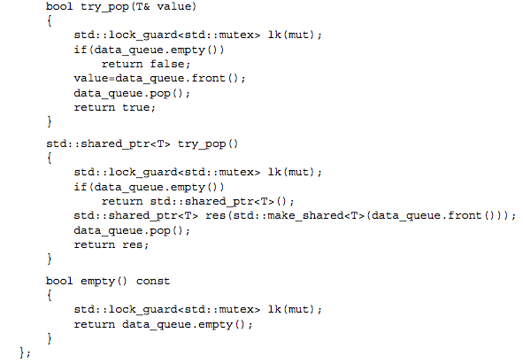
Synchronizing concurrent operations
Thread safe queue (Cont.)
Notes:
RAII to make sure thread is correctly joined

Slide 26
Synchronizing concurrent operations
Waiting for one-off events
std::future<>, only one thread can wait for its result
std::shared_future<>, multi-threads can wait for the result
std::async
Associate a task with a future
std::packaged_task<> ties a future to a function or a callable object. When it is invoked, it calls the associated function or callable object and makes the future ready, with the return value stored as the associated data
It is a callable object. When it is called, it routes to the contained function, and the return value is stored as the asynchronous result in the std::future obtained from get_future()
Notes:
RAII to make sure thread is correctly joined

Slide 27
Synchronizing concurrent operations
std::async
If the function call invoked as part of std::async throws an exception, that exception is stored in the future in place of a stored value, the future becomes ready, and a call to get() rethrows that stored exception. Note: the standard leaves it unspecified whether it is the original exception object that’s rethrown or a copy; different compilers and libraries make different choices on this matter
The same happens if you wrap the function in a std::packaged_task—when the task is invoked, if the wrapped function throws an exception, that exception is stored in the future in place of the result, ready to be thrown on a call to get()
By default (if not explicitly specifying flags), whether it spawns new thread depends on implementation
std::promise<>
Provides a means of setting a value of type T, which can later be read through an associated std::future<T> object
promise<>::set_value() get the associated future ready. promise<>::get_future() returns associated future<>
If promise<> is destroyed without setting a value, an exception is stored instead
Notes:
RAII to make sure thread is correctly joined

Slide 28
Synchronizing concurrent operations
std::promise<> (cont.)
extern std::promise<double> some_promise; try { some_promise.set_value(calculate_value()); } catch(...) { some_promise.set_exception(std::current_exception()); }
some_promise.set_exception(std::copy_exception(std::logic_error("foo "))); is preferred if the type of the exception is known. Not only it simplifies the code, but it also provides the compiler with greater opportunity to optimize the code
If destroy the std::promise or std::packaged_task associated with the future without calling either of the set functions on the promise or invoking the packaged task, the destructor of the std::promise or std::packaged_task will store a std::future_error exception with an error code of std::future_errc::broken_promise in the associated state if the future isn’t already ready. If the compiler didn’t store anything in the future in this case, waiting threads could potentially wait forever.
Notes:
RAII to make sure thread is correctly joined

Slide 29
Synchronizing concurrent operations
std::future<>
Itself is not synced, not thread safe
Once retrieved (get()), no value left
std:shared_future<>
Itself is not synced, not thread safe
Each thread make its own copy and than access the state against the copy is recommended
shared_future<> sf (move(future<>))
Notes:
RAII to make sure thread is correctly joined

Slide 30
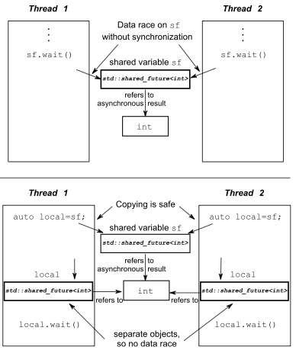
Synchronizing concurrent operations
Notes:
RAII to make sure thread is correctly joined

Slide 31
Synchronizing concurrent operations
std::future<>
Itself is not synced, not thread safe
Once retrieved (get()), no value left
future<>::shared()
std:shared_future<>
Itself is not synced, not thread safe
Each thread make its own copy and than access the state against the copy is recommended
shared_future<> sf (move(future<>))
Notes:
RAII to make sure thread is correctly joined

Slide 32
Synchronizing concurrent operations
Function programming (FP)
Pure function produces no side effects, the output purely depends on input parameters
FP is popular in concurrent programming, coz it is easier, no shared state
Separate the code into pure and impure functions, impure functions indeed modify shared state, we can focus on these impure function while doing concurrent programming
Notes:
RAII to make sure thread is correctly joined

Slide 33
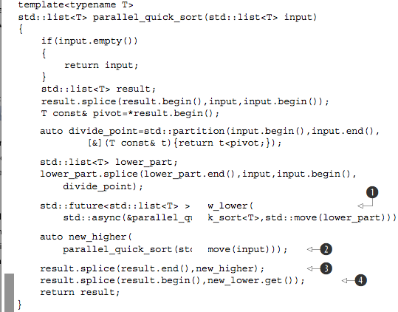
Synchronizing concurrent operations
Parallel quicksort
Notes:
RAII to make sure thread is correctly joined

Slide 34
Synchronizing concurrent operations
CSP (Communicating Sequential Processes)
Erlang’s paradigm
There has no shared data, with all communication passed through the message queues
In C++, if we are doing CSP, it’s our responsibility to enforce there is no shared data between threads
Notes:
RAII to make sure thread is correctly joined

Slide 35
The C++ memory model
Memory Model
The basic structural aspects, which relate to how things are laid out in memory
Concurrency aspects
Objects and memory locations
Every variable is an object, including those that are members of other objects.
Every object occupies at least one memory location.
Variables of fundamental type such as int or char are exactly one memory location, whatever their size, even if they’re adjacent or part of an array.
Adjacent bit fields are part of the same memory location.
If multiple threads (r/w) access to the same memory location, there will be data race
Notes:
RAII to make sure thread is correctly joined

Slide 36
The C++ memory model
std::atomic<>
load(), store(), exchange()
compare_exchange_weak(), compare_exchange_strong()
atomic<> operations
Store
memory_order_relaxed, memory_order_release, or memory_order_seq_cst
Load
memory_order_relaxed, memory_order_consume,
memory_order_acquire, or memory_order_seq_cst
Read-modify-write
memory_order_relaxed, memory_ order_consume, memory_order_acquire,
memory_order_release, memory_order_ acq_rel, or memory_order_seq_cst
The default ordering for all operations is memory_order_seq_cst.
Notes:
RAII to make sure thread is correctly joined

Slide 37
The C++ memory model
std:atomic<> convention
It is a common pattern with the atomic types: the assignment operators they support return values (of the corresponding nonatomic type) rather than references. If a reference to the atomic variable was returned, any code that depended on the result of the assignment would then have to explicitly load the value, potentially getting the result of a modifi- cation by another thread. By returning the result of the assignment as a nonatomic value, you can avoid this additional load, and you know that the value obtained is the actual value stored.
Notes:
RAII to make sure thread is correctly joined

Slide 38
The C++ memory model
std:atomic<bool>
compare_exchange_weak(), the store might not be successful even if the original value was equal to the expected value, in which case the value of the variable is unchanged and the return value of compare_exchange_weak() is false. This is most likely to happen on machines that lack a single compare-and-exchange instruction, if the processor can’t guarantee that the operation has been done atomically—possibly because the thread performing the operation was switched out in the middle of the necessary sequence of instructions and another thread scheduled in its place by the operating system where there are more threads than processors. This is called a spurious failure, because the reason for the failure is a function of timing rather than the values of the variables.
Because compare_exchange_weak() can fail spuriously, it must typically be used in a loop: bool expected=false; extern atomic<bool> b; // set somewhere else while(!b.compare_exchange_weak(expected,true) && !expected);
Notes:
RAII to make sure thread is correctly joined

Slide 39
The C++ memory model
The synchronizes-with relationship
The synchronizes-with relationship is something that you can get only between operations on atomic types
The basic idea is this: a suitably tagged atomic write operation W on a variable x synchronizes-with a suitably tagged atomic read operation on x that reads the value stored by either that write (W), or a subsequent atomic write operation on x by the same thread that performed the initial write W, or a sequence of atomic read-modify-write operations on x (such as fetch_add() or compare_exchange_weak()) by any thread, where the value read by the first thread in the sequence is the value written by W
Notes:
RAII to make sure thread is correctly joined

Slide 40
The C++ memory model
The happens-before relationship
it specifies which operations see the effects of which other operations
If the operations occur in the same statement, in general there’s no happens-before relationship between them, because they’re unordered. This is just another way of say- ing that the ordering is unspecified
if operation A in one thread synchronizes-with operation B in another thread, then A inter-thread happens- before B. It’s also a transitive relation: if A inter-thread happens-before B and B inter- thread happens-before C, then A inter-thread happens-before C
Inter-thread happens-before also combines with the sequenced-before relation: if operation A is sequenced before operation B, and operation B inter-thread happens- before operation C, then A inter-thread happens-before C. Similarly, if A synchronizes- with B and B is sequenced before C, then A inter-thread happens-before C.
Notes:
RAII to make sure thread is correctly joined

Slide 41
The C++ memory model
Memory ordering for atomic operations
sequentially consistent ordering (most stringent and by default)
memory_order_seq_cst
acquire-release ordering
memory_order_consume, memory_order_acquire,
memory_order_release, memory_order_acq_rel
relaxed ordering
memory_order_relaxed
These distinct memory-ordering models can have varying costs on different CPU architectures.
Notes:
RAII to make sure thread is correctly joined

Slide 42
The C++ memory model
sequentially consistent ordering
If all operations on instances of atomic types are sequentially consistent, the behavior of a multithreaded program is as if all these operations were performed in some particular sequence by a single thread.
Operations can’t be reordered; if your code has one operation before another in one thread, that ordering must be seen by all other threads.
From the point of view of synchronization, a sequentially consistent store synchronizes-with a sequentially consistent load of the same variable that reads the value stored.
you must use sequentially consistent operations on all your threads in order to get its benifit
On a weakly ordered machine with many processors, it can impose a noticeable performance penalty, because the overall sequence of operations must be kept consistent between the processors, possibly requiring extensive (and expensive!) synchronization operations between the processors
Notes:
RAII to make sure thread is correctly joined

Slide 43
The C++ memory model
Non-sequentially consistent ordering
there’s no longer a single global order of events. This means that different threads can see different views of the same operations
threads don’t have to agree on the order of events
It’s not just that the compiler can reorder the instructions. Even if the threads are running the same bit of code, they can disagree on the order of events because of operations in other threads in the absence of explicit ordering constraints, because the different CPU caches and internal buffers can hold different values for the same memory. It’s so important I’ll say it again: threads don’t have to agree on the order of events
In the absence of other ordering constraints, the only requirement is that all threads agree on the modification order of each individual variable
Notes:
RAII to make sure thread is correctly joined

Slide 44
The C++ memory model
Relaxed ordering (Strongly suggest avoiding using this)
Operations on atomic types performed with relaxed ordering don’t participate in synchronizes-with relationships. Operations on the same variable within a single thread still obey happens-before relationships, but there’s almost no requirement on ordering relative to other threads. The only requirement is that accesses to a single atomic variable from the same thread can’t be reordered; once a given thread has seen a particular value of an atomic variable, a subsequent read by that thread can’t retrieve an earlier value of the variable. Without any additional synchronization, the modification order of each variable is the only thing shared between threads that are using memory_order_relaxed.
Relaxed operations on different variables can be freely reordered provided they obey any happens-before relationships they’re bound by (for example, within the same thread). They don’t introduce synchronizes-with relationships.
They must be used in combination with atomic operations that feature stronger ordering semantics in order to be useful for inter-thread synchronization.
Notes:
RAII to make sure thread is correctly joined

Slide 45
The C++ memory model
Acquire-releasing ordering
atomic loads are acquire operations (memory_order_acquire), atomic stores are release operations (memory_order_release), and atomic read-modify-write opera- tions (such as fetch_add() or exchange()) are either acquire, release, or both (memory_order_acq_rel)
Synchronization is pairwise, between the thread that does the release and the thread that does the acquire.
A release operation synchronizes-with an acquire operation that reads the value written. This means that different threads can still see different orderings, but these orderings are restricted
Notes:
RAII to make sure thread is correctly joined

Slide 46
The C++ memory model
Mixed memory ordering
If you mix acquire-release operations with sequentially consistent operations, the sequentially consistent loads behave like loads with acquire semantics, and sequentially consistent stores behave like stores with release semantics. Sequentially consistent read- modify-write operations behave as both acquire and release operations. Relaxed operations are still relaxed but are bound by the additional synchronizes-with and consequent happens-before relationships introduced through the use of acquire-release semantics.
The acquire and release operations have to be on the same variable to ensure an ordering
Notes:
RAII to make sure thread is correctly joined

Slide 47
The C++ memory model
Data dependency and memory_order_consume
dependency-ordered-before
Can apply between threads. It’s introduced by using atomic load operations tagged with memory_order_consume. This is a special case of memory_order_acquire that limits the synchronized data to direct dependencies; a store operation A tagged with memory_order_release, memory_order_acq_rel, or memory_order_seq_cst is dependency-ordered-before a load operation B tagged with memory_order_consume if the consume reads the value stored.
if A is dependency- ordered-before B, then A also inter-thread happens-before B.
carries-a-dependency-to
Just like sequenced-before, carries-a-dependency-to applies strictly within a single thread and essentially models the data dependency between operations; if the result of an operation A is used as an operand for an operation B, then A carries-a-dependency-to B
std::kill_dependency() to explicitly break the dependency chain
std::kill_dependency() to explicitly break the dependency chain
Notes:
RAII to make sure thread is correctly joined

Slide 48
The C++ memory model
Fences (enfore ordering)
Also called memory barriers, nd they get their name because they put a line in the code that certain operations can’t cross
Fences are global operations and affect the ordering of other atomic operations in the thread that executed the fence
Relaxed operations on separate variables can usually be freely reordered by the compiler or the hardware. Fences restrict this freedom and introduce happens-before and synchronizes-with relationships that weren’t present before.
general idea with fences: if an acquire operation sees the result of a store that takes place after a release fence, the fence synchronizes-with that acquire operation; and if a load that takes place before an acquire fence sees the result of a release operation, the release operation synchronizes-with the acquire fence.
std::atomic_thread_fence(memory_order_release/acquire)
Notes:
RAII to make sure thread is correctly joined

Slide 49
The C++ memory model
Ordering nonatomic operations
Ordering of nonatomic operations through the use of atomic operations is where the sequenced-before part of happens-before becomes so important. If a nonatomic operation is sequenced-before an atomic operation, and that atomic operation happens-before an operation in another thread, the nonatomic operation also happens-before that operation in the other thread.
Notes:
RAII to make sure thread is correctly joined

Slide 50
Lock-based data structure
Guidelines
Ensure objects are not accessed before ctor are completely done or after dtor has started
If data structure supports assignment, swap(), or copy construction, need decide whether these operations are safe to call concurrently with other operations or whether they require the user to ensure exclusive access even though the majority of functions for manipulating the data structure may be called from multiple threads concurrently without problem
Pay attention to exception safety (RAII)
Notes:
RAII to make sure thread is correctly joined

Slide 51
Lock-based data structure
Questions
Can the scope of locks be restricted to allow some parts of an operation to be performed outside the lock?
Can different parts of the data structure be protected with different mutexes?
Do all operations require the same level of protection?
Can a simple change to the data structure improve the opportunities for concurrency without affecting the operational semantics?
The target
Minimize the locking scope (lock granularity)
Notes:
RAII to make sure thread is correctly joined

Slide 52
Lock-free data structure
Blocking/nonblocking data structure
Algorithms and data structures that use mutexes, condition variables, and futures to synchronize the data are called blocking data structures and algorithms. The application calls library functions that will suspend the execution of a thread until another thread performs an action. Such library calls are termed blocking calls because the thread can’t progress past this point until the block is removed.
Data structures and algorithms that don’t use blocking library functions are said to be nonblocking.
Lock free data structure
More than one thread can access it in parallel without breaking its structure
When one of the threads accessing the data structure is suspended by the scheduler midway through its operation, the other threads must still be able to complete their operations without waiting for the suspended thread
Notes:
RAII to make sure thread is correctly joined

Slide 53
Lock-free data structure
Lock free
Algorithms that use compare/exchange operations on the data structure often have loops in them. The reason for using a compare/exchange operation is that another thread might have modified the data in the meantime, in which case the code will need to redo part of its operation before trying the compare/exchange again
Spin lock (is not lock free)
Wait free data structure
Is a lock-free data structure with the additional property that every thread accessing the data structure can complete its operation within a bounded number of steps, regardless of the behavior of other threads. Algorithms that can involve an unbounded number of retries because of clashes with other threads are thus not wait-free
Notes:
RAII to make sure thread is correctly joined

Slide 54
Lock-free data structure
Pros and cons of lock free data structure
Maximum concurrency
Robustness - if a thread dies partway through an operation on a lock-free data structure, nothing is lost except that thread’s data; other threads can proceed normally
Deadlocks are impossible
Considerably harder than lock-based data structure
May decrease overall performance – atomic operations are expensive and there may be lots of atomic operations in lock free data structure; hardware needs sync the data between threads which causes cache ping pong
Notes:
RAII to make sure thread is correctly joined

Slide 55
Lock-free data structure
Guidelines
use std::memory_order_seq_cst for prototyping
only relaxed the memory- ordering constraints once the basic operations were working
use a lock-free memory reclamation scheme
Waiting until no threads are accessing the data structure and deleting all objects that are pending deletion
Using hazard pointers to identify that a thread is accessing a particular object
Reference counting the objects so that they aren’t deleted until there are no outstanding references
watch out for the ABA problem
How can you tell the object is valid when the object you are holding is deleted and then re-created with the same memory location by other thread ?
The most common way to avoid the problem is to include an ABA counter alongside the variable x. The compare/exchange operation is then done on the combined structure of x plus the counter as a single unit. Every time the value is replaced, the counter is incremented, so even if x has the same value, the compare/exchange will fail if another thread has modified x
Notes:
RAII to make sure thread is correctly joined

Slide 56
Lock-free data structure
Guidelines (cont.)
identify busy-wait loops and help the other thread
Try to avoid busy-wait
Notes:
RAII to make sure thread is correctly joined

Slide 57
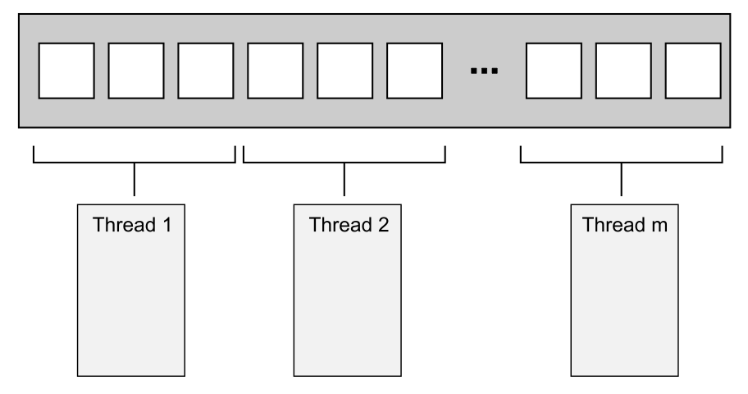
Designing concurrent code
Dividing work between threads
Dividing data between threads before processing begins
http://www.mpi-forum.org/
http://www.openmp.org/
Notes:
RAII to make sure thread is correctly joined

Slide 58
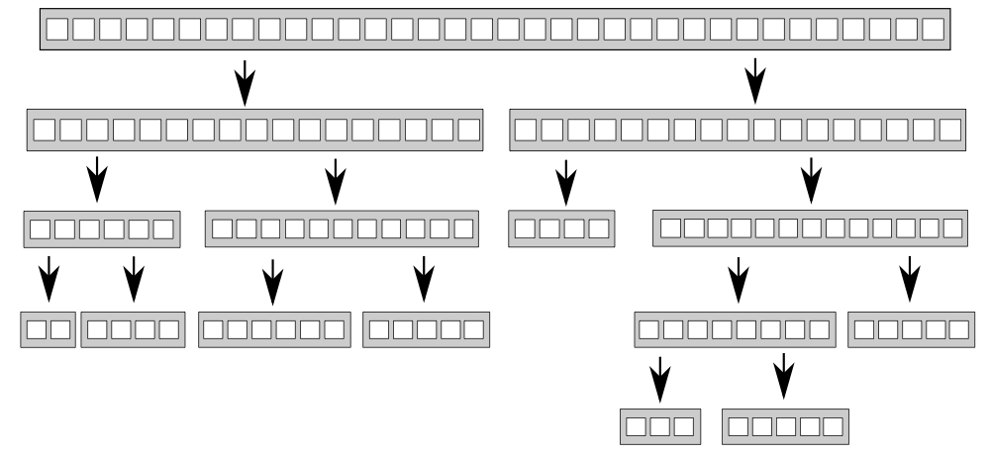
Designing concurrent code
Dividing work between threads (cont.)
Dividing data recursively (quick sort)
Notes:
RAII to make sure thread is correctly joined

Slide 59
Designing concurrent code
Dividing work between threads (cont.)
Dividing work by task type to separate concerns
Be wary of ending up separating the wrong concerns, symptom: there is a lot of data shared between the threads or the different threads end up waiting for each other; both cases boil down to too much communication between threads
Dividing a sequence of tasks between threads
If your task consists of applying the same sequence of operations to many independent data items, you can use a pipeline to exploit the available concurrency of your system
Notes:
RAII to make sure thread is correctly joined

Slide 60
Designing concurrent code
Factors affecting the performance of concurrent code
How many processors? Single core multiple processors or single processor multiple cores or multiple processors and multiple cores
Data contention and cache ping-pong
The effects of contention with mutexes are usually different from the effects of contention with atomic operations for the simple reason that the use of a mutex naturally serializes threads at the operating system level rather than at the processor level
As the number of processors accessing the data goes up, the contention on the mutex itself increases, and the cache line holding the mutex must be transferred between cores, thus potentially increasing the time taken to acquire and release locks to undesirable level
Notes:
RAII to make sure thread is correctly joined

Slide 61
Designing concurrent code
Factors affecting the performance of concurrent code
False sharing (cache line pollution)
Keep related data compact and close to each other
Keep unrelated data far far away
Oversubscription and excessive task switching
Notes:
RAII to make sure thread is correctly joined

Slide 62
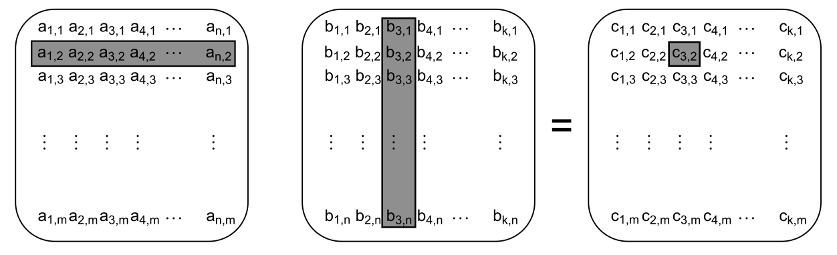
Designing concurrent code
Matrix multiplication
have each thread calculate the values for a number of columns in the result matrix
have each thread calculate the results for a number of rows (may be better than above option)
have each thread calculate the results for a rectangular subset of the matrix (may be better than above two options)
Notes:
RAII to make sure thread is correctly joined

Slide 63
Designing concurrent code
Data access patterns in other data structures
Try to adjust the data distribution between threads so that data that’s close together is worked on by the same thread
Try to minimize the data required by any given thread
Try to ensure that data accessed by separate threads is sufficiently far apart to avoid false sharing
(Pay attention to the mutex false sharing problem, for e.g, when the mutex and the data items are close together in memory, when loading the mutex, the data items are also loaded into the same cache line. Mutex lock is read-modify-write operation which will cause the cache line invalidated.)
Notes:
RAII to make sure thread is correctly joined

Slide 64
Designing concurrent code
Data access patterns in other data structures
Try to adjust the data distribution between threads so that data that’s close together is worked on by the same thread
Try to minimize the data required by any given thread
Try to ensure that data accessed by separate threads is sufficiently far apart to avoid false sharing
(Pay attention to the mutex false sharing problem, for e.g, when the mutex and the data items are close together in memory, when loading the mutex, the data items are also loaded into the same cache line. Mutex lock is read-modify-write operation which will cause the cache line invalidated. One way to test whether this kind of false sharing is a problem is to add huge blocks of padding between the data elements that can be concurrently accessed by dif- ferent threads. For eg: struct protected_data { std::mutex m; char padding[65536]; my_data data_to_protect; };
Notes:
RAII to make sure thread is correctly joined

Slide 65
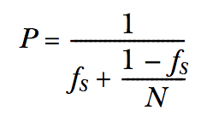
Designing concurrent code
Additional considerations when designing for concurrency
Exception safety in parallel algorithms (essential to C++, RAII is the solution)
async
packaged_task
Scalability and Amdahl’s law (fs is the serial part)
Hiding latency with multiple threads
Try best to avoid the thread is blocking with doing nothing
(1) Running one or more additional thread (when we are blocking for sth.) or
(2) Without spawning additional threads, the waiting thread itself does the work
Notes:
RAII to make sure thread is correctly joined

Slide 66
Advanced thread management
Thread pool (design consideration)
Waiting for tasks submitted to a thread pool (return “future” when submitting task)
Tasks that wait for other tasks
Avoiding contention on the work queue
global queue + thread specific queue and thread fetch jobs from thread queue, or global queue, or stealing job from other thread queue
Interrupting threads
Insert interruption point into (while loop) code
Interrupting a condition variable wait
Interrupting a wait on condition_variable_any
Interrupting other blocking calls (with timeout option)
Notes:
RAII to make sure thread is correctly joined

Slide 67
Testing and debugging
Bugs
Race conditions
Data races
Broken invariants: dangling pointers, random memory corruption, double free
Lifttime issues
Unwanted blocking
Dead lock
Live lock (which is similar to deadlock in that one thread is waiting for another, which is in turn waiting for the first. The key difference here is that the wait is not a blocking wait but an active checking loop, such as a spin lock)
Blocking on I/O or other external input
Notes:
RAII to make sure thread is correctly joined

Slide 68
Testing and debugging
Techniques for locating concurrency-related bugs
Reviewing code to locate potential bugs
Which data needs to be protected from concurrent access?
How do you ensure that the data is protected?
Where in the code could other threads be at this time?
Which mutexes does this thread hold?
Which mutexes might other threads hold?
Are there any ordering requirements between the operations done in this thread and those done in another? How are those requirements enforced?
Is the data loaded by this thread still valid? Could it have been modified by other threads?
If you assume that another thread could be modifying the data, what would that mean and how could you ensure that this never happens?
Notes:
RAII to make sure thread is correctly joined

Slide 69
Testing and debugging
Techniques for locating concurrency-related bugs
Testing
Designing for testability
The responsibilities of each function and class are clear.
The functions are short and to the point.
Your tests can take complete control of the environment surrounding the code being tested.
The code that performs the particular operation being tested is close together rather than spread throughout the system.
You thought about how to test the code before you wrote it
Performance
Notes:
RAII to make sure thread is correctly joined

